Slide 1
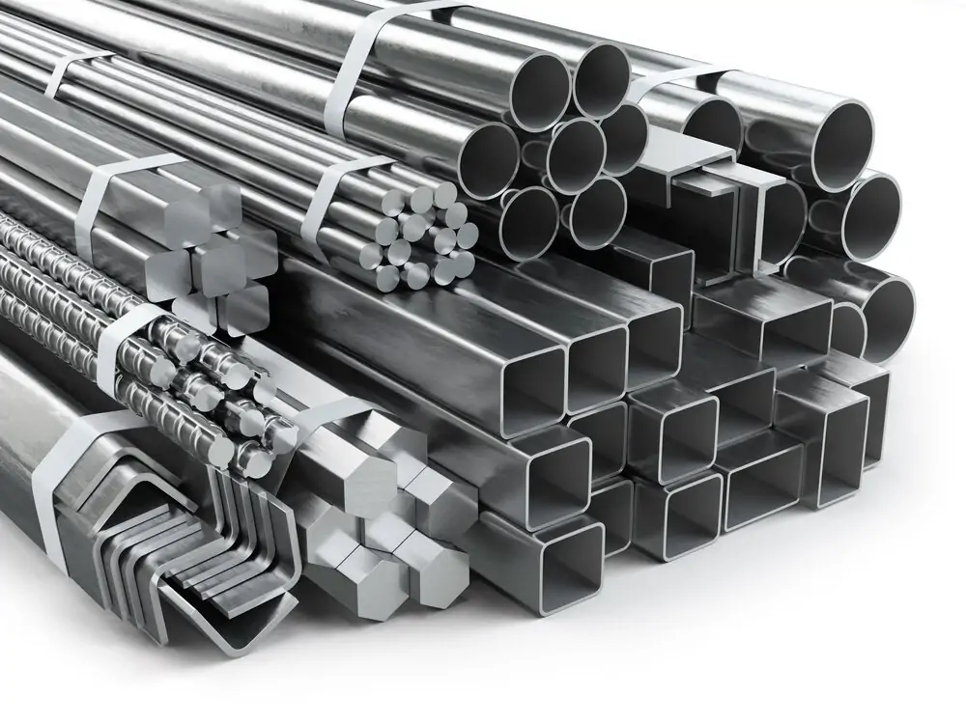
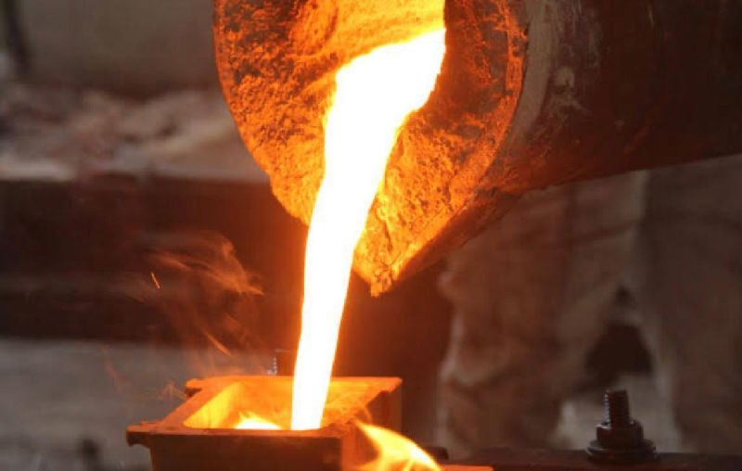
Half Yearly Review of MTD 6 & MTD 19
Presented by:
Ajay Kumar Soni
Scientist-C/Deputy Director
Metallurgical Engineering Department
Bureau of Indian Standards

Slide 2
Overview
Sl No. | Sectional Committee | No. of Standards | Standard in QCO
1 | Pig iron and Cast iron Sectional Committee, MTD 6 | 46 | 11
2 | Steel Tubes, Pipes and Fittings Sectional Committee, MTD 19 | 39 | 5

Slide 3
APS 2024-25
 | Sectional Committee | NWIP received | Under Consideration | P-draft | Published
NWIP | Steel Tubes, Pipes and Fittings Sectional Committee, MTD 19 | 5 | 1 | 3 | 1
Due for Review 2024-25 | SC | Standards due for review | Allotted as (ARP/ R&D/ WG/ Workshop) | Revised/Amended | Withdrawn | Decision taken to Reaffirm | Decision taken to Archive
Due for Review 2024 / 25 | MTD 6 | 28 | 23 | 1 | 0 | 0 | 4
 | MTD 19 | 5 | 2 | 0 | 0 | 3 | 0

Slide 4
Progress of NWIPs and Process adopted
Sectional Committee | NWIP | Mode of Proposal | Mode of execution | Status
MTD 19 (Current) | Stainless Steel for Decorative Purpose | Industry Association | Working group | P- draft circulated among members
MTD 19 (Current) | Stainless Steel for Water Applications | Industry Association | Working group | P- draft circulated among members
MTD 19 (Current) | Seamless Carbon Steel Tubes for High Temperature Services | Industry Association | Working Group | P- draft prepared
MTD 19 (Current) | Single Wall Copper and Zinc Coated Steel Condenser Tubes | Industry | Working Group | Proposal Under consideration
MTD 19 (Carried Over) | IS 18573 Cold formed welded carbon steel square and rectangular hollow sections for mechanical, general engineering and decorative purposes | Industry | Working Panel | Published

Slide 5
APS 2024-25 (Due for Review)
Due for Review 2024-25 | SC | Standards due for review | Allotted as ARP | Under Review with WG | R&D | Decision taken to Reaffirm | Decision taken to Archive
Due for Review 2024 / 25 | MTD 6 | 27 | 10 | 12 | 1 | 0 | 4
 | MTD 19 | 5 | 0 | 2 | 0 | 3 | 0

Slide 6
ARP Allotted (MTD 6)
S. No. | IS No. | IS Title | Allocated To | Phase | Current Status
1 | IS 1537 : 1976 | Specification for vertically cast iron pressure pipes for water, gas and sewage (First Revision) | SHIV PRAKASH, SCIENTIST-D, AHMEDABAD BRANCH OFFICE I | Phase-9 | Pending
2 | IS 7520 : 1974 | Specification for corrosion - Resistant high silicon iron castings | SHIV PRAKASH, SCIENTIST-D, AHMEDABAD BRANCH OFFICE I | Phase-8 | Pending
3 | IS 8329 : 2000 | Centrifugally cast (Spun) ductile iron pressure pipes for water, gas and sewage - Specification (Third Revision) | PYLA DESHICK, SCIENTIST-B, HEADQUARTERS, NEW DELHI | Phase-10 | Pending
4 | IS 210 : 2009 | Grey iron castings - Specification (Fifth Revision) | HIMANSHU KUMAR, SCIENTIST-C, PATNA BRANCH OFFICE | Phase-9 | Pending
5 | IS 5531 : 2014 | Cast iron specials for asbestos cement pressure pipes for water and sewage - Specification (Third Revision) | HIMANSHU KUMAR, SCIENTIST-C, PATNA BRANCH OFFICE | Phase-8 | Pending
6 | IS 1865 : 1991 | Iron castings with spheroidal or nodular graphite - Specification (Third Revision) | SACHIN CHOUDHARY, SCIENTIST-C, HEADQUARTERS, NEW DELHI | Phase-9 | Pending

Slide 7
ARP Allotted (MTD 6)
S. No. | IS No. | IS Title | Allocated To | Phase | Current Status
7 | IS 5519 : 1979 | Deviations for untoleranced dimensions and mass of grey iron castings (First Revision) | ANANT KUMAR, SCIENTIST-C, GHAZIABAD BRANCH OFFICE | Phase-9 | Pending
8 | IS 8349 : 1977 | Deviations for untoleranced dimensions of malleable iron castings | ANANT KUMAR, SCIENTIST-C, GHAZIABAD BRANCH OFFICE | Phase-10 | Pending
9 | IS 10299 : 1982 | Specification for cast iron saddle pieces for service connection from asbestos cement pressure pipes | KANCHAN ORAON, SCIENTIST-C, HEADQUARTERS, NEW DELHI | Phase-8 | Pending
10 | IS 9523 : 2000 | Ductile iron fittings for pressure pipes for water, gas and sewage - Specification (First Revision) | SATYENDRA KUMAR PANDEY, SCIENTIST-C, RAJKOT BRANCH OFFICE I | Phase-9 | Pending

Slide 8
Working Panels and Working Groups (MTD6)
Sl No. | Sectional Committee | Working Panel/ Working Group | Title | Work assigned
1 | MTD 6 | MTD 6 : P1 | Ductile iron pipes and fittings | Standardization in the field of ductile iron pipes and fittings
2 | MTD 6 | MTD 6 : WG1 | Revision of IS 8329 | The working group is tasked with the revision of IS 8329 (Centrifugally cast (Spun) ductile iron pressure pipes for water, gas and sewage - Specification)
3 | MTD 6 | MTD 6 : WG2 | Revision of IS 9523 | The working group is tasked with the revision of IS 9523 (Ductile iron fittings for pressure pipes for water, gas and sewage - Specification)

Slide 9
Working Panels - MTD19
Sl No. | Working Panel | Title | Work assigned
1 | MTD 19 : P-2 | Seamless Tubes & Pipes | Standardization in the field of seamless pipes and tubes
2 | MTD 19 : P-7 | Stainless steel pipes and tubes | Standardization in the field of stainless steel pipes and tubes
3 | MTD 19 : P 8 | Welded Tubes & Pipes | Standardization in the field of Welded steel pipes and tubes

Slide 10
Working Groups - MTD19
Sl No. | Working Group | Title | Work assigned
1 | MTD 19 : WG-1 | Adoption of ISO 11960 and 11961 | The working group is tasked with the adoption of ISO 11960 ("Petroleum and natural gas industries — Steel pipes for use as casing or tubing for wells") and ISO 11961 ("Petroleum and natural gas industries — Steel drill pipes").
2 | MTD 19 : WG-2 | Revision of IS 3589 | The working group is tasked with the revision of IS 3589 (Steel pipes for water and sewage (168.3 To 2540 Mm Outside Diameter) - Specification)
3 | MTD 19 : WG-3 | Revision of IS 11714 Part (1-5) | The working group is tasked with the revision of IS 11714 : PART 1 to 5 (Specification for steel tubes for heat exchangers)
4 | MTD 19 : WG-4 | Revision of IS 12791 | The working group is tasked with the revision of IS 12791 (High carbon chromium bearing steel tubes for the manufacture of bearing races - Specification)
5 | MTD 19 : WG-5 | Indigenous standard on High T Seamless Steel Tubes | The working group is tasked with development of Indigenous standard on “High T Seamless Steel Tubes”
6 | MTD 19 : WG-6 | Indigenous standard on SS Pipes for water application | The working group is tasked with development of Indigenous standard on "SS Pipes for water application"
7 | MTD 19 : WG-7 | Indigenous Standard on SS Pipes for Decorative Application | The working group is tasked with development of Indigenous standard on "SS Pipes for decorative application"

Slide 11
SC/WP/WG meeting planned outside HQ
Sl No. | SC/WP | Date | Venue
1 | 38th Meeting of MTD 19 | 11-12-2024 | IIT Indore
2 | 32rd Meeting of MTD 6 | 21-02-2025 | NIT Jamshedpur
3 | 2nd Meeting of MTD 19 : WG05 | January 2025 | Maharashtra Seamless Limited, Sukeli

Slide 12
ISO/IEC Projects
Sl No. | Type of Ballot | Total Ballots | In Progress with committee members | Voted
1 | CIB (ISO) | 7 | 2 | 5
2 | DIS (ISO) | 4 | 3 | 1
3 | FDIS (ISO) | 1 | 0 | 1
4 | NP (ISO) | 2 | 0 | 2
5 | SR (ISO) | 8 | 6 | 2
Total |  | 22 | 11 | 11

Slide 13
ISO/IEC Projects
Sl No. | ISO TC | ISO Project | Level of Interest | Expert Designated
1 | ISO/ TC 5/ SC 2 | IISO/NP 24131-4 Internal protection by polymeric lining for ductile iron pipes — Requirements and test methods — Part 4: --Part 4: ceramic epoxy lining | High (H) | Shri Atindra Dey, Electrosteel Casting
2 | ISO/ TC 5/ SC 2 | ISO/FDIS 10803 (Ed 3) Design method for ductile iron pipes | Medium (M) | Shri Maneesh Kumar, JindalSaw Ltd.
3 | ISO/TC 67/SC 2 | ISO/NP TS 25170 Type B sleeves for pipeline defects repair | Medium (M) | Shri J. Choksi, Welspun Corp.
4 | ISO/ TC 5/ SC 2 | ISO 21053:2019 Life cycle analysis and recycling of ductile iron pipes for water applications | Medium (M) | Prof. Seema Unnikrishnan, IIM Mumbai
5 | ISO/ TC 25 | ISO 945-4:2019 (Ed 3) Microstructure of cast irons — Part 4: Test method for evaluating nodularity in spheroidal graphite cast irons | Low (L) | -
6 | ISO/ TC 25 | ISO 945-1:2019 (Ed 3) Microstructure of cast irons — Part 1: Graphite classification by visual analysis | Low (L) | -

Slide 14
Status of Process Reform
Meeting Calendar 2024-25
Sectional Committee | Q1 | Q2 | Q3 | Q4
Pig iron and Cast iron Sectional Committee, MTD 6 | - | 22.08.2024 | 20.12.2024 | 21.02.2025
Steel Tubes, Pipes and Fittings Sectional Committee, MTD 19 | 10.04.2024 | 22.07.2024 | 11.12.2024 | 03.03.2025

Slide 15
Status of Process Reform
TC meeting attendance
SC | Meeting No. | Date | Attendance, %
Steel Tubes, Pipes and Fittings Sectional Committee, MTD 19 | 36th | 10.04.2024 | 52.94
Steel Tubes, Pipes and Fittings Sectional Committee, MTD 19 | 37th | 22.07.2024 | 78.95
Pig iron and Cast iron Sectional Committee, MTD 6 | 31th | 22.08.2024 | 75

Slide 16
Status of Process Reform
Inactive member
New members co-opted
Sectional Committee | Inactive Members | Identified/removed
Steel Tubes, Pipes and Fittings Sectional Committee, MTD 19 | 3 | Identified
Pig iron and Cast iron Sectional Committee, MTD 6 | - | -
Sl No. | SC | Organisation | Expert
1 | Steel Tubes, Pipes and Fittings Sectional Committee, MTD 19 | STMAI | Avnish Kumar
 |  | STMAI | Hemant Matreja
2 | Pig iron and Cast iron Sectional Committee, MTD 6 | IIM Mumbai | Prof. Seema Unnikrishnan
Notes:
BHEL FII

Slide 17
Status of Process Reform
Comments on P-Draft
Sl. No. | Sectional Committee | P-draft circulated | Comments Received
1 | Steel Tubes, Pipes and Fittings Sectional Committee, MTD 19 | 3 | 3

Slide 18
Status of Process Reform
SC Membership Rationalization
MTD 6 | MTD 19
R&D Organization- 1 Academic Institution- 0 Industry - 10 Industry Association - 1 Consumer Group- 0 Central Ministry/Dept.- 3 | R&D Organization- 0 Academic Institution- 0 Industry - 7 Industry Association - 3 Consumer Group- 5 Central Ministry/Dept.- 1 Technologist- 1
Vacancy
R&D Organization- 2 Academic Institution – 3 Consumer Group – 2 | R&D Organization- 3 Academic Institution- 3

Slide 19
Standards Published in FY 2024-25
Sl No. | IS No. | Title | New/Revision
1 | IS 15905 : 2024 | Hubless Centrifugally Cast (Spun) Iron Pipes, Fittings and Accessories - Spigot Series - Specification (First Revision) | Revision
2 | IS 18573 : 2024 | Cold formed welded carbon steel square and rectangular hollow sections for mechanical, general engineering and decorative purposes – Specification | New

Slide 21
ARP Allotted (MTD 19)
S. No. | IS No. | IS Title | Allocated To | Phase | Current Status
1 | IS 1161 : 2014 | Steel tubes for structural purposes - Specification (Fifth Revision) | SACHIN CHOUDHARY, SCIENTIST-C, HEADQUARTERS, NEW DELHI | Phase-8 | Pending
2 | IS 2039 : Part 1 to 3 : 1991 | Steel tubes for bicycle and cycle rickshaws - Specification (Second Revision) | ARUN PUCCHAKAYALA, SCIENTIST-D, HEADQUARTERS, NEW DELHI | Phase-8 | Pending
3 | IS 3074 : 2013 | Steel tubes for automotive purposes - Specification (Third Revision) | ARUN PUCCHAKAYALA, SCIENTIST-D, HEADQUARTERS, NEW DELHI | Phase-10 | Pending
4 | IS 12620 : 1989 | Seamless steel tubes for manufacturing high pressure gas cylinders - Specification | VIPIN BHASKAR, SCIENTIST-C, HEADQUARTERS, NEW DELHI | Phase-8 | Pending
5 | IS 2416 : 1986 | Specification for boiler and supherheater tubes for marine and naval purposes (First Revision) | RANJIT KUMAR, SCIENTIST-D, HEADQUARTERS, NEW DELHI | Phase-9 | Pending

Slide 22
ARP Allotted (MTD 19)
S. No. | IS No. | IS Title | Allocated To | Phase | Current Status
6 | IS 7174 : 1974 | Specification for carbon steel tubes for use on board ships for working pressures 0.7 to 1.7 n/mm2 | VINITH KUMAR G, SCIENTIST-D, PUNE BRANCH OFFICE | Phase-9 | Pending
7 | IS 8036 : 1976 | Specification for mild steel transformer cooling tubes | VINITH KUMAR G, SCIENTIST-D, PUNE BRANCH OFFICE | Phase-10 | Pending
8 | IS 11714 : Part 1 to 5 : 1986 | Specification for steel tubes for heat exchangers | MANISH RAJ, SCIENTIST-C, HEADQUARTERS, NEW DELHI | Phase-9 | Pending
9 | IS 5429 : 2013 | Dimensions for steel tubes for automotive purposes (Second Revision) | VIPIN BHASKAR, SCIENTIST-C, HEADQUARTERS, NEW DELHI | Phase-9 | Pending
10 | IS 4270 : 2001 | Steel tubes used for water wells specification (Third Revision) | VIPIN BHASKAR, SCIENTIST-C, HEADQUARTERS, NEW DELHI | Phase-10 | Pending

