Slide 1
Half yearly review
HARSHADA GANESH KADAM
MEMBER SECRETARY- MHD 05 & MHD 07

Slide 2
PROGRESS OF NWIP’S AGAINST THE ANNUAL ACTION PLAN FOR 2024-2025 AND THE PROCESS
SECTIONAL COMMITTEE | SUBJECT/TITLE OF NWIP | STATUS | PROCESS
MHD 05 - Ophthalmic Instruments and Appliances (Carried over + Current ) | Sterile Blades for Ophthalmic Microsurgeries -Requirements and Test Methods | P-draft | Working Panel P04
 | optics and instruments Near reading charts | Ready for Gazette | Working Panel P04
 | Fundamental requirements for uncut finished lenses | Under Printing | Working Panel P04
 | contact lens care products Labelling | Under Printing | Working Panel P02
 | contact lens care products Fundamental requirements | Under Printing | Working Panel P07
 | Spectacle lenses Vocabulary | Under Printing | Working Panel P06

Slide 3
PROGRESS OF NWIP’S AGAINST THE ANNUAL ACTION PLAN FOR 2024-2025 AND THE PROCESS ADOPTED
SECTIONAL COMMITTEE | SUBJECT/TITLE OF NWIP | STATUS | PROCESS
MHD 05 - Ophthalmic Instruments and Appliances (Current) | General Requirements of Ophthalmic Conformers | Under R & D | Working Panel P10
 | General Requirements of Ophthalmic Glaucoma Shunts | Under R & D evaluation | Working Panel P05
 | General Requirements of Silicone stent for Lacrimal intubation surgery | Under R & D evaluation | Working Panel P09
New work item : Carried over -1 Indigenous (Under p draft circulation) : Current - 13 (3 R & D/ 10 ISO Standards)

Slide 4
PROGRESS OF NWIP’S AGAINST THE ANNUAL ACTION PLAN FOR 2024-2025
SECTIONAL COMMITTEE | SUBJECT/TITLE OF NWIP | STATUS | PROCESS
MHD 07- Neurosurgery Instruments Implants and Accessories (Carried over ) | Repetitive Transcranial Magnetic Stimulation | Under R &D | Allotted to NIT Jalandhar
 | Computer Assisted Surgical Systems - Surgical Navigation System or Surgery Guidance systems | Working draft under preparation | Working Group 01
 | Bipolar Cautery | Working draft under preparation | Working Group 02
 | Leyla retractors | Draft under circulation | Received from Intern

Slide 5
PROGRESS OF NWIP’S AGAINST THE ANNUAL ACTION PLAN FOR 2024-2025
SECTIONAL COMMITTEE | SUBJECT/TITLE OF NWIP | STATUS | PROCESS
MHD 07- Neurosurgery Instruments Implants and Accessories (Carried over ) | Spine Implant | Working draft under preparation | Working Panel 02
 | Endoscope Spine | Working draft under preparation | Working Panel 02
 | Vagal Nerve Stimulator | Working draft under preparation | Working Panel 04
 | Intracranial stents | Working draft under preparation | Working Panel 02

Slide 6
PROGRESS OF NWIP’S AGAINST THE ANNUAL ACTION PLAN FOR 2024-2025
SECTIONAL COMMITTEE | SUBJECT/TITLE OF NWIP | STATUS | PROCESS
MHD 07- Neurosurgery Instruments Implants and Accessories (Current) | Specification for Intracranial Pressure Monitors | P draft circulated | Draft received from Intern
 | Specification for Electroconvulsive Therapy Machine | P draft circulated | Draft received from Intern
 | Specification For Algometer | P draft circulated | Draft received from Intern
 | Specification for Single Channel Physiological Recorder | P draft circulated | Draft received from Intern
New Work Item : Carried Over : 8 (1 R&D / 7 draft under preparation) : Current – 6 (4 P draft / 2 dropped)

Slide 7
PROGRESS OF REVIEWS FOR 2024-2025
Sectional Committee | Standards due for Review |  | Review Completed |  | Review under Progress |  | Outcome of Review
 |  |  |  |  |  |  | Revised |  | Reaffirmed |  | Amended |  | Withdrawal |  | Archived |  | Total
 | Pre 2K | Post 2K | Pre 2K | Post 2K | Pre 2K | Post 2K | Pre 2K | Post 2K | Pre 2K | Post 2K | Pre 2K | Post 2K | Pre 2K | Post 2K | Pre 2K | Post 2K | Pre 2K | Post 2K
MHD 05 | 58 | 6 | 16 | 6 | 3 | 0 | 7 | 1 | 1 | 5 | 0 | 0 | 7 | 0 | 0 | 0 | 39 | 0
MHD 07 | 1 | 3 | 1 | 3 | 0 | 0 | 0 | 1 | 1 | 2 | 0 | 0 | 0 | 0 | 0 | 0 | 0 | 0

Slide 8
WORKING PANELS AND WORKING GROUPS
Sectional Committee | No. of existing Working Panels and Working Groups | Title of Working Panels (WP) and Working Groups (WG) | No. of Working Panels/Groups created | No. of Working Panels/Groups abolished | Plan of Action
MHD 05 | Working Panels-0 Working Groups-0 | Spectacle frames and spectacle lenses Ophthalmic Implants and Contact lenses Ophthalmic Devices (Diagnostic and surgical electro medical devices) Ophthalmic surgical instruments | Working Panels-4 Working Groups-0 | Working Groups-0 | Working Panels/Groups will be restructured in line with the sectorial classification of the Sectional Committees.
MHD 07 | Working Panels-0 Working Group-1 | Neurosurgical instruments- WP Neurosurgical implants –WP Neurosurgical Accessories –WP Neurosurgical Monitoring Devices –WP Neuro navigation System Working Group | Working Panels-4 Working Groups-0 | Working Panels-0 Working Groups-0 | Working Panels/Groups will be restructured in line with the sectorial classification of the Sectional Committees.

Slide 9
WPs & WGs
MHD 05 TC
Ophthalmic Instruments and Appliances Sectional Committee
Working Panel
Spectacle frames and spectacle lenses
Ophthalmic Implants and Contact lenses
Ophthalmic Devices
Ophthalmic surgical instruments

Slide 10
WPs & WGs
MHD 07 TC
Neurosurgery Instruments Implants and Accessories Sectional Committee
Working Panel
Working Group
Neurosurgical Implant
Neurosurgical Accessories
Neurosurgical Devices
Neuronavigation system wo
Neurosurgical monitoring Devices

Slide 11
ISO/IEC Projects - Identified in H & M category, experts designated, strategies adopted to identify experts. ISO/TC 172/SC 7 Ophthalmic optics and instruments
Ballot received | Ballots identified as High priority | Experts nominated | Strategies
38 | ISO/DIS 11979-1 (Ed 5) | Prof. Jolly Rohtagi, university of medical collge Mr. Rathingar, L V Prasad eye institute Ms. Premnandini , L V Prasad eye institute | National Working groups aligning with ISO working groups Webinar/Seminar MoU institutes
 | SR 9801:2009 (Ed 2)
 | SR 7998:2005(Ed 2)
 | SR 13666:2019 (Ed 3)
https://docs.google.com/spreadsheets/d/1Kv3PT1BivtQP2oh-jxsJNKwd19hvj0U-2si1yubXZfI/edit?gid=1933623389#gid=1933623389

Slide 12
SC/WP meetings planned and held outside HQ
Sl No. | Technical Committee | Venue | Planned
1. | MHD 05 - -Ophthalmic Instruments and Appliances Sectional Committee | IIT, Hyderabad in March 2025 | Planned in Q4
2. | MHD 7- Neurosurgery Instruments Implants and Accessories Sectional Committee | IIT ,BHU, Varanasi in March 2025 | Planned in Q4

Slide 13
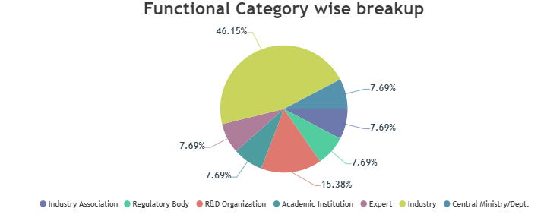
Status of Process Reform measures
SC membership rationalized
MHD 7
Existing
Industry – Manufacturer/User = 6/13(46.15 percent)
Research Institute = 2/13 (15.38 percent)
Regulator = 1/13 (7.69 percent)
Experts = 1/13 (7.69 percent)
Association = 1/13(7.69 percent)
Central Ministry =1/13 (7.69 percent )

Slide 14
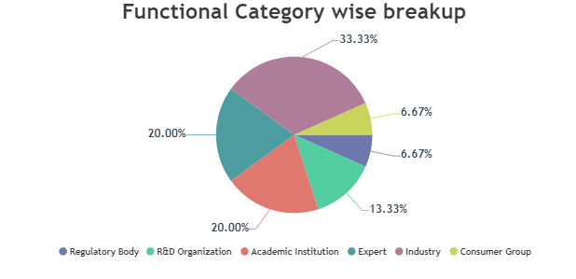
Status of Process Reform measures
SC membership rationalized
MHD 5
Existing
Industry – Manufacturer/User = 5/15 (33.33percent)
Consumer = 1/15(6.67 percent)
Experts = 3/15 (20 percent)
Research Institute = 2/15 (13.33 percent)
Regulator/Central Ministry /Department = 1/15 (6.67 percent)
Academia = 3/15(20 percent )

Slide 15
Status of Process Reform measures
Attendance:
b) Inactive Members:
Sectional Committee | Attendance
 | 1st meeting | 2nd meeting
MHD 5 | 88.24 % | 76.47 %
MHD 7 | 69.23 % | 86.67%
Sectional Committee | Inactive members removed
MHD 5 | 1
MHD 7 | 2

Slide 16
Status of Process Reform measures
a) Comments on P-draft:
b) Resolutions:
Resolution are always sent within 24 h of the meeting
c) Member Trained:
New members are always trained when inducted into the Committee.
P-draft issued | No. of organization commented
5 | 6

Slide 17
Thank you

