Slide 1
Water Resources Department
Half Yearly Review 2024-25

Slide 2
Water Resources – Landscape
Flow
Utilities
Sources
Recycle
EXCLUDES:
Waster-water Treatment/Management
Supply of treated water to households
Water quality
Environment

Slide 3
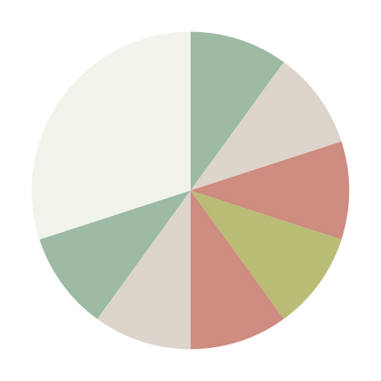
04
Construction
Design and Safety
WRD 08,09,13,,15,21.28,29
03
05
Investigations
WRD 05, 08.
Repair& Retrofitting
WRD 30
02
06
Planning & Management
WRD 03,06,10, 23
Env. Impact
& Mitigation
WRD 03, 24, 22,31
WRD
Landscape
01
07
Flow Measurments
WRD 01 & ISO TC 113
Supporting Technology and Infrastructures
WRD 12,14.16

Slide 4
S. No. | Sector | Sub-sector | Existing Panels/Working Groups
1 Flow Measurement | Hydrometry | Flow Measurement in Open Channels (P-1) Fluid Flow in Closed Conduits (P-2) Sediment Transport and Sampling(P-3) Hydrometric and Meteorological Instruments(P-4) Acoustic and Doppler Methods(P-5) Water Level and Flow Instruments(P-6) Automation ISO/TC 113/SC 01 ----- (P-1) ISO/TC 113/SC 02 ----- (P-1) ISO/TC 113/SC 05 ----- (P-6) ISO/TC 113/SC 06 ----- (P-3) | WG- 1 Revision of IS 3911: 1994 Surface floats - Functional requirements WG- 2 Revision of IS 9118: 1979 Method for measurement of pressure WG- 3 Revision OF IS 15454:2004 ISO/TR 9823:1990 Liquid Flow Measurement
2 Planning & Management | Water Resources Planning, Management | Project reports (P-1) Management & evaluation of water resources project progress (P-2) | WRD 06: WG 1 Improving Water Use Efficiency in Irrigation Sector WRD 06: WG 3 Piped Irrigation Network WRD 06 Canal Automation Panel
 | Reservoirs and Lakes | Planning and design(P-1) Operation and maintenance (including sediment management) (P-2)
 | Groundwater | Exploration and measurement (P-1) Harvesting and recharge (P-2) WRD 03: Groundwater (ISO/TC 113/SC 08) (P-3) | WG- 1 Revision of IS 15797 : 2008 & IS 15792 : 2008 WG- 2 Hydro-fracturing and Bore-well Blasting Techniques WG- 3 Springs WG-04 Subsurface Dykes Panel constituted for Development of Standard on Sustainable Groundwater Management
 | Cost Estimation Proforma | Geological Investigation (P-1) Dam and Appurtenant Structures (P-2) Canals and CD works(P-3) | WRD 23 : WG 01 Revision of IS 11590:1995
3 Investigations | Foundation and Foundation Treatment | Investigation (P-1)
 | Geological Investigation and Subsurface Exploration | Presentation of data (P-1) Investigation & Subsurface exploration (P-2) | WG 01 Revision of IS 6955 : 2008

Slide 5
S. No. | Sector | Sub-sector | Existing Panels/Working Groups
4 Construction Design and Safety | Dams and Spillways | Planning (P-1) Design (P-2) Construction and maintenance (P-3) | WRD 09 Review of IS 9296 Working Group WRD 09 Review of standards on PVC water stops Working Group WRD 09 Review of IS 13551 : 1992 and IS 6512 : 2019 Working Group WRD 09 Design of Piano Key Weir Working Group WRD 09 Review of IS 7894 Working Group WRD 09 Review of IS 12169 Working Group WRD 09 Dam Break Analysis Working Group WRD 09 Review of IS 8605:1977 and Review of IS 13645:1993 Working Group WRD 09 Roller Compacted Dams WRD 09 Rubber Dams Treatment of Dam Body
 | Foundation & Foundation Treatment | Design of Foundation ( P-1) Construction of Foundation ( P-2) Treatment (P-3) | WRD 08: WG 01 Foundation treatment for barrages on gravelly and boundary reaches WRD 08: WG 02 Revision of IS 6066: 1994
 | Canals And Cross Drainage Works | Planning and design (P-1) Construction & Linings(P-2) Inspection and maintenance (P-3)
 | Hydroelectric Power House Structures | Civil Works (P-1) Electro-mechanical Works (P-2) | WRD 15 First Revision of IS 12800 (Part 1): 1993 Panel WRD 15 First Revision of IS 7418: 1991 Panel WRD 15 Code of Practice for Ventilation of Underground Hydro - Electric Power Stations Panel
 | Coastal Zone Water Management | Erosion Protection (P-1) Salt Water Intrusion (P-2) Coastal Hazards (P-3) | WRD 28 Coastal Erosion Protection Using Gabions - Guidelines Working Group WRD 28 Prevention of Sea Water Intrusion in Coastal Aquifers Working Group WRD 28 Prevention of Coastal Hazards in Coastal Area - Guidelines Working Group WRD 28 : Action of Waves & Current on Coastal Structures
 | Small Hydropower Plants | Planning (P-1) Civil Works (P-2) Electro-mechanical Works (P-3) Pumped Storage Plants(PSP) (P-4) | WRD 29 Small Hydropower Plants – General Panel WRD 29 Small Hydropower Plants- Civil Works Panel WRD 29 Small Hydropower plants – Electro-mechanical Works Panel
5 Repair& Retrofitting | Repair and Retrofitting of Dams | Assessment of the Structure (P-1) Materials and Methods for R&R (P-2)

Slide 6
S. No. | Sector | Sub-sector | Existing Panels/Working Groups
6 Env. Impact & Mitigation | Groundwater | Impact Assessment
 | Flood Management | Design and Construction of Training Works (P-1) Design and Construction of Diversion Works (P-2) | WG -1 Revision of IS 8408 :1994, IS 10751 :1994, IS 14262 : 1995 and New Formulation of IS 6966 : 1989 /Pt-2
 | Environmental Impact Assessment | Environmental Assessment and Management Socioeconomic Impact Assessment and Management | WRD 24 Preparation of Guidelines for Environmental Impact Assessment and Environmental Management Plan for Water Resources Projects Panel (P01) WRD 24 Preparation of guidelines on environmental and socioeconomic impacts due to river training works working group (WG01)
 | Urban Flooding
 | GLOFs & LLOFs | Mapping of Existing Lakes (P-1) Mitigation Measures (P-2) | Panel-1 for the Standard practice of nomenclature and standardization of glacier and glacial lakes Panel-2 for the Delineation and mapping of existing glacier and glacial lakes and potential lake sites Panel-3 for the Estimation of glacial/landslide lake volume Panel-4 for the Estimation of glacier Ice thickness Panel-5 for the Hydrodynamic modelling to estimate the potential of flash floods Panel-6 for the Standardization of glacial mass balance estimation Panel-7 for the Guidelines for risk assessment Panel-8 for the Early warning system assessment and installation Panel-9 for the Mitigation planning and implementation procedures
7 Supporting Technology and Infrastructures | Hydraulic Gates and Valves | Selection and design(P-1) Construction, operation, maintenance and testing(P-2) | WG 01Quality Assurance Plan for Hydraulic Gates Valves WG 02 Recommendations for Structural Design Criteria for Stop-logs P-1 Automation of Radial Gates
 | Water Conductor Systems | Planning and design (P-1) Construction and maintenance (P-2) | WRD 14 Revision of IS 4880 (Part 4) Working Group WRD 14 Revision of IS 9761 Working Group WRD 14 Review and revision of pre-2000 standards Panel WRD 14: Revision of IS 11639 on Penstocks & Design of Branching in Penstocks
 | Hydraulic Structures Instrumentation | Selection (P-1) Installation and maintenance (P-1) | WRD 16 : WG 01 Guidelines for Performance, Monitoring, and Surveillance of Hydraulic Structures

Slide 7
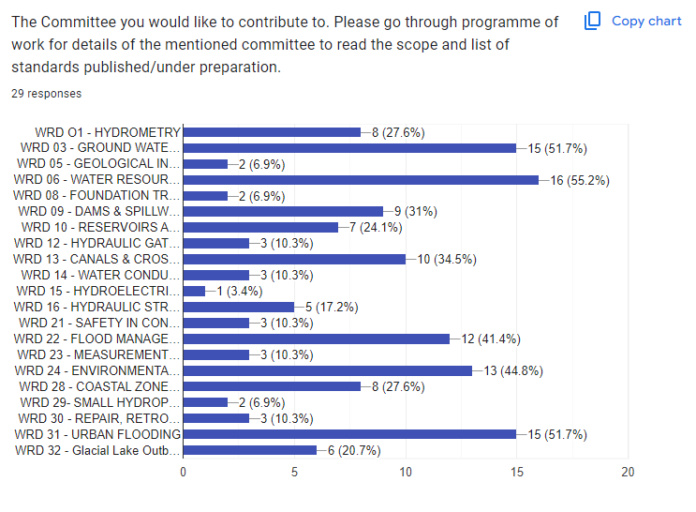
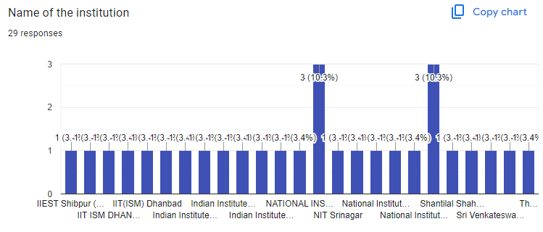
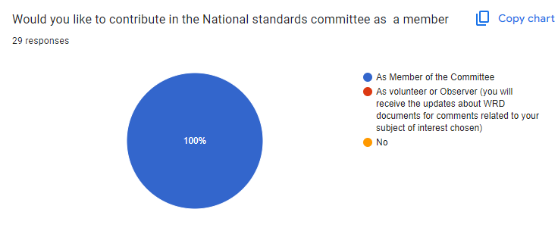
Engagement with the partner institutions
92 MoU Institutions were approached through Google form sharing the WRD Standards and seeking interest areas
: 29 Responses

Slide 8
Engagement with the partner institutions
Sharing of WC documents with the MoU institutions
Opportunities to the Interested Academia for participation in Working Groups/Panels and Sectional Committees.
Active involvements with IIT Roorkee, IIT Indore, MNIT Jaipur, IIT Guwahati, IIT Madras, IISC Bangalore, ISM Dhanbad. Other Institutes are also being approached for participation.

Slide 9
Progress on Sustainable Groundwater Management
Two Consultative Group Meeting Meetings: The outcome has been sketched down as below:
P-1 | P-2 | P-3 | P-4
Extraction of Groundwater: | Use of Extracted water | Recharge to Groundwater | Control and Testing
Natural Sources/Manmade bodies Direct Methods/Indirect Methods Urban Area//Rural Areas Addressing the involvement of local bodies to address implementation aspect through standards Use of approx. Energy efficient technologies for groundwater extraction Addressing the mechanism to stop puncturing of deep/confined aquifers | The efficient use of groundwater in Agriculture, Domestic and Industrial use. Addressing the guidelines of regulators like CGWB and CPCB for treatment of used water before discharge specially to groundwater. Addressing the min. requirements of water quality of recharged water back to aquifer. | Natural/Artificial recharge processes and engineering systems Methods and processes of recharge, their efficacy Addressing the target so as to achieve net water neutrality/balance in a area/catchment. (This will give an approach to address balancing the supply and demand of groundwater in area). | Mechanism to map the aquifers and testing of the water quality at regular interval. Reporting Mechanism for the local bodies for quantifying the amount of recharge in a specified area

Slide 10
Programmes Organized/Scheduled:
ISO/TC 113 Plenary meeting hosted by BIS in April 2024 at New Delhi from 22nd to 26 April 2024 at IHC
Lets Talk about Standards in July 2024 with MoU Institutions
National Seminar through Balmer Lawrie on Small Hydropower Plants at Kerala
Workshop/Lecture by 2 Officers at IIT Indore in Jun 2024
2 Seminar on Flood mitigation is planned on
Flood Mitigation Koshi and Brahmaputra river with WRD Assam and WRD Bihar.
Optimizing Geological Investigations in RVP along with NEEPCO at Shilong.
Webinar on CFRD (IS 18662)
Participation of 2 Officers in 4 days workshop/Conference at Vadodara on Dam Safety in Sept 2024.
Participation of HWRD and 2 Officers in ICOLD (International Congress on Large Dams) at New Delhi in Oct 2024.
2 Officers will participate in 2 days workshop at CSMRS New Delhi on Instrumentation and Testing in Water Resources Sector.

Slide 11
R&D Projects under WRD
PHASE 2:
3 Projects have been allotted.
- Safety Practices in Operation and Maintenance of Canals and Cross drainage works
- Filter for Roof top rainwater harvesting
- Mitigation Strategies for Coastal Hazards for Indian Coastlines
PHASE 3:
3 Projects are under process of evaluation.
-Study of Structural Design of Stop-logs. (Project code: WRD 0282 , WRD 12) -Study of Automation of Radial Gates. (Project code: WRD 0281, WRD 12) -Study of Water-stops Used at Transverse Contraction Joints in Masonry and Concrete dams. (Project code: WRD 0270 , WRD 09)
PHASE 4:
2 Projects identified
- Development of Manual (SP) for Canals
-

Slide 12
EXPERTS DESIGNATED FOR SUBJECTS
Sr. No. | ISO Technical Committee | National Mirror Committee | Project | Experts Designated | Organization Name
1. | ISO/TC 113 | WRD 01 | Revision of SBP | Ballot Circulated
1. | ISO/TC 113 | WRD 01 | Dilution Gauging | Dr. G. A. Panvalkar | CWPRS, Pune
2. | ISO/TC 113/SC 1 | WRD 01 | Revision of ISO/TR 11330 | Mrs. Neena Isaac | CWPRS, Pune
2. | ISO/TC 113/SC 1 | WRD 01 | Non- Contact Methods for measuring water surface velocity and discharge | Prof. J Indu | IIT Bombay

Slide 13
EXPERTS DESIGNATED FOR SUBJECTS
Sr. No. | ISO Technical Committee | National Mirror Committee | Project | Experts Designated | Organization Name
3. | ISO/TC 113/ SC 5 | WRD 01 | Radioactive Methods | Dr. H. J. Pant | BARC
4. | ISO/TC 113/SC 8 | WRD 03 | Test Pumping of Water Wells | Mr. Ranjan Ray | CGWB
4. | ISO/TC 113/SC 8 | WRD 03 | Manual Methods for the measurement of the Groundwater level in a well | Mr. Tapan Chakraborty | CGWB
4. | ISO/TC 113/SC 8 | WRD 03 | Well Management | Under Consideration

Slide 14
Sr. No. | ISO Technical Committee | National Mirror Committee | Project | Experts Designated | Organization Name
5 | ISO/TC 339 | WRD 29 | Small Hydropower Plants- Vocabulary | Prof S.K. Singal | IIT Roorkee

Slide 15
Proposal from India on New Subject Areas
WRD (BIS) is proposing new Technical Committee on Groundwater . Subject matter is approved in the last ISO/TC 113 Planery meeting as well as WRDC meeting.
Recently updated the BIS Membership of ISO/TC 30/SC 05 from ‘O’ to ‘P’ Membership
WRD is also working for proposing the Technical Committee on Dams (Design and Construction). Presently ISO do not hold any standard related to Water Resources Sector except for Hydrometry.

