Slide 1






Bureau of Indian Standards
Surat Branch Office
Kunjan Kumar Anand
Scientist C

Slide 2
Normal Application procedure- Option 1p 1 Complete Your Profile
Submit application through Manak Online (without test report)
Make sure to submit conformity of raw material
Factory inspection within 20 days from date of submission of application.
Sample offered will be tested in factory.
Sample will be drawn as per grouping guidelines (for the intended scope)
Based on satisfactory inspection and passing of sample in Third Party Testing, case to be processed for grant of licence.
Timeline for grant of Licence is 90 days.

Slide 3
Simplified Application procedure- Option 2p 1 Complete Your Profile
Application to be submitted with test report from BIS Recognised Lab
Test request generated through Manak Online/LIMS.
Follow grouping guidelines for covering the intended scope
Please ensure that test report also covers the requirement of Raw material (as given in the Indian Standard)
The test reports submitted shall not be more than 90 days old (test report generation date).
Factory inspection within 15 days from date of submission of application.
Timeline for grant of Licence (subject to satisfactory inspection) is 30 days.

Slide 4
Licence granted by Surat Branch Office 1 Complete Your Profile
Granted All India First Licence for the product Wrought Copper Tubes for Refrigeration And Air-Conditioning Purposes as per IS 10773
Granted All India First Licence for the product Copper Rods and Bars for Electrical Purposes as per IS 613
All India first case going for IS 2501, IS 4171 and IS 1545.
Approx 25 licences for different copper products with 22 licences in DD&DNH, Vapi, Umergam and Valsad.
Currently 10 application are under process.
Aluminium- 09 licences under Surat Branch Office (Distt Surat and Valsad).

Slide 5
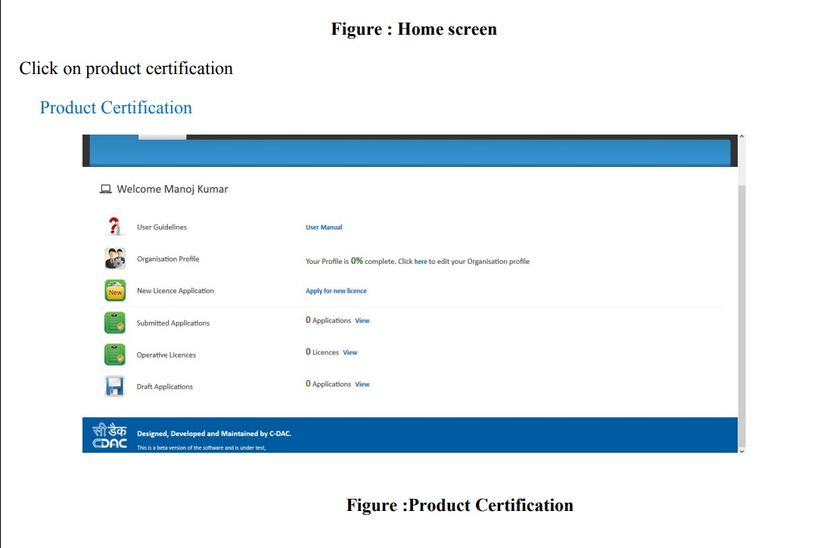
Steps for application-
Step 1 Complete Your Profile

Slide 6
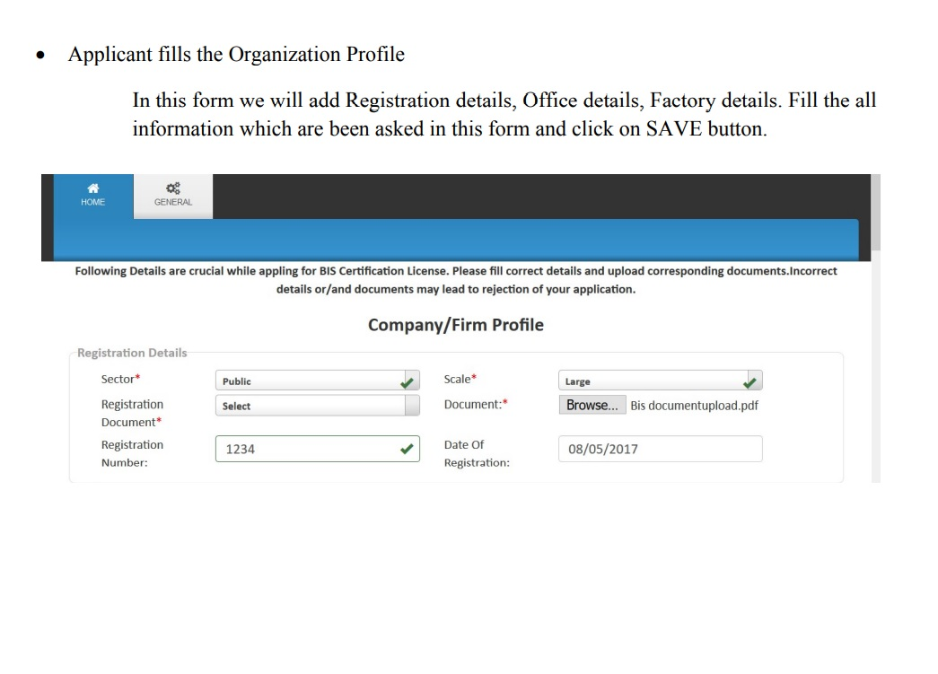
Continue……

Slide 7
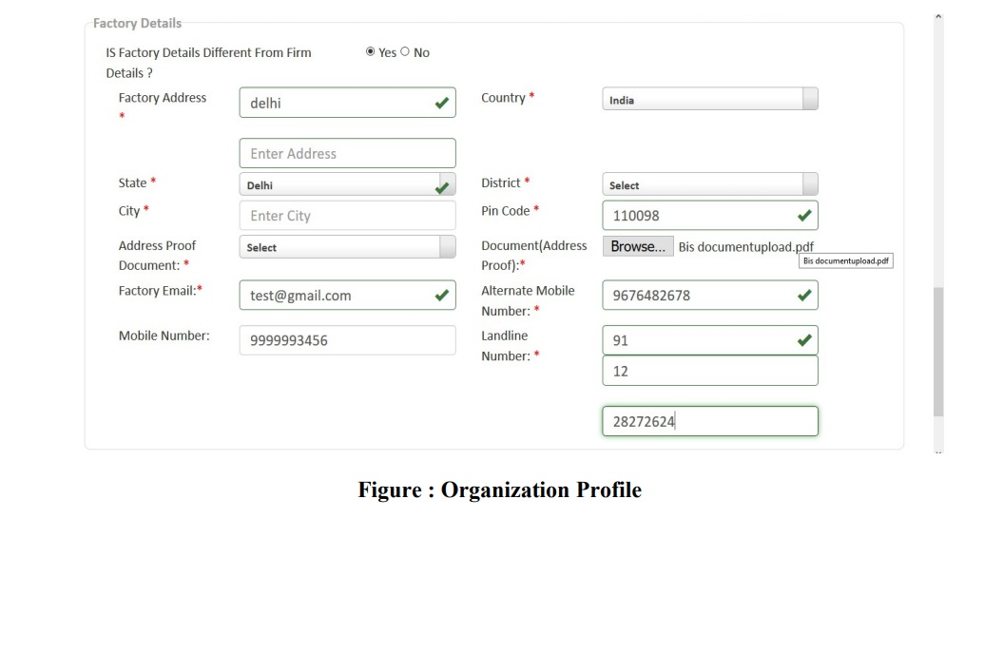
Continue……..

Slide 8
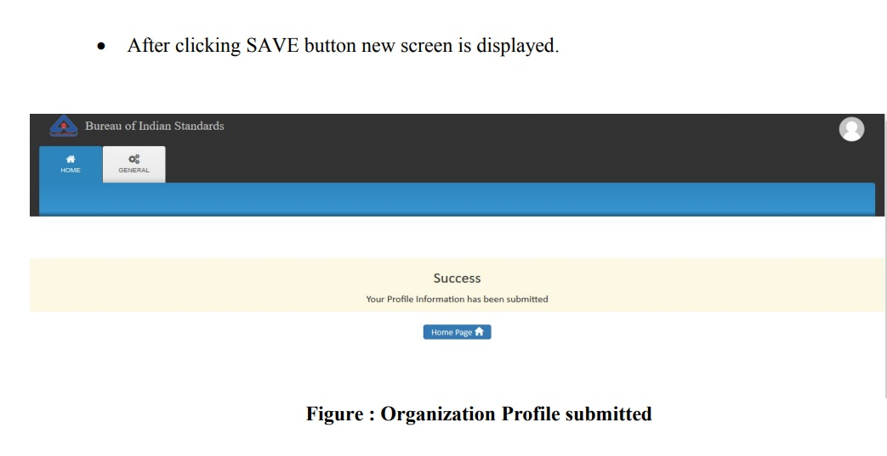
Continue……..

Slide 9
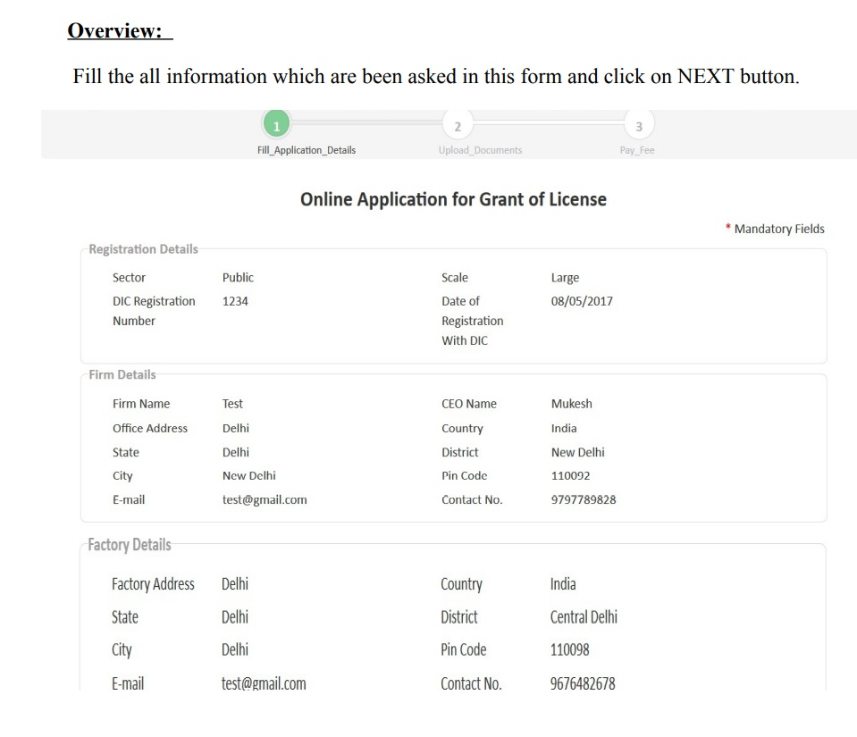
Step 2- fill the application form

Slide 10
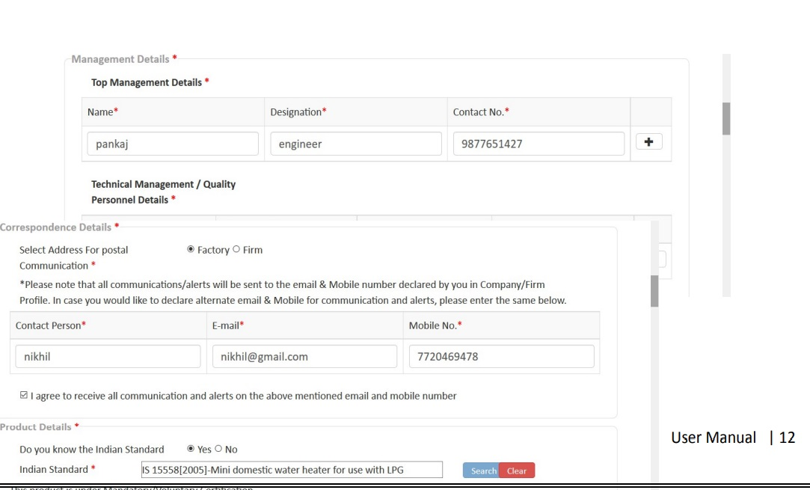
Continue…..

Slide 11
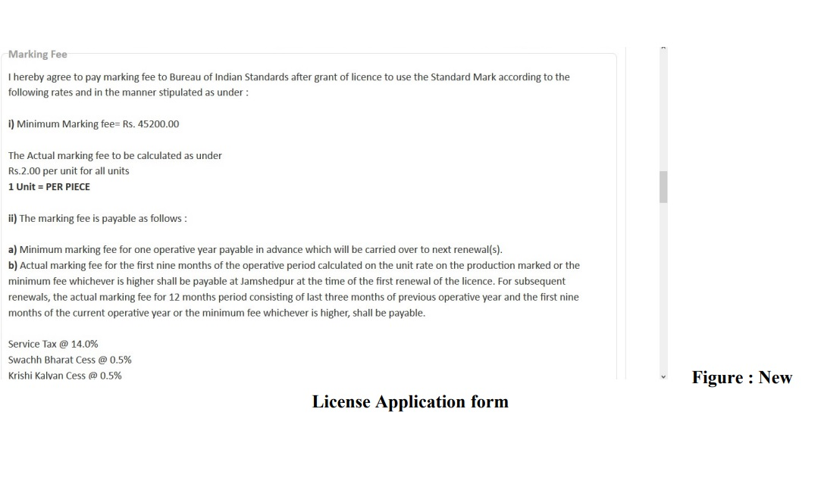
Continue………..

Slide 12
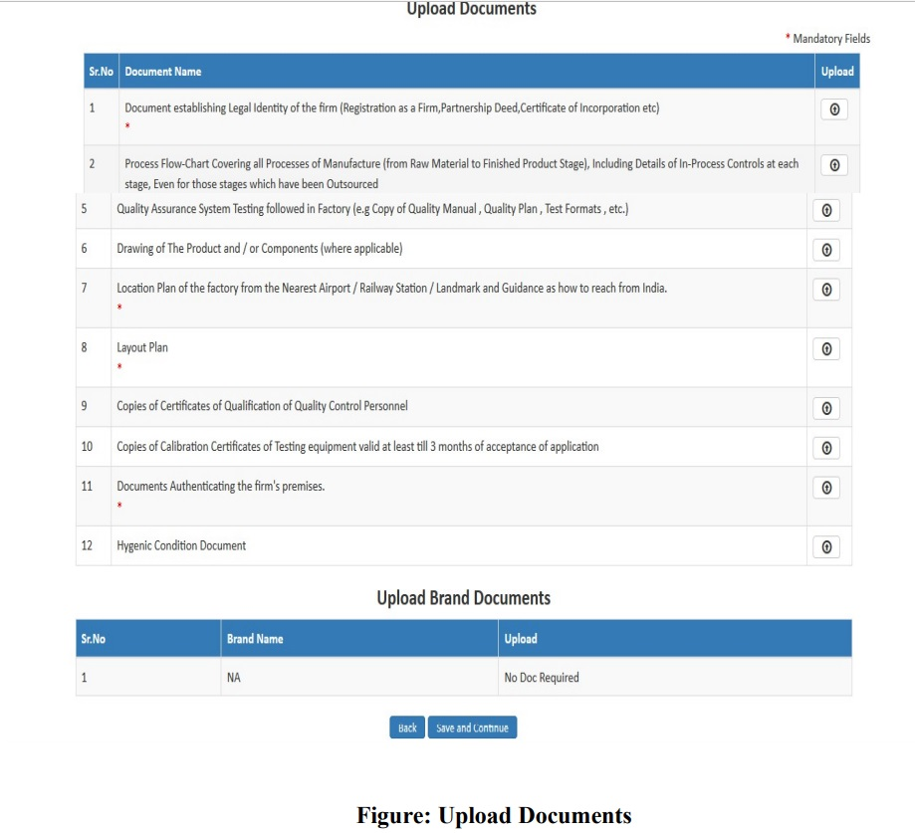
Step 3- Upload Documents

Slide 13
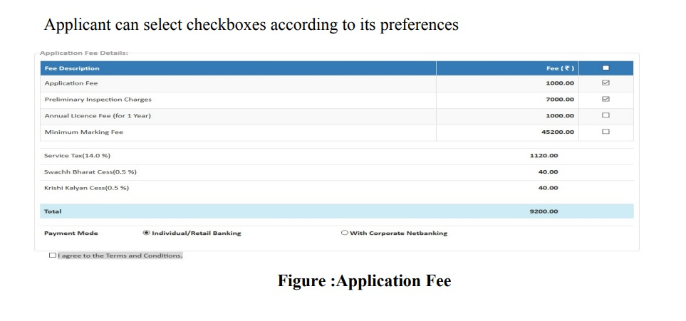
Step 4 – application fee Payment

Slide 14
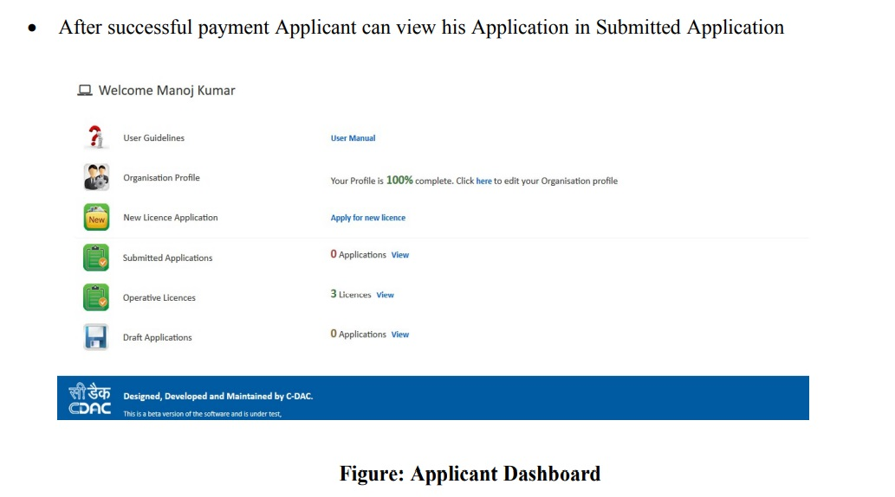
Continue…..

Slide 15
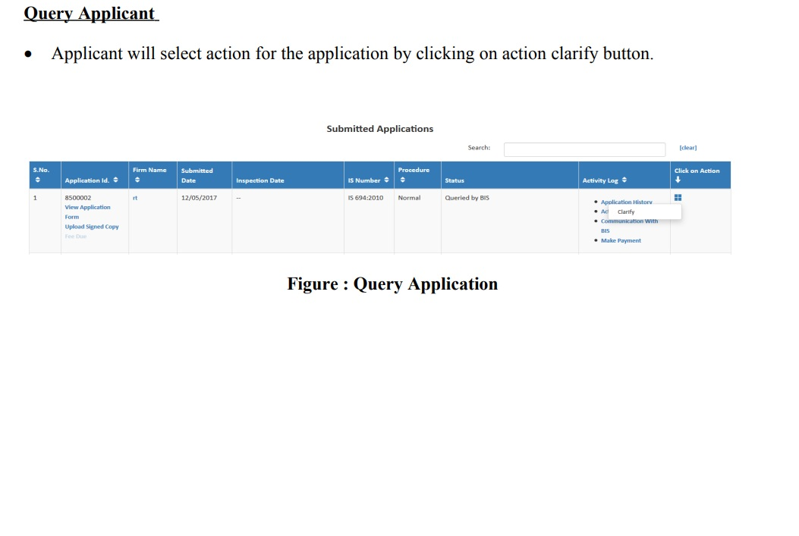
Step 5- Query in Initial Scrutiny I f any

Slide 16
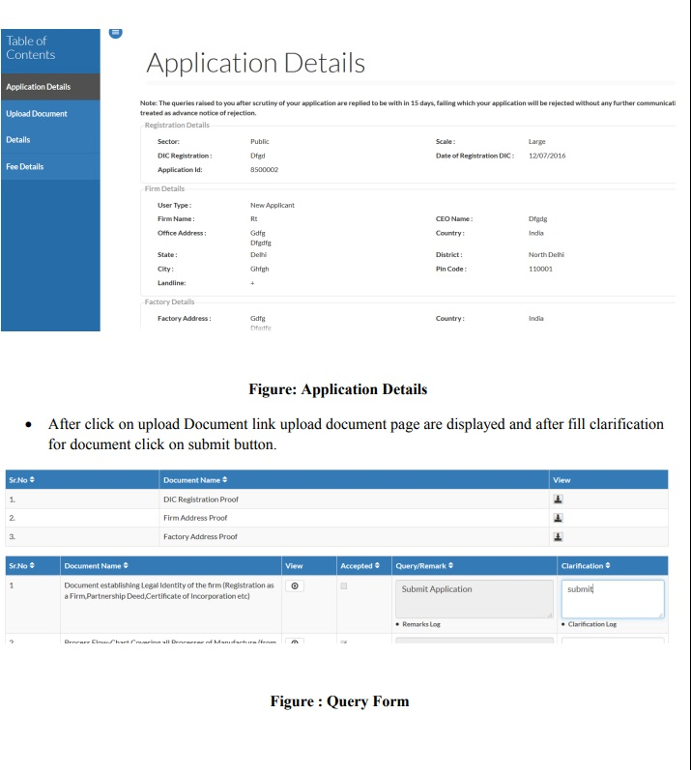
Continue……

Slide 17
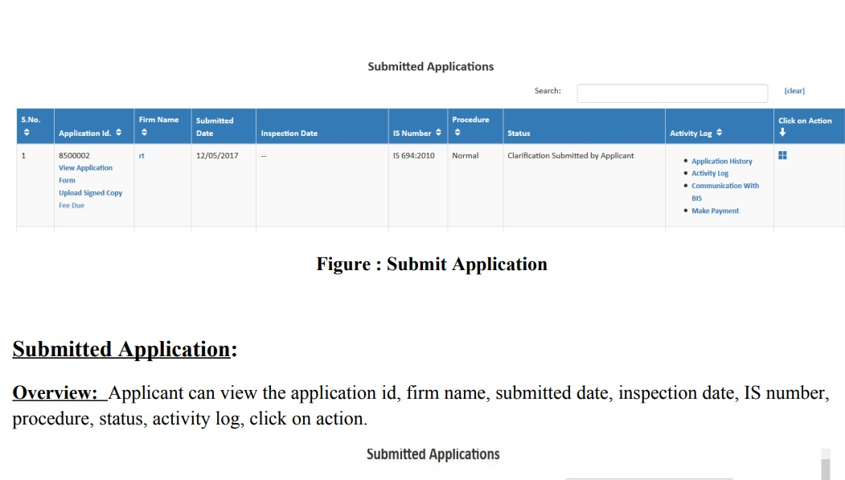
Continue….

Slide 18
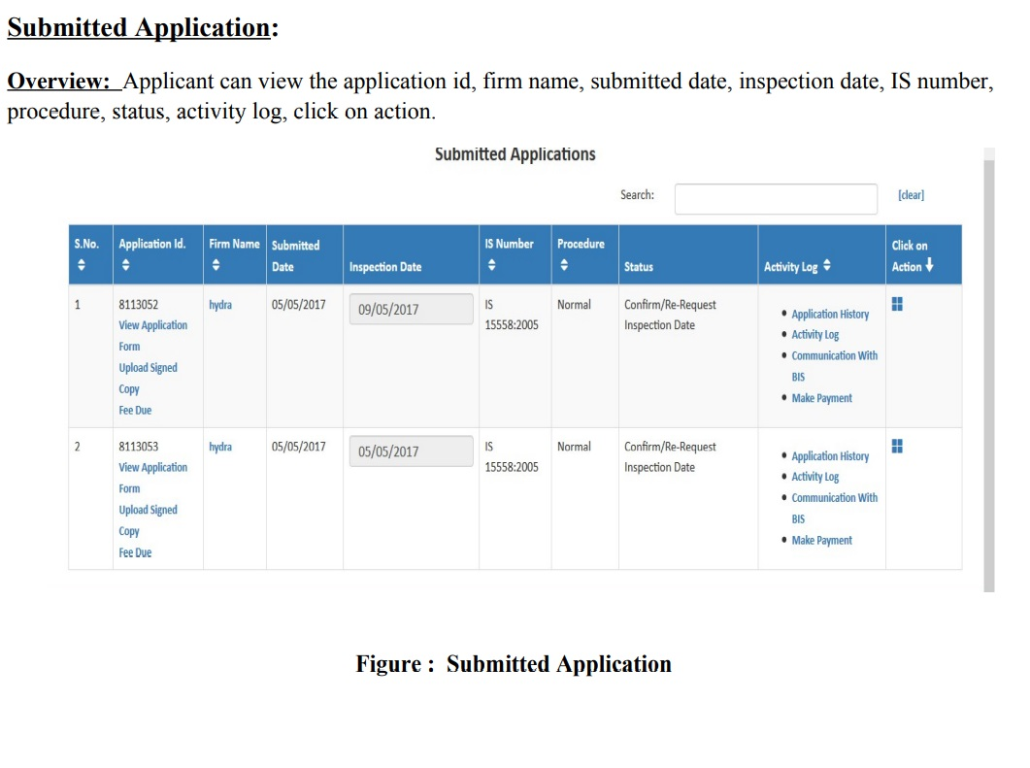
Step 6- Preliminary Inspection

Slide 19
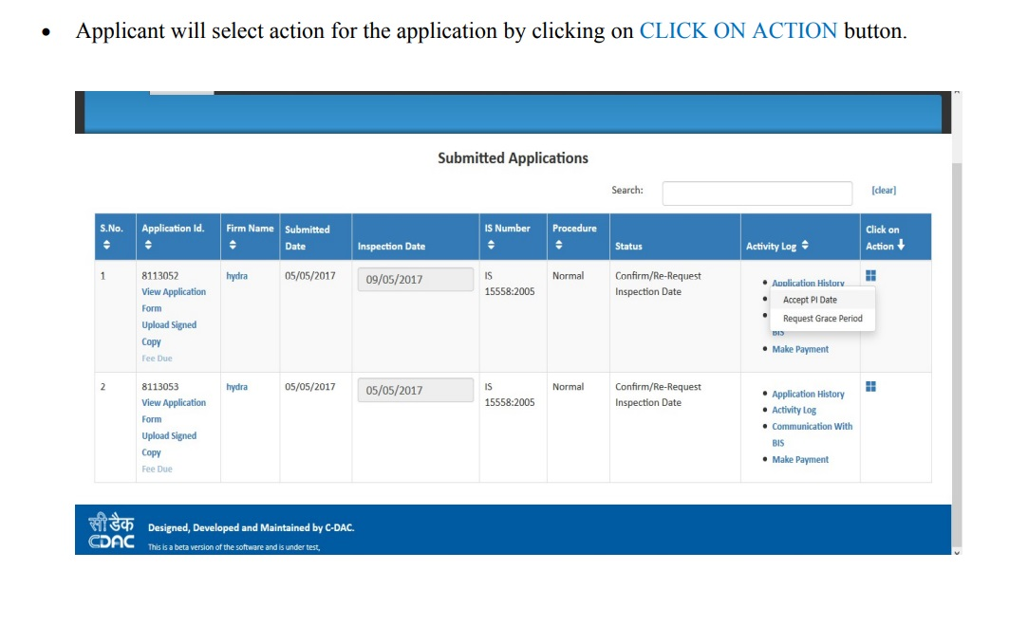
Continue….
(Accept or request grace period for pi date)

Slide 20
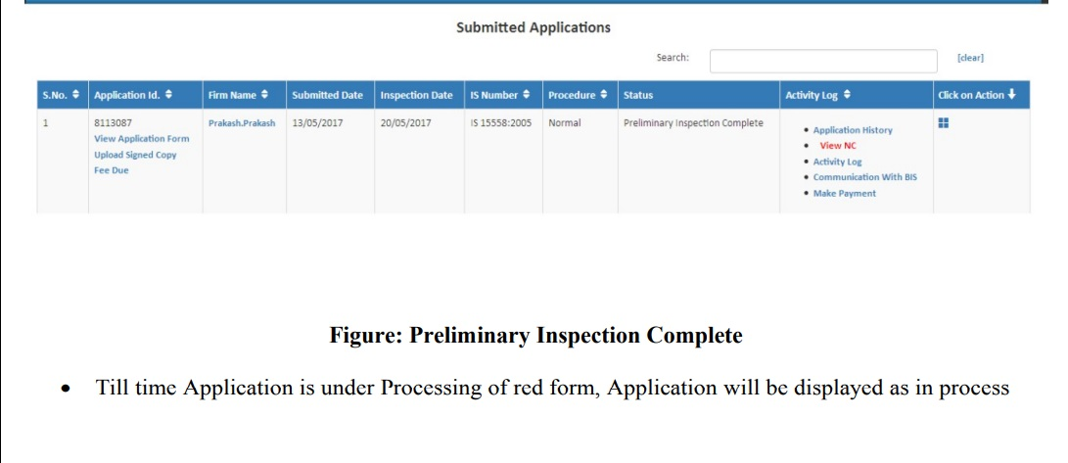
Status of application after pi and submitting nc clarification

Slide 21
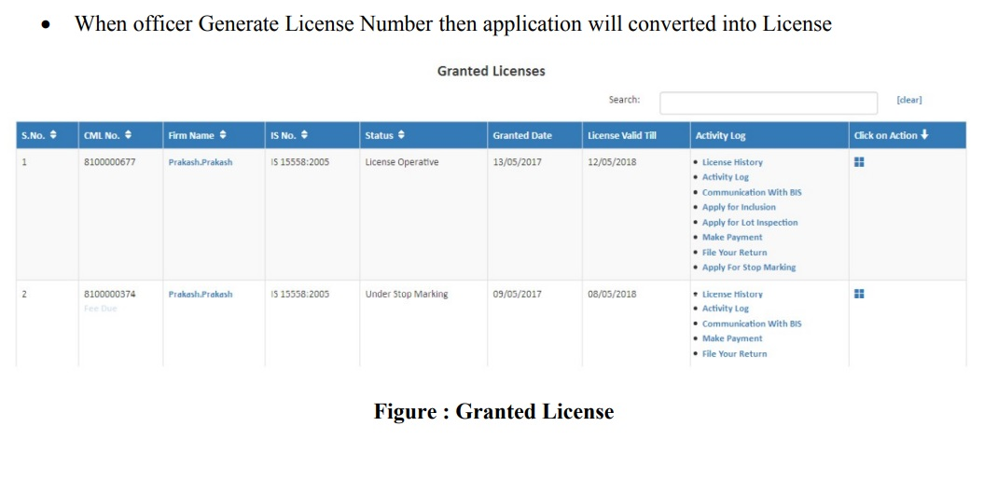
Final Step GOl

Slide 22
Incentive to Industries
In order to promote certification scheme and also to encourage small scale units BIS is incentivising appropriately by giving concession of 20% to Small and Medium industries and 80% discount is given to Micro Scale Industries for three years for new licences in annual minimum marking fee as compared to large scale industries.
Similarly 50% discount is also given to women entrepreneurs and start-ups of MSME Units.

Slide 23
Sharing of Testing Facilities
Criteria for Sharing/Sub Contracting:
Test equipment is very costly
Test equipment is not readily available
The frequency of the particular test is such that it enables testing by an outside laboratory conveniently without affecting the routine in-house quality control
Specialised nature of test
Cluster of manufacturing units at one place willing to utilise centralised testing facility

Slide 24
Cluster Based Test Facility (CBTF)
Only for Micro, Small & Medium Enterprises (MSMEs)
multiple enterprises situated in geographical proximity
producing same or similar or complementary products
elements of shared quality control checks, testing etc.
CBTF may be treated as in house test facility except for the following:
tolerances of size and geometry
visual examination up to 10x magnification level
workmanship like absence of burrs, solder flux splatter, sharp edges etc.
any requirement which necessitates quality checks during the production process

Slide 25
Cluster Based Test Facility (CBTF)
Outside the premises of any MSME manufacturer
(Licencee or applicant)
Within the premises of any MSME manufacturer
(Licencee or applicant)

Slide 26
IS 10773:1995- Wrought Copper Tubes for Refrigeration And Air-Conditioning Purposes
requirements of solid drawn ( seamless ) copper tubes in straight length or coil form for air-conditioning and refrigeration purposes.
Grade 1
Grade 2
Copper*- 99.90% min
Phosphorus- 0.004 to 0.015%
*includes silver (if any)
Copper- 99.85% min
Phosphorus- 0.015 to 0.040%
Lead- 0.01% (max)
Tin- 0.01% (max)
Iron- 0.03% (max)
Arsenic – 0.05% (max)

Slide 27
IS 10773:1995- Wrought Copper Tubes for Refrigeration And Air-Conditioning Purposes
The tube shall be manufactured from tube shell by drawing.
The tubes shall be supplied either in soft annealed, light annealed, light drawn
The tube shall be cut to size in coil or straight length, duly drafted and sealed at both ends.
Tubes shall not be manufactured from used tubes.

Slide 28
IS 10773:1995- Wrought Copper Tubes for Refrigeration And Air-Conditioning Purposes
Flattening Test (as per IS 2328)- in soft annealed condition. The light annealed and light drawn tubes shall be soft-annealed before testing.
Drift Expanding Test- in soft annealed condition. The light annealed and light drawn tubes shall be soft-annealed before testing.
Eddy Current Test- shall be tested in as drawn condition prior to the final annealing or heat treatment

Slide 29
IS 10773:1995- Wrought Copper Tubes for Refrigeration And Air-Conditioning Purposes
Grouping Guidelines
Samples ,covering combination of lowest and highest Outside Diameter (OD) and wall thickness of Tubes, from the sizes intended to be covered in the licence, shall be drawn and tested to cover all sizes of Tubes.
The above samples drawn shall be such which shall cover all conditions (Soft Annealed, Light Annealed, Light Annealed) intended to covered in the licence.

Slide 30
Test Equipment Format- to be provided in excel sheet
Sr No | Test Equipment/Chemicals and Identification Numbers (Where applicable) | Least Count and Range (Where applicable) | Valid Calibration (Where required) Yes/No | Tests Used in with Clause Reference | Remarks (Indicate number of Equipment)

Slide 31
Important Things to take care of
QC Personnel should be competent to carry out all the test in the Indian Standard and shall have sound understanding of the same.
The contact details (email and phone number) submitted at the time of application shall be of responsible person in the firm.
MSME firms shall have latest MSME Udhyog aadhar to avail the benefits.
Don’t wait for the last moment for QCO to become effective.
Beware of any fraud calls regarding the acceptance or submission of application in exchange of monetary benefits.

Slide 32

Thank You.

