Slide 1
Manak Manthan
IS 2202 Part 1 :2023
Wooden Flush Door Shutters(Solid Core Type)-Plywood Face Panels
Presented By
Shri Rakesh Tanneeru
Joint Director/Scientist-D
भारतीय मानक ब्यूरो / BUREAU OF INDIAN STANDARDS
हैदराबाद शाखा कार्यालय/ HYDERABAD BRANCH OFFICE

Slide 2
BACKGROUND-IS 2202 PART 1 :2023
This Indian Standard developed by the Doors, Windows and Shutters Sectional Committee & approved by the Civil Engineering Division Council.
This standard was first published in 1962 and subsequently revised in 1966, 1973, 1980, 1983, 1991 and 1999. During this period, the standard has undergone modifications relating to grades of doors, species of timbers, inclusion of tests, etc.
In this revision, considering the rapid changes in lifestyle as well as material availabilities and acceptance of ecofriendly options in door constructions during the last two decades, a number of improvements have been made.

Slide 3
OUTLINE OF MODIFICATIONS
Wooden flush door shutters (solid core type) have been categorized in two grades that is BWP (Boiling Water Proof) Grade and MR (Moisture Resistance) Grade.
Particle board with block board and medium density fibre board with block board type core have been deleted.
Thickness criterion for flush door shutter designations 8 DS 20 and 8 DS 21 have been revised.
Raw materials, requirements have been modified as per new grades of wooden flush door shutters (solid core type). Under raw materials, particle board, medium density fibre board, stiles and rails, requirements have been modified.
Laminated veneer lumber (LVL) and veneer laminated lumber (VLL) have been incorporated as raw materials for use as stiles and rails.
End immersion and glue adhesion test requirements have been modified as per grades of wooden flush door shutters (solid core type).
All the amendments issued to the previous version of the standard have been absorbed, and the text of the standard has been suitably modified to make it more user friendly

Slide 4
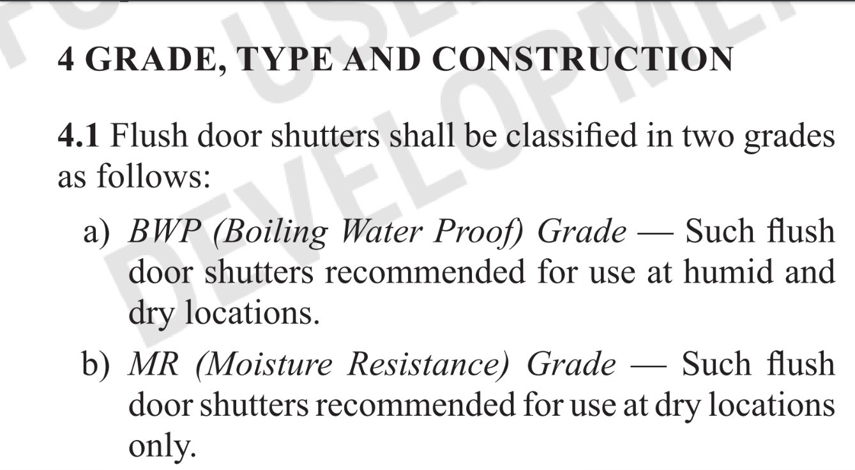
GRADE,TYPE AND CONSTRUCTION
No Grades were specified in IS 2202 Part 1 :1999.

Slide 5
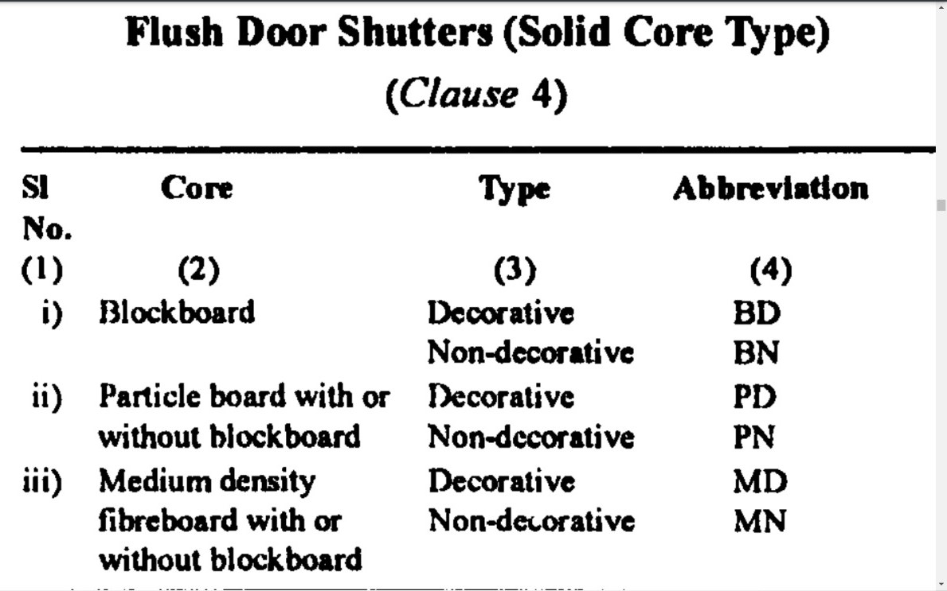
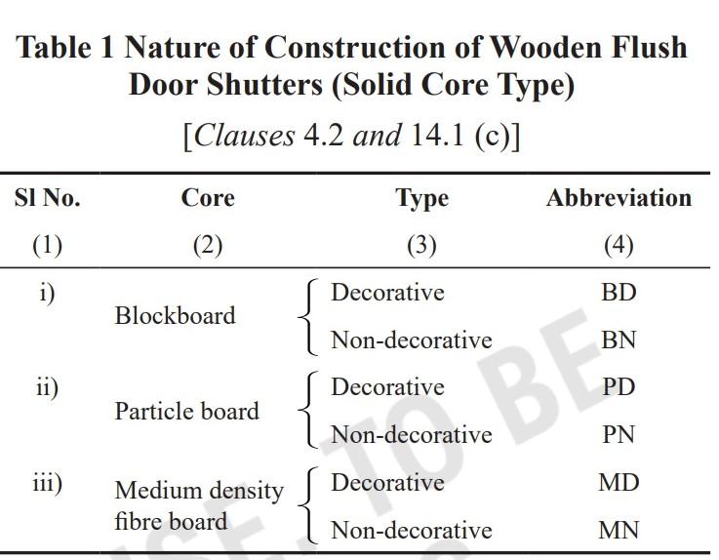
Table 1- Nature of Construction of Wooden Flush
Door Shutters (Solid Core Type)
Particle board & Medium density Fibre board with Block Board type core have been deleted. .

Slide 6
Clause 5 -sizes
Thickness criterion for flush door shutter designations 8 DS 20 and 8 DS 21 have been revised.
Grade | IS 2202 PART 1 :1999 | IS 2202 PART 1 :2023
8DS 20 & 8DS 21 | NOMINAL THICKNESS : 25 MM | NOMINAL THICKNESS : 25 MM & 30 MM

Slide 7
Clause 5 -sizes
Species of Timber changed
Clause | IS 2202 PART 1 :1999 | IS 2202 PART 1 :2023
Timber | Any species of timber may be used for the core of flush door shutters. However, a list of species is given in Group 1 of Annex B for guidance | No change
Stiles,Rails and Lipping | For stiles, rails and lipping only non-coniferous timber(Hard Wood), given in group 2A 2A and Group 2B of Annex B shall be used | For stiles, rails and lipping, list of species for guidance purpose is given in Group 2A and Group 2B of Annex B

Slide 8
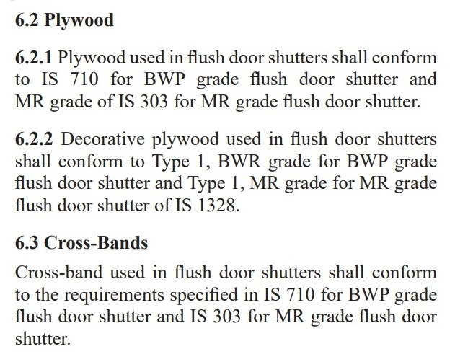
Plywood & Cross Bands

Slide 9
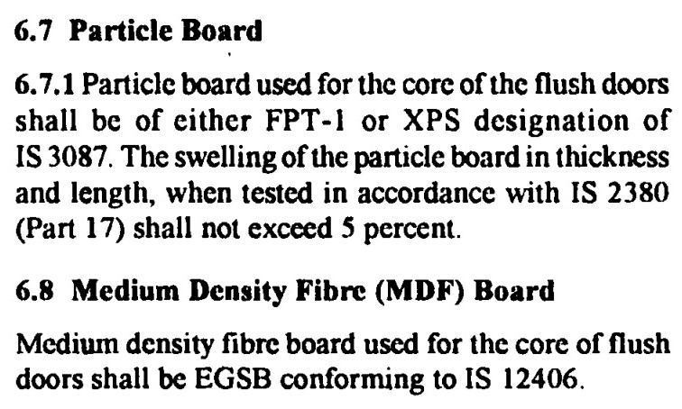
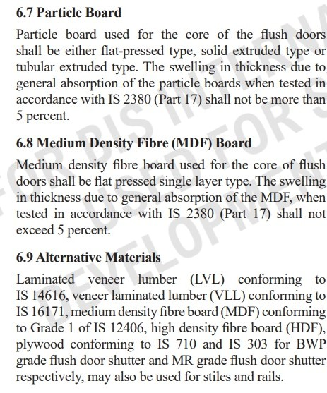
Particle Board & Medium Density Fibre Board

Slide 10
Clause 7.2 PARTICLE BOARD OR MDF CORE
Additional Requirements Specified
The core shall be either particle board or MDF board as specified in 6.7 and 6.8 respectively
No conformity to IS 3087 & IS 12046 required
Now core shall be of Particle Board or MDF board but not in combination with Block Board

Slide 11
Clause 6.6 ADHESIVES
Additional Requirements Specified
Adhesives used for bonding plywood or cross-band and face veneers to core shall be conforming to BWP grade and MR grade as specified in IS 848 for BWP grade flush door shutter and MR grade flush door shutter respectively.
Only synthetic resin adhesive shall be used for bonding core members to one another, including, core frame, and for lipping, glazing frame, venetian frame and other exposed parts where such bonding is required.

Slide 12
Clause 7.3 –Stiles and Rails
Specific Requirement for Material for Stiles and Rails joint Introduced
Stiles and rails of shutters shall be of timber or LVL or VLL as per clause 6.9
The frame for holding the core, including lipping where it occurs, shall be not less than 40 mm and not more than 75 mm in width.
Second stile and rail of alternative material (other than LVL and VLL) (see 6.9) may also be used, in such case the outer stile and rail shall be of timber or LVL or VLL and shall be minimum 30 mm width after trimming and sizing.
Butt (end) joints shall not be permitted for making-up the length of the frame.
Maximum one finger joint or one scarf joint shall be allowed for timber stiles only with following details: a) Joint shall be located between 300 to 500 mm from center liner of door; b) In case of scarf joint it shall be diagonally cut at an angle of maximum 30 degree of horizontal; and c) The joints to both the stiles shall be located diagonally opposite to each other.
The rails shall be made without any joints.

Slide 13
Clause 7.6.3 –Lipping
Requirements for External Lipping has been Changed
External lipping where provided, shall have their edges lipped by timber external lipping of any of the species mentioned in Annex B for guidelines or by any other edge banding (as agreed to between the manufacturer and the purchaser) and shall be glued using a moisture resistant glue
No mentioning of Material for External Lipping earlier

Slide 14
Clause 8 Locks and Fittings
Requirements for Locks and Fittings Modified
Shutters shall be shop-prepared for taking mortice locks or latches as may be agreed to between the manufacturer and the purchaser. Shop-preparing the door with mortised holes for lock fixing shall be done only when desired, suitable blocks of wood or LVL or VLL may be provided for fixing the hardware; in the absence of specific requirements, the sizes of blocks shall preferably correspond to the maximum size of lock covered in IS 16015.
Other fittings, such as pull bolt, tower bolt, doors handle etc, may be provided as agreed to between the purchaser and the manufacturer.
Earlier Lock sizes Standard Withdrawn-IS 2209

Slide 15
Clause 11.12 End Immersion Test
Additional Requirements Specified
When tested in accordance with IS 4020 (Part 13), there shall be no delamination at the end of the test. Glue lines in all the exposed edges of the plywood on both faces of the specimen, between the plywood faces and the stile and rail shall be examined for delamination. The immersion cycles for MR grade door shutter shall however be three.
Specified number of immersion cycles for MR Grade

Slide 16
Clause 11.14 Glue Adhesion Test
Additional Requirements Specified
Door shutters, when tested in accordance with IS 4020 (Part 15), shall be considered to have passed the test if no delamination has occurred in the glue lines in the plywood or if no single delamination or more than 50 mm in length and more than 3 mm in depth has occurred in the assembly glue lines only between the plywood faces and stile and rail. Delamination at a knot, knot hole, a pitch pocket and wormhole or other permissible wood defects shall not be considered in assessing the sample. A door shutter shall be deemed to have passed the test if both the specimen tested passed the test. However, in the test for MR grade door shutter, the water with submerged specimens shall be bought to (60 ± 2) °C in the place of boiling water.

