Slide 1
Standards Club Nurturing Future Ambassadors

Slide 2
भारतीय मानक ब्यूरो भारत का राष्ट्रीय मानक निकाय उपभोक्ता मामले, खाद्य और सार्वजनिक वितरण मंत्रालय, भारत सरकार पुणे शाखा कार्यालय
BUREAU OF INDIAN STANDARDS
The National Standards Body of India
Ministry of Consumer Affairs, Food and Public Distribution, Govt. of India.
Pune Branch Office

Slide 3
What is BIS
BIS full form is Bureau of Indian Standards.
BIS is the National Standards Body of India.
BIS formulate Standards for daily used Products related to general consumers.
BIS is Third Party assurance for Industry and Consumer about same product that Product is reliable for both.

Slide 4
BIS works for Consumers under

Slide 5
A Brief History Foundation of BIS as Indian Standards Institution

Slide 7
What is a STANDARD??????
ISO Definition
Document, established by consensus and approved by a recognized body, that provides, for common and repeated use, rules, guidelines or characteristics for activities or their results, aimed at the achievement of the optimum degree of order in a given context.

Slide 8
Standards Formulation Composition of Standards Forming Committee
Chairman (Independent Body)
Member Secretary (BIS)
Manufacturer
Laboratories/ R&D Institutions
Government & Regulatory Bodies
Consumer/ User Organization
Industry Association
Public Sector Units
Consulting Firms
Professional & Academic Bodies

Slide 9
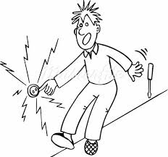
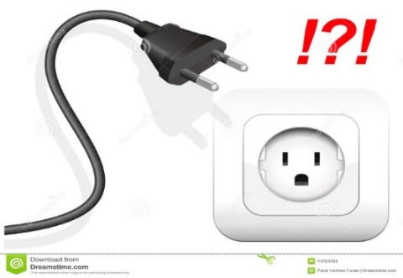
LIFE WITHOUT STANDARDS
Products might not work as expected
They may be of inferior quality
They may be incompatible with other equipment – in fact, they may not even connect with them
In extreme cases, non-standardized products may be dangerous
Customers would be restricted to one manufacturer or supplier
Manufacturers would be obliged to invent their own individual solutions to even the simplest needs, with limited opportunity to compete with others.

Slide 10
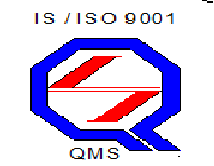
Important Marks of BIS
ISI Mark- Scheme 1
Compulsory Registration Mark Scheme 2
Hallmark
Management System Certification Mark
Eco Mark

Slide 11
Bureau of Indian Standards
BIS Act 2016
HQ- Delhi
5 Regional Offices
38 Branch Offices
8 Labs
Standards under Certification - 1173
Technical Departments for Standard Formulation - 16
Standards Published - 22358
Official website: www.bis.gov.in
e-bis portal- https://www.manakonline.in
BIS Apps - BIS Care App available on play store

Slide 12
LABORATORIES
BIS has 8 Laboratories to support product certification.
CENTRAL LABORATORY (CL) : 1 (Sahibabad)
Central Laboratory (CL) was first to be set up in 1962.
REGIONAL LABORATORIES : 4
(Chennai, Kolkata, Mohali & Mumbai)
BRANCH LABORATORIES : 3
(Bangalore, Guwahati & Patna)
Samples are also tested in approx. 253* BIS recognized outside labs.

Slide 13
MAIN ACTIVITIES
Standard Formulation
Certification
Testing & Calibration
Foreign Manufacturers & Indian Importers
Management Systems
Hallmarking of Jewellery & Artefacts
Product
Training Services

Slide 14
BIS Conformity Assessment Schemes
Product Certification Scheme
Voluntary
Mandatory (through QCO)
Compulsory Registration Scheme
Management System Certification
Hallmarking

Slide 15
Mandatory BIS Certification
Government of India, in public interest (for example public health and safety, security, infrastructure requirements, mass consumption) has enforced mandatory certification on various products through various Quality Control Orders issued from time to time under various Acts.
While BIS continues to grant licences on application, the enforcement of compulsory certification is done by the authorities notified in such quality control orders
As on date there are 404 products covered under Mandatory BIS Certification

Slide 16
Mandatory Certification
Infant Milk Products and Milk Powder
Packaged Drinking Water and Natural Mineral Water
Cement
Electrical Appliances and Switchgear, Dry Cell Batteries, CFL Lamps
Clinical Thermometers
Steel Tubes
Pressure Stoves
Gas Cylinders, Valve Fittings and Regulators
Diagnostic Medical X-Ray equipment
Plastic Feeding Bottles
Steel and Steel Products
Automotive Tyres and Tubes
Electrical Transformers

Slide 17
Hallmarking

Slide 19
Virtual Demonstration of BIS Care App

Slide 20
Thank You

