Slide 1
BUREAU OF INDIAN STANDARDS
Jammu & Kashmir Branch Office
Types of Standards
&
Structure of Standards

Slide 2
Types of Standards
Basic standards
Product Standard
Method of tests
Code of practices, Recommendations, Guidelines
Terminology, Symbols
Sampling & inspection
Systems Standard
Service Standard

Slide 3
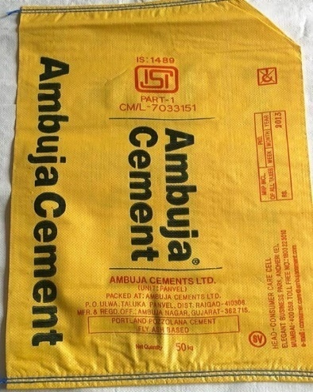
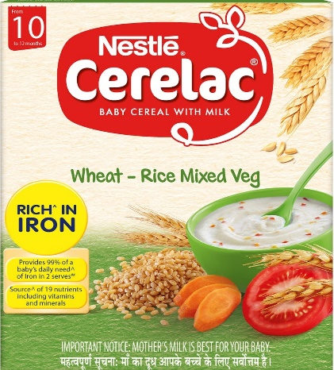



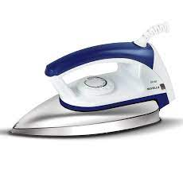
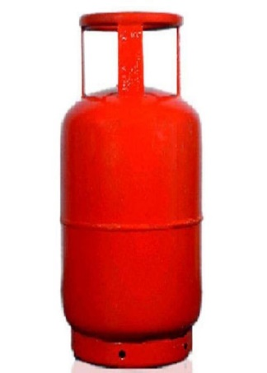



Slide 4
Product Standards
IS 4151: Protective Helmets for Motorcycle Riders
IS 269, IS 1489 : Different types of Cements
IS 9873, IS 15644 : Non Electric and Electric Toys
IS 3196 (Part 1): Cylinders
IS 14543: Packaged Drinking Water

Slide 5
Methods of Test
IS 3196(Part 3): Welded low carbon steel cylinder exceeding 5litres water capacity for LPG gases: Methods of Test
IS/IEC 61196-1-108: Methods of tests for coaxial communication cables
IS 1459: Methods of tests for dairy industry
IS 169 (Part 169) / ISO 15597:2001: Methods of Tests for Petroleum and its Products [P : 169] Determination of Chlorine and Bromine Content - Wavelength Dispersive X- Ray Fluorescence Spectrometry

Slide 6
Code of practices, Recommendations, Guidelines
IS 1172 : Code of basic requirements for water supply, drainage and sanitation
IS 12011: Code of Safety Practice for domestic LPG installation
IS 8827: Recommendations for basic requirements for school buildings
IS 6541: Code for hygienic conditions for establishment and maintenance of midday school meal programmes
IS 8338: Recommendations relating to primary elements in the design of school library buildings
IS/ISO/IEC Guide-14 : Purchase information of goods and services intended for consumers

Slide 7
Terminology and Symbols
IS 1885 (Part 82) :Electrotechnical vocabulary: Part 82 integrated services digital networks
IS 7879 (Part 7) : Glossary of astronautical terms: Part 7 air traffic and ground services
IS 813: Scheme of symbols for welding
IS 13230: Graphical symbols for use on mine plans
IS 14452: Textiles- care labeling code using symbols
IS 16283: Fibre Optic terminology
IS 13807: Medical terminology

Slide 8
Sampling and Inspection
IS 326(Part 1): Methods of sampling and test for natural and synthetic perfumery materials: Part 1 sampling
IS 286: Methods of sampling and test for soaps
IS 17614: WATER QUALITY - SAMPLING Part 1 Guidance on the design of sampling programmes and sampling techniques.
IS 6092: Methods of sampling and test for fertilizers
IS 82 : Methods of sampling and test for thinners and solvents for paints

Slide 9
System Standards
Quality Management System, IS/ISO 9001
Food Safety Management System, IS/ISO 22000
Information Security Management System, IS/ISO 27001
Occupational Health & Safety Management System,
IS 18001 & IS/ISO 45001
Energy Management System, IS/ISO 50001
Educational Organizations Management System, IS/ISO 21001
Social Accountability at Workplace, IS/ISO 16001
Piped Drinking Water Supply Management System, IS 17482

Slide 10
Service Standards
SP 69-69 : 2012: ISO/TR 13569 : 2005 Financial Services- Information Security Guidelines
IS/ISO 11121 : Recreational Diving Services - Requirements for Introductory Programmes to Scuba Diving
IS/ISO 13009 : Tourism and Related Services - Requirements and Recommendations for Beach Operation
IS 13808(Part 1): Quality management procedures for out - Patient department (OPD) and emergency services - Guidelines: Part 1 upto 30 bedded hospitals
IS/ISO/TS 13811 : Tourism and Related Services - Guidelines on Developing Environmental Specifications for Accommodation Establishments
IS 16273 : 2014, ISO 18245 : 2003 Retail Financial Services — Merchant Category Codes

Slide 11
Structure of standards
Document No.
Title of the Standard

Slide 12
Foreword
(a) Contains formal paragraphs as are relevant to the needs of standard like
(b) Name of the Committee responsible for preparation of the standard, date of publication of the standard etc.
(c )Information about the brief history of standard, product, practices, uses as relevant.
(d)Acknowledging other international/national standard which were taken into consideration.
(e)Information about other related standards.
(f) Reference to IS 2 on Rounding Off.
Details as at a), c), d) & e) are generally incorporated at the time of final (printing) stage by Sectt.

Slide 13
Scope
Clear statement indicating the field covered by the standard defining its extent and limitation. Sometime, for the purpose of clarity, it is also mentioned what the standard ‘does not’ cover or ‘excludes’.

Slide 14
REFERENCES – Information related to other standards referred in text of the standard.
DEFINITIONS, TERMINOLOGIES etc. Technical terms to be defined or referenced to other relevant standards.
GRADES, TYPES AND CLASSES – As applicable to the product
MANUFACTURE – Where considered necessary the manufacturing process(es) may be specified

Slide 15
REQUIREMENTS
Shall be as self-contained as possible
Requirement clauses shall state tolerances, where necessary
May be obligatory, optional or recommendatory or informative (like typical compositions etc.)
Could be related to Raw Materials as well, having direct bearing on the finished product characteristics etc.
Requirements could of chemical/physical/other characteristics of the product.
Tables could be used to eliminate repetition or show a relationship more clearly

Slide 16
Methods of Test
Could be part of the product specifications or independent standards. It may be included in the body of the standard, if brief; otherwise may be given as annexure. Test methods shall include the following, as applicable:
Preparation of sample/specimen
Atmospheric conditions like temp., relative humidity
Testing equipment with accuracy
Materials & reagents
Test procedure
Method of analysis and evaluation of results, where necessary
Repeatability & reproducibility of test method, where possible

Slide 17
PACKING AND PACKAGING – Wherever applicable, details of packing and/or packaging be given.
MARKING – Product specifications shall contain marking clause indicating basic requirements about the identity of product, source of manufacture, etc., and any other requirement specific to the products like shelf-life; ingredients; grade, type, class; statutory & regulatory requirements.
BIS CERTIFICATION MARKING
ANNEXURES – These are part of the standard and may be normative or informative to the standard, depending upon the nature of reference made to them in the standard.

Slide 18


