Slide 1
CAPSULE COURSE ON PLYWOOD & RELATED PRODUCTS IS 303, IS 710, IS 2202:P1, IS 1659, IS 4990
KOLKATA BRANCH OFFICE-I
BUREAU OF INDIAN STANDARDS

Slide 2
INDIAN STANDARD- IS 303:1989
Cl 1 Scope
Cl 2 References
Cl 3 Terminology
Cl 4 Grades
Cl 5 Types Based on Classification By appearance
Cl 6 Materials
Cl 7 Manufacture
Cl 8 Dimensions and Tolerances
Cl 9 Workmanship and Finish
Cl 10 Sampling
Cl 11 Tests
Cl 12 Marking
Cl 13 Delivery

Slide 3
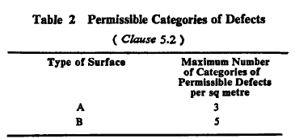
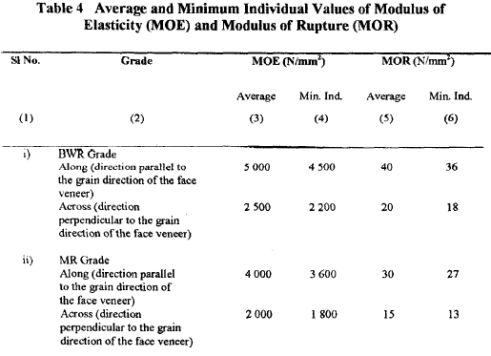
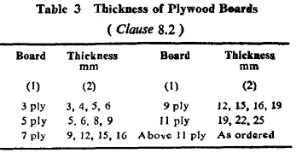
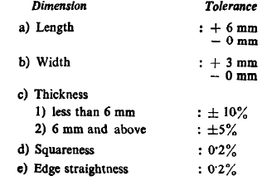

Slide 4
INDIAN STANDARD- IS 710:2010
Cl 1 Scope
Cl 2 References
Cl 3 Terminology
Cl 4 Materials
Cl 5 Manufacture
Cl 6 Dimensions
Cl 7 Workmanship and Finish
Cl 8 Sampling
Cl 9 Tests
Cl 10 Additional requirements for Eco-Mark
Cl 11 Marking
Cl 12 Tender Sample

Slide 5
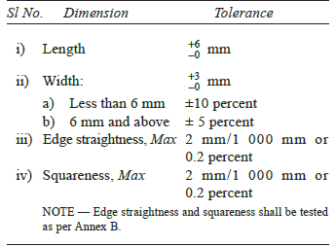
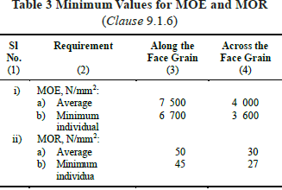
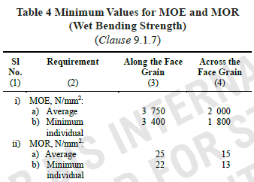

Slide 6
INDIAN STANDARD- IS 1659:2004
IS 1659:2004
Cl 3 Terminology
Cl 4 Grades and Types
Cl 5 Materials
Cl 6 Manufacture
Cl 7 Dimensions and Tolerances
Cl 8 Sampling and Inspection
Cl 9 Tests
Cl 10 Additional requirements for Eco-Mark
Cl 11 Marking
Cl 2 References
Cl 1 Scope

Slide 7
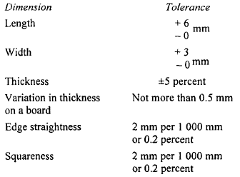
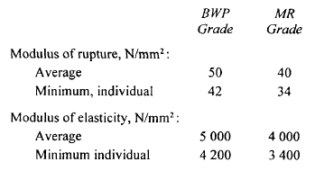

Slide 8
INDIAN STANDARD- IS 2202:PART 1:2023
Cl 1 Scope
Cl 2 References
Cl 3 Terminology
Cl 4 Grade, Type and Construction
Cl 5 Sizes
Cl 6 Material
Cl 7 Construction
Cl 8 Fittings
Cl 9 Workmanship and Finish
Cl 10 Tests
Cl 11 Requirements
Cl 12 Sampling and Criteria for conformity
Cl 13 Additional requirements for Eco-Mark
Cl 14 Marking

Slide 9
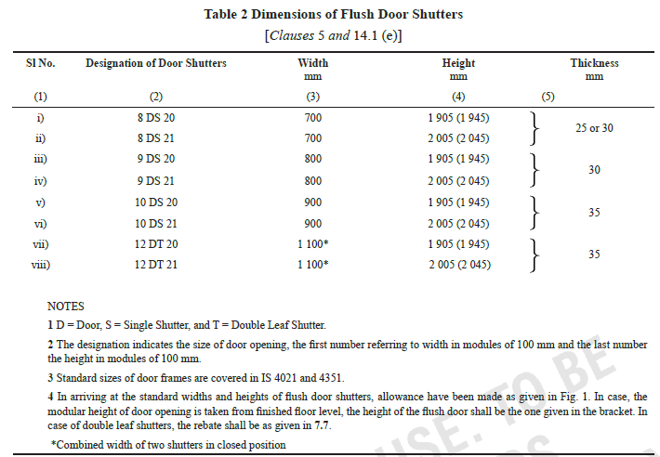
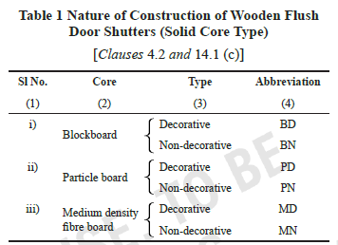

Slide 10
INDIAN STANDARD- IS 4990:2011
IS 4990:2011
Cl 3 Terminology
Cl 4 Types
Cl 5 Materials
Cl 6 Manufacture
Cl 7 Dimensions and Tolerances
Cl 8 Workmanship and Finish
Cl 9 Sampling
Cl 2 References
Cl 1 Scope
Cl 10 Tests
Cl 11 Additional requirements for Eco-Mark
Cl 12 Marking
Cl 13 Information to be supplied by the manufacturer

Slide 11
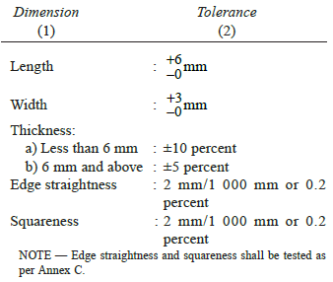
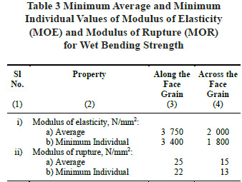

Slide 12
EXERCISE : UNDERSTANDING THE REQUIREMENTS OF INDIAN STANDARD

Slide 13
PRODUCT MANUAL
ANNEX A- GROUPING GUIDELINES
ANNEX B- LIST OF TEST EQUIPMENT
ANNEX D- POSSIBLE TESTS IN A DAY
ANNEX C- SCHEME OF INSPECTION AND TESTING

Slide 14
WORKSHOP: CASE STUDIES

Slide 15
UPDATION OF DETAILS IN MANAKONLINE PORTAL
CONSIGNEE DETAILS
PRODUCTION DETAILS
WEEKLY OFF
BRAND NAME
VARIETIES COVERED UNDER THE SCOPE OF LICENCE
CORRECT AND OPERATIONAL EMAIL ID
CORRECT AND OPERATIONAL MOBILE NUMBER
CORRECT FACTORY ADDRESS AND FIRM ADDRESS
DOCUMENTS AGAINST OPTIONS AVAILABLE IN MANAKONLINE DASHBOARD

Slide 16
UPDATION OF CONSIGNEE DETAILS
You are required to submit month-wise consignee details (with complete address and quantity supplied) on ManakOnline portal on quarterly basis, as per Circular on Submission of production and consignee details on online portal of BIS product certification activity dated 09th April 2021.
The month-wise consignee details shall be filled in the online portal by 10th. For example, the details for the period from April 2021 to June 2021 needs to be filled by 10 July 2021.
For any assistance or issues faced while uploading details, please write to bis@its.gov.in

Slide 17
AUTOMATIC RENEWAL
The link for “Apply for Renewal” is available in your dashboard
Fill Renewal application, submit CA certified production details, pay the requisite fees.
The renewal of your licence will be done automatically.
However, do not forget to submit acceptance of the latest SIT (Doc: PM/14543/ 3 July 2020) in the communication window.
For any queries related to marking fees in automatic renewal, please write to bis@its.gov.in
Please apply for renewal before expiration of the validity of your licence.
Late Fees are automatically charges upon renewal after validity date.
Download auto-generated renewal endorsements under History Tab>Generic Information

Slide 18
CHANGE IN SCOPE OF LICENCE (INCLUSION)
Revised guidelines for Change in Scope of Licence (Inclusion) has come into effect from 13 May 2021.
Salient change: Under option 2, licensee shall ensure submission of sample(s) in third party laboratory(ies) through online portal. The laboratories shall send the test report(s) of such sample(s) through portal to the licensee manufacturer - Clause 4(d) of revised guidelines
The reports will then be scrutinized and if found conforming, the scope of existing licence will be changed.

Slide 19
A simplistic process flow-
Step 1: Login into e-BIS/Manakonline with your credentials
( https://www.manakonline.in/MANAK/eBISLogin )
Step 2: Go to Test Samples Section

Slide 20
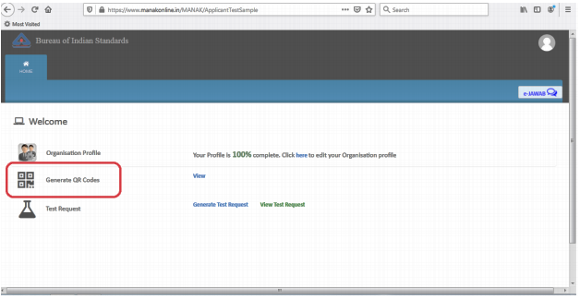
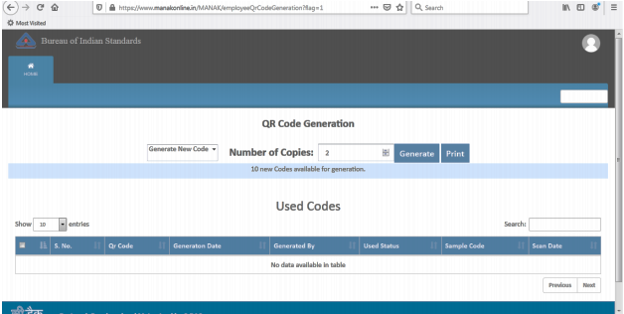
Step 3: Generate QR code(s)

Slide 21
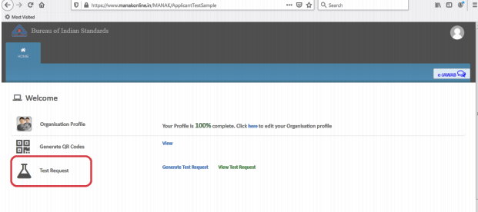
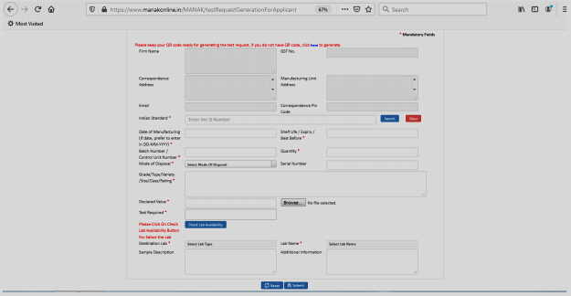
Step 4: Generate Test Request
Step 5: Deposit the sample to concerned third party laboratory(ies) with the generated Test Request and QR code(s)
Step 6: After the third party laboratory issues the test report(s) to the manufacturer, submit the inclusion application using the same test report(s) only.

Slide 22
UNDERSTANDING RECENT TRENDS IN SAMPLE FAILURE
1. COMMON FAILURE PARAMETERS
86% of sample failures of IS 303 and IS 710 are due to Modulus of Rupture along face grain(6), 43% is due to Modulus of Elasticity along face grain (3) and Glue adhesion water resistance test(3), and 28% is for Wet bending strength (2) and Water resistance test(2)
For IS 2202, 100% of sample failures are due to failure in dimensions( thickness).
For IS 1659, 100% of sample failures are due to Modulus of Rupture along face grain and 50% of failures in squareness, thickness.

Slide 23
2. SAMPLE FAILURE ANALYSIS - IS 303:1989

Slide 24
3. SAMPLE FAILURE ANALYSIS - IS 710:2010

Slide 25
4. SAMPLE FAILURE ANALYSIS- IS 2202: PART 1:2023

Slide 26
4. SAMPLE FAILURE ANALYSIS - IS 1659:2004

Slide 27
5. SAMPLE FAILURE ANALYSIS- IS 4990:2011

Slide 28
6. NATURE OF CORRECTIVE ACTIONS TAKEN BY LICENCEES
Discarding sap portions of wood before forming wooden strips to construct core frame.
Improvement of adhesive concentration using less percentage of extender.
Constructing core frame balancing perfectly in central line.
Setting the applied pressure and temperature of the Hot press properly
Increasing the solid content of BWP grade PF resin.
Increasing glue coverage.
Changing the supplier of veneer.

Slide 29
GUIDELINES FOR DEALING WITH PRODUCT NON-CONFORMITY
1st Non-conformity and consecutive non-conformity
Deviation observed in labelling and marking requirements (for example, absence of Batch code, date of manufacturing, best before, grade/type, etc.) is also to be treated as non-conformity of product.
Risk assessment & Product recall
Receipt and review of corrective actions.
Corrective action Verification visits
Public alert issued for non-conforming product, wherever directions for product recall issued.
Suspension due to non-conformity of products
Visit to check compliance of suspension orders
Receipt and review of Corrective actions in reply to suspension
Inspection for Revocation of suspension (ROS)
Intentionally using Standard Mark on non-conforming goods.
Suspension on establishment of complaint
Suspension along with cancellation notice
Discreet visit.

Slide 30
PRODUCT RECALL
A “product recall” is the process of retrieving defective and/or potentially unsafe goods from market/retailer/traders, etc.
Upon receipt of information on any non-conforming product, risk assessment analysis will be carried out by Product Recall Committee of Branch Office.
If it is found that the product failure will have serious impact on public health/safety, directions on product recall shall be issued.
Such cases will be notified in all public domain and print media.

Slide 31
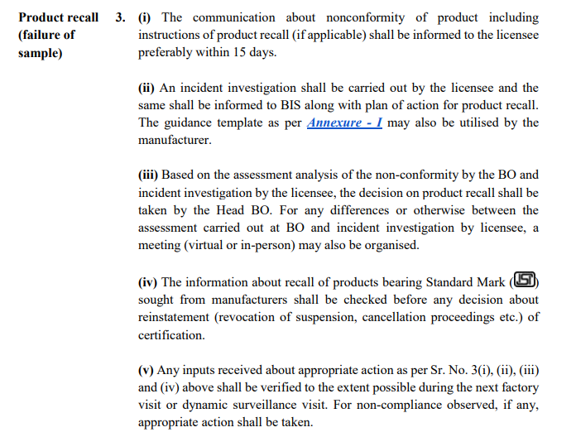

Slide 32
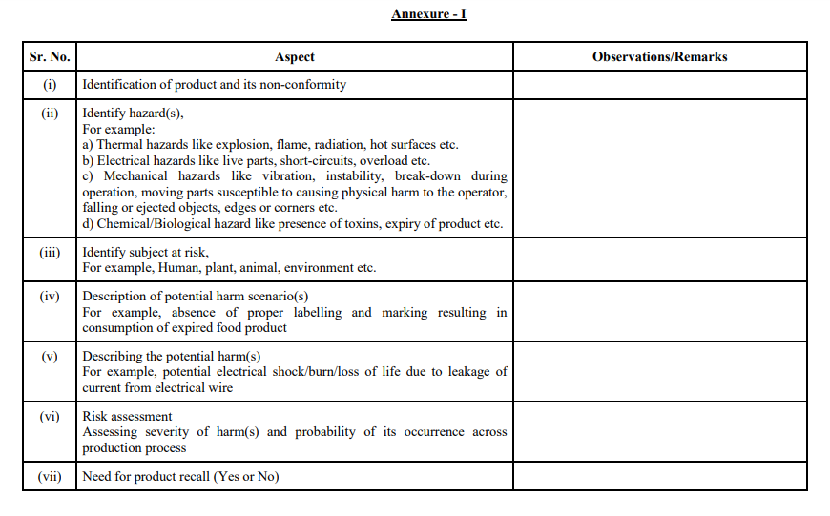

Slide 33
REASONS BEHIND UNSATISFACTORY INSPECTIONS
Outside lab test reports and Internal testing records not available
QCI not available even as production is going on and Standard Mark is being used on mandatory products being dispatched/sold without testing,
Incompetent QCI
Valid Calibration certificates not available, Test equipment not available/not working.
Raw material Test Certificate from supplier/BIS recognized laboratory not available for all consignments.
Marking on products/varieties other than those covered in the scope of the licence

Slide 34
FACTORY INSPECTIONS-LESSONS LEARNT
ISSUES | REASONS
Major deviation in implementation of Scheme of Inspection and Testing. Incompetent QCI. Non-availability of QCI even as Standard Mark is being used and product is being dispatched /sold. Marking on products which is outside the scope of the licence. Non-availability of Test equipment/Not working. | Lack of awareness about Product Manual, SIT, etc. Lack of sense of responsibility and ownership regarding smooth operation of the licence. Lack of technical competence. Lack of understanding regarding conditions of licence and the implications of violating any of them. Firm is not self-reliant regarding operation of Manakonline portal.

Slide 35
GUIDELINES FOR DEALING WITH UNSATISFACTORY INSPECTIONS
Discrepancies leading to unsatisfactory inspection
Suspension due to unsatisfactory inspection.
Visit to check compliance of suspension orders
Receipt and review of corrective actions taken
Inspection for Revocation of suspension
Shifting of premises
Non-payment of fee
Non-implementation of Amendment/Product manual/revised Indian standard
Suspension along with cancellation notice
Discreet visit.

Slide 36
BIS CONFORMITY ASSESSEMENT REGULATIONS, 2018
REGULATION 11 - CANCELLATION

Slide 37
CONDITIONS OF LICENCE

Slide 39
TESTING OF PLYWOOD AND RELATED PRODUCTS

