Slide 1
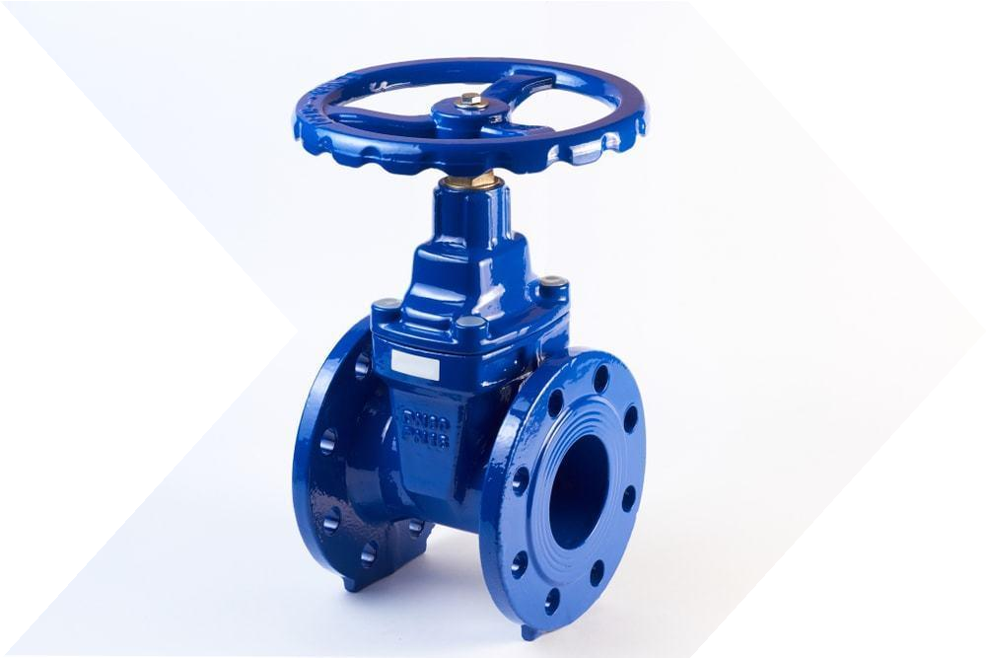

Slide 2
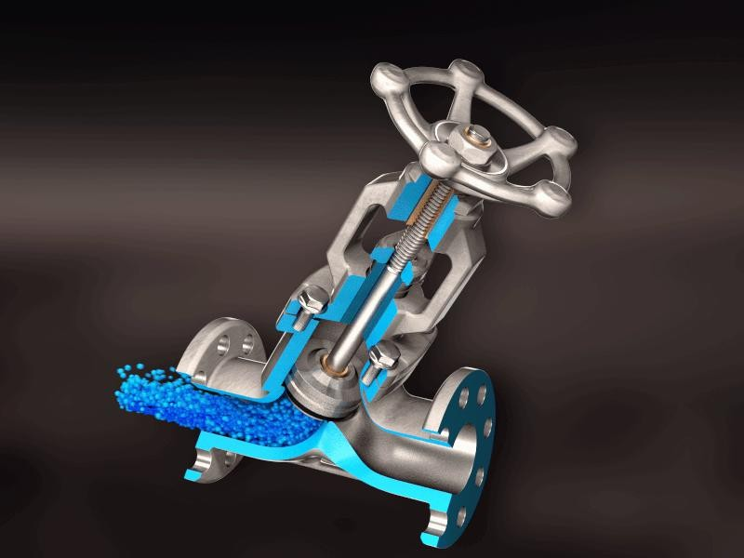
These standards prescribe quality requirement for various types of valves used:
1
IS 14845:2000
Resilient seated cast iron air relief valves for water works purposes
2
IS 14846:2000
Sluice valve for water works purposes (50 To 1200 mm size)
3
IS 13095:2020
Butterfly Valves for General Purposes
4
IS 5312(P-1):2004
Swing check type reflux (non-return) valves for water works purposes – Part 1 Single door pattern

Slide 4
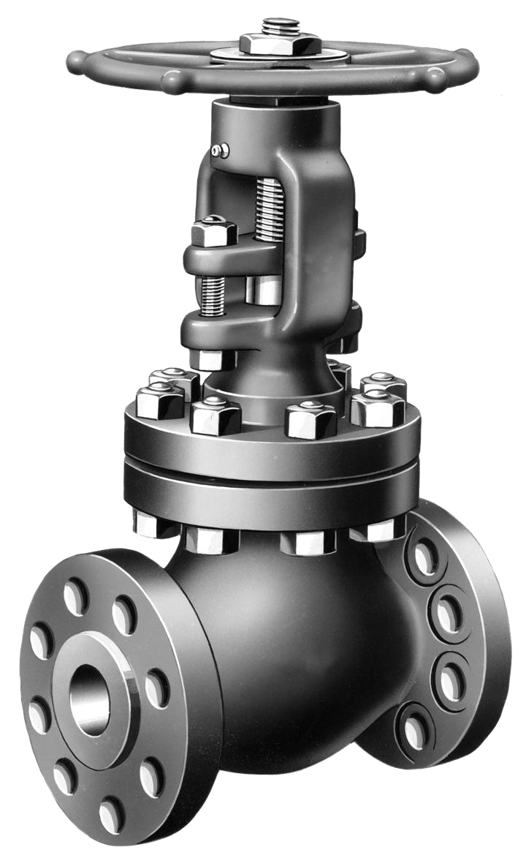
17
17
21
44
IS 14845 IS 14846 IS 13095 IS 5312(Part 1)

Slide 5
This Indian Standard covers requirement of single air vaIve (small and large orifice), doubIe air valves (smaII and large orifice with or without integral isolating valve) and kinetic air valves with or without separate isolating sluice valve for use on water mains
Single air valve - Small Orifice type (S1) and Large orifice type (S2)
Double air valve - Standard type with in-built isolating valve (DS 1) or without isolating valves (DS 2)
Kinetic air valve - Kinetic air valve (DK)
I
Types
The valves shall be designed for maximum permissible gauge working pressure PN 1.0 Mpa and PN 1.6 Mpa
Nominal Pressure & Nominal Sizes
Single air valve (S1) - (Small orifice type) 15, 25, 40 mm
Single air valve (S2) - (Large orifice type) - 25, 40, 50 mm
Double air valve (DS 1, 2) - (All types) - 40, 50, 80,100,150, 200 mm
Kinetic air valve (DK) - 40, 50, 80,100,150, 200 mm

Slide 6
Scope
Nominal Sizes
The sluice valves shall be designed for the following sizes:
This standard covers requirements for non-rising stem type sluice valves from 50 to 1200 mm sizes used for water supply up to 45°C and having double flanged
ends for connections
50,65,80,100,125,150,200,250,30
0,350,
400,500,600,700,750,800,900,10
00,1100 and 1200mm
Nominal Pressure
Nominal Pressure (PN) | Nominal Sizes
MPa | mm
PN 1.0 | 50 to 1200
PN 1.6 | 50 to 600

Slide 7
Scope
Size of valve( in mm) | Nominal Pressure(in MPa)
50 to 600 | 1.0 and 1.6

Slide 8
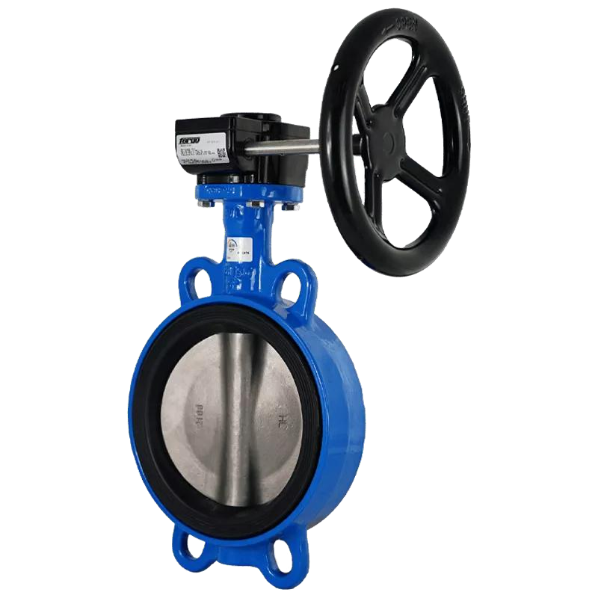
IS 13095
This standard covers double flanged and wafer type of metal seated, resilient seated cast iron, ductile iron and carbon steel, stainless steel and lined butterfly valves, for general purposes.
Valves covered under this standard are manually, pneumatically, hydraulically or electrically operated.
It covers valves of nominal pressure designations up to and including 4 MPa and Class 300 with ends flanged or wafer type valves with bodies designed to be accommodated between pipe work flanges in accordance with appropriate tables of IS 6418 ‘Cast iron and malleable cast iron flanges for general engineering purposes’, IS 9523 ‘Ductile iron fittings for pressure pipes for water, gas and sewage — Specification’ or
IS 6392 ‘Steel pipe flanges’ in nominal sizes DN 40 to DN 2000.

Slide 9
70
62
60
50
40
38
38
30
24
22
20
18
17
12
10
0
0
0
1
0
 | IS 14845 | IS 14846 | IS 13095 | IS 5312:Part 1
Total Samples Drawn | 0 | 62 | 22 | 38
Total Samples Passing | 0 | 18 | 17 | 24
Total Samples Failures | 0 | 38 | 1 | 12
Total Samples Drawn Total Samples Passing Total Samples Failures

Slide 10
10
9
8
7
6
5
4
3
2
1
0
 |  | 9
 |  |  |  |  |  |  |  |  |  |  |  |  |  | 7
 |  |  |  |  |  |  |  |  |  |  |  |  |  |  |  | 5
 |  |  |  | 4
 |  |  |  |  |  |  |  |  | 3
 |  |  |  |  |  | 2
 |  |  |  |  |  |  |  |  |  |  | 1
 | 0 0 0 |  |  |  |  |  |  |  |  |  |  |  | 0 |  |  |  |  | 0
 | IS 14845 | IS 14846 |  |  |  |  |  |  | IS 13095 |  |  |  |  | IS 5312:Part 1
Total Samples Drawn | 0 | 9 |  |  |  |  |  |  | 3 |  |  |  |  | 7
Total Samples Passing | 0 | 4 |  |  |  |  |  |  | 1 |  |  |  |  | 5
Total Samples Failures | 0 | 2 |  |  |  |  |  |  | 0 |  |  |  |  | 0
Total Samples Drawn Total Samples Passing Total Samples Failures

Slide 11
18
16
16
14
12
10
10
8
8
8
8
6
6
5
4
2
2
2
0
0
0
0
 | IS 14845 | IS 14846 | IS 13095 | IS 5312:Part 1
Total Samples Drawn | 2 | 16 | 8 | 8
Total Samples Passing | 0 | 5 | 6 | 8
Total Samples Failures | 2 | 10 | 0 | 0
Total Samples Drawn
Total Samples Passing
Total Samples Failures

Slide 12
IS 14845 - Sample Failure is attributed to requirement
of dimensions.
IS 13095 - Sample Failure is attributed to requirement
of dimensions.
IS 14846- Sample Failure is attributed to requirement of dimensions (Facing and Seat Rings, Size of Hand
wheel)
IS 5312 : Part 1- Sample failure is attributed to requirement of dimensions (Thickness of flange),
Hydrostatic Seat test

Slide 13
IS | No. of Visits | Satisfactory | Unsatisfactory
14845 | 45 | 43 | 2
14846 | 116 | 114 | 2
13095 | 55 | 55 | 0
5312 : Part 1 | 53 | 52 | 1
Unsatisfactory visit reported are mostly due to non maintenance of records as per the SIT of the standard

Slide 14
As per Cl 11 of IS 5312 (Part 1)
As per Cl. 11 of IS 14846
Manufacturer’s name or trade-mark
Nominal pressure of valve (PN 1.0 or PN 1.6)
Size of valve, mm
Direction of flow e) Heat No. of cast
As per Cl. 21 of IS 13095
The following information shall be cast on each valve body in raised letters
As per Cl 15 of IS 14845
Marking shall be cast integral on the body or on a plate securely attached to the body
The manufacturer's name or trade- mark
The nominal pressure of valve (PN 1.0 or PN 1.6)
Size of valve (mm)
Heat number of cast
Year of manufacture
In addition each valve shall bear conspicuously upon it prior to despatch
Serial number in punch, on top of flanges g) Where a valve has been tested for only open end test, it should be marked '0' distinctly and permanently on flanges adjacent to serial number
Each valve body shall be permanently marked with a plate securely fixed to the body with the following information:
Nominal size
Nominal pressure rating
Type of valve
Single air valve S1, S2, etc
Double air valve OS 1, DS2, etc
Kinetic air valve (DK)
Manufacturers name or trade- mark
Sl No. and year of manufacture

Slide 15
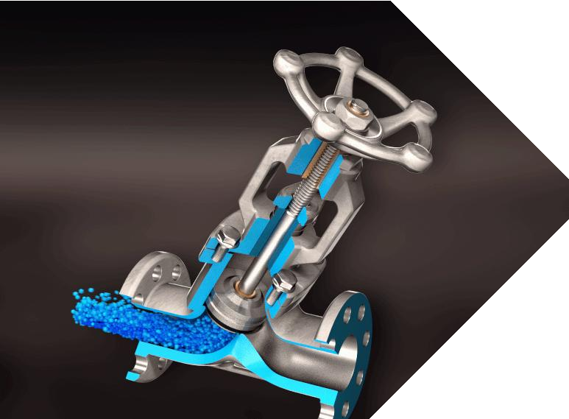
THANK YOU

