Slide 1
Core Activities
about us
BIS CARE
Mandatory products
Rule 50-51
Section 17
Bureau of Indian Standards
Jammu and Kashmir Branch Office

Slide 2
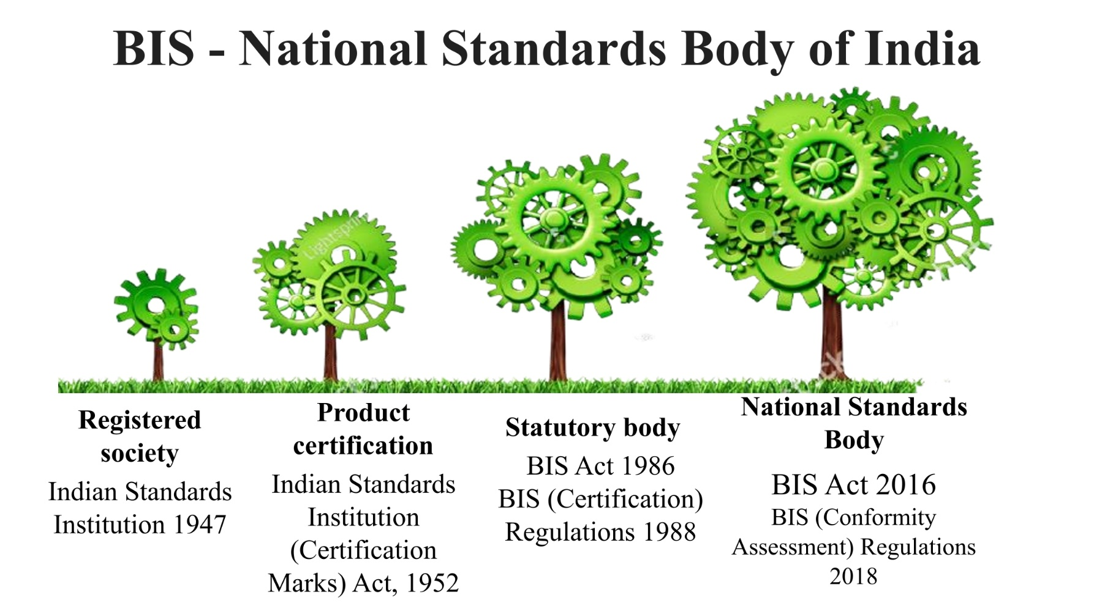
Mandatory products
Rule 50-51
Section s
about us

Slide 3
Standardization
Core Activities
about us
Mandatory products
Rule 50-51
Section 17
Conformity Assessment
Laboratory Activity
Hallmarking
Training and Consumer Protection

Slide 4
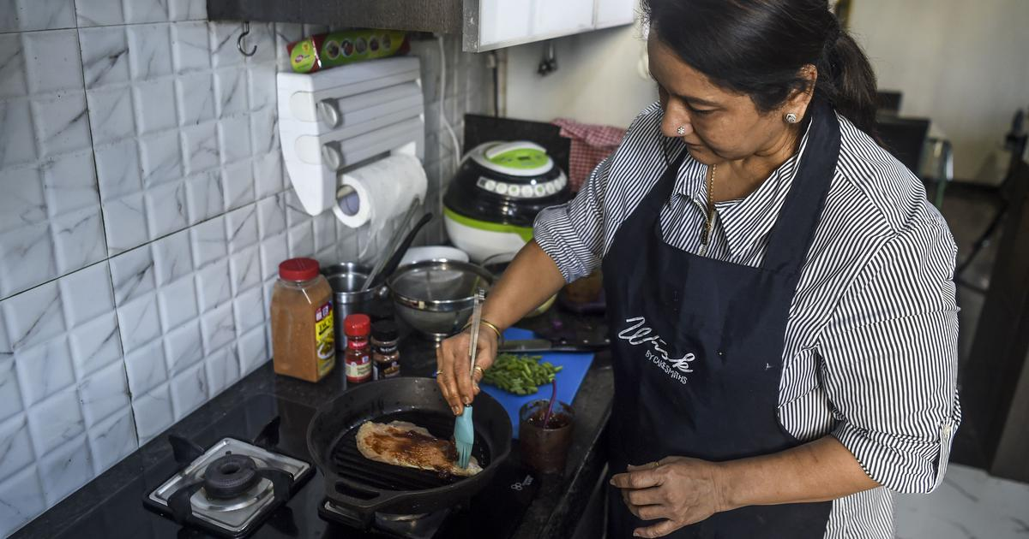
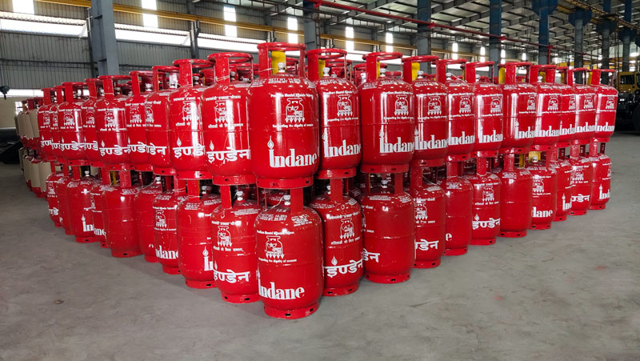
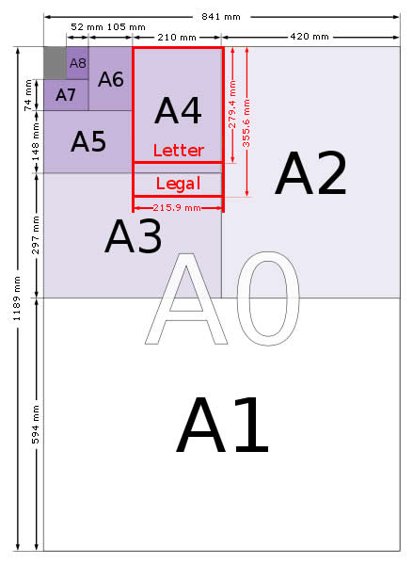
Standards
Quality Safety
Core Activities
about us
Mandatory products
Rule 50-51
Section 17
Interchangeability Life Made Easier

Slide 5
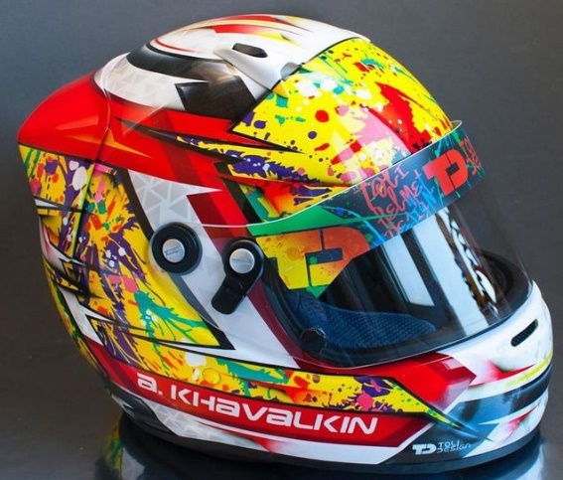
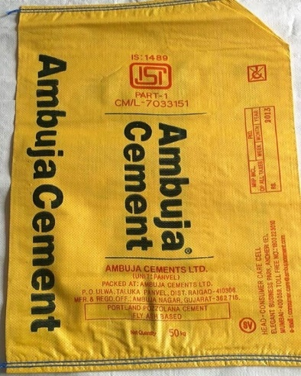
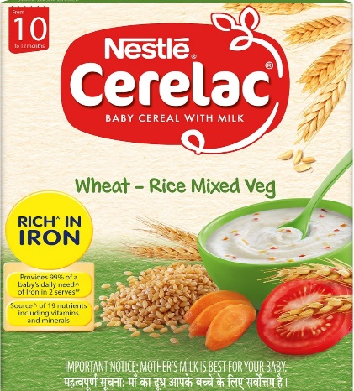
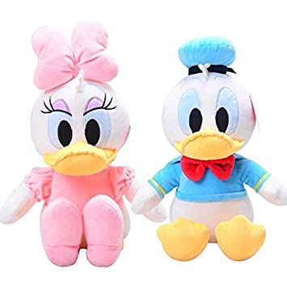
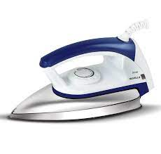
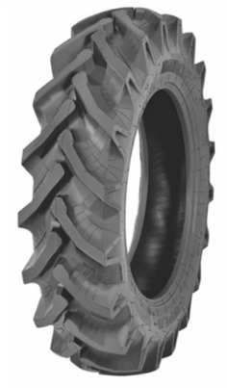
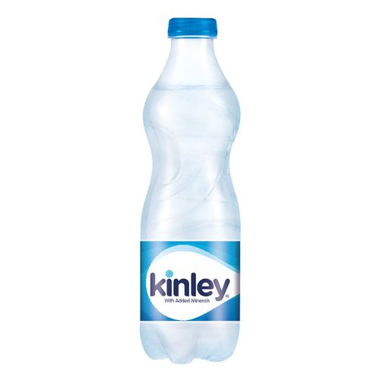
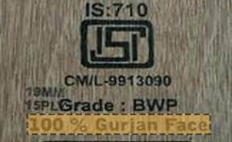
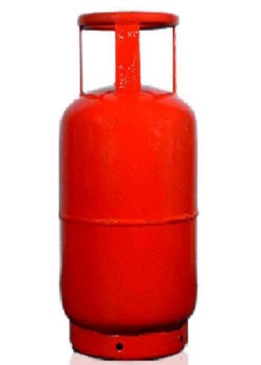
Product Certification
Core Activities
about us
Mandatory products
Rule 50-51
Section 17

Slide 6
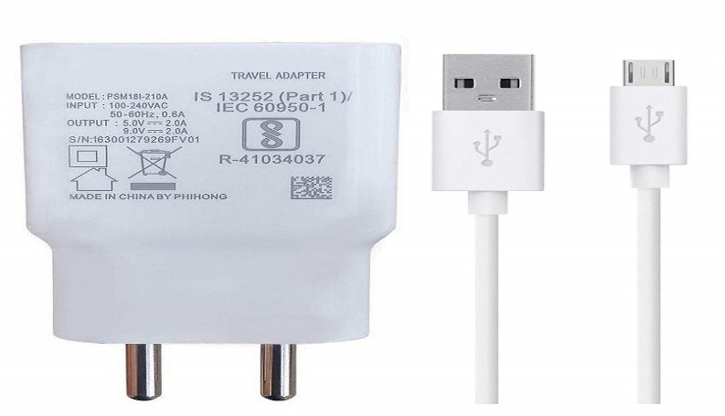
Compulsory Registration Scheme (CRS) for Self Declaration of conformity
Core Activities
about us
Mandatory products
Rule 50-51
Section 17

Slide 7
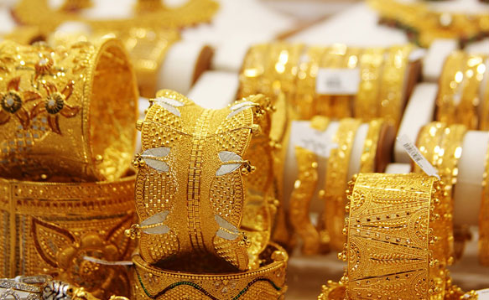
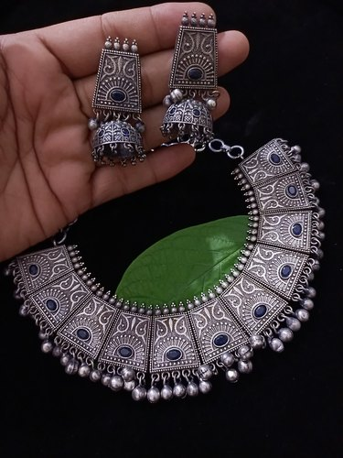
Hallmark
Core Activities
about us
Mandatory products
Rule 50-51
Section 17

Slide 8
Compulsory Hallmarking of Gold Articles
BIS Hallmark
Purity /Fineness Mark 22K916
HUID – XXXXXX containing alphabets and digits
Fineness grades that can be certified as per IS 1417
Fineness (in ppt) 958 916 833 750 585
Caratage 23K 22K 20K 18K 14K
Purity Mark 23K958 22K916 20K833 18K750 14K585
Core Activities
about us
Mandatory products
Rule 50-51
Section 17
22 K 916
(fineness)
XXXXXX
(HUID)

Slide 9
Compulsory Hallmarking of Gold Articles
HALLMARKING CHARGES:
Following hallmarking charges are applicable:
Rs. 45/- per article
Minimum payable charges Rs. 200
Core Activities
about us
Mandatory products
Rule 50-51
Section 17
After paying testing charges of Rs. 200 to any of BIS recognized A&H centre. The list of BIS recognized A&H centre is available at BIS website www.bis.gov.in under the hallmarking tab.

Slide 10
17. (1) No person shall manufacture, import, distribute, sell, hire, lease, store or exhibit for sale any such goods, article, process, system or service under sub-section (1) of section 16— (a) without a Standard Mark, except under a valid licence; or (b) notwithstanding that he has been granted a license, apply a Standard Mark, unless such goods, article, process, system or service conforms to the relevant standard or prescribed essential requirements. (2) No person shall make a public claim, through advertisements, sales promotion leaflets, price lists or the like, that his goods, article, process, system or service conforms to an Indian standard or make such a declaration on the goods or article, without having a valid certificate of conformity or licence from the Bureau or any other authority approved by the Central Government under sub-section (2) of section 16.
Core Activities
about us
Mandatory products
Rule 50-51
Section 17

Slide 11
28. (1) If the certification officer has reason to believe that any goods or articles, process, system or service in relation to which the contravention of section 11 or sub-sections (6) or (8) of section 14 or section 15 or section 17 has taken place are secreted in any place, premises or vehicle, he may enter into and search such place, premises or vehicle for such goods or articles, process, system or service, as the case may be. (2) Where, as a result of any search made under sub-section (1), any goods or article, process, system or service has been found in relation to which contravention of section 11 or sub-sections (6) or (8) of section 14 or section 15 or section 17 has taken place, the certification officer may seize such goods or article and other material and documents which, in his opinion will be useful for, or relevant to any proceeding under this Act: Provided that where it is not practicable to seize any such goods or article or material or document, the certification officer may serve on the owner an order that he shall not remove, part with, or otherwise deal with, the goods or article or material or document except with the previous permission of the certification officer. (3) The provision of the Code of Criminal Procedure, 1973, relating to searches and seizures shall, so far as may be, apply to every search or seizure made under this section
Core Activities
about us
Mandatory products
Rule 50-51
Section 28

Slide 12
Sectiopn 29. (1) Any person who contravenes the provisions of section 11 or sub-section (1) of section 26 shall be punishable with fine which may extend to five lakh rupees.
(2) Any person who contravenes the provisions of sub-sections (6) or (8) of section 14 or section 15 shall be punishable with imprisonment for a term which may extend to one year or with fine which shall not be less than one lakh rupees, but may extend up to five times the value of goods or articles produced or sold or offered to be sold or affixed or applied with a Standard Mark including Hallmark, or with both
Provided that where the value of goods or articles produced or sold or offered to be sold cannot be determined, it shall be presumed that one year's production was in such contravention and the annual turnover in the previous financial year shall be taken as the value of goods or articles for such contravention
3) Any person who contravenes the provisions of section 17 shall be punishable with imprisonment for a term which may extend up to two years or with fine which shall not be less than two lakh rupees for the first contravention and not be less than five lakh rupees for the second and subsequent contraventions, but may extend up to ten times the value of goods or articles produced or sold or offered to be sold or affixed or applied with a Standard Mark, including Hallmark, or with both
Core Activities
about us
Mandatory products
Rule 50-51
Section 29

Slide 13
Rule 50. Compounding of offences. – (1) Any offence committed for the first time punishable under the Act may either before or after the institution of any prosecution, be compounded by an officer so authorised by Director General: Provided that the Director General shall authorise in writing, the Head of the Regional office or any other senior officer of the Bureau of equivalent rank, to be the compounding authority under this rule. #
(2) Any person may, either before or after the institution of prosecution, make an application in Form-‘A’ to the compounding authority for composition of an offence as specified in section 33 of the Act.
(3) On receipt of an application under sub- rule (2), the compounding authority shall call for a report from the concerned branch office with reference to the particulars furnished in the application or any other information which may be considered relevant for examination of such application and a report shall be furnished by the branch office within a period of thirty days or within such extended period as may be allowed by the compounding authority, from the date of receipt of communication from the compounding authority.
(4) The compounding authority, after giving personal hearing to the applicant and after taking into account the contents of the said application may by order giving reasons of arriving at the decision, either allow the application indicating the compounding amount or reject such application: Provided that the application shall not be rejected unless an opportunity has been given to the applicant of being heard and the grounds of such rejection are mentioned in such order. Provided that the applicant shall not claim, as a matter of right, that his offence be compounded: Provided further that no compounding shall be allowed by the compounding authority where there are apparent contradictions, inconsistencies or incompleteness in the case of the applicant.
Core Activities
about us
Mandatory products
Rule 50-51
Section 17

Slide 14
Rule 50
(8) The amount so compounded under this rule shall be as provided in the following table:
S No | Offence specified under the Ac | Compounding amount
1. | Sub-section (1) of section 29 | fifty percent of the maximum and subject to minimum of twenty-five percent of the applicable fine.
2. | Sub-section (2) of section 29 | fifty percent of the maximum and subject to a minimum of one lakh rupees of the applicable fine.
3. | Sub-section (3) of section 29 | fifty percent of the maximum and subject to a minimum of two lakh rupees of the applicable fine.
Core Activities
about us
Mandatory products
Rule 50-51
Section 17

Slide 15
Rule 51. Powers and duties of compounding authority. – (1) The compounding authority, if he is satisfied that any person who has made the application for compounding of offence under sub-rule (2) of rule 50 has cooperated in the proceedings before him and has made full and true disclosure of the facts relating to the goods, articles, process, system or service, grant such person immunity from prosecution under the Act, if the prosecution has not been instituted with respect to the case so compounded, subject to such conditions as the compounding authority may find fit to impose. (2) The compounding authority shall endeavour to decide every application for compounding within sixty days of its filing. (3) The compounding authority shall file before the Director General, a monthly report indicating the details of applications received by him and actions taken thereon.
Core Activities
about us
Mandatory products
Rule 50-51
Section 17

Slide 16
Important standards related to Police Department
Non-metal helmet for police force (IS 9562)
Visor for helmets (IS 9995)
High Ankle tactical boots (IS 17012)
Bullet proof jacket (IS 17051)
Road Traffic signals (IS 7537)
Road traffic safety management systems (IS 39001)
Core Activities
about us
Mandatory products
Rule 50-51
Section 17

Slide 17
Important standards for Enforcements
Helmets for Two wheeler (IS 4151 :2015) as per Section 129 of Motor Vehicle Act 1988
Toys
Package drinking water
Hallmarking of Gold Jewellery
For QCO orders please click here
Core Activities
about us
Mandatory products
Rule 50-51
Section 17
129. Wearing of protective headgear.—Every person driving or riding (otherwise than in a side car, on a motor cycle of any class or description) shall, while in a public place, wear 2 [protective headgear conforming to the standards of Bureau of Indian Standards]: Provided that the provisions of this section shall not apply to a person who is a Sikh, if he is, while driving or riding on the motor cycle, in a public place, wearing a turban: Provided further that the State Government may, by such rules, provide for such exceptions as it may think fit. Explanation.—”Protective headgear” means a helmet which,— (a) by virtue of its shape, material and construction, could reasonably be expected to afford to the person driving or riding on a motor cycle a degree of protection from injury in the event of an accident; and (b) is securely fastened to the head of the wearer by means of straps or other fastenings provided on the headgear.

Slide 18
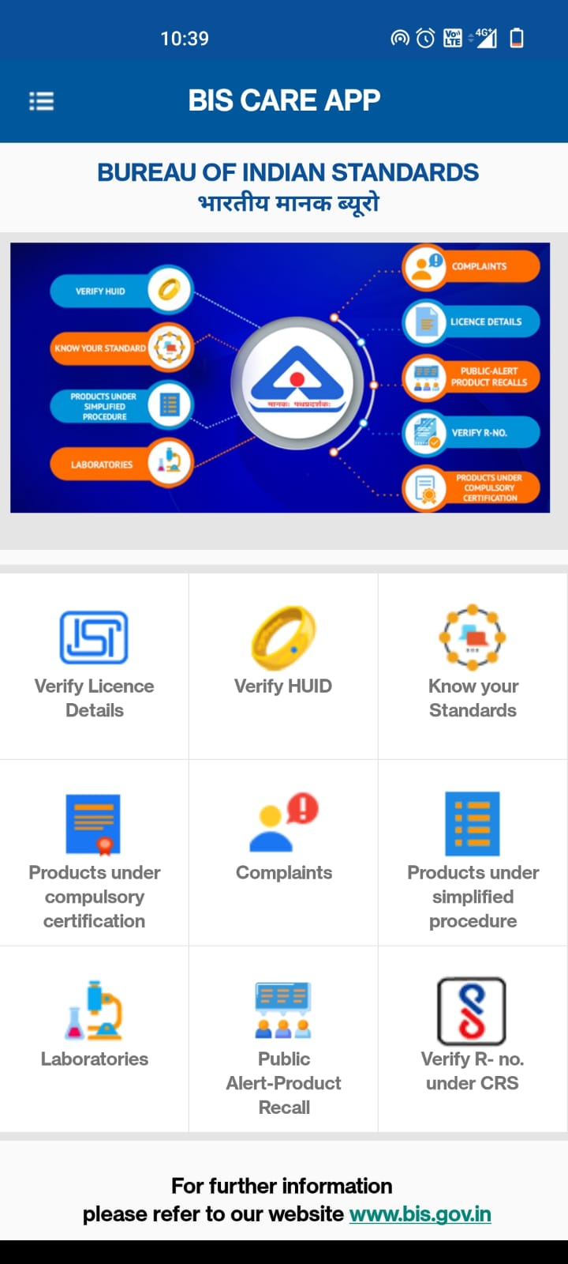
Core Activities
about us
BIS CARE
Mandatory products
Rule 50-51
Section 17
Download App from Play Store or Apple Store

Slide 19
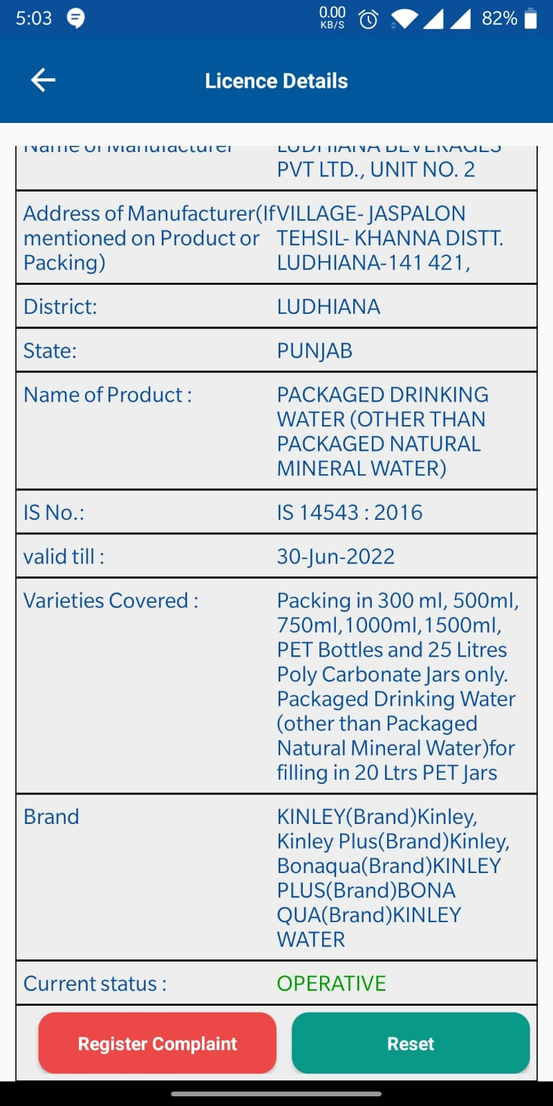
Core Activities
about us
BIS CARE
Mandatory products
Rule 50-51
Section 17
Download App from Play Store or Apple Store

Slide 20
THANK YOU
Core Activities
about us
Mandatory products
Rule 50-51
Section 17
www.bis.gov.in
www.manakonline.in, www.standardsbis.in

