Slide 1
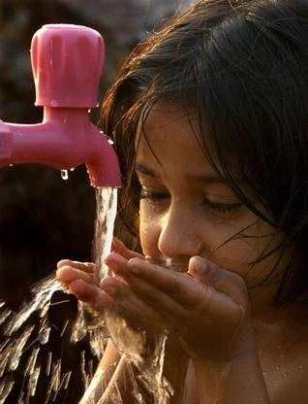

INDIAN STANDARDS
on
Drinking Water
(including Packaged)
Notes:
m

Slide 2

Significance of Drinking Water Quality
Water is vital for human survival, economic development, environmental sustainability, and social well-being
Human body composition: 55-60% of the human body is water
Cellular functions: Water is necessary for cellular processes, such as metabolism and temperature regulation
Hydration: Water helps maintain fluid balance and supports bodily functions.
Health: Access to clean water reduces disease risk and improves public health.

Slide 3
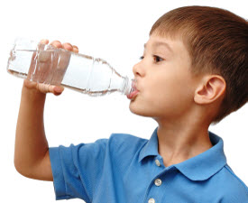
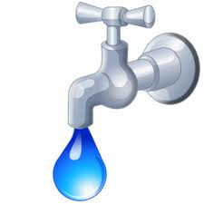
Concerns related to Water Quality
Many episodes of diarrhea, dysentery and other water borne diseases due to microbes in water
Presence of dangerous chemicals like Fluoride, Arsenic and Selenium in water
Consumption of water supplied through open wells, borewells, tubewells, hand pumps, tankers, etc. still prevalent
Safe treated Piped water supply yet to reach all households

Slide 4

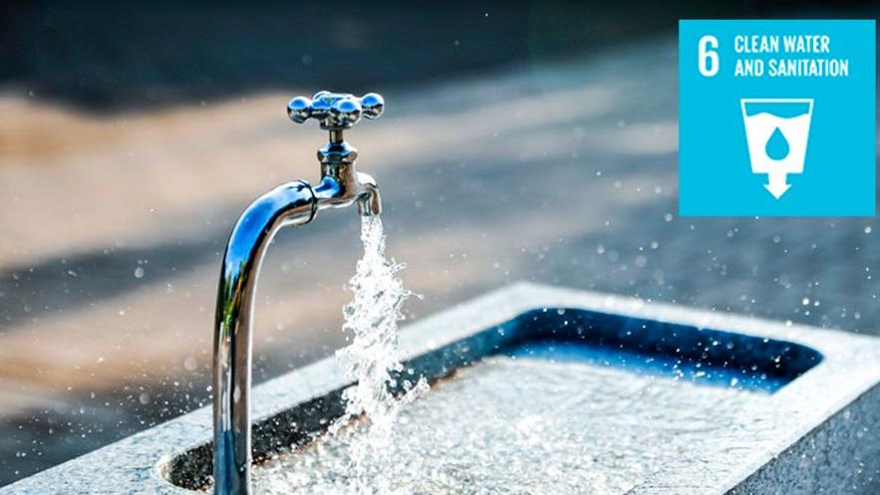
Water and Sustainability
Sustainable Development Goal 6 (SDG 6) on water and sanitation, adopted by United Nations Member States at the 2015 UN Summit as part of the 2030 Agenda for Sustainable Development, provides the blueprint for ensuring availability and sustainable management of water and sanitation for all.
Sustainable Development Goal target 6.1 calls for universal and equitable access to safe and affordable drinking-water. Providing access to safe water is one of the most effective instruments in promoting health and reducing poverty.
Notes:
Access to safe water, sanitation and hygiene is the most basic human need for health and well-being. Billions of people will lack access to these basic services in 2030 unless progress quadruples. Demand for water is rising owing to rapid population growth, urbanization and increasing water needs from agriculture, industry, and energy sectors.
The demand for water has outpaced population growth, and half the world’s population is already experiencing severe water scarcity at least one month a year. Water scarcity is projected to increase with the rise of global temperatures as a result of climate change.
Investments in infrastructure and sanitation facilities; protection and restoration of water- related ecosystems; and hygiene education are among the steps necessary to ensure universal access to safe and affordable drinking water for all by 2030, and improving water-use efficiency is one key to reducing water stress.
There has been positive progress. Between 2015 and 2022, the proportion of the world’s population with access to safely managed drinking water increased from 69 per cent to 73 per cent.
Goal 6 Targets
6.1 By 2030, achieve universal and equitable access to safe and affordable drinking water for all
6.2 By 2030, achieve access to adequate and equitable sanitation and hygiene for all and end open defecation, paying special attention to the needs of women and girls and those in vulnerable situations
6.3 By 2030, improve water quality by reducing pollution, eliminating dumping and minimizing release of hazardous chemicals and materials, halving the proportion of untreated wastewater and substantially increasing recycling and safe reuse globally
6.4 By 2030, substantially increase water-use efficiency across all sectors and ensure sustainable withdrawals and supply of freshwater to address water scarcity and substantially reduce the number of people suffering from water scarcity
6.5 By 2030, implement integrated water resources management at all levels, including through transboundary cooperation as appropriate
6.6 By 2020, protect and restore water-related ecosystems, including mountains, forests, wetlands, rivers, aquifers and lakes
6.A By 2030, expand international cooperation and capacity-building support to developing countries in water- and sanitation-related activities and programmes, including water harvesting, desalination, water efficiency, wastewater treatment, recycling and reuse technologies
6.B Support and strengthen the participation of local communities in improving water and sanitation management

Slide 5
Some Facts and Figures
1,95,813 habitations in India ─ Poor water quality 276 districts in India ─ Groundwater contaminated with fluoride, arsenic, and nitrate beyond the permissible limits (https://timesofindia.indiatimes.com/blogs/voices/water-contamination-still-a-serious-national-challenge/)
Waterborne diseases ─ Estimated economic burden of approximately USD 600 million a year in India (https://www.unicef.org/india/what-we-do/clean-drinking-water)
Water borne diseases in India makes one crore people sick every year (https://indiainfacts.in/world-food-safety-day-diarrhoea-water-borne-diseases-india/)

Slide 6
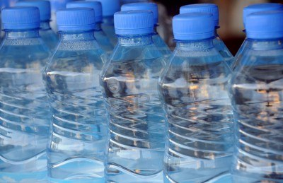
How standards address the concern?
Prescribe requirements for assessing the quality of water and to check the effectiveness of water treatment and supply by the concerned authorities
Sets criteria for conformity assessment and provides tool for regulatory compliance.
Prescribes good hygienic practices to improve processes and make them more efficient
Guide in consistent functioning and quality
Ensure health and safety from water borne diseases

Slide 7
Important Indian Standards on Drinking Water Quality
Indian Standard | Title
IS 10500 : 2012 | Drinking Water — Specification
IS 14543 : 2024 | Packaged Drinking Water (Other than Packaged Natural Mineral Water) — Specification
IS 13428 : 2024 | Packaged Natural Mineral Water — Specification
IS 17482 : 2020 | Drinking Water Supply Management System- Requirements for Piped Drinking Water Supply
IS 3025 (Series of standard) | Methods of Sampling and testing (Physical and Chemical for Water and Wastewater
.

Slide 8

Terminology (IS 10500)
Drinking Water (IS 10500, Cl. 3,1)
Drinking water is water intended for human consumption for drinking and cooking purposes from any source. It includes water (treated or untreated) supplied by any means for human consumption.
ACCEPTABILITY CRITERIA (IS 10500, Foreword, Para 5)
This standard specifies the acceptable limits and the permissible limits in the absence of alternate source
Acceptable limits are the values in excess of which the water is not suitable for drinking purposes. Such a value may, however, be tolerated in the absence of an alternative source
However, if the value exceeds the limits indicated under ‘permissible limit in the absence of alternate source’, the sources will have to be rejected
Notes:
It is recommended that the acceptable limit is to be implemented as values in excess of those mentioned under ‘Acceptable’ render the water not suitable. Such a value may, however, be tolerated in the absence of an alternative source. However, if the value exceeds the limits indicated under ‘permissible limit in the absence of alternate source’ in col 4 of Tables 1 to 4, the sources will have to be rejected.
IS 10500: 2012 specifies maximum acceptable limit of TDS as 500 mg/l. The standard recommends that the acceptable limit is to be implemented and values in excess of those mentioned under ‘acceptable’ render the water not suitable for drinking. However, in the absence of any alternate source, water may be tolerated upto the limits indicated under ‘permissible limit’. For TDS, the maximum permissible limit is specified as 2000 mg/l. The permissible limit is applicable only where there is a single source of water available without access to necessary treatment facilities to purify water upto the acceptable limit. Therefore, the desalination plant is using reverse osmosis technology, the acceptable limit of TDS as 500 mg/l shall be applicable

Slide 9
REQUIREMENTS COVERED (IS 10500)
Organoleptic & Physical (6 Parameters)
Chemical requirements affecting acceptability (24 Parameters)
Toxic Substances (15 Parameters)
Pesticides Residues (20 Residues)
Biological Requirements [Bacteria , Virus , Protozoa ]
01
02
REQUIREMENTS
03
04
05

Slide 10
Organoleptic & Physical Requirements
Colour, cloudiness, particulate matter and visible organisms effect acceptability.
These parameters in drinking-water may be indicative of potentially harmful substances.
Taste and odour can originate from natural inorganic and organic chemical contaminants and biological sources or processes.
The cause should be investigated and the appropriate remedial action to be taken.
Notes:
Should there be min. requirement for TDS

Slide 11
Organoleptic & Physical Requirements
Colour
Drinking-water should ideally have no visible colour. Colour in drinking-water is usually due to the presence of coloured organic matter associated with the humus fraction of soil. Colour is also strongly influenced by the presence of iron and other metals, either as natural impurities or as corrosion products. It may also result from the contamination of the water source with industrial effluents and may be the first indication of a hazardous situation.
Limits specified for colour in drinking water:
Acceptable limit: 5 Hazen units, Max
Permissible limit: 15 Hazen units, Max
Notes:
Should there be min. requirement for TDS

Slide 12
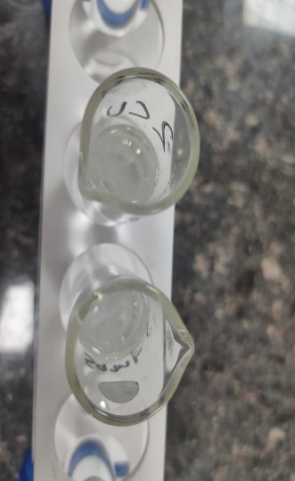
Organoleptic & Physical Requirements
Colour: How to test ?
As per IS 3025 Part 4
This standard prescribes the following methods of test for the determination of colour:
  Platinum cobalt (visual comparison method),
  b) Spectrophotometric — Single wavelength method, and
  c) Spectrophotometric — Multi wavelength method
Notes:
Should there be min. requirement for TDS

Slide 13
Organoleptic & Physical Requirements
Odour & Taste
Water should be free of tastes and odours that would be objectionable to the majority of consumers. Microbial, chemical and physical constituents of water may affect odour or taste of the water, and the consumer will evaluate the quality and acceptability of the water on the basis of these criteria.
Changes in the normal appearance, taste or odour of a drinking-water supply may signal changes in the quality of the raw water source or deficiencies in the treatment process and should be investigated.
Requirement specified for odour and taste in drinking water: Acceptable
Notes:
Should there be min. requirement for TDS

Slide 14
Organoleptic & Physical Requirements
Odour & Taste : How to test ?
Odour as per IS 3025 (Part 5) | Taste as per IS 3025 (Part 8)
Thoroughly clean the required number of wide – mouth glass – stoppered bottles of about one litre capacity. Fill a bottle half – full of sample, insert the stopper, shake vigorously for 2 to 3 seconds and then quickly observe the odour. Report the true odour of the sample at the mouth of the bottle as rotten egg, burnt sugar, soapy, fishy septic, aromatic, chlorinous, alcoholic odour or any other specific odour. In case it is not possible to specify the exact nature of odour, it is reported as agreeable or disagreeable. | Each panellist (tester) is presented with a list of nine statements about the water, ranging from very favourable to very unfavourable. The tester selects a statement that best expresses his opinion. The scored rating is the scale number of the statement selected. The panel rating is the arithmetic mean of the scale numbers of all testers. Tasting: About half of the sample is tasted by taking the water into the mouth, holding it for several seconds and discharging it without swallowing. Temperature control: Temperature of the samples shall be such that the observers find it pleasant for drinking. A temperature of 15°C is recommended but in any case do not allow it to exceed 27°C.
Notes:
Should there be min. requirement for TDS

Slide 15
Organoleptic & Physical Requirements
Turbidity
Turbidity, typically expressed as nephelometric turbidity units (NTU), describes the cloudiness of water caused by suspended particles (e.g. clay and silts), chemical precipitates (e.g. manganese and iron), organic particles (e.g. plant debris) and organisms. Turbidity can be caused by poor source water quality, poor treatment and, within distribution systems, disturbance of sediments and biofilms or the ingress of dirty water through main breaks and other faults.
Limits specified for turbidity in drinking water:
Acceptable limit: 1 NTU, Max
Permissible limit: 5 NTU, Max
Notes:
Should there be min. requirement for TDS

Slide 16
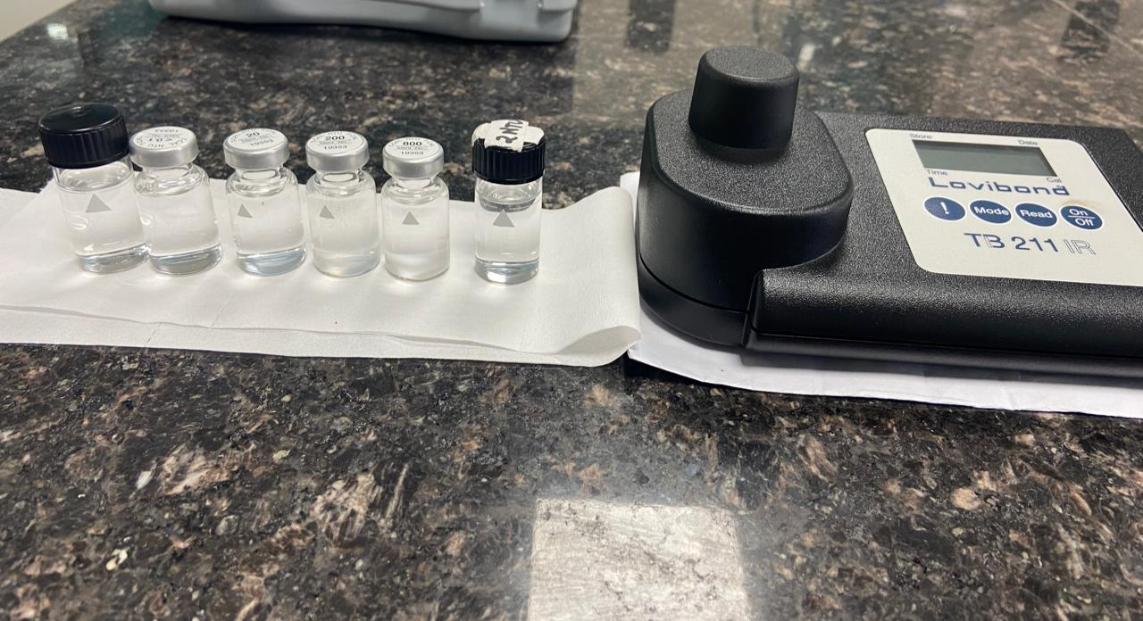
Organoleptic & Physical Requirements
Turbidity: How to test ?
As per IS 3025 Part 10
This standard prescribes nephelometric method for the measurement of turbidity of water.
Principle: It is based on comparison of the intensity of light scattered by the sample under defined conditions with the intensity of light scattered by a standard reference suspension under the same conditions.
The higher the intensity of scattered light, the higher the turbidity.
Followed manufacturer’s operating instructions for calibration, measurement of sample and reporting.
Notes:
Should there be min. requirement for TDS

Slide 17
Organoleptic & Physical Requirements
pH
The pH level of drinking water is important because it affects many aspects of the water, including its taste, odor, and nutritional content. It also affects the water's ability to dissolve substances, how aquatic life can use it, and how well it can be disinfected.
High pH causes a bitter taste, water pipes and water-using appliances become encrusted with deposits, and it depresses the effectiveness of the disinfection of chlorine, thereby causing the need for additional chlorine when pH is high. Low-pH water will corrode or dissolve metals and other substances.
Requirement specified for pH in drinking water: 6.5-8.5
Notes:
Should there be min. requirement for TDS

Slide 18
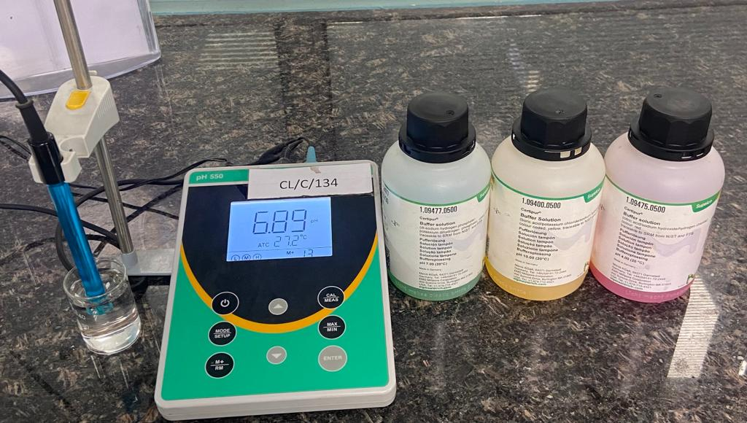
Organoleptic & Physical Requirements
pH: How to test ?
As per IS 3025 Part 11
The determination of the pH value is based on measuring the potential difference of an electrochemical cell using a suitable pH meter.
The pH of a sample also depends on the temperature because of dissociation equilibrium. Therefore, the temperature of the sample is always stated together with the pH measurement.
The pH value may change rapidly as a result of chemical, physical or biological processes in the water sample. For this reason, whenever applicable, it is advisable to measure the pH value immediately at the sampling point.
Notes:
Should there be min. requirement for TDS

Slide 19
Organoleptic & Physical Requirements
Total dissolved solids
The palatability of water with a total dissolved solids (TDS) level of less than about 500 mg/l is generally considered to be good; drinking-water becomes significantly and increasingly unpalatable at TDS levels greater than about 1000 mg/l. The presence of high levels of TDS may also be objectionable to consumers, owing to excessive scaling in water pipes, heaters, boilers and household appliances.
Limits specified for total dissolved solids in drinking water:
Acceptable limit: 500 mg/l, Max
Permissible limit: 2000 mg/l, Max
Notes:
Should there be min. requirement for TDS
WHO Guidelines for Drinking-water Quality Edition 4 (2011) and other international guidelines do not recommend any minimum values for minerals ‘Calcium & Magnesium’ as there is no conclusive evidence for the same. The WHO guidelines state that‘….Although certain mineral waters may be useful in providing essential micronutrients, such as calcium and magnesium, these Guidelines do not make recommendations regarding minimum concentrations of essential elements because of the uncertainties surrounding mineral nutrition from drinking-water.’

Slide 20
Organoleptic & Physical Requirements
Total dissolved solids: How to test ?
As per IS 3025 Part 16
This standard prescribes a gravimetric method for the determination of filterable residue in water and wastewater.
A well-mixed sample is filtered through a standard glass-fiber filter and the filtrate is evaporated in a pre-weighed tared dish on steam-bath. The residue after evaporation is dried to constant mass in an oven at 180±2°C.
The value of filterable residue obtained by drying at 180°C conforms more closely to those obtained by summation of various constituents.
Notes:
Filterable residue is the term applied to the residue remaining in a weighed dish after the sample has been passed through a standard fiberglass filter and dried to constant mass at 103 °C – 105 °C or 179 °C – 181 °C

Slide 21
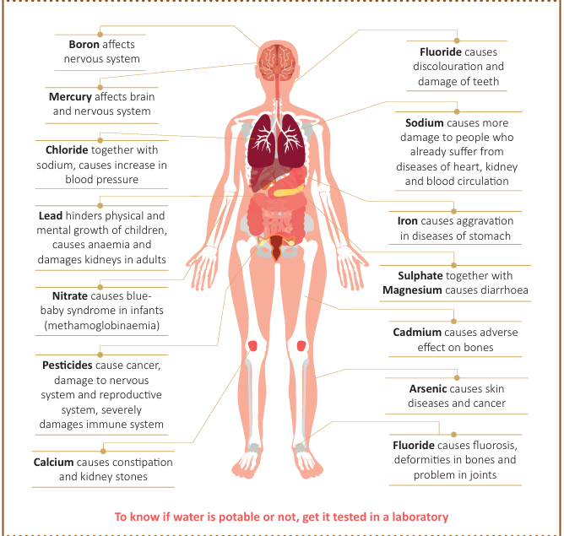
Significance of Various Chemical Parameters in Drinking Water

Slide 22
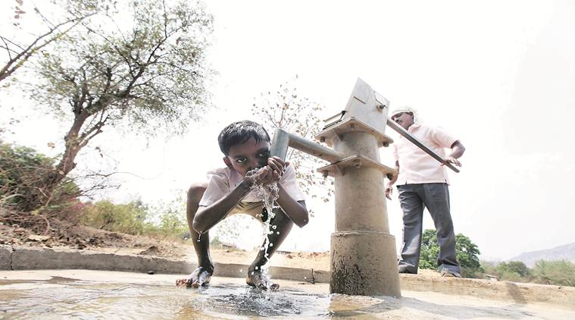
Chemical Contaminants in Drinking Water
High levels of arsenic, fluoride, iron, and uranium exist naturally in some geological formations, contaminating groundwater.
Excessive use of fertilizers, pesticides, and herbicides leach harmful chemicals into the water table.
Untreated industrial effluents often find their way into groundwater sources, introducing heavy metals and other toxins.
        Leaky sewage systems and improper waste disposal in urban areas contribute to groundwater pollution
        Water may also be contaminated by trace metals such as lead, mercury, cadmium, copper, chromium, and nickel, which possess carcinogenic properties.

Slide 23
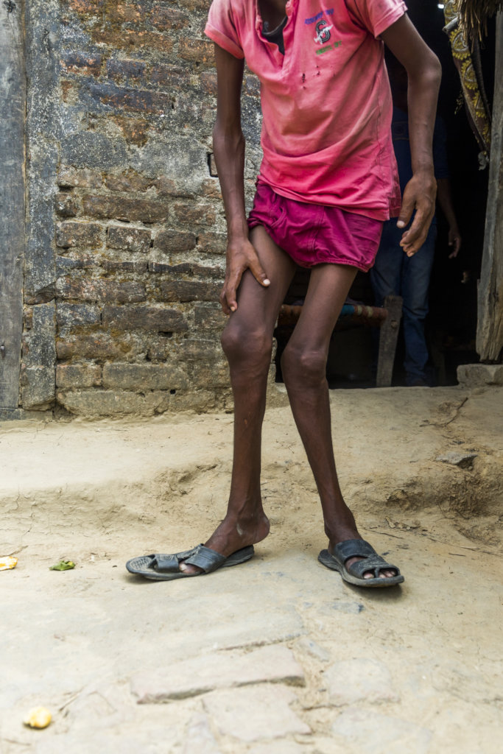
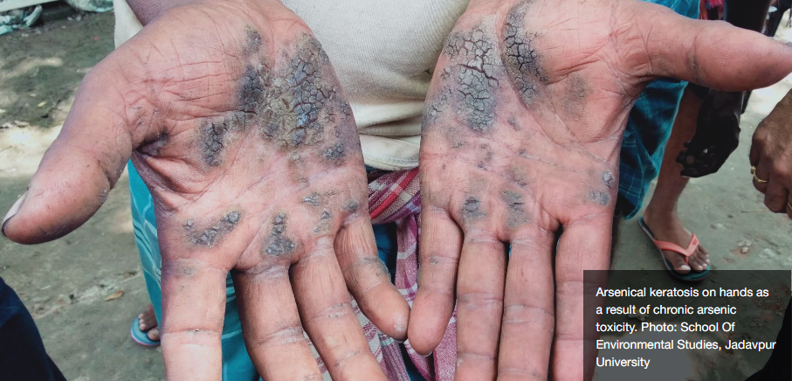
Arsenic and Fluoride in Drinking Water
Arsenic has been detected in groundwater in parts of 230 districts in 25 states and fluoride in 469 districts in 27 states
(https://sansad.in/getFile/annex/262/AU99.pdf?source=pqars)
Arsenicosis
Skin pigmentation changes and skin thickening (hyperkeratosis)
Cancer of the skin, lungs, bladder and kidney
Tooth discoloration and decay
Fluorosis
Crippling skeletal damage

Slide 24
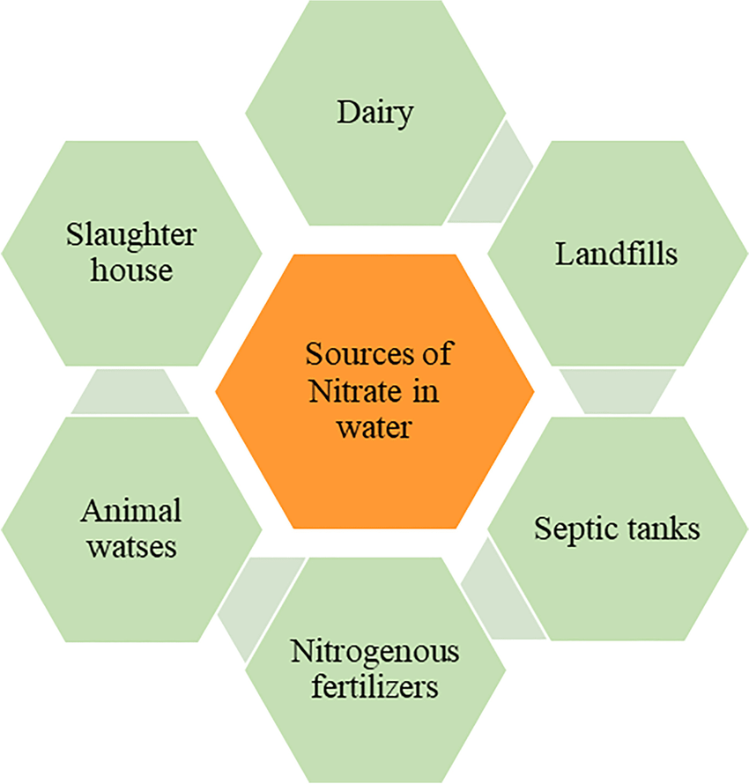
Nitrates in Drinking Water
Excessive nitrate levels in drinking water can contribute to the formation of carcinogens
Blue Baby Syndrome cause a bluish discolouration of the skin in babies
Methemoglobinemia is a condition where an abnormal form of haemoglobin (methemoglobin) is present in the blood, reducing its ability to carry oxygen.

Slide 25
Substances Undesirable in Excessive Amount
IS 10500, Table 2
Requirements | Acceptable | Permissible
Aluminium (as Al), mg/l, Max | 0.03 | 0.2
Ammonia (as total ammonia-N), mg/l, Max | 0.5 | No relaxation
Anionic detergents (as MBAS) mg/l, Max | 0.2 | 1.0
Chloramines (as Cl2), mg/l, Max | 4 | No relaxation
Copper (as Cu), mg/l, Max | 0.05 | 1.5
Fluoride (as F) mg/l, Max | 1.0 | 1.5
Iron (as Fe), mg/l, Max | 1.0 | No relaxation
Nitrate (as NO3) mg/l, Max | 45 | No relaxation
Phenolic compounds (as C₆H₅OH), mg/l, Max | 0.001 | 0.002
Residual free chlorine, mg/l, Min | 0.2 | 1
Selenium (as Se), mg/l, Max | 0.01 | No relaxation

Slide 26
Toxins in Drinking Water
Govt data shows there are excess amount of toxic metals in groundwater. The problem is more serious in the villages than in the cities. (https://www.indiatoday.in/india/story/poison-not-water-govt-data-shows-toxic-metals-groundwater-1982841-2022-08-02)
Drinking water with higher amounts of arsenic, iron, lead, cadmium, chromium and uranium has a direct effect on an individual’s health.
While excess arsenic increases the risk of skin diseases and cancer, higher amounts of iron can lead to diseases related to the nervous system such as Alzheimer’s and Parkinson’s.
Lead consumed more than the prescribed amount can affect one’s nervous system, while high levels of cadmium can increase the risk of kidney disorders.
Consuming excess amount of uranium in drinking water, poses higher risk of kidney diseases and cancer.
High amounts of chromium can result in diffuse hyperplasia in the small intestine, leading to tumours.

Slide 27
Toxic Substances
IS 10500, Table 3
Requirements | Acceptable | Permissible
Cadmium (as Cd), mg/l, Max | 0.003 | No relaxation
Chromium (as Cr), mg/l, Max | 0.05 | No relaxation
Cyanide (as CN), mg/l, Max | 0.05 | No relaxation
Lead (as Pb), mg/l, Max | 0.01 | No relaxation
Polychlorinated biphenyls, mg/l, Max | 0.0005 | No relaxation
Polynuclear aromatic hydrocarbons (as PAH), mg/l, Max | 0.0001 | No relaxation
Total Arsenic (as As), mg/l, Max | 0.01 | No relaxation
Uranium, mg/l, Max | 0.03 | No relaxation

Slide 28
Radiological Safety in Drinking Water
Water sources can contain radionuclides of natural and artificial origin
Radiation protection is based on the assumption that any exposure to radiation involves some level of risk.
The process of identifying individual radionuclides in drinking-water and determining their concentration is time-consuming and expensive. A more practical approach is to use a screening procedure, where the total radioactivity present in the form of alpha and beta radiation is first determined, without regard to the identity of specific radionuclides.
Radioactive Substances IS 10500, Table 4
Alpha emitters Bq/l, Max | 0.1 | No relaxation
Beta emitters Bq/l, Max | 1.0 | No relaxation
In case of non-conformity of radioactive residues, the source of water shall be abandoned and water shall be recalled immediately.

Slide 29
Pesticides in Drinking Water
The occurrence of pesticides in the water body is derived by the runoff from the agricultural field and industrial wastewater.
Pesticides are potentially toxic to humans and can have both acute and chronic health effects.
The health effects of pesticides depend on the type of pesticide:
  Affect the nervous system.
  Irritate the skin or eyes.
  Carcinogens (cancer causing).
  Endocrine disrupters

Slide 30
Pesticides
Pesticide residues limits in IS 10500 are based on consumption pattern, persistence and available manufacturing data.
Some of the specified limits are as under (IS 10500, Table 5)
Pesticide | Acceptable (µg/l) | Permissible
Alachlor | 20 | No relaxation
Aldrin/ Dieldrin | 0.03 | No relaxation
Alpha HCH | 0.01 | No relaxation
Beta HCH | 0.04 | No relaxation
Delta HCH | 0.04 | No relaxation
DDT (o, p and p, p – Isomers of DDT, DDE and DDD) | 1 | No relaxation
Ethion | 3 | No relaxation
Gamma — HCH (Lindane) | 2 | No relaxation

Slide 31
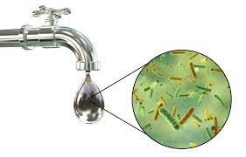
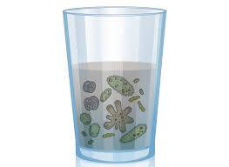
Microbial Safety in Drinking Water
Infectious diseases caused by pathogenic bacteria, viruses, protozoa and helminths are the most common and widespread health risk associated with drinking‑water
It is not practical to set performance targets for all potentially waterborne pathogens. A more practical approach is to identify reference pathogens that represent groups of pathogens.
The human health effects caused by waterborne transmission vary in severity from mild gastroenteritis to severe and sometimes fatal diarrhoea, dysentery, hepatitis and typhoid fever.
Waterborne out breaks have been associated with inadequate treatment of water supplies and unsatisfactory management of drinking water distribution.
Analysis for faecal indicator organisms provides a sensitive, indication of pollution of drinking-water supplies.

Slide 32
Microbiological Requirements (IS 10500)
Organisms | Requirements
E. coli or thermotolerant coliform bacteria (IS 10500,Table 6) | shall not be detectable in any 100 ml sample
Coliforms (IS 10500, Table 6) | shall not be detectable in any 100 ml sample
MS2 phage (indicator of viral contamination) (IS 10500, Clause 4.2.7) | shall be absent in 1 liter water
Cryptosporidium (IS 10500, Clause 4.3.8) | shall be absent in 10 liter of water
Giardia (IS 10500, Clause 4.3.9) | shall be absent in 10 liter of water
The microbiological requirements for Packaged drinking water(IS 14543) are more elaborate than those in IS 10500 in terms of the variety of microbiological parameters tested which includes microbiological requirements w.r.t. Faecal Streptococci and Staphylococcus aureus, Sulphite Reducing Anaerobes, Pseudomonas Aeruginosa, Aerobic Microbial Count, Yeast and mould, Salmonella and Shigella, Vibrio cholera and V. parahaemolyticus
Notes:
With regard to failure in the requirement for E. Coli, the Indian standard further provides following guidelines:
Immediate investigative action shall be taken if either E.coli or total coliform bacteria are detected. The minimum action in the case of total coliform bacteria is repeat sampling; if these bacteria are detected in the repeat sample, the cause shall be determined by immediate further investigation.
Although, E. coli is the more precise indicator of faecal pollution, the count of thermos-tolerant coliform bacteria is an acceptable alternative. If necessary, proper confirmatory tests shall be carried out. Total coliform bacteria are not acceptable indicators of the sanitary quality of rural water supplies, particularly in tropical areas where many bacteria of no sanitary significance occur in almost all untreated supplies.
It is recognized that, in the great majority of rural water supplies in developing countries, faecal contamination is widespread. Under these conditions, the national surveillance agency should set medium-term targets for progressive improvement of water supplies.
The Indian standard further provides that Chlorination, at the dosages normally employed in waterworks, is ineffective against certain parasites, including amoebic cysts; they can be excluded only by effective filtration or by higher chlorine doses than can be tolerated without subsequent dechlorination. Amoebiasis can be conveyed by water completely free from enteric bacteria; microscopic examination after concentration is, therefore, the only safe method of identification.

Slide 33

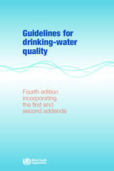
WHO GUIDELINES FOR DRINKING WATER QUALITY
WHO Guidelines are international standards for drinking water quality which are used by various countries and regions across the world including CODEX, EU Directives, etc. The primary purpose of the Guidelines for drinking-water quality is the protection of public health.
Technical specifications for drinking water quality in IS 10500 is at par with WHO Guidelines. (https://www.who.int/publications/i/item/9789240045064 )

Slide 34
INDIAN STANDARDS ON PACKAGED WATERS
IS 14543 : 2016 is for Packaged Drinking Water (Other than Packaged Natural Mineral Water) which may be subjected to various treatments such as decantation, filtration, combination of filtration, cartridge filter, activated carbon filtration, demineralization, remineralization, reverse osmosis and packed after disinfecting the water and is offered or sold in packaged form.
IS 13428 : 2005 covers various mineral waters in packaged form such as Naturally Carbonated Natural Mineral Water, Non-carbonated Natural Mineral Water, decarbonated Natural Mineral Water, Natural Mineral Water Fortified with Carbon Dioxide from the Source, Carbonated Natural Mineral Water

Slide 35
Sources and Treatments permitted under IS 14543
5.1.1 Water shall be derived from surface water or civic water supply or underground water or sea water or any other consistent source of water which may be subjected to herein under specified treatments, namely, decantation, distillation, filtration, combination of filtration, aerations, filtration with membrane filter, depth filter, cartridge filter, activated carbon filtration, demineralization, remineralization, reverse osmosis and packed after disinfecting the water to a level that shall not lead to any harmful effect in the drinking water by means of chemical agents or physical methods to reduce the number of micro-organisms to a level below scientifically accepted level for food safety or its suitability: Provided that sea water, before being subjected to the above treatments, shall be subjected to desalination and related processes.

Slide 36
Natural Mineral Water As per IS 13428
It is clearly distinguishable from ordinary drinking water because:
it is obtained directly from natural or drilled sources from underground water;
b) it is characterized by its content of certain mineral salts and their relative proportions and the presence of trace elements or of other constituents;
c) of the constancy of its composition and the stability of its discharge and its temperature;
d) it is collected under conditions which guarantee the original microbiological purity and chemical composition of essential components;
e) it is packaged close to the point of emergence of the source with particular hygienic precautions; and
f) it is not subjected to any treatment other than those permitted

Slide 37
PACKAGING REQUIREMENTS
Water shall be packed in clean, hygienic and tamperproof containers/bottles/pouches
Packaging material permitted:
Plastic containers conforming to IS 15410;
Polyethylene flexible pouches conforming to IS 15609;
Paper and paper board materials; glass;
Metal and metal alloys which may or may not contain plastic as component; compatible with the water to be packaged;
Paper based multilayer laminated/extruded composite cartons conforming to IS 17753
Aluminium cans conforming to Indian standard on 'Aluminium cans for packaged natural mineral water and packaged drinking water — Specification
All packaging materials of plastic origin shall pass the overall migration, colour migration and specific migration limits for toxic substances as laid down in IS 15410’

Slide 38
Key Differences Between IS 10500 & IS 14543
IS 10500 & IS 14543 have been formulated for drinking water based on the end use of the product and the treatments generally done
The requirements are generally comparable keeping safety in view
The standards primarily differ in the microbiological requirements which are more elaborate (11 more) and stricter (for E. coli & coliforms) in case of IS 14543 because the product needs to be kept safe for its entire shelf life in packaged form.

Slide 39
Key Differences Between IS 10500 & IS 14543
Some requirements like those of viruses & protozoan cysts have been specified only in case of IS 10500 because of the simpler treatments done and contamination during distribution through pipes/ tankers, etc.
IS 10500 also has additional parameters like chloramines, ammonia and tri-halomethanes, which are process by-products of disinfection methods employed
IS 10500 also specify permissible limits (in addition to acceptable limits) which are more relaxed and have been kept for tolerability of water where there are no alternate sources

Slide 40

Hygienic Practices for PDW processing Units
1
Collection of Drinking Water
2
Protective Measures
3
Transport of Drinking Water
4
Design & Facilities
5
Establishment
6
Personal Hygiene & Health Requirements
7
Hygienic Processing Requirements

Slide 41
QUIZ
Q-1 Whether a water sample with TDS as 10 ppm is in compliance with IS 10500?
Q-2 Whether a water sample with Turbidity as 3 NTU is in compliance with IS 10500?
Q-3 Through which amendment, maximum limit for Uranium was introduced in IS 10500?
Q-4 Indian Standard IS 10500 is aligned with which International guide?
Q-5 Detection of MS-2 phage in water sample calls for what further actions?

Slide 42
How to get engaged in Standardization?
By commenting on our published standards and/or draft standards.
By proposing a subject for standardization – Any individual/organization can propose a subject for development of a new standard to BIS, on BIS Website
By becoming a member of a technical committee

Slide 43
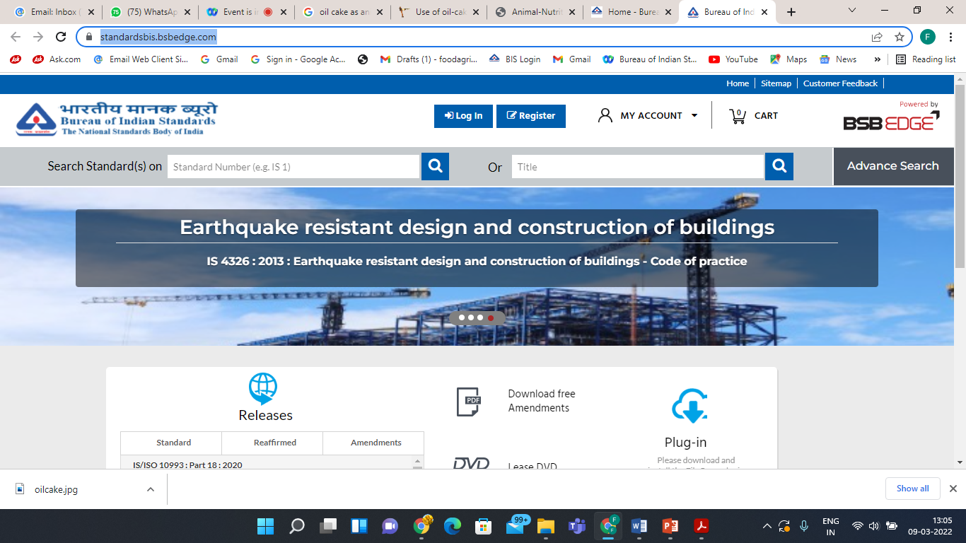
Download Indian Standards
Indian Standards are available free of cost at https://standardsbis.bsbedge.com/

Slide 44

THANK YOU

