Slide 1
International Participation

Slide 2
ISO
Overview: The International Organization for Standardization (ISO) is a global, non-governmental organization dedicated to developing and publishing international standards.
Founded in 1947, 25 founding member countries
Aim: Develop and publish international standards

Slide 3
ISO Membership
Current Membership: 172 national standardization bodies
Bureau of Indian Standards (India) is key member
Categories of Membership:
Member Bodies
Correspondent Members
Subscriber Members
International Organizations
Liaison Organizations

Slide 4
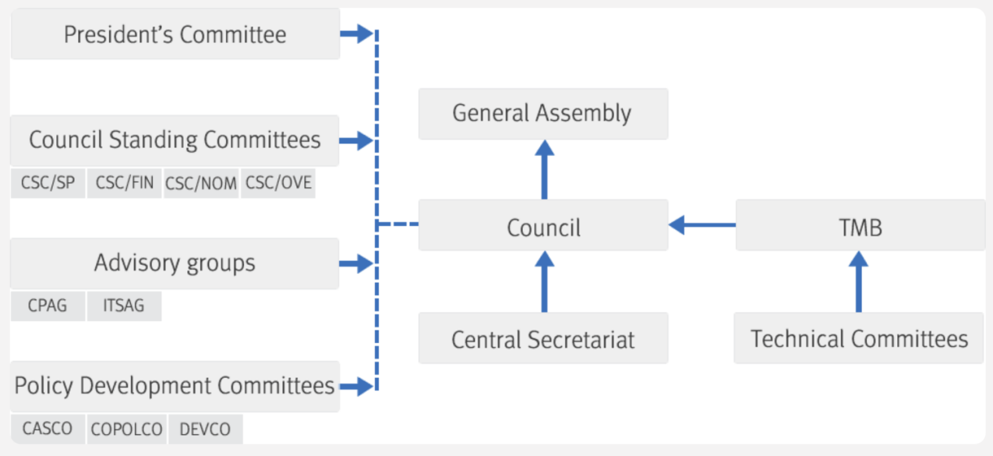
Structure of ISO
General Assembly: Ultimate authority
ISO Council: Core governance body
Technical Management Board (TMB): Oversees technical work

Slide 5
ISO Deliverables
Types of ISO publications:
International Standards
Technical Specifications
Technical Reports
Publicly Available Specifications
International Workshop Agreements (IWA)
Guides

Slide 6
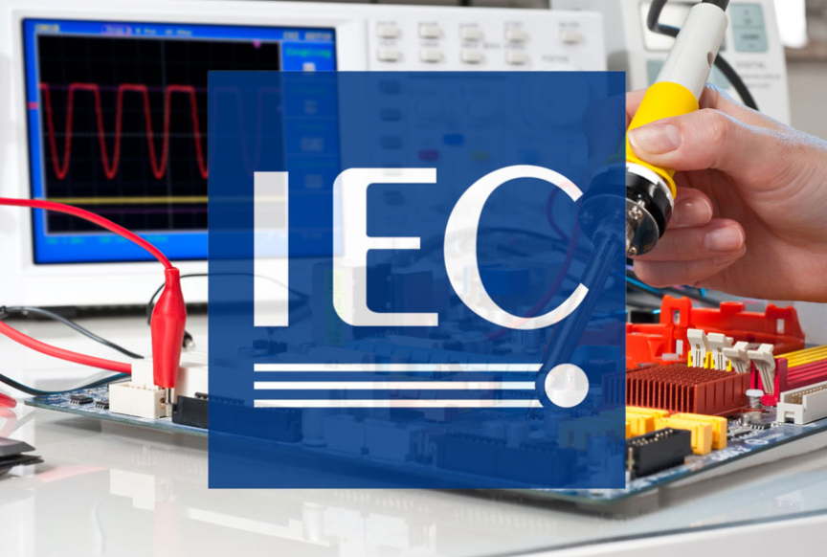
IEC
Overview: International Electrotechnical Commission (IEC) is a global organization that develops and publishes international standards for electrical, electronic, and related technologies. IEC's primary mission is to ensure that these technologies are safe, reliable, and efficient, and that they facilitate international trade and interoperability.
Founded in 1906

Slide 7
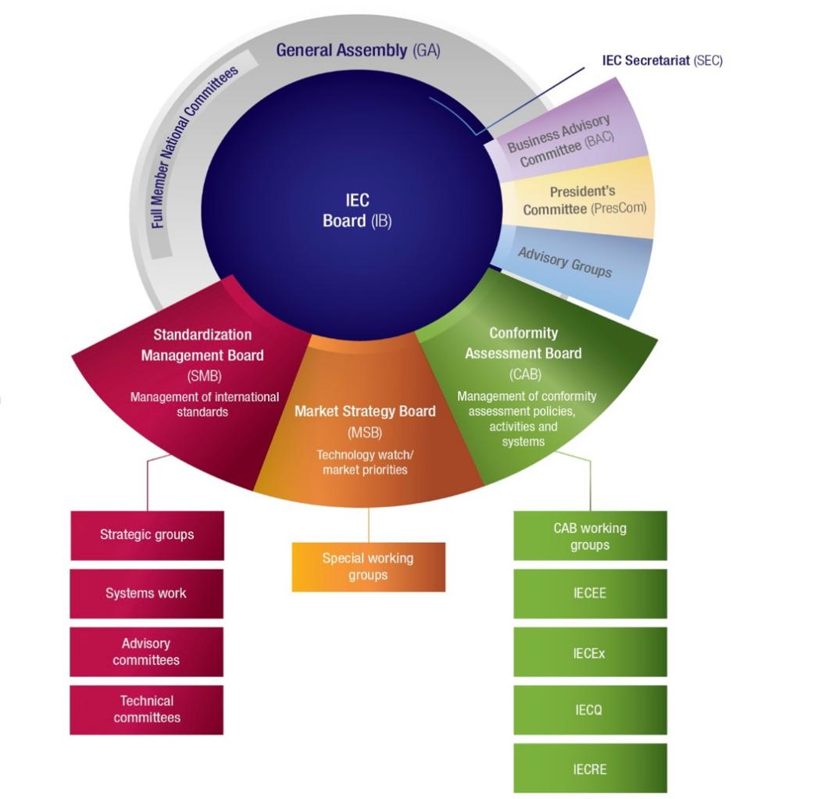
IEC Management Structure
General Assembly (GA): Supreme governing body
IEC Board (IB): Core executive body
Standardization Management Board (SMB): Manages standards work

Slide 8
ITU
Overview: International Telecommunication Union (ITU) responsible for issues related to information and communication technologies (ICT). ITU plays a crucial role in global telecommunication standardization, promoting international cooperation, and ensuring the efficient use of the world's telecommunication resources.
Member representation: Department of Telecommunication, Government of India

Slide 9
Regional Standardization Bodies
Pacific Area Standards Congress (PASC):PASC is a voluntary organization of 25 Pacific Rim National Standards Bodies, established to enhance regional participation in international standardization for economic, societal, and environmental advancement.
Founded in 1972, PASC supports the Asia-Pacific region's international engagement, essential for trade, technology, and market access
Focus on communication, capacity building, trade facilitation, and policy governance

Slide 10
SARSO
South Asian Regional Standards Organization (SARSO)
Established in 2011, operational in 2014, based in Dhaka, Bangladesh.
Goal: Coordinate and harmonize standards across South Asia
Members: 8 SAARC countries (Afghanistan, Bangladesh, Bhutan, India, Maldives, Nepal, Pakistan, Sri Lanka)
The six STCs are, STC 01: Food and Agricultural Products, STC 02: Electrical, Electronics, Telecom & IT, STC 03: Building Materials, STC 04: Jute, Textile and Leather, STC 05: Chemicals and Chemical Products, STC 06: Conformity Assessment

Slide 11
Participation in ISO/IEC Level Standardization

Slide 12
Introduction
National Standards Body: Bureau of Indian Standards (BIS)
Representation in ISO and IEC
Membership Types:
Participating Member (P-member)-Active involvement in committees
Observer Member (O-member)-Limited participation

Slide 13
Why Participation in ISO & IEC is Important?
Importance of Participation
Influence on international standards
Leadership Positions
Importance of harmonizing standards
Strategic Considerations
Focus on areas of trade and technology
Addressing national requirements
Enhancing global competitiveness for Indian industries
Benefits for Indian stakeholders
Critical role of Indian experts in Working Groups
Identifying sectors for leadership
Leveraging India's influence on global standards

Slide 14
Priority Areas of Participation &Proposing New Work Items
BIS Sectional Committees to identify priority areas
Ensuring continuity in expert participation
Grab opportunities to propose new standardization areas
Establishing new technical committees
Claiming secretariats of relevant committee

Slide 15
Proposal for a New Field of Technical Activity
ISO Form 1 Requirements
Justification for the new field
Precise definition of scope- Specific area of concern, avoid redundancy with existing activities
Avoid general aims and principles

Slide 16
Proposal for a New Work Item (NWIP)
ISO Form 4 Requirements
Scope definition
Justification for societal need
Identification of supporting Sustainable Development Goals (SDGs)
Essential Elements of NWIP
Stakeholder Identification
Who will be impacted?
Importance of engagement
Project Leadership
Role of project leader in initiating work

Slide 17
Acquiring ISO Secretariat
Overview
Allocation to national bodies/national committees
Criteria for participation: a) has indicated its intention to participate actively in the work of that Technical Committee b) has accepted that it will fulfill its responsibilities as secretariat and is in a position to ensure that adequate resources are available for secretariat work. Once the secretariat of a Technical Committee or has been allocated by ISO to the national body/national committee.
Secretariat Responsibilities
Launching CIB ballots
Preparing meeting agendas and documents
Recording discussions and decisions
Maintaining timelines for projects

Slide 18
Processing of ISO/IEC Draft Standards
Project Stages of ISO/IEC Standards
Preliminary Stage (PWI)
Proposal Stage (NP)
Enquiry Stage (DIS/CDV)
Preparatory Stage (WD)
Committee Stage (CD)
Approval Stage (FDIS)
Publication Stage (ISO, IEC, or ISO/IEC)

Slide 19
Processing of ISO/IEC Draft Standards
Voting Process
Participants: P-members and O-members
Expectation: Examination of documents in light of national work and trade interests
Constitution of Special Panels
Purpose: Consultation on ISO/IEC draft documents and questions submitted for voting
Procedure: Circulation of relevant documents
Inclusion of experts/stakeholders

Slide 20
Processing of ISO/IEC Draft Standards
Voting on New Work Item Proposals
Recommendation: Nominate experts for participation in standard development
Analysis of Comments
Types of Observations:
Approval of the document
Approval with comments
Disapproval with reasons
Abstention from voting

Slide 21
Processing of ISO/IEC Draft Standards
Ballot Process
Analyze and edit comments
Approval from the Chairperson of the Sectional Committee (NMC)
Responsibility of the Head of Department to cast the ballot
Ensure timely voting for Technical Committees

Slide 22
Participation in ISO/IEC Meetings
General Expectations
Active involvement in Working Groups/Task Forces.
Individual contributions while reporting to the NMC
Importance of influencing international standards early on.

Slide 23
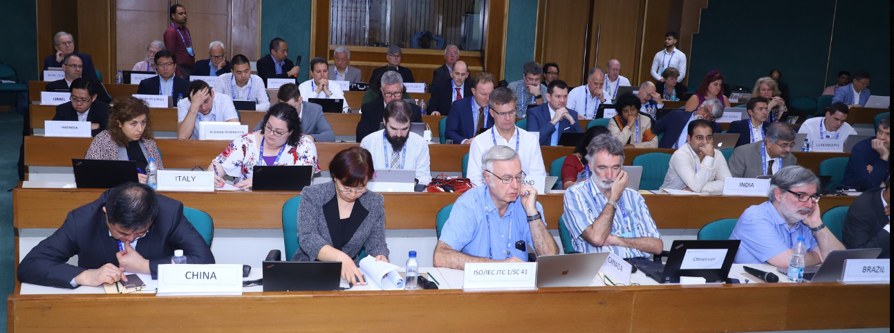
Participation in ISO/IEC Meetings
Nominating Experts in Working Groups
Key considerations:
Knowledge and Expertise
Willingness and commitment to devote ample time for such purpose
Organizational support-to provide necessary resources for the same

Slide 24
Participation in ISO/IEC Meetings
Selecting Delegates for ISO/IEC Meetings
Criteria for delegate selection:
Familiarity with the subject matter.
Understanding of meeting procedures.
Technical knowledge and experience.
Ability to represent Indian viewpoints.
Willingness to adhere to agreed briefs.

Slide 25
Participation in ISO/IEC Meetings
Briefing and Debriefing Meetings
Briefing of and debriefing by the experts nominated to the meetings of ISO or IEC is compulsory
This will ensure that our experts are fully prepared to represent the country’s interest.
Helps in effective representation of India's interests.

Slide 26
Participation in ISO/IEC Meetings
Key Discussion Items for Briefing and Debriefing Meetings
Expected contributions of the Indian delegation
Identification of subsequent issues.
Action points and important decisions.
Emphasis on the Indian viewpoint.

Slide 27
WTO Good Practices of Standardization (45)
1
Transparency
Ensuring easy access to information on standards development and providing opportunities for public comments.
2
Openness
Enabling non-discriminatory participation in the standards development process by all interested parties.
Impartiality and Consensus
3
Ensuring that the standards development process is impartial and based on consensus-building.

Slide 28
WTO Good Practices (46) (cont.)
4
Effectiveness and Relevance
Ensuring that standards are relevant, responsive to market needs, and do not create unnecessary trade barriers.
5
Coherence
Promoting coordination and cooperation among international standardizing bodies to avoid duplication and conflicts.
6
Development Dimension
Considering the constraints of developing countries and facilitating their participation in the standards development process.

Slide 29
Sustainability Framework for Standardization
This framework outlines how standards can be developed to address the three pillars of sustainability: environmental, social, and economic. It provides guidance on incorporating sustainability considerations into the standards development process.

Slide 30
What is Sustainability?
Environmental
Preserving natural environments and resources.
Social
Promoting equity, health, safety, and human rights.
Economic
Managing resources and growth responsibly.

Slide 31
Why Address Sustainability?
1
Environmental Impact
Mitigate issues like climate change, pollution, and biodiversity loss.
2
Resource Scarcity
Manage essential resources like water, land, and energy efficiently.
3
Economic Stability
Promote innovation, efficiency, and resilience in industries.
4
Global Responsibility
Address international challenges through collective action.

Slide 32
ISO Guidelines for Sustainability
ISO Guide 82
Provides guidance on addressing sustainability in standards development.
ISO Guide 84
Outlines a framework for addressing climate change in standards.
Key Approaches
Systemic, precautionary, life cycle, risk-based, and stakeholder-focused.

Slide 33
Consultative Groups on Sustainability
Chemical Sector
Experts advising on sustainability in chemical standards.
Civil Engineering & Water
Experts advising on sustainability in construction and water standards.
Electrotechnical & IT
Experts advising on sustainability in electronics and IT standards.
Food & Agriculture
Experts advising on sustainability in food and agriculture standards.

Slide 34
Addressing Sustainability in Standards
1
Horizontal Standards
Develop standards for sustainable materials, manufacturing, packaging, and waste management.
2
Life Cycle Analysis
Assess environmental impact across the entire product/process lifecycle.
3
Health & Safety
Address worker conditions and product/process safety considerations.

Slide 35
Sustainable Practices in Standards
Sustainable Varieties
Include sustainable product/process options that match conventional performance.
Recycled Materials
Specify the use of recycled materials in technical requirements.
Sustainable Testing
Prescribe eco-friendly test methods wherever possible.

Slide 36
Phased Approach
High Impact First
Address standards with the greatest sustainability impact in the first phase.
Medium & Low Next
Address standards with medium and low sustainability impact in subsequent phases.
Ongoing Process
Continuously review and update standards to address evolving sustainability needs.

Slide 37
Stakeholder Engagement
Collaborative Approach
Iterative Process
Engage a wide range of stakeholders to ensure standards address their needs.
Incorporate stakeholder feedback throughout the standards development lifecycle.

Slide 38
Conclusion
1
Comprehensive Framework
This framework provides a holistic approach to addressing sustainability in standards.
2
Collaborative Effort
Successful implementation requires the engagement of diverse stakeholders.
3
Continuous Improvement
Standards must evolve to keep pace with changing sustainability needs.

