Slide 2
Introduction to Conformity Assessment
Conformity Assessment: Conformity assessment is a process that verifies an object or entity (e.g. product, process, system or service etc. meets the requirements of a standard or specification. These requirements can include performance, safety, efficiency, effectiveness, reliability, durability, and environmental impact.
Certification: A third-party attestation where an independent organization assesses and verifies that a product, process, or service meets specified standards or requirements.

Slide 3
Key Pillars for Certification
Impartiality: objective assessment without bias
Independence: Certification body operates without external control
Confidentiality: Protection of client information during the assessment

Slide 4
BIS Conformity Assessment Legal Framework
Bureau of Indian Standards Act, 2016: Provides the statutory framework for BIS, replacing the Bureau of Indian Standards Act, 1986. It aims to establish and promote standardization, marking, and quality certification of goods and services.
Bureau of Indian Standards (Conformity Assessment) Regulations, 2018: Provides detailed procedures for the certification process. They cover the application process, assessment procedures, marking and labelling requirements, and conditions for the grant of licences and certificates.
Bureau of Indian Standards Rules, 2018: Provides a broader framework for the functioning of BIS, including governance, financial management, and administrative procedures.

Slide 5
Key Provisions of BIS Act, 2016
Section 12: Certification for goods and services.
Section 13: Granting of licenses/certificates.
Sections 16 & 17: Mandatory compliance and protection measures.
Section 29 (3): Penalties for non-compliance.

Slide 6
Overview of BIS Conformity Assessment Schemes
Scheme | Scope of the Scheme | Based on
I | Grant of licence to use or apply Standard Mark on products as per Indian Standard | Type 4 - ISO/IEC 17067 : 2013
II | Grant of licence to use or apply Standard Mark through registration based on self-declaration of conformity for goods and articles as per Indian Standard | Type 2 - ISO/IEC 17067 : 2013
III | Grant of licence or certificate of conformity for management systems as per Indian standard | ISO/IEC 17021 documents
IV | Grant of CoC for goods and articles as per any standard | Type 4 - ISO/IEC 17067 : 2013
V | Grant of CoC for a batch or lot of products as per any standard | Type 1b - ISO/IEC 17067 : 2013

Slide 7
Overview of BIS Conformity Assessment Schemes
Scheme | Scope of the Scheme | Based on
VI | Grant of CoC for services as per any standard | IS/ISO/IEC TR 17026 : 2015
VII | Grant of CoC for type approval of products as per any standard | Type 1a - ISO/IEC 17067 : 2013
VIII | Grant of licence or CoC for process as per any standard/requirements | IS/ISO/IEC TR 17032 : 2019
IX | Grant of licence for products + system as per Indian Standard and applicable process requirements | Type 5 - ISO/IEC 17067 : 2013
X | Grant of licence or CoC for products as per specified requirements, given in applicable Standards and essential requirements | Technical file evaluation

Slide 8
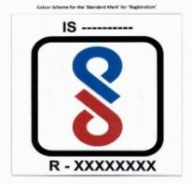
BIS Conformity assessment Schemes for Product Certification
BIS Conformity Assessment Scheme-I: certification to manufacturers for use of Standard Mark (ISI mark)
BIS Conformity Assessment Scheme-II: Compulsory Registration Scheme (CRS). Registration is based on self-declaration of conformity for goods or articles to all the requirements of the relevant Indian Standard

Slide 9
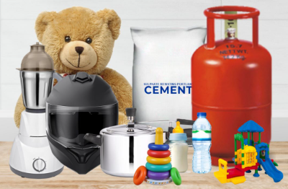
BIS Conformity assessment Schemes for Product Certification
BIS Conformity Assessment Scheme-IV: Certification for specified requirements given in standard or part of standard or essential requirements as applicable and need not be complete requirements of relevant Indian Standard.
BIS Conformity Assessment Scheme-X: Certification of diverse nature of machinery and related components/equipment for conformity to applicable specified requirements contained in the Standard.

Slide 10
Hallmarking Scheme
Background
Difficulty in detecting gold adulteration.
Complexities of Indian jewellery (high cartage, soldered joints).
Consumer vulnerability to unscrupulous traders.
Government Response
Action by Government of India for consumer protection.
RBI Standing Committee on Gold and Precious Metals mandated to standardize gold products.
BIS identified as the sole agency for the Hallmarking Scheme.

Slide 11
Hallmarking Scheme
What is Hallmarking?
Hallmarking is the accurate determination and official recording of the proportionate content of precious metal in the jewellery/artefacts or bullion/coins.
Who can do Hallmarking?
BIS recognized Assaying & Hallmarking (A&H) centre. The recognition is granted to A&H centres for hallmarking of jewellery/artefacts after verifying the infrastructure requirements, capability and competency of personnel to carry out assaying & hallmarking as per Indian Standard IS 15820:2009.

Slide 12
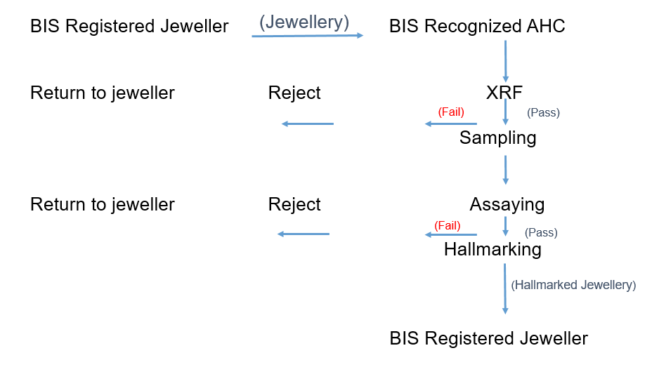
Assaying and Hallmarking Procedure
.

Slide 13
Mandatory Hallmarking Order
Implementation in 256 districts (June 2021)
Expansion to 288 districts (June 2022)
Current status: Extended to 343 districts (September 2023)

Slide 14
Management Systems Certification
Introduction
Operating since 1991
Initially focused on Quality Management System (IS/ISO 9001)
Expanded to various sectors as per BIS regulations

Slide 15
Management Systems Certification
Quality Management System (QMS) IS/ISO 9001:2015 - It results in improved output through continual improvement, better management control and reporting
Environmental Management System (EMS) IS/ISO 14001:2015 - Environmental management systems —it aims to reduce environmental pollution, conserve resources and energy and preserve biodiversity.
Food Safety Management System (FSMS) IS/ISO 22000:2018 - Facilitates identification and control food safety hazards and reduces risk of food safety incidents.
Energy Management System (EnMS) IS/ISO 50001:2018 - Facilitates identification of significant energy users, implementation of effective load management system, conservation of energy and reduction of impact on environment.

Slide 16
Management Systems Certification
Occupational Health & Safety Management System (OHSMS) IS/ISO 45001:2018 - Helps to protect employees and working environment by facilitating identification and mitigation of potential hazards and risks involved.
Service Quality Management System (SQMS) IS 15700:2018- Enables public service organizations to achieve Sevottam requirements, implement an effective complaints handing mechanism and deliver services effectively and efficiently to customers, thereby improving customer satisfaction.
Hazard Analysis and Critical Control Point (HACCP) IS 15000:2013- Assists in the determination of critical control points in the process to control and reduce significant food hazards and ensure food safety.
Medical Devices Management System (MDMS) IS/ISO 13485:2016 - Enables organizations to demonstrate their ability to provide medical devices and related services that consistently meet customer and applicable regulatory requirements.

Slide 17
Management Systems Certification
Medical Devices Safety and Performance Management System (MDSPMS) IS 23485:2019 - This system combines the regulatory requirement aspects of IS/ISO 13485
Social Accountability at Workplace (SAMS) IS 16001:2012 - Implementation of this system would promote good practices at the workplace
Road Traffic Safety Management System (RTSMS) IS/ISO 39001:2012 - Enables an organization that interacts with the road traffic system
Adventure Tourism Safety Management System (ATSMS) IS 21101:2014 - Enables an adventure tourism activity provider to ensure safety of both participants and staff.
Ready-Mixed Concrete Process Certification IS 4926:2003 - Under this scheme, RMC plants are certified against the process requirements prescribed in IS 4926

Slide 18
Management Systems Certification
Ready-Mixed Concrete Certification Scheme IS/ISO 9001:2015- This scheme combines the principles of both IS/ISO 9001 and IS 4926 for a comprehensive coverage of ready-mixed concrete.
Educational Organizations Management System (EOMS) IS/ISO 21001:2018 - Provides a specific framework for educational organizations that aim to enhance the satisfaction of their learners by improving the educational processes and ensuring conformity to learners’ requirements.
Anti-Bribery Management System (ABMS) IS/ISO 37001:2016- ABMS facilitates raising awareness among employees and stakeholders regarding bribery and enhances aptitude for the prevention of corruption within the organization.
Information Security Management System (ISMS) IS/ISO/IEC 27001:2022- Information Security Management Systems. This system supports monitoring, reviewing, maintaining and improving an organisation’s information security management system.

Slide 19
Management Systems Certification
Piped Drinking Water Supply Management System (PDWSMS) IS 17482: 2020- It addresses the requirements and responsibilities of the supplier regarding processes involved in the procurement of raw water, its treatment and distribution, the quality of the water provided and guidelines on how to ensure the same, as well as the requirements/responsibilities of the management.
Conformity Assessment Scheme for Milk & Milk Products (CAS MMP)- This scheme integrates product certification, management system certification and process requirements with the objective of giving a holistic approach to quality ecosystem in the dairy and milk production sector envisaging to fulfil regulatory, product, and system requirements.

Slide 20
Quality Control Orders (QCOs)
What is Quality Control Order?
The Central Government, after consulting BIS, publishes Quality Control Orders in exercise of the powers conferred by the BIS Act, 2016 for bringing the products under BIS Mandatory Certification.
Role of the Bureau of Indian Standards (BIS)
Interacts with Line Ministries/ Departments
Participates in stakeholder’s consultation meeting.
Acts as the Certification Authority and grants Licence or CoC to manufacturers
Acts as the Enforcement Authority for the products specified in the QCO.

Slide 21
Important products covered under compulsory certification (QCOs)
Consumer Products
LPG Cylinder, Valves & Regulators, LPG Gas Stoves, Domestic Pressure Cooker, Helmet (Two Wheeler), Rubber hose for LPG, Aluminium Foil for food packaging, Plain Copier Paper, Safety Glass (Architectural, Building and General uses) & Safety Glass (Road Transport), LPG Water Heater, Cookware and Utensils, Kitchen Sinks, Portable Fire Extinguishers, Plywood and Wooden flush door shutters, Utility Lighters
Food Products
Milk Powder, Complimentary Food, Condensed Milk, Packaged Drinking Water & Natural Mineral Water
Feeding Bottles
Plastic & Glass Feeding Bottles

Slide 22
Important products covered under compulsory certification (QCOs)
Automobile Accessories
Pneumatic tyres for two and three-wheeled motor vehicles, Tubes for pneumatic tyres
Cements
PPC, OPC, White Cement & Composite Cement
Thermometer
Clinical Thermometer
Products for safety of children
Toys (Electric & Non Electric)
Electrical Products
Domestic Electric Food Mixer, Hand-held Blender, Plug & Socket, PVC Cable, Capacitors, Switches, Low Voltage Switchgears

Slide 23
Important products covered under compulsory certification (QCOs)
Electronic Products
Mobile Phone, Laptops/Notebook/Tablets, LCD/LED TVs, Power adapter, LED Hand lamps, LED Flood Lights, LED Lighting Chains, LED Luminaries, CCTV Cameras, Rice Cooker, Bluetooth Speakers, Wireless Microphone, Smart Watches, Barcode Readers, Copying Machine, Point of Sale Terminals, Set Top Box, Printers, Scanners, Microwave Oven, Webcams, Digital Television Receiver for Satellite Broadcast Transmission
Steel Products
Structural Steels, HSD Bars, Stainless Steel Wire, Rods, Bars & Flats, Steel Tubes
Chemicals & Petrochemcials
Caustic Soda, Boric Acid, Poly Aluminium Chloride, Hydrogen Peroxide
Textile Products
Agro Textiles, Medical Textiles, Protective Textiles, Geo Textiles, Jute Bags, HDPE Bags

Slide 24
Important products covered under compulsory certification (QCOs)
Household Electrical Appliances
Air Conditioners & Hermetic Compressors, Refrigerators, Freezers
Footwear Sector
Rubber and Polymeric Footwear like Rubber Gum Boots, Ankle Boots, PVC Sandal, Rubber Hawai Chappal, Slipper, Rubber Sole & Heels, PVC Soles & Heels, PVC Industrial Boots, Moulded Plastic Footwear, footwear for municipal scavenging work.
Leather and Other Material Footwear like Canvas Shoes & Boots, Leather Safety Shoes & Boots, Sports Footwear, High Ankle Tactical Boots, Antiriot Shoes, Derby Shoes.
Mobility Sector
Retro-reflective Devices for fixing in Bicycle to ensure safety of riders Wheel Rims for two & three wheeled vehicles, Passenger Cars

Slide 25
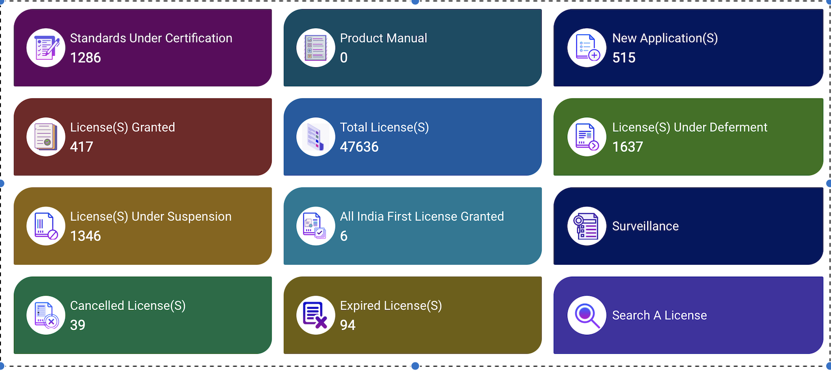
Digital Platforms
Accessing BIS Certification Portal
· e-BIS Portal (www.manakonline.in) >“Conformity Assessment”

Slide 26
Digital Platforms
Accessing BIS Hallmarking Portal
· e-BIS Portal (www.manakonline.in) >“Hallmarking”

Slide 27
Laboratory Operations

Slide 28
About BIS Labs
8 BIS laboratories established across India to support conformity assessment schemes
Regular testing of products for checking conformity to the relevant Indian Standards
Domains include Chemical testing, Microbiological testing, Electrical testing, Mechanical testing

Slide 29
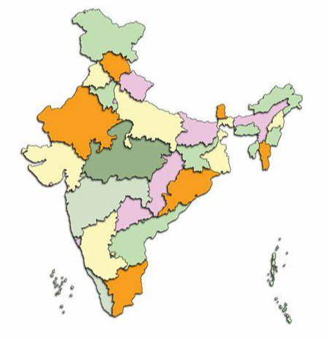
About BIS Labs
Central Laboratory (Sahibabad)
Eastern Regional Laboratory (Kolkata)
Northern Regional Laboratory (Mohali)
Western Regional Laboratory (Mumbai)
Southern Regional Laboratory (Chennai)
Branch Laboratories in Bengaluru, Patna, and Guwahati
Satellite Laboratories in Hyderabad, and Jammu

Slide 30
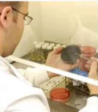
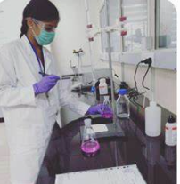
Types of Testing and Services
Chemical Testing: Analysing the chemical composition of materials
Microbiological Testing: Testing for microbial contamination in products
Electrical Testing: Ensuring the safety and performance of electrical products
Mechanical Testing: Assessing the mechanical properties and durability of products
Testing facilities for gold and silver jewellery

Slide 31
Laboratory Recognition Scheme (LRS)
Objective: Utilize testing infrastructure in public and private sectors.
Goal: Ensure wide availability of laboratories across India and abroad.
Importance: Supports the Product Certification Scheme.
Based on: ISO/IEC 17025
Current Status:
Recognized: 332 laboratories.
Empanelled: 269 laboratories.

Slide 32
Laboratory Recognition Scheme (LRS)
BIS own laboratories
1 Central Lab
4 Regional Labs
BIS Recognized OSLs
332 OSLs
250 Private Labs
Goverment Laboratories empanelled by BIS
269 Government Labs
3 Branch Labs
2 Satellite Labs
82 Government Labs
Laboratory Recognition Scheme

Slide 33
Types of Recognized Laboratories
Categories of Laboratories:
Third party commercial testing laboratories
Laboratories of associations
Educational institute laboratories
Manufacturer’s laboratories.
Government organization laboratories

Slide 34
Types of Recognized Laboratories
Empanelled Laboratories:
Purpose: Specialized testing facilities for conformity assessment
CSIR Laboratories
DRDO Laboratories
IIT Laboratories
Textile Associations
ICAR Laboratories

Slide 35
Role of Laboratories in BIS Certification Scheme
Testing and Analysis
• Laboratories conduct detailed testing and analysis of products to ensure they meet the specified standards set by BIS.
• Tests may include physical, chemical, mechanical, and performance assessments depending on the product category.
• The results from these tests help in determining whether a product conforms to the relevant BIS standards.

Slide 36
Role of Laboratories in BIS Certification Scheme
Certification Support
• Laboratories support the certification process by providing reliable test results.
• They perform the testing required for initial certification for applicant samples, as well as ongoing surveillance and periodic testing of samples drawn from both factory as well as from market for operative licences to check for consistency with BIS standards.
• Accurate and consistent test results are essential for granting and maintaining BIS certification. Continuous monitoring helps in maintaining the integrity of the BIS certification scheme and ensuring that products remain compliant over time.

Slide 37
Role of Laboratories in BIS Certification Scheme
Handling Complaints and Disputes
• Laboratories may be involved in handling complaints or disputes related to product testing and certification.
• They may perform additional tests or re-evaluations if there are concerns about the accuracy of previous results.
• Resolving disputes ensures fairness and accuracy in the certification process.

Slide 38
Role of Laboratories in BIS Certification Scheme
Impartiality
Laboratory activities shall be undertaken impartially and structured and managed so as to safeguard impartiality.
The laboratory management shall be committed to impartiality.
The laboratory shall be responsible for the impartiality of its laboratory activities and shall not allow commercial, financial or other pressures to compromise impartiality.
The laboratory shall identify risks to its impartiality on an on-going basis. If a risk to impartiality is identified, the laboratory shall be able to demonstrate how it eliminates or minimizes such risk.

Slide 39
Role of Laboratories in BIS Certification Scheme
Procedural Integration of laboratories in BIS Certification
Application Submission: Manufacturers apply for BIS certification, which includes submitting samples for testing.
Testing: Laboratories perform the required tests on submitted samples to evaluate compliance with BIS standards.
Reporting: Laboratories provide detailed test reports to BIS, which are used to make certification decisions.
Certification Decision: BIS reviews the test results and decides on granting or renewing certification.
Surveillance: Laboratories conduct testing of samples drawn during periodic inspections by BIS to ensure ongoing compliance with BIS standards.

