Slide 1
Basic Concepts of Standardization
SD

Slide 2
Why Standardization?
Standardization is the foundation of modern civilization, ensuring consistency, reliability, and quality across products, services and processes.
It enables global coordination, facilitates trade, and drives
technological innovation.
SD

Slide 3
What is a Standard?
ISO Definition
BIS Act, 2016
Purpose of Standards
A standard is a document that provides rules, guidelines, or characteristics for activities or their results, aimed at the achievement of the optimum degree of order.
Standards are documented agreements containing technical specifications or criteria to ensure that goods, services, and systems are fit for purpose.
Standards facilitate coordination, cooperation, and technological development, influencing every aspect of modern life.

Slide 4
Types of Standards
Basic Standards
Product Specifications
Sampling and Inspection
These include standards on nomenclature, terminology, graphic symbols, system of units, preferred numbers etc. Few examples of basic standards are; Fire Fighting Equipment - Glossary of Terms, IS 2 : 2022 Rules for rounding off numerical values etc.
Comprehensive requirements for materials, products, and their production, processing, and use. Few examples of product standards are IS 1: 1968 Specification for the national flag of India (cotton khadi), IS 4246 : 2002 Domestic gas stoves for use with liquefied petroleum gases
Standardized protocols for sampling and inspecting goods to ensure consistent quality. Examples are IS 10572 : 1983 Methods of sampling for pumps, IS 9040 : 1978 Methods for sampling of utensils etc.

Slide 5
Types of Standards (cont.)
Test and Analysis
Grading and Classification
Codes of Practice
Standardized methods for testing and analyzing products to ensure reproducible and comparable results like IS 17004 : 2018 Testing methods for processed glass, IS 6931 : 2023 Printing Inks Methods of Test etc.
Standards that define grades, classes, and criteria for categorizing products, processes, and services. Examples are IS 2275 : 1984 Grades of platinum, IS 13622 : 1993 Indian Timbers for Furnitures and Cabinets- Classification, IS 13834 (Part 1) : 2018 Cranes - Classification Part 1 general etc.
Deals with a wide front of a technological activity and help regulate it in the interest of safety and efficiency, and expedite decisions like IS 10947 : 1984 Code of practice for lighting for ports and harbours,

Slide 6
Types of Standards (cont.)
Management System Standards
Service Standards
Support governance and leadership functions to help organizations achieve their objectives, such as quality, efficiency, and environmental performance (e.g. IS/ISO 9001 : 2015 Quality management systems, IS/ISO 14001: 2015 Environmental management systems)
Specify requirements to ensure the fitness for purpose of services, such as in the financial, tourism, and healthcare sectors like IS 15256: 2024 Financial services – Key management retail.

Slide 7
Importance of Standardization
1
For Industry
Enhances quality, efficiency, and interoperability; facilitates trade and market access; and provides ready-made solutions.
2
For Consumers
Ensures safer, healthier, and more reliable products and services at competitive prices.
3
For Technologists
Catalyzes innovation, facilitates research and development, and enables comparable and reproducible results.
4
For Policymakers
Supports implementation of policies, reduces trade barriers, and contributes to overall economic development.

Slide 8
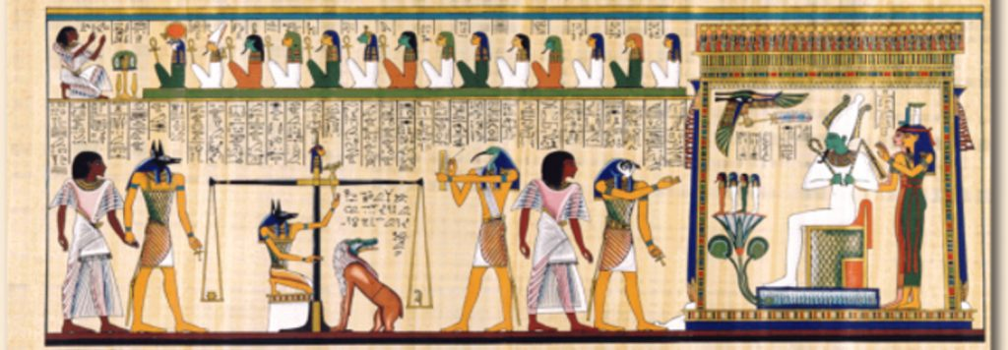
History of Standardization
Ancient Roots
Standardization principles observed in nature and early human civilizations, such as the Indus Valley's standardized weights and measures.
Industrial Revolution
The need for mass production and interchangeable parts drove the development of industry-wide and national standards.
Global Cooperation
The rise of international trade and globalization led to the establishment of international standardization organizations like IEC and ISO.

Slide 9
Standardization Today
Cornerstone of Civilization
Standardization is a fundamental aspect of modern society, enabling the smooth functioning of complex systems and facilitating trade and innovation.
Global Coordination
International standards promote global cooperation and ensure compatibility across borders, supporting the interconnected world of today.
Driving Innovation
Standards serve as a catalyst for technological development, providing a foundation for new ideas and solutions to emerge and thrive.

Slide 10
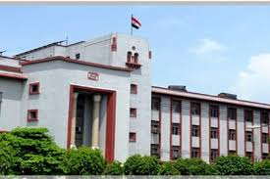
Standardization in India
India's national standards body, the Bureau of Indian Standards (BIS), plays a crucial role in developing and promoting standards across various sectors to support the country's economic and technological growth.
SD

Slide 11
BIS - The National Standards Body
Mandate
Stakeholder Participation
Consensus-based Approach
BIS is responsible for the development and implementation of standards for products, services, and systems in India.
BIS technical committees bring together stakeholders to develop standards that consider national interests and diverse viewpoints.
Decisions in BIS technical committees are reached through a process of consensus.

Slide 12
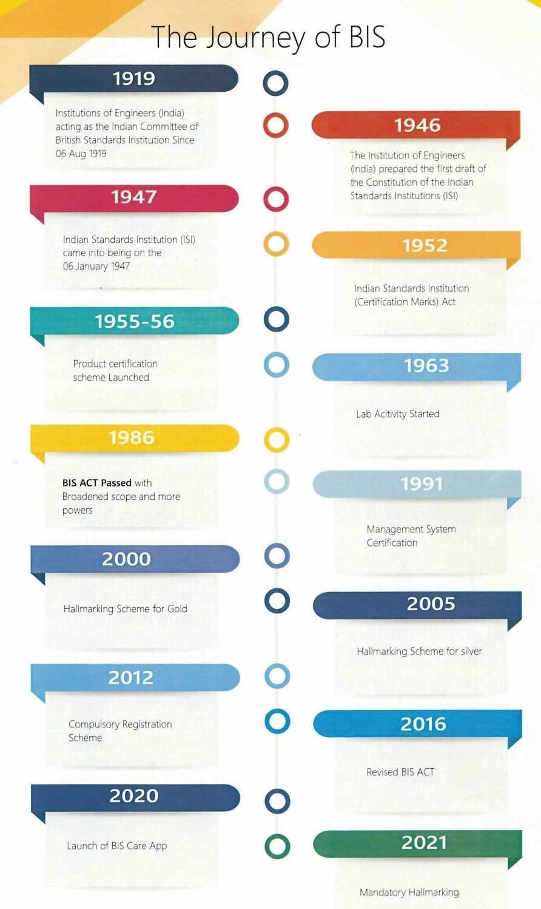
History and Legal Framework
1
1947
Establishment of the Indian Standards Institution (ISI), the predecessor to the Bureau of Indian Standards (BIS).
1986
2
The BIS Act of 1986 positions BIS as the National Standards Body for India.
3
2016
The BIS Act of 2016 further strengthens BIS's role and responsibilities as the National Standards Body.

Slide 13
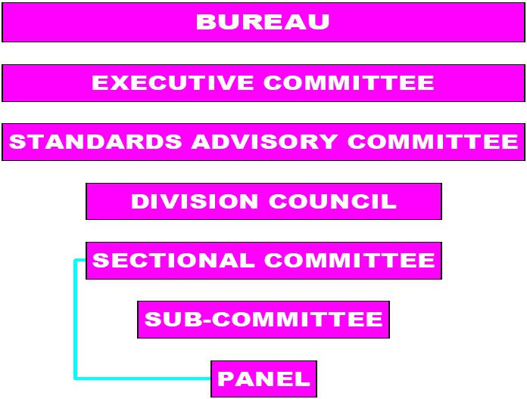
Governing Structure of BIS
1
Governing Council
Oversees the powers and duties of BIS as defined in the BIS Act of 2016.
2
Standards Advisory Committee
Advises on policy matters related to standards development and promotion.
3
Division Councils
Advise on the subject areas to be taken up for formulation of standards in their respective areas keeping in view the national needs and priorities
4
Sectional Committees
Responsible for the technical work of standards development and revision.

Slide 14
Functions of Division Council
Advise on the subject areas to be taken up for formulation of Indian Standards in their respective areas keeping in view the national needs and priorities;
Approve proposals for work and determine the priority to be assigned to the work;
Direct the sectional committees concerned to undertake the work of formulation of standards;
Advise on matters relating to research and development needed for the establishment of Indian Standards or their revisions
Study the work of international organisations and their committees in standards formulation related to the area of work of the Division Council and recommend on the extent and manner of participation in standardisation activities at the international level;
Advise on implementation of established standards and promotion of Indian Standards;
Receive and deal with activity reports and to make recommendations thereon to the Governing Council concerning matters in which the decision of the Governing Council is necessary.

Slide 15
Functions of Sectional Committees
Decide on the NWIPs and to assign their priorities
Take up the review/revision/amendments of the existing standards based on the latest technological advancements
Provide clarification on the technical issues relevant to POW of the committee
Constitute sub-committees/Panel/Working group and appoint their Conveners
Review the progress of work of sub-committees/Panel/Working group under its domain
Undertake any R & D work, technical study for establishment/ revision of standards
Deliberate on the NWIP/CD/DIS/FDIS drafts emanating from international/regional standardization bodies (ISO/IEC/SAARC)
Decide on the participation of Indian Delegation for participation in international/regional standardization meetings.
Decide on India’s point of view on different documents emanating from ISO/IEC/SAARC etc.

Slide 16
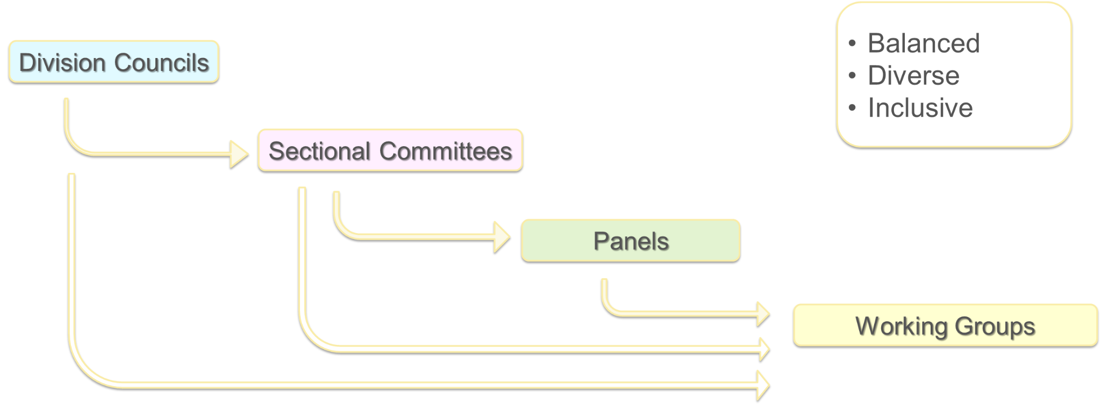
Standards development in BIS – Technical Committee Structure of BIS

Slide 17
Standardization areas/sectors of BIS

Slide 18
Standards Formulation Process
Identification
Identifying the need for new or revision of standards based on national priorities.
Development
Formulating standards through a consultative process involving stakeholders.
Notification
Indian Standards are notified and remain valid until withdrawn by BIS.

Slide 19
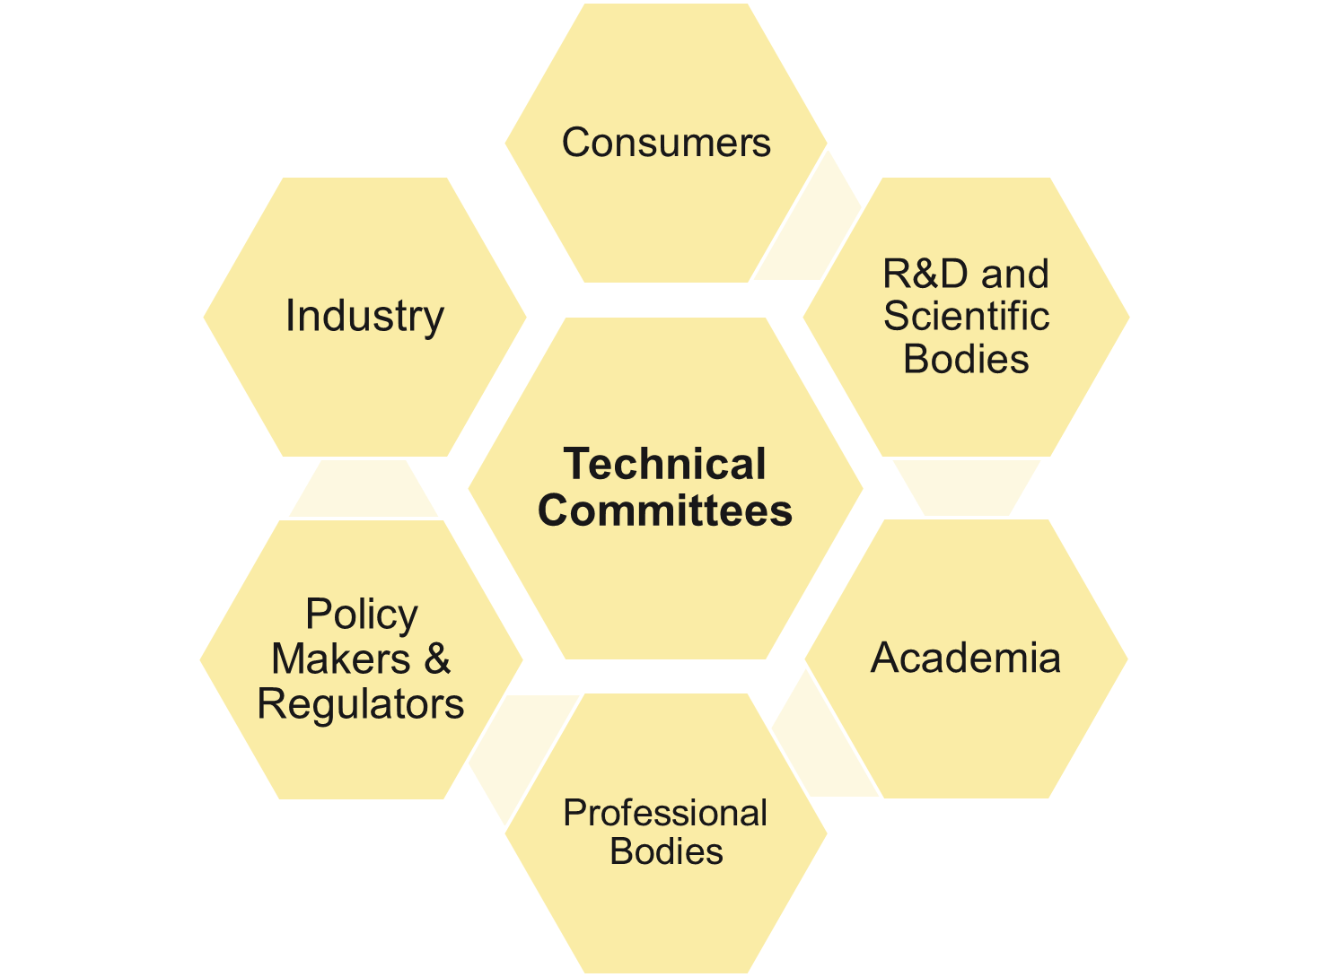
How are standards written?

Slide 20
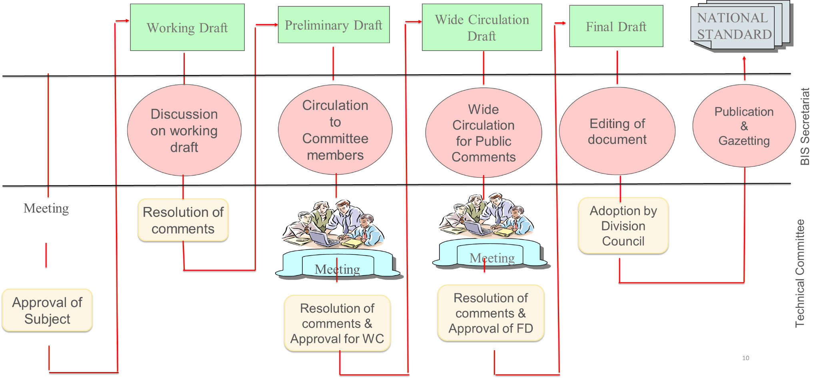
Standards Development Process of BIS

Slide 21
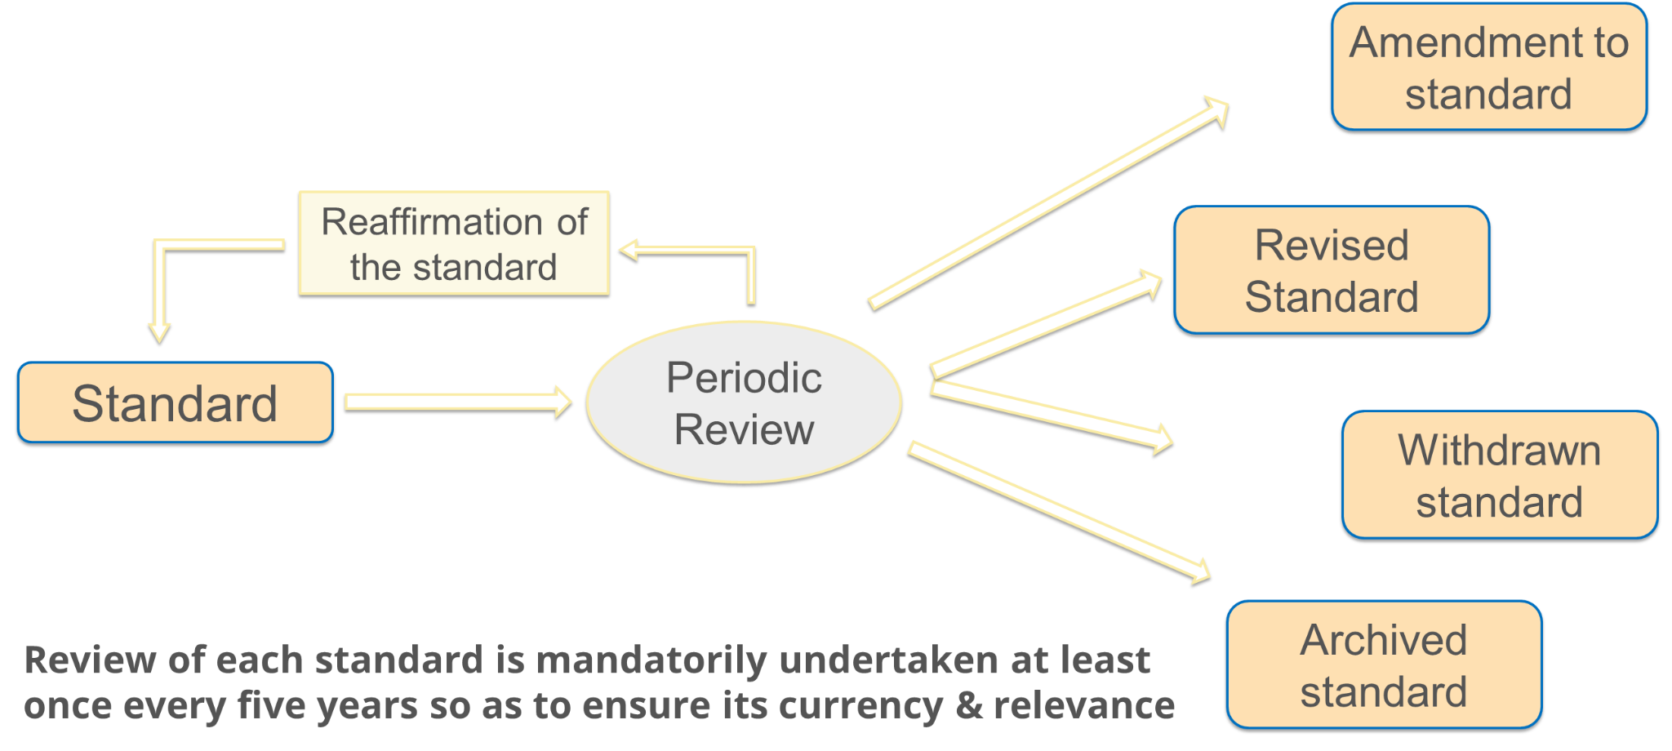
Life cycle of standards

Slide 22
Standard Formulation
Discover the key stages in the development and review of Indian Standards, from new work item proposals to final drafts and gazette notification.

Slide 23
New Work Item Proposal
Proposal Submission
Requests for new or revised standards can come from various stakeholders, including government, industry, and consumers.
Proposal Analysis
Proposals are evaluated based on factors like national priorities, economic and social impact, and sustainability.
Sectional Committee Review
The Sectional Committee decides whether to accept the proposal and set the priority and timeline.

Slide 24
Preliminary Drafts
1
Circulation
The preliminary draft is circulated to Sectional Committee members and relevant panels for comments.
2
In-depth Analysis
Members must provide detailed feedback to ensure the quality of the proposed standard.
3
Online Submission
Comments on drafts are submitted through the BIS Standardization Portal.

Slide 25
Wide Circulation Drafts
Stakeholder Engagement
Public Access
Online Comments
WC drafts are circulated to a wide range of stakeholders, including producers, users, and government agencies.
WC drafts are hosted on the BIS website for public comments, typically for 60 days.
Stakeholders can submit comments through the BIS Standardization Portal.

Slide 26
Final Drafts
1
Consensus-based Finalization
The Sectional Committee finalizes the draft standard based on consensus among members.
2
Decision in Meeting
The decision to finalize a standard is made during a Sectional Committee meeting.
3
Gazette Notification
The final standard is established by notification in the official gazette.

Slide 27
Standard Review Process
Evaluation
The Sectional Committee evaluates the standard's current status and technological developments.
Action Research
An in-depth review is conducted, involving research, stakeholder feedback, and expert analysis.
Decision
The Sectional Committee decides whether to reaffirm, revise, amend, or withdraw the standard.

Slide 28
Archiving Standards
Prioritize Review
Archiving helps Sectional Committees focus on more relevant standards.
Maintain Accessibility
Archived standards remain available, allowing stakeholders to request a review if needed.
Efficient Management
Archiving ensures the standards database remains up-to-date and relevant.

Slide 29
Action Research Projects
1
Comprehensive Review
Action research projects ensure a thorough, evidence-based review of standards.
2
Global Perspective
The review includes analysis of relevant international standards and latest technological developments.
3
Stakeholder Engagement
Feedback is sought from industry, laboratories, and other relevant stakeholders.

Slide 30
Assigning Action Research
Sectional Committee's Role
The Sectional Committee decides which individuals or organizations will conduct the action research.
Diverse Expertise
Action research can be assigned to committee members, experts, academic institutions, or industry associations.
Timely Submission
The action research report and proposed revisions are submitted to the Sectional Committee within a specified timeline.

Slide 31
Continuous Improvement
Responsive to Change
Collaborative Effort
Delivering Value
The standardization process adapts to technological advancements, stakeholder feedback, and evolving needs.
Sectional Committees, experts, and stakeholders work together to ensure standards remain relevant and effective.
The standardization process aims to develop high-quality standards that benefit industry, consumers, and society.

