Slide 1
Introduction to the concept of Artificial Intelligence systems – A standard’s perspective
Bureau of Indian Standards

Slide 2
AI System
engineered system that generates outputs such as content, forecasts, recommendations or decisions for a given set of human-defined objectives
the engineered system can use various techniques and approaches related to artificial intelligence to develop a model to represent data, knowledge, processes, etc. which can be used to conduct tasks
Source: IS/ISO/IEC 22989 : 2022
Notes:
artificial intelligence : capability of a functional unit to perform functions that are generally associated with human intelligence such as reasoning and learning

Slide 3
Where Does Intelligence Begin?
In order to call a system ‘AI system’ how much autonomy or intelligence is required?
Notes:
The intelligence is comparative .. If a 3 year old kid is good in arithmetic we call the kid smart or intelligent, but we don’t call a teenager with the same level arithmetic skill smart only because the teenager has arithmetic skills (47 +56 = ?)

Slide 4
Smart or Intelligent?
Refrigerators:
Refrigerators can learn users' habits, optimize temperature settings, and even suggest recipes based on available ingredients.
Washing Machines:
Washing machines can adjust wash cycles based on load size, fabric type, and water hardness. They learn from user preferences and optimize energy consumption
Security Cameras:
Advanced security cameras use computer vision and image recognition to detect and classify objects or people. They can send alerts for unusual activity, recognize familiar faces, and adapt to changing lighting conditions.
Cooking Ovens:
Ovens can recommend cooking times and temperatures based on the type of dish being prepared. They learn from user behavior and adjust settings for consistent results.
Voice Assistants:
Devices like Amazon Echo or Google Home understand voice commands, answer questions, and control other smart appliances in the home.
Notes:
It is difficult to identify the border line between the IoT systems and AI systems
Smart, and intelligence are terms used very commonly and loosely these days. The phrase “AI based” is not uncommon today. When somebody says, the system is AI based or its an AI system..
What is an AI system? Or how much intelligence is termed as AI? If the AC in my room automatically controls the temperature, can I call it intelligent? If the sensors placed in my garden automatically identifies the moisture level and supply water automatically, is it AI or IOT?
Can we really call them intelligent systems as they are doing some automation? It’s highly subjective..

Slide 5
Level of automations
Source: IS/ISO/IEC 22989 : 2022
Notes:
Probably classifying AI systems based on the level of automation could be a good start… defining such levels can bring more clarity among the stakeholders.
Source: IS/ISO/IEC 22989 : 2022

Slide 6
AI systems are software systems
IS 16457 | ISO/IEC/IEEE 15288
IS 16124 : 2020 | ISO/IEC/IEEE 12207 : 2017
IS 16446 : 2021 | ISO/IEC 25020 : 2019
ISO/IEC 38500:2024
ISO 31000:2018
IS/ISO/IEC 27001 : 2013
IS/ISO 8000
…
System Life Cycle Processes
Software Life Cycle Processes
Software Quality Requirements and Evaluation (SQuaRE) Quality measurement framework
Governance of IT for the organization
Risk management — Guidelines
information Security Management Systems – Requirements
Data quality
…
Notes:
There are many well stablished global standards for software systems like
IS 16457:2020 | ISO/IEC/IEEE 15288 : 2015 System Life Cycle Processes
All these standards are dynamic and evolving according to the emerging market needs and technology trends.
Afterall AI systems are software and IT systems, then why another set of standards?
The answer lies in the fact that AI systems have AI specific problems, risks and challenges. The systems are designed and developed not in a traditional manner.

Slide 7
Afterall… AI systems are software systems… then why another set of standards?
Let’s look at some of the risks, challenges, and key concerns in AI systems
Notes:
There are number of AI specific issues which are not present in the traditional software systems.

Slide 8
Can you name any AI specific concerns or challenges?
Notes:
Here the question can be asked to the audience before going to the next slides..

Slide 9
AI specific risks and challenges
The data used for building an AI system may not be a true or appropriate representation of the context or intended use of the AI system, and the ground truth may either not exist or not be available.
Datasets used to train AI systems may become detached from their original and intended context or may become stale or outdated relative to deployment context.
AI system scale and complexity (many systems contain billions or even trillions of decision points) housed within more traditional software applications.
Notes:
Source: AIRMF NIST

Slide 10
AI specific risks and challenges
Higher degree of difficulty in predicting failure modes for emergent properties of large-scale pre-trained models.
Privacy risk due to enhanced data aggregation capability for AI systems.
Increased opacity and concerns about reproducibility.

Slide 11
AI specific risks and challenges
Underdeveloped software testing standards and inability to document AI-based practices to the standard expected of traditionally engineered software for all but the simplest of cases.
Computational costs for developing AI systems and their impact on the environment and planet.
Inability to predict or detect the side effects of AI-based systems beyond statistical measures.

Slide 12
AI specific risks and challenges
Bias
human cognitive bias, societal bias
selection bias,
sampling bias,
technical errors
AI specific security threats
data poisoning
adversarial attacks
model stealing
AI specific privacy threats
During Data acquisition
Data pre-processing and modelling
Unpredictability
Opaqueness
Source: IS/ISO/IEC 24028 : 2020

Slide 13
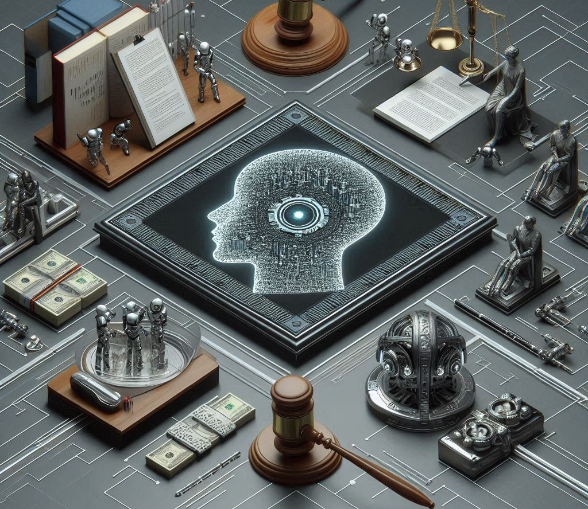
Artificial Intelligence regulatory framework
Notes:
The legal framework for AI governance varies widely across different countries and regions, reflecting diverse approaches to regulating AI technologies. The legal frameworks for AI governance are evolving, with many countries and regions emphasizing ethical principles, transparency, data protection, and innovation. While the approaches differ, there is a common goal to harness the benefits of AI while mitigating risks and ensuring public trust.

Slide 14
AI regulations in other countries
Australia
Artificial Intelligence (AI) Ethics Principles Framework
Canada
The Artificial Intelligence and Data Act (AIDA)
China
New Generation Artificial Intelligence Development Plan’ (2017)
European Union
EU AI Act,2024
India
National Strategy for AI
USA
Executive Order on the Safe, Secure, and Trustworthy Development and Use of AI

Slide 15
AI regulations - Key concerns
Human rights, human values
Environment and ecosystem
Inclusive
Safety, security
Fairness, non-discrimination
Privacy, data protection
Transparency, explainability
Responsibility, accountability

Slide 16
AI systems: Role of standards
Creating common understanding
Develop interoperable and coherent AI applications
Standards can help to mitigate risks by providing a framework for:
Ensuring the Robustness of AI Systems
Promoting Fairness and Accountability in AI Decision-Making
Protecting Privacy and Individual Rights

Slide 17
AI systems – A standards perspective

Slide 18
AI System core concepts
Based on IS/ISO/IEC 22989 : 2022 Artificial Intelligence Concepts and Terminology
Notes:
The standard serves as a comprehensive guide to the world of artificial intelligence (AI). It aims to establish a common language and understanding of fundamental AI concepts and terminology. The document meticulously defines a range of terms related to AI, spanning areas such as data handling, machine learning, natural language processing, and trustworthiness considerations. By offering clear definitions and explanations, it equips stakeholders with the necessary knowledge to effectively communicate, collaborate, and develop AI systems in a standardized and consistent manner.

Slide 19
IS/ISO/IEC 22989: Terms defined
AI General terms
AI
AI agent
AI component
AI system
Data
data annotation
data augmentation
data sampling
PII
machine learning
ML
ML algorithm
ML model
Neural Networks
Convolution
CNN
Deep learning
trustworthiness
Bias
Explainability
Predictability
reliability
Notes:
Also mention stat of total concepts defined in the system
Also add the definition of AI system from the std.

Slide 20
IS/ISO/IEC 22989: Terms and definitions

Slide 21
IS/ISO/IEC 22989: Terms and definitions

Slide 22
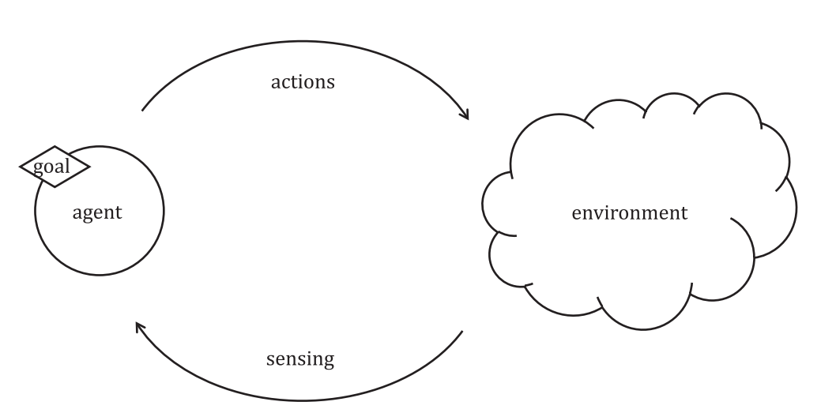
IS/ISO/IEC 22989: Key concepts defined
Agent
Knowledge
Cognition and cognitive computing
Semantic computing
Data
Machine learning concepts
Data
Information
Knowledge
Notes:
Agent
AI agent: automated entity that senses and responds to its environment and takes actions to achieve its goals.
An AI agent interacts with its environment through sensors and actuators, taking actions that maximize its chance of successfully achieving its goals. The standard also discuusses several types of AI agents:
— reflex agents, which rely only on the current situation to choose an action;
— model-based agents, which rely on a model of their environment that allows them to consider the results of their available actions;
— goal or utility-based agents, which rely on an internal utility function that allows them to choose actions that achieve goals, and among goals, look for the most desirable ones;
— learning agents, which can gather information on their environment and learn to improve their performance. Several sophisticated and high-level architectures based on different theories have been developed to implement agents.
Knowledge
In a generic sense, knowledge is associated to cognitive capabilities, but in the context of AI it is a purely technical term that refers to contents, not capabilities. The knowledge concept is part of the data-information-knowledge hierarchy, according to which data can be used to produce information, and information can be used to produce knowledge. In the context of AI, these are purely technical, non-cognitive processes.
Knowledge differs from information in that information is observed by the system, while knowledge is what the system retains from such observations. Knowledge is structured and organized; it abstracts away from the specificities of individual observations. Depending on the goal, the same information can lead to different knowledge.
Cognition, cognitive computing, semantic computing
Cognition comprises the acquisition and processing of knowledge through reasoning, experience, learning and perception. It encompasses concepts such as attention, the formation of knowledge, memory, judgment and evaluation, reasoning and computation, problem solving and decision making, comprehension and production of language.
Cognitive computing is among the subdisciplines of AI. It aims to implement cognition using capabilities such as pattern identification from the processing of huge amounts of information. It enables people to interact more naturally with machines. Cognitive computing tasks are associated with machine learning, speech processing, natural language processing, computer vision and human-machine interfaces.
Machine learning concepts:
The standard further defines the following machine learning concepts:
5.11.1 Supervised machine learning
5.11.2 Unsupervised machine learning
5.11.3 Semi-supervised machine learning
5.11.4 Reinforcement learning
5.11.5 Transfer learning
5.11.6 Training data

Slide 23
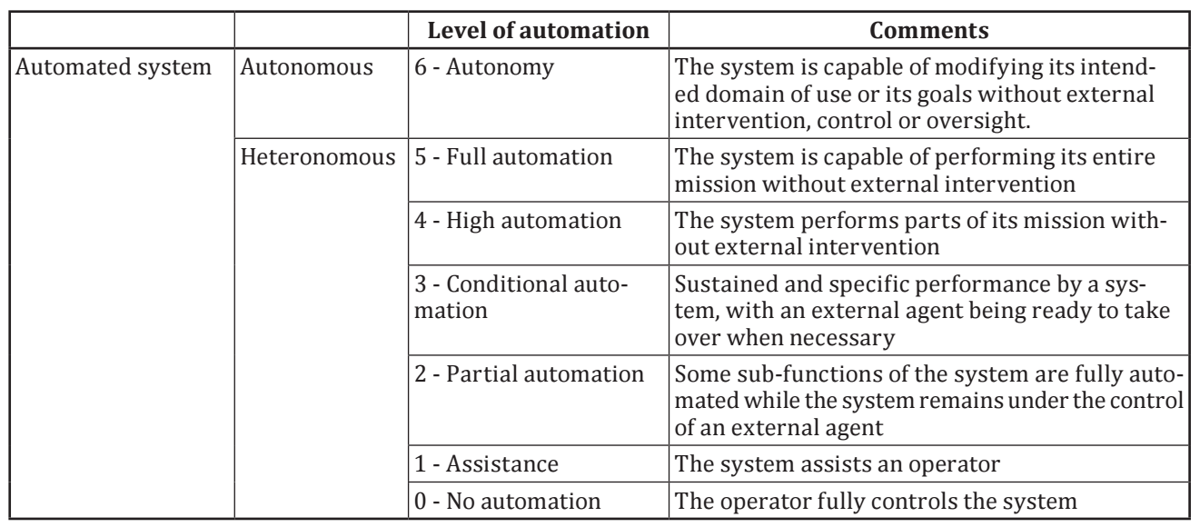
Level of autonomy
AI systems can be compared based on the level of automation and whether they are subject to external control. Autonomy is at one end of a spectrum and a fully human-controlled system on the other.

Slide 24
AI stakeholder roles and their sub-roles
Notes:
AI Provider: An AI provider is an organization or entity that provides products or services that uses one or more AI systems. AI providers encompass AI platform providers and AI product or service providers.
AI platform provider: An AI platform provider is an organization or entity that provides services that enable other stakeholders to produce AI services or products.
AI producer: An AI producer is an organization or entity that designs, develops, tests and deploys products or services that use one or more AI system.
AI developer: An AI developer is an organization or entity that is concerned with the development of AI services and products. Examples of AI developers include, but are not limited to:
— Model designer: the entity that receives data and a problem specification and creates an AI model;
AI customer: An AI customer is an organization or entity that uses an AI product or service either directly or by its provision to AI users.
AI users: An AI user is an organization or entity that uses AI products or services.
AI system integrator: An AI system integrator is an organization or entity that is concerned with the integration of AI components into larger systems, potentially also including non-AI components.
Data provider: A data provider is an organization or entity that is concerned providing data used by AI products or services.
AI auditor: An AI auditor is an organization or entity that is concerned with the audit of organizations producing, providing or using AI systems, to assess conformance to standards, policies or legal requirements.

Slide 25
AI system functional view
Notes:
A functional view is a representation that focuses on how a system transforms input into output and its capabilities.

Slide 26
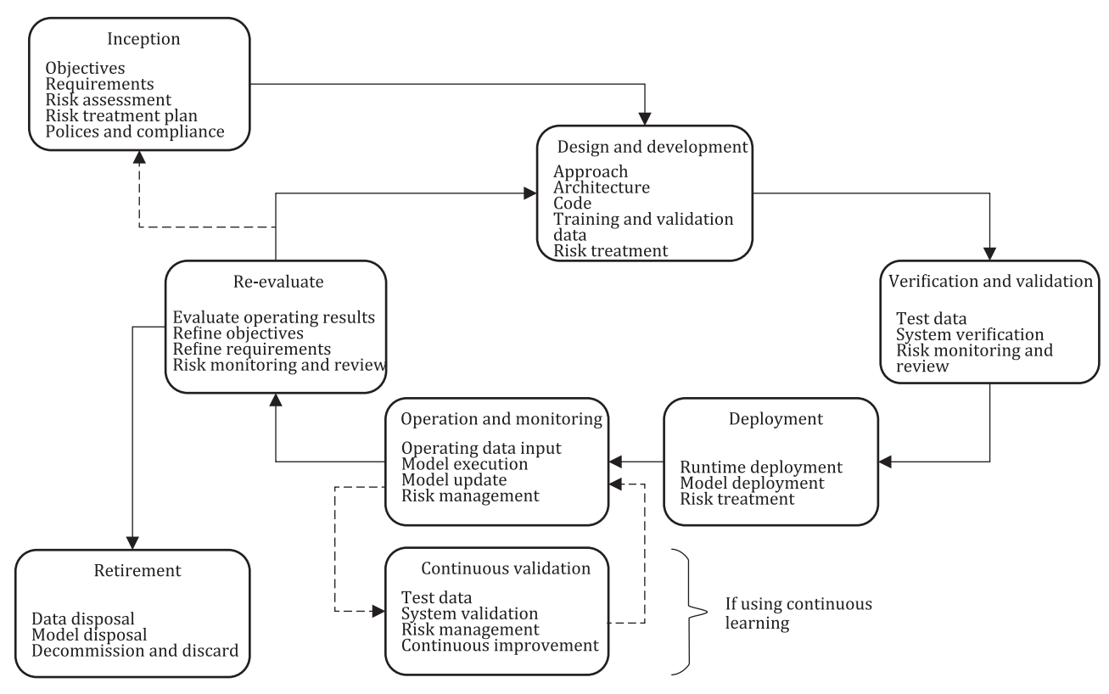
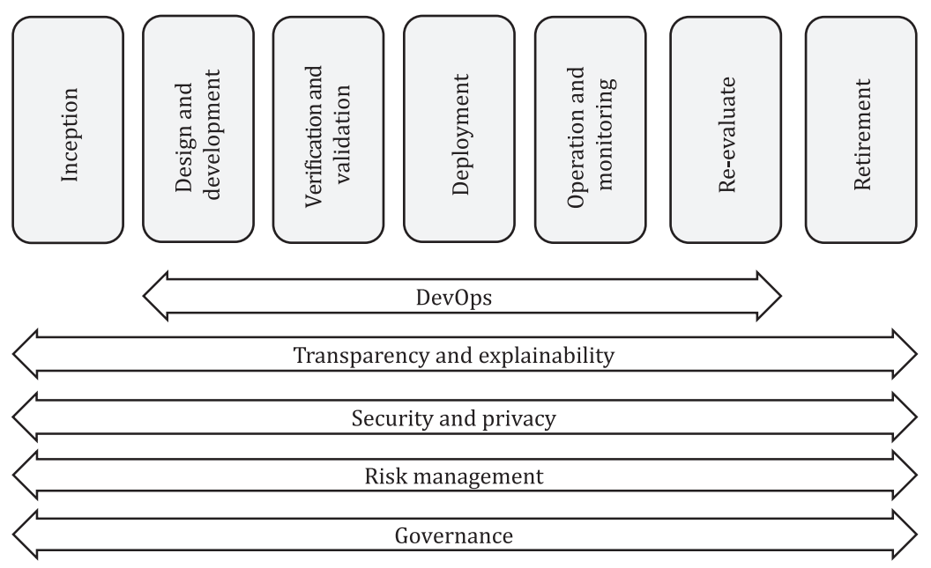
AI system life cycle model & life cycle processes
The AI system life cycle model describes the evolution of an AI system from inception through retirement. This document does not prescribe a specific life cycle model but underlines some processes that are specific to AI systems that can occur during the system life cycle.
Notes:
The AI system life cycle model describes the evolution of an AI system from inception through retirement. This document does not prescribe a specific life cycle model but underlines some processes that are specific to AI systems that can occur during the system life cycle.
A system life cycle model helps stakeholders build AI systems more effectively and efficiently.
The standard also discusses some of the AI specific aspects that are different from traditional software such as:
Most software systems are programmed to behave in precisely defined ways that are driven by their requirements and specifications. The AI systems based on machine learning use data-driven training and optimization methods to deal with widely varying inputs.
Traditional software applications are usually predictable, which is less often the case for AI systems.
Traditional software applications are also usually verifiable, while performance assessment of AI systems often requires statistical approaches and their verification can be challenging.
AI systems typically need multiple iterations of improvement to achieve acceptable levels of performance.
For the same reason, the standard also describes the processes with each stage that are significant for AI systems and require special consideration, beyond the consideration required for the development of typical non-AI systems.

Slide 27
AI System Life Cycle Processes
Based on ISO/IEC 5338:2023 AI System Life cycle Processes (under development)
Notes:
This document defines a set of processes and associated concepts for describing the life cycle of AI systems based on machine learning and heuristic systems. It is based on ISO/IEC/IEEE 15288 and ISO/IEC/IEEE 12207 with modifications and additions of AI-specific processes from ISO/IEC 22989 and ISO/IEC 23053.
This document provides processes that support the definition, control, management, execution and improvement of the AI system in its life cycle stages. These processes can also be used within an organization or a project when developing or acquiring AI systems.

Slide 28
AI System Life Cycle Processes
Defining AI system life cycle based on ML and heuristic systems
ISO/IEC/IEEE 15288 Systems and software engineering — System life cycle processes
ISO/IEC/IEEE 12207:2017, Systems and software engineering — Software life cycle processes
with AI-specific modifications
Notes:
IS 16457:2020 | ISO/IEC/IEEE 15288 System Life Cycle Processes
This International Standard establishes a common framework of process descriptions for describing the life cycle of systems created by humans.
ISO/IEC/IEEE 12207:2017 Software Life Cycle Processes
This document establishes a common framework for software life cycle processes, with well‐defined terminology, that can be referenced by the software industry. It contains processes, activities, and tasks that are applicable during the acquisition, supply, development, operation, maintenance or disposal of software systems, products, and services.

Slide 29
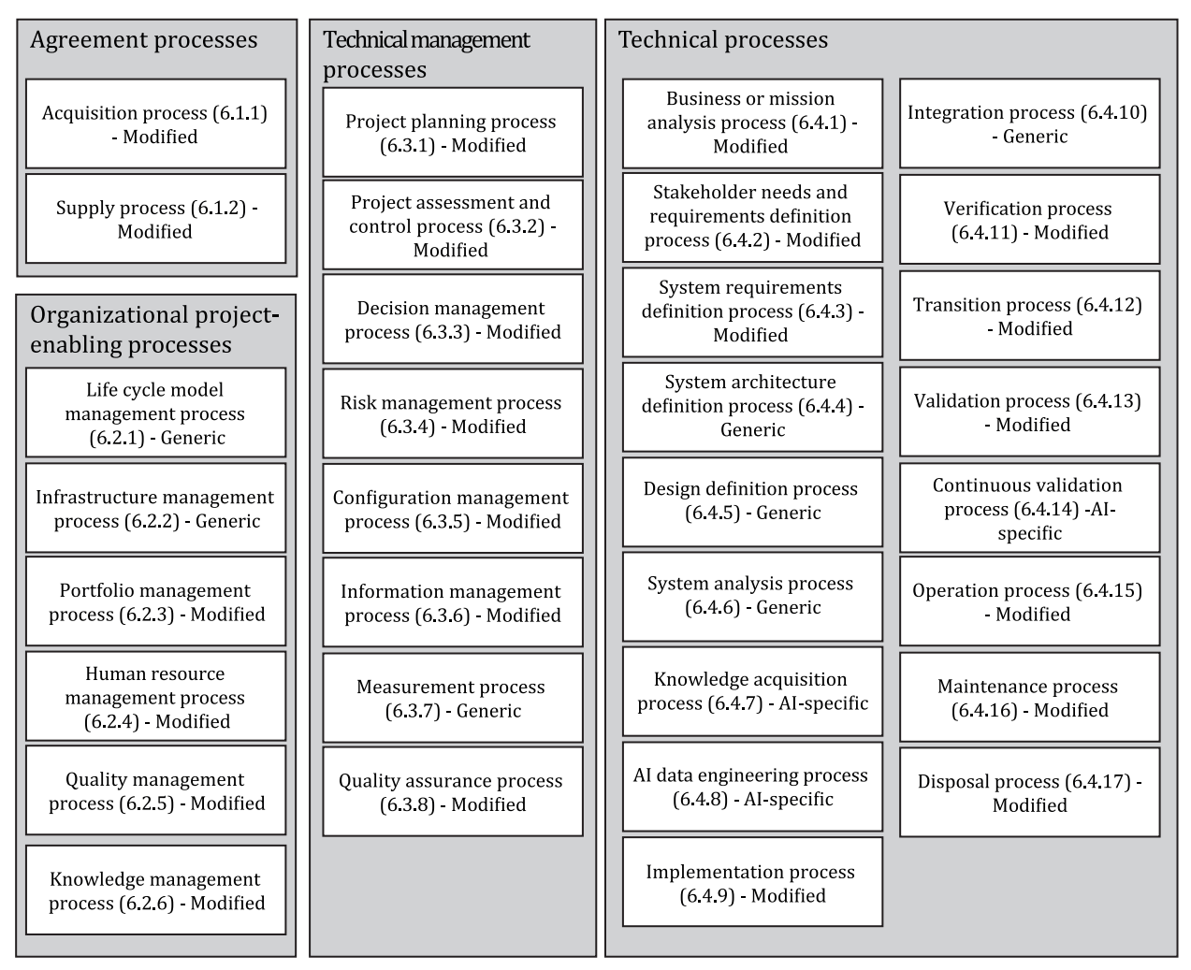
System life cycle processes ISO/IEC/IEEE 15288:
Applicability to AI systems
Notes:
The systems and software life cycle processes are classified into three groups in this standard:
— Generic processes: Processes that are identical to the processes defined in ISO/IEC/IEEE 15288 and ISO/IEC/IEEE 12207.
— Modified processes: Processes where elements are modified, added or removed from the ISO/IEC/IEEE 15288 and ISO/IEC/IEEE 12207 definition.
— AI-specific processes: Processes that are specific to characteristics of AI systems but are not based directly on any processes in ISO/IEC/IEEE 15288 and ISO/IEC/IEEE 12207.

Slide 30
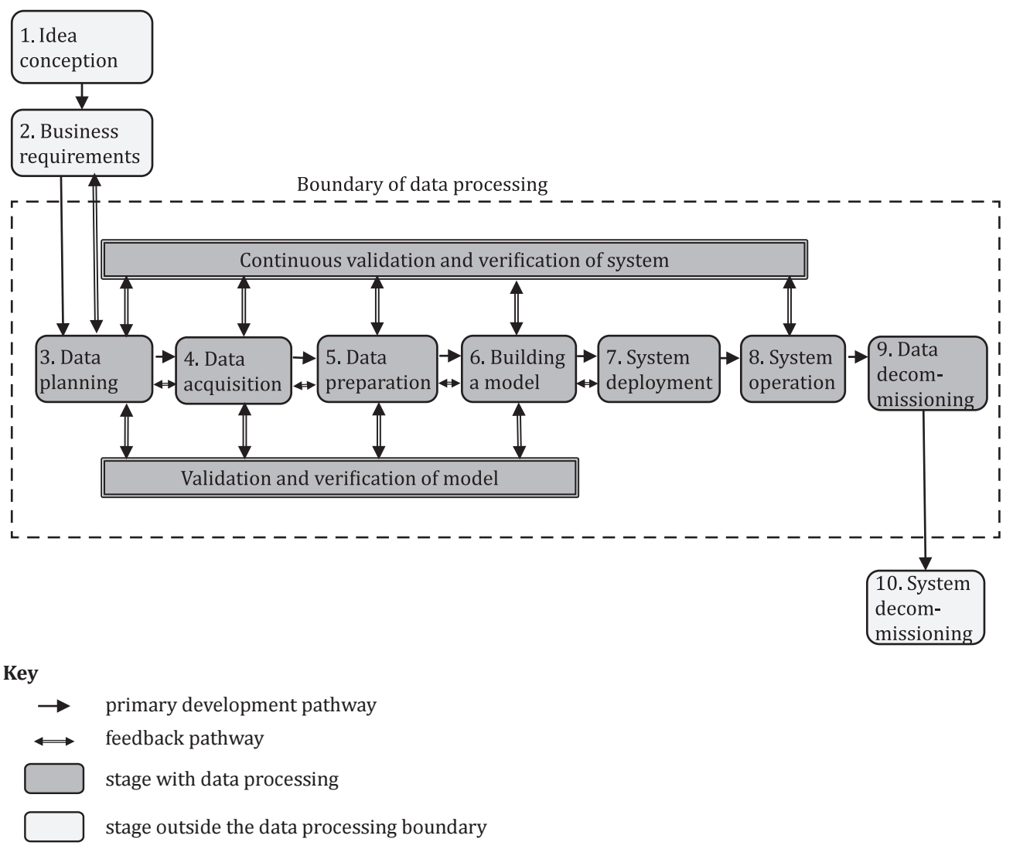
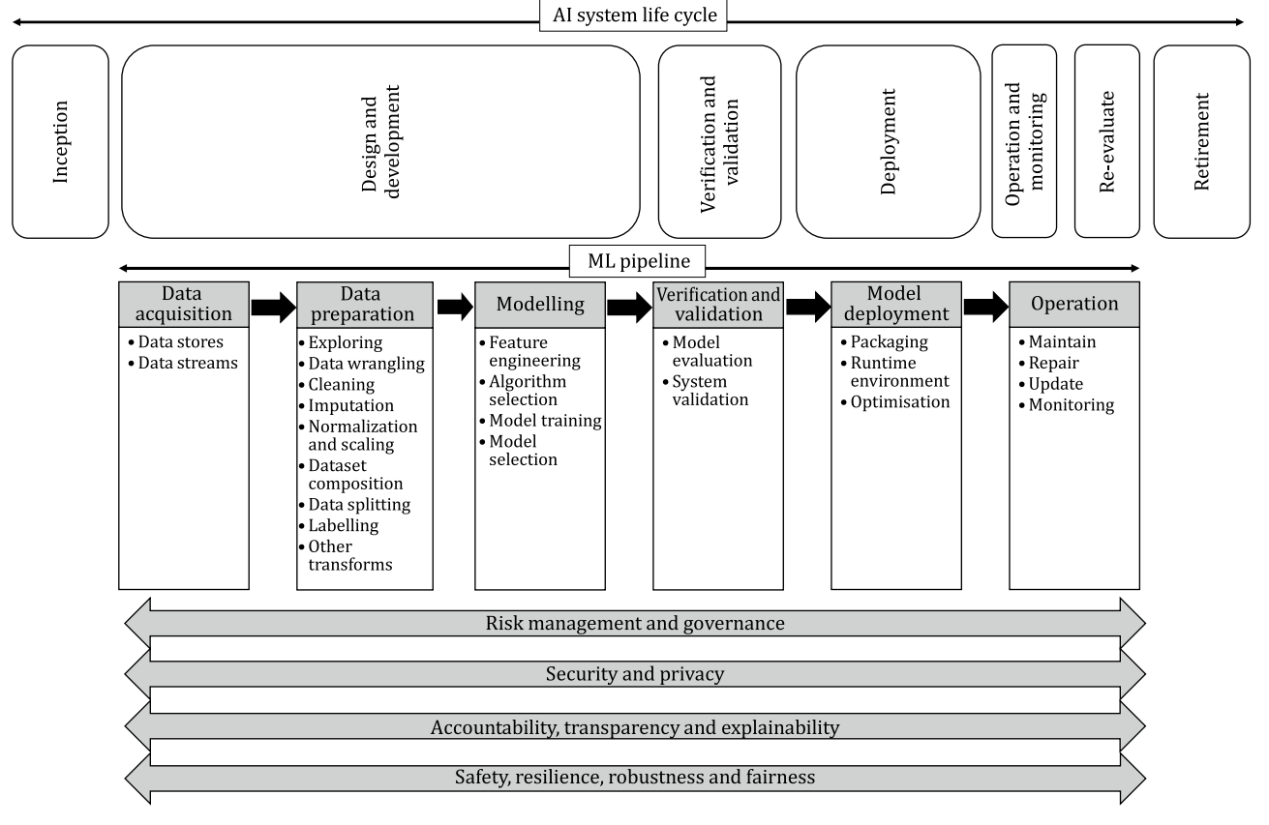
AI life cycle from a data and ML perspective
The data life cycle framework, identifies a set of conceptually distinct stages that data used in an AI system go through from data planning to data decommissioning. The overarching framework helps correct interpretation even by those without previous knowledge, context and expertise.
Notes:
In this slide, the life cycle models from the following 2 standards were added to indicate the alignment of these standards:
IS/ISO/IEC 8183 AI data life cycle framework
IS/ISO/IEC 23053 AI Systems Using Machine learning

Slide 31
Differentiating factors of AI systems
Measurable potential decay
Potentially autonomous
Iterative requirements
Probabilistic nature
Data reliance
Knowledge intensity
Novelty
Incomprehensibility
Notes:
The standard also identifies a couple of differentiating factors of AI systems: the factors are defined in the coming slides.

Slide 32
Differentiating factors of AI systems
Measurable Potential Decay:
AI models can degrade over time as the real world data they interact with changes. This necessitates processes to monitor and measure these deviations and to retrain or update the model as required.
Potentially Autonomous:
AI systems can make complex decisions without human intervention. This necessitates special attention to ensure fairness, security, safety, privacy, reliability, transparency and explainability, accountability, availability, integrity and maintainability.
Iterative Requirements and Behavior Specification:
AI system development often involves iterative cycles of requirement specification, prototyping, and refinement. This is because AI systems can learn and adapt over time, and requirements may evolve as the system is used.
Probabilistic:
Decisions made by AI systems based on machine learning are inherently probabilistic. It is important to acknowledge that these decisions are not always correct, and there are limitations to formally testing the correctness of models.

Slide 33
Differentiating factors of AI systems
Reliant on Data:
AI systems based on machine learning rely on sufficient, representative data to train, test, and validate models. The quality of the data significantly impacts the performance of the AI system.
Knowledge Intensive:
Heuristic models require significant knowledge acquisition to encode the knowledge required for the system to function correctly.
Novel:
The novelty of AI systems can introduce challenges related to trust, adoption, and potential biases. Stakeholders may not be familiar with AI and may overestimate or underestimate its capabilities.
Incomprehensible:
In some cases, AI system behavior can be difficult to understand or explain, especially for complex models. This can reduce trust and confidence in AI systems.

Slide 34
Benefits of ISO/IEC 5338: Building Trustworthy AI Systems
Enhanced Transparency and Accountability
Defines a structured life cycle with clear stages and documented processes
Promotes documenting decisions and rationale behind each stage of AI development.
Improved Safety and Security
Emphasizes risk management throughout the lifecycle
Encourages practices to mitigate potential security vulnerabilities in AI systems
Mitigated Risks and Biases
Promotes data quality and fairness considerations during AI development
Encourages ongoing monitoring and improvement to address potential bias in the system

Slide 35
ISO/IEC 5338: A Competitive Advantage
Increased Trust and Confidence
Following a recognized standard demonstrates commitment to responsible AI development.
Can enhance user and stakeholder trust in the AI system, leading to greater adoption
Improved Efficiency and Cost Management:
Provides a structured framework to streamline AI development processes
Can potentially help avoid rework and delays caused by unforeseen issues.
Stronger Market Positioning:
Compliance with ISO/IEC 5338 can be a differentiator in a competitive market.
Signals a commitment to ethical and responsible AI practices, potentially attracting a wider range of customers and partners.

Slide 36
Trustworthiness in AI
Based on IS/ISO/IEC/TR 24028 : 2020 Artificial intelligence Overview of trustworthiness in artificial intelligence

Slide 37
What is Trustworthiness in AI?
Trustworthiness in AI refers to an AI system's ability to consistently meet stakeholders' expectations in a verifiable way.
This concept applies to a wide range of AI systems, technologies, and applications. It is not merely a desirable feature but a fundamental requirement.

Slide 38
AI specific risks and challenges
Bias
human cognitive bias, societal bias
selection bias,
sampling bias,
technical errors
AI specific security threats
data poisoning
adversarial attacks
model stealing
AI specific privacy threats
During Data acquisition
Data pre-processing and modelling
Unpredictability
Opaqueness
Notes:
Previous slide looking at it again

Slide 39
AI Ecosystem
Stakeholders
Data source organization
AI system developer
AI producer
AI user
Tools& middleware developer
Testing & evaluation agency
Assets
Training data
Test data
Product that uses AI system
Incoming data
Computing resources
Human resources
Reputation of the org using AI system
Notes:
Steps involved in ensuring Trustworthiness as per ISO/IEC TR 24028:2020
1. Idnetify the stakeholders and assets
2. Recognize high level concerns such as responsibility, accountability etc.
3. Identify vulnerabilities and threats and challenges
Finally, the standard also discussed the mitigation methods
The coming slides speaks about the above

Slide 40
High-Level Concerns
Responsibility and Accountability:
Clearly defined roles and responsibilities are essential in AI development and deployment. Establishing accountability frameworks ensures that stakeholders are answerable for their decisions and actions related to AI systems.
Governance:
Implementing robust governance frameworks based on standards like ISO/IEC 38500 helps organisations manage AI-related risks and ensure ethical development and use.
Safety:
AI systems must be designed and operated to minimise harm to individuals and society. Safety should be prioritised throughout the AI lifecycle, considering potential risks and implementing measures to mitigate them

Slide 41
Vulnerabilities and Challenges
AI-Specific Security Threats:
Adversarial Attacks: AI systems, particularly those based on machine learning, are vulnerable to adversarial attacks, where attackers can manipulate input data to mislead the system.
AI-Specific Privacy Threats:
Data Acquisition, Pre-processing, and Modelling: AI's reliance on vast amounts of data raises concerns about privacy, especially when dealing with sensitive information.
Bias:
AI systems trained on biased data can perpetuate and even amplify existing societal biases, leading to unfair or discriminatory outcomes.
Unpredictability:
The lack of predictability in some AI systems can undermine trust, especially in critical applications where human safety is paramount.
Opaqueness:
The "black box" nature of certain AI models makes it difficult to understand how they arrive at decisions, creating challenges for accountability and trust
Notes:
Vulnerabilities: weakness of an asset or control that can be exploited by one or more threats.
Threats: potential cause of an unwanted incident, which may result in harm to a system or organization.

Slide 42
Mitigation Measures
Transparency
provides visibility to the features, components and procedures of an AI system
involves making data, features, models, algorithms, training methods and quality assurance processes available for external inspection.
Explainability
Explanations of processes relevant to the development, implementation and use of an AI system, such as data gathering practices, self-auditing processes,
Controllability
providing reliable mechanisms for an operator to take over control from the AI system.
Data Handling
Robustness, Resilience, and Reliability
Reliability is the ability of a system to perform its required functions under stated conditions for a specific period of time
Resilience is the ability of the system to recover operational condition quickly following an incident.
Robustness is the ability of a system to maintain its level of performance under any circumstances including external interference or harsh environmental conditions.
Testing and Evaluation
Use and Applicability

Slide 43
AI standardization efforts in BIS

Slide 44
LITD30 : Artificial Intelligence
Scope
Standardization in the area of Artificial Intelligence and Big Data
Liaison
ISO/IEC JTC 1/SC 42 - Artificial intelligence

Slide 45
LITD 30 Standards published
# | IS No. | TITLE
1 | IS/ISO/IEC 20546 : 2019 | Big Data - Overview and Vocabulary
2 | IS/ISO/IEC/TR 20547-1 : 2020 | Big data reference architecture Part 1: Framework and application process
3 | IS/ISO/IEC 20547-3 : 2020 | Big data reference architecture Part 3: Reference architecture
4 | IS/ISO/IEC 22989 : 2022 | Artificial intelligence concepts and terminology
5 | IS/ISO/IEC 23053 : 2022 | Framework for Artificial Intelligence AI Systems Using Machine Learning ML
6 | IS/ISO/IEC/TR 24028 : 2020 | Overview of trustworthiness in artificial intelligence
7 | IS/ISO/IEC/TR 24029-1 : 2021 | AI Assessment of the robustness of neural networks Part 1: Overview
8 | IS/ISO/IEC 24029-2 : 2023 | Assessment of the robustness of neural networks Part 2: Methodology for the use of formal methods

Slide 46
LITD 30 Standards published
# | IS No. | TITLE
9 | IS/ISO/IEC/TR 24030 : 2021 | Artificial intelligence AI Use cases
10 | IS/ISO/IEC/TR 24368 : 2022 | Artificial Intelligence Overview of Ethical and Societal Concerns
11 | IS/ISO/IEC/TR 24372 : 2021 | Overview of computational approaches for AI systems
12 | IS/ISO/IEC 24668 : 2022 | Process management framework for big data analytics
13 | IS/ISO/IEC 25059 : 2023 | Software engineering Systems and software Quality Requirements and Evaluation SQuaRE Quality model for AI systems
14 | IS/ISO/IEC 38507 : 2022 | Governance of IT Governance implications of the use of artificial intelligence by organizations
15 | IS/ISO/IEC/TS 4213 : 2022 | Assessment of machine learning classification performance
16 | IS/ISO/IEC 8183 : 2023 | Artificial intelligence Data life cycle framework

Slide 47
LITD 30 Standards Under development
# | Doc No | TITLE
1 | LITD 30 (22592) | Artificial intelligence Guidance on risk management
2 | LITD 30 (24566) | Artificial Intelligence- Management System
3 | LITD 30 (24862) | Artificial Intelligence -Functional Safety and AI Systems
4 | LITD 30 (24865) | Artificial Intelligence- Guidance for AI Applications
5 | LITD 30 (24866) | Information Technology- Artificial Intelligence- AI System Life Cycle Processes
6 | LITD 30 (24867) | Systems and Software Quality Requirements and Evaluation SQuaRE -Guidance for Quality Evaluation of Artificial Intelligence AI Systems

Slide 48
Contribution of BIS in the international standards development
Standards developed under ISO/IEC JTC 1/SC 42

Slide 49
IS/ISO/IEC 24668:2022 Process management framework for Big data analytics
This document provides a framework for developing processes to effectively leverage big data analytics across the organization irrespective of the industries or sectors. This document describes processes to acquire, describe, store and process data at an organization level which provides big data analytics services.
Project Editor – Mr. Gautam Banerjee, Data Science Foundation India

Slide 50
IS/ISO/IEC 5339:2024 Artificial Intelligence — Guidelines for AI applications
This document provides a set of guidelines for identifying the context, opportunities and processes for developing and applying AI applications. The guidelines provide a macro-level view of the AI application context, the stakeholders and their roles, relationship to the lifecycle of the system, and common AI application characteristics, properties and considerations.
Project Editor – Dr. Shrikant Bhat, ABB India

Slide 51
ISO/IEC WD 42106 Overview of differentiated benchmarking of AI system quality characteristics
This document provides an overview of conceptual frameworks for graded benchmarking of AI system quality characteristics. The aim is to examine the feasibility of using differentiated benchmarking of quality characteristics based on the complexity and context of use of an AI system
Project Editor – Prof. Nisheeth Srivastava, IIT Kanpur, India

Slide 52
ISO/IEC WD 17847 Verification and validation Analysis of AI systems
This standard Intends to describe approaches for verification and validation analysis of AI systems against their stated requirements and specifications
Project Editor – Mr. Raghavendra Bhat, Intel India

Slide 53
Other International Standards at the early stages, under the leadership of India
PWI 42118 Reliability of AI systems
This proposal Intends to describe reliability measures for AI systems so that reliability is measured and reported before use. (Dr C Anantaram)
Guidance for Generative AI Applications
This document provide guidance to identify value contribution and value realization for each stakeholder when developing or using a generative AI application. This document also provide guidance for governance mechanism to manage use of an existing generative AI application as a service (Dr Shrikant Bhat)
PWI 47559 ‘De-identification of training data for ML’
This document provides guidelines and requirements on privacy preservation including de-identification methods for training data used in machine learning.

Slide 54
Some useful Resources:
LITD 30: Committee composition
LITD 30: Standards published

Slide 55
Benefits of AI Standards
Conclusion

Slide 56
System developer Benefits
Enhanced Transparency and Trust:
The standard promotes clear and open communication regarding AI use within the organization, fostering trust with stakeholders.
Mitigated Risks:
By establishing a robust governance framework, the standard helps organizations identify and address potential risks associated with AI implementation.
Responsible AI Development and Deployment:
The standard outlines best practices for responsible AI development and deployment, ensuring ethical considerations are addressed.
Optimized Performance:
The framework promotes efficient use of AI resources, maximizing the return on investment for the organization.

Slide 57
Stakeholder Benefits
Investors:
Increased confidence in the organization's responsible AI practices and risk management.
Customers:
Enhanced trust in the fairness, transparency, and safety of AI-powered products and services.
Employees:
Assurance of ethical AI use within the organization, promoting job security and upskilling opportunities.
Regulators:
Streamlined compliance with AI-related regulations and policies.

Slide 58
The Future of AI: Standards Paving the Way
AI systems are evolving rapidly and hold immense potential to revolutionize various industries.
Ensuring responsible and trustworthy development of AI is crucial.
Standards provide a robust framework for developing and deploying safe, reliable, and unbiased AI systems.

Slide 59
Thank you!..

