Slide 1
Introduction to
Standards in the field of
Cloud Computing, Multi-cloud
&
Data Centre

Slide 2
Topics generally covered in the Syllabus
Concepts of Cloud Computing
Current Trends in information Security - Cloud Computing
Cloud Computing Principles
Basics of Cloud Infrastructure
Common Technologies and Techniques in Cloud Computing
Architecture, models of cloud services (IaaS, PaaS, SaaS)
Virtualization
Virtual Machines,
Hypervisors,
Data Centre Concepts
Data Centre Facilities and Infrastructures
Performance of Data Centre – Key performance indicators
Notes:
The subject of Cloud Computing is generally taken up as elective in Semester VI to VIII in B.Tech Programmes or Semester III to IV in Master Programmes

Slide 3
Benefits of Standards
For Industry
Define & raise level of quality, safety & health and protect environment
Facilitate interoperability
Enhance quality and efficiency
Assessment and demonstration conformity of quality
Efficiently make available technical information
Disseminate good management and business practices
Government/Regulator
Support Government policies and legislations
Technical references in public tenders
Promote access to global trade
For Consumer
Provide consumer choice of certified products & services
Products with improved quality and reliability at competitive prices
Safer, healthier, more environmentally sound products and services
Better operational compatibility greater consistency in delivery
Notes:
Standard
A document, established by consensus and approved by a recognized body, that provides, for common and repeated use, rules, guidelines or characteristics for activities or their results, aimed at the achievement of the optimum degree of order in a given context.
Stakeholders - Government, Regulators, Industry, Laboratories, R& D Institutes, Consumers, Academia

Slide 4
Concepts of Cloud Computing
Components of cloud
Data storage, servers, databases, networking, internet and software
Cloud
Definition: Paradigm for enabling network access to a scalable and elastic pool of shareable physical or virtual resources with self-service provisioning and administration on-demand.
(reference clause 3.2.5 of IS/ISO/IEC 17788)
Cloud Computing
Notes:
Today topic is Cloud Computing and Data Centres. Let us start with Cloud Computing.
"The cloud" refers to servers that are accessed over the Internet, and the software and databases that run on those servers. Cloud servers are located in data centers all over the world. By using cloud computing, users and companies do not have to manage physical servers themselves or run software applications on their own machines.
Cloud computing is the delivery of different services through the Internet, including data storage, servers, databases, networking, and software

Slide 5
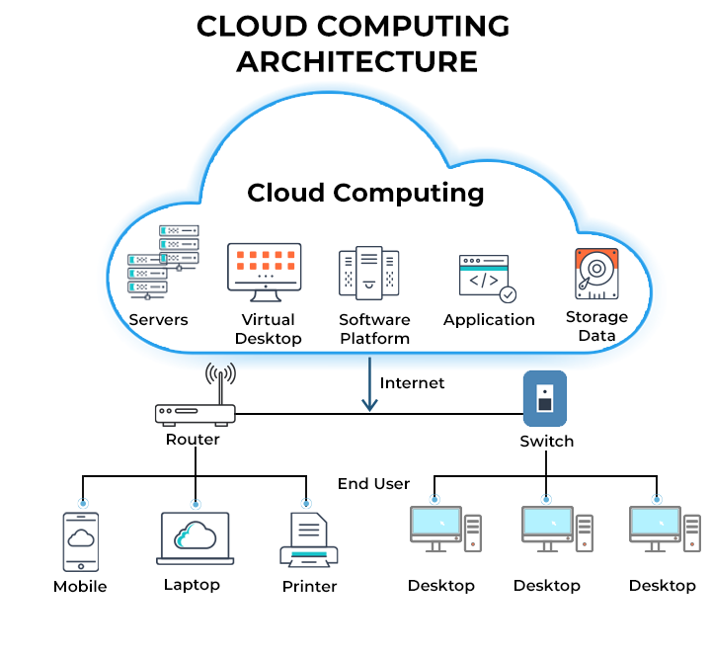
Notes:
Cloud computing is the delivery of computing services using servers, storage, databases, networking, software, analytics, and more—over the internet. This allows for flexible resources, faster innovation, and economies of scale.
Cloud computing is the on-demand availability of computer system resources, especially data storage (cloud storage) and computing power, without direct active management by the user. Large clouds often have functions distributed over multiple locations, each of which is a data center.
It works the same way with cloud email providers like Gmail or Microsoft Office 365, and with cloud storage providers like Dropbox or Google Drive.

Slide 6
Benefits of cloud computing and Data Centres
Cloud computing provide organization to successfully adopt and leverage cloud technologies to drive business growth, optimize costs, and improve operational efficiency.
Examples:
Netflix: Leading online streaming service, relies on the Amazon Web Services (AWS) cloud infrastructure to support its massive scale and global reach.
Airbnb/booking.com: Popular online marketplace for lodging, primarily uses cloud services to host their applications and manage its massive amounts of data. By leveraging cloud services, have grown rapidly, streamlined its operations, and developed innovative features to enhance user experience and satisfaction.
Coca-Cola/Shell/General Electric: By leveraging Google’s cloud services, these companies have enhanced its global data analytics capabilities, improved its supply chain efficiency, and delivered personalized experiences to its customers.
Notes:
"The cloud" refers to servers that are accessed over the Internet, and the software and databases that run on those servers. Cloud servers are located in data centers all over the world. By using cloud computing, users and companies do not have to manage physical servers themselves or run software applications on their own machines.
Cloud computing is the on-demand availability of computer system resources, especially data storage (cloud storage) and computing power, without direct active management by the user.
It works the same way with cloud email providers like Gmail or Microsoft Office 365, and with cloud storage providers like Dropbox or Google Drive.

Slide 7
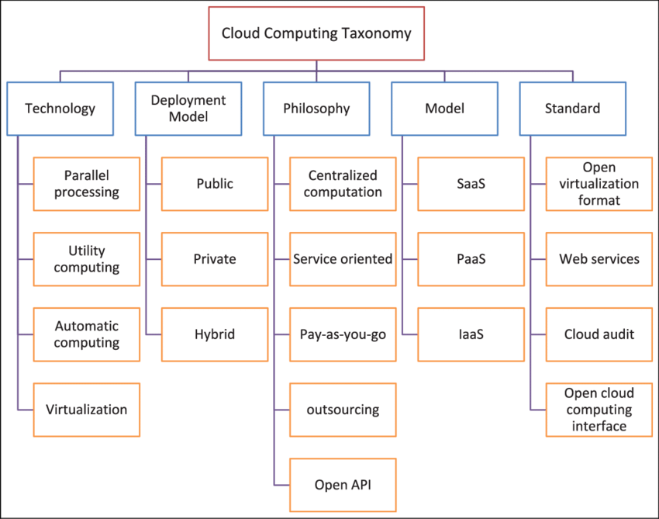
Structure of Cloud Computing Taxonomy
Notes:
What is Taxonomy – It is a scientific process of arranging things into groups.

Slide 8
Taxonomy Based Data Handling for Cloud Services
Overview
Data polices and practices, at corporate and government level, needs to be crispy expressed with desired degree of precision and clarity. It requires,
Framework for structured expression of data related policies and practices;
Guidance for using the framework;
Use of framework in specific areas of concern;
Application of framework to code of conduct.
IS/ISO/IEC 22624 : 2020, Cloud Computing Taxonomy Based Data Handling for Cloud Services
Notes:
Taxonomy is a hierarchical structure in cloud computing that organizes the given data and provide an efficient and effective way of organizing and classifying data. This standard describes a common structure and approach to express any desired data handling policies and practices.
The standard broadly describes a framework for the structured expression of data-related policies and practices in the cloud computing environment.
IS/ISO/IEC 22624
Scope: The standard broadly cover the following aspects on taxonomy based data handling for cloud services:
— describes a framework for the structured expression of data-related policies and practices in the cloud computing environment,
— provides guidelines on application of the taxonomy for handling of data based on data subcategory and classification;
— covers expression of data-related policies and practices including, but not limited to data geolocation, cross border flow of data, data access and data portability, data use, data management, and data governance;
— describes how the framework can be used in codes of conduct for practices regarding data at rest and in transit, including cross border data transfer, as well as remote access to data;
— provides use cases for data handling challenges, i.e. control, access and location of data.

Slide 9
Important Definitions
Cloud service (clause 3.2.8): One or more capabilities offered via cloud computing invoked using a defined interface.
Cloud service customer (clause 3.2.11): Party which is in a business relationship for the purpose of using cloud services.
Cloud service provider (clause 3.2.15): Party which makes cloud services available.
Private cloud (clause 3.2.32): Cloud deployment model where cloud services are used exclusively by a single cloud service customer and resources are controlled by that cloud service customer.
Public cloud (clause 3.2.33) : Cloud deployment model where cloud services are potentially available to any cloud service customer and resources are controlled by the cloud service provider.
Community cloud (clause 3.2.19): Cloud deployment model where cloud services exclusively support and are shared by a specific collection of cloud service customers who have shared requirements and a relationship with one another, and where resources are controlled by at least one member of this collection.
Service level agreement (SLA) (clause 3.1.7): Documented agreement between the service provider and customer that identifies services and service targets.
IS/ISO/IEC 17788: 2014, “Cloud Computing — Overview and Vocabulary”
Notes:
IS/ISO/IEC 17788: 2014 provides overview and terms and definitions.
The standard is a terminology foundation for cloud computing standards and provide key characteristics of cloud computing and definitions.

Slide 10
Key characteristics of cloud computing
Resource pooling
Broad network access
Rapid elasticity and scalability
Key characteristics of cloud computing (clause 6.2)
Measured service
On-demand self-service
Multi-tenancy
IS/ISO/IEC 17788: 2014, “Cloud Computing — Overview and Vocabulary”
Notes:
i) Broad network access - A feature where the physical and virtual resources are available over a network and accessed through standard mechanisms.
ii) Measured service - A feature where the metered delivery of cloud services is such that usage can be monitored, controlled, reported, and billed.
iii) Multi-tenancy - A feature where physical or virtual resources are allocated in such a way that multiple tenants and their computations and data are isolated from and inaccessible to one another.
iv) On-demand self-service - A feature where a cloud service customer can provision computing capabilities, as needed, automatically or with minimal interaction with the cloud service provider
v) Rapid elasticity and scalability - A feature where physical or virtual resources can be rapidly and elastically adjusted, in some cases automatically, to quickly increase or decrease resources.
vi) Resource pooling - A feature where a cloud service provider's physical or virtual resources can be aggregated in order to serve one or more cloud service customers.

Slide 11
Cloud deployment models
Community cloud
Private cloud
Cloud deployment models (clause 6.5)
Hybrid cloud
Public cloud
IS/ISO/IEC 17788: 2014, “Cloud Computing — Overview and Vocabulary”

Slide 12
Private cloud services are maintained on a private network and are used exclusively by one organization. Unlike public clouds, private clouds are not shared with other organizations.
Examples: VMware: Provides virtualization software and services for building private clouds.
Private Cloud
(clause 6.5)
Public cloud services are delivered over the public internet and shared across multiple organizations, providing scalable and flexible computing resources on a pay-as-you-go basis.
Examples: AWS, Google Cloud Platform (GCP), Microsoft Azure
Public Cloud
(clause 6.5)
Hybrid cloud combines public and private cloud environments, allowing data and applications to be shared between them. This integration provides flexibility and optimization of IT resources based on specific business needs.
Examples: VMware Cloud Foundation: Integrates private cloud infrastructure with public cloud services from AWS, Azure, and Google Cloud.
Hybrid Cloud
(clause 6.5)
A community cloud is a shared infrastructure that serves several organizations with similar requirements, such as specific security, compliance, or regulatory needs. It may be managed internally by the organizations or by a third-party provider.
Examples:
Government Community Cloud: Used by government agencies to share resources and data securely while meeting regulatory requirements.
Healthcare Community Cloud: Shared by healthcare organizations to store and manage patient data securely, ensuring compliance with healthcare regulations like HIPAA.
Community Cloud
(clause 6.5)
Notes:
Benefits of Private Cloud
i) Enhanced Security: Dedicated infrastructure ensures higher levels of security and privacy, as resources are not shared with other organizations.
ii) Greater Control: Organizations have more control over the infrastructure, including performance, security policies, and compliance requirements
Benefits of Public Cloud
i) Cost-effective: Lower costs due to shared infrastructure.
ii) Scalability: Easily scalable to meet varying demand.
iii) No Maintenance: Providers handle maintenance, updates, and security.
Benefits of Hybrid Cloud
Flexibility: Enables organizations to move workloads between public and private clouds based on changing needs, such as fluctuating demand or specific security requirements.
Enhanced Security: Provides enhanced security by allowing sensitive data and critical applications to be stored and managed in the private cloud, while less sensitive resources can be hosted in the public cloud.
Community Cloud - Organizations do not have to worry about the security concerns linked with Public Cloud because of the closed user group.

Slide 13
Primary Models of Cloud Computing
Infrastructure as a Service (IaaS) (clause 3.2.24): Cloud service category in which the cloud capabilities type provided to the cloud service customer is an infrastructure capabilities type.
Examples:
Amazon Web Services (AWS), Microsoft Azure, Google Cloud Platform (GCP).
Platform as a Service (PaaS) (clause 3.2.30): A cloud service category in which the cloud capabilities type provided to the cloud service customer is a platform capabilities type
Examples:
Heroku: A cloud platform that enables developers to build, run, and operate applications entirely in the cloud.
Microsoft Azure App Services: A cloud platform for building, deploying, and scaling web apps and APIs.
IS/ISO/IEC 22624 : 2020 - Primary Models of Cloud Computing
Notes:
Infrastructure as a service, or IaaS, delivers on-demand infrastructure resources to organizations via the cloud, such as compute, storage, networking, and virtualization. Customers don’t have to manage, maintain, or update their own data center infrastructure, but are responsible for the operating system, middleware, virtual machines, and any apps or data.
Platform as a service, or PaaS: delivers and manages all the hardware and software resources to develop applications through the cloud. Developers and IT operations teams can use PaaS to develop, run, and manage applications without having to build and maintain the infrastructure or platform on their own. Customers still have to write the code and manage their data and applications, but the environment to build and deploy apps is managed and maintained by the cloud service provider.
Software as a service, or SaaS: provides the entire application stack, delivering an entire cloud-based application that customers can access and use. SaaS products are completely managed by the service provider and come ready to use, including all updates, bug fixes, and overall maintenance. Most SaaS applications are accessed directly through a web browser, which means customers don’t have to download or install anything on their devices.

Slide 14
Primary Models of Cloud Computing
Software as a Service (SaaS) (clause 3.2.36): Cloud service category in which the cloud capabilities type provided to the cloud service customer is an application capabilities type.
Examples:
Google Workspace: A suite of cloud-based productivity and collaboration tools including Gmail, Docs, Drive, and Calendar.
Microsoft 365: A collection of cloud services including Word, Excel, PowerPoint, and Outlook, along with collaboration tools like Teams and OneDrive.
Salesforce: A cloud-based customer relationship management (CRM) platform that provides various tools for sales, service, marketing, and analytics.
IS/ISO/IEC 22624 : 2020 - Primary Models of Cloud Computing

Slide 15
Comparison in terms of who manage what
IaaS
PaaS
SaaS
Data & Configurations
Data & Configurations
Data & Configurations
Application code
Application code
Application code
Managed by CSC
Scaling
Scaling
Scaling
Run Time
Run Time
Run Time
Managed by CSP
OS
OS
OS
Virtualization
Virtualization
Virtualization
Hardware
Hardware
Hardware
Notes:
Depending on need of Cloud Service Customer, the model is chosen.

Slide 16
Common Technologies and Techniques used in Cloud Computing
Infrastructure capabilities type of cloud services which includes:
virtual machines, containers, virtualized storage, virtualized networking and security.
Platform capabilities type of cloud services which includes:
containers, server less computing, virtualized storage, virtualized networking, security.
Software application capabilities type of cloud services which includes:
virtualized storage, virtualized networking, and security.
IS/ISO/IEC TS 23167 : 2020 (clause 5.2)
Notes:
Considering different type of models of Cloud Computing, the common technologies and techniques are used to provide the services.
Here, Server less computing does not mean "no servers. “Serverless describes the developer's experience with those servers—they are invisible to the developer, who doesn't see them, manage them or interact with them in any way. What developers need to do is write their application code and deploy it to containers managed by a CSP.
Virtual Storage – is a concept in which Storage virtualization software identifies the amount of storage capacity available across the physical storage components, and provides it to the applications for use.

Slide 17
Virtual machines and Hypervisors
Virtual machines (VM) and hypervisors are technologies that provide virtualized processing (also known as virtualized compute) for cloud services. The hypervisor, termed a virtual machine monitor, is software that virtualizes physical resources and allows for running virtual machines. Virtualization means control of the abstraction of the underlying physical resources of the system. The hypervisor also manages the operation of the VMs. The hypervisor allocates resources to each running VM including processor (CPU), memory, disk storage and networking capabilities and bandwidth.
(Refer IS/ISO/IEC TS 23167 : 2020) (clause 6)
Notes:
Cloud computing is possible because of a technology called virtualization. Virtualization allows for the creation of a simulated "virtual" computer that behaves as if it is a physical computer with its own hardware and technically known as Virtual Machine.
A Virtual Machine (VM) is a compute resource that uses software instead of a physical computer to run programs and deploy apps. Virtual machines (VMs) allow to run an operating system that behaves like a completely separate computer in an app window on a desktop. VMs can run multiple operating system environments on a single physical computer, saving physical space, time and management costs.
A hypervisor is a software that you can use to run multiple virtual machines on a single physical machine. A hypervisor's role is to allocate hardware resources to VMs and keep them separate from each other, which helps maintain the system.

Slide 18
Types of Hypervisors
Type of Hypervisor
1. Bare metal", "native" or "type I";
2. Embedded", "hosted" or "type II".
IS/ISO/IEC TS 23167 : 2020 (clause 6.3.1)
Notes:
Type 1 Hypervisor
Type I hypervisors run directly on the underlying system hardware and control that hardware directly as well as managing the VMs. Type I hypervisors can be faster and more efficient, since they do not need to work via a host operating system. It works independently, without using host operating system and control the hardware and VMs.
Type II hypervisors run on top of a host operating system, more specifically the host OS kernel. It is the host operating system that controls the system hardware, while the hypervisor makes use of its capabilities to run and manage the VMs.
Type II hypervisors may be slower, but have the advantage of being typically easier to set up and are compatible with a broader range of hardware than type I hypervisors, since hardware variations have to be dealt with in the Type I hypervisor code, whereas the type II hypervisors take advantage of the hardware support built in to the host operating system.

Slide 19
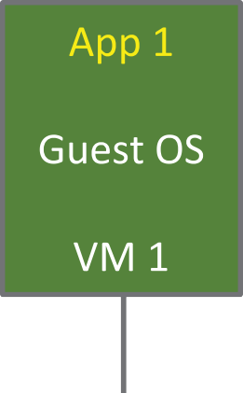
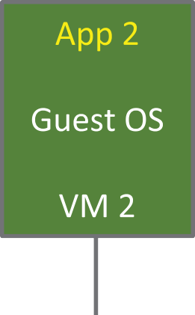
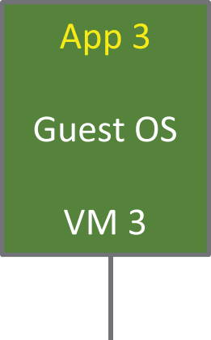



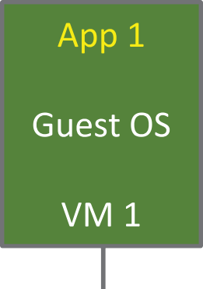
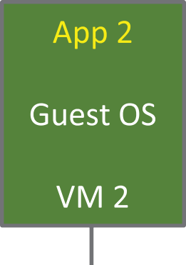
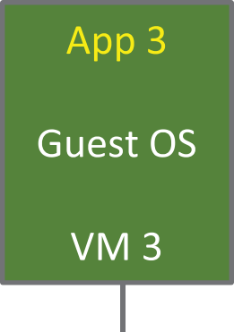



Common Technologies and Techniques used in Cloud Computing
Bare metal", "native" or Type I
Embedded", "hosted" or Type II

Slide 20
Cloud Computing — Guidance for Policy Development
Formulation of government/enterprises policies
Aspects for Policy Makers
Cloud computing essential characteristics (clause 6.2)
Major benefits of cloud computing (clause 6.3)
Implications for policy makers (clause 6.4)
Using international standards to assist in developing policies that cover cloud Computing (clause 7)
Considerations of regulatory, advisory and procurement policy when developing policy (clause 8)
IS/ISO/IEC TR 22678 : 2020), Cloud Computing — Guidance for Policy Development
Notes:
In order to run the services of Cloud Computing, the government/regulator require policies and regulations and the service providers have to follow them. Therefore this standard is quite i
important and assist for development of policies.
This standard provides guidance as a tool in the development of those policies that govern or regulate cloud service providers (CSPs) and cloud services, and those policies and practices that govern the use of cloud services in organizations.
This includes material that explains cloud computing concepts and the role of cloud computing international standards in formulating polices and practices.

Slide 21
Cloud Computing — Edge Computing Landscape
Concepts of edge computing
Edge computing is distributed computing in which data processing and storage takes place on nodes which are near to the edge.
Edge computing is characterized by networked systems in which significant data processing and storage takes place on nodes near the edge, rather than in some centralized location. Edge computing can be contrasted with centralized computing where the centralized nodes are remote from the edge.
(Reference – clause 5.2 of IS/ISO/IEC TR 23188 : 2020)
Architectural foundations of edge computing
Edge computing involves nodes that are highly heterogeneous and which are commonly arranged in tiers of compute and storage capabilities. A simplified view of the organization of edge computing nodes and the networks connecting them in edge computing is shown in Figure.
Reference – clause 5.3 of IS/ISO/IEC TR 23188 : 2020
Notes:
The explosive growth and increasing computing power of IoT devices has resulted in unprecedented volumes of data. Sending all device-generated data to a centralized data center or to the cloud causes bandwidth issue.
Example of Edge Computing
Imagine an oil drilling platform in the middle of the Sea. Operators collect data from sensors all over the platform as part of a daily routine, measuring things like pressure, temperature, wave height, and other factors that affect operating capacity. This kind of data comes fast, changes often and requires a real-time response.
Suppose that the oil platform data is stored and processed in a cloud data center. The platform operators would have to send their data over the internet – and in the Sea that means via satellite which is slow and expensive – just to evaluate their measurements which may lead to disaster.
With edge computing, instead of sending data to the cloud, it’s processed in an edge data center – no more waiting on a slow connection for critical analysis. Operations are more efficient and safety risks are significantly reduced.
So, Edge computing offers a more efficient alternative; data is processed and analyzed closer to the point where it's created. Because data does not traverse over a network to a cloud or data center to be processed, it would results in improved response times and less bandwidth usage.
We use edge devices such as smart speakers, watches, point of sale (POS) systems and phones that do edge computing everyday which are locally collecting and processing data while touching the physical world. Edge computing allows healthcare providers to process data from medical devices quickly and efficiently, which can lead to faster diagnosis and treatment.
Edge computing is a networking philosophy that moves computing closer to the source of data, rather than sending it to a central data enter. This helps to improve application performance, reduce bandwidth usage, and provide faster insight.
IS/ISO/IEC TR 23188 : 2020 (Cloud Computing — Edge Computing Landscape) aims to describe edge computing and the significant elements which contribute to the successful implementation of edge computing systems.

Slide 22
Edge Computing Landscape
Organization of nodes in edge computing
Edge computing involves nodes that are highly heterogeneous and which are commonly arranged in the tiers of compute and storage capabilities. A simplified view of the organization of edge computing nodes and network connecting them in edge computing is given in the figure below:
IS/ISO/IEC TR 23188 : 2020, “Cloud Computing — Edge Computing Landscape”
Notes:
One of the primary functions of an edge node is to collect data from local devices or sensors. This data may include sensor readings, logs, video feeds, or any other information generated at the edge. The edge nodes often perform initial data preprocessing tasks, such as data filtering, aggregation, compression, and even simple analytics.
You may refer IS/ISO/IEC TR 23188 : 2020 for further details on the topic.

Slide 23
Cloud Service Metering Elements and Billing Modes
Basically there are three Cloud service metering elements covered in the standard:
Cloud service metering elements for
1. Infrastructure capabilities type (clause 6.1) include processing resources, storage resources and networking resources
2. Platform capabilities type (clause 6,2) include message oriented middleware, catche size, instant running time, database (like processing requests, memory size etc)
3. Application capabilities type (clause 6.3) include API usage, application software (such as application count, running time)
IS/ISO/IEC TR 23613 : 2020- Cloud Service Metering Elements and Billing Modes
Notes:
Metering Element - the characteristics of cloud service that is subject to be metered.
The purpose of this standard is to provide basic clarity and guidance on cloud service metering elements and billing modes for different cloud capabilities types. It help a cloud service providers (CSPs) better describe its billing and metering practices and can help cloud service customers (CSCs) to better understand the metering and billing of their cloud services.
Metering unit-
Gibibyte (A gigabyte is equal to 109 or 1,000,000,000 bytes. One gibibyte equals 1.074 gigabytes.

Slide 24
Cloud Computing Service Level Agreement (SLA) Framework
A Service Level Agreement (SLA) is the bond for performance negotiated between the cloud services provider and the client.
Earlier, in cloud computing all Service Level Agreements were negotiated between a client and the service consumer. Now a days, with the initiation of large utility-like cloud computing providers, most Service Level Agreements are standardized.
Notes:
SLA outlines a level of service that a supplier promises to deliver to the customer. It outlines metrics such as uptime, delivery time, response time, and resolution time. A cloud agreement is the same as any other contract but may have different framework.

Slide 25
Series of Indian Standards on SLA:
Cloud Computing Service Level Agreement (SLA) Framework
1. IS/ISO/IEC 19086-1 : 2016
Service Level Agreement (SLA) Framework - Part 1 - Overview and Concepts
2. IS/ISO/IEC 19086-2 : 2018
Service Level Agreement (SLA) Framework - Part 2 - Metric Model
3. IS/ISO/IEC 19086-3 : 2017
Service Level Agreement ( SLA ) Framework - Part 3 - Core Conformance Requirements
4. IS/ISO/IEC 19086-4 : 2019
Service Level Agreement ( SLA ) Framework - Part 4 - Components of Security and of Protection of PII
Notes:
The cloud SLA should account for the key characteristics of a cloud computing service and needs to facilitate a common understanding between cloud service providers and cloud service customers.

Slide 26
Service Level Agreement ( SLA ) Framework - Overview and Concepts
Fundamental concepts of the cloud SLA framework:
1. Cloud Service Agreement (CSA)
2. Cloud Service Level Agreement (SLA)
3. Cloud Service Level Objectives (SLO)
4. Cloud Service Qualitative Objectives (SQO)
IS/ISO/IEC 19086-1 : 2010 CLOUD COMPUTING — SERVICE LEVEL
AGREEMENT ( SLA ) FRAMEWORK- PART 1 OVERVIEW AND CONCEPT
Notes:
CSA is documented agreement between the cloud service provider and cloud service customer that governs the covered service(s).
SLA part of CSA that includes cloud service level objectives (SLO) and cloud service qualitative objectives (SQO) for the covered cloud service(s)
IS/ISO/IEC 19086-1 : 2010 specifies,
a) an overview of cloud SLAs,
b) identification of the relationship between the cloud service agreement and the cloud SLA,
c) concepts that can be used to build cloud SLAs, and
d) terms commonly used in cloud SLAs.
This standard aims to assist cloud service customers when they compare cloud services from different cloud service providers.

Slide 27
Service Level Agreement ( SLA ) Framework - Metric Model
Metric – Standard of measurement (key performance indicator) that defines the conditions and rules for performing the measurement and for understanding the measurement result.
IS/ISO/IEC 19086-2 : 2018CLOUD COMPUTING — SERVICE LEVEL AGREEMENT ( SLA ) FRAMEWORK - PART 2 - METRIC MODEL
Notes:
IS/ISO/IEC 19086-2 , establishes common terminology, defines a model for specifying metrics for cloud SLAs and establishes a common terminology and approach for specifying metrics.
The metrics used in the cloud services are usually described using natural languages, typically in ‘plain English’, which is often difficult to understand, compare, and implement. The typical concern may be clarity in defining metric and subsequently facing a situation when it is not possible to measure and compare different services in terms of their promised service levels. This standard has been developed to help in addressing these problems and provides a metric model that defines the conditions and rules for performing a measurement and understanding the result.
The focus of this standard is on metrics for cloud SLAs, but it is also usable for cloud service metrics (CSMs) that are not included in cloud SLAs [such as ones used by cloud service providers (CSPs) for their internal performance monitoring], and may also be usable for non-CSMs. This standard is for the benefit of and use for both cloud service providers (CSPs) and cloud service customers (CSCs)

Slide 28
Service Level Agreement ( SLA ) Framework - Core Conformance Requirements
Components for defining core requirements
Cloud response time
Protection of personally identified information (PPI) content area
Information security content area
Governance (government) component
Changes to the cloud service features and functionality
Service reliability
Disaster recovery component
Intellectual property rights (IPR) component
Cloud service customer data
IS/ISO/IEC 19086-3 : 2017, “Cloud Computing — Service Level Agreement (SLA) Framework - Part 3 Core Conformance Requirements
Notes:
IS/ISO/IEC 19086-3 :specifies the core conformance requirements for service level agreements (SLAs) for cloud services based on ISO/IEC 19086-1 and guidance on the core conformance requirements. This standard is for the benefit of and use by both cloud service providers and cloud service customers.

Slide 29
Service Level Agreement ( SLA ) Framework - Components of Security and of Protection of PII
Components of Information Security System
Information security policy
Asset management component
Access control component
Cryptography component
Physical and environmental security component
Operations security component
Communications security component
Systems acquisition, development and maintenance component
Supplier relationships component
Information security incident management
IS/ISO/IEC 19086-4 : 2019”, “Cloud Computing — Service Level Agreement ( SLA ) Framework - Part 4 - Components of Security and of Protection of PII
Notes:
IS/ISO/IEC 19086-4 specifies security and protection of personally identifiable information (PII) components, Cloud Service Level Objectives (SLOs), Service Qualitative Objectives (SQOs) for Cloud Service Agreement s including guidance and requirements.

Slide 30
Multi-cloud
Multi-cloud refers to a cloud computing strategy where organizations use services and resources from multiple cloud providers. This approach allows them to distribute workloads across different cloud environments, optimizing performance, enhancing resilience, avoiding vendor lock-in, and meeting specific business and regulatory requirements effectively.
Examples
Company A: uses Amazon Web Services (AWS) for its data storage and Microsoft Azure for its machine learning and AI services. By adopting a multi-cloud strategy, Company A can leverage AWS's robust storage capabilities while benefiting from Azure's advanced AI tools.
Notes:
With a multi-cloud approach, you're not tied to a single provider. You can choose whatever solution best suits your business needs.
Benefits of Multi-Cloud Services
1. Avoid Vendor Lock-In: By utilizing multiple cloud providers, organizations reduce dependency on any single vendor.
2. Resilience and Redundancy: It mitigates the impact of potential outages or disruptions from a single provider, ensuring continuous service availability.
3. Regulatory Compliance: Multi-cloud environments support compliance with data sovereignty and regulatory requirements by hosting data in specific geographic regions as mandated by laws or regulations.
4. Innovation and Flexibility: Access to diverse tools, services, and innovation from multiple cloud providers fosters flexibility.

Slide 31
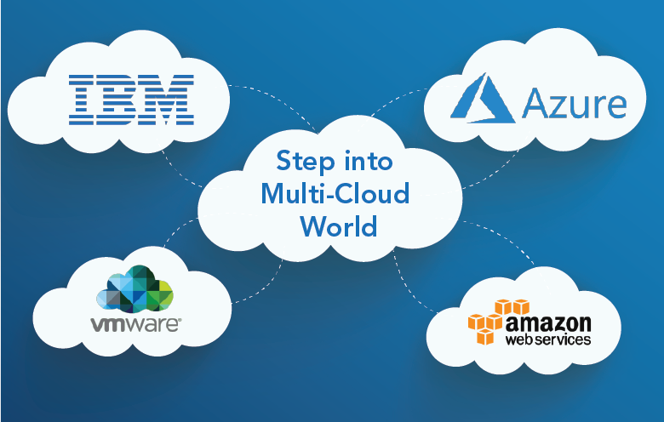
Example of Multi-cloud

Slide 32
Models of Multi-Cloud
1 Multi-Cloud
In a multi-cloud CDM, the CSC is responsible for providing cloud service administrator and business manager functions for a defined set of cloud service users (CSUs)..
2. Federated cloud
A federated cloud is a CDM in which cloud services are provided by two or more members of a cloud service federation (CSF).
3. Hybrid cloud
A hybrid cloud is a CDM that uses both a public cloud and a private cloud. The public and private clouds involved remain unique but are bound together by appropriate technology that enables interoperability, data portability and application portability.
ISO/IEC 5140:2024
Cloud computing — Concepts for multi-cloud and the use of multiple cloud services
Notes:
This international standard specifies foundational concepts for multiple cloud services including multi-cloud, hybrid cloud, and federated cloud.
The standard addresses the complexities and benefits of using multiple cloud services from different cloud service providers (CSPs), emphasizing interoperability, flexibility, and management.

Slide 33
Data Centers
Data centers provide critical infrastructure for the storage, management, and dissemination of data and are essential for business operations in various industries.
A data center in cloud computing is the physical foundation. Data centers are the powerhouses behind cloud computing and provide the essential infrastructure that allows cloud providers to offer services like storage, compute power, and databases on-demand.
There are 14 Indian standards published or under development on Data Centres
Notes:
Data centers and cloud computing are often used interchangeably but are quite different. While data center facilities and cloud computing both deal with data storage and processing, they have distinct features.

Slide 34
Data Centre vs. The Cloud
Point of Difference | Data Centre | Cloud Computing
Definition | A physical facility for storing, managing, and processing data | A virtualized service that provides on-demand access to computing resources
Ownership | Owned and managed by the organization itself | Owned and managed generally by a third-party provider
Infrastructure | Dedicated hardware and software | Shared hardware and software
Scalability | Limited by physical capacity and upgrades | Highly scalable, can quickly add or remove resources
Availability | Limited by physical location and connectivity | Accessible from anywhere with an internet connection
Security | Typically provides physical and network security | The provider manages security measures
Cost | High initial capital investment and ongoing maintenance | Pay-as-you-go model; more cost-effective for small businesses and startups
Customization | Highly customizable to meet specific needs | Limited customization options for off-the-shelf services
Notes:
There is confusion sometimes about difference between Data Centres and Cloud Computing. This slide provide the basic difference.

Slide 35
Data Centre Facilities and Infrastructures
Classification for Design of Data Centre
Availability (Single site / Multi-site)
Physical Security
3. Energy Efficiency enablement- Classification by Design
IS/ISO/IEC 22237-1: 2021, “Data Centre Facilities and Infrastructures - Part 1: General Concepts
Notes:
Physical security in terms of unauthorized access, intrusion, internal and external environmental shall be taken care while designing.
Energy Efficiency enablement- The data centre owner/user shall define appropriate energy efficient enablement prior to data centre design.
This standard, address the general aspects of the facilities and infrastructure required to support a Data Centre including terminology, parameters and reference models, addressing both the size and complexity of their intended purpose.
This series of standards specifies requirements and recommendations to support the various parties involved in the design, planning, procurement, integration, installation, operation and maintenance of facilities and infrastructures within data centres.

Slide 36
Data Centre Facilities and Infrastructures : Building construction
Requirement for building constructions of Data Centre
a) Location and site selection (taking in to account natural environment and adjacencies);
b) Protection from environmental risks;
c) Site configuration;
d) Building construction;
e) Building configuration;
f) Provision of access;
g) Physical intrusion protection;
h) Physical fire protection;
i) Protection against damage from water;
j) Quality construction measures.
ISO/IEC 22237-2 : 2024 - Data Centre Facilities and Infrastructures : Building construction
Please use the following link to access standard ISO/IEC 22237-1: 2021
https://www.iso.org/standard/82248.html

Slide 37
Typical functional elements of power supply and distribution
Area | Functional element | Typical accommodation
Supply | Primary supply/ Secondary Supply | Transformer space
 | Supply transfer equipment (where multiple supply exists) | Electrical space
 | Addition supply (Generator/UPS) | Generator space/ Electrical space
Distribution | Primary distribution equipment | Electrical distribution space Transformer space
 | UPS | Electrical space (or computer room space)
 | Secondary distribution equipment | Electrical space Transformer space (if required)
 | Tertiary distribution equipment | Computer room spaces or spaces requiring provisions of protected supplies
IS/ISO/IEC 22237-3: 2021-Data Centre Facilities and Infrastructures : Power Distribution
Notes:
This standard specifies requirements and recommendations for the following:
a) power supplies to data centres;
b) power distribution systems to all equipment within data centres;
c) telecommunications infrastructure bonding;
d) lightning protection;
e) devices for the measurement of the power consumption and power quality characteristics at points along the power distribution system and their integration within management tools.

Slide 38
Data Centre Facilities and Infrastructures : Environmental Control
This standard addresses environmental control within data centres based upon the criteria and classifications for “availability”, “security” and “energy efficiency enablement” within IS/ISO/IEC 22237-1.
This standard specifies requirements and recommendations for the following:
a) temperature control;
b) fluid movement control;
c) relative humidity control;
d) particulate control;
e) vibration;
f) physical security of environmental control systems.
IS/ISO/IEC 22237-4: 2021, “Data Centre Facilities and Infrastructures : Environmental Control ”
Notes:
In addition to the energy consumption of the data centres, the environmental issues are critical interns of carbon footprint and economic consideration, i.e. cost of energy. Therefore data centres shall be sustainable in their functioning.

Slide 39
Data Centre Facilities and Infrastructures : Telecommunications cabling infrastructure
This standard addresses the wide range of telecommunications cabling infrastructures within data centres based upon the criteria and classifications for “availability” within IS/ISO/IEC TS 22237-1.
This standard specifies requirements and recommendations for the following:
a) information technology and network telecommunications cabling (e.g. SAN and LAN);
b) general information technology cabling to support the operation of the data centre;
c) telecommunications cabling to monitor and control, as appropriate, power distribution, environmental control and physical security of the data centre;
d) other building automation cabling;
pathways, spaces and enclosures for the telecommunications cabling infrastructures.
ISO/IEC 22237-5 : 2018, “Data Centre Facilities and Infrastructures : Telecommunications cabling infrastructure”

Slide 40
Data Centre Facilities and Infrastructures : Security systems
This standard specifies requirements and recommendations concerning the physical security of data centres based on the criteria and classifications for “availability”, “security” and “energy efficiency enablement” within IS/ISO/IEC 22237-1.
This standard provides designations for the data centre spaces defined in IS/ISO/IEC 22237-1.
This standard specifies requirements and recommendations for such data centre spaces, and the systems employed within those spaces, in relation to protection against:
a) unauthorized access addressing organizational and technological solutions;
b) intrusion;
c) internal fire events igniting within data centre spaces;
d) internal environmental events (other than fire) within the data centre spaces which would affect the defined level of protection;
e) external environmental events outside the data centre spaces which would affect the defined level of protection.
ISO/IEC 22237-6:2024, “Data Centre Facilities and Infrastructures : Security systems“

Slide 41
Performance of Data Centre
Series of standards on Key Performance Indicators (KPI) of Data Center
1. IS/ISO/IEC 30134 - 1 : Part 1 Overview and General Requirements
2. IS/ISO/IEC 30134 - 2 : Part 2 Power Usage Effectiveness ( PUE )
3. IS/ISO/IEC 30134 - 3 : Part 3 Renewable Energy Factor ( REF )
4. IS/ISO/IEC 30134 - 4 : Part 4 Equipment Energy Efficiency for Servers (ITEEsv )
5. IS/ISO/IEC 30134 - 5 : Part 5 IT Equipment Utilization for Servers (ITEUsv )
6. IS/ISO/IEC 30134 - 6 : Part 6 Energy Reuse Factor ERF
7. IS/ISO/IEC 30134 - 8 : Part 8 Carbon Usage Effectiveness CUE
8. IS/ISO/IEC 30134 - 9 : Part 9 Water Usage Effectiveness WUE
Notes:
The key performance indicators (KPIs) covers the effective use of resources and the reduction of CO2 emissions.

Slide 42
Data Centers Key Performance Indicators
Common Objectives
the minimization of energy and other resource (e.g. water) consumption;
the task effectiveness of the IT load (data processing, storage and transport) within the data centre,
maximizing the IT output with the minimum energy consumption;
the energy reuse in the form of waste heat, if possible;
the use of renewable energy, both generated on site and off site.
IS/ISO/IEC 30134-1:2016 , “Data Centers Key Performance Indicators - Part 1 Overview and General Requirements”
Notes:
Due to the variable nature of type, size, purpose and geographical location of data centres, it is not possible to define a single, universally relevant KPI for resource usage effectiveness.
IS/ISO/IEC 30134-1 covers common requirements and objectives for KPIs of data centre resource usage effectiveness and efficiency.

Slide 43
Data Centers Key Performance Indicators - Power Usage Effectiveness (PUE)
Power Usage Effectiveness (PUE)
ratio of the data centre total energy consumption to information technology equipment energy consumption, calculated, measured or assessed across the same period
IS/ISO/IEC 30134-2 : 2016, “Data Centers Key Performance Indicators - Power Usage Effectiveness (PUE)”
Notes:
It is well accepted fact that data centre growth, and power consumption in particular, is an inevitable consequence and that growth will demand increasing power consumption despite the most stringent energy efficiency strategies. This make the need of key performance indicators (KPIs) that cover the effective use of resources and the reduction on CO2 emission essential.
IS/ISO/IEC 30134 -2 specifies the power usage effectiveness (PUE) as a key performance indicator (KPI) to quantify the efficient use of energy in the form of electricity which
defines the power usage effectiveness (PUE) of a data centre,
introduces PUE measurement categories,
describes the relationship of this KPI to a data centre’s infrastructure, information technology
equipment and information technology operations,
defines the measurement, the calculation and the reporting of the parameter,
provides information on the correct interpretation of the PUE.

Slide 44
Data Centers Key Performance Indicators - Renewable Energy Factor (REF)
Renewable Energy Factor (REF)
ratio of the renewable energy (3.1.1) owned and controlled by a data centre to the total data centre energy consumption
IS/ISO/IEC 30134-3 : 2016, “Data Centers Key Performance Indicators - Renewable Energy Factor (REF)”
Notes:
The use of and the demand for renewable energy (RE) became increasingly popular as it reduces or replaces the use of non-RE sources. The use of RE as one of the sources to power data centre becomes increasingly important as their electricity consumption has risen to a significant share of the total global electricity consumption.
The use of REF as a key performance indicator (KPI) allows data centre managers to improve a data centre’s energy procurement portfolio and increase the diversity of energy dependence.
IS/ISO/IEC 30134-3 defines the renewable energy factor (REF) of a data centre, specifies a methodology to calculate and to present the REF, and
provides information on the correct interpretation of the REF.

Slide 45
Data Centers Key Performance Indicators - IT Equipment Energy Efficiency for Servers (ITEEsv)
Information Technology Equipment Energy Efficiency for servers (ITEEsv)
maximum performance per kW of all servers or a group of servers in a data centre
IS/ISO/IEC 30134-4 : 2017, “Data Centers Key Performance Indicators - IT Equipment Energy Efficiency for Servers (ITEEsv)”
Notes:
IT equipment installed in a data centre consists of servers, storage systems, and network equipment. But it is difficult to calculate the summarized value of the energy effectiveness or efficiency among different types of IT equipment since the metrics for measuring their performance are different and simple addition or average is not an appropriate method for summarizing. ITEEsv defines the method to obtain average energy effectiveness or efficiency for servers.
IS/ISO/IEC 30134-4 : 2017
defines ITEEsv;
describes the purpose of ITEEsv;
describes how to use ITEEsv;
describes reporting of ITEEsv.

Slide 46
Data Centers Key Performance Indicators - IT Equipment Utilization for Servers (ITEUsv)
IT Equipment Utilization for Servers (ITEUsv)
average utilization ratio of all servers or a group of servers in a data centre
IS/ISO/IEC 30134-5 : 2017, “Data Centers Key Performance Indicators - IT Equipment Utilization for Servers (ITEUsv)
Notes:
One approach to improve the resource effectiveness or efficiency of servers in a data centre is to:
improve the utilization ratio of servers by using such technologies as virtualization and server consolidation for sharing use of servers, and
reduce the number of servers to achieve the same level of information processing.
IS/ISO/IEC 30134-5 : 2017
describes the purposes of ITEUsv,
defines ITEUsv in a conceptual manner,
describes how to use ITEUsv, and
describes reporting of ITEUsv.

Slide 47
Data Centers Key Performance Indicators - Energy Reuse Factor (ERF)
Energy Reuse Factor (ERF)
is defined as the ratio of energy being reused divided by the sum of all energy consumed in a data centre. The ERF does reflect the efficiency of the reuse process; the reuse process is not part of a data centre.
IS/ISO/IEC 30134-6 : 2021, “Data Centers Key Performance Indicators - Energy Reuse Factor ERF“
Notes:
The energy reuse factor (ERF) provides the data centre practitioner with greater visibility into energy efficiency in data centres that make beneficial use of any reused energy from the data centre.
IS/ISO/IEC 30134-6 specifies the energy reuse factor (ERF) as a KPI to quantify the reuse of the energy consumed in a data centre

Slide 48
Data Centers Key Performance Indicators - Carbon Usage Effectiveness (CUE)
Carbon Usage Effectiveness (CUE)
ratio of the data centre annual CO2 emissions and IT equipment energy demand
IS/ISO/IEC 30134-8 : 2022, “Data Centers Key Performance Indicators - Carbon Usage Effectiveness CUE”
Notes:
Carbon usage effectiveness (CUE) is intended to enable data centre practitioners to quickly calculate the sustainability of their data centres, compare the results and determine if any energy efficiency and/or sustainability improvements need to be made. The impact of operational carbon usage is emerging as being extremely important in the design, location and operation of current and future data centres.
IS/ISO/IEC 30134-8
defines the CUE of a data centre;
introduces CUE measurement categories;
describes the relationship of this KPI to a data centre’s infrastructure, information technology equipment and information technology operations;
defines the measurement, the calculation and the reporting of the parameter; and
provides information on the correct interpretation of the CUE.
This standard presents specific rules on CUE’s use, along with its theoretical and mathematical development. This document concludes with several examples of site concepts that could employ the CUE metric.

Slide 49
Data Centers Key Performance Indicators - Water Usage Effectiveness (WUE)
Water Usage Effectiveness (WUE)
ratio of the data centre water consumption divided by the energy consumed by IT equipment
IS/ISO/IEC 30134-9 : 2022, “Data Centers Key Performance Indicators: Water Usage Effectiveness (WUE)“
Notes:
Water usage effectiveness (WUE) is intended to support data centre practitioners in obtaining an in depth understanding of the performance of the data centre’s cooling installation in comparison with similar systems, thereby creating a tool for improving the sustainability of the data centre.
The impact of operational water usage is emerging as being extremely important in the design, location and operation of current and future data centres.
IS/ISO/IEC 30134-9
defines the WUE of a data centre;
introduces WUE measurement categories;
describes the relationship of this KPI to a data centre’s infrastructure, information technology equipment and information technology operations;
defines the measurement, the calculation and the reporting of the parameter; and
provides information on the correct interpretation of the WUE.

Slide 50
Indian Standards
in the field
of
Cloud Computing, Multi-cloud
&
Data Centre
Notes:
List should be end of the presentation

Slide 51
Standards in the field of Cloud Computing and Multi-Cloud
1. Cloud computing Overview and vocabulary - IS/ISO/IEC 17788
Cloud Computing Service Level Agreement SLA Framework
Series of IS/ISO/IEC 19086
2. Part 1 : Overview and Concepts
3. Part 2 : Metric Model
4. Part 3 : Core Conformance Requirements
5. Part 4 : Components of Security and of Protection of PII
6. IS/ISO/IEC 22624 - Cloud Computing : Taxonomy Based Data Handling for Cloud Services
7. IS/ISO/IEC/TR 22678 - Cloud Computing : Guidance for Policy Development
8. IS/ISO/IEC/TS 23167 - Cloud Computing : Common Technologies and Techniques
9. IS/ISO/IEC/TR 23187 - Cloud Computing : Interacting with Cloud Service Partners CSNs

Slide 52
Standards in the field of Cloud Computing and Multi-Cloud
10. IS/ISO/IEC/TR 23187 - Cloud Computing : Interacting with Cloud Service Partners CSNs
11. IS/ISO/IEC/TR 23188 - Cloud Computing : Edge computing landscape
12. IS/ISO/IEC/TR 23951 - Cloud Computing : Guidance for using the cloud SLA metric model
13. ISO/IEC 5140 - Cloud computing : Concepts for multi-cloud and the use of multiple cloud services
Please use the following link to access standard and other definitions:
https://www.services.bis.gov.in/php/BIS_2.0/bisconnect/knowyourstandards/Indian_standards/isdetails/

Slide 53
Standards in the field of Data Centre
Series of standards on Data Centre Facilities and Infrastructures
IS/ISO/IEC 22237 - 1 : Part - 1: General Concepts
IS/ISO/IEC 22237 - 2 : Part - 2 : Data Centre Facilities and Infrastructures
IS/ISO/IEC 22237 - 3 : Part - 3 : Power Distribution
IS/ISO/IEC 22237 - 4 : Part - 4: Environmental Control
IS/ISO/IEC 22237 - 5 : Part - 5 : Telecommunications Cabling Infrastructure
ISO/IEC 22237 – 6 : Part - 6: Security systems
Series of standards on KPI of Data Center
7. IS/ISO/IEC 30134 - 1 : Part 1 Overview and General Requirements
8. IS/ISO/IEC 30134 - 2 : Part 2 Power Usage Effectiveness ( PUE )
9. IS/ISO/IEC 30134 - 3 : Part 3 Renewable Energy Factor ( REF )
10. IS/ISO/IEC 30134 - 4 : Part 4 Equipment Energy Efficiency for Servers (ITEEsv )
11. IS/ISO/IEC 30134 - 5 : Part 5 IT Equipment Utilization for Servers (ITEUsv )
12. IS/ISO/IEC 30134 - 6 : Part 6 Energy Reuse Factor ERF
13. IS/ISO/IEC 30134 - 8 : Part 8 Carbon Usage Effectiveness CUE
14. IS/ISO/IEC 30134 - 9 : Part 9 Water Usage Effectiveness WUE
Please use the following link to access standard and other definitions:
https://www.services.bis.gov.in/php/BIS_2.0/bisconnect/knowyourstandards/Indian_standards/isdetails/

Slide 54
Thank You

