Slide 1
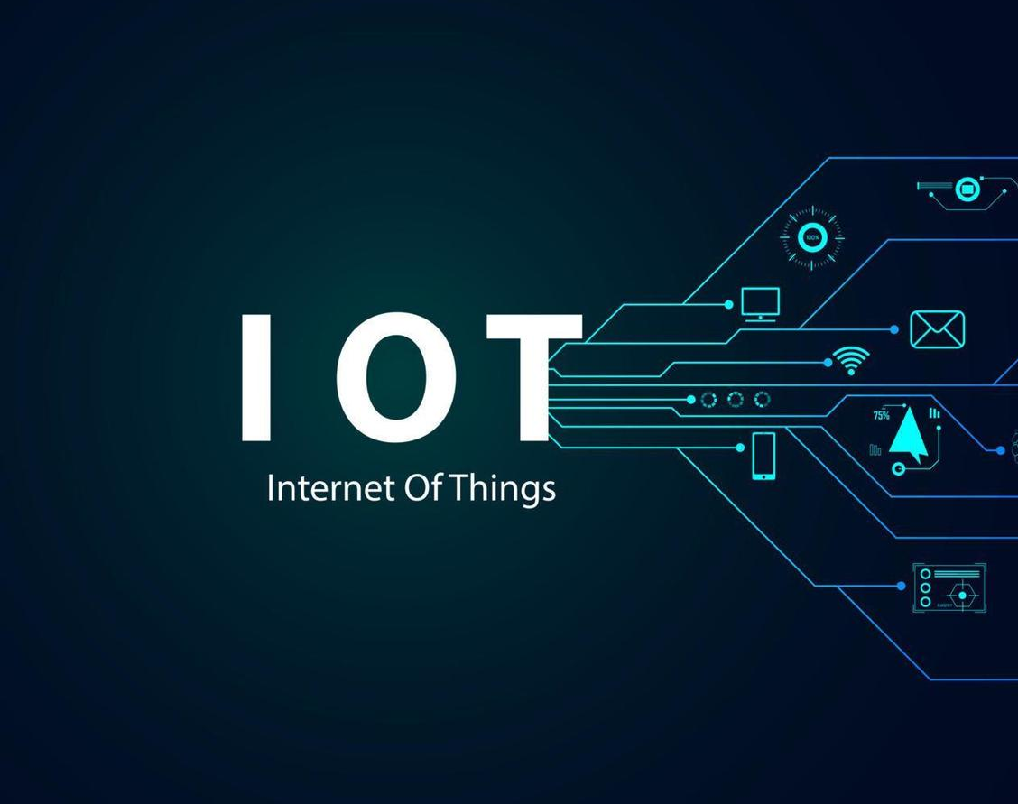
Brainstorming about Standards pertaining to Internet of Things (IoT) & Digital Twins

Slide 2
CONTENTS
Introduction to IoT
Advent of IoT ERA
IoT System : Reference Architecture
Desirable Features IoT must possess
Interoperability
Security & Privacy
Digital Twin

Slide 3
INTRODUCTION
What do we mean by Internet of Things (IoT) ?
Internet of Things (IoT): Infrastructure of interconnected entities, people, systems and information resources together with services which processes and reacts to information from the physical world and virtual world
(ISO/IEC 20924:2024 Internet of Things (IoT) and digital twin - Vocabulary)

Slide 4
INTRODUCTION

Slide 5
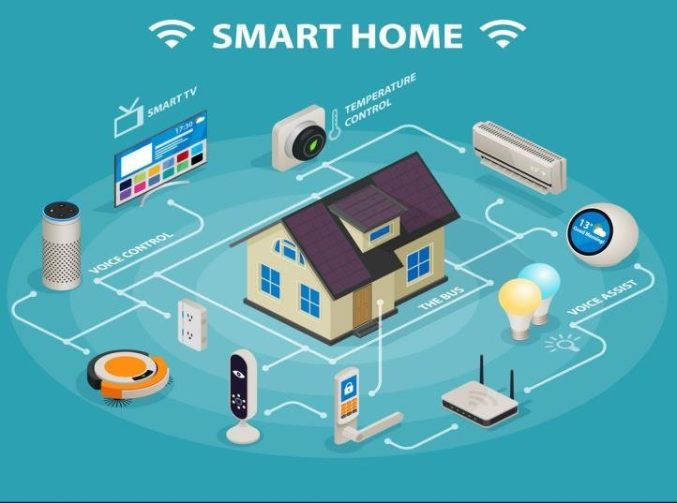
INTRODUCTION

Slide 6
ADVENT OF IoT ERA……..
In 2008, the number of devices connected to the internet surpassed the global human population, signaling the dawn of a new era where the internet's primary function shifted from connecting people to connecting things
In 2030, the number of devices are expected to grow to 40 billion by 2030.
Connecting physical and digital realms
Applications of IoT include Smart Home automation, Industrial IoT, Smart Cities, Health Care, Agriculture, Retails and Logistics, Energy Management, Environment Monitoring etc

Slide 7
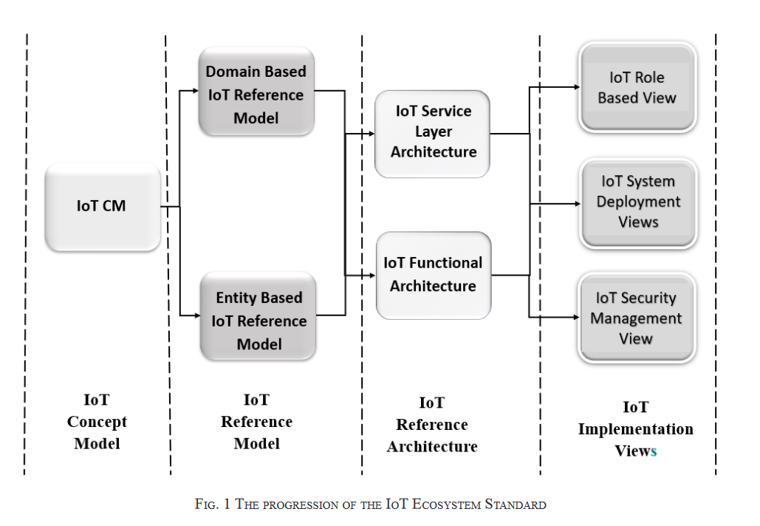
IoT System : Reference Architecture
IoT ECOSYSTEM
(IS 18004 (PART 1) : 2021 IoT System : Reference Architecture)
Contd….

Slide 8
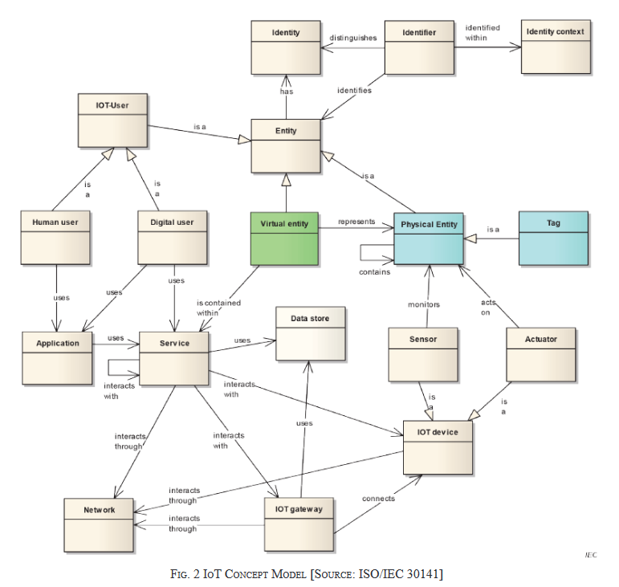
IoT System : Reference Architecture
IoT CONCEPT MODEL
(IS 18004 (PART 1) : 2021 IoT System : Reference Architecture)
Contd….

Slide 9
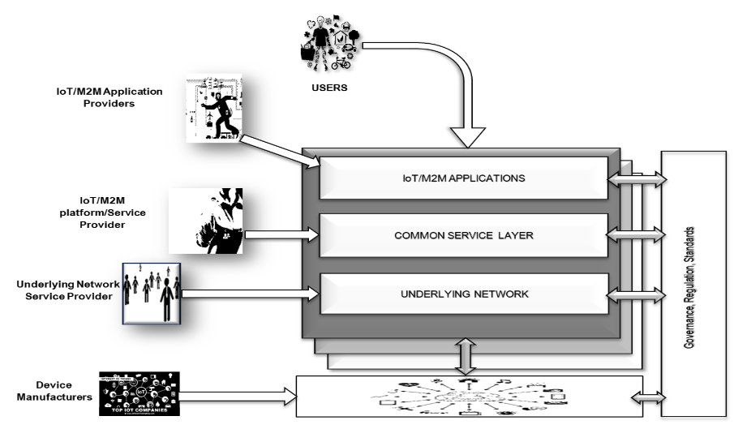
IoT System : Reference Architecture
What are the roles to be played by corresponding stakeholders in an IoT system ?
(IS 18004 (PART 1) : 2021 IoT System : Reference Architecture)
Contd….

Slide 10
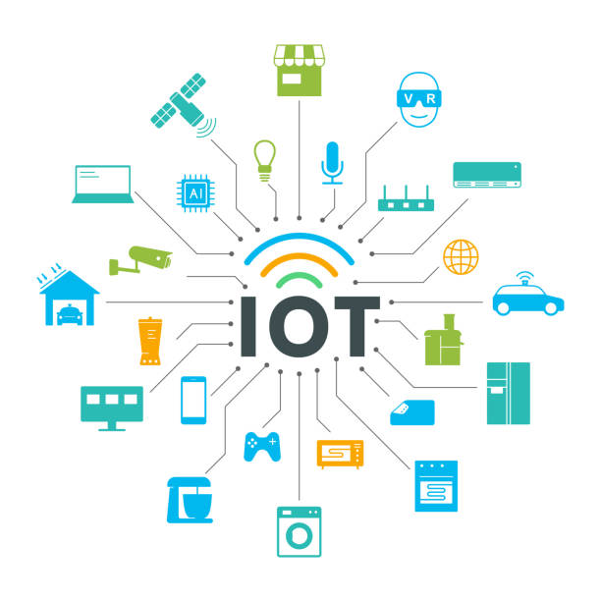
IoT System : Reference Architecture
What are the roles to be played by corresponding stakeholders in an IoT system ?
User
Lawfully subscribes to an IoT System
Application service Provider
Registers the application
Operates IoT/M2M Application service
The IoT/M2M Service Provider
Obtains the required registrations and certifications for the provisioning of end to end IoT services
Operates IoT/M2M Services
(IS 18004 (PART 1) : 2021 IoT System : Reference Architecture)
Contd….

Slide 11
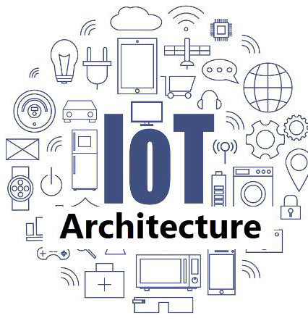
IoT System : Reference Architecture
Network Service Provider
Provides connectivity and related services for IoT System
Operates an underlaying Network
Device Manufacturers
Provides/Manufactures the devices in the field
Conforms to the specifications of the standards as applicable in the IoT System
(IS 18004 (PART 1) : 2021 IoT System : Reference Architecture)

Slide 12
DESIRABLE FEATURES IoT MUST POSSESS…
What are the main features an IoT system/device/application must have?
Interoperability
Security & Privacy

Slide 13
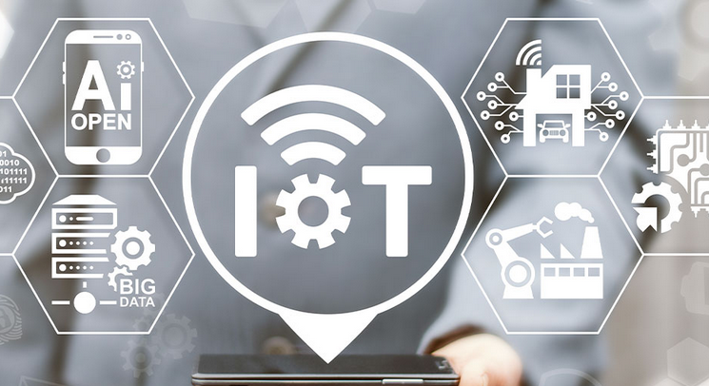
INTEROPERABILITY
What does “Interoperability” means ?
Entities of IoT system are able to exchange information and mutually use the information in an efficient way
Devices from different manufactures should communicate and work together seamlessly felicitating data exchange between devices
Enabling peer to peer interoperability between separate IoT systems
Definition
Ability for two or more systems or applications to exchange information and to mutually use the information that has been exchanged
(ISO/IEC 21823-1 Internet of things (IoT)- Interoperability for IoT systems – Part-1: Framework)

Slide 14
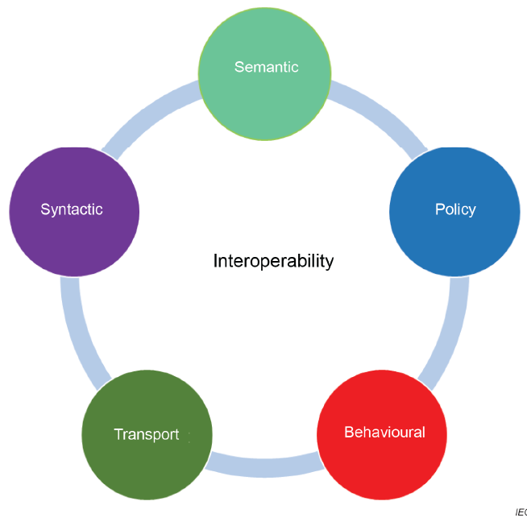
INTEROPERABILITY
Facets of IoT Interoperability
(ISO/IEC 21823-1 Internet of things (IoT)- Interoperability for Iot systems – Part-1: Framework)

Slide 15
TRANPORT INTEROPERABILITY
Information exchange uses an established communication infrastructure between the participating systems
Aim: Data Transfer between Systems
Objects: Physical Connections, Signals
Requirements: Protocols for Data Transfer
Examples: HTTP/S, MQTT
(ISO/IEC 21823-2 Internet of things (IoT)- Interoperability for iot systems – Part-2: Transport Interoperability)

Slide 16
SYNTACTIC INTEROPERABILITY
The formats of the exchanged information can be understood by the participating systems
Aim: Receive Data in an understood Format
Objects: Data
Requirements: Standardized data exchange formats
Examples: JSON, XML, ASN.1
(ISO/IEC 21823-4 Internet of things (IoT)- Interoperability for iot systems – Part-4: Syntactic Interoperability)

Slide 17
SEMANTIC INTEROPERABILITY
The meaning of the data model within the context of a subject area is understood by the participating systems
Aim: Receive Data using data information model
Objects: Programmatic Interface
Requirements: Common Interpretation of data information model
Examples: Directories, data keys, ontologies
(ISO/IEC 21823-3 Internet of things (IoT)- Interoperability for iot systems – Part-3: Semantic Interoperability)

Slide 18
BEHAVIOURAL INTEROPERABILITY
The actual result achieves the expected outcome
Aim: Obtain expected outcomes to interface operations
Objects: Information
Requirements: Behavioural Model(s) of the invoked IoT entity
Examples: UML models, pre and post conditions, constraint specifictions
(ISO/IEC 21823-5 Internet of things (IoT) — Interoperability for IoT systems Part 5: Behavioural and policy interoperability)

Slide 19
POLICY INTEROPERABILITY
Interoperability while complying with the legal, organizational, and policy frameworks applicable to the participating systems
Aim: Assurances that interoperating systems follow applicable regulatory and organizational policies
Objects: Regulatory and organizational policies and interoperation context
Requirements: Conditions and control for use and access
Examples: Security policies of IoT system stakeholders, restriction on cross-border data transfer, regulations controlling Personally identifiable information (PII)
(ISO/IEC 21823-5 Internet of things (IoT) — Interoperability for IoT systems Part 5: Behavioural and policy interoperability)

Slide 20
INTEROPERABILITY
Interoperability with respect to IoT characteristics
IoT System characteristics
IoT Component characteristics
(ISO/IEC 21823-1 Internet of things (IoT)- Interoperability for Iot systems – Part-1: Framework)

Slide 21
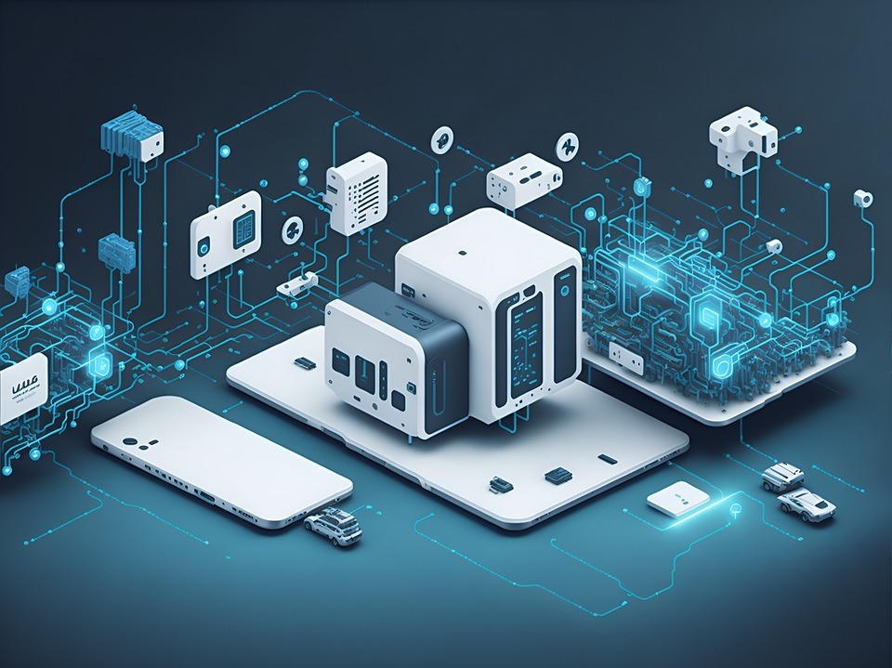
INTEROPERABILITY
IoT System characteristics
Network Communication
Mainly focused on the transport facet
Two entities are interoperable if:
they use same communication infrastructure
Or with the use of network intermediary devices such as routers and gateways if their physical mediums are different
(ISO/IEC 21823-1 Internet of things (IoT)- Interoperability for Iot systems – Part-1: Framework)

Slide 22
INTEROPERABILITY
Self Description
Self-description is mainly focused on the syntactic facet
To enable communication with an IoT entity from other IoT entities, Self-description of following elements is necessary:
Interface definition(s)
Network description (type of network, endpoint identifiers)
Security capabilities and parameters
Entity metadata including entity type, capabilities description, constraints
(ISO/IEC 21823-1 Internet of things (IoT)- Interoperability for Iot systems – Part-1: Framework)

Slide 23
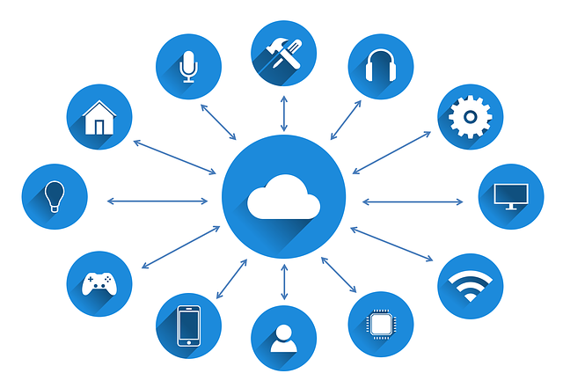
INTEROPERABILITY
IoT Component characteristics
Discoverability
Allows users, services, and other devices to find both devices on the network and the capabilities and services they offer at any particular time
Network connectivity
In order to support network communication interoperability, network connectivity should be described as self-description
Unique identification
Unique identification is very important to make one IoT system interoperable with other IoT systems
(ISO/IEC 21823-1 Internet of things (IoT)- Interoperability for Iot systems – Part-1: Framework)
Contd….

Slide 24
INTEROPERABILITY
Security
Confidentiality: Confidentiality should be guaranteed between two interoperating IoT systems
Integrity: Data integrity should be guaranteed between two interoperating IoT systems
Protection of personally identifiable information: Protection of Personally Identifiable Information should be guaranteed over two interoperating IoT systems. Confidentiality may impact the behavioural and policy facets
(ISO/IEC 21823-1 Internet of things (IoT)- Interoperability for Iot systems – Part-1: Framework)
Contd….

Slide 25
INTEROPERABILITY
Legacy support
A support for service, protocol, device, system, component, technology, or standard that is outdated but which is still in current use may be needed for interoperability with backward compatibility
Heterogeneity
Heterogeneity of IoT systems indicates that they may have different interfaces with each other. Heterogeneous IoT systems should be interoperable by means of appropriate mechanisms
Compliance
In order to support policy interoperability between IoT entities, those IoT entities should conform to the applicable regulations
(ISO/IEC 21823-1 Internet of things (IoT)- Interoperability for Iot systems – Part-1: Framework)
Contd….

Slide 26
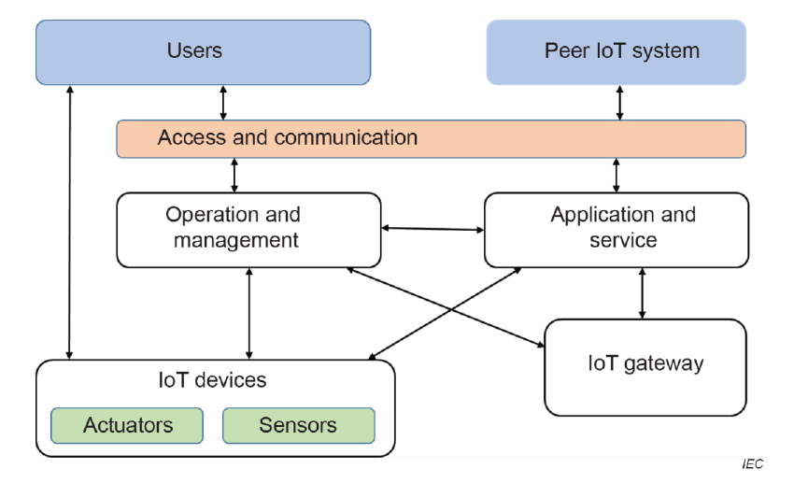
INTEROPERABILITY
Framework for interoperable IoT systems
(ISO/IEC 21823-1 Internet of things (IoT)- Interoperability for Iot systems – Part-1: Framework)

Slide 27
INTEROPERABILITY
Framework for interoperable IoT systems
Two Broad Type of Interactions :
Interactions between two IoT systems, indicated by the arrow linking Peer IoT system and Access and communication
Communication between entities within a single IoT system, indicated by all the other arrows
(ISO/IEC 21823-1 Internet of things (IoT)- Interoperability for Iot systems – Part-1: Framework)

Slide 28
INTEROPERABILITY
The major interactions taking place between entities within an IoT system are :
(ISO/IEC 21823-1 Internet of things (IoT)- Interoperability for Iot systems – Part-1: Framework)
Applications and services with IoT devices. | Applications and services with IoT gateways. | IoT gateways with IoT devices.
Applications with services. | Services with services | Management systems with IoT devices
Management systems with IoT gateways | Management systems with applications and services | Management systems with user devices

Slide 29
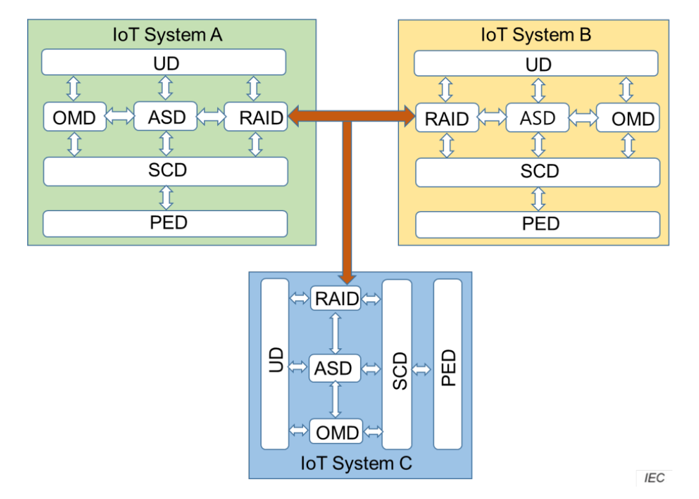
INTEROPERABILITY
Framework for interoperable IoT systems
ASD 21Application & Service Domain
OMD Operation & Management Domain
RAID Resource Access & Interchange Domain
SCD Sensing & Controlling Domain
UD User Domain
PED Physical Entity Domain
(Communication and data exchange between IoT Systems)
(ISO/IEC 21823-1 Internet of things (IoT)- Interoperability for Iot systems – Part-1: Framework)

Slide 30
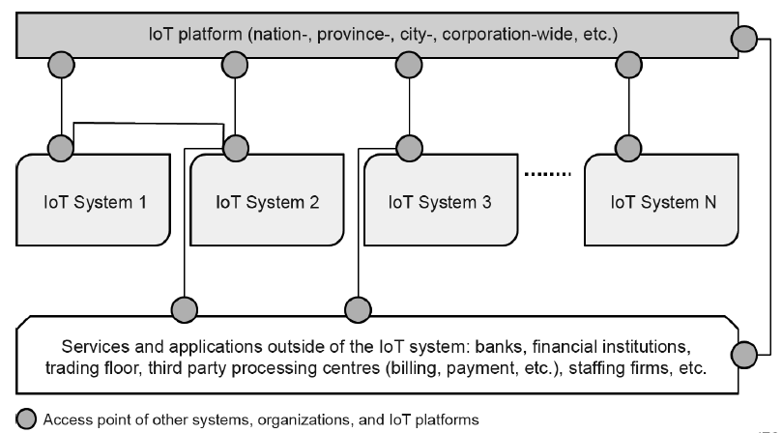
INTEROPERABILITY
Framework for interoperable IoT systems
Overall IoT Infrastructure
(Integration of various types of IoT Systems in vertical ASD)
Interoperability through IoT platforms at different organizational levels
The lines represent network connectivity and the grey circles represent interoperable access points (e.g. IoT gateways)
(ISO/IEC 21823-1 Internet of things (IoT)- Interoperability for Iot systems – Part-1: Framework)

Slide 31
INTEROPERABILITY
Other Standards for detailed study on Interoperability
ISO/IEC 21823-2 Internet of things (IoT)- Interoperability for iot systems – Part-2: Transport Interoperability
ISO/IEC 21823-3 Internet of things (IoT)- Interoperability for iot systems – Part-3: Semantic Interoperability
ISO/IEC 21823-4 Internet of things (IoT)- Interoperability for iot systems – Part-4: Syntactic Interoperability
(ISO/IEC 21823-5 Internet of things (IoT) — Interoperability for IoT systems Part 5: Behavioural and policy interoperability

Slide 32
SECURITY AND PRIVACY
What are the requirements for security and privacy?
Risk Management
IoT security and privacy risks should be :
Identified
Quantified or qualitatively described
Prioritized
against risk evaluation criteria and objectives relevant to the organization.
(ISO/IEC 27400:2022(E) Cybersecurity — IoT security and privacy — Guidelines)

Slide 33
SECURITY AND PRIVACY
What could be the sources of Security Risk in an IoT system ?
Vulnerability of the IoT system, application or service
Lack of knowledge and skills of persons who have roles in the provision or use of the IoT system, application or service
Human error of persons who have roles in the provision or use of the IoT system, application or Service
Existence of persons who have malicious intent of attacking the IoT system, application or service
Quality of the IoT system, application or service and components of them
(ISO/IEC 27400:2022(E) Cybersecurity — IoT security and privacy — Guidelines)
Contd….

Slide 34
SECURITY AND PRIVACY
Existence of external systems and devices that can be abused in generating attacks on the IoT system, application or service
Existence of natural phenomena, e.g. lightning, flood and earthquake
Lack of the organizational governance within the stakeholders of the IoT systems.
And many more, which may be classified domain-wise:
- Sensing and controlling domain
- Operations and Management domain
- Application and Service domain
- Resource Access and Interchange domain
- User domain
(ISO/IEC 27400:2022(E) Cybersecurity — IoT security and privacy — Guidelines)

Slide 35
SECURITY AND PRIVACY
What could be the sources of Privacy Risk in an IoT system ?
IoT sensors collecting tons of data from the users
Capability of IoT devices to talk to each other and Technical Capability of these devices to share the contextual data between these devices and third parties can aid in:
- Profiling of users
- Gauging user behavior by Data Aggression, Re-identification and Analytic methods
Trail of data left on internet can be used to create digital footprint of devices and device owners
(ISO/IEC 27400:2022(E) Cybersecurity — IoT security and privacy — Guidelines)

Slide 36
SECURITY AND PRIVACY
How to address Security and Privacy through requirements in the Standard?
Requirements divided into two broad categories :
Requirements for IoT device policies and documentation
Requirements for IoT device capabilities and operations
(ISO/IEC 27402:2023(E) Cybersecurity — IoT security and privacy — Device baseline requirements)

Slide 37
SECURITY AND PRIVACY
Requirements for IoT device policies and documentation
Risk Management
Documentation recording the results risk assessment process
Appropriate risk treatment options based on risk assessment results
Determination of all the controls necessary to implement risk treatment options
Formulation of risk treatment plan
Information to the risk owner of the risk treatment plan and any residue risks, or where applicable, obtain their approval of the plan, and acceptance of the residual plan
(ISO/IEC 27402:2023(E) Cybersecurity — IoT security and privacy — Device baseline requirements)
(ISO/IEC ISO 31000:2018 Risk management — Guidelines)

Slide 38
SECURITY AND PRIVACY
Information disclosure
IoT devices shall have user documentation that lists the features that the IoT device provides to support controls for security and privacy
Such information shall be publicly available for the period of time the IoT device is supported
IoT devices shall be covered by a security support policy and other supporting documentation wherein users are made aware in advance of when security updates will be discontinued
(ISO/IEC 27402:2023(E) Cybersecurity — IoT security and privacy — Device baseline requirements)

Slide 39
SECURITY AND PRIVACY
Vulnerability disclosure and handling processes
IoT devices shall have documentation that defines the vulnerability disclosure and handling processes that will apply for the supported lifetime of the device
Vulnerability disclosure and handling processes shall include, at a minimum, a capability to receive reports of potential vulnerabilities from the public
(ISO/IEC 27402:2023(E) Cybersecurity — IoT security and privacy — Device baseline requirements)

Slide 40
SECURITY AND PRIVACY
Requirements for IoT device capabilities and operations
Configuration
If the configuration settings of the IoT device can be modified, only authorized entities shall be able to modify the configuration settings of the IoT device
If IoT devices are capable of changing the configuration of IoT and other devices, they shall only be capable of making such changes when authorized
(ISO/IEC 27402:2023(E) Cybersecurity — IoT security and privacy — Device baseline requirements)

Slide 41
SECURITY AND PRIVACY
Software reset
If IoT devices have the capability to be reset, that process shall be secure.
This capability shall only be executable by an authorized entity.
(ISO/IEC 27402:2023(E) Cybersecurity — IoT security and privacy — Device baseline requirements)

Slide 42
SECURITY AND PRIVACY
User data removal
If the IoT device stores user data, it shall provide a function for deleting appropriate user data stored on the device in any type of memory
The function shall be restricted to authorized entities only
(ISO/IEC 27402:2023(E) Cybersecurity — IoT security and privacy — Device baseline requirements)

Slide 43
SECURITY AND PRIVACY
Protection of data
IoT devices shall be capable of protecting the data they store and transmit from unauthorized access, modification and disclosure
This shall include configuration settings, identifying data, user data, event logs and sensitive security parameters
(ISO/IEC 27402:2023(E) Cybersecurity — IoT security and privacy — Device baseline requirements)

Slide 44
SECURITY AND PRIVACY
Interface access
IoT devices shall have mechanisms to limit logical access to its interfaces to authorized entities only
IoT devices shall employ appropriate authentication and access control mechanisms
Security and privacy requirements shall be assessed when designing and implementing the functions of IoT devices regarding creation and use of identifiers
IoT devices shall ensure that common values for critical security parameters, such as global private keys or standard passwords, are replaced by values that are unique per device or explicitly defined by an appropriate external entity before they are put into operation
(ISO/IEC 27402:2023(E) Cybersecurity — IoT security and privacy — Device baseline requirements)

Slide 45
SECURITY AND PRIVACY
Software and firmware updates
If the IoT device supports software updates, updates shall be performed using a secure procedure
Updates shall only be initiated by authorized entities
Unexpected interruption of an update shall leave the IoT device in a state that minimizes potential for harm, taking into account the risks of the IoT device not functioning as expected
(ISO/IEC 27402:2023(E) Cybersecurity — IoT security and privacy — Device baseline requirements)

Slide 46
SECURITY AND PRIVACY
User notifications
Not a mandatory requirement.
IoT devices to notify users about to a variety of circumstances including a negative event or condition.
Some IoT devices do not have capabilities to actively inform the user, but they can respond with a message when query or assessed remotely.
(ISO/IEC 27402:2023(E) Cybersecurity — IoT security and privacy — Device baseline requirements)

Slide 47
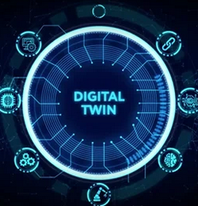
DIGITAL TWIN
What do we understand by Digital Twin ?
Virtual representation or digital replica of a physical entity, process, or system
simulates the behavior, characteristics, and functions of its real-world counterpart in a virtual environment
Involves real-time data integration, allowing the digital twin to mirror the physical entity's current state and behavior accurately
Definition
Digital representation of a target entity with data connections that enable convergence between the physical and digital states at an appropriate rate of synchronization
(ISO/IEC 30173:2023 Digital twin – Concepts and terminology)

Slide 48
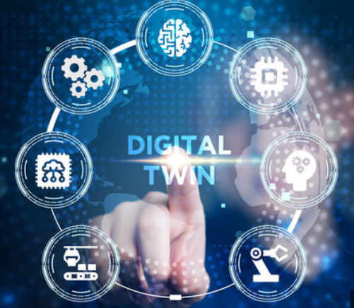
DIGITAL TWIN
APPLICATIONS OF DIGITAL TWIN
Manufacturing
Healthcare
Cities
Power-generation Equipment
Automotive Industry
Buildings and Civil Infrastructure
(ISO/IEC 30173:2023 Digital twin – Concepts and terminology)

Slide 49
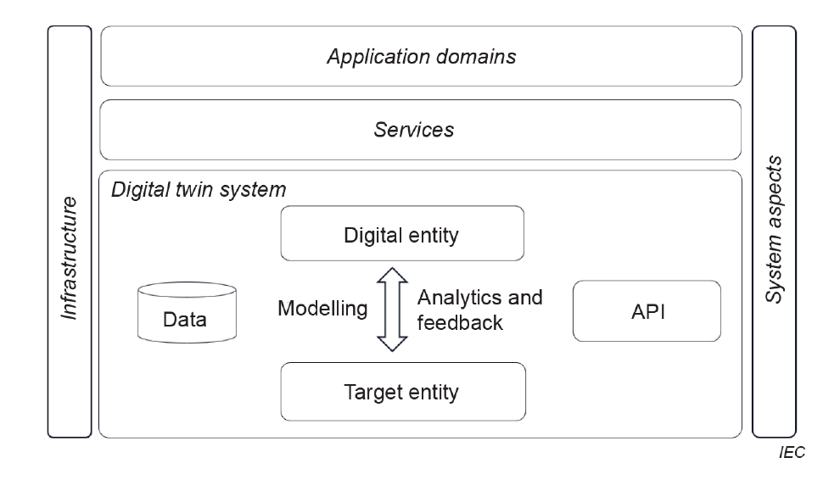
DIGITAL TWIN
DIGITAL TWIN SYSTEM
(ISO/IEC 30173:2023 Digital twin – Concepts and terminology)

Slide 50
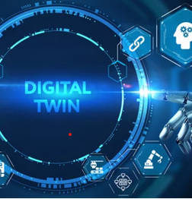
DIGITAL TWIN
A hybrid entity, or system of systems, composed of target entities, digital entities, data connection between the two, and models, data and interfaces involved in the data connection process
The target entity to provide modelling data and near real-time operating data to the digital entity, and the digital entity should feedback the analysis results to the target entity, promoting each other
The digital twin system may interact with external modules such as infrastructure through APIs and other interfaces
(ISO/IEC 30173:2023 Digital twin – Concepts and terminology)

Slide 51
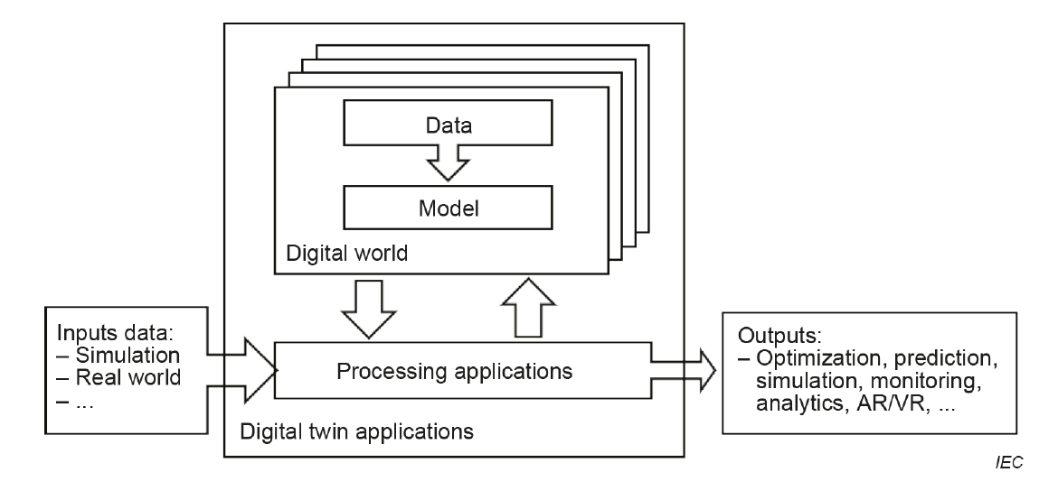
DIGITAL TWIN
FUNCTIONAL VIEW OF DIGITAL TWIN
(ISO/IEC 30173:2023 Digital twin – Concepts and terminology)

Slide 52
DIGITAL TWIN
FUNCTIONAL VIEW OF DIGITAL TWIN
Digital twin systems can be created by digitalizing and simulating target entities in the digital domain, establishing connections between the target entities and digital entities, and forming a closed or open loop by gathering data from the physical domain, integrating optimization in the digital domain, then making decisions, and applying adjustments to the physical domain based on those decisions
(ISO/IEC 30173:2023 Digital twin – Concepts and terminology)

Slide 53
DIGITAL TWIN
Distinguishing Features Compared with Conventional Non-DTw Systems
Increased Visibility
Reduced Time To Market
Sustainably Optimized Operation
Reduced Energy Consumption
Reduced Maintenance Cost
Increased User Engagement
Fusion Of Information Technologies
(ISO/IEC 30173:2023 Digital twin – Concepts and terminology)

Slide 54
DIGITAL TWIN
What are the limitations for Non-DTw Systems?
Network Reliability
Low Data Rate
Transmission
Delay
Network Coverage
Limited Available Power
Deployment
Environmental impact
(ISO/IEC 30173:2023 Digital twin – Concepts and terminology)

Slide 55
Brainstorming about Standards pertaining to Internet of Things (IoT) & Digital Twins

