Slide 1
Indian Standards and Milk Processing Equipments

Slide 2
Introduction on Milk Production
Milk production began 6000 years ago or even earlier.
Milk become one of the essential food components for man in his day to day life.
If not treated properly, milk will turn into a source of infection, as it is a perfect growth medium for micro-organisms.
Milk Processing equipments are the building block of safe milk production.

Slide 3
Milk Production Process Flow
1
3
5
Milking
Collection
Storage
Transport
Reception
2
4

Slide 4
Milk Production Process Flow
6
8
10
Standardi -zation
Homogeni-zation
Pasteuri
-zation
Storage
Separation
7
9

Slide 5
Milk Production Process Flow
11
Packing
Transport
12

Slide 6
Milking
Hand Milking
In our country, majority of milking is still done by hand.
The milk is collected in pails and poured through a strainer, to remove coarse impurities, into a cans holding 32 – 50 litres.
The cans are then collected, chilled and stored at low temperature to await transport to the dairy.
Machine Milking
In use predominantly in medium to large dairy farms.
The milking machine sucks the milk out of the teat by vacuum.
Automatic milking machines these days are designed not only to efficiently extract milk but also to ensure the well-being of the cows and the quality of the milk.

Slide 7
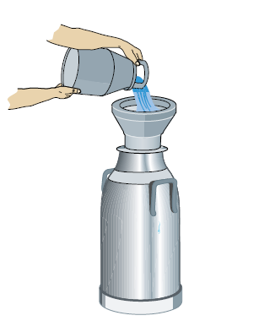
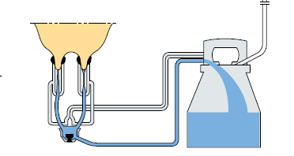
Equipments used in Milking
Hand Milking
Machine Milking
--- IS 1825 : 1983
Specification for Aluminum Alloy Milk Cans
--- IS 16440 : 2016
Specification for Stainless Steel Milk cans
--- Scope for development of Indian Standard for Milking Machine

Slide 8
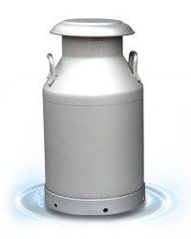
Milk Cans
Milk cans are typically containers used to transport and store milk.
They are often made of stainless steel or aluminum.
They come in various sizes, ranging from small cans used by farmers to larger industrial-sized containers for dairy processing plants.
Milk cans are designed to be durable, easy to clean, and capable of maintaining the freshness and quality of milk during transportation.
Historically, they were crucial in the dairy industry for ensuring that milk could be safely transported from farms to dairies before modern bulk transportation methods became prevalent.

Slide 9
What does Indian Standards specify about these Milk Cans?
IS 1825 : 1983 – Specification for Aluminum Alloy Milk Cans
a) Covers two varieties :
Delivery cans of rated capacity 20 litre
Transport cans of rated capacity 20,30,40 & 50 litre
b) transport contents safety without spillage and with minimum of churning (Pneumatic Test and Leakage Test)
c) Withstand rough handling (Birnell Hardness, Drop Test)
d) Occupy minimum space on trucks or lorries.
d) Shall facilitate easy cleaning.
e) It bas to be light and durable.

Slide 10
Significance of Brinell Hardness Test
Milk cans often undergo rough handling in the hands of users.
Strength of the Cans is very essential for its capability to withstand mishandling.
Brinell Hardness Test - it is a hardness test method with high precision.
d value the Brinell hardness value, the softer the material
d value the Brinell hardness value, and the harder the material.
Notes:
Explanation for the figure
Principle of the Brinell hardness test method is to press a tungsten carbide ball with a diameter of D (mm) into the surface of the test piece under the action of a specified load P (Kgf) and stay for a certain period of time to cause plastic deformation.
After stabilization, remove the load and measure the diameter d of the indentation formed on the metal surface to be tested. From this, calculate the indentation ball area F (mm2), and then calculate the average load per unit area of ​​the indentation ( P/F), as the Brinell hardness value of the tested metal.
When the indenter is a hardened steel ball, the hardness symbol is indicated by HBS, which is suitable for metal materials with a hardness value of less than 450. When the indenter is a tungsten carbide ball, the hardness symbol is indicated by HBW, which is suitable for the metal materials with a hardness value of 450-650.

Slide 11
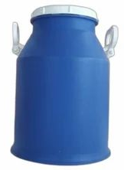
Why HDPE Cans are not encouraged in Milk handling?
Though HDPE cans are less expensive, less in weight, easy to handle. Why Dairies don’t encourage its usage ?
Difficulty in cleaning
Better Insulation properties resulting in temperature retention
Can anyone guess!
Why temperature retention is detrimental here?
Notes:
temperature retention is detrimental because it accelerates the growth of harmful bacteria as well as it increases the energy consumption for chilling.

Slide 12
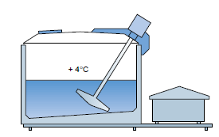
Importance of Keeping the milk cool
Milk should be chilled to below + 4°C immediately after milking and be kept at this temperature all the way to the dairy
If the cold chain is broken, then the micro-organisms in the milk will start to multiply, resulting in the development of various metabolic products and enzymes.
Subsequent chilling will arrest this development, but the damage has already been done.
It is imperative to chill the milk as quick as
possible after milking.

Slide 13
Milk Collection
IS 9853 : 2018 Stainless steel accessories for village milk collection centre.
milk collection tray, plunger, sampler, sample bottle, sample bottle stand, milk measures set, funnel for can, lactometer cylinder
for facilitating collection and pouring of milk through strainer, directly into the cans, for quick measurement of milk and sample testing
In our country, milk collection accessories in use are made of aluminium, stainless steel or tinned mild steel.
to ensure hygienic handling of milk, only Stainless Steel is covered in this Standard.
conformity to grade designation X04Cr19Ni9

Slide 14
Milk Storage at Collection Point
IS 2688 : 2009 Insulated stainless steel horizontal milk storage tank
IS 4938 : 2009 Insulated stainless steel milk storage tank vertical type
Covers milk storage tanks of vertical cylindrical shape of capacity 5 000, 10 000 and 15 000 litre.
Stainless steel conforming to designation X04Cr19Ni9.
Agitator shall be constructed with TEFC squirrel cage flanged induction motor with IP 55 protection and an oil drip proof reduction gearbox.
Agitator shall run on slow speed, generally around 32 rpm, to ensure non-separation of fat and uniform mixing of milk in the tank within 10 min.
Dye penetration test for weld joints.

Slide 15
Milk Reception at Plant
IS 11585 : 2009 insulated, stainless steel vertical cylindrical milk silos of 30,000, 40,000, 60,000 and 100,000 litres capacities.
Stainless steel conforming to designation X04Cr19Ni9.
Agitator shall be constructed with TEFC squirrel cage flanged induction motor with IP 55 protection and an oil drip proof reduction gearbox.
Agitator shall run on slow speed, generally around 32 rpm, to ensure non-separation of fat and uniform mixing of milk in the tank within 10 min
Dye penetration test for weld joints.
The common tests carried out on milk upon receipt are: taste and smell, cleaning, sediment, hygiene, somatic cell count, bacteria count, protein content, fat content, freezing point.

Slide 16
Milk Reception at Plant
Taste and smell – significant deviations in taste and smell should be rejected by the dairy.
Cleaning – milk residue is evidence of inefficient cleaning of cans.
Sediment – bottom of a cans and is then passed through a filter.
Hygiene or Resazurin tests – bacteria content of the milk is a measure of its hygienic quality, Resazurin is a blue dye which becomes colorless when it is chemically reduced by the removal of oxygen. If the sample starts to change shade immediately, the consignment is considered unfit for human consumption.

Slide 17
Milk Reception at Plant
Somatic cell count – A large number (more than 500 000/ml of milk) of somatic cells in the milk indicates that the cows are suffering from udder diseases.
Protein and fat content – the farmers gets paid according to the fat protein content of the milk.
Freezing point – to determine whether or not it has been diluted with water. Milk of normal composition has a freezing point of - 0.54 to -0.59 °C. The freezing point will rise if water is added to the milk.

Slide 18
Milk Storage at Plant
IS 11585 : 2009 Insulated stainless steel silos for milk storage capacity 30, 40, 60 and 100 kilo litres.
Silos for milk storage shall be of vertical cylindrical shape for the body with flat bottom sloping towards the outlet and conical (15° approximate) top.
The cradle provided to the bottom of the milk silo shall be so designed as to take the weight of the silo when filled with milk.
The agitator shall be of sanitary construction.
All openings shall be constructed in a manner that there is no possibility of accumulation of liquid or other foreign matters.
Larger tanks are placed outdoors to reduce building costs

Slide 19
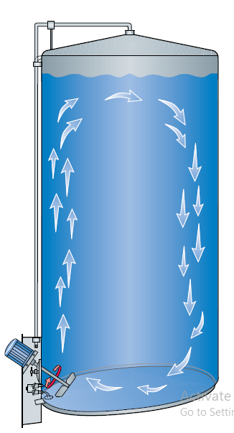
Why Agitation in Silo Tanks?
To prevent cream separation by gravity.
The agitation must be very smooth. Too violent agitation causes aeration of the milk and fat globule disintegration.
Exposes the fat to attack from the lipase enzymes in the milk.
Gentle agitation - basic rule in the treatment of milk
The agitator must therefore not be started before it is covered with milk.

Slide 20
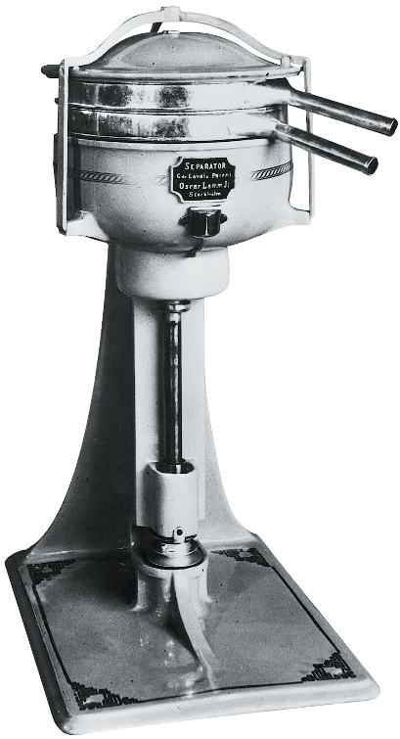
Cream Separation
Sedimentation by gravity was the original technique used in dairying to separate fat from milk.
Centrifugal separation is the common device nowadays used to ‘separate’ cream from whole milk, dividing the whole milk into Skim Milk and Cream.
It’s a unit contains conical disks spinning in a bowl or drum at the speed of around 6,000 to 10000 revolutions per minute.
Fat globules being the lighter part of the milk move to the heart of the drum, while the heavier skim milk moves to the outer sides as they get separated from the fat component
One of the very first separators, the Alfa A 1, manufactured in 1882
Notes:
Interesting Story behind Centrifugal Separators
Newly invented appliance for separating cream from milk was described in the German trade journal “Milch–Zeitung” dated the 18th of April 1877. This was “a drum which is made to rotate and which, after turning for a time, leaves the cream floating on the surface so that it can be skimmed off in the usual fashion”. After having read this article a young Swedish engineer, Gustaf de Laval said, “I will show that centrifugal force will act in Sweden as well as in Germany”.
The daily newspaper “Stockholms Dagblad” of 15th January 1879 reported: “A centrifugal separator for cream skimming has been on show here since yesterday and will be demonstrated every day between 11 a.m. and 12 noon on the first floor of the house of number 41, Regeringsgatan.
The machine can be likened to a drum which is driven round by a belt and pulley. The cream, which is lighter than the milk, is driven by centrifugal force to the surface of the milk and flows off into a channel from which it is led into a collection vessel; under it, the milk is forced out to the periphery of the drum and is collected in another channel whence it is led to a separate collecting vessel.” Today most makes of similar machines are equipped with conical disc stacks.

Slide 21
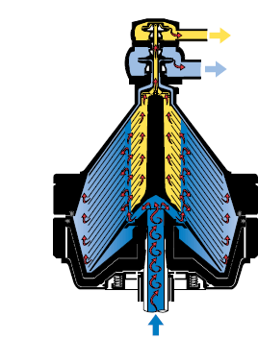
Centrifugal Separator
Machinery that separates cream from milk based on density.
Under the influence of centrifugal force the sediment and fat globules in the milk begin to settle radially outwards or inwards in the separation channels
The cream, i.e. the fat globules, has a lower density than the skim milk and therefore moves inwards in the channels, towards the axis of rotation.
Scope for working on the project for development of Indian standard for this equipment
Skim Milk
Cream

Slide 22
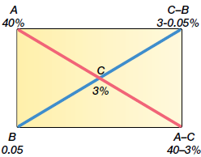
Milk Standardization
adjustment of the fat content of milk, or a milk product, by addition of cream or skim milk as appropriate to obtain a given fat content.
standardization was done manually, but, along with increased volumes to process the need for fast, direct inline standardization is now combined with separation.
Skim Milk
Notes:
Figure Explanation
A Cream fat content 40%
B Skim milk fat content 0.05%
C Fat content of the end product 3%
Subtract the fat content values on the diagonals to give C – B = 2.95 and A – C = 37.
The mixture is then 2.95 kg of 40% cream and 37 kg of 0.05 % skim milk to obtain 39.95 kg of a standardized product containing 3% fat.

Slide 23
Homogenization
Homogenization has become a standard industrial process, universally practiced as a means of stabilizing the fat emulsion against gravity separation.
primarily causes disruption of fat globules into much smaller ones.
achieved by a combination of contributing factors such as turbulence and cavitation
Notes:
Who invented it?
Gaulin, who invented the process in 1899,

Slide 24
Pasteurization
Pasteurization is a mild heat treatment developed by Louis Pasteur in 1860.
process of heating milk to at least 63℃ (sixty three degree centigrade) and holding at such temperature continuously for at least 30 minutes or
heating it to at least 71.5℃ (seventy one point five degree centigrade) and holding at such temperature continuously for at least 15 seconds.
UHT (135°C to 150°C for one to two seconds)
Kills Pathogens (such as M. paratuberculosis, Coxiella burnettii and E. coli) - denaturing the protein structure of microbial cells.
It is the heart of any dairy processing unit.
Notes:
Who invented it?
Gaulin, who invented the process in 1899,

Slide 25
Nutrients such as vitamins are generally, heat sensitive.
But how in a heat treatment process such pasteurization nutrients are retained?

Slide 26
How nutrients are retained?
The advantage of using higher temperatures is that the z value for chemical reactions such a vitamin loss, browning reactions and enzyme inactivation is typically 25–40 deg. Celsius compared with 10 deg. Celsius for spore inactivation.
This means that they are less temperature sensitive so that higher temperatures will increase the microbial death rate more than they increase the loss of food quality associated with thermal reactions.
This is exactly how in UHT (135°C to 150°C for one to two seconds) process nutrients are retained.
It is extremely fortunate that none of the major pathogens in milk form spores
Notes:
z value - he number of degrees (Celsius or Fahrenheit) required to change a D-value by one factor of ten
D-value - the time it takes to reduce a microbial population by 1 logarithm, or 90% of its initial value, under specified conditions

Slide 27
IS 2689 : 2019 Stainless Steel Batch Pasteurizer
The batch pasteurizer is used for pasteurizing milk where the volume of milk is too small to justify the use of the continuous flow HTST (High Temperature Short Time) system.
stainless steel holding type batch pasteurizers of 500, 750 and 1 000 l capacities for pasteurizing milk at 63°C for 30 min or any other time-temperature combination,
the temperature of pasteurization does not exceed 65°C
heating being done by injecting steam into water.
surfaces of which come into contact with milk shall be made of stainless steel conforming to a designation Austenitic X04 Cr19 Ni9 (SS 304).

Slide 28
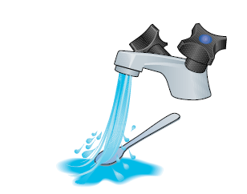
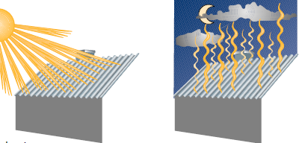
Heat Transfer Principle
Heat Transfer by Conduction – Heat is transferred from the
bowl of the spoon to the handle
Heat Transfer by
Convection – The spoon is rinsed in running
cold water. Heat is absorbed by the
water and the spoon gets cooler, until
the spoon and the water are at the same
temperature.
Heat Transfer by
Radiation – A roof accumulates solar heat during the day and radiates the heat at night.

Slide 29
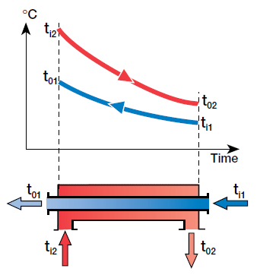
IS 2689 : 2019 Stainless Steel Batch Pasteurizer
All heat transfer in dairies takes place in the form of convection and conduction.
Two principles are used: direct and indirect heating
In Pasteurization, a heat exchanger is used to transfer heat by the indirect method.
Hot water (red) flows through one channel and milk (blue) through the other. Heat is transferred through the partition.
The hot water enters the channel at a temperature of ti2 and is cooled to a temperature of to2 at the outlet.
Milk enters the heat exchanger at a temperature of ti1 and is heated by the hot water to an exit temperature of to1.
Temperature profiles for heat
transfer in a heat exchanger.

Slide 30
Packing
Filling Machines: Automated systems for filling bottles, cartons, or containers with milk or dairy products.
Sealing Machines: Seal containers to maintain product freshness and integrity.

Slide 31
Conclusion
Each piece of dairy processing equipment plays a crucial role in ensuring milk and dairy products are processed efficiently, safely, and to high-quality standards.
Standardization of these machines are important to handle safely and hygienically various volumes of milk and cater to different stages of dairy processing, from raw milk reception to packaging the final products for distribution and sale.
Opportunity : There are gap areas for standardization of various equipments in dairy processing, which a students can take up as Research project and participate in Standards development.

