Slide 1
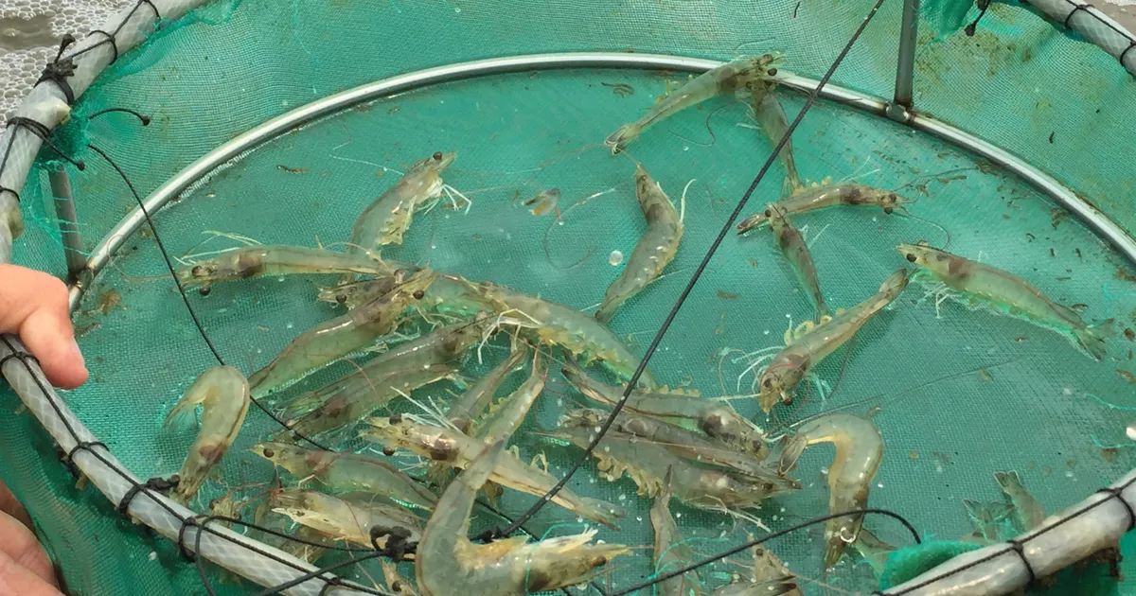
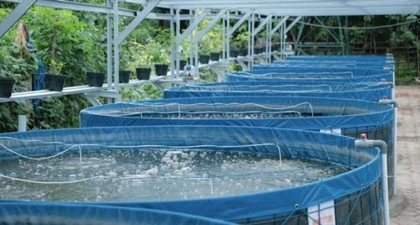
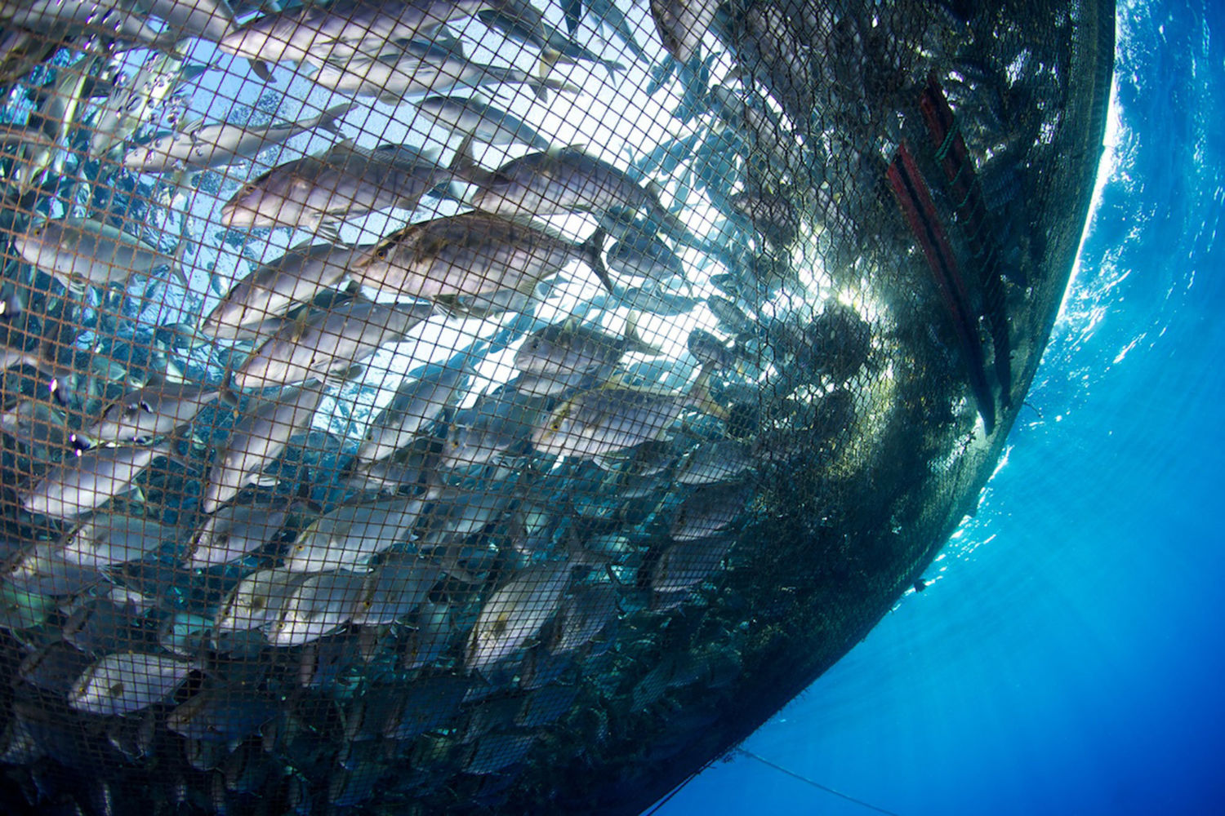
INDIAN STANDARDS ON GOOD AQUACULTURE PRACTICES
Bureau of Indian Standards

Slide 2
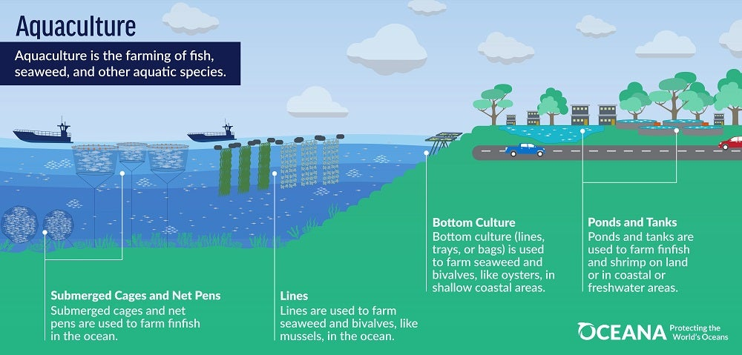
AQUACULTURE
Aquaculture is the farming of aquatic organisms, including fish, molluscs, crustaceans and aquatic plants.
Aquaculture or farming in water is the aquatic equivalent of agriculture or farming on land.
Aquaculture occurs in both inland (freshwater) and coastal (brackishwater, seawater) areas.
5
5

Slide 3
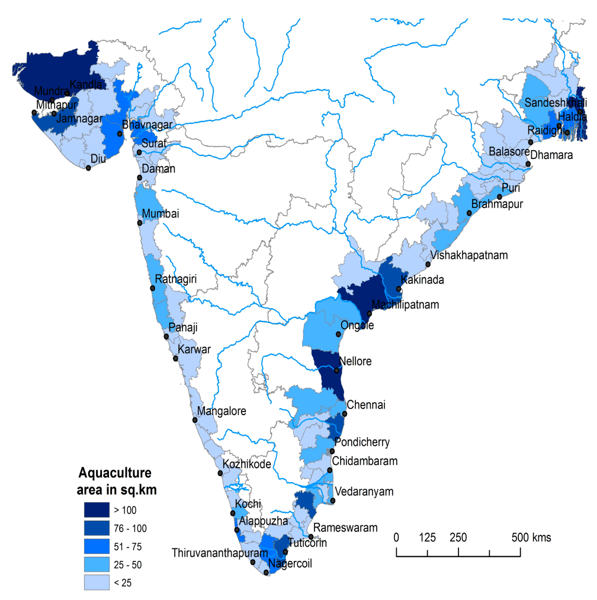
Significance in Food security
India has a coastline of 7 000 km, an Exclusive Economic Zone (EEZ) of 1.6 million km², and more than 1 billion people live in the coastal areas.
Fisheries and aquaculture play an important role in economy and livelihood, provided employment to some 14.5 million people. Women representing about 32 percent of the people employed in the sector mainly in the post-harvest sector.
In terms of total fisheries and aquaculture production, India is the second major producer in the world.
Aquaculture is the major fish producing subsector, about 87 percent of farmed fish comes from inland aquaculture, and carps and other freshwater fishes account for the bulk of aquaculture production.
Aquaculture map of India
BIS Act
2016
3
3

Slide 4
GOOD AQUACULTURE PRACTICES
Good Aquaculture Practices (GAqP) — Practices that address environmental, economic and social sustainability for on-farm processes, and result in safe and quality food and non-food aquaculture products.
Concerns about food safety and quality,
sustainability, environmental protection,
worker safety and welfare have also gained importance.
In India, aquacultural practices are highly localized occupations and display a lot of variability in cultural practices and varietal preferences across regions.
Due to Globalization, there is a flow of trade in the aquacultural products, it is necessary to define and assign certain common minimum standards to facilitate trade in these products.

Slide 5
Good Aquaculture practices
Development of basic infrastructure at the field level,
Build up culture for good aquaculture practices by the farmers,
Uniform approach across farms regardless of their sizes.
Increased awareness among the producers and consumers about the need for consumption of good quality and safe food
Traceability through complete integration of food chain
Worker safety and welfare,
Improvement in the environment,
Reputation in the international market as a producer of good quality and safe produce, and Overcoming the Technical Barriers to Trade (TBTs).
Indian standards on Good Aquaculture practices - framed to set up control and compliance systems for various kinds of aquaculture produce.

Slide 6
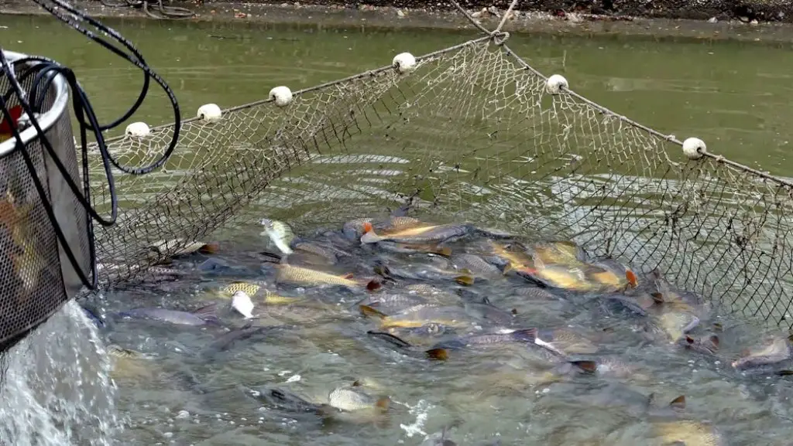
Indian standards on Good aquaculture practices
IS 17281 : 2019 - Requirements for Good Aquaculture Practices — India GAqP Shrimp Hatchery and Grow Out Farms
IS 17282 : 2019 Requirements for Good Aquaculture Practices - India GAqP Striped Catfish ( Pangasianodon hypophthalmus )
IS 17283 : 2019 Requirements for Good Aquaculture Practices India GAqP CARPS
IS 17284 : 2019 Requirements for Good Aquaculture Practices India GAqP for Freshwater Prawn Culture
IS 17285 : 2019 Good Aquaculture Practices for Cage Culture in Fresh Water

Slide 7
Indian standards -Good aquaculture practices
Under development
Good Aquaculture Practices for Sea Cage Farming
Requirements for Good Aquaculture Practices India GAqP Marine Finfish Hatchery
Requirements for Good Aquaculture Practices India GAqP Seaweed cultivation

Slide 8
Indian standards on Good aquaculture practices
General principle
CONTROL POINTS AND COMPLIANCE CRITERIA
To be followed by the applicant producer and by the certification body.
Criteria are marked as ‘Major’, ‘Minor’ or ‘Reco’.
Major’ have a definite effect on the safety and quality of the produce
Minor - if implemented, would provide an advantage to the assessment for India GAqP certification.
Reco - may not have direct bearing on safety and quality of produce but may have other benefits to the producer
Category of Licence | Compliance of Major Requirements (in Percent) | Compliance of Minor Requirements (in Percent)
India GAqP — A | 100 | 90
India GAqP — B | 100 | 80
India GAqP — C | 100 | 75

Slide 9
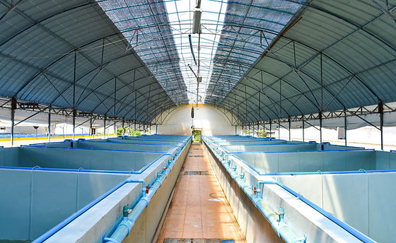
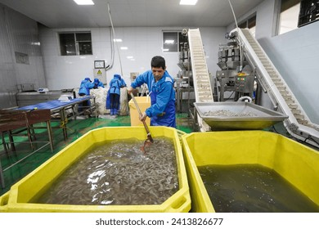
Shrimp hatcheries

Slide 10
IS 17281 : 2019 — India GAqP Shrimp Hatchery & Grow Out Farmses
BRACKISHWATER SHRIMP FARMING — GROW OUT
B-1 Farm registration
B-2 Biosecurity measures
B-3 Pond preparation
B-4 Seed quality
B-4.1 Seed stocking and initial management
B-5 Soil and water management
B-6 Feed management
B-7 Health management
B-8 Use of antibiotic and other chemicals
B-9 Effluent management
B-10 Harvest
B-11 Traceability and recall/withdrawal
A-1 Hatchery And Seed Production
A-2 Broodstock Management
A-3 Hatchery Inputs : Probiotics, Prebiotics, Immunestimulants
A-4 Storage Of Fresh Feed, Equipment, And Other Material
A-5 Training
A-6 Transport
A-7 Hatchery Sanitation
A-8 Traceability

Slide 11
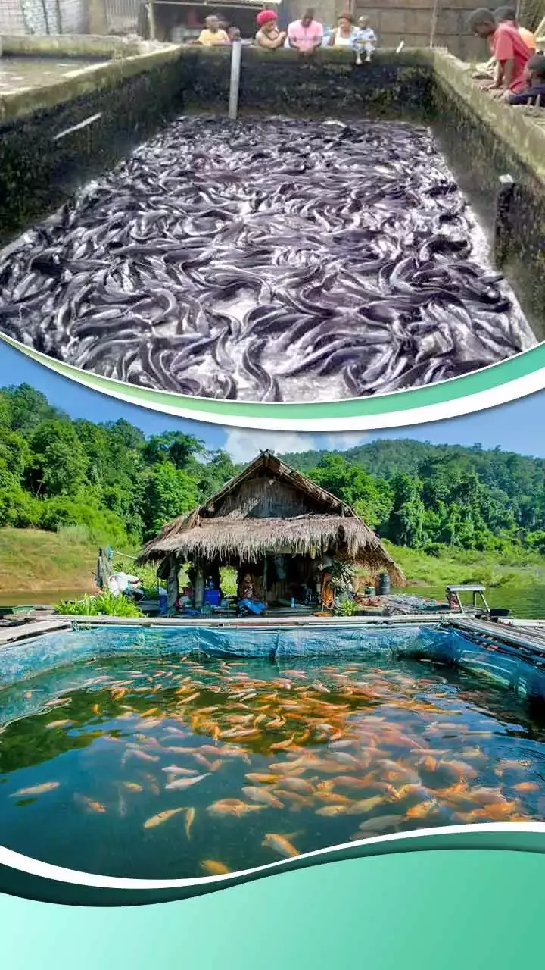
IS 17282 : 2019 India GAqP Striped Catfish
(Pangasianodon hypophthalmus )
catfish, Pangasinodon hypophthalmus (striped catfish) recently introduced in India has taken acceleration in aquaculture due to its good growth and high density culture.
a) It has immense food value;
b) It adapts well in freshwater and matured in captivity; and
c) The catfish is having accessary respiratory organ, which helps it to survive in low oxygenated condition.

Slide 12
IS 17282 : 2019 India GAqP Striped Catfish
(Pangasianodon hypophthalmus )
PROBABLE ISSUES
Poor disease surveillance and disease management;
Conversion of agricultural land to ponds;
Water pollution resulting from pond effluents;
Excessiv use of ground water and other freshwater supplies for filling ponds;
Excessive use of drugs, antibiotics, and other chemicals for aquatic animal disease control;
Negative effects on biodiversity due to escape of non-native species illegally introduced for aquaculture;

Slide 13
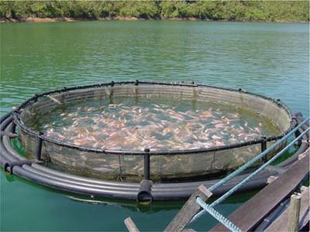
IS 17282 : 2019 India GAqP Striped Catfish
(Pangasianodon hypophthalmus )
1.Location And Layout Of Fish Farm, Site Record And Traceability
2.Soil And Water Management
3 Grower Record
4 Culture Species And System
5.Grow-out Culture Practices
6.Seed Sourcing
7 Stocking
8. Post-stocking Pond Management 9. Post-harvest Management 10. Building, Equipment And Other Infrastructure 11. Hygiene Condition In Farm 12. Personnel Hygiene And Welfare 13. Training To Farm Personnel 14. Record Keeping

Slide 14
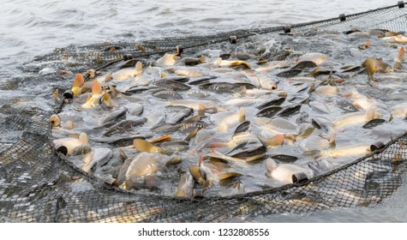
NECESSITY OF GAQPS IN SUTCHI AQUACULTURE
Responsible management practices could avoid or reduce the negative impacts in pond environment for sustainable Sutchi production.
The Good Management Practices (GAqP) is adopted to improve the farming at a given time for efficient and optimized resource utilization, improved growth, higher productivity, production of quality fish and with good pond environment during its aquaculture.

Slide 15
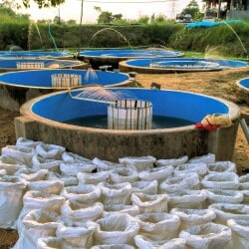
IS 17283 : 2019 Requirements for Good Aquaculture Practices — India GAqP CARPS
Salient requirements for carp farm
1 LOCATION AND LAYOUT OF FISH FARM, SITE RECORD AND TRACEABILITY
2 SOIL AND WATER MANAGEMENT
3 GROWER RECORD
4 CULTURE SPECIES & SYSTEM
5 SEEDS
6 NURSERY & REARING
7 GROW-OUT CULTURE PRACTICES
8 POST-HARVEST MANAGEMENT
9 BUILDING, EQUIPMENT AND OTHER INFRASTRUCTURE
10 HYGIENE IN FARM
11 PERSONAL HYGIENE AND WELFARE
12 TRAINING TO FARM PERSONNEL
13 RECORD KEEPING

Slide 16
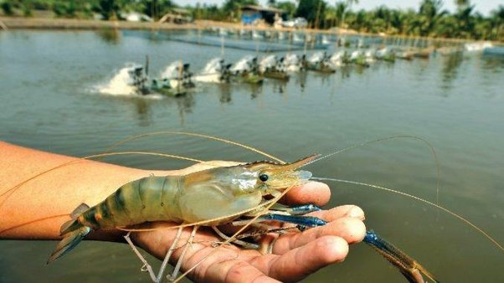
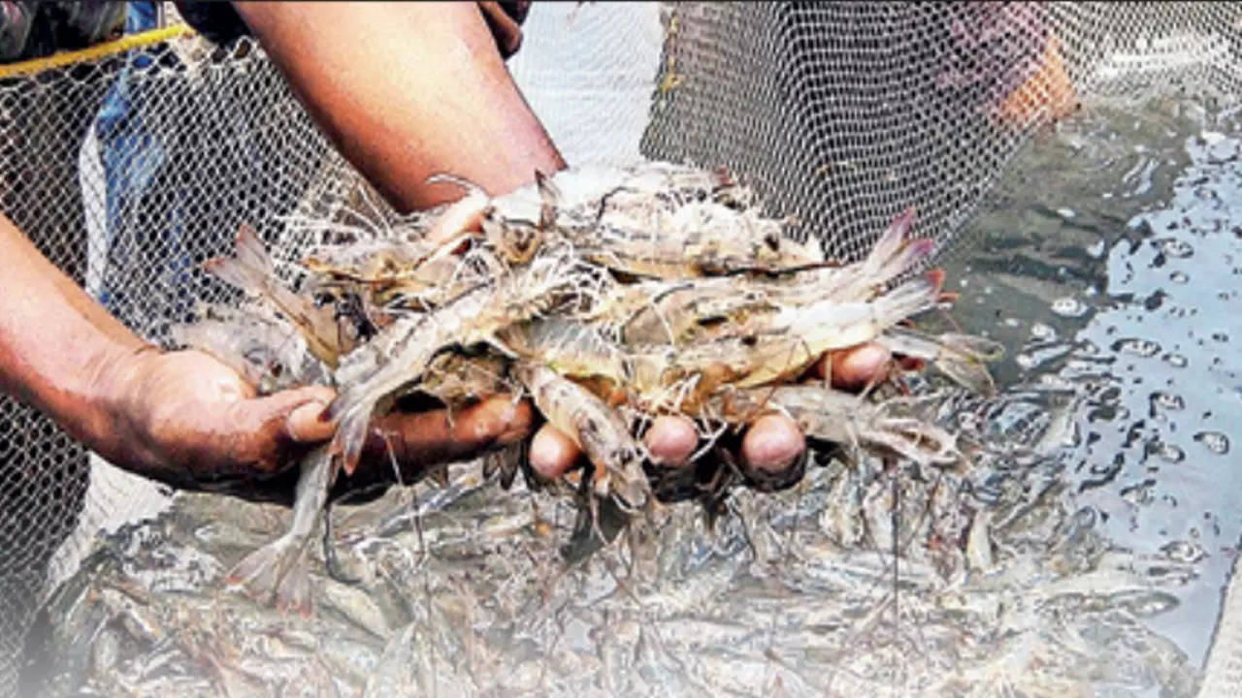
IS 17284 : 2019 India GAqP for Freshwater Prawn Culture
Fresh Water Prawn (Macrobrachium malcolmsonii), the second largest fast-growing prawn occurs commonly in Indian rivers, draining into Bay of Bengal.
Freshwater prawn culture has now occupied a significant position in inland aquacultural
practices.
Freshwater prawn known as keystone species, meaning they play a crucial role in maintaining the balance of the ecosystem.
Freshwater prawns help to control the population of other aquatic species, such as algae and small invertebrates, and they are an important food source for larger aquatic predators.

Slide 17
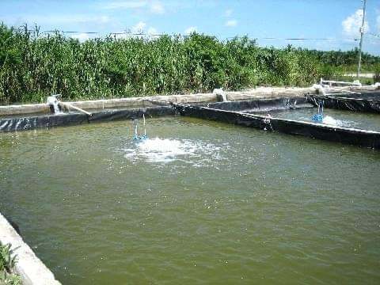
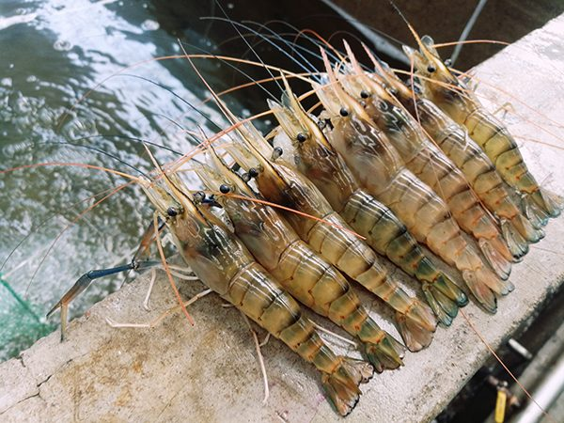
IS 17284 : 2019 India GAqP for Freshwater Prawn Culture
GAqP’s for freshwater prawn farm
1 LOCATION AND LAYOUT OF FISH FARM, SITE RECORD AND TRACEABILITY
2 SOIL AND WATER MANAGEMENT
3 GROWER RECORD
4 CULTURE SPECIES AND SYSTEM
5 SEED
6 NURSERY
7 GROW-OUT CULTURE PRACTICES
8. FARM HYGIENE
9 POST-HARVEST MANAGEMENT
10 RECORD KEEPING

Slide 18
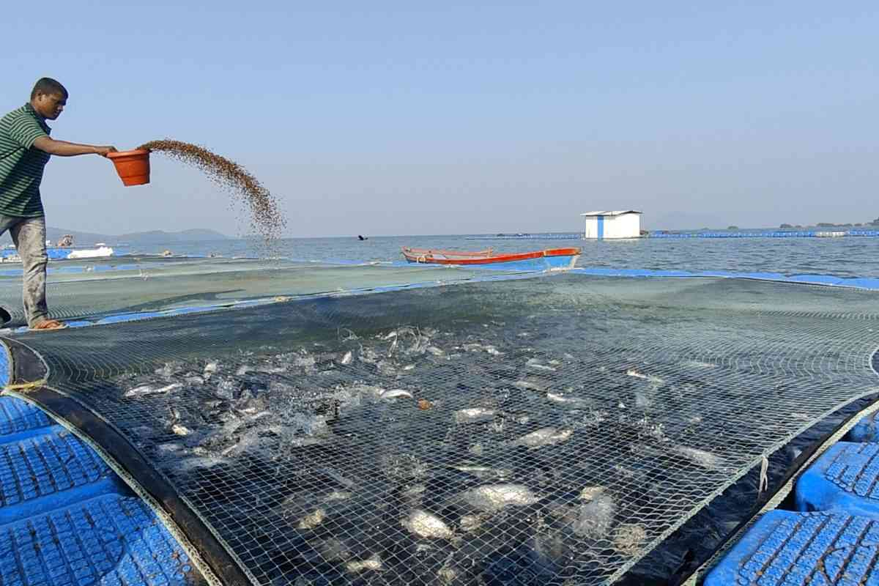
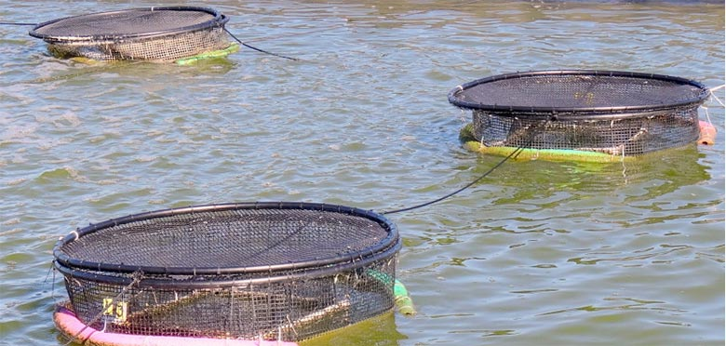
IS 17285 : 2019 Good Aquaculture Practices for Cage Culture in Fresh Water
It is estimated that at an average production rate of 3 ton per cage, the cage culture is producing about 45 000 t of fish contributing around 15 percent of the total fish production from the reservoirs and providing employment at the rate of 7.4 lakh man-days/year.
Cage aquaculture involves growing fishes in existing water resources while being enclosed in a net cage which allows free flow of water
It is an aquaculture production system made of a floating frame, net materials and mooring system (with rope, buoy, anchor etc.)
A preliminary study by ICAR-CIFRI in Jharkhand reservoirs revealed that cage farming contributes around 30 percent to livelihood of fishermen involved in cage farming.
.

Slide 19
IS 17285 : 2019 Good Aquaculture Practices for Cage Culture Fresh Water
fixed
floating
submersible
submerged

Slide 20
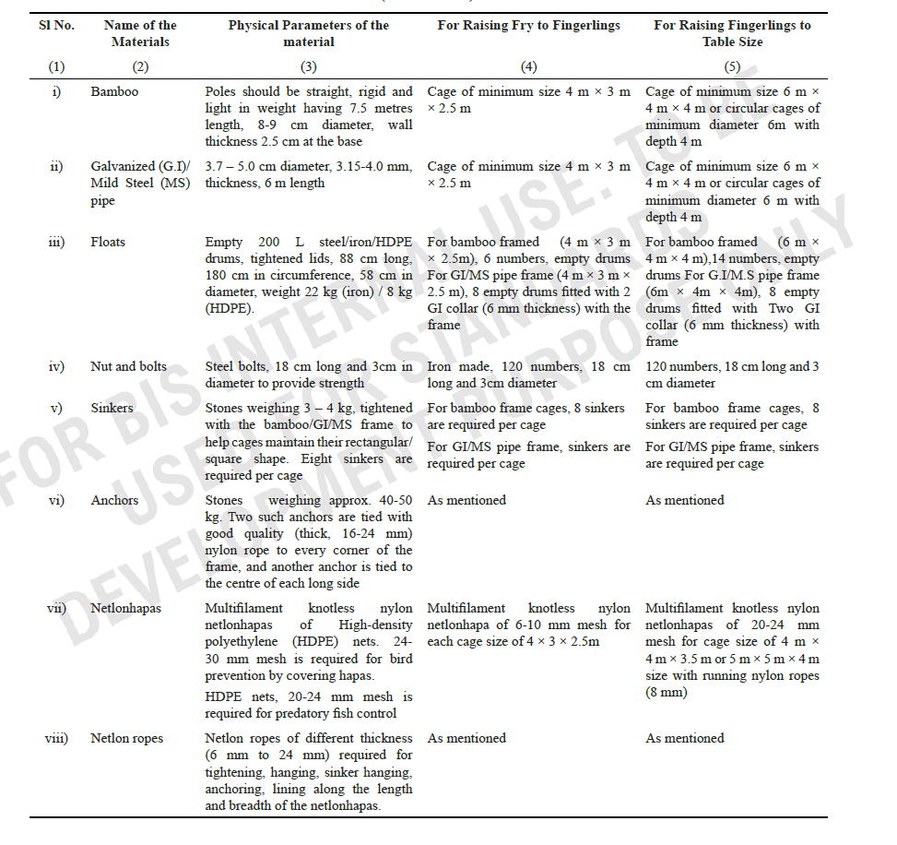
IS 17285 : 2019 Good Aquaculture Practices for Cage Culture in Fresh Water
Table 2 Cage Material

Slide 21
IS 17285 : 2019 Good Aquaculture Practices for Cage Culture in Fresh Water

Slide 22
2.6 Selection of Stocking Materials/Fish Seed and Stocking

Slide 23
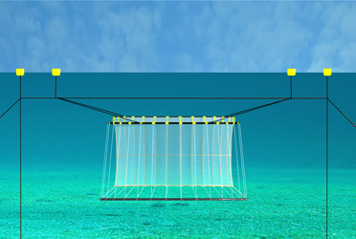
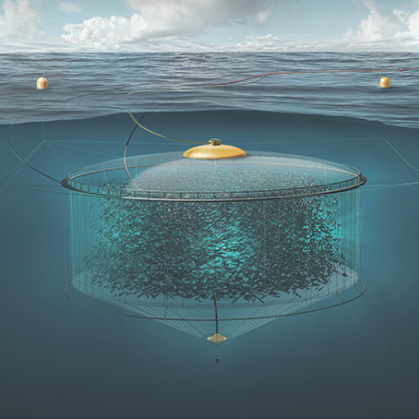
IS 17285 : 2019 Good Aquaculture Practices for Cage Culture in Fresh Water
Other salient features covered
2.7 Grow-out Period-growth Monitoring
2.8 Stock Management
2.9 Fish Health Monitoring
2.10 Removal and Release

Slide 24
Indian standards on Good aquaculture practices Standards Under development
Good Aquaculture Practices for Sea Cage Farming
Requirements for Good Aquaculture Practices India GAqP Marine Finfish Hatchery
Requirements for Good Aquaculture Practices India GAqP Seaweed cultivation
Sea cage farming is viewed as a major option for increasing the seafood production and has been expanding rapidly in recent years at global level.
Mariculture is the fastest growing sub-sector of aquaculture in the world. Cage farming technology is widely recognized as the most important technology in mariculture for increasing fish production to meet the food fish demand.
Seaweeds are also termed as the ‘Medical Food of the 21st Century’ as they are being used in various therapeutic and medical treatments.

Slide 25
Good Aquaculture Practices for Sea Cage Farming
marine fish catch in the country is stagnating annually, indicating that increasing the fish catch from the existing fishing grounds is not sustainable economically and ecologically.
Dwindling catch in capture fisheries, resulting unemployment in the coastal region and demand for additional seafood necessitates the development of mariculture as a substantial seafood production sector.
It is necessary to;
bring out standardized guidelines for good aquaculture practices in sea cage culture for the fishermen, fish farmers and officials of the fisheries departments
pay attention to the quality of production practices requiring minute attention at different aspects of production, storage, handling and distribution.

Slide 26
Good Aquaculture Practices for Sea Cage Farming
The cage aquaculture has grown very rapidly during the past 20 years and is presently undergoing rapid changes due to globalization and a growing global demand for aquatic products.
it was felt necessary to bring out standardized guidelines for good aquaculture practices in sea cage culture for the fishermen, fish farmers and officials of the fisheries departments.
Through this guide, the concerns about food safety and quality, sustainability, environmental protection etc are being catered.
It is necessary to pay attention to the quality of production practices requiring minute attention at different aspects of production, storage, handling and distribution

Slide 27
Good Aquaculture Practices for Sea Cage Farming
salient REQUIREMENTS covered
1 TYPES OF CAGE
2 CAGE ACCESSORIES
3 SITE SELECTION
4 CAGE STRUCTURE DEPLOYMENT
5 SPECIES SELECTION
6 NURSERY REARING
7 SEED TRANSPORTATION FOR GROW-OUT STOCKING
8 STOCKING
9 GROW-OUT CULTURE
10 FEEDING
11 CAGE STRUCTURE MANAGEMENT
12 FISH HEALTH MANAGEMENT
13 FISH HARVEST AND MARKETING

Slide 28
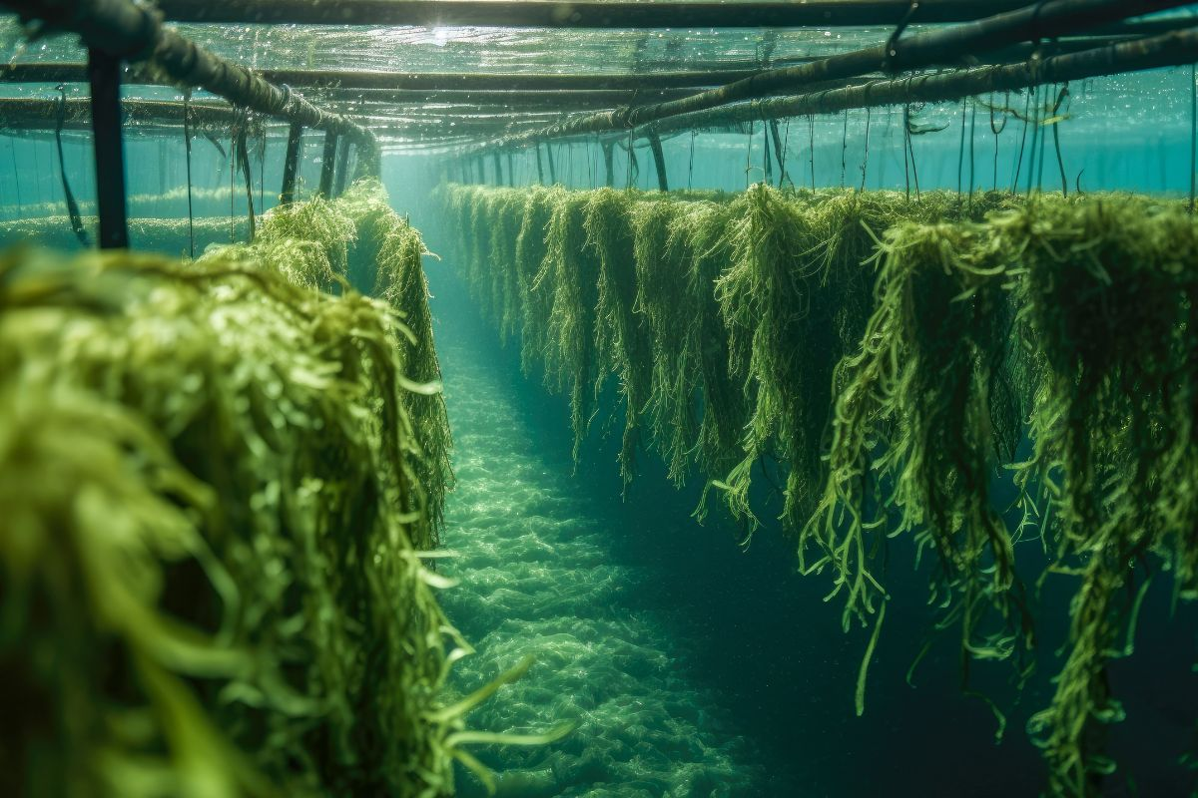
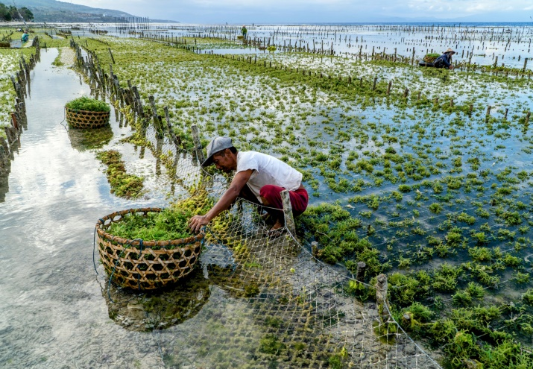
Good Aquaculture Practices Seaweed Cultivation
Seaweeds are macroscopic algae growing in the marine and shallow coastal waters and on rocky shores. Seaweed cultivation is undertaken in shallow coastal waters of maritime States, wherein bamboo-rafts or tube-nets are held in clusters.
Seaweeds are wonder plants of the sea, the new renewable source of food, energy, chemicals and medicines with manifold nutritional, industrial, biomedical, agriculture and personal care applications
it is desirable to set up control and compliance systems for various kinds of aquaculture produce. In this context, it is necessary to pay attention to the quality of production. Practices requiring minute attention at different aspects of production, storage, handling and distribution.
It is, therefore, necessary to define and assign certain common minimum standards to facilitate trade in these products and to win the confidence of the consumers within the country and outside.

Slide 29
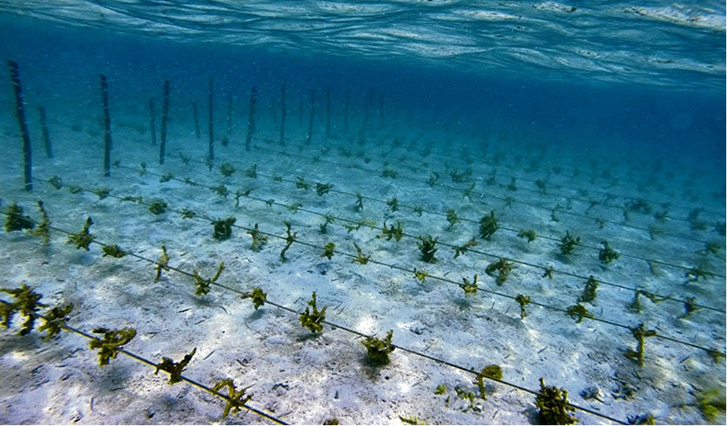
Good Aquaculture Practices Seaweed Cultivation
salient REQUIREMENTS covered
1 IDENTIFICATION, PREPARING THE FARM & FARMING METHODS
2 MAINTENANCE
3 MANAGEMENT
4 HARVEST
5 POST-HARVEST HANDLING
6 STORAGE OF SEEDS & FARMING MATERIALS
7 TRAINING
8 TRANSPORT
9 TRACEABILITY

Slide 30
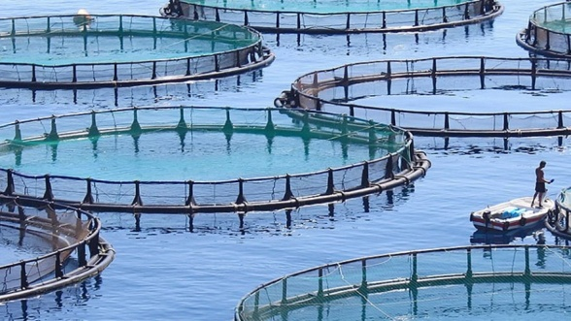
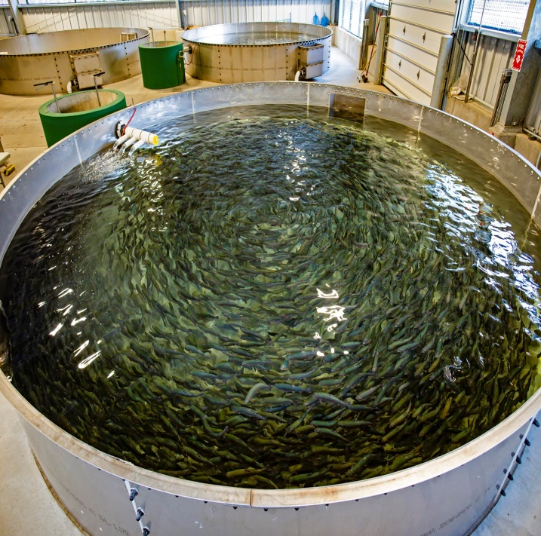
Good Aquaculture Practices Marine Finfish Hatchery
Marine finfish seed production has to be up-scaled for meeting the stocking demand of the cages. In recent years, success in breeding and seed production technology of several high value commercially important finfishes has resulted in good production.
Evidently, this very important sector needs special attention to ensure the supply of good quality seed-stock and in turn, ensure the sustainability of marine finfish farming in India.
This can be achieved following the proper management guidelines by developing good aquaculture practices (GAqPs). GAqPs are necessary for broodstock management, egg and larval rearing, fry nursing and fingerlings grading, and water quality management
Standard on Good Aquaculture Practices for Marine Finfish Hatcher is being brought out for hatchery operators and technicians, in providing them the required technical knowledge on large-scale marine seed production for orange spotted grouper and Indian pompano.

Slide 31
Good Aquaculture Practices Marine Finfish Hatchery
salient REQUIREMENTS covered
HATCHERY AND SEED PRODUCTION
BROODSTOCK MANAGEMENT
HATCHERY INPUTS : PROBIOTICS, PREBIOTICS, IMMUNOSTIMULANTS
STORAGE OF FRESH FEED, EQUIPMENT, AND OTHER MATERIAL
Training
Transport
Hatchery Sanitation
Traceability

Slide 32
B I S C A R E
A P P

Slide 33
THANK YOU
www.bis.gov.in
www.manakonline.in, www.standardsbis.in

