Slide 1
Food Safety Codes & FSMS
Concept of Food Safety
Hazard Analysis and Critical Control Point System (HACCP)
Prerequisite Programmes to Food Safety
Sector specific Food Safety Codes
Food Safety Management Systems (FSMS)

Slide 2
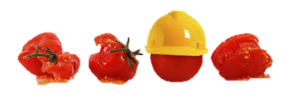
Safe Food
“Complete freedom of food from risk is an unattainable goal. A safe and wholesome food is related to a level of risk that society regards as reasonable in the context, and in comparison with other risks in everyday life.”
- FAO/ WHO

Slide 3
Concept of Food Safety – Global Perspective
IS/ ISO 22000* defines food safety as:
“assurance that food will not cause an adverse health effect for the consumer when it is prepared and/or consumed in accordance with its intended use.”
Note 1: Food safety is related to the occurrence of food safety hazards in end products and does not include other health aspects related to, for example, malnutrition.
Note 2: It is not to be confused with the availability of, and access to, food (“food security”).
Note 3: This includes feed and animal food.
* IS/ISO 22000:2018 Indian Standard on “Food Safety Management Systems (FSMS) — Requirements for any Organization in the Food Chain”]

Slide 4
Ensuring Food Safety through Indian Standards
BIS has a Technical Committee working exclusively on Indian Standards relevant to Food Safety, viz.
Food Hygiene, Safety Management And Other Systems Sectional Committee, FAD 15
IS 2491:2013 Food Hygiene - General Principles - Code of Practice
IS 15000:2013 Hazard analysis and critical control point (HACCP) - Requirements for any organization in the food chain
IS 16019:2012 Food Retail Management – Basic Requirements
IS 16020:2012 Food Safety Management – Requirements for Good Hygienic Practices
IS 16021:2012 Good Manufacturing Practices (GMP) – Requirements for organizations in the Food Processing Sector
IS 16066:2017 Street Food Vendors – Food Safety Requirements
IS/ ISO 22000:2018 Food Safety Management Systems (FSMS) – Requirements for any organization in the food chain
IS 17453:2020 Food Safety and Hygiene - Code of Practice for Food Businesses during Epidemic Pandemic Situations with Specific Reference to COVID-19
Notes:
IS 15930 Series Requirements for Good Agricultural Practices – IndiaGAP (Series of Indian Standards)

Slide 5
Hazard Analysis & Critical Control Points (HACCP)
IS 15000 : 2013 helps in implementing HACCP and guides on requirements for any organization in the food chain
A science based and systematic system which identifies, evaluates and controls hazards which are significant for food safety
Proactive System of Assuring Food Safety
A tool that focus on prevention rather than end-product testing
Addresses all Hazards – Physical, Chemical, Biological
Can be applied to the entire chain – from Farm to Table
Internationally recognized and in some cases mandatory
Notes:
SCOPE of IS 15000 : 2013 - This standard sets out the principles of the hazard analysis and critical control point (HACCP) system and provides general guidelines for the application of these principles, while recognizing that the details of application may vary depending on the circumstances of the food operation.

Slide 6
How IS 15000 defines key aspects of HACCP?
Control measure | Any action and activity that can be used to prevent or eliminate a food safety hazard or reduce it to an acceptable level.
Critical Control Point (CCP) | A step at which control can be applied and is essential to prevent or eliminate a food safety hazard or reduce it to an acceptable level
Critical Limit | A criterion which separates acceptability from unacceptability
Hazard analysis | The process of collecting and evaluating information on hazards and conditions leading to their presence to decide which are significant to food safety and therefore, should be addressed in the HACCP plan
Notes:
SCOPE of IS 15000 : 2013 - This standard sets out the principles of the hazard analysis and critical control point (HACCP) system and provides general guidelines for the application of these principles, while recognizing that the details of application may vary depending on the circumstances of the food operation.

Slide 7
The HACCP System..!
PRE-REQUISITE REQUIREMENTS
- Plant Hygiene
- Personnel Hygiene
- Food Hygiene
- Any Legal Requirements/Legislations
- Training
HACCP REQUIREMENTS
- HACCP Team - Fixation of limits of CCPs
- Flow Chart - Monitoring System
- Hazard Analysis - Corrective Actions
- Product Description - Verification Mechanism
- Identification of CCPs - Records
- Identification of Users
Notes:
SCOPE of IS 15000 : 2013 - This standard sets out the principles of the hazard analysis and critical control point (HACCP) system and provides general guidelines for the application of these principles, while recognizing that the details of application may vary depending on the circumstances of the food operation.

Slide 8
IS 15000 guides you to follow these steps for HACCP.!
Assemble The HACCP Team
Describe Product
Identify Intended Use
Construct Flow Diagram
On-site Confirmation of Flow Diagram
List All Potential Hazards, Conduct Hazard Analysis & Consider Control Measures
Determine CCPs
Establish Critical Limit for Easy CCP
Establish A Monitoring System for Each CCP
Establish Corrective Actions
Establish Verification Procedures
Establish Documentation & Record Keeping
Notes:
SCOPE of IS 15000 : 2013 - This standard sets out the principles of the hazard analysis and critical control point (HACCP) system and provides general guidelines for the application of these principles, while recognizing that the details of application may vary depending on the circumstances of the food operation.

Slide 9
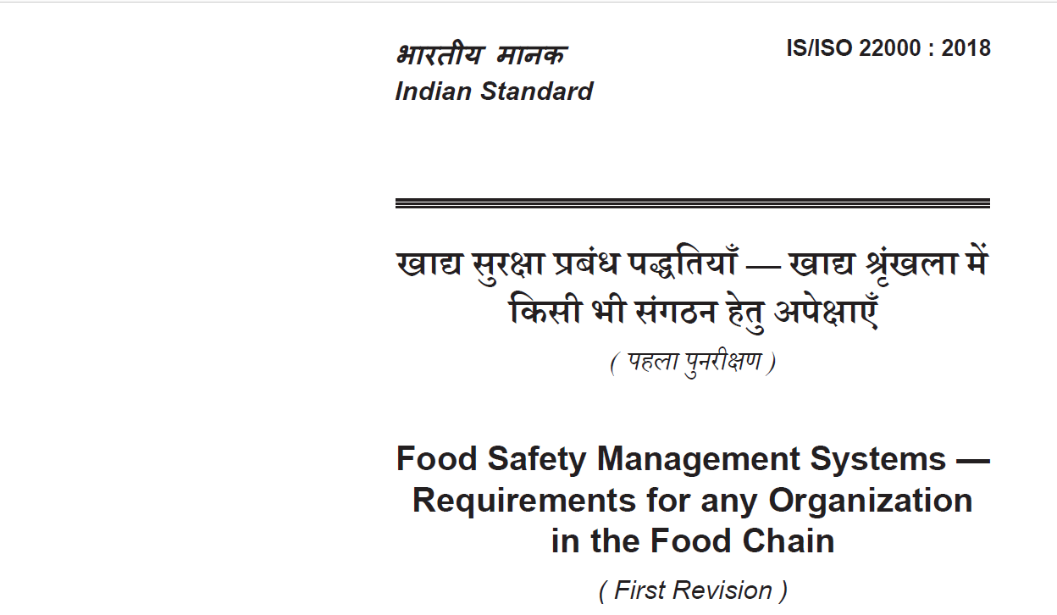
IS/ISO 22000 : 2018

Slide 10
Why Food Safety Management?
Significant increase of illnesses caused by infected food in both developed and developing countries.
In addition to the health hazards, food-borne illnesses can give rise to considerable economic costs covering
medical treatment,
absence from work,
insurance payments
legal compensation.

Slide 11
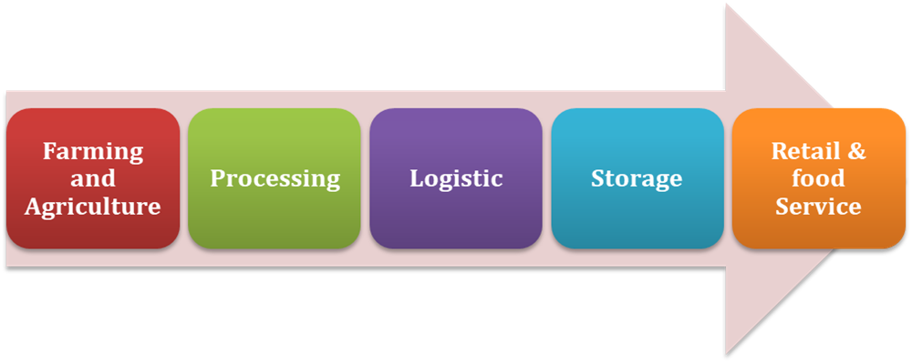
What does IS/ISO 22000 (FSMS) has to offer?
Global standard for Food Safety Management System
Designed to enable organizations to control food safety hazards along the food supply chain
Applies to all types and sizes of organizations participating in food chains

Slide 12
Applicability of FSMS
The requirements of IS/ISO 22000 are generic and are intended to be applicable to all organizations in the food chain regardless of size and complexity.
This includes organizations which are involved:
directly in one or more steps of the food chain (such as, feed producers, harvesters, farmers, food manufacturers, retailers, food services, catering services, organizations providing cleaning and sanitation services, transportation, storage and distribution services);
indirectly in the food chain (for example, suppliers of equipment, cleaning and sanitizing agents, packaging materials and other food contact materials).

Slide 13
FSMS Principles
adequate control throughout the food chain through interactive communication, system management, prerequisite programmes and HACCP principles
principles common to ISO management standards:
customer focus
Leadership
engagement of people
process approach
Improvement
evidence-based thinking
relationship management

Slide 14
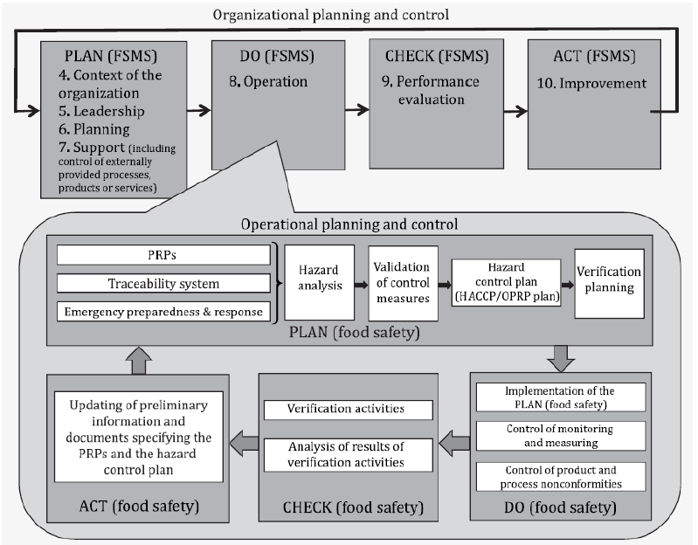
PDCA cycle – The DIY Mantra of IS/ISO 22000
Notes:
Plan-Do-Check-Act cycle
The PDCA cycle can be described briefly as follows:
Plan: establish the objectives of the system and its processes, provide the resources needed to deliver the results, and identify and address risks and opportunities;
Do: implement what was planned;
Check: monitor and (where relevant) measure processes and the resulting products and services, analyse and evaluate information and data from monitoring, measuring and verification activities, and report the results;
Act: take actions to improve performance, as necessary.

Slide 15
Prerequisite programs (PRPs) – Stairway to food safety
IS/ISO 22000 defines PRPs as the basic conditions and activities that are necessary within the organization and throughout the food chain to maintain food safety
When selecting and/or establishing PRP(s), the organization shall ensure that applicable statutory, regulatory and mutually agreed customer requirements are identified.
The organization should consider:
a) applicable standards, codes of practice and guidelines
b) the applicable part of the ISO/TS 22002 series from the following:
ISO/TS 22002-1:2009, Food manufacturing
ISO/TS 22002-2:2013, Catering
ISO/TS 22002-3:2011, Farming
ISO/TS 22002-4:2013, Food packaging manufacturing
ISO/TS 22002-6:2016, Feed and animal food production
Notes:
When establishing PRP(s) the organization shall consider:
construction, lay-out of buildings and associated utilities;
lay-out of premises, including zoning, workspace and employee facilities;
supplies of air, water, energy and other utilities;
pest control, waste and sewage disposal and supporting services;
the suitability of equipment and its accessibility for cleaning and maintenance;
supplier approval and assurance processes (e.g. raw materials, ingredients, chemicals and packaging);
reception of incoming materials, storage, dispatch, transportation and handling of products;
measures for the prevention of cross contamination;
cleaning and disinfecting;
personal hygiene;
product information/consumer awareness;
others, as appropriate.
Documented information shall specify the selection, establishment, applicable monitoring and verification of the PRP(s).

Slide 16
Benefits accrued from FSMS
Increased international acceptance of food products
Reduces risk of product/ service liability claims
Satisfies customer contractual requirements
Ensures safety of food products
Greater health protection
conformance to international standards
FSMS
Helps to meet applicable statuary & regulatory requirements

Slide 17
Management System Standards are structured likewise.!
All Management System Standards (MSS), be it ISO 9000 (QMS), 14000 (EMS), 45000 (OH&S) or any other standard, have been structured in a common manner for an easier and chronological understanding of how these systems function.
1.Scope
2.Normative references
3.Terms and definitions
4.Context of the organization
5.Leadership
6.Planning
7.Support
8.Operation
9.Performance evaluation
10.Improvement
High
Level
Structure
Notes:
When establishing PRP(s) the organization shall consider:
construction, lay-out of buildings and associated utilities;
lay-out of premises, including zoning, workspace and employee facilities;
supplies of air, water, energy and other utilities;
pest control, waste and sewage disposal and supporting services;
the suitability of equipment and its accessibility for cleaning and maintenance;
supplier approval and assurance processes (e.g. raw materials, ingredients, chemicals and packaging);
reception of incoming materials, storage, dispatch, transportation and handling of products;
measures for the prevention of cross contamination;
cleaning and disinfecting;
personal hygiene;
product information/consumer awareness;
others, as appropriate.
Documented information shall specify the selection, establishment, applicable monitoring and verification of the PRP(s).

Slide 18
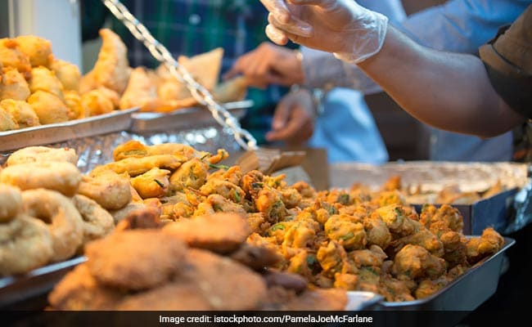
IS/ISO 16066: 2017

Slide 19
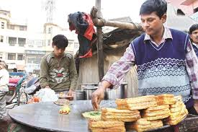
IS 16066 – A Systematic Approach towards lip-smacking yet safe street food
Scope of IS 16066 covers:
Control check points with minimum requirements
Checklist with grading criteria of street food vendors to ensure safe food
Covers all mobile and fixed food
vendors serving prepared /raw
food for human consumption.

Slide 20
Globally relevant Grading/ Rating of street foods
Two levels of grading recommended (based on method developed by WHO-FCSD)
Level 1- Preliminary Basic Safety Rating System
A simple basic assessment rating method, mostly visual.
Level 2 – Advanced Safety Rating System
For doing a confirmed Grading, specially for either high risk foods or foods sold in vulnerable areas like near school, hospitals etc, using supportive laboratory supported assessment.
Administrative monitoring by use of special indicators to be done by authorities.

Slide 21
How does IS 16066 categorize street food vendors
Category I
Foods prepared in small scale or cottage industry and brought to the street food stalls by different vendors for sale (eg. Sandesh, Bhelpuri, chaat-papdi etc).
Category II
Foods prepared at the home of vendor and brought to street food stall for sale (eg. Curries , biryani etc).
Category III
Foods prepared and sold at the street food stall itself (eg. Parantha roll, Dosa, chowmein, jalebis etc).

Slide 22
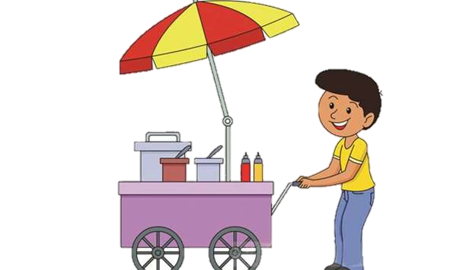
How do we go about implementing IS 16066 for a safe street food
Way forward through the standard
To identify locations having good number of street vendors.
Vulnerable areas (e.g. schools, hospitals, temples, etc) to be identified.
Municipalities/ Local urban bodies to be sensitized with respect to requirements of the specification.
Conduct trainings and awareness programmes based on IS 16066:2017 so that vendors, consumers, NGO’s etc. can do self-regulation.
Surveys to be carried out to check the efficacy of training.
Municipalities/Local bodies can contact local BIS offices for implementation of the standard.
Coordination between different stakeholders.

Slide 23
Sector Specific Food Safety Codes
Commonly called as the Codes of Hygiene, various Indian Standards may be referred for sector/ food product specific food safety aspects.
All the food safety codes generally cover the minimum requirements of hygiene for growing, harvesting and post-harvest practices (for example, curing, bleaching, blanching, cutting, drying, cleaning, grading, packing, transportation and storage, including disinfestation and fumigation), processing establishments, processing technology and practices (eg: grinding, blending, freezing and freeze-drying, treatments to reduce the microbial load), packaging and storage of processed products.
Some useful Codes of hygiene:
IS 14216 : 2023 Spices and Condiments Processing Units Code of Hygiene Practices
IS 5839 : 2000 Food hygiene - Code of practice for manufacture storage and sale of ice cream
IS 14350 : 2023 Code For Hygienic Conditions For Sugar Factories
IS 8182 : 2023 Conditions for Processed Meat Products Hygienic Code of Practice
IS 10974 (Series) Code for hygienic conditions for production transport storage & distribution of milk products
IS 14348 : 1996 Code for hygienic conditions for alcoholic beverage industry
Notes:
IS 14366 : 1996 Food processing machinery - Dough mixers - Safety and hygiene requirements
IS 14595 : 1998 Food hygiene - Microbiological criteria - Principles for establishment and application
IS 14134 : 1994 Code for hygienic practices for units for processing and handling of quick frozen foods

Slide 24
BIS Technical Committee on Food Safety Standards
Food Hygiene, Safety Management And Other Systems Sectional Committee, FAD 15
Scope : Standardization in the field of –
a) Food hygiene including codes of hygienic practices applicable for food products in general (except subject/ product specific codes covered under other Sectional Committees of FAD);
b) Food safety management systems; and
c) Food labelling.
Liaison :
ISO TC 34 / SC 17 - Management systems for food safety - Principle (P)
ISO TC 34 / SC 17 - Communication on the ISO 22000 family of standards
ISO TC 34 / SC 17 - Cooperation between Codex Alimentarius and SC 17
ISO TC 34 / SC 17 - Prerequisite programmes on food safety
For comments/ feedback on Indian Standards related to Food Safety, emails may be sent to fad15@bis.gov.in

Slide 25
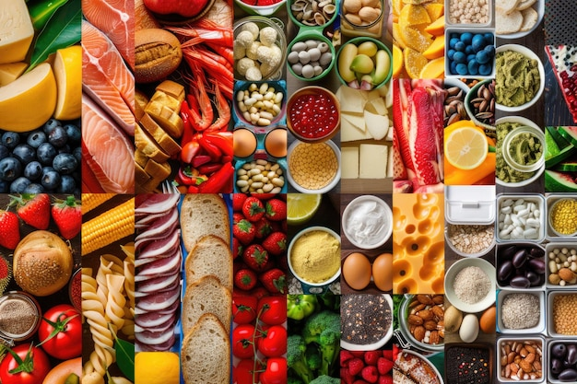
Other relevant BIS Technical Committees for product specific food safety guidelines/ codes
FAD 2 Sugar Industry
FAD 3 Apiary Industry
FAD 6 Stimulant Foods
FAD 9 Spices And Condiments
FAD 10 Fruits, Vegetables, and Allied Products
FAD 12 Fish, Fisheries, and Aquaculture
FAD 13 Oils And Oilseeds
FAD 14 Drinking Water and Carbonated Beverages
FAD 16 Foodgrains, Allied products, and other agricultural produce
FAD 18 Slaughter House And Meat Industry
FAD 19 Dairy Products
FAD 20 Agriculture And Food Processing Equipments
FAD 24 Ready-to-eat foods and specialized products
FAD 29 Alcoholic Drinks
FAD 31 Food Microbiology

