Slide 1
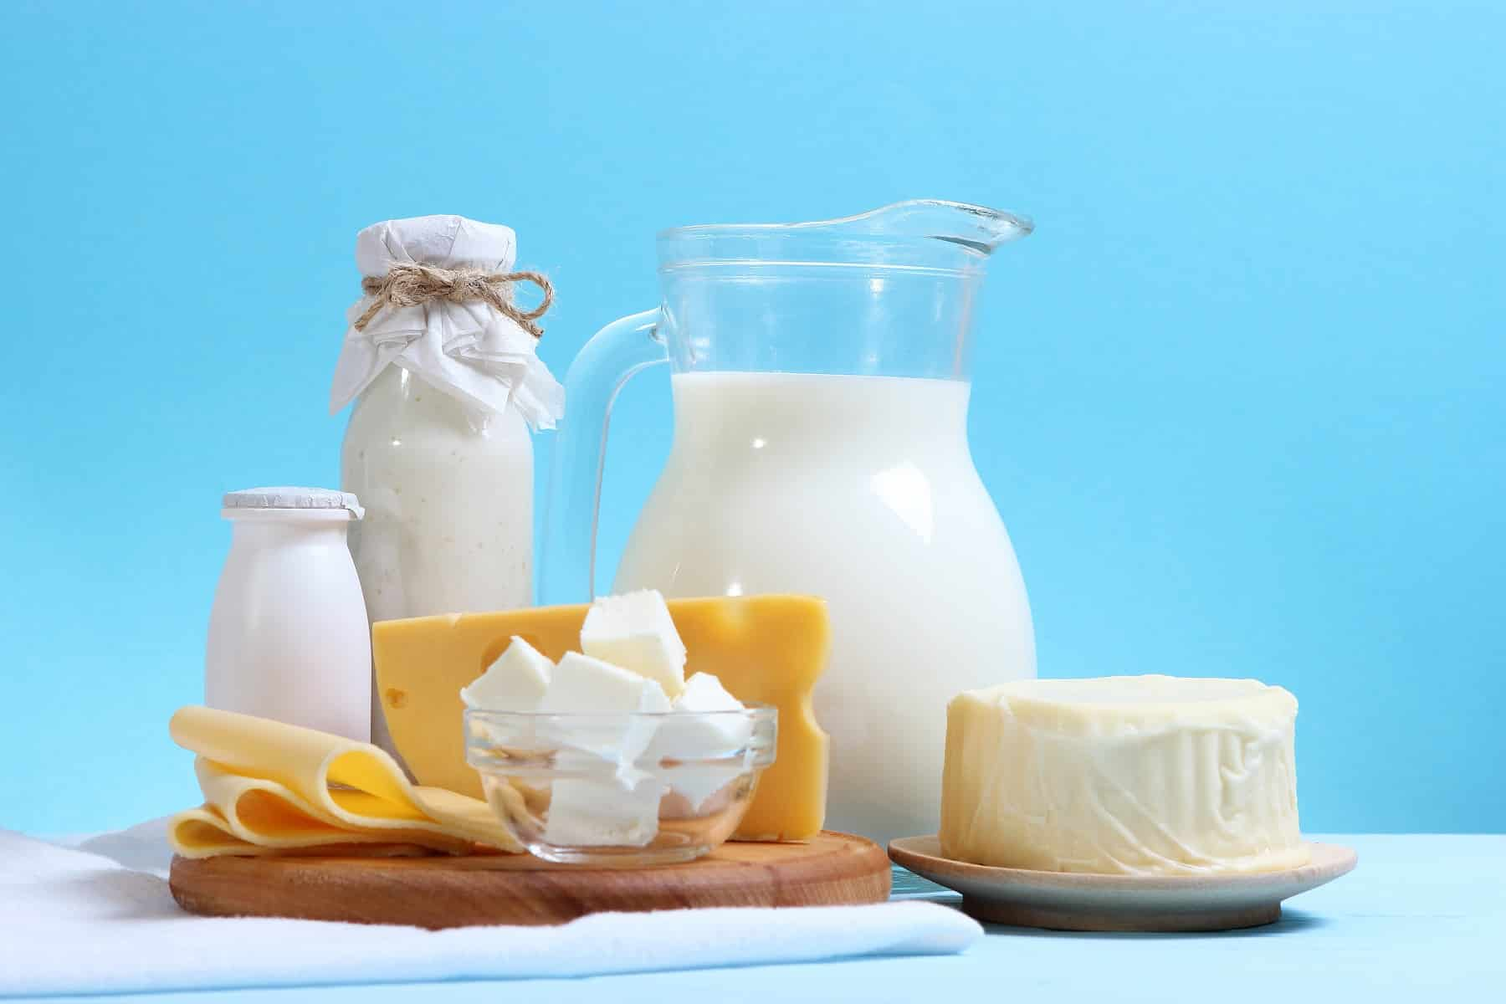
Analyzing Composition and Contaminants in Food Products – Milk & Milk Products
Bureau of Indian Standards

Slide 2
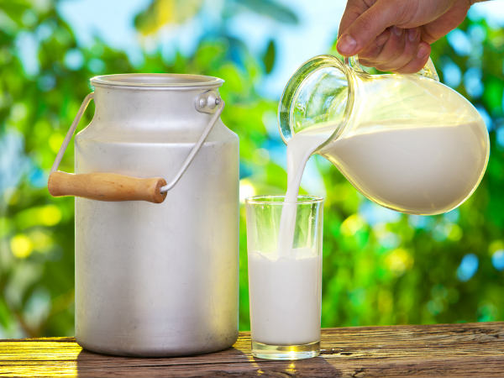
SESSION PLAN
Session 1: Analyzing Composition – Milk & Milk Products
Session 2: Analyzing Contaminants – Milk & Milk Products

Slide 3
SETTING THE CONTEXT

Slide 4
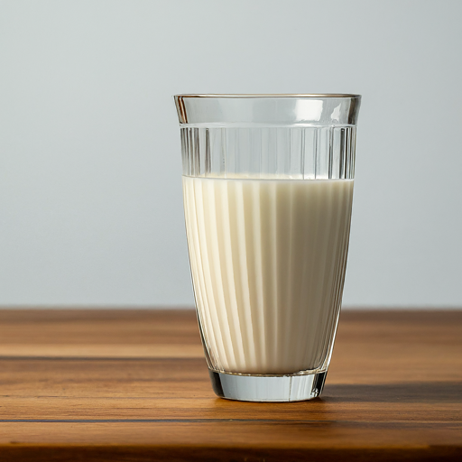
HISTORY OF MILK CONSUMPTION…
Domestication of animals for Milk – 10,000 yrs ago
Technological Advancements (Fermentation)- Development of Yoghurt & Cheese
With Industrial revolution- Mechanized Dairy Production- Large scale commercial Dairy Farms
Milk and Dairy products remain a significant source of nutrition, providing essential nutrients such as calcium, protein, and vitamins.
Notes:
Definition of Milk: “Milk” means the normal mammary secretion derived from complete milking of healthy milch animal, without either addition thereto or extraction therefrom, unless otherwise provided in FSSAI regulations and it shall be free from colostrum.
Definition of Milk Products: “Milk Product” means a product obtained by processing of milk, which may contain food additives and other ingredients functionally necessary for the milk product as permitted in FSSAI regulations and shall include (i)cheese;(ii)chhana, skimmed-milk chhana, paneer; (iii) condensed milk-sweetened and unsweetened; (iv) condensed skimmed milk-sweetened and unsweetened; (v) cream; (vi) 81[dahi, skimmed milk dahi;]; (vii) ghee, butter oil; (viii) ice-cream; (ix) infant milk food; (x) khoa; (xi) malai; (xii) milk derivatives such as whey proteins, casein, lactose etc.; (xiii) milk ices, milk lollies, kulfi; (xiv) milk powder, skimmed milk powder, partly skimmed milk powder; (xv) processed cheese; (xvi) table butter and white butter; (xvii) yoghurt; (xviii) any other product as may be specified in these regulations.

Slide 5
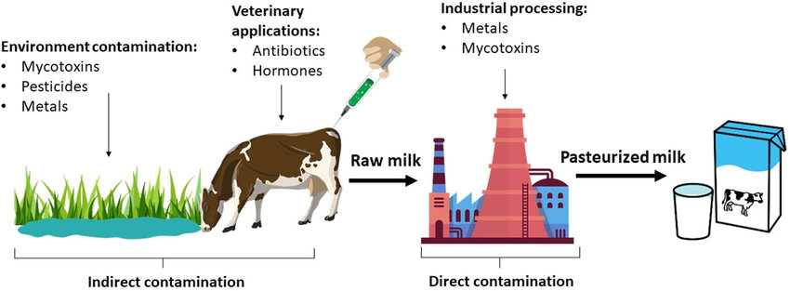
… AND SO OF ITS CONTAMINATION
Milk is susceptible to various forms of contamination throughout its production, processing, and distribution
Microbial Contamination: Bacteria; Yeast & Mold
Chemical Contamination: Pesticides & Herbicides; Antibiotics & Hormones; Cleaning agents
Physical Contamination: Foreign objects
Causes of Contamination: Poor Hygiene; Improper Storage; Environmental factors; Cross- contamination

Slide 6
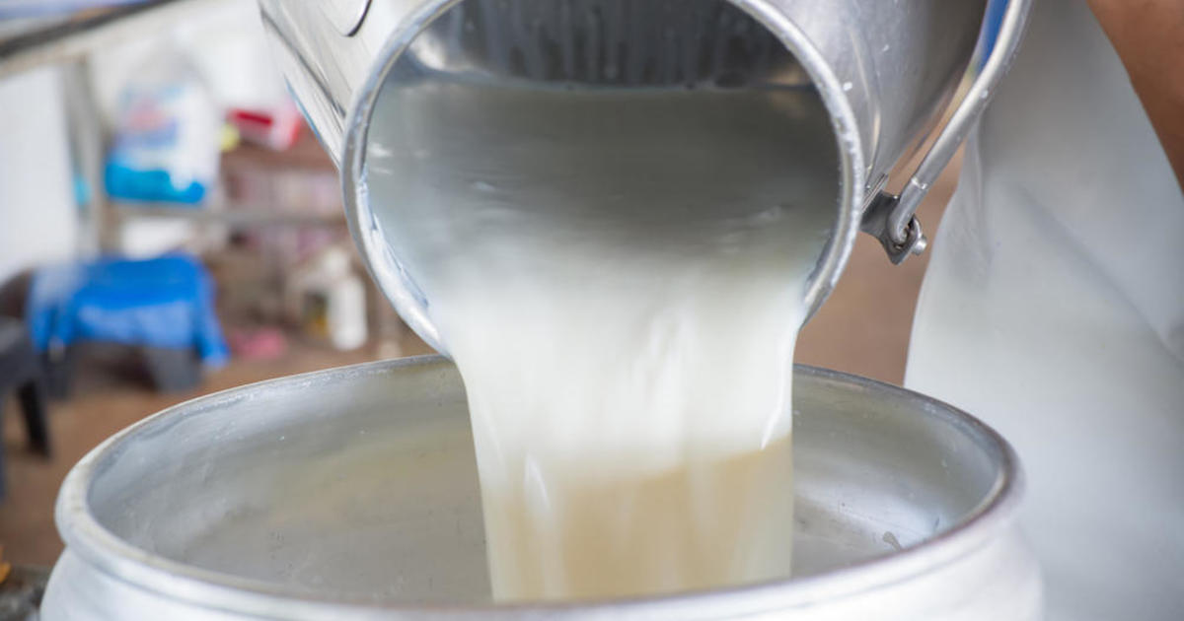
MILK ADULTERATION
Adulteration is the deliberate addition of substances to increase profit or extend shelf life
Common Adulterants in Milk:
Water
Detergents
Starch or Sugar
Urea
Melamine
Formalin
All leads to inferior ‘QUALITY’ Milk

Slide 7
STANDARDIZATION: FOUNDATION OF QUALITY

Slide 8
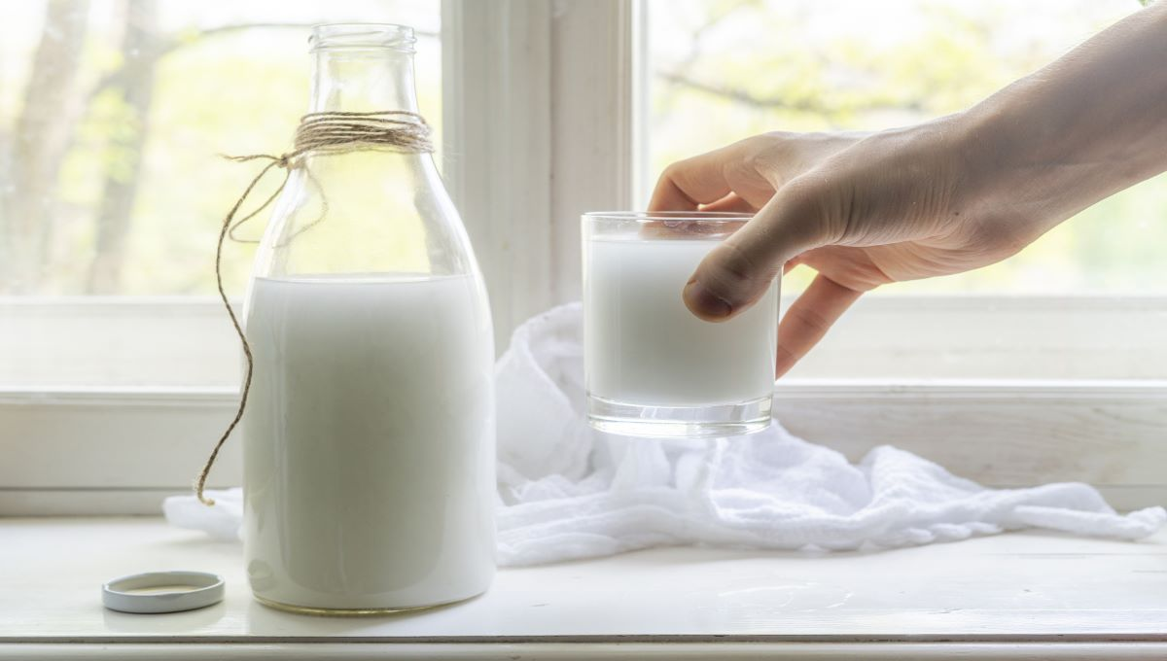
WHAT IS QUALITY?
Satisfy the intended Need
Role of Standards
Bureau of Indian Standards (BIS)- National Standards Body of India
Manufacturer Quality Customer

Slide 9
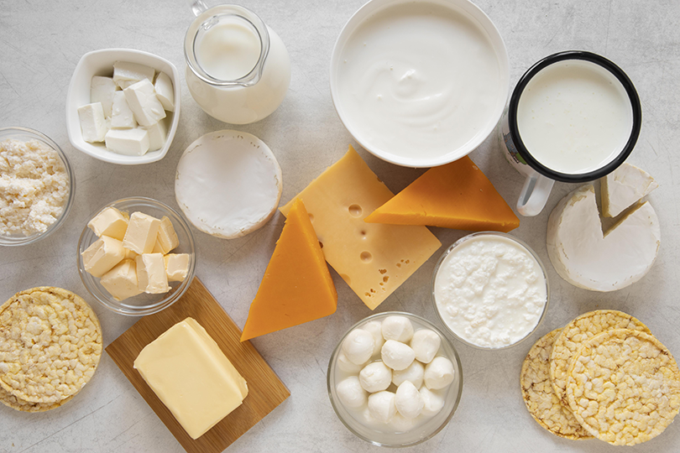
WHY ‘STANDARDS’?
Standardization plays a critical role in ensuring safety, consistency & reliability of Milk and Dairy Products.
Ensures comparability of test results across different laboratories and regions.
Beneficial to all Stakeholders:
Consumers
Producers
Regulators

Slide 10
WHY ‘STANDARDS’? Contd..
Standardization in Testing ensures Milk undergoes tests for fat content, protein levels, presence of antibiotics, and other parameters using established and approved procedures.
Standardization in Processes ensures Milk processing facilities utilize standardized equipment like milk tankers and pasteurizers to ensure consistent handling and processing.
Standardization in Cleaning & Sanitation ensures cleaning and sanitation protocols minimize the risk of contamination throughout the milk production chain.

Slide 11
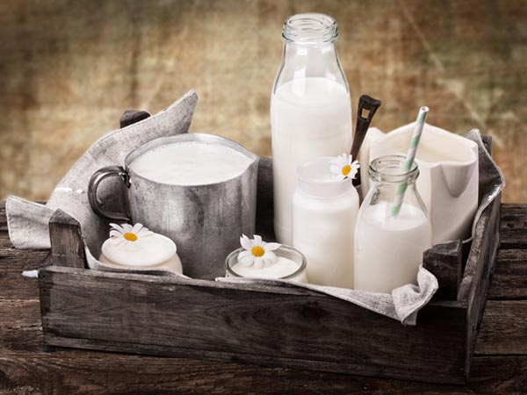
GLOBAL STANDARDIZATION PERSPECTIVE
Codex Alimentarius Commission: The Codex Standard for Milk and Milk Products provides internationally recognized guidelines on milk quality, including methods for sampling and analysis. It ensures harmonization of practices globally, facilitating trade and consumer protection.
ISO Standards: ISO/TC 34/SC 5 ‘Milk and Milk Products’ formulated International Standards for methods of analysis and sampling for milk and milk products, covering the dairy chain from primary production to consumption. ISO 11816 series covers methods for the determination of fat, protein, lactose, and other components in milk.

Slide 12
GLOBAL STANDARDIZATION PERSPECTIVE Contd.
International Dairy Federation (IDF): A leading authority setting scientific and technical standards for milk and milk products since 1903. It publishes guidelines for milk preservation, hygienic practices, and terminology.
Collaborates with ISO and CAC in developing guidelines for Milk and related products.
IDF covers key issues working within 4 Strategic pillars:
Standards
Nutrition & Health
Sustainability
Safety & Quality

Slide 13
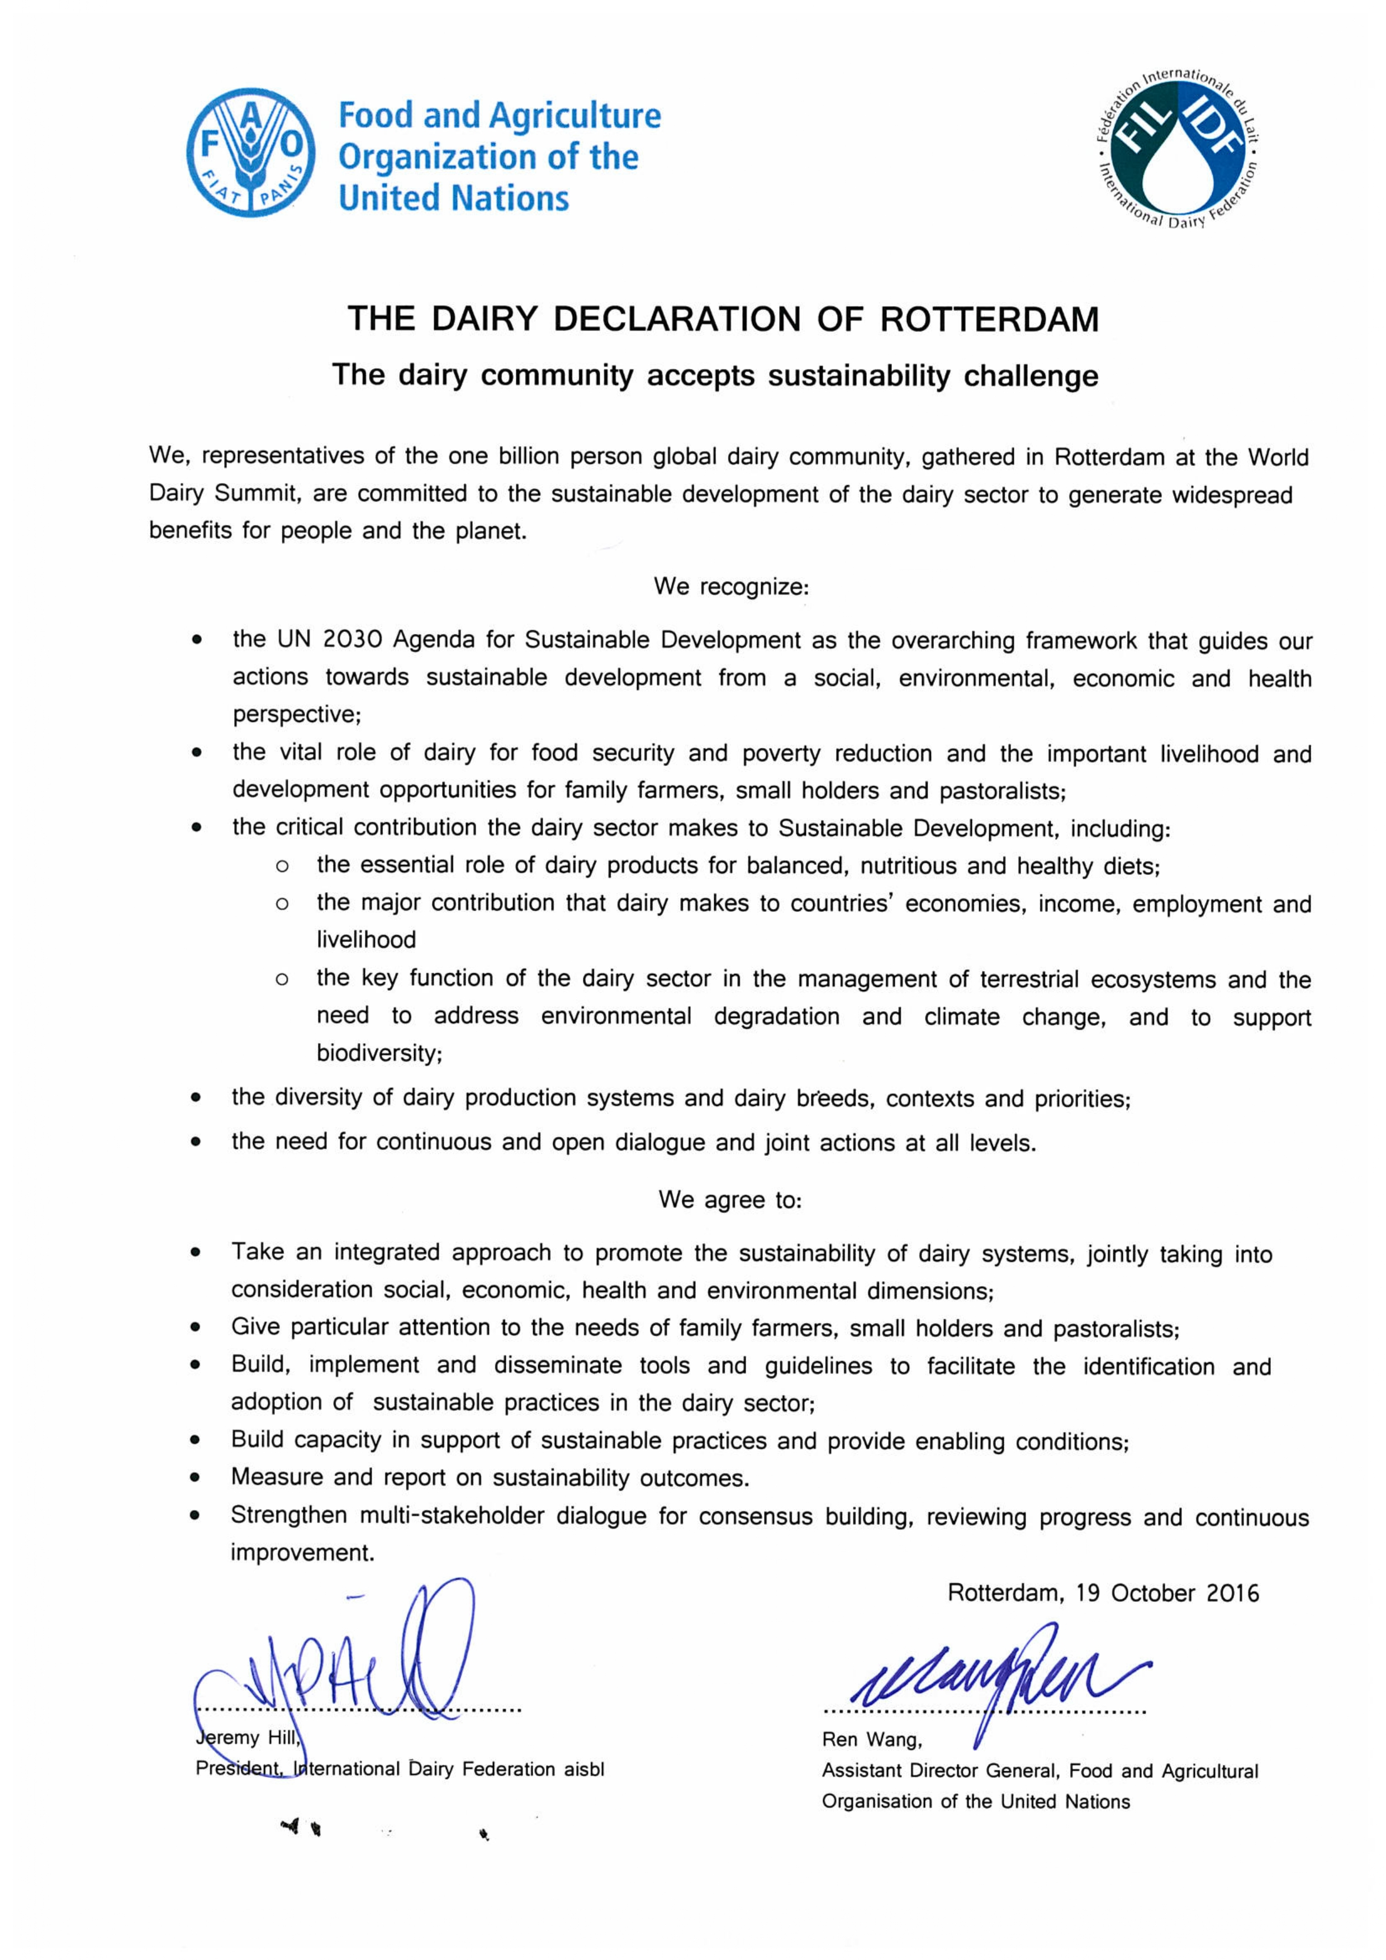
THE DAIRY DECLARATION OF ROTTERDAM

Slide 14
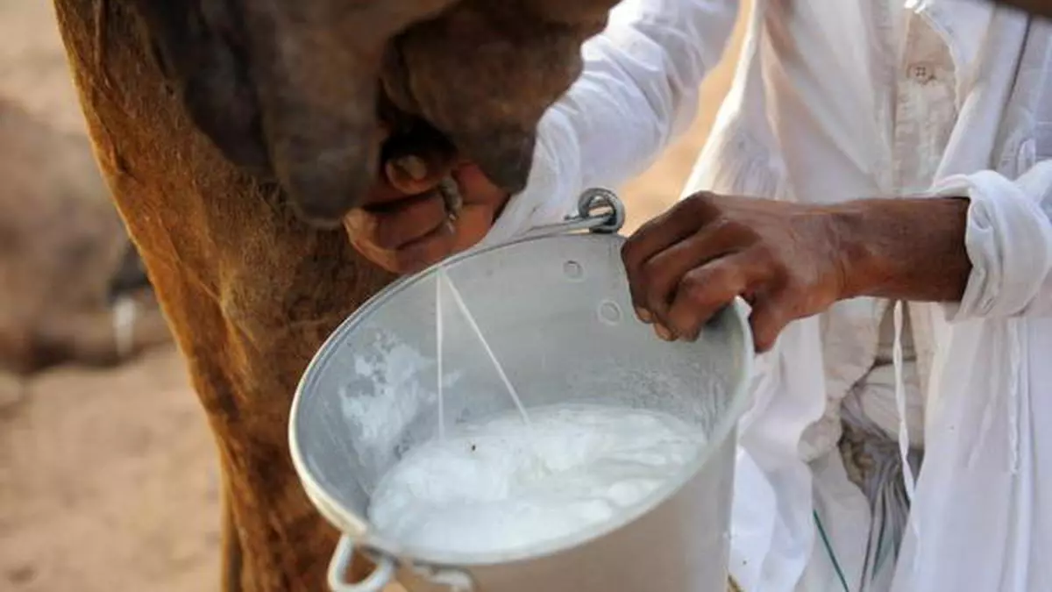
National Scenario for Standardization for Dairy Sector
BIS: Bureau of Indian Standards (BIS) formulates Indian Standards on Milk & related products; Dairy Equipment; Food Hygiene & Safety Management and Methods of Tests for Food Products, and in- sync ensures implementation of FSSAI regulations, and serves to the Standardization, Conformity and Testing requirement of the country’s Dairy sector.
FSSAI : The Food Safety and Standards Authority of India (FSSAI) sets national regulations for milk and milk products in India. These standards encompass composition, hygiene, labeling, and contaminant limits. The FSSAI also conducts regular milk quality surveys to monitor compliance with national standards.

Slide 15
FORMULATION OF INDIAN STANDARDS THROUGH BIS SECTIONAL COMMITTEES
FAD 19: Dairy Products Sectional Committee
Scope: Standardization in the field of dairy and dairy products covering the dairy chain from primary production to consumption, in particular:
a) Product specifications including milk based infant
foods
b) Methods of test and analysis including sampling
c) Codes of hygienic practices.
Notes:
Liaison :ISO/TC 34/SC 5 - Milk and milk products - Participating (P)

Slide 16
FORMULATION OF INDIAN STANDARDS THROUGH BIS SECTIONAL COMMITTEES
FAD 33: Dairy Equipment Sectional Committee
Scope: Standardization in the field of specifications and Code of practices for equipment used for collection, handling, processing, packaging, storage & transportation and testing and analysis in dairy sector.

Slide 17
FORMULATION OF INDIAN STANDARDS THROUGH BIS SECTIONAL COMMITTEES
FAD 15: Food Hygiene, Safety Management and Other Systems Sectional Committee
Scope: The Standardization in the field of –
a) Food hygiene including codes of hygienic practices
applicable for food products in general (except subject/
product specific codes covered under other Sectional
Committees of FAD)
b) Food safety management systems
c) Food labelling.
Notes:
Liaison :
ISO/TC 34/SC 17 - Management systems for food safety - Participating (P)
ISO/TC 34/SC 17/AG 2 - Communication on the ISO 22000 family of standards
ISO/TC 34/SC 17/AG 3 - Cooperation between Codex Alimentarius and SC 17
ISO/TC 34/SC 17/WG 11 - Prerequisite programmes on food safety

Slide 18
FORMULATION OF INDIAN STANDARDS THROUGH BIS SECTIONAL COMMITTEES
FAD 28: Test Methods for Food Products Sectional Committee
Scope: Standardization in the field of - Horizontal methods of test for food products including physical, chemical and sensory evaluation excluding the microbiological methods of test covered under the scope of FAD 31 and methods of test for estimation of pesticide residues covered under the scope of FAD 27.
Notes:
Liaison : ISO/TC 34 - Food products - Participating (P)
ISO/TC 34/SC 12 - Sensory analysis - Participating (P)
ISO/TC 34/WG 14 - Vitamins, carotenoids and other nutrients

Slide 19
LIST OF INDIAN STANDARDS FOR MILK AND MILK PRODUCTS ISs
Sr No. | IS No. | Product | Laboratories |  | No of Licences
 |  |  | BIS labs | OSLs
1 | IS 1656:2022 | Milk Cereal based Complementary foods |  |  | 09
2 | IS 1166:2022 | Sweetened condensed Milk, Partly skimmed and skimmed conden | 4 | 22 | 12
3 | IS 13334:Part 1:2014 | Skimmed Milk Powder- Standard Grade | 6 | 32 | 229
4 | IS 13334:Part 2:2014 | Skimmed Milk Powder- Extra Grade | 5 | 28 | 53
5 | IS 14433:2022 | Infant Milk Substitutes | 1 | 17 | 15
6 | IS 14542:1998 | Partly Skimmed Milk Powder | 4 | 13 | 01
7 | IS 15757:2022 | Follow-up Formula- Complementary Foods | 2 | 14 | 10
8 | IS 13688:2020 | Packaged Pasteurized Milk | 2 | 7 | 01
9 | IS 12299:2021 | Dairy Whitener | 3 | 8 | 10
10 | IS 1806:2018 | Malted Milk Foods | 3 | 4 | 02
11 | IS 2785:2022 | Natural Cheese (hard Variety), Processed cheese, Processed Cheese spread and soft cheese | 5 | 7 | 04
12 | IS 2802:2022 | Ice-cream and Kulfi | 2 | 1 | 01
13 | IS 9532:2023 | Chakka and Shrikhand | 1 | 3 | 03
14 | IS 1165:2022 | Whole Milk Powder | 6 | 29 | 107

Slide 20
LIST OF MILK RELATED PRODUCT ISs
Sr No. | IS No. | Product | Laboratories
 |  |  | BIS labs | OSLs
15 | IS 1000:2021 | Lactose Commercial | 0 | 0
16 | IS 1167:2021 | Casein (Edible Quality) | 0 | 7
17 | IS 4079:2023 | Canned Rasogolla | 0 | 7
18 | IS 4238:2020 | Sterilized Milk | 2 | 1
19 | IS 4709:2021 | Flavoured Milk | 0 | 7
20 | IS 4883:2023 | Khoa | 0 | 2
21 | IS 4884:2021 | Sterilized Cream | 0 | 1
22 | IS 5162:2021 | Chhana | 0 | 7
23 | IS 5550:2023 | Burfi | 0 | 2
24 | IS 7839:2022 | Dried Ice-Cream Mix | 0 | 1
25 | IS 9584:2022 | Cheese Powder | 0 | 1
26 | IS 9617:2023 | Dahi | 1 | 7
27 | IS 10484:2021 | Paneer | 1 | 4
28 | IS 11602:2023 | Packed Gulab Jamuns | 1 | 7
29 | IS 12898:2022 | Dairy Products - Yoghurt | 0 | 7
30 | IS 13689:2021 | Butter Oil (Butter Fat) | 0 | 7
31 | IS 13690:2021 | Pasteurised butter | 0 | 7
32 | IS 16326:2015 | Ghee | 0 | 7
Note: More than 170 labs notified by FSSAI have milk testing capabilities within their scope

Slide 21
ENSURING MILK QUALITY

Slide 22
COMPOSITION OF MILK
As per IS 13688: 2020 Packaged Pasteurized Milk, the milk of different classes shall conform to the requirements for milk fat and milk solids-not-fat, independently, as specified in columns (4) and (5) of the table below:
Sr. No | Class of Milk. | Minimum Milk Fat (per cent, m/m). | Minimum Milk Solids- not-Fat (SNF) (per cent, m/m).
1. | Buffalo Milk | 5.0 | 9.0
2. | Cow Milk | 3.2 | 8.3
3. | Goat Milk | 3.0 | 8.0
4. | Camel Milk | 2.0 | 6.0
5. | Mixed Milk | 4.5 | 8.5
6. | Standardized Milk | 4.5 | 8.5

Slide 23
COMPOSITION OF MILK Contd..
Sr. No | Class of Milk. | Minimum Milk Fat (per cent, m/m). | Minimum Milk Solids- not-Fat (SNF) (per cent, m/m).
7. | Toned Milk | 3.0 | 8.5
8. | Double Toned Milk | 1.3 | 9.0
9. | Skimmed Milk | Not more than 0.5 | 8.7
10. | Full Cream Milk | 6.0 | 9.0
11 | Sheep Milk | 3.0 | 9.0

Slide 24
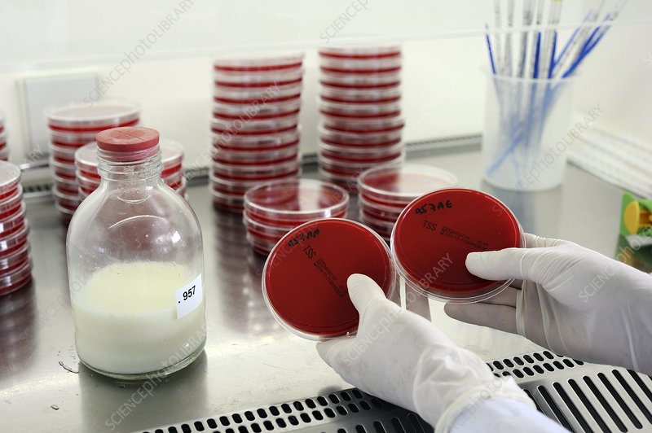
TESTING OF RAW MILK
Raw milk testing is done at milk collecting centres. But selection of method, and its appropriate application is of paramount importance to get desired results.
The physical (density, sediment test etc.), chemical (adulterants, fat content, Solids-not-Fat, acidity, resazurin, MBRT test etc.) microbiological analysis (direct microscopic count etc.) are used for assessing rapidly the quality of raw milk supplies for processing and manufacture.
Rapid examination of milk is carried out for routine check with the objective of ensuring purity of milk, hygienic quality and fitness for acceptance as raw milk for further processing
BIS has published the Indian Standard IS 1479 (Part 1):2016 which prescribes the methods of test for Rapid examination of milk
Notes:
BIS does not test raw milk because milk has a limited shelf life, leading to constraints in storage and transportation.

Slide 25
RAPID EXAMINATION OF MILK- WHAT DOES THE STANDARD TELL?
Sampling: Homogeneity is a pre-requisite for accurate analysis
‘FAT’ as classifying parameter: ‘FAT’ content classifies milk, and determines cost. Composite Milk sample for Fat test.
Organoleptic Test: Taste & Smell that determines the quality
Reference ‘Standard’ Sedimentation Disc: How to prepare

Slide 26
RAPID EXAMINATION OF MILK- WHAT DOES THE STANDARD TELL?
Sl No. | SPECIFIED TEST | REMARKS
1 | Clot-on-Boiling (C.O.B) Test | To check acidity & suitability of milk for processing
2 | Alcohol Test | Aids in detection of colostrum milk
3 | M.B.R.T | Indicates microbial load (and hence Stability)
4 | Direct Microscopic Count | Reveal information regarding source of contamination
5 | Titratable Acidity | High acidity indicates reduced keeping quality & heat stability
6 | Determination of Fat | Gerber method as per IS 1224 (Part 1)
7 | Determination of Solids-Not-Fat (SNF) | Measured to ensure proper protein & lactose content

Slide 27
IMPORTANCE OF MILK QUALITY TESTING as per IS
Gives indication whether it is suitable for further processing/ sterilization.
Milk which gives a positive C.O.B. test has an acidity generally above 0.17 percent (as lactic acid) and is not suitable for distribution as liquid milk or for processing.
Alcohol Test tells about Stability of Milk for processing
Precautions to be taken to avoid contamination leading to False positive in MBRT

Slide 28
DETECTION OF ADULTERANTS: SAFEGUARDING MILK INTEGRITY
Sl No | ADULTERANT | REMARKS
1 | Water | Dilutes- reducing nutritional value
2 | Starch | Creating thicker consistency
3 | Sugar | Increasing volume
4 | Detergents | Increases frothability
5 | Urea or Melamine | Artificially inflate protein content, but causes kidney damage
6 | Formalin or H₂O₂ | Acts as preservative masking spoilage, causes cancer
7 | Neutralizers | Neutralize natural acidity indicate of poor hygiene practices
8 | Skimmed Milk Powder | Increases SNF content

Slide 29
DETECTION OF ADULTERANTS: SAFEGUARDING MILK INTEGRITY Contd.
BIS has published 2 Indian Standards addressing Detection of Adulteration in milk
a. IS 1479 (Part 1): Method of Tests for Dairy Industry- Rapid examination of Milk
b. IS 15642 (Part 1& 2): Quick methods for Detection of
Adulterants/ Contaminants in common Food products

Slide 30
DETECTION OF ADULTERANTS: SAFEGUARDING MILK INTEGRITY Contd.
National Dairy Development Board (NDDB) has developed a ready-to-use kit for the detection of adulterants in milk. The kit has been available in the market for over a decade and is available in three pack sizes, each suited for specific use at household, dairy cooperative society and dairy plant levels.

Slide 31
Test methods for Nitrate and Nitrite Content in Milk and Milk products
IS 9967 prescribes the methods for determination of nitrate and nitrite contents in milk and milk products
Published in 3 parts based on different methods (identical adoption of corresponding ISO Standards):
IS 9967 (Part 1) : 2008/ISO 14673-1:2004 ‘Method using cadmium reduction and spectrometry (second revision)’
IS 9967 (Part 2) : 2008/ISO 14673-2: 2004 ‘Method using segmented flow analysis Routine Method (second revision)’
IS 9967 (Part 3) : 2008/ISO/14673-3: 2004 ‘Method using cadmium reduction and flow injection analysis with in-line dialysis (Routine Method) (second revision)’

Slide 32
Test Methods for Dried and Concentrated Milk Products
IS 11766 : 1986/ISO 6092 : 1980 ‘Method for determination of titratable acidity in milk powder and similar products − Routine Method’
IS 11202 : 2012/ISO 8069 : 2005 ‘Dried milk − Determination of content of lactic acid and lactates (second revision)’
IS 16072 : 2012 ‘Determination of moisture content in milk powder and similar products (Routine method)’
IS 11721 : 2013/ISO 1736 : 2008 ‘Dried milk and dried milk products − Determination of fat content - Gravimetric method (Reference Method) (second revision)’
Notes:
The milk production in our country is characterized by seasonal variations and drying of milk, an important method of preservation, facilitates later consumption during the lean season.
The dried milk products, thus, have become an essential part of the chain between the producer and the consumer.
Indian Standards on test methods for dried and concentrated milk products, some of which are mentioned below:

Slide 33
Test Methods for Dried and Concentrated Milk Products
IS 11762 : 2013/ISO 1737 : 2008 ‘Evaporated milk and sweetened condensed milk − Determination of fat content − Gravimetric method (Reference method) (second revision)’
IS 11764 : 2005/ISO 2911 : 2004 ‘Sweetened condensed milk - Determination of sucrose milk content − Polarimetric method (first revision)’
IS 12759 : 2019/ISO 8156 : 2005 ‘Dried milk and dried milk products – Determination of insolubility index (first revision)’
Notes:
The milk production in our country is characterized by seasonal variations and drying of milk, an important method of preservation, facilitates later consumption during the lean season.
The dried milk products, thus, have become an essential part of the chain between the producer and the consumer.
Indian Standards on test methods for dried and concentrated milk products, some of which are mentioned below:

Slide 34
ANALYZING CONTAMINANTS: QUANTITATIVE APPROACH

Slide 35
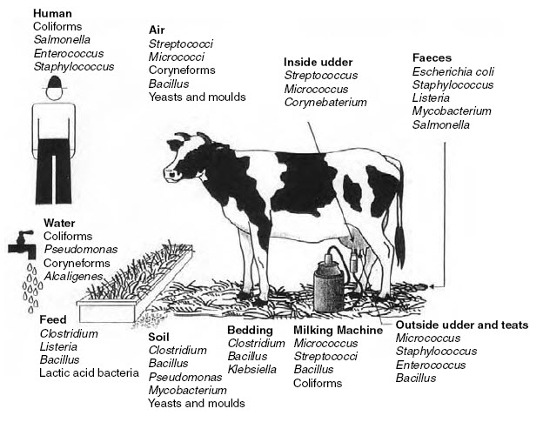

Slide 36
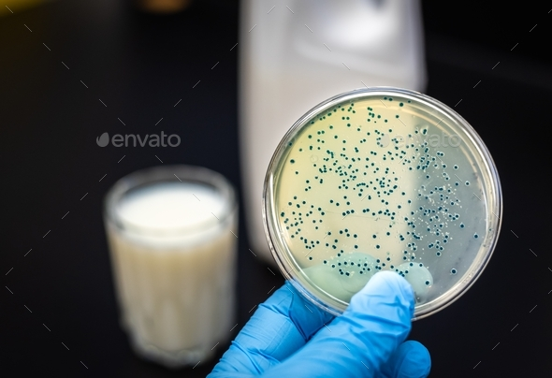
ADVANCED TECHNIQUES FOR CONFIRMATION OF CONTAMINANTS
Detection and Quantification of contaminants has always been a challenge considering the various factors including product matrix, heterogeneity and trace amount of the contaminant.
But with advancement in technologies, various methods have come up which easily determines contaminants in ppb level, and beyond.
ELISA- Enzyme Linked Immunosorbent Assay
HPLC- High Performance Liquid Chromatography
LCMS- Liquid Chromatography Mass Spectrometry
PCR- Polymerase Chain Reaction
Biosensors
Notes:
Contaminants, Toxins & Residues: The products shall comply with the limits stipulated under the Food Safety and Standards (Contaminants, toxins and Residues) Regulations, 2011.

Slide 37
SELECTION OF METHOD
The selection of the most suitable technique depends on various factors, including:
Type of contaminant being analyzed
Desired level of sensitivity and specificity
Availability of resources and equipment
Time constraints for analysis
Notes:
Contaminants, Toxins & Residues: The products shall comply with the limits stipulated under the Food Safety and Standards (Contaminants, toxins and Residues) Regulations, 2011.

Slide 38
SELECTION OF METHOD Contd.
Sl.No | METHOD | SPECIFIC INTENDED USE
1 | ELISA | Utilizes antibodies to detect specific contaminants in milk; Rapid and relatively simple technique for on-site screening of specific contaminants like antibiotics or drug residues
2 | HPLC | Separates and quantifies various components in a liquid sample, including antibiotics, pesticides, mycotoxins (fungal toxins), and aflatoxins; Highly sensitive and specific
3 | LCMS | Combines HPLC with mass spectrometry, providing even greater sensitivity and specificity for contaminant identification; Can differentiate between different types of contaminants and even identify unknown compounds
4 | PCR | Amplifies specific DNA sequences, allowing for detection of pathogens or genetically modified organisms (GMOs) in milk; Highly specific and sensitive for detecting even minute amounts of DNA
5 | Biosensor | Employ biological elements like enzymes or antibodies to detect specific contaminants; Portable and rapid testing for on-site screening
Notes:
Contaminants, Toxins & Residues: The products shall comply with the limits stipulated under the Food Safety and Standards (Contaminants, toxins and Residues) Regulations, 2011.

Slide 39
DETECTION & QUANTIFICATION OF MELAMINE IN MILK
Melamine Adulteration: The adulteration of milk with melamine is a serious issue that has significant health consequences, particularly affecting infants and young children. Melamine is an industrial chemical used in plastics, resins and fertilizers, that is sometimes added illegally to milk to artificially inflate its protein content in quality control tests.
Harmful consequences: Kidney stones & Renal Damage; UTI issues; Impaired child development; Gastrointestinal problems
FSSAI has explicitly stated that addition of Melamine in milk is prohibited, though max. permissible limit in milk have been given to address incidental contamination.

Slide 40
DETECTION & QUANTIFICATION OF MELAMINE IN MILK Contd.
Melamine in milk can be detected and quantified by any of the given method:
Sl. No. | TEST METHOD | REMARKS
1 | Liquid Chromatography- Mass Spectrometry (LC-MS) | LC-MS is highly effective for detecting and quantifying melamine in milk. It separates melamine from other components in the sample and identifies it based on mass spectrometry; Provides high sensitivity & specificity
2 | High- Performance Liquid Chromatography (HPLC) | HPLC can separate melamine from other compounds in milk based on its chemical properties and quantify it accurately
3 | Capillary Electrophoresis (CE) | CE separates charged molecules like melamine based on their electrophoretic mobility in a capillary filled with a buffer solution
4 | Enzyme- Linked Immunosorbent Assay (ELISA) | ELISA utilizes antibodies specific to melamine to detect and quantify its presence in milk samples

Slide 41
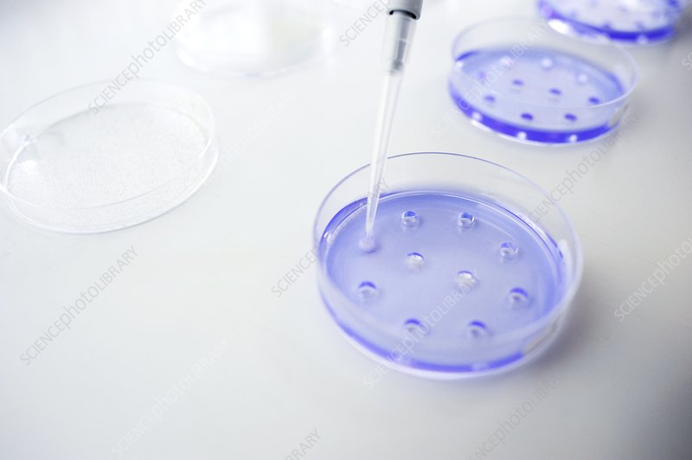
INDIAN STANDARD ON DETERMINATION OF MELAMINE CONTAMINATION IN MILK
IS 16195 is identical with ISO/TS 15495 : 2010 ‘Milk, milk products and infant formulae — Guidelines for the quantitative determination of melamine and cyanuric acid by LC-MS/MS’
Melamine content is determined in ppm ( mg/ Kg) level
Prescribes Method validation to demonstrate fitness for the purpose
(Min. required Sensitivity; Trueness & Recovery; Repeatability;
Within laboratory Reproducibility)
The analytical procedure encompasses a dilution of the sample in an acetonitrile: water solution, leading to the precipitation of proteins and allowing melamine acid to be extracted at the same time. After centrifugation, the supernatant is analysed by LC-MS/MS

Slide 42
IS ON DETERMINATION OF MELAMINE CONTAMINATION IN MILK Contd..
Method A [liquid chromatography electrospray ionization tandem mass spectrometry ]: The analytical procedure encompasses a dilution of the sample in an acetonitrile: water solution, leading to the precipitation of proteins and allowing melamine acid to be extracted at the same time. After centrifugation, the supernatant is analysed by LC-MS/MS
Method B [liquid chromatography using linear ion-trap mass spectrometry ]: Melamine is extracted in acetonitrile while achieving protein precipitation. After centrifugation, the supernatant is considered for subsequent analysis by ion-trap LC-MS/MS

Slide 43
DETECTION & QUANTIFICATION OF AFLATOXIN M1 IN MILK
Aflatoxin M1 is a metabolite of aflatoxin B1, a highly toxic compound produced by certain molds (Aspergillus flavus) that can contaminate crops such as maize, peanuts, and tree nuts. Aflatoxin M1 is specifically found in milk and dairy products when dairy cattle consume feed contaminated with aflatoxin B1.
Sources of Aflatoxin M1 in Milk: Dairy cattle may consume feed contaminated with aflatoxin B1, which is metabolized and excreted as aflatoxin M1 in milk.
Harmful effects of Aflatoxin M1 in Milk: Carcinogenic; Liver toxicity; Weakens the immune system

Slide 44
DETECTION & QUANTIFICATION OF AFLATOXIN M1 IN MILK Contd.
Aflatoxin M1 in Milk can be detected and quantified by any of the following methods:
Sl. No. | TEST METHOD | REMARKS
1 | High-Performance Liquid Chromatography (HPLC) | Separates and quantifies aflatoxin M1 from other components in milk. Highly sensitive and specific, capable of detecting low levels of aflatoxin M1
2 | Enzyme- Linked Immunosorbent Assay (ELSIA) | Uses antibodies to detect and quantify aflatoxin M1 in milk samples. Rapid screening method suitable for large-scale analysis
3 | Liquid Chromatography- Mass Spectrometry (LC-MS) | Combines chromatography with mass spectrometry for highly sensitive detection and quantification of aflatoxin M1. Provides accurate identification and measurement of aflatoxin M1 in complex matrices like milk

Slide 45
INDIAN STANDARD ON DETERMINATION OF AFLATOXIN M1 CONTAMINATION IN MILK
IS 18108 is identical with ISO 14674 : 2005 ‘Milk and milk powder — Determination of aflatoxin M1 content — Clean-up by immunoaffinity chromatography and determination by thin-layer chromatography’’
The method is applicable to raw milk, low fat or skimmed liquid milk and milk powder. The lowest quantity of AFM1 that can commonly be determined is 2 ng, which corresponds to a limit of quantification close to 0,10 µg/l for liquid milk or dissolved milk powder (for a spot of 20 µl).
Prescribes Method validation to demonstrate fitness for the purpose (Min. required Sensitivity; Trueness & Recovery; Repeatability ; Within laboratory Reproducibility)

Slide 46
IS ON DETERMINATION OF AFLATOXIN M1 CONTAMINATION IN MILK Contd.
Aflatoxin M1 (AFM1) is extracted by passing the test portion through an immunoaffinity column. The column contains specific antibodies bound onto a solid support material. As the sample passes through the column, the antibodies selectively bind with any AFM1 (antigen) present and form an antibody-antigen complex. All other components of the sample matrix are washed off the column with water. Then the AFM1 is eluted from the column with methanol and acetonitrile. After concentration of the eluate, the amount of AFM1 is determined by one-dimensional thin-layer chromatography. In the case of interference, two-dimensional thin layer chromatography is carried out to separate the AFM1 from its impurities.

Slide 47
IS ON DETERMINATION OF AFLATOXIN M1 IN MILK Contd. [ IMMUNOASSAY]
IS 18109 is identical with ISO 14675 : 2003 ‘Milk and milk products — Guidelines for a standardized description of competitive enzyme immunoassays — Determination of aflatoxin M1 content’
Proprietary methods such as ELISA methods cannot be described in separate International Standards. Therefore, this Standard is intended to provide guidelines on basic parameters required for evaluation/validation of competitive enzyme immunoassays for the quantitative determination of aflatoxin M1 in milk and milk products.
The “quality” of any immunoassay is a function of the immunochemical principle of the method, the properties of the reagents, the assay design and the experimental errors. These basic principles determine the sensitivity, specificity, precision and accuracy of the assay.

Slide 48
IS ON DETERMINATION OF AFLATOXIN M1 IN MILK Contd. [ HPLC]
IS 18110 is identical with ISO 14501 : 2021 ‘Milk and milk powder — Determination of aflatoxin M1 content — Clean-up by immunoaffinity chromatography and determination by high-performance liquid chromatography’
Aflatoxin M1 is extracted by passing the test portion through an immunoaffinity column that contains specific antibodies bound onto a solid support material. As the sample passes through the column, the antibodies are selectively bound with any aflatoxin M1 (antigen) present and form an antibody-antigen complex. All other components of the sample matrix are washed off the column with water. Then aflatoxin M1 is eluted from the column and the eluate is collected. The amount of aflatoxin M1 present in this eluate is determined by means of high-performance liquid chromatography (HPLC) coupled with fluorometric detection.

Slide 49
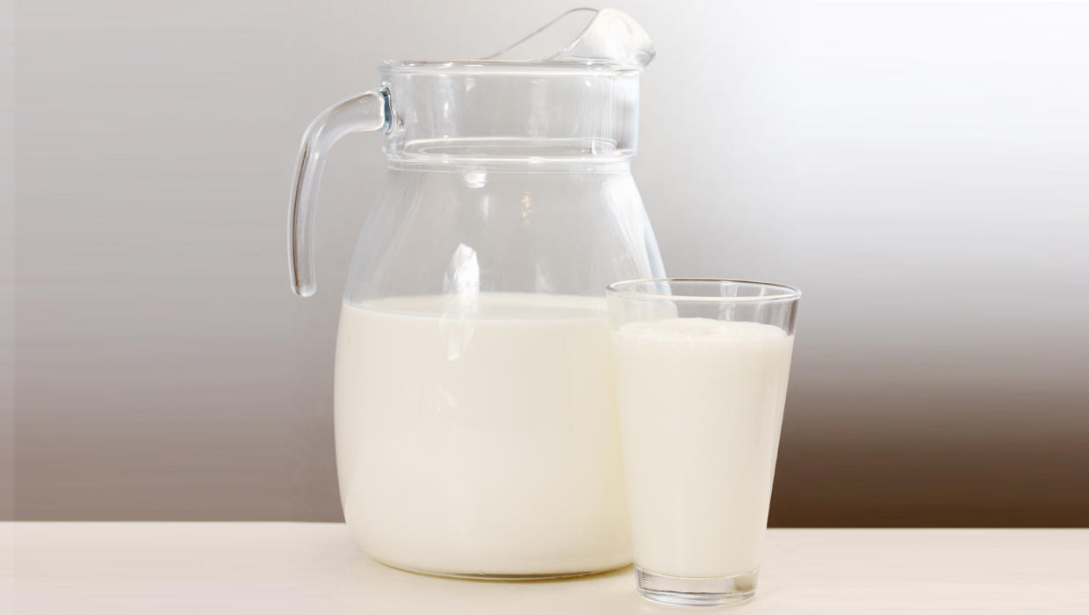
CONCLUSION & FUTURE TRENDS
Adulteration & Contamination is going to stay, and more new contaminants may be encountered which may require tweaking in our established methods.
Studies are being carried out to develop new methods for analysis. Few of the developmental methods are:
Microfluidic devices: Miniaturized platforms for rapid and automated contaminant detection.
Aptamers: Synthetic molecules that can bind specifically to contaminants, offering potential for portable and sensitive tests.

Slide 50
SO WHAT’S ‘NEW’ ABOUT IT

Slide 51
COURSE THROUGH STANDARDS- A CONCISE & PRECISE WAY
Once a Stakeholder (here, it is Academia) goes through a relevant Standard, he can appreciate:
How a Standard address a ‘Topic’ already covered in Text books, in concise way
How the problem statement (issue) is getting addressed in the Standard
How many parameters are tested to ensure Conformity (Quality) of a Product

Slide 52
COURSE THROUGH STANDARDS- A CONCISE & PRECISE WAY Contd
How the parameters are tested (Detailed description of Method of Tests, along with sample preparation/ conditioning details)
Why it is so? (Selection of a particular method considering Product matrix; Limit of Detection/ Quantification based on Repeatability/ Reproducibility)
What additional ‘value’ the standards are bringing in? (Measurement Uncertainty in testing and its impact; Reporting of Results and its impact, highlighting the significance of IS 2: 2022)

Slide 53
STRUCTURED SCIENTFIC APPROACH
Foreword: Genesis of the Standard in brief, along with major changes brought through revisions (as applicable)
Scope : Defines the ‘Applicability’ of the Standard
Normative References: Documents which have been referred to
Terms & Definitions: As is used in the Standard
Requirements: The set of specified Tests which determines the ‘Quality’ of the Product/ services

Slide 54
STRUCTURED SCIENTFIC APPROACH Contd..
Sampling & Conditioning: Describes Sample preparation for Tests to be carried out
Test Methods : Describes how the specified requirements/ tests to be performed
Packing: How the materials to be packed
Marking: Details which are required to be marked
Sampling Criteria for SQC: Scale of sampling for guidance of manufacturers for Statistical Quality Control purpose

Slide 55
WHAT IS ‘THAT’ IS AMISS ?
What is the ‘Aspect’ which is NOT being covered by Standards
ANYONE PLEASE
Manufacturing Process
Transportation and Distribution [Upto retailer/ consumer]
Usage of the Product
Notes:
Manufacturing Process – Machinery, Process Flow-chart and Process Description; Critical Control Points (CCP)
Transportation and Distribution- Unless otherwise specified in special cases as that of Hazardous Chemicals
Usage of the Product- Unless otherwise specified in special cases (User Manual is prescribed in the Standard) where it directly impacts performance (Quality) requirements of the Standard

Slide 56
ASSOCIATE & COLLABORATE
Solicit comments on the existing Indian Standards
Revision of existing Standards for making them relevant, as per requirement (Coverage of Grades/ Varieties) & advancement in Technologies
Formulation of Indian Standards where NO Standards exist
Need Based Standards

Slide 57
TAPPING THE UNTAPPED !
Benefitting from the Scientific acumen of Eminent Faculties & Research Scholars
Making the Indian Standard ‘Indian’ in real terms
Indian Standards becomes dynamic and coherent with recent advancement in Technologies
Active Participation in R & D Projects; Not a Stand alone exercise

Slide 58
HOW TO IDENTIFY THE STANDARD
‘KNOW YOUR STANDARDS’
Once Standard is identified, Scope of the Standard defines its coverage
All Indian Standards (ISs) are Downloadable Free of Cost

Slide 59
HOW TO TEACH ‘STANDARDS’
Teaching & Learning needs to be made part of Curriculum
Introduction to the ‘World of Standards’
Credit-based System
Year Long Academic Calendar; Identification of Faculty
IIT Roorkee has introduced course in Sem-I

Slide 60
PLANNING FOR ACADEMIC YEAR
Introduction of ‘Standards’ in Course Curricula
Participation in R & D Projects
Tailor made Discipline wise Workshops/ Physical meetings
Creation of Standards Club in every Discipline/ Department
Academic Dashboard; Lecture Series

Slide 61
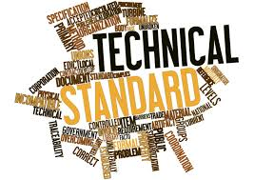
AND THE STRENGTH LIES IN…..
Area of Strength (Focused Approach)
Faculty wise Mapping vis-à-vis Area of interest/ Specialization
Data-base of Faculty & Research Scholars
Incubation/ Innovation Centre (Technology Readiness Level on Scale of 10)
Available Infrastructure

Slide 62
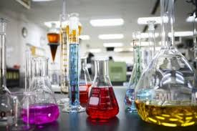
REALIZING TRUE POTENTIAL OF TESTING INFRASTRUCTURE
Utilization of Test Facilities under BIS Lab Recognition Scheme (LRS)
IS/ ISO 17025: 2017 Accreditation is a prerequisite
NABL: nabl-india.org
Support to Laboratories (Grant in Aid)

Slide 63
VARIOUS CERTIFICATION SCHEMES
Scheme | Scope of the Scheme
Scheme- I ( ) | Grant of licence to use or apply Standard Mark on products as per Indian Standard
Scheme – II ( ) | Grant of licence to use or apply Standard Mark through registration based on self-declaration of conformity for goods and articles as per Indian Standard
Scheme - III | Grant of licence or certificate of conformity for management systems as per Indian standard e.g. Quality Management Systems (IS/ISO 9001), Environmental Management Systems (IS/ISO 14001), Anti Bribery Management Systems (IS/ISO 37001)
Scheme-IX | Grant of licence for products + system as per Indian Standard and applicable process requirements

Slide 64
Conformity Assessment Scheme for Milk and Milk Products
Scheme by BIS notified on 08.12.2021
Scheme launched by Hon’ble Prime Minister on 23.12.2021

Slide 65
Conformity Assessment Scheme for Milk Products (CAS)
Single Point Quality Certification- Comprehensive certification scheme covering all elements of
Product Certification as per relevant Indian Standards
Food Safety Management System as per IS/ISO 22000
Process Certification as per NDDB’s Quality Mark guidelines.

Slide 66
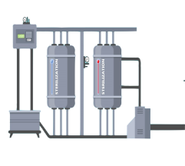
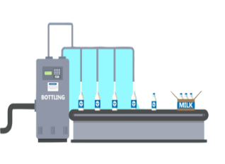
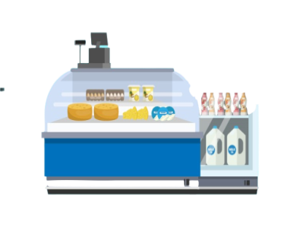
Scheme Overview
Collection at Village level
Milk Chilling
Process certification
Transportation
Food Safety
Management
System
CAS
Testing
Processing/
Packaging
Product Certification
Product

Slide 67
IS/ISO 22000: 2018 Food Safety Management System: Risk Assessment

Slide 68
MAP THE GAP
Every Manufacturing Process is Unique, so are its Food Safety Risks

Slide 69
BIS QUALITY ECOSYSTEM IN THE COUNTRY
QCOs for BIS certification | QCOs implemented | QCOs under implementation | Total QCOs
Scheme - I | 103 QCOs 448 products | 63 QCOs 196 products | 166 QCOs 644 products
Scheme - II | 5 QCOs 71 products | 1 QCOs 2 products | 6 QCOs 73 products
Scheme - X | ----- | 1 QCO 8 products | 1 QCO 8 products
Hallmark | 1 QCO 1 product | ----- | 1 QCO 1 product
Total | 109 QCOs 520 products | 65 QCOs 206 products | 173 QCOs 725 products

Slide 70
BIS CARE APP- THE MASTER KEY!
Verify Licence (Manufacturer) Details
Verify Registration (under BIS CRS) Details
Products under Compulsory Certification
Know Your Standards
Complaints

Slide 71
SYNERGY TRANFORMING ‘ME’ TO ‘WE’
Participation of faculties/ Research scholars in Standards Formulation Process
Faculty Engagement as an Expert in BIS Sectional Committee
Engagement in R & D Projects; Guest Faculty on ‘Standardization’
Engagement in Student Internship Programmes
Standard Club Activities in-sync with Student Academic Profile
Optimum utilization of Testing and other Infrastructure

