Slide 1
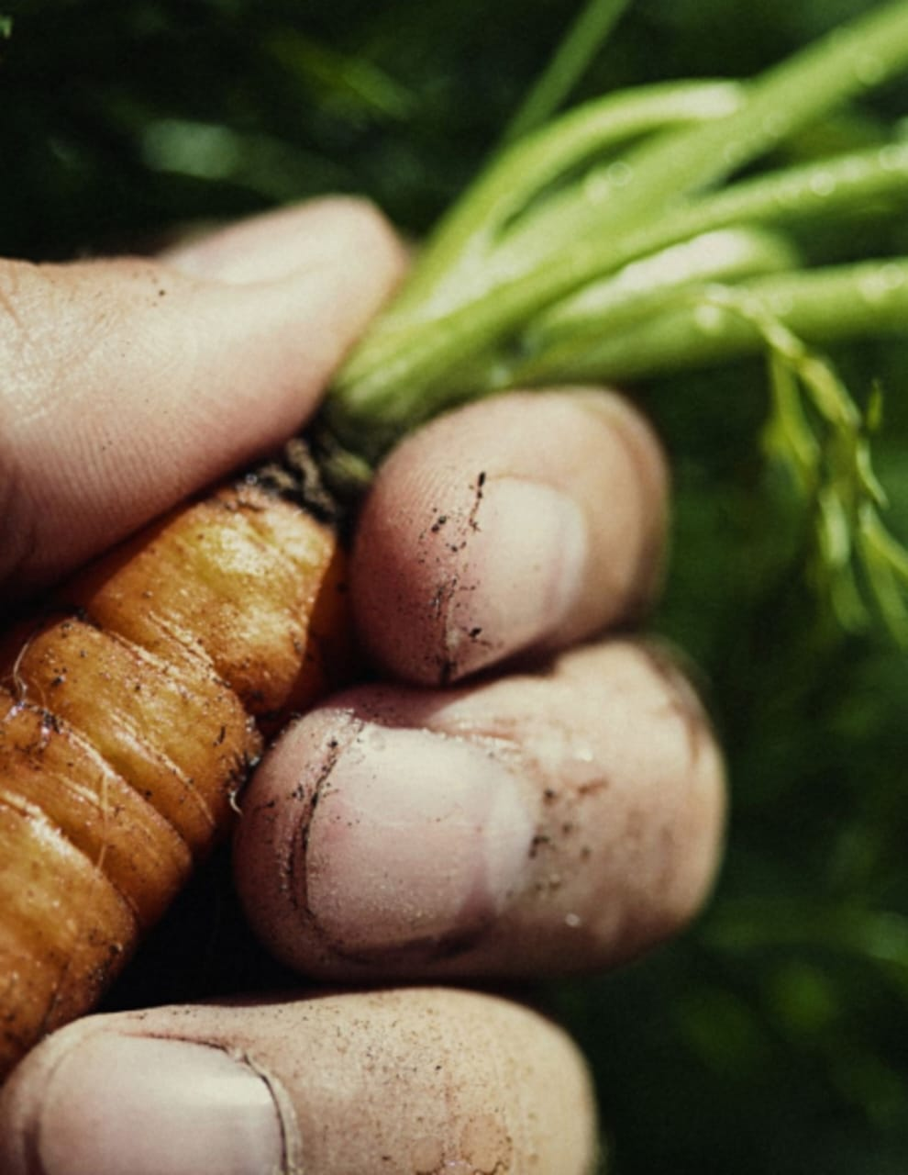
FOOD QUALITY & Contamination of Foods
Shri Shouvik Chanda
Sc-E & Director
KKBO-II, BIS

Slide 2
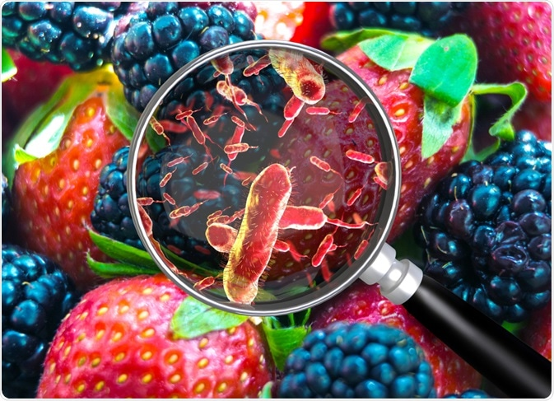
Standardization: Foundation of Quality
What is Quality?
Satisfy the intended Need
Role of Standards
Bureau of Indian Standards (BIS)- National Standards Body of India
Manufacturer Quality Customer

Slide 3
Why “Standards”?
Standardization plays a critical role in ensuring safety, consistency & reliability of Food Products.
Ensures comparability of test results across different laboratories and regions.
Beneficial to all Stakeholders:
Consumers
Producers
Regulators

Slide 4
Why “Standards”?
Standardization in Testing ensures food undergoes tests for fat content, protein levels, presence of antibiotics, and other parameters using established and approved procedures.
Standardization in Processes ensures food processing facilities utilize standardized equipment like milk tankers and pasteurizers to ensure consistent handling and processing.
Standardization in Cleaning & Sanitation ensures cleaning and sanitation protocols minimize the risk of contamination throughout the food production chain.

Slide 5
Where does India Stand?
FSSAI : The Food Safety and Standards Authority of India (FSSAI) sets national standards for food products in India. These standards encompass composition, hygiene, labeling, and contaminant limits. The FSSAI also conducts regular milk quality surveys to monitor compliance with national standards.
BIS: Bureau of Indian Standards (BIS) formulates Indian Standards on food product; Food Hygiene & Safety Management AND Methods of Tests for Food Products, and in- sync ensures implementation of FSSAI regulations, and serves to the Standardization, Conformity and Testing requirement of the country’s Dairy sector.

Slide 6
National vs. International Standardization
Benefits of National Standardization : Adding Specific requirements & Local contaminants; Adoption of Test Methods or Modification & Development of own Test methods through Method validation; Consumer Protection & Awareness; Efficient Regulatory Framework; Trade & Commerce
Challenges: Balancing National Needs with International Trade; Regular review and updates; Enforcement; Resources

Slide 7
IS Formulation through BIS Sectional Committees
FAD 15: Food Hygiene, Safety Management and Other Systems Sectional Committee
Scope: The Standardization in the field of –
a) Food hygiene including codes of hygienic practice applicable for food products in general (except subject/ product specific codes covered under other Sectional Committees of FAD)
b) Food safety management systems
c) Food labelling.

Slide 8
IS Formulation through BIS Sectional Committees
FAD 28: Test Methods for Food Products Sectional Committee
Scope: Standardization in the field of - Horizontal methods of test for food products including physical, chemical and sensory evaluation excluding the microbiological methods of test covered under the scope of FAD 31 and methods of test for estimation of pesticide residues covered under the scope of FAD 27.

Slide 9
IS Formulation through BIS Sectional Committees
FAD 31:Scope : Standardization in the field of –
Horizontal methods in the field of microbiological analysis of the food chain from primary production stage to food products, animal feed products, the environmental samples from food production and handling;
B) Methods in the field of microbiological analysis of water;
C) Specifications for ingredients used in media for microbiological work;
D) Methods of sampling and handling of food samples for microbiological testing; and
E) Safe handling and containment of infectious microorganisms and hazardous biological materials.

Slide 10
INTRODUCTION
Food is “any edible material” that supports growth, repair and maintenance of the body.
“Any edible substance” that we consume to fulfil our daily requirement of nutrition is known as food.
“Any nutritious substance” that people or animals eat or drink or that plants absorb in order to maintain life and growth.

Slide 11
INTRODUCTION
Let’s begin with:
Why discuss food contamination?
What are the adverse impacts of contaminated foods on our health?

Slide 12
INTRODUCTION
All food items are associated with microorganisms in one or other form
Even naturally occurring food such as fruits and vegetables contain microorganisms
✓ Food gets contaminated
-During handling,
- Harvesting
- Methods of cooking and preparation
-Storing and prepared foods.

Slide 13
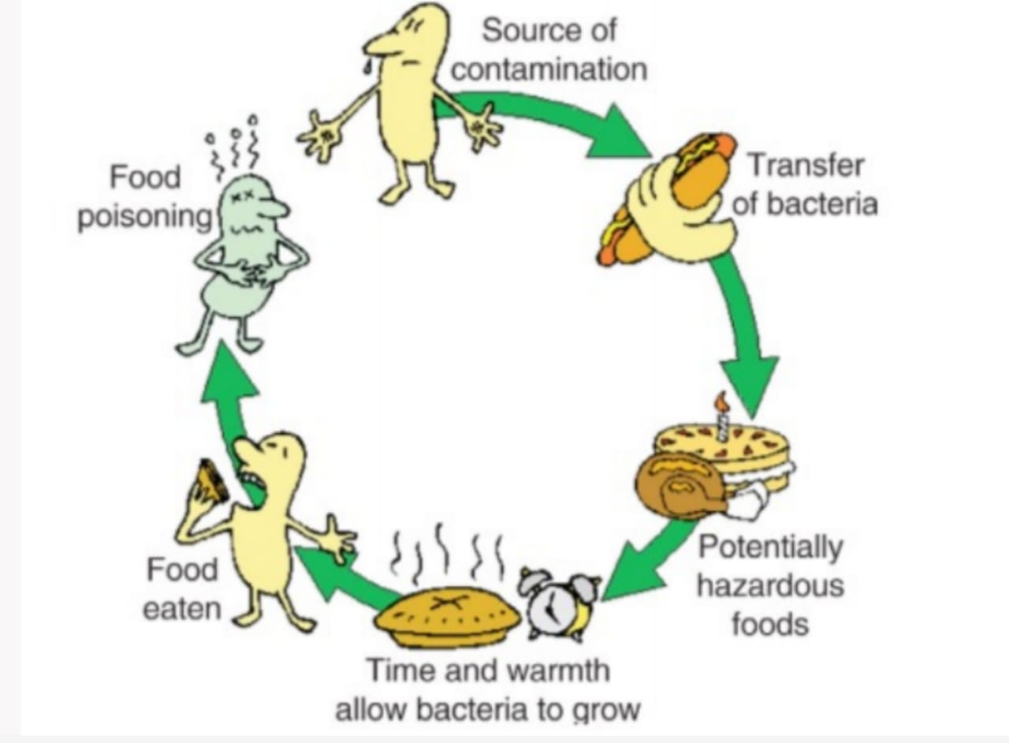
Contamination - Sources and factors
Growing plants carry a typical flora of microorganisms on their surfaces and may become contaminated from outside sources.
Animals/aquatic food sources have a typical surface flora plus an intestinal one given off organisms in excretions and secretions and also become contaminated from various outside sources.

Slide 14
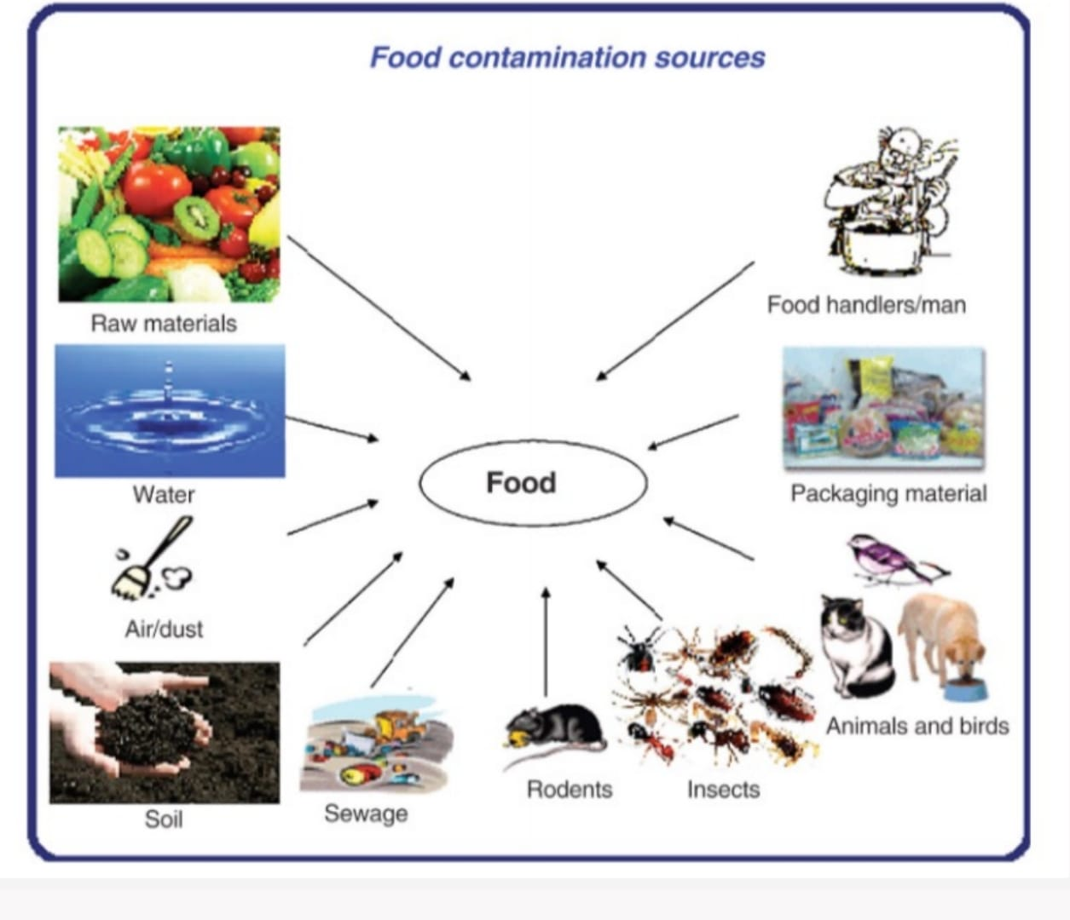
Microorganisms from various natural sources
From green plants and fruits.
From Animals
From sewage
From soil
From water
From air
During handling and processing

Slide 15
From Green Plants and Fruits
The natural flora of plants varies with the plant but usually includes species of
Pseudomonas,
Alcaligens,
Flavobacterium,
Micrococcus
Lactic acid bacteria (Lactobacillus brevis, L. plantarum, Leuconostoc mesenteroides, Leuconostoc dextranicum, Streptococcus faecium, and Streptococcus faecalis).

Slide 16
From Green Plants and Fruits
The number of bacteria will depend on the plant and its environment and may range from a few hundred (or) thousands per square centimeter of surface.
The surface of a well washed tomato may show 400 to 700 microorganisms per square centimeter, while unwashed tomato has several thousands of microbes.
An outer tissue of unwashed cabbage might contain 1 million to 2 millions microorganisms per gram, but washed cabbage contains 200,000 to 500,000.

Slide 17
From Animals
Sources of microorganisms from animals include the surface flora, the flora of the respiratory tract and flora of the gastrointestinal tract.
The natural surface flora of meat animals usually is not important as the microbes from intestinal (or) respiratory tract.
Feathers from animals and feet of poultry carry heavy contaminations from soil.

Slide 18
From Animals
The skin of many meat animals may contain Micrococci, Staphylococci, and beta hemolytic Streptococci
Staphylococci on the skin (or) from the respiratory tract may enter on carcass and then to the final raw products.
The faces and fecal contaminated products of animals can contain many enteric organisms including Salmonella
Salmonellosis in animals can result in contamination of animal products and contaminate the foods.

Slide 19
From Animals
Pig and beef carcasses may be contaminated with Salmonella. Because of further processing and handling.
Meat from slaughtered animals is not frequently associated with human Salmonellosis
Statistics in recent years reported eggs and egg products cause Salmonellosis in human much more frequently.
Salmonellosis associated with eggs has been reduced because of the pasteurization of egg products.

Slide 20
From Sewage
When untreated domestic sewage is used to fertilize plant crops,the raw plant food will be contaminated with human pathogens especially those causing gastrointestinal diseases.
In addition to the pathogens, Coliforms bacteria, Enterococci, intestinal bacteria and viruses can contaminate the foods from this source.
Natural waters contaminated with sewage contribute their microorganisms to shell fish, fish and sea foods.

Slide 21
From Soil
The soil contains the greatest variety of microorganisms of any source of contamination.
Not only numerous kinds of microorganisms but also large total number of microorganisms present in fertile soil ready to contaminate the surface of plants growing in them and surfaces of animals roaming over the land.

Slide 22
From Soil
Soil dust is whipped by air currents and soil particles are carried by running water to get into foods.
The soil is an important source of heat-resistant spore forming bacteria. Various kinds of yeasts, molds and bacterial species are Bacillus, Clostridium, Enterobacter, Micrococcus, Chromobacterium, Escherichia, Streptococcus and Acetobacter

Slide 23
From Water
Natural water contain not only their natural flora but also microorganisms from soil and possibly from animals or sewage
Surface waters in streams or pools and stored water in lakes and large ponds vary considerably in their microbial content from many thousands per milliliter.
The kind of bacteria in natural waters are chiefly species ofm Pseudomonas Chromobactrium, Proteus, Micrococcus, Bacillus, Streptococcus, Enterobacter and Escherichia.
Contamination of food may come from water used as an ingredient ,for washing foods, for cooling heated foods and manufactured ice for preserving foods

Slide 24
From Water
The gas forming coliform bacteria may enter milk from cooling–tank water and cause trouble in cheese made from the milk.
Cannery cooling water often contains coliform and other spoilage bacteria that enter canned foods during cooling.
The bacterium causing the surface taint of butter, Pseudomonas putrifaciens comes primarily from water.
The bacterial flora of crushed ice to be applied to fish (or) other food consists mostly of Cornybacterium, Alcaligens, Flavobacterium, Pseudomonas, and Cocci.

Slide 25
From Air
Air does not contain a natural flora of microorganisms, for all that are present have come there by accident and usually are on suspended solid materials (or) in moisture droplets
Microorganisms get in to air on dust or lint, dry soil, spray from streams, lakes, oceans, droplets of moisture from coughing, sneezing or talking
It is possible for any kind of bacterium to be suspended in air, especially on dust particles or in moist droplets but some kinds are more commonly found in air. Cocci are usually more numerous than rod shapes bacteria.
Mold spores (Fungi), because of their small size, resistant to drying, and large number of spores in fungi are usually present in air

Slide 26
During Handling and Processing
In addition to above mentioned sources additional contamination may come from equipments coming in contact with foods, from packaging materials and from personnel
Personnel in food processing plants can contaminate foods during handling and processing.
The processor attempts to clean and sanitize equipment to reduce such contaminations to employ packaging materials that will minimize the contamination.

Slide 27
Techniques suitable for preservation of samples

Slide 28
Techniques suitable for preservation of samples

Slide 29
Analysis of proximate composition
Proximate analysis refers to the analysis of food products to establish their composition.
It provides information related to the content of following components:
Water
Protein
Fat
Ash (Mineral content)
Carbohydrate
Necessity arises for this aspect due to labeling and quality control purposes of the product.

Slide 30
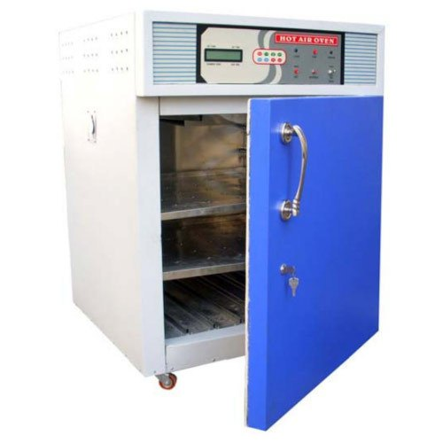
Analysis of Water
Most common methods of water analysis are:
Hot air oven drying (100 ± 5 °C)
Vacuum oven drying (60 to 70 °C)
Hot air oven

Slide 31
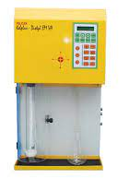
Analysis of protein
Kjeldahl analysis is a method to analyze the protein composition in a food product.
Food to be analyzed is treated with sulphuric acid. Ammonium sulphate is formed.
Sodium hydroxide is added to neutralize the acid digestion.
Ammonia gas is formed as a result and it is collected in a boric acid container .
Remaining boric acid is distilled and volume of titrant, that is percentage of Nitrogen can be calculated.
It is multiplied with a factor of 6.25 to achieve the protein content.
Kjeldahl apparatus

Slide 32
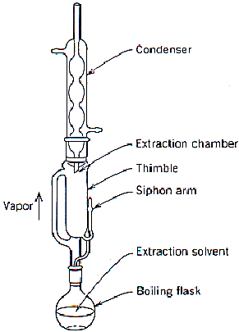
Analysis of fat
Fat is analyzed using soxhlet apparatus
It can be done in two steps:
Dissolving solvent with fat
Extraction of fat from the food material.
Soxhlet apparatus

Slide 33
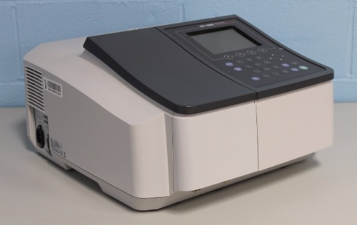
Analysis of carbohydrate
Carbohydrate content in food products can be determined by anthrone method spectrophotometry at wavelength of 750 nm.
Spectrophotometer

Slide 34
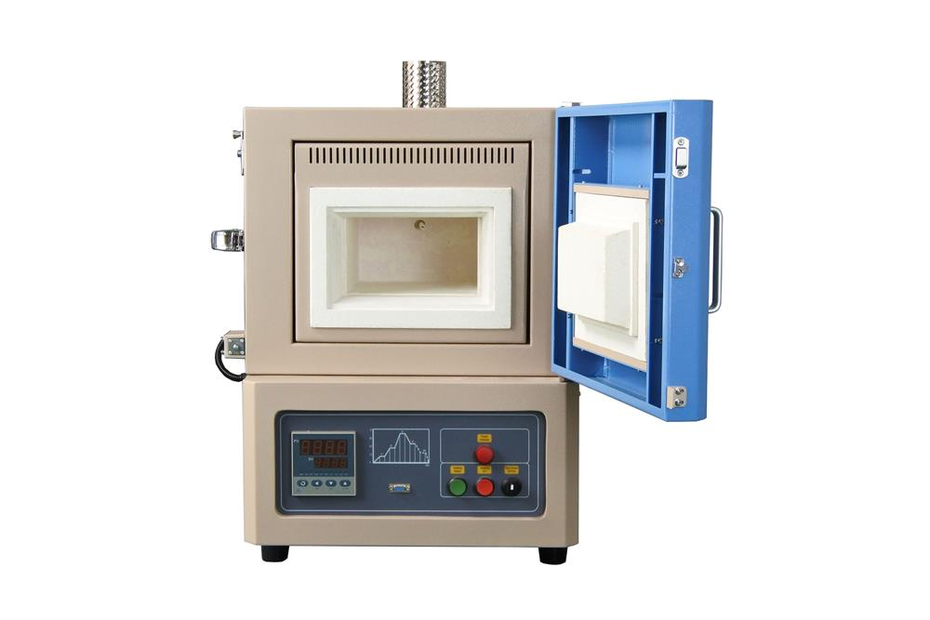
Analysis of ash (Mineral content)
Ash content of a food product can be determined using muffle furnace (600 °C)
Muffle furnace

Slide 35
Micronutrient Analysis
This involves analyzing trace elements and essential micronutrients like selenium, iodine, or copper.
Determining the micronutrient content provides insights into the nutritional value of the food product.

Slide 36
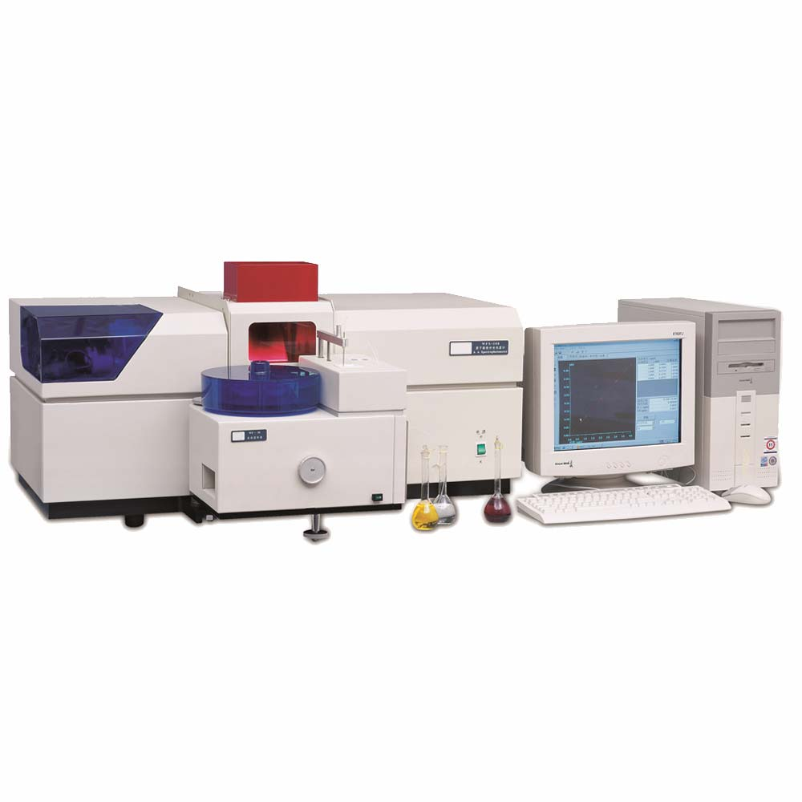
Atomic absorption spectroscopy
In the context of food analysis, AAS enables the precise quantification of elements such as calcium, iron, zinc, lead, and many others.
This information is invaluable for various aspects of the food industry, from nutritional labeling to food safety assessments.
Atomic absorption spectrometer

Slide 37
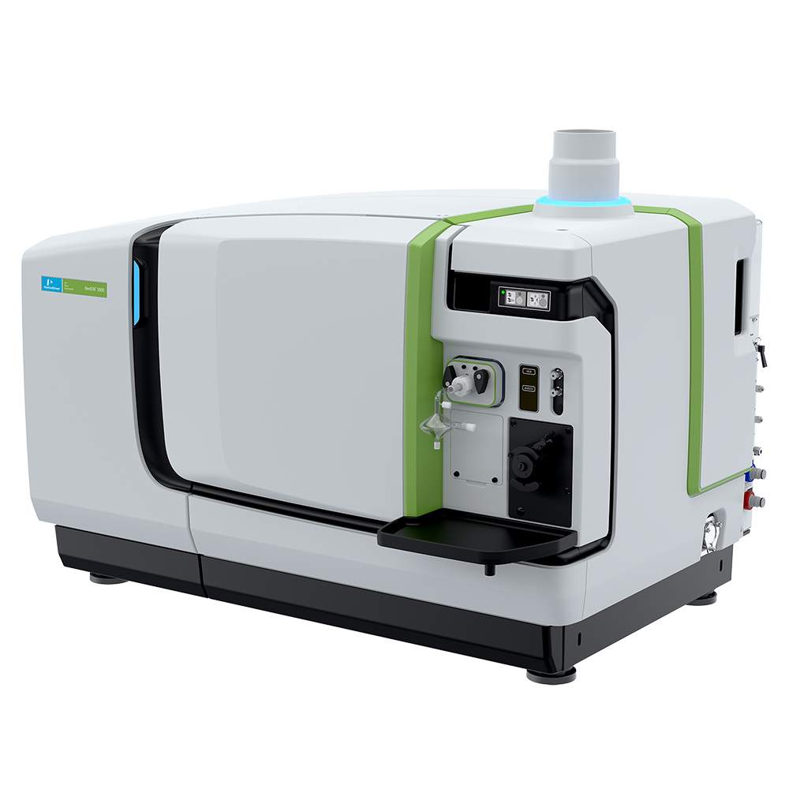
Inductively coupled plasma Mass spectrometry (ICP-MS)
Elemental analysis of food substances presents a challenge because of the wide variety of food types and range of concentrations that need to be analyzed.
The complexity of food matrices requires digestion to both break down the matrix and to convert solids into liquids for analysis.
ICP-MS has the ability to measure both trace and elevated elements.
ICP-MS

Slide 38
Analysis of important contaminants of food
Food contamination is when something is incorporated into the food intentionally or accidentally.
Types of contaminants can be: microbiological, mycotoxins, pesticides, heavy metals

Slide 39
Microbiological contaminants
Microbiological contamination can occur due to pathogens such as Salmonella, E. coli, Coliform, etc may be detected using methods such as polymerase chain reactions, immunoassays, Total plate count, coliform count, ELISA.

Slide 40
Pesticides
Gas chromatography (GC) coupled with mass spectrometry (MS) to analyze pesticide residues in food samples.
This analysis allows for the identification and quantification of pesticide residues, ensuring compliance with regulatory limits.

Slide 41
Heavy metals
The presence of heavy metals in food samples is a significant concern. Nutritional testing labs in India utilize techniques like ICP-AES or AAS to analyze heavy metal contamination.
This analysis ensures that food products meet the permissible limits set by regulatory authorities.

Slide 42
Mycotoxins
Mycotoxins are toxic compounds produced by certain molds that can contaminate food products.
Nutritional testing labs in India employ methods such as high-performance liquid chromatography (HPLC) or enzyme-linked immunosorbent assay (ELISA) to detect and quantify mycotoxins, ensuring the safety of food samples.

Slide 43
Indian Standards on Testing of Food Products
We have multiple standards developed for testing of various food products.
Let’s know about them!

Slide 44
IS on test methods of Fruit and vegetable products
Sl. No. | IS No. | Title
1. | IS 5781 : 1993/ ISO 1026: 1982 | Fruit and vegetable products ― Determination of dry matter content by drying under reduced pressure and of water content by Azeotropic distillation (first revision)
2. | IS 13815 : 2009/ ISO 2173 : 2003 | Fruit and vegetable products ― Determination of soluble solids content ―Refractometric method (first revision)
3. | IS 13816: 2009/ ISO 762: 2003 | Fruit and vegetable products ― Determination of mineral impurities content (first revision)
4. | IS 13844: 2003/ ISO 750: 1998 | Fruit and vegetable products ― Determination of titratable acidity (first revision)

Slide 45
IS on test methods of Fruit and vegetable products
Sl. No. | IS No. | Title
5. | IS 13845: 2003/ ISO 751: 1998 | Fruit and vegetable products ― Determination of water - Insoluble solids (first revision)
6. | IS 13846: 2009/ ISO 763: 2003 | Fruit and vegetable products ― Determination of ash insoluble in hydrochloric acid (first revision)
7. | IS 15096: 2002/ ISO 2448: 1998 | Fruit and vegetable products ― Determination of ethanol content
8. | IS 15529: 2004/ ISO 1955: 1982 | Citrus fruits and derived products ― Determination of essential oils content (reference method)

Slide 46
IS on test methods of Fruit and vegetable products
Sl. No. | IS No. | Title
9. | IS 15706: 2006/ ISO 6632: 1981 | Fruits, vegetables and derived products ― Determination of volatile acidity
10. | IS 17551: 2021/ ISO 1842: 1991 | Fruit and vegetable products ― Determination of pH
11. | IS 17552: 2021/ ISO 3634: 1979 | Vegetable products ― Determination of chloride content
12. | IS 17553: 2021/ ISO 5518: 2007 | Fruits Vegetables and Derived products ― Determination of benzoic acid content - Spectrometric methods

Slide 47
IS on test methods of Fruit and vegetable products
Sl. No. | IS No. | Title
13. | IS 17554: 2021/ ISO 5519: 2008 | Fruits vegetables and derived products ― Determination of sorbic acid content
14. | IS 17555: 2021/ ISO 5520: 1981 | Fruits vegetables and derived products ― Determination of alkalinity of total ash and water soluble ash
15. | IS 17556: 2021/ ISO 5521: 1981 | Fruits vegetables and derived products ― Qualitative method for the detection of Sulphur dioxide
16. | IS 17557: 2021/ ISO 5522: 1981 | Fruits vegetables and derived products ― Determination of total Sulphur dioxide content

Slide 48
IS on test methods of Fruit and vegetable products
Sl. No. | IS No. | Title
17. | IS 17558: 2021/ ISO 5523: 1981 | Liquid fruit and vegetable products ― Determination of Sulphur dioxide content (Routine Method)
18. | IS 17559(Part1): 2021/ ISO 6557-1:1986 | Fruits vegetables and derived products - Determination of Ascorbic acid - Part 1 - Reference method
19. | IS 17559 (Part 2): 2021/ ISO 6557-2: 1984 | Fruits vegetables and derived products ― Determination of Ascorbic acid - Part 2 - Routine method
20. | IS 17560: 2021/ ISO 6560: 1983 | Fruits vegetables and derived products ― Determination of Benzoic acid content ― Benzoic acid contents greater than 200 mg per litre or per kilogram ― Molecular absorption spectrophotometric method

Slide 49
IS on test methods of Fruit and vegetable products
Sl. No. | IS No. | Title
21. | IS 17561: 2021/ ISO 6635: 1984 | Fruits vegetables and derived products ― Determination of nitrite and nitrate content ― Molecular absorption spectrometric method
22. | IS 17562: 2021/ ISO 22855: 2008 | Fruit and vegetable products ― Determination of Benzoic acid and sorbic acid concentrations ― High performance liquid chromatography method
23. | IS 17574 (Part 2): 2021/ ISO 6558-2: 1992 | Fruits vegetables and derived products ― Determination of carotene content - Part 2 Routine methods

Slide 50
IS on test methods of oils and fats
Sl. No. | IS No. | Title
1. | IS 548 (Part1 to 3) : 2021 | Method of sampling and test for oils and fats part I sampling, physical and chemical tests section 1 sampling
2. | IS 17459 : 2021/ ISO 17932 : 2011 | Palm oil ―Determination of the deterioration of bleachability index (DOBI) and carotene content
3. | IS 17460 : 2021/ ISO 18395 : 2005 | Animal and vegetable fats and oils ― Determination of monoacylglycerols diacylglycerols triacylglycerols and glycerol by high-performance size-exclusion chromatography HPSEC
4. | IS 17667 : 2021/ ISO 11701 : 2009 | Vegetable fats and oils― Determination of phospholipids content in lecithins by HPLC using a light-scattering detector

Slide 51
IS on test methods of vitamins and nutrients
Sl. No. | IS No. | Title
5. | IS 16642 : 2018 ISO 20639 : 2015 | Infant formula and adult nutritionals ― Determination of pantothenic acid by ultra-high performance liquid chromatography and tandem mass spectrometry method (UHPLC - MS/MS)
6. | IS 16639 : 2018 ISO 20633 : 2015 | Infant formula and adult nutritionals ― Determination of vitamin E and vitamin A by normal phase high performance liquid chromatography
7. | IS 16640 : 2018 ISO 20634 : 2015 | Infant formula and adult nutritionals ― Determination of vitamin B12 by reversed phase high performance liquid chromatography (RP - HPLC)
8. | IS 17668 : 2021 ISO 21468 : 2020 | Infant formula and adult nutritionals― Determination of free and total choline and free and total carnitine Liquid chromatography tandem mass spectrometry HPLC-MSMS

Slide 52
IS on test methods of vitamins and nutrients
Sl. No. | IS No. | Title
9. | IS 17176 : 2019 ISO 20635 : 2018 | Infant formula and adult nutritionals― Determination of vitamin C by ultra-high performance liquid chromatography with ultraviolet detection(UHPLC-UV)
10. | IS 17671 : 2021 ISO 23443 : 2020 | Infant formula and adult nutritionals― Determination of beta-carotene lycopene and lutein by reversed-phase ultra-high performance liquid chromatography RP-UHPLC

Slide 53
IS on test methods of spices, culinary herbs and condiments
Sl. No. | IS No. | Title
1. | IS 11582 : 2023 | Method for sensory evaluation of pungency of ginger by Scoville units
2. | IS 15460 (Part 2) : 2004 ISO 5565-2 : 1999 | Vanilla [vanilla fragrans (Salisbury) ames]: Part 2 Test methods
3. | IS 15695 : 2006/ ISO 11027 : 1993 | Pepper and pepper oleoresins ― Determination of piperine content ― Method using high-Performance liquid chromatography
4. | IS 15697 :2006(Part 1 to 2)/ ISO 7543: 1994 | Chillies and chilli oleoresins ― Determination of total capsaicinoid content: Part 1 spectrometric method

Slide 54
IS on test methods of spices, culinary herbs and condiments
Sl. No. | IS No. | Title
5. | IS 16359 : 2017 ISO 5566 : 1982 | Turmeric ― Determination of colouring power - Spectrophotometric method
6. | IS 16360 : 2017 ISO 5564 : 1982 | Black pepper and white pepper, whole or ground - Determination of piperine content ― Spectrophotometric method
7. | IS 1797 : 2017 | Spices and condiments ― Methods of test (third revision)
8. | IS 7807 : 1975 | Methods of test for asafetida

Slide 55
IS on test methods of spices, culinary herbs and condiments
Sl. No. | IS No. | Title
9. | IS 8104 : 1996 ISO 3513 : 1995 | Chillies― Determination of scoville index (First Revision)
10. | IS 8105 : 2023 | Method for sensory evaluation of pungency of black pepper by Scoville heat units
11. | IS 8104 : 1996 ISO 3513 : 1995 | Chillies― Determination of scoville index (First Revision)
12. | IS 8105 : 2023 | Method for sensory evaluation of pungency of black pepper by Scoville heat units

Slide 56
IS on test methods of meat and meat products
Sl. No. | IS No. | Title
1. | IS 5960 : 2023 (Part 1to 17)/ ISO 937 : 2023 | Meat and Meat products ― Methods of Test (Part 1 to 17) Determination of Nitrogen content (second revision of IS 5960)
2. | IS 18371 : 2023 ISO 23776 | Meat and meat products―Determination of total phosphorus content
3. | IS 15990 : 2023 ISO 6887-2 : 2017 | Microbiology of Food and AnimalFeeding Stuffs — Preparation of TestSamples, Initial Suspension andDecimal Dilutions for MicrobiologicalExamination Part 2 Specific Rules for the Preparationof Meat and Meat Products( first revision )
4. | IS 15938 : 2011 ISO 13496:2000 | Meat and meat products — Detection of Colouring agents — Method usingthin-layer chromatography

Slide 57
IS on test methods of meat and meat products
Sl. No. | IS No. | Title
5. | IS 15937 : 2011 | Meat and meat products — Determination of chloramphenicol content — Method using liquid chromatography
6. | IS 14843 : 2017 ISO 13720 : 2010 | Meat and meat products - Enumeration of presumptive pseudomonas spp. (First Revision)

Slide 58
IS on test methods of dairy products
Sl. No. | IS No. | Title
1. | IS 1479 (Part 1to 5) : 2016 | Methods of test for dairy industry: (Part 1 to 5) rapid examination of milk (first revision)
2. | IS 9967 (Part 1to 3) : 2008 ISO 14673-1 : 2004 | Milk and milk products ― Determination of nitrate and nitrite contents Part 1 method using cadmium reduction and spectrometry (second revision)
3. | IS 11766 : 1986/ ISO 6092 : 1980 | Method for determination of titratable acidity in milk powder and similar products ― Routine Method
4. | IS 11202 : 2012/ ISO 8069 : 2005 | Dried milk ― Determination of content of lactic acid and lactates (second revision)

Slide 59
IS on test methods of dairy products
Sl. No. | IS No. | Title
5. | IS 16072 : 2012 | Determination of moisture content in milk powder and similar products (Routine method)
6. | IS 11721 : 2013/ ISO 1736 : 2008 | Dried milk and dried milk products ― Determination of fat content ― Gravimetric method (Reference Method) (second revision)
7. | IS 11762 : 2013 ISO 1737 : 2008 | Evaporated milk and sweetened condensed milk - Determination of fat content ― Gravimetric method (Reference Method) (second revision)
8. | IS 11764 : 2005/ ISO 2911 : 2004 | Sweetened condensed determination of sucrose milk content ―Polarimetric method (first revision)

Slide 60
IS on test methods of dairy products
Sl. No. | IS No. | Title
9. | IS 12759 : 2019/ ISO 8156 : 2005 | Dried milk and dried milk products ― Determination of insolubility index (first revision)
10. | IS 12760 : 2012/ ISO 8070 : 2007 | Milk and milk products ― Determination of calcium sodium potassium and magnesium contents ― Atomic absorption spectrometric method (first revision)
11. | IS 9070 : 1979/ ISO 3433 | Method for determination of fat in cheese by van gulik method
12. | IS 12758 : 2005/ ISO 1735 : 2004 | Cheese and processed cheese products ― Determination of fat content ― Gravimetric method

Slide 61
IS on test methods of dairy products
Sl. No. | IS No. | Title
13 | IS 11763 : 2011/ ISO 5943 : 2006 | Cheese and processed cheese products ― Determination of chloride content − Potentiometric titration method (third revision)
14 | IS 12757 : 2012/ ISO/TS 2963 : 2006 | Cheese and processed cheese products ― Determination of citric acid content ― Enzymatic method (second revision)
15 | IS 12756 : 2019/ ISO 2962:2010 | Cheese and processed cheese products ― Determination of total phosphorus content ― Molecular absorption spectrometric method (first revision)
16 | IS 11888 : 2005/ ISO 5739 : 2003 | Caseins and caseinates― Determination of contents of scorched particles and of extraneous matter (first revision)

Slide 62
IS on test methods of dairy products
Sl. No. | IS No. | Title
17 | IS 11919 : 2012/ ISO 5544 : 2008 | Caseins ― Determination of Fixed Ash (Reference Method)
18 | IS 11962 : 2012/ ISO 5545 : 2008 | Rennet caseins and caseinates― Determination of ash Reference Method (first revision)
19 | IS 11920 : 2012/ ISO 5550 : 2006 | Caseins and caseinates― Determination of moisture content (Reference Method) (first revision)
20 | IS 11963 : 2005/ ISO 5548 : 2004 | Caseins and caseinates― Determination of lactose content - Photometric method (first revision)

Slide 63
IS on test methods of aflatoxin
Sl. No. | IS No. | Title
1 | IS 16287 : 2015 ISO 16050 : 2003 | Foodstuffs ― Determination of aflatoxin B1 , and the total content of aflatoxins B1 , B2 , G1 and G2 in cereals, nuts and derived products ― High performance liquid chromatographic method

Slide 64
IS on test methods of dairy products
Sl. No. | IS No. | Title
21 | IS 11964 : 2012/ ISO 5547 : 2008 | Caseins ― Determination of free acidity Reference Method (first revision)
22 | IS 11917 : 2018/ ISO 8968-1 : 2014 | Milk and milk products − Determination of nitrogen content ―Kjeldahl principle and crude protein calculation (first revision)

Slide 65
Food Adulteration
Now lets discuss food adulteration!

Slide 66
Adulteration
Adulteration is an addition of another substance to a food item in order to increase the quantity of the food item in raw form or prepared form, which may result in the loss of actual quality of food item.

Slide 67
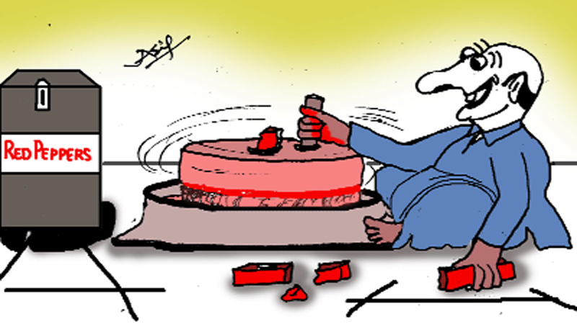
Why adulterate?
Merchants and traders to make quick profit.
Shortage and increasing prices
Consumer demands
Lack of awareness
Food adulterated is dangerous as it affects the health ,it may be toxic and deprive from essential nutrients.

Slide 68
Prevention of Food Adulteration Act PFA(1954)

Slide 69
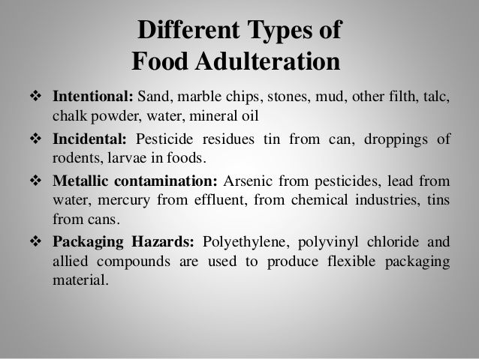
Types of food adulteration

Slide 70
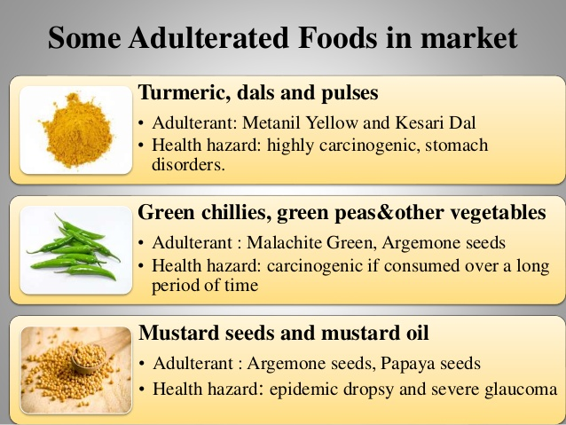
Adulterated foods

Slide 71
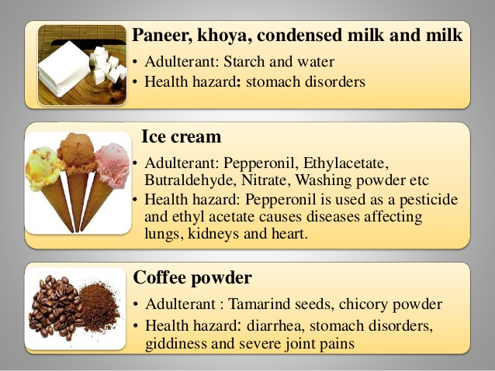
Adulterated foods

Slide 72
Detection of adulterants

Slide 73
Detection of adulterants

Slide 74
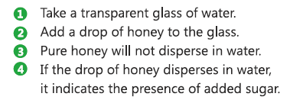
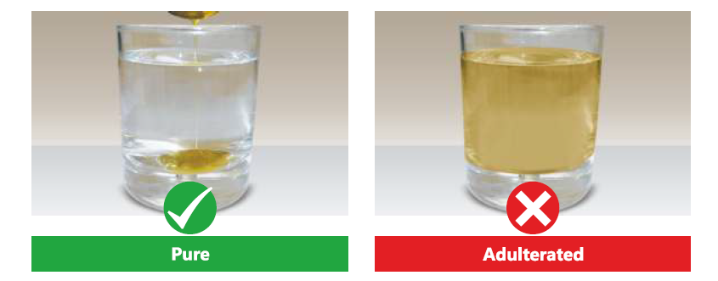
Detection of adulterants
Testing Method:

Slide 75
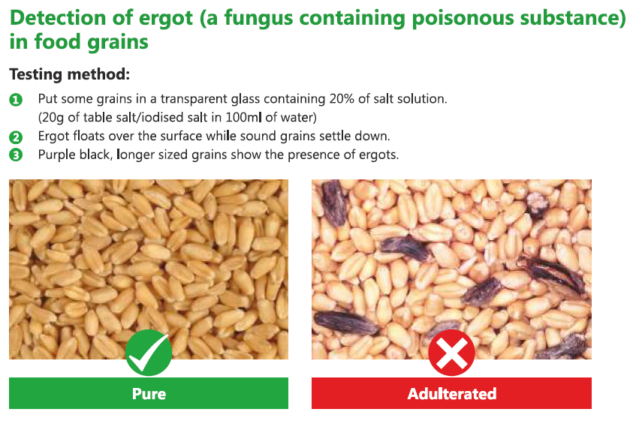
Detection of adulterants

Slide 76
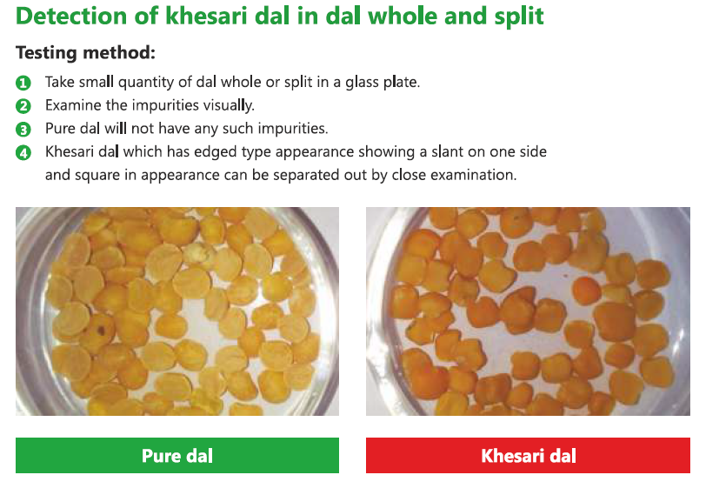
Detection of adulterants

Slide 77
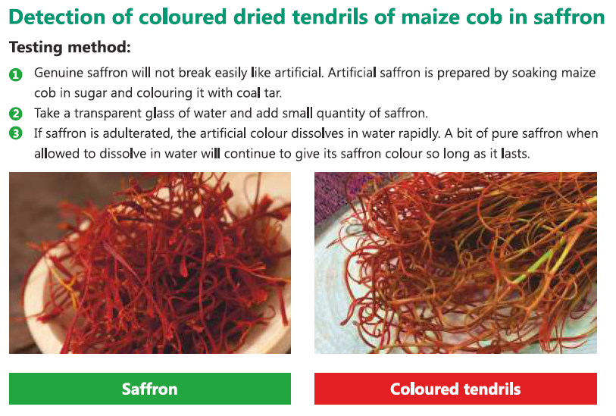
Detection of adulterants

Slide 78
Detection of adulterants

Slide 79
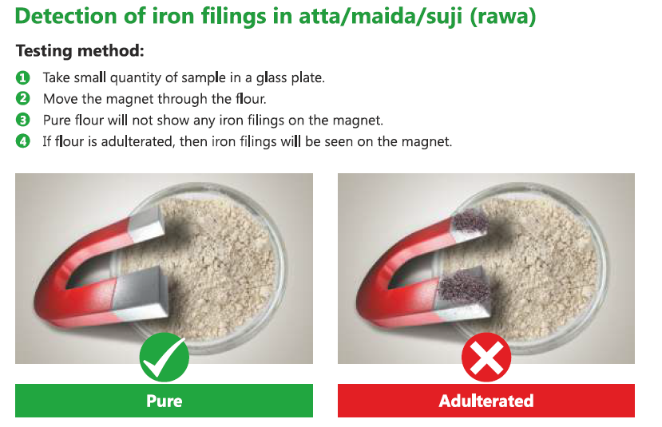
Detection of adulterants

Slide 80
Detection of adulterants

Slide 81
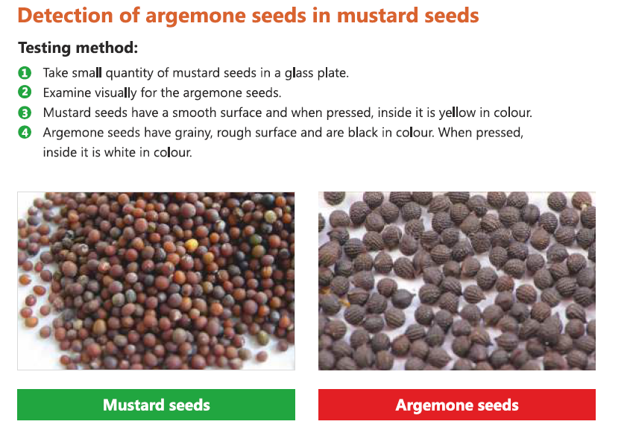
Detection of adulterants

Slide 82
Detection of adulterants

Slide 83
FOOD ARTICLE | ADULTERANT | HARMFUL EFFECTS
Bengal Gram dhal & Thoor Dhal | Kesai dhal | cancer
Tea | Used tea leaves processed and coloured | Liver Disorder
Coffee Powder | Tamarind seed, date seed powder | Diarrhoea
 | Chicory powder | Stomach disorder, Giddiness and joint pain
Milk | Unhygenic water & Starch | Stomach disorder
Khoa | Starch & Less Fat content | Less - nutritive value
Wheat and other food grains (Bajra) | Ergot (a fungus containing poisonous substance) | Poisonous
Sugar | Chalk powder | Stomach - Disorder
Black powder | Papaya Seeds and light berrys | Stomach, liver problems
Mustard powder | Argemone seeds | Epidemic dropsy & Glucoma
Edible oils | Argemone oil | Loss of eyesight, heart diseases, tumour
 | Mineral oil | Damage to liver,carcinogenic effects
 | Karanja oil | Heart problems, liver damage
 | Castor oil | Stomach problem
Asafoetida | Foreign resins galbanum, colophony resin | dysentery
Turmeric powder | Yellow aniline dyes | Carcinogenic
 | Non-permitted colourants like metanil yellow | Highly Carcinogenic
 | Tapioca starch | Stomach disorder
Chilli powder | Brick powder, saw dust | Stomach problems
 | Artificial Colours | Cancer
Sweets, Juices, Jam | Non-permitted coaltar dye, (Metanil Yellow) | Metanil yellow is toxic and carcinogenic
Jaggery | Washing soda, chalkpowder | vomiting, diarrhoea
Pulses (Green peas and dhal) | coaltar dye | stomach pain, ulcer
Suapari | colour and saccharin | cancer
Honey | Molasses sugar (sugar plus water) | Stomach disorder
Carbonator water beverages | Aluminium leaves | Stomach Disorder
Cloves | Cloves from which volatile oil has been extracted | cheating waste of money

Slide 84
CONCLUSION
It can be concluded that food product contamination and adulteration are harmful to our health and safety measures are to be increased in this aspect.
In this regard, BIS helps to formulate IS through sectional committees.
Recent trends and future opportunities indicate growth in analytical technology of contamination and adulteration of food products to tackle the problem.

Slide 85
Thank You!
Website: www.bis.gov.in

