Slide 1
STORAGE OF FRUITS & VEGETABLES
Types of Indian Standards on Storage of Fruits & Vegetables
Guidelines for Storage and Transport of F&V
Guidelines for Storage of F&V

Slide 2
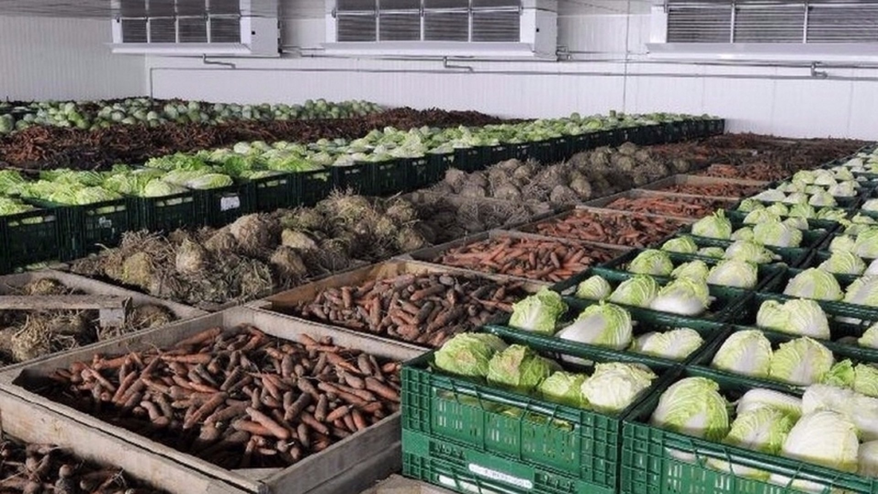
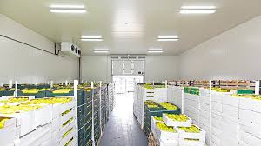
METHODS OF F&V STORAGE
REFRIGERATION
Cold storage facilities to maintain low temperatures so as to slow ripening and decay
CONTROLLED
ATMOSPHERE
Modifying gas composition (e.g., high CO2, low O2) to extend storage life of fruits & vegetables

Slide 3
RECOMMENDED STORAGE TEMPERATURE & STORAGE LIFE
GREEN BANANAS
TABLE GRAPES
MOSSAMBI
MANDARINS
GRAPEFRUITS
Short Term
Storage
Temperature:
15 to 18
Storage Life:
3 Weeks
Long Term
Storage
Temperature:
15 to 18
Storage Life:
12 to 16 Weeks
Short Term
Storage
Temperature:
15 to 18
Storage Life:
3 Weeks
Long Term
Storage
Temperature:
5 to 7
Storage Life:
3 to 6 Weeks
Long Term
Storage
Temperature:
5 to 7
Storage Life:
12 Weeks
Storage
Temperature:
10 to 15
Storage Life:
4 to 12 Weeks
Storage
Temperature:
25 to 30º C
Storage Life:
12 to 14
Weeks
Storage
Temperature:
0 to 1º C
Storage Life:
Less than 1 Week

Slide 4
IS 9304:2022 - storage and ripening of mangoes
Mango (Mangifera indica L.) is the native of Indo-Burma region and innumerable varieties of mangoes are cultivated. It is a seasonal crop and is highly perishable.
Fruits picked at proper stage of maturity can be kept in fresh state for a few days only, under normal conditions.
Therefore, fruits should be preserved under proper conditions so as to prolong their life for fresh consumption and processing.

Slide 5
IS 9304:2022 - storage and ripening of mangoes
Conditions for harvesting and putting into storage
Maturity
Maximum fruit quality is attained when the fruits are harvested at optimum stage of maturity as immature fruits develop into inferior quality after ripening.
Mangoes should be harvested at mature green stage, which can be judged by fully developed cheeks with outgrown shoulders and prominent pit at the stalk end; Change in skin colour from dark-green to light-green; Visibility of lenticels; spurt of sap exudation from the cut end of stalk is very less; Change in flesh colour from white to yellowish; and specific gravity is more than 1.0 (Alphonso, Kesar, Langra, Raspuri).

Slide 6
IS 9304:2022 - storage and ripening of mangoes
Conditions for harvesting and putting into storage
Pre-storage Operations - Sorting, de-sapping, washing, hot water treatment before storage are detailed in the standard.
Quarantine Treatments - Different countries demand different disinfestation treatments against mango fruit fly and or stone weevil as a quarantine treatment for export purpose.
Mangoes should be treated in hot water at 48 °C for one hour as a disinfestations treatment against fruit fly. After hot water treatment the fruits should be cool rapidly and surface dried before packing.

Slide 7
IS 9304:2022 - storage and ripening of mangoes
Conditions for harvesting and putting into storage
Quarantine Treatments –
For control of quarantine pests (fruit fly), Vapor Heat Treatment (VHT) system that uses heat saturated water vapour is used. During VHT treatment fruit pulp core temperature is maintained at 47.5 ºC for a minimum of 20 min.
Mangoes may be irradiated with a D min. of 400 Grays at the approved and certified irradiation treatment facility.
Irradiation treatment is approved for control of both fruit fly and seed/stone weevil infestation. The radiation dose used are within the window of approved dose range for Fresh Fruits and Vegetables as per regulations

Slide 8
IS 9304:2022 - storage and ripening of mangoes
Storage
The fruits should be packed properly before putting into storage rooms.
Fruits can be placed in ventilated plastic crates of 20-25 kg capacity or in 5 ply corrugated fiberboard (CFB) boxes.
At ambient temperature the storage life of mangoes is limited to 7-12 days depending on the variety and maturity.
However, at an optimum temperature of 13 °C and 85-95 percent relative humidity, mango can be stored for about 20-25 days.

Slide 9
IS 9304:2022 - storage and ripening of mangoes
Pre-cooling
Mangoes are harvested during summer season with more field heat, it is advisable to pre-cool them faster before putting into cold rooms.
Pre-cooling is usually done by more efficient forced air cooling method.
Mangoes should be pre cooled to 13°C (the recommended storage temperature) by placing the fruits in pre-cooler room where temperature is set at 13 °C with 90 to 95 percent RH.

Slide 10
IS 9304:2022 - storage and ripening of mangoes
Optimum Storage Conditions
After precooling the fruits should be immediately shifted to cold rooms set at 13 °C and 85-95 percent RH.
At storage temperature below 13 °C, mangoes are susceptible to chilling injury that cause discoloration of the skin, pitting and uneven ripening when shifted to ambient conditions with increase susceptibility to decay.
At optimum temperature mangoes can be stored up to 3 weeks.
The crates or boxes should be staked and arranged in the cold room in a manner so as to permit free circulation of air.
The storage density between 200 and 250 kg per cubic meter of usable space is considered suitable.

Slide 11
IS 9304:2022 - storage and ripening of mangoes
RIPENING
Natural Ripening
Mature mangoes are ripened naturally by covering the heap with paddy straw or by individually wrapping the fruits with newspaper. Ethylene gas is released from the fruits in due course of time that helps in ripening of fruits.
Natural ripening of mangoes is a bit slow leading to high weight loss, shrivelling and in some cases uneven ripening
Permitted Artificial Ripening
Ethylene in the form of gas can be sourced from commercial ethylene gas cylinders or small canisters or produced by ethylene generators.
Mangoes should be exposed to the ethylene gas in air-tight chamber/plastic tent for 24 h with the concentration of the gas about 100 ppm

Slide 12
IS 9311 : 2021 ‘Guide to storage of onions’
Provides recommendations for the storage,
with or without the use of artificial refrigeration, of onions
intended for long term conservation and consumption in the fresh state
prescribing conditions of harvesting and putting into store which include quality characteristics, various treatments before storage and methods of storage.

Slide 13
IS 9311 : 2021 ‘Guide to storage of onions’
Cultivars
Choose onions cultivars suitable for long storage.
Varieties having medium bulb size with:
higher dry matter/total soluble solids content,
higher pungency,
less or no splits and
thinner necks with retention of higher number of dry outer scales have better keeping quality with lower storage losses.

Slide 14
IS 9311 : 2021 ‘Guide to storage of onions’
Harvesting
As onions mature, their dry matter content and pungency increase, with a resulting increase in storage potential.
Onion bulbs should be harvested one week after 50 percent of plants have shown neck fall. By this time the bulbs are covered with well-differentiated outer scales signifying that they are in a state of physiological rest.
Early harvesting would result in more sprouting during storage.
Whereas delayed harvesting may result in reduction of skin quality, increased rooting and reduction in firmness.
Harvesting of onions should be carried out when the weather is dry; harvesting after a rainfall, or when the humidity is high increases susceptibility to post-harvest disease.

Slide 15
IS 9311 : 2021 ‘Guide to storage of onions’
Irradiation
Post-harvest treatment with gamma irradiation is successful in reducing storage losses
The application of low doses of radiation can arrest sprouting of onions during storage
Application of irradiation of the order of 60 Gy to 100 Gy for control of sprouting and extension of shelf life of onion is recommended
The irradiated onion bulbs are reported to be superior in quality with respect to internal and external appearance and firmness after 180 days storage than non-irradiated ones

Slide 16
IS 9311 : 2021 ‘Guide to storage of onions’
Storage
The onions may be stored in bulk, in packages on pallets, in box pallets, in crates, in sacks or in containers.
Onions packed in sacks may be stored for only a short period of time. In the case of storage in bulk, the maximum depth to which onion can be heaped is between 0.9 to 1.5 meters.
Higher depth of bulk storage causes excessive damage from pressure impact/bruising.
Onion should not be dropped on ground from higher than 1 to 2 meters which would damage the bulbs.
In case of packed onions, to avoid damage, packages should be stacked 5 to 7 tiers high, and a gap of 15 cm to 20 cm in the proximity of the side walls and 5 cm to 8 cm between the stacks of packages should be provided to ensure the free circulation of air.

Slide 17
IS 9311 : 2021 ‘Guide to storage of onions’
Storage
For long term storage of onions, proper ventilation, optimum temperature and humidity are of paramount importance.
Absence of proper aeration/ventilation, high atmospheric humidity (75-80 percent RH) promotes development of pathogen/rotting, and promotes root growth.
Low humidity (less than 65% RH) leads to excessive moisture loss from bulbs, resulting in shriveling and loss in weight.

Slide 18
Guidelines for Storage of F&V
IS No. | Title
IS 6669: 2001/ ISO 1212:1995 | Apples - Guide to cold storage
IS 6670: 2018 | Storage of potatoes - Guidelines
IS 7192: 2022 | Citrus fruits - Guidelines for storage
IS 7730: 2022 | Guide for storage of pears
IS 7731: 2021 | Guide for storage of peaches
IS 9303: 2021 | Guide for cold storage of table grapes
IS 9304: 2022 | Guide for storage and ripening of mangoes
IS 9311: 2021 | Guide to storage of onions

Slide 19
Guidelines for Storage of F&V
IS No. | Title
IS 11965: 2022 | Guide for storage of round headed cabbage
IS 11966: 1997/ ISO 6663:1995 | Garlic - Cold storage
IS 16118: 2013/ ISO 6665 : 1983 | Strawberries - Guide to cold storage
IS 16119:2013/ ISO 7562 : 1990 | Potatoes - Guidelines for storage in artificially ventilated stores
IS 16120:2013/ ISO 5525: 1986 | Potatoes - Storage in the open (In Clamps)

Slide 20
Guidelines for Storage & Transportation OF F&V
IS No. | Title
IS 7191: 2001/ ISO 5524:1991 | Tomatoes - Guide to cold storage and refrigerated transport
IS 6028:2002/ ISO 931:1980 | Green bananas - Guide to storage and transport
IS 15691: 2006 | Guidelines for storage and transportation of bamboo shoot

