Slide 1
STORAGE OF AGRICULTURAL PRODUCE

Slide 2
FOOD LOSS & WASTAGE
According to an FAO report (2013), India wastes about 40% of its total agricultural produce including 30% of fruits and vegetables due to inadequate storage and transportation infrastructure.
01
According to the ICAR-CIPHET (2020), post-harvest losses in India are estimated at around:
10-15% for cereals,
25-30% for fruits and vegetables, and
8-10% for pulses and oilseeds
02
03
Proportions of the produce that farmers are unable to sell in
the market are 34 % and 44.6 % for fruits and vegetables, (Report of Committee on doubling of farmers’ income, 2018)

Slide 3
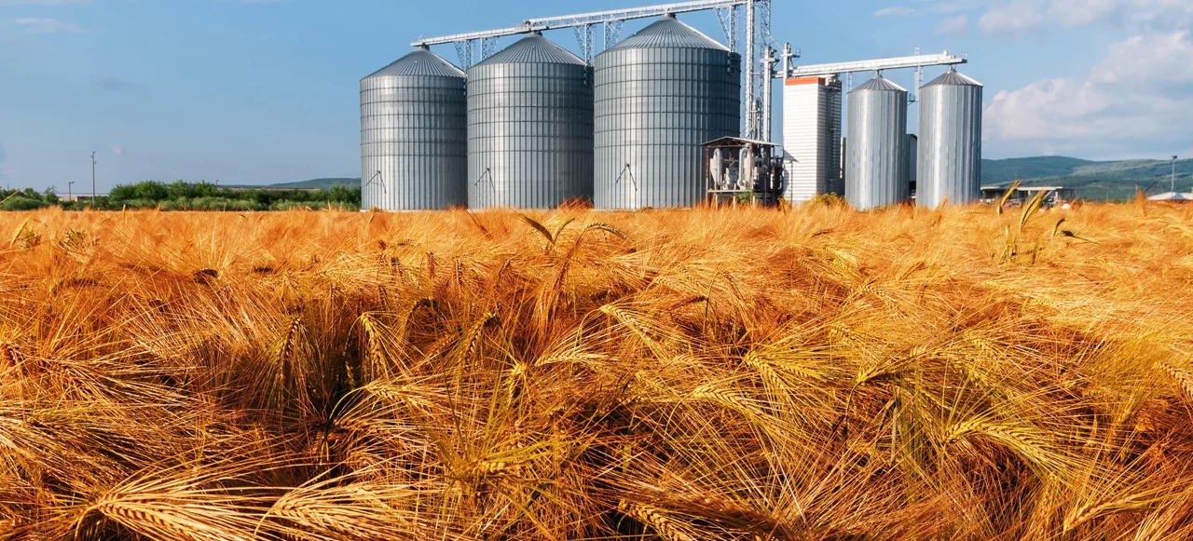
IMPORTANCE OF PROPER STORAGE
Maintaining Quality
Price Stability
Food Security
Minimizing Waste
Proper storage techniques can significantly reduce spoilage and loss, ensuring that the maximum amount of food reaches consumers.
Storage conditions like temperature, humidity, and ventilation play a crucial role in preserving the nutritional value and taste of grains.
Effective storage practices contribute to a stable supply of grains, preventing price fluctuations and ensuring affordability.
By safeguarding the grain harvest, proper storage contributes to a reliable food supply, addressing food security concerns.

Slide 4
SIGNIFICANCE OF STANDARDIZATION IN STORAGE OF AGRICULTURAL PRODUCE
Help to provide clear guidelines on temperature, humidity, and handling, which help in minimizing spoilage and losses
Resources such as space, energy, and labour are utilized more efficiently, reducing waste.
Ensures consistent quality of agricultural produce, which is crucial for consumer satisfaction and marketability
Reduces the risk of contamination and pest infestation, ensuring that the produce is safe for consumption
Produce stored under standardized conditions fetches higher prices due to its better quality and longer shelf life
Standardized storage conditions allow for better traceability of produce

Slide 5
STORAGE OF FOODGRAINS
Types of Indian Standards on Storage of Foodgrains
Guidelines for Handling & Storage
Specification for Storage Structures
Fumigation of Foodgrains

Slide 6
FACTORS AFFECTING FOODGRAIN STORAGE
1
2
3
4
High temperatures accelerate spoilage, while low temperatures can cause condensation
TEMPERATURE
Excessive humidity can promote mold growth, while low humidity can lead to drying and quality deterioration
HUMIDITY
Insects, rodents, and birds can contaminate and damage stored grains
PEST INFESTATION
Proper ventilation helps maintain a healthy environment, preventing moisture buildup and reducing spoilage
VENTILATION

Slide 7
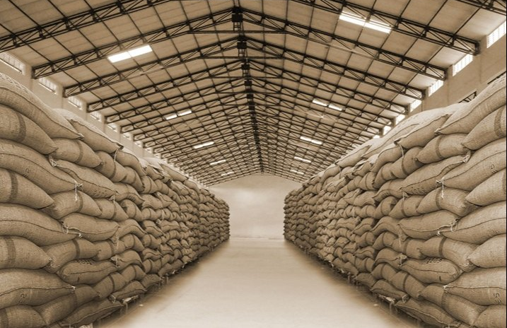
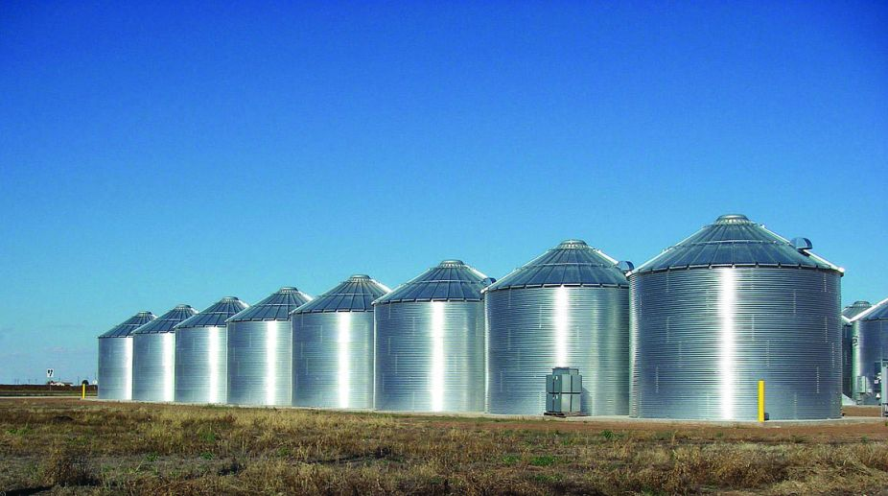
METHODS OF FOODGRAIN STORAGE
BAG STORAGE
Grain is stored in bags, either stacked or placed on pallets, offering flexibility in storage and transportation
SILO STORAGE
Tall, cylindrical structures made of concrete or steel, designed for large-scale storage

Slide 8
INDIAN STANDARDS ON GUIDELINES FOR FOODGRAIN STORAGE

Slide 9
IS 6151-1 - Storage management code: Terminology
Aeration
Fumigation
Hidden Infestation
Agricultural Produce
Airtight Storage
Alley Way
Ancillary Structures
Angle of Repose (Angle of Internal Friction)
Bag storage Structure
Bulk storage Structures
Bin
Bulk Weight
Degassing
Delivery
Disinfestation
Drying
Dunnage
Flat Storage Structures
Fumigation Covers
Gas Mask
Godown (Warehouse)
Infestation
Loading point
Long Term Storage
Loss in Storage
Major Insect Pests
Minor Insect Pests
Occupancy
Overall
Net-plinth Area

Slide 10
IS 6151-1 - Storage management code: Terminology
Receipt
Rural Storage
Indoors Storage
Outdoors Storage
Rated Capacity
Safe Moisture Level
Short Term Storage
Silo
Storage Block
Head House
Distribution Gallery
Marine Tower
Collection Gallery
Garner
Truck or Wagon Dump
Stack
Stack Height
Spraying
Stored Grain Pests
Sweepings
Temperature Sensing Devices
Temperature Gradient
Transit Storage
Unloading Point
Ventilation
Waterproofing

Slide 11
IS 6151-2 RECEIPT OF FOODGRAIN FOR STORAGE
Prescribes Guidelines for:
RECEIPT OF FOODGRAINS
PRIOR TO STORAGE
DURING STORAGE
PERIODIC INSPECTION
ISSUING OF FOODGRAINS

Slide 12
IS 6151-2 RECEIPT OF FOODGRAIN FOR STORAGE
Trucks, wagons or carts shall be carefully inspected for dump and infested foodrains
Wagon or truck dumps receiving grain for storage should be provided with suitable sieves to separate hay, stones, etc
Temporary sheds and weighing scales receiving bags or loose grain for storage should be cleaned prior to receipt of agricultural produce
Wagon or truck dumps, temporary sheds and weighing scale should be provided protection against rain

Slide 13
IS 6151-2 - PRIOR TO STORAGE
Bags used for storage shall be either new or sound second hand bags
All bags prior to storage shall be examined, and segregated:
Bags which are cut, torn, slack or have deleterious contaminations
Bags which contain foodgrain either damaged due to insect infestation, moisture, dampness or having deleterious refractions or contamination.
If sound second-hand bags are used, they shall be fumigated before filling them with foodgrain

Slide 14
IS 6151-2 - PRIOR TO STORAGE
Damaged Bags
Bags damaged due to moisture, fungus or deleterious contaminations, or those unduly damaged or cut shall be discarded and replaced
Slack bags shall be made up to the average weight of bags of the lot

Slide 15
IS 6151-2 – DAMAGED FOODGRAINS
INSECT-INFESTED FOODGRAINS
MOIST FOODGRAINS
Bags containing insect infested foodgrains shall be fumigated
If the moisture content exceeds safe moisture limit shall be treated to safe moisture level.
Drying of foodgrains may be done either in the sun or by means of mechanical driers. Rice shall not be dried in the sun.
.
01
HEATED FOODGRAINS
05
02
If Foodgrain feels hot on the
palm of hand, but no cake
formation has set in, it shall be aerated by spreading in layers not exceeding 2.5 cm in thickness on a smooth plastered, dry and clean floor inside the BGSS
Foodgrain should not be exposed to the sun
FUNGUS-ATTACKED, CAKY OR SPROUTING FOODGRAINS
04
03
Such foodgrain shall be disposed of for animal feed or industrial use
CONTAINING DELETERIOUS REFRACTIONS OR CONTAMINANTS
Lot containing deleterious refractions and contaminants shall be suitably segregated to remove substandard grains

Slide 16
IS 6151-2 - SAFE LIMITS OF MOISTURE CONTENT FOR STORAGE OF FOODGRAINS
Sl. No | Commodity | Moisture (Percent)
1. | Cereals and Millets
 | Paddy | 14
 | Raw Rice | 14
 | Boiled Rice | 14
 | Wheat | 12
 | Jowar | 12
 | Maize | 12
 | Barley | 12
 | Ragi | 12
 | Bajra | 12
2. | Pulses
 | Pulses (Whole) | 12
 | Pulses ( Broken ) | 12
 | Gram Kabuli | 12
 | Gram Desi | 12
 | COMMODITY | Moisture (Percent)
3. | Milled Products and Bran
 | Wheat Atta | 12.5
 | Maida | 12.5
 | Besan | 12.5
 | Rava or Suji | 13.5
 | Rice Bran | 10.0
 | Maize Bran | 10.0

Slide 17
IS 6151-2 - BAG STORAGE SPECIFIC RECOMMENDATIONS
Before storage of foodgrains, disinfestation of vacant area shall be done
The capacity of a Bag storage space shall be approximately estimated at the rate of:
10 bags (each bag weighing approximately 93.2 kg to 102.6 kg) per 0.6 m² if stacked 15 bags high
10 bags per 0.65 m² if stacked 12 bags high
10 bags for 0.7 m² if stacked 10 bags high
While estimating the height of the stacks, care shall be taken to see that a minimum of 2 m clear space is left between the top surface of the stack and the inside surface of the roof (or ceiling)
The maximum height to which the bags of foodgrains may be placed in a stack depends upon the load bearing capacity of floor, nature of com­modity, strength of container, etc.

Slide 18
IS 6151-2 - Maximum Stack Height for Bag Storage of Agricultural Produce
S. No. | Agricultural produce | Maximum General Stack Height (Bags) – Unit | Approximate Height in Metres
1. | Wheat, maize, barley, paddy, oats, grain and other unmilled whole pulses, sorghum, other millets, oilseeds, oilcakes, and coffee seeds | 16 | 4
2. | groundnut, and rice, rice bran, and milled pulses | 14 | 3.5
3. | Wheat flour, gram flour, semolina, broken pulses, other milled products, cashew nut kernels, fertilizers, and pesticides | 12 | 3

Slide 19
IS 6151-2 - BAG STORAGE SPECIFIC RECOMMENDATIONS
All bags in a given stack shall be of uniform size and weight
The stack shall be built over the dunnage as laid on the stack spaces
The stack shall be so built that when completed, it is stable and perfectly cuboid in shape and also that all peripheral bags on the faces of the stack are in one plane without any face of the stack bulging outward or inward at any point
Care shall be taken to see that the stitched mouth of the bags shall not face the peripheral side of the stack.
After the completion of a stack, it shall be sprayed with aluminium phosphide
All spillages during building of a stack shall be collected and separately dealt with as sweepings not thrown over or placed in the stack

Slide 20
IS 6151-2 - SILOS SPECIFIC RECOMMENDATIONS
Before filling, silos shall be thoroughly cleaned and disinfested
Temperature sensory devices, fumigation system, air controlling accessories and other openings, shall be thoroughly checked and repaired
Foodgrain shall be filled in silo taking care to leave about 30 cm from the ceiling, irrespective of the type of structure
While loading foodgrain, some of the covers on opening of the roof should be removed as an escape for trapped air
All spillages during the filling of the foodgrain in the silo shall be collected and separately dealt with as sweepings and never allowed to be mixed up with the bulk of foodgrain

Slide 21
IS 6151-2 - DURING STORAGE
Bag storage space shall be kept thoroughly clean, and sweepings collected from time to time
Empty bags, tarpaulins, dunnage and such other accessories, not in use shall also be treated for disinfestation purposes, where there is little likelihood of their becoming infested
Empty second-hand gunny bags shall be made up in rolls of 20 bags each and stored at one place.
As and when necessity arises, empty second-hand gunny bags shall be fumigated
Each stack shall contain produce of one type only
Each stack shall be periodically fumigated
All cut bags in the stacks shall be either suitably repaired or replaced

Slide 22
IS 6151-2 - Periodical Inspection and Treatment of Stacks
Each stack shall be inspected at least once in two weeks to check the condition of agricultural produce
Foodgrains may be inspected for any increase in moisture content and temperature, and damage by pests
Draw a sample of 500 g (250 g from top and 250 g from four sides) from 40 to 50 bags taken at random from each stack of 1 000 bags.
In this composite sample look for insect infestation of major and minor insect pests and excess moisture

Slide 23
IS 6151-2 - Periodical Inspection and Treatment of Stacks
The insect infestation, if any, shall be classified
The stack having few infestation shall be fumigated
If rats are observed doing damage, their points of entry in the storage space shall be checked up and necessary measures to protect against their entry
If it is observed that damage is being caused by dampness the source of dampness or rain shall be removed by adopting necessary measures for protection against ingress of dampness or rain
Source of dampness may be either seepage of water from the floor or from the walls of the storage space or due to leakage of rain-water
Also the stack shall be broken and the damaged agricultural produce segregated and undamaged agricultural produce salvaged

Slide 24
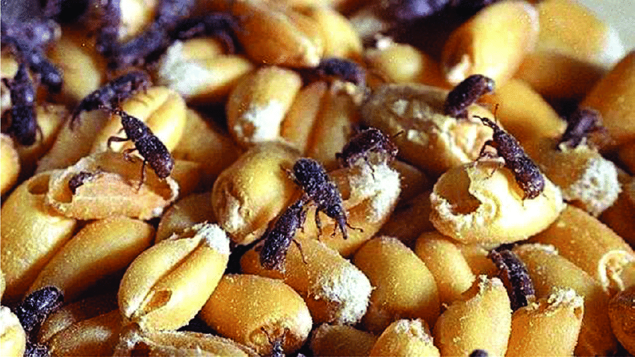
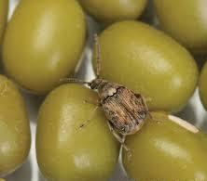
IS 6151-1 - CLASSIFICATION OF INFESTATION
Live insect and mite species which, during some stage(s) of their life cycle, are capable of causing damage to the grain
Clear
If the lot is completely free from living infestation
Few
If the lot is having upto 2 living minor or major insects per 500 g of sample
Heavy
If the lot is having more than 2 living minor or major insects per 500 g of sample

Slide 25
IS 6151-2 - Periodical Inspection and Treatment of Stacks
Each stack shall bear a tally card giving details of:
date of receipt
origin
kind of agricultural produce
number of bags and average weight of each bag
nature of dunnage provided
date of dispatch
date of inspection
condition of grain and nature of infestation
category of infestation; treatment, if any
signature and remarks of the inspector

Slide 26
IS 6151-2 - Periodical Inspection and Treatment of Stacks
Foodgrains in Silos shall be regularly inspected at monthly intervals
If foodgrain is previously fumigated, all the openings of the silo above the level of the foodgrain mass stored inside shall be kept open for a period of about 12 hours
During this period, no one shall be allowed to approach storage area, unless wearing a mask
After 12 hours samples of the stored foodgrain shall be drawn from 10 different points within the grain mass as far removed from one another as practicable
The samples shall be drawn with the help of a bulk sampling tube
The sampl­ing tube shall be of sufficient length so as to be able to reach the bottom of the stored mass

Slide 27
IS 6151-2 - Periodical Inspection and Treatment of Stacks
Each sample shall be examined for:
Moisture content
Heating
Fungus attack and cake formation
Insect infestation

Slide 28
IS 6151-2 - ISSUING OF FOODGRAINS
Extent of damage to the commodity is most important criterion in determining priority of issue, irrespective of the fact whether commodity was received earlier or later
Commodity which is most damaged shall be issued first while the least damaged or sound agricultural produce issued last
Small lots of foodgrain left over from larger lots after earlier issues shall be given priority in issue
In Bag Storage, the stack shall be so broken as to cause least disturbance to bags.
After taking out the bags to be delivered the stack shall be properly rebuilt

Slide 29
INDIAN STANDARDS ON GUIDELINES FOR FOODGRAIN STORAGE
Sl. No. | IS No. | IS TITLE
1. | IS 6151-1:2020 | Storage management code: Part 1 Terminology
2. | IS 6151-2:1971 | Storage management code: Part 2 General care in handling and storage of agricultural produce and inputs
3. | IS 6151-3:1976 | Storage management code: Part 3 Specific care in handling and storage of agricultural produce and inputs
4. | IS 11816-1: 2010/ ISO 6322-1:1996 | Storage of cereals and pulses: Part 1 General recommendations for the keeping of cereals
5. | IS 11816-2:2009/ ISO 6322-2:2000 | Storage of cereals and pulses: Part 2 Practical recommendations
6. | IS 11816-3:2018/ ISO 6322-3:1989 | Storage of cereals and pulses: Part 3 Control of attack by pests

Slide 30
INDIAN STANDARDS ON SPECIFICATION FOR STORAGE STRUCTURES

Slide 31
IS 16144 : 2014 REQUIREMENTS FOR STORAGE GODOWNS
Location
Ancillary Structures and Other Amenities
Capacities and Dimensions
Foundation
Plinth (Filling & Protection of Plinth & Foundation)
Floor
Walls
Doors and Ventilators
Roof
Gable and Partition Walls
Drainage
Rain Water Pipes
Finishing
Lighting

Slide 32
IS 16144 : 2014 - REQUIREMENTS FOR STORAGE GODOWNS
LOCATION
Raised well-drained site not liable to flooding or inundations and away from a place likely to be affected by seepage water
Maximum attention to be paid to hygienic and sanitary conditions of the area and the construction in residential areas shall be avoided
Minimum distances :
a) | Bone crushing mills, garbage dumping grounds, slaughter houses, tanneries and hide curing centres, sewage treatment plants, or such other places, the vicinity of which is deleterious to the safe storage of | 500 m
b) | Kilns, dairies (processing units) and poultry runs | 300 m
c) | Factories and other sources of fire and environmental hazard such as workshops, hay stacks, timber stores, petrol pumps, CNG stations and LPG bottling plants | 150 m

Slide 33
IS 16144 : 2014 - REQUIREMENTS FOR STORAGE GODOWNS
Free from passing over of any high tension electric line, or in such cases, relevant Electrical Code provisions should be considered, godown should be free from gas/oil pipe lines
There shall be no tree, the roots of which affect the foundation, near the godown
The godown shall always be kept clear of branches of trees, poles, etc, by at least 3 m
Necessary precautions for preventing attacks by termites
Preferably be situated near a transport head or a main road
If located in interior, then must have accessibility through an approach road
Sufficient parking and maneuvering space for vehicles
If situated at a ferry head, railway station, airport, etc, sufficient berthing, loading and unloading facilities

Slide 34
IS 16144 : 2014 - REQUIREMENTS FOR STORAGE GODOWNS
Ancillary Structures and Other Amenities
One or more ancillary structures at each site depending upon the storage capacity and scope for future expansion
A small compact block consisting of an office room, a store room and a separate room for keeping pesticides shall be provided at each site with proper aeration
For small capacity godowns, the following sizes of rooms are suggested
a) | Office room | 4.5 m × 3.5 m
b) | Store room | 3.5 m × 3.5 m
c) | Chowkidar/Sentry room | 4.0 m × 2.25 m
d) | Cycle/scooter stand 1) Upto 10 000 MT capacity 2) Above 10 000 and upto 50 000 MT | 14 m² 36 m²

Slide 35
IS 16144 : 2014 - REQUIREMENTS FOR STORAGE GODOWNS
Recommended Capacities and Dimensions
Type of Godown | Capacity (Tonnage) | Internal Dimensions
 |  | Length (m) | Breadth (m)
Small | 100 | 12 | 7.5
 | 250 | 20 | 9
 | 500 | 34 | 12
 | 1 000 | 35.5 | 18
 | 2 500 | 97.19 | 14.48
Large | 5 000 | 124.01 | 21.34

Slide 36
IS 16144 : 2014 - FOUNDATION & PLINTH
Suitable foundation depending upon the site conditions : the property of subsoil
Plinth height is kept 80 cm above the finished ground level and in exceptional cases, can be extended upto 90 cm to 120 cm, for road-fed godowns, 106 cm above the top of the rail for corresponding broad gauge track for rail-fed godowns
Minimum width of platform for the road-fed godowns shall be 183 cm and 244 cm for rail-fed godowns
Platform provided with a slope of at least 1 in 40 from wall to its outer edge to prevent rain water from getting inside the godowns through the doors

Slide 37
IS 16144 : 2014 - FLOOR & WALL
Flooring in storage godown should be damp proof, rigid, durable and free from any cracks or crevices
Design of walls as per general constructional practices and tensile stresses not to exceed cracking limit
Walls flush with inner surface of column and plastered in cement mortar (1 cement : 6 fine sand), rendered smooth both on outer and inner surfaces. There shall be no offsets or projections in the wall

Slide 38
IS 16144 : 2014 - DOOR & VENTILATORS
Door shall be provided preferably opposite each gangway
Doors shall be of rolling shutters and fixed into suitably prepared openings. The doors shall be not less than 1830 mm × 2450 mm
Regular and periodical inspections and maintenance of the rolling shutters should be carried out to avoid defects and damages
In longitudinal walls, one steel ventilator of opening not less than 1494 mm × 594 mm in each bay b/w RCC columns spaced at 4650 mm from centre to centre
Fixed 150 mm below top of tie beam that is truss level of the godown
Frames of ventilators provided with suitable beading to avoid any chance of air and moisture leakage

Slide 39
IS 16144 : 2014 - ROOF & DRAINAGE
Shall be of single span structural steel or tubular trusses which shall be fixed on the RCC columns or RS joists at a height not less than 5600 mm from plinth level to the tie level at column ends, both for road-fed and rail-fed storage godowns
Materials used in roofing may be corrugated asbestos sheets or galvanized corrugated sheet, steel sheets or corrugated Al or black corrugated sheet, not thinner than 0.56 mm
Rain water pipes: On rail-side platform, rain water pipes shall be provided at each bay for drainage of rain water from the roof

Slide 40
IS 16144 : 2014 – FINISHING & LIGHTING
Internal faces of walls of godowns cement plastered and external faces up to floor level smooth plastered
Internal faces whitewashed and external faces provided with colour wash.
All steelwork and woodwork provided with two coats of superior quality paint over a coat of primer
Galvanized iron (GI) or Al sheets shall be painted with two coats of superior quality paint suitable for GI or Al sheets over a coat of primer suitable for such surfaces.
Paint to be used inside the godown for steelwork and steel/aluminium sheets shall resist adverse effects of fumigants

Slide 41
IS 16144 : 2014 – FINISHING & LIGHTING
In coastal area, choice of paint on steel items/structure according to environmental conditions to combat effect of rusting etc.
In heavy rainfall areas, external surface of walls finished with cement water proofing paint
Sufficient lighting may be provided inside in the alleyways and on the outside of the godown to facilitate loading and unloading operations

Slide 42
IS 5503-1 - Constructional requirements for silos
Silo storage area mainly consist of:
Ancillary Structures:
office and store rooms
laboratory
non-combustible store building for storing fuels
bagging shed
truck shed
weigh bridges for lorries and wagons etc.
truck and/or wagon dump or both
head-house
storage block
distribution and collection galleries

Slide 43
TRUCK OR WAGON DUMP
IS 5503-1- Constructional requirements for silos
Protected against rain and shall be provided with suitable metal sieves
The hopper may be made of steel with suitable slope for easy flow of the grains
Adequate provision for drainage in case of water accumulation
Bag filter for collection of dust shall be provided
TRUCK DUMP
consist of a single hopper or series of hoppers where the grain is dumped by trucks, wagons or carts head-house
generally located near the headhouse by the side of a road
WAGON DUMP
Wagon dump shall be located near the headhouse by the side of a railway track

Slide 44
IS 5503-2- requirements for silos
GRAIN HANDLING EQUIPMENT
Hoppers
Conveyor
Elevators

Slide 45
IS 5503-2- GRAIN HANDLING EQUIPMENT: CONVEYOR
Factors Affecting Choice of Conveyors
type of grain to be handled in bulk
type of duty to be performed
distance to be conveyed
handling capacity required
availability of space
number and position of charging and discharging points
capital and operating costs
Belt Conveyor
Chain Conveyor
Screw Conveyor
Pneumatic Conveyor
TYPES OF CONVEYOR

Slide 46
IS 5503-2- GRAIN HANDLING EQUIPMENT: ELEVATOR
Separate elevators should be employed for receipt and issue of grain into and from the bins or other storage structures
Elevator has a leg with boot for receiving the grain at the bottom and elevator head for discharging the grain at the top
Leg casings and connecting spouts shall be dust-tight
Aspiration system shall be installed in the head and the boot of the elevator to avoid dust concentration

Slide 47
IS 5503-2- GRAIN HANDLING ACCESSORIES
Cleaning machines
Drying equipment
Temperature detection equipment
Aeration equipment
Fumigation pumps
Weighing and bagging machines
Man lift
Communication Devices
Fire-fighter equipment
01
02
03
04
05
06
07
08
09

Slide 48
INDIAN STANDARDS SPECIFICATION FOR STORAGE STRUCTURES
Sl. No. | IS No. | IS TITLE
1. | IS 16144 : 2014 | Foodgrain storage godowns ⎯ Code of practice
2. | IS 609:2020 | Improvement of existing structures used or intended to be used for food grain storage – Code of practice
3. | IS 5503-1: 1969 | General requirements for silos for grain storage: Part 1 Constructional requirements
4. | IS 5503 (Part 2): 2020 | General requirements for silos for grain storage: Part 2 Grain handling equipment and accessories

Slide 49
INDIAN STANDARDS ON FUMIGATION OF FOODGRAINS

Slide 50
Fumigation of Foodgrains
Fumigation involves the use of gaseous fumigant to eliminate pests, such as insect, mites, and rodents, that infest stored agricultural produce
The process typically involves enclosing the produce in a sealed environment
Introducing a fumigant gas that penetrates the produce and the surrounding storage area.
What is
Fumigation?

Slide 51
Fumigation of Foodgrains
Most Commonly used Fumigant: Aluminium Phosphide (ALP)
The minimum recommended dosage of ALP is 2 g to 3 g phosphine cubic meter (two to three tablets per cubic meter)
For fumigation of empty RCC roof warehouses or godowns, the recommended dosage is 1.5 g phosphine per cubic meter

Slide 52
Infographic Style
FACTORS AFFECTING DOSAGE OF PHOSPHINE
COMMODITY TYPE
PEST FACTOR
Higher dosages and longer exposure period needed when Trogoderma granarium, khapra larvae or groundnut bruchid, Caryedon serratus are the target insects.
Exceptionally sorptive commodities such as paddy and pulses, require higher dosages
PHOSPHINE DOSAGE
TEMPERATURE CONDITIONS
PEST STATUS
Lower the temperature, longer is the exposure period as insect development i.e., from egg to larval stage, is highly influenced by temperature
Normal or phosphine-resistant

Slide 53
METHOD OF FUMIGATION IN STACKS
Make the stacks to uniform height.
Measure the dimensions (length, width and height) of stacks preferably after sheeting/covering with fumigation sheet
Calculate the volume and apply as g of phosphine/volume in m³
Spread phosphine tablet evenly on a tray/ kraft paper/ enamel tray, so that residual material can be collected at the end of the fumigation for proper disposal after deactivation
When the stack has been built on wooden pallets, the tray containing the tablets can be placed at the base of the stack
The operators should wear the gas-mask and hand gloves before handling the tablets or sachet

Slide 54
METHOD OF FUMIGATION IN STACKS
In absence of wooden pallets as dunnage, the tablets held in thin cloth bags (about 10 tablets per bag) may be distributed along the four sides of the stack.
ALP sachet or powder formulation (34 g sachet releases 11 g phosphine) provides ease of application and convenient to dispose after the treatment
After dispensing the fumigant, cover the stack with the fumigation immediately and make it airtight by pressing the sheet/cover all around with sand snakes of 1 m length and 15 cm diameter filled with about 80 percent dry sand
While dosing, the tablet should not be heaped

Slide 55
METHOD OF FUMIGATION IN STACKS
The operation should be completed within half-an-hour of the placement or exposure of the tablets/sachet
Check for any leakage of the fumigant around the stack using an electronic phosphine leak checker and rectify the leakage
A placard or clearly visible warning sign board with details of fumigant used, name of fumigation agency, contact number etc. should be displayed immediately after fumigation
Preferably the fumigated area be also cordoned with ribbon barricades

Slide 56
METHOD OF FUMIGATION IN GODOWNS
Empty storage areas (RCC roofed warehouses) and empty silos can be fumigated with ALP tablets or sachet
Close the doors and ventilators of the godown and make the structure airtight by fixing polyethylene sheets cut to the sizes of doors and ventilators on them
Lock from outside all the doors except the exit door
After sealing sources of gas loss/leakage, required quantity of tablets/ pouches based on dosage arrived on total volume basis are dispensed at various points on suitable substrates (trays/kraft papers/cardboard sheets) held on floor
Turn off all lights and electrical motors within the treated area

Slide 57
METHOD OF FUMIGATION IN GODOWNS
Doors leading to the fumigated space must be closed, sealed and post warning placards/ ribbon barricades.
At the end of 7 days of exposure period open windows, vents etc. and fumigated structure allowed to aerate
Do not enter the treated area without proper respiratory protective equipment or breathing apparatus until phosphine concentration inside is below the threshold limit value (0.3 ppm)
Collect the spent residual dust and dispose it off after wet deactivation.
Dispose used ALP cans/flasks after crushing or puncturing

Slide 58
INDIAN STANDARDS ON Fumigation of Foodgrains
Sl. No.\ | IS No. | IS TITLE
1. | IS 7247 (Part 3) : 2023 | Fumigation of Agricultural Produce - Code of Practice Part 3 Aluminium Phosphide (Phosphine)
2. | IS 7247 (Part 5) : 2023 | Fumigation of Agricultural Produce - Code of Practice Part 5 General Requirements

