Slide 1
Indian Standards on Post Harvest Processing Equipment – Part 2
Bureau of Indian Standards

Slide 2
Chaff Cutting
Purpose of Chaff Cutting: Chaff cutting is essential for reducing the size of fodder crops to make them consumable for animals, as fodder grown at farms cannot be directly consumed.
Role in Animal Husbandry: Proper feed availability is crucial for the rapid growth of the animal husbandry sector, which is significant in countries like India that lead in milk production globally.
Mechanism of Chaff Cutters: Chaff cutters achieve size reduction of fodder crops through a cutting mechanism, which can be either manually or power operated.
Impact on Feed Efficiency: By cutting fodder into smaller pieces, chaff cutters improve the efficiency of feed consumption, contributing to better nutrition and productivity of livestock.
Importance of Standards: Adherence to Indian standards on chaff cutters is important to ensure the equipment's effectiveness, safety, and reliability in the feed preparation process.

Slide 3
It covers material, construction, safety requirements and method of testing for power- operated chaff cutter run by electric motor, diesel engine, tractor PTO or any source providing the required rotary power.
IS 11459 : 2024 POWER OPERATED CHAFF CUTTER — SPECIFICATION & TEST CODE

Slide 4
Types of Power-Operated Chaff Cutter on the basis of
cutting mechanism, | Based on feed dropping | feeding system
Flywheel type | Let-fall type | Chute-fed
Cylinder type | Throw-away type | Conveyor-fed
 | Blow-up type.
IS 11459 : 2024 POWER OPERATED CHAFF CUTTER — SPECIFICATION & TEST CODE (First Revision)

Slide 5
IS 11459 : 2024 POWER OPERATED CHAFF CUTTER — SPECIFICATION & TEST CODE (First Revision)
Material Requirements
Components | Material | Relevant IS
Flywheel | MS/CI | IS 2062/IS 210
Cylinder | MS | IS 2062
Frame | CI/MS | IS 210/ IS 2062
Shear plate | CI/MS/AS | IS 210/ IS 2062/ IS 4711
Feed rolls | CI/MS | IS 210/ IS 2062
Feed roll shafts | CI/MS | IS 210/ IS 2062
Shaft and axles | MS | IS 2062
Pulley | CI | IS 210
Blower | MS | IS 2062
Discharge box | MS/CRCA Sheets | IS 2062/ IS 513
Spring | Spring steel | IS 4454 (Part 1)
MS – Mild Steel
CI – Cast Iron
AS – Alloy Steel

Slide 6
IS 11459 : 2024 POWER OPERATED CHAFF CUTTER — SPECIFICATION & TEST CODE (First Revision)
Constructional Requirements
Cutter Head - Provision For Lubricating Bearings At Each End Of The Real Shaft.
Blower - Centrifugal Type Blower
Transmission System - The Gears Shall Properly Mesh And Shall Be Suitably Covered
Mounting Of Power Source – To Be Mounted On A Frame Made Of MS Angle (Minimum 35 Mm × 35 Mm × 5 Mm).
Cylinder – To Be Made Up Of MS Sheet Of Minimum 2 Mm Thickness .
Feeding Systems - The Minimum Length Of Chute And Conveyor Shall Be 900 mm And 200 Mm Respectively.

Slide 7
IS 11459 : 2024 POWER OPERATED CHAFF CUTTER — SPECIFICATION & TEST CODE (First Revision)
Tests : General
Checking of Specifications – e.g. make, model, type and dimensions etc.
Checking of Material – for all the components
Visual Observations – e.g. smoothness of castings, to check loose fasteners, welding of seams and other necessary provisions etc.
Tests : at no-load
Power Consumption – by running chaff cutter for 30 min
Visual Observations – e.g. to check any marked oscillation, knocking, slippage in belts, bearing temperature etc.
Tests : at Load
To check quality and quantity of cut piece.
Power requirement
Performance index
Blowing efficiency

Slide 8
IS 11459 : 2024 POWER OPERATED CHAFF CUTTER — SPECIFICATION & TEST CODE (First Revision)
Safety Requirements
Provision for blade guard
Warning roller at feeding chute
Feeding chute cover of minimum 450mm
Height of feeding chute should be 750 mm to 1100 mm from ground
A minimum cautionary notice to be followed during operation
Providing operator’s manual
Workmanship and Finish
All components should free from cracks
Welding should be non-porous
Avoiding sharp corners and protruding fasteners
Suitably painted

Slide 9
Indian Standards on chaff cutters and maize sheller (click to view)
Sl. No. | IS No. | Title
1. | IS 7051: 2023 | Power Operated Maize Shellers — Specification (First Revision)
2. | IS 18313: 2023 | Dehusker Sheller for Maize — Specification
3. | IS 7898: 2024 | Manually-Operated Chaff Cutter — Specification and Test Code (Third Revision)
4. | IS 11459: 2024 | Power-Operated Chaff Cutter — Specification and Test Code (First Revision)

Slide 10
Fruit and Vegetable Processing
Fruit and vegetable processing encompasses a range of activities aimed at preserving and enhancing the quality and value of fresh produce. Here’s a brief overview of what it covers:
Cleaning and Sorting: Initial steps involve washing and sorting fruits and vegetables to remove dirt, debris, and damaged items.
Cutting and Slicing: Preparation of produce into desired shapes and sizes, readying them for further processing.
Blanching: Brief heating to deactivate enzymes, improve color retention, and ensure product safety.
Juicing and Extracting: Extraction of juices and essential oils for beverages or flavoring.
These processes play a crucial role in meeting consumer demand for convenient, nutritious, and flavorful fruit and vegetable products year-round.

Slide 11
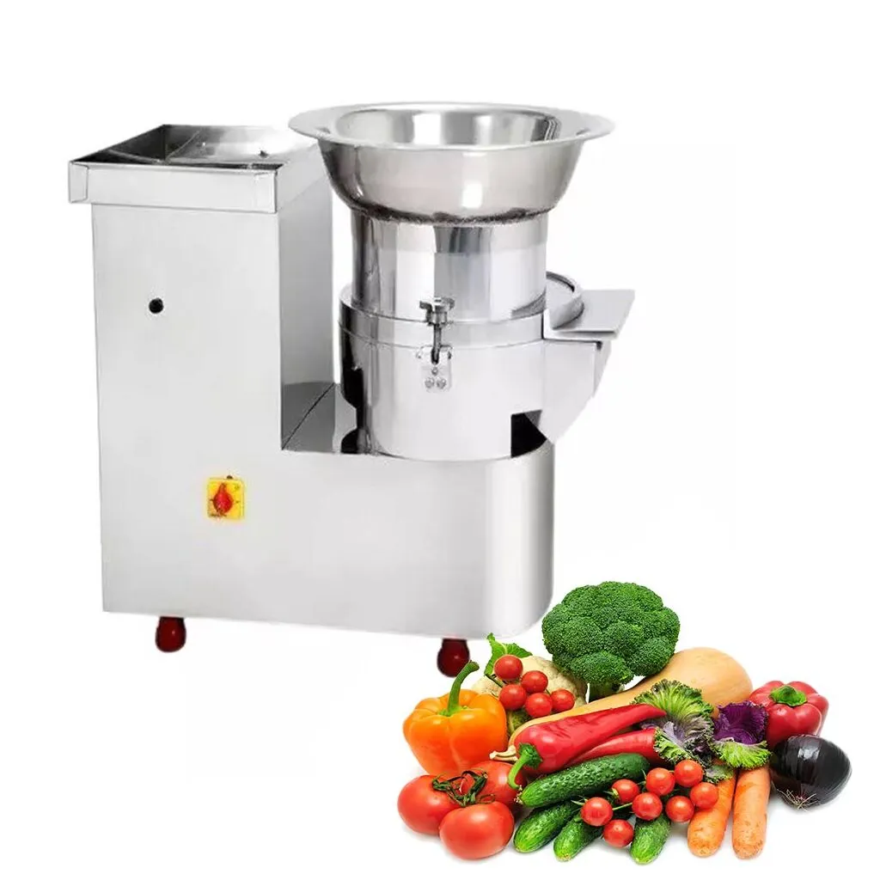
IS 18145 : 2023 VEGETABLE CUTTING MACHINE — SPECIFICATION
It covers safety and hygiene requirements for the power operated vegetable cutting machine

Slide 12
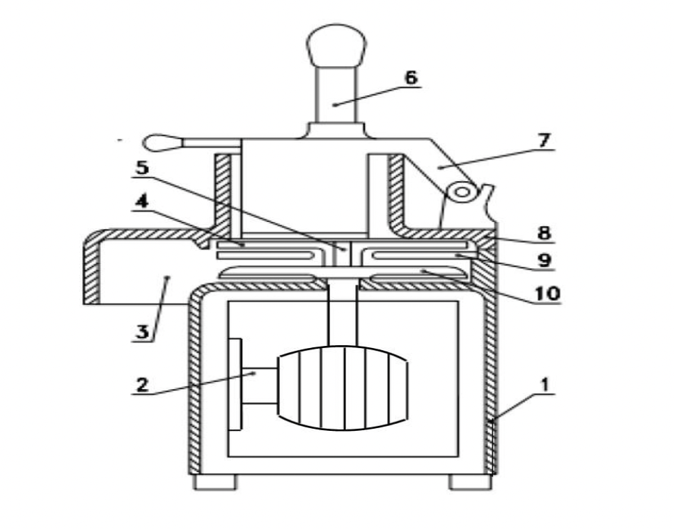
IS 18145 : 2023 VEGETABLE CUTTING MACHINE — SPECIFICATION
Two types of Vegetable Cutting Machines
1) Main frame
2) Electric motor
3) Delivery chute
4) Cutting device
5) Shaft
6) Plunger (removable)
7) Pusher device
8) Feed chute
9) Fixed plate
10) Ejector
Type – 1 Machine with rotating cutting device

Slide 13
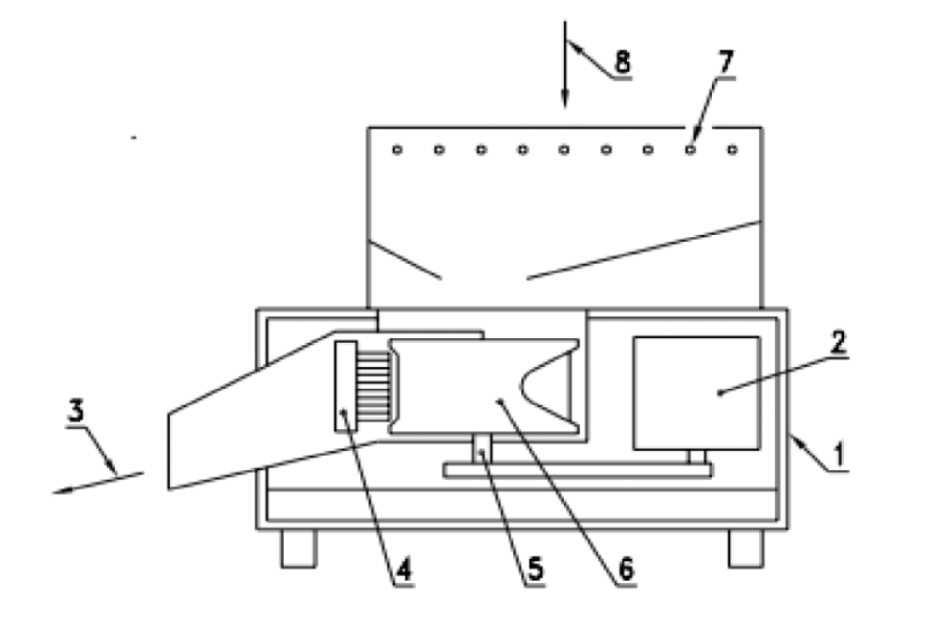
IS 18145 : 2023 VEGETABLE CUTTING MACHINE — SPECIFICATION
Two types of Vegetable Cutting Machines
1) Body
2) Motor
3) Delivery chute
4) Cutting device
5) Shaft
6) Rotating drum
7) Fixed grid
8) Feed hopper
Type – 2 Machine with rotary drum

Slide 14
IS 18145 : 2023 VEGETABLE CUTTING MACHINE — SPECIFICATION
General Requirements
major components are easily removable for inspection and cleaning
It should be able to run without load to without any loosening of fitted parts and excess noise.
Hazard posing machine parts are
To be covered for safety
self-cleaning arrangement should be provided
provision to adjust the slice thickness of the cut vegetables should

Slide 15
IS 18145 : 2023 VEGETABLE CUTTING MACHINE — SPECIFICATION
Additional Accessories and Surrounding Conditions
Machine should be placed on smooth surface without any crevices or pits
place of installation it to be provided with good drainage facility, and should be well aerated
with good lighting.
Appropriate water supply
Quality of water used in cleaning machine
Adequate safe and potable water ae per IS 10500
Storage tanks for water shall be kept covered
Periodical chemical and microbiological analysis of water

Slide 16
IS 18145 : 2023 VEGETABLE CUTTING MACHINE — SPECIFICATION
Hygienic Conditions
strict hygienic conditions are to be followed as per IS 2491
Hygiene in Operation
Avoiding wood and other materials which cannot be adequately cleaned and disinfected
Provision for easy and thorough cleaning and disinfection
Microbial analysis of cut slice
Leak-proof container for waste handling
Equipment & utensils meant for waste are marked for identification

Slide 17
Important Standards on Fruit & Vegetable Processing (click to view)
Sl. No. | IS No. | Title
1. | IS 18145: 2023 | Vegetable Cutting Machine — Specification
2. | IS 15831 : 2009 | Citrus Grader — Size Based — Specification
3. | IS 14603: 2023 | Potato Grader — Test Code (First Revision)

Slide 18
Seed Cotton Processing
Seed cotton processing for seed production involves specific procedures to ensure the extraction of high-quality cotton seeds. Here’s an outline of what it covers:
Cleaning: Removal of debris, leaves, and other non-seed materials from the harvested seed cotton.
Delinting: Separation of cotton lint from the seeds using a mechanical lint cleaner, ensuring seeds are free from lint fibers.
Drying: Reduction of moisture content in seeds to prevent mold growth and maintain seed viability during storage.
Grading: Sorting seeds based on size, weight, and quality criteria to ensure uniformity and optimal planting performance.
Nowadays, seed delinting, a critical process, can be achieved through following methods:
Manual Acid (H₂SO₄) Delinting — Often conducted by farmers in the field.
Gas (HCL) Delinting — Industrial method
Machinery Dilute Acid (H₂SO₄) Delinting — Industrial method

Slide 19
Indian Standards on Seed Cotton Delinting Equipment (click to view)
Sl. No. | IS | Tittle
1. | IS 15858: 2013 | Cotton Seed Delinting Machinery — Delinting Machine With Electrical Heating And Hydraulic System — Specification
2. | IS 15859: 2013 | Cotton Seed Delinting Machinery — Buffing Machine With Air Jet And Nylon Brush — Specification
3. | IS 15860: 2013 | Cotton Seed Delinting Machinery — Ammonia Cotton Seed Neutralizer Machine With Ammonia Vaporizer — Specification
4. | IS 15861: 2013 | Cotton Seed Delinting Machinery — Pollution Control System With Scrubber, Cyclone, Chimney, Hoods And Ducting — Specification
5. | IS 15862: 2013 | Cotton Seed Delinting Machinery — HCL Gas Generation Unit — Specification

Slide 20
Seed Processing
Seed processing is a crucial step in the production of high-quality seeds for agriculture. It encompasses a series of operations designed to ensure that seeds are clean, viable, and capable of healthy germination. The main stages of seed processing include cleaning, drying, grading, treating, and packaging. Here is a brief overview of what each stage covers:
Cleaning
Drying
Grading
Treating
Packaging
Overall, seed processing aims to produce high-quality seeds that meet specific purity, germination, and health standards, ensuring successful crop production and productivity.

Slide 21
Indian Standards on Seed Processing Equipment (click to view)
Sl. No. | IS No. | Title
1. | IS 11041: 1984 | Specification for Air-Screen Seed Cleaner
2. | IS 12576: 1989 | Seed Processing Machinery — Indented Cylinder Grader — Test Code
3. | IS 14460: 1997 | Seed Processing Equipment — Gravity Separator — Specification
4. | IS 5718: 2000 | Agricultural Produce Processing Equipment — Seed Cleaners — Test Code (Second Revision)
5. | IS 8108 (Part 1): 2019 | Methods of Test for Grain Dryers: Part 1 Selection and Preparation for Test (Second Revision)
6. | IS 8108 (Part 2): 1984 | Test Code for Grain Dryers: Part 2 Method of Tests for Continuous Dryers
7. | IS 8108 (Part 3): 1985 | Test Code for Grain Dryers: Part 3 Methods of Tests for In-Silo Dryers

Slide 22
Millet Processing
Millet processing is important because it enhances the nutritional value, palatability, and shelf life of millet grains. It removes impurities and antinutritional factors, making millets more suitable for human consumption. This process also increases market value, supports food security, and provides economic benefits to farmers and producers.
Pre-cleaning and Cleaning: Removal of impurities such as dust and other foreign materials from the harvested millets to ensure purity and quality.
Dehusking : Removing the outer husk or hull of the millet grains to make them more digestible and suitable for further processing and consumption.
Destoning: Removal of stones from millet so that it can be further pearled or polished.
Pearling and polishing: Smoothing and enhancing the appearance of the millet grains or flour to improve their marketability and consumer appeal by removing the bran layer from dehusked millet grain.

Slide 23
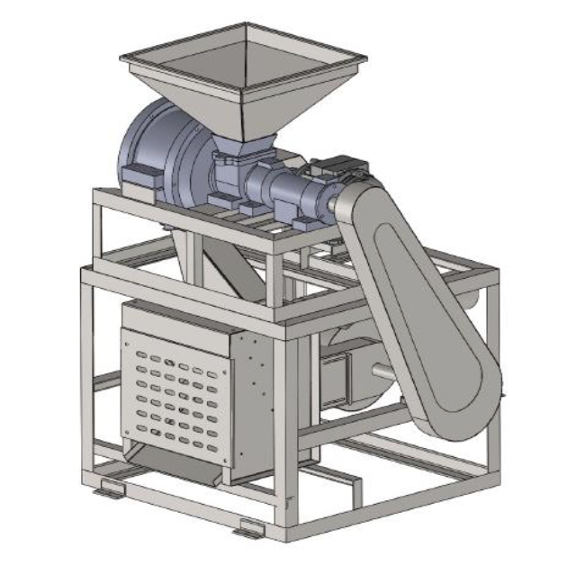
It covers material, performance, constructional and other requirements for millet dehusker of centrifugal type millet dehusker
IS 19040 : 2024 MILLET DEHUSKER — CENTRIFUGAL TYPE — SPECIFICATION & TEST CODE

Slide 24
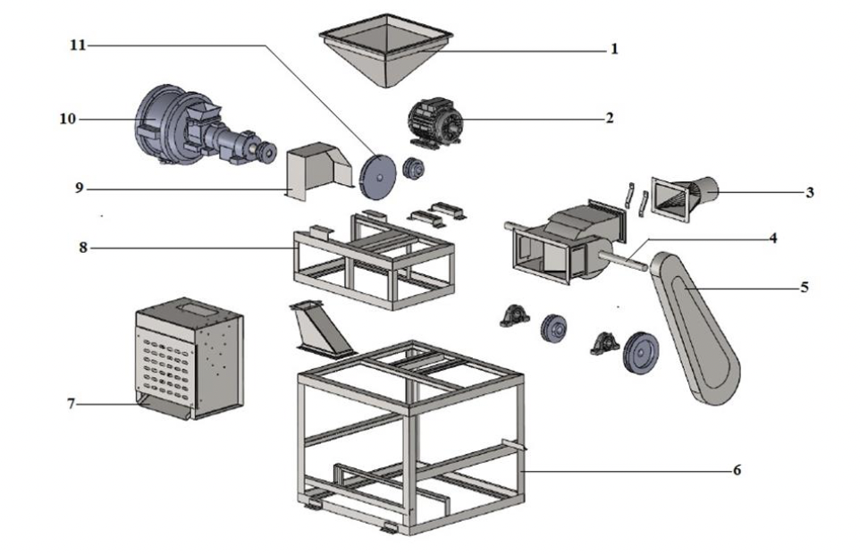
IS 19040 : 2024 MILLET DEHUSKER — CENTRIFUGAL TYPE — SPECIFICATION & TEST CODE
Exploded view of millet dehusker
Feed hopper
2) Electric motor;
3) Husk outlet
4) Machine/Aspirator shaft
5) Dehusker belt guard
6) Machine frame
7) Dehusked millet outlet
8) Dehusker frame
9) Belt guard
10) Dehusker chamber
11) Dehusker impeller

Slide 25
IS 19040 : 2024 MILLET DEHUSKER — CENTRIFUGAL TYPE — SPECIFICATION & TEST CODE
Material Requirements
Components | Material | Conforming to
Belt guard | MS | IS 2062
Blower/aspirator | MS | IS 2062
Husk outlet/aspirator | MS | IS 2062
Impeller shaft | MS | IS 2062
Dehusking chamber | CI | IS 210
Frame | MS | IS 2062
Dehusker impeller | SS (SS 304) | IS 6911
Dehusked millet outlet | SS (SS 304) | IS 2062/IS 6911
Feed hopper | MS/SS (SS 304) | IS 6911
Rubber ring/lining | Food grade rubber sheet and moulded rubber | -

Slide 26
IS 19040 : 2024 MILLET DEHUSKER — CENTRIFUGAL TYPE — SPECIFICATION & TEST CODE
Constructional Requirements
Aspirator – to be balanced and mounted on self-aligned bearings to run without vibration
Dehusking chamber - provided with crank gear and provision to rotate the chamber to facilitate uniform wear of the rubber lining.
Feed screw – Should feed feed the millets uniformly
Frame – Should be covered wherever required
Feed Hopper – To be provided with a feed regulating device
Impeller – Should withstand the rotation at 2 000 rpm to 2 800 rpm
Outlets (of husk and millet both) – To be placed at the suitable height from ground for easy collection.
Shafts – To be supported with suitable bearings on the stable part of machine.
Transmission Drive - To be provided with suitable guard/cover.

Slide 27
IS 19040 : 2024 MILLET DEHUSKER — CENTRIFUGAL TYPE — SPECIFICATION & TEST CODE
Workmanship and Finish
All the welding joints should be non-porous
Any sharp corners and protruding fasteners shall be avoided.
All the components shall be finished smooth and properly painted.

Slide 28
IS 19040 : 2024 MILLET DEHUSKER — CENTRIFUGAL TYPE — SPECIFICATION & TEST CODE
Tests
at no load
To be run for 10 min and power requirement is to be recorded
Presence of any marked vibration, undue knocking, rise in bearing temperature, etc ae to be checked
At load
Collection of data when operated for 30 min
Preparation and analysis of sample
Determination of dehusking efficiency, % of breakage, % of husk in milled kernel, cleaning efficiency, power consumption, and rated input capacity
Long run test for 20 hours to ensure that there is no break downs
Tests

Slide 29
Indian Standards on Millet Processing (click to view)
Sl. No. | IS No. | Tittle
1. | IS 19039 : 2023 | Cleaner cum Grader for Millets with Pre-Cleaner — Specification and Test Code
2. | IS 19040 : 2023 | Millet Dehusker — Centrifugal Type — Specification and Test Code
3. | IS 19041: 2023 | Destoner for Millets — Specification and Test Code
4. | IS 19042 : 2023 | Symbols and Flow Diagrams Used in Primary Processing of Millets

Slide 30
Sugarcane Juice Extraction
Sugarcane Juice Extraction
Harvesting: Sugarcane is harvested either manually or mechanically before the juice extraction process begins.
Cleaning: The harvested sugarcane stalks are cleaned to remove dirt and impurities.
*Crushing: Sugarcane stalks are crushed using roller mills to extract the juice.
*Filtration: The extracted juice is filtered to remove fibres and other solid particles.
Pasteurization: The juice is pasteurized to kill bacteria and extend its shelf life.

Slide 31
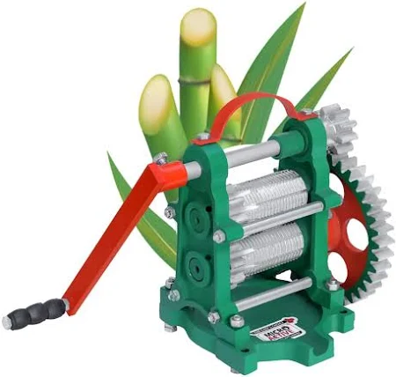
It covers methods for type and routine testing of sugarcane crushers
IS 6997 : 2021 TEST CODE FOR SUGARCANE CRUSHERS (First Revision)

Slide 32
IS 6997 : 2021 TEST CODE FOR SUGARCANE CRUSHERS (First Revision)
Type Tests - Tests carried out on crushers to prove conformity with the requirements of the relevant standard. These are intended to prove the general qualities and design of a given type of sugarcane Crusher
It includes checking of:
Dimensions
Material
Visual observation before run
Test at no load
Test at load where power consumption, crushing capacity, extraction efficiency, fibre percent in cane, reduced juice extraction, visual observations, juice content in bagasse are determined.
Routine Tests - Tests carried out on each crusher to check the requirements which are likely to vary during production.
It includes visual observation before run and test at no load.

Slide 33
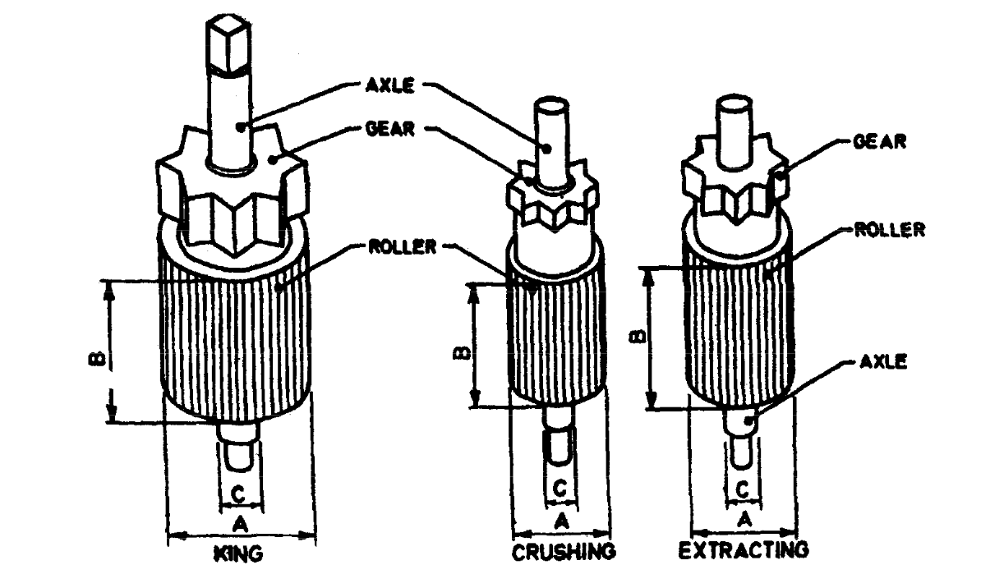
IS 6997 : 2021 TEST CODE FOR SUGARCANE CRUSHERS (First Revision)
Test at no load :
Crusher is to be installed with the clearance of 6.4 mm between king & crushing and o.8 mm between king & extracting roller
Operate the crusher for at least 30 min continuously
Take the reading of power meter at an interval of 5, 10, 15, 20, 25 and 30 min.

Slide 34
IS 6997 : 2021 TEST CODE FOR SUGARCANE CRUSHERS (First Revision)
Test at load :
Determination of power requirement
Crushing capacity
Juice extraction efficiency (after crushing minimum of 25 kg sugarcane)
Fibre content in cane
Purity of extracted juice
Brix percent bagasse
Fibre percent bagasse
Fibre percent cane
Reduce juice content (corrected on the basis of 12.5 percent fibre content in cane)
Visual Observations

Slide 35
Indian Standards on Sugarcane Juice Extractor (click to view)
Sl. No. | IS No. | Tittle
1. | IS 6997 : 2021 | Test Code for Sugarcane Crusher (First Revision of IS 6997)
2. | IS 15561 : 2005 | Sugarcane Crushers — Safety Requirements
3. | IS 1973 : 1999 | Sugarcane Crusher — Specification (Third Revision of IS 1973)

Slide 36
Reference taken from other than Indian Standards
Book : Unit Operations in Agricultural Processing by Singh and Sahay

Slide 37
Quiz time

Slide 38
Q 1 Which Indian Standard (IS) specifies the requirements for vegetable cutting machines?
A) IS 456:2000
B) IS 18145:2023
C) IS 304:2014
D) IS 12345:2018

Slide 39
Q 2 Manual Acid (H2SO4) Delinting is often conducted by farmers in the field ?
True
False

Slide 40
Q 3 Which Indian Standard is referred for material for the flywheel in a power-operated chaff cutter?
A) IS 4454 (Part 1)
B) IS 2062
C) IS 210
D) IS 4711

Slide 41
Q 4 What is the specified feature of the blower in a power-operated chaff cutter?
A) Axial type blower
B) Centrifugal type blower
C) Radial type blower
D) Mixed-flow type blower

Slide 42
Q 5 According to the requirements, the minimum length for the chute in the feeding system of a power-operated chaff cutter is 900 mm and the conveyor is 200 mm ?
A) True
B) False

Slide 43
Q 6 According to the requirements, what is a key feature of the feed hopper in a millet dehusker?
A) It should have an automatic cleaning system.
B) It should be equipped with a feed regulating device.
C) It should have a built-in heating element.
D) It should be made of transparent material for visibility.

Slide 44
Q 7 What feature is required for the aspirator in a millet dehusker to ensure smooth operation?
A) It should have adjustable speed settings.
B) It should be balanced and mounted on self-aligned bearings to run without vibration.
C) It should be equipped with a temperature control system.
D) It should be made of stainless steel for rust resistance.

Slide 45
Q 8 According to IS 18145, what is a key requirement for the major components of a vegetable cutting machine?
A) They should be made of mild steel.
B) They should be easily removable for inspection and cleaning.
C) They should be permanently fixed to the machine.
D) They should be equipped with an automatic lubrication system.

Slide 46
Q 9 What feature is required for a vegetable cutting machine to ensure safe operation according to IS 18145?
A) It should have a built-in heating element for sterilization.
B) It should be able to run without load with no loosening of fitted parts and minimal excess noise.
C) It should include an external fan to cool down the machine.
D) It should have a digital display for monitoring

Slide 47
Q 10 Which standard specifies the need for strict hygienic conditions in the operation of vegetable cutting machines, as mentioned in IS 18145?
A) IS 2062
B) IS 2491
C) IS 4711
D) IS 513

Slide 48
Thank You

