Slide 1
PRESENTATION ON ELECTROMAGNETIC COMPATIBILITY (EMC) AND ELECTROMAGNETIC INTERFERENCE (EMI)

Slide 2
GENESIS
Electromagnetic compatibility (EMC) and electromagnetic interference (EMI) are frequently referred to when discussing the regulatory testing and compliance of electronic and electrical products.
Electromagnetic compatibility and interference are extremely important design considerations. Failing to consider them in the early stages of product development can result in the time-consuming and costly need to redesign the product at a later stage.
Without proper design, products won’t meet regulatory requirements which means the manufacturers can’t sell them unless those issues are resolved.

Slide 3
THE NEED FOR STANDARDS
Electronic devices and equipment are constantly being used nowadays in various settings, ranging from homes and businesses to industrial applications and healthcare facilities.
With the proliferation of digital technology, ensuring electromagnetic compatibility (EMC) has become crucial to prevent interference and disturbances that can affect the functionality and performance of electronic equipment.

Slide 4
THE NEED FOR STANDARDS (CONTD..)
EMC encompasses two key principles:
Emission control: Electronic devices should limit the electromagnetic emissions they generate to prevent interference with other devices. This includes controlling conducted and radiated emissions, such as radio frequency (RF) signals, harmonics and spurious emissions, to comply with regulatory limits and standards.
Immunity to interference: Electronic devices should have robust immunity to external electromagnetic interference from sources such as power lines, radio transmitters, and electric motors. This involves designing equipment to withstand common types of interference, such as electrostatic discharge (ESD), power surges, and conducted disturbances, without performance degradation.

Slide 5
THE NEED FOR STANDARDS (CONTD..)
The standards are developed on these principles to address EMC issues and provide guidelines for equipment manufacturers, regulatory bodies and testing laboratories.
Compliance with these standards is essential-
To address EMC issues and ensure the compatibility of electronic equipment in different environments;
For equipment manufacturers to demonstrate that their products meet EMC requirements and are safe to use in different environments.

Slide 6
STANDARDS ON EMI/EMC
EMC standards are documents that define EMI emission limits and immunity level requirements for electrical and electronic devices. These standards also specify rules, guidelines, test methods, testing environments etc. for conducting EMC testing.
EMC standards and regulations are developed and written by international, regional and national organizations and committees specializing in standardization and regulatory compliance e.g., ISO, IEC, CEN, FCC, SAE etc.
EMC standards can be broadly categorized into the following types-
Basic EMC publications
EMC product standards
EMC product family standards
Generic EMC standards

Slide 7
STANDARDS ON EMI/EMC
Basic EMC Publications (Basic Standards): The Basic EMC Publications define EMC terminology, general conditions & rules, and guidelines for achieving electromagnetic compatibility; they also specify testing techniques, test setup, test equipment and environment, and other considerations for EMC emission and immunity testing.
The basic EMC Publications are the basic EMC standards/foundational standards to which other EMC standards (such as EMC Product Standards, Generic EMC Standards, etc.) refer to. Some examples of basic EMC Publications are:
IEC 61000-4-X series (immunity-related)
IEC TS 61000-2-5 (electromagnetic environment-related)

Slide 8
STANDARDS ON EMI/EMC
EMC Product Standards: These are the EMC standards that apply to specific products. These standards specify the emission limits and minimum immunity test levels. For a particular product, the product standard refers to the relevant basic EMC publications. Examples of the EMC product standards include:
IEC 62104 - Applies to Digital Audio Broadcasting (DAB) receivers
IEC 61851-21 - Applies to electric road vehicle charging systems

Slide 9
STANDARDS ON EMI/EMC
EMC Product Family Standards: These standards apply to groups of products that share common characteristics, are used in the same environment, and have related fields of application. They detail the emission limits and minimum immunity test levels. For a particular product, the product family standard refers to the relevant basic EMC publications. Examples of product family standards include:
CISPR 32 (emission-related) - Applies to Information Technology Equipment (ITE)
CISPR 14-2 (immunity-related) - Applies to household appliances, electric tools and similar apparatus
IEC 61547 (Immunity related) - Applies to lightning equipment

Slide 10
STANDARDS ON EMI/EMC
Generic EMC Standards: These standards apply to products operating in a particular EMC environment, like industrial/residential. They are used when a specific Product (Family) EMC Standard does not exist. The Generic EMC Standards are general and somewhat simplified EMC Product Standards. The limited number of essential emission and immunity tests, as well as minimum immunity test levels, are specified in these standards. Examples of the generic EMC standards include:
IEC 61000-6-3 (emission-related) - Applies to equipment in residential environments
IEC 61000-6-2 (immunity-related) – Applies to equipment in industrial environments

Slide 11
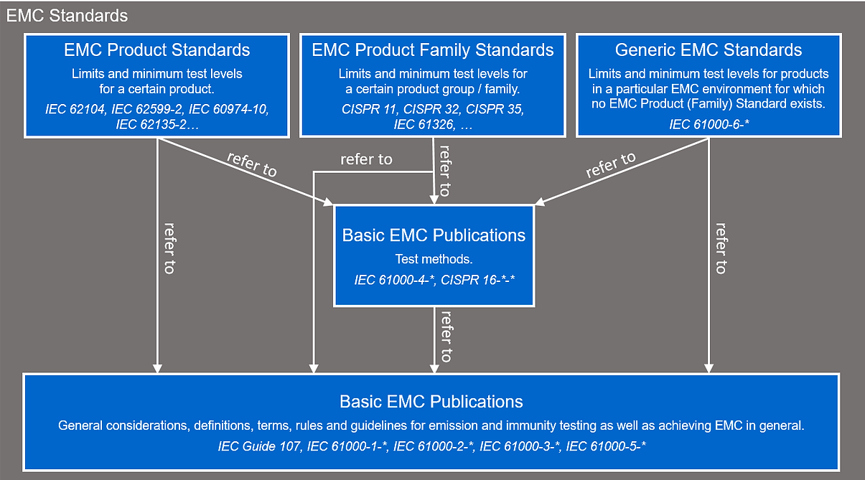
STANDARDS ON EMI/EMC

Slide 12
IEC 61000 SERIES
IEC 61000 series of standards deals with EMC requirements for different types of equipment. These standards are published in separate parts, according to the following structure:
Sl. No. | Part No. | Contents
1. | Part 1: General | General considerations (introduction, fundamental principles) Definitions, terminology
2. | Part 2: Environment | Description levels Classification of the environment Compatibility levels
 | Part 3: Limits | Emission limits Immunity limits (in so far as they do not fall under the responsibility of the product committees)
3. | Part 4: Testing and measurement | Measurement techniques Testing techniques
4. | Part 5: Installation and mitigation | Installation guidelines Mitigation methods and devices
5. | Part 6: Generic standards | Generic emission and immunity requirements in various environments
6. | Part 9: Miscellaneous

Slide 13
IEC 61000 SERIES
The standards provide guidelines for selecting appropriate immunity tests and test levels based on the intended use of the equipment.
Immunity tests are designed to assess the ability of equipment to withstand electromagnetic disturbances.
The standard defines various types of immunity tests, including tests for electrostatic discharge (ESD), electrical fast transients (EFT), surges, voltage dips and radiated fields etc.

Slide 14
IEC 61000 SERIES (CONTD…)
The standards emphasize the importance of proper documentation in test reports, including test setup details, equipment information, and environmental conditions.
Test setups and procedures should be standardized to ensure the repeatability and reproducibility of test results.
IEC 61000 also includes guidelines for calibrating test equipment and measurement chains to maintain accuracy and consistency in EMC testing. Each part is further subdivided into several parts, published either as international standards or as technical specifications or technical reports, some of which have already been published as sections. Others have been published with the part number followed by a dash and a second number identifying the subdivision (example: IS 14700-6-1).
Please refer the brief write-up on these standards.

Slide 15
INDIAN STANDARDS ON EMI/EMC
India has adapted several international standards from the IEC 61000 series under its IS 14700 series.
This set includes specific parts and sections that correspond to IEC standards on electromagnetic compatibility. For example:
IS 14700-3-2 (Harmonics Emission): This standard aligns with IEC 61000-3-2, covering limits for harmonic current emissions in devices that draw less than 16A per phase.
IS 14700-3-3 (Voltage Fluctuations and Flicker): This standard corresponds to IEC 61000-3-3, specifying limits on voltage fluctuations and flicker in low-voltage public systems.
Please refer the list of Indian Standards on EMI and EMC.

Slide 16
BASIC TERMS & DEFINITIONS
IS 14700 (Part 1/Sec 1): 2000 is an Indian Standard that focuses on electromagnetic compatibility (EMC) which is adopted from the International Electrotechnical Commission (IEC) standard IEC 61000-1-1:2022.
It provides a comprehensive overview of fundamental definitions and terms related to EMC. It defines basic terms like electromagnetic disturbance and immunity, along with combined terms such as emission level and compatibility level emphasizing the role of probability and margins in achieving EMC.
It also illustrates the application of these concepts in real-world scenarios, such as the harmonic disturbances in a public low-voltage network.
It emphasizes the importance of distinguishing between standardized tests and in situ tests for evaluating EMC.

Slide 17
BASIC TERMS & DEFINITIONS (CONTD..)
Electromagnetic Compatibility (EMC) is the ability of equipment or systems to function satisfactorily in their electromagnetic environment without introducing intolerable electromagnetic disturbances to anything in that environment [Clause 2.1].
This means that a device should be able to tolerate electromagnetic disturbances from other devices ("tolerant of others") and not emit disturbances that could interfere with other devices ("gives no offense to others").
Electromagnetic Interference (EMI) is the degradation of a device, equipment, or system performance caused by an electromagnetic disturbance [Clause 2.1].
Disturbance and interference are related as cause and effect respectively. An EMI problem consists of three elements: an emitter (the source of the disturbance), a susceptor (the affected device), and a coupling path (the medium between them).

Slide 18
BASIC TERMS & DEFINITIONS (CONTD..)
Electromagnetic Environment is the totality of electromagnetic phenomena existing at a given location [Clause 2.1].
In general, this totality is time dependent and its description may require a statistical approach.
Electromagnetic Disturbance is an electromagnetic phenomenon which may degrade the performance of a device, equipment or system or adversely affect living or inert matter [Clause 2.1].
An electromagnetic disturbance may be an electromagnetic noise, an unwanted signal or a change in the propagation medium itself.

Slide 19
BASIC TERMS & DEFINITIONS (CONTD..)
Susceptibility is the inability of a device, equipment, or system to operate without degradation when exposed to an electromagnetic disturbance [Clause 2.1].
It is a fundamental property of most devices.
Immunity is the ability of a device, equipment, or system to operate without degradation in the presence of an electromagnetic disturbance [Clause 2.1].
It's the opposite of susceptibility. Immunity is typically achieved through preventive or corrective measures.
Degradation (of performance) is an undesired departure in the operational performance of any device, equipment, or system from its intended performance [Clause 2.1].
It can be temporary or permanent. It is crucial to clearly define what constitutes unacceptable degradation in EMC specifications.

Slide 20
BASIC TERMS & DEFINITIONS (CONTD..)
The level (of a quantity) is the magnitude of that quantity evaluated in a specified manner [Clause 2.2].
When evaluating levels in EMC, it is essential to clearly define the quantity being measured (e.g., voltage, field strength) and the specific measurement method used.
Emission level is the level of a given electromagnetic disturbance emitted from a particular device, equipment or system, measured in a specified way. Immunity level is the maximum level of a given electromagnetic disturbance, incident in a specified way on a particular device, equipment or system, at which no degradation of operation occurs [Clause 2.2].
The (electromagnetic) compatibility level is the specified disturbance level at which an acceptable, high probability of electromagnetic compatibility should exist. [Clause 2.2].
This level helps in determining acceptable emission and immunity limits for various equipment in a given environment.

Slide 21
BASIC TERMS & DEFINITIONS (CONTD..)
Emission margin is the ratio of the electromagnetic compatibility level to the emission limit.
Immunity margin is the ratio of the immunity limit to the electromagnetic compatibility level.
Electromagnetic compatibility margin is the ratio of the immunity limit to the emission limit.
Margins are essential in ensuring electromagnetic compatibility (EMC) due to various uncertainties inherent in real-world scenarios.

Slide 22
TESTS ON EMC
Standardized vs. In-situ Tests:
Standardized tests are designed to be reproducible anywhere in the world and aim to verify EMC specifications generally. They achieve this by focusing on one electromagnetic disturbance at a time, using well-defined equipment and measurement conditions. However, this approach has limitations in representing the complexities of real-world installations.
In-situ tests are conducted in the actual environment where the equipment will be used. While similarly defined equipment as in standardized tests can be used, the measurement conditions are harder to control in the field. For example, the load impedance in an in-situ test is often unknown and changes over time, directly impacting the measured emission levels. This makes in-situ tests less reproducible than standardized tests, but they provide a more accurate assessment of EMC in a specific installation.

Slide 23
TESTS ON EMC (CONTD…)
IS 14700 (Part 1/Sec 1): 2000 outlines three fundamental properties of standardized EMC tests:
Focus on One Disturbance Type: Standardized tests isolate and examine one type of electromagnetic disturbance at a time. This controlled approach allows for a more accurate assessment of a device's emission or immunity to a particular disturbance. For example, a test might focus solely on emissions via conducted or radiated emissions. This differs from real-world scenarios where various disturbances occur concurrently.

Slide 24
TESTS ON EMC (CONTD…)
Well-Defined Measuring Equipment (Emission) and Disturbance Source (Immunity):
Emission Tests: Standardized tests utilize specifically defined measuring equipment, such as voltage probes or antennas, connected to calibrated measurement instruments. This ensures consistency and reproducibility in measuring the chosen disturbance parameter (e.g., magnetic field strength, voltage).
Immunity Tests: For immunity evaluation, standardized tests use precisely defined disturbance sources, comprising a generator and a coupling network. This setup replaces the unpredictable impedance characteristics of real-world emitters with a controlled and reproducible source.

Slide 25
TESTS ON EMC (CONTD…)
Standardized Measurement Conditions: To ensure global reproducibility, standardized tests establish precise and consistent measurement conditions. This includes specifying:
Measuring Device and Equipment: The selection of appropriate measuring devices and equipment based on the type of disturbance and desired signal characteristics.
Loading Conditions of the Disturbance Source: A detailed description of the load impedances presented to the disturbance source by the equipment under test (EUT). This is particularly crucial for standardized tests, as it ensures consistency.
Test Configuration: This encompasses various aspects, including the choice of ground reference, the positioning of the EUT and measuring equipment, grounding connections, interconnections, termination of unused terminals, and EUT operating conditions during testing.

Slide 26
TESTS ON EMC (CONTD…)
Sl. No. | Test | Indian Standard | Test Level
1. | Electrostatic Discharge Immunity Test | IS 14700 (Part 4/Sec 2): 2018 | ±2 kV, ±4 kV (contact discharge)
2. | Radiated Radio-Frequency Electromagnetic Field Immunity Test | IS 14700 (Part 4/Sec 3): 2023 | 1 V/m to 10 V/m at various frequencies
3.
 | Test methods for protective devices for HEMP conducted disturbance | IS 14700 (Part 4/Sec 4): 2018 | ±0.5 kV, ±1 kV and ±2 kV (signal and power lines)
4. | Surge Immunity Test / Telecom Surge Immunity Test | IS 14700 (Part 4/Sec 5) : 2019 | ±0.5 kV, ±1 kV and ±2 kV for line-to-line and line-to-earth
5. | Immunity to conducted disturbances, induced by radio - frequency fields | IS 14700 (Part 4/Sec 6) : 2016 | 3 V across the frequency range of 150 kHz to 80 MHz
6. | Power Frequency Magnetic Field Immunity Test 3 A/m - 30 A/m | IS 14700 (Part 4/Sec 8) : 2018

Slide 27
TESTS ON EMC (CONTD…)
Sl. No. | Test | Indian Standard | Test Level
7. | Impulse Magnetic Field Immunity Test | IS 14700 (Part 4/Sec 9) : 2019
8. | AC Voltage Dips, Short Interruption And Voltage Variation Immunity Test For Equipment With Input Current Upto 16A Per Phase | IS 14700 (Part 4/Sec 11) : 2021 | Voltage dips typically at 0%, 30%, and 60% for various durations
 | Ring Wave Immunity Test | IS 14700 (Part 4/Sec 12) : 2019
9. | Harmonics And Interharmonics Including Mains Signaling At A.C. Power Port, Low Frequency Immunity Test | IS 14700 (Part 4/Sec 13) : 2016
10. | Voltage Fluctuation Immunity Test For Equipment With Input Current Not Exceeding 16 A Per Phase | IS 14700 (Part 4/Sec 14) : 2018
11. | Ripple On D.C. Input Power Port Immunity Test | IS 14700 (Part 4/Sec 17) : 2018

Slide 28
EMC TESTING & MEASUREMENT
The IEC 61000-4 series of standards pertains to EMC testing and measurement techniques. The purpose of this series is to provide guidance on EMC basic standards and documents for electric and electronic equipment, with a focus on immunity tests. This information assists technical committees, users, and manufacturers in:
Considering applicable immunity test methods for their products.
Identifying relevant test methods based on the intended electromagnetic environment of product use.
Specifying the product ports to undergo the identified immunity tests.

Slide 29
EMC TESTING & MEASUREMENT (CONTD..)
IS 14700 (Part 4/Sec 1): 2019, an Indian Standard identical to IEC TR 61000-4-1: 2016, classifies electromagnetic environments and lists applicable IEC 61000-4 series tests.
Residential locations exist as an area of land designated for the construction of domestic dwellings, and is characterized by the fact that equipment is directly connected to a low voltage public mains network or connected to a dedicated DC source which is intended to interface between the equipment and the low-voltage mains network.

Slide 30
EMC TESTING & MEASUREMENT (CONTD..)
Commercial, Public and Light-Industrial Locations exist as areas of the city centre, offices, public transport systems (road/train/underground), and modern business centres containing a concentration of office automation equipment (PCs, fax machines, photocopiers, telephones, etc.) and is characterized by the fact that equipment is directly connected to a low-voltage public mains network or connected to a dedicated DC source which is intended to interface between the equipment and the low-voltage mains network.

Slide 31
EMC TESTING & MEASUREMENT (CONTD..)
Both these typically require testing for ESD, radiated electromagnetic fields, EFT/burst, surges, conducted RF disturbances, voltage dips and interruptions.
These locations may also require tests for power frequency magnetic fields, pulse magnetic fields, oscillatory magnetic fields, harmonics and interharmonics, voltage fluctuations, conducted disturbances (0 Hz to 150 kHz), ripple on DC power supplies, damped oscillatory waves, unbalance in 3-phase mains, and variations of power frequency.
The need for these additional tests is highly dependent on the specific equipment and its intended use.

Slide 32
EMC TESTING & MEASUREMENT (CONTD..)
Industrial locations are characterized by a separate power network, supplied from a high- or medium-voltage transformer, dedicated for the supply of the installation.

Slide 33
EMC TESTING & MEASUREMENT (CONTD..)
Industrial locations are further subdivided into General, Heavy, Power and Process categories. While all Industrial locations generally require the tests listed for Residential, Commercial/Public, and Light-Industrial locations, specialized tests are recommended depending on the Industrial location subcategory:
General, Heavy, and Power Industrial locations: Tests for pulse magnetic fields, oscillatory magnetic fields, conducted disturbances in the range of 0 Hz to 150 kHz, and damped oscillatory waves are recommended for equipment in these locations.
Process Industrial locations: Tests for voltage dips, interruptions, and variations on DC power ports are recommended.
It's important to remember that this is a general guide, and specific product committees or agreements between manufacturers and users may dictate the final selection of tests.

Slide 34
EMC TESTING & MEASUREMENT (CONTD..)
Factors to Consider When Selecting Immunity Tests:
When determining which immunity tests from the IEC 61000-4 series to use, there are many factors to consider. The standards emphasize that no precise rules exist due to the wide range of equipment and environmental conditions. Instead, the sources offer some high-level guiding principles and recommendations:
Types of disturbances affecting the equipment: Each standard in the IEC 61000-4 series focuses on a specific type of electromagnetic disturbance. Tests relevant to the disturbances the equipment may encounter during its operation need to be selected.
Environmental conditions: The intended operating environment heavily influences the types and severity of electromagnetic disturbances the equipment may experience. For instance, industrial equipment often faces harsher conditions than residential equipment.

Slide 35
EMC TESTING & MEASUREMENT (CONTD..)
Required reliability and behaviour: Equipment critical for safety or essential operations demands a higher level of immunity compared to less critical equipment. This means more stringent tests and acceptance criteria may be necessary.
Economic constraints: Performing every conceivable test can be costly and time-consuming. Balancing thoroughness with practical limitations requires selecting a reasonable subset of tests, potentially prioritizing those deemed most critical.
Equipment characteristics: The inherent susceptibility of the equipment itself to different disturbances should factor into the test selection. For example, equipment with long cables might be more vulnerable to conducted disturbances.

Slide 36
EMC TESTING & MEASUREMENT (CONTD..)
Responsibility for Test Selection:
The primary responsibility for choosing appropriate immunity tests typically falls on the product committees, who leverage their expertise and experience to make informed decisions. However, the manufacturers and users can reach agreements to define the testing scope, especially in unique circumstances.

Slide 37
EMC TESTING & MEASUREMENT (CONTD..)
Prioritization of Standards:
When a dedicated product standard, product family standard, or generic standard exists, those standards supersede these general guidelines in terms of priority. The order of precedence is as follows:
Dedicated product standard: Most specific and directly applicable.
Product family standard: Covers a broader range of similar products.
Generic standard: Provides general guidance for a wide range of equipment.

Slide 38
A FEW IMPORTANT TESTS

Slide 39
VOLTAGE FLUCTUATION & FLICKER
IS 14700 (Part 3/Sec 3) : 2018 is an Indian Standard, identical to IEC 61000-3-3 : 2013, which focuses on limiting voltage fluctuations and flicker in public low-voltage supply systems.
It is designed to assess the impact of electrical and electronic equipment on voltage fluctuations and flicker in low-voltage distribution networks. Specific test conditions and limits are detailed for a variety of equipment types, including household appliances, lighting, and welding equipment.
This standard applies to electrical and electronic equipment with a rated current of 16A per phase or less that connects to 220V-250V, 50Hz systems.
This standard helps maintain the quality of electricity supply, preventing disturbances from individual devices from causing broader network issues.

Slide 40
VOLTAGE FLUCTUATION & FLICKER (CONTD..)
Key Parameters:
Voltage Fluctuations: Variations in the voltage supplied by an electrical grid, which can occur due to load changes caused by equipment turning on or off.
Flicker: A phenomenon where voltage fluctuations cause light intensity variations in lighting equipment, which may be visible to human eyes.

Slide 41
VOLTAGE FLUCTUATION & FLICKER (CONTD..)
The standard defines limits for the following parameters:
Pst (Short-term flicker severity): Measured over a 10-minute period. The value of Pst must not exceed 1.0 under normal operation.
Plt (Long-term flicker severity): Measured over a 2-hour period. The value of Plt must not exceed 0.65.
dmax (Maximum voltage change): The maximum permissible percentage voltage change (ΔV/V), which must not exceed 4%.
dc (Steady-state voltage change): The maximum steady-state change in voltage, which should not exceed 3.3%.
d(t) (Voltage changes as a function of time): A series of short-term voltage variations, which must stay within specified limits.

Slide 42
VOLTAGE FLUCTUATION & FLICKER (CONTD..)
Testing Process:
Preparation:
The equipment under test (EUT) is connected to a simulated or real public low-voltage network.
A standard test voltage of 230 V, 50 Hz (for Europe) is applied, unless otherwise specified for different regions.
Load Changes:
The test measures the impact of the EUT's load on the supply voltage. The load variations might occur when equipment like refrigerators, washing machines or motors start and stop.
Flickermeter:
A specialized device, called a flickermeter, is used to measure the voltage fluctuations and calculate Pst and Plt values according to predefined statistical methods.

Slide 43
VOLTAGE FLUCTUATION & FLICKER (CONTD..)
Test Duration:
Voltage fluctuations and flicker measurements are taken over different periods, such as short-term (Pst) and long-term (Plt), to ensure compliance with the standard.
Compliance:
The EUT must meet the voltage fluctuation and flicker limits specified in the standard. Non-compliance may require design changes or the use of mitigation measures such as filters or soft start circuits to reduce the impact on the grid.

Slide 44
EMF IMMUNITY TESTS
IS 14700 (Part 4/Sec 3) : 2023 is an Indian Standard, a second revision of a document originally published in 2005, concerning electromagnetic compatibility (EMC) testing. This standard, identical to IEC 61000-4-3:2020, an international standard, outlines procedures for radiated, radio-frequency electromagnetic field immunity tests for electronic equipment.
Provides requirements for test equipment and facilities, details the test setup, and explains the test procedure, evaluation of results, and necessary information for a comprehensive test report.
Annexes provide supplemental information, including guidance for product committees on selecting appropriate test levels, explanations of modulation types and antenna options, and procedures for calibrating E-field probes.
The document aims to ensure that electronic equipment can function properly in environments with electromagnetic radiation.

Slide 45
EMF IMMUNITY TESTS (CONTD..)
Key Considerations for Setting Up a Radiated Electromagnetic Field Immunity Test:
Setting up a radiated electromagnetic field immunity test, as detailed in the sources, requires careful consideration of various factors to ensure accurate, repeatable, and reliable results. Here are some key considerations:
Test Facility and Environment:
Shielded Enclosure: Due to the high field strengths used, testing must be conducted within a shielded enclosure, typically an anechoic chamber or a modified semi-anechoic chamber, to prevent interference with external radio communications and protect sensitive test equipment.
Uniform Field Area (UFA): A defined UFA within the shielded enclosure is crucial for ensuring a consistent electromagnetic field is applied to the EUT. The sources recommend a preferred UFA dimension of 1.5 m × 1.5 m, but smaller sizes are permitted if full illumination of the EUT and its cabling is possible.

Slide 46
EMF IMMUNITY TESTS (CONTD..)
Absorber Material: Effective absorption of reflected RF energy is critical for maintaining field uniformity. The type, shape, and placement of absorber material require careful consideration, especially at frequencies above 1 GHz where ferrite tiles become less effective.
Ground Plane: While a metallic ground plane is not mandatory, the grounding of the EUT housing or case should be consistent with the manufacturer's instructions. Non-conductive supports are generally preferred to minimize field distortion.

Slide 47
EMF IMMUNITY TESTS (CONTD..)
Test Equipment:
RF Signal Generator: The signal generator should cover the required frequency range and support the specified modulation scheme, typically 80% AM sine wave as recommended by the sources. The use of low-pass or band-pass filters can help suppress unwanted harmonics from the signal generator.
Power Amplifier: The amplifier should provide sufficient power to achieve the target field strength within the UFA, while also maintaining linearity to avoid signal distortion. The linearity characteristic of the amplifier needs to be evaluated, and appropriate measures, such as feedback control or adjusting forward power during the test, may be necessary to mitigate non-linearity.

Slide 48
EMF IMMUNITY TESTS (CONTD..)
Field Generating Antennas: The choice of antenna depends on the frequency range and desired field characteristics. Common types include biconical, log periodic, and horn antennas. The sources recommend linearly polarized antennas, and the specific type should be selected based on factors like frequency requirements and the need to minimize reflections.
Isotropic Field Sensor: A calibrated isotropic field sensor is essential for accurate measurement of the field strength within the UFA. Proper calibration of the sensor, accounting for factors like frequency response, linearity, and temperature sensitivity, is crucial for reliable test results.

Slide 49
EMF IMMUNITY TESTS (CONTD..)
EUT Setup and Cable Arrangement:
EUT Positioning: The EUT should be placed within the UFA in a manner representative of its actual installation conditions. For larger EUTs, partial illumination techniques may be necessary, requiring multiple exposures with the antenna or EUT moved to different positions.
Cable Routing: Cables connected to the EUT can influence the electromagnetic field and affect test results. The length, type, and positioning of cables should replicate typical installation practices. The sources provide detailed guidance on cable arrangement, including recommendations for minimizing cable coupling to the field and the potential use of common-mode absorption devices (CMADs) for decoupling.

Slide 50
EMF IMMUNITY TESTS (CONTD..)
Test Procedure:
Test Levels and Frequency Ranges: The appropriate test levels and frequency ranges should be selected based on the intended use environment of the EUT and the potential electromagnetic disturbances it may encounter. Relevant standards or product specifications often define these parameters.
Modulation: While the sources recommend a default modulation of 80% AM sine wave, alternative modulation schemes can be considered based on the specific requirements of the EUT and the potential disturbance sources. Annex A of the source material provides a comprehensive discussion on the rationale for choosing modulation techniques.

Slide 51
EMF IMMUNITY TESTS (CONTD..)
Dwell Time: The dwell time at each frequency should be sufficient for the EUT to respond to the applied field. The sources recommend a minimum dwell time of 0.5 seconds.
Polarization: Testing should be conducted with both horizontal and vertical polarization of the electromagnetic field to account for different orientations of the EUT in its actual use environment.

Slide 52
EMF IMMUNITY TESTS (CONTD..)
Evaluation of test results:
The test results shall be classified in terms of the loss of function or degradation of performance of the equipment under test, relative to a performance level defined by its manufacturer or the requestor of the test or agreed between the manufacturer and the purchaser of the product. The recommended classification is as follows:
a) normal performance within limits specified by the manufacturer, requestor or purchaser;
b) temporary loss of function or degradation of performance which ceases after the disturbance ceases, and from which the equipment under test recovers its normal performance, without operator intervention;
c) temporary loss of function or degradation of performance, the correction of which requires operator intervention;

Slide 53
EMF IMMUNITY TESTS (CONTD..)
d) loss of function or degradation of performance which is not recoverable, owing to damage to hardware or software, or loss of data.
The evaluation of the test result shall be based on the performance of the EUT during the dwell time with the appropriate modulation applied. EUT performance evaluation should be based on a single cause and effect basis. If multiple test signals were used during testing, care should be taken to ensure that any recorded.
Performance degradation was caused by a single test signal and was not caused by the combination of multiple test signals. This classification may be used as a guide in formulating performance criteria, by committees responsible for generic, product and product-family standards, or as a framework for the agreement on performance criteria between the manufacturer and the purchaser, for example where no suitable generic, product or product family standard exists.

Slide 54
EMF IMMUNITY TESTS (CONTD..)
Additional Considerations:
Measurement Uncertainty: The sources emphasize the importance of understanding and quantifying measurement uncertainty in immunity testing. Annex J provides detailed guidance on calculating uncertainty budgets, taking into account factors like probe calibration uncertainty, power meter accuracy, and cable losses.
Special Cases: The sources also address special cases, such as testing of large and heavy EUTs (Annex H) and testing with multiple signals simultaneously (Annex I), providing specific recommendations and considerations for these scenarios.
By carefully considering these key aspects, a robust and reliable setup can be established for radiated electromagnetic field immunity testing, ensuring that the EUT meets the required standards and performs reliably in its intended environment.

Slide 55
EMF IMMUNITY TESTS (CONTD..)
Challenges in Creating a Uniform Electromagnetic Field:
Creating a uniform electromagnetic field (UFA) for testing the immunity of electrical and electronic equipment to radiated electromagnetic energy presents several challenges:
Achieving Uniformity: The field strength within the UFA must be uniform, meaning it should have minimal variations across the area where the equipment under test (EUT) is placed. This is important for repeatable and reliable testing.
The sources recommend a tolerance of 0 dB to +6 dB from the nominal value for at least 75% of the grid points within the UFA. Achieving this tolerance requires careful consideration of factors like chamber size and shape, absorber material and placement, antenna type and positioning, and the presence of reflective surfaces.
At frequencies above 1 GHz, achieving uniformity becomes even more difficult as ferrite tiles, commonly used in anechoic chambers, start to reflect rather than absorb electromagnetic waves, leading to multiple reflections and difficulty in establishing a UFA.

Slide 56
EMF IMMUNITY TESTS (CONTD..)
Cable Management:
Cables connected to the EUT can interact with the electromagnetic field, leading to inaccurate test results. The length and positioning of cables, as well as the use of cable decoupling methods like common-mode absorption devices (CMADs), can influence field uniformity. The challenge lies in replicating typical installation practices while minimizing the impact of cables on the field.
EUT Size and Positioning:
The size and shape of the EUT can also affect field uniformity. For larger EUTs that cannot be fully contained within the UFA, partial illumination techniques, involving either moving the antenna or the EUT itself, are needed. This introduces complexity in ensuring uniform exposure of the entire EUT surface.

Slide 57
EMF IMMUNITY TESTS (CONTD..)
Test Equipment Limitations:
The test equipment itself, such as amplifiers and signal generators, can introduce non-linearity and harmonic distortion, which can affect the accuracy of the test.
Probe Calibration:
Accurate measurement of the electromagnetic field within the UFA is crucial for ensuring test repeatability. The isotropic field probes used for this purpose need to be calibrated carefully.
The calibration method for E-field probes has been detailed in the standard, highlighting the factors influencing calibration accuracy and the procedures for validating the calibration environment. This underscores the importance of proper probe calibration for reliable UFA characterization.

Slide 58
EMF IMMUNITY TESTS (CONTD..)
Impact of Modulation Techniques on Electromagnetic Fields and Test Results:
The standard primarily focuses on establishing a standardized testing methodology for radiated immunity, with a default modulation scheme of 80% AM sine wave. However, it acknowledges that different modulation techniques can influence both the characteristics of the electromagnetic field and the test outcomes.

Slide 59
EMF IMMUNITY TESTS (CONTD..)
Experimental Findings:
Experiments comparing the interference generated by different modulation methods, using a constant maximum RMS value for all modulations are described in the standard. The results indicate that:
The tested equipment generally responded similarly to the different modulations, highlighting the importance of consistent maximum RMS levels.
In cases where variations were observed, sine wave AM often proved to be the most severe.
Product-specific differences between sine wave and TDMA responses could be addressed by adjusting compliance criteria in product standards.

Slide 60
EMF IMMUNITY TESTS (CONTD..)
Conclusion and Rationale for 80% AM Sine Wave:
Based on the experimental findings and considering practical factors, the standard recommends 80% AM sine wave modulation for several reasons:
Reduced Background Noise: Narrowband detection in analog systems minimizes background noise interference.
Universal Applicability: No need to mimic specific disturbance source behavior.
Consistent Modulation: Same modulation across all frequencies simplifies testing.
Worst-Case Severity: Generally as or more severe than pulse modulation, ensuring a conservative test.
While the standard advocates for 80% AM sine wave modulation as a robust and practical choice, it acknowledges that product committees can opt for alternative modulation methods if specific circumstances warrant it.

Slide 61
HARMONIC & INTERHARMONIC CURRENT MEASUREMENT
IS 14700 (Part 4/Sec 7) : 2017, an Indian Standard identical to IEC 61000-4-7 : 2009, provides guidelines for measuring harmonic and interharmonic currents and voltages in power supply systems.
It details methods for measuring harmonics, interharmonics and other spectral components up to 9 kHz, emphasizing the use of the Discrete Fourier Transform (DFT) for analysis.
The parameters are tested both for individual equipment and actual supply systems.

Slide 62
HARMONIC & INTERHARMONIC CURRENT MEASUREMENT (CONTD..)
The standard outlines the requirements for instrumentation used in testing equipment for compliance with emission limits, specifying two accuracy classes to accommodate varying needs.
Accuracy Classes:
Class I: This class is recommended for emission measurements where higher accuracy is required, especially when emissions are close to the limit values.
Class II: Designed for general surveys and emission measurements where measured values are significantly below the allowed limits.

Slide 63
HARMONIC & INTERHARMONIC CURRENT MEASUREMENT (CONTD..)
Harmonics: Defined as frequencies that are integer multiples of the fundamental frequency of the power system (fH,h = h × fH,1, where h is the harmonic order). In simpler terms, if the fundamental frequency is 50 Hz, its harmonics would be 100 Hz (2nd harmonic), 150 Hz (3rd harmonic), and so on.
Interharmonics: Defined as spectral components with frequencies that lie between consecutive harmonic frequencies. Unlike harmonics, these frequencies are not integer multiples of the fundamental frequency. For instance, in a 50 Hz system, a frequency of 75 Hz or 125 Hz would be considered an interharmonic.
The standard highlights the distinction between an "interharmonic component" and a "spectral component". An interharmonic component is generated by equipment (e.g., 183.333 Hz), while a spectral component is calculated by an instrument during waveform analysis (e.g., 185 Hz for a 50 Hz system). It clarifies that a spectral component can also be a harmonic component under specific conditions (k = hN).

Slide 64
HARMONIC & INTERHARMONIC CURRENT MEASUREMENT (CONTD..)
Difference between these two phenomena:
Harmonics: Typically arise from non-linear loads in power systems, causing distortion in the current and voltage waveforms. These distortions can lead to various problems such as increased losses, equipment overheating, and malfunctioning of sensitive devices.
Interharmonics: Primarily originate from equipment with switching frequencies not synchronized with the power system frequency (e.g., AC/DC converters, power factor correctors) or variations in the fundamental and harmonic components. They can contribute to issues like noise in audio systems, torque pulsations in motors, and interference with ripple control receivers.
In essence, the standard differentiates harmonics and interharmonics based on their frequency relationship to the fundamental frequency and their typical sources. This distinction is crucial for understanding their individual impacts on power system quality and selecting appropriate mitigation techniques.

Slide 65
HARMONIC & INTERHARMONIC CURRENT MEASUREMENT (CONTD..)
Accuracy Requirements:
Accuracy requirements for instrumentation and measurement setups specifically for evaluating harmonic emissions are described in detail in the standard. This information is crucial for ensuring accurate and reliable assessments of harmonic content in power systems, which is essential for maintaining power quality and compliance with relevant standards.
Two accuracy classes for instruments used in harmonic measurements are defined in the standard: Class I and Class II. These classes offer flexibility depending on the measurement's criticality.
Class I instruments are recommended for emission measurements requiring high accuracy, such as those used for compliance verification or dispute resolution. These instruments, when measuring the same signal, should produce results within the specified accuracy limits.
Class II instruments, while suitable for general surveys, can also be used for emission measurements if the measured values are well below the allowed limits (less than 90%).

Slide 66
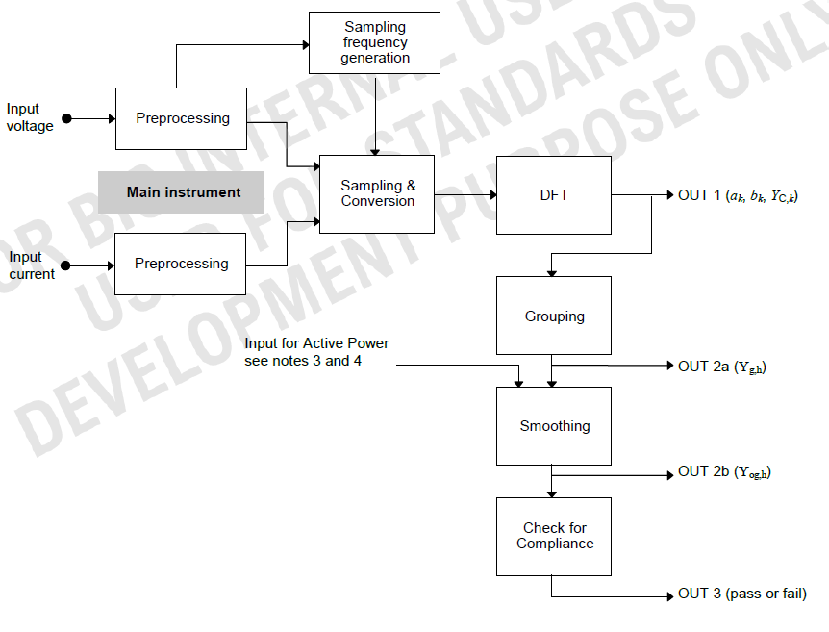
Fig: General structure of the measuring instrument

Slide 67
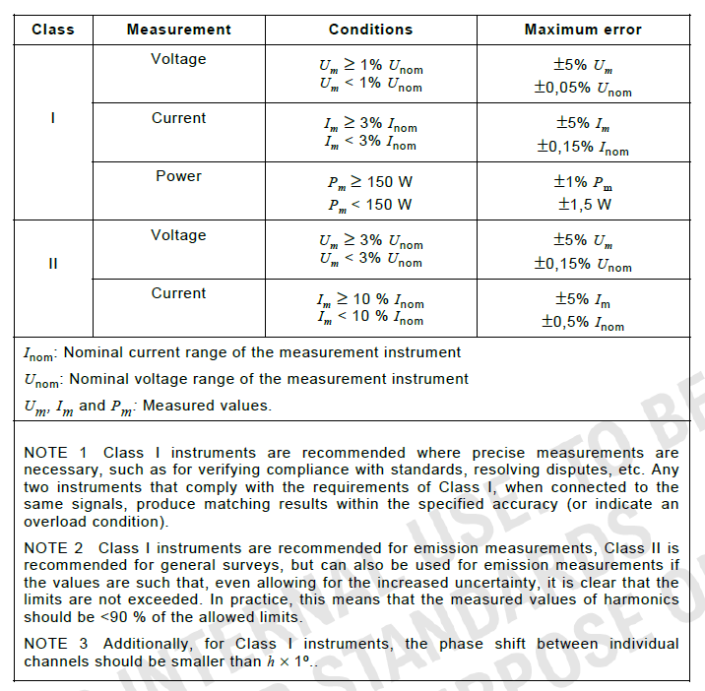
Fig: The maximum permissible errors for current, voltage and power measurements for both classes are defined in this table. This table is vital for understanding the acceptable tolerances for instruments used in harmonic assessments.

Slide 68
HARMONIC & INTERHARMONIC CURRENT MEASUREMENT (CONTD..)
Phase shift between individual channels should be smaller than h × 1° for Class I instruments, where 'h' is the harmonic order.
The accuracy requirements apply only to harmonic components for instruments specifically designed to measure harmonics.
Manufacturers may allow for some instrument adjustments using internal or external calibrators to achieve the stated accuracy.
Manufacturers should clearly specify the rated operating conditions and the potential errors introduced by variations in temperature, humidity, supply voltage, and other environmental factors.

Slide 69
HARMONIC & INTERHARMONIC CURRENT MEASUREMENT (CONTD..)
Emission Assessment:
Measurement points: The standard clearly defines the measurement points for both voltage and current. Voltage (U) is measured at the terminals of the equipment under test (EUT). Current is measured in series with the EUT, typically using current transformers or shunts.

Slide 70
HARMONIC & INTERHARMONIC CURRENT MEASUREMENT (CONTD..)
Single-Phase Setup: This setup is relatively straightforward, with the instrument connected between the line and neutral conductors.

Slide 71
HARMONIC & INTERHARMONIC CURRENT MEASUREMENT (CONTD..)
Three-Phase Setup: This setup is more complex, with the instrument potentially connected in a line-to-neutral or line-to-line configuration.

Slide 72
HARMONIC & INTERHARMONIC CURRENT MEASUREMENT (CONTD..)
Artificial Neutral: The standard acknowledges that a neutral conductor might not always be available, particularly in three-phase delta connections. In such cases, it permits using an artificial neutral point created using three matched resistors.
Voltage Drop: The voltage drop (ΔU) across the current sensing part and wiring should be minimized. For instance, the standard specifies a maximum peak voltage drop of 0.5 V during testing.
Supply Voltage Requirements: The standard outlines specific requirements for the test voltage (U) at the EUT terminals to ensure consistent and reliable test conditions.

Slide 73
IMMUNITY TO DISRUPTIONS
IS 14700 (Part 4/Sec 11) : 2021, an adoption of the international standard IEC 61000-4-16:2020 defines testing methods to determine the immunity of electrical and electronic equipment to disruptions in the power supply. These disruptions, including voltage dips, short interruptions, and voltage variations, are simulated under controlled conditions using a test generator.
The document specifies preferred test levels and durations for different classes of equipment and provides guidelines for evaluating their performance. The testing focuses on equipment with an input current of up to 16 A per phase, operating on 50 Hz or 60 Hz AC networks.
This standard aims to provide consistent evaluation methods for the immunity of electrical and electronic equipment. Test results are categorized based on the equipment's performance during and after the simulated power disturbances.

Slide 74
IMMUNITY TO DISRUPTIONS (CONTD..)
This standard defines testing methods to evaluate the immunity of electrical and electronic equipment connected to low-voltage power supply networks. Specifically, this standard addresses immunity to:
Voltage dips: Sudden reductions of voltage followed by recovery after a short time. These are often caused by faults or sudden load changes in the power network.
Short interruptions: Complete drops in voltage on all phases, followed by restoration after a short period. This typically occurs due to switchgear operations related to short circuits.
Voltage variations: Gradual, defined transitions between the rated voltage and a changed voltage, often caused by load changes (this test is optional).

Slide 75
IMMUNITY TO DISRUPTIONS (CONTD..)
The standard's primary purpose is to establish a common reference for evaluating how well equipment withstands these voltage disturbances. It outlines preferred test levels and durations based on real-world occurrences and research, aiming to simulate these events realistically in a lab setting.
This standard is applicable to:
Equipment with a rated input current up to 16A per phase.
Equipment designed for 50 Hz or 60 Hz AC networks.

Slide 76
IMMUNITY TO DISRUPTIONS (CONTD..)
This standard is not applicable to:
Equipment designed for 400 Hz AC networks (though future IEC documents may address this).
Voltage fluctuation immunity tests (covered by IEC 61000-4-14).
While the standard defines test methods, it doesn't specify which test levels to apply to specific devices; instead IEC product committees determine which tests are relevant for their specific product categories.
They also define the appropriate test levels and durations based on the intended use environment of the product.

Slide 77
IMMUNITY TO DISRUPTIONS (CONTD..)
The standard provides guidance on:
Test levels and durations based on different electromagnetic environment classes (e.g., protected environments vs. industrial settings).
Test equipment specifications, including calibration and verification procedures, to ensure consistent and comparable results.
It is important to note that passing the tests in this standard does not guarantee immunity to all real-world voltage disturbances. The standard aims to provide a reasonable level of confidence based on typical occurrences.

Slide 78
IMMUNITY TO DISRUPTIONS (CONTD..)
Definitions and Characteristics of Voltage Disturbances:
Voltage Dip: A voltage dip is a sudden decrease in voltage at a specific point in an electrical system, dropping below a defined threshold, followed by a quick recovery back to the normal voltage level.
Characteristics:
Residual Voltage: This is the lowest RMS voltage value recorded during the dip. It can be expressed in volts or as a percentage of the rated voltage (UT).
Duration: The length of time the voltage remains below the dip threshold.
Phase Angle: The point in the AC cycle where the voltage dip begins. This can significantly impact the severity of the disturbance.
Typical Causes: Short circuits, faults in the power network, or sudden large increases in load.

Slide 79
IMMUNITY TO DISRUPTIONS (CONTD..)
Short Interruption: A short interruption is similar to a voltage dip but involves a complete drop in voltage to almost zero on all phases. Essentially, it's a very deep voltage dip.
Characteristics:
Duration: The length of time the voltage remains below the interruption threshold (which is typically much lower than the dip threshold).
Typical Causes: Switchgear operations responding to short circuits or faults in the power network.

Slide 80
IMMUNITY TO DISRUPTIONS (CONTD..)
Voltage Variations: These are defined changes in voltage that involve a transition between the rated voltage and a changed voltage level. Unlike the abrupt changes of dips and interruptions, voltage variations involve a specified rate of change.
Characteristics:
Rate of Change: The speed at which the voltage decreases or increases, ideally constant but can be stepped (steps should be at zero crossings).
Duration: This includes the time for the voltage to decrease (td), the time spent at the reduced voltage (ts), and the time for it to increase back (ti).
Typical Causes: Continuously changing loads connected to the network, such as a motor starting.

Slide 81
IMMUNITY TO DISRUPTIONS (CONTD..)
Key Points to Note:
These disturbances are random events, but they can be characterized and simulated in a lab environment for testing purposes.
The standard provides preferred test levels and durations based on real-world data and experience. However, passing these tests doesn't guarantee immunity to all possible events.
Product committees or specific product standards determine which tests are most relevant and the appropriate severity levels.

Slide 82
IMMUNITY TO DISRUPTIONS (CONTD..)
Preferred Test Levels, Durations, and Procedures in IS 14700 (Part 4/Sec 11):
This standard focuses on evaluating the immunity of equipment to voltage dips, short interruptions, and (optionally) voltage variations. Here's a breakdown of the preferred test levels, durations, and procedures:
Voltage Dips
Test Levels (Residual Voltage): 0%, 40%, 70%, and 80% of the rated voltage (UT).
Durations: The preferred durations vary depending on the electromagnetic environment class:
Class 1: Defined on a case-by-case basis.
Class 2: 0% for ½ cycle, 0% for 1 cycle, 70% for 25/30 cycles (25 cycles for 50 Hz, 30 for 60 Hz).
Class 3: Same as Class 2, with the addition of 40% for 10/12 cycles and 80% for 250/300 cycles.
Class X: To be defined by the specific product committee. Equipment connected to the public network should be tested at least at Class 2 levels.

Slide 83
IMMUNITY TO DISRUPTIONS (CONTD..)
Procedure:
Subject the EUT to three dips in a row for each test level and duration combination, with at least a 10-second interval between each dip.
Dips should occur at the zero crossings of the voltage waveform, as well as at additional angles considered critical (e.g., 45°, 90°, 135°).
For three-phase systems:
Test each phase-to-neutral and phase-to-phase voltage individually.
This means six different test series for systems with a neutral and three for systems without.
For EUTs with multiple power cords, test each cord separately.

Slide 84
IMMUNITY TO DISRUPTIONS (CONTD..)
Short Interruptions:
Test Levels: 0% of UT (a complete voltage interruption). A test level of 0% to 20% UT can be considered a total interruption in practice.
Durations:
Class 1: Case-by-case.
Class 2: 0% for 250/300 cycles.
Class 3: Same as Class 2.
Class X: Product committee defined, with a minimum severity of Class 2 for public network equipment.

Slide 85
IMMUNITY TO DISRUPTIONS (CONTD..)
Procedure:
Similar to voltage dips: three interruptions with 10-second intervals, testing all representative operating modes.
Interruptions should occur at the worst-case phase angle, as defined by the product committee. If undefined, 0° for one phase is recommended.
For three-phase systems, test all three phases simultaneously.

Slide 86
IMMUNITY TO DISRUPTIONS (CONTD..)
Voltage Variations (Optional):
Test Level: 70% of UT.
Duration:
Time for decreasing voltage (td): Abrupt (as per Table 3).

Slide 87
IMMUNITY TO DISRUPTIONS (CONTD..)
Duration (Contd..):
Time at reduced voltage (ts): 1 cycle.
Time for increasing voltage (ti): 25/30 cycles.
Procedure:
Subject the EUT to the specified voltage variation three times with 10-second intervals.
Test in the most representative operating modes.

Slide 88
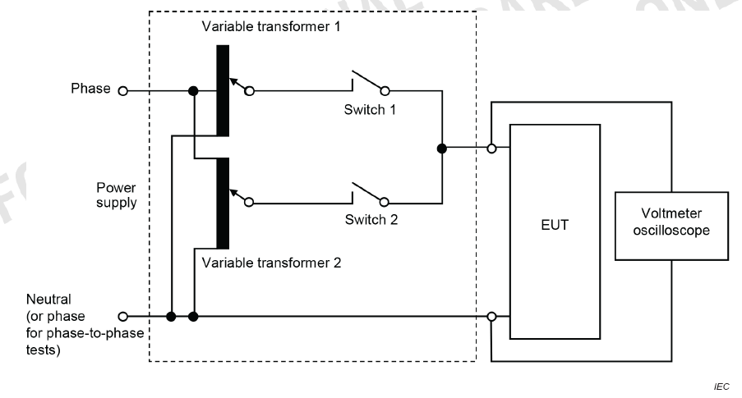
Fig: Schematic Of Test Instrumentation For Voltage Dips, Short Interruptions And Voltage Variations Using Variable Transformer And Switches

Slide 89
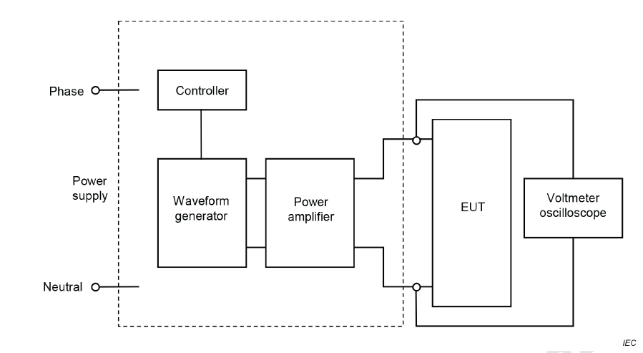
Fig: Schematic Of Test Instrumentation For Voltage Dips, Short Interruptions And Voltage Variations Using A Power Amplifier

Slide 90
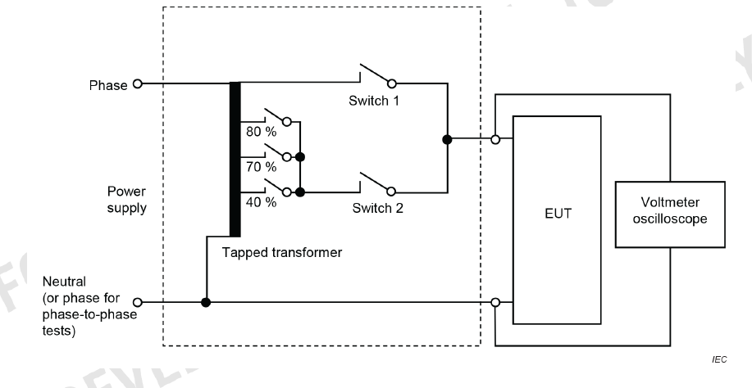
Fig: Schematic Of Test Instrumentation For Voltage Dips, Short Interruptions And Voltage Variations Using A Tapped Transformer And Switches

Slide 91
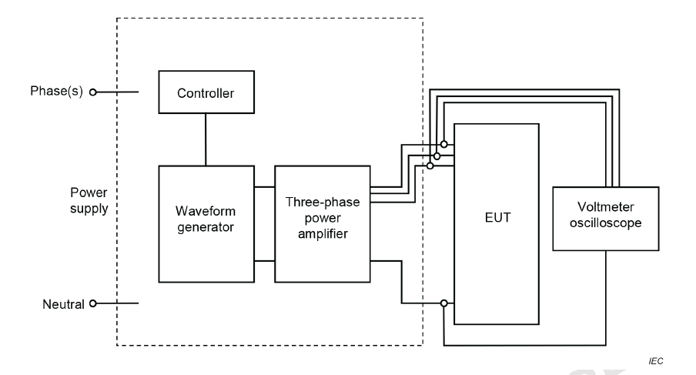
Fig: Schematic Of Test Instrumentation For Three Phase For Voltage Dips, Short Interruptions And Voltage Variations Using A Power Amplifier

Slide 92
IMMUNITY TO DISRUPTIONS (CONTD..)
Additional Points:
The standard suggests shorter durations (particularly the half-cycle) should be tested to ensure the EUT operates within its performance limits.
The voltage change in dips and short interruptions should be abrupt. The voltage change can begin at any point (phase angle) in the mains voltage cycle..
The rise and fall times of the voltage change are defined for the test generator, not the EUT, and should be between 1 µs and 5 µs when tested with a 100 Ω resistive load.
The selection of specific test levels and durations for a particular device depends on factors such as the intended electromagnetic environment, the criticality of the equipment's function, and relevant product standards..
While the standard provides guidance, passing these tests does not guarantee immunity to all possible real-world voltage disturbances.

Slide 93
MEASUREMENT METHODS FOR HIGH POWER TRANSIENT PARAMETERS
IS 14700 (Part 4/Sec 33) : 2018 is the Indian adoption of the international standard IEC 61000-4-33 : 2005, which defines measurement methods for high-power transient parameters related to electromagnetic compatibility (EMC).
The document provides an overview of measurement techniques, equipment, and data analysis for characterizing transient responses, with a particular focus on high-power electromagnetic (HPEM) events. It outlines the use of sensors, baluns, attenuators, integrators, and recording devices in a measurement chain, emphasizing the importance of calibration, noise reduction and minimizing signal perturbation.
It discusses the use of waveform parameters and norms to interpret transient responses, highlighting their significance in assessing potential impacts on electrical systems.

Slide 94
MEASUREMENT METHODS FOR HIGH POWER TRANSIENT PARAMETERS (CONTD..)
Key Components and Principles of High-Power Transient Parameter Measurement :
Measurement Chain
High-power transient parameter measurement relies on a carefully constructed measurement chain that detects, processes, transmits and records transient responses. The major elements of this chain include:
Sensor: This device converts the measured quantity (e.g., EM field component, current, or charge) into a voltage.
Transmission System: This system transports the measured voltage from the sensor to the recording equipment, typically using either coaxial cables or fiber optic links.
Detection (Digitization) System: This system, often a digital oscilloscope or waveform digitizer, converts the received voltage response into a digital format suitable for processing and storage.
Computer: This element controls the measurement process, performing data processing, storage, and analysis.

Slide 95
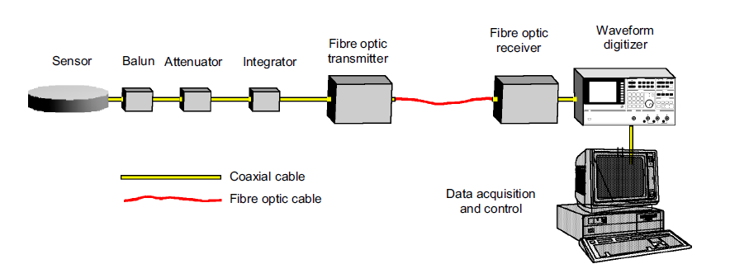
MEASUREMENT METHODS FOR HIGH POWER TRANSIENT PARAMETERS (CONTD..)
Key Components and Principles of High-Power Transient Parameter Measurement
Fig: Instrumentation Chain Using A Coaxial Cable And Fibre Optics

Slide 96
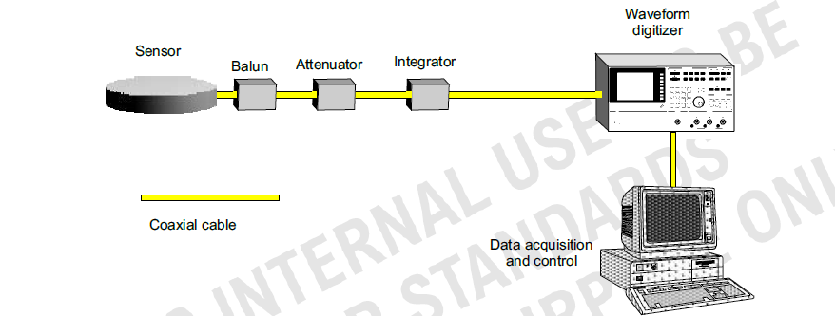
MEASUREMENT METHODS FOR HIGH POWER TRANSIENT PARAMETERS (CONTD..)
Fig: Instrumentation Chain With Only Coaxial Signal Lines

Slide 97
MEASUREMENT METHODS FOR HIGH POWER TRANSIENT PARAMETERS (CONTD..)
Sensor Types:
Various sensors are used in high-power transient measurements, and they are broadly categorized based on their output response relative to the measured quantity:
Proportional Sensors: These sensors produce an output directly proportional to the excitation quantity (e.g., the electric field).
Differentiating Sensors: The output of these sensors is proportional to the time rate of change (i.e., the derivative) of the measured quantity. For instance, a D-dot sensor's output is proportional to the rate of rise of the electric displacement vector (D) or the electric field (E).

Slide 98
MEASUREMENT METHODS FOR HIGH POWER TRANSIENT PARAMETERS (CONTD..)
Calibration:
Accurate calibration of the measurement chain is crucial for reliable high-power transient parameter measurement. Calibration can be performed on the entire chain as a single unit or individually for each component.
Direct Calibration: This method involves placing the sensor in a known electromagnetic field environment and recording the detector's reading. Test chambers like TEM cells are often used to create these controlled environments.
Relative Calibration: Two measurement chains are used in this approach, with their sensors positioned close together to measure the same EM field environment. The ratio of their responses is then used to calibrate the chain.
Component-Level Calibration: This approach involves characterizing the electrical behavior of each component in the chain. The individual calibration factors are then combined to derive the overall calibration function for the entire chain. This can be achieved using techniques like circuit modeling and S-parameter measurements.

Slide 99
MEASUREMENT METHODS FOR HIGH POWER TRANSIENT PARAMETERS (CONTD..)
Electromagnetic (EM) sensors form the foundation of HPEM measurements. These sensors act as antennas operating below their resonant frequency, converting the measured EM field component, current, or charge into a measurable voltage.
Data Acquisition and Processing
Digital oscilloscopes or waveform digitizers are commonly used to capture HPEM waveforms.
The measured waveform, a complex function of time, is characterized using:
Waveform parameters: Immediately evident from the response, such as peak value, rise time, pulse width, and maximum rate of rise.
Waveform norms: Mathematically defined scalar parameters requiring numerical processing of the waveform, such as energy contained in the waveform.
Frequency spectrum: Provides insights into the frequency content of the transient response, often analyzed using Fourier transforms.

Slide 100
MEASUREMENT METHODS FOR HIGH POWER TRANSIENT PARAMETERS (CONTD..)
Addressing Measurement Challenges:
Minimizing Measurement System Influence:
Sensor Perturbation: Sensors inherently perturb the EM field they measure, necessitating calibration to account for this.
Measurement Chain Loading: The measurement chain can impact the system being measured, highlighting the need for careful design and calibration.
Cable Interference: Cables connecting sensors to equipment can perturb the measured field. Using surface-mounted sensors with cables routed beneath ground planes minimizes this impact.

Slide 101
MEASUREMENT METHODS FOR HIGH POWER TRANSIENT PARAMETERS (CONTD..)
Calibration and Signal Correction:
Calibration Chain: Characterizing each element (sensor, attenuator, filter, etc.) independently allows for a comprehensive calibration of the entire measurement chain.
Transfer Function: Determining the transfer function of each element enables accurate signal correction by accounting for frequency-dependent attenuation and phase shifts.
Specialized Sensors and Applications:
Ground Plane Sensors: Specifically designed for measurements near conductors, these sensors utilize image theory to determine electric field or magnetic field components based on surface charge density or surface current density, respectively.
Active Sensors: Equipped with internal electronics for signal processing, active sensors offer enhanced sensitivity and noise characteristics. However, they require external power supplies.
Low-Frequency Measurements: For low-frequency signals, techniques commonly used for quasi-dc measurements are employed, such as low-resistance sense resistors for current, voltage dividers for voltage, and Hall-effect sensors for magnetic fields.

Slide 102
IMMUNITY REQUIREMENTS FOR RESIDENTIAL, COMMERCIAL AND LIGHT-INDUSTRIAL ENVIRONMENTS
IS 14700 (Part 6/Sec 1): 2019 is the Indian adoption of IEC 61000-6-1: 2016, an international standard defining electromagnetic compatibility (EMC) immunity requirements. This standard applies to electrical and electronic equipment used in residential, commercial, public, and light-industrial settings.
It outlines acceptable immunity levels for equipment against continuous and transient, conducted and radiated electromagnetic disturbances, including electrostatic discharges, within the frequency range of 0 Hz to 400 GHz.
The document further lists specific testing procedures and performance criteria for different equipment ports, emphasizing the importance of proper testing and documentation to ensure adequate immunity levels in various environments.
Importantly, the standard highlights that these requirements represent a minimum benchmark, and additional tests may be necessary based on specific product types, environmental considerations, and anticipated future electromagnetic phenomena.

Slide 103
IMMUNITY REQUIREMENTS FOR RESIDENTIAL, COMMERCIAL AND LIGHT-INDUSTRIAL ENVIRONMENTS (CONTD..)
These standards apply to equipment used in:
Indoor and outdoor residential locations, where equipment is connected to a low-voltage public mains network or a dedicated DC source connected to the mains. Examples include houses and apartments.
Indoor and outdoor commercial, public, and light industrial locations, where equipment is connected similarly. Examples include shops, offices, hospitals, and workshops.
These standards also apply to equipment powered by batteries or non-public, non-industrial low-voltage power distribution systems if used in the locations mentioned above.

Slide 104
IMMUNITY REQUIREMENTS FOR RESIDENTIAL, COMMERCIAL AND LIGHT-INDUSTRIAL ENVIRONMENTS (CONTD..)
The standards define immunity test requirements for:
Continuous and transient disturbances
Conducted and radiated disturbances
Electrostatic discharges
The standards emphasize that:
The levels do not cover extreme cases, which have a low probability of occurrence.
Only disturbances relevant to the covered equipment are included for testing.
Safety considerations are not included.

Slide 105
IMMUNITY REQUIREMENTS FOR RESIDENTIAL, COMMERCIAL AND LIGHT-INDUSTRIAL ENVIRONMENTS (CONTD..)
The immunity test requirements are outlined on a 'port-by-port' basis for the following:
Enclosure port : The data is given in Table 1.
Signal/control ports : The data is given in Table 2.
Input and output DC power ports : The data is given in Table 3.
Input and output AC power ports : The data is given in Table 4.

Slide 106
IMMUNITY REQUIREMENTS FOR RESIDENTIAL, COMMERCIAL AND LIGHT-INDUSTRIAL ENVIRONMENTS (CONTD..)
Performance Criteria:
Performance criterion A: The EUT shall continue to operate as intended during and after the test. No degradation of performance or loss of function is allowed below a performance level specified by the manufacturer, when the EUT is used as intended. If the performance level is not specified by the manufacturer, this may be derived from the product description and documentation and what the user may reasonably expect from the equipment if used as intended.
Performance criterion B: The EUT shall continue to operate as intended after the test. No degradation of performance or loss of function is allowed below a performance level specified by the manufacturer, when the EUT is used as intended. The performance level may be replaced by a permissible loss of performance. However, during the test degradation of performance is allowed but no change of actual operating state or stored data is allowed. If the minimum performance level or the permissible performance loss is not specified by the manufacturer, either of these may be derived from the product description and documentation and what the user may reasonably expect from the equipment if used as intended.

Slide 107
IMMUNITY REQUIREMENTS FOR RESIDENTIAL, COMMERCIAL AND LIGHT-INDUSTRIAL ENVIRONMENTS (CONTD..)
Performance Criteria:
Performance criterion C: Temporary loss of function is allowed during the test, provided the function is self-recoverable or can be restored by the operation of the controls. If, as a result of the application of the tests defined in this standard, the EUT becomes dangerous or unsafe, it shall be deemed to have failed the test.

Slide 108
EMISSION REQUIREMENTS FOR RESIDENTIAL, COMMERCIAL AND LIGHT-INDUSTRIAL ENVIRONMENTS
IS 14700 (Part 6/Sec 3): 2023, identical to IEC 61000-6-3: 2020, is an Indian Standard outlining electromagnetic emission limits for electrical and electronic equipment used in residential settings.
This standard, a second revision aligned with the latest international version, aims to ensure that such equipment does not interfere with radio reception.
The document specifies testing methodologies and requirements for various equipment classifications, encompassing conducted and radiated emissions across a wide frequency spectrum.

Slide 109
EMISSION REQUIREMENTS FOR RESIDENTIAL, COMMERCIAL AND LIGHT-INDUSTRIAL ENVIRONMENTS (CONTD..)
Key electromagnetic compatibility requirements for residential electronic equipment :
Applicability: The standard applies to all electrical and electronic equipment intended for use in residential locations, defined as domestic dwellings directly connected to the low-voltage public mains network. This encompasses houses, apartments, and similar dwellings where radio receivers might operate within 10 meters of the equipment.
Objective: The standard aims to ensure that equipment used in residential environments does not emit excessive electromagnetic disturbances that could interfere with radio reception.
Scope: The standard primarily focuses on conducted and radiated emissions within the frequency range of up to 400 GHz.
Exclusions: The standard does not cover intentional transmissions from radio transmitters as defined by the ITU or disturbances arising from equipment faults.
Classification: The standard doesn't explicitly use classifications like Class A or Class B, but the limits and requirements align with those concepts.

Slide 110
EMISSION REQUIREMENTS FOR RESIDENTIAL, COMMERCIAL AND LIGHT-INDUSTRIAL ENVIRONMENTS (CONTD..)
Testing: Equipment is evaluated based on its intended use and operational configuration. The standard mandates testing across various ports:
Enclosure Port (Radiated Emissions): Testing is conducted in various facilities, including Open Area Test Sites (OATS), Semi-Anechoic Chambers (SAC), Transverse Electromagnetic (TEM) cells, and Fully Anechoic Rooms (FAR), with specific limits based on frequency and distance (please refer Table 3).
Low Voltage AC Mains Port (Conducted Emissions): The standard mandates compliance with the harmonic requirements of IEC 61000-3-2 or IEC 61000-3-12 and flicker requirements of IEC 61000-3-3 or IEC 61000-3-11, along with specific limits using a V-AMN network (please refer Table 4).
DC Power Port (Conducted Emissions): The standard outlines detailed requirements based on the type of DC power source and cable length, with limits defined for both V-AN and Δ-AN networks (please refer Table 5).
Other Wired Ports (Conducted Emissions): This includes wired network ports, optical fibre ports with metallic shielding, broadcast receiver tuner ports, and antenna ports, with limits derived from CISPR 32 (please refer Table 6).
Notes:
CISPR: The Comité International Spécial des Perturbations Radioélectriques (CISPR; English: International Special Committee on Radio Interference) was founded in 1934 to set standards for controlling electromagnetic interference in electrical and electronic devices and is a part of the International Electrotechnical Commission (IEC). CISPR's standards cover the measurement of radiated and conducted interference and immunity for some products. CISPR 14-1 and 14-2 related to EMC focus on requirements for household appliances, electric tools, and similar apparatus and their immunity - product family standard. CISPR 32 pertains to emission requirements for electromagnetic compatibility of multimedia equipment.

Slide 111
EMISSION REQUIREMENTS FOR RESIDENTIAL, COMMERCIAL AND LIGHT-INDUSTRIAL ENVIRONMENTS (CONTD..)
Determining And Applying Emission Limits For Electronic Devices:
The specific limits and how they're applied depend on several factors:
Type of Emission: The standard distinguishes between radiated emissions, emanating from the device's enclosure, and conducted emissions, traveling through its power and data ports.
Port: Different ports have different emission limits based on their function and potential for interference. The standard defines limits for the enclosure port, low voltage AC mains port, DC power port, and other wired ports like network and antenna ports.
Frequency: Emission limits are frequency-dependent, acknowledging that different frequency ranges are used by various radio services. The limits generally become stricter at higher frequencies.
Measurement Distance: For radiated emissions, the limits are specified at a reference distance (e.g., 3m or 10m). If measurements are taken at a different distance, the limits are adjusted using a logarithmic formula to account for signal strength variations.

Slide 112
EMISSION REQUIREMENTS FOR RESIDENTIAL, COMMERCIAL AND LIGHT-INDUSTRIAL ENVIRONMENTS (CONTD..)
Test Facility: The standard acknowledges that the test environment can influence measurements. Different limits may apply depending on whether the testing is conducted in an Open Area Test Site (OATS), Semi-Anechoic Chamber (SAC), Transverse Electromagnetic (TEM) cell, or Fully Anechoic Room (FAR).
Device Classification: While not explicitly using terms like "Class A" or "Class B," the standard's limits and requirements are designed to address the varying emission characteristics of different equipment types, similar to how those classifications are used in other standards.
The standard emphasizes a performance-based approach, focusing on the actual emissions of the device rather than dictating specific design features.

Slide 113
EMISSION REQUIREMENTS FOR RESIDENTIAL, COMMERCIAL AND LIGHT-INDUSTRIAL ENVIRONMENTS (CONTD..)
Considerations for Testing and Documenting Electromagnetic Emissions :
Planning and Preparation:
Applicable Standards: All relevant EMC standards based on the equipment's intended use (residential, commercial, industrial) and the target markets where it will be sold must be identified. This includes considering both generic standards (like IS 14700 (Part 6/Sec 3): 2023, which focuses on residential environments) and any specific product family standards.
Equipment Classification: The appropriate classification for the equipment based on its intended use and emission characteristics must be determined. While IS 14700 doesn't explicitly use terms like "Class A" or "Class B," the limits and requirements align with these classifications used in other standards. This helps determine the applicable limits and test procedures.
Test Plan: A comprehensive test plan outlining the scope, objectives, test methods, equipment configuration, operating modes, test environment, measurement procedures, and documentation requirements must be developed. This plan ensures all necessary aspects of testing are addressed and documented.

Slide 114
EMISSION REQUIREMENTS FOR RESIDENTIAL, COMMERCIAL AND LIGHT-INDUSTRIAL ENVIRONMENTS (CONTD..)
Equipment Configuration and Operation:
Representative Configuration: The equipment must be tested in a configuration that accurately reflects its typical use and installation. If the device is part of a larger system, it will be connected to the minimum representative configuration of associated equipment needed to exercise its ports and functionalities.
Worst-Case Operation: The equipment will be operated in a way that produces the highest emissions in each frequency band being assessed. This may involve varying the configuration, selecting specific operating modes, or using specific functions to ensure worst-case emissions are captured.
External Mitigation Measures: If the equipment instructions require external filtering, shielding, or other mitigation measures to meet the emission limits, the implementation of these measures are during testing must be ensured.

Slide 115
EMISSION REQUIREMENTS FOR RESIDENTIAL, COMMERCIAL AND LIGHT-INDUSTRIAL ENVIRONMENTS (CONTD..)
Measurement Procedures and Environment:
Test Facility Selection: A test facility appropriate for the type of measurements being conducted (radiated or conducted) and the frequency range under evaluation must be chosen. This includes considering the advantages and limitations of different test environments like OATS, SAC, TEM cells, and FARs.
Measurement Distance: For radiated emissions, the correct measurement distance between the equipment under test and the receiving antenna as specified in the standard must be maintained. If a different distance is used, apply the appropriate correction factors to the measured values.
Artificial Networks: For conducted emissions testing, the correct artificial network (e.g., V-AMN, Δ-AN) with the appropriate impedance and characteristics as specified in the standard for the specific port under test must be used.

Slide 116
EMISSION REQUIREMENTS FOR RESIDENTIAL, COMMERCIAL AND LIGHT-INDUSTRIAL ENVIRONMENTS (CONTD..)
Detector Types: The specified detector types (quasi-peak, average, peak) for each measurement as defined in the standard must be utilized and the characteristics of each detector and how they influence the measured values must be understood.
Frequency Range: Measurements over the entire frequency range specified in the standard for each port and emission type must be conducted. Attention must be paid to transitional frequencies where lower limits might apply.
Ambient Conditions: Temperature, humidity and atmospheric pressure must be controlled and documented, as these can affect the equipment's emissions.

Slide 117
EMISSION REQUIREMENTS FOR RESIDENTIAL, COMMERCIAL AND LIGHT-INDUSTRIAL ENVIRONMENTS (CONTD..)
Documentation and Reporting:
Test Report: A detailed test report must be prepared documenting all aspects of the testing process, including:
Test plan and procedures
Equipment under test (EUT) details, including model number, serial number, and configuration
Test facility and equipment used, including calibration details
Measurement data, including raw data, corrected values, and comparisons to limits
Deviations from the standard, if any
Measurement uncertainty analysis
Conclusion regarding compliance with the standard

Slide 118
EMISSION REQUIREMENTS FOR RESIDENTIAL, COMMERCIAL AND LIGHT-INDUSTRIAL ENVIRONMENTS (CONTD..)
User Documentation: The equipment's instructions for use should clearly state that it complies with the relevant EMC requirements for its intended environment (e.g., residential location). Any specific instructions or precautions users need to take to ensure continued compliance, such as using shielded cables or maintaining adequate ventilation must be included.

Slide 119
EMISSION REQUIREMENTS FOR RESIDENTIAL, COMMERCIAL AND LIGHT-INDUSTRIAL ENVIRONMENTS (CONTD..)
Additional Considerations:
Measurement Uncertainty: Measurement uncertainty must be accounted for when determining compliance with the limits. The standard requires using CISPR 16-4-2 for calculating instrumentation uncertainty. If the uncertainty exceeds the defined limits, adjustments to the test results or further investigation may be necessary.
Pre-testing: Conducting pre-testing can help identify potential compliance issues early on, allowing for design modifications or adjustments to the test plan before formal testing.
Justification for Exclusions: If any tests defined in the standard are deemed not applicable to the specific equipment under test, the justification for these exclusions in the test report must be clearly documented .

Slide 120
FURTHER READING
Sl. No. | IS | TITLE
1. | IS 10052 (Part 1/Sec 1) : 2021 | Radio Disturbance and Immunity Measuring Apparatus and Methods Specification Part 1 Radio Disturbance and Immunity Measuring Apparatus Section 1 Measuring apparatus Third Revision
2. | IS 10052 (Part 1/Sec 4) : 2018 | Radio disturbance and immunity measuring apparatus and methods - Specification: Part 1 radio disturbance and immunity measuring apparatus: Sec 4 antennas and test sites for radiated disturbance measurements
3. | IS 12233 (Part 1) : 2018 | Radio interference characteristics of overhead power lines and high - Voltage equipment: Part 1 description of phenomena
4. | IS 12233 (Part 2) : 2021 | Radio Interference Characteristics Of Overhead Power Lines And High Voltage Equipment Part 2 Methods Of Measurement And Procedure For Determining Limits (First Revision)
5. | IS 12233 (Part 3) : 2019 | Radio Interference Characteristics of Overhead Power Lines and High-Voltage Equipment Part 3 Code of Practice for Minimizing the Generation of Radio Noise ( Second Revision)
6. | IS 13397 : 2018 | Consideration of reference impedances and public supply network impedances for use in determining the disturbance characteristics of electrical equipment having a rated current (less then) 75 A per phase (First Revision)

Slide 121
FURTHER READING (CONTD..)
Sl. No. | IS | TITLE
7. | IS 14700 (Part 1/Sec 1) : 2000 | Electromagnetic compatibility (EMC): Part 1 general: Sec 1 application and interpretation of fundamental definitions and terms
8. | IS 14700 (Part 3/Sec 2) : 2020 | Electromagnetic Compatibility (EMC) Part 3 Limits Section 2 Limits for harmonic current emissions ( equipment input current ? 16 A per phase ) ( Third Revision )
9. | IS 14700 (Part 3/Sec 3) : 2018 | Electromagnetic compatibility (EMC): Part 3 limits section 3 limitation of voltage changes, voltage fluctuations and flicker in public low-voltage supply system, for equipment with rated current ? 16 a per phase and not subjected to conditional connection (Second Revision)
10. | IS 14700 (Part 4/Sec 1) : 2019 | Electromagnetic compatibility (EMC): Part 4 testing and measurement techniques: Sec 1 overview of the IEC 61000 - 4 series (Second Revision)
11. | IS 14700 (Part 4/Sec 2) : 2018 | Electromagnetic compatibility (EMC): Part 4 testing and measurement techniques: Sec 2 electrostatic discharge immunity test (Second Revision)
12. | IS 14700 (Part 4/Sec 3) : 2023 | Electromagnetic compatibility EMC Part 4 Testing and Measurement Techniques Section 3 Radiated radio-frequency electromagnetic field immunity test Second Revision

Slide 122
FURTHER READING (CONTD..)
Sl. No. | IS | TITLE
13. | IS 14700 (Part 4/Sec 4) : 2018 | Electromagnetic compatibility (EMC): Part 4 testing and measurement techniques: Sec 4 electrical fast transient / burst immunity test (Second Revision)
14 | IS 14700 (Part 4/Sec 5) : 2019 | Electromagnetic compatibility (EMC): Part 4 testing and measurement techniques: Sec 5 surge immunity test (First Revision)
15. | IS 14700 (Part 4/Sec 6) : 2016 | Electromagnetic compatibility (EMC): Part 4 testing and measurement techniques: Sec 6 immunity to conducted disturbances, induced by radio - Frequency fields
16. | IS 14700 (Part 4/Sec 7) : 2017 | Electromagnetic compatibility (EMC): Part 4 testing and measurement techniques: Sec 7 general guide on harmonic and interharmonics measurements and instrumentation, for power supply systems and equipment eonnected thereto (First Revision)
17. | IS 14700 (Part 4/Sec 8) : 2018 | Electromagnetic compatibility (EMC): Part 4 testing and measurement techniques: Sec 8 power frequency magnetic field immunity test (Second Revision)
18. | IS 14700 (Part 4/Sec 9) : 2019 | Electromagnetic compatibility (EMC): Part 4 testing and measurement techniques: Sec 9 impulse magnetic field immunity test (Second Revision)

Slide 123
FURTHER READING (CONTD..)
Sl. No. | IS | TITLE
19. | IS 14700 (Part 4/Sec 11) : 2021 | Electromagnetic compatibility EMC: Part 4 testing and measurement techniques: Sec 11 voltage dips short interruptions and voltage variations immunity tests for equipment with input current up to 16 A per phase
20. | IS 14700 (Part 4/Sec 12) : 2019 | Electromagnetic compatibility (EMC): Part 4 testing and measurement techniques: Sec 12 ring wave immunity test (Second Revision)
21. | IS 14700 (Part 4/Sec 13) : 2016 | Electromagnetic compatibility (EMC): Part 4 testing and measurement techniques: Sec 13 harmonics and interharmonics including mains signaling at a.c. power port, low frequency immunity test
22. | IS 14700 (Part 4/Sec 14) : 2018 | Electromagnetic compatibility (EMC): Part 4 testing and measurement techniques: Sec 14 voltage fluctuation immunity test for equipment with input current not exceeding 16 A per phase
23. | IS 14700 (Part 4/Sec 15) : 2018 | Electromagnetic compatibility (EMC): Part 4 testing and measurement techniques: Sec 15 flickermeter - Functional and design specifications (Second Revision)
24. | IS 14700 (Part 4/Sec 16) : 2019 | Electromagnetic compatibility (EMC): Part 4 testing and measurement techniques: Sec 16 test for immunity to conducted, common mode disturbances in the frequency range 0 hz to 150 kHz (Second Revision)

Slide 124
FURTHER READING (CONTD..)
Sl. No. | IS | TITLE
25.. | IS 14700 (Part 4/Sec 17) : 2018 | Electromagnetic Compatiblity (EMC) Part 4 Testing & Measurement Techniques Section 17 Ripple on d.c input Power Port Immunity Test
26. | IS 14700 (Part 4/Sec 24) : 2018 | Electromagnetic compatibility (EMC): Part 4 testing and measurement techniques: Sec 24 test methods for protective devices for HEMP conducted disturbance (First Revision)
27. | IS 14700 (Part 4/Sec 25) : 2018 | Electromagnetic compatibility (EMC): Part 4 testing and measurement techniques: Sec 25 HEMP immunity test methods for equipment and systems
28. | IS 14700 (Part 4/Sec 32) : 2018 | Electromagnetic compatibility (EMC): Part 4 testing and measurement techniques: Sec 32 high - Altitude electromagnetic pulse (HEMP) simulator compendium
29. | IS 14700 (Part 4/Sec 33) : 2018 | Electromagnetic compatibility (EMC): Part 4 testing and measurement techniques: Sec 33 measurement methods for high - Power transient parameters
30. | IS 14700 (Part 4/Sec 34) : 2017 | Electromagnetic compatibility (EMC): Part 4 testing and measurement techniques: Sec 34 voltage dips, short interruptions and voltage variations immunity tests for current more than 16 A per phase

Slide 125
FURTHER READING (CONTD..)
Sl. No. | IS | TITLE
31. | IS 14700 (Part 4/Sec 35) : 2018 | Electromagnetic Compatibility (EMC) Part 4 Testing & Measurement Techniques Section 35 HPEM Simulator Compendium
32. | IS 14700 (Part 6/Sec 1) : 2019 | Electromagnetic Compatibility ( EMC ) Part 6 Generic Standards Section 1 Immunity standard for residential, commercial and light-industrial environments ( First Revision )
33. | IS 14700 (Part 6/Sec 2) : 2019 | Electromagnetic Compatibility ( EMC ) Part 6 Generic Standards Section 2 Immunity standard for industrial environments ( First Revision )
34. | IS 14700 (Part 6/Sec 3) : 2023 | Electromagnetic compatibility EMC Part 6 Generic standards Section 3 Emission standard for equipment in residential environments Second Revision

Slide 126
Thank You

