Slide 1
Coding of Audio-Visual Objects: JPEG, MPEG & JVET
Understanding Importance of Standards

Slide 2
Contents
Recalling concepts, you are aware of:
Digital Image Processing
Digital Audio Processing
Video Processing
Audio Visual Coding – Importance of Standards
Introduction to JPEG Standard
Introduction to MPEG Standard
Introduction to JVET
List of some important Standards

Slide 3
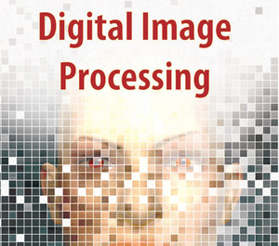

Slide 4
Concepts you study..
What is a digital image?
What is digital image processing?
History of digital image processing
State of the art examples of digital image processing
Key stages in digital image processing
Face detection

Slide 5
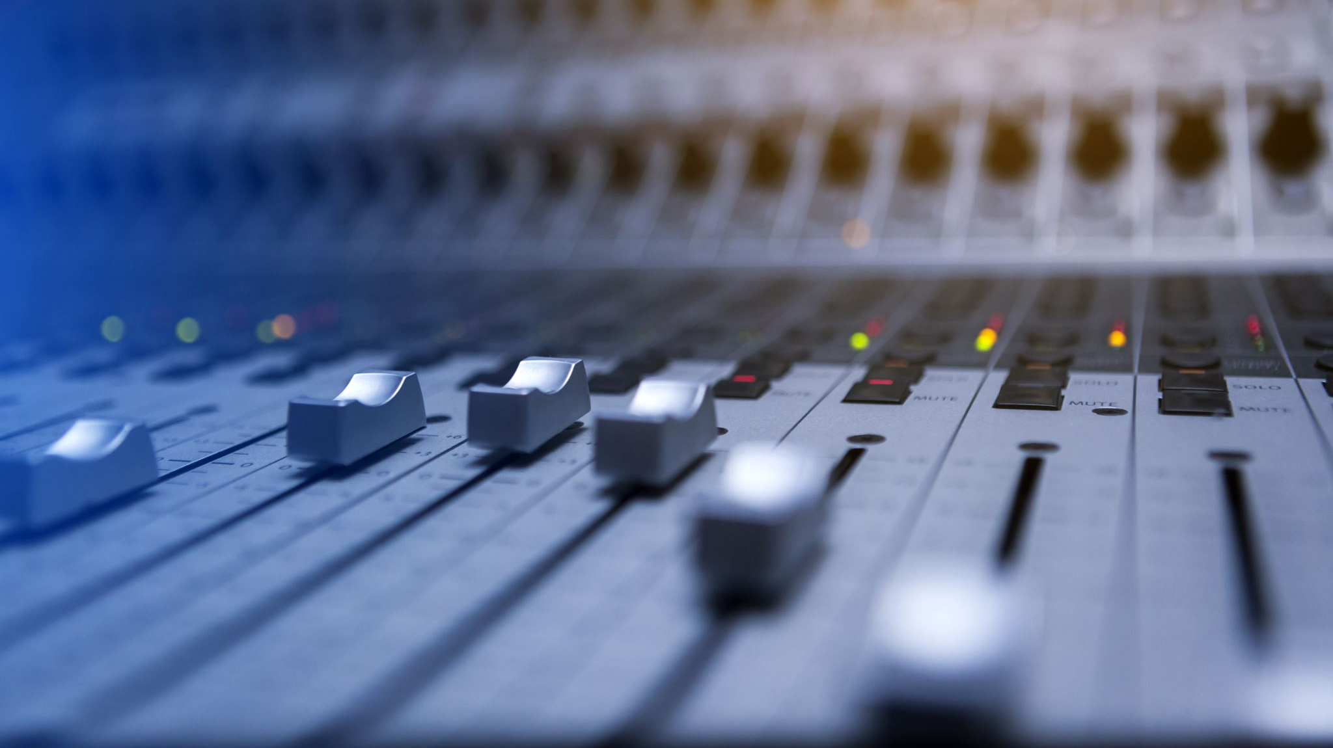
AUDIO PROCESSING

Slide 6
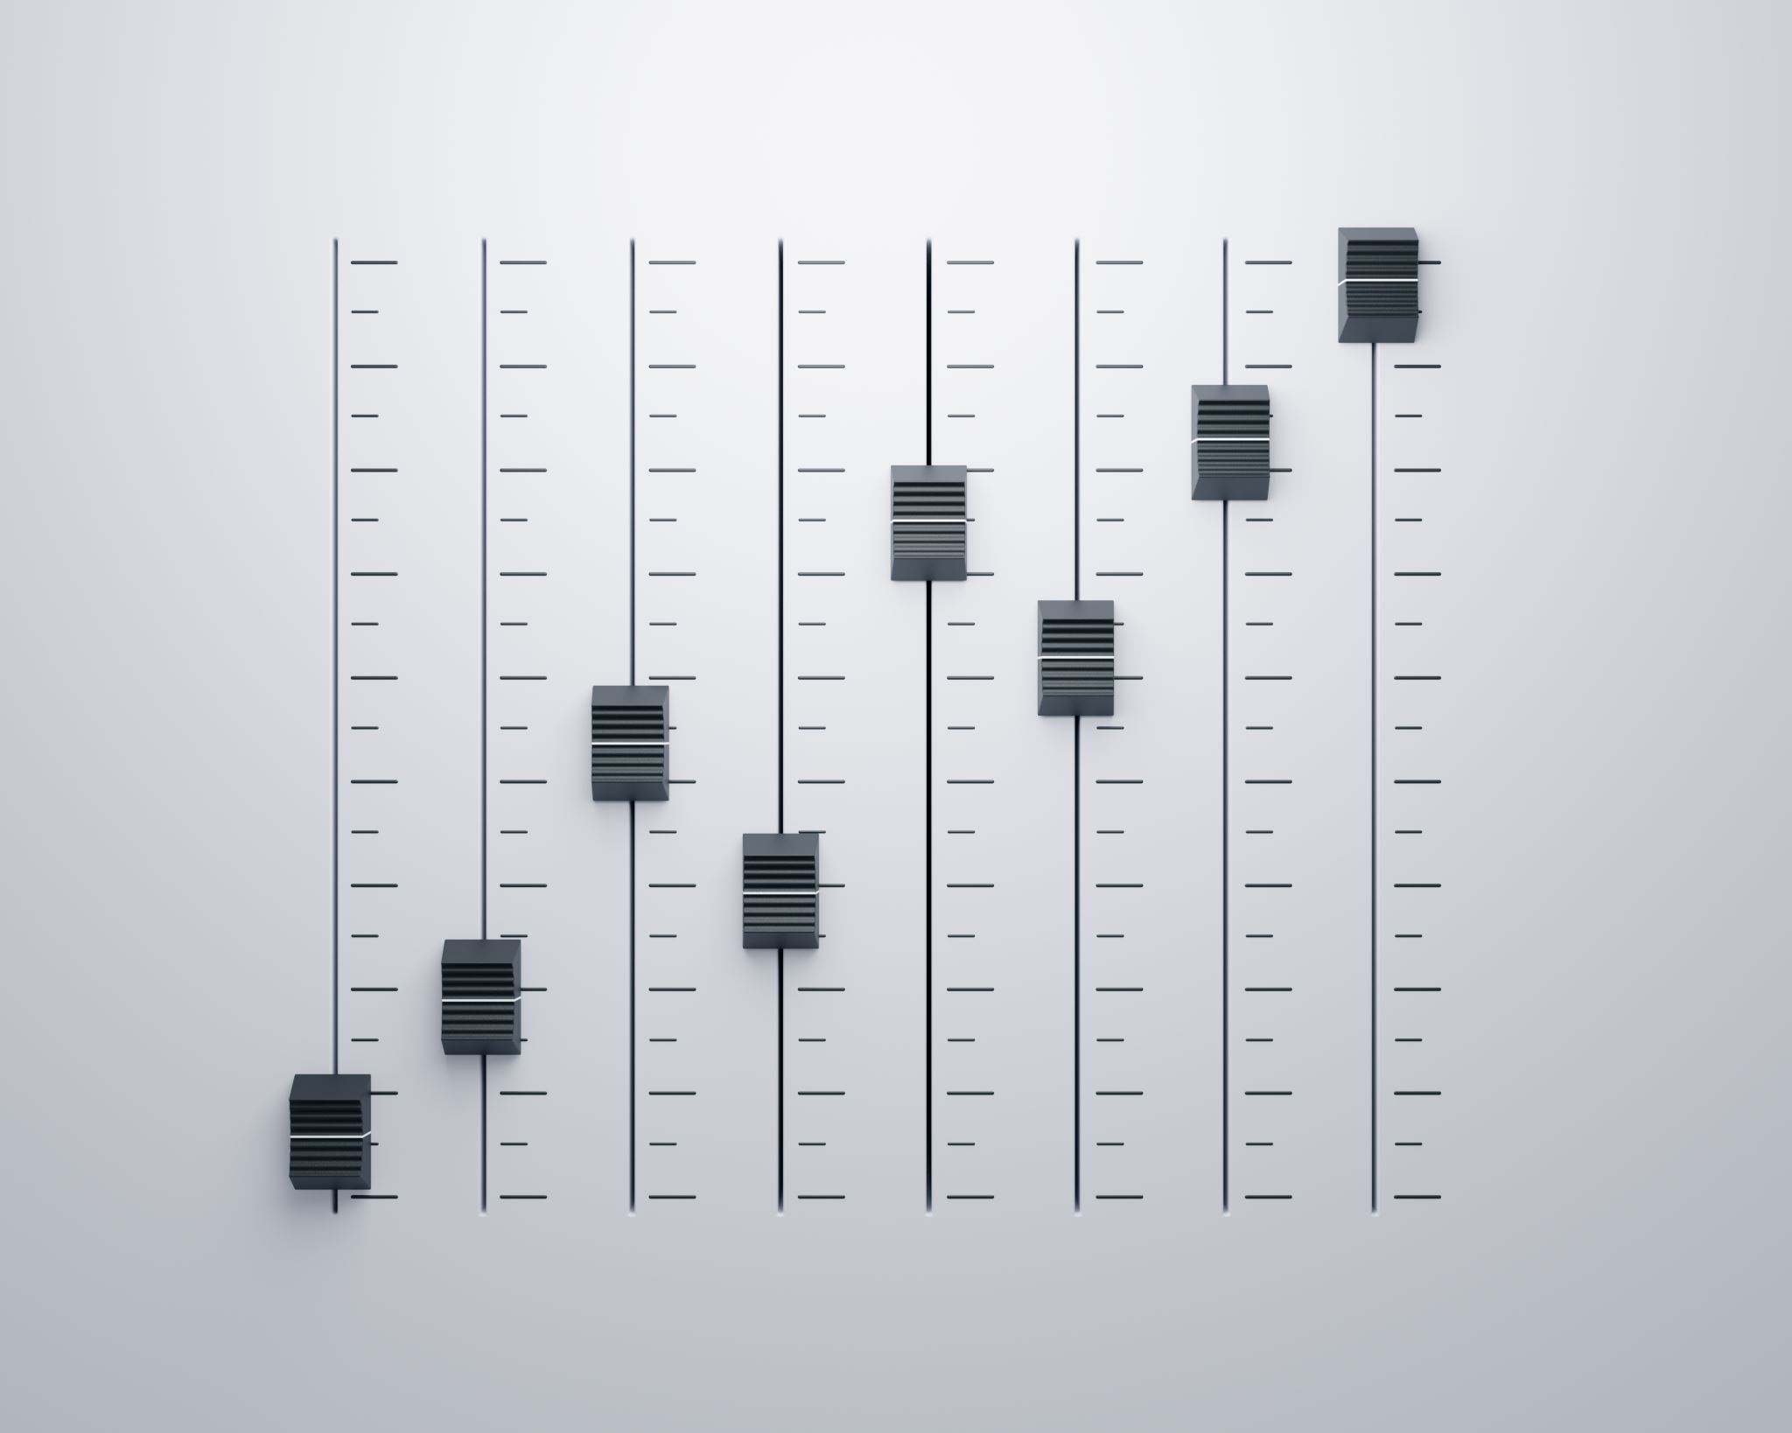
1. Characteristics of Sound and Digital Audio
1.1 Voice and Music
1.2 Digitizing Sound
1.3 Calculating Audio Data Size
2. Digital Audio System
2.1 Digital Audio Software Support
2.2 Editing Digital Audio
2.3 Sound Controls
3. MIDI
4. Audio File Formats
4.1 Audio Files
4.2 MIDI Files
5. Using Audio in Multimedia Applications
5.1 Audio Quality
5.2 Audio for Managing Software Function
Concepts use study…

Slide 7
Characteristics of Sound and Digital Audio
Sound comprises the spoken word, voices,
music and even noise.
It is a complex relationship involving:
1. a vibrating object (sound source)
2. a transmission medium (usually air)
3. a receiver (ear) and
4. a preceptor (brain).
Concepts use study…

Slide 8
What is Audio-Visual Coding?
Process of converting audio and visual data into a digital format that can be easily stored, transmitted, and reconstructed.
The main purpose is- “Compression” to reduce file sizes while maintaining quality.

Slide 9
Importance of Standards

Slide 10
Why are Coding Standards needed?
Standards for coding audiovisual objects, such as video and audio content, are crucial for several reasons, primarily to ensure:
data compression
interoperability,
efficiency,
quality, and
compatibility across different devices and platforms.

Slide 11
Data Compression
Reducing File Size: For example, a raw video might be several gigabytes in size, but with efficient coding, it can be reduced to a fraction of that size.
Efficient Streaming: Compressed media files are essential for streaming over the internet, where bandwidth may be limited. Coding enables smooth streaming of high-quality content by optimizing the amount of data that needs to be transmitted.

Slide 12
Interoperability:
Standards define common protocols and formats that enable different systems and devices to communicate effectively.
For audiovisual coding, this means that content encoded using a specific standard can be decoded and played back correctly on any device or software that supports that standard.
This interoperability is essential for seamless content distribution and consumption.

Slide 13
Efficiency:
Standards often incorporate efficient encoding and decoding algorithms that optimize file sizes without significant loss in quality.
This efficiency is crucial for streaming services, where reducing bandwidth consumption while maintaining quality is paramount.

Slide 14
Quality:
Standards ensure a baseline level of quality for encoded audiovisual content.
By specifying encoding parameters and algorithms, standards help maintain consistency and fidelity in both audio and video reproduction across different devices.

Slide 15
Scalability:
As technology evolves, standards provide a framework for scalability.
New versions of standards can incorporate advancements in compression techniques, resolution support, and audio fidelity.
This allowa content creators to adapt to higher quality and resolution requirements without sacrificing compatibility.

Slide 16
Future-proofing:
Adherence to standards ensures that content remains accessible and usable in the future.
1
It reduces the risk of content becoming obsolete due to changes in technology or software platforms.
2

Slide 17
Overview of JPEG
JPEG stands for Joint Photographic Experts Group of ISO/IEC
.jpg and .jpeg extensions are used to store images in this format.
JPEG is a commonly used method of lossy compression for digital images, particularly for those images produced by digital photography using the standard developed by ISO/IEC JPEG.
The degree of compression can be adjusted, allowing a selectable tradeoff between storage size and image quality.
It uses a lossy compression algorithm, which means some of the image data is lost.

Slide 18
The ISO standard for JPEG (Joint Photographic Experts Group) is ISO/IEC 10918. This standard defines the method for compressing and encoding still images, making it one of the most widely used image compression standards in the world.
Details of ISO/IEC 10918:
Part 1: Specifies the core coding system, including the basic algorithms and file format structure for compressing and encoding images.
Part 2: Defines the compliance testing to ensure that implementations conform to the standard.
Part 3: Describes extensions that provide additional functionalities, such as progressive coding.
Part 4: Deals with the registration of JPEG profiles, tags, and other parameters.
Part 5: Provides the reference software for JPEG, which serves as a basis for validating other implementations.
Part 6: Describes application to printing systems
Part 7 : Reference Software

Slide 19
Advantages of JPEG:
Small file size: JPEG images can be compressed to small file sizes, making them ideal for sharing over the internet or storing on limited storage devices.
Widely supported: JPEG is a widely supported image format, and most devices and software can read and display JPEG images.
High-quality output: JPEG compression allows for high-quality output images, even after compression.
Adjustable compression level: JPEG compression level can be adjusted to balance file size and image quality.

Slide 20
Disadvantages of JPEG:
Lossy compression: JPEG compression is lossy, which means that some data is lost during the compression process, resulting in a lower quality image.
Limited editing: Editing a JPEG image repeatedly can result in further loss of quality due to the lossy compression.
Not ideal for text or graphics: JPEG compression is not well-suited for compressing text, graphics, or images with sharp edges, as these can become blurry or pixelated after compression.

Slide 21
Overview of MPEG
MPEG stands for Moving Picture Experts Group of ISO/IEC, is a standard used for compressing digital video files.
It is optimized for compressing moving images rather than still images.
The MPEG standards actually consist of three main parts: video, audio, and systems.
The MPEG systems part coordinates between the video and audio parts, as well as coordinating external synchronization for playing.

Slide 22
Overview of MPEG
The MPEG-1 standard was completed in 1993 and was adopted in video CDs.
MP3 audio, which is popular on the Internet, is actually an MPEG-1 standard adopted to handle music in digital audio. It is called MP3 because it is an arrangement for MPEG Audio Layer 3.
The MPEG-2 standard was proposed in 1996.
It is used as the format for many digital television broadcasting applications and is the basis for digital versatile disks (DVDs), a much more compact version of the video CD with the capacity for full-length movies.
The MPEG-4 standard was completed in 1998 and was adopted in 1999.
MPEG-4 is designed for transmission over channels with a low bit rate . It is now the popular format for video scripts on the Internet.

Slide 23
What does IS/ISO/IEC 14496 series of Standards Cover?

Slide 24
Coded representation of media objects
MPEG-4 audiovisual scenes are composed of several media objects, organized in a hierarchical fashion, such as:
Still images (e.g. as a fixed background),
video objects (e.g. a talking person - without the background)
audio objects (e.g. the voice associated with that person); etc.
MPEG-4 standardizes a number of such primitive media objects, capable of representing both natural and synthetic content types, which can be either 2- or 3-dimensional.
In addition to the media objects mentioned above, MPEG-4 defines the coded representation of objects such as:
text and graphics;
talking synthetic heads and associated text used to synthesize the speech and animate the head;
synthetic sound

Slide 25
IS/ISO/IEC 14496 - A system for the communication of interactive audio-visual scenes
This specification includes the following elements.
The coded representation of natural or synthetic, two-dimensional (2D) or three-dimensional (3D) objects that can be manifested audibly and/or visually (audio-visual objects) (specified in Parts 2, 3, 10, 11, 16, 19, 20, 23 and 25 of ISO/IEC 14496).
The coded representation of the spatio-temporal positioning of audio-visual objects as well as their behavior in response to interaction (scene description, specified in Parts 11 and 20 of ISO/IEC 14496).
The coded representation of information related to the management of data streams (synchronization, identification, description and association of stream content, specified in this Part and in Part 24 of ISO/IEC 14496).
A generic interface to the data stream delivery layer functionality (specified in Part 6 of ISO/IEC 14496).
An application engine for programmatic control of the player: format, delivery of downloadable Java byte code as well as its execution lifecycle and behavior through APIs (specified in Parts 11 and 21 of ISO/IEC 14496).
A file format to contain the media information of an ISO/IEC 14496 presentation in a flexible, extensible format to facilitate interchange, management, editing, and presentation of the media specified in Part 12 (ISO File Format), Part 14 (MP4 File Format) and Part 15 (AVC File Format) of ISO/IEC 14496.
The coded representation of font data and of information related to the management of text streams and font data streams (specified in Parts 17, 18 and 22 of ISO/IEC 14496)

Slide 26
Architecture
The information representation specified in ISO/IEC 14496 describes the means to create an interactive audio-visual scene in terms of coded audio-visual information and associated scene description information.
The entity that composes and sends, or receives and presents such a coded representation of an interactive audio-visual scene is generically referred to as an “audio-visual terminal” or just “terminal”.
This terminal may correspond to a stand-alone application or be part of an application system.

Slide 27
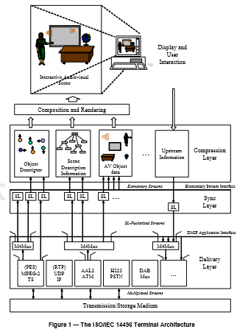

Slide 28
Syntax and Symantics
The standard provides the Syntex and Semantics for Media Header Boxes, Sample Description Boxes, IPMS Decoder, OCU Decoder etc.
Typical Example of IPMP Message Syntax is as shown.

Slide 29
Composition of Media Objects
Figure explains the way in which an audiovisual scene in MPEG-4 is described as composed of individual objects.
Such grouping allows authors to construct complex scenes and enables consumers to manipulate meaningful (sets of) objects.
The scene description builds on several concepts from the Virtual Reality Modeling language (VRML) in terms of both its structure and the functionality of object composition nodes and extends it to fully enable the aforementioned features.

Slide 30
Detailed Technical Description of MPEG 4 Standard
Description and Synchronization of Streaming Data for Media Objects
Delivery of Streaming Data
Interaction with Media Objects
Management and Identification of Intellectual Property
DMIF

Slide 31
Detailed Technical Description of MPEG 4 Standard
Demultiplexing, Synchronization and description Streaming Data for Media Objects
Syntax Description
Coding of Audio Objects
Coding of Visual Objects
Scene Description

Slide 32
Introduction to JVET
Joint Video Experts Team of IS)/IEC to Develop next-generation video coding standards’
Versatile Video Coding (VVC), also known as H.266
Enhancements over HEVC (H.265):
50% better compression efficiency
Support for higher resolutions (up to 8K)
Improved adaptability for various network conditions
Applications: Ultra-high-definition (UHD) broadcasting, virtual reality (VR), augmented reality (AR)

Slide 33
Some Important Standards in the field of Coding of Audio and Video Objects

Slide 34
S.No. | Indian Standard No. | Title
1 | IS/ISO/IEC 14496-1 : 2010 | Information Technology - Coding of Audio-Visual Objects Part 1 Systems
2 | Part 2 | Visual
3 | Part 3 | Audio
4 | Part 4 | Conformance Testing
5 | Part 5 | Reference Software
6 | Part 6 | Delivery Multimedia Integration Framework ( DMIF )
7 | Part 7 | Optimized Reference Software for Coding of Audio-Visual Objects
8 | Part 8 | Carriage of ISO / IEC 14496 Contents over IP Networks
9 | Part 9 | Reference Hardware Description
10 | Part 10 | Advanced Video Coding
11 | Part 11 | Scene Description and Application Engine
12 | Part 12 | ISO Base Media File Format
13 | Part 13 | Intellectual Property Management and Protection ( IPMP ) Extensions
14 | Part 14 | MP4 FILE FORMAT
15 | Part 15 | CARRIAGE OF NETWORK ABSTRACTION LAYER NAL UNIT STRUCTURED VIDEO IN THE ISO BASE MEDIA FILE FORMAT
16 | Part 16 | Animation Framework extension ( AFX )

Slide 35
S.No. | Indian Standard No. | Title
17 | Part 17 | Streaming Text Format
18 | Part 18 | Font Compression and Streaming
19 | Part 19 | Synthesized Texture Stream
20 | Part 20 | Lightweight Application Scene Representation ( LASeR ) and Simple Aggregation Format ( SAF )
21 | Part 21 | MPEG-J Graphics Framework eXtensions ( GFX )
22 | Part 22 | Open font format
23 | Part 23 | Symbolic Music Representation
24 | Part 24 | Audio and Systems Interaction
25 | Part 25 | 3D Graphics Compression Model
26 | Part 26 | Audio Conformance
27 | Part 27 | 3D Graphics Conformance
28 | Part 28 | Composite Font Representation
29 | Part 29 | Web Video Coding
30 | Part 30 | Timed Text and Other Visual Overlays in ISO Base Media File Format
31 | Part 33 | Internet Video Coding

Slide 36
S.No. | Indian Standard No. | Title
32 | IS 16125 (Part 1) : 2014 | Information technology - Multimedia content description interface: Part 1 systems
33 | IS 16125 (Part 2) : 2013 | Information technology - Multimedia content description interface: Part 2 description definition language

Slide 37
What would have been the scenario in the absence of these standards?
Device Compatibility Issues: Different manufacturers would likely have developed their own proprietary formats leading to a fragmented ecosystem where media files could only be played on specific devices, creating significant compatibility issues.
Cross-Platform Incompatibility: Difficulty in sharing media across different platforms (Windows, macOS, Linux, mobile devices, etc.), as each platform might have supported different, non-standard formats.
Reduced Growth of Social Media: Platforms like Instagram, Facebook, YouTube, and others rely heavily on standardized image and video formats. Without MPEG and JPEG, the ease of uploading and viewing media across different devices and networks would have been severely hampered.
Delayed Streaming Services: The development and adoption of streaming services like Netflix, YouTube, and Spotify could have been significantly delayed as they rely on MPEG standards (like MP3, H.264, etc.) for efficient streaming and compression of audio and video content.

Slide 38
What would have been the scenario in the absence of these standards?
Less Efficient Compression: Proprietary formats might not have achieved the same level of compression efficiency as JPEG and MPEG, leading to larger file sizes and slower transmission speeds.
Lower Quality Media: Without the optimized algorithms provided by these standards, the quality of digital images and videos might have been lower, especially when compressed for storage or transmission.
Difficulty in Media Preservation: The long-term preservation of digital media could have been more challenging. Archiving non-standard or proprietary formats would have required specific software or hardware, which might not be available in the future, risking the loss of digital content.
Reduced Innovation in Media Technologies: The lack of standardized formats might have slowed down innovation in media technologies. Developers and content creators would have been more focused on ensuring compatibility rather than pushing the boundaries of what’s possible with digital media.

Slide 39
Conclusion:
Without the MPEG and JPEG standards, the digital media landscape would have been far more fragmented, less efficient, and likely slower to develop.
These standards have played a crucial role in enabling the seamless exchange of media across devices and platforms, driving the growth of digital content and the internet as we know it today.

Slide 40
Bibliography:
MPEG4 Overview- ISO/IEC/JTC1/SC29WG11 N3156
Information available on https://google.com
IS/ISO/IEC14496 series of Standards
IS/IEC 10918 series of standards
Digital Image Processing by Rafael C Gongalez & Richard E Woods

Slide 41
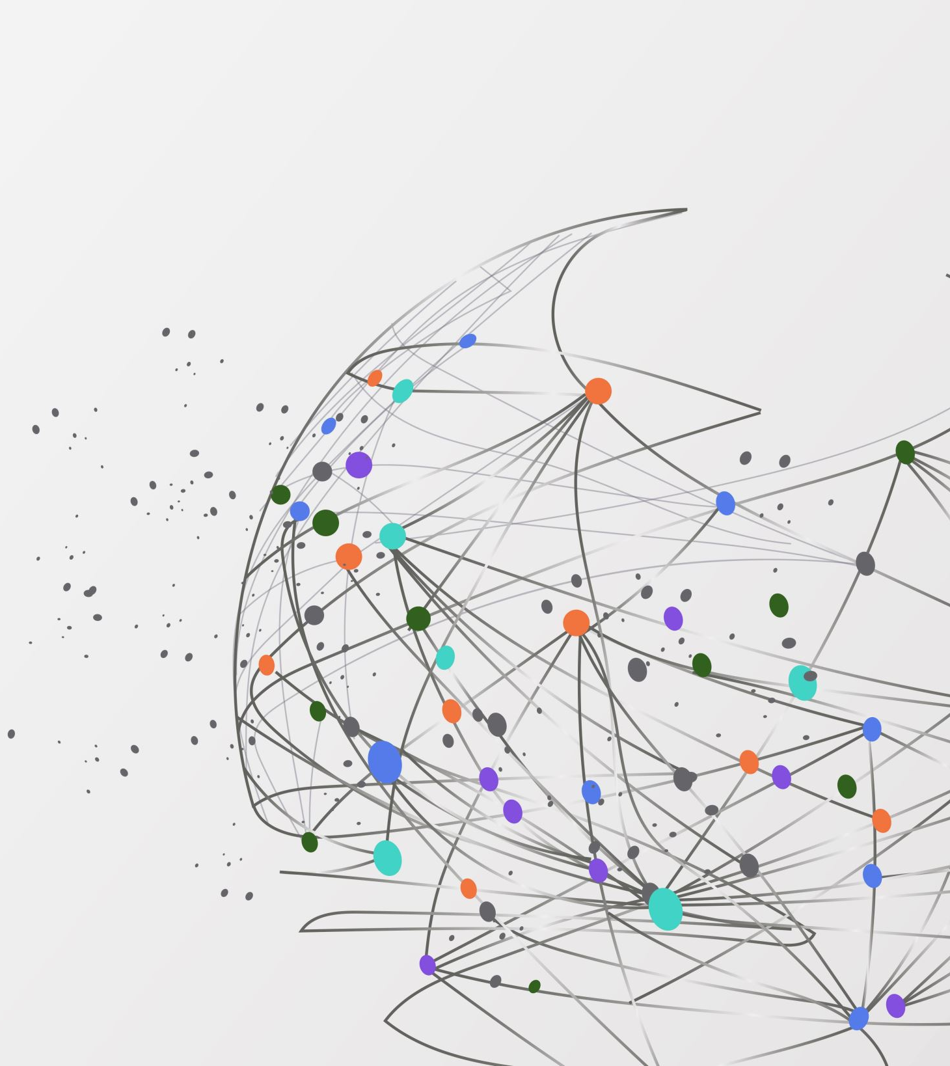
Thanks!

