Slide 1
भारतीय मानक ब्यूरो
BUREAU OF INDIAN STANDARDS
Low Voltage and High Voltage Switch Gears

Slide 2
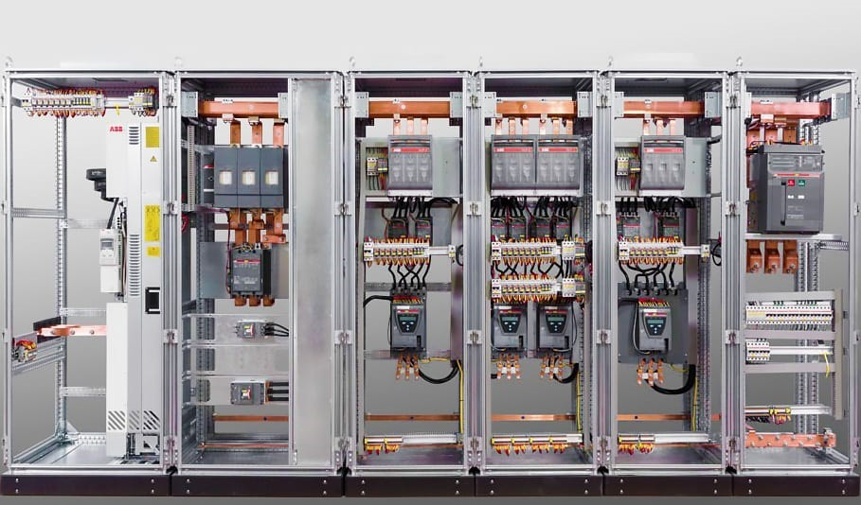
SESSION 1
What is switchgear
Components of Switch gear
Key Functions
Classification

Slide 3
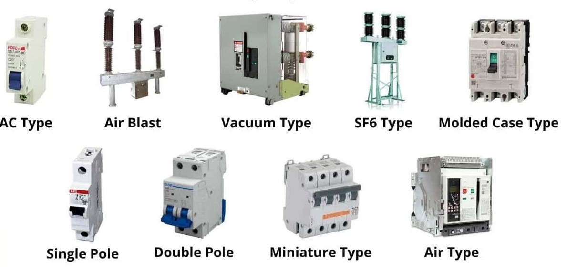
WHAT IS SWITCHGEAR?
A Device or a combination of devices primarily intended for the purpose of making, breaking and carrying the electric currents in circuit under normal conditions as well as abnormal (faulty) conditions

Slide 4
SWITCHGEAR - IS/IEC 60947 PART 1
• A general term covering switching devices & their combinations with associated control, measuring, protective and regulating equipment, also assemblies of such devices & equipment with associated interconnections, accessories, enclosures & supporting structures, intended in principle for use in connection with generation, transmission, distribution & conversion of electric energy.
In short – Switchgear are integral to a power system to ensure continuity, safety, protection against faults

Slide 5
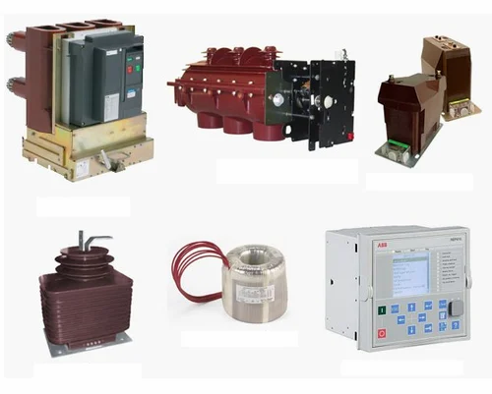
COMPONENTS OF SWITCHGEAR

Slide 6
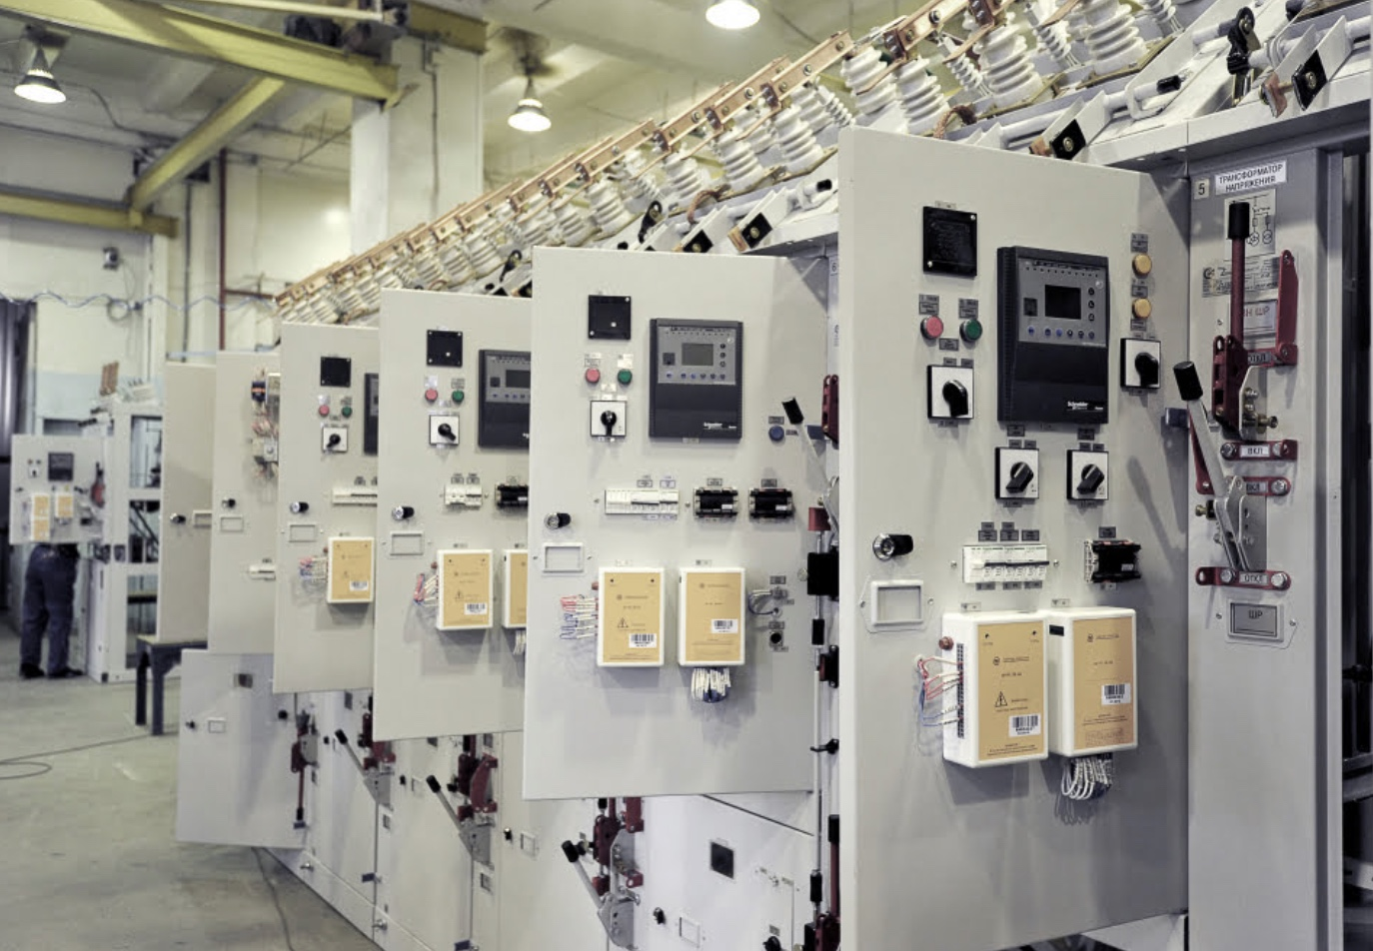
COMPONENTS OF SWITCHGEARS
Main
Components:
Circuit Breakers
Switches
Starters Fuses
Relays
Disconnectors
Busbars
Supporting
Components:
Control Panels
Protective Relays
Metering Devices

Slide 7
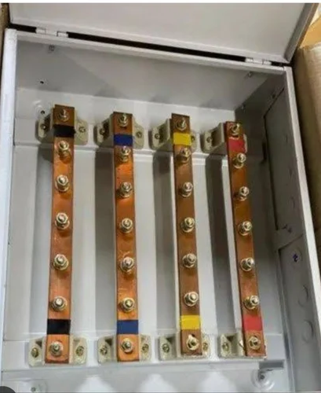
BUSBAR
In electric power distribution, a busbar (also bus bar) is a metallic strip or bar, typically housed inside switchgear, panel boards, and busway enclosures for local high current power distribution.
It acts as a conductor or group of conductors that collects electric power from incoming feeders and distributes it to outgoing feeders.

Slide 8
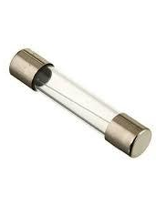
FUSE
Fuse is a device used in circuit for protecting electrical equipments against ovehoads and/or short circuits.
Fuse element or fuse wire is that part of the fuse device which melts when an excessive current flows in the circuit and thus isolates the faulty device from the supply circuit
A fuse is a short piece of wire or thin strip which melts when excessive current flows through it for a sufficient time.
it is inserted in series with the circuit to be protected.

Slide 9
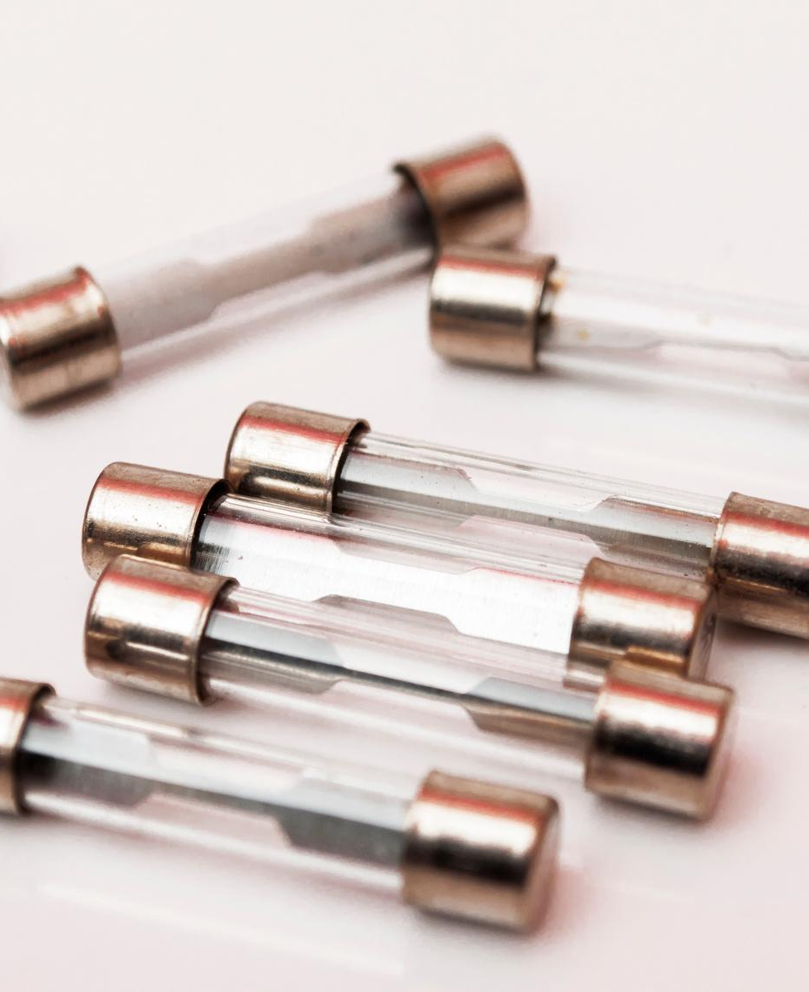
FUSE
Desirable qualities of fuse elements
Low melting point
Low ohmic losses
High conductivity
Low cost

Slide 10
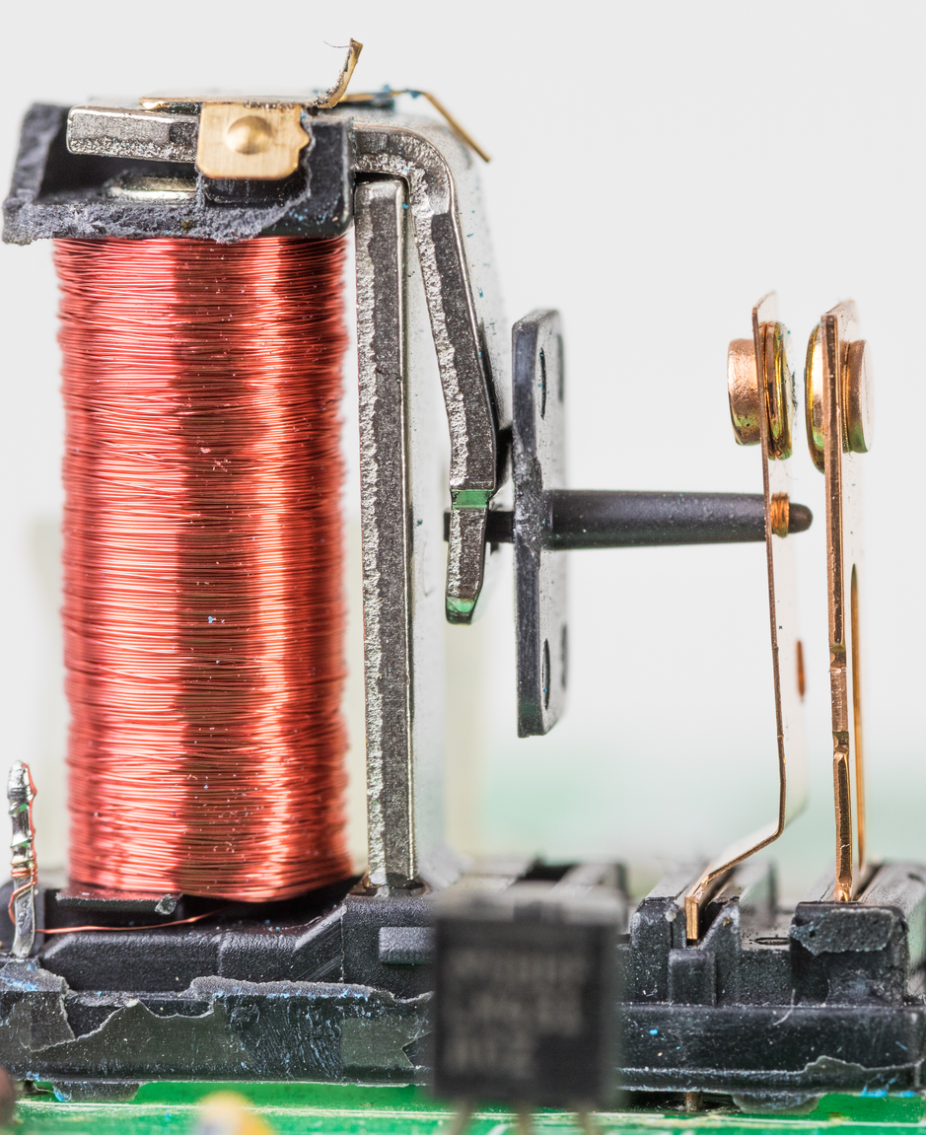
RELAY
A relay may also be called an "electromagnetic switch". Protective relay is a device designed to trip a circuit breaker when fault is detected.
Protective relay were electromagnetic device.
It is operating on moving parts to provide detection of abnormal condition.
Definition
A relay is a automatic device which senses an abnormal condition of electric circuit and closes its contacts.
There are two basic classifications of relays:-
Electromechanical Relays
Solid State Relays

Slide 11
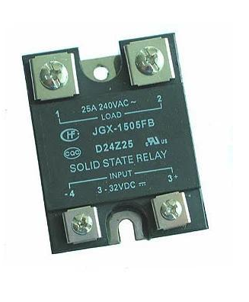
RELAY
One main difference between them is electromechanical relays have moving parts, whereas solid state relays have no moving parts.
In conventional electromagnetic relay the measurement of quantities is done by comparing operating torque/force with restraining torque/force. the electromagnetic relay operates when the operating torque/force is greater than the restraining torque/force. in electromagnetic relays the pick up is obtain by the movement of movable element in the relay.
A static relay is the relay which uses solid state components like transistors, diodes etc. for the measurement or comparison of electrical quantities.

Slide 12
CIRCUIT BREAKERS
Function: Automatically interrupt current flow in case of faults. Extinguishes the arc
Types:
Air Circuit Breakers (ACB),
Molded Case Circuit Breakers (MCCB), Miniature Circuit Breakers (MCB)

Slide 13
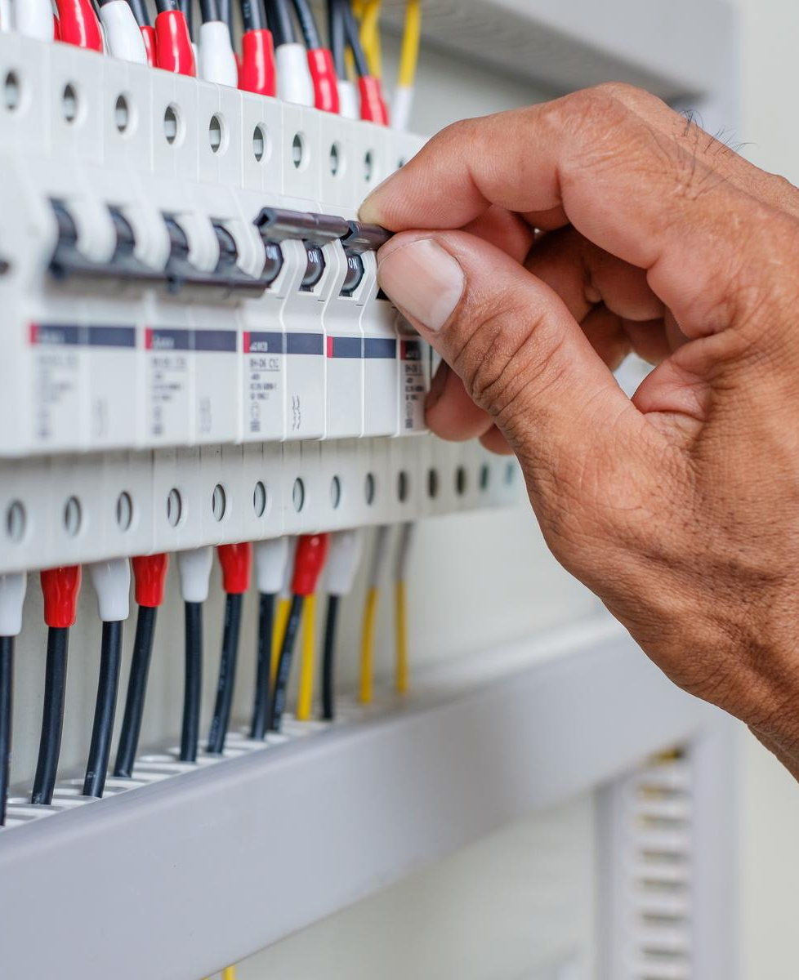
TYPES OF CIRCUIT BREAKERS
Low Voltage Circuit Breakers: ACB,
MCCB, MCB, RCCB
High Voltage Circuit Breakers
SF6 Circuit Breakers
Vacuum Circuit Breakers
Oil Circuit Breakers

Slide 14
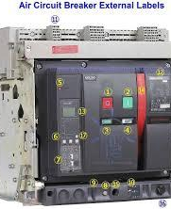
AIR CIRCUIT BREAKER (ACB)
Air Circuit Breaker (ACB) is an electrical device used to provide Overcurrent and short-circuit protection for electric circuits over 800 Amps to 10K Amps.
These are usually used in low voltage applications below 450V.

Slide 15
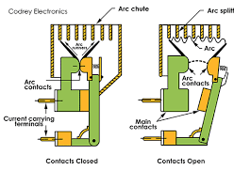
WORKING PRINCIPLE OF AIR CIRCUIT BREAKER
To extinguish the arc, the ACB relies on the surrounding air. The arc is drawn into arc chutes where it is subjected to the cooling effect of the surrounding air, causing the arc to lose energy and eventually extinguish.

Slide 16
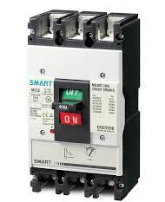
MOULDED CASE CIRCUIT BREAKER
An MCCB is an electrical protection device designed to prevent overloads and short circuits with a current rating up to 2500A. It is suitable for various voltages and frequencies with adjustable trip settings and is used in large PV systems for isolation and protection, replacing MCBs.

Slide 17
WORKING OF MCCB
MCCBs operate using thermal and magnetic protection.
A bimetallic strip bends with excessive heat from overcurrent, tripping the breaker.
An electromagnetic coil generates a magnetic field during a short circuit, causing an immediate trip.
Arc chutes extinguish the arc when the circuit breaks.
MCCBs can be manually operated or automatically trip when a fault is detected, ensuring safety and preventing circuit damage.

Slide 18
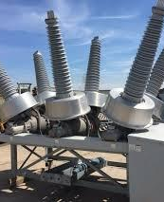
SF6 CIRCUIT BREAKERS
SF6 is a sulfur hexafluoride circuit breaker in which sulfur hexafluoride is used as the arc extinguishing medium. The sulfur hexafluoride gas attracts free electrons. As the circuit contacts are opened, the gas flows through the chamber striking the arc.

Slide 19
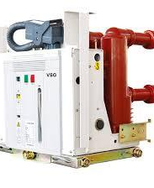
VACUUM CIRCUIT BREAKERS
A VCB is a specific type of breaker that interrupts the current in a vacuum. A small arc is often created in a circuit breaker when the contacts move apart. The arc must be extinguished in order for the current to stop completely.

Slide 20
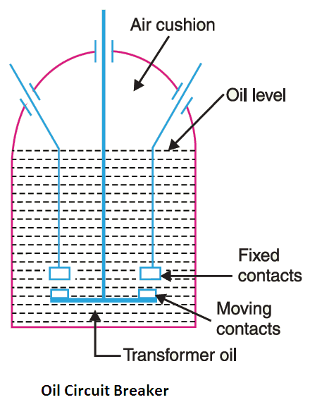
OIL CIRCUIT BREAKERS
An oil circuit breaker is a traditional type of circuit breaker. It has a separate contact. This contact's primary function is to separate the insulating oil. When a fault or problem occurs, this includes good comparable properties to air, which opens in the lower part of the breaker contact oil.

Slide 21
SWITCHES
Function: Manually interrupt or route electrical current.
Types: Isolators, Load Break Switches, Transfer Switches

Slide 22
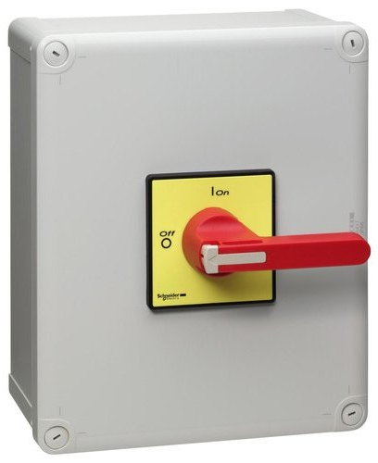
ISOLATORS
An isolator switch is usually used in situations where there is a risk of electric shocks, such as damp conditions. When the switch is in the “off” position, it creates a break in the circuit that prevents the current from flowing. This allows you to work safely on the circuit without the risk of electrocution.

Slide 23
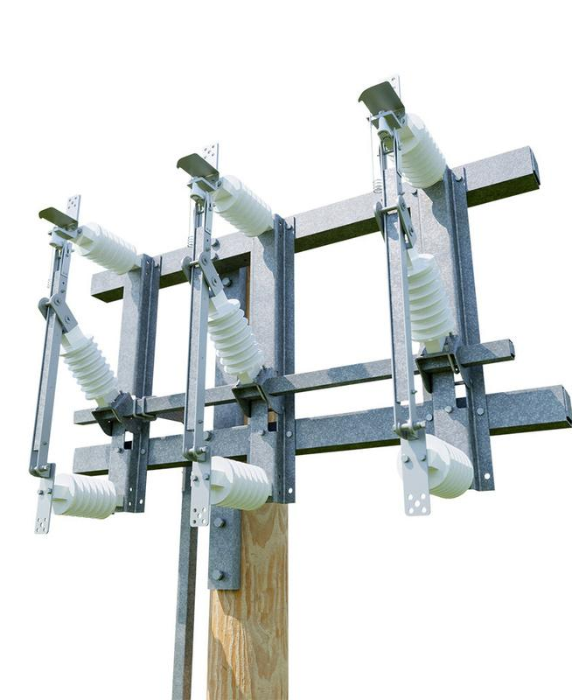
LOAD BREAK SWITCHES
A load break switch or LBOR switch is an “on / off” switch, similar to an “on / off” light switch in your house. A load break switch is designed to switch the power “on or off” or change the position when the transformer is energized (meaning it has a load on it)—the switch will break this load.

Slide 24
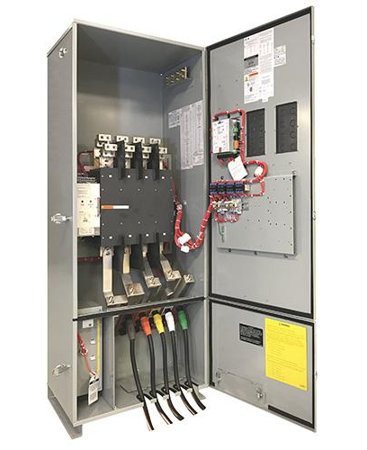
TRANSFER SWITCHES
A transfer switch is a device designed to transfer electrical loads between power sources, such as utility power and generator power. During a power outage, it is utilized to connect electrical loads to a backup power source, typically a generator.
Transfer switches prevent electricity travelling in the wrong direction, such as from a home generator into the power grid.

Slide 25
FUNCTIONS & CLASSIFICATION OF SWITCHGEAR

Slide 26
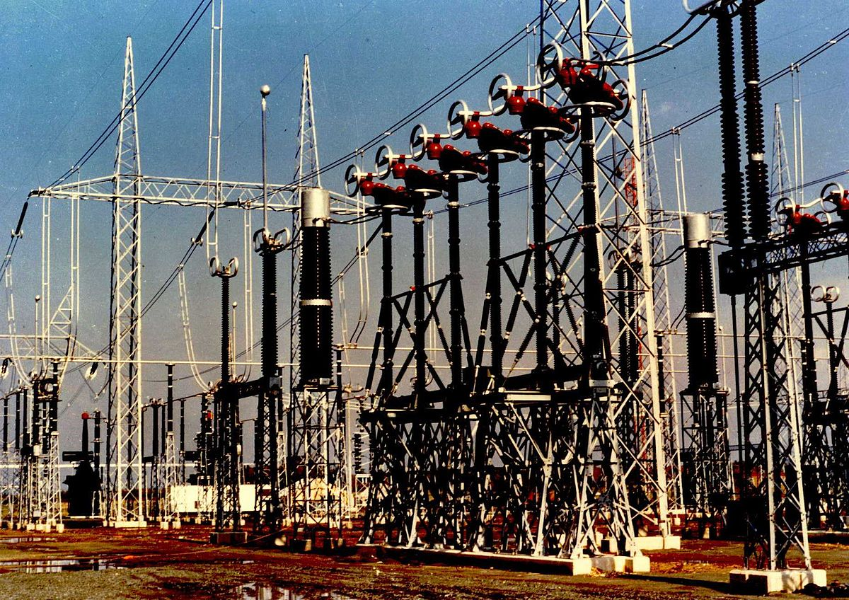
KEY FUNCTIONS OF SWITCHGEAR
Control: It allows operators to control the flow of electricity in a system, enabling them to connect or disconnect circuits as needed.
Protection: It protects electrical circuits from overloads, short circuits, and other faults by interrupting the flow of electricity when a problem is detected.
Isolation: It provides a means to isolate parts of the electrical system for maintenance or repair, ensuring safety for personnel working on the equipment.

Slide 27
CLASSIFICATION OF SWITCH GEARS
By Voltage: Low Voltage (LV) and High Voltage (HV)
By Installation: Indoor and Outdoor
By Function: Protection, Isolation, and Control

Slide 28
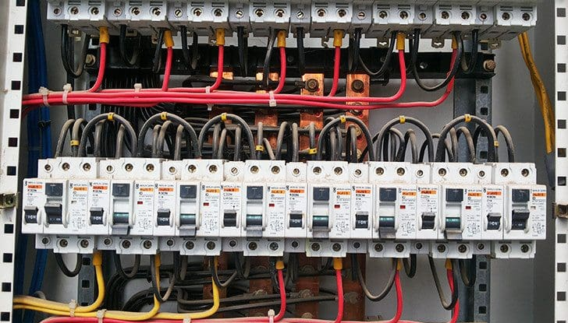
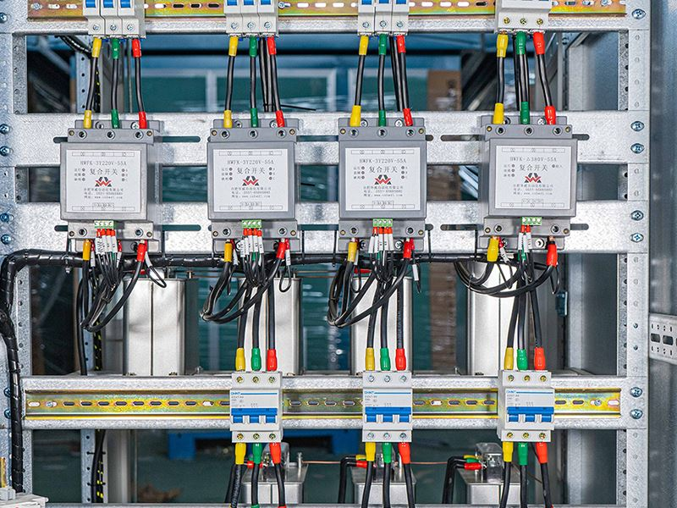
LOW VOLTAGE SWITCHGEARS
Indian standard pertains to low voltage switch gears- IS/IEC 60947 (With Different Parts).
Voltage Rating- Low voltage switchgear typically operates at voltages up to 1000V AC or 1500V DC.
Applications:
Commercial buildings,
Residential areas
Small industrial applications.

Slide 29
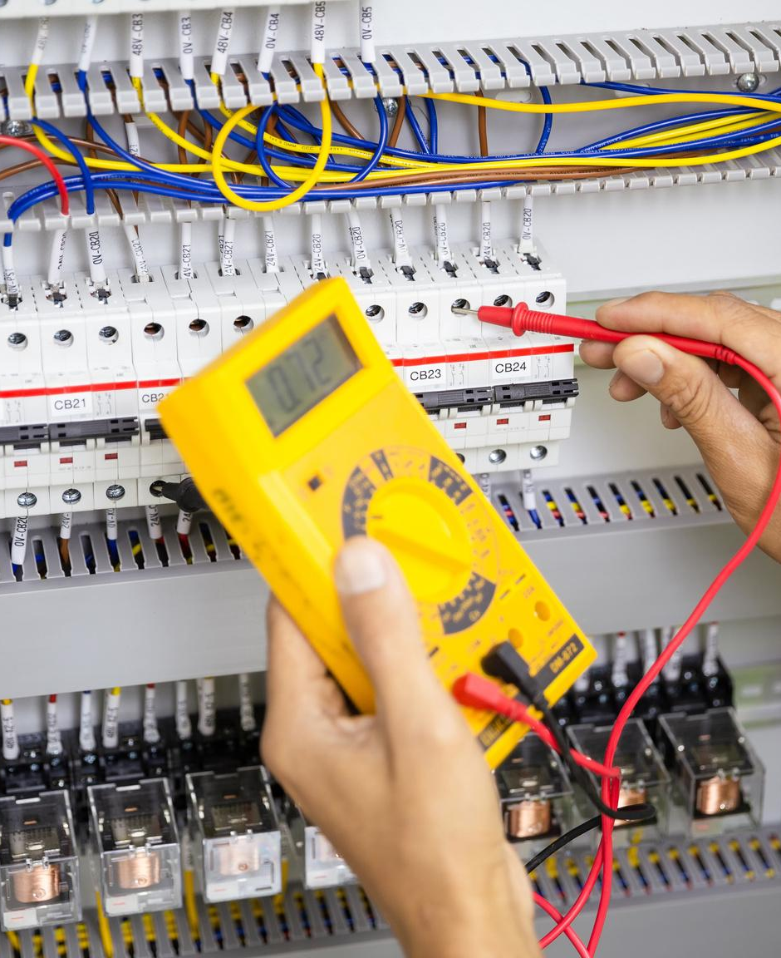
PRODUCT STANDARDS FOR LV SWITCHGEAR
IS/IEC: 60947
﻿Part 1- General rules of all products
﻿Part 2- Circuit Breakers
﻿Part 3- Switch Disconnector Fuse
﻿Part 4- Contactors/Relays/starters
﻿Fuse - IS/IEC 60269 – Low Voltage Fuses
﻿MCBs- IS/IEC 60898 – Circuit Breakers for
Overcurrent Protection

Slide 30
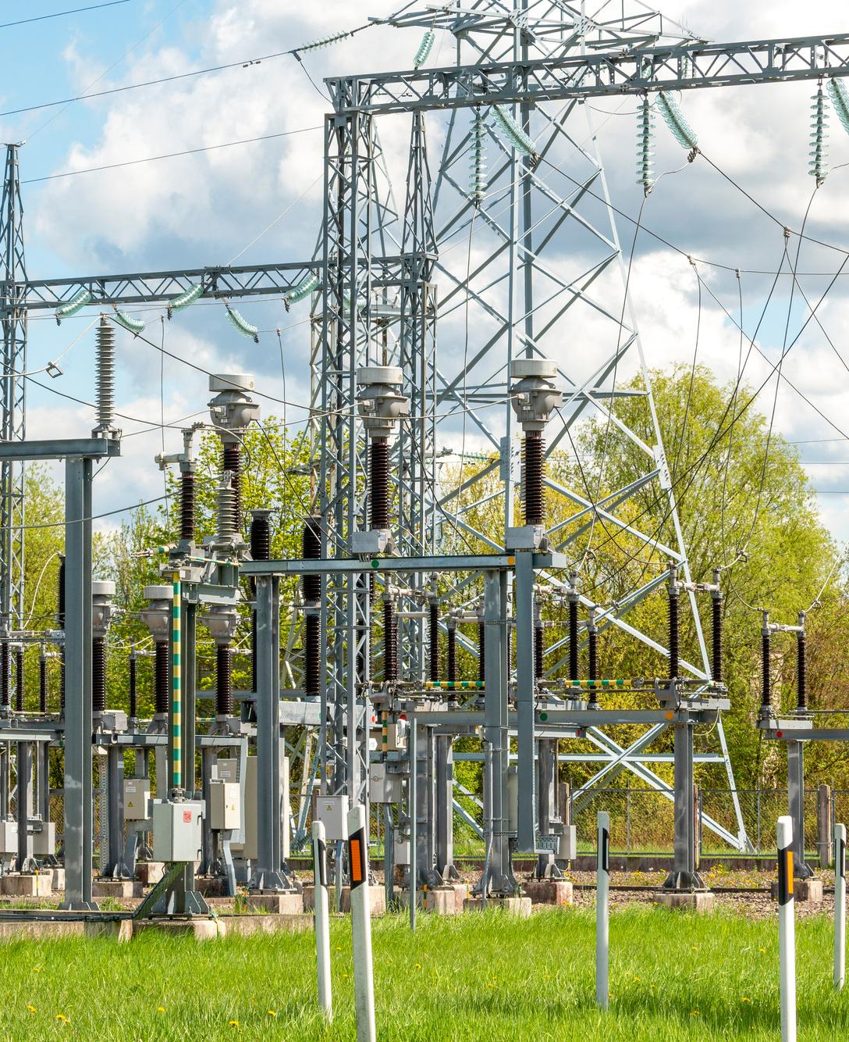
HIGH VOLTAGE SWITCHGEARS
Indian standard pertains to high voltage switch gears- IS/IEC 62271 (With different parts).
Voltage Rating- It typically operates at voltages above 1 kV, up to 52 kV or more, depending on the specific design and application.
Applications
Power transmission
large industrial applications,
Utility companies.

Slide 31
PROPERTIES OF SWITCHGEAR
Dielectric Properties
Mechanical Properties
Temperature Rise
Environmental Protection

Slide 32
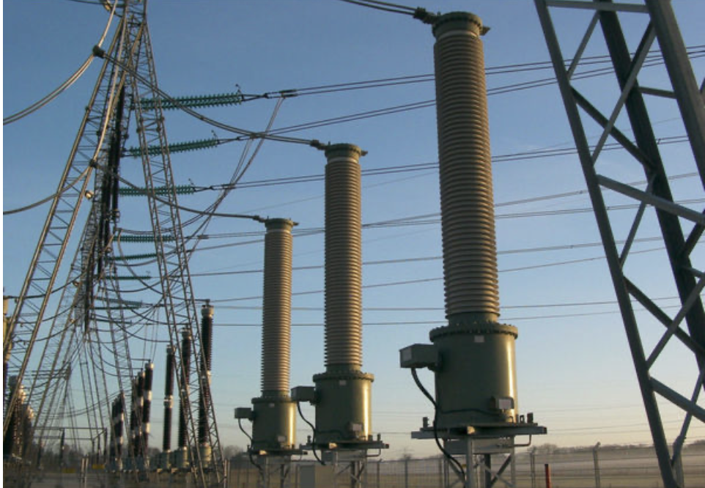
Dielectric Properties
Switchgear often relies on dielectric materials to ensure that components remain insulated and that electrical arcs are prevented, especially in high-voltage applications. The choice of dielectric material in switchgear can influence its performance, safety, and reliability
Must have superior dielectric properties to handle high voltages and transient conditions for HV switchgears.
Dielectric properties ensures the capability of switchgear for withstanding rated impulse withstand voltage (transient voltage), power frequency withstand voltage
Clearances shall be sufficient to enable the equipment to withstand the rated impulse withstand voltage
Dielectric requirements can be less stringent for LV switchgear due to lower operating voltages.

Slide 33
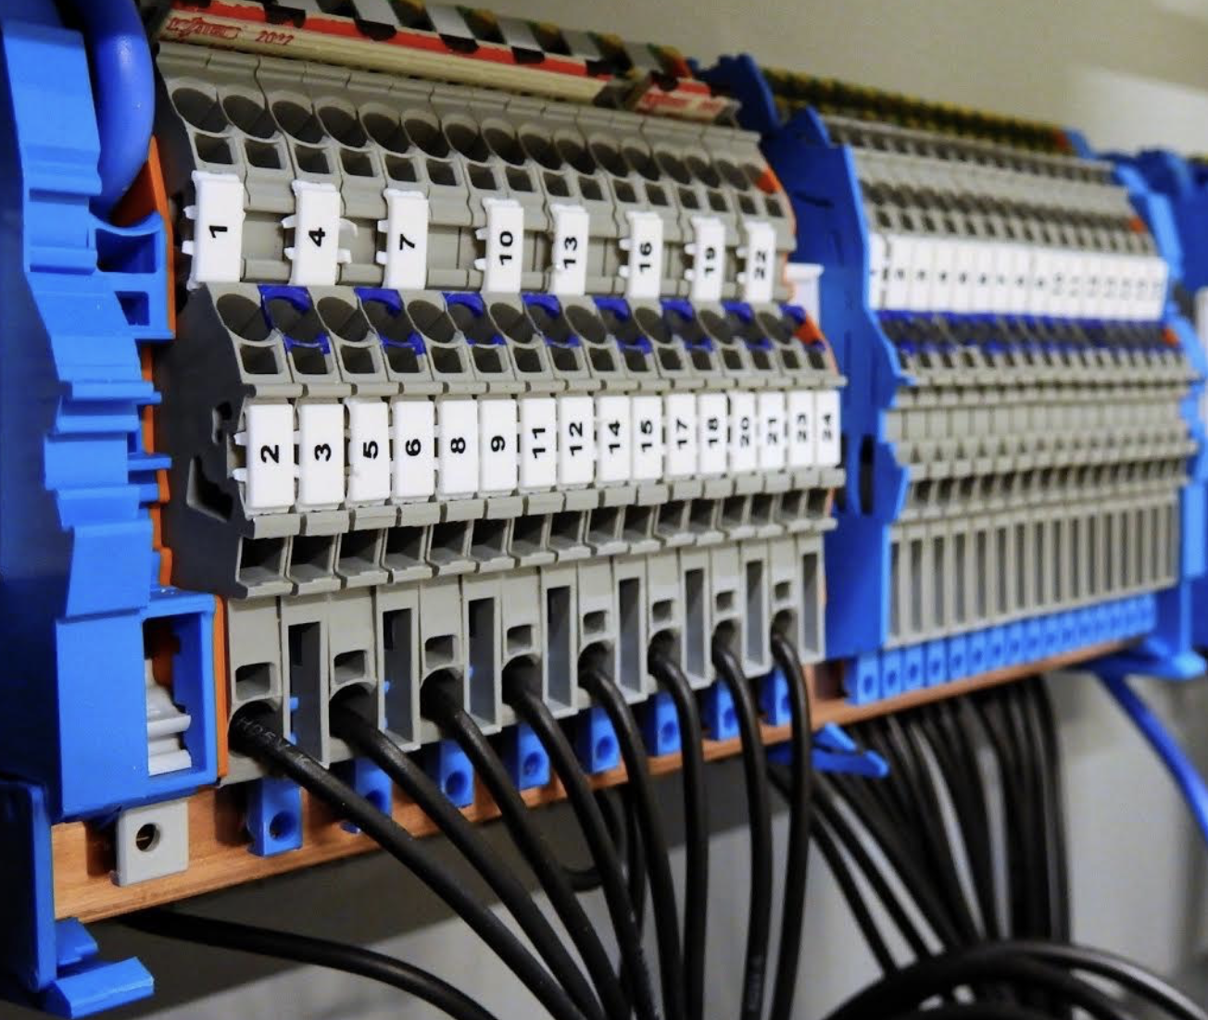
Mechanical Properties
The mechanical properties of switchgear are crucial for ensuring that the equipment can withstand physical stresses, maintain structural integrity, and operate reliably in various conditions. These properties impact the durability, safety, and performance of the switchgear in both normal and extreme conditions
Switchgear components must resist mechanical shocks and vibrations that may occur during transportation, installation, or from external sources like seismic events or nearby machinery.
The materials used in the switchgear, particularly for busbars and other conductive components, must resist bending or deformation under mechanical stress. This is essential to maintain proper electrical connections and prevent short circuits.

Slide 34
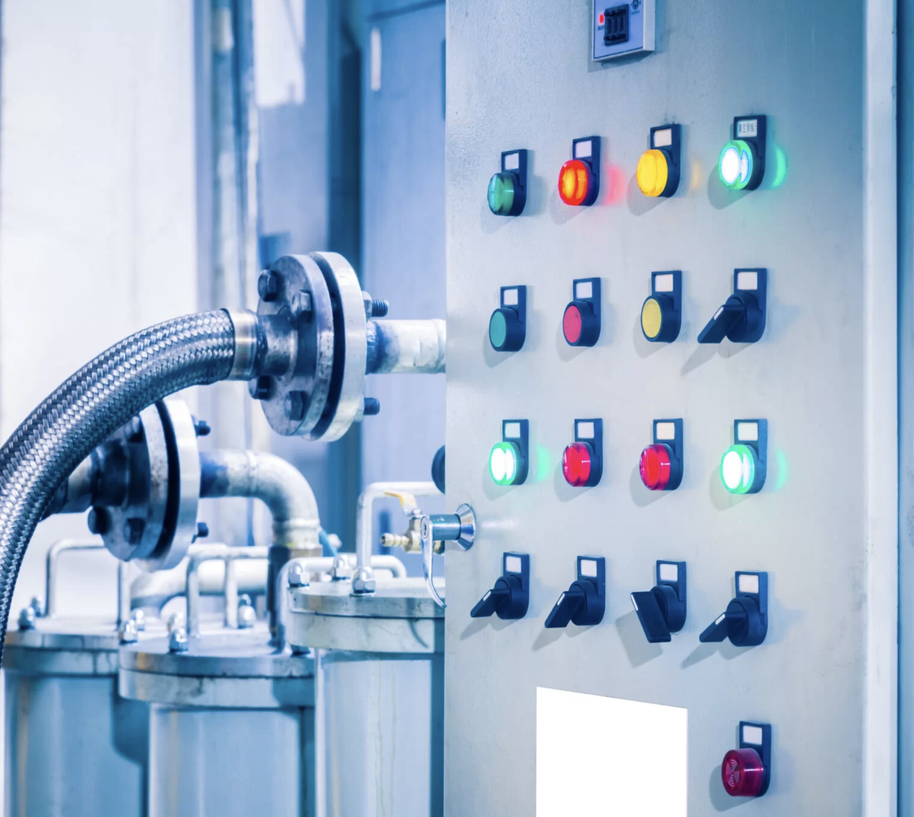
Temperature Rise
Temperature rise in switchgear is a critical factor that affects the performance, safety, and longevity of the equipment. It refers to the increase in temperature that occurs in the components of the switchgear during operation due to the flow of electrical current.
Impacts of Temperature Rise:
Component Degradation: Excessive temperature rise can degrade insulation materials, reduce the lifespan of components, and increase the risk of electrical failures.
Thermal Runaway: If heat is not adequately dissipated, it can lead to a thermal runaway condition, where the temperature continues to rise, potentially causing catastrophic failures.
Reduced Performance: Elevated temperatures can affect the performance of the switchgear, leading to malfunctions or reduced efficiency.

Slide 35
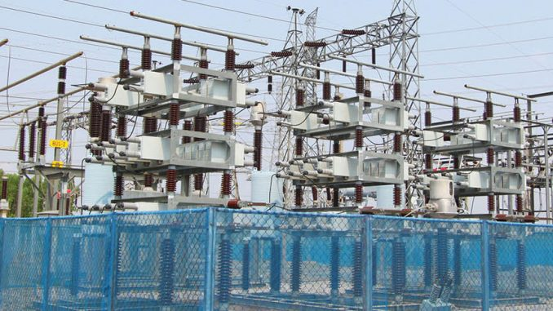
Environmental Protection
Ingress Protection : Switchgear enclosures are designed to protect against the ingress of solid objects (like dust) and liquids (like water). The IP rating system classifies the level of protection, where higher numbers indicate better protection.
Corrosion Resistance : In corrosive environments (such as coastal areas or industrial plants with chemical exposure), switchgear materials and coatings must resist corrosion. This includes use of stainless steel, aluminum, or special coatings like galvanization or epoxy paints.

Slide 36
ACTIVITY
Difference between MCB and MCCB
Difference between MCCB and RCCB
Difference between Fuse and Circuit Breaker
d) Why does the fuse shall have low melting point
e) Difference between RCCB and RCBO
Answers

Slide 37
SESSION 2
Characteristics of Switch gear
Type of Tests
Requirements specified in ISS
Test Methods

Slide 38
CURRENT RATING
High Voltage Switchgear: Current ratings can be several thousand amperes, often exceeding 4000 A, depending on the application.
Low Voltage Switchgear: Current ratings typically range from a few amperes up to 6300 A for industrial applications

Slide 39
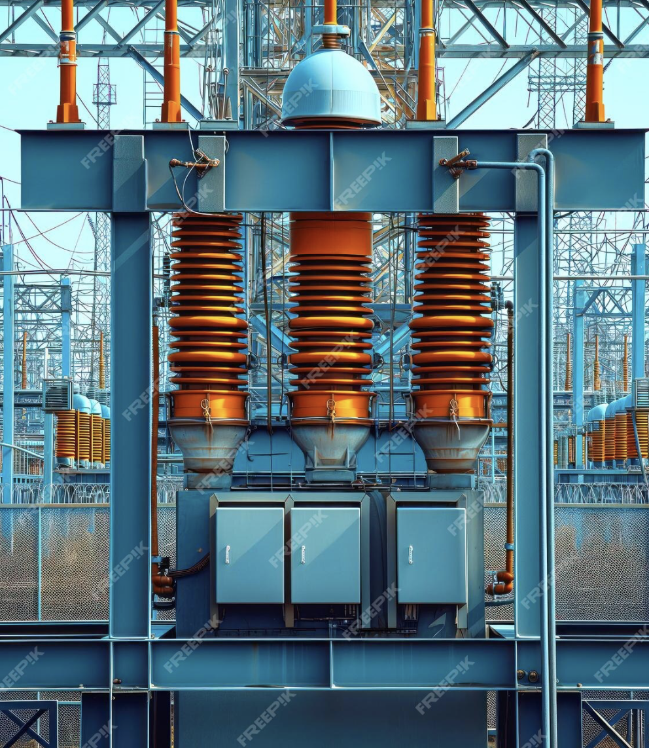
SHORT-CIRCUIT WITHSTAND STRENGTH
High Voltage Switchgear: Designed to withstand and interrupt high short-circuit currents, often in the range of tens of kA (kiloamperes).
Low Voltage Switchgear: Short-circuit ratings are generally lower, typically in the range of 10 kA to 100 kA, depending on the equipment and application.

Slide 40
TYPE OF TEST (CL. 3.8 OF IS/IEC 60947-1)
Type test: Test of one or more devices made to a certain design to show that the design meets certain specifications.
Routine test: Test to which each individual device is subjected during and/or after manufacture to ascertain whether it complies with certain criteria.
Sampling test (Acceptance test): Test on a number of devices taken at random from a batch.
Special test: Test additional to type tests and routine tests, made either at the discretion of the manufacturer or according to an agreement between manufacturer and user

Slide 41
TYPE TEST (CL. 9.1.2 OF IS/IEC 60947-1)
Type tests are intended to verify compliance of the design of a given equipment. They may comprise, as appropriate, the verification of,
constructional requirements
temperature-rise
dielectric properties
making and breaking capacities
short-circuit making and breaking capacities
critical load current performance
operating limits
operational performance
degree of protection of enclosed equipment
tests for EMC

Slide 42
ROUTINE TESTS (CL. 9.1.3 OF IS/IEC 60947-1)
Routine tests are intended to detect faults in materials and workmanship and to ascertain proper functioning of the equipment. They shall be made on each individual piece of equipment.
Routine tests may comprise,
Functional tests
Dielectric tests

Slide 43
SAMPLING TESTS (CL. 9.1.4 OF IS/IEC 60947-1)
Sampling tests may also be made to verify specific properties or characteristics of an equipment, either on the manufacturer's own initiative, or by agreement between manufacturer and user.
Sampling tests may comprise,
Functional tests
Dielectric tests

Slide 44
SPECIAL TESTS (CL. 9.1.5 OF IS/IEC 60947-1)
The conducting of special tests is at the discretion of the manufacturer.
Reliability data tests: If the manufacturer decides to provide reliability data for functional safety applications.
Environmental tests: In cases where it is necessary to verify the behavior of products under special environmental conditions.(e.g. EMC, damp heat, salt mist, vibration and shock).

Slide 45
SAFETY RELATED PROVISIONS MENTIONED IN INDIAN STANDARD

Slide 46
CL. 9.6 OF IS/IEC 60947-1 TEST OF PROTECTION AGAINST ELECTRIC SHOCK
This verification is applicable to those parts of circuit breakers which are exposed to the operator when mounted as for normal use
During this test, enclosures or covers shall not deform to such an extent that live parts can be touched with the unjointed test finger
Risks Associated with Non-Compliance : Possibility of electric shock during normal operation

Slide 47
CL. 9.7 OF IS/IEC 60947-1 TEST OF DIELECTRIC PROPERTIES
Following tests are to be carried out
Resistance to humidity
Insulation resistance of the main circuit
Dielectric strength of the main circuit
Insulation resistance and dielectric strength of auxiliary circuits
Verification of impulse withstand voltages and of leakage current across open contacts
Risks Associated with Non – Compliance : Failure of Insulation, Damage to the equipment connected with Power System

Slide 48
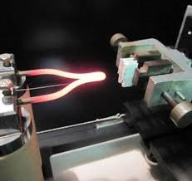
CL. 9.15 OF IS/IEC 60947-1 RESISTANCE TO ABNORMAL HEAT AND TO FIRE
To check compliance glow-wire test is performed on a complete circuit breaker.
The glow-wire test is applied to ensure that an electrically heated test wire under defined test conditions does not cause ignition of insulating parts.
The sample is regarded as having passed the glow-wire test if
There is no visible flame and no sustained glowing.
Or flames and glowing on the sample extinguish themselves within 30 s after the removal of the glow-wire
Risk Associated : Fire Accident

Slide 49
PERFORMANCE RELATED PROVISIONS MENTIONED IN INDIAN STANDARD

Slide 50
CL. 9.10 OF IS/IEC 60947-1 TEST OF TRIPPING CHARACTERISTIC
The tripping characteristic of circuit-breakers shall be such that they ensure adequate protection of the circuit, without premature operation.
Test of time-current characteristic-
A current equal to conventional non-tripping current is passed for the conventional time through all poles and the CB shall not trip.
2. The current is then steadily increased to conventional tripping current. The circuit-breaker shall trip within the conventional time.

Slide 51
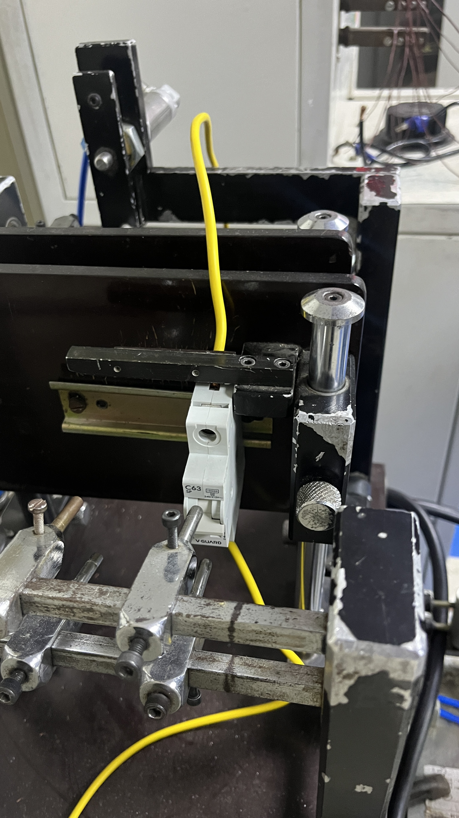
CL. 9.11 OF IS/IEC 60947-1 ENDURANCE TEST
The circuit-breaker is submitted to 4 000 operating cycles with rated current.
Each operating cycle consists of a making operation followed
by a breaking operation.
Condition of the circuit-breaker after test (Sample shall not show)-
Undue wear
Loosening of electrical or mechanical connections
Damage to the enclosure permitting access to live parts by the test finger
Risk Associated with Non-Compliance : Less Durability

Slide 52
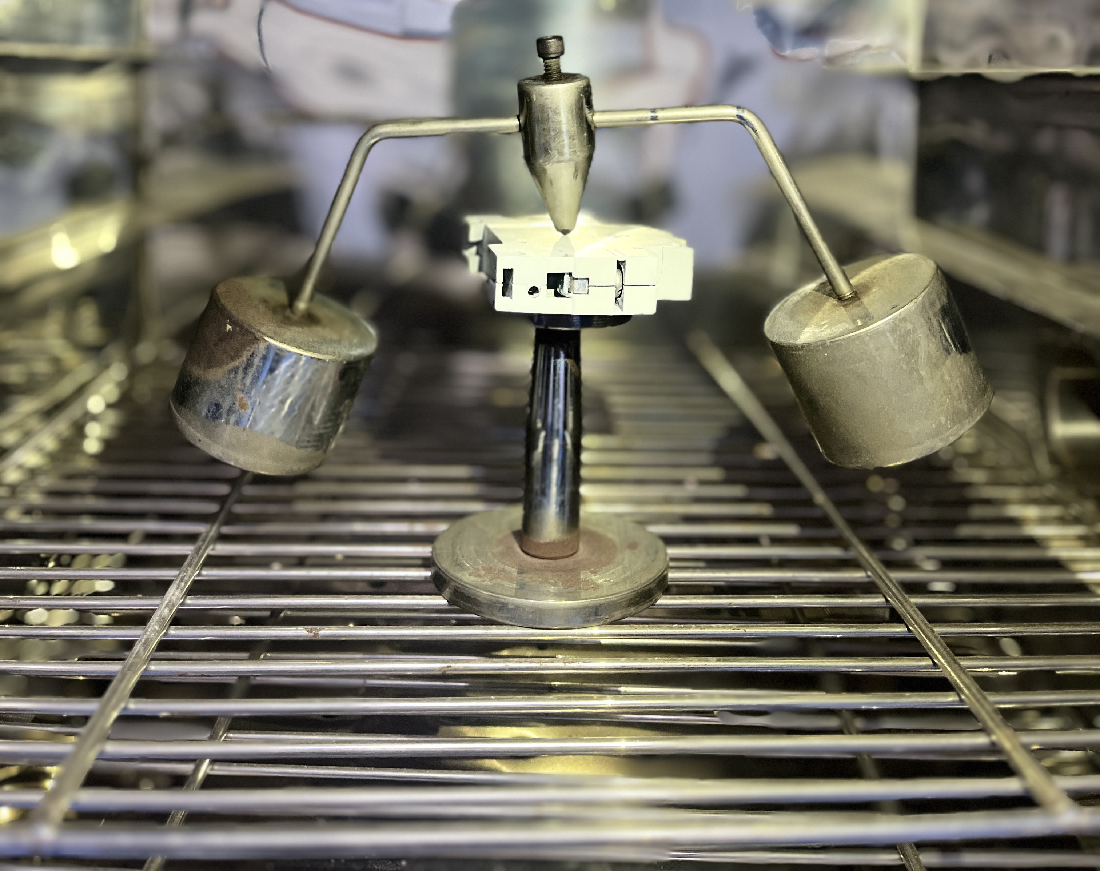
CL. 9.12 OF IS/IEC 60947-1 SHORT-CIRCUIT TESTS
Standard tests for the verification of the short-circuit performance consist of sequences of making and breaking operations.
CL. 9.14 OF IS/IEC 60947-1 TEST OF RESISTANCE TO HEAT
The samples, without removable covers, if any, are kept in a heating cabinet
After the test and after the samples have been allowed to cool down to
approximately room temperature, there shall be no access to live parts.
After the test, markings shall still be legible.

Slide 53
Food for Thought
A consumer needs circuit breaker for pickup current of 10 A. When he visits a near by electrical shop, circuit breaker of pickup current 10 A is not available. Shop keeper says, he is having a circuit breaker for pickup current of 100 A, which is of higher capacity. Should the consumer buy circuit breaker of pickup current 10A or 100 A?

Slide 54
CONCLUSION
As discussed, Indian Standard specifies safety, performance requirements for Switchgears and its components
An ISI marked MCB/MCCB/RCCB means it has undergone the necessary tests at the factory and it conforms to all the requirments specified by Indian Standard
In short, a switchgear is crucial to a power system, and adhering to Indian Standards for switchgear is equally important to ensure safety and reliability.

Slide 55
BIBLIOGRAPHY/RESOURCES
www.bis.gov.in
https://www.services.bis.gov.in/php/BIS_2.0/bisconnect/knowyourstandards/Indian_standards/isdetails/
IS/IEC 62271-1 and IS/IEC 60947

Slide 58
Difference Between MCB and MCCB
Sl No | Feature | MCB | MCCB
1 | Adjustability | Fixed trip settings (non-adjustable). | Adjustable trip settings for both thermal and magnetic trips.
2 | Interrupting Capacity | Lower, generally up to 10 kA (kiloamperes). | Higher, typically up to 100 kA or more.
3 | Operation Mechanism | Manual reset required after tripping; typically uses a bimetallic strip for thermal tripping and an electromagnetic coil for short circuit protection. | Can be reset manually or automatically; uses a combination of thermal, magnetic, and sometimes electronic trip units.
4 | Application | Ideal for lighting circuits, small appliances, and residential use. | Suitable for large motors, industrial machinery, and heavy-duty applications.

Slide 59
Difference Between MCCB and RCCB
Sl No | Feature | MCCB | RCCB
1 | Primary Function | Protects against overcurrent, including overloads and short circuits. | Protects against earth leakage (residual current) to prevent electric shocks.
2 | Adjustability | Trip settings for overcurrent protection can be adjustable. | Fixed settings; typically not adjustable
3 | Operation Mechanism | Operates based on thermal and magnetic trip mechanisms; can be reset after tripping. | Operates based on detecting an imbalance between live and neutral currents; requires manual reset after tripping.
4 | Application | Used in industrial, commercial, and large-scale residential installations for circuit protection. | Used in residential and commercial installations primarily for preventing electric shocks and fire hazards.

Slide 60
Difference Between Fuse and Circuit Breaker
Sl No | Feature | Fuse | Circuit Breaker
1 | Primary Function | Protects electrical circuits by melting its element when the current exceeds a certain limit, thus breaking the circuit. | Protects electrical circuits by mechanically opening the circuit when the current exceeds a set limit.
2 | Operation | One Time use | Can be reset after tripping
3 | Operation Mechanism | Based on the thermal effect of overcurrent causing the fuse element to melt. | Uses a combination of thermal, magnetic, or electronic mechanisms to detect and interrupt the circuit.
4 | Speed of Operation | Typically faster than circuit breaker | Slightly slower compared to fuses, but can offer more precise protection through adjustable settings.

Slide 61
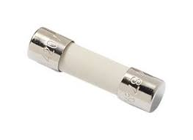
Why Fuse shall have low melting point ?
Fuses are made from materials that have specific melting points, such as lead, tin, or alloys. These materials are chosen based on their ability to melt at a precise temperature when the fuse is subjected to excessive current. The low melting point ensures that the fuse will blow before other components in the circuit are damaged.

Slide 62
Difference Between RCCB and RCBO
Sl No | Feature | RCCB | RCBO
1 | Primary Function | Detects and disconnects in case of earth leakage | Detects and disconnects in case of earth leakage and overcurrent
2 | Protection Against | Earth Leakage Current | Earth leakage currents, overloads, and short circuits

