Slide 1
Transformers
Lesson Plan Lecture Series

Slide 2
Curriculum Perspective

Slide 3
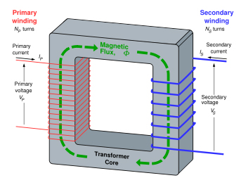
Transformers : Basic Principles
An electromagnetic device that
transfers electrical energy from one electrical circuit to another electrical circuit
through the medium of magnetic field and without any change in the frequency.

Slide 4
Transformers - Curriculum of Academia (1)
Single Phase/3 Phase and Auto Transformers
Basic Constructional Features
Phasor Diagram
Equivalent Circuit
Transformer Connection
Voltage Regulation
Parallel Operation
Eddy Current and Hysteresis Losses
Efficiency of Transformer (All Day)
Open Circuit and Short Circuit Test
Notes:
This slide covers the topics that are taught in the curriculum in a UG course. The idea is to appreciate the contrast between what is taught in the academic curriculum and what understanding is desirable in the practical use case scenario.

Slide 5
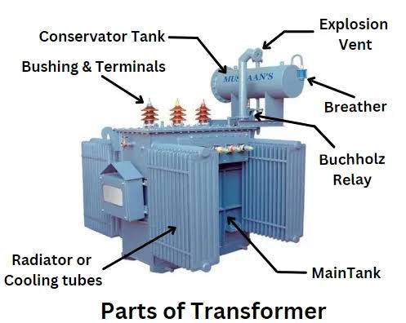
Transformers - Curriculum of Academia (2)
Basics of Transformer Design
Cooling Arrangement
Terminal Marking
Rating Plate
Installation and commissioning
Routine Test
Type Test
Notes:
This slide covers the topics that are taught in the curriculum in a UG course. The idea is to appreciate the contrast between what is taught in the academic curriculum and what understanding is desirable in the practical use case scenario.

Slide 6
Indian Standard Perspective

Slide 7
Transformers : Definition & Terminology

Slide 8
Definition of Transformer Types (IS 1885 – Part 38)
Power Transformer : A static piece of apparatus with two or more windings which, by electromagnetic induction, transforms a system of alternating voltage and current into another system of voltage and -current usually of different values and at the same frequency for the purpose of transmitting electrical power. { Clause 421-01-01 of the Indian Standard }
Auto Transformer : A transformer in which at least two windings have a common part { Clause 421-01-11 of the Indian Standard }
Core Type Transformer : A transformer in which the magnetic circuit takes the form of columns (legs) { Clause 421-01-07 of the Indian Standard }
Shell Type Transformer : A transformer where the packets of laminations forming the core and yokes surround the windings and enclose generally the major parts of them. { Clause 421-01-09 }
Dry Type Transformer : A transformer of which the magnetic circuit and windings are not immersed in an insulating liquid. { Clause 421-01-16 }
Sealed Type Transformer : A transformer which is non-breathing, that is, so sealed that there can be no significant interchange between its contents and the external atmosphere. { Clause 421-01-18 }

Slide 9
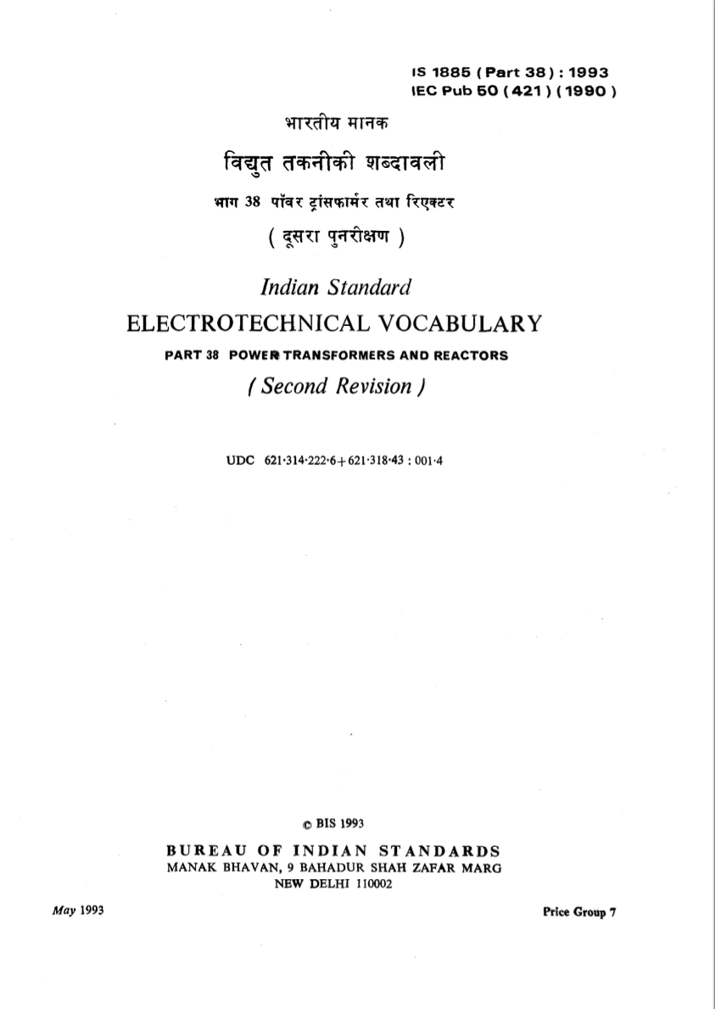
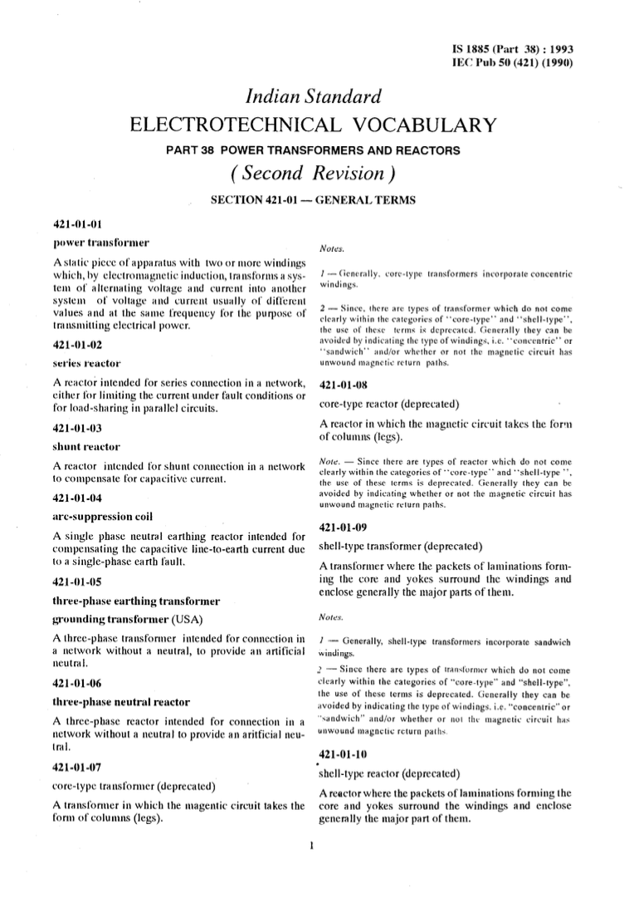
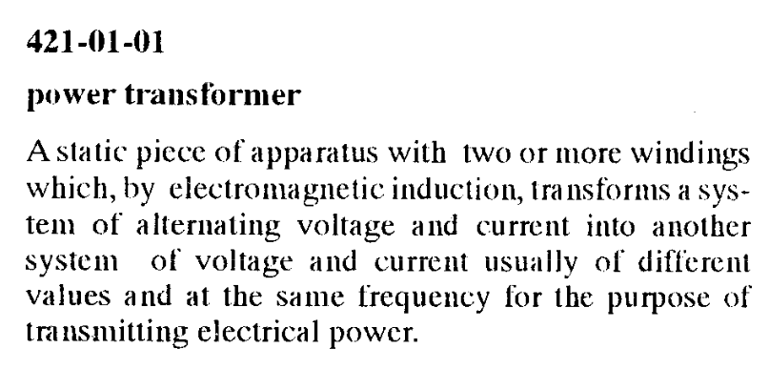
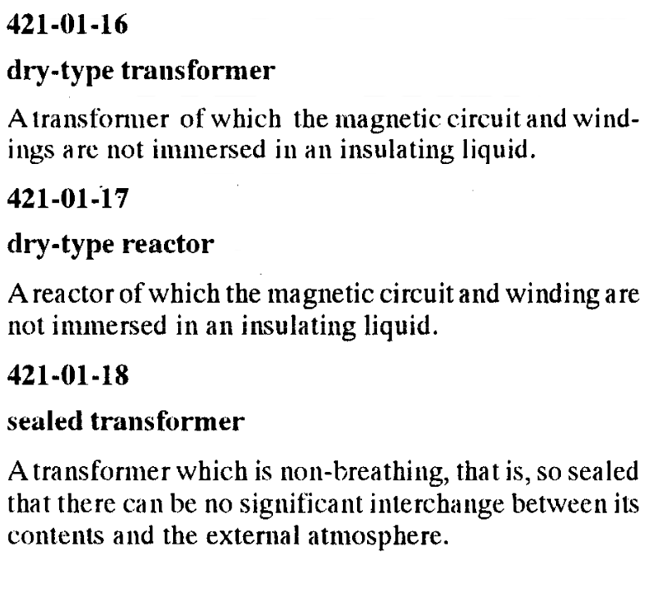
IS 1885 (Part 38)

Slide 10
CLASSIFICATION OF TRANSFORMERS
Transformers
Core Design
a. Core Type
b. Shell Type
Type of Core
a. CRGO Core
b. Amorphous Core
Application
Power Transformer
Distribution Transformer
Auto Transformer
Testing Transformer
Arc furnace Transformer
Welding Transformer
Mining Transformer
Instrument Transformer
Transformers for Wind Turbine Applications.
No. of Phases
a. Single Phase
b. Three Phase
No. of Windings
a. Two Winding
b. Three Winding
Type of Insulating media
a. Mineral Oil
b. Ester Oil
c. Gas Filled
Notes:
Classification of transformers based on different aspects is presented in this slide. These classifications are also taught in the academic curriculum and they are also used in Indian Standards – albeit with a broader base for classification.

Slide 11
Standardization in the field of Transformers
TRANSFORMERS
Power Transformers
Distribution Transformers
Selection, installation and maintenance
Instrument Transformers
Arc Furnace Transformers
Welding Transformers
IS 2026 Series
IS 1180 Series
IS 10028 series (code of practice)
IS 16227 series
IS 12977
IS 13339
IS 1851
IS 4804 (Part 1)
IS7931 (Part 2)
Oil immersed as well as dry type, including method of tests
Part 1 deals with mineral oil immersed
Part 3 deals with easter immersed
Notes:
This slide aims to present the different types of Indian Standards that exist for different types of transformers, their selection and test methods.

Slide 12
Transformers : Quality and User Expectation

Slide 13
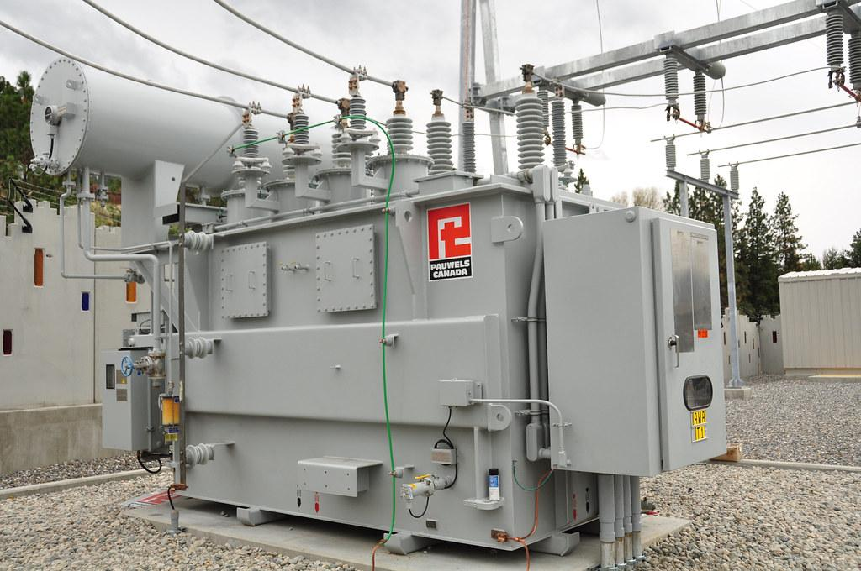
Transformer – Expectations from the Product
Reliability of operation
Safety in operation
Interoperability
Efficiency
Notes:
Every product has a set of user expectation. In case of transformers, the users are the power utilities and distribution companies. From their view point, the expectations are broadly classified into the four categories.
Reliability – It is expected that the transformer performs reliably and is able to provide continuity to electricity supply.
Safety – It should be safe to operate the transformer safely without abnormal temperature rise, leakage, faults that can cause safety hazards under normal operation conditions.
Interoperability – In a practical use case scenario, in the event of a fault in a transformer, it should be possible to replace the faulty one with a healthy one, which is possible only when interoperability is ensured. Even for parallel operation also, this is a desirable feature.
Efficiency – Transformers should have minimum operational losses for that they are under continuous operation (24 x 7 x 365)

Slide 14
Transformer – Reliability of Operations
ability to withstand operational disturbances
provide continuity of electric supply
perform to deliver load as per the rating

Slide 15
Transformer – Safety
Safety in operation –
temperature rise within the desired limit
electrical safety
condition monitoring

Slide 16
Transformer – Interoperability
Interoperability –
vector group
voltage, voltage ratio and frequency
standard fittings and accessories
Terminal marking and rating plate for marking

Slide 17
Transformer – Expectations
Efficiency –
Load loss at different levels of loading
No load loss

Slide 18
Reliability – How is it addressed in Standard
Standard guides the manufacturer to use appropriate raw material and components. For example, Clause 9.1 and 20.1 of IS 1180 (Part 1) provide for materials and components, respectively, to be used in manufacture of Distribution Transformer.
Validation of reliability through specific tests – Induced over voltage withstand test, Separate source voltage withstand test etc.
Permissible flux density and over-fluxing requirement are prescribed in the standard (Cl. 6.9, 7.9 and 8.9)

Slide 19
Tests for Validation of ‘Reliability’
Specific tests which assures reliability of operation while withstanding operational disturbances are :
Induced over voltage withstand test {Clause 21.2(f) of IS 1180 (Part 1)}
Separate Source voltage withstand test {Clause 21.2 (g) of IS 1180 (Part 1)}
Lightning impulse test {Clause 21.3 (a) of IS 1180 (Part 1)}
Flux density and its limit are prescribed in the standard {Clause 6.9, 7.9 and 8.9 of IS 1180 (Part 1)}

Slide 20
Safety – How is it addressed in Standard
Permissible temperature rise limits are specified for different ratings, For example, in IS 1180 (Part 1) prescribes permissible temperature rise under clause 6.10, 7.10 and 8.10 for different type and ratings.
Development of pressure inside the tank is measured and permissible limits of its impact on metal plates are given.
Leak proofness test of transformer tank is prescribed.

Slide 21
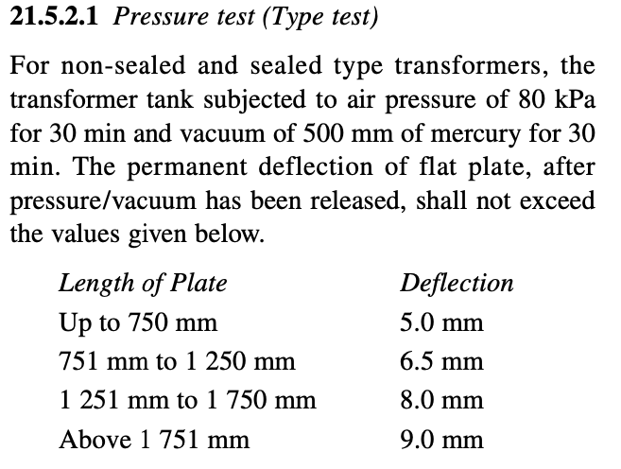
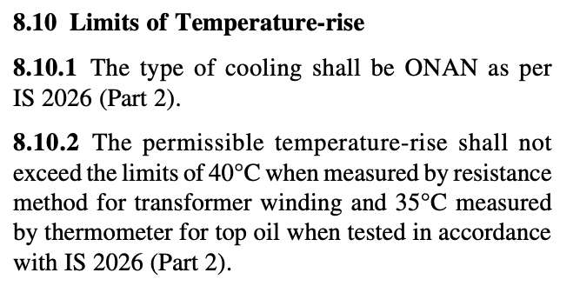
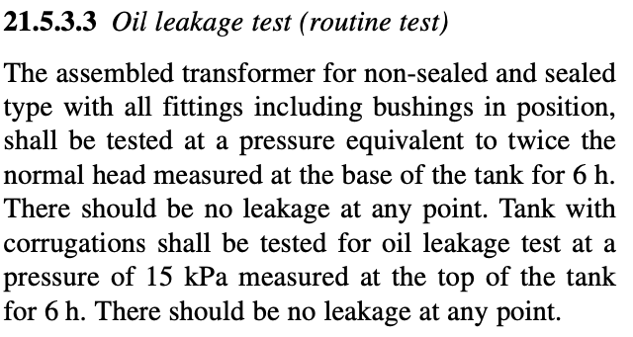
Tests for Validation of ‘Safety’
Specific tests which assures ‘safety’ of operation are :
Temperature Rise Test {Clause 21.3(b) of IS 1180 (Part 1)}
Pressure Test {Clause 21.5.2.1 of IS 1180 (Part 1)}
Oil Leakage Test {Clause 21.5.3.3 of IS 1180 (Part 1)}

Slide 22
Interoperability – How Standard facilitates
Terminal Marking and their relative positions are prescribed in the standard {(e.g. Cl. 10 of IS 1180 (Part 1)}
Rating Plate is standardized {(e.g. Cl. 13 of IS 1180 (Part 1)}
Dimensions of Bushings, Minimum clearances in Air, are prescribed {(e.g. Cl. 10 and Cl. 11 of IS 1180 (Part 1)}
Standard ratings of transformers are defined.
Winding connection and phase displacement (Vector group) is defined for 3 phase transformers {e.g. Cl.6.6 and 7.6 of IS 1180 (Part 1)}

Slide 23
Terminal Marking Plate and Rating Plate of Distribution Transformer as per IS 1180 (Part 1)

Slide 24
Efficiency – What Standards say about
No load loss and losses at 50% and 100% loading is defined for different voltage class and type (1phase/3phase)
{e.g. Clause 6.8 and 7.8 of IS 1180 (Part 1)}
Transformers are categorized into 5 different energy efficiency levels based on total loss
Energy Efficiency Level I Energy Efficiency Level IV
Energy Efficiency Level II Energy Efficiency Level V
Energy Efficiency Level III

Slide 25
Efficiency – How is it addressed in Standard
Rating (kVA) | Impedance (Percent) | Maximum Total Loss(W) at 75 deg C for 11 kV Three Phase Distribution Transformers
 |  | Energy Efficiency Level 1 |  | Energy Efficiency Level 2 |  | Energy Efficiency Level 3 |  | Energy Efficiency Level 4 |  | Energy Efficiency Level 5
 |  | 50 Percent Load | 100 Percent Load | 50 Percent Load | 100 Percent Load | 50 Percent Load | 100 Percent Load | 50 Percent Load | 100 Percent Load | 50 Percent Load | 100 Percent Load
16 | 4.5 | 135 | 440 | 120 | 400 | 108 | 364 | 97 | 331 | 87 | 301
25 | 4.5 | 190 | 635 | 175 | 595 | 158 | 541 | 142 | 493 | 128 | 448
63 | 4.5 | 340 | 1140 | 300 | 1050 | 270 | 956 | 243 | 870 | 219 | 791
100 | 4.5 | 475 | 1650 | 435 | 1500 | 392 | 1365 | 352 | 1242 | 317 | 1130
160 | 4.5 | 670 | 1950 | 570 | 1700 | 513 | 1547 | 462 | 1408 | 416 | 1281
200 | 4.5 | 780 | 2300 | 670 | 2100 | 603 | 1911 | 543 | 1739 | 488 | 1582
250 | 4.5 | 980 | 2 930 | 920 | 2 700 | 864 | 2 488 | 811 | 2 293 | 761 | 2 113
315 | 4.5 | 1 025 | 3 100 | 955 | 2 750 | 890 | 2 440 | 829 | 2 164 | 772 | 1 920

Slide 26
Practical Use Case Perspective

Slide 27
Design, Materials and Components – Vital Considerations
Design – should standards cover this aspect or not?
Materials
Core
Winding
Insulation
Insulating fluid
Tank….
Components
Bushings
Valves
Guide Rails ….

Slide 28
Standard Materials and Standard Components
If not, Overall performance is affected
If Quality of materials is ensured, reliability in operation will result
Ease of repair and maintenance
Replacement of components becomes easier
Standards guide the user on the applicable material and component standards.

Slide 29
Standard Materials and Components – Guidance in Standards (eg. IS 1180-1)
Standard Material
Standard Components
CRGO Core Material | IS 3024
Aluminium Conductor | IS 6162 (Part 1), IS 6162 (Part 2), IS 13730
Copper Conductor | IS 191, IS 1897, IS 7404, IS 13730
Mineral Oil | IS 335
Synthetic Ester | IS 16081
Natural Ester | IS 16559
Kraft Paper | IS 1576, IS 16498
Press Board | IS 9335
Pressure relief device or explosion vent
Liquid level gauge indicating level at minimum, 30 °C and maximum operating temperature.
Rating and Terminal Marking Plate
Unidirectional flat rollers
Lifting lugs for the complete transformer as well as for core and winding assembly
Thermometer pocket with cap
Suitable rating lightning arrestors for HT side
This is a non-exhaustive list

Slide 30
Benefit of Standard Material : Example
CRGO Core Material as per IS 3024 :-
The magnetic material is tested for core loss parameter and as such, the transformer core loss gets limited when material used conforms to IS 3024.
Minimum polarization values are specified for different grades enabling selection of appropriate grade of the material while designing the transformer core.
Physical and mechanical properties such as Stacking factor and Ductility are defined so that the user of such material is assured of the performance of the material while manufacturing the transformer core.

Slide 31
Benefit of Standard Components : Example
Pressure Release Device or Explosion Vent : It is provided in oil immersed transformers to release the excess pressure that may be caused due to evolution of gases during fault conditions. Therefore, it maintains the integrity of transformer tank.
Lifting Lugs : They are provided for facilitating lifting and handling of transformer during manufacture, testing, mounting and installation.
Unidirectional Flat Rollers : Rollers facilitate ease of movement of transformers on guide-rail platforms.

Slide 32
Testing on Transformers Academic vs Industry Framework

Slide 33
Tests on Transformers (Academic)
Short Circuit Test
Open Circuit Test
Voltage Ratio
Winding Resistance Measurement
Are these tests sufficient from an application point-of-view?

Slide 34
Tests on Transformers (Actual)
To mimic the actual operation scenario and assess the design for safe, reliable and efficient performance as per the design and rating
Routine Test
Type Test
Special Test
Winding Resistance Measurement
Measurement of Voltage Ratio and Phase Displacement
Measurement of Short-circuit impedance and load loss
Measurement of no load loss
Measurement of Insulation Resistance
Dielectric Test
Leakage Test for tank
Lightning Impulse Test
Short Circuit Test
Temperature Rise Test
Pressure Test
Determination of sound levels
Over-fluxing test for core
Paint Adhesion Test
BDV and Moisture Content

Slide 35
Dielectric Stress on Insulation
Inter-turn insulation
Insulation between winding and Core
Insulation between windings of different phases

Slide 36
Insulation – The Primary Consideration to ensure reliability of operation
How are these tests performed ?
Test Method Standards – IS 2026 series
Capability of Insulation to Endure Di-electric Stress
Lightning Impulse as per IS 2026 (Part 3)
Switching Impulse
Short Circuit as per IS 2026 (Part 5)
Health and Continuity of Insulation
Induced Overvoltage as per IS 2026 (Part 3)
Separate Source Voltage withstand (V/f = constant) as per IS 2026 (Part 3)

Slide 37
Why Lightning Impulse Test?
Lighting a common phenomenon in transmission lines because of their tall height.
This lightning stroke on the line conductor causes impulse voltage.
The terminal equipment of transmission line such as power transformer then experiences this lightning impulse voltages.

Slide 38
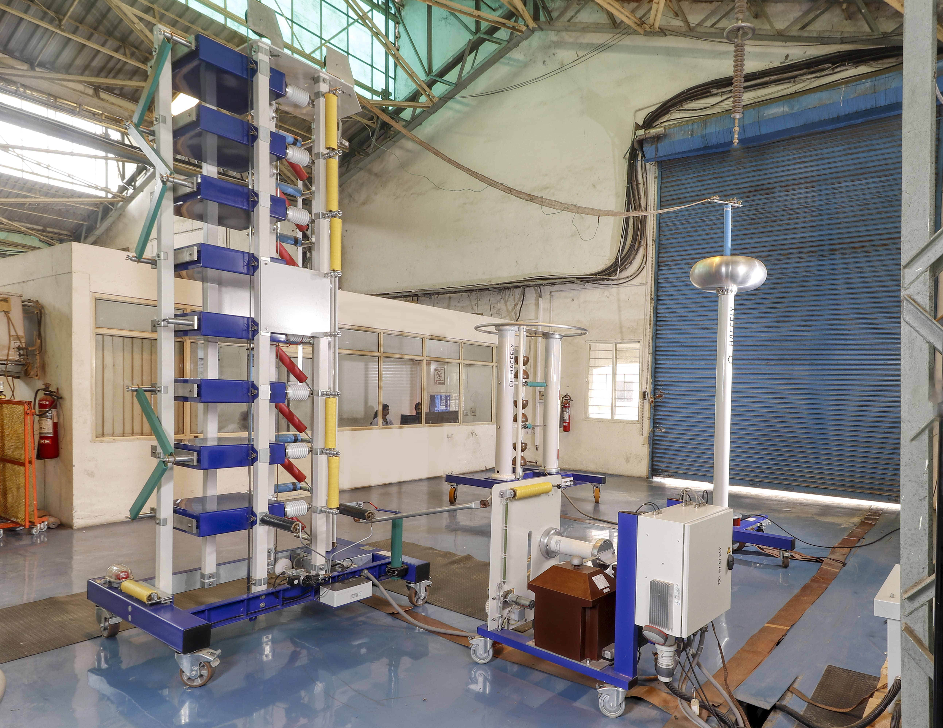
Lightning Impulse Test(As per IS 2026 (Part 3))
Lightning Impulse Test: This test uses natural lightning-like voltages to assess transformer insulation, identifying weaknesses that could cause failure.
It is very difficult to predict the actual wave shape of a lightning disturbance. From the data compiled about natural lightning, it may be concluded that the system disturbance due to natural lightning stroke, can be represented by three basic wave shapes.
Full wave
Chopped wave and
Front of wave

Slide 39
Lightning Impulse Test

Slide 40
Lightning Impulse Test – Procedure and Interpretation of Results
Test is carried out as per IS 2026 (Part 3)
Waveforms on oscillogram are examined to detect any abnormality.

Slide 41
Short Circuit Test(As per IS 2026 (P-5))
Different from the Short circuit test studied in syllabus – which is essentially carried out for determination of circuit parameters
Practical short circuit test performed on a transformer is to test its ability to withstand the following short circuit conditions that may arise due to different types of faults:
Large Overcurrent for a short span of time
Mechanical stress that are developed during short-circuit event
In high voltage systems, the most probable type of short circuit is a single-line-to earth flashover.
Mechanical stress – both Axial and Radial develop during a short circuit event.

Slide 42
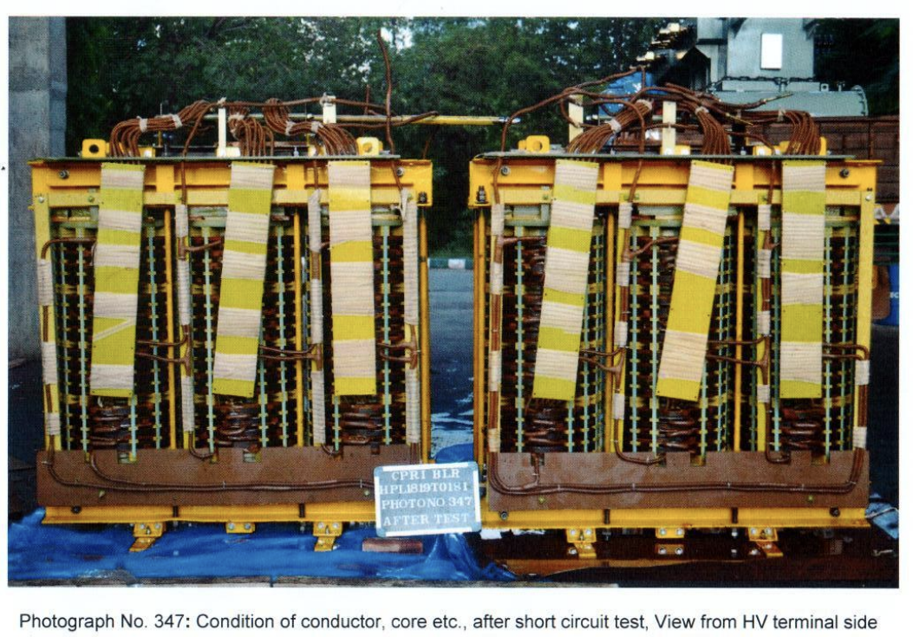
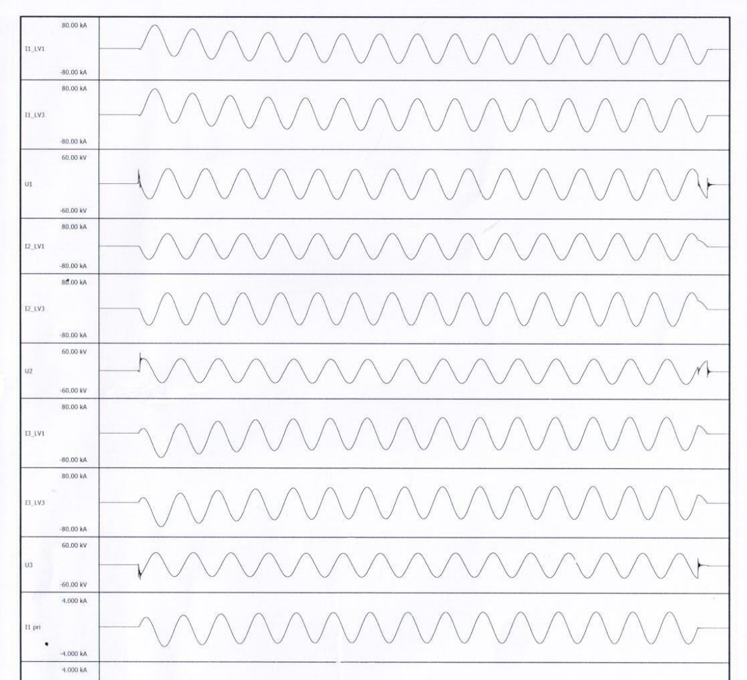
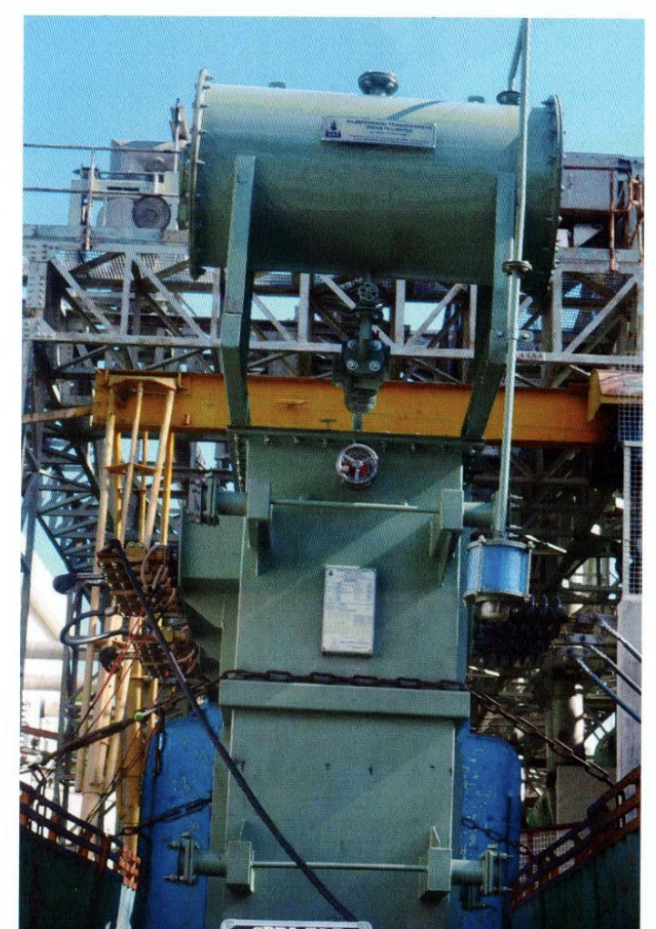
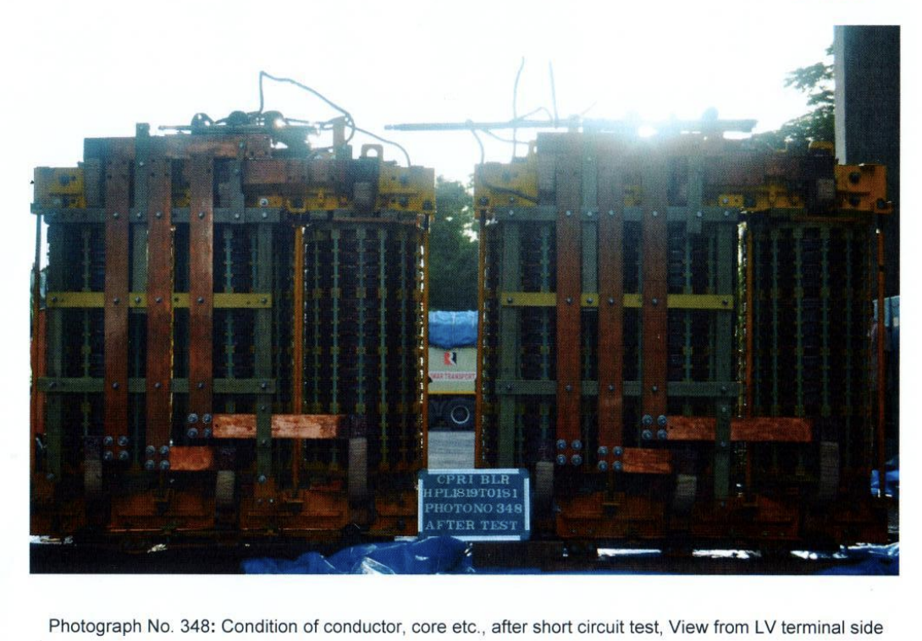
Short Circuit Test is performed as per clause 4.2 of IS 2026 (P-5).
Routine tests are performed before and after short circuit test to check the integrity of the core and winding and also the change in the impedance values, if any.
While conducting the test, voltage and current waveforms are observed to detect any abnormal change.
After the test, the transformer winding and core are un-tanked to find out any damages to them.
If everything is found to be in order, the transformer is declared as conforming to the Short Circuit Test.
Waveforms of Voltage and Current
Mounting Arrangement Before Short Circuit Test

Slide 43
Short Circuit Test – (Un)expected results?
1) The results of the short circuit tests and the measurements and checks performed during tests do not reveal any condition of faults.
2) The routine tests have been successfully repeated and the lightning impulse test, if specified, successfully performed.
3) The out-of-tank inspection does not reveal any defects such as displacements, shift of laminations, deformation of windings, connections or supporting structures, so significant that they might endanger the safe operation of the transformer.
4) No traces of internal electrical discharge are found.
5) The short circuit reactance values, in ohms, evaluated for each phase at the end of the tests do not differ from the original values by more than the allowed limits (in %).

Slide 44
Temperature Rise Test(As per IS 2026 (Part 2) )
Objective : A temperature rise test of a transformer checks if the temperature increase of its winding and oil meets specified limits.
Oil temperature is measured directly by use of thermometers or temperature sensors
Winding temperature rise is measured by Resistance method
The temperature rise test is an essential part of the transformer testing process and is performed to ensure that the transformer can operate safely and reliably under normal operating conditions.

Slide 45
Temperature Rise Test – Insulation Class
Abnormally high temperature rise during continuous operation of a transformer leads to deterioration of insulation and then its failure.
Insulation classes of materials along with their normal operating temperature withstanding capacity are defined in IS 1271

Slide 46
Pressure test (Cl. 21.5 of IS 1180(Part 1)
Why?
Pressure tests on transformers are important for ensuring the safety, reliability, and integrity of the transformer's tank and insulation system.
Pressure tests can help detect leaks in the transformer’s joints and gaskets.
The test confirms that the transformer tank can withstand internal pressures without deforming, which is crucial for ensuring the safety and durability of the equipment.
Procedure:
During a pressure test, the transformer tank is subjected to air pressure of 80 kPa for 30 min
A vacuum of 250 mm of mercury for 30 min for up to 200 kVA and 500 mm of mercury for 30 min for above 200 kVA
The permanent deflection of flat plates, after pressure/ vacuum has been released, shall not exceed the specified values

Slide 47
Other Special Tests
BDV and moisture content of oil in the transformer (as per IS 335): The Breakdown Voltage (BDV) test measures the dielectric strength of transformer oil, which is its ability to withstand electrical stress without breaking down. The test involves applying an increasing AC voltage between two electrodes submerged in the transformer oil until the oil fails .
Why is BDV Testing Important? Insulation Quality Assessment: Transformer oil acts as both an insulator and a coolant. A high BDV indicates that the oil has good insulating properties, which is crucial for the safe and efficient operation of the transformer.
Determination of sound levels [IS 2026 (Part 10)] : Transformers produce noise due to vibrations in the core and winding. It is necessary to measure the sound level of transformers in order to control Noise Pollution
Paint adhesion tests(as per ASTM D3359):It ensures that the paint film stays attached to the surface for a long time, especially in challenging conditions.

Slide 48
Test Method Standards - Significance
Standard Test Methods – so that test results are acceptable
Repeatability and Reproducibility
Uniformity of test and environment conditions
Uniformity in reporting of test results

Slide 49
Benefits of Following Standards
Standardized Test Method
Standardized Reporting
Unambiguous interpretation of results

Slide 50
Bridge the Gap – through Standards

Slide 51
The Gap – What and Why?
Generally, at academic level, fundamentals are what we learn
To develop professional ability, many practical aspects are to be learned.
Understanding the requirement from a practical and application point of view is limited due to many reasons, including the limited time and scope of the academic curriculum

Slide 52
How to Bridge this Gap (Academia-Industry)
Industrial Visits
Practical Training
Internship Programme
Literature
…..
…..
STANDARDS -

Slide 53
Why Standards as a Bridge between Academia and Industry
Standards Development is a collaborative process involving wide stakeholder consultations
Latest in the technology which are accepted both by manufacturers and Users
The purest form of knowledge which have been demonstrated as practicable and implementable

Slide 54
Indian Standards on Transformers
Sl. No. | Transformer Type | IS No. | Title of the Indian Standard
1 | Oil Immersed Distribution Transformers | IS 1180 (Part 1) | Outdoor/Indoor Type Oil Immersed Distribution Transformers Upto and Including 2 500 kVA 33kV - Specification Part 1 Mineral Oil Immersed
2 | Natural/Synthetic Organic Ester Liquid Immersed Distribution Transformers | IS 1180 (Part 3) | Outdoor/Indoor Type Liquid Immersed Distribution Transformers Up to and Including 2 500 kVA 33 kV Specification Part 3 Natural Synthetic Organic Ester Liquid Immersed
3 | Power Transformers | IS 2026 (Part 1) | Power transformers: Part 1 general
4 | Dry-Type Transformers | IS 2026 (Part 11) | Power Transformers Part 11 Dry-Type Transformers

Slide 55
Indian Standards on Transformers
Sl. No. | Transformer Type | IS No. | Title of the Indian Standard
5 | Testing transformer | IS 13956:1994 | Testing transformers - Specification
6 | Arc Furnace Transformer | IS 12977:1990 | Arc furnace transformers specification
7 | Welding transformer | IS 1851:1997 IS 13339:1992 | Single Operator type arc welding transformers Multi-operator type arc welding transformers
8 | Mining Transformer | IS 11333:1985 IS 2772:1982 | Specification for flameproof dry type transformers for use in mines. Specification for non - Flameproof mining transformers for use below ground
9 | Instrument Transformer | IS 16227 (Part 1): | Instrument Transformers-General Requirements
10 | Gas Filled Power Transformer | IS 2026 (Part 15): 2018 | Power transformers: Part 15 gas - Filled power transformers
11 | Power Transformers for Wind Turbine Applications | IS 2026 (Part 16):2023 | Power transformers: Part 16 transformers for wind turbine applications

Slide 56
Indian Standards Related to Transformer and Components/Materials
Material Type | IS/IEC No | Title
Press Board | 1576:1992 | Solid Pressboard for Electrical Purposes-Specification.
 | 16498 Part-1:2018 | Specification for Pressboard and Press paper for Electrical Purposes Part 1 Definitions and General Requirements.
 | 16498 Part-2: 2017 | Specification for Pressboard and Presspaper for Electrical Purposes Part 2 Methods of Tests.
 | IS 16498 (Part 3/Sec 1):2019 | Specification for Pressboard and Press paper for Electrical Purposes Part 3 Specifications for Individual Materials Sheet 1 Requirements for pressboard, types B.0.1, B.0.3, B.2.1, B.2.3, B.3.1, B.3.3, B.4.1, B.4.3, B.5.1, B.5.3 and B.6.1
 | IS 16498 (Part 3/Sec 2):2019 | Specification for Pressboard and Press paper for Electrical Purposes Part 3 Specifications for Individual Materials Sheet 2 : Requirements for Presspaper, Types P.2.1, P.4.1, P.4.2, P.4.3 and P.6.1.

Slide 57
Indian Standards Related to Transformer and Components/Materials
Material Type | IS/IEC No | Title
Kraft Paper | IS 9335 (Part 1):2024 | Cellulosic Papers for Electrical Purposes- Specification Part 1 Definitions and General Requirements.
 | IS 9335 (Part 2):2024- | Cellulosic Papers for Electrical Purposes Part 2 Methods of Tests
 | IS 9335 (Part 3/Sec 1): 1984 | Specification for cellulosic papers for electrical purposes: Part 3 specifications for individual materials: Sec 1 general purpose electrical paper
 | IS 9335 (Part 3/Sec 3):1984 | Specification for cellulosic papers for electrical purposes: Part 3 specifications for individual materials: Sec 3 crepe paper
 | IS 9335 (part 3/Sec 5):1985 | Specification for cellulosic papers for electrical purposes: Part 3 specifications for individual materials: Sec 5 special papers

Slide 58
Indian Standards Related to Transformer and Components/Materials
Material Type | IS No. | Title
Gasket | IS 11149:1984 | Specification for Rubber Gaskets
 | IS 4253 (Part 2):2008 | Cork Composition Sheets-Specification: Part 2 Cork and Rubber.
Bushings | IS/IEC 60137:2017 | Insulated Bushings for Alternating Voltages above 1000 V.
 | IS 7421:1988 | Specification for Porcelain Bushings for Alternating Voltages up to and including 1000 V
 | IS 3347 (Part 1/Sec 1):1979 | Dimensions for porcelain transformer bushings for use in normal and lightly polluted atmospheres: Part 1 up to and including 1 KV: Sec 1 porcelain parts.
 | IS 3347 (Part 1/Sec 2):1979 | Dimensions for porcelain transformer bushings for use in normal and lightly polluted atmospheres: Part i up to and including 1 kV: Sec 2 metal parts
 | IS 3347 (Part 2/Sec 1): 1979 | Dimensions for porcelain transformer bushings for use in normal and lightly polluted atmospheres: Part ii 3.6 kV bushings: Sec 1 porcelain parts.

Slide 59
Indian Standards Related to Transformer and Components/Materials
Material Type | IS No | Title
Bushings | IS 3347 (Part 2/Sec 2): 1979 | Dimensions for porcelain transformer bushings for use in normal and lightly polluted atmospheres: Part ii 3.6 kV bushings: Sec 2 metal parts.
 | IS 3347 (Part 3/Sec 1): 1988 | Dimensions for porcelain transformer bushings for use in 1 lightly polluted atmospheres: Part 3 17.5 kV bushings: Sec 1 porcelain parts.
 | IS 3347 (Part 3/Sec 2) : 1982 | Dimensions for porcelain transformer bushings for use in normal and lightly polluted atmospheres: Part iii 12 and 17.5 kV bushings: Sec 2 metal parts.
 | IS 3347 (Part 4/Sec 1) : 1988 | Dimensions for porcelain transformer bushings for use in lightly polluted atmospheres: Part 4- 24 kv bushings: Sec 1 porcelain parts.
 | IS 3347 (Part 4/Sec 2):1982 | Dimensions for porcelain transformer bushings for use in normal and lightly polluted atmospheres: Part 4 24 kV bushings: Sec 2 metal parts.
 | IS 3347 (Part 5/Sec 1):1979 | Dimension for porcelain transformer bushings for use in normal and lightly polluted atmospheres: Part 5 36 kV bushings: Sec 1 porcelain parts.
 | IS 3347 (Part 5/Sec 2):1979 | Dimensions for porcelain transformer bushings for use in normal and lightly polluted atmospheres: Part 5 36 kV bushings: Sec 2 metal parts

Slide 60
Indian Standards Related to Transformer and Components/Materials
Material Type | IS No. | Title
Mineral Oil | IS 335:2018 | New insulating Oils-Specification
Natural Ester | IS 16659: 2017/IEC 62770:2013 | Fluids for Electrotechnical Applications-Unused Natural Esters for Transformers and Similar Electrical Equipment
Synthetic Organic Ester | IS 16081:2013/IEC 61099:2010 | Insulating Liquids-Specifications for Unused Synthetic Organic Esters for Electrical Purposes
Aluminium | IS 6162 (Part 1):1971 | Specification for paper - Covered aluminium conductors: Part 1 round conductors.
 | IS 6162 (Part 2):1971 | Specification for paper covered aluminium conductors: Part 2 rectangular conductors.
 | IS 13730 (Part 0/Sec 3):2012 | Specifications for particular types of winding wires: Part 0 general requirements: Sec 3 enamelled round aluminium wire.

Slide 61
Indian Standards Related to Transformer and Components/Materials
Material Type | IS No. | Title
Copper | IS 191: 2007 | Copper Specification
 | IS 1897:2008 | Copper strip for electrical purposes – Specification
 | IS 7404 (Part 1):1991 | Paper covered copper conductors - Specification: Part 1 round conductors
 | IS 12444:2020 | Copper Wire Rods for Electrical Applications.
 | IS 13730 (Part 0/Sec 1):2018 | General requirements, Section 1 Enamelled round copper wire
 | IS 13730 (Part 0/Sec 2): 2018 | General requirements, Section 2 Enamelled rectangular copper wire.
 | IS 13730 (Part 17):2014 | Polyvinyl acetal enameled rectangular copper wire, Class 105.
 | IS 13730 (Part 27):2018 | Paper tape covered rectangular copper wire

Slide 62
Indian Standards Related to Transformer and Components/Materials
Material Type | IS No. | Title
CRGO | IS 3024:2015 | Grain Oriented Electrical Steel Sheet and Strip
Amorphous | IS 16585:2023 | Magnetic Materials-Specifications for Individual Materials-Fe Based Amorphous Strip Delivered in the Semi-Processed Stage

Slide 63
Quality Control Order
Mandatory vs Voluntary
Why QCO ?
Importance
Other Government Regulations

Slide 64
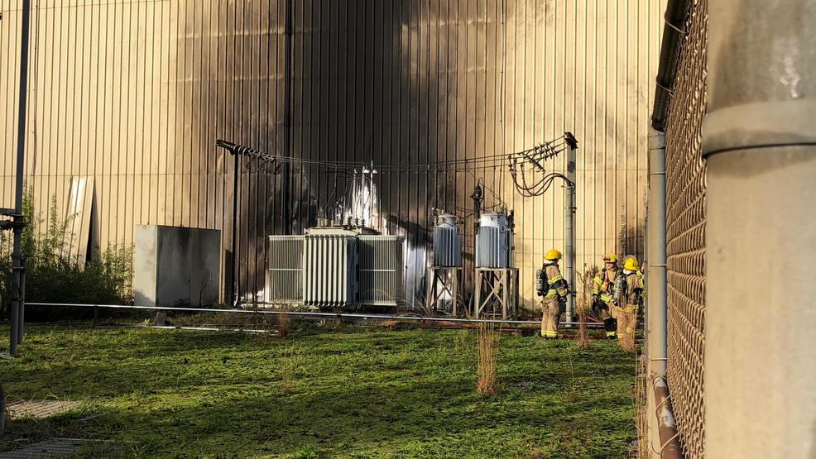
Safety :
Why ?
Risks Associated
What is non-compliance
Stakeholders
Casualties
Fire in a Transformer

Slide 65
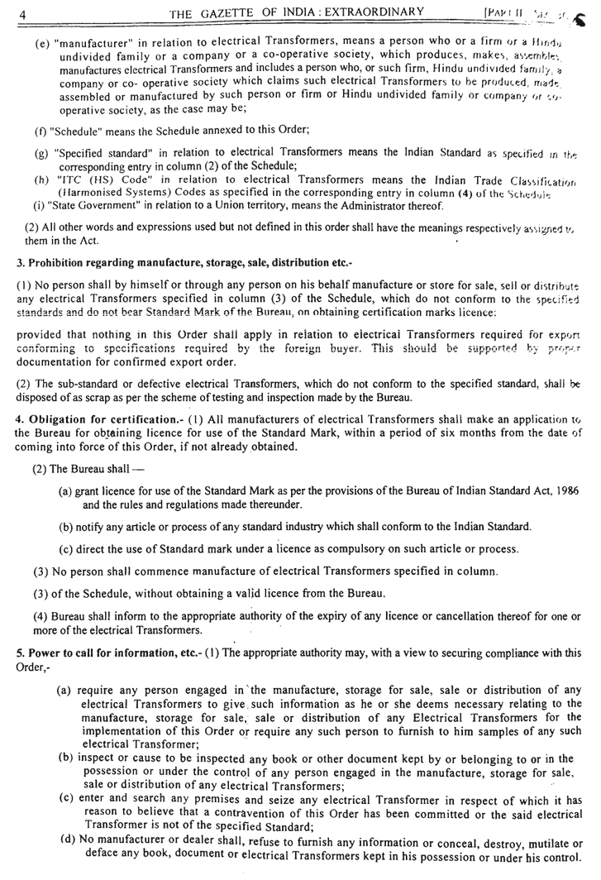
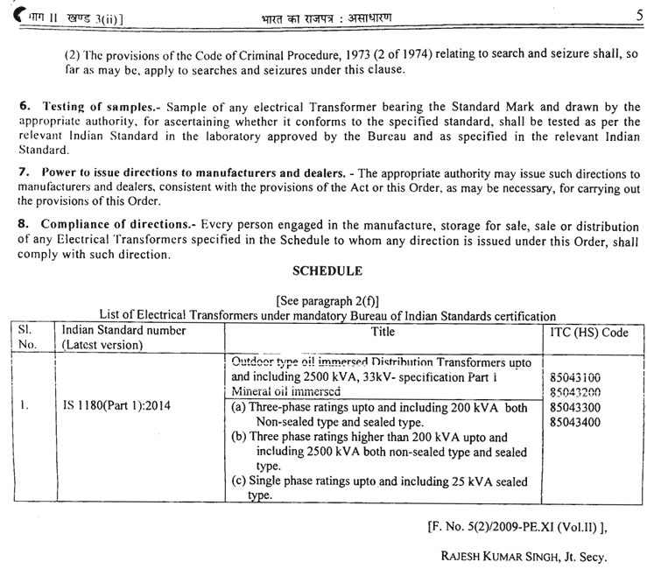
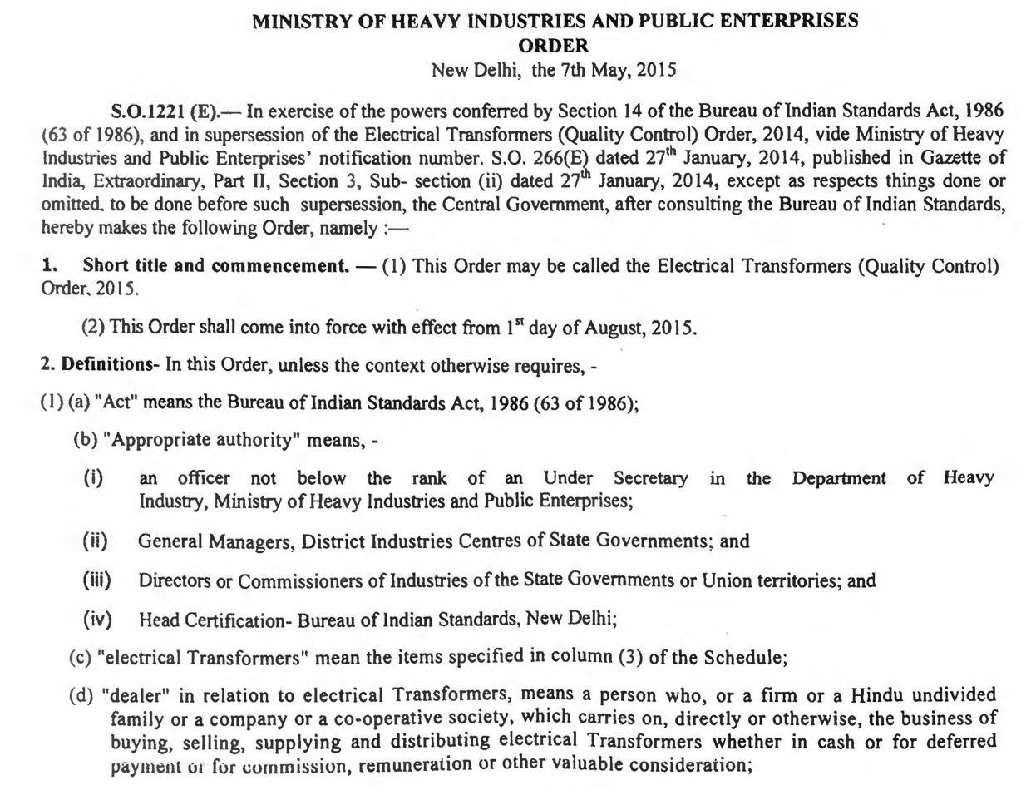
Quality Control Order

Slide 66
Industry Perspective

Slide 67
eBIS Portal
https://www.manakonline.in

Slide 68
World of Standards : www.manakonline.in

Slide 69
BIS CARE APP

Slide 70
Standardsbis.bsbedge.com

Slide 71
T H A N K Y O U

