Slide 1
STANDARDIZATION OF MOTORS

Slide 2
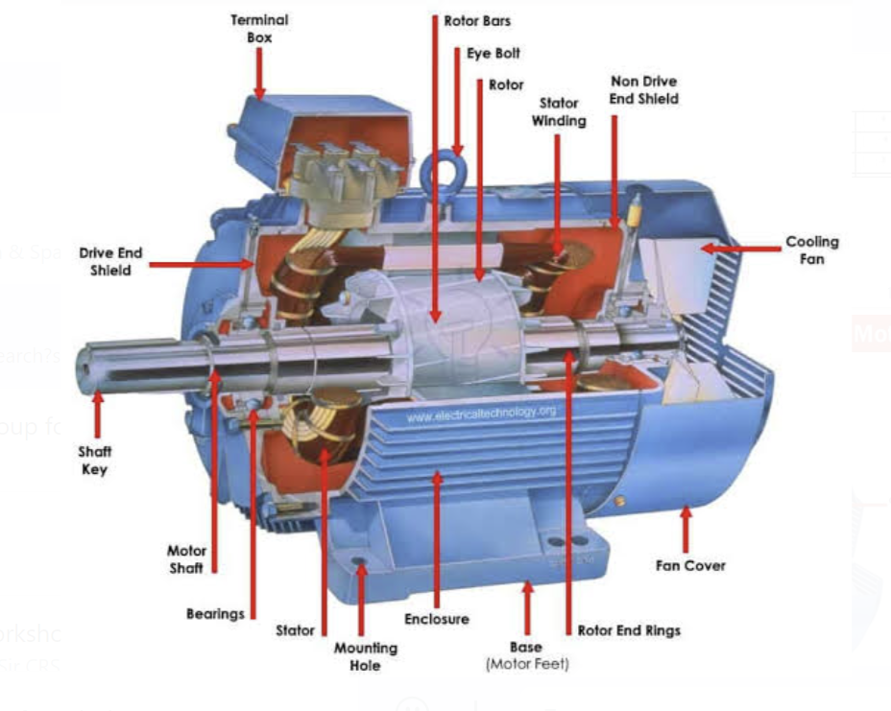
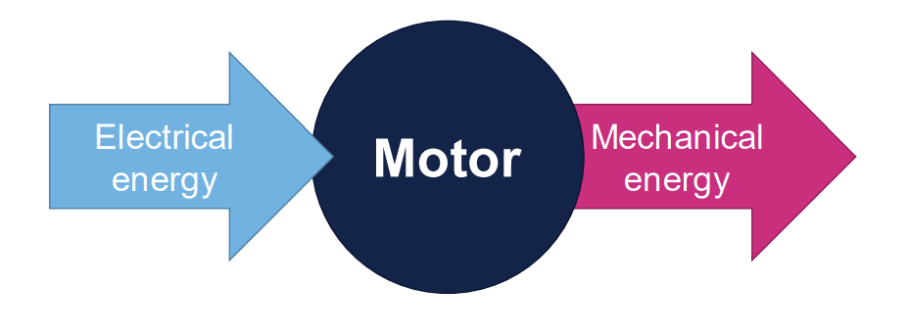
ELECTRICAL MOTORS: BASIC PRINCIPLE

Slide 3
Curriculum Perspective

Slide 4
Electric Motors- Curriculum of Academia
Classification of Electric Motors
Working Principle
Constructional features
Methods of starting of motors
Types of losses
Efficiency of Motors
Types of Tests
Cooling Arrangements

Slide 5
Electric Motors- Definition & Terminology (IS 1885- Part 35)
Stator (Cl. 411-43-01 IS 1885 (Part 35) : 2021) : The stationary portion of the machine
Rotor : The rotating portion of the machine (Cl. 411-43-02)
Armature : The portion of the machine which carries the armature winding. (Cl. 411-43-03)
Field system : The portion of the machine which carries the field winding (Cl. 411-43-04 )
Field Windings : An excitation winding contributing to the creation of principle magnetic field of a machine. (Cl. 411-37-09 )
Excitation Winding : A winding for the production of magnetic field which is stationary with respect to that winding. (Cl. 411-37-08 )
Brush : A conducting part, generally stationary, which provides electrical sliding contact with a commutator or slip rings. (Cl. 411-41-01 )

Slide 6
Commutator: An assembly of conducting members insulated from one another and from their supports, against which the brushes are maintained, enabling current to flow between a rotating winding and a generally stationary part of a circuit by sliding contact and also enabling commutation between the particular coils of the rotating winding. (Cl. 411-41-13 )
Efficiency : The ratio of active output power to active input power, expressed per unit or as a percentage (Cl. 411-53-08 )
Slip : The difference between the synchronous speed and the actual speed of rotor expressed as per unit or as a percentage of the synchronous speed. (Cl. 411-46-07 )
Starting Current: The steady state r.m.s. current taken from the line over the starting period from zero speed to load speed with rated voltage and frequency applied. (Cl. 411-48-18 )

Slide 7
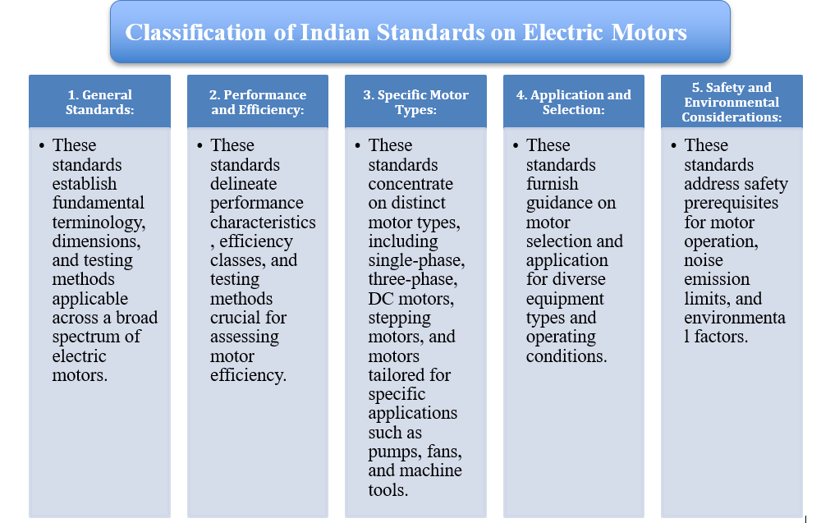

Slide 8
Classification of Indian Standards (IS) for Electric Motors:
Classification by Motor Type
AC MOTORS
DC MOTORS
STEPPING
MOTORS
OTHER
MOTOR TYPES
Single Phase: IS 996, IS 11537, IS 8789, IS 7572
Three Phase: IS 12615, IS
15999 (Part 26), IS 12066,
IS 14377, IS 13555, IS 9628,
IS 7538, IS 8151
IS 15429, IS 9320
IS 15999 (Part 20/Sec
1)
Motors for Specific Applications: IS 9283 (Submersible pumps), IS 2254 (Vertical shaft pumps), IS 2972 (Textile)

Slide 9
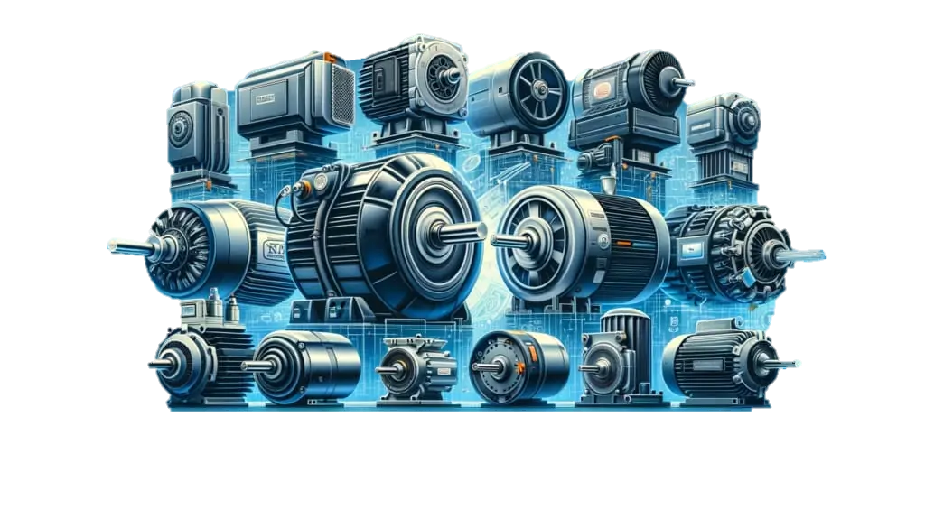
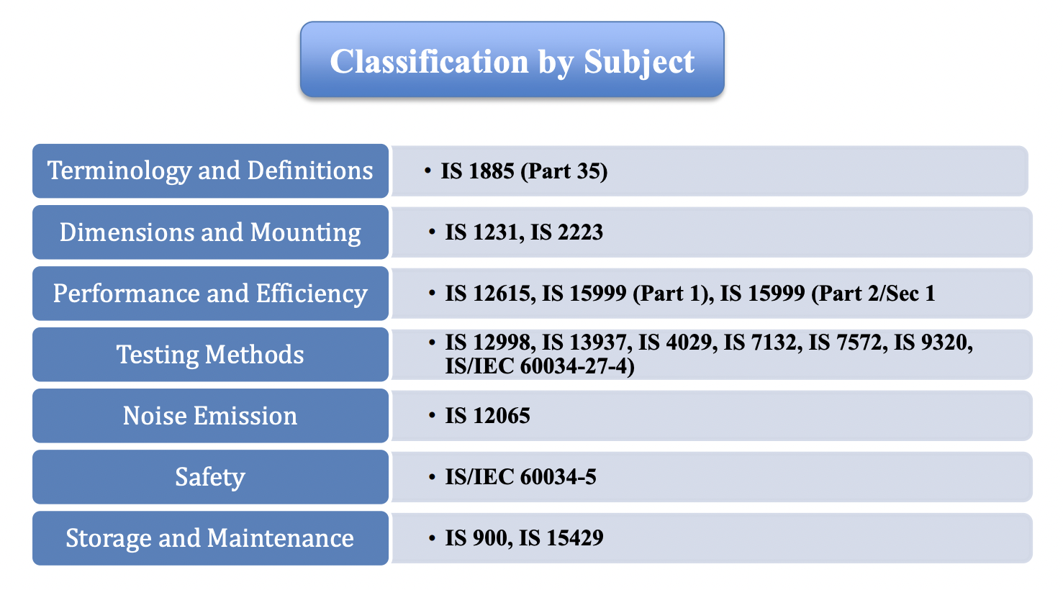

Slide 10
General Tests for Electrical Machines
Measurement of winding resistance: Determining the resistance of the motor windings.
Insulation resistance test: Checking the insulation resistance of the motor.
High voltage test: Applying a high voltage to test the insulation strength.
Efficiency: measures how effectively motor converts electrical power into mechanical power.
No-load test: Running the motor without any load to measure its no-load current, power, and speed.
Load test: Running the motor under load conditions to measure its efficiency, power factor, and temperature rise.
Temperature rise test: Measuring the temperature rise of the motor during operation.
Vibration and noise test: Measuring the vibration and noise levels produced by the motor.
Leakage current test: Measuring the leakage current to ensure it is within permissible limits.

Slide 11
INDEX
IS 996 : 2009
IS 12615 : 2018
IS 9283 : 2013
IS 15999 series
IS/IEC 60034-5 : 2000
IS 6362 : 1995 (IEC Pub 34-6 : 1991)
IS 12075 : 2008

Slide 12
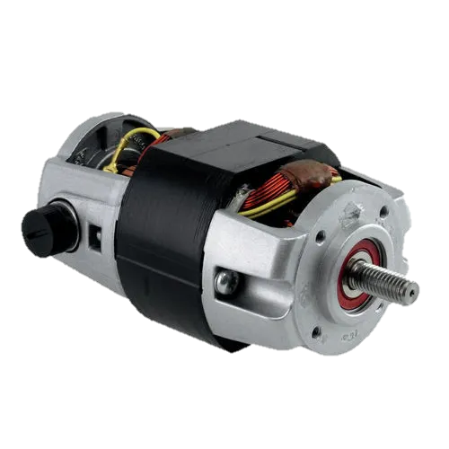
IS 996 : 2009 Single-Phase AC Induction Motors for General Purpose
Scope: This standard covers the requirements for single-phase small AC and universal electric motors used in household and similar applications.
Applications: Includes motors used in household appliances such as fans, mixers, grinders, and other similar devices.
Construction: Specifies constructional features to ensure safety and durability.
Performance: Defines performance characteristics, including starting and running performance, to ensure reliability in operation.

Slide 13
Key points of the standard:
Scope: Covers capacitor-type motors up to 250V and 2200W with Class A, B, F, or H insulation.
Terminology: Defines terms like overload, fan-duty motors, reversible motors, and more.
Rated Conditions (Cl. 4): Specifies preferred voltage (230V), frequency (50Hz), output ratings, and speeds.
Site Conditions & Environment (Cl. 5 & 6): Outlines acceptable altitude, temperature, voltage/frequency variations, and environmental factors.
Dimensions & Construction (Cl. 7 & 9): Provides recommendations for motor dimensions and construction features, including mounting types, terminal boxes, materials, and thermal protection.
Types of Enclosures (Cl. 10): Defines various enclosure types like open ventilated, drip-proof, totally enclosed, etc., as per IS 4691.
Methods of Cooling (Cl. 11): Categorizes cooling methods according to origin and manner (natural, self, separate, open circuit, surface).

Slide 14
Key points…….
General Characteristics (Cl. 12): Specifies requirements for torques (breakaway, pull-up, pull-out), temperature rise limits, performance values (speed, current, efficiency), vibration severity, and insulation resistance.
High Voltage & Leakage Current (Cl.13): Details high voltage test values and methods, moisture proofness test procedures, and limits for leakage current.
Terminal Marking & Labelling (Cl. 14): Specifies requirements for terminal markings and criteria for labelling environment-friendly products.
Marking & Diagram Connections (Cl. 16): Requires a rating plate with specific information and a connection diagram.
Tests (Cl. 17): Defines type tests, routine tests, and acceptance tests for ensuring motor compliance.
General Information (Cl. 18): Lists information to be provided with inquiries and orders for motors.
Selection and Application (Cl. 19): Offers guidance on selecting motors based on factors like the number of starts and specific applications.

Slide 15
PERFORMANCE REQUIREMENTS OF IS 996 : 2009
For ensuring the quality and performance of motors, some of the important tests are:
Test for no-load current, power input and speed at rated voltage and frequency
Test for breakaway starting current at rated voltage and frequency (Cl. 12.1.1)
Moisture proofness Test (Cl. 13.2)
Vibration test (Cl. 12.6)
Efficiency (Cl. 12.5.1)

Slide 16
Moisture proofness test (Cl. 13.2)
The moisture proofness test requires a chamber that varies temperatures between 25 ± 10°C and 40 ± 2°C with humidity levels of at least 95% at high temperatures and 80% otherwise. The test cycle involves heating, maintaining, and cooling phases, with strict conditions on water purity and condensation management. Items must be in a ready-to-use state, and post-test, insulation resistance should be at least 2 MΩ, and the motor must pass a high voltage test at 80% specified values.

Slide 17
Problems if Moisture proofness Test is Not Performed:
Moisture-induced insulation breakdown
Electrical leakage and short circuits
Corrosion of components
Reduced motor lifespan
Increased failure rates and maintenance costs
Safety hazards

Slide 18
Solutions Provided by Passing the Moisture Proofness Test:
Ensures robust insulation and electrical integrity
Prevents moisture-induced electrical faults
Protects against corrosion and component damage
Enhances motor reliability and lifespan
Reduces maintenance requirements and costs
Improves overall safety and operational efficiency

Slide 19
vibration test (Cl. 12.6)
A vibration test for a single-phase induction motor is conducted to assess the motor's condition and performance by analyzing the vibrations it generates during operation.
The vibration test ensures that for a motor operating at rated values the maximum root mean square (rms) vibration-velocity does not exceed 4.5 mm/s, as measured according to IS 12075.

Slide 20
Problems if Vibration Test is Not Performed:
Excessive vibration leading to mechanical stress
Premature wear and tear of components
Reduced operational lifespan
Increased noise levels
Potential for catastrophic failure
Safety hazards for operators and equipment

Slide 21
Solutions Provided by Passing the Vibration Test:
Ensures mechanical stability and integrity
Reduces wear and tear, extending component lifespan
Enhances operational reliability and efficiency
Lowers noise levels for a safer working environment
Prevents potential failures, ensuring safety for operators and equipment

Slide 22
Efficiency (Cl. 12.5.1)
The values of minimum full load speed, maximum full load current, nominal efficiency and maximum breakaway starting current for 2 pole, 4 pole and 6 pole general purpose ac single phase motors at rated voltage of 230 V, 50 Hz shall be in accordance with Tables 1 to 11. The tolerances for efficiency are given in table 12.
For labelling environment friendly products the motor shall have at least 3 percent improvement in efficiency over and above that prescribed in this standard.

Slide 23
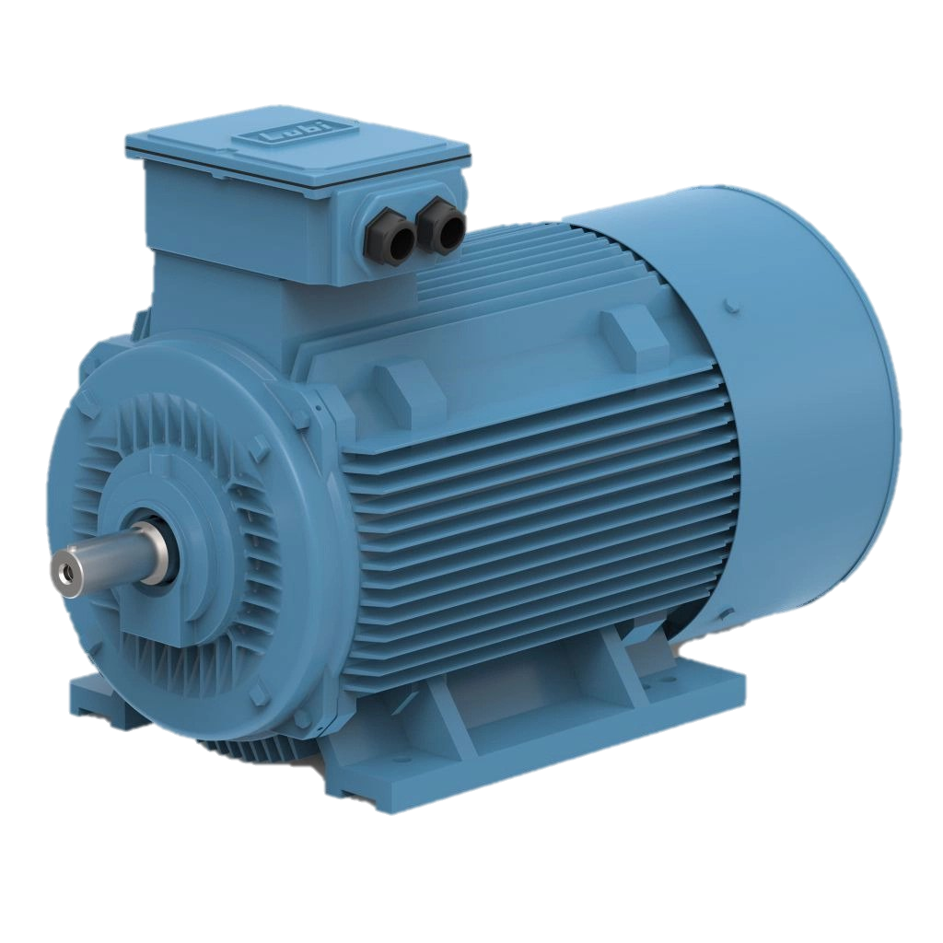
IS 12615 : 2018 Line Operated Three Phase a.c. Motors (IE CODE) “Efficiency Classes and Performance Specification”
Scope: This Indian Standard specifies the performance and efficiency requirements for single-speed, three-phase AC motors used in various industrial applications. It covers motors with power ratings from 0.12 kW to 1000 kW, various pole configurations (2, 4, 6, or 8), and rated voltages up to 1000V at 50Hz.
Efficiency Classes: IE2 (High Efficiency), IE3 (Premium Efficiency), IE4 (Super Premium Efficiency). Higher efficiency classes offer better energy savings and reduced operating costs

Slide 24
Key points of the standard:
Site Conditions (Cl. 4): Motors should be designed for specific site conditions, including altitude (up to 4000m) and ambient temperature (between -20°C and +60°C).
Electrical Operating Conditions (Cl. 4.2): Motors must operate on sinusoidal and balanced voltage conditions and withstand voltage and frequency variations within specified limits.
Type of Enclosures and Cooling Methods (Cl. 5 & 6): The standard recommends specific enclosure types (IP44 or better) and cooling methods (IC411 preferred) to ensure proper protection and performance.
Performance Specifications (Cl. 14): The standard outlines specific performance parameters, including locked rotor torque, locked rotor current, full load speed, full load current, and frame size correlations to output power.
Testing and Certification (Cl. 16 & 17): The standard details routine and type tests to verify motor performance and efficiency. Manufacturers should provide test certificates as evidence of compliance.
Marking and Labelling (Cl. 18): Motors must be marked with the rated efficiency, IE code, and other relevant information on the rating plate.

Slide 25
Benefits of using motors compliant with IS 12615: 2018:
● Energy Savings: Higher efficiency motors consume less energy, leading to reduced electricity bills and environmental impact.
● Improved Performance: The standard ensures that motors meet specific performance criteria, resulting in reliable and efficient operation.
● Enhanced Durability: Motors built to this standard are designed for specific environmental conditions, leading to increased lifespan and reduced maintenance costs.
● Compliance with Regulations: Adopting motors compliant with this standard can help industries meet energy efficiency regulations and avoid potential trade barriers.

Slide 26
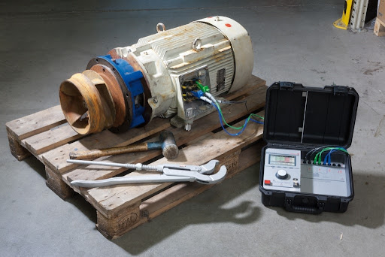
PERFORMANCE REQUIREMENTS OF IS 12615
For ensuring the quality and performance of motors, some of the important tests are:
Momentary Excess torque (Cl. 12.1)
Pull-up torque test (Cl. 12.2)
Temperature rise test (Cl. 13)
Efficiency (Cl. 15)
Locked Rotor test (Cl. 16.2.2)

Slide 27
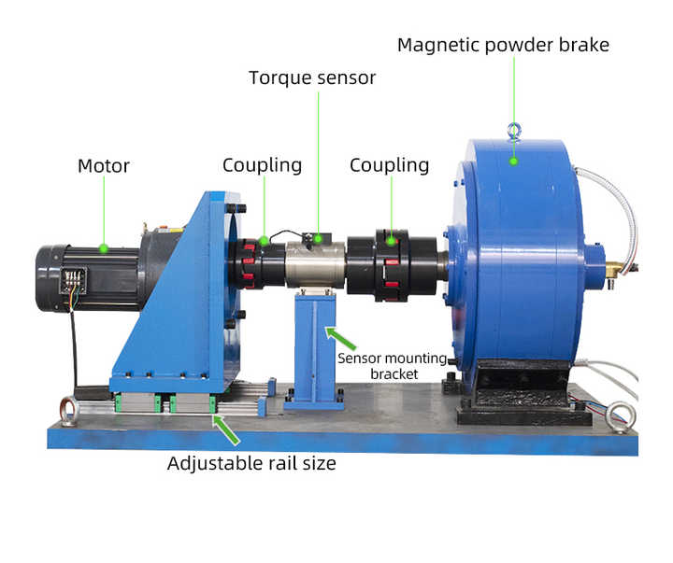
Momentary Excess torque test (Cl. 12.1)
The motors shall be capable of withstanding for 15 s without stalling or abrupt change in speed (under gradual increase of torque) 1.6 times their rated torque, the voltage and frequency being maintained at their rated values (at the motor terminals).

Slide 28
Problems Faced by Motors Without Momentary Overload Capability
Motors that cannot handle momentary overloads often experience :
stalling,
abrupt speed changes,
thermal overload, mechanical stress,
electrical overload,
operational unreliability,
safety risks, and
efficiency losses.
These issues can lead to frequent breakdowns, higher maintenance costs, reduced performance, and hazardous operating conditions.

Slide 29
Solutions Provided by Passing the Momentary Overload Test
Passing the momentary overload test ensures that the motor can withstand sudden increases in load without stalling or abrupt speed changes, maintain stable thermal and mechanical integrity, handle higher currents without electrical failure, and operate reliably and efficiently under stress. This results in reduced downtime, lower maintenance costs, enhanced performance, extended lifespan, and improved safety in its operating environment.

Slide 30
Temperature rise test (Cl. 13)
The Temperature Rise Test of AC motors is conducted to evaluate the thermal performance and ensure the motor operates safely under specified conditions. During the test, the motor is run at its rated load and voltage for a predetermined period, typically until it reaches a steady-state temperature. The key objectives are to measure the temperature rise of the motor windings and other critical components, verify that the temperature rise is within acceptable limits, and assess the effectiveness of cooling systems. This test helps in ensuring the motor's reliability, performance, and longevity by identifying potential overheating issues and verifying compliance with thermal ratings.

Slide 31
Problems Faced by Motors Without Adequate Temperature Rise Control
Motors that cannot manage temperature rise effectively often suffer from
insulation breakdown,
reduced lifespan,
increased risk of thermal overload,
higher failure rates,
degraded performance, and
safety hazards.
These problems can lead to frequent malfunctions, excessive maintenance requirements, inefficient operation, and potential risks to surrounding equipment and personnel.

Slide 32
Solutions Provided by Passing the Temperature Rise Test
Passing the temperature rise test ensures that the motor can operate within safe thermal limits, maintaining insulation integrity, prolonging lifespan, and reducing the likelihood of thermal overload and failure. This results in more reliable performance, lower maintenance costs, higher efficiency, and enhanced safety, ensuring the motor can withstand operational stresses without compromising its components or surrounding environment.

Slide 33
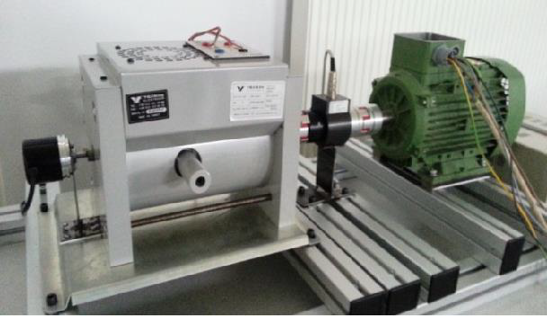
Locked Rotor Test (Cl. 16.2.2)
This test is carried out to determine the soundness of rotor in case of squirrel cage induction motors and their starting current, power factor, starting torque and impedance. This also enables a circle diagram to be drawn in case of squirrel cage induction motors and wound rotor motors. This test may be carried out at reduced voltage, one of the readings may be at a voltage that will produce rated current of the motor.
Induction Motor Test Setup

Slide 34
Problems Faced by Motors Without Adequate Locked Rotor Capability
Motors that cannot effectively handle locked rotor conditions often face issues such as
excessive current draw,
overheating,
mechanical stress,
insulation damage,
reduced lifespan,
increased failure rates, and
potential safety hazards.
These problems can lead to frequent breakdowns, high maintenance costs, inefficient operation, and risks to both the motor and its surroundings.

Slide 35
Solutions Provided by Passing the Locked Rotor Test
Passing the locked rotor test ensures that the motor can handle the high current and stress associated with starting conditions without overheating or damaging its components. This results in improved durability, reliable performance during startup, reduced maintenance requirements, higher operational efficiency, and enhanced safety, ensuring the motor can withstand the rigors of locked rotor situations without adverse effects.

Slide 36
Efficiency (Cl. 15)
The standard deals with single-speed motors operated on-line. In order to make efficiency class ratings comparable between different motor technologies, all tests according to this standard shall be performed on sinusoidal voltage as defined in 7.2.1.1 of IS 15999 (Part 1).
Efficiency and losses shall be determined in accordance with the preferred method of the individual motor type as given in IS 15999 (Part 2/Sec 1).
Nominal Limits for Efficiency Classes IE2, IE3 and IE4, the values of efficiency listed under appropriate efficiency class are as per Table 1 to Table 4. The values given in Table 1 to Table 4 are subject to tolerance as specified in IS 15999 (Part 1).
The losses and efficiency of these motors shall be calculated according to IS 15999 (Part 2/Sec 1).

Slide 37
Problems Faced by Motors with Lower Efficiency
Motors with low efficiency can face several problems that impact their performance, longevity, and overall operational costs. Here are some common issues:
Higher Operating Costs
Excess Heat Generation
Reduced Lifespan
Poor Performance
Increased Wear and Tear
Voltage Drops and Power Quality Issues.
Noise and Vibration
Increased Maintenance Requirements

Slide 38
Solutions Provided by Motors with Higher Efficiency
Higher-efficiency motors provide a range of significant benefits over less efficient models. They reduce operating costs by consuming less electricity to perform the same work, leading to substantial savings. Additionally, these motors generate less heat, which helps maintain cooler operating conditions and minimizes the need for extra cooling systems. Their improved performance translates into extended lifespan and reduced wear and tear, resulting in fewer repairs and replacements. Higher-efficiency motors also enhance power quality, operate more quietly, and require less maintenance, further reducing costs. Moreover, they integrate well with advanced control systems, such as variable speed drives, optimizing energy savings and operational flexibility.

Slide 39
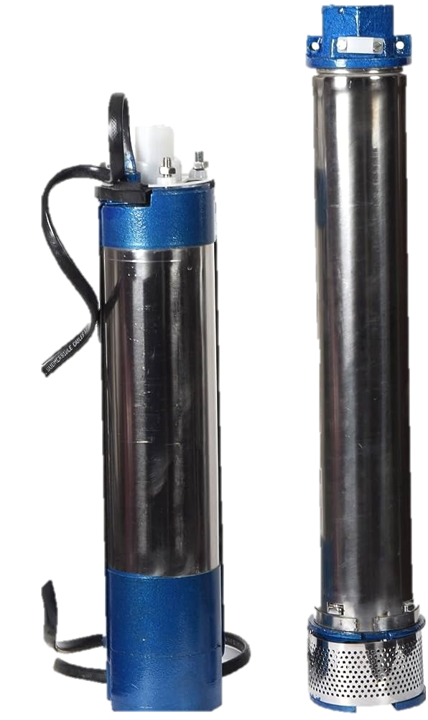
IS 9283 : 2013 Motors for Submersible Pumpsets
Scope: This standard specifies the requirements and performance criteria for electric motors used in submersible pump sets.
Design: Focuses on the design and construction to ensure water tightness and reliability under submerged conditions.
Performance: Specifies performance requirements including efficiency, power factor, and starting characteristics.

Slide 40
Key points of the standard:
● Types of motors covered:
Wet type water filled
Wet type oil filled
Resin filled
● Water characteristics (Cl. 4): Defines the parameters of “clear, cold, and fresh water” for which the motors are suitable.
● Construction(Cl. 5): Specifies materials for various components, including the cable, shaft, bearings, and casings. Also covers earthing requirements and protection against foreign matter.
● Voltage and Frequency (Cl. 6): Preferred values are 415V (3-phase) and 240V (single-phase) at 50Hz. The standard also defines permissible variations.
● Output Ratings (Cl. 6.3): Provides preferred output ratings in kW for both three-phase and single-phase motors.
● Dimensions and Tolerances (Cl. 7): Defines maximum overall diameters for different bore sizes and provides recommended shaft dimensions. Tolerance limits for shaft extension runout, concentricity, and face runout are also specified.

Slide 41
Key points contd……
● Performance Characteristics (Cl. 11): Specifies minimum full load speed, maximum full load current, minimum starting torque, and nominal efficiency for 2-pole motors of different bore sizes and phases.
● Overload Test (Cl. 18) : Details the requirements for momentary and sustained overloads.
● Temperature Rise Test (Cl. 19) : Defines the acceptable temperature rise limits for stator windings at rated and reduced voltage.
● High Voltage Test (Cl. 20): Specifies the procedure and voltage levels for testing insulation strength.
● Insulation Resistance Test (Cl. 21): Defines the minimum acceptable insulation resistance.
● Leakage Current Test (Cl. 23): Sets the limit for maximum leakage current at rated voltage and no load.

Slide 42
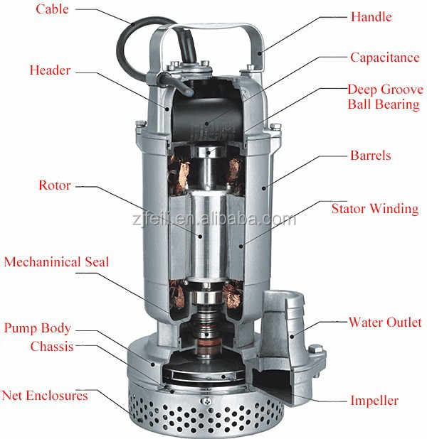
PERFORMANCE REQUIREMENTS OF IS 9283 : 2013
For ensuring the quality and performance of motors, some of the important tests are:
High Voltage test (Cl. 20)
Insulation Resistance test (Cl. 21)
Leakage current test (Cl. 23)
Efficiency (Cl. 12.1)

Slide 43
HIGH VOLTAGE TEST (Cl. 20)
The high voltage test is applied between the windings and the frame only to a new and completed motor with all of its parts in place filled with water. The test is carried out at the conclusion of the temperature rise test of the motor where such a test is carried out.
The test voltage shall be of the supply frequency and shall be as near as possible to sine wave form. The test shall be commenced at a voltage of not more then one half of the full test voltage. The voltage shall then be increased to the full value steadily or in the steps of not more than 5 percent of the full value, the time allowed for the increase of the voltage from half to full value being not less then 10 s. The full test voltage of 1500 V shall be maintained for 30 s.

Slide 44
Problems Faced by Motors Without Adequate High Voltage Capability
Motors that cannot effectively handle high voltage conditions often face
insulation breakdown,
short circuits,
electrical leakage,
component damage,
reduced lifespan,
increased failure rates, and
potential safety hazards.
These issues can lead to frequent electrical faults, high maintenance costs, unreliable operation, and risks to both the motor and surrounding equipment.

Slide 45
Solutions Provided by Passing the High Voltage Test
Passing the high voltage test ensures that the motor's insulation system is robust and capable of withstanding high voltage conditions without electrical breakdown or leakage. This results in improved electrical integrity, reliable performance, reduced maintenance requirements, extended lifespan, and enhanced safety, ensuring the motor can operate safely and effectively even under high voltage stress.

Slide 46
INSULATION RESITANCE TEST (Cl. 21)
The insulation resistance when the high voltage test is applied shall be not less than 5 m ohm. The insulation resistance shall be measured with a dc voltage of 500 V applied for a sufficient time for the reading of the indicator to become practically steady, such voltage being taken from an independent source or generated in the measuring instrument.

Slide 47
Problems Faced by Motors Without Adequate Insulation Resistance
Motors with insufficient insulation resistance are prone to
insulation breakdown,
electrical leakage,
short circuits,
reduced lifespan,
increased failure rates, and
safety hazards.
These issues can lead to frequent electrical faults, high maintenance costs, inefficient operation, and potential risks to both the motor and its surroundings.

Slide 48
Solutions Provided by Passing the Insulation Resistance Test
Passing the insulation resistance test ensures that the motor's insulation is robust and has a resistance of not less than 5 megaohms, capable of preventing electrical leakage and breakdown. This results in enhanced electrical integrity, reliable performance, reduced maintenance requirements, extended lifespan, and improved safety, ensuring the motor can operate efficiently and safely even under varying electrical conditions.

Slide 49
LEAKAGE CURRENT TEST (Cl. 23)
The maximum leakage current value shall not be more than 50 mA at rated voltage at no load. The motor shall be placed on either a rubber mat or a wooden base or any other insulated base. A voltage equal to the rated voltage shall be applied to any supply line and accessible outside metal parts of the motor. The resistance of the test circuit shall be 2 000 ± 50 ohm.

Slide 50
Problems Faced by Motors Without Adequate Leakage Current Control
Motors that cannot effectively manage leakage current often face issues such as
Electrical Leakage,
Insulation Breakdown,
Potential for Electric Shock,
Reduced Efficiency
These problems can lead to
Frequent Electrical Faults,
High Maintenance Costs,
Unreliable Operation, and
Risks to both the motor and personnel handling the equipment

Slide 51
Solutions Provided by Passing the Leakage Current Test
Passing the leakage current test ensures that the motor's leakage current does not exceed 50 mA at rated voltage under no load conditions, verifying the motor's insulation effectiveness and overall electrical safety. This results in enhanced electrical integrity, reliable and efficient performance, reduced maintenance requirements, and improved safety, ensuring the motor can operate without posing electrical hazards to users and surrounding equipment.

Slide 52
EFFICIENCY (Cl. 12.1)
The statement of efficiency at rated load of the motor shall be made by the manufacturer. The values for 2-pole motors shall not be inferior than those given in Tables 2, 3, 4, 5, 6 and 7. The values of 4-pole motors are under consideration.
For determination of efficiency of three-phase submersible motors by summation of losses method as outlined in IS 4029, the stator copper losses I2R shall be calculated using the value of resistance as at 50°C for motors wound with PVC / Polywrap insulation and 75°C for motors wound with enamelled copper wires.
For determination of efficiency of single-phase submersible motors by method as outlined in IS 7572.

Slide 53
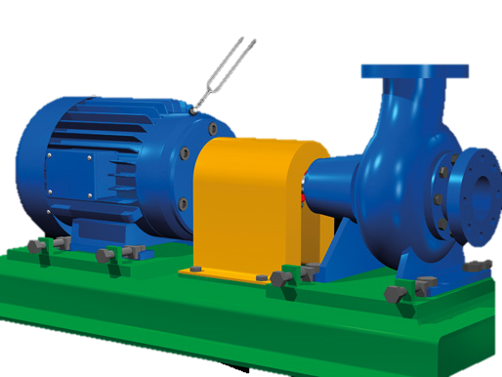
IS 15999 series Rotating Electrical Machines
Scope: Specifies standards for rotating electrical machines including motors and generators.
Part 1: Provides guidelines for the rating and performance of rotating electrical machines
Part 2/Sec 1: provides a comprehensive guide for determining the losses and efficiency of rotating electrical machines.
Objectives: Ensures reliability, efficiency, and performance consistency across electrical machines.
Applicability: Applies to machines used in industrial, commercial, and residential sectors.
Importance: Facilitates compliance with international standards, enhancing interoperability and reliability in electrical systems.

Slide 54
IS 15999 (Part 1)
Key features of this standard:
Defines various duty types (S1 to S10) based on load characteristics and operating conditions.
Each duty type has specific requirements and considerations for rating and performance.
Different classes of rating exist: Continuous running, Short-time, Periodic, Non-periodic, Discrete constant loads and speeds, and Equivalent loading.
Defines standard site conditions for altitude, ambient temperature, and water coolant temperature
Defines requirements for electrical supply, voltage and frequency variations, and operation on unearthed systems.
Assigns thermal class to insulation systems according to IEC 60085
Defines methods for measuring temperature: Resistance, Embedded temperature detector (ETD), and Thermometer.

Slide 55
Establishes safe operating speeds and overspeed withstand capabilities.
Sets limits for total harmonic distortion (THD) for synchronous machines.
Defines requirements for protective earthing of machines and shaft-end keys
Specifies tolerances for various quantities like efficiency, current, power factor, speed, slip, torque, etc
Defines EMC requirements for machines with rated voltages up to 1000 V AC or 1500 V DC
Requires machines to comply with relevant safety standards like IEC 60204-1, IEC 60204-11, or IEC 60335-1, as appropriate.
Provides guidance for applying duty type S10 and establishing the relative thermal life expectancy (TL).
Lists electromagnetic compatibility (EMC) limits for Class A and Class B equipment according to CISPR 11.
Overall, IS 15999 (Part 1):2021 provides a comprehensive framework for ensuring the proper rating, performance, and safety of rotating electrical machines in various applications.

Slide 56
IS 15999 (Part 2/SEC 1)
Indian Standard, details methods for determining the losses and efficiency of rotating electrical machines through various testing procedures. It aligns with the IEC 60034- 2-1: 2014 standard and applies to:
● DC machines: Covering various types and sizes.
● AC synchronous machines: Including those with electrical and permanent magnet excitation.
● AC induction machines: Including single-phase and three-phase configurations of all sizes.
Key features of this standard:
● Efficiency Determination: The document outlines both direct and indirect methods for calculating efficiency. Direct methods involve measuring input and output power, while indirect methods involve calculating losses and then adding them to output power or subtracting them from input power.
● Test Methods: A variety of test methods are detailed, categorized as either preferred or for specific applications like field testing or routine checks.

Slide 57
● Preferred Methods: These methods offer low uncertainty and are recommended for specific machine types and sizes. They include:
Method 2-1-1A (Induction machines): Direct measurement of input and output power using a dynamometer. Suitable for single-phase machines.
Method 2-1-1B (Induction machines): Summation of losses with additional load losses determined using the residual loss method. Applicable for three-phase machines up to 2 MW.
Method 2-1-1C (Induction machines): Summation of losses with additional load losses based on assigned values. Used for three-phase machines above 2 MW.
Method 2-1-2A (Synchronous machines): Direct measurement of input and output power using a dynamometer. Suitable for machines with frame sizes below 180 mm and permanent magnet excited machines.
Method 2-1-2B (Synchronous machines): Summation of losses with a rated load temperature test and a short circuit test. Applicable for machines with frame sizes above 180 mm and power ratings up to 2 MW.

Slide 58
Method 2-1-2C (Synchronous machines): Summation of losses without a full load test and additional load losses determined from a short circuit test. Used for machines above 2 MW.
In essence, IS 15999 (Part 2/Sec 1) : 2023 acts as a comprehensive guide for determining the losses and efficiency of rotating electrical machines. By following the outlined methods and procedures, manufacturers and testing laboratories can obtain accurate and reliable results.

Slide 59
IS/IEC 60034-5 : 2000 Rotating electrical machines: Part 5 degrees of protection provided by the integral design of rotating electrical machines (IP Code) - Classification
Scope: Specifies the degrees of protection provided by enclosures applicable to rotating electrical machines as regards the:
Protection of persons against contacts with or approach to live parts and against contact with moving parts (other than smooth rotating shafts and the like) inside the enclosure and protection of the machine against ingress of solid foreign objects;
Protection of machines against the harmful effects due to ingress of water. It gives designations for these protective degrees and tests to be performed to check that the machines meet the requirements of this standard.
Purpose: Defines the IP (Ingress Protection) codes to classify and rate the protection of electrical machines against intrusion of solids and liquids.
Applicability: Applies to motors and generators used in various environments, including industrial, commercial, and outdoor applications.
Importance: Ensures machines meet specified protection standards, enhancing durability and reliability in diverse operating conditions.

Slide 60
Key features of this standard:
IP Codes: It defines IP (Ingress Protection) codes, consisting of two digits. The first digit indicates protection against solid objects, while the second digit denotes protection against water.
Solid Object Protection: The first digit ranges from 0 to 6, indicating protection levels against various sizes of solid objects, from larger objects like hands (0) to dust particles (6).
Water Protection: The second digit ranges from 0 to 9, indicating protection levels against various forms of water ingress, from no protection (0) to powerful jets of water (9).
Ingress Protection rating Chart

Slide 61
Key benefits of this standard:
Standardization: It provides a standardized method for classifying the degrees of protection provided by enclosures for rotating electrical machines, ensuring consistency and clarity in specifications and evaluations.
Safety Assurance: Compliance with the standard ensures that electrical machines are adequately protected against ingress of solid objects and water, reducing the risk of equipment damage, malfunctions, and potential hazards to personnel.
Reliability: By adhering to the specified levels of protection, IS/IEC 60034-5 helps enhance the reliability and longevity of rotating electrical machines, minimizing downtime and maintenance costs.
Interoperability: Manufacturers and users can communicate effectively using the standardized IP codes, facilitating compatibility and interchangeability of components and equipment across different applications and industries.
Regulatory Compliance: Many industries and regions require adherence to specific standards for electrical equipment. Following IS/IEC 60034-5 ensures compliance with relevant regulations and industry standards.
Quality Assurance: Compliance with the standard reflects a commitment to quality and excellence in manufacturing processes, helping build trust with customers and stakeholders.

Slide 62
Problems due to Inefficient Protection against Solid Foreign Objects in Electric Motors
Insulation Damage
Dust and debris accumulation can lead to insulation breakdown and short circuits.
Reduced Efficiency
Build-up of dirt on windings increases electrical resistance, lowering motor efficiency.
Mechanical Wear
Abrasive particles cause wear on bearings and moving parts, reducing lifespan.
Heat Build-up
Blocked cooling passages due to dust lead to overheating and thermal damage.
Safety Risks
Accumulated dust poses fire hazards in high-temperature environments.

Slide 63
Ensuring Effective Protection with IS/IEC 60034-5 : 2000
IP Rating Standards
Specifies levels of protection against solid foreign objects based on motor design and enclosure.
Ingress Protection Tests
Verifies the motor's ability to resist dust penetration, ensuring specified IP ratings.
Sealing and Enclosure Requirements
Defines requirements for motor enclosures and seals to prevent dust ingress.
Material Selection
Recommends materials resistant to dust accumulation and corrosion.
Regular Inspection and Maintenance
Guidelines for periodic inspection and cleaning to maintain effective protection.

Slide 64
Problems Due to Inefficient Protection Against Water Ingress in Electric Motors
Insulation Degradation:
Moisture penetration can lead to insulation breakdown and electrical faults.
Corrosion:
Water exposure accelerates corrosion of motor components, reducing lifespan.
Reduced Efficiency:
Water in windings increases electrical resistance, lowering motor efficiency.
Mechanical Damage:
Water can cause rusting and erosion of bearings and other components, leading to mechanical failure.
Safety Hazards:
Water ingress increases the risk of electrical shorts and operational hazards, posing safety risks.

Slide 65
Problems Due to Inefficient Protection Against Solid Foreign Objects in Electric Motors
IP Rating Standards: Defines degrees of protection against water ingress, from minimal protection (0) to powerful jets (9).
Ingress Protection Tests: Includes rigorous tests to verify the motor's ability to withstand water ingress according to specified IP ratings.
Sealing and Enclosure Requirements: Specifies requirements for motor enclosures and seals to prevent water penetration.
Material and Coating Selection: Recommends materials and coatings resistant to water and corrosion.
Regular Inspection and Maintenance: Guidelines for periodic inspection and maintenance to ensure continued protection against water ingress.

Slide 66
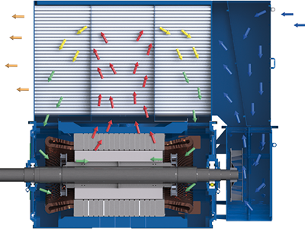
IS 6362 : 1995 (IEC Pub 34-6 : 1991) Designation of Methods of Cooling of Rotating Electrical Machines
Scope: This Indian Standard, identical to the IEC publication, provides a systematic way to designate the cooling methods employed in rotating electrical machines. The standard outlines a comprehensive system using the “IC Code” to represent various cooling circuit arrangements, coolants, and methods of coolant movement.

Slide 67
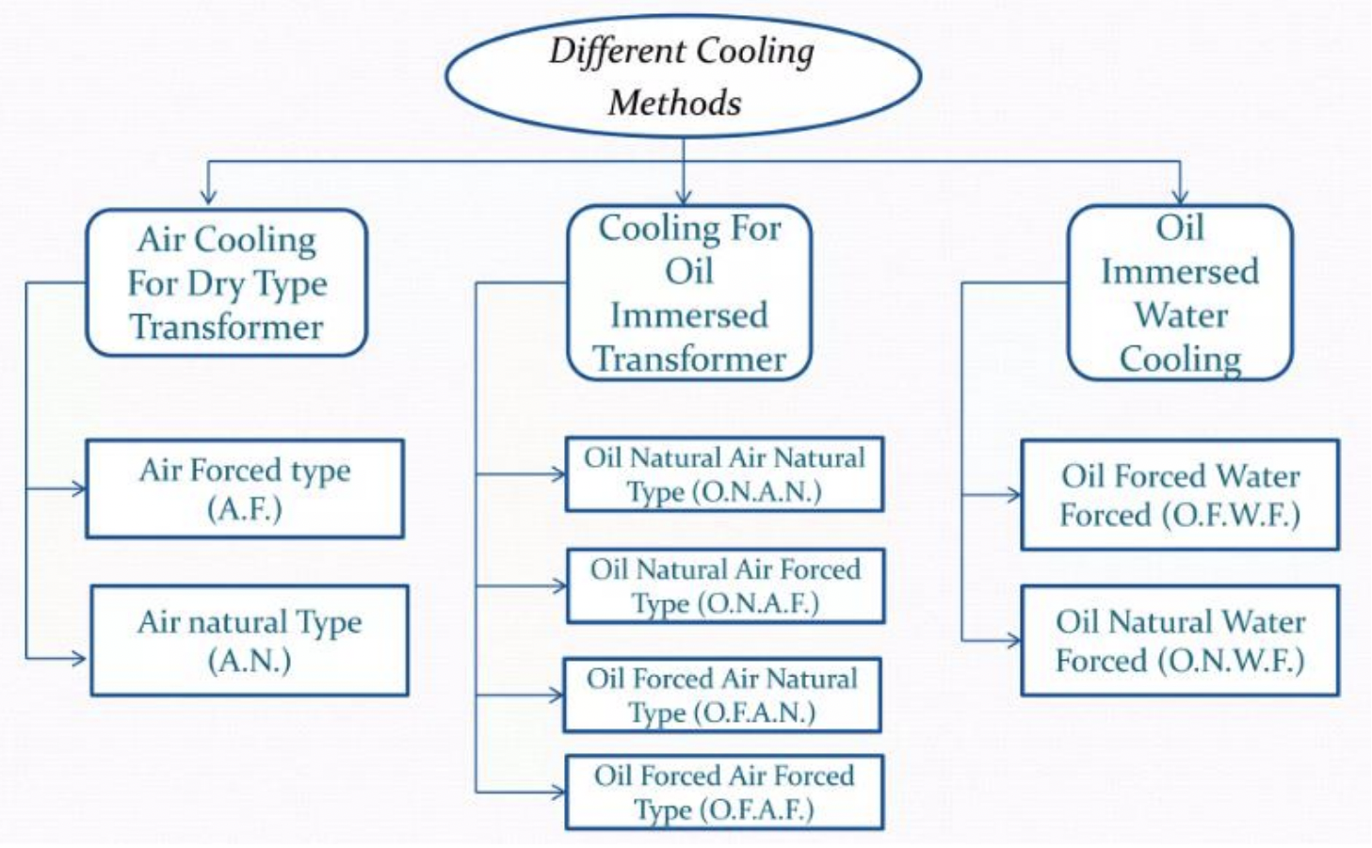

Slide 68
Key features of this standard:
● IC Code Structure: The code begins with “IC” followed by a series of numerals and letters. Each element signifies a specific aspect of the cooling system. This code contains following numerals
○ Circuit Arrangement: The first numeral indicates the cooling circuit arrangement (open or closed circuit, use of heat exchangers, etc.). Examples include:
IC0: Free circulation (open circuit)
IC4: Frame surface cooled (closed primary circuit, open secondary circuit)
IC7: Integral heat exchanger with remote medium (closed primary circuit, open secondary circuit)

Slide 69
○ Primary Coolant: A letter identifies the type of coolant used. Common examples are: A: Air (omitted in simplified designations), W: Water, H: Hydrogen, S: Other coolants (specified elsewhere)
○ Method of Movement of Primary Coolant: A numeral specifies the method used to move the coolant. Examples include:
0: Free convection
1: Self-circulation (dependent on machine rotation)
5: Integral independent component (e.g., motor-driven pump)
7: Separate and independent component or coolant system pressure
○ Secondary Coolant
○ Method of Movement of Secondary Coolant

Slide 70
● Complete vs. Simplified Designations: The standard defines both complete and simplified designation systems. The simplified version omits certain elements under specific conditions, making it more concise for common scenarios.
● Multiple Cooling Systems: The document addresses situations with different coolants or methods of movement in various parts of a machine, or even different circuit arrangements for different parts. The designations are combined accordingly.
● Direct Cooled Windings: For machines with direct cooled windings (coolant flows through hollow conductors), the relevant part of the designation is enclosed in brackets.
● Stand-by/Emergency Cooling: The standard allows for designating stand-by or emergency cooling systems, which are indicated within brackets after the normal cooling method designation.
Overall, IS 6362 : 1995 (IEC Pub 34-6 : 1991) plays a crucial role in establishing a clear and consistent method for designating cooling systems in rotating electrical machines, benefiting manufacturers, users, and maintenance personnel alike.

Slide 71
Problems Due to Ineffective Cooling in Electric Motors
Overheating: Insulation breakdown, motor failure, and reduced component lifespan.
Reduced Efficiency: Increased electrical resistance lowers efficiency.
Premature Bearing Failures: Accelerated lubricant degradation and bearing wear.
Decreased Performance: Potential demagnetization of permanent magnets.
Thermal Expansion: Misalignment and mechanical stresses causing damage.
Safety Hazards: Fire risks and safety issues.

Slide 72
Ensuring Effective Cooling with IS 6362: 1995
Temperature Rise Limits: Specifies maximum allowable temperature rise.
Thermal Management Guidelines: Provides design and implementation guidelines for cooling systems.
Temperature Rise Testing: Mandates tests to verify safe operating temperatures.
Insulation Quality Standards: Ensures use of high-quality, heat-resistant insulation materials.
Cooling System Requirements: Defines standards for effective cooling systems.
Monitoring and Maintenance Protocols: Recommends regular temperature monitoring and cooling system maintenance.

Slide 73
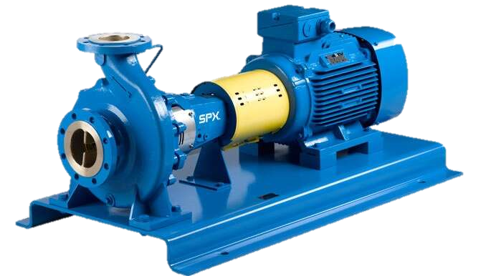
IS 12075 : 2008 Mechanical Vibration of Rotating Electrical Machines
Scope: This Indian Standard outlines the procedures for measuring and evaluating the severity of vibrations in rotating electrical machines with shaft heights of 56mm and above. It applies to DC and AC machines (single or three-phase) with a power rating of up to 50 MW and speeds ranging from 500 to 3000 rpm
Key features of this standard:
● The standard uses the root-mean-square (rms) value of vibration velocity (mm/s) as the primary metric for vibration severity.
● Displacement amplitude (peak-to-peak, in microns) can be used if velocity measurement is unavailable.
● Measurements are taken at specific points on the machine bearings and housing, as defined in the standard.

Slide 74
● Measurements are typically done in a “free suspension” state, achieved by using elastic supports like ropes, springs, or placing the machine on a test bed.
● For machines with shaft heights exceeding 400mm, rigid mounting on a solid floor is also allowed.
● AC machines are tested at rated voltage and frequency with a sinusoidal waveform.
● DC machines are tested at nominal current and voltage to achieve nominal speed.
● Tests are conducted at various speeds for machines with variable speed capabilities.
● The standard defines three quality grades (N, R, S) with corresponding vibration limits based on shaft height and speed.
● Grade N is the standard for most machines, while R and S represent higher quality grades with lower vibration limits.
● Separate limits are provided for displacement amplitude measurements.
● Machines with rigid mounting have slightly relaxed limits compared to free suspension.
● The standard acknowledges that vibrations at the installation site might be higher due to coupled equipment and foundation stiffness.
● For specific cases like two-pole machines or machines with sleeve bearings, additional evaluation and limits for relative shaft vibration might be needed.

Slide 75
Now that we have talked about Standards , you would appreciate:
The Standards addressing the Topics already covered in Text Books in Practical Applications
Standards ensuring that Conformity Assesment Needs and Aspirations of the Society are addressed effectively
The parameters that matter are tested to ensure Conformity (Quality) of a Product
How the Parameters are tested to ensure Conformity

Slide 76
STRUCTURE OF STANDARDS
THE STRUCTURE OF STANDARDS IS ALSO STANDARDIZED
Foreword: Genesis of the Standard in brief, along with major changes brought through revisions (as applicable)
Scope : Defines the ‘Applicability’ of the Standard
Normative References: Documents which have been referred to
Terms & Definitions: As is used in the Standard
Requirements: The set of specified Tests which determines the ‘Quality’ of the Product/ services

Slide 77
STRUCTURE OF STANDARDS
Sampling & Conditioning: Describes Sample preparation for Tests to be carried out
Test Methods : Describes how the specified requirements/ tests to be performed
Packing: How the materials to be packed
Marking: Details which are required to be marked
Sampling Criteria for SQC: Scale of sampling for guidance of manufacturers for Statistical Quality Control purpose

Slide 78
STANDARDIZATION : CONTINUOUS IMPROVEMENT
ASPECT RELEVANT BUT MISSING
TECHNOLOGICAL ADVANCEMENTS NECESSITATING UPDATION
SUGGESTIONS WELCOME!!

Slide 79
IDENTIFYING THE RIGHT STANDARD
‘KNOW YOUR STANDARDS’
Once Standard is identified, Scope of the Standard defines its coverage
All Indian Standards (ISs) are Downloadable Free of Cost

Slide 80
TESTING INFRASTRUCTURE FOR CONFORMITY ASSESMENT
Utilization of Test Facilities under BIS Lab Recognition Scheme (LRS)
IS/ ISO 17025: 2017 Accreditation is a prerequisite
NABL: nabl-india.org
Support to Laboratories (Grant in Aid)

Slide 81
QUALITY CONTROL ORDERS (QCO)
BIS certification scheme is basically voluntary in nature.
However, for a number of products, compliance to Indian Standards is made compulsory by the Central Government under various considerations viz. public interest, protection of human, animal or plant health, safety of environment, prevention of unfair trade practices and national security. For such products,
The Central Government directs mandatory use of Standard Mark under a Licence or Certificate of Conformity (CoC) from BIS through issuance of QCOs.
173 QCOs addressing 725 Products as on date including IS 12615 on Energy Efficient Motors

Slide 82
BIS CARE APP
Verify Licence (Manufacturer) Details
Verify Registration (under BIS CRS) Details
Products under Compulsory Certification
Know Your Standards
Complaints

Slide 83
#WORKINGTOGETHERWORKS
Involvement through Standards Clubs
Faculties/ Research scholars in Standardization
Faculty Engagement as an Expert in BIS Sectional Committee
Engagement in R & D Projects; Guest Faculty on ‘Standardization’
Engagement in Student Internship Programmes
Testing and other Infrastructure in Standardization and Conformity Assesment

Slide 84
THANK YOU

