Slide 1
Design Characteristic of an Insulator

Slide 2
Syllabus for Electrical Engineers for insulators
Electrical engineering Syllabus generally covers the following topics related to INSULATORS during the course-
Insulators, Types of Insulators
Insulating Material and their Properties
Design of Transmission System- Selection of Insulators
The aspects related to Types, Properties, Designing, Selection and applications wrt Safety and Performance requirements in accordance with Indian Standards will be discussed.

Slide 3
INSULATORS
Insulators used in electrical equipment are to support and separate electrical conductors without allowing current through themselves.
Designing of an insulator can be done using different materials like glass, ceramic, PVC, steatite, polymer, etc
These are classified into different types based on their rating and usage which includes the following:
Pin Insulator
Suspension Insulator
Strain Insulator
Shackle Insulator
Post-Insulator
Stay Insulator
Disc Insulator

Slide 5
Types of Insulators
Pin Insulator:- Rigid insulator intended to be mounted rigidly on a supporting structure by means of a pin passing up inside the insulating component which consists of one or more pieces of insulating material permanently connected together.
Pin insulators shall generally be used on the straight stretch of a line. The pin insulators may be used on lines up to 33 kV voltage level. It shall consist of a single piece of porcelain mounted rigidly on a supporting structure on a pin.
Strain insulator:- insulator placed in a structural support such as a guy or span wire to isolate a portion of the support or to prevent leakage current through the support.
Note: Stay wires shall be connected to the pole with a Porcelain Guy Strain Insulator. The Porcelain insulator shall be inserted in the stay wire at a height of minimum 3 m vertically above the ground level. The strain insulators shall be free from defects, thoroughly vitrified and smoothly glazed.

Slide 6
Types of Insulators
Shackle Insulator:- Insulator consisting of one component of insulating material and intended to be secured to the structure by means of a spindle passing through it.
Shackle insulators shall be used in lines below 500 volts
Post insulator:- Rigid insulator intended to be subjected to cantilever, tensile and compressive loads, constructed with one or more insulating materials and assembled on a metal base that is intended to be mounted rigidly on a supporting structure.
Note: In the areas where problem of insulator pollution is expected (such as near sea, thermal power station, railway station, industrial area, etc.) special insulators viz. semi conducting glazed porcelain or polymer insulators with higher leakage resistance and creepage distance shall be used.
The special coating on the insulators may be used.

Slide 7
Types of Insulators (material based)
Polymeric insulator:- insulator whose insulating body consists of at least one organic based material (Polymeric insulators are also known as non-ceramic insulators).
Ceramic insulator:- shaped and fired inorganic material usually consisting of refractory substances and mainly crystalline when cooled
(Note – Examples of refractory materials used in ceramics are silicates, oxides, titanates and silicon nitride.)
Composite insulator:- insulator made of at least two insulating parts, namely a core and a housing equipped with end fittings (Composite insulators, for example, can consist either of individual sheds mounted on the core, with or without an intermediate sheath, or alternatively, of a housing directly moulded or cast in one or several pieces onto the core).
Hollow insulator:- insulator which is open from end to end, with or without sheds, including end fittings (A hollow insulator can be made from one or more permanently assembled insulating elements).
Source:- IEC-electropedia

Slide 8
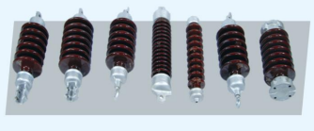
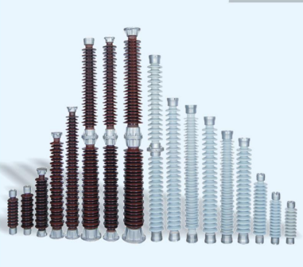
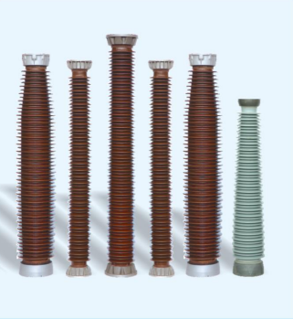
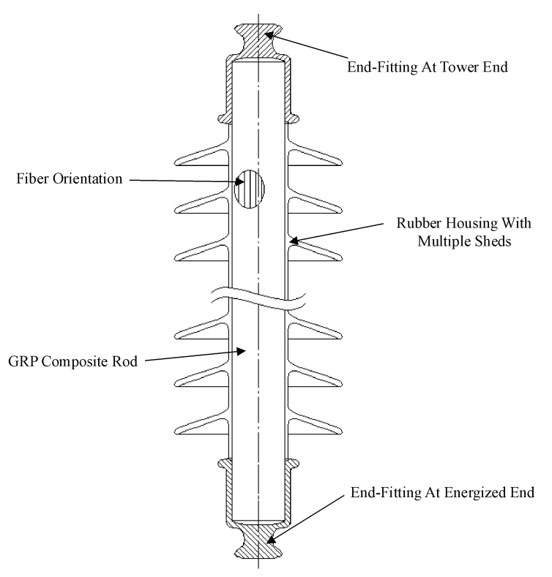
Usage of Insulators
Polymer insulators (non-ceramic / silicone rubber insulators) are widely used over conventional porcelain / Glass insulators due to lighter in weight, good contamination / pollution performance because of hydrophobicity, ease of operation and less prone to vandalism.
Similarly, Room Temperature Vulcanized (RTV) Silicone Rubber coating on porcelain insulators is a practical option for improving the flashover performance in presence of the pollution.
To prevent birds perching immediately above the suspension insulator strings and fouling the insulators with bird dropping, suitable bird guards as per IS 5613, shall be provided on cross arms.
Porcelain Insulator
Composite insulator
Superior performance near seashore, polluted areas.
Hydrophobic nature- water repellent
High tensile strength
Light weight
Substation
Line post- upto 1200 KV
Traction- upto 25 KV
Apparatus Insulators- Instrument transformer(CT/PT), circuit breaker, lightning arrester, transformer bushings – upto 800KV

Slide 9
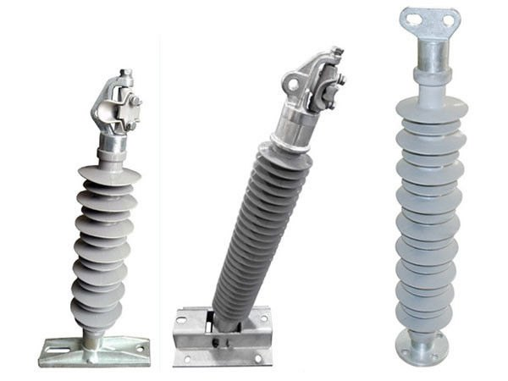
Silicon Rubber Insulator
Properties | Particulars
Insulating | High electrical resistivity and high dielectric strength
U V Radiation | Silicon is highly resistant to solar UV radiation, ideal for outdoor application, longer life
Hydrophobicity | Water repellent
Flammability | Requires high temperature, ideal in case of fault

Slide 10
Classification based on parameter
The insulator type is electrically defined by
The insulator type is mechanically defined by
The arcing distance
Creepage distance
Shed inclination
Shed diameter
Shed spacing.
SCL (specified cantilever load)
Core material
Core Diameter
Method of attachment of the end fittings
Coupling zone of the base end fittings

Slide 11
Typical manufacturing process
Source: “Outdoor Insulators” R. S. Gorur, E. A. Cherney, J. T. Burnham, ISBN 0-9677611-0-7

Slide 12
Components in Electrical System

Slide 13
Transmission system
Design aspect of overhead transmission system:
Configuration of tower
Span length
Sag of conductor
Environmental condition- wind, snow.....
Cross arm length
Ground clearance
Right of way (RoW)
Transmission of electric power is dominated by cables or conductor
Cables are electrically insulated
Conductors are to be connected through Insulators – Insulators are device intended for electrical insulation and mechanical fixing of equipment or conductors which are subject to electric potential differences.

Slide 14
Parameters for insulator selection and dimensioning (cl. 6 of IS 16683-1)
System requirements | Environmental conditions | Insulator parameters
Type of system: | Pollution types and levels: | Overall length:
Maximum operating voltage across the insulation | Rain, fog, dew, snow and ice | Type (pin, suspension…..)
Insulation co-ordination parameters | Wind, storms, temperature, humidity | Material, profile
Imposed performance requirements | Altitude | Creepage distance
Clearances, imposed geometry, dimensions | Lightning earthquake, vandalism, animals | Diameter, arcing distance
Live line working and maintenance practice | Biological growths | Mechanical and electrical design

Slide 16
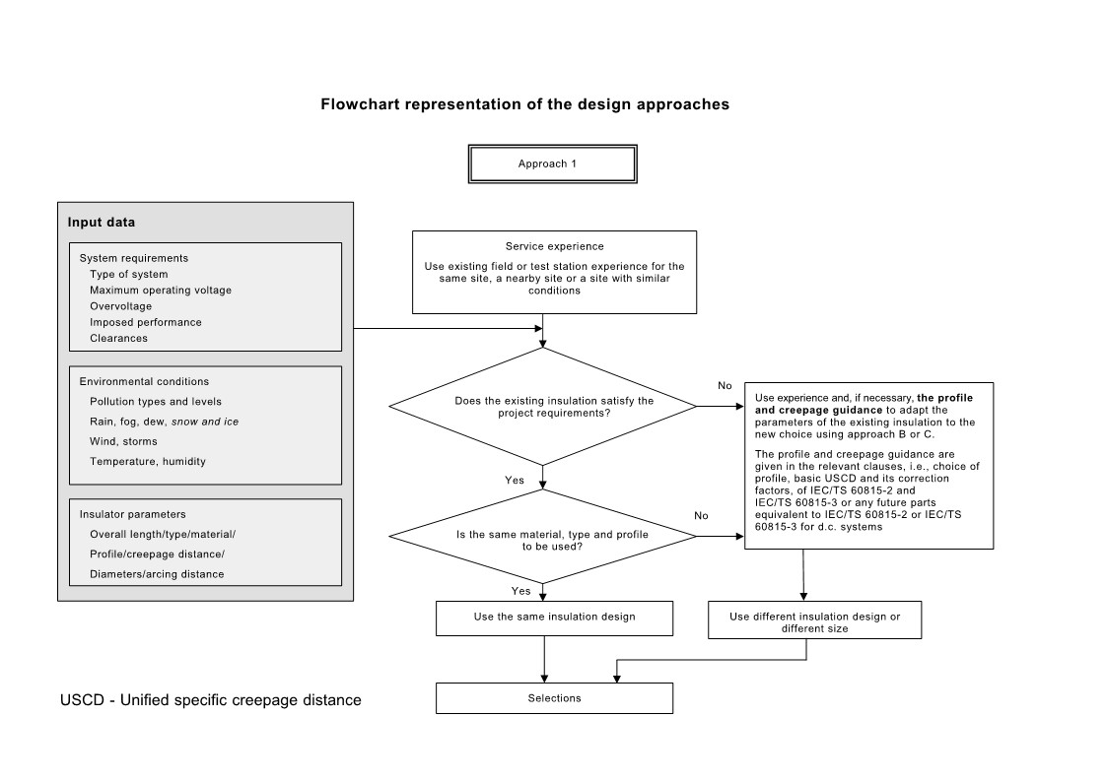

Slide 17
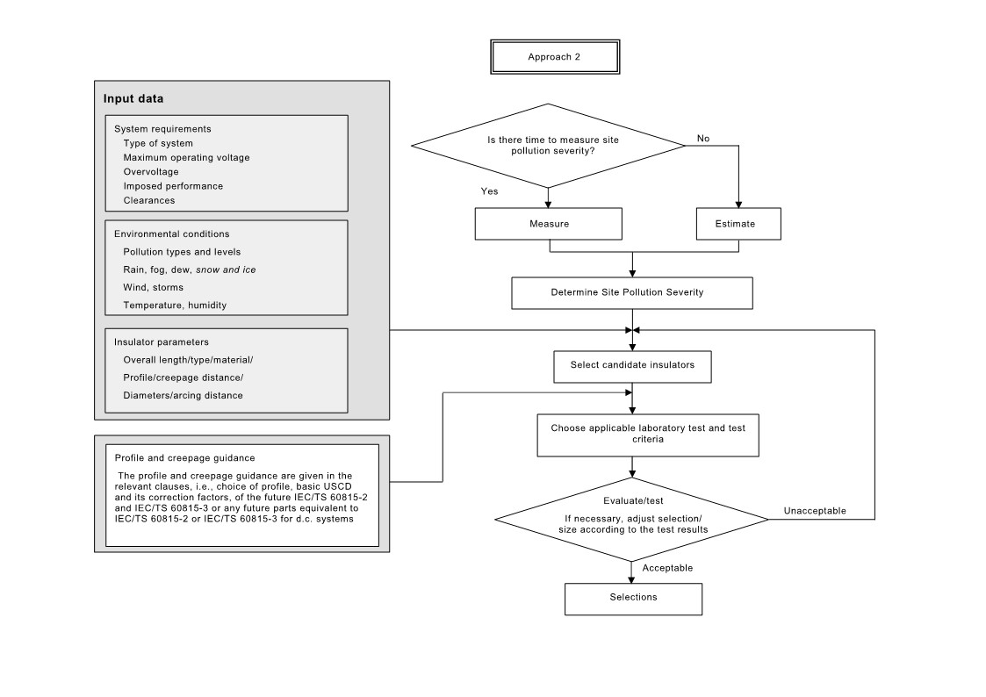

Slide 18
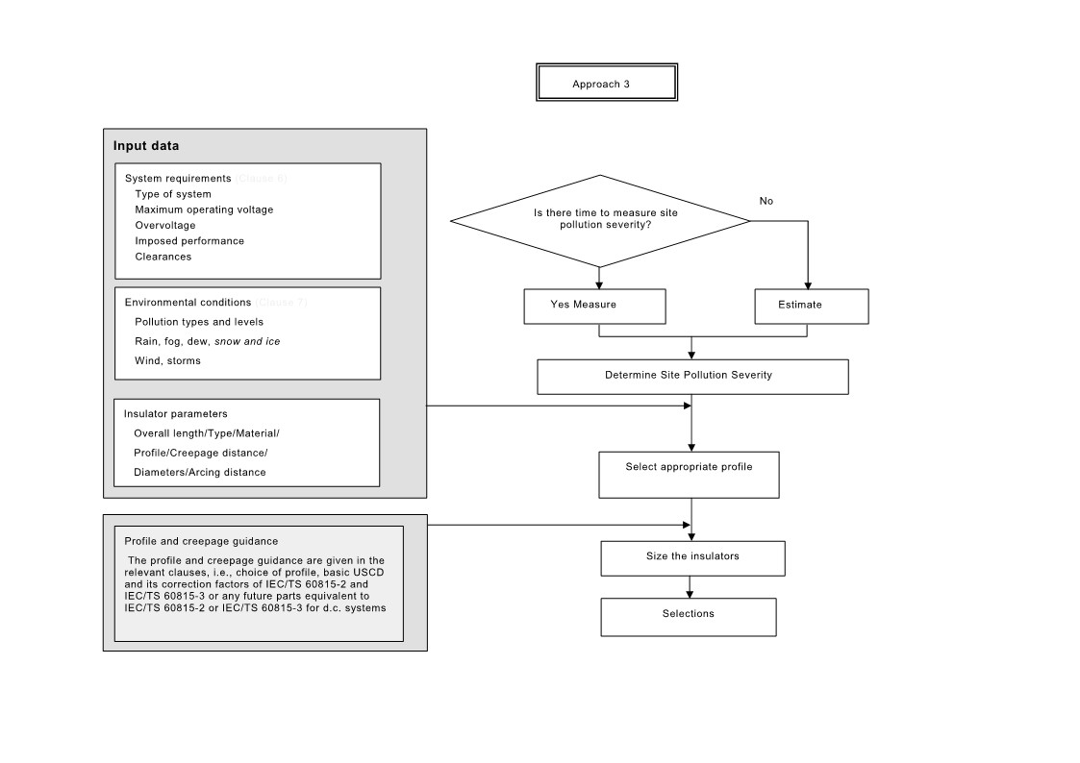

Slide 19
POLLUTION LEVELS (IS 13134)
Pollution Level | Example of typical environment
I- Light | Areas without industries and with low density of houses equipped with heating plants; Areas with low density of industries or houses but subjected to frequent winds and/or rainfall; Agricultural areas; Mountainous areas; and All these areas shall be situated at least 10 km to 20 km from the sea and shall not be exposed to winds directly from the sea
II- Medium | Areas with industries not producing particularly polluting smoke and/or with average density of houses equipped with heating plants; Areas with high density of houses and/or industries but subjected to frequent winds and/or rainfall; and Areas exposed to wind from the sea but not too close to the coast.
III- Heavy | Areas with high density of industries and suburbs of large cities with high density of heating plants producing pollution; and Areas close to the sea or in any case exposed to relatively strong winds from the sea
IV- Very heavy | Areas generally of moderate extent, subjected to conductive dusts and to industrial smoke producing particularly thick conductive deposits; Areas generally of moderate extent, very close to the coast and exposed to sea-spray or to very strong and polluting winds from the sea; and Desert areas, characterized by no rain for long periods, exposed to strong winds carrying sand and salt, and subjected to regular condensation.

Slide 20
Creepage distance
The minimum specific creepage distances shall be decided for the maximum pollution condition in the area of installation, including any transient conditions, causing different pollution levels.
The minimum specific creepage distances, as per relevant standard, shall be as indicated:
In highly polluted areas, the performance of insulation of substation equipment housing or insulators could be improved by using high temperature vulcanized silicone rubber insulation or room temperature vulcanized silicone rubber coating
Pollution level | Specific creepage distance (mm/kV of line-to-line voltage)
Light | 16
Medium | 20
Heavy | 25
Very heavy | 31

Slide 21
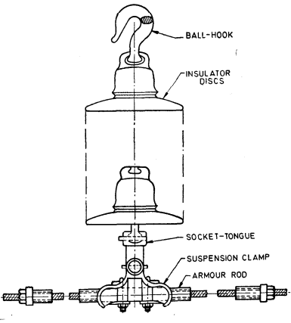
Important Standards related to Insulators
IS 1445- Specification for porcelain insulators for overhead power lines wih a nominal voltage up to and including 1000V.
IS 2486 series- Specification for Insulator fittings
IS 3347 series- Dimensional requirements of Insulator Bushings
IS 16683 series- Selection and dimensioning of high - Voltage insulators intended for use in polluted conditions
IS/IEC 62073- Guidance on the Measurement of Hydrophobicity of Insulator Surfaces
IS 10136 (code of practice for selection of disc insulator fittings for highest system voltages of 72.5KV and above)
Each single suspension string shall consist of the following fittings assembled in the order as shown in Fig.
a) Ball-hook,
b) Socket-tongue, and
c) Suspension clamp.

Slide 22
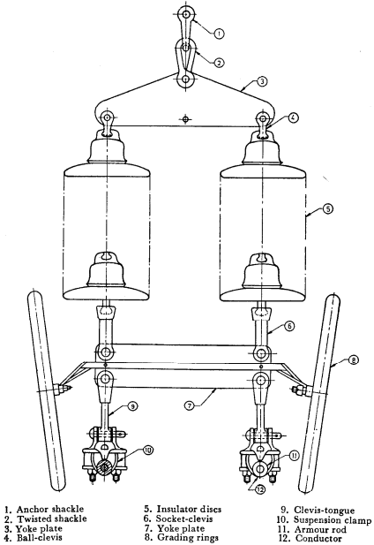
Each double suspension insulator set consisting of two insulator strings for 400 kV twin-conductor bundle line shall consist of the following fittings assembled in the order as shown in Fig

Slide 23
IS 13134 Guide for the selection of insulators in respect of polluted conditions
This Indian Standard is a guide for the selection of insulators in different polluted condition.
The important data in this Indian standard are
The artificial pollution testing to be done on the insulator
Range of profile parameters of insulator in polluted environment :
IS 13305 Permissible limits of visual defects for insulating porcelains for
electrical circuits
This Indian Standard tells about the permissible limits of visual defects on the surface of insulator in electrical circuits.
The important data in this standard are :
1. Different types of defects on the surface of insulator
2. Permissible limits of those defects on surface of insulators
3. Mathematical formula for determining the permissible limit of defect

Slide 24
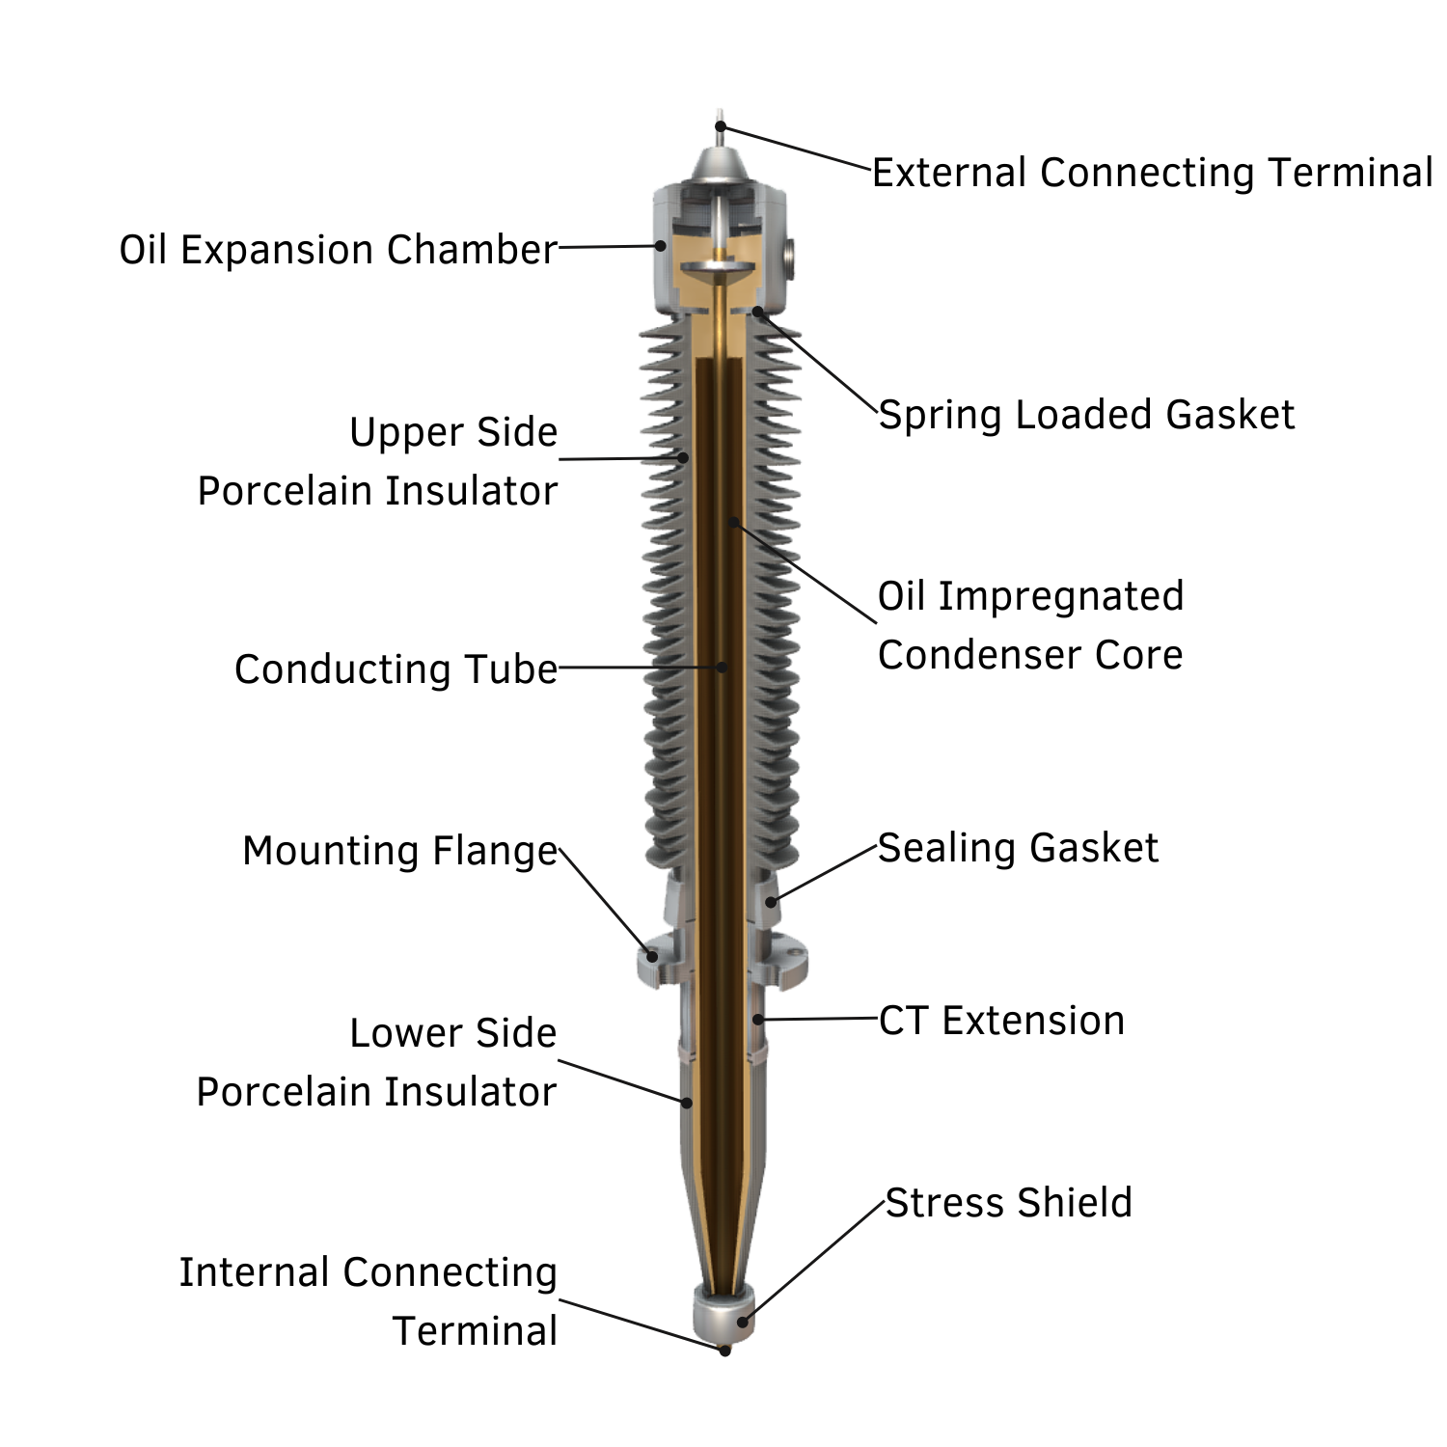
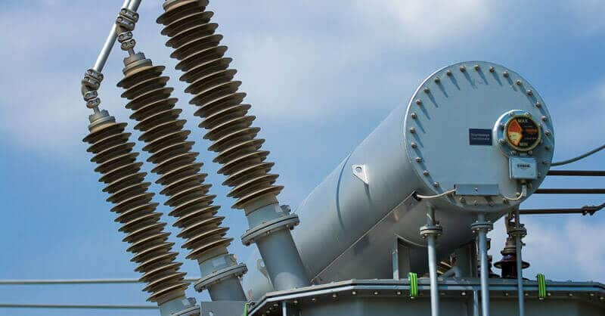
Bushing
Bushing is an insulating structure that facilitates the passage of an energized, current carrying conductor through the grounded body.
Enables one or several conductors to pass through a partition such as a wall or a tank, and insulates the conductors from it

Slide 25
Usage of Bushing
Bushing
Current Transformer
Voltage Transformer
Circuit Breaker
Power Transformer
Distribution Transformer
Surge Arrester
Hollow Insulators are generally used as Bushings
IS 3347 series- Dimensional requirements of Insulator Bushings
IS 7421- Specification for porcelain bushings for alternating voltages upto and including 1000V
IS/IEC 60137: 2017- Insulated Bushings for Alternating Voltages above 1 000 V

Slide 26
TESTS
ELECTRICAL
Pressure withstand
Thermal stability
Interchangeability
Dimension
MECHANICAL
Cantilever load withstand
Rating
Temperature rise
Voltage withstand test
Electromagnetic compatibility

Slide 27
Why Design tests?
Design test Aspects
(IS 16684:2018 IEC 62217:2012)
The design tests are intended to verify the suitability of the design, materials and method of manufacture (technology).
A polymeric insulator design is generally defined by:
– materials of the core, housing and manufacturing method;
– material of the end fittings, their design, and method of attachment;
– layer thickness of the housing over the core
Dye penetration test (porosity)
Water diffusion test (to check the core material for resistance to water attack)
Hardness test
Accelerated weathering test (housing material shall be subjected to 1000h UV light)
Tracking and erosion test (1000h salt fog test)
Flammability test (to check the housing material for ignition and selfextinguishing properties)
Pre- stressing (thermal, mechanical, water)
Impulse voltage test
Dry power frequency voltage test
Maximum Design Cantilever Load (MDCL)
Tensile load test

Slide 28
Analysis of failure of Transmission lines
Name and size of conductor
Type of insulators in use(Porcelain / Glass / Polymer/ /Disc/ Porcelain long rod)
Configuration of insulators (I / V / Y / tension)
No. of insulators per string and No. of strings per phase
Weather condition on the date of failure
Wind Zone (1/2/3/4/5/6) and velocity of wind
Performance of insulator
The pollution performance of insulator is poor in DC transmission systems than in AC. The main reason attributed is-
The accumulation of the contaminant is more under DC voltage than with AC because of electrostatic effect. The electrostatic force being dominant than other forces like wind force and gravitational pull acting on the pollutant, results in more pollutant adhering on to the insulator surface.

Slide 29
Transportation, storage, handling, erection aspect
The transport to site, storage and on-site handling etc. needs to done properly.
For example, the damage to the moisture seal (interface housing to metal) can precipitate complete mechanical and electrical breakdown.
Rodent can inflict considerable damage to the insulator housing during transport and storage.
Moreover, the damage may not be clearly visible and with the consequent mechanism of failure being time-related, unexpected fracture can occur after a few years of service.
The insulators generally made of composite material and silicone rubber housing on which the line-man should not walk on.
The easy solution is the pre-assembly of the insulated cross arm at the ground level. The tubular pole has a modular structure and the insulated cross arms can also be preassembled at the ground level and fixed to the tower segments in order to simplify the erection process with considerable cost savings in comparison to a lattice tower.

Slide 30
Latest Developments on Insulators
Composite pin insulators for distribution system
Composite insulated cross arms
Room Temperature Vulcanising (RTV) silicon rubber for outdoor installations
Diagnostic of polymer insulators with respect to water induced corona
Selection of high voltage insulators intended for use in polluted conditions
Artificial pollution test on insulators made of hydrophobic material
Radio interference test on insulators

Slide 31
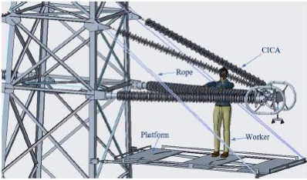
Composite insulated cross arm (New Advancement)
The Composite Insulated Cross Arm (CICA) is composed of Fiber Reinforced Polymer (FRP) mandrel/ core, High Temperature Vulcanized (HTV) silicone rubber shed, associated fittings & accessories and is connected to the tower/ pole body through the flange node.
CICA is insulated from metallic tower/ structure, the conductor of a suspension tower can be directly hung on the cross arm through short metal fittings, eliminating use of suspension insulators.
Source:- CEA

Slide 32
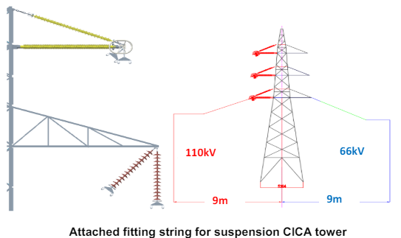
The reduced length of ICA in comparison to the length of conventional steel cross arm and elimination of suspension & tension insulator strings result in reduction in corridor width and RoW

Slide 33
RISKS associated with non-compliance to ISS
-Potential hazard can be associated like damage to equipments , accessories, etc.
-Current can pass through the towers which may be fatal
-Purpose of insulation will be defeated thus making the system more sensitive or prone to breakdown of supply
-May lead to grid failure

Slide 34
Reference Indian standards related to Insulators
IS 13134 : 1992 Reviewed In : 2018 (Active)- Guide for the selection of insulators in respect of polluted conditions
IS 1445 : 1977-Reviewed In : 2019 (Active)- Specification for porcelain insulators for overhead power lines with a nominal voltage up to and including 1 000 V (Second Revision)
IS 16683 (Part 1) : 2018IEC TS 60815-1 : 2008 Reviewed In : 2024 (Active)
Selection and Dimensioning of High-Voltage Insulators Intended for Use in Polluted Conditions Part 1 Definitions, Information and General Principles
IS 16683 (Part 2) : 2018IEC TS 60815-2 : 2008 Reviewed In : 2024 (Active)
Selection and Dimensioning of High-Voltage Insulators Intended for Use in Polluted Conditions Part 2 Ceramic and Glass Insulators for a.c. Systems
IS 16683 (Part 3) : 2018IEC/TS 60815-3 : 2008 Reviewed In : 2024 (Active)
Selection and dimensioning of high - Voltage insulators intended for use in polluted conditions: Part 3 polymer insulators for a.c. systems
IS 16683 (Part 4) : 202160815-4 (Active)
High-Voltage Insulators Intended for use in Polluted Conditions - Selection and Dimensioning Part 4 Insulators for d.c. Systems
IS 4318 : 1993Reviewed In : 2018 (Active)
Solid core porcelain insulators for overhead traction lines - Specification (First Revision)
IS 5300 : 1969Reviewed In : 2019 (Active)
Specification for porcelain guy strain insulators
IS 5350 (Part 1) : 1970Reviewed In : 2019 (Active)
Dimensions of indoor and outdoor porcelain post insulators and post insulator units for systems with nominal voltages greater than 1000 V: Part 1 indoor post insulators
IS 5350 (Part 2) : 1973Reviewed In : 2019 (Active)
Dimensions of indoor and outdoor porcelain post insulators and post insulator units for systems with nominal voltage greater than 1000 V: Part 2 outdoor cylindrical post insulators (First Revision)
IS 5350 (Part 3) : 1971Reviewed In : 2019 (Active)
Dimensions of indoor and outdoor porcelain post insulators and post insulator units for systems with nominal voltages greater than 1000 V: Part 3 outdoor pedestal post insulators

Slide 35
Reference IS/IEC standards related to Insulators
IS/IEC 60168 : 2000IEC 60168 : 2001 Reviewed In : 2024 (Active)
Tests on indoor and outdoor post insulators of ceramic material or glass for systems with nominal voltages greater than 1 000 v
IS/IEC 60273 : 1990IEC 60273 : 1990 (Active)
Characteristic of indoor and outdoor post insulators for systems with nominal voltages greater than 1 000 v
IS/IEC 60305 : 2021IEC 60305:2021 (Active)
Insulators for Overhead Lines with a Nominal Voltage Above 1 000 V - Ceramic or Glass Insulator Units for a.c. Systems - Characteristics of Insulator Units of the Cap and Pin Type ( First Revision )
IS/IEC 60372 : 1984Reviewed In : 2020 (Active)
Locking devices for ball and socket couplings of string insulators units - Dimensions and tests
IS/IEC 60372 : 2020IEC 60372:2020 (Active)
Locking devices for ball and socket couplings of string insulators units - Dimensions and tests (First Revision)
IS/IEC 60383-1 : 1993IEC 60383-1 : 1993 (Active,Concurrent Running )
Insulators for Overhead Lines with a Nominal Voltage Above 1 000 V Part 1 Ceramic or Glass Insulator Units for a.c. Systems â€” Definitions, Test Methods and Acceptance Criteria
IS/IEC 60383-1 : 2023IEC 60383-1: 2023 (Active)
Insulators for Overhead Lines with a Nominal Voltage above 1 000 V Part 1 Ceramic or Glass Insulator Units for a.c Systems - Definitions, Test Methods and Acceptance Criteria (First Revision)
IS/IEC 60383-2 : 1993IEC 60383-2 : 1993 (Active)
Insulators for Overhead Lines with a Nominal Voltage Above 1 000 V Part 2 Insulator Strings and Insulator Sets for a.c. Systems â€” Definitions, Test Methods and Acceptance Criteria
IS/IEC 60433 : 2021IEC 60433:2021 (Active)
Insulators for overhead lines with a nominal voltage above 1 000 V - Ceramic insulators for ac systems - Characteristics of insulator units of the long rod type
IS/IEC 60720 : 1981IEC 60720:1981 (Active)
Line Post Insulators Characteristics

Slide 36
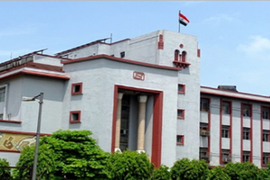
Thank You !

