Slide 1
POWER CAPACITORS
BUREAU OF INDIAN STANDARDS
MINISTRY OF CONSUMER AFFAIRS, FOOD & PUBLIC DISTRIBUTION
MANAK BHAWAN, 9, BAHADUR SHAH ZAFAR MARG, NEW DELHI-110002

Slide 2
POWER CAPACITORS – SYLLABUS OVERVIEW

Slide 3
COVERAGE OF POWER CAPACITORS IN ACADEMIC SYLLABI
COURSE: POWER SYSTEM ENGINEERING, ELECTRICAL MACHINES, DESIGN OF ELECTRICAL SYSTEMS
Power Factor Correction: Power capacitors are primarily used to correct power factor. Power factor refers to the ratio of real power (used to perform work) to apparent power (delivered by the utility). A low power factor signifies inefficient power utilization and leads to increased energy costs, higher transmission losses, and reduced equipment capacity. Power capacitors inject leading reactive power into the system, counteracting the lagging reactive power consumed by inductive loads (motors, transformers) and improving the overall power factor.
Voltage Regulation: Power capacitors help maintain voltage stability within the power system. During peak demand periods, voltage levels can drop due to increased current flow. Capacitors act as a reservoir of reactive power, releasing it back into the system to support voltage and prevent voltage sags that can damage sensitive equipment.
Improved System Efficiency: By correcting power factor and regulating voltage, power capacitors contribute to a more efficient power system. Reduced losses in transmission lines translate to lower energy consumption and cost savings for both utilities and consumers.

Slide 4
COVERAGE OF POWER CAPACITORS IN ACADEMIC SYLLABI (CONTD.)
COURSE: POWER ELECTRONICS
Smoothing DC Voltage: In power converters that convert AC to DC (rectifiers), capacitors help smooth out the pulsating DC output voltage, providing a more stable and continuous supply for electronic devices.
Filtering Harmonics: Power electronic converters can introduce harmonic distortions into the power system. Power capacitors, in conjunction with filters, can help mitigate these harmonics, ensuring cleaner power and protecting sensitive equipment from damage.
COURSE: RENEWABLE ENERGY TECHNOLOGY
Energy Storage: In emerging applications like renewable energy integration, power capacitors can be used for short-term energy storage. They can store excess energy generated from solar or wind sources and release it back into the grid when needed.
In essence, power capacitors play a crucial role in promoting a more sustainable and environmentally conscious power system for the future.

Slide 5
Indian Standards on Power Capacitors
Power Capacitors Sectional Committee ETD 29 under the Electrotechnical Division Council of BIS is responsible for standardization in capacitors. The standards specify uniform rules regarding performance, testing and rating, specific safety requirements and provide a guide for proper installation and operation. It is important that the capacitors manufactured and used shall comply with the relevant national standard.
Many of these standards are harmonized with the corresponding International Standard published by International Electrotechnical Commission (IEC) and are indicated by dual numbering in the fashion IS……../IEC………, or by single numbering in the fashion IS/IEC………..
Some of the important Indian Standards published by this committee and few related standards published by other committees are as given at the end of this presentation. Whether they are harmonized with international standards or not is also specified.

Slide 6
INDIAN STANDARDS PERSPECTIVE ON ACADEMIC CURRICULUM
WORKING PRINCIPLE
DEFINITION, TERMINOLOGY
CLASSIFICATION OF POWER CAPACITORS
DESIGN OF POWER CAPACITORS
TESTING OF POWER CAPACITORS

Slide 7
Working Principle
When a voltage is applied across the plates of a capacitor, an electric field is established within the dielectric material, causing the accumulation of positive and negative charges on the plates. This separation of charges creates an electric potential between the plates, resulting in the storage of electrical energy in the form of an electrostatic field.
The ability of a capacitor to store electrical charge is quantified by its capacitance, measured in farads (F). Capacitance represents the ratio of stored charge to the applied voltage, with larger capacitance values indicating a greater ability to store charge for a given voltage.

Slide 8
definition
A capacitor is a passive electrical component designed to store and release electrical energy. It consists of two conductive plates, typically made of metal, separated by an insulating material known as a dielectric.
The definition as per Electrotechnical Vocabulary for capacitors, IS 1885(Part 45) is:
Capacitor – A device consisting essentially of two electrodes separated by an insulating (dielectric) material, its intended characteristic being capacitance.
Capacitance ( Quantity ) – The quantity of charge on one of the electrodes of a capacitor divided by the corresponding potential difference between the two electrodes, the influence of any other conductor being negligible.

Slide 9
Definition, terminology IS 1885 (Part 42) : 1993
capacitance of a capacitor (quantity)
The electrical charge on one of the capacitor electrodes divided by the potential difference between them, the influence of any other conductor being negligible.
(capacitor) element
A device consisting essentially of two electrodes separated by a dielectric.
(capacitor) unit
An assembly of one or more capacitor elements in the same container with terminals brought out.

Slide 10
Definition, terminology IS 1885 (Part 42) : 1993
power capacitor
A capacitor intended for use in a power network.
tangent of the loss angle (of a capacitor) - tan δ (Delta) (abbreviation)
The ratio between the equivalent series resistance and the capacitive reactance of the capacitor at specified sinusoidal alternating voltage and frequency.

Slide 11
CLASSIFICATION OF POWER CAPACITORS

Slide 12
CLASSIFICATION OF capacitors
CAPACITORS
Connection
a. Series
b. Shunt
c. Filter
Dielectric State
a. Dry Type
b. Wet Type
Voltage Rating
Low Voltage -MPP - APP
High Voltage
-Shunt
-Series
No. of Phases
a. Single Phase
b. Three Phase
Healing Property
a. Self-Healing
b. Non Self-Healing
Notes:
Classification of transformers based on different aspects is presented in this slide. These classifications are also taught in the academic curriculum and they are also used in Indian Standards – albeit with a broader base for classification.

Slide 13
Types of Power Capacitors
Series Capacitors: These capacitors are connected in series with the load to improve voltage regulation and reduce voltage drops across the load. They are commonly used in transmission lines and distribution systems to compensate for reactive power. (IS 1885 ( Part 42 ) : 1993)
Shunt Capacitors: Shunt capacitors are connected in parallel with the load or the power source. They primarily serve to improve power factor by reducing reactive power and enhancing the overall efficiency of electrical systems. Shunt capacitors are widely employed in industrial and commercial facilities to minimize energy losses and optimize power distribution. (IS 1885 ( Part 42 ) : 1993)
SHUNT CAPACITOR

Slide 14
Types of Power Capacitors
Filter Capacitors: Filter capacitors are used to remove unwanted noise or ripple voltage from power supplies. They are commonly employed in electronic circuits, power supplies, and audio systems to ensure a stable and clean voltage output. (IS 1885 ( Part 42 ) : 1993)
FILTER CAPACITOR

Slide 15
Dry-Type vs. Wet-Type Capacitors
Dry-Type Capacitors: Utilize a solid dielectric material (film or ceramic) and do not contain any liquid electrolyte. They offer advantages like fire safety, longer lifespan, and wider operating temperature range. However, they typically have lower capacitance density compared to wet-type capacitors.
Wet-Type Capacitors: Utilize a liquid electrolyte (electrolytic capacitors) and offer higher capacitance density in a smaller size. However, they have limitations like lower fire safety, shorter lifespan, and potential leakage risks.

Slide 16
Self-Healing Type vs. Non Self-Healing Type Capacitors
Indian and International standards classify power capacitors into two type – Self Healing type and Non Self-Healing type:
a) Self-Healing Capacitors [IS 13340 SERIES]
Construction:
These capacitors typically utilize metallized polypropylene films (MPP).
The film dielectric is much thinner compared to non-self-healing types, allowing for higher capacitance density.
These capacitors exhibit a self-healing property by causing vaporization of the metal upon encountering a localized high temperature caused by a small puncture or breakdown.
The vaporization process effectively isolates the fault area, preventing further damage and allowing the capacitor to continue functioning.

Slide 17
Merits:
High Reliability: The self-healing mechanism helps prevent complete capacitor failure due to minor internal breakdowns.
Extended Lifespan: By recovering from minor faults, self-healing capacitors can offer a longer operational life compared to non-self-healing types.
Improved Safety: The self-healing process helps contain internal faults, reducing the risk of catastrophic failures like explosions or fire.

Slide 18
b) Non-Self-Healing Capacitors [IS 13585 SERIES]
Construction:
These capacitors can utilize various dielectrics, including film (with thicker films than self-healing types), electrolytic (aluminium or tantalum), or ceramic.
The construction is simpler and often involves a thicker dielectric layer compared to self-healing capacitors.
They do not incorporate any specific self-healing mechanism.
Merits:
Cost-Effective: Non-self-healing capacitors are generally less expensive than self-healing types due to the simpler construction.
Compact Size: They can achieve higher capacitance density for a given size compared to self-healing types due to the thicker dielectric layer.
Wide Range of Applications: Available in various dielectric materials, non-self-healing capacitors cater to a broader range of applications with diverse voltage and temperature requirements.

Slide 19
Classification based on voltage rating
1.
LV capacitors: Capacitors of voltage rating up to and including 1000 V AC
Capacitor unit rating (Typical):
Voltage: 415 V, 440 V, 525 V, 650 V
Output: 1, 2, 5, 10, 25, 50,100 kVAr
Covered under - IS 13340 series, IS 13585 series, IS 16636 (APFC)
HV capacitors: Capacitors of voltage rating above 1000 V AC
Typical unit rating:
Voltage: 6.8 kV, 6.99 kV, 7.3 kV, 8.0 kV, 11.8 kV, 12.0 kV, 14.8 kV,18.94 kV, 20 kV, 22.0 kV, 24.0 kV
Output: 100, 200, 300, 380, 400, 484, 500,1000 kVAr
Covered under – IS 11548 (For surge protection), IS 13925 series
Capacitors are installed As:
Single phase
Three Phase

Slide 20
TYPES OF LV POWER CAPACITORS
Metallized Polypropylene (MPP) APACITORS(Dry)
Applications:
Voltage improvement-Reactive power compensation/PF for Inductive Loads
Suitable for hazardous locations
Suitable for non-harmonic environment
All PP (APP)CAPACITORS-
(Oil Impregnated) Applications:
Voltage improvement-Reactive power compensation/PF for Inductive Loads
Not suitable for hazardous locations
Suitable for harmonic environment

Slide 21
TYPES OF HV POWER CAPACITORS
SHUNT CAPACITORS
(IS 13925 SERIES):
Applications:
Voltage improvement-Reactive power compensation for Inductive Loads
Power Factor Improvement
SERIES CAPACITORS
(IS/IEC 60143 SERIES)
Applications:
Line Compensation- reactive power flow control
Increasing current capability of transmission lines

Slide 22
DESIGN OF POWER CAPACITORS

Slide 23
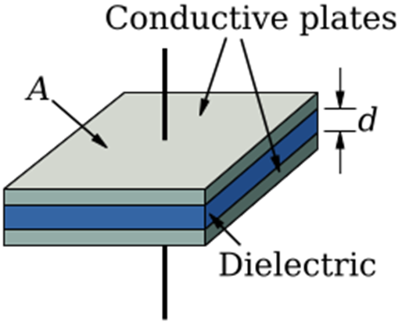
Dielectric Materials:
Dielectric materials play a crucial role in the performance and reliability of power capacitors
C =$𝓔\frac{A}{d}$
where $ℰ is the permittivity of the dielectricDielectric materials play a$
$$crucial role in the performance and reliability of power capacitors$$
The permittivity $ℰ$is defined to be a product of two factors:
Ɛ = KƐ₀
Where
K is Dielectric Constant of the material, and
Ɛ₀ = 8.854 x 10⁻¹² farads per meter, Permittivity of Vacuum.

Slide 24
These materials are chosen based on their electrical properties, dielectric strength, thermal stability, and mechanical robustness. Some common dielectric materials used in power capacitors are:
Polypropylene (PP): Polypropylene is one of the most widely used dielectric materials in power capacitors due to its excellent dielectric properties, high breakdown voltage, low dissipation factor, and good thermal stability. PP capacitors offer high energy storage density and long-term reliability, making them suitable for various power factor correction and harmonic filtering applications. IS 11298 ( Part 3/Sec 1) specifies requirements for Polypropylene film for capacitors. The standard specifies requirements and test methods for various parameters like thickness, density, tensile strength, elongation at break, heat shrinkage, dielectric strength, breakdown voltage, dissipation factor, electrical weak spots etc.
Polyethylene Terephthalate (PET or Polyester): Polyester capacitors exhibit good dielectric properties, high breakdown strength, and low losses, making them suitable for applications requiring high voltage and high-frequency operation. They are commonly used in power electronics, motor run capacitors, and electromagnetic interference (EMI) suppression circuits. IS 11298 (Part 3/Sec 3) specifies requirements for POLYETHYLENE TEREPHTHALATE (PET) FILMS for capacitors.

Slide 25
Metallized Polypropylene Film: Metallized polypropylene film capacitors combine the dielectric properties of polypropylene with the high conductivity of metal coatings. The metal coating act as the conducting plate of the capacitor and polypropylene as dielectric. Metallized film capacitors offer improved self-healing properties, reduced size, and enhanced reliability compared to traditional film capacitors with separate foil electrodes. They are widely used in power factor correction, motor run capacitors, and DC-link applications.
IS 11298 (Part 3/Sec 2) specifies requirements for Metallized Polypropylene film (MPP) for capacitors. The standard specifies requirements and test methods for various parameters like Thickness, Width, Length / Diameter, Shrinkage, Coating Adhesion, Tram lines, Tightness of winding, Resistance of metal layer, Voltage proof test, Power Factor, Electrostatic charge etc.
IS 11298 (Part 2) specifies the detailed and precise test method for each of the above tests for plastic films for electrical purposes.
Polyethylene (PE): Polyethylene is known for its high dielectric strength, low dielectric loss, and good thermal stability. Capacitors using polyethylene as the dielectric material are suitable for high-voltage applications requiring excellent insulation properties, such as power distribution and transmission systems.

Slide 26
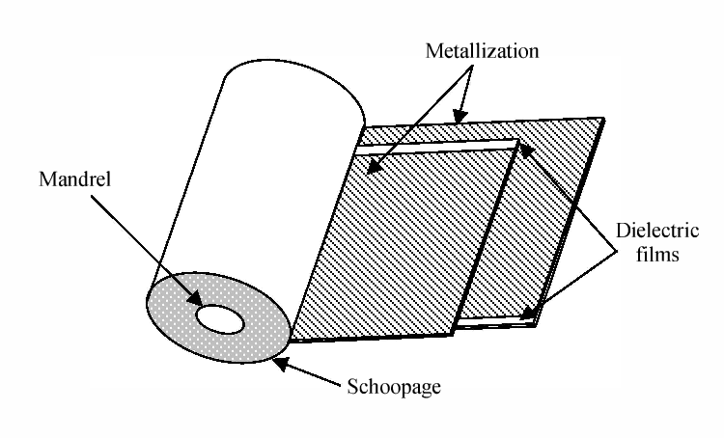
(Source : https://www.semanticscholar.org/paper/Modeling-of-metallized-polymer-films-capacitor's-Makdessi Sari/b2cbfc4daae60160ecbe555f4be8a9715b7e7432/figure/0)

Slide 27
Paper: Although less commonly used in modern power capacitors, paper dielectric capacitors were widely employed in earlier generations of electrical equipment. Paper capacitors offer good dielectric strength and thermal stability but are susceptible to moisture absorption, aging, and degradation over time. They are still found in some niche applications, such as high-voltage filter circuits and pulse applications.
Paper used as dielectric shall confirm to the following standards:
IS 9335 (Part 3/Sec 2) : 1985 Specification for cellulosic papers for electrical purposes: Part 3 specifications for individual materials: Sec 2 capacitor paper
IS 9335 (Part 3/Sec 4) : 1984 Specification for cellulosic papers for electrical purposes: Part 3 specifications for individual materials: Sec 4 electrolytic capacitor paper
IS 9335 (Part 1) : 2024 Cellulosic Papers for Electrical Purposes Part 1 Definitions and General Requirements
IS 9335 (Part 2) : 2024 Cellulosic Papers for Electrical Purposes Part 2 Methods of Test
Tensile strength, Moisture Content, Ash Content, Apparent density, pH, Electric Strength, Dissipation factor etc are some of the important quality parameters specified in the standards along with test methods for the same.

Slide 28
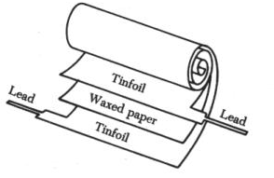
(Source: http://avstop.com/ac/apgeneral/capacitance.html)

Slide 29
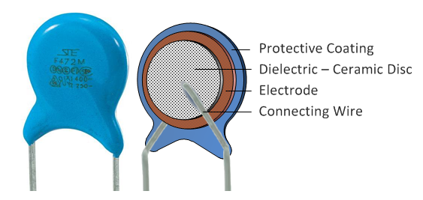
Ceramic: Certain types of ceramic materials, such as barium titanate and zirconate, exhibit ferroelectric properties suitable for power capacitor applications. Ceramic capacitors offer high dielectric constant, stability over a wide temperature range, and excellent reliability. They are used in high-frequency power converters, resonant circuits, and RF applications. IS/IEC 60384-9 specifies requirements for ceramic dielectric capacitors.
Oil-Impregnated Paper: In some high-voltage and high-power applications, power capacitors use oil-impregnated paper as the dielectric material. Oil-impregnated paper capacitors offer high dielectric strength, good thermal conductivity, and self-healing properties. They are commonly used in capacitor banks for power factor correction and voltage support in utility substations.
The choice of dielectric material depends on factors such as operating voltage, frequency, temperature, size constraints, cost considerations, and specific application requirements
(Source: https://www.theengineeringprojects.com/2017/01/evolution-of-capacitors.html)

Slide 30
Impregnating Agents
Wound capacitor elements are often impregnated with mineral / synthetic oil or other impregnants which will flush out the air and moisture, and improve the dielectric strength of the capacitor. IS 13067:1991 gives the requirement of impregnants for use in power capacitor. This standard covers Ester Compounds and Synthesised Hydrocarbon Compounds. The standard specifies the following requirements:
Pour Point
Flash Point
Chlorine Content
Specific Heat
Fire Point
Dielectric Constant
Dielectric Dissipation Factor
Volume Resistivity
Dielectric Strength
Colour
Specific Gravity
Refractive Index
Coefficient of Thermal Expansion
Neutralization Value
Ash Content
Water Content
Kinematic Viscosity
TEST METHODS FOR EACH OF THE ABOVE TESTS ARE GIVEN IN DIFFERENT CROSS REFERRED STANDARDS.

Slide 31
POWER CAPACITORS – SPECIFICATION AND TESTING

Slide 32
IS 13340: SHUNT POWER CAPACITORS OF THE SELF - HEALING TYPE FOR AC SYSTEMS HAVING A RATED VOLTAGE UP TO AND INCLUDING 1000 V
This standard is published in two parts:
Part 1 General - Performance, testing and rating - Safety requirements - Guide for installation and operation
Part 2 Ageing test, Self - Healing test and Destruction test
a) Scope: The standard is applicable to both capacitor units and capacitor banks intended to be used, particularly, for power-factor correction of a.c. power systems having a rated voltage up to and including 1 000 V and frequencies of 15 Hz to 60 Hz.

Slide 33
b) Specifications: The standard specifies various parameters and characteristics of shunt capacitors, including:
Electrical properties such as rated voltage, frequency, and reactive power.
Performance criteria concerning temperature rise, losses, and durability.
Overload conditions
Safety requirements
Marking Requirements
Self-Healing capacitors are marked as “SH” or by the symbol
Internal fuses if present are indicated by the symbol
Service conditions
The standard defines different ambient air temperature categories in which the capacitor is designed to operate. The preferred values for lowest temperature are +5 °C, –5 °C, –25 °C, –40 °C, –50 °C. The highest values are represented by symbols A, B, C, or D with maximum of 40, 45, 50 or 55 °C.
The temperature category is marked as, for example, “–40/A”.
Guide for installation and operation
Additional requirements for power filter capacitors
Formulae for information

Slide 34
c) Testing: The standard outlines testing procedures and methodologies to evaluate the performance and reliability of shunt capacitors.
The tests are generally classified into Routine tests and Type tests.
Routine tests – Carried out on each individual item during or after manufacture:
Capacitance measurement and output calculation (Cl.7)
Power capacitors are generally rated in terms of kVAR output which is calculated from the capacitance measured, based on the configuration.
Measurement of the tangent of the loss angle (tan δ) of the capacitor (Cl. 8) –
Real capacitors have some internal resistance and dielectric losses. Tan δ, also known as dissipation factor or loss tangent, quantifies this deviation from ideal behaviour. A lower tan δ indicates a higher quality capacitor with less energy loss.
tan δ = $\frac{ESR}{Xc}$
where:
ESR = Equivalent Series Resistance (internal resistance of the capacitor)
Xc = Capacitive Reactance = $\frac{1}{2πfC}$

Slide 35
Tan δ meters measure impedances of a bridge circuit and calculate the loss angle.
Voltage test between terminals, Voltage test between terminals and container – High voltage withstand tests for electrical safety. (Cl. 9.1 and 10.1)
Test of the internal discharge device – Capacitors may have an internal discharge device to discharge the capacitor for safe handling, after disconnected from supply. Functioning of this device is checked through this test. (Cl. 11)
Sealing test – Applicable when there is liquid dielectric in the capacitor. (Cl. 12)
Type tests – Tests done to confirm whether a particular design conform to the requirements of the standard:
Thermal stability test and Measurement of the tan δ of the capacitor at elevated temperature (Cl. 13 and 14)
To determine the stability of the capacitance during continuous operation at maximum rated ambient temperature conditions.
Voltage test between terminals, Voltage test between terminals and container (Cl. 9.2 and 10.2)
Lightning impulse voltage test between terminals and container (Cl. 15)
Capacitors intended for exposed installations shall not fail during lightning impulses.

Slide 36
Discharge test (Cl. 16)
Ageing test (Cl. 17)
Accelerated ageing test by subjecting capacitors to a series of charge-discharge cycles which shall not break down the capacitor and shall not cause variation in capacitance beyond a specified limit.
Self-healing test (Cl. 18)
To check the self-healing break downs of capacitors and stability of capacitance during this process.
Destruction test (Cl. 19)
Capacitor is applied with a high DC voltage to promote failures and electrical and mechanical safety is verified.

Slide 37
IS 13585: SHUNT POWER CAPACITORS OF THE NON SELF - HEALING TYPE FOR AC SYSTEMS HAVING A RATED VOLTAGE UP TO AND INCLUDING 1000 V
This standard is published in three parts:
Part 1 General - Performance, testing and rating - Safety requirements - Guide for installation and operation
Part 2 Ageing test, Self - Healing test and Destruction test
Part 3 Internal Fuses
a) Scope: The standard is applicable to both capacitor units and capacitor banks intended to be used, particularly, for power-factor correction of a.c. power systems having a rated voltage up to and including 1 000 V and frequencies of 15 Hz to 60 Hz.
b) Specifications: The standard specifies various parameters and characteristics of shunt capacitors, including:
Electrical properties such as rated voltage, capacitance, and reactive power.
Performance criteria concerning temperature rise, losses, and durability.
Other parameters as discussed in the previous standard.

Slide 38
c) Testing : Testing details are same as that of Self – Healing capacitors, except that the self-healing test is not applicable.
d) Safety Requirements: The standard includes safety considerations to mitigate risks associated with the operation and maintenance of shunt capacitors. This involve guidelines for installation, discharge resistors, overpressure protection, and safety markings.

Slide 39
IS 13925: SHUNT POWER CAPACITORS FOR AC SYSTEMS HAVING A RATED VOLTAGE ABOVE 1000 V
This standard is published in four parts:
Part 1 General - Performance, testing and rating - Safety requirements - Guide for installation and operation
Part 2 Endurance Testing
Part 3 Protection of Shunt Capacitors and Shunt Capacitor Banks
Part 4 Internal Fuses

Slide 40
A) Scope: The standard is applicable to both capacitor units and capacitor banks intended to be used, particularly, for power-factor correction of a.c. power systems having a rated voltage above 1 000 V and frequencies of 15 Hz to 60 Hz.
b) Specifications: The standard specifies various parameters and characteristics of shunt capacitors, including:
Electrical properties such as rated voltage, capacitance, and reactive power.
Mechanical aspects like dimensions, mounting arrangements, and environmental conditions.
Performance criteria concerning overload, temperature rise, losses, and durability.
Service conditions.
Marking Requirements
Guide for installation and operation.
c) Testing :
Routine tests
a) Capacitance measurement (Cl. 7)
b) Measurement of the tangent of the loss angle (tan δ) of the capacitor (Cl. 8)
c) Voltage test between terminals, AC voltage test between terminals and container (Cl. 9 and 10)

Slide 41
e) Test of internal discharge device (Cl. 11) f) Sealing test (Cl. 12) g) Discharge test on internal fuses (Cl. 5.1.1 of IS 13925 (Part 4))
Type tests
Thermal stability test and Measurement of tan δ at elevated temperature (Cl. 13 and 14)
AC voltage test between terminals and container (Cl. 15)
Lightning impulse voltage test between terminals and container (Cl. 16)
Short-circuit discharge test (Cl. 17)
Test of an external fuse in combination with a capacitor (Annex C)
Disconnecting test on internal fuses (Cl. 5.3 of IS 13925 (Part 4))
Special Test - Endurance test - As this is a time consuming and expensive test, not included in the type tests but carried out in case required.

Slide 42
IS/IEC 60143: SERIES CAPACITORS FOR POWER SYSTEMS
This standard is published in four parts:
Part 1 General
Part 2 Protective Equipment for Series Capacitor Banks
Part 3 Internal Fuses
Part 4 Thyristor Controlled Series Capacitors
a) Scope: The standard is applicable to both capacitor units and capacitor banks intended to be used connected in series with an a.c. transmission or distribution line or circuit forming part of an a.c. power system having a frequency of 15 Hz to 60 Hz. The standard is primarily focussed on transmission application.

Slide 43
b) Specifications: The standard specifies various parameters and characteristics of series capacitors, including:
Electrical properties such as rated voltage, capacitance, frequency range and reactive power.
Service conditions.
Performance criteria concerning temperature rise, losses, and durability.
Over Voltage Protector types
Insulation levels
Marking requirements.
Requirements for external fuses
c) Testing: The standard outlines testing procedures and methodologies to evaluate the performance and reliability of series capacitors. These tests includes:
Routine tests
Capacitance measurement (Cl. 5.3)
Capacitor loss measurement (Cl. 5.4)
Voltage test between terminals (CL. 5.5)
AC voltage test between terminals and container (Cl. 5.6)
Test on internal discharge device (Cl. 5.7)
Sealing test (Cl. 5.8)
Discharge test of internal fuses (Cl. 3.1.2 of IEC 60143-3)

Slide 44
Type tests
a) Thermal stability test (Cl. 5.9)
b) AC voltage test between terminals and container (Cl. 5.10)
c) Lightning impulse voltage test between terminals and container (Cl. 5.11)
d) Cold duty test (cl. 5.12)
This test demonstrates the ability of the capacitor to withstand an overvoltage at the protective level followed by an overcurrent condition with the capacitors initially at the lowest ambient temperature.
e) Discharge current test (Cl. 5.13)
Special test – Ageing test (Cl. 5.2.4)
d) Safety Requirements: The standard includes safety considerations to mitigate risks associated with the operation and maintenance of series capacitors. This involve guidelines for installation and operation, discharge resistors, container connection and protection of the environment

Slide 45
IS/IEC 61071: CAPACITORS FOR POWER ELECTRONICS
These types of capacitors are used for filtering and smoothing the voltage. They can be ac or dc, and self-healing or non self-healing.
A) Scope: This standard applies to capacitors for power electronics applications having operating frequency of the systems in which these capacitors are used usually up to 15 kHz. This standard covers wide range of capacitor technologies for numerous applications, e.g. overvoltage protection, DC and filtering, switching circuits, energy storage, auxiliary inverters, etc.
b) Specifications: The standard specifies various parameters and characteristics of capacitors for use in power electronics, including:
Electrical properties such as rated voltage, capacitance, frequency range, etc
Service conditions
Operating temperature maximum 45, 55, 70 or 85 °C
Overloads.
Performance criteria concerning temperature rise, losses, and durability.
Marking requirements.

Slide 46
c) Testing: The standard outlines testing procedures and methodologies to evaluate the performance and reliability of capacitors for use in power electronics. These tests includes:
Routine tests
a) Sealing test (may not be required if there is no liquid material) (Cl. 5.8)
b) External inspection (Cl. 5.14.2)
c) Voltage test between terminals (Cl. 5.5.2)
d) Voltage test between terminals and case (Cl. 5.6.1)
e) Capacitance and tan δ measurements (Cl. 5.3)
f) Test of internal discharge device (CL. 5.7)
Type tests
a) Mechanical tests ( as per IS/IEC 60068 series) (Cl. 5.14)
Tests for terminals for their robustness – tensile strength, flexural strength, torsion resistance, torque resistance and solderability- and Vibration and Shock test
b) Voltage test between terminals (Cl. 5.5.3)
c) Voltage test between terminals and case (Cl. 5.6.2)
d) Surge discharge test (Cl. 5.9)

Slide 47
Charging through a DC source and short circuiting 5 times. There shall be no failure and capacitance shall not vary more than a specified limit.
e) Self-healing test (only for self-healing type capacitors) (Cl. 5.11)
f) Environmental testing (Cl. 5.13)
Tests for temperature change, and Damp heat in accordance with IS/IEC 60068 series standards for Environmental Testing.
g) Measurement of the tangent of the loss angle (tan δ) (Cl. 5.4)
h) Thermal stability test (Cl. 5.10)
i) Test of internal discharge device (Cl. 5.7)
j) Resonance frequency measurement - Self inductance is measured from the resonance frequency which shall be below specified limit. (Cl. 5.12)
k) Endurance test between terminals (Cl. 5.15)
l) Disconnection test on fuses (Cl. 5.17)
m) Destruction test (Cl. 5.16)
d) Safety Requirements: The standard includes safety considerations to mitigate risks associated with the operation and maintenance of series capacitors. This involve guidelines for installation and operation, discharge resistors, case connections and protection of environment.

Slide 48
IS 2993: AC MOTOR CAPACITORS
Scope: This standard is applicable to motor capacitors intended for connection to windings of asynchronous motors supplied from a single-phase system having a frequency up to and including 100 Hz, and to capacitors to be connected to three-phase asynchronous motors so that these motors may be supplied from a single-phase system.
a) Specifications:
Based on the minimum total life as per design, capacitors as designated as
Class A – 30000 h
Class B – 10000 h
Class C – 3000 h
Class D – 1000 h
Class of Safety Protection
P2 – Designed to fail in the open circuit mode only and is protected against fire and shock hazard
P1 – May fail in the open circuit or short circuit mode, and is protected against fire or shock hazard.
P0 – No specific failure protection

Slide 49
Operating Temperature
Minimum -40 °C, -25 °C , -10 °C or 0 °C
Maximum 55 °C, 70 °C, 85 °C, or 100 °C.
Damp Heat Severity
Between 4 days and 56 days. Preferred 21 days.
Climatic Category has to be marked on the capacitor in the fashion, for example, 25/85/21 which indicate minimum temperature -25 °C, maximum temperature 85 °C, and damp heat severity of 21 days.
b) Safety Considerations:
Insulation: Ensures adequate insulation to withstand voltage stresses and prevent electrical breakdown.
Overpressure Protection: Incorporates measures to prevent the buildup of excessive internal pressure, reducing the risk of capacitor failure or rupture.
Discharge Resistor: Includes a discharge resistor to safely discharge the capacitor when not in use, reducing the risk of electrical shock during maintenance.
Environmental Compatibility: Ensures the capacitor's materials and construction are suitable for the intended operating environment, considering factors like temperature, humidity, and vibration.

Slide 50
c) Testing Requirements:
Routine tests
Sealing test, if applicable (Cl. 2.12)
Voltage test between terminals (Cl. 2.7)
Voltage test between terminals and case (Cl. 2.8)
Visual examination (Cl. 2.6)
Capacitance measurement (Cl. 2.9)
Tangent of loss angle (Cl. 2.5)
Type tests
Visual examination, Check markings, Check of dimensions (Cl. 2.6,5.1,2.10)
Mechanical tests (as per IS/IEC 60068 series) (Cl. 2.11)
Robustness of terminations – Tensile, Bending, Torsion, Torque
Soldering
Vibration
Sealing tests (if applicable ) (Cl. 2.12)
Endurance test (Cl. 2.13)
Damp heat test (as per IS/IEC 60068 series) (Cl. 2.14)

Slide 51
Voltage test between terminals (Cl. 2.7)
Voltage test between terminals and case (Cl. 2.8)
Self-healing test (if applicable) (Cl. 2.15)
Destruction test (for Classes of safety P1 and P2 type only) (Cl. 2.16)
d) The standard also specifies
Permissible overloads
Safety requirements
Marking requirements
Guide for installation and operation

Slide 52
AUTOMATIC POWER FACTOR CORRECTION (APFC) PANELS (IS 16636:2017)
Capacitor banks with associated switching devices and control and protective circuits form automatic power factor correction panels and are widely used for dynamic power factor correction at distribution point. APFCs enable us to maintain power factor at the desired level during varying load conditions, avoid over compensation during low load conditions and help to avoid penalties imposed by electric supply companies for low power factor.
Automatic Power Factor Controller is defined as per standard as “Device designed to sense power factor of the load connected to the power line and to control the switching on and off of the steps of the capacitor bank, in order to correct the power factor to the target value”.
Requirements of APFC
a) Verification of Output (Cl. 5.3) - The output reactive power kVAR of the panel and of each individual stage shall be equal to the declared value within the tolerance limit specified in the standard
b) Dielectric tests (Cl. 5.4) – Ability to withstand temporary over voltages and transient over voltages
i) Insulation resistance test (Cl. 5.5)
ii) Power frequency withstand voltage test (Cl. 5.6)
iii) Voltage withstand test between phases (Cl. 5.7)
iv) Lightning Impulse voltage withstand test (Cl. 5.8) – A standard lightning impulse of 1.2/50 µs of specified peak voltage by an impulse voltage generator used for the test
c) Temperature rise test (Cl. 5.9)

Slide 53
d) Verification of the effectiveness of protective circuit (Cl. 5.10) – Resistance between exposed conductive part and incoming protective conductor shall not exceed 0.1 Ω
e) Short circuit withstand test (Cl. 5.11) – based on the declared short circuit current capacity of the panel
f) Verification of clearances (Cl. 5.12)
g) Verification of mechanical operation (Cl. 5.13)
h) Verification of the degree of protection of enclosure (Cl. 5.14) – Based on the declared degree of protection (IP code) as per IS/IEC 60529
i) Verification of the effectiveness of automatic PF correction (Cl. 5.15)
j) Measurement of transient over currents due to capacitor switching (Cl. 5.16) – the transient over current shall not exceed 10 I_{N} for electronically switched panels and 100 I_{N} for others.
The standard also gives guidelines for design, installation, operation and safety of APFC Panels.

Slide 54
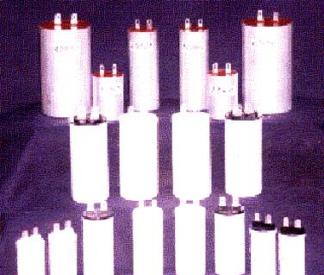
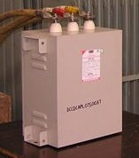
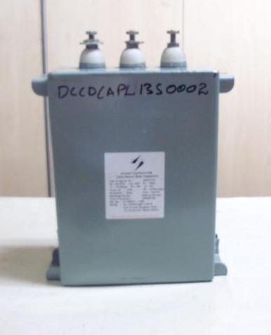
LV Capacitors
AC Motor Capacitors
IS 2993
Shunt Capacitors- SH Type
IS 13340
Shunt Capacitors-Non-SH Type
IS 13585

Slide 55
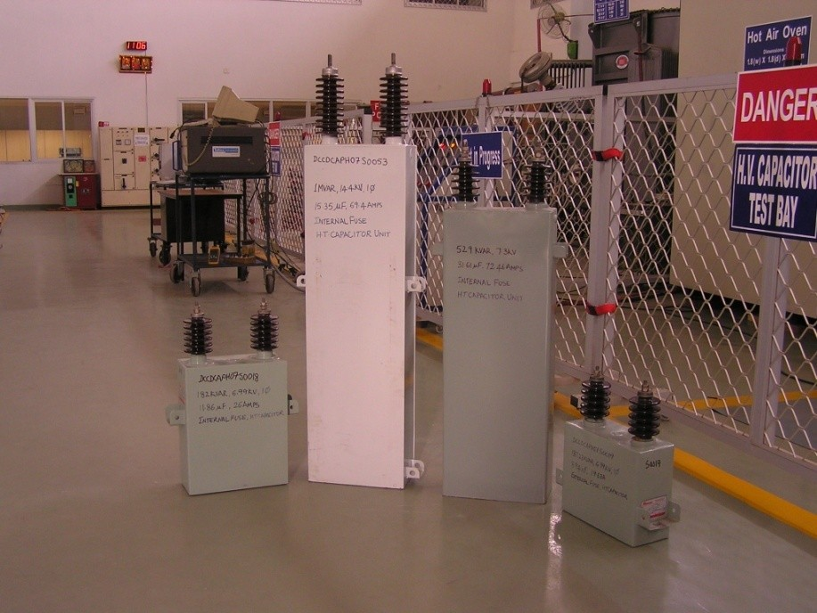
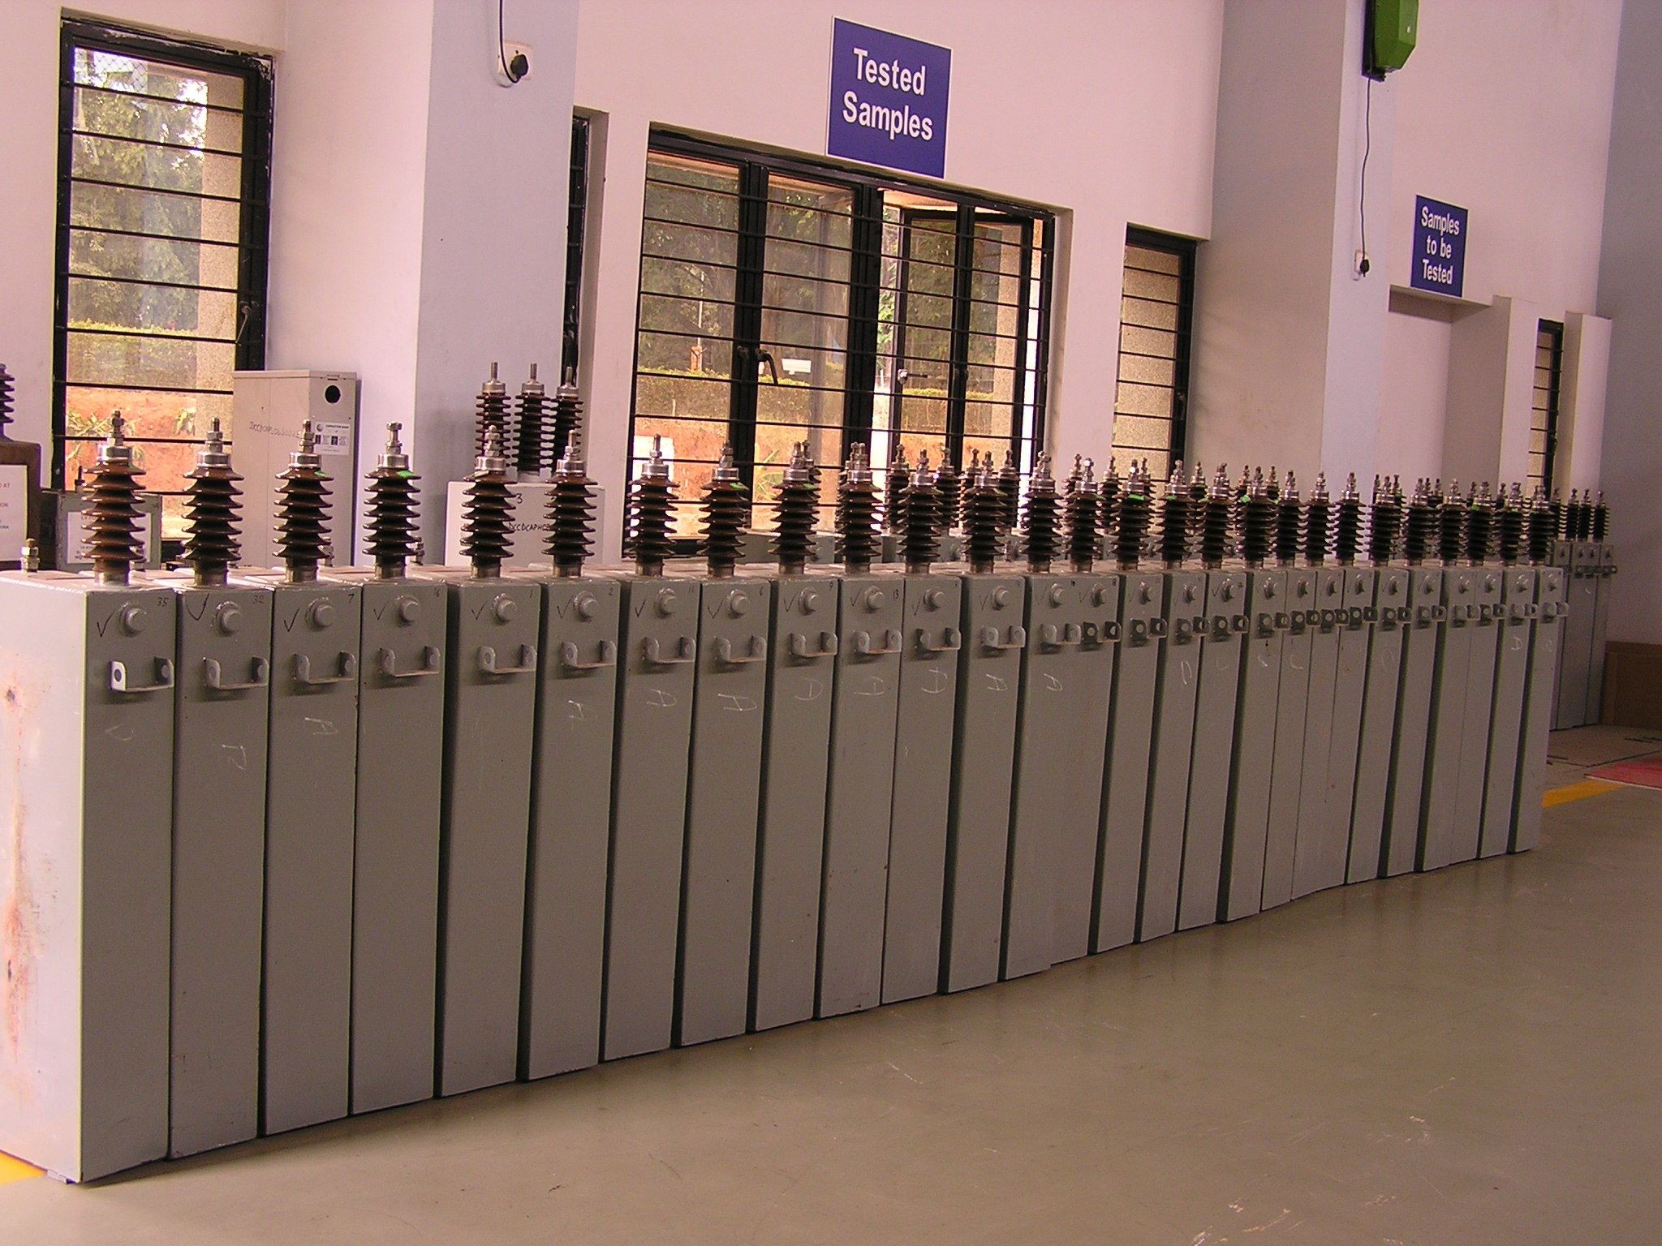
HV Capacitors

Slide 56
How standards help power capacitors meet expectations

Slide 57
Performance:
Capacitance Measurement: Verify the capacitance value of the capacitor to ensure it meets specified requirements.
Dissipation Factor (or Loss Angle): Measure the losses within the capacitor when subjected to an AC voltage, indicating its efficiency and performance.
Environmental Tests: This include tests to evaluate the capacitor's performance under various environmental conditions such as temperature, humidity, and vibration. There are a series of standards under IS/IEC 60068 covering various environmental tests in detail.
Thermal Stability Test: To assess the capacitor's performance under temperature variations and ensure it operates within specified limits without degradation.
Visual Inspection:
Check for any physical damage, such as cracks, bulges, or leaks.
Ensure proper connections and terminal integrity, Connection diagram if required.
Marking details as required by the standard

Slide 58
Safety:
Lightning Impulse Voltage Test: Evaluate the capacitor's ability to withstand transient overvoltage conditions without failure, ensuring its resilience to voltage spikes.
Discharge Test: To verify the capacitor's ability to discharge its stored energy within a specified time period.
High Voltage withstand test: To evaluate the capacitors ability to withstand short time high voltages without failure.
Destruction Test: To assess the behaviour of the capacitor during failure.
Durability:
Endurance Test: Subject the capacitor to prolonged operation under specified conditions to assess its long-term reliability and durability.
Major laboratories in India for Capacitor testing:
Central Power Research Institute (CPRI) Bangalore
Electrical Research and Development Association, Vadodara
Hi Physics Laboratory India Pvt Ltd, Pune.

Slide 59
CAPACITOR SELECTION AND APPLICATION GUIDELINES
Power capacitor selection and application guidelines provide a systematic approach to choosing and utilizing capacitors effectively in electrical systems, particularly for tasks such as power factor correction and voltage regulation. These guidelines help ensure that the selected capacitors meet the specific requirements of the application, operate efficiently, and comply with relevant standards and regulations.
Factors Influencing Capacitor Selection:
Power capacitor selection is influenced by various factors that need to be considered to ensure optimal performance, reliability, and efficiency in electrical systems. Some key factors influencing power capacitor selection:
Power Factor Correction Requirement: Power factor correction (PFC) is the process of improving the power factor of an electrical system by adding power capacitors to counteract the effects of reactive power generated by inductive loads. The primary purpose of power factor correction is to reduce wasted energy, improve system efficiency, and optimize the use of electrical infrastructure. The required level of power factor correction, such as achieving unity power factor or a specific target, influences the selection of capacitors

Slide 60
Reactive Power Demand: The reactive power (VAR) demand of the electrical system determines the capacitance required for power factor correction. Capacitors are selected to provide the necessary reactive power compensation to improve the power factor.
The first step in power factor correction is to determine the reactive power (VAR) requirement of the electrical system. This is typically done by conducting power quality measurements and analyzing the power factor of the system.
Reactive power is the portion of the apparent power that oscillates between the source and the load without performing useful work. It is caused by inductive loads such as motors, transformers, and fluorescent lighting.
Once the reactive power requirement is known, the required capacitance for power factor correction can be calculated. Capacitance is determined using formulas that consider the reactive power, system voltage, and frequency.
The formula for calculating capacitance is:
$$C=\frac{Q}{2πfV^{2}}$$
Where,
C is capacitance (in farads),
Q is reactive power (in VAR),
f is the frequency of the system (in Hz), and
V is the voltage (in volts).

Slide 61
Based on the calculated capacitance requirement, the appropriate rating for power capacitors can be selected. Capacitors are available in various capacitance ratings to meet different system requirements. It is essential to choose capacitors with voltage ratings that exceed the maximum voltage of the electrical system to ensure safety and reliability.
Load Characteristics: The type of loads in the electrical system, such as resistive, inductive, or capacitive loads, affects the choice of capacitors. Inductive loads contribute to a lagging power factor, requiring capacitors for correction, while capacitive loads may require careful balancing.
System Voltage: Capacitors must be rated to withstand the system voltage without breakdown. The voltage rating of capacitors should match or exceed the maximum voltage of the electrical system.
Harmonic Content: Harmonic distortion in the electrical system can affect capacitor performance and reliability. Capacitors with harmonic filtering capabilities may be necessary to mitigate harmonic issues and prevent damage.
Dielectric Material: The dielectric material used in power capacitors plays a crucial role in their performance, reliability, and suitability for specific applications in electrical systems. Different dielectric materials offer varying characteristics in terms of dielectric strength, temperature stability, energy storage capacity, self-healing properties, and cost.
Common dielectric materials include polypropylene, metallized film, Polyester (PET), Polyethylene Napthalate (PEN) and ceramic.

Slide 62
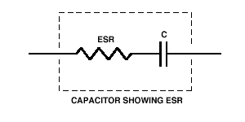
Equivalent Series Resistance (ESR): Equivalent Series Resistance (ESR) is a critical parameter in power capacitors, especially in applications where high efficiency, low losses, and high frequency performance are essential. ESR represents the internal resistance of a capacitor, which includes the resistance of the dielectric material, the internal connections, and any other parasitic resistances within the capacitor construction. In power capacitors, ESR can significantly affect the performance and efficiency of the capacitor and the overall system.
Environmental Conditions: Environmental factors such as temperature, humidity, and altitude can affect capacitor performance and lifespan. Capacitors should be selected with ratings suitable for the environmental conditions of the installation site.
Compliance and Standards:
In India, power capacitors and their usage are subject to various compliance requirements and standards to ensure their safety, performance, and reliability. These need to be factored during their selection and usage.
Economics: Cost-effectiveness is an important factor in capacitor selection, balancing performance requirements with budget constraints. It's essential to evaluate the total cost of ownership, considering factors such as initial purchase cost, reliability, maintenance, and system downtime associated with capacitor failure.
IS 7752 (Part 1) : 1975 gives a detailed guidance for selection of capacitors for power factor correction including calculations and recommended ratings of capacitors.

Slide 63
(Recommended size of capacitor for desired power factor correction as given IS 7752 (Part 1))

Slide 64
Risks associated with substandard power capacitors

Slide 65
Risks associated with substandard power capacitors
Safety Hazards
Overheating and Fire
Electric Shock
Leakage of Harmful Substances
Operational Failures
Premature Failure
Reduced Lifespan
Unreliable Performance
Frequent Repairs and Increased Maintenance Costs
System Instability
Voltage Fluctuations
Harmonic Distortion
Impact on System Efficiency
Poor Power Factor Correction
Energy Losses

Slide 66
Risks associated with substandard power capacitors
Compatibility Issues
Integration Problems
Interference with Other Equipment
Damage to Equipment
Overvoltage Damage
Chain Reactions
Environmental Impact
Pollution: using prohibited materials, and leaks caused due to substandard material usage
Non-recyclable Materials: Complicating disposal and increasing environmental risks

Slide 67
NATIONAL ELECTRICAL CODE OF INDIA- 2023
The National Electrical Code of India (NEC) is an all-inclusive guide and code of practice for Electrical Installations in the country, prepared by BIS, providing guidelines for regulating electrical installation practises across the country.
The code contains:
Good practices for the selection of electrical equipment forming part of an electrical installation;
Recommendations concerning safety in the wiring of electrical installations,
General safety procedures and practices in electrical work; and
Additional precautions that must be taken when using electrical equipment in hazardous environments such as an explosive or active atmosphere.

Slide 68
The NEC contains 8 Parts and 49 sections
Part1 | General and Common Aspects ( 22 Sections )
Part2 | Electrical installations in stand by generating stations and captive substations (2 Sections)
Part3 | Requirements for special installations or locations ( 22 Sections )
Part4 | Electrical installations in industrial buildings
Part5 | Outdoor installations ( 3 Sections )
Part6 | Electrical installations in agricultural premises
Part7 | Electrical installations in Hazardous area
Part8 | Solar Photovoltaic (PV) power supply systems

Slide 69
Electrical accidents will be drastically reduced if the electrical engineers design the electric installation considering the requirements mentioned in the National Electrical Code of India, using the right protection devices for the right equipment, and if electricians and other professionals carry out proper verification (initial and periodic) in accordance with the criteria given in the NEC in adherence to the safety regulations.
Power Capacitors in NEC
NEC has devoted an entire section (Part 1/Section 20.1 Power Quality Improvement – pf Correction and harmonics control) for power quality improvement in which usage of power capacitors are discussed. The code discusses causes of low power factor, disadvantages of it, economics of power factor improvement and use of capacitors and APFCs for the same. It also gives method of selection, methods of connection and calculations of ratings of capacitor required for power factor correction.
Section 21 Energy Efficiency Aspect discuss the need of power factor correction and the requirement of maintaining minimum power factor of 0.95 for industries and 0.90 for medium and large commercial buildings. The need of active harmonic filters are also discussed when the Total Harmonic Distortion (THD) exceeds the maximum specified value of 5% for commercial and industrial establishments.

Slide 70
REGULATORY REQUIREMENTS
Standards are basically voluntary in nature, adopted by the manufacturer to ensure quality of their product. They can also form a part of contract between purchaser and manufacturer and become mandatory in a sense.
However, the government may enforce conformity to standard by including them in their regulatory framework, considering safety, health, prevention of unfair trade practices or national interest. In India, Quality Control Orders (QCOs) are issued by various departments of Government of India making conformity to Indian Standard and BIS Certification mandatory for certain products.
The Electrical Capacitors (Quality Control) Order, 2017 has made the following capacitors mandatory to confirm to given Indian Standards.

Slide 71
1. | IS 2993 | A.C. motor capacitors | QCO - SO 2434(E), dated 01st August 2017 Date of Implementation 01/02/2018
2. | IS 13340 | Power Capacitors of Self-healing Type for AC Power Systems having Rated Voltage up to 1000 V
3. | IS 13585 Part 1 | Shunt Power Capacitors of the Non-Self-Healing Type for AC System having a Rated Voltage up to and Including 1000V Part-1 General Performance, Testing and Rating Safety Requirements Guide for Installation and Operation

Slide 72
According to this QCO, no person shall manufacture, import, store or store for sale, sell or distribute capacitors as given in the table which do not conform to the specified Indian Standard and which do not bear the standard mark of BIS. Foreign manufacturers also need to take BIS Certification for exporting to India. Bureau of Indian Standards Act 2016 specifies fines and imprisonment for violation of QCOs.
Central Electricity Authority (CEA): CEA is a statutory organization responsible for formulating policies and regulations related to the power sector in India.
Indian Electricity Act 2003: Consolidated laws related to generation, transmission, distribution, trading and use of electricity.
Central Electricity Authority (Measures relating to Safety and Electric Supply) Regulations, 2023 mentions that the relevant standards including National Electrical Code and National Building Code shall be followed to carry out the purpose of these regulations, with reference to construction, installation, protection, operation and maintenance of electric supply lines and apparatus. International standards shall be used only when Indian Standards are not available.

Slide 73
References:
“Introduction to Electric Circuits” by James A. Svoboda and Richard C. Dorf
“Power System Capacitors” by Ramasamy Natarajan
Charles K. Alexander and Matthew N.O. Sadiku. "Fundamentals of Electric Circuits." McGraw-Hill Education, 2013.
“Electric Circuits” by Nilsson and Riedel
“Power Capacitors: Theory and Applications” by P.S. Bimbhra
“Power Capacitors: Testing and Failure Analysis” by G. R. Jones and D. H. W. Davies
Bureau of Indian Standards (BIS- https://www.bis.gov.in/) publications.

Slide 74
Indian standards on Power Capacitors – Ready Reference
IS Number | IS Title | Aspect | Degree of Equivalence with IEC Standard
IS 13585 (Part 1) : 2012 / IEC 60931-1 : 1996 | Shunt power capacitors of the non - Self - Healing type for ac systems having a rated voltage up to and including 1 000 v: Part 1 general - Performance, testing and rating - Safety requirements - Guide for installation and operation (First Revision) | Product Specification | Identical under dual numbering
IS 13585 (Part 2) : 2013 / IEC 60931-2: 1995 | Shunt power capacitors of the non - Self - Healing type for A.C. systems having a rated voltage up to and including 1 000 v: Part 2 ageing test, self-healing test and destruction test | Methods of tests | Identical under dual numbering
IS 13585 (Part 3) : 2013 / IEC 60931_3: 1996 | Shunt power capacitors of the non - Self - Healing type for A.C. systems having a rated voltage up to and including 1 000 V: Part 3 internal fuses | Product Specification | Identical under dual numbering

Slide 75
IS 13340 (Part 1) : 2012 / IEC 60831 - 1 : 2002 | Shunt power capacitors of the self - Healing type for AC systems having a rated voltage up to and including 1000 V: Part 1 general - Performance, testing and rating - Safety requirements - Guide for installation and operation (First Revision) | Product Specification | Identical under dual numbering
IS 13340 (Part 2) : 2012 / IEC 60831_2 : 1995 | Shunt power capacitors of the self - Healing type for AC systems having a rated voltage up to and including 1000 V: Part 2 ageing test, self - Healing test and destruction test | Methods of tests | Identical under dual numbering
IS 13925 (Part 1) : 2012 / IEC 60871-1 : 2005 | Shunt capacitors for AC power systems having a rated voltage above 1000 V: Part 1 general (First Revision) | Product Specification | Identical under dual numbering
IS 13925 (Part 2) : 2002 / IEC 60871-2 | Shunt capacitors for A.C. power systems having a rated voltage above 1000 V: Part 2 endurance testing (First Revision) | Methods of tests | Identical under dual numbering
IS 13925 (Part 3) : 2002 / IEC 60871-3 | Shunt capacitors for A.C. power systems having a rated voltage above 1000 V: Part 3 protection of shunt capacitors and shunt capacitor banks | Others | Identical under dual numbering

Slide 76
IS 13925 (Part 4) : 2013 / IEC 60871-4: 1996 | Shunt capacitors for A.C. power systems having a rated voltage above 1000 V: Part 4 internal fuses | Product Specification | Identical under dual numbering
IS 11530 : 1985 | Specification for voltage grading capacitor | Product Specification | Indigenous
IS 11548 : 1986 | Specification for capacitors for surge protection for use in voltage system above 650 V and up to 33 KV | Product Specification | Indigenous
IS 13203 : 1991 (IEC 60996) | Method for verifying accuracy of tan delta measurements | IS 13925 (Part 4) : 2013 / IEC 60871_4: 1996 | Modified/Technically Equivalent
IS 13666 : 1993 | Energy storage capacitors - Specification | Product Specification | Indigenous
IS 15395 : 2003 / IEC 61642 | Industrial AC networks affected by harmonics application of filters and shunt capacitors | Others | Identical under dual numbering

Slide 77
IS 16636 : 2017 | Automatic power factor correction (APFC) panels for voltage rating up to and including 1000 V | Product Specification | Indigenous
IS/IEC 60143-1 : 2015 | SERIES CAPACITORS FOR POWER SYSTEMS PART 1 : GENERAL First Revision | Product Specification | Identical under single numbering
IS 9835 (Part 2) : 2021 / IEC 60143-2:2012 | Series Capacitors For Power Systems Part 2: Protective Equipment For Series Capacitor Banks | Product Specification | Identical under single numbering
IS/IEC 60143-3 : 2015 | Series Capacitors For Power Systems Part 3: Internal Fuses First Revision | Product Specification | Identical under single numbering
IS/IEC 60143-4 : 2010 | Series Capacitors For Power Systems Part 4: Thyristor Controlled Series Capacitors | Product Specification | Identical under single numbering
IS/IEC 60110-1 : 1998 | Power Capacitors For Induction Heating Installations Part 1 General (First Revision) | Product Specification | Identical under single numbering

Slide 78
IS/IEC/TS 60110-2 : 2000 | Power Capacitors For Induction Heating Installations Part 2 : Ageing Test Destruction Test And Requirements For Disconnecting Internal Fuses | Methods of tests | Identical under single numbering
IS/IEC 61071 : 2017 | Capacitors For Power Electronics | Product Specification | Identical under single numbering
IS/IEC 60358-1 : 2012 | Coupling Capacitors And Capacitor Dividers Part 1 General Rules | Safety Standard | Identical under single numbering
IS/IEC 60358-2 : 2013 | Coupling Capacitors And Capacitor Dividers Part 2 Ac Or Dc Single-Phase Coupling Capacitor Connected Between Line And Ground For Power Line Carrier-Frequency Plc Application | Methods of tests | Identical under single numbering
IS 11298 (Part 3/Sec 1) : 1991 | Plastic films for electrical purposes - Specification: Part 3 specifications for individual materials: Sec 1 polypropylene films for capacitors (First Revision) | Product Specification | Modified/Technically Equivalent
IS 11298 (Part 3/Sec 2) : 1990 | Plastic films for electrical purposes - Specification: Part 3 specifications for individual materials: Sec 2 metallized polypropylene films | Product Specification | Indigenous

Slide 79
IS 13067 : 1991 | Impregnants for power capacitors - Specification | Product Specification | Modified/Technically Equivalent
IS 1885 (Part 42) : 1993 / IEC Pub 60 (436 ) ( 1990 ) | Electrotechnical vocabulary: Part 42 Power Capacitors | terminology | Identical under dual numbering
IS 1885 (Part 45) : 1977 | Electrotechnical vocabulary: Part 45 capacitors | Terminology | Modified/Technically Equivalent
IS 824 : 2021 / IEC 60063: 2015 | Preferred number series for Resistors and Capacitors | Code of Practice | Identical under dual numbering
IS 9402 : 1980 (IEC 549) | Specification for high Voltage fuses for external protection of shunt power capacitors | Product Specification | Modified/Technically Equivalent
IS 2993 : 1998 (IEC 252) | A.C. motor capacitors (Second Revision) | Product Specification | Identical under dual numbering

Slide 80
IS 7752 (Part 1) : 1975 | Guide for improvement of power factor in consumer installations: Part 1 low and medium supply voltages | Code of Practice | Indigenous
IS 4486 : 1967 | Recommended methods for the determination of the permittivity and dielectric dissipation factor of electrical insulating materials at power, audio and radio frequencies including metre wavelengths | Methods of tests | Indigenous

Slide 81
eBIS Portal
https://www.manakonline.in

Slide 82
World of Standards : www.manakonline.in

Slide 83
BIS CARE APP

Slide 84
For viewing/downloading standards
standardsbis.bsbedge.com

