Slide 1
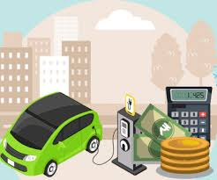
BUREAU OF INDIAN STANDARDS
Ministry of Consumer Affairs, Food and Public Distribution
The National Standards Body of India
Electric Mobility
Shri Vijayaveeran K
Scientist-E / Director & Head
Bengaluru Branch
(GROUP 8)
(Shri Vijayaveeran K, Shri Tapan Haldar, Smt Meghna Mudgal)

Slide 2
NEED FOR EV
Climate Change
India plans to reduce its carbon emission intensity, the emission per unit of GDP, by 45% from what it was in 2005, by 2030. Carbon Neutral by 2070
Air Quality
India is home for 46 out of 100 top polluted cities in the world, 100/100 in Asia
Energy Security
85% crude oil import
Make In India
Battery Production in India -Production Linked Incentive(PLI) PLIs announced for 13 Sectors including Automotive

Slide 3
Electric Machines and Drives: Understanding the design and operation of electric motors and drive systems used in EVs.
Power Electronics: Study of converters and inverters essential for EV power management.
Battery Technology: Focus on energy storage systems, particularly lithium-ion batteries, and their management.
Control Systems: Application of control theory to optimize EV performance.
Embedded Systems: Microcontroller-based systems for vehicle management.
Academic Curriculum

Slide 4
Vehicle Dynamics and Design: Principles of mechanical design specific to electric vehicles.
Sustainability and Renewable Energy Integration: Exploring the role of renewable energy in EV charging infrastructure.
Regulations and Standards: Overview of industry standards and regulations pertaining to EV design and deployment.
Academic Curriculum

Slide 5
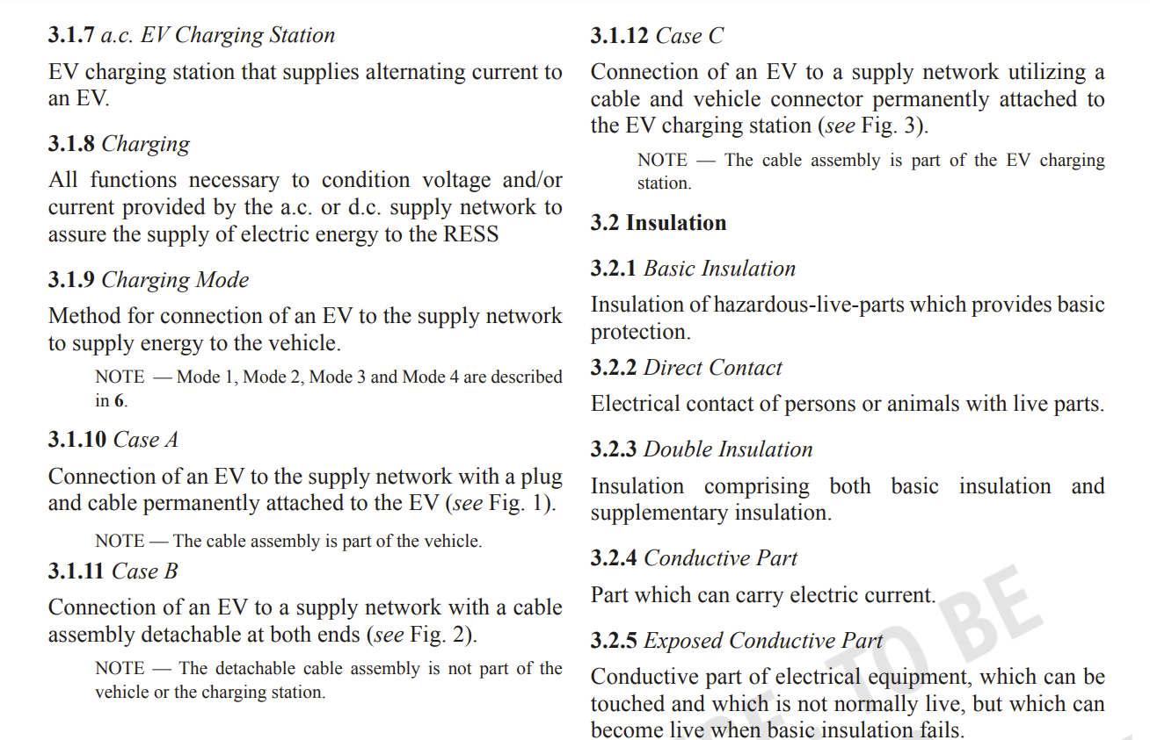
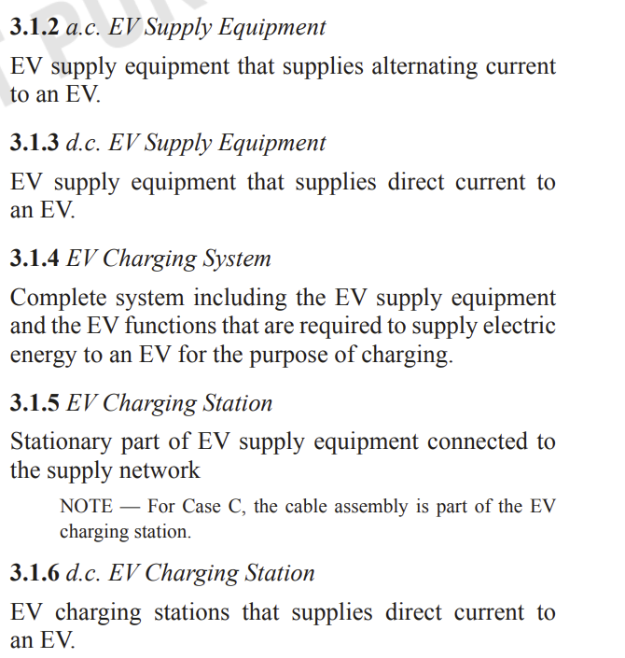
IS 17017 & IS 1885 Series
Terms and definitions

Slide 6
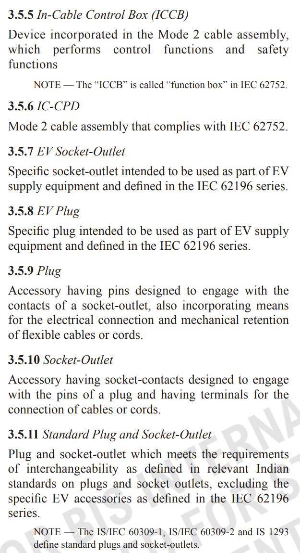
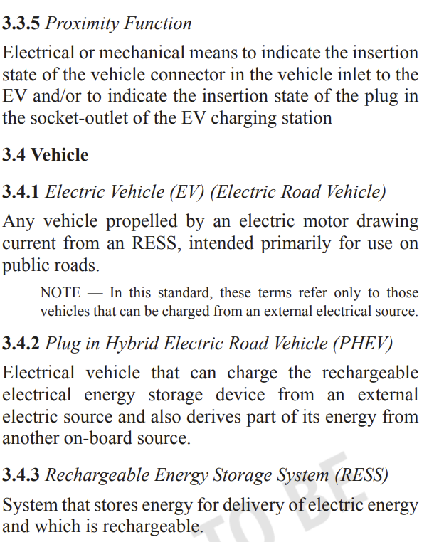
IS 17017 & IS 1885 Series
Terms and definitions

Slide 7
Concept of Electric
and
Hybrid Electric Vehicles

Slide 8
Type of Electric Vehicles
Battery Powered Electric Vehicle : BEV
Series Hybrid Electric Vehicle : Series HEV
Parallel Hybrid Electric Vehicle : Parallel HEV
Series-Parallel Hybrid Electric Vehicle : Series-Parallel HEV
Plug in Hybrid Electric Vehicle : PHEV

Slide 9
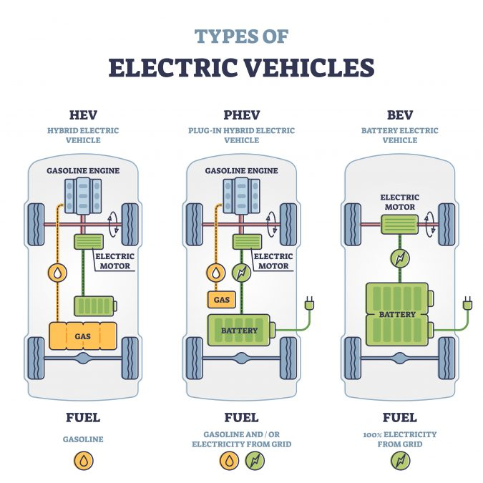
Types of EV
Electric vehicles (EVs) encompass various types, each designed for specific purposes and applications. The primary types of EVs include:
Battery Electric Vehicles (BEVs): BEVs are powered solely by electric batteries and do not rely on internal combustion engines. They produce zero tailpipe emissions and offer the longest driving range among EV types. Examples include the Tesla Model S, Nissan Leaf, and Chevrolet Bolt EV (3.4.1, 3.4.3 of IS 17017 (Part 1))
Plug-in Hybrid Electric Vehicles (PHEVs): PHEVs combine an electric battery with an internal combustion engine and can be charged through an external power source. They offer both electric and hybrid driving modes, providing flexibility and extended range. Examples include the Toyota Prius Prime, Mitsubishi Outlander PHEV, and BMW i3 REx. (3.4.2 of IS 17017 (Part 1))

Slide 10
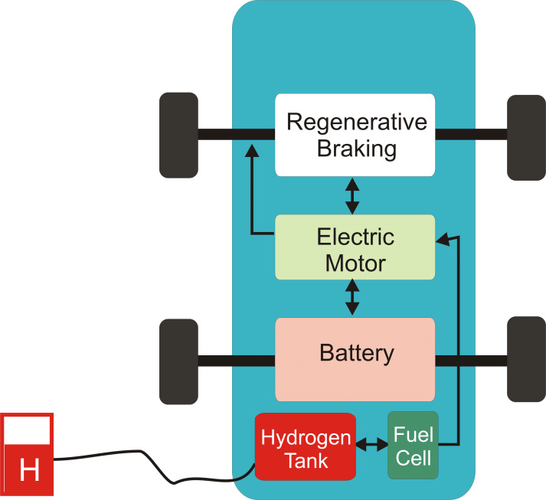
Types of EV
Hybrid Electric Vehicles (HEVs): HEVs utilize an internal combustion engine along with an electric battery to improve fuel efficiency and reduce emissions. Unlike PHEVs, HEVs cannot be charged externally and rely on regenerative braking and engine power to recharge the battery. Examples include the Toyota Prius, Honda Insight, and Ford Fusion Hybrid.
Fuel Cell Electric Vehicles (FCEVs): FCEVs use hydrogen fuel cells to generate electricity, powering an electric motor to propel the vehicle. They emit only water vapor as a byproduct and offer fast refueling times compared to battery electric vehicles. However, FCEVs face challenges related to hydrogen infrastructure and production. Examples include the Toyota Mirai, Hyundai Nexo, and Honda Clarity Fuel Cell.

Slide 11
Lead-acid (Pb-PbO2 ) batteries IS 16373 Lead acid storage batteries for motor vehicles - Valve regulated type, IS 16825 Secondary Cells and Batteries - Monitoring of Lead Acid Stationary Batteries
Alkaline (Ni-Cd, Ni-Fe & Ni-MH) batteries - IS 10893 Specification for sealed nickel cadmium button type rechargeable single cells
Sodium-Nickel Chloride (Na-NiCl2 ) batteries –IS 16048 (Part 2) Secondary cells and batteries containing alkaline or other non-acid electrolytes secondary sealed cells and batteries for portable applications part 2: nickel-metal hydride
Sodium-Sulpur (Na-S) batteries
Lithium-ion (Li-ion) batteries – IS 16805 , IS 16893 Part 2
BATTERY TYPES

Slide 12
Battery technologies are crucial components in the development of various electronic devices, electric vehicles, and renewable energy systems. Here are some key battery technologies:
Lithium-ion (Li-ion):
Lithium-ion batteries are the most prevalent rechargeable batteries in modern electronic devices and electric vehicles.
They offer high energy density, long cycle life, and relatively low self-discharge rates.
Li-ion batteries are commonly used in smartphones, laptops, tablets, and electric vehicles due to their lightweight design and high energy storage capacity.
Lithium Polymer (LiPo):
Lithium polymer batteries are a type of lithium-ion battery that uses a solid or gel-like electrolyte instead of a liquid one.
LiPo batteries are known for their flexibility in shape and size, making them suitable for applications where space is limited.
They are commonly used in consumer electronics, radio-controlled vehicles, and small-scale applications.
Lithium Iron Phosphate (LiFePO4):
Lithium iron phosphate batteries offer enhanced safety and thermal stability compared to traditional lithium-ion batteries.
They have a longer lifespan and are less prone to thermal runaway, making them suitable for applications where safety is critical.
BATTERY TYPES

Slide 13
LiFePO4 batteries are commonly used in electric vehicles, solar energy storage systems, and grid-scale energy storage.
Solid-State Batteries:
Solid-state batteries replace the liquid or gel electrolyte found in traditional lithium-ion batteries with a solid-state electrolyte.
They offer higher energy density, improved safety, and longer lifespan compared to conventional batteries.
Solid-state batteries have the potential to revolutionize electric vehicles and consumer electronics due to their improved performance and safety features.
Flow Batteries:
Flow batteries store energy in chemical compounds dissolved in liquid electrolytes contained in separate tanks.
They offer scalability and flexibility, making them suitable for grid-scale energy storage and renewable energy integration.
Flow batteries can be charged and discharged rapidly, making them ideal for applications requiring high-power output.
Sodium-ion (Na-ion) Batteries:
Sodium-ion batteries are similar to lithium-ion batteries but use sodium ions instead of lithium ions for energy storage.
They are cheaper and more abundant than lithium, making them a promising alternative for large-scale energy storage applications.
BATTERY TYPES

Slide 14
Na-ion batteries are still in the research and development stage but show potential for use in stationary energy storage systems and electric vehicles.
Nickel-Metal Hydride (NiMH):
Nickel-metal hydride batteries are rechargeable batteries commonly used in hybrid vehicles, cordless power tools, and portable electronics.
They offer higher energy density compared to nickel-cadmium batteries and are considered more environmentally friendly.
NiMH batteries have been largely replaced by lithium-ion batteries in many applications due to their lower energy density and higher self-discharge rates.
BATTERY TYPES

Slide 15
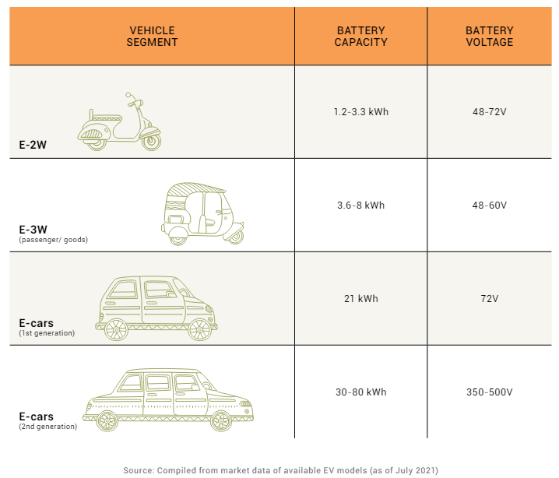
EV charging requirements depend on the specifications of EV batteries, as power must be supplied to the battery at the right voltage and current levels to permit charging. Typical capacity and voltage of EV batteries vary among the different EV segments, as shown in Table below.

Slide 16
Charging Methods

Slide 17
How Electric Vehicles Work-EV BASIC
COMPONENTS
Understanding the core components of EVs helps grasp their functionality and efficiency.
1
Battery
EVs use lithium-ion batteries for energy storage. These batteries are rechargeable and provide the power for the electric motor.
2
Electric Motor
The electric motor converts electrical energy into mechanical power, propelling the vehicle.
3
Charging Systems
EVs are charged through various methods, including Level 1 (household outlet), Level 2 (dedicated outlet), and DC Fast Charging.

Slide 18
Range and Efficiency: Users expect a high driving range on a single charge and efficient energy use.
Charging Infrastructure: Fast, accessible charging options are crucial.
Reliability and Safety: EVs must be durable with advanced safety features.
Performance: Smooth acceleration, quiet operation, and overall driving comfort are key.
Cost and Maintenance: Lower operating and maintenance costs are expected.
Environmental Impact: Reduced emissions and sustainable materials are important for eco-conscious consumers.
Quality and Expectations

Slide 19
Battery Technology: Use of high-energy-density lithium-ion batteries adhering to IS 16046 ensures longer range and better efficiency
Battery management systems (BMS) adhering to IS 17387 : 2020 standard enhance safety and longevity.
Aerodynamics and Lightweight Materials: Design vehicles with aerodynamically efficient shapes and lightweight materials to reduce drag and improve range.
Regenerative Braking: Implement regenerative braking systems that recover energy during braking, following standards like IS 17017.
Requirements addressed
in the IS

Slide 20
Efficient Motors and Power Electronics: Utilize highly efficient electric motors and power electronics, compliant with IS 18073 (Performance and functional requirement- traction motor), IS 17191 (Part 1) (Measurement of electrical energy consumption), IS 15999 series (Rating and performance for Rotating electrical machines) for improved performance.
Optimized Charging: Use fast-charging solutions in line with IS 17017 to reduce charging time without compromising battery life.
Energy Management Systems: Develop advanced energy management systems to optimize energy use, following relevant IS standards.
Requirements addressed
in the IS

Slide 21
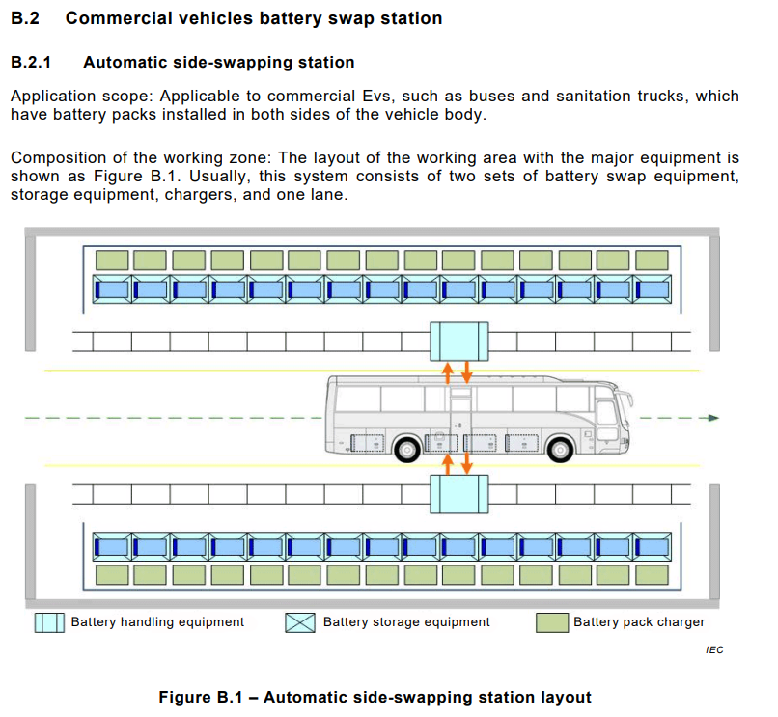
IS 17896 (Part 1) : 2022
IEC TS 62840-1 : 2016
ELECTRIC VEHICLE BATTERY SWAP SYSTEM
PART 1 GENERAL AND GUIDANCE

Slide 22
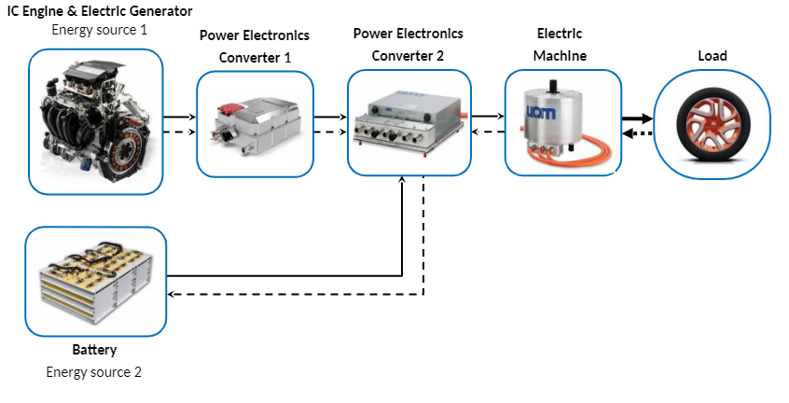
Developed by adding a small IC engine/generator to the BEV.
Usually used in heavy vehicles, heavy commercial vehicles, buses and even locomotives.
Series Hybrid Electric Vehicle

Slide 23
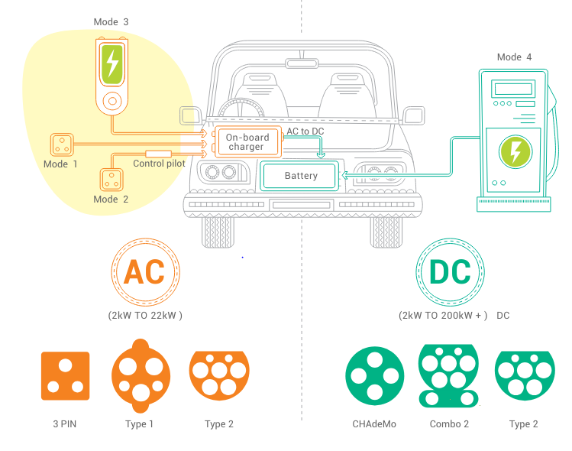

Slide 24
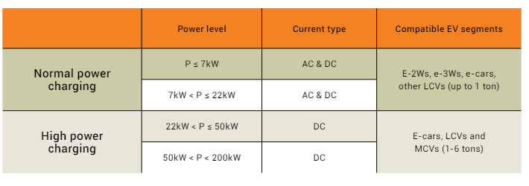
Power Rating of EVSE (Electric Vehicle Supply Equipment):

Slide 25
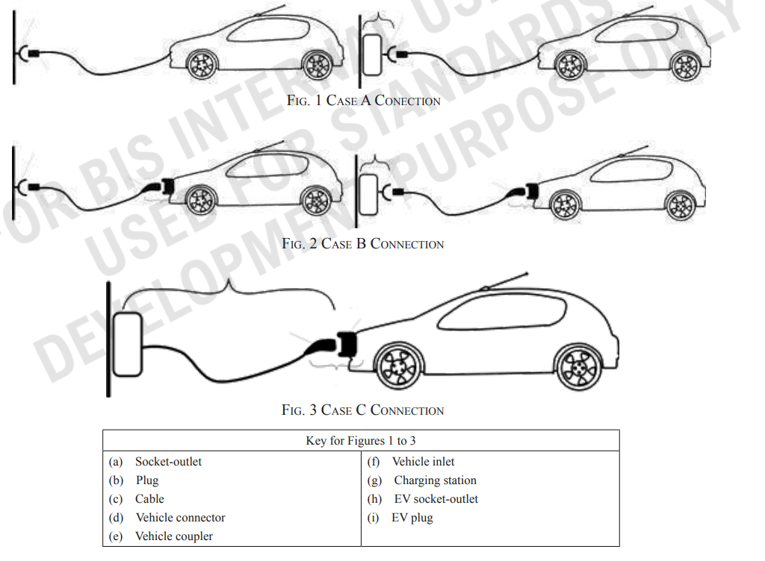
IS 17017 (Part 1) : 2018 ELECTRIC VEHICLE CONDUCTIVE CHARGING SYSTEM
PART 1 GENERAL REQUIREMENTS

Slide 26
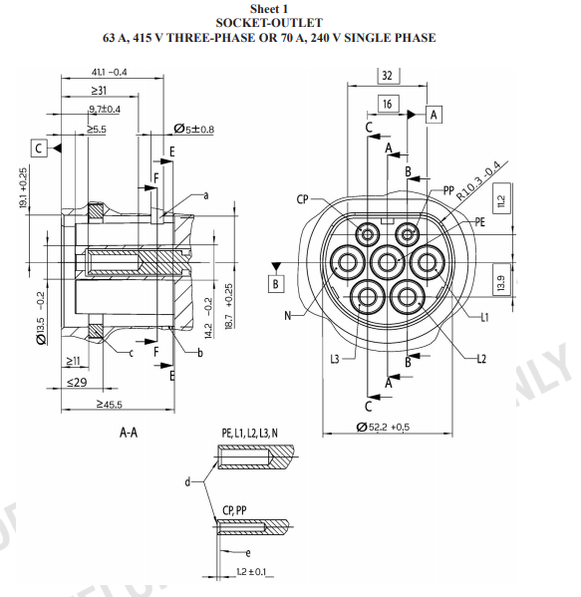
IS 17017 (Part 2/Sec 2) : 2020
ELECTRIC VEHICLE CONDUCTIVE CHARGING SYSTEM
PART 2 PLUGS, SOCKET-OUTLETS, VEHICLE CONNECTORS AND VEHICLE INLETS
Section 2 Dimensional compatibility and interchangeability requirements for a.c. pin and contact-tube accessories

Slide 27
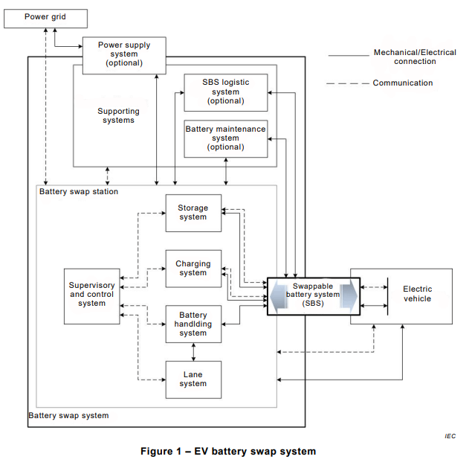
IS 17896 (Part 1) : 2022
IEC TS 62840-1 : 2016
ELECTRIC VEHICLE BATTERY SWAP SYSTEM
PART 1 GENERAL AND GUIDANCE

Slide 28
IS/IEC 61439-7 : 2022 LOW-VOLTAGE SWITCHGEAR AND CONTROLGEAR ASSEMBLIES
PART 7 ASSEMBLIES FOR SPECIFIC APPLICATIONS SUCH AS MARINAS, CAMPING SITES, MARKET SQUARES, ELECTRIC VEHICLE CHARGING STATIONS
Endurance test

Slide 29
EV - Charging Methods

Slide 30
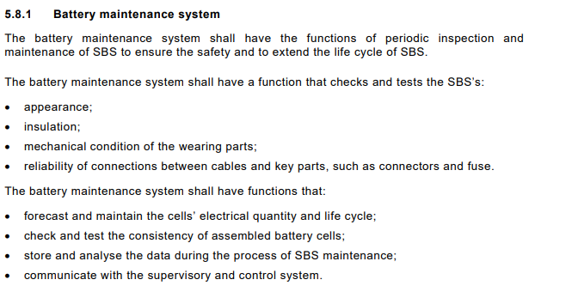
IS 17896 (Part 2) : 2022 /
IEC 62840-2 : 2016
ELECTRIC VEHICLE BATTERY SWAP SYSTEM
PART 2 SAFETY REQUIREMENTS

Slide 31
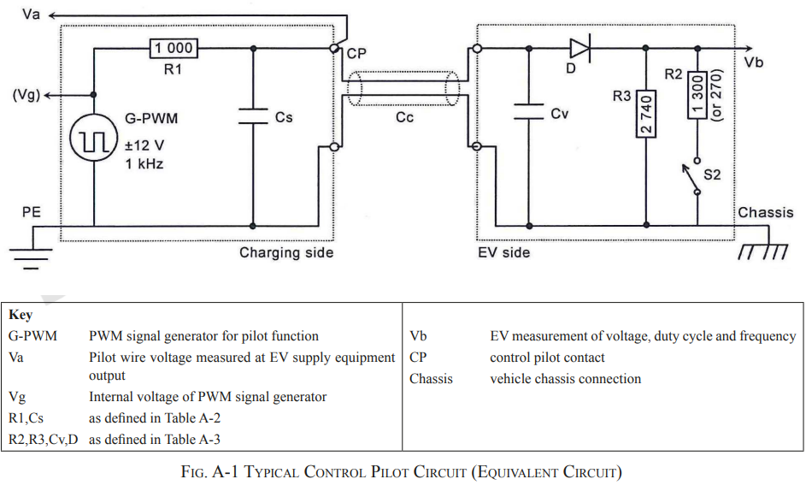
IS 17017 (Part 1) : 2018 ELECTRIC VEHICLE CONDUCTIVE CHARGING SYSTEM
PART 1 GENERAL REQUIREMENTS

Slide 32
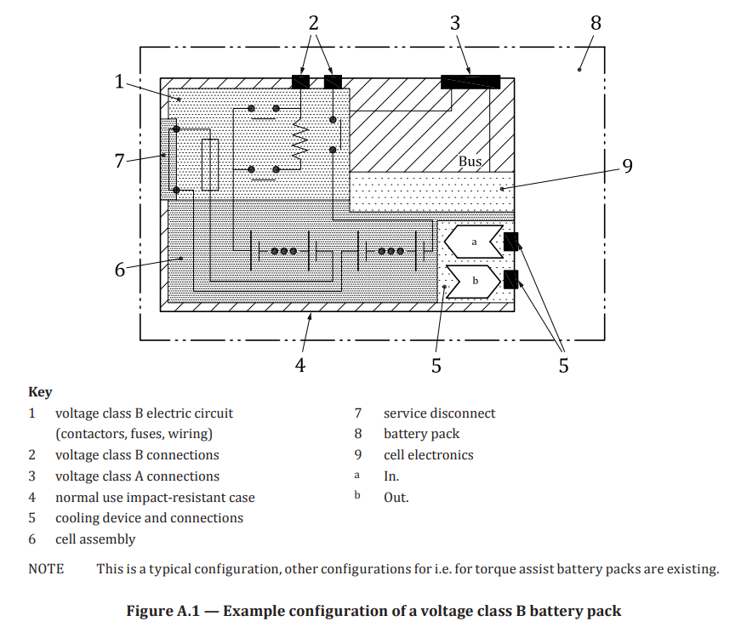
IS 17855 : 2022
/ ISO 12405-4 : 2018
ELECTRICALLY PROPELLED ROAD VEHICLES — TEST SPECIFICATION FOR LITHIUM-ION TRACTION BATTERY PACKS AND SYSTEMS — PERFORMANCE TESTING

Slide 33
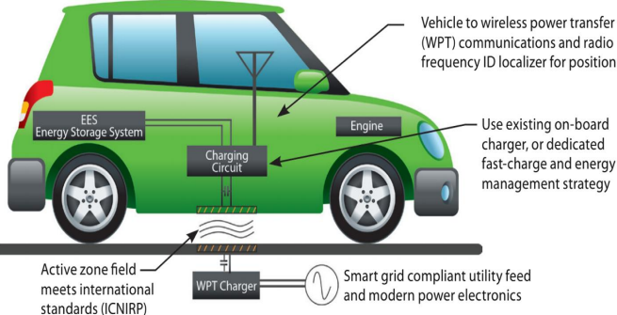
With stationary charging, the electric energy is transferred to a parked vehicle (without passengers on board).
Electric vehicles simply park over an induction pad and charging commences automatically.
WPT requires no charging poles or associated cabling only requires a charging pad buried in the pavement and a pad integrated onto the vehicle.
WIRELESS CHARGING (OR)
WIRELESS POWER TRANSFER - WPT

Slide 34
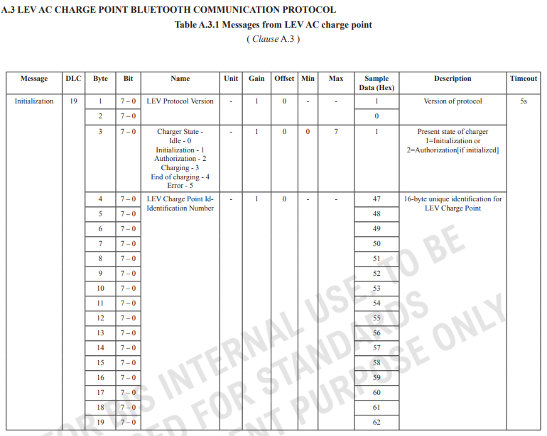
IS 17017 (Part 22/Sec 1) : 2021
ELECTRIC VEHICLE CONDUCTIVE CHARGING SYSTEM
PART 22 A.C. CHARGING CONFIGURATIONS
Section 1 A.C. Charge point for light electric vehicles

Slide 35
Motor Testing: Assessing efficiency, torque, and power output of electric motors.
Power Electronics Testing: Ensuring proper functioning of inverters, converters, and other power electronics.
Simulation and Modeling: Using software to simulate EV systems, including battery management, drive cycles, and energy efficiency.
Regenerative Braking: Implement regenerative braking systems that recover energy during braking,
Testing- Academia

Slide 36
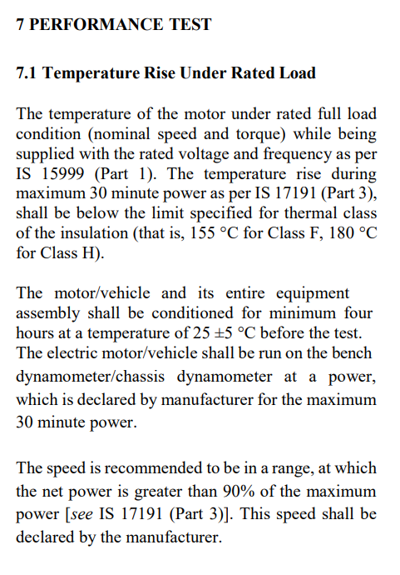
IS 18073 : 2023
ELECTRIC TRACTION MOTOR — PERFORMANCE AND FUNCTIONAL REQUIREMENTS

Slide 37
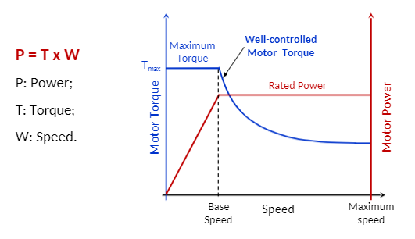
The ideal torque-speed proﬁle is the constant power in all the speed ranges.
EVs require a constant-torque region at low speed and a constant-power region at high speed.
Torque-Speed Proﬁle for reliable and eﬃcient traction system

Slide 38
Tests
Type tests
Routine tests
Acceptance tests
Special tests

Slide 39
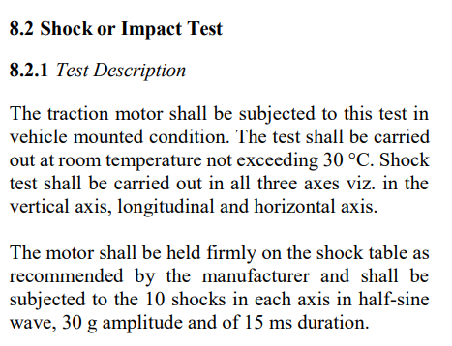
IS 18073 : 2023
ELECTRIC TRACTION MOTOR — PERFORMANCE AND FUNCTIONAL REQUIREMENTS

Slide 40
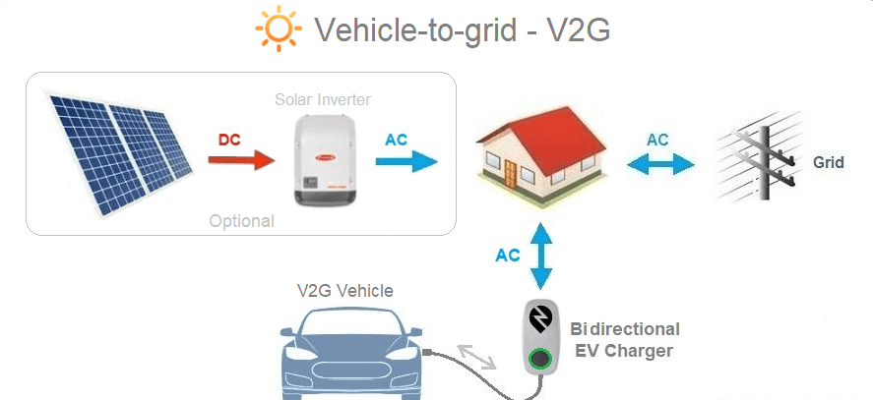
Smart Grids and Vehicle-to-Grid (V2G) Technology

Slide 41
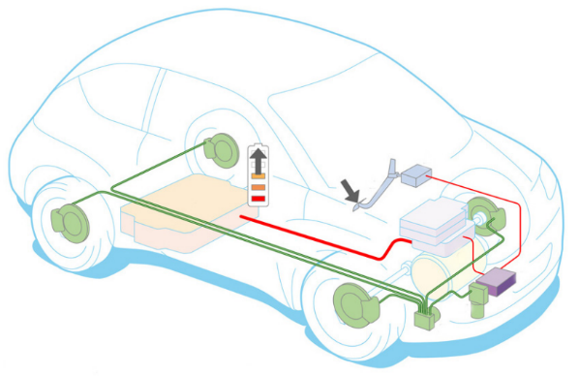
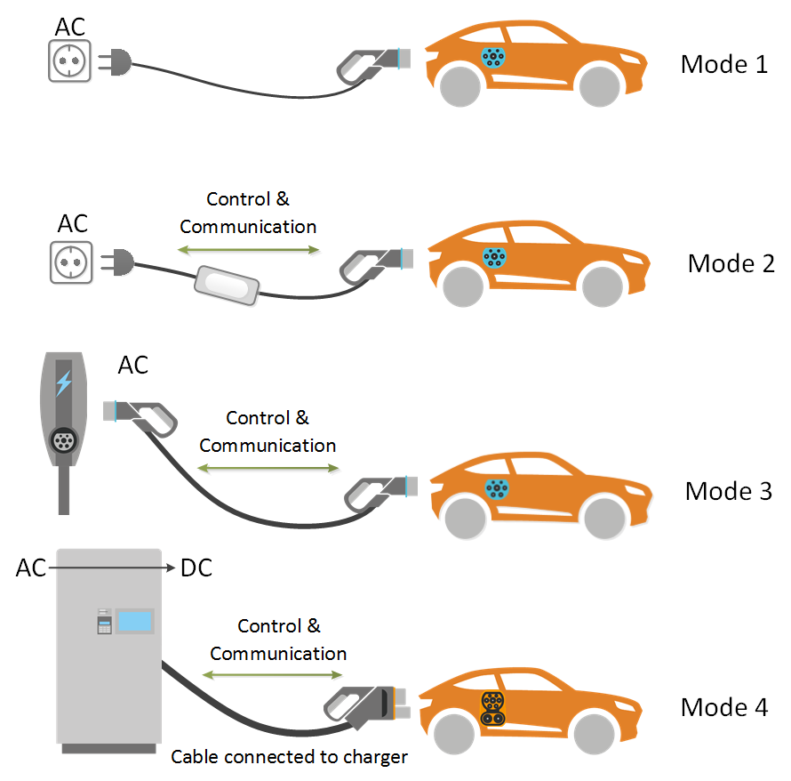
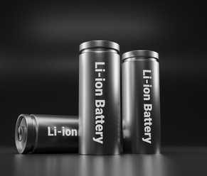
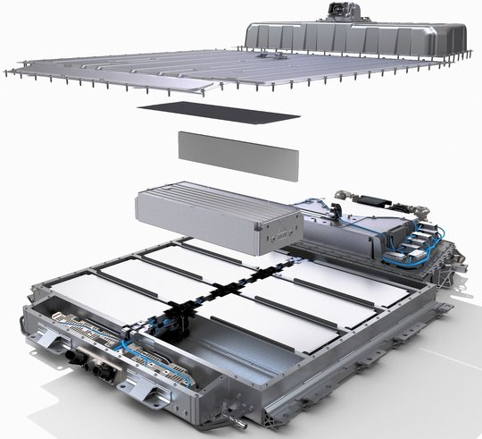
E MOBILITY STANDARDIZATION AT BIS
BIS COMMITTEES FOR E MOBILITY STANDARDISATION
1. TED 27
2. ETD 51
3. ETD 11
Pantograph Charging
Pantograph Charging

Slide 42
Categories of standards on eV Charging infrastructure
EVSE & Installation
Plug and Sockets
Communication
Battery Swapping
Battery Swap Station
Pantograph Charging

Slide 43
Indian Standards on EV
S.No. | IS No. | IS Title
1 | IS 17017 (Part 1) : 2018 (Active) | Electric Vehicle Conductive Charging System Part 1 General Requirements
2 | IS 17017 (Part 2/Sec 1) : 2020 (Active) | Electric Vehicle Conductive Charging System Part 2 Plugs, Socket-Outlets, Vehicle Connectors, and Vehicle Inlets Section 1 General requirements
3 | IS 17017 (Part 2/Sec 2) : 2020 (Active) | Electric Vehicle Conductive Charging System Part 2 Plugs, Socket Outlets, Vehicle Connectors and Vehicle Inlets Section 2 Dimensional compatibility and interchangeability requirements for a.c. pin and contact-tube accessories
4 | IS 17017 (Part 2/Sec 3) : 2020 (Active) | Electric Vehicle Conductive Charging System Part 2 Plugs, Socket Outlets, Vehicle Connectors and Vehicle Inlets Section 3 Dimensional compatibility and interchangeability requirements for d.c. and a.c./d.c. pin and contact-tube vehicle couplers
5 | IS 17017 (Part 2/Sec 6) : 2021 (Active) | Electric Vehicle Conductive Charging System Part 2 Plugs, Socket-Outlets, Vehicle Connectors and Vehicle Inlets Section 6 Dimensional compatibility requirements for DC pin and contact-tube vehicle couplers intended to be used for DC EV supply equipment where protection relies on electrical separation
6 | IS 17017 (Part 2/Sec 7) : 2023 (Active) | Electric Vehicle Conductive Charging System Part 2 Plugs, Socket-Outlets, Vehicle Connectors and Vehicle Inlets Section 7 Dimensional Compatibility and Interchange Ability Requirements for a.c., d.c. and a.c./d.c. Pin and Contact-Tube Vehicle Couplers Intended to be used for a.c./d.c. EV Supply Equipment where Protection Relies on Electrical Separation

Slide 44
Indian Standards on EV ..contd
S.No. | IS No. | IS Title
7 | IS 17017 (Part 21/Sec 1) : 2019IEC 61851-21-1 : 2017 (Active) | Electric Vehicle Conductive Charging System Part 21 Electromagnetic Compatibility ( EMC ) Requirements Section 1 On-board chargers
8 | IS 17017 (Part 21/Sec 2) : 2019IEC 61851-21-2 : 2018 (Active) | Electric Vehicle Conductive Charging System Part 21 Electromagnetic Compatibility ( EMC ) Requirements Section 2 Off-board chargers
9 | IS 17017 (Part 22/Sec 1) : 2021 (Active) | Electric Vehicle Conductive Charging Systems Part 22 AC Charging Configurations Section 1 - AC Charge Point for Light Electric Vehicle
10 | IS 17017 (Part 23) : 2021 (Active) | Electric Vehicle Conductive Charging Systems Part 23 dc Electric Vehicle Supply Equipment
11 | IS 17017 (Part 24) : 2021 (Active) | Electric Vehicle Conductive Charging System Part 24 : Digital Communication between a DC Electric Vehicle Supply Equipment and an Electric Vehicle for control of DC Charging
12 | IS 17017 (Part 25) : 2021 (Active) | ELECTRIC VEHICLE CONDUCTIVE CHARGING SYSTEM Part 25: DC EV supply equipment where protection relies on electrical separation

Slide 45
Indian Standards on EV ..contd
S.No. | IS No. | IS Title
13 | IS 17017 (Part 31) : 2024 (Active) | ELECTRIC VEHICLE CONDUCTIVE CHARGING SYSTEM Part 31: ac or dc EV supply equipment for where protection relies on electrical separation
14 | IS 17896 (Part 1) : 2022IEC TS 62840-1:2016 (Active) | Electric vehicle battery swap system - Part 1: General and Guidance
15 | IS 17896 (Part 2) : 2022IEC 62840-2:2016 (Active) | Electric vehicle battery swap system - Part 2: Safety requirements
16 | IS/IEC/TS 61439-7 : 2023IEC 61439-7:2022 (Active) | Low-voltage switchgear and controlgear assemblies Part 7: Assemblies for specific applications such as marinas camping sites market squares electric vehicle charging stations (First Revision)

Slide 46
Indian Standards on EV ..contd
S.No. | IS No. | IS Title
17 | IS 15886 : 2010 | Road Vehicles Battery Operated--Vehicles Code Of Practice
18 | IS 17191 (Part 1) : 2019 | Electric Power Train Vehicles Part 1 Measurement of Electrical Energy Consumption
19 | IS 17191 (Part 2) : 2019 | Electric Power Train Vehicles Part 2 Method of Measuring the Range
20 | IS 17191 (Part 3) : 2019 | Electric Power Train Vehicles Part 3 Measurement of Net Power and the Maximum 30 Minute Power
21 | IS 18073 : 2023 | Electric Traction Motor - Performance and Functional Requirements

Slide 47
Indian Standards on EV ..contd
S.No. | IS No. | IS Title
22 | IS 17855 : 2022 | Electrically propelled road vehicles - Test specification for lithium-ion traction battery packs and systems - Part 4 Performance testing
23 | IS 18294 : 2023 | Electric Rickshaw E-Kart Construction and Functional Safety Requirements Specification
24 | IS 18590 : 2024 | Electric Power Train of L Category Vehicles -Specific Requirements
25 | IS 18606 : 2024 | Electric Power Train of M and N Category Vehicles - Specific Requirements
IS/ISO 15118 series: The IS/ISO 15118 series of standards focuses on communication between electric vehicles (EVs) and charging infrastructure, aiming to standardize the communication protocols and functionalities necessary for safe and efficient charging.

Slide 48
EV – Academic Importance
The latest UN Intergovernmental Panel on Climate Change (IPCC) Assessment Report makes abundantly clear the scientific perspective of impending large scale global disasters due to global warming.
The Government of India has committed at COP21 Summit held at Paris to reduce emission intensity by 33- 35% by 2030.
Based on the NEP 2020 recommendations for interdisciplinary education, AICTE Model EV Elective Curriculum has been introduced

Slide 49
Ministry of Power (Mop)
Ministry of Road Transport And Highways (MORTH)
Department of Science And Technology (DST)
Indian Space Research Organisation (ISRO)
Ministry of Housing And Urban Affairs (MOHUA)
Ministry of Power (MoP)
NITI Aayog
Ministry of Finance (MoF)
Department of Heavy Industry (DHI)
State Level Policies/Initiatives
Policy Initiatives

