Slide 1
Types of Concrete
BUREAU OF INDIAN STANDARDS

Slide 2
Types of Concrete
Plain Cement Concrete
Reinforced Cement Concrete
High Strength Concrete
Self compacting concrete
Mass concrete
Ready mixed concrete
Alkali Activated Concrete

Slide 3
Plain Cement concrete
Main components ?
cement, coarse aggregates and sand with specific amount of water.
Common mix proportions
1:2:4, 1:3:6 and 1:4:8
Density ?
usually 220 kg/m3 to 2500 kg/m cube
Compressive strength ?
M10, M15 and M 20 are commonly used
High durability
Indian Standards:
The relevant standards for PCC in India are mentioned in IS 456:2000 (Code of Practice for Plain and Reinforced Concrete).
IS 383 specifies the quality and grading of aggregates used.
IS 10262 provides guidelines for concrete mix design.

Slide 4
Plain Cement concrete

Slide 5
Plain Cement concrete
IS 456 (Code of Practice for Plain and Reinforced Concrete) IS 456:2000 is the key standard that governs the design, construction, and material requirements for plain cement concrete and reinforced concrete structures in India. | Mix Proportions: The standard outlines the mix proportions for different grades of concrete, including those used in PCC. The standard emphasizes the importance of proper mix design to achieve the desired strength and durability. Workmanship and Construction: IS 456:2000 provides guidelines on the mixing, placing, compaction, and curing of concrete. It emphasizes the importance of proper compaction and curing to achieve the desired strength and longevity of the PCC.
IS 383 (Specification for Coarse and Fine Aggregates from Natural Sources for Concrete) This standard specifies the quality and grading of coarse and fine aggregates used in concrete, including PCC. It ensures that the aggregates used are of suitable quality to produce durable concrete. | Grading Requirements: IS 383 provides details on the grading of aggregates to be used in PCC. Proper grading is crucial to achieve good workability and minimize voids in the concrete mix.
IS 10262 (Concrete Mix Proportioning – Guidelines) This standard provides guidelines for the proportioning of concrete mixes, including those used for PCC. It includes methods for determining the appropriate mix based on the specific requirements of the project, such as workability, strength, and durability. | Nominal Mix Proportions: IS 10262 also provides guidance on nominal mix proportions (e.g., 1:2:4 for M15 grade concrete) that are commonly used in construction.

Slide 6
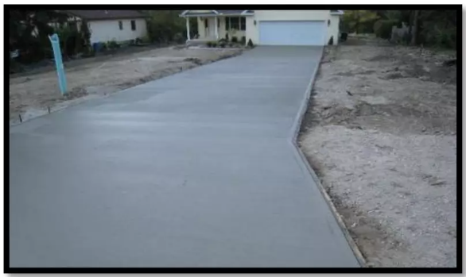
Plain or ordinary concrete — Applications
Used if very high tensile strength is not required
PCC is often used as a foundation bed for RCC (Reinforced Cement Concrete) structures, pavements, or as a base layer in roads. It is also employed in minor structural work where reinforcement is not necessary.

Slide 7
Reinforced Cement Concrete
Material Composition:
Concrete: A mixture of cement, sand, aggregates, and water.
Steel Reinforcement: High-strength deformed steel bars or mild steel bars embedded in the concrete to resist tensile stresses.
Primary Indian Standard:
IS 456:2000 (Code of Practice for Plain and Reinforced Concrete):
This is the main code that governs the design, construction, and material requirements for RCC in India.
It covers the design philosophy (limit state method), specifications for materials, construction practices, and quality control measures.
Design Guidelines:
Limit State Design: IS 456:2000 provides guidelines for designing RCC structures based on the limit state method, ensuring safety and serviceability.
Structural Elements: Guidelines are provided for the design of various RCC elements like beams, columns, slabs, and foundations.
Material Specifications:
Cement: Must conform to IS standards like IS 269 (Ordinary Portland Cement).Aggregates:
Quality and grading as per IS 383:2016.
Steel Reinforcement: Must comply with IS 1786:2008 (for high-strength deformed bars) or IS 432 (for mild steel).

Slide 8
Reinforced Cement Concrete
Concrete Grades:
Concrete used in RCC is classified by its grade (e.g., M20, M25), which indicates the compressive strength of the concrete mix in MPa after 28 days.
Construction Practices:
Mixing, Placing, and Curing: Detailed in IS 456:2000 to ensure uniformity and strength in RCC construction.
Quality Control: Emphasizes the need for stringent quality control at all stages of RCC construction, from material selection to the finished structure.
Seismic Considerations:
IS 13920:2016 provides additional guidelines for the ductile detailing of RCC structures in seismic zones to ensure they can withstand earthquake forces.

Slide 9
Reinforced Cement Concrete

Slide 10
High strength concrete(HSC)
Compressive Strength:
HSC Definition: As per Indian practices, concrete is usually categorized as HSC when its compressive strength exceeds 60 MPa. This can include grades like M60, M70, M80, and higher.
IS 456 (Code of Practice for Plain and Reinforced Concrete): While this standard provides general guidelines for concrete up to M60, for higher grades, more specialized considerations are required.
Design Considerations:
IS 10262 (Concrete Mix Proportioning – Guidelines):This standard provides guidelines for mix design of concrete, including HSC. However, for very high-strength concrete (above M60), additional considerations such as admixtures, precise aggregate grading, and lower water-cement ratios are necessary.
Use of Admixtures: The mix design often requires high-quality superplasticizers and other chemical admixtures to achieve the necessary workability and strength.

Slide 11
High strength concrete(HSC)
Materials:
Cement: Higher grades of cement such as 53 Grade OPC (IS 269) are commonly used for HSC to achieve the required early strength.
Aggregates: The quality, grading, and strength of aggregates are critical. Aggregates used for HSC need to be of high strength and should be well-graded to reduce voids.
Water-Cement Ratio: For HSC, the water-cement ratio is generally lower, sometimes below 0.30, to reduce porosity and increase strength.
Durability:
IS 456 emphasizes the importance of durability, especially for HSC, which might be used in aggressive environments. This includes considerations for carbonation, chloride penetration, and sulfate attack.
Curing: Proper and prolonged curing is essential to achieve the desired strength and durability.
Seismic Considerations:
IS 13920 (Ductile Design and Detailing of Reinforced Concrete Structures Subjected to Seismic Forces): While this standard focuses on seismic design, in the context of HSC, it is important to ensure that the concrete does not become too brittle, maintaining adequate ductility.
Applications:
High-Rise Buildings: HSC is often used in high-rise buildings where reducing the size of structural elements without compromising strength is critical.
Bridges and Infrastructure: HSC is used in long-span bridges and infrastructure projects that require high load-bearing capacities.

Slide 12
Self compacting concrete

Slide 13
Self compacting concrete
Definition:
SCC Characteristics: SCC is a highly flowable concrete mix that spreads into place, fills formwork, and encapsulates reinforcements without requiring any mechanical compaction or vibration.
Workability: The primary characteristic of SCC is its excellent workability, achieved through the use of superplasticizers and viscosity-modifying agents (VMAs).
Relevant Indian Standards:
IS 456:2000 (Code of Practice for Plain and Reinforced Concrete):
While IS 456:2000 provides general guidelines for concrete, it doesn't specifically cover SCC. However, it is referred to in conjunction with international standards and guidelines tailored for SCC.
IS 10262:2019 (Concrete Mix Proportioning – Guidelines):
This standard includes provisions for the mix design of SCC. It provides guidelines on achieving the desired workability, strength, and durability specific to SCC.
The mix design must ensure that SCC achieves the necessary self-compactability, stability, and strength.
Properties and Mix Design:
High Flowability: SCC has a slump flow typically ranging from 650 to 800 mm. The mix design ensures the concrete is highly flowable without segregation.
Passing Ability: SCC can pass through densely packed reinforcement without getting blocked, which is essential in structures with complex geometries or congested reinforcement.
Filling Ability: SCC can fill intricate formwork completely and uniformly, reducing the likelihood of voids or honeycombing.

Slide 14
Admixtures:
Superplasticizers: These are essential in SCC to reduce water content while maintaining workability.
Viscosity-Modifying Agents (VMAs): Used to enhance the stability of the mix by controlling segregation and bleeding, especially important in SCC.
Air-Entraining Agents: Sometimes used to improve the freeze-thaw resistance of SCC, though typically not required for general applications.
Applications:
Complex Structures: SCC is ideal for casting in situations with complex formwork, dense reinforcement, or inaccessible areas where conventional vibration methods would be difficult or impossible.
Precast Concrete: SCC is widely used in the precast concrete industry due to its ability to produce smooth, defect-free surfaces without the need for additional finishing.
Repair and Rehabilitation: SCC's ability to flow into and fill voids makes it suitable for repairing and rehabilitating existing structures.
Testing and Quality Control:
Slump Flow Test: Measures the horizontal spread of SCC when it is released from a slump cone, indicating its flowability.
L-Box Test: Assesses the passing ability of SCC through reinforcements.
V-Funnel Test: Measures the time it takes for SCC to flow through a narrow opening, indicating its viscosity and flow rate.
Compressive Strength: Like conventional concrete, SCC is tested for compressive strength,
These standard test methods are outlined in IS 516.
Durability Considerations:
Segregation Resistance: SCC must resist segregation to ensure uniform strength and durability throughout the structure.
Curing: Proper curing is critical to maintaining the desired properties of SCC, similar to conventional concrete.

Slide 15
Mass Concreting
IS 457: 2000 is the Indian Standard for "Code of Practice for General Construction of Reinforced Concrete for Buildings." This standard includes guidelines for constructing reinforced concrete structures, and it provides specific provisions relevant to mass concrete.
IS 457 emphasizes the importance of controlling the temperature of mass concrete. High temperatures can lead to excessive thermal stresses and potential cracking. Recommendations include:
Using low heat cement or blended cements to reduce heat generation.
Cooling the mixing water or aggregates.
Using insulation or shading to protect the concrete from direct sunlight.
Mix Design:
The standard suggests using a mix design that minimizes the heat of hydration. This could involve optimizing the cement content and using supplementary materials such as fly ash or slag.

Slide 16
Mass Concreting
Curing
Proper curing is critical to prevent drying shrinkage and to maintain adequate moisture for hydration. IS 457 outlines methods such as continuous wet curing or covering the concrete with moisture-retaining materials.
Placement and Compaction:
Guidelines are provided for the proper placement and compaction of concrete to ensure uniformity and reduce the risk of voids or segregation. This includes recommendations for handling large volumes and ensuring that the concrete is compacted thoroughly.
Monitoring and Testing:
IS 457 stresses the need for regular monitoring of temperature and conducting tests to ensure that the concrete is achieving the desired strength and durability.

Slide 17
Ready Mix Concrete
IS 4926 is the key standard for "Ready-Mixed Concrete - Specification" in India. It provides detailed guidelines for the production, transportation, and use of ready-mixed concrete (RMC).
IS 4926 covers all aspects of RMC production, including materials, equipment, and procedures.

Slide 18
Alkali Activated Concrete
IS 17452"Alkali-Activated Concrete – Specification" provides guidelines for the composition, properties, and application of alkali-activated concrete (AAC).
Alkali-Activated Concrete (AAC): AAC is a type of concrete where traditional Portland cement is replaced with an alkali-activated binder, such as fly ash, slag, or metakaolin, activated by alkaline solutions.
Binder Materials:
Types: Fly ash, slag, metakaolin.
Activation: Use of alkaline solutions (sodium hydroxide, potassium hydroxide, soluble silicates).
Mix Design:
Proportioning: Based on binder type, activator concentration, and binder-to-aggregate ratio.
Activator Solution: Concentration and type must be controlled for desired performance.

Slide 19
Alkali Activated Concrete
Properties:
Strength: Must meet specified compressive strength requirements.
Durability: Includes resistance to chemical attack and stability.
Workability: Ensuring ease of mixing and placement.
Quality Control:
Testing: Compressive strength, workability, and durability tests.
Documentation: Maintain records of mix design, activator concentrations, and test results.
Application:
Use: Suitable for structural elements, pavements, and precast products, offering reduced carbon footprint and enhanced durability.

Slide 20
Concrete Mix Proportioning

Slide 21
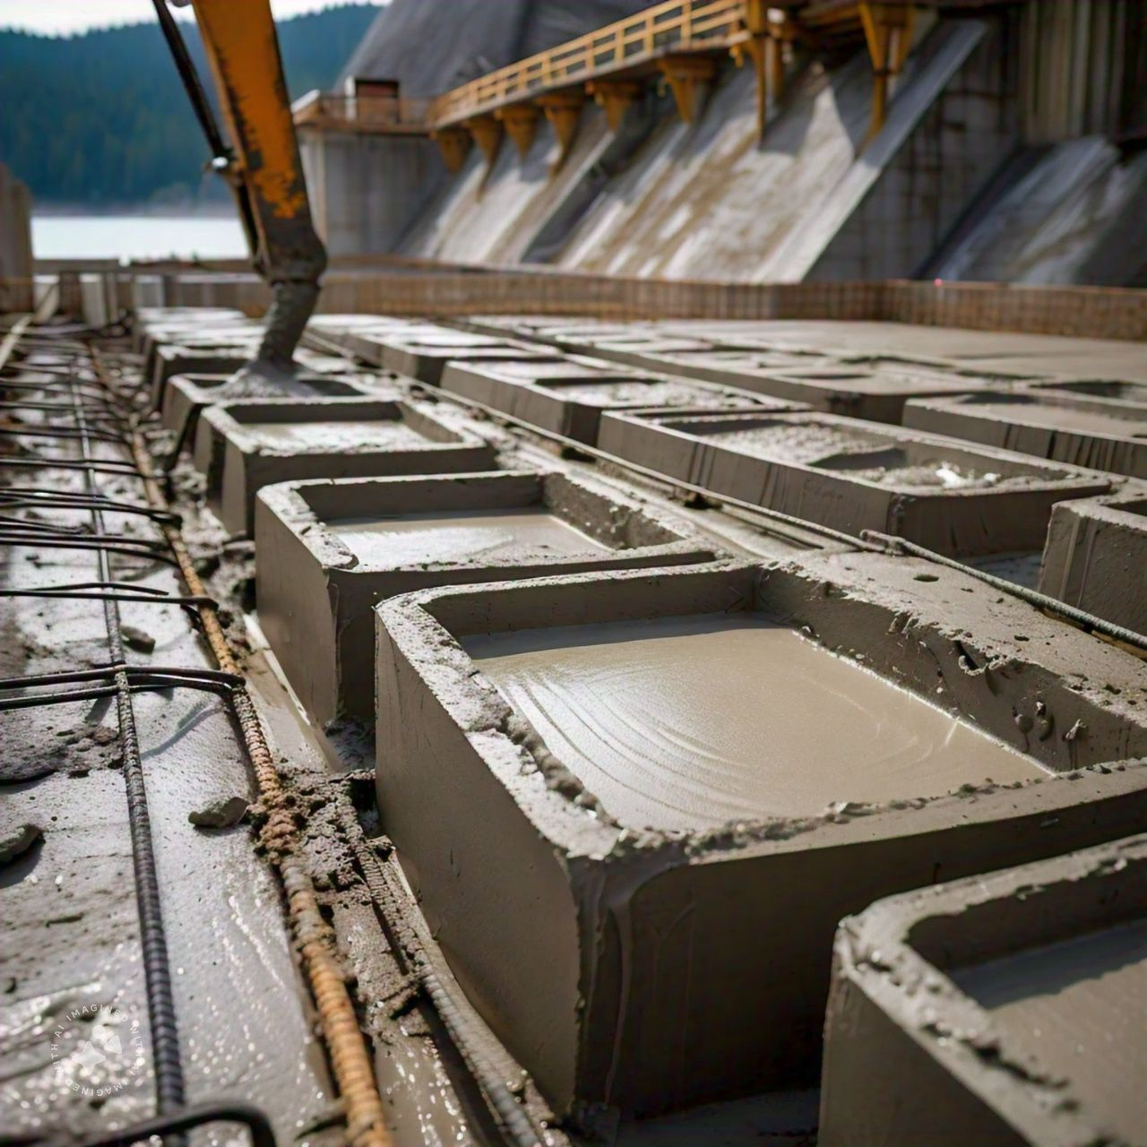
What is concrete mix proportioning?
Definition:
Process of determining the right proportions of cement, aggregates, water, and admixtures.
Purpose:
Achieve desired strength, workability, and durability.
Ensure economical use of materials.

Slide 22
Factors Influencing Proportioning?
Strength requirements
Workability
Durability

Slide 23
Key Components of Concrete?
Cement
Aggregates
Water
Admixtures

Slide 24
Indian Standard?
IS 10262 --Concrete Mix Proportioning – Guidelines
Provides guidelines for proportioning concrete mixes
Key areas
Design Criteria – Provides guidelines for proportioning concrete mixes
Materials selection – Quality standards for cement, aggregates and water
Water cement ratio

Slide 25
Mix Design Procedure?
Determine Design Criteria:
Specify strength, workability, and durability.
Select Materials
Cement, aggregates, water, and optional admixtures.
Calculate Proportions
Use IS 10262 for calculations based on target mean strength.
Conduct Trial Mixes
Prepare and test mixes to verify performance.
Adjust Proportions:
Refine mix based on trial results.

Slide 26
mix proportion calculation methodology?
Target mean strength – required strength plus quality control margin
Workability – adjust based on type of work
Trial mixes – Validate proportions and performance

Slide 27
mix proportion calculation methodology?
Target mean strength – required strength plus quality control margin
Workability – adjust based on type of work
Trial mixes – Validate proportions and performance

Slide 28
Thank You
www.bis.gov.in
ced@bis.gov.in

