Slide 1
Fresh and Hardened Concrete ― Tests
BUREAU OF INDIAN STANDARDS

Slide 2
IS 516 Hardened Concrete ‒ Methods of Test
Existing standards………
Part 1 Sec 1 | Determination of strength of hardened concrete ― Compressive, Flexural & Split Tensile Strength of Concrete
Part 2 | Properties of Hardened Concrete other than strength
Sec 1 | Density of hardened concrete & Depth of water penetration
Sec 2 | Initial Surface Absorption
Sec 3 | Oxygen Permeability of Concrete
Sec 4 | Carbonation resistance by Accelerated carbonation method
Part 4 | Sampling, preparing and testing of concrete cores
Part 5 | Non-destructive testing of hardened concrete
Sec 1 | Ultrasonic Pulse Velocity testing
Sec 2 | Half-cell potentials of uncoated reinforcing steel in concrete
Sec 3 | Carbonation Depth Test
Sec 4 | Rebound Hammer test
Part 6 | Drying shrinkage & moisture movement of concrete samples
Part 8 Sec 1 | Determination of modulus of elasticity ― Static modulus of elasticity & Poisson's ratio in compression
Part 11 | Portland cement content of hardened hydraulic cement concrete

Slide 3
IS 516 Hardened Concrete ‒ Methods of Test
In the pipeline…..
Part 2 | Properties of Hardened Concrete other than strength
Sec 5 | Surface and bulk resistivity of concrete ─ IITD
Sec 6 | Volume of permeable voids and determination of permeability ─ NCB
Sec 7 | Rapid Chloride Penetration Test
Part 3 | Making, curing and determining compressive strength of accelerated cured concrete test specimens
Part 7 | Creep of concrete cylinders in compression
Part 8 Sec 2 | Determination of modulus of elasticity ― Modulus of elasticity by electrodynamic method **
Part 9 | Determination of wear resistance
Part 10 | Bond in reinforced concrete
Part 12 | Water soluble & acid soluble chlorides in hardened mortar & concrete
Sec 1 | Determination of total chlorides
Sec 2 | Determination of chloride profile
** available in clause 10 of IS 516: 1959

Slide 4
IS 1199 Fresh Concrete ‒ Methods of Sampling, Testing and Analysis
Existing standards………
Part 1 | Sampling of fresh concrete
Part 2 | Determination of consistency of fresh concrete
Part 3 | Determination of Density of Fresh Concrete
Part 4 | Determination of Air Content of Fresh Concrete
Part 5 | Making and curing of test specimens
Part 6 | Tests on fresh Self Compacting Concrete
Part 7 | Setting time of concrete by penetration resistance

Slide 5
IS 1199 Fresh Concrete ‒ Methods of Sampling, Testing and Analysis
In the pipeline…..
Part 8 | Water soluble & acid soluble chlorides in mortar & concrete
Part 9** | Analysis of freshly mixed concrete
Part 10 | Field Tests for capturing heat signature and pumpability
** available in clause 6 of IS 516: 1959

Slide 6
Hardened Concrete ‒ Methods of Test Part 1 Sec 1 Determination of strength of hardened concrete ― Compressive, Flexural & Split Tensile Strength of Concrete
IS 516 (Part 1/Sec1)

Slide 7
Compressive Strength test
Compressive strength testing is essential for working out the capacity of concrete to withstand a load and determine at which point it will experience failure.
Compression testing machine as per IS 14858 may be used for testing.
The testing is usually carried out at 7 or 28 days after casting
At least 3 samples may be chosen, and they may be cured, wiped clean, dimensions measured. (as per IS 10086)
Load is applied at 14N/mm2 per minute.
Wat will happen?

Slide 8
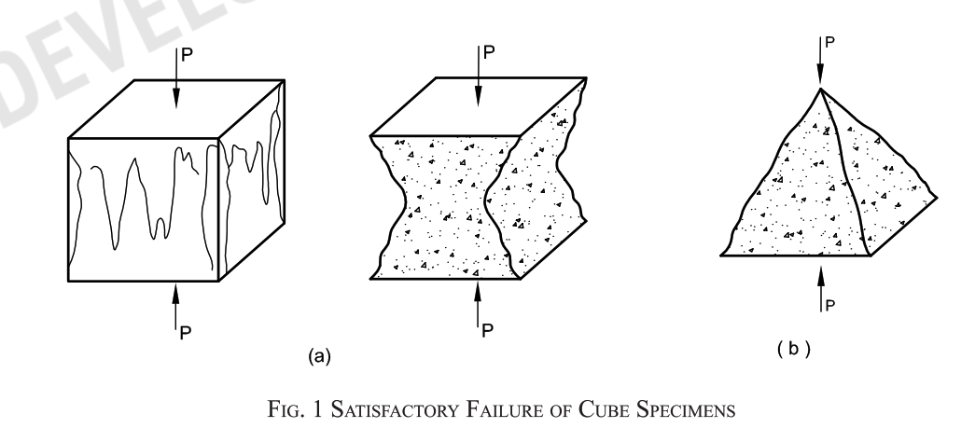
Compressive Strength test

Slide 9
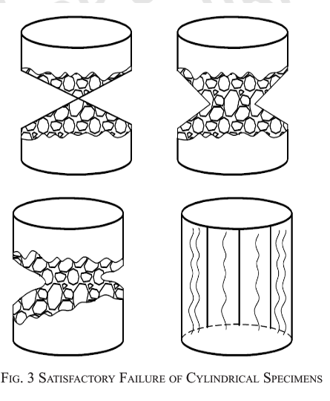
Compressive Strength test

Slide 10
Compressive Strength test
Have you observed any other failure patterns?
Can you draw them ?

Slide 11
Compressive Strength test

Slide 12
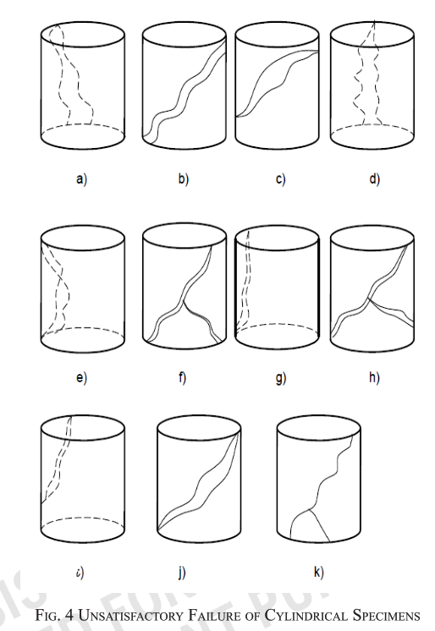
Compressive Strength test

Slide 13
Flexural Strength test
Specimen – Usually Prism as per IS 1199 Part 5
Test usually carried out at 7 or 28 days
Atleast 3 specimens
Loading rate – 0.7 N/mm2/min

Slide 14
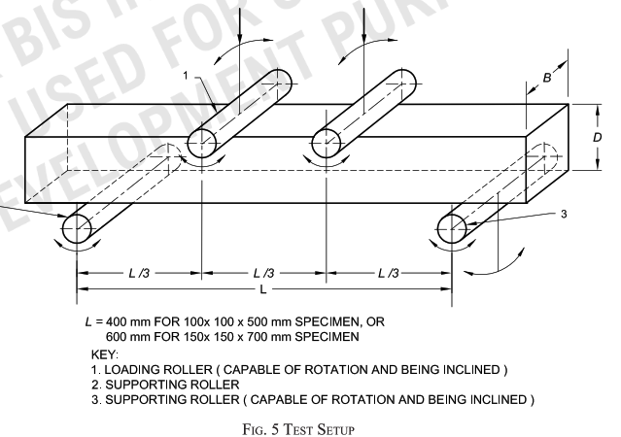
Flexural Strength test

Slide 15
Flexural Strength test

Slide 16
Flexural Strength test
What if the failure falls outside this zone?

Slide 17
Split tensile strength
Split tensile strength is a simple way to measure concrete's ability to resist tensile forces.
It's an important parameter for estimating cracking failure and structural integrity.
Testing machine shall be as per IS 14858.
Loading rate is 1.2 to 2.4 N/mm2/min

Slide 18
Hardened Concrete ‒ Methods of Test Part 2 Sec 1 Properties of Hardened Concrete other than strength ― Density of hardened concrete & Depth of water penetration
IS 516 (Part 2/Sec1)

Slide 19
Density of hardened concrete
This test method is applicable to normal-weight and
heavy-weight concrete. It differentiates hardened
concrete in the following states: as received, saturated
and oven-dried.
Calculate the density using the value determined for
the mass of specimen and its volume, using the following
equation:
D = m/V;
where
D = density related to the conditions of the specimen and the method of determining the volume, in kg/ m3;
m=mass of the specimen in its condition at the time of the test, in kg;
V = volume determined by the particular method, in m3.

Slide 20
Depth of water penetration
The method determines the depth of penetration of water under pressure in hardened concrete that has been water cured.
Water is applied under pressure to the surface of hardened concrete. The specimen shall then be split and the depth of penetration of the water front is recorded and measured.

Slide 21
Hardened Concrete ‒ Methods of Test Part 2 Sec 2 Properties of Hardened Concrete other than strength ― Initial Surface Absorption
IS 516 (Part 2/Sec2)

Slide 22
Initial surface absorption
This test method gives data for assessing the uniaxial water penetration characteristics of a concrete surface.
The results may be considered to be related to the quality of finish and durability of the surface under the effects of natural weathering. The results are of little relevance to the behaviour of concrete under higher water pressures and cannot be used to assess the permeability of the concrete.
This test method can also be applied to exposed aggregate or profiled surfaces provided that a watertight seal can be obtained with the apparatus. The test is not applicable to specimens or areas showing obvious porosity, honeycombing or cracking. Misleading results can also be obtained when tests are performed on thin concrete sections through which water could penetrate during the test. Tests shall not be repeated at locations within an area affected by previous tests.

Slide 23
Hardened Concrete ‒ Methods of Test Part 2 Sec 3 Properties of Hardened Concrete other than strength ― Oxygen Permeability of Concrete
IS 516 (Part 2/Sec 3)

Slide 24
Oxygen Permeability of Concrete
This test determines the gas permeability of concrete through the use of oxygen gas, where oxygen permeability index is defined as the negative log of the coefficient of permeability. It consists of measuring the pressure decay of oxygen passed through a 30 mm oven-dried thick slice (representing the cover concrete) of a (typically) 70 mm diameter concrete core placed in a falling head permeability apparatus.

Slide 25
Hardened Concrete ‒ Methods of Test Part 2 Sec 4 Properties of Hardened Concrete other than strength ― Carbonation resistance by Accelerated carbonation method
IS 516 (Part 2/Sec 4)

Slide 26
Hardened Concrete ‒ Methods of Test Part 2 Sec 4 Properties of Hardened Concrete other than strength ― Carbonation resistance by Accelerated carbonation method
IS 516 (Part 2/Sec 4)
What is carbonation?
What causes carbonation?
So what do we do?

Slide 27
Carbonation resistance by Accelerated carbonation method
Two concrete cubes are cast and cured for 28 days in accordance with IS 1199 (Part 5). The two concrete cubes are then conditioned in a laboratory air environment for 14 days prior to sealing the top, bottom, and two opposite side faces. After sealing of all but two faces, the cubes are placed in a storage chamber meeting the conditions specified in 5.4 and having a carbon dioxide level of 3.0 ± 0.5 percent for a period of 70 days. After 70 days of exposure, the cubes shall be split in half, perpendicular to the exposed faces, and the depth of carbonation measured in accordance with the procedure given in 7.
The test under reference conditions takes therefore a minimum of 112 days period that comprises a minimum age of the specimen of 28 days prior to conditioning, a minimum conditioning period of 14 days, and a minimum exposure to increased carbon dioxide levels of 70 days. In case of concretes made with blended cements or having mineral admixtures, extended curing and drying times are allowed and the same should be reported.

Slide 28
Hardened Concrete ‒ Methods of Test Part 4 Sampling, preparing and testing of concrete cores
IS 516 (Part 4)

Slide 29
Hardened Concrete ‒ Methods of Test Part 4 Sampling, preparing and testing of concrete cores
IS 516 (Part 4)
What are concrete cores?
Why do we take concrete cores?

Slide 30
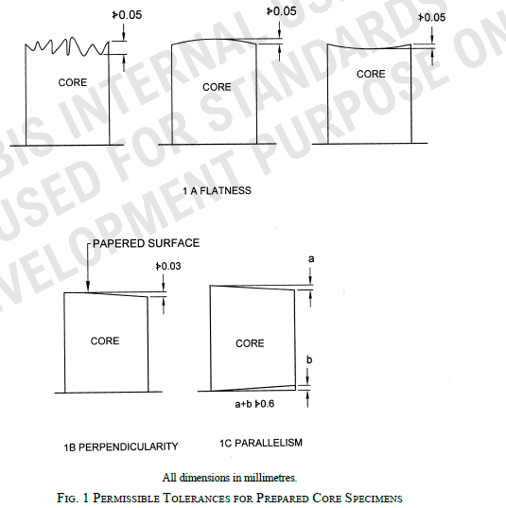
Sampling, preparing and testing of concrete cores

Slide 31
Hardened Concrete ‒ Methods of Test Part 5/Sec 1 Non-destructive testing of hardened concrete — Ultrasonic Pulse Velocity testing
IS 516 (Part 5/Sec 1)

Slide 32
Hardened Concrete ‒ Methods of Test Part 5/Sec 1 Non-destructive testing of hardened concrete — Ultrasonic Pulse Velocity testing
IS 516 (Part 5/Sec 1)
What is non destructive testing of concrete?
Examples?

Slide 33
Ultrasonic Pulse Velocity testing
The ultrasonic pulse is generated by an electroacoustical transducer. When the pulse is induced into the concrete from a transducer, it undergoes multiple reflections at the boundaries of the different material phases within the concrete. A complex system of stress waves is developed which includes longitudinal (compressional), shear (transverse) and surface (Raleigh) waves. The receiving transducer detects the onset of the longitudinal waves, which is the fastest. Because the velocity of the pulses is almost independent of the geometry of the material through which they pass and depends only on its elastic properties, pulse velocity method is a convenient technique for investigating in-situ concrete.
The underlying principle of assessing the quality of concrete is that comparatively higher velocities are obtained when the quality of concrete in terms of density, homogeneity and uniformity is good. In case of poorer quality, lower velocities are obtained. If there is a crack, void or flaw inside the concrete which comes in the way of transmission of the pulses, the pulse strength is attenuated and it passes around the discontinuity, thereby making the path length longer. Consequently, lower velocities are obtained. The actual pulse velocity obtained depends primarily upon the materials and mix proportions of concrete. Density and modulus of elasticity of aggregate also significantly affect the pulse velocity.

Slide 34
Hardened Concrete ‒ Methods of Test Part 5 Sec 2 Non-destructive testing of hardened concrete — Half-cell potentials of uncoated reinforcing steel in concrete
IS 516 (Part 5/Sec 2)

Slide 35
Half-cell potentials of uncoated reinforcing steel in concrete
The corrosion potential Ecorr (half-cell rebar/concrete) is measured as potential difference (or voltage) against a reference electrode (half-cell). The numerical value of the measured potential difference between the steel in concrete and the reference electrode will depend on the type of reference electrode used and on the corrosion condition of the steel in concrete. It is therefore, important to indicate the reference electrode being used for the half-cell potential measurements. Corrosion of a metal implies separate anodic and cathodic processes occurring simultaneously on the same metal surface. Corroding steel in concrete acts as a mixed electrode with coupled anodic and cathodic reactions taking place simultaneously on its surface. At the corroding site (the anode), iron is dissolved and oxidized to iron ions leaving electrons in the steel. Due to the condition of electro neutrality, these electrons have to be consumed by the cathodic reaction at the steel surface, where oxygen is reduced and hydroxyl ions are produced.
Depending on the spatial distribution of anodic and cathodic reactions on the surface of the steel and the conductivity of the medium, following two different types of corrosion can take place:
a) Uniform corrosion, in which anodic and cathodic reactions are coupled to form numerous micro-cells on the steel surface and occur on the same areas.
b) Macro-cell corrosion or localized corrosion, in which the anodic and cathodic areas of the corrosion process are separated in space with significant potential drop.

Slide 36
Hardened Concrete ‒ Methods of Test Part 5 Sec 3 Non-destructive testing of hardened concrete — Carbonation Depth Test
IS 516 (Part 5/Sec 3)

Slide 37
Carbonation Depth Test
Carbonation is a process in which carbon dioxide from the atmosphere diffuses through the porous cover concrete and may reduce the pH to 8 or 9, at which the passivating/oxide film is no longer stable. Carbonation process involves the following two stages: First, the atmospheric carbon dioxide (CO2) reacts with water in the concrete pores to form carbonic acid (H2CO3).
This is followed by reaction of the carbonic acid with calcium hydroxide [Ca(OH)2] to form calcium carbonate(CaCO3). This process leads to cause a reduction in the pH value of the pore solution from 12.5 to 13.5 to around 8 to 9, which causes depassivation of protective layer ofthe reinforcement bars and initiates their corrosion.

Slide 38
Hardened Concrete ‒ Methods of Test Part 5 Sec 4 Non-destructive testing of hardened concrete — Rebound Hammer test
IS 516 (Part 5/Sec 4)

Slide 39
Rebound Hammer test
When the plunger of rebound hammer is pressed against the surface of the concrete, the spring-controlled mass rebounds and the extent of such rebound depends upon the surface hardness of concrete. Based on the rebound distance of the spring-controlled mass after it impacts the plunger or based on the ratio of the hammer speed after impact to the speed before impact, a rebound number is produced. Rebound number produced based on two measurement principles are not comparable. The surface hardness and therefore the rebound is taken to be related to the compressive strength of the concrete. The rebound is read off along a graduated scale, recording paper or an electronic display and is designated as the rebound number or rebound index.
The rebound hammer method could be used for,
assessing the likely compressive strength of concrete with the help of suitable correlation between rebound index and compressive strength developed;
assessing the uniformity of concrete quality;
assessing the quality of the concrete in relation to standard requirements; and
assessing the quality of one element of concrete in relation to another.

Slide 40
Hardened Concrete ‒ Methods of Test Part 6 Drying shrinkage & moisture movement of concrete samples
IS 516 (Part 6)

Slide 41
Drying shrinkage & moisture movement of concrete samples
For the determination of the moisture movement, the specimen shall first be tested for drying shrinkage as described above and the dry measurement determined. The specimen shall then be immersed in water at 27± 2°C in such a manner that one of the larger faces of the specimen just breaks surface in the water and shall be left so immersed for four days after which the ‘final wet measurement’ shall be determined. The moisture movement shall be calculated as the difference between
the ‘dry measurement’ and ‘final wet measurement’ expressed as percentage of the ‘dry measurement’.

Slide 42
Hardened Concrete ‒ Methods of Test Part 8/Sec 1 Determination of modulus of elasticity ― Static modulus of elasticity & Poisson's ratio in compression
IS 516 (Part 8/Sec 1)

Slide 43
Static modulus of elasticity & Poisson's ratio in compression
This test method provides a stress to strain ratio value and a ratio of lateral to longitudinal strain for hardened concrete at whatever age and curing conditions may be designated.
The modulus of elasticity and Poisson's ratio values, applicable within the customary working stress range (0 to 40 % of ultimate concrete strength), are used in sizing of reinforced and nonreinforced structural members, establishing the quantity of reinforcement, and computing stress for observed strains.
The modulus of elasticity values obtained will usually be less than moduli derived under rapid load application (dynamic or seismic rates, for example), and will usually be greater than values under slow load application or extended load duration, given other test conditions being the same.

Slide 44
Hardened Concrete ‒ Methods of Test Part 11 Portland cement content of hardened hydraulic cement concrete
IS 516 (Part 11)

Slide 45
Portland cement content of hardened hydraulic cement concrete
Only for concrete made with OPC
2 procedures – soluble silica procedure and calcium oxide procedure.
We find the percentage silica/calcium oxide in the concrete through chemical means and divide them by the known value of these chemicals in cement.
The cement content in the sample, mentioning the procedure used, shall be reported. If both procedures (soluble silica and calcium oxide) have been used, the lower of the two shall be reported and the procedure name shall be mentioned. All analysis shall be done in triplicate, and the average of the three values reported.

Slide 46
Fresh Concrete ‒ Methods of Sampling, Testing and Analysis Part 1 Sampling of fresh concrete
IS 1199 (Part 1)

Slide 47
Sampling of fresh concrete
Composite Sample
Concrete is sampled from a stream of moving concrete or from a pile, in a series of increments
These increments are then thoroughly mixed together.
Spot Sample
Concrete is sampled from a stream of moving concrete or from a pile, at a single point.
Spot samples are not representative of the batch and should not be used to cast strength specimens.

Slide 48
Fresh Concrete ‒ Methods of Sampling, Testing and Analysis Part 2 Determination of consistency of fresh concrete
IS 1199 (Part 2)

Slide 49
Determination of consistency of fresh concrete
The consistency of the concrete can be determined by
any of the following tests:
a) Slump test,
b) Vee bee test,
c) Compacting factor test,
d) Degree of compactability,
e) Flow table test, and
f) Slump flow test for high fluidity concrete.

Slide 50
Fresh Concrete ‒ Methods of Sampling, Testing and Analysis Part 3 Determination of Density of Fresh Concrete
IS 1199 (Part 3)

Slide 51
Determination of Density of Fresh Concrete
The fresh concrete is compacted into a calibrated rigid and watertight container and is then weighed.
This test method may not be applicable to aerated concrete or very stiff concrete that cannot be compacted by normal vibration and care is needed in its use with these concretes.

Slide 52
Fresh Concrete ‒ Methods of Sampling, Testing and Analysis Part 4 Determination of Air Content of Fresh Concrete
IS 1199 (Part 4)

Slide 53
Determination of Air Content of Fresh Concrete

Slide 54
Fresh Concrete ‒ Methods of Sampling, Testing and Analysis Part 5 Making and curing of test specimens
IS 1199 (Part 5)

Slide 55
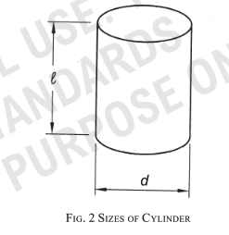
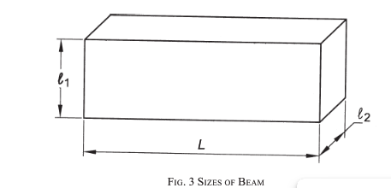
Making and curing of test specimens

Slide 56
Fresh Concrete ‒ Methods of Sampling, Testing and Analysis Part 6 Tests on fresh Self Compacting Concrete
IS 1199 (Part 6)

Slide 57
Tests on fresh Self Compacting Concrete
The slump-flow test is an indication of the flowability of self-compacting concrete in the absence of obstructions. It is based on the slump test described inIS 1199 (Part 2). The flowability is evaluated by measuring the maximum spreading diameter (dmax) and the time it reaches the spreading diameter of 500 mm(t500).
The dmax of spreading is a measure of the self compacting concrete flow range when subjected to Load from its own weight. It is an indication of the yield stress of the self-compacting concrete.
The t500 time is a measure of the speed of flow and an indication of the relative viscosity of the self-compacting concrete. The result is an indication of the filling ability of self compacting concrete.
The fresh concrete is poured into a cone as used for the IS 1199 (Part 2) slump test. When the cone is withdrawn upwards the time from commencing upward movement of the cone to when the concrete has flowed to a diameter of 500 mm is measured; this is the t500 time. The largest diameter of the flow spread of the concrete and the diameter of the spread at right angles to it are then measured and the mean diameter is the slump flow.

Slide 58
Fresh Concrete ‒ Methods of Sampling, Testing and Analysis Part 7 Setting time of concrete by penetration resistance
IS 1199 (Part 7)

Slide 59
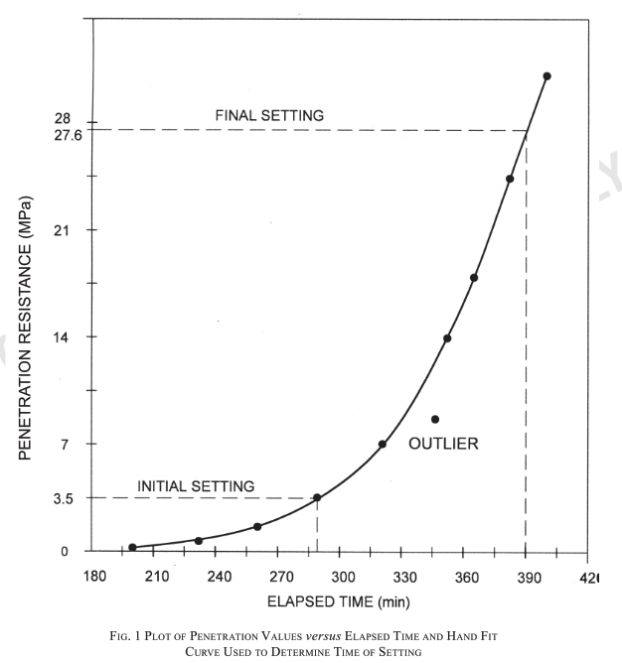
Setting time of concrete by penetration resistance
The mortar sample is obtained by sieving a representative sample of fresh concrete. The mortar sample is placed in a container and stored at a specified ambient temperature. At regular time intervals, the resistance of the mortar to penetration by standard needles is measured. From a plot of penetration resistance versus elapsed time, the time of initial and final setting are determined.

