Slide 1
Refractories
Narender Reddy BeesU Scientist ‘E’/Director Bengaluru Branch Office Bureau of Indian Standards

Slide 2
Syllabus of NIT, Nagpur on refractories(IV Semester B. Tech. (MME))
MML 218 CERAMICS MATERIALS (3-0-0) 6 credits
Introduction, Definition of ceramic materials, Spectrum of applications, Classification of Ceramics. Basis of crystal structures in ceramics, Crystal Structures (Rock salt, NiAs, CsCl, Wurtzite, Rutile, Fluorites, Antifluorites, Perovskites, Silicates etc.).
Imperfection in ceramic materials – Kroger-Vink notation, Defect reactions, Stoichiometry and non-stoichiometry. Processing of ceramic materials –Powder synthesis techniques, Consolidation techniques (slip casting, tape casting etc.), Sintering theory and mechanisms, Advanced techniques of sintering
Principles of Characterization of powders and sintered bodies (particle size and distribution, porosity, density, shrinkage, surface area etc.)
Basics of ceramic properties (Physical, Electrical, Mechanical, Magnetic, and thermal) Structure-Property co-relationship.
Classification of refractory materials into Acidic, basic, neutral, rarer refractories. Requirements of a refractory and applications. Introduction to Advanced Ceramics and Applications (electro-ceramics, bio-ceramics, ultra-high temperature ceramics, thin films etc.), Opportunities and Challenges.

Slide 3
outline
Refractories –
Definitions and requirements/Properties of refractories
Major Terminology
Functions of refractories
Classifications/Types of refractories
Uses of refractories
Specification of majorly used refractories
Test methods for verification of properties
Published Indian Standards
Current developments in refractories

Slide 4
Definition
“Refractarius,” which means stubborn or obstinate
The word refractory means “not affected by a treatment, change, or process”
refractory, noun refractory product refractory material
non-metallic material or product (but not excluding those containing a proportion of metal) whose chemical and physical properties allow it to be used in a high temperature environment (cl 107 IS 4041/ISO 836)
The main requirements from refractories are:
to withstand high temperatures even under high load
to have high volume stability Refractory
to sustain under sudden changes of temperatures (Thermal Shock Resistance)
to resist the action of molten metal slag, glass, hot gases, etc.
to withstand abrasive/wear/erosive forces
to have a low coefficient of thermal expansion
to be able to conserve heat
to not contaminate the product/process material

Slide 5
Major Terminology(IS 4041/ISO 836)
Abrasion : surface wear of a material caused by the mechanical action of moving solids
acid refractory : refractory containing a substantial amount of silica which reacts chemically with a basic refractory, a basic slag, a high alumina refractory or alkali bearing components at high temperature
Aggregate : grain constituent particle of a refractory composition, normally coarse in size
air-setting jointing material : air-setting mortar
refractory cement : type of jointing material which hardens at ambient temperature by a chemical bond or a hydraulic bond
apparent porosity : ratio of the total volume of the open pores in a porous refractory to its bulk volume expressed as a percentage of the bulk volume
basic refractory : refractory which may react chemically at high temperature with an acid refractory, an acid slag, an acid flux or alumina
Binder : substance added to a non-plastic granular or fibrous material to give workability and green strength or dry strength to the formed material
Bond : connecting link between the constituent particles of a refractory producing coherency and strength
bulk ceramic fibre : ceramic fibre in the as-produced state, before conversion to other products
bulk density : ratio of the mass of the dry material of a porous refractory to its bulk volume
bulk density (of a granular material) : grain bulk density : ratio of the mass of a quantity of dry granular material to the total volume of its grains, including the volume of any closed pores within the grains
Courtesy: Indian Standard : IS 4041 : 2006/ISO 836:2001 Terminology for refractories First Revision

Slide 6
Major Terminology (IS 4041/ISO 836)
bulk volume sum of the volumes of the solid materials, the open pores and the closed pores in a porous refractory
castable ceramic fibre ceramic fibre with inorganic and/or organic binder which may be cast
ceramic bond bond produced by sintering or liquid formation at high temperature
ceramic fibre refractory ceramic fibre - man-made mineral fibre suitable for use as heat-insulating material, containing less than 2 % in total mass of alkaline oxide and alkaline earth oxides
ceramic fibre blanket flexible, normally needled, ceramic fibrous insulating material, free of binder, with nominally determined dimensions
ceramic fibre board substantially rigid flat sheet normally containing inorganic and/or organic binder, produced by a wet process
ceramic fibre felt flexible, fibrous insulating material of nominally determined dimensions, containing some proportion of inorganic and/or organic binder
ceramic fibre mat chromite raw material containing a substantial amount of chromium sesquioxide combined with other di- and tri- valent metal oxides to form a cubic crystalline structure, and whose chemical composition is suitable for use in a refractory
closed pores pores that are enclosed within a refractory and are not penetrated by the immersion liquid in the test specified in ISO 5017:1998
closed porosity ratio of the total volume of the closed pores in a porous refractory to its bulk volume, expressed as a percentage of the bulk volume
Courtesy: Indian Standard : IS 4041 : 2006/ISO 836:2001 Terminology for refractories First Revision

Slide 7
Major Terminology (IS 4041/ISO 836)
cold compressive strength maximum load (applied under specified conditions at room temperature) divided by the area over which the load is applied, that a refractory will withstand before failure occurs
corner defect missing corner of a brick defined by three dimensional measurements
Doloma intimate mixture of calcium and magnesium oxides produced by calcination of the naturally occurring or synthetic mixed carbonate or hydroxide
dry mix unshaped refractory specially designed to be placed in the dry state by vibration or ramming
dry strength mechanical strength of a shaped and dried, but unfired, refractory
Fines small-sized fraction of a mixture of particles used in the manufacture of a refractory
fireclay refractory firebrick refractory composed predominantly of alumino-silicate containing greater than or equal to 30 % and less than 45 % by mass of aluminium oxide
Forsterite magnesium orthosilicate, often naturally occurring, with a chemical composition suitable for use as a refractory raw material
forsterite refractory granulometric class mesh width of the finest sieve through which 95 % by mass of an unshaped refractory material passes
Courtesy: Indian Standard : IS 4041 : 2006/ISO 836:2001 Terminology for refractories First Revision

Slide 8
Major Terminology (IS 4041/ISO 836)
heat setting jointing material heat setting mortar refractory mortar type of jointing material which hardens at elevated temperatures and contains a chemical bond and/or a ceramic bond
high alumina refractory refractory composed predominantly of alumina and/or alumino-silicate containing greater than or equal to 45 % by mass of aluminium oxide
injection mix unshaped refractory specially designed to be injected by a pump using pressures of between 10 bar and 20 bar
insulating refractory refractory with a low thermal conductivity and low heat capacity
jointing material refractory intended for laying and jointing brick(s) or block(s) by trowelling, grouting in the joints or dipping
lime refractory refractory containing greater than or equal to 70 % by mass of calcium oxide and less than 30 % by mass of magnesium oxide
Magnesia magnesium oxide produced by calcination of naturally occurring or synthetic magnesium carbonate or hydroxide and used as a raw material, normally in the dead-burned state
modulus of rupture maximum stress that a prismatic test piece of a refractory of specified dimensions can withstand when it is bent in a three-point bending device
mouldable ceramic fibre ceramic fibre with inorganic and/or organic binder which may be moulded
open pores pores in a refractory that are penetrated by the immersion liquid in the test specified in ISO 5017:1998
Permeability property of a refractory allowing a fluid to pass through it when under a difference of pressure
permanent change in dimensions on heating permanent linear change dimensional expansion or contraction that remains in a refractory that is heated with no externally applied force to a specified temperature for a specified time and then cooled to ambient temperature
Courtesy: Indian Standard : IS 4041 : 2006/ISO 836:2001 Terminology for refractories

Slide 9
Major Terminology (IS 4041/ISO 836)
pitch bonding tar bonding use of pitch or tar to produce a bond in a pressed unfired refractory
pitch impregnation use of liquid pitch or tar to impregnate a refractory after forming or firing
plastic refractory mouldable refractory unshaped refractory, supplied ready for use, with a high workability, made up of aggregate, bond and liquid, and which hardens after placing by the action of heat
pyrometric cone equivalent reference number of the pyrometric reference cone that has bent over to the same degree as test pieces of a refractory or the number of the two cones that have bent over, one a little more and one a little less than the test pieces when the cones and the test pieces have been mounted together and heated under specified conditions
pyrometric reference cone blunt-tipped skew triangle pyramid with sharp edges, of specified shape and dimensions and of such composition that, when mounted and heated under specified conditions, it bends in a known manner with reference to its heat temperature
Ramming process of installing or shaping an unshaped refractory involving repeated impact
reference temperature temperature of collapse temperature at which the tip of a pyrometric reference cone reaches the level on which the base of the cone is mounted when the cone is heated at a specified rate under specified conditions
refractory, noun refractoriness characteristic property of a refractory that allows it to withstand a high temperature in its environment and conditions of use
Segregation separation of aggregate and fines during fabrication of a refractory to leave a honeycomb appearance and/or a layer of excess fines
Courtesy: Indian Standard : IS 4041 : 2006/ISO 836:2001 Terminology for refractories First Revision

Slide 10
Major Terminology (IS 4041/ISO 836)
Sintering joining of particles and increasing their contact interfaces by atom movement within and between the particles due to the application of heat
Slag non-metallic material formed during refining of metal, as a by-product of a high temperature process, or resulting from chemical reaction between refractory and its service environment
tap-hole mix specially designed plastic refractory, supplied ready for use, made up of aggregate, bond and liquid which, after firing, form a carbon bond
thermal conductivity quantity of heat transmitted through a refractory in unit time divided by unit cross-sectional area and unit temperature gradient along the direction of heat flow
thermal diffusivity thermal conductivity of a refractory divided by its heat capacity per unit volume
thermal shock resistance resistance of a refractory to damage caused by abrupt temperature changes
true density ratio of the mass of the solid material of a porous refractory to its true volume
true porosity ratio of the total volume of the open pores and the closed pores in a porous refractory to its bulk volume
true volume volume of the solid material in a porous refractory
ultra-low cement castable deflocculated castable containing greater than 0,2 % and up to 1,0 % calcium oxide on a calcined basis
vibro-compaction use of vibration to compact an unshaped refractory during installation or test piece preparation
yield by volume mass of unshaped refractory, as delivered, which is necessary to place 1 m³ of material, expressed in tonnes to the nearest 1 %
Courtesy: Indian Standard : IS 4041 /ISO 836 Terminology for refractories

Slide 11
Functions of Refractories
refractories are nonmetallic inorganic materials suitable for use at high temperatures in furnace construction.
is to resist the high temperatures under high load, they are also called on to resist other destructive influences during the hot processing, such as abrasion pressure, chemical attack, and rapid changes in temperature.
In practical terms, refractories are the products used for any high-temperature processing to insulate the system, introduce erosion/corrosion/abrasion resistances against the process conditions, and are made mainly from nonmetallic minerals.
They are designed and processed in such a way that they become resistant to the corrosive and erosive action of hot gases, liquids, and solids at high temperatures in various types of kilns and furnaces.
Refractories provide protection to other substances at high temperature without changing its own character.

Slide 12
Classification of refractories
(drawn from
IS 4041/ISO 836)
Refractories
Physical Form
Chemical Behaviour
Acidic
Ex. Silica (SiO₂),
alumina (Al₂O₃),
Neutral
chromia (Cr₂O₃), alumino-silicate, and
magnesia-chromia,
Oxides, Nitrides, Carbides, Borides of metals and metalloids
C, W, Mo
Basic
Ex. MgO
High Alumina
Chemical Composition
Unshaped (monolithic)
Shape
Bricks, cones etc
Advances refractories: Ex. ZrO₂, Y₂O₃ and combination alloys

Slide 13
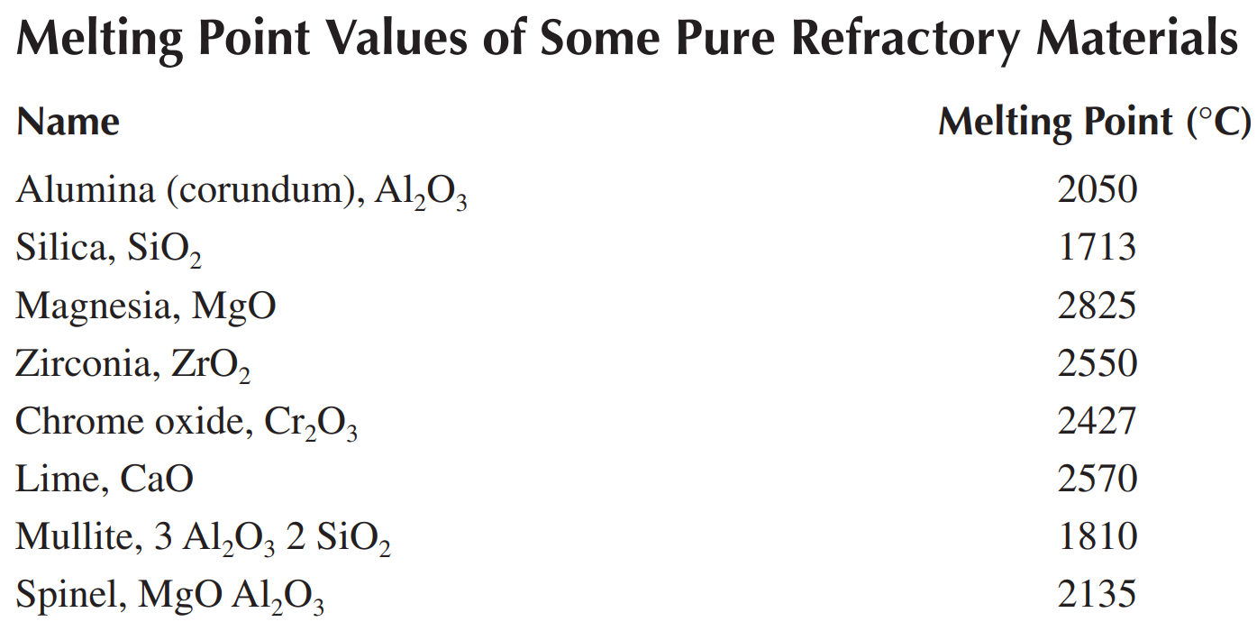

Slide 14
Uses of refractories
Refractory materials are used in numerous fields of the national economy, such as
steel industry,
non-ferrous metals, glass, cement, ceramics, petrochemicals, machinery, boiler manufacturing,
light industry, electric power, military industry, etc. It is an indispensable basic material to ensure
the production, operation, and technological development of the mentioned industries.

Slide 15
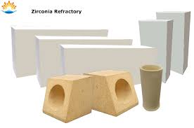
IS 9930 - Zircon refractories for glass furnace applications
Zircon
Apparent porosity. percent, Max 20.0
Permanent linear change after
heating at 1550ºC, percent. Max ±0.5
ZrO₂, min : 63 percent
Fe₂O₃ Max : 1 percent
Bulk density. in g/cc. Min 3.4
Cold crushing strength, in MPa, min. 30
Dimensional Tolerances for Bricks

Slide 16
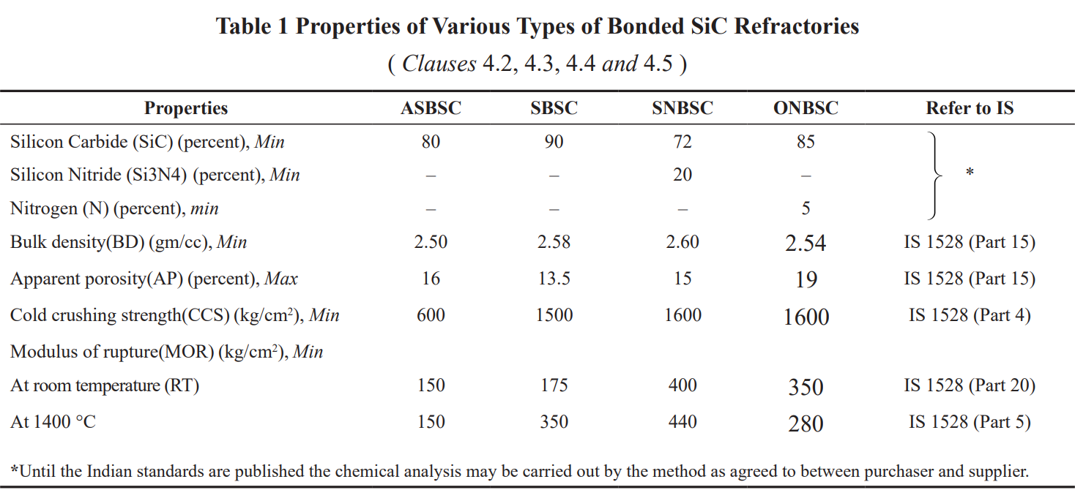
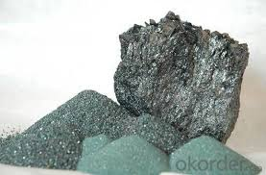
IS 17699 - Silicon Carbide SiC Refractories
Oxinitride Bonded SiC (ONBSC),
Silicon Nitride Bonded SiC (SNBSC),
Self- Bonded SiC (SBSC),
Alumino- Silicate Bonded SiC (ASBSC)

Slide 17
IS 15895 - High alumina refractory cement
Refractory high alumina cement is made by grinding alumina and calcareous material such as lime through sintering or fusing.
It is also known as calcium aluminum cement, it is a common and popular refractory material because of its benefits and uses.
HOW IS HIGH ALUMINA CEMENT MADE?
It differs from the production of ordinary concrete. This is because it essentially uses bauxite and lime as the raw material.
They are mixed following the set amounts which will be grounded into 100 mm fragments. Then, the fragments enter a kiln to heat up to its fusion point (1600°C).
The molten product is then transferred down a steel plate to cool in a rotary kiln. Afterward, it is finely grounded into tube mills until the product is at 2250cm²/gram.
Properties:
Generally has a low pH level
Basically a high refractive index
Also durable in sulfuric acid
Similarly fast cement hardening
Acts as bonding material when added in refractory castables (forms ceramic bond at high temperatures)

Slide 18
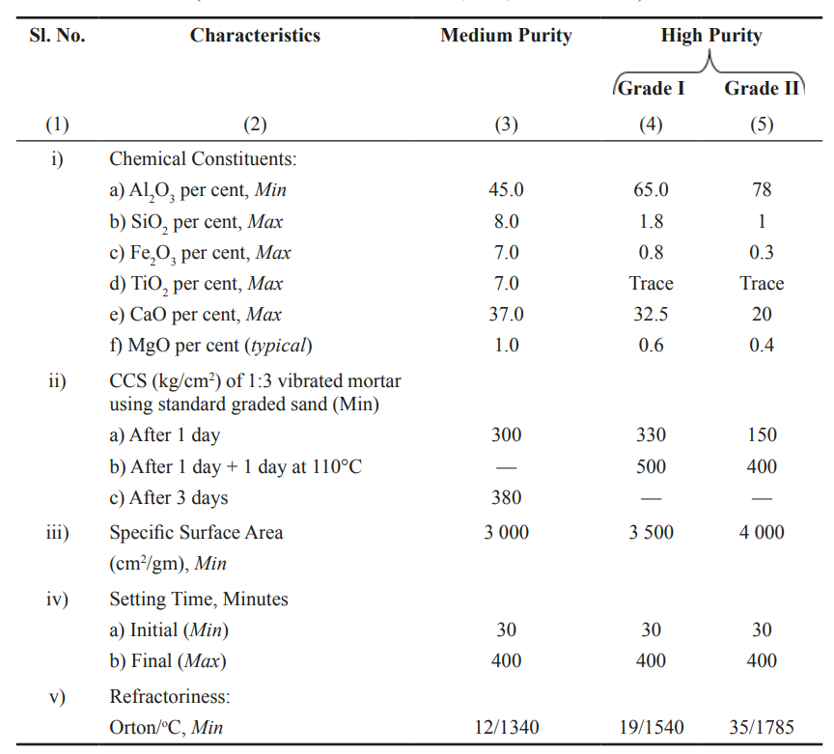
IS 15895- High alumina refractory cement

Slide 19
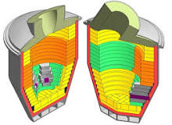
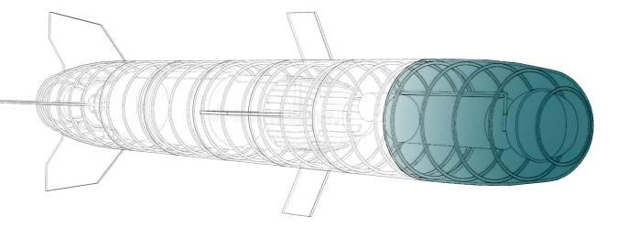
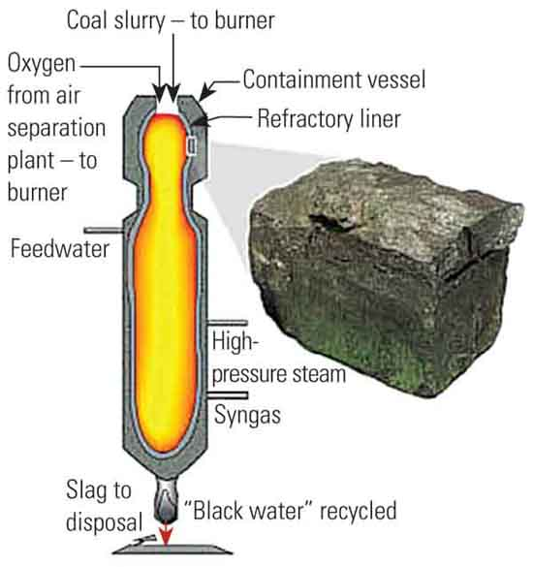
Few specific applications of refractories
Furnace: units used in the metal foundry industry are lined with various refractory components (including silicon dioxide, aluminosilicate, high alumina, zirconium, magnesium oxide, spinel, chromium, and magnesium carbon) and forms (overall, prefabricated shapes and bricks). Most smelting furnaces and holding furnaces in the metal foundry industry are equipped with ceramic refractory materials. The selection of these refractory materials is designed to minimize the reaction with the specific metal being processed.
Missile: Improved pneumatic valve and improved thrust directional valve missile. In one embodiment, the refractory lining for pneumatic valves allows for better valve operation and better valve performance. A thin-walled cylindrical sleeve made of rhenium or other suitable refractory metal is contained in the cylinder. Therefore, the valve piston can move in the refractory sleeve, with higher reliability and better performance. Refractory sleeve cylinder liner can quickly withstand high temperatures and keep running. In such a harsh environment, including the corrosive/erosive environment generated by the passage of hot propellant gas, the refractory cylinder liner has a more reliable service life and is lighter than a traditional valve made entirely of refractory metal.
Gas turbines: Driven by the increased combustion temperature of gas turbines and the need for better emission control, the use of complex materials and processes has promoted the major development of combustion hardware. The main basis for the material changes that have been made is to improve high-temperature creep resistance without sacrificing oxidation/corrosion resistance.

Slide 20
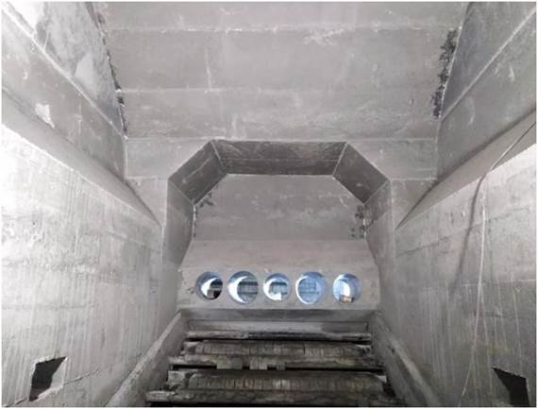
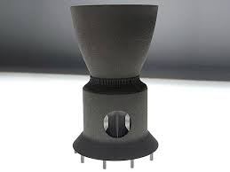
Few specific applications of refractories
Bio-fuel boiler: Refractory materials are used in the internal structure of biofuel boilers (lining). These materials are non-metallic inorganic materials, which do not melt or decompose at high temperatures (600-2000°C). The main components of the lining are made of shaped refractories (bricks, blocks, etc.) and unshaped (concrete, mortar, lining, etc.).
Rocket Nozzle: Refractories are mainly used in ultra-high temperature areas. The area most affected by high temperatures in rockets is the nozzle throat area. Rocket nozzles are widely used in mechanical components such as tactical missiles and weather surveillance satellites. This rocket nozzle works at high temperatures because a large amount of high-temperature exhaust gas produced by combustion passes through the throat area, which is the area with the smallest cross-sectional area. Therefore, the material of the rocket nozzle must have good mechanical properties, such as high melting point, good thermal shock resistance, and low thermal expansion coefficient to maintain propulsion performance. Refractory materials including niobium, tantalum, molybdenum, and tungsten have strong heat resistance and wear resistance.
Combustion chamber partition wall: Silica bricks are mainly used to build partition walls of coke oven carbonization combustion chambers, open-hearth regenerators, high-temperature load-bearing parts of hot blast stoves, and other high-temperature furnaces. The SiO₂ content of silica bricks is more than 93%, the main component is phosphorous quartz, cristobalite, residual quartz, and glass.
The overall lining of furnaces: Ramming materials are mainly used for the general lining of various industrial furnaces, such as open-hearth bottom, electric furnace bottom, induction furnace lining, ladle lining, threading trough, etc. The ramming material is a bulk material formed by a strong ramming method, which consists of a certain size of refractory material, binder, and an additive.
Metallurgy Industry: High alumina bricks are mainly used in the metallurgical industry to construct plugs and nozzles for blast furnaces, hot blast stoves, electric furnace roofs, steel drums and pouring systems. More than 48%, mainly composed of corundum, mullite and glass.

Slide 21
Methods of sampling and physical tests for refractory materials – IS 1528 (Part 1 to 27)
Part 16 /ISO 8894-2 | Determination of Thermal Conductivity According to Hot-Wire Method Parallel
Part 17 /ISO 8895 | Shaped insulating refractory products - Determination of cold crushing strength
Part 18 /ISO 3187 | Determination of creep in compression
Part 19 /ISO 16835 | Determination of Thermal Expansion
Part 20 /ISO 5013 | Determination of Modulus of Rupture at Elevated Temperature first revision
Part 21 /ISO 8894-1 | Determination of Thermal Conductivity According to Hot-Wire Method Cross-Array and Resistance Thermometer
Part 22 /ISO 8841 | Method for determination of permeability to gases of dense shaped refractory products
Part 23 | Methods of test for dense shaped refractory products - Determination of resistance to abrasion at ambient temperature
Part 24 /ISO 16334 | Monolithic Refractory Products - Determination of Resistance to Explosive Spalling
Part 25/ISO 16349 | Determination of Abrasion Resistance at Elevated Temperature
Part 26 /ISO 8890 | Method for Determination of Resistance to Sulfuric Acid of Dense Shaped Refractory Products
Part 27 /ISO 22685 | Method for Determination of Compressive Strength at Elevated Temperature of Refractory Products
Part 1 | Determination of pyrometric cone equivalent PCE or softening point
Part 2 | Determination of refractoriness under load
Part 3 | Determination of spalling resistance
Part 4 | Determination of cold crushing strength of dense shaped refractories products
Part 5/ISO 5014 | Method for determination of modulus of rupture at ambient temperature of dense and insulating shaped refractory products
Part 6 | Determination of permanent linear change after reheating for shaped insulating and dense refractories
Part 7 | Methods of sampling and criteria for conformity
Part 9 / ISO 5018 | Determination of true density
Part 12 /ISO 5016 | Method for determination of bulk density and true porosity of shaped insulating refractory products
Part 13 /ISO 12676 | Determination of resistance to carbon monoxide
Part 14 | Determination of sieve analysis
Part 15 /ISO 5017 | Method for Determination of Bulk Density, Apparent Porosity and True Porosity of Dense Shaped Refractory Products

Slide 22
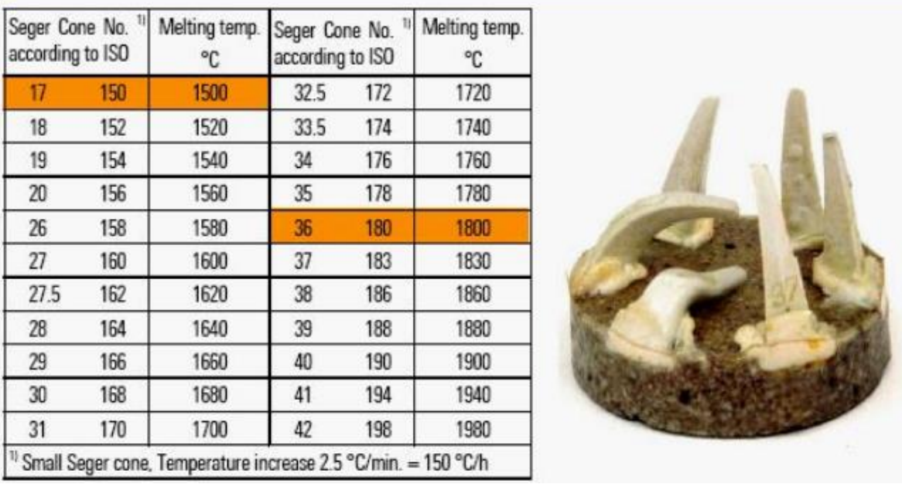
pyrometric cone equivalent Pce or softening point - IS 1528 (part 1)

Slide 23
Strength or Refractories-under load (RUL) IS 1528 (ParT 2)
R.U.L. test is performed by applying a constant load of 3.5 or 1.75 kg/cm² to the refractory specimen (of size 5 cm² and 75 cm high) and heating in a carbon resistance furnaces at a standard rate of 10°C / min.
The record of the height of the specimen vs. temperature is made by a plot, until the test-piece deforms or collapses by 10%.
The R.U.L. is expressed as the temperature at which 10% deformation takes place.

Slide 24
spalling resistance(Thermal Spalling IS 1528 (part 3)
“Spalling resistance” is the ability of the refractory material to maintain it's true form when exposed to high temperatures. It can be measured either in the amount of coating required for lining that particular surface, or the temperatures that it can withstand.
The test in which the number of cycles to failure is determined is called the spalling test. This test can be performed in different ways. The selection of the method depends on the brick material and its working conditions. For example, silica refractory has excellent thermal shock or spalling resistance above 300°C but poor resistance below it. Hence, a spalling test on silica should avoid temperatures below 300°C.
One way of testing for spalling resistance is by heating the brick sample slowly up to its working temperature, then cooling it rapidly for 10 min in a cold air jet or on a steel plate, and then reheating it for 10 min in a furnace maintained at the working temperature. This cycle is repeated until a piece of the brick is detached. The number of cycles to failure is noted. A brick surviving 30 cycles has good thermal shock resistance. The spalling resistance of such a brick is said to be +30 cycles.

Slide 25
Importance of Spalling resistance IS 1528 (part 3)
Spalling resistance is a function of four properties of the brick:
Thermal conductivity. This determines the temperature gradient set up during the test. The higher the conductivity, the lower the temperature gradient will be. In this case, the brick will be more resistant to spalling.
Coefficient of thermal expansion. This property determines the extent of the strain induced by the temperature gradient—the higher the coefficient, the greater the strain. The more the strain, the less resistance there will be to spalling.
Modulus of elasticity. The higher the modulus of elasticity, the greater the brick’s resistance will be to spalling.
Shear strength. Modulus of elasticity and shear strength together determine the intensity of the stress. When the stress exceeds the shear strength of the material, a crack will develop to relieve the stress.
Spalling resistance is decreased with increasing porosity, high thermal expansion coefficient, low thermal conductivity

Slide 26
modulus of rupture at Ambient temperature IS 1528 (part 5)
The cold strength of a refractory material is an indication of its suitability for use in refractory construction. (It is not a measure of performance at elevated temperatures.)
These test methods are for determining the room temperature flexural strength in 3-point bending (cold modulus of rupture) or compressive strength (cold crushing strength), or both, for all refractory products.

Slide 27
Properties at Elevated Temperature
IS 1528 (Part 12) | High-temperature Crushing Strength | is the ultimate pressure that a material can withstand per unit section at high temperatures. The unit is kg/cm². As the temperature rises, the strength of most refractory products increases, among which fireclay refractory and high-alumina refractory are particularly significant, reaching the maximum at 1000-1200°C.
IS 1528 (Part 20) | High-temperature Rupture Strength | refers to the ultimate bending stress that a material can withstand per unit section at high temperatures. It characterizes the ability of a material to resist bending moments at high temperatures. The high-temperature rupture strength index of refractory materials mainly depends on the chemical mineral composition, organizational structure and production process of the products. The flux substance in the material and the firing temperature have a significant effect on the high-temperature rupture strength of the refractories.

Slide 28
Properties at Elevated Temperature
IS 1528 (Part 20) | High-temperature Torsional Strength | The refractory products of masonry kilns are subjected to complex shear stress during heating or cooling, so the high-temperature torsional strength of the products is an important technical index. High-temperature torsional strength is one of the high-temperature mechanical properties of refractory materials, which characterizes the ability of the material to resist shear stress at high temperatures.
IS 1528 (Part 18) | High temperature Creep Resistance | When a material is subjected to a certain constant load less than its ultimate strength at high temperatures, plastic deformation will occur. The amount of deformation will gradually increase with time and even damage the material. This phenomenon is called Creep. Therefore, for materials at high temperatures, the strength cannot be considered in isolation, but the temperature and time factors should be considered at the same time as the strength.

Slide 29
Published Indian Standards Related to Refractories as on 23.07.2024
Please refer to our website given below for the list standards published and the draft induna standards under wide circulation for comments
For list of standards published by Refractories Technical Committee:
https://www.services.bis.gov.in/php/BIS_2.0/dgdashboard/Published_Standards
https://www.services.bis.gov.in/php/BIS_2.0/dgdashboard/Published_Standards_new/totalpublishedstandardslist_commwise?commttid=Mzg%3D&commttname=TVREIDE1&aspect=&doe=&dt_from=&dt_to=
2. For the list of draft Indian Standards under wide circulation for comments https://www.services.bis.gov.in/php/BIS_2.0/dgdashboard/draft/wcdraftDepartment

Slide 30
Current developments in refractories
efforts to develop new techniques or improve conventional processes
additives and alloying elements that either decrease manufacturing difficulties or improve material performance have proven to be valuable for refractory material systems
TiC cermets are important refractory materials for cutting tools and high-temperature applications
High-entropy alloys
New Tungsten, molybdenum, zircon alloys are being innovated
Demand for energy-efficient refractory materials

Slide 31
Thank You

