Slide 1
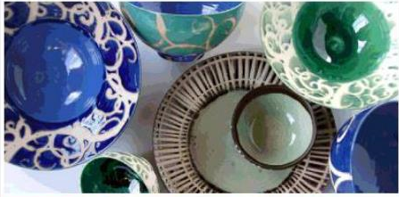
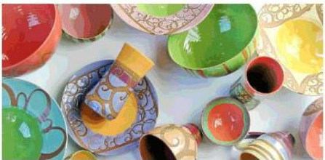
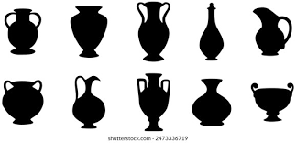
Ceramic Raw Materials
Standards on Raw Materials for Ceramic and
Method of Test for Ceramic

Slide 2
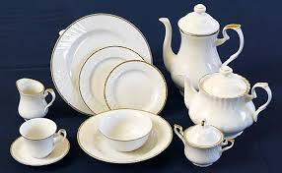
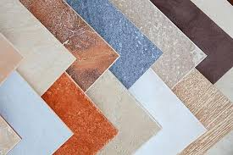
Introduction
The term “ceramics” comes from the Greek word “keramikos” which means “of or for pottery”
Ceramic materials are inorganic, non-metallic material and things made from them.
They may be crystalline or partly crystalline
They are formed by the action of heat and subsequent cooling.
Clay was one of the earliest materials used to produce ceramics, but may different ceramic materials are now used in domestic, industrial and building products.
A wide-ranging group of materials whose ingredients are clays, sand and feldspar.

Slide 3
History of Ceramics
26,000 B.C.
Early man discovered that clay, consisting of mammoth fat & bone mixed with bone ash & local loess, can be molded & dried in sun to form brittle & heat resistant material.
1960
Discovery of fiber optic cable which allows laser light pulse to carry large amount of information with extremely low energy loss.
1965
The development of photovoltaic cells which convert light into electricity opens a ne way to access solar energy.
Mid 1800’s
Thomas Edison has tried various types ceramics for resistivity towards his newly discovered carbon microphone.
Discovered of Porcelain electrical insulation an incandescent light bulb
1987
Discovery of semiconducting ceramic oxide with a critical temperature of 72 K.
A potential application of ceramic superconductor is in integrated circuit in new high speed computers
4,000 B.C.
. Glass was discovered in ancient Egypt.
. This glass consisted of a silicate glaze over a sintered quartz body.
. It was initially used in jewelry.
50 B.C.- 50 A.D.
Production of optical glasses (Lenses & mirrors). Window glasses begins in Rome.
600 -1500A.D.
Iznik pottery flourished, especially with the introduction of glazed ceramics and intricate tilework, during the Ottoman Empire (Turkey).
Porcelain (first ceramic composite) is created by the Chinese. This material is made by firing clay along with feldspar and quartz
2000
Certain ceramics known as “smart materials”, “nanoceramics” are published.

Slide 4
Classification of Ceramic Materials
Traditional ceramics
Advanced Ceramics
Electroceramics
Advanced Structural Ceramics
Whitewares
Electronic Substrate, Package Ceramics
Nuclear Ceramics
Structural Clay Products
Capacitor Dielectric, Piezoelectric ceramics
Bioceramics
Brick and Tile
Magnetic Ceramics
Tribological (Wear- Resistant) Ceramics
Abrasives
Optical Ceramics
Refractories
Automotive Ceramics
Conductive Ceramics
Cement

Slide 5
Properties of ceramics
Density
Physical
Porosity
Properties of ceramics
Mechanical properties
Chemical
Thermal Properties
Magnetic properties
Electrical Properties

Slide 6
Ceramics: A Comprehensive Overview for Students Essential Topics in Ceramic Studies
Ceramic Science & Technology Syllabus covers :
- Ceramic materials
- Classification of Ceramics
- Properties and applications of ceramic materials
-Testing of Ceramics in Lab
-Porosity and bulk density
-Hardness
-Thermal expansion
-Flexural Strength, Modulous of Rupture
-Testing of various parameters of Ceramic tiles

Slide 7
DEFINITION OF CERAMICS (as per IS 2781:2020)
A class of brittle, inorganic, nonmetallic materials produced by high-temperature processing. The term covers glass, refractories, enamels, whiteware, etc.
Also a generic term applied to the art or technique of producing articles by a ceramic process
[ IS 2781:2020 Glossary of Terms Relating to Ceramicware]

Slide 8
Important Terminologies (IS 2717:1979 & IS 2781:2020)
Bone China — A white translucent porcelain made from a ceramic body containing a minimum of 25 percent bone ash as the chief fluxing material.
Chipping — Breaking off of chips from the edge of a glazed ceramicware.
Clay — A natural mineral aggregate, consisting essentially of hydrous aluminium silicates. It is plastic when sufficiently wetted, rigid when dried en masse, and vitrified when fired to a sufficiently high temperature.one ash as the chief fluxing material.
Crawling - A defect in the vitreous enamel appearing as agglomerates or irregularly shaped islands.
Crazing (or Craze) — The hair like cracking which occurs in fired glazes or other ceramic coatings due to critical tensile stresses.
Glaze — A ceramic coating matured to glassy state on a formed ceramic article, or the material or mixture from which the coating is made.
Kaolin (China Clay) — A refractory clay consisting essentially of minerals of the kaolin group and which fires to a white or nearly white colour.
Tile — A ceramic surfacing unit, usually relatively thin in relation to facial area, made from clay or a mixture of clay and other ceramic materials, called the body of the tile, having either a ‘glazed’ or ‘unglazed’ face and fired above red heat in the course of manufacture to a temperature sufficiently high to produce specific physical properties and characteristics.

Slide 9
Important Terminologies (IS 2717:1979 & IS 2781:2020)
Porcelain — A glazed or unglazed vitreous whiteware. This term designates such products as electrical, chemical, mechanical, structural, thermal and tablewares when they are vitreous.
Porosity, Apparent — The volume fraction of all pores, voids, and channels within a solid mass that are interconnected with each other and communicate with the external surface, and thus are measurable by gas or liquid penetration.
Porosity, Closed — The volume fraction of all pores within a solid mass that are closed off by surrounding solid and, hence, are inaccessible to each other and to the external surface. They, thus, are not detectable by gas or liquid penetration.
Porosity, Connected — The volume fraction of all pores, voids and channels within a solid mass that are interconnected with each other
Pottery — All fired ceramicwares that contain clay when formed, except technical, structural, and refractory products
Saggar — A fire clay container for keeping glazed ware for firing to protect it from smoke, dust and dirt of the kiln atmosphere.
Vitreous (Vitrified) — That degree of vitrification evidenced by low water absorption.
(NOTE — The term ‘vitreous’ generally signifies less than 0.5 percent water absorption.)
Vitrification — The progressive reduction in porosity of a ceramic composition as a result of heat treatment, or the process involved.
Vitreous China — A while vitrified body biscuited at a high temperature and glost fired at a relatively lower temperature and having water absorption less than 0.5 percent by mass.
(NOTE — Vitreous china sanitaryware is fired only once.)

Slide 10
Important Terminologies (IS 17936 : 2022 / ISO 20507 : 2014)
Advanced ceramic/ advanced technical ceramic/ fine ceramic- highly engineered, high performance, predominately non-metallic, inorganic, ceramic material having specific functional attributes
Antibacterial ceramic- fine ceramic that reveals surface antibacterial activity, usually associated with an antibacterial agent or photocatalytic behaviour, and is widely used for sanitary ware, tiles, and various kinds of apparatus
Bioceramic- fine ceramic employed in or used as a medical device which is intended to interact with biological systems
Ceramic capacitor -capacitor in which the dielectric material is a ceramic
Calcination process for changing the chemical composition and/or phases of a powder or powder compact by the action of heat and atmosphere, prior to consolidation and processing
Ferromagnetic ceramic- fine ceramic that exhibits a spontaneous magnetization without an applied external magnetic field, in which unpaired electrons with a small magnetic field of their own, align with each other and show a large net magnetic moment

Slide 11
Indian Standards on Ceramic Raw Materials
IS No | Title
IS 9749 : 2020 | Potash Feldspar & Soda Feldspar For Glass & Ceramic Industry
IS 2840 : 2021 | China Clay For Ceramic Industry
IS 10429:2011 | Powdered Talc For Ceramic Industry
IS 11464:2021 | Quartz For Ceramic Industry
IS 11477:2011 | Pyrophyllite For Ceramic Industry
IS 12621 : 1988 | Bentonite For Ceramic Industry
IS 14721 : 1999 | Zinc Oxide For Ceramic Industry
IS 15751 : 2024 | Calcite For Ceramic Industry
IS 15752 : 2007 | Sericite For Ceramic Industry
IS 2333 : 1992 | Plaster Of Paris For Ceramic Industry
IS 4589 : 2022– | Plastic Clay And Washed Plastic Clay For Ceramic Industry

Slide 12
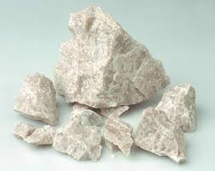
Indian Standards on Raw Materials for Ceramic
Potash Feldspar and Soda Feldspar
- IS 9749 : 2020 - POTASH FELDSPAR AND SODA FELDSPAR FOR GLASS AND CERAMIC INDUSTRY
-Prescribes the requirements and the methods of sampling and test for soda feldspar and potash feldspar for glass and ceramic industry. Grade 1, Grade 2, Grade 3, Garde 4
Requirements:
-Description
-Moisture content (by Air oven)
-Size grading (by Stirrer, Shaker)
-Particle size distribution (by Anderson pipette)
- True Specific gravity (by Pyknometer)
-Reaction with Water (by difference in pH
-Limit of Sodium (Estimation of Sodium Salts in ppm Na)
-Fusibility (fusibility of feldspar in terms of Orton Standard Pyrometric Cone Equivalent (PCE).
-Chemical composition (Alumina, Silica, Magnesia, Iron oxide, Calcium Oxide, Loss on ignition,Alkalis-Gravimetric, Titrimetric method analysis by using Furnace, Platinum crucible, Balance, Reagents etc. Alkalis by Flame photometer )

Slide 13
Requirements of Potash and Soda Feldspar for Glass and Ceramics

Slide 14
Indian Standards on Raw Materials for Ceramic
Potash Feldspar and Soda Feldspar
Tests
--Moisture content (by Air oven)
-Size grading (by Stirrer, Shaker)
-Particle size distribution (by Anderson pipette)
- True Specific gravity (by Pyknometer)
-Reaction with Water (by difference in pH
-Limit of Sodium (Estimation of Sodium Salts in ppm Na)
-Fusibility (fusibility of feldspar in terms of Orton Standard Pyrometric Cone Equivalent (PCE).
-Chemical composition (Alumina, Silica, Magnesia, Iron oxide, Calcium Oxide, Loss on ignition,Alkalis-Gravimetric, Titrimetric method analysis by using Furnace, Platinum crucible, Balance, Reagents etc. Alkalis by Flame photometer )

Slide 15
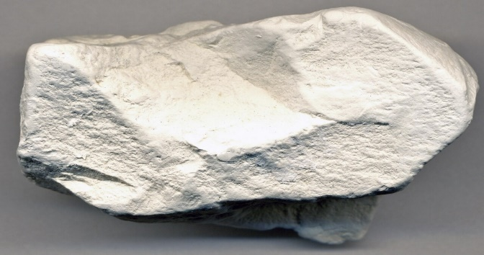
Indian Standards on Raw Materials for Ceramic
China Clay
-IS 2840 : 2021–China Clay for Ceramic Industry
Prescribes requirements, and methods of sampling and test for china clay for use in ceramic industry.
The material shall be of three grades, namely, Grade 1, Grade 2 and Grade 3
The material shall be the natural mineral consisting essentially of hydrated aluminium silicate,
suitably beneficiated to remove extraneous substances

Slide 16
Requirements

Slide 17
Indian Standards on Raw Materials for Ceramic
Tests
Grit content /Fineness (by Sieves)
Particle size distribution (by Anderson pipette)
Plasticity by hand feel test /Water of plasticity (by plastic consistency)
Atterberg number [The difference in water contents between the lower limit of mobility (liquid limit) and the rolling limit
(plastic limit) of the clay is determined by Mechanical Liquid Limit Device]
Apparent porosity (determination of total volume of open pores in the bulk)
Dry linear shrinkage (by moulds)

Slide 18
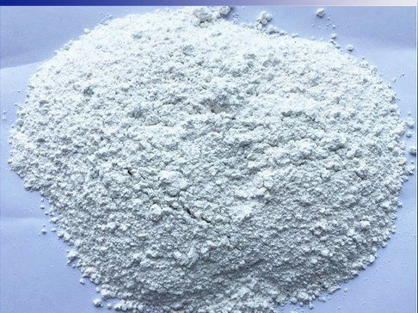
Indian Standards on Raw Materials for Ceramic
IS 10429:2011-POWDERED TALC FOR CERAMIC INDUSTRY
Prescribes requirements and methods of sampling and test for talc suitable for use in ceramic insulator industry and pottery industry.
GRADES
Grade I — Suitable for ceramic insulator industry,
Grade II — Suitable for pottery industry.

Slide 19
Indian Standards on Raw Materials for Ceramic
Requirements:
-Description
-Moisture content ((Specified limit - 1% max by Air oven)
-Size grading (pass thro 75 micron >99%; pass thro 45 micron >80% IS Sieve or as agreed to between the purchaser and the supplier, by Sieve, Shaker)
-Specific gravity (2.7-2.8 by Pyknometer)
-Fired colour (The object of this test is to determine the fired colour of a plaque made from the material by heating in a
suitable furnace at a definite rate of rise of temperature)
-Fusibility (The object of this test is to determine the softening point of talc by comparing the test cones prepared from the material under test with standard pyrometric cones heated in a suitable furnace at a definite rate of rise of temperature.)
-

Slide 20
By Gravimetric, Titrimetric method analysis by using Furnace, Platinum crucible, Balance, Reagents etc

Slide 21
Water Absoprtion- Determined by soaking the fired discs in water.
Linear Shrinkage-Determined by measuring the decrease in one dimension of aplastic mass upon drying and expressing it as percentage on plastic basis.
Fire Modulous-The decrease in one dimension of a clay specimen in plastic state, when dried and heated to the required temperature, is measured.
(iv)Loss Factor: As per IS 4486:1967 Recommended methods for the determination of the permittivity and dielectric dissipation factor of electrical insulating materials at power, audio and radio frequencies including metre wavelengths)

Slide 22
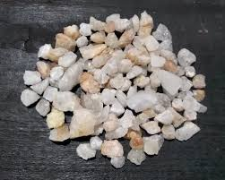
Indian Standards on Raw Materials for Ceramic
Quartz
-IS 11464:2021-QUARTZ FOR CERAMIC INDUSTRY
Prescribes requirements and the methods of sampling and test for quartz used in ceramic industry
GRADES
a) Grade 1 — Suitable for white opaque, transparent glaze and whiteware body with transparent glaze;
b) Grade 2 — Suitable for ceramic body for which fired colour is not of much relevance and for which the body is coated with opaque glaze.

Slide 23
Indian Standards on Raw Materials for Ceramic
Requirements:
-Description
-Moisture content (Specified limit - 2% max by Air oven)
-Grain Size (as agreed to between the purchaser and the supplier)
-Specific gravity (2.5- 2.7 by Pyknometer)
-Fired colour (The colour of the material may be white and free from any coloured specks when
fired at 1 200 °C in an oxidizing condition.)

Slide 24
By Gravimetric, Titrimetric method analysis by using Furnace, Platinum crucible, Balance, Reagents etc)

Slide 25
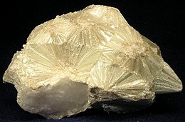
Indian Standards on Raw Materials for Ceramic
PYROPHYLLITE
-IS 11477:2011-PYROPHYLLITE FOR CERAMIC INDUSTRY
Prescribes the requirements and the methods of sampling and test for pyrophyllite suitable for use in ceramic industry.
Grades:
Grade 1 — Suitable for whiteware and insulator industry; and
Grade 2 — Suitable for other ceramic industries.
Requirements:
-Description
-Moisture content (Specified limit -2% max by Air oven)
-Grain Size (as agreed to between the purchaser and the supplier)
-Specific gravity (2.8- 2.9 by Pyknometer)
-Fusability -The object of this test is to determine the softening point of pyrophyllite by comparing the test cones prepared from the material under test with standard pyrometric cones heated in a suitable furnace at a definite rate of rise of temperature
-Fired colour (The colour of fired pyrophyllite shall be greenish white for Grade 1 and greyish brown or black for Grade 2..)

Slide 26
-Chemical composition (except Potassium Oxide, Sodium Oxide ) by Gravimetric, Titrimetric method analysis by using Furnace, Platinum crucible, Balance, Reagents etc.
-Potassium Oxide, Sodium Oxide by Flame photometer

Slide 27
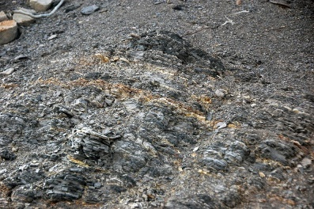
Indian Standards on Raw Materials for Ceramic
BENTONITE
-IS 12621 : 1988 -BENTONITE FOR CERAMIC INDUSTRY
Prescribes the requirements and methods of sampling and test for bentonite of least swelling type for use in ceramic industry
. Requirements:
-Free Moisture content (by Air oven)
-Residue on 106 micron IS sieve ( Sieve shaker)
-Grit content on micron IS sieve ( Sieve shaker)
-Chemical requirements (Alumina, Silica, Iron oxide, Loss on ignition, Magnesium oxide, Calcium oxide, Titanium dioxide, Potassium oxide & Sodium oxide- Gravimetric, Titrimetric method analysis by using Furnace, Platinum crucible, Balance, Reagents etc. Alkalis by Flame photometer)
-Water plascticity: The water content of bentonite at the point of maximum workability is determined.
-Swelling power after 24 hours : determined by difference of volume
-Viscosity at 30°C, centipoise: by Direct Indicating Torsion Viscometer

Slide 29
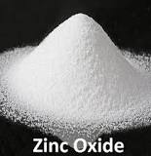
Indian Standards on Raw Materials for Ceramic
ZINC OXIDE
-IS 14721 : 1999 -ZINC OXIDE FOR CERAMIC INDUSTRY
Prescribes the requirements and methods of sampling and test for zinc oxide for ceramic industry.
Requirements:
-Description
-Moisture content (Specified limit - 0.5% max by Air oven)
-Residue on 45 micron IS sieve (0.1% max by Gallie Porritt Sieve)
-Powder Density (Limit 5.5-5.65)

Slide 30
By Gravimetric, Titrimetric method analysis by using Furnace, Platinum crucible, Balance, Reagents etc.)
-

Slide 31
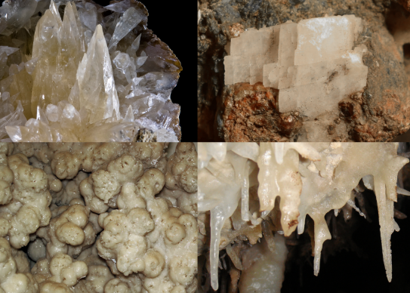
Indian Standards on Raw Materials for Ceramic
CALCITE
-IS 15751 : 2024 -CALCITE FOR CERAMIC INDUSTRY
Prescribes the requirements and the methods of sampling and test for calcite suitable for use in ceramic industry.
Requirements
-Description
-Moisture content ((Specified limit - 2% max by Air oven)
-Size (as agreed to between the purchaser and the supplier)
--Fired colour (The colour of fired calcite shall be white or off white)

Slide 32
By Gravimetric, Titrimetric method analysis by using Furnace, Platinum crucible, Platinum dish, Balance, Reagents etc

Slide 33
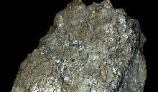
Indian Standards on Raw Materials for Ceramic
SERICITE
-IS 15752 : 2007 -SERICITE FOR CERAMIC INDUSTRY
Prescribes the requirements and the methods of sampling and test for calcite suitable for use in ceramic industry.
GRADES
a) Grade 1 — Suitable for low maturing crockery, sanitarywares and vitreous wares.
b) Grade 2 — Suitable for whiteware and insulator industry.
Requirements
-Description
-Moisture content ((Specified limit - 2% max by Air oven)
-Size grading (as agreed to between the purchaser and the supplier)
-Specific Gravity (2.8-2.9 by Pyknometer)
-Fusibility-The fusion characteristics of sericite is expressed in terms of Orton Standard Pyrometric Cone Equivalent (PCE). (Determined by Furnace)

Slide 34
-Chemical composition (except Potassium Oxide, Sodium Oxide ) by Gravimetric, Titrimetric method analysis by using Furnace, Platinum crucible, Balance, Reagents etc.
-Potassium Oxide, Sodium Oxide by Flame photometer

Slide 35
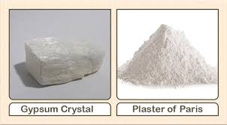
Indian Standards on Raw Materials for Ceramic
IS 2333 : 1992 –PLASTER OF PARIS FOR CERAMIC INDUSTRY
Prescribes requirements and method of sampling and test for plaster of paris for use in ceramic, optics industries, jiggering and Roller head for automatic machines. .
Types
a) Type 1 - Suitable for moulds for slip casting ;
b) Type 2 - Suitable for moulds for jiggering case and block making;
c) Type 3 - Suitable for mounting optical glass items; and
d) Type 4 -~ Suitable for automatic machine jiggering and for roller head.

Slide 38
PLASTER OF PARIS
Tests
Physical:
-Fineness (by Sieves)
-Normal Consistency (Water plaster ratio by Vicat Apparatus)
-Setting Time / Expansion after setting time (by Vicat Apparatus, Apparatus for linear expansion of setting)
-Modulous of rupture (by MOR testing assembly)
-Dry Compressive Strength (CST test assembly)
-Water absorption ( by Vacuum desiccator, vacuum oven)
Chemical:
-Chemical composition (Free moisture by Air oven, Carbonate by Evolution/ Volumetric method, Matter insoluble in HCl by Evaporation, Calcium sulphate-85% min by Ignition, Compound water- by fusion)

Slide 39
-Green MOR (by MOR test assembly)
-Fired characteristic at 1 200 °C /Fired colour -Should be free from black speck/spots and cracks /White, cream, Light buff
-CE value in Orton -determine the PCE value of china clay by comparing the test cones prepared from the material under test with standard pyrometric cones heated in a suitable furnace at a definite rate of rise of temperature
-Water absorption (Maturity)-Discs of china clay are fired to a temperature of 1 200 °C and the water absorption is determined by soaking the fired discs in water
-Chemical composition (Loss on ignition, Alumina, Oxide of Iron, Titanium dioxide, Calcium oxide- Gravimetric, Titrimetric method analysis by using Furnace, Platinum crucible, Balance, Reagents etc.)

Slide 40
Indian Standards on Raw Materials for Ceramic
Plastic Clay and Washed Plastic Clay
-IS 4589 : 2022–PLASTIC CLAY AND WASHED PLASTIC CLAY FOR CERAMIC INDUSTRY
Prescribes the requirements, methods of sampling and test for plastic clays for use in ceramic industry.
-Types & grades
Type 1— Unwashed plastic clay, and
Type 2 — Washed plastic clay
Type 1 shall have three grades, namely, Grade 1, Grade 2 and Grade 3.

Slide 42
Indian Standards on Raw Materials for Ceramic
Tests
-Grit content /Fineness (by Sieves)
-Particle size distribution (by Anderson pipette)
-Plasticity by hand feel test /Water of plasticity (by plasctic consistency)
-Atterberg number [The difference in water contents between the lower limit of mobility (liquid limit) and the rolling limit (plastic limit) of the clay is determined by Mechanical Liquid Limit Device]
-Apparent porosity (determination of total volume of open pores in the bulk)
-Dry linear shrinkage (by moulds)
-Green MOR (by MOR test assembly)
-Fired characteristic at 1 200 °C /Fired colour -Should be free from black speck/spots and cracks /White, cream, Light buff
-CE value in Orton -determine the PCE value of china clay by comparing the test cones prepared from the material under test with standard pyrometric cones heated in a suitable furnace at a definite rate of rise of temperature
-Water absorption (Maturity)-Discs of china clay are fired to a temperature of 1 200 °C and the water absorption is determined by soaking the fired discs in water
-Chemical composition (Loss on ignition, Alumina, Oxide of Iron, Titanium dioxide, Calcium oxide- Gravimetric, Titrimetric method analysis by using Furnace, Platinum crucible, Balance, Reagents etc.)

Slide 43
Various tests related to Ceramics (In Engineering course curriculum)
-Porosity and bulk density
-Hardness
-Thermal expansion
-Flexural Strength, Modulous of Rupture
-Testing of various parameters of Ceramic tiles

Slide 44
Indian Standards on testing of Ceramics
IS No | Title
IS 17935 : 2022 /ISO 18754 : 2020 | Fine Ceramics ( Advanced Ceramics, Advanced Technical Ceramics) — Determination of Density and Apparent Porosity
IS 17991 : 2022/ISO 14705 : 2016 | Fine Ceramics (Advanced Ceramics, Advanced Technical Ceramics) — Test Method for Hardness of Monolithic Ceramics at Room Temperature
IS 17933 : 2022/ISO 14704 : 2016 | Fine Ceramics (Advanced Ceramics, Advanced Technical Ceramics) — Test Method for Flexural Strength of Monolithic Ceramics at Room Temperature
IS 13630 : 2019 (Part 1 to 16) | Ceramic Tiles — Methods of Test, Sampling and Basis for Acceptance
IS 14179:1999 | Methods of Test For Ceramic Tableware
IS 11475:2002 | Stoneware Crockeryware
IS 12038 (Part 1):2007 / ISO 4531-1:1998 | Vitreous and porcelain enamels —Release of lead and cadmium from Enamelled ware in contact with food
IS 17502 :2008 | Methylene Blue Index of Clay
IS 7935 : 2022/ ISO 18754 : 2020 | Fine Ceramics ( Advanced Ceramics, Advanced Technical Ceramics ) —Determination of Density and Apparent Porosity
IS 18221 : 2023/ ISO 17562 : 2016 | Fine Ceramics (Advanced Ceramics, Advanced Technical Ceramics) —Test Method for Linear Thermal Expansion of Monolithic Ceramics by Push-Rod Technique
IS 9806 : 2001 | Methods of test for and permissible limits of toxic materials released from ceramicware, vitreous enamelware, glassware and glass - Ceramicware in contact with food

Slide 45
Indian Standard on Determination of Density and Porosity
IS 17935 : 2022 /ISO 18754 : 2020 Fine Ceramics ( Advanced Ceramics, Advanced Technical Ceramics) — Determination of Density and Apparent Porosity
Specifies methods for the determination of the apparent solid density, bulk density, apparent porosity and geometric bulk density of fine ceramics, including all ceramic matrix composites.
Method A: Determination of bulk density, apparent solid density and apparent porosity by liquid
displacement (Archimedes' method).
Method B: Determination of bulk density only, by measurement of geometric dimensions and mass.
Method by liquid displacement (Method A)
Principle
The mass of the dry test piece, then its apparent mass when immersed in a liquid with which it has been
impregnated, and finally its mass in air while still soaked with the impregnation liquid are determined
by weighing. From the masses above, the bulk density, the apparent solid density and the apparent
porosity are determined by calculation.
Impregnation of the test piece can be achieved either by maintaining it in a liquid under boiling
conditions (Method A1) or under vacuum (Method A2)

Slide 46
Apparent solid density
$ρ_{a}=$ $\frac{m_{1}}{m_{1}−m_{2}}×{\text{ρ}}_{1}$
$ρ_{a}$ is the apparent solid density, expressed in kilograms per cubic metre (kg/m3);
$m_{1}$ is the mass of the dry test specimen, expressed in kilograms (kg);
$m_{2}$ is the apparent mass of the immersed test specimen, expressed in kilograms (kg);
${\text{ρ}}_{1}$ is the density of the immersion liquid at the temperature of the test, expressed in kg per cubic metre (kg/m3).
Bulk density
$ρ_{b}=$ $\frac{m_{1}}{m_{3}−m_{2}}×{\text{ρ}}_{1}$
$ρ_{b}$ is the bulk density, expressed in kilograms per cubic metre (kg/m3);
$m_{1}$ is the mass of the dry test specimen, expressed in kilograms (kg);
$m_{2}$ is the apparent mass of the immersed test specimen, expressed in kilograms (kg);
$m_{3}$ is the mass of the soaked test specimen, expressed in kilograms (kg);
${\text{ρ}}_{1}$ is the density of the immersion liquid at the temperature of the test, expressed in kg per cubic metre (kg/m3).

Slide 47
Apparent porosity
$π_{a}=$ $\frac{m_{3−}m_{1}}{m_{3}−m_{2}}×100$
$π_{a}$𝑖𝑠 𝑡ℎ𝑒 𝑎𝑝𝑝𝑎𝑟𝑒𝑛𝑡 𝑝𝑜𝑟𝑜𝑠𝑖𝑡𝑦, 𝑒𝑥𝑝𝑟𝑒𝑠𝑠𝑒𝑑 𝑎𝑠 𝑎 𝑝𝑒𝑟𝑐𝑒𝑛𝑡𝑎𝑔𝑒 𝑏𝑦 𝑣𝑜𝑙𝑢𝑚𝑒
$m_{1}$ is the mass of the dry test specimen, expressed in kilograms (kg);
$m_{2}$ is the apparent mass of the immersed test specimen, expressed in kilograms (kg);
$m_{3}$ is the mass of the soaked test specimen, expressed in kilograms (kg);

Slide 48
Method by measurement of dimensions and mass (Method B)
Principle
A test piece of uniform geometry within specified tolerances is dried and weighed. Its volume is determined by measurement of the appropriate dimensions. The geometric bulk density (see 3.9) is calculated as mass per unit volume.
Calculate the geometric volume of each test piece from its mean dimensions.
The bulk density, ρb, expressed in kilograms per cubic metre, kg/m3, shall be calculated to the second decimal place according to
$ρ_{b}=$ $\frac{m_{1}}{V_{b}}$
where
$m_{1}$ is the dry mass of the test piece;
$V_{b}$ is the bulk volume of the test piece taken as its geometric volume.

Slide 49
Indian Standard on Test method for Hardness of Ceramics
IS 17991 : 2022/ISO 14705 : 2016- Fine Ceramics (Advanced Ceramics, Advanced Technical Ceramics) —
Test Method for Hardness of Monolithic Ceramics at Room Temperature
Vickers hardness
Principle
Forcing a diamond indenter in the form of a right-angle pyramid with a square base, and with a specified angle between opposite faces at the vertex into the surface of a test piece and measuring the length of the diagonals of the indentation left in the surface after removal of the test force
Vickers hardness=$Constant×\frac{Test force}{Surface area of indentation}$
Units of Gpa = 0.001$\frac{2F sin\frac{{136}^{0}}{2}}{d^{2}}$= 0.001 $854\frac{F }{d^{2}}$
Hardness number (no units specified)
0.102$\frac{2F sin\frac{{136}^{0}}{2}}{d^{2}}$= 0$.1891\frac{F }{d^{2}}$

Slide 50
Thermal expansion coefficient
The coefficient ratio of thermal expansion indicates how much a material expands per unit rise in temperature.
The coefficients of thermal expansion depend also on the bond strength between the atoms that make up the material.
Thermal expansion of ceramic material is generally lower, than that of metals.
Applications parts for high-precision measuring equipment.
Strong bonding (Fine ceramics: silicon carbide, silicon nitrite, alumina) have low thermal expansion coefficient.
Weak bonding (stainless steel) have higher thermal expansion in comparison

Slide 51
Indian Standard on Test method for Thermal Expansion of Ceramics
IS 18221 : 2023/ISO 17562 : 2016- Fine Ceramics (Advanced Ceramics, Advanced Technical Ceramics) —Test Method for Linear Thermal Expansion of Monolithic Ceramics by Push-Rod Technique
Principle
A specimen of known size is heated/cooled to a specific temperature at a controlled temperature rate in a known atmosphere under a minimal load. During the heating and cooling, the length and the temperature of the specimen are monitored. The change in dimension of the specimen across a given temperature region is used to calculate a linear thermal expansion coefficient or an instantaneous linear thermal expansion coefficient against temperature

Slide 52
$∆L_{sp}$/ $L_{0}$ and $\overline{α}$ between temperatures (T1 , T2) shall be calculated from Formulae
$$\frac{∆L_{sp}}{L_{0}}=\frac{∆L_{sp,m}−∆L_{ref.m}+∆L_{ref}}{L_{0}}$$
$\overline{α}=\frac{∆L_{sp,m}−∆L_{ref.m}+∆L_{ref}}{L_{0}∆T}+$ ${\overline{α}}_{ref}$
where
$∆L_{sp}$ is the change of length of the specimen between $T_{1}$ and $T_{2}$ ;
$L_{0}$ is the specimen length at room temperature;
$∆L_{sp,m}$is the difference of indication of displacement measuring device at $T_{1}$ and $T_{2}$ when the
specimen is measured;
$∆L_{ref.m}$is the difference of indication of displacement measuring device at $T_{1}$ and $T_{2}$ when the reference specimen is measured;
$∆L_{ref}$ is the calculated length change of the reference specimen between $T_{1}$ and $T_{2}$ ;
$\overline{α}$ is the mean linear thermal expansion coefficient of specimen between $T_{1}$ and $T_{2}$ ($K^{−1}$);
ΔT is the temperature change of specimen $T_{1}$ and $T_{2}$ in degrees Celsius;
${\overline{α}}_{ref}$is the calculated mean linear thermal expansion coefficient of the reference specimen between $T_{1}$ and $T_{2}$ ($K^{−1}$)

Slide 53
Indian Standard on Test method for flexural strength of Ceramics
IS 17933 : 2022/ISO 14704 : 2016- Fine Ceramics (Advanced Ceramics, Advanced Technical Ceramics) — Test Method for Flexural Strength of Monolithic Ceramics at Room Temperature
Principle
A beam test piece with a rectangular cross-section is loaded in flexure until fracture. The load at fracture, the test fixture and test piece dimensions are used to compute the flexural strength which is often used in substitute for uniaxial tensile strength of a ceramic. The material is assumed to be isotropic and linearly elastic.

Slide 54
Indian Standard on Test method for flexural strength of Ceramics
The standard formula for the flexural strength in four-point flexure is
$$σ_{f}=\frac{3Fa}{bd^{2}}$$
where
$σ_{f}$ is the flexural strength, in MPa;
$F$ is the fracture load, in N;
a is the length of the fixture moment arm (10 mm);
b is the test piece width, in mm;
d is the test piece thickness, parallel to the direction of test force, in mm.

Slide 55
Indian Standards on Testing of Ceramic Tiles
Various parts of IS 13630 : 2019- Ceramic Tiles — Methods of Test, Sampling and Basis for Acceptance
Part 1 Determination of dimensions and surface quality
Part 2 Determination of water absorption and bulk density
Part 3 Determination of moisture expansion using boiling water
Part 4 Determination of linear thermal expansion
Part 5 Determination of resistance to thermal shock
Part 6 Determination of modulus of rupture and breaking strength
Part 7 Determination of stain and chemical resistance of unglazed tiles
Part 8 Determination of stain and chemical resistance of glazed tiles
Part 9 Determination of crazing resistance of glazed tiles
Part 10 Determination of frost resistance
Part 12 Determination of resistance to deep abrasion of unglazed tiles
Part 13 Determination of scratch hardness of surface according to Mohs’ scale
Part 14 Determination of impact resistance by measurement of coefficient of restitution
Part 15 Sampling and basis for acceptance
Part 16 Determinations of lead and cadmium given off by glazed tiles

Slide 56
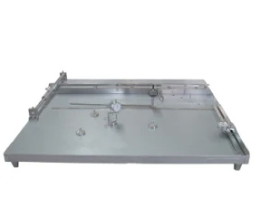
Indian Standards on Testing of Ceramic Tiles
IS 13630 (Part 1) : 2019- Ceramic Tiles — Methods of Test, Sampling and Basis for Acceptance Part 1 Determination of Dimensions and Surface Quality
covers methods for determining the dimensional characteristics (length, width, thickness, straightness of sides, rectangularity, surface flatness) and the surface quality of all ceramic tiles.
Major equipment-
-Vernier calipers
-Micrometer
-Apparatus for Measurement of Straightness of Sides and Rectangularity
-Apparatus for Measurement of Surface Flatness
-Fluorescent Lighting of Colour Temperature 6 000 K to 6 500 K
-Meter Rule or Other Suitable Means of Measuring Distance
-Light Meter

Slide 57
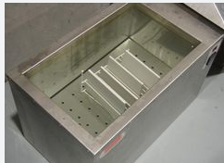
Indian Standards on Testing of CeramicTiles
IS 13630 (Part 2) : 2019- Ceramic Tiles — Methods of Test, Sampling and Basis for Acceptance Part 2 Determination of Water Absorption and Bulk Density
This standard (Part 2) covers methods of test for determining the water absorption and bulk density of all ceramic tiles. 1.2 There are two methods of obtaining impregnation with water of the tile’s open pores: a) Boiling, and b) Immersion under vacuum.
Major equipment-
-Drying Oven
-Balance
-Heating Apparatus
-Vacuum Chamber and Vacuum System

Slide 58
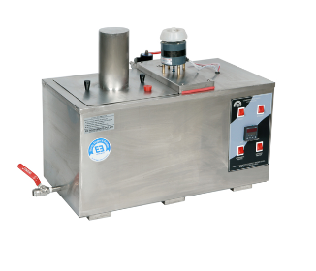
Indian Standards on Testing of CeramicTiles
IS 13630 (Part 3) : 2019- Ceramic Tiles — Methods of Test, Sampling and Basis for Acceptance Part 3 Determination of Moisture Expansion Using Boiling Water
This standard (Part 3) covers methods of test for determining the moisture expansion of both glazed and unglazed ceramic tiles.
Major equipment-
-Kiln, capable of firing up to 600 °C
-Vernier calipers
-An apparatus for maintaining the specimens in boiling water for
24 h.

Slide 59
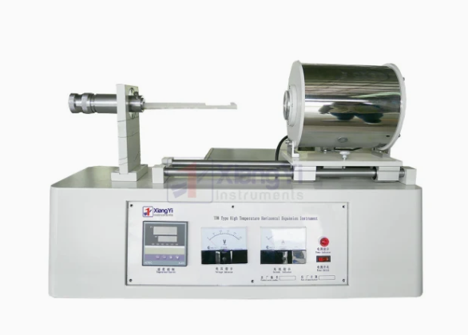
Indian Standards on Testing of CeramicTiles
IS 13630 (Part4) : 2019- Ceramic Tiles — Methods of Test, Sampling and Basis for Acceptance Part 4 Determination of Linear Thermal Expansion
This standard (Part 4) covers a method of test for determining the coefficient of linear thermal expansion of all ceramic tiles. The coefficient of linear thermal expansion is determined for the temperature range from ambient temperature to 100°C.
Major equipment-
-Suitable Calibrated Thermal Expansion Apparatus
-Vernier calipers
-Drying Oven

Slide 60
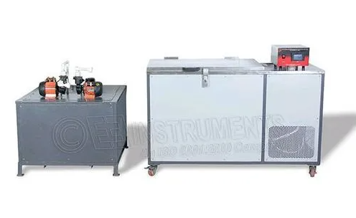
Indian Standards on Testing of Ceramic Tiles
IS 13630 (Part5) : 2019- Ceramic Tiles — Methods of Test, Sampling and Basis for Acceptance Part 5 Determination of Resistance to Thermal Shock
This standard (Part 5) covers a method of test for determining the resistance to thermal shock of all ceramic tiles in normal conditions of use.
Principle: Determination of resistance to thermal shock of a whole tile by cycling 10 times between the temperature of cold water and a temperature just above that of boiling water. Usually tests are carried out between 15 °C and 145 °C.
Major equipment-
-Low Temperature Bath
-Oven

Slide 61
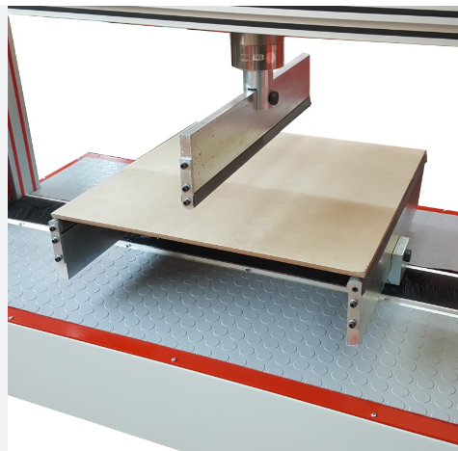
Indian Standards on Testing of Ceramic Tiles
IS 13630 (Part6) : 2019- Ceramic Tiles — Methods of Test, Sampling and Basis for Acceptance Part 6 Determination of Modulus of Rupture and Breaking Strength
This standard (Part 6) covers a method of test for determining the modulus of rupture and breaking strength of all ceramic tiles.
Principle: Determination of modulus of rupture and breaking strength of a whole tile by means of three-point loading, the central point being in contact with the proper surface of the tile.
Major equipment-
- Drying Oven
- Apparatus for Measurement of modulus of rupture

Slide 62
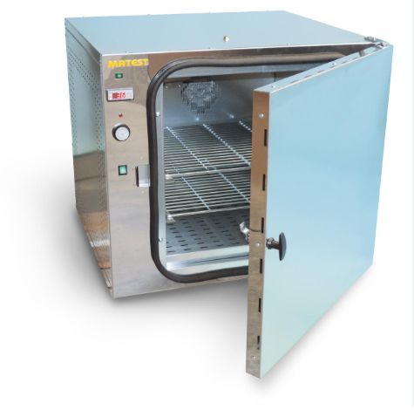
Indian Standards on Testing of Ceramic Tiles
IS 13630 (Part7) : 2019- Ceramic Tiles — Methods of Test, Sampling and Basis for Acceptance Part 7 Determination of Stain and Chemical Resistance of Unglazed Tiles
This standard (Part 7) covers a method of test for determining the stain and chemical resistance of the proper surface of all unglazed ceramic tiles.
Principle: Determining the resistance to stains by maintaining test solutions in contact with the proper surface of the tiles for a certain duration. The surfaces are then subjected to defined cleaning methods and inspected for visual changes.
Major equipment/ reagents-
-Vessel with lid made of borosilicate glass or any other suitable material.
-Drying Oven, Balance, Electric lamp of 40 W
-Chemical Resistance Test set up, Staining Agents
- Household Chemicals, Acids and Alkalis

Slide 63
Indian Standards on Testing of Ceramic Tiles
IS 13630 (Part8) : 2019- Ceramic Tiles — Methods of Test, Sampling and Basis for Acceptance Part 8 Determination of Stain and Chemical Resistance of Glazed Tiles
This standard (Part 8) covers a method of test for determining the stain and chemical resistance of the proper surface of all glazed ceramic tiles.
Principle: For testing the resistance to staining, the test solutions are maintained in contact with the proper surface of the tiles for a suitable length of time. They are then subjected to defined cleaning methods, and finally inspected for visual changes.
Major equipment-
-Vessel with lid made of borosilicate glass or any other suitable material.
-Drying Oven, Balance, Electric lamp of 40 W
-Chemical Resistance Test set up, Staining Agents
- Household Chemicals, Acids and Alkalis

Slide 64
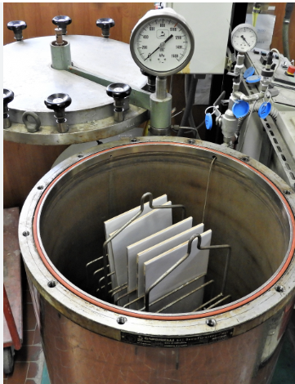
Indian Standards on Testing of Ceramic Tiles
IS 13630 (Part9) : 2019- Ceramic Tiles — Methods of Test, Sampling and Basis for Acceptance Part 9 Determination of Crazing Resistance of Glazed Tiles
This standard (Part 9) covers a method of test for determining the crazing resistance of all glazed tiles except when the crazing is an inherent feature of the product.
Principle: The resistance to the formation of crazes is determined by subjecting whole tiles to steam at high pressure in an autoclave and then examining the tiles for crazes after applying a stain to the glazed faces.
Major equipment-
- Autoclave

Slide 65
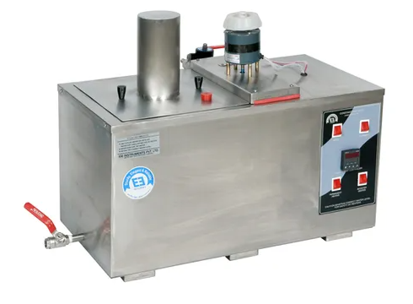
Indian Standards on Testing of Ceramic Tiles
IS 13630 (Part10) : 2019- Ceramic Tiles — Methods of Test, Sampling and Basis for Acceptance Part 10 Determination of Frost Resistance
This standard (Part 10) covers a method of test for evaluating the frost resistance of all ceramic tiles intended for use in conditions of frost in the presence of water.
Principle: After impregnation with water tiles are cycled between +5 °C and -5 °C, all sides of tiles are exposed to freezing during 100 freeze thaw cycles.
Major equipment-
- Drying Oven
- Balance -Apparatus for impregnation with water after evacuation by
means of a vacuum pump
-Freezer

Slide 66
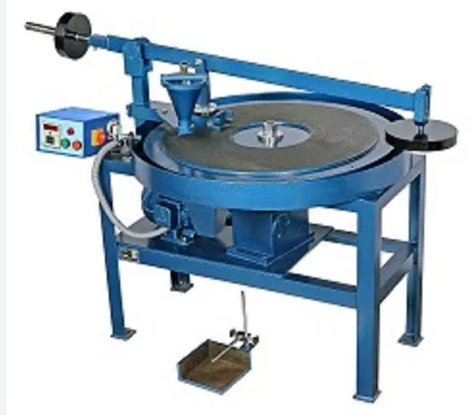
Indian Standards on Testing of Ceramic Tiles
IS 13630 (Part11) : 2019- Ceramic Tiles — Methods of Test, Sampling and Basis for Acceptance Part 11 Determination of Resistance to Surface Abrasion of Glazed Tiles
This standard (Part 11) covers methods of test for determining the resistance to surface abrasion of all glazed ceramic tiles used for floor covering.
Principle: Determination of the abrasion resistance of the glaze of tiles by rotation of an abrasive load on the surface and assessment of the wear by means of visual comparison of abraded test specimens and non-abraded tiles.
Major equipment-
- Abrasion Apparatus
- Apparatus for Visual Assessment
- Drying Oven
-Balance

Slide 67
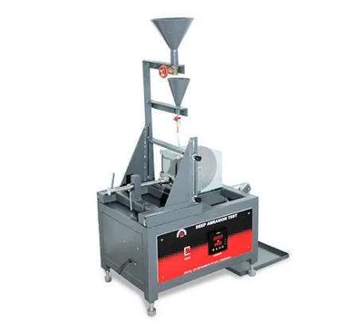
Indian Standards on Testing of CeramicTiles
IS 13630 (Part12) : 2019- Ceramic Tiles — Methods of Test, Sampling and Basis for Acceptance Part 12 Determination of Resistance to Deep Abrasion of Unglazed Tiles
This standard (Part 12) covers a method of test for determining the resistance to deep abrasion of all unglazed ceramic tiles used for floor coverings.
Principle: Determination of the abrasion resistance of unglazed ceramic tiles by measuring the length of the groove produced in the proper surface by means of a rotating disc under given conditions and with the use of abrasive material.
Major equipment-
- Abrasion Apparatus
- Measuring Gauge

Slide 68
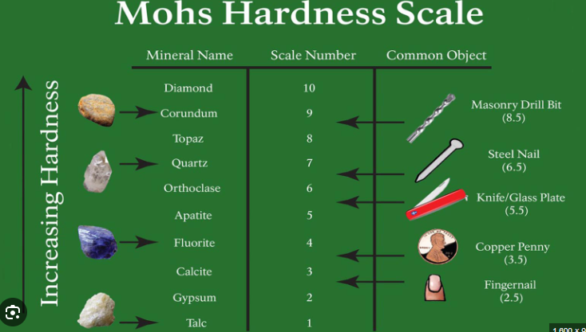
Indian Standards on Testing of CeramicTiles
IS 13630 (Part13) : 2019- Ceramic Tiles — Methods of Test, Sampling and Basis for Acceptance Part 13 Determination of Scratch Hardness of Surface According to Mohs’ Scale
This standard (Part 13) covers a method of test for determining the scratch hardness of the surface of all ceramic tiles.
Principle: Determination of the scratch hardness on Mohs’ scale by drawing minerals of defined hardness by hand over the surface.

Slide 69
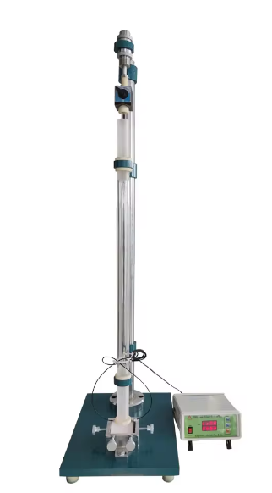
Indian Standards on Testing of CeramicTiles
IS 13630 (Part14) : 2019- Ceramic Tiles — Methods of Test, Sampling and Basis for Acceptance Part 14 Determination of Impact Resistance by Measurement of Coefficient of Restitution
This standard (Part 14) defines a method of test for determining the impact resistance of ceramic tiles by measuring the coefficient of restitution.
Principle: Determination of coefficient of restitution by dropping a steel ball from a fixed height on to the test specimen and measuring the height of rebound.
Major equipment-
- Ball Release Apparatus
- Chrome Steel Ball
- Electronic Timing Device

Slide 70
Indian Standards on Testing of CeramicTiles
IS 13630 (Part15) : 2019- Ceramic Tiles — Methods of Test, Sampling and Basis for Acceptance Part 15 Sampling And Basis For Acceptance
This standard (Part 15) defines rules for batching, sampling, inspection and acceptance/rejection. It applies to unfixed ceramic tiles that have been stored under cover.
Principle: This standard provides for a sampling inspection system with a double sampling plan, partly for the method of inspection by attributes (individual values) and partly for a method of inspection by average values (variables). The number of tiles to be tested varies for each property.

Slide 71
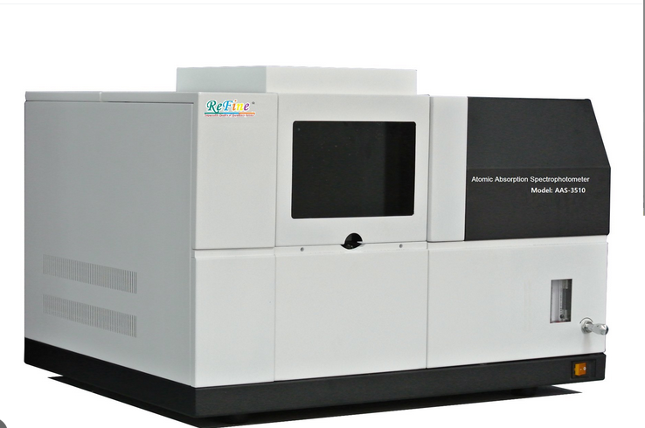
Indian Standards on Testing of Ceramic Tiles
IS 13630 (Part16) : 2019- Ceramic Tiles — Methods of Test, Sampling and Basis for Acceptance Part 16 Determination of Lead and Cadmium Given Off by Glazed Tiles
This standard (Part 16) specifies a method for the determination of lead and cadmium given off by the glaze of ceramic tiles.
Principle: Exposing the glazed surface of a ceramic tile to an acetic acid solution and determining the amount of lead and cadmium released into the solution by Atomic Absorption Spectrometry (AAS).
Major equipment-
- Atomic Absorption Spectrometer (AAS)

Slide 72
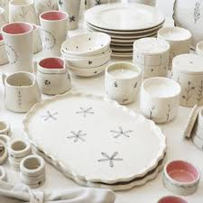
Indian Standards on Ceramicware and Method of Test
IS 14179:1999 METHODS OF TEST FOR CERAMIC TABLEWARE
This standard prescribes the methods of sampling test for ceramic tableware.
Requirements:
-Visual assessment
-Test for warpage (by Dial indicator)
-Test for Crazing Resistance (by Autoclave)
-Test for Impact Strength and Chipping Resistance (by Impact Tester)
-Test for Water absorption (determined by the amount of water absorbed by boiling the sample in distilled water and finding the increase in the mass)
-Test for Resistance to detergents (The tableware articles are immersed into detergent solution at a temperature of 60°C for 48 h and loss of gloss of the glaze is compared visually against untested sample.
-Test for Resistance to boiling Citric acid (The pieces of tableware articles are immersed into 10 percent citric acid solution at 100 ± 10°C for 16h and loss of glaze of glaze is compared visually against untested sample)
- Test for Resistance to abrasion (determination of abrasion loss by apparatus as per ISS)

Slide 73
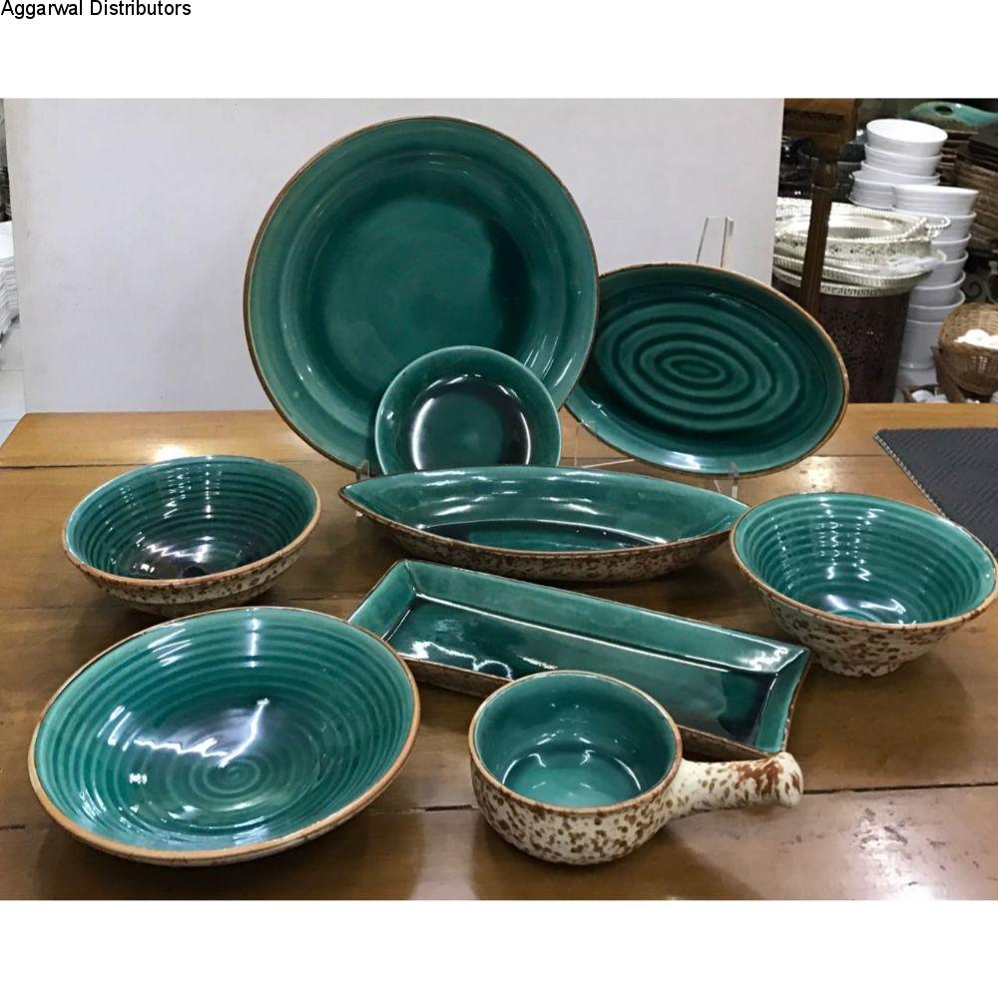
Indian Standards on Ceramicware and Method of Test
-IS 11475:2002-STONEWARE CROCKERYWARE
-Prescribes requirements and methods of sampling and test for stoneware crockeryware
-Requirements:
-Material
-Workmanship, Finish
-Warpage (as per IS 14179:1999-by Dial indicator)
- Release of Lead and Cadmium (Toxic element)- by Atomic Absorption Spectrophotometer (as per IS 9806:2021)
-Thermal shock resistance (as per IS 14179:1999-by Air Oven)
- Water absorption (as per IS 14179:1999- determined by the amount of water absorbed by boiling the sample in distilled water and finding the increase in the mass)
- Impact Strength and Chipping Resistance (as per IS 14179:1999-by Impact Tester)
- Resistance to detergents (as per IS 14179:1999-The tableware articles are immersed into detergent solution at a temperature of 60°C for 48 h and loss of gloss of the glaze is compared visually against untested sample)
- Resistance to Citric acid (as per IS 14179:1999- The pieces of tableware articles are immersed into 10 percent citric acid solution at 100 ± 10°C for 16h and loss of glaze of glaze is compared visually against untested sample)
-Crazing Resistance (as per IS 14179:1999- by Autoclave)

Slide 74
Indian Standards on Method of Test for Ceramic-
IS 12038 (Part 1):2007 / ISO 4531-1:1998 Vitreous and porcelain enamels —Release of lead and cadmium from Enamelled ware in contact with food-Method of Test
Specifies a simulating method of test for determination of the release of lead and cadmium from enamelled ware which are intended to come into contact with food (including drinks).
-Applicable to enamelled ware including tanks and vessels which are intended to be used for the preparation, serving and storage of food.
-Applicable to enamelled ware including tanks and vessels which can be used for the preparation, serving and storage of food.
-Also specifies a method of test for determining the release of lead and/or cadmium from a drinking rim.

Slide 75
Indian Standards on Method of Test for Ceramic
IS 12038 (Part 2):2007 / ISO 4531-2:1998 Vitreous and porcelain enamels —Release of lead and cadmium from Enamelled ware in contact with food- PERMISSIBLE LIMITS
Prescribes permissible limits for the release of lead and cadmium from enamelled ware intended for use in contact with food (including drinks)
-Applicable to enamelled foodware including tanks and vessels which are intended to be used for the preparation, serving and storage of food.
-Also specifies permissible limits for the release of lead and cadmium from a drinking rim. It is not applicable to ceramic ware, nor to glassware and glass ceramic ware.

Slide 76
Indian Standards on Method of Test for Ceramic
IS 17502 :2008
Methylene Blue Index of Clay — Method of Test
Prescribes the method of test for the determination of methylene blue index of clay (using pH Meter).
-Determination of methylene blue index is based on the adsorption of methylene blue dye by clay. It is directly
related to fundamental properties like cation exchange capacity, dry bond strength and casting rate. Methylene
blue index correlates well with ceramic forming properties of clay.
-.

Slide 77
Indian Standards on Method of Test for Ceramic
IS 17933 : 2022/ISO 14704 : 2016
Fine Ceramics (Advanced Ceramics, Advanced Technical Ceramics) — Test Method for Flexural Strength of Monolithic Ceramics at
Room Temperature
Specifies a test method for determining the flexural strength of monolithic fine ceramics, and whisker- or particulate-reinforced ceramic composites, at room temperature and applies to materials with grain size less than 200 µm. This test method may be used for materials development, quality control, characterization and design data-generation purposes.
IS 17934 : 2022/ ISO 20501 : 2019
Fine Ceramics ( Advanced Ceramics, Advanced Technical Ceramics ) —Weibull Statistics for Strength Data
Covers the reporting of uniaxial strength data and the estimation of probability distribution parameters for advanced ceramics which fail in a brittle fashion. The failure strength of advanced ceramics is treated as a continuous random variable. Typically, a number of test specimens with well-defined geometry are brought to failure under well-defined isothermal loading conditions. The load at which each specimen fails is recorded. The resulting failure stresses are used to obtain parameter estimates associated with the underlying population distribution.

Slide 78
Indian Standards on Method of Test for Ceramic
IS 7935 : 2022/ ISO 18754 : 2020
Fine Ceramics ( Advanced Ceramics, Advanced Technical Ceramics ) —Determination of Density and Apparent Porosity
Specifies methods for the determination of the apparent solid density, bulk density, apparent porosity and geometric bulk density of fine ceramics, including all ceramic matrix composites.
IS 17936 : 2022/ ISO 20507 : 2014
Fine Ceramics ( Advanced Ceramics, Advanced Technical Ceramics ) —Weibull Statistics for Strength Data
Covers the reporting of uniaxial strength data and the estimation of probability distribution parameters for advanced ceramics which fail in a brittle fashion. The failure strength of advanced ceramics is treated as a continuous random variable. Typically, a number of test specimens with well-defined geometry are brought to failure under well-defined isothermal loading conditions. The load at which each specimen fails is recorded. The resulting failure stresses are used to obtain parameter estimates associated with the underlying population distribution.

Slide 79
Indian Standards on Method of Test for Ceramic
IS 17975 : 2022/ ISO 14627 : 2012
Fine Ceramics (Advanced Ceramics, Advanced Technical Ceramics) —Test Method for Fracture Resistance of Silicon Nitride Materials for Rolling Bearing Balls at Room Temperature by Indentation Fracture (IF) Method
Describes a test method that covers the determination of fracture resistance of silicon nitride bearing balls at room temperature by the indentation fracture (IF) method, as specified in ISO 26602. This International Standard is intended for use with monolithic silicon nitride ceramics for bearing balls. It does not include other ceramic materials.
IS 17981 : 2022/ ISO 17561 : 2016
Fine Ceramics (Advanced Ceramics, Advanced Technical Ceramics) — Test Method for Elastic Moduli of Monolithic Ceramics at Room Temperature by Sonic Resonance

Slide 80
Indian Standards on Raw Materials for Ceramic
IS 17985 : 2022/ISO 26602 : 2020
Fine Ceramics (Advanced Ceramics, Advanced Technical Ceramics) — Silicon Nitride Materials for Rolling Bearing Balls and Rollers
This document specifies the requirements for preprocessed silicon nitride materials for rolling bearing balls and rollers.
IS IS 17991 : 2022/ ISO 14705 : 2016
Fine Ceramics (Advanced Ceramics, Advanced Technical Ceramics) —Test Method for Hardness of Monolithic Ceramics at Room Temperature
This document specifies a test method for determining the Vickers and Knoop hardness of monolithic fine ceramics at room temperature.

Slide 81
Indian Standards on Raw Materials for Ceramic
IS 9806 : 2001 Methods of test for and permissible limits of toxic materials released from ceramicware, vitreous enamelware, glassware and glass - Ceramicware in contact with food (First Revision)
This standard prescribes the methods of test for and permissible limits of toxic materials released from ceramicware, vitreous enamelware, glassware and glass-ceramicware used in preparation, storage, cooking or serving of food and beverages.
Sl No. | Type of Ware | Unit of Measure | Lead Limit | Cadmium Limit
i) | Flatware | mg/dm² | 0.8 | 0.07
ii) | Small Hollow ware | mg/1 | 2.0(1.5¹⁾) | 0.50
iii) | Large Hollow ware | mg/1 | 1.0(0.75¹⁾) | 0.25
iv) | Storage Hollow ware | mg/1 | 0.5 | 0.25
V) | Cups and mugs | mg/1 | 0.5 | 0.25
vi) | Cooking ware | mg/l | 0.5 | 0.05
1) For glass hollow ware.
-Method of Test-By Atomic Absorption Spectrometer (AAS)

Slide 82
Indian Standards on Method of Test for Ceramic
IS 18221 : 2023/ ISO 17562 : 2016
Fine Ceramics (Advanced Ceramics, Advanced Technical Ceramics) —Test Method for Linear Thermal Expansion of Monolithic Ceramics by Push-Rod Technique
Specifies a method for the determination of the linear thermal expansion and the linear thermal expansion coefficient of monolithic ceramics from near liquid nitrogen temperature up to a maximum temperature of 2 000 °C.
IS 3972 (Part 1) : 2020/ ISO 28764 : 2015
Methods of Test for Vitreous Enamelware Part 1 Production of Specimens for Testing
This International Standard specifies a method for the production of specimens suitable for testing vitreous and porcelain enamel coatings.
It specifies two different specimens:
— specimens taken from production articles;
— specially produced specimens.

Slide 83
Provisions in the standards ensure safety, durability and performance of the product.
1. Safety
Provisions: Standards for tableware IS 14179:1999, Stoneware Crockeryware IS 11475:2002 etc specify the requirements of Resistance to abrasion, Impact Strength, Chipping Resistance, Resistance to boiling Citric acid, Release of Toxic element (e.g., lead and cadmium in ceramic)
Impact: These provisions prevent health risks, such as toxic release from tableware/ crockerywares or breakage-related injuries from weak sanitaryware, thereby ensuring safe usage.
2. Durability
Provisions: Performance tests like Modulus of rupture and breaking strength, Resistance to abrasion, thermal expansion and Resistance to thermal shock and chemical resistance assess the long-term durability of ceramic products (e.g., ceramic tiles -IS 13712:2019).
Impact: By setting benchmarks for withstanding mechanical stress, temperature fluctuations, and corrosive environments, the standards ensure that ceramic products remain durable under regular use, thereby increasing their lifespan.
3. Performance
Provisions: Performance is evaluated through tests for breaking strength, surface quality, glaze finish, and refractoriness, ensuring that ceramic products meet the intended functionality.
Impact: The standards ensure that ceramic products, whether used in construction, household, or industrial applications, consistently perform as expected, maintaining their structural and functional integrity over time.

Slide 84
Risks associated with non-compliance of provisions of standards
Safety Hazards: Non-compliance with safety standards, such as limits on harmful substance release or insufficient mechanical strength, can result in health risks (e.g., lead contamination from tableware etc) or accidents (e.g., breaking of weak sanitarywares).
Decreased Durability: Products (Ceramic Tiles,Tableware, sanitaryware etc.)that fail to meet durability standards (e.g., impact strength or thermal shock resistance) may crack, wear out quickly, or fail under regular use, leading to frequent replacements/lesser service life.
Poor Performance: Products (Ceramic Tiles,Tableware, sanitaryware etc.) that don't meet performance criteria may fail to function as intended, leading to operational issues, customer dissatisfaction
Overall, non-compliance increases the likelihood of product failure, endangering users' safety and undermining the reliability of ceramic products in various applications.

Slide 85
Books 1. Introduction to Ceramic Materials – W. D. Kingery. 2. Refectories & Ceramics – Norton. 3. Engineering Materials Vol I/ II – Jones. 4. Science & Engineering of Materials -D. R. Askeland. 5. Material Science & Engineering – W. D. Callistor. 6. Refectories: Production & Properties – Chester Website www.bis.gov.in https://www.manit.ac.in/content/materials-metallurgical-engineering (Department of Materials Science and Metallurgical Engineering, Maulana Azad National Institute of Technology, Bhopal)
References

Slide 86
Books 1. Introduction to Ceramic Materials – W. D. Kingery. 2. Refectories & Ceramics – Norton. 3. Engineering Materials Vol I/ II – Jones. 4. Science & Engineering of Materials -D. R. Askeland. 5. Material Science & Engineering – W. D. Callistor. 6. Refectories: Production & Properties – Chester Website www.bis.gov.in https://www.manit.ac.in/content/materials-metallurgical-engineering (Department of Materials Science and Metallurgical Engineering, Maulana Azad National Institute of Technology, Bhopal)
References

