Slide 1
INDIAN STANDARD TEST METHODS FOR PLASTICS
NAGAMANI.T
Sc E/Director & Head(BNBL)
BUREAU OF INDIAN STANDARDS

Slide 2
Properties of Plastics….
The term ‘Plastics’ is derived from Greek word ‘Plastikos’, meaning ‘to mould’
Most of the plastics are organic polymers with long chains of hydrocarbons (aliphatic or aromatic base chains), linked with O, S, N based side chains/backbones, which have specific set of chemical and mechanical properties
By mixing with additives, like colours for identification, fillers, adhesives, plasticisers, lubricants, etc, properties of plastics can be modified
Of late, polymers are blended making them composite materials, reinforced plastics, etc
For each of such plastics, mechanical, chemical, electrical and optical properties may vary.

Slide 3
Properties of Plastics….
Based on the procedure for manufacture of resin, it’s end application and the process of preparation of the article, properties of the plastics are generally decided
For example, Polyproylene (PP)
is used for making fibre, or for packaging purposes or for automobile parts will be tested for the properties applicable for intended end use.
Depending the process of it’s manufacture, PP can be hard or soft; opaque or transparent; light or heavy; insulating or conductive, etc.
Homopolymers and copolymers also vary in their properties. Homopolymers can be stiffer and stronger than copolymers; While copolymers are tougher and more durable than homopolymers
With different additives and fillers, different properties can be achieved and used for different applications
So, plastics are to be tested for different properties based on their end use

Slide 4
Polypropylene can be
Polypropylene homopolymers
Polypropylene random copolymers or terpolymer
Polypropylene impact co-polymers
Polypropylene based compounds
Tests for PP resin varies for each of the above as well as their end use application
PP resins are tested for MFI, Flexural modulus and Izod Impact tests
In case of
PP films, sheets, etc, to be tested for tensile strength & strain at break; coefficient of water vapour transmission, etc
PP in electrical appliances (films/sheets), it need to be tested for dielectric strength, volume resistivity, dielectric constant, dissipation factor, also.It will be tested for breaking strength (warp & weft) for its use as textile yarn.

Slide 5
IS 13360 series….
IS 13360 series of Indian Standards prescribes various test methods applicable for different plastics based on their intended uses
Around 110 standard test methods have been published by Test methods for plastics Sectional Committee, PCD 27
IS 13360 series is classified into 11 Parts based on the type of property
Parts are further classified into sections based on the test method
Most of them are adopted from ISO….internationally equivalent methods
IS 13360 (Part 1) specifies a rationalized collection of methods for testing plastics materials and includes general guidance on
preparation of samples and test pieces, number of test pieces;
Standard atmosphere for conditioning and testing;
tests that are applied to moulding and extrusion compounds, synthetic resins, reinforced plastics, semi-fabricated products such as sheet, film, rod and tube and finished articles in the form of mouldings and extrusions

Slide 6
IS 13360 series number | Title | Number of sections
Part 1 | Plastics - Methods of testing Part 1 Introduction | --
Part 2 | Sampling and preparation of test specimen | 11
Part 3 | Physical and dimensional properties | 11
Part 4 | Rheological properties | 7
Part 5 | Mechanical properties | 27
Part 6 | Thermal properties | 19
Part 7 | Electrical properties | 01
Part 8 | ChemicaI permanence properties | 14
Part 9 | Optical properties | 10
Part 10 | Thermosetting (resin) properties | 4
Part 11 | Special properties | 11

Slide 7
Apart from IS 13360 series, the following important standard test methods are also published
15 test methods for assessing biodegradability,
4 standards for the determination of average molecular weight and molecular weight distribution of polymers
5 standards on testing biobased content in plastics
2 standards for determination of carbon footprint in biobased content of plastics
Few important test methods, generally used are mentioned in the next slides

Slide 8
IS 13360 (Part 3/Sec 10) : 2021 ISO 1183-1: 2019
Plastics — Methods of Testing
Part 3 Physical and Dimensional Properties
Section 10 Determination of Density of Non-cellular Plastics Immersion Method Liquid Pyknometer Method and Titration Method

Slide 9
Scope
Density of non-cellular plastics is determined by measuring the mass and volume of the specimen using different methods
Method A- immersion method, for solid plastics (except for powders) in void-free form;
Method B - liquid pyknometer, for articles, powders, flakes, granules or small pieces of finished parts; and
Method C – Titration, for plastics in any void-free form
Density is useful in assessing the uniformity of samples and specimens
Applicable for PP, PE, PC, PVC and other resins
Gives an idea of composition of different monomers present in the polymer

Slide 10
Method A -Immersion Method
APPARATUS
Analytical balance: Accurate to ±0.1 mg.
Immersion vessel: A beaker or other wide-mouthed container.
Stationary support: To hold the immersion vessel above the balance pan.
Thermometer: Graduated at 0.1°C intervals, covering the range 0°C to 30°C.
Wire: Corrosion-resistant, diameter not greater than 0.5 mm, for suspending specimens.
Sinker: Suitable mass to ensure complete immersion of the specimen, used when the density of the specimen is less than that of the immersion liquid.
Pyknometer: For determining the density of the immersion liquid if it's not water.
Liquid bath: Thermostatically controlled to within ±0.5°C.
Immersion Liquid
Use freshly distilled or deionized water, or another suitable liquid with no more than 0.1% of a wetting agent.
Specimens
Any void-free form except for powder, preferably at least 1 g in mass.
Smooth surface free from cavities to minimize air bubble entrapment

Slide 11
Procedure
Weigh the specimen in air using a wire (maximum diameter 0.5 mm). Record the mass.
Immerse the specimen in the liquid and remove any air bubbles.
Weigh the immersed specimen.
Weigh the pyknometer empty and filled with distilled water at the test temperature.
Weigh the pyknometer filled with the immersion liquid.
Calculate the density of the immersion liquid as given below:
where:
mS,A = mass of the specimen in air.
mS,IL = mass of the specimen in immersion liquid.
ρIL= density of the immersion liquid.

Slide 12
For Specimens with Density Below Immersion Liquid:
Use a sinker and adjust the formula:
where:
mK,IL = mass of the sinker in the immersion liquid.
mS+K,IL = mass of the specimen and sinker in the immersion liquid.
Repeat the Test:
Perform the test on at least three specimens and calculate the mean result to three decimal places.

Slide 13
Method B -Liquid Pyknometer Method
Apparatus
Balance: Accurate to ±0.1 mg.
Stationary support.
Pyknometer.
Liquid bath.
Desiccator: Connected to a vacuum system.
Immersion Liquid
As specified in Clause 5.1.2 of IS 13360 (Part 3/Sec 10) : 2016 .
Specimens
Powders, granules, or flakes in the form received, mass between 1 g to 5 g.
Weigh the Pyknometer
Weigh the pyknometer empty and dry.
Weigh the pyknometer with the specimen and immersion liquid.
Remove air by vacuum.

Slide 14
Determine Mass of Liquid
Fill the pyknometer with water, remove air, and weigh.
Repeat with the immersion liquid to determine its density.
Calculate Density of Specimen using
where:
m_{S}​ = mass of the specimen.
m₁​ = mass of the liquid filling the empty pyknometer.
m₂= mass of the liquid filling the pyknometer with the specimen.
ρ_{IL}= density of the immersion liquid.
Repeat the Test:
Perform the test on at least three specimens and calculate the mean result to three decimal places.

Slide 15
Method C -Titration Method
Apparatus
Liquid bath.
Glass cylinder: Capacity 250 ml.
Thermometer: Graduated at 0.1°C intervals.
Volumetric flask: Capacity 100 ml.
Flat-tipped glass rod stirrer.
Burette: Capacity 25 ml, dispensing 0.1 ml portions of liquid.
Immersion Liquids
Two miscible liquids of different densities. One with density below and one above the test material.
Specimens
In a suitable void-free form

Slide 16
Procedure
Measure 100 ml of the less dense liquid into the cylinder and stabilize at the bath temperature.
Add the test specimen and ensure no air bubbles. Stir and allow stabilization at the bath temperature.
Add the denser liquid in small increments, stirring and observing the specimen.
Note the amount of denser liquid when the specimen suspends in the liquid without moving for at least 1 minute.
Establish the relationship between the amount of denser liquid added and the density of the resulting mixture using a graph.

Slide 17
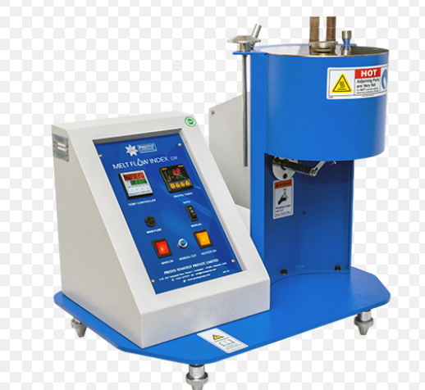
IS 13360 (Part 4/Sec 1) : 2000 ISO 1133:1997
Plastics — Methods of Testing
Part 4 Rheological properties
Section 1 Determination of the melt mass – Sub Section 2 Flow rate (MFI)And the Melt volume - Flow rate (MVR) of thermoplastics

Slide 18
Scope
The test measures the rate at which molten thermoplastic material flows through a capillary under controlled conditions of temperature and load. MFR is expressed in grams per 10 minutes, and MVR is expressed in cubic centimeters per 10 minutes.
It is an indirect method for knowing average molecular weight and thus to determine its processing and end-use application
Apparatus required –
Melt Flow Indexer (MFI): A device equipped with a temperature-controlled heating barrel, a piston, and a capillary die.
Weighing Balance: To measure the extrudate to the nearest 0.001 g.
Timer: To measure the flow time accurately.
Micrometer or Caliper: To measure the dimensions of the capillary die and extrudate.

Slide 19
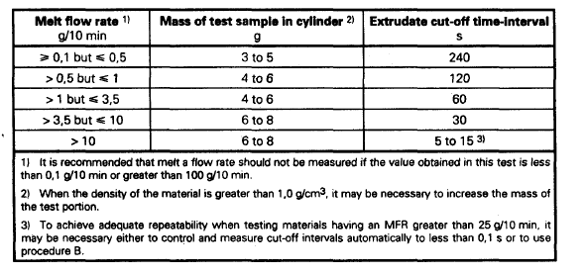
Test Specimen
Material: Thermoplastic in granulated or powdered form.
Mass: Typically around 4 to 6 grams, depending on the expected flow rate and specific requirements of the material.

Slide 20
Procedure
Preheat the melt flow indexer to the test temperature specified for the material.
Load the test specimen into the heating barrel and allow it to preheat for a specified time to ensure complete melting.
Prepare the piston and load it with the specified weight.
Ensure that the capillary die dimensions comply with the standard requirements.
Once the preheating period is complete, start the timer and allow the piston to push the molten material through the capillary die.
Collect the extrudate for a specified time interval (typically 10 minutes). Weigh the extrudate collected during the specified time interval to the nearest 0.001 g for MFR.
Measure the volume of the extrudate for MVR.

Slide 21
MVR and MFR

Slide 22
IS 13360 (Part 5/Sec 2) : 2021 ISO 527-1: 2019
Plastics — Methods of Testing
Part 5 Mechanical Properties
Section 2 Determination of tensile properties — Test conditions for moulding and extrusion plastics

Slide 23
Scope
The test specimen is extended along its major longitudinal axis at a constant test speed until the specimen fractures or until the stress (load) or the strain (elongation) reaches some predetermined value.
During this procedure, the load sustained by the specimen and the elongation are measured
Apparatus required –
UTM/TTM, strain gauge/extensometer
Test specimen-
Dumbbell shape specimen(please see figure 1) with dimensions given in table-1

Slide 24
Type 1 A specimen- For Directly injection-moulded test specimen
Type 1B specimen- For machined specimens

Slide 25
Procedure
Shape and dimensions of test specimen shall be as given in figure 1 and table 1
Mark the gauge length( 75mm/50mm) on the specimen under test
Measure width( to the nearest 0.01 mm) and thickness of the specimen( to the nearest 0.001 mm)
Place the test specimen in the grips
Set and adjust an extensometer to the gauge length of the test specimen, or provide longitudinal strain gauge.
Apply uniaxial tensile stress on the specimen.
Measure Load and gauge length at yield point and breaking point.

Slide 26
Cont.
Calculate tensile yield strength and tensile breaking strength by dividing Load and initial cross sectional area at respective points
Calculate elongation % at yield point and breaking load by dividing elongation at these respective points by original gauge length.

Slide 27
IS 13360 (Part 5/Sec 2) : 2021 ISO 527-1: 2019
Plastics — Methods of Testing
Part 5 Mechanical Properties
Section 4 Determination of Izod impact strength

Slide 28
Principle: The test specimen, supported as a vertical cantilever beam, is broken by a single impact of a striker, with the line of impact a fixed distance from the specimen clamp and, in the case of notched specimens, from the center line of the notch
Test apparatus: Test machine, micrometres and gauges
Test specimen:
Placement of Izod test specimen in the testing machine

Slide 29
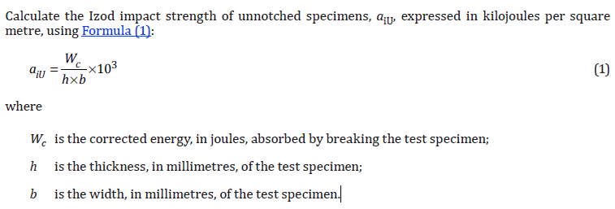
Procedure
Lift the pendulum to the prescribed height and support it.
Fix the specimen inside the clamping device. The specimen should be held vertically as shown in Figure. Half of the V-notch should be above the horizontal surface.
Release the lever and the pendulum is swung such that specimen is impacted
Stop the swinging of the specimen by applying the brake.
Note the readings on the dial gauge corresponding to the pointer. This value gives the impact energy directly in joules.

Slide 30
IS 13360 : Part 5 : Sec 7 : 2017 ISO 178 : 2019
Plastics — Methods of Testing
Part 5 Mechanical Properties
Section 7 Determination of Flexural Properties

Slide 31
Principle
The test specimen is subjected to a bending force until it fractures or reaches a predetermined deflection. The load and deflection are measured during the test.
Apparatus required –
Universal Testing Machine (UTM) or Flexural Testing Machine: Used to apply a controlled bending force to the specimen.
Deflectometer: Used to measure the deflection of the specimen accurately.
Test specimen-As per Clause 6 of the standard.

Slide 32
Procedure
Ensure that the UTM/Flexural Testing Machine is calibrated and in proper working condition.
Select and prepare the test specimen as per the dimensions given in Clause 6.
Mark the span length on the test specimen.
Measure the width and thickness of the specimen to the nearest 0.01 mm.
Place the test specimen on the supports of the testing machine, ensuring it is properly aligned.
Attach the deflectometer to measure the deflection during the test.
Apply a uniaxial bending force at a constant rate.
Continue the test until the specimen fractures or reaches the predetermined deflection.
Continuously record the load and deflection data during the test.Use the recorded data to calculate the flexural properties of the specimen.
Determine the flexural stress and strain using the recorded data.

Slide 33
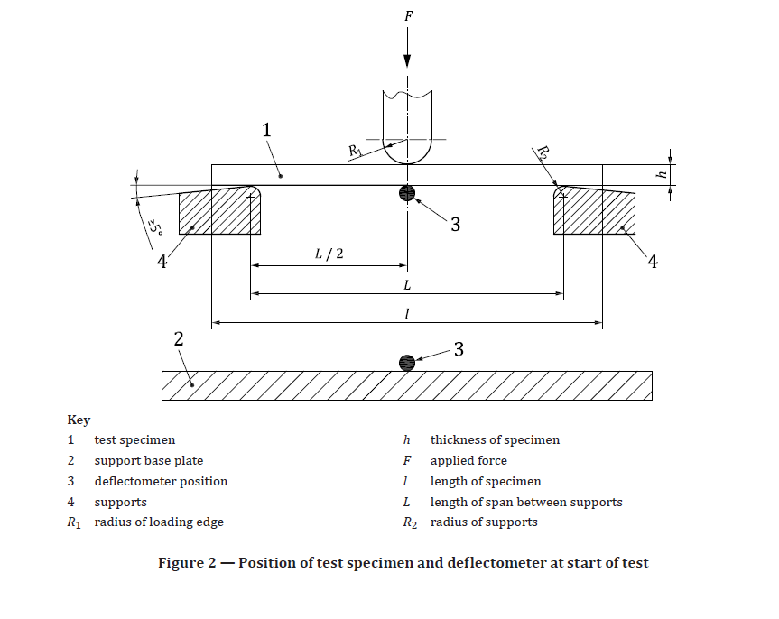
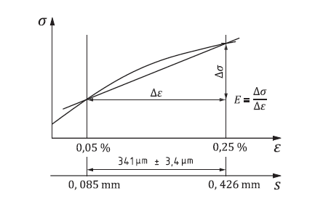

Slide 34
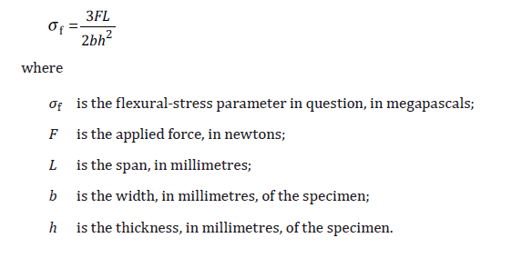
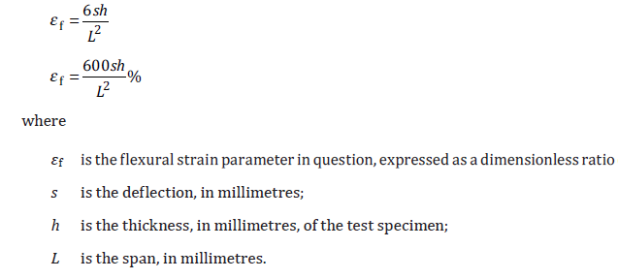
Flexural stress
Flexural strain

Slide 35
Flexural modulus Ef :
To determine the flexural modulus, calculate the deflections s1 and s2 corresponding to the given values of the flexural strain εf1 = 0.000 5 and εf2 = 0.002 5

Slide 36
IS 13360 (Part 5/Sec 11) : 2013
Plastics- Methods of Testing
Part 5-Mechanical Properties
Sec 11- Determination of Indentation Hardness by means of Durometer(Shore Hardness)

Slide 37
Scope
A specified indenter is forced into the test material under specified conditions and the depth of penetration measured.
The indentation hardness is inversely related to the penetration and is dependent on the modulus of elasticity and the viscoelastic properties of the material
Apparatus:
Type A (for softer materials) / Type D ( for harder materials) Shore durometer
Test specimen :
Test specimen shall be atleast 4mm thick

Slide 39
Procedure
Place the specimen on a hard, horizontal, plane surface.
Hold the durometer in vertical position on the test specimen and apply the pressure foot keeping it parallel to the surface of the specimen.
Read the scale on the indicating device after 15+1s. If instantaneous reading is obtained, note it after 1 s of applying the pressure foot.
Make five readings on the specimen at different positions which are at least 6mm apart and measure the mean value as Shore hardness value.

Slide 40
IS 13360 (Part 5/Sec 13) : 1992
PLASTICS-Methods of testing
Part 5- Mechanical Properties
Sec 13 Determination of Rockwell Hardness

Slide 41
Principle
A constant minor load is applied to a steel ball resting on the material to be tested, followed by the application of major load, and then returned to the minor load to determine the Rockwell hardness number (R, L and M scales)
Apparatus:
Rockwell hardness tester,
steel indenter
Test specimen: Standard test specimen
is a flat sheet at least 6 mm thick

Slide 42
Procedure
Place the test specimen on the platform of the tester
Apply minor load corresponding to the scale chosen. Within 10s of applying the minor load, apply major load. Remove major load after applying for 15+1s
After 15s of the start of removing of major load, note the reading on the dail gauge ( one division = 0.0022 mm)
Rockwell hardness(HR) is calculated by subtracting this reading(e) from 130.
HR= 130-e

Slide 43
Cont.
Make 5 more measurements on the same surface of the specimen. No reading shall be within 10 mm from the edge of the specimen and no two readings shall be taken within 10 mm apart.
Ideally, Rockwell hardness numbers shall be within 50-115. Next severe / less severe scale shall be chosen if values are outside this range ( M is most severe, R is less severe)
Express the Rockwell hardness number by prefixing it with letter of the scale chosen for testing.

Slide 44
THANK YOU..

