Slide 1


COURSE MATERIAL
Safety and Hazards in Process Industries
Presentation by
D P KUMAR
SCIENTIST- E/ DIRECTOR & HEAD HUBO

Slide 2








Ensuring safety and Compliance in Process Industries
HAZARD, ACCIDENT, RISK AND SAFETY
SAFETY AND RISK MANAGEMENT PRINCIPLES
ELEMENTS OF SAFETY AND RISK MANAGEMENT SYSTEMS
UTILITY OF SAFETY AND RISK ANALYTICS

Slide 3




INTRODUCTION
Importance of Safety and Hazard Management in process industries
Role of Indian standards in ensuring safety and mitigation of hazards.
The Indian Standards (IS) related to safety and hazards in process industries are formulated by the Bureau of Indian Standards (BIS). These standards aim to ensure safety in the design, operation, and maintenance of industries, preventing accidents and ensuring the well-being of workers and the environment

Slide 4








Importance of Safety Standards in Process Industries
Protection of Human Life
Regulatory Compliance
Primary Concern: The foremost goal of safety standards is to protect workers, the public, and first responders from the dangers associated with process industries. This includes preventing accidents that could lead to injuries, fatalities, or long-term health issues.
Reducing Risk: Implementing safety standards ensures that risks are identified, assessed, and mitigated, thus reducing the likelihood of accidents and incidents.
Legal Requirements: Safety standards often reflect legal requirements. Compliance helps companies avoid penalties, legal action, and potential shutdowns imposed by regulatory authorities.
Global Standards: For companies operating internationally, adherence to globally recognized safety standards ensures compliance across different jurisdictions.
Environmental Protection
Preventing Pollution: Safety standards help prevent the release of hazardous substances into the environment, protecting air, water, and soil from contamination.
Sustainable Operations: Adhering to safety standards promotes sustainable industrial practices that minimize environmental impact.
Reputation and Trust
Corporate Reputation: Companies known for strict adherence to safety standards build a positive reputation. This can attract investors, customers, and top talent.
Community Relations: Maintaining high safety standards fosters trust and good relations with the local community and other stakeholders.
Economic Benefits
cost Savings: By preventing accidents, companies avoid costs related to medical expenses, legal fees, fines, and compensation claims. They also save on costs associated with production downtime and equipment damage.
Insurance: Compliance with safety standards can lead to lower insurance premiums due to reduced risk.

Slide 5






Importance of Safety Standards in Process Industries
Operational Efficiency
Continuous Improvement
Minimized Downtime: Fewer accidents and incidents mean less disruption to operations, leading to higher efficiency and productivity.
Maintenance and Reliability: Regular maintenance and inspections mandated by safety standards ensure that equipment is in good working condition, reducing the likelihood of breakdowns.
On-going Enhancement: Safety standards promote a culture of continuous improvement. Regular audits, reviews, and updates to safety practices ensure that the latest knowledge and technologies are applied.
Learning from Incidents: Standards often require thorough investigation of incidents and near-misses, allowing companies to learn and improve from past experiences.
Employee Morale and Productivity
Safe Work Environment: A commitment to safety standards creates a safer, more comfortable work environment, which boosts employee morale.
Increased Engagement: Employees who feel safe and valued are more likely to be engaged and productive.

Slide 6
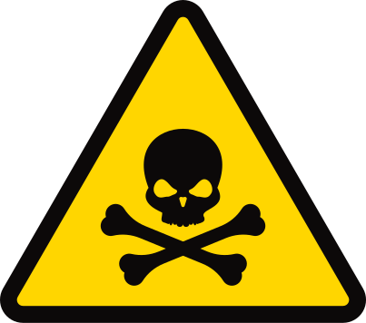
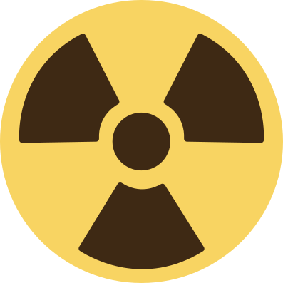
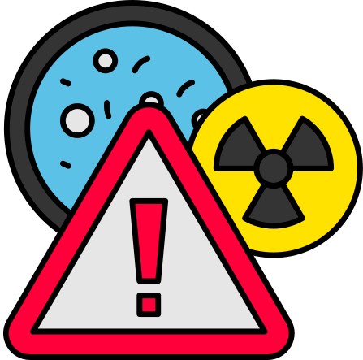


HAZARD
A hazard is any source of potential harm, damage, or adverse health effects on something or someone. In the workplace, hazards can take many forms, including:
Common Hazards in Process Industries
Ergonomic Hazards
Environmental Hazards
Chemical Hazards
Physical Hazards
Mechanical Hazards
Toxicity: Exposure to toxic chemicals can cause acute or chronic health effects.
Corrosiveness: Corrosive substances can damage materials and human tissues.
Flammability: Flammable chemicals pose fire and explosion risks.
Reactivity: Reactive chemicals can cause dangerous reactions, including explosions.
High Pressure: Equipment operating under high pressure can lead to explosions if containment fails.
High Temperature: Processes involving high temperatures can cause burns and equipment damage.
Noise: High noise levels can cause hearing loss and stress.
Radiation: Exposure to ionizing and non-ionizing radiation can cause health issues.
Moving Machinery: Can cause injuries such as cuts, bruises, or amputations.
Falling Objects: Risk of injury from objects falling from height.
Repetitive Motion: Can lead to musculoskeletal disorders.
Manual Handling: Improper lifting techniques can cause injuries.
Spills and Leaks: Can lead to soil and water contamination.
Air Emissions: Release of hazardous substances into the atmosphere.

Slide 7





DEFINITIONS
ACCIDENT
RISK
SAFETY
Risk is the likelihood that a hazard will cause harm or have an adverse effect, combined with the severity of that harm. Risk is typically assessed by evaluating both the probability of occurrence and the potential impact.
Formula:
Risk=Probability of Occurrence × Severity of Consequence
Example: The risk of an employee getting injured from a fall increases if there are no safety rails on a high platform.
Safety refers to the condition of being protected from or unlikely to cause danger, risk, or injury. In the workplace context, safety is the state in which risks are managed to acceptable levels through the identification and control of hazards.
Example: Implementing safety measures like installing guardrails and providing proper training ensures safety on a construction site.
Understanding these concepts is fundamental to managing workplace safety effectively, as they are interrelated and form the foundation of safety practices.
An accident is an unplanned and uncontrolled event that results in injury, illness, damage to property, or some other loss. Accidents are often caused by unsafe acts, unsafe conditions, or a combination of both.
Example: A worker slipping on a wet floor and breaking a leg is an accident.

Slide 8
SAFETY & RISK MANAGEMENT
Safety and Risk Management are closely intertwined concepts that focus on preventing harm and managing potential risks in various settings, particularly in workplaces. Below is an overview of both concepts and how they are integrated.
SAFETY MANAGEMENT
Safety Management involves the development, implementation, and continuous improvement of policies, procedures, and practices that protect the health and safety of workers. The goal is to create a safe working environment by preventing accidents, injuries, and illnesses.

Slide 9
KEY COMPONENTS OF SAFETY MANAGEMENT
SAFETY POLICY
Safety Planning
SAFETY PROCEDURES
A formal statement outlining the organization’s commitment to safety.
Defines roles and responsibilities for safety within the organization.
Identification of potential hazards and development of safety measures.
Establishment of safety objectives and targets.
Detailed guidelines on how to perform tasks safely.
Emergency response procedures for incidents such as fires, spills, or medical emergencies.
TRAINING AND EDUCATION
Monitoring and Reporting
AUDITS AND INSPECTIONS
Regular training programs to ensure employees are aware of safety practices and how to use safety equipment.
Induction training for new employees.
Continuous monitoring of safety performance.
Reporting of accidents, near misses, and unsafe conditions.
Regular safety audits and inspections to ensure compliance with safety policies and regulations.
Identification of areas for improvement.

Slide 10
RISK MANAGEMENT
Risk Management is the systematic process of identifying, assessing, and controlling risks that could potentially harm people, property, or the environment. It involves evaluating the likelihood and impact of risks and taking proactive steps to minimize or eliminate them.
KEY STEPS IN RISK MANAGEMENT
RISK IDENTIFICATION
Risk Assessment
Identifying potential hazards that could cause harm.
Involves analyzing processes, equipment, materials, and working conditions.
Evaluating the likelihood of the hazard causing harm and the potential severity of the outcome.
Prioritizing risks based on their level of threat.
Risk Control
MONITORING AND REVIEW
COMMUNICATION AND CONSULTATION
implementing measures to eliminate or reduce risks to an acceptable level.
Controls can include engineering solutions, administrative actions, or personal protective equipment (PPE).
Continuously monitoring the effectiveness of risk controls.
Reviewing risk management strategies and updating them as necessary
Engaging with employees, stakeholders, and experts to identify and manage risks effectively.
Ensuring clear communication of risk management practices throughout the organization.

Slide 11
INTEGRATION OF SAFETY AND RISK MANAGEMENT
Effective safety management cannot exist without risk management, as managing risks is central to ensuring safety. By identifying and controlling risks, organizations can create safer work environments, comply with legal requirements, and protect their workforce from harm.
BENEFITS OF INTEGRATING SAFETY AND RISK MANAGEMENT
1
2
3
4
PROACTIVE PREVENTION
IMPROVED COMPLIANCE
ENHANCED SAFETY CULTURE
COST SAVINGS
Reduces costs associated with workplace injuries, illnesses, and incidents
Identifying risks before they result in accidents allows for proactive measures to be taken
Ensures that organizations meet regulatory and legal requirements related to workplace safety
Promotes a culture of safety where employees are aware of risks and take active steps to manage them

Slide 12
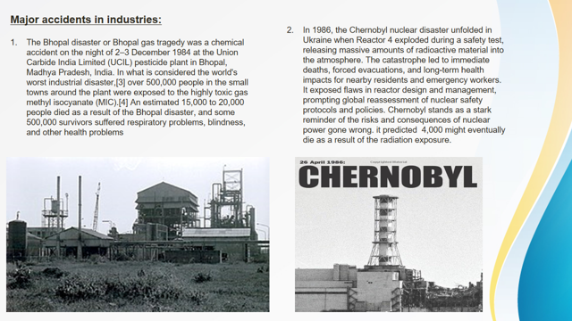

Slide 13




REGULATORY BODIES
&
STANDARDS IN INDIA
Key Organization
  Bureau of Indian Standards (BIS)
  Central Pollution Control Board (CPCB)
  Directorate General of Factory Advice Service and Labor Institutes (GGFASLI)
Important Standards
  IS 14489: 2018 Code of Practice on Occupational Safety and Health Audit.
  IS 18001: 2007 Occupational Health and Safety Management Systems.
  IS 16957 : 2018: Hazard and operability studies (Hazop Studies)

Slide 14


RISK ASSESSMENT AND MANAGEMENT
Key Concepts
Hazard Identification and Risk Assessment (HIRA)
Process Hazard Analysis (PHA)
Standards Referenced
IS 15656:2006 Hazard Identification and Risk Assessment

Slide 15


PROCESS SAFETY MANAGEMENT
Elements of Process Safety Management (PSM)
Relevant Indian Standard
IS 14489 :2018- Occupational Health and Safety Audit - Code of Practice
  Process safety information
  Process hazard analysis
  Operating procedures
  Training

Slide 16


SAFETY EQUIPMENT AND CONTROLS
Personal Protective Equipment (PPE)
Standards for PPE in process industries
IS 2925: 1984 Specification for Industrial safety Helmets to protect workers from head injuries
Engineering Controls
Ventilation systems, alarm systems, and emergency shutdown systems.
IS 61511: -1:2017 Safety Instrumented systems.

Slide 17
STORAGE AND HANDLING
Best Practices
Key Standards
  Safe Storage methods
  Proper labeling and signage
  Handling procedures
IS 3594: 1991 Code of Practice for Fire Safety of
Industrial Buildings: General Storage and Warehousing Including cold storage
IS 6044 (Part 1) : 2018 Liquefied petroleum gas storage installations - Code of practice: Part 1 residential, commercial and industrial cylinder installations

Slide 18
Some References
IS 4560: 1968 - Code of Safety for Nitric Acid: Provides safety requirements for the handling, storage, and transportation of nitric acid.
IS 6164: 2023 - Code of Practice for Safe Handling and Use of Hydrochloric Acid: Specifies safety measures for handling, storage, and use of hydrochloric acid.
IS 6818: 1973 - Code of Safety for Phosphoric Acid: Provides safety guidelines for handling, storage, and transportation of phosphoric acid.
IS 15201: 2022 - Code of Safety for Hydrogen: Provides guidelines for safe handling, storage, and use of hydrogen gas.
IS 4544: 2000 - Code of Safety for Ammonia: Specifies safety requirements for the handling, storage, and use of ammonia.
IS 4263: 1967 - Code of Safety for Chlorine: Specifies safety measures for the handling, storage, and use of chlorine
IS 6269: 1971 - Code of Safety for Ethylene Oxide: Specifies safety requirements for handling, storage, and use of ethylene oxide.
IS 9786: 1981 - Code of Safety for Vinyl Chloride: Provides safety guidelines for the handling, storage, and use of vinyl chloride

Slide 19
EMERGENCY RESPONSE PLANNING.
Components of an Effective Plan
  Emergency response teams
  Evacuation procedures
  Communication plans
Relevant Standards
  IS 18001:2007 - Occupational Health and Safety Management Systems - Requirements with Guidance for Use.
  IS 14489: 2018 - Code of Practice on Occupational Safety and Health Audit: Provides guidelines for conducting safety audits in processing facilities

Slide 20
IS 18001:2007 - Occupational Health and Safety Management Systems (OHSAS)
Objective: To provide a framework for managing occupational health and safety (OHS) responsibilities in a systematic manner.
Structure: Based on the Plan-Do-Check-Act (PDCA) model.
Plan: Establish objectives and processes necessary to deliver results in accordance with the organization’s OHS policy.
Do: Implement the processes.
Check: Monitor and measure processes against OHS policy, objectives, and legal requirements.
Act: Take actions to continually improve OHS performance.
Key Elements
  Hazard Identification: Systematic process to identify potential hazards.
  Risk Assessment: Evaluating risks associated with identified hazards.
  Control Measures: Implementing measures to mitigate identified risks.
  Legal Compliance: Ensuring adherence to applicable OHS legislation and standards.
  Training and Awareness: Providing necessary training to employees about OHS policies and procedures.
  Emergency Preparedness: Planning and preparing for potential emergency situations

Slide 21
IS 14489:2018 - Occupational Safety and Health Audit- Code of Practice
Objective: To provide guidelines for auditing occupational safety and health practices in process industries.
Scope: Covers all elements of safety management, including policy, organization, planning, implementation, and review.
Audit Process:
Planning: Includes understanding the scope, objectives, and resources required.
Execution: Conducting the audit through interviews, document reviews, and site inspections.
Reporting: Documenting findings, observations, and providing recommendations.
Follow-up: Ensuring corrective actions are implemented.

Slide 22
IS 15126:2002 –Natural Gas - Standard reference conditions
Objective: To provide guidance on conducting Hazard and Operability Studies (HAZOP) for identifying potential hazards and operability problems in chemical processes.
HAZOP Process:
Preparation: Define the scope and objectives of the study, form the HAZOP team, and gather necessary information.
Examination: Systematic examination of the process using guidewords (e.g., No, More, Less, As Well As) to identify deviations.
Analysis: Evaluate the consequences of deviations and identify causes.
Recommendations: Propose measures to mitigate identified hazards and operability issues.
Documentation: Record findings, recommendations, and follow-up actions.
Benefits:
Improved Safety: Early identification of potential hazards and operability issue
Cost Savings: Prevention of accidents and downtime.
Compliance: Ensuring compliance with safety regulations and standards.

Slide 23
IS 15656:2006 - Hazard Identification and Risk Analysis (HIRA)
Objective: To provide a systematic approach for identifying hazards and assessing risks in chemical process industries.
HIRA Process:
  Identification: Systematic identification of hazards in the workplace.
  Risk Analysis: Assessing the likelihood and consequences of identified hazards.
  Risk Evaluation: Determining the significance of risks and prioritizing them for control.
  Control Measures: Implementing measures to mitigate significant risks.
Techniques Used:
  Checklists: Using standardized checklists to identify hazards.
  What-If Analysis: Posing "What-If" questions to identify potential hazards.
  Failure Modes and Effects Analysis (FMEA): Analyzing potential failure modes and their effects.
  Event Tree Analysis (ETA): Analyzing the probability of different outcomes following an initiating event.
  Documentation and Review: Keeping detailed records of the HIRA process and periodically reviewing and updating the risk assessment.

Slide 24
Some References
IS 818: 1968 - Code of Practice for Safety and Health Requirements in Electric and Gas Welding and Cutting Operations: Provides safety guidelines for welding and cutting operations, which are often used in chemical processing facilities.
IS 3034: 1993 - Code of Practice for Fire Safety of Industrial Buildings – Electrical Generating and Distributing Stations
IS 7689 : 1989 - Guide for control of undesirable static electricity

Slide 25
Open Discussion on CASE STUDIES AND BEST PRACTICES
Examples of Implementation:
Successful safety practices in Indian process industries.
Lessons learned from past incidents.
Standard References:
Integration of standards in daily operations.

Slide 26
Open Discussion on CASE STUDIES AND BEST PRACTICES
Examples of Implementation:
Successful safety practices in Indian process industries.
Lessons learned from past incidents.
Standard References:
Integration of standards in daily operations.

Slide 27

Conclusion
Summary:
Recap of key standards and practices.
Importance of continuous improvement in safety measures.
Call to Action:
Encouraging adherence to standards and regular safety audits.

