Slide 1
Petroleum Product and their test methods

Slide 2
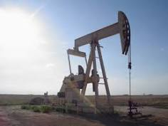
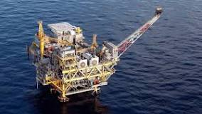
What is Petroleum
Petroleum, often referred to as crude oil, is a naturally occurring, flammable liquid found beneath the Earth's surface. It consists primarily of hydrocarbons, which are organic compounds composed of hydrogen and carbon atoms. Petroleum is a vital energy source and serves as the raw material for many everyday products such as gasoline, diesel fuel, and plastics.

Slide 3
Continued
Petroleum or crude oil: A naturally occurring yellowish-black liquid mixture of mainly hydrocarbons.
- Found in geological formations
- Covers both naturally occurring unprocessed crude oil and petroleum products that consist of refined crude oil

Slide 4
Petroleum Products
Petroleum products refer to a wide range of fuels and other products derived from crude oil through various refining processes. These products are crucial for energy production, transportation, and industrial use.
Some common petroleum products include:
Gasoline (Petrol): Used primarily as fuel for internal combustion engines in vehicles.
Diesel Fuel: Used in diesel engines, which power many trucks, buses, trains, and some cars.
Jet Fuel: Specifically designed for use in jet engines, powering airplanes.

Slide 5
Petroleum Products
Heating Oil: Used for heating homes and businesses, particularly in colder climates.
Liquefied Petroleum Gas (LPG): Includes propane and butane, used for heating, cooking, and as fuel in vehicles.
Fuel Oil: Used in industrial boilers, furnaces, and power plants.
Bitumen: Also known as asphalt, used in road construction and roofing.
Petroleum Coke: A solid carbon material derived from oil refining, used as a fuel and in manufacturing processes.
These products undergo various refining processes such as distillation, cracking, and reforming to separate and enhance their properties, making them suitable for different applications.

Slide 6
Recovery of Petroleum
Recovered by oil drilling : An oil well is a drill hole boring in Earth that is designed to bring petroleum oil hydrocarbons to the surface.
Unconventional reserves: Oil sands and oil shale (Oil shale is a form of sedimentary rock that contains kerogen, which is released as a petroleum-like liquid when the rock is heated. Tar sands are a combination of clay, sand, water and bitumen, which is a heavy hydrocarbon. Like the kerogen in oil shale, tar sands' bitumen can be upgraded to synthetic crude oil.)

Slide 7
Recovery of Petroleum
Crude oil can appear in various forms:
  -Fluid and volatile liquids
  -Viscous, semisolid materials
  Colours: Black, greenish, reddish, yellow, transparent
Natural gas: Colourless and odourless gas (predominantly made up of methane (CH4).

Slide 8
Bridge the Gap – through Standards

Slide 9
The Gap – What and Why?
Generally, at academic level, fundamentals are what we learn.
To develop professional ability, many practical aspects are to be learned.
Understanding the requirement from a practical and application point of view is limited due to many reasons, including the limited time and scope of the academic curriculum.

Slide 10
How to Bridge this Gap (Academia-Industry)
Industrial Visits
Practical Training
Internship Programme
Literature
…..
…..
STANDARDS

Slide 11
Why Standards as a Bridge between Academia and Industry
Standards Development is a collaborative process involving wide stakeholder consultations
Latest in the technology which are accepted both by manufacturers and Users
The purest form of knowledge which have been demonstrated as practicable and implementable

Slide 12
Methods of Sampling

Slide 13
IS 1447 (Part 1) - Manual Sampling
Methods of sampling of petroleum and its products (Part 1)
- Covers procedures and equipment for manual sampling of liquid petroleum products, intermediate products, and crude oils
- Excludes sampling of electrical insulating oils and fluid power hydraulic fluids

Slide 14
Sampling Procedures
Pre-cooled bottle sampling
Cooler tap sampling
Bottle sampling
Tap sampling
In-line sampling
Dipper sampling

Slide 15
Sampling Procedures
Tube sampling
Thief sampling
Grab sampling (Grab sampling, also known as lab sampling or spot sampling, is the collecting of a sample of liquid or gas in a pipeline, tank, or system with the intent of transporting the sample to a laboratory for analysis)
Grease sampling
Extended-tube sampling

Slide 16
IS 1447 (Part 2) - Liquefied Petroleum Gases
Methods of sampling of petroleum and its products (Part 2)
Covers procedure for obtaining samples of unrefrigerated liquefied petroleum gases (LPG)Suitable for sampling from bulk containers.
Principle and General Considerations
Liquid sample transferred from source into sample container through transfer line.
Great care required to obtain a representative sample, especially for mixtures of liquefied gases

Slide 17
Continued
Factors to consider:
  Take samples from liquid phase only
  Avoid sampling from bottom of vessel
  Ensure homogeneity of contents
  Permit settling of aqueous material and dissipation of static charge

Slide 18
Continued
General Safety Precautions
Hazards involved in sampling liquefied gases
Safety considerations:
  Safety at sampling point
  Safety of container
  Safety during transport

Slide 19
IS 1447 (Part 3) - Semi-Solid and Solid Petroleum Products
Methods of sampling of petroleum and its products (Part 3)
Covers methods for obtaining representative samples of semi-solid and solid petroleum and its products
Boring Sample, Grab Sample, and Grease Sample
Boring sample: Collecting chips made by boring holes with a ship auger
Grab sample: Collecting loose solids in equal quantities from each part or package
Grease sample: Scooping or dipping a quantity of soft or semi-liquid material

Slide 20
IS 1447 (Part 4) - Petroleum Coke
Methods of sampling of petroleum and its products (Part 4)
Covers procedure for collection and preparation of petroleum coke samples for laboratory analysis
Gross Samples, Bulk Samples, and Analytical Samples
Gross sample: Original sample representing one lot of petroleum coke
Bulk sample: Representative portion of gross sample prepared for ease of handling
Analytical sample: Quantity of petroleum coke sample delivered to laboratory for further preparation and analysis

Slide 21
IS 1447 (Part 5) - Lubricating Greases
Methods of sampling of petroleum and its products (Part 5)
Covers methods for obtaining samples of lubricating grease from production lots or shipments Gives instructions for inspecting greases in sales packages

Slide 22
Indian Standards For Petroleum Products
Liquid fuels
  -IS 2796:2017 Motor Gasoline
  -IS 1460:2017 Automotive Diesel Fuel
  -IS 1587 : 2017 Aviation Turbine fuel, high flash point type
  -IS 1571 : 2018 Aviation Turbine Fuels Kerosene Type Jet- A
  -IS 1604 : 2022 Aviation gasoline

Slide 23
Indian Standards For Petroleum Products
  -IS 1459:2018 Kerosene
  -IS 1593:2018 Fuel Oils
  -IS 11489:1985 Heavy Petroleum stock (HPS)
  -IS 15770:2008 Light Diesel Oil
  -IS 16861 : 2018 High Flash High Speed Diesel Fuel
  -IS 15217:2002 Fuel Oil for Diesel Generating Sets

Slide 24
Indian Standards For Petroleum Products
Gaseous fuels
  -IS 4576: 2018 Liquefied Petroleum Gases
  -IS 14861 : 2000 Liquefied Petroleum Gases LPG for Automotive Purposes
  -IS 15958 : 2012 Compressed natural gas CNG for Automotive Purposes
  -IS 17314 : 2019 Hydrogen Enriched Compressed Natural Gas HCNG for Automotive Purposes

Slide 25
Indian Standards For Petroleum Products
Bitumen and Asphalt:
  IS 73: 2013 Paving Bitumen.
  IS 702 : 2022 Industrial Bitumen
  IS 8887: 2018 Bitumen emulsion for roads (Cationic Type)
  IS 3117 : 2004 Bitumen emulsion for roads and allied applications (Anionic Type)

Slide 26
Indian Standards For Petroleum Products
E Fuels
    -IS 17021:2018 E 20 Fuel - Admixture of anhydrous Ethanol and Gasoline -as fuel for spark ignited engine
    -IS 17943 : 2022 - E20 Reference Fuel -Admixture of Anhydrous Ethanol and Motor Gasoline
    -IS 17586 : 2021- E12 and E15 Fuel - Admixture of Anhydrous Ethanol and Motor Gasoline- For Positive Ignition Engine Powered Vehicles

Slide 27
Properties of Petroleum Products and their tests
Appearence: Visual, Colour, Particulate Contamination
Composition: Acidity, Aromatics, Olefins, Sulfur
Volatility: Density, Distillation, Vapor Pressure, Flash Point/Fire Point
Combustion: Antiknock Quality (RON/MON), Ignition Quality (Cetane No), Burning Quality (Calorific Value)
Fluidity: Viscosity, Viscosity Index, Penetration
Stability: Induction Period, Gum Content

Slide 28
Properties of Petroleum Products and their tests
Change of State: Freezing Point, Pour Point, Cloud Point, Drop Point (Grease), Softening Point
Corrosivity: Total Sulphur, Doctor Test, Acidity/Alkalinity, Copper/Silver Corrosion
Others: Ash/Sediments/Carbon Residue, Asphaltenes, Water Tolerance, Metal Content, Benzene/Aromatics, Olefins/PAH
How are these tests performed ?
  Test Method Standards – IS 1448 series

Slide 29
Test Method Standards - Significance
Standard Test Methods – so that test results are acceptable
Repeatability and Reproducibility
Uniformity of test and environment conditions
Uniformity in reporting of test results

Slide 30
Benefits of Following Standards
Standardized Test Method
Standardized Reporting
Unambiguous interpretation of results

Slide 31
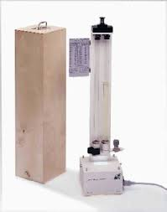
Color Determination
Purpose: Quality control and contamination detection.
Methods:
  ASTM Color: For various petroleum products.
  Gardner Color : For transparent liquids.
  Platinum-Cobalt Color : For light-colored liquids.
  Saybolt Color : For refined oils and gasoline.
  Reference: IS 1448 (Part 12) : 2013/ISO 2049 : 1996 Determination of colour ASTM Scale, IS 1448 (Part 13) : 2023 Lovibond tintometer and IS 1448 (Part 14) : 2019 Saybolt chromometer

Slide 32
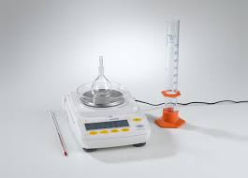
Density
Definition: Mass of liquid per unit volume at 15°C.
Importance: Key in product specifications and conversions between mass and volume.
Measurement Methods: Hydrometer, pyknometer, digital density meter.
API Gravity Formula: API Gravity = 141.5 - (131.5 × Relative Density at 15.6°C).
Reference: IS 1448 (Part 16) : 2014 / ISO 3675 : 1998 Density measurement by Hydrometer method and IS 1448 (Part 32) : 2019/ISO 3838 : 2004 Capillary stoppered pyknometer and graduated bicapillary pyknometer method

Slide 33
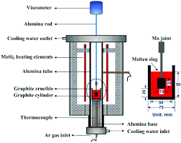
Kinematic Viscosity
Importance: Affects lubricating properties, fuel pump service life, and injector system.
Low Temperature: Ensures adequate fuel flow and pressure.
Definition: Measure of resistive flow under gravity.
Equation: Dynamic Viscosity = Kinematic Viscosity x Density.
Reference: IS 1448 (Part 25/Sec 1) : 2018/ISO 3104 : 1994 determination of kinematic viscosity and calculation of dynamic viscosity.

Slide 34
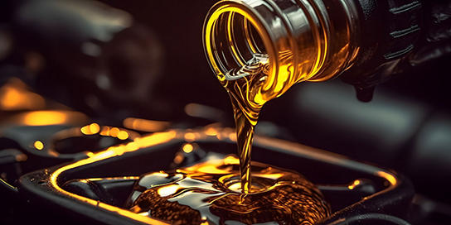
Acidity in Petroleum Products
Inorganic Acidity
Total Acidity
Significance: Measures trace acids that can cause metal corrosion and impair water separation.
Reference: IS 1448 (Part 53) :1979

Slide 35
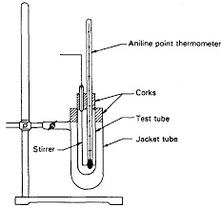
Aniline Point
Definition: Lowest temperature at which fuel is miscible with aniline.
Significance: Indicates aromatic content; higher points suggest better ignition quality.
Reference: IS 1448 (Part 3) : 2007/ISO 2977

Slide 36
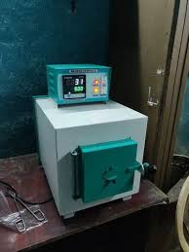
Ash Content
Sulfated Ash
Significance: Indicates ash-forming impurities and potential for engine performance impact.
Reference: IS 1448 (Part 4/Sec 1) : 2021

Slide 37
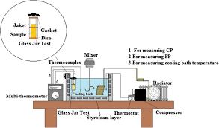
Cloud Point
Definition: Temperature at which wax crystals first appear when cooled.
Significance: Indicates the lowest temperature at which oil remains usable.
Applications: Important for low-temperature performance.
Reference: IS 1448 (Part 10/Sec 1) : 2021/ISO 3015

Slide 38
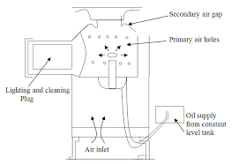
Calorific Value
Gross Calorific Value (GCV): By Bomb
Net Calorific Value (NCV): By Calculation
Significance: Measures heat-producing capacity; critical for fuel efficiency.
Reference: IS 1448 (Part 7) : 2004

Slide 39
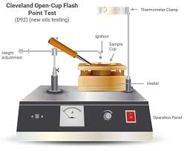
Flash Point
Definition: Tendency of a sample to form a flammable mixture with air.
Significance: Used in shipping and safety regulations.
Methods:
- Cleveland Open Cup
-Pensky Martens Closed Cup Tester
-Tag Closed Tester
-Small Scale Closed Tester
-Continuously Closed Cup Flash Point
Reference: IS 1448 (Part 20) : 2019/ISO 13736 : 2013 Abel closed - Cup method and IS 1448 (Part 21) : 2019/ISO 2719 : 2016 Pensky - Martens closed cup method

Slide 40
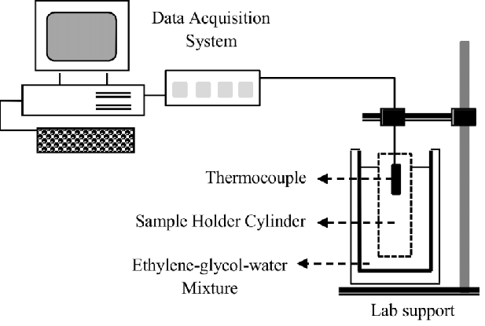
Cold Test/Freezing Point
Definition: Lowest temperature at which aviation fuel remains usable.
Importance: Ensures fuel does not freeze and restrict flow in aircraft systems.
Reference: IS 1448 (Part 11) : 2004/ISO 3013

Slide 41
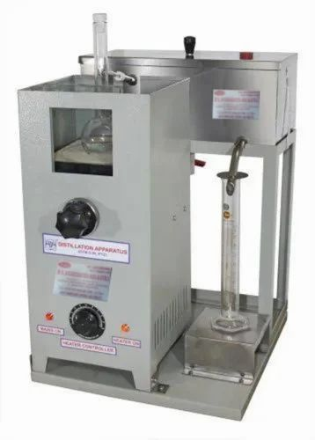
Distillation
Purpose: Determines the boiling range and volatility of hydrocarbons.
Impact: Affects safety, performance, and tendency to form deposits.
Applications: Critical for aviation and automotive fuels.
Reference: IS 1448 (Part 18) : 2020

Slide 42
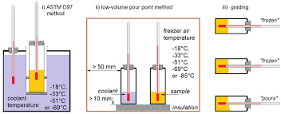
Pour Point
Definition: Lowest temperature at which oil will flow.
Importance: Indicates lowest utility temperature for certain applications.
Influences: Previous thermal history and wax structure.
Reference: IS 1448 (Part 10/Sec 2) : 2021/ISO 3016

Slide 43
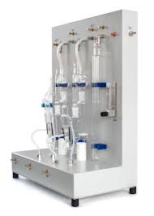
Sulfur Content
Impact: Causes corrosion, catalyst poisoning, and environmental pollution.
Sources: Depends on crude oil origin and refining methods.
Test Methods:
-Lamp Method
-Wick Bold Method
-XRF Method
-Bomb Method
-Oxidative Micro Coulometer
-UV Fluorescence Method
Reference: IS 1448 (Part 33) : 2021 Bomb Method and IS 1448 (Part 34) : 1979 Lamp Method

Slide 44
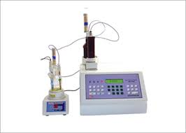
Water Content
Significance: Indicates contamination in residual fuel oil.
Detection Methods:
-Distillation
-Karl Fischer titration
Concerns: Presence of water, emulsions, inorganic materials like sand and rust.
Reference: IS 1211 :2022

Slide 45
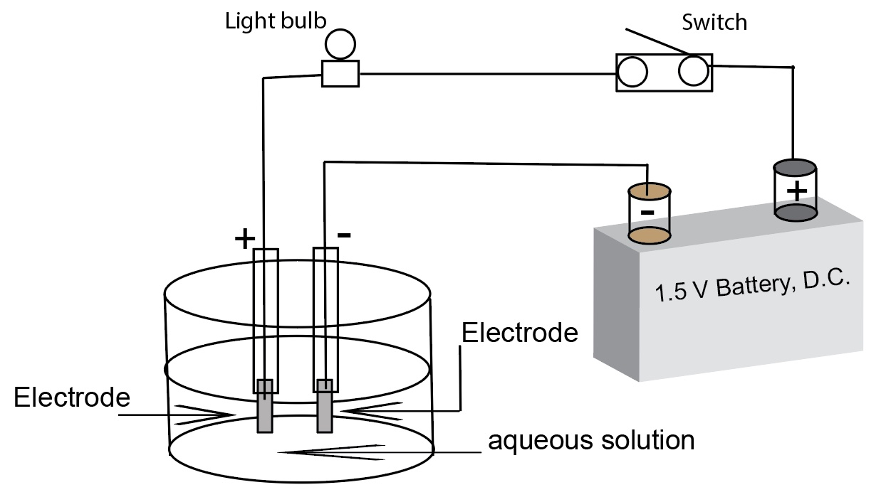
Electrical Conductivity
Purpose: Measures the ability of fuel to dissipate charge and prevent accumulation.
Dependence: On ionic species content.
Application: For aviation and distillate fuels with or without static dissipator additives.
Reference: IS 1448 (Part 148) : 2019/ISO 6297:1997

Slide 46
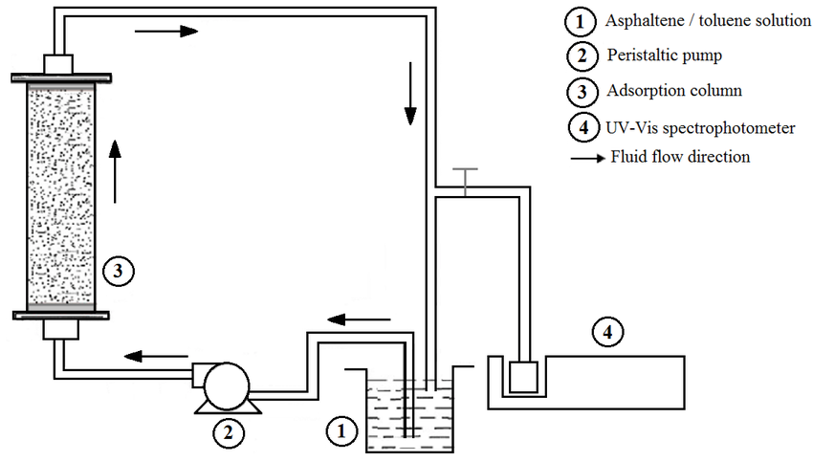
Asphaltene Content
Definition: Wax-free material insoluble in n-heptane but soluble in hot benzene.
Significance: Indicates coke formation tendency and handling issues.

Slide 47
Aromatics & Olefins
Significance: Controls blending ratios and assesses fuel quality. Aromatics influence boiling range, viscosity and stability.
Reference: IS 1448 (Part 104) : 1981

Slide 48
Burning Test & Bromine Number
Burning Test: Measures burning quality of kerosene.
Reference: IS 1448 (Part 5) : 1970
Bromine Number: Indicates aliphatic unsaturation and olefins.
Reference: IS 1448 (Part 43 & 44) : 2018

Slide 49
Carbon Residue
Methods: CCR, RCR, Micro Method
Significance: Indicates tendency to form deposits in burners and combustion chambers.
Reference :IS 1448 (Part 8) : 2012/ISO 4262:1993

Slide 50
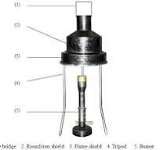
Conradson Carbon Residue (CCR)
Purpose: Determines the amount of carbon residue after evaporation and pyrolysis.
Significance: Indicates coke-forming propensities.
Note: High carbon residue may result from ash-forming constituents.

Slide 51
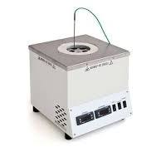
Ramsbottom Carbon Residue (RCR)
Purpose: Applicable to non-volatile petroleum products.
Comparison: Results differ from Conradson Carbon Method.

Slide 52
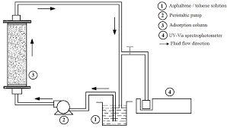
Micro Method
Purpose: Equivalent to Conradson Carbon Method but with better control and efficiency.
Advantages:
Smaller sample sizes.
Up to twelve samples simultaneously.
Less operator attention required.

Slide 53
Asphaltene Content
Purpose: Indicates the propensity to form carbonaceous deposits (thermal coke).
Importance: Indicates the amount of high-boiling constituents in petroleum.
Reference :IS 1448 (Part 22) : 2019

Slide 54
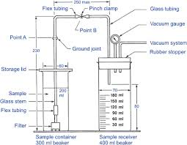
Cold Filter Plugging Point (CFPP)
Purpose: Estimates the lowest temperature for trouble-free fuel flow in diesel engines.
Applicability: Includes fuels with additives for improved flow.
Reference: IS 1448 (Part 110) : 2023

Slide 55
Carbon-Hydrogen Ratio (CH Ratio)
Purpose: Indicates energy content and efficiency of the fuel.
Factors: Based on specific gravity at 15°C.

Slide 56
Cetane Number
Definition: Numerical result from engine tests evaluating fuel ignition delay.
Calculation: Nearest whole number to the value determined by the blend of normal cetane (Cetane No. 100) and alpha-Methylnaphthalene (Cetane No. 0) that matches the test fuel's ignition quality.
Impact:
  Lower pressure rise and peak pressures.
  Easier starting and faster warm-up.
  Reduced exhaust smoke and odor.
  Reference: IS 1448 (Part 174) : 2020/ISO 4264 : 2018

Slide 57
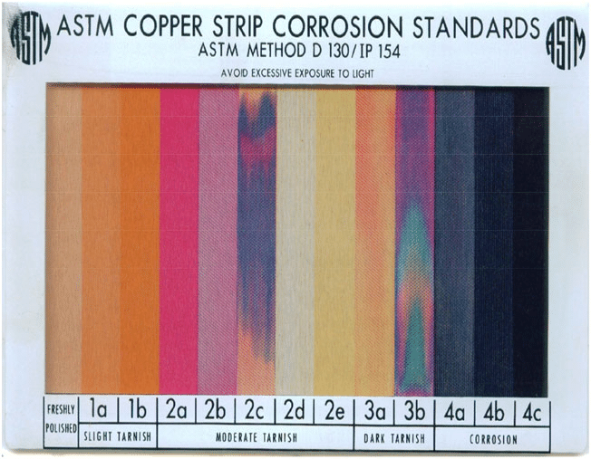
Copper Strip Corrosion
Purpose: Measures corrosiveness to copper, brass, or bronze in diesel fuel.
Significance: Important for pressure burner vaporizing tubes operating at high temperatures.
Application: Also used for gasolines, fuels, lubricating oils, or other hydrocarbons.
Reference: IS 1448 (Part 15) : 2004/ISO 2160 Copper strip test

Slide 58
Diesel Index
Definition: Indicates ignition quality of diesel fuel.
Formula: Diesel Index = Aniline Point (°F) × API Gravity / 100.
Note: The equation may be misleading for blended fuels.
Reference: IS 1448 (Part 17) : 1960

Slide 59
Doctor Test
Purpose: Detects mercaptan sulfur and hydrogen sulfide.
Significance: Ensures removal of these contaminants and prevents corrosion and odor issues.
Reference: IS 1448 (Part 19) : 2015/ISO 5257:2003

Slide 60
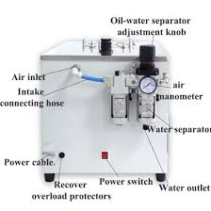
Existent Gum
Definition: Nonvolatile residue present in gasoline.
Impact: High gum can cause induction-system deposits and valve sticking.
Application: Measures oxidation products in motor gasolines.
Reference: IS 1448 (Part 29) : 2021/ISO 6246

Slide 61
Potential Gum
Purpose: Predicts gum formation during storage and decomposition of antiknock additives.
Application: For aviation, turbine, and jet engine fuels.
Reference: IS 1448 (Part 147) : 1998

Slide 62
Induction Period (Oxidation Stability)
Motor Gasoline: Indicates tendency to form gum in storage.
Middle Distillates: Provides basis for estimating storage stability.
JFTOT: Measures thermal oxidative stability of aviation fuels.
Reference: IS 1448 (Part 154) : 2012/ISO 12205:1995

Slide 63
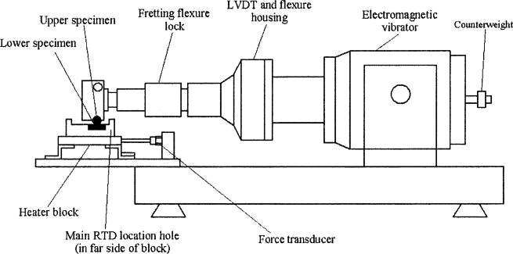
Lubricity of Diesel & ATF Content:
Tests:
Ball on Cylinder Lubricity Evaluator (BOCLE) - D 5001.
High Frequency Reciprocating Rig (HFRR) - D 6078.
Importance: Evaluates lubricating properties to prevent wear and extend engine life.
Sensitivity: Influenced by contamination, presence of oxygen and water, and temperature.
Reference: IS 1448 (Part 149) : 2020/ ISO 12156-1 : 2018

Slide 64
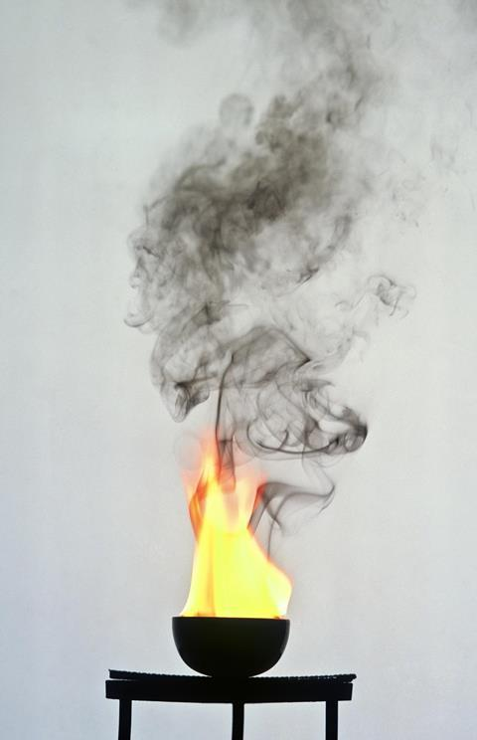
Naphthalene Content
Relevance: Affects combustion characteristics of ATF in kerosene boiling range.
Impact: Leads to sooty flame, smoke, and thermal radiation.

Slide 65
Octane Number
Definition: Knock rating of gasoline, expressed as percentage of iso-octane.
Importance: Determines fuel's resistance to knocking.

Slide 66
Research Octane Number (RON)
Application: Mild operating conditions (low inlet mixture temperature, low engine loading).
Usage: Common in passenger cars and light-duty commercial vehicles.

Slide 67
Motor Octane Number (MON)
Application: Severe operating conditions (high inlet mixture temperature, high engine loading).
Difference: MON values are usually lower than RON, difference known as gasoline sensitivity.

Slide 68
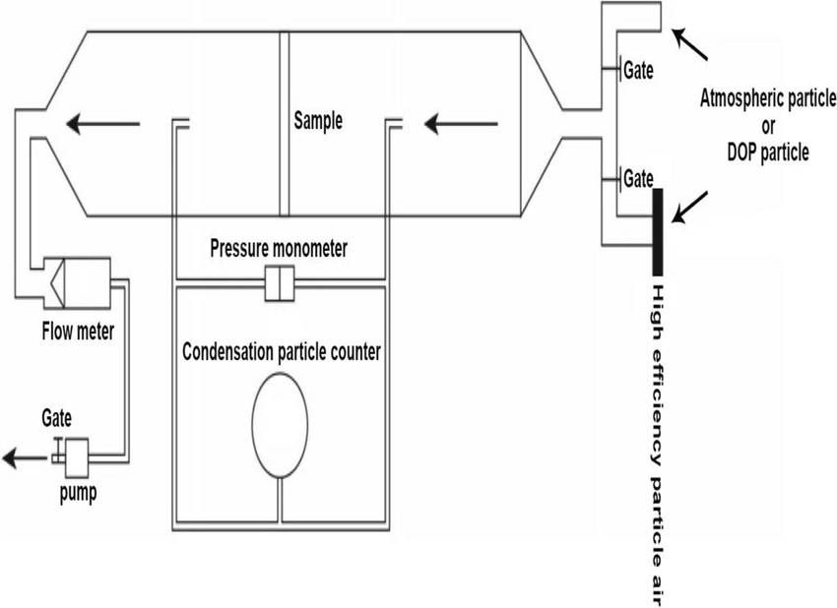
Particulate Matter
Test Method: Membrane filtration, dirt retained expressed as weight per unit volume.
Importance: Controls dirt content to prevent filter plugging and operational problems.
Reference: IS 1448 (Part 190) : 2021
ISO 15167:1999

Slide 69
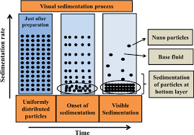
Sediments
Significance: Affects refining operations, equipment corrosion, and processing.
Test Method: Gravimetric measurement to determine sediment content in crude and fuel oils.
Reference IS 1448 (Part 30) : 2013/ISO 3735: 1999 Determination of sediment - Extraction method

Slide 70
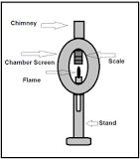
Smoke Point
Importance: Related to potential radiant heat transfer and metal temperature in turbines.
Relevance: Indicates smoke-producing properties of kerosene and aviation turbine fuels.

Slide 71

Silver Strip Corrosion
Importance: Increasing focus on corrosiveness towards silver.
Method: Similar to the copper corrosion test.
Relevance: Although not recommended by DEFSTAN, included in CEMILAC type approval specifications.

Slide 72

Trace Metals in Fuels
Types: Iron, nickel, vanadium, calcium, titanium, magnesium, sodium, cobalt, copper, tin, zinc.
Sources: Crude oils, additives in lubricating oils.
Impacts:
-Corrosion and deposition on turbine components.
-Deactivation of catalysts during processing.
-Engine deposits in diesel fuels.

Slide 73
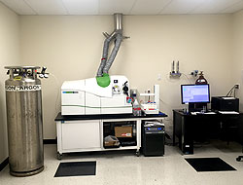
Testing Methods for Trace Metals
Techniques:
XRF (X-ray fluorescence)
Flame AAS (Atomic Absorption Spectroscopy)
ICP-AAS (Inductively Coupled Plasma Atomic Absorption Spectroscopy)
ICP-MS (Inductively Coupled Plasma Mass Spectroscopy)
ICP-AES (Inductively Coupled Plasma Atomic Emission Spectroscopy)
Measurement Levels: ppm, ppb, ppt.

Slide 74
Vapor Pressure Content
Importance: Indicates fuel performance under various conditions (e.g., vapor lock, easy starting).
Regulation: Limits set by government agencies to ensure suitable volatility performance.
Applications: Shipping and storage of crude oil.

Slide 75
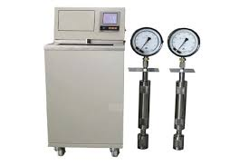
Reid Vapour Pressure (RVP)
Parameter: Measures tendency to form explosive vapors.
Measurement: Absolute vapor pressure at 37.8°C (100°F).
Influence: Largely governed by butane content.

Slide 76
Viscosity Index
Measure: Variation in kinematic viscosity due to temperature changes.
Interpretation: Higher viscosity index means smaller effect of temperature on viscosity.
Application: Characterizes the stability of lubricating oils under varying temperatures.
Reference: IS 1448 (Part 56) : 2013/ISO 2909: 2002

Slide 77
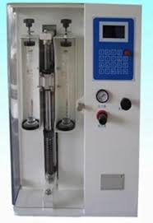
Water Reaction
Purpose: Prevent addition of high-octane, water-soluble components to aviation gasoline.
Detection: Water reaction volume change indicates presence of alcohols and surfactants.
Application: Reveals presence of contaminants in aviation turbine fuels.

Slide 78

BIS CARE APP

Slide 79


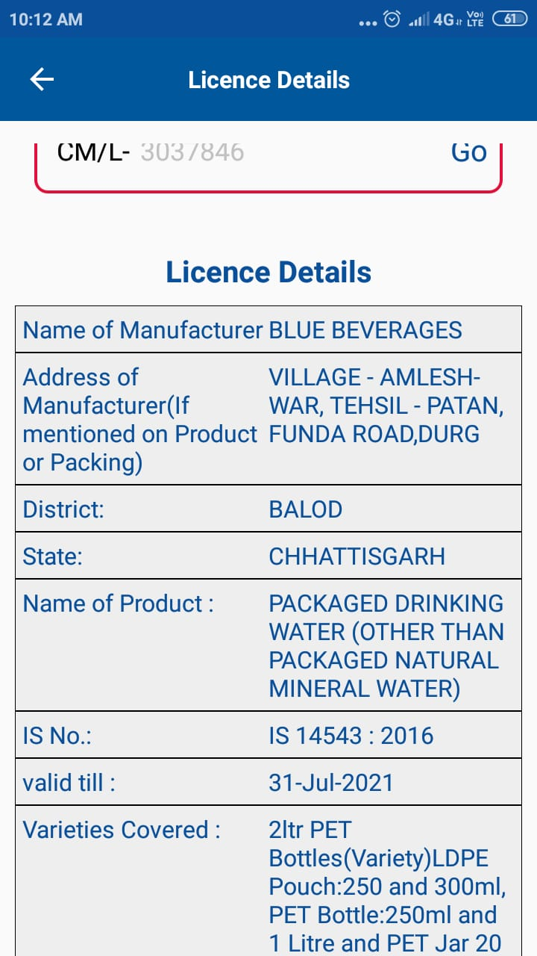

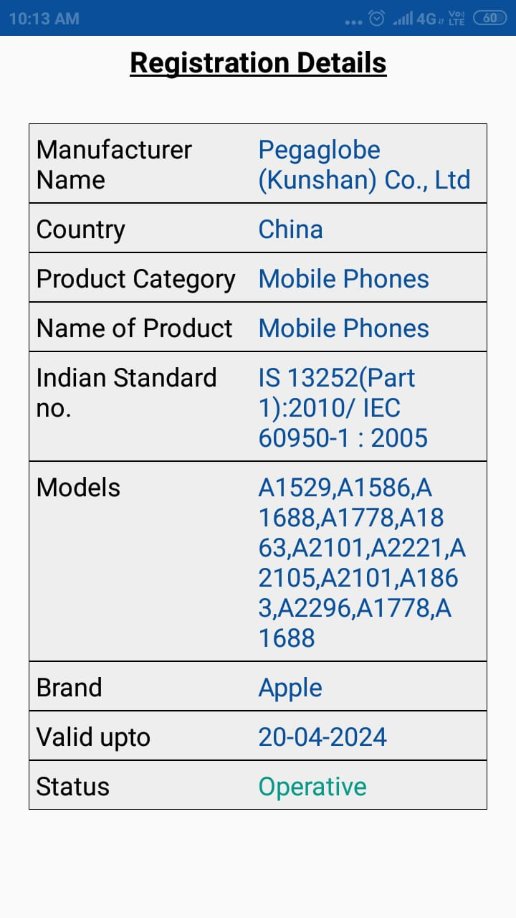



Slide 80
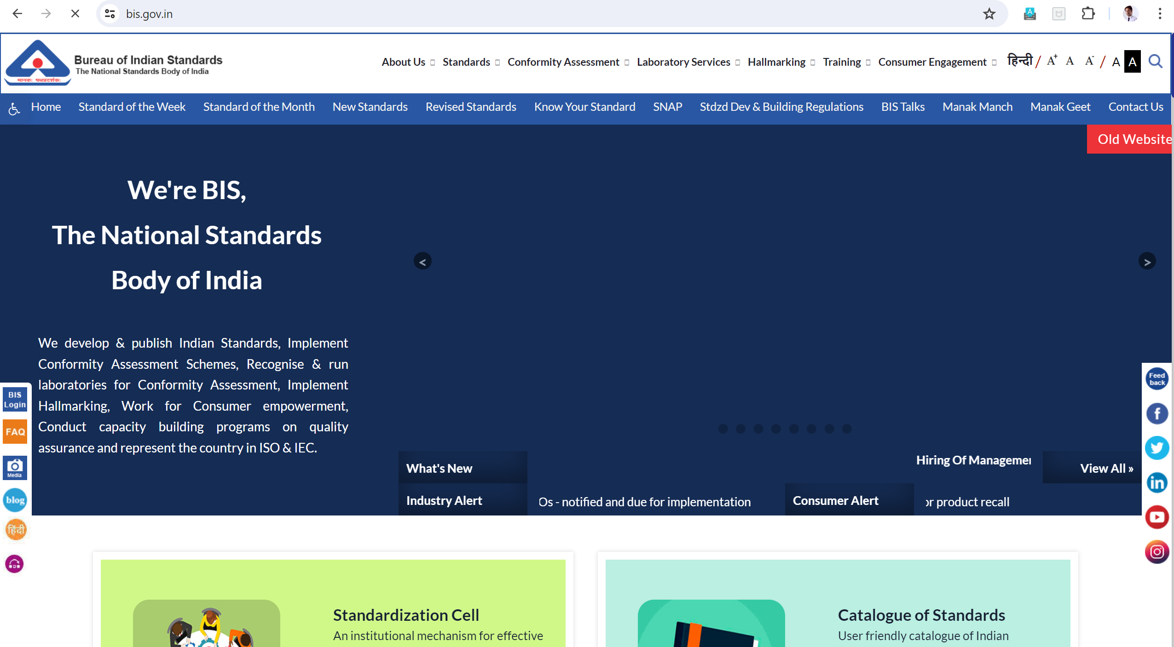
Know Your Standard

Slide 81
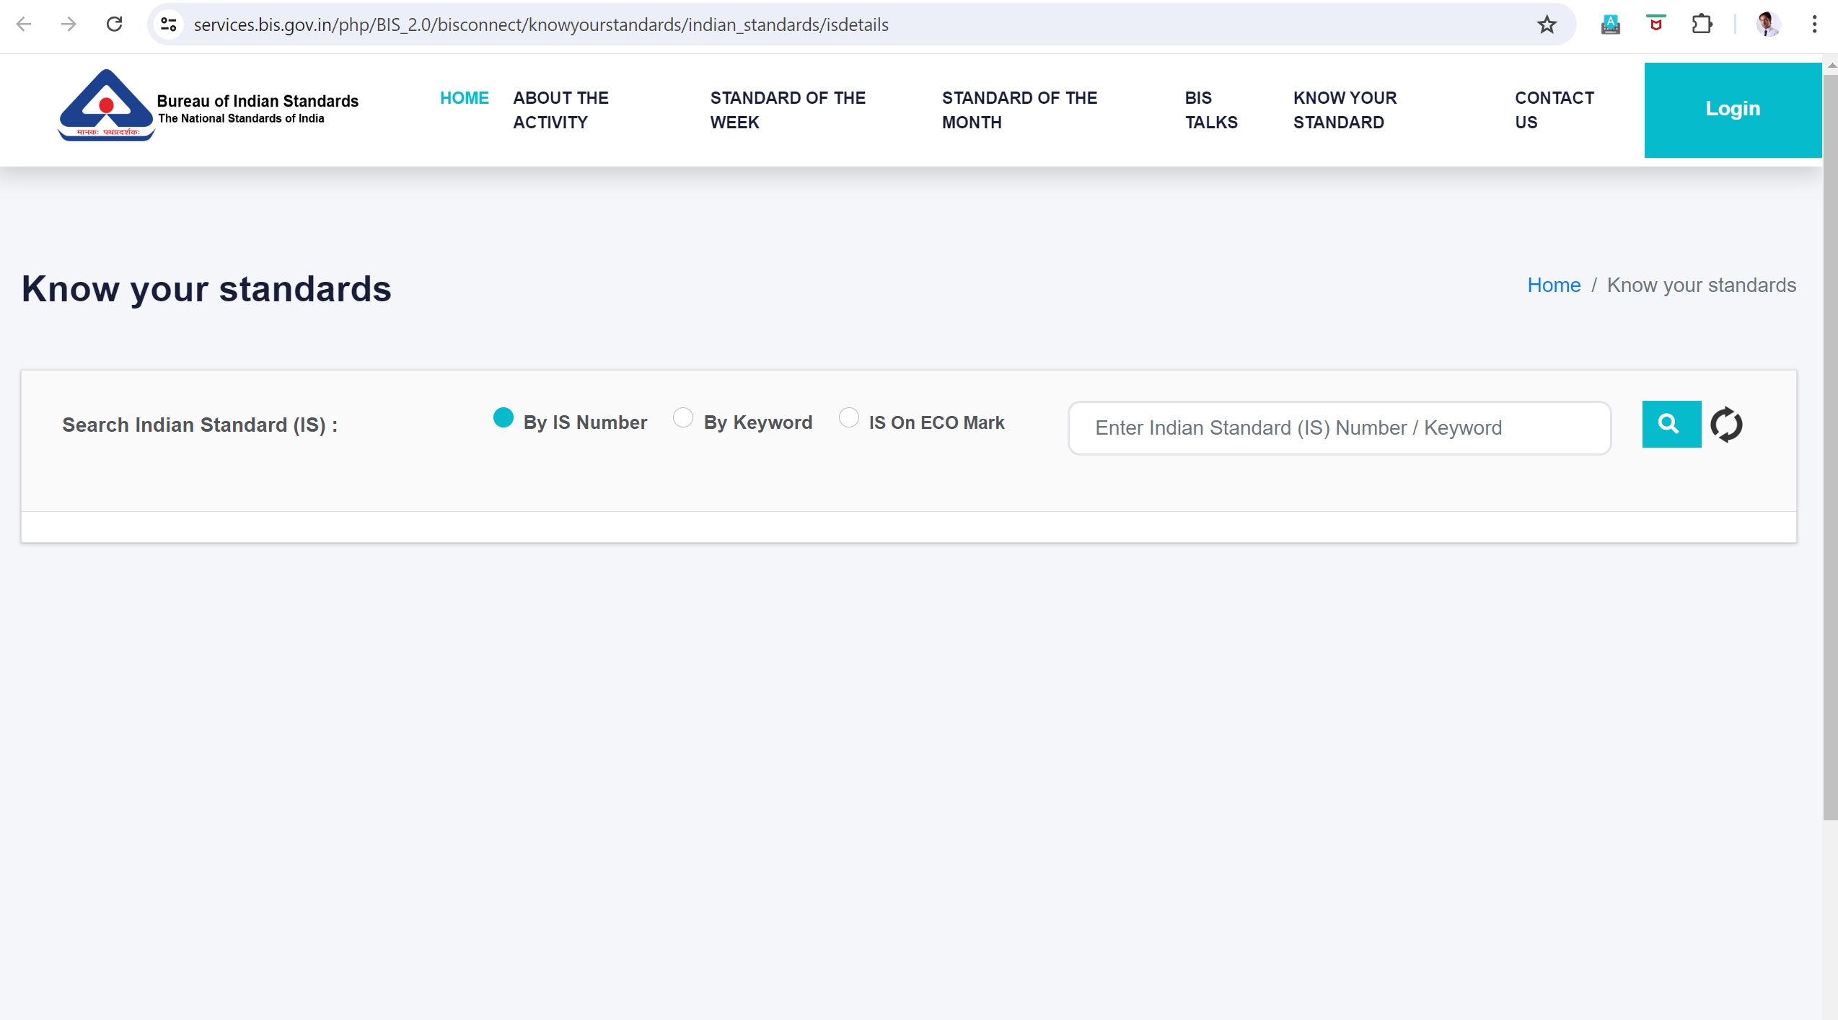

Slide 82
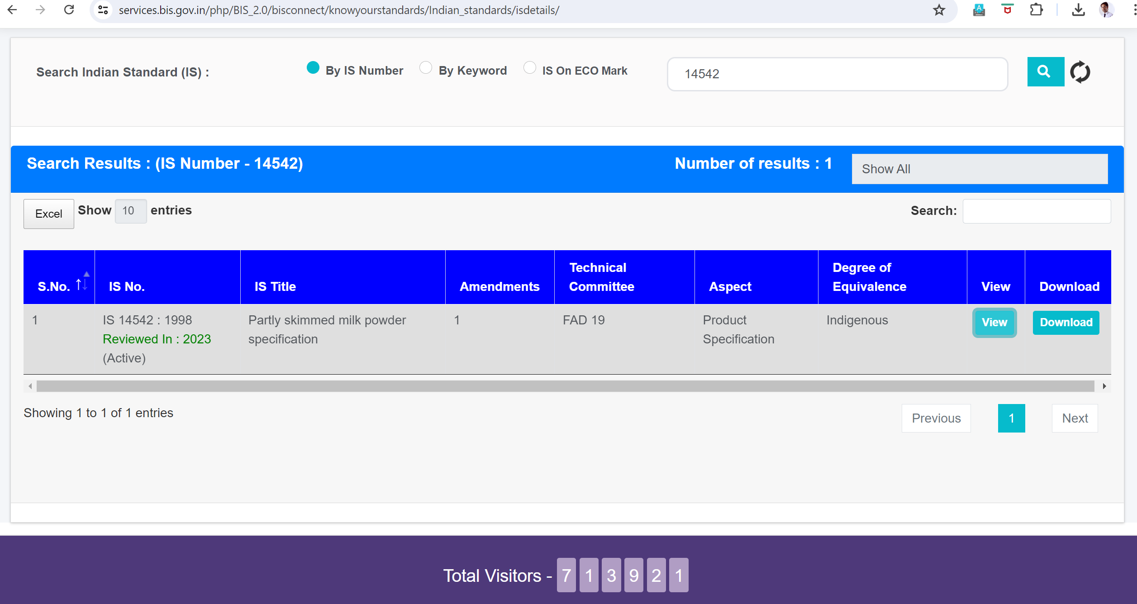

Slide 83
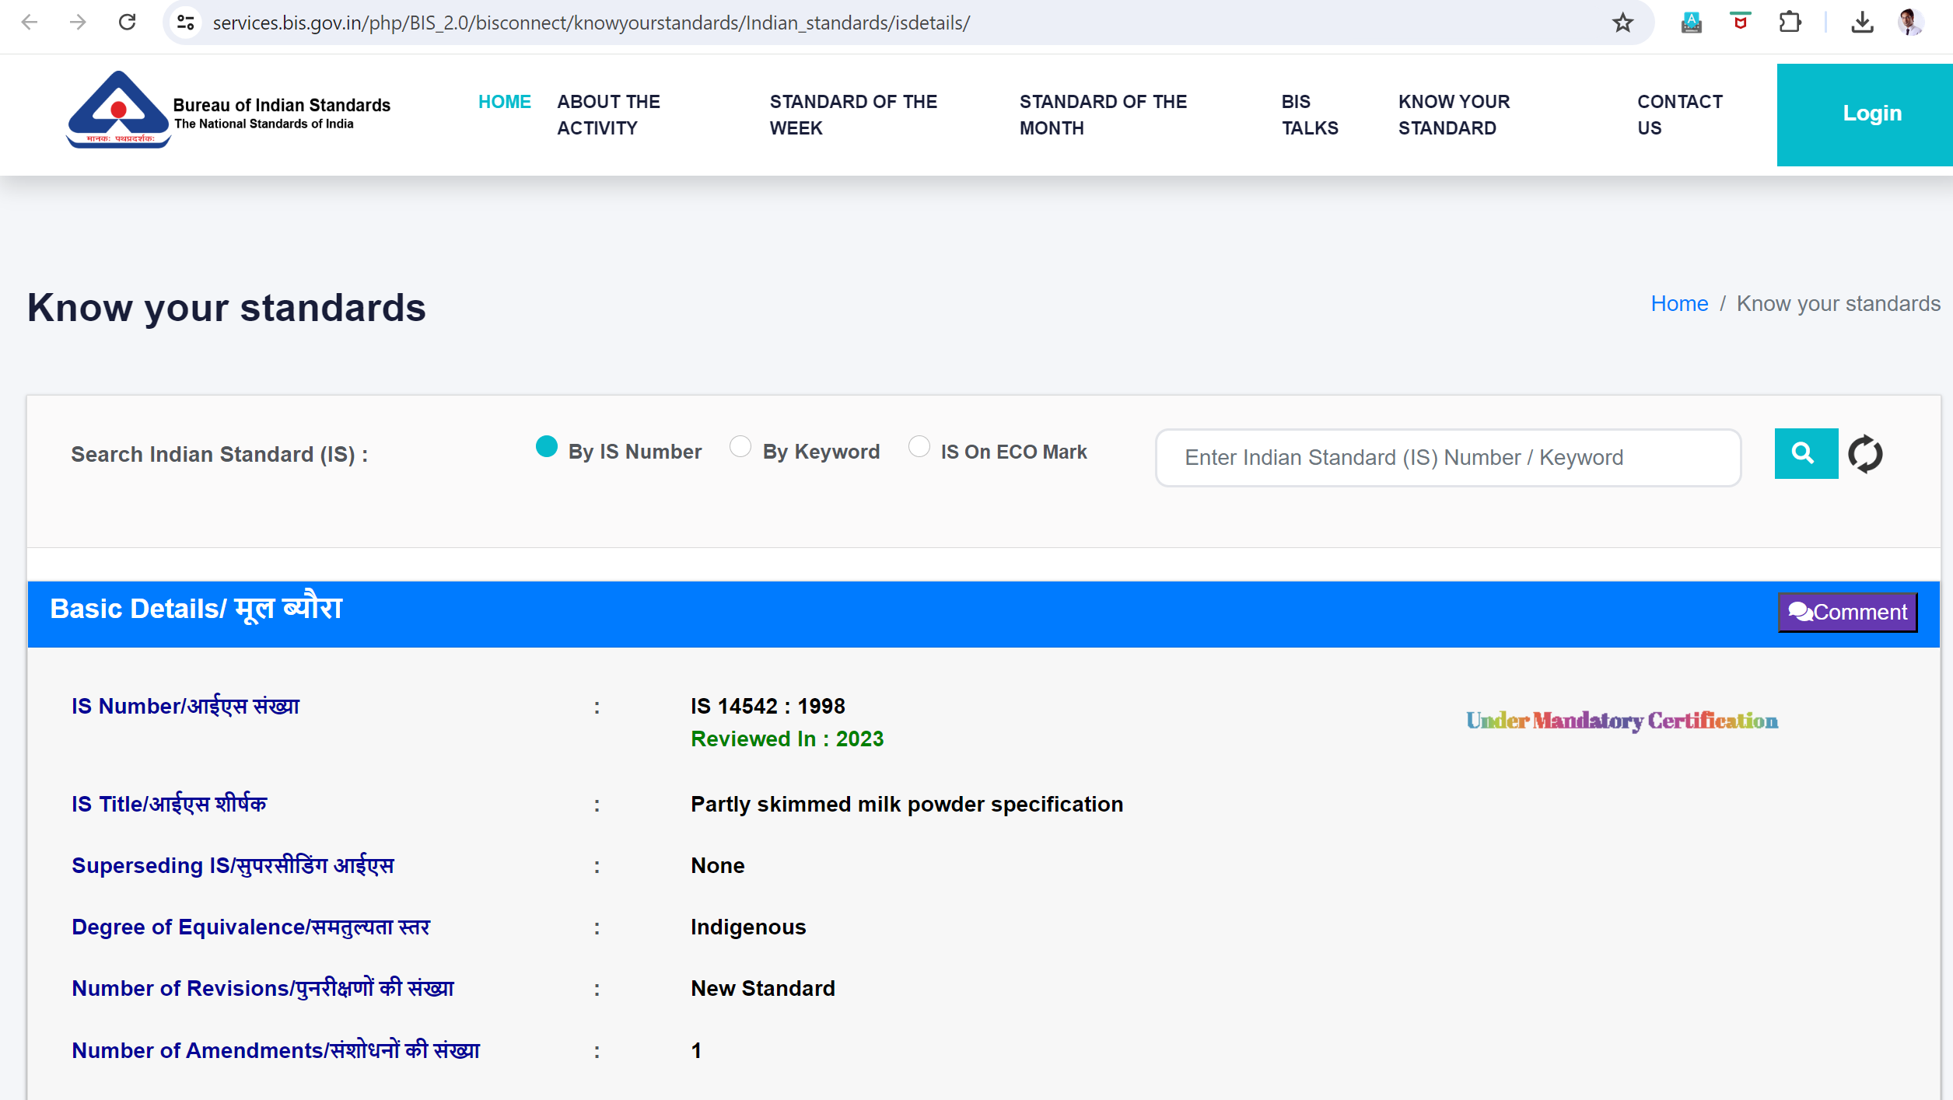

Slide 84


