Slide 1
A Technical Presentation on Powder Metallurgy and Its Terminology
Product Standard on Nickel, Iron, Copper-Lead, & Bronze-Lead Powder,
Cobalt, Tin Powder, and their Test Methods for determination of Apparent Porosity, Flow Rate of Powders, Tests on Hard Metals etc.
Presented by,
Ramakanth Sagar
Scientist- D/Joint Director

Slide 2
What is Standards?
A standard is a document, established by consensus and approved by a recognized body, that provides, for common and repeated use, rules, guidelines or characteristics for activities or their results, aimed at the achievement of the optimum degree of order in a given context.
“ It is Filtered and Purified form of Knowledge” and used by Industry, academia, Regulatory Bodies Etc.
Standards should be based on the consolidated results of science, technology and experience, and aimed at the promotion of optimum community benefits.
Standards are Reviewed, Amended , Updated According to the changes Technology, Regulatory aspects.
Role of Bis in making Standards
Standards are formulated by BIS through specialist technical committees (functioning under the Division Councils) namely, Sectional Committees.
The committee structure is designed such as to bring together all substantial interest in a particular field, so that standards are developed keeping in view the balance of interests among the relevant stakeholders like manufacturers, users, technologists and regulators and after taking into account all significant viewpoints through a process of wide consultation.
Decisions in BIS technical committees are reached through consensus. As a policy, the standards formulation activity of BIS has been harmonized as far as possible with the relevant standards as laid down by the International Organization for Standardization (ISO)/International Electrotechnical Commission (IEC).

Slide 3
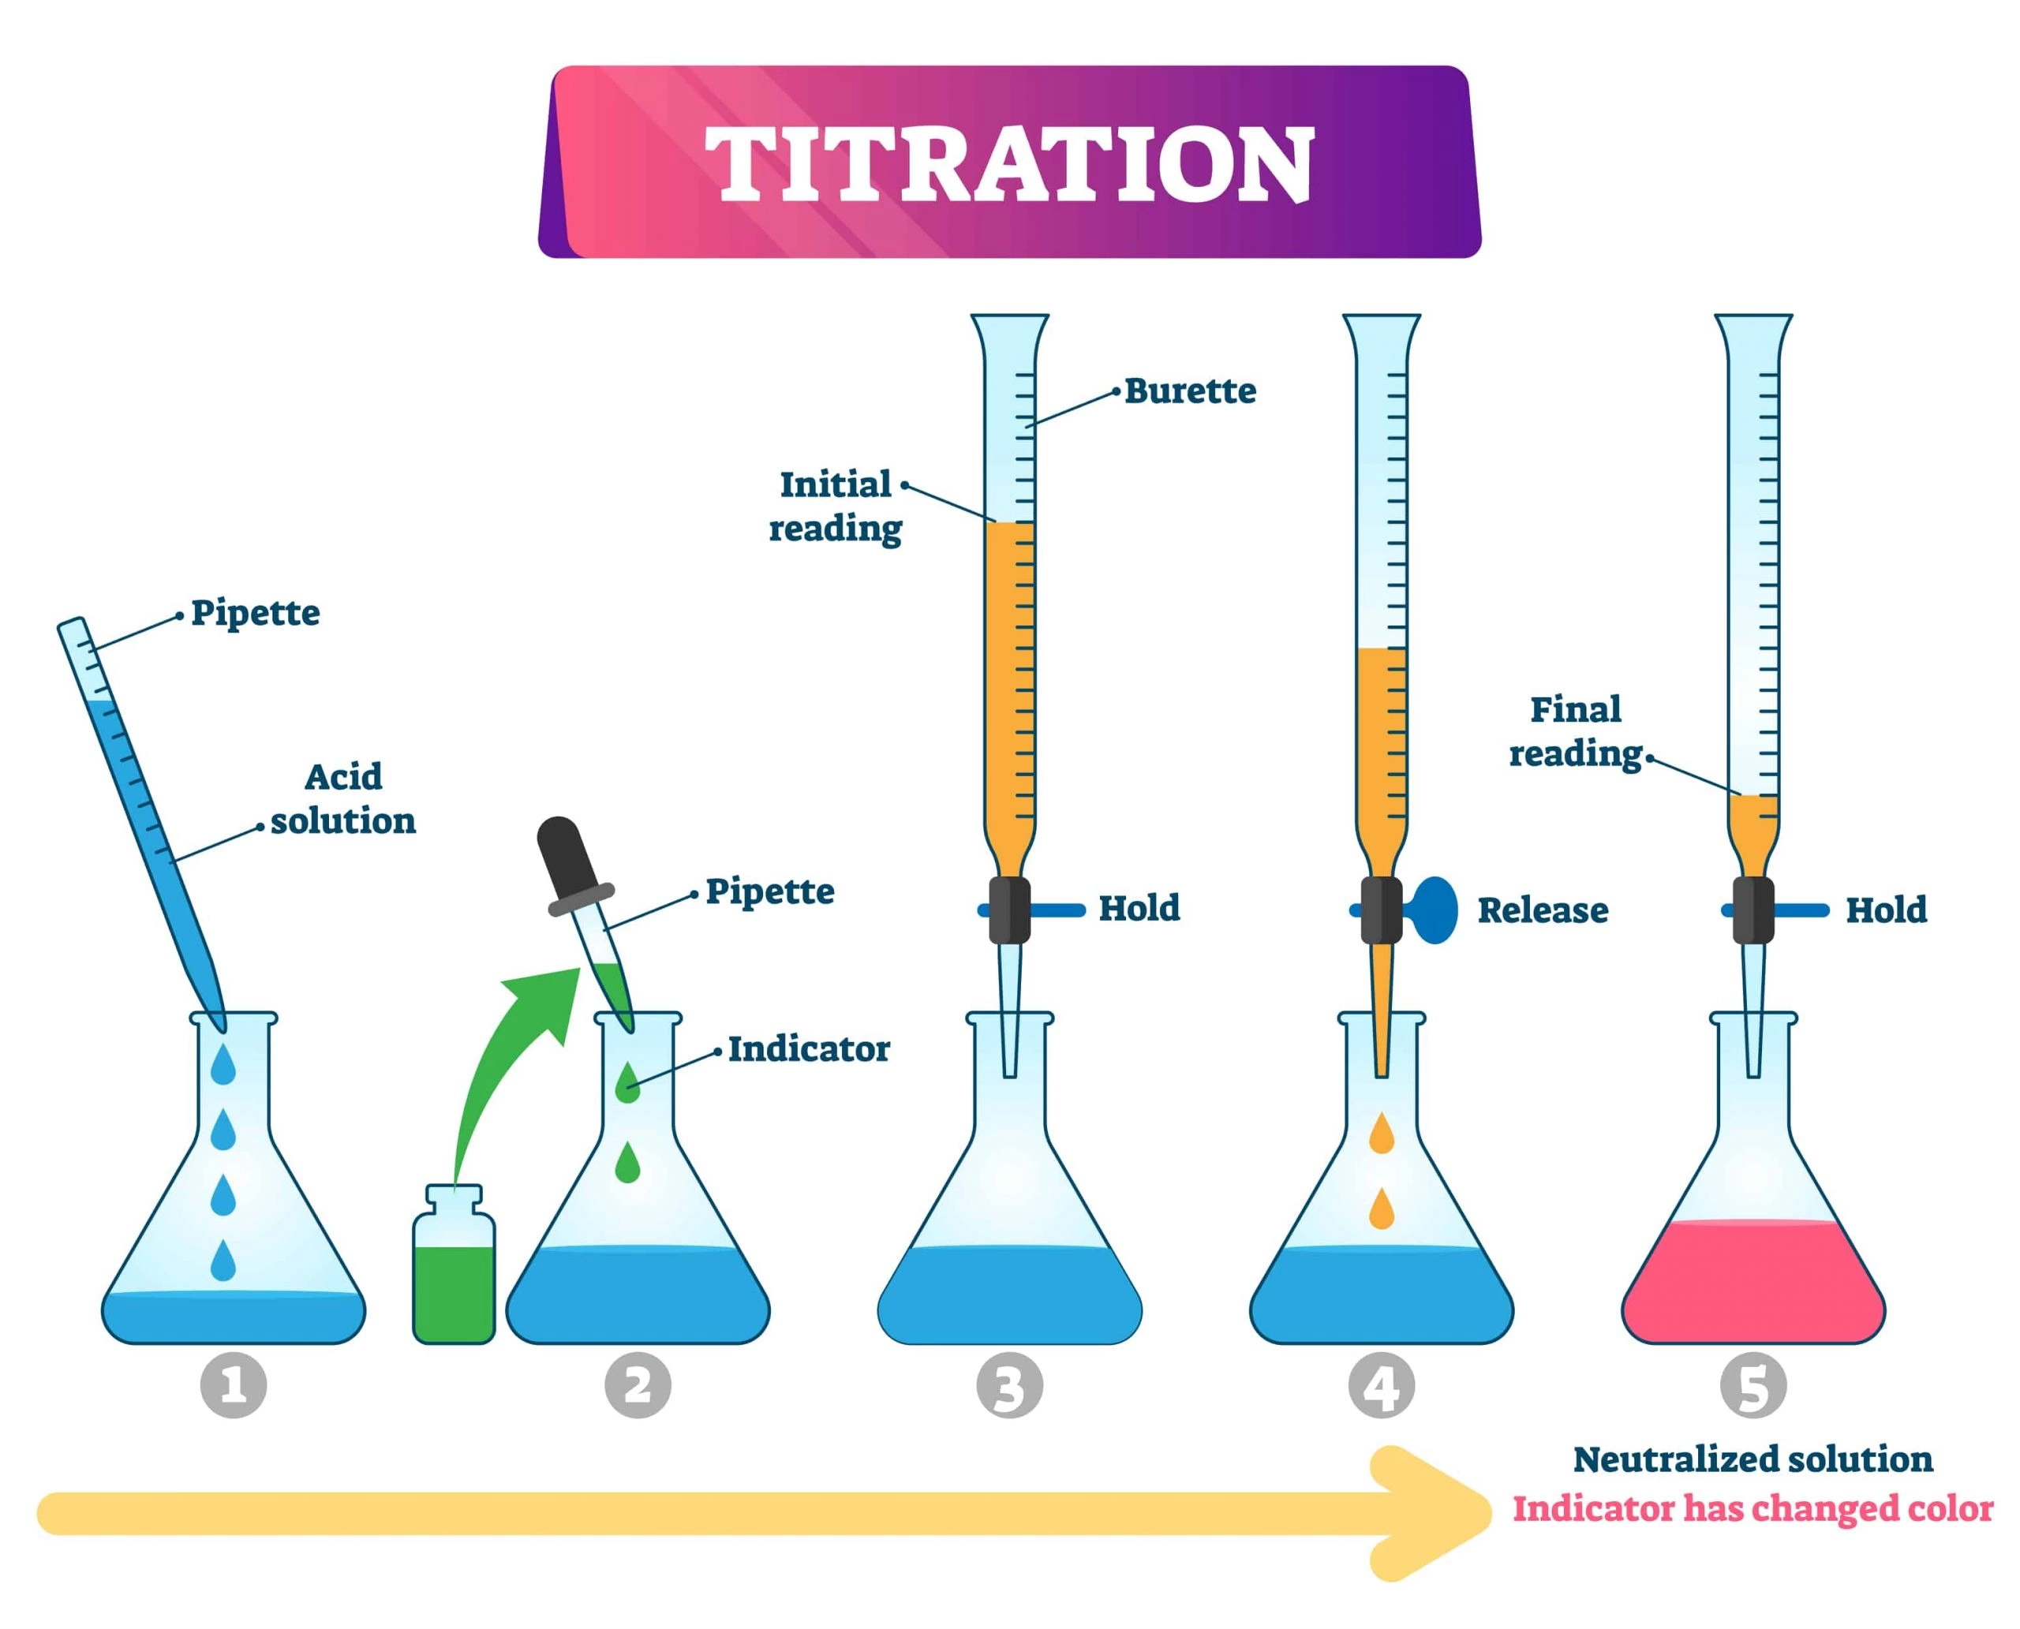
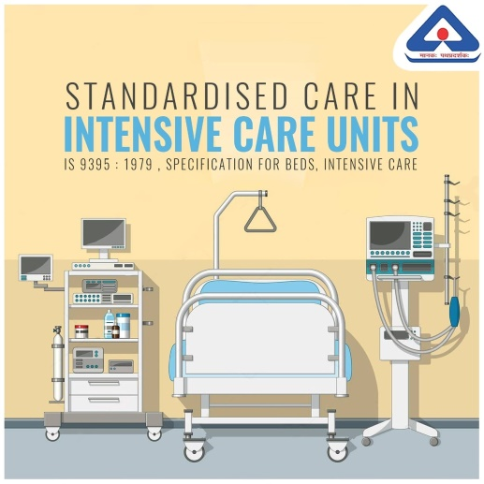

TYPES OF STANDARDS
PRODUCT STANDARDS | TESTING STANDARDS
SYSTEM AND SERVICE STANDARDS | STANDARDS FOR CODE PRACTICE

Slide 4
How Are Standards Useful for Students?
Students are the future and form the foundation on which a strong, vibrant and dynamic nation is built. The values students are exposed to in their formative years get inculcated in their young minds and serve as a force multiplier that has the capacity to transform the future of a nation.
Quality consciousness, based on standardization, is one of the pillars of accelerated economic development and priming students to appreciate the significance of quality, standards and standardization can serve as a catalyst to improve societal awareness on these subjects.
Also the knowledge of Standards helps the students in
Enhancing their technical knowledge about the products of their domain.
Developing critical thinking about further technical advancement of products.
Gaining knowledge about real life industry practices.
Improving their own employability in industries by implementing the understanding of standards.

Slide 5
Potential Benefits of Including Standards in the Curriculum
Awareness and understanding: Students learn about the importance of standards, their development, and application in various industries. They can also give their feedback to BIS for further development or amendments in the standards
Practical application: Students can apply standards to real-world problems, projects, and research, enhancing their problem-solving skills and industry preparedness. So when you refer your Technical Books, Journuls/ Papers, you can also refer Indian standards
Industry readiness: Students become familiar with industry expectations, making them more employable and better equipped to meet the requirements of their future professions.
Global perspective: Students gain insight into international standards and their harmonization, preparing them for global challenges and opportunities.
Critical thinking and analysis: Students learn to critically evaluate and apply standards, developing their analytical skills.

Slide 6
Problems solved by Indian Standards
Ensure consistency: Standards guarantee a consistent quality of products and services.
Promote safety: Standards help prevent accidents and injuries by establishing guidelines for safe practices.
Encourage innovation: Standardization provides a foundation for innovation, allowing for the development of new products and services.
Enhance customer satisfaction: Standards ensure products and services meet customer expectations, leading to increased satisfaction.
Support economic growth: Standards facilitate trade, both domestically and internationally, contributing to economic growth.
Protect the environment: Standards address environmental concerns, promoting sustainable practices and reducing waste.
Build trust: Standards establish trust among consumers, businesses, and industries, ensuring credibility and reliability.
Save resources: Standards reduce the need for repeated testing and certification, saving time, money, and resources.

Slide 7
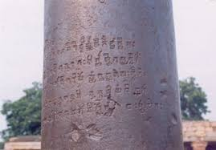
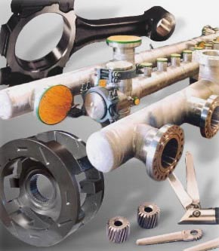
Introduction to Powder Metallurgy
Powder metallurgy (PM) is the art & science of manufacturing complex shaped Objects from Powder were in metal-forming process performed by heating compacted metal powders to just below their melting points. Although the process has existed for more than 100 years, over the past quarter century it has become widely recognized as a superior way of producing high-quality parts for a variety of important applications.
This success is due to the advantages the process offers over other metal forming technologies such as forging and metal casting, advantages in material utilization, shape complexity, near-net-shape dimensional control, among others. These, in turn, contribute to sustainability of Technology making powder metallurgy a recognized green technology.
The different Powder metallurgical parts like a helical gear and blades of stainless steel used in laparoscopic surgical scissors, a manifold weighing over 6.5 tons used on an offshore oil platform, and a steel connecting rod used in V-8 engines. All of these components were made using powder metallurgy.
Some of the archeological evidence to prove that the ancient man knew something about PM

Slide 8
Powder Metallurgy Technologies at the 3rd and 4th Semister of Engineering
In reality, powder metallurgy comprises several different technologies for fabricating semi-dense and fully dense components. The conventional powder metallurgy process, referred to as press-and-sinter,
There are other Powder metallurgical Technologies like metal injection molding (MIM) process, powder forging (PF), metal additive manufacturing (AM) is also gaining popularity
Using many of these PM processing techniques, as well as other processes such as spray forming, Roll compaction, rapid solidification, and others, components are also produced today from particulate materials other than metal powders. Today's advanced materials are seldom made of metals and metallic alloys alone, often incorporating ceramics, ceramic fibers, and intermetallic compounds. These include:
Cermet's : A cermet is a Composite material composed of ceramic and metal materials.
Nanostructured materials
High-speed steels
Powder metallurgy is an integral part of our lives.

Slide 9
Definitions and Terminologies related to powder Metallurgy
IS 5432:2022/
ISO 3252:2019
Powder Metallurgy - Vocabulary
Bulk density: It is the ratio of the mass of an untapped powder sample and its volume including the contribution of the interparticulate void volume. Hence, the bulk density depends on both the density of powder particles and the spatial arrangement particles
Dopant: substance added in small quantity to a metallic powder to prevent or control recrystallization or grain growth either during sintering
electrolytic powder : Powder produced by an electrolytic process
elutriation : classification of a powder through movement of the particles through a fluid medium
flow rate : time required for a powder sample of standard weight to flow through an orifice in a standard instrument according to a specified procedure
Terms relating to Powders
Terms relating to Compaction of Powder
Green density : mass per unit volume of an unsintered compact
Hot isostatic pressing : HIP at elevated temperature, thus activating the phenomena of diffusion and creep, the pressure-transmitting medium normally being a gas
fluid permeability: measure of the amount of liquid or gas flowing through a porous object per unit of time, as determined under specified condition
Apparent Hardness: Hardness of a sintered material measured under specified conditions so as to include the effects of porosity
Terms relating to sintering and characteristics of sintered materials
Sintered metal-matrix composite: MMC sintered material consisting of a metal matrix and a dispersed second phase (plus possibly other dispersed phases) essentially insoluble in the matrix

Slide 10
Understanding Key concept of Powder Metallurgy
Powder Metallurgy Process includes various manufacturing steps to produce the final products like
i. Powder Production
ii. Blending
iii. Shaping and Compaction
iv. Sintering
Areas covered are manufacturing process with emphasis on various BIS standards and its test methods
Objectives
To learn the concept of Powder metallurgy along with the Indian standards
To gain insights into scientific principles underlying design and Operation of Powder metallurgy Process
To be able to select and design the optimal Processing route for any given Product properties

Slide 11
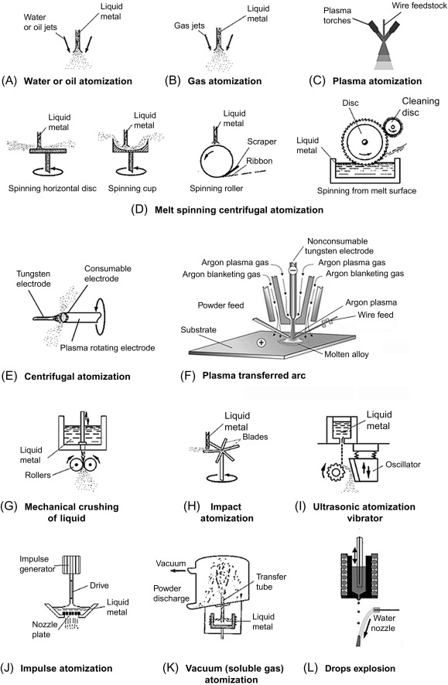
The first step in Powder Metallurgy is Powder Production
Methods of Production Powder
Atomization :
This is the most utilized process for the production of Powders were in liquid -Metal Stream by Injecting Molten Metal through a small orifice, the stream is broken up by Jets of Inert Gas or Air
Other methods are also used for production of Powders like
Reduction, Commination , Mechanical Alloying , Eletrolytic solutions etc
IS 5432: 2022 give a detailed definition and Vocabulary of each Process and tests

Slide 12
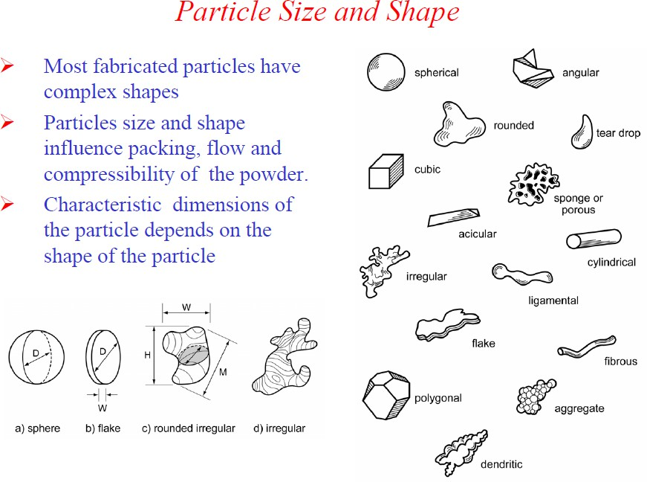
IS 5461 : 2024 / ISO 4497: 2020
Metallic powders, Determination of particle size by dry sieving
This IS specify the method of determining the particle size distribution of metallic powders by dry sieving into size fractions.
IS 18657 (Part 6) : 2024
ISO 9276-6 :2008
Representation of Results of Particle Size Analysis Part 6 Descriptive and Quantitative Representation of Particle Shape and Morphology

Slide 13
How Standards can be useful in the field of Powder metallurgy & Implications on Application of IS
Standards
Promotion of Best Practice
Safety /Health and Environmental Factors
Product Requirements/ test methodology
Regulatory compliance
Historical Experience
End user satisfaction
Transfer of technology/ trade

Slide 14
Indian Standards on Powder Metallurgy
Standardized Testing Procedures: Adherence to IS Codes ensures standardized testing procedures for PM Parts. During the Production stage and after Production stage, This promotes consistency and reliability in the interpretation of PM parts characteristics such as strength, durability parameters
Quality Assurance: Application of IS Codes facilitates quality assurance in production of PM parts. Engineers can rely on standardized methodologies to obtain accurate production plan.
Safety : Health safety is being the top most priorities. Usage of some powder like Lead, Copper, which cause skin irritation , cancer , the safety related issues are addressed in the standard.
Regulatory Compliance: Many regulatory bodies and government agencies in India require compliance with BIS standards for production of powders. Adhering to these standards ensures projects meet environmental requirements and obtain necessary approvals.
Optimized Design: Knowledge of Different Powder as per IS Codes allows engineers to optimize usage of process designs and tailored to easy production of PM parts . This helps in achieving cost-effective and efficient solutions.
Environmental Consideration and Education and Training: IS Codes serve as educational tools for teaching soil mechanics principles and testing techniques in engineering curricula. They contribute to the professional development of engineers and technicians involved in geotechnical engineering.
Understanding the Implications on its Application

Slide 15
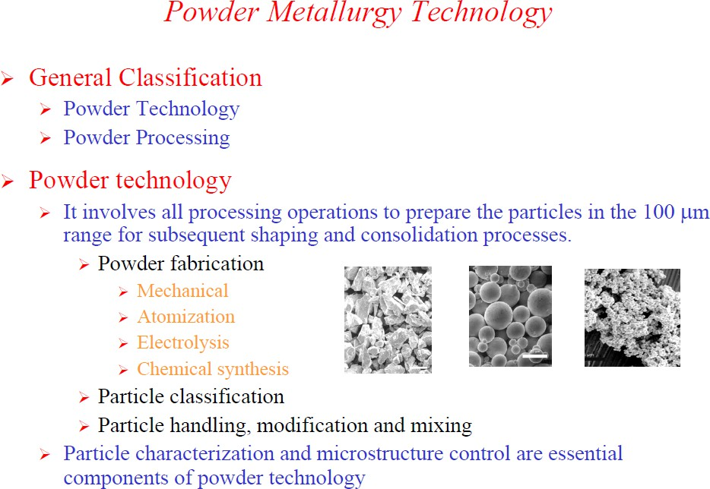
IS 8370 : 2018
Iron powder for powder metallurgical applications
This standard covers the requirements for iron powder for use in the manufacture of sintered bearings and parts.
This standard inform about different Grade of Powder based on Size, and the Chemical Composition, Acid Insoluble content, Apparent density , Flow Rate of the Powder, Compressibility

Slide 16
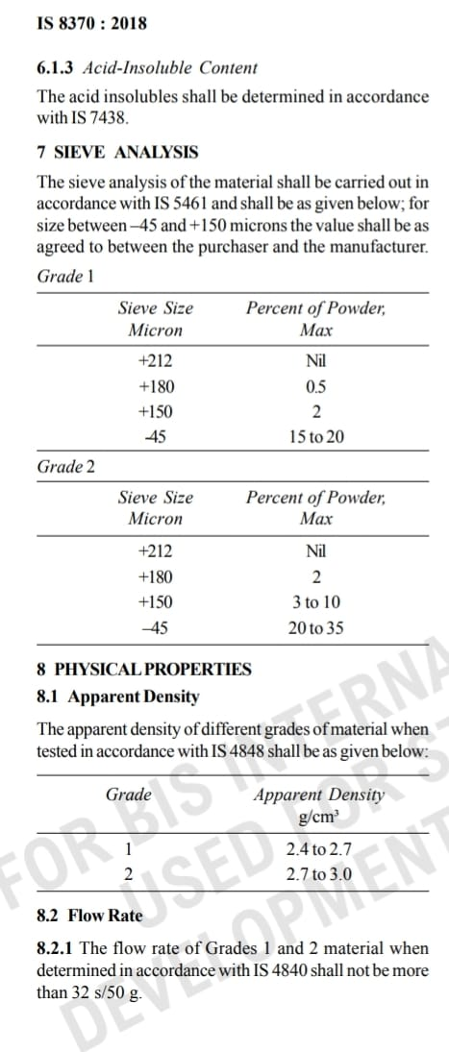
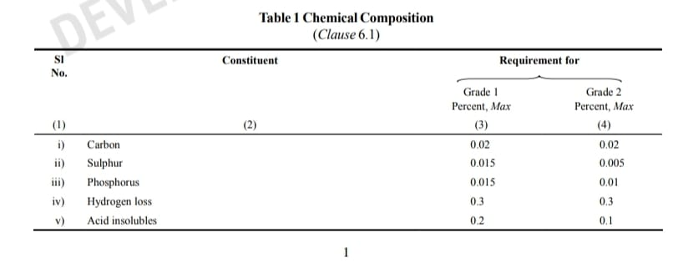
Impact of application of Indian standard in the field of Powder Metallurgy
Indian Standards prescribe the physical/chemical properties of Iron Powder
This standard inform about different Grade of Powder based on Size, and the Chemical Composition, Acid Insoluble content, Apparent density , Flow Rate of the Powder, Compressibility

Slide 17
IS 5432 : 2022
Questions
Q What is apparent density?
Ans: Mass per unit volume (g/cm3) of a powder in loose packed state. Symbol of Apparent density is ρ.
Q What is Compression ratio of a metal powder?
Ans: Compression ratio of the powder is define as the ratio of the volume of the loose powder to the volume of the compact made from it
Q Do you Know about hydrogen loss?
Ans: Hydrogen loss is define as loss in weight of metal powder or of a compact caused by heating a representative sample for a specified time and temperature in a purified hydrogen atmosphere
Q What is Electrolytic powder?
Ans: A powder formed by the electrolytic technique is often dendritic or spongy in shape although considerable control of particle size and shape is possible.

Slide 18
Powder treatment & Handling
In powder conditioning, the powders prepared by various methods are subjected to a variety of treatments to improve or modify their physical, chemical characteristics
Powder treatments
Powders manufactured for P/M applications can be classified into - elemental powders, and pre-alloyed powders
Elemental powders => powders of single metallic element; eg.: iron for magnetic applications
Pre-alloyed powders => more than one element; made by alloying elemental powders during manufacturing process itself; In this case, all the particles have same nominal composition and each particle is equivalent to small ingot
Majority of powders undergo one or more treatments prior to compaction like,
i) Drying to remove moisture,
ii) grinding/crushing to obtain fine sizes,
iii) particle size classification to obtain the desired particle size distribution,
iv) annealing, v) mixing and blending of powders,
vi) lubricant addition for powder compaction, vii) Powder Coating

Slide 19
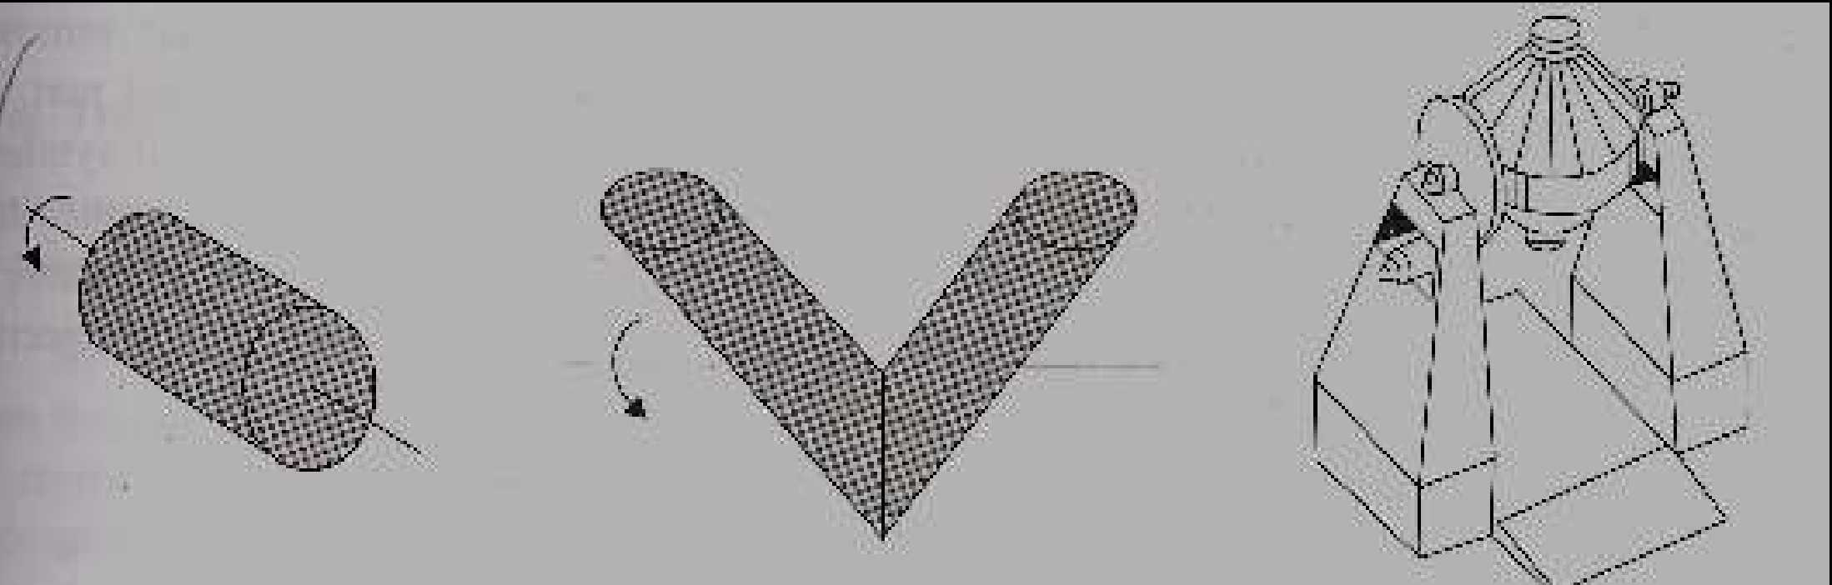
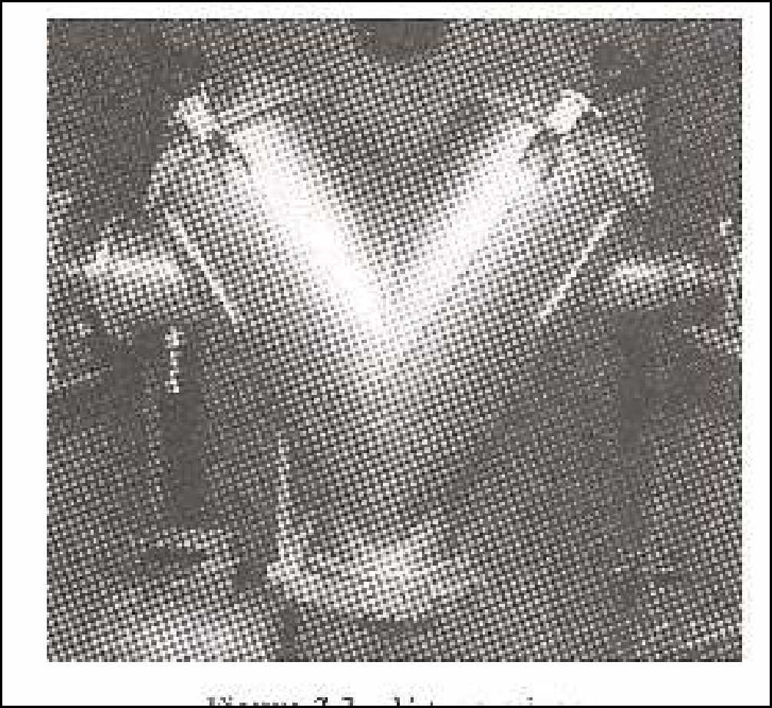
Blending and Addition of Lubricants to the powders for better compaction
IS 11506 : 2019
ISO 13944 : 2012
Lubricated metal-powder mixes - Determination of lubricant content - Modified Soxhlet extraction method
1. Cylindrical Blending Unit 2. V-type Blending Unit 3. Double Cone Blender
This International Standard specifies a method for the determination of the lubricant content of a powder mix. The lubricant is extracted from a weighed test portion using a suitable solvent. The test portion is reweighed after the extraction, and the percentage mass loss, representing the extracted lubricant, is calculated. The extracted test portion can then be used to determine, by the normal methods, the content of other constituents, without any interference from the lubricant
V-type Mixer

Slide 20
Heat treatment of powders
Heat treatment is generally carried out before mixing or blending the metal powders. Some of the important objectives are,
i) Improving the purity of powder: Reduction of surface oxides from powders by annealing in hydrogen or other reducing atmosphere. Dissolved gases like hydrogen and oxygen, other impurities are removed by annealing of powders. Lowering impurities like carbon results in lower hardness of the powder and hence lower compaction pressures & lower die wear during compaction. For eg., atomized powders having a combined carbon and oxygen content as high as 1% can be reduced after annealing to about 0.01% carbon and 0.2% oxygen. Heat treatment is done at protective atmosphere like hydrogen, vacuum.
ii) Improving the powder softness: Aim is to reduce the work hardening effect of powders that has be crushed to obtain fine powders; while many powders are made by milling, crushing or grinding of bulk materials. Powder particles are annealed under reducing atmosphere like hydrogen. The annealing temperature is kept low to avoid fusion of the particles.
iii) Modification of powder characteristics: The apparent density of the powders can be modified to a higher or lower value by changing the temperature of treatment.

Slide 21
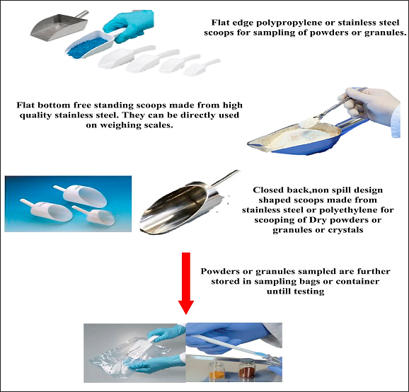
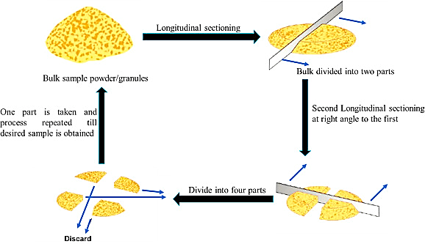
Sampling Method of Powder as per IS 1548:2024
(i) Scoop Sampling
(ii) Coining and Quartering

Slide 22
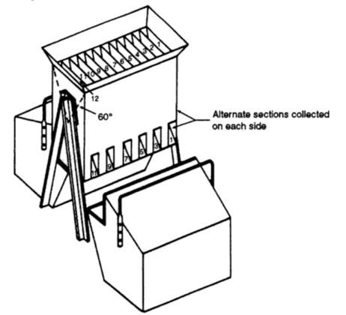
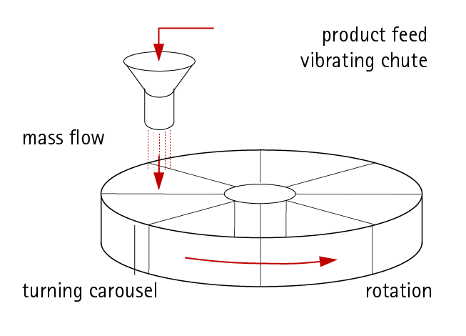
Sampling method of Powders as per IS 1548:2024
This standard explains the various statistical concepts underlying sampling inspection and lays down basic principles of lot sampling. This standard describes sampling inspection techniques applicable for estimation of quality of lot consisting of discrete items or bulk material, and for lot acceptance. 1.2 Specific procedures necessary for sampling a particular material giving details of sampling implements, methods of preparing specimens, etc are not covered in this standard.
(iii) Chute Riffler
(iv) Spinning Riffler

Slide 23
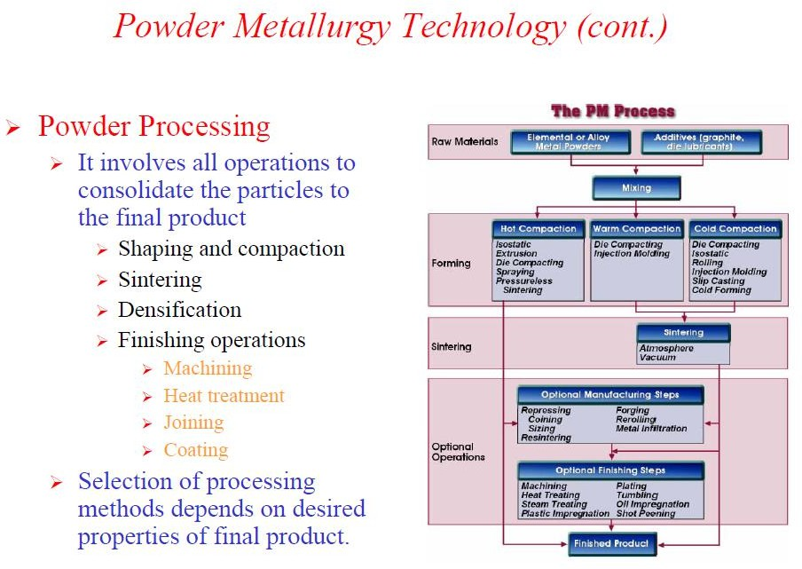

Slide 24
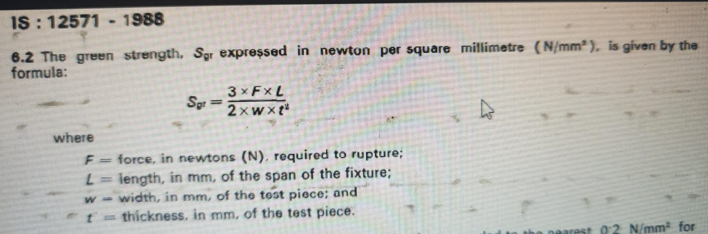
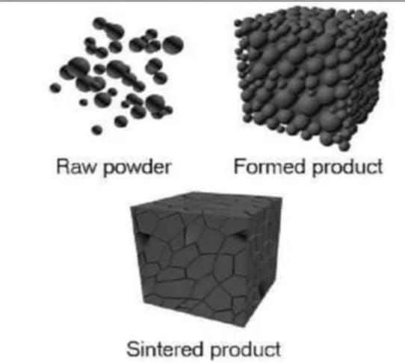
Understanding Powder Metallurgy by application of Indian Standards
Compacting and sintering for determining the quality of the Product and its performance
Compaction : Powder are compressed into desired shapes
Most Fabricated Particles have Complex Shapes and Size , the shape of the Particles will influence the Packing, flow and Compressibility of the Powder
The Product dimension and accuracy will depend upon the compressibility of the Powder i.e Green Strength
IS 12571 : 1988
Reviewed In : 2024
Determination of Green strength by transverse Rupture of rectangular Compacts of Metallic Powder Method
Metallic powders excluding powders for hard metals Determination of dimensional changes associated with compacting and sintering
IS 12570 : 2022
ISO 4492:2017
Sintering: The Green Compacts are heated to Bond the Particles into a Hard and Rigid Mass, performed at Temperature below the melting point of the Metal
Standard test pieces made from a reference lot of powder are processed together with the sample under test and the dimensional changes of the two powders are reported

Slide 25
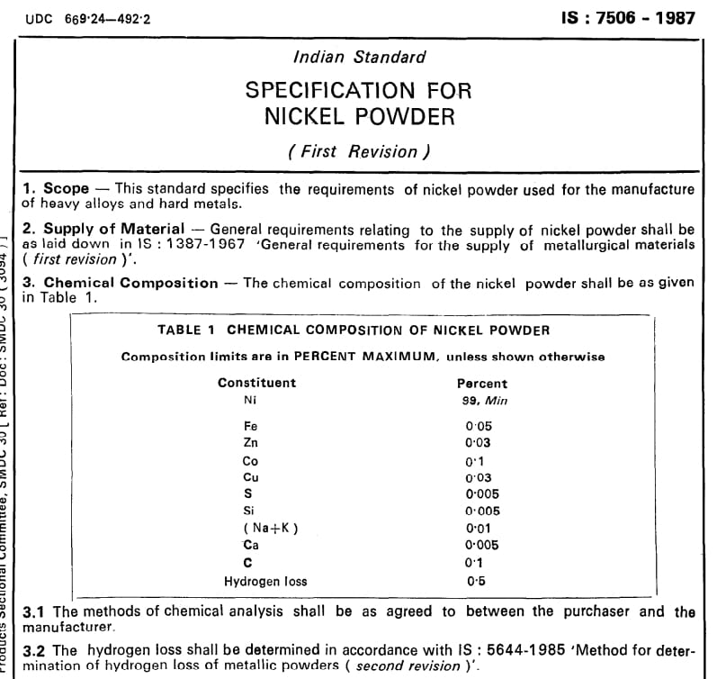
INDIAN STANDARDS ON NICKEL POWDER
About Nickel : Nickel is one of the key strategic metals because it has many applications in Petrochemical, Metallurgical for making Stainless steel, and electroplating industries where the resistance to corrosion and wear is needed, making it necessary to find newly developed technologies.
Nickel metal is widely used in the society, mainly as a component in stainless steel, steel and alloys. In stainless steel nickel stabilizes the austenitic structure, the largest group within the stainless steel family. Austenitic stainless steel grades have excellent mechanical properties through a wide temperature range (from cryogenic to high temperatures), are weldable, very formable and nonmagnetic.
Production of Nickel Powder: The most common process, which provides high purity nickel powders, is the carbonyl refining process. Were Solid nickel reacts with carbon monoxide to form nickel carbonyl gas. The gaseous mixture is further heated resulting in decomposition of the metal-carbonyl complex to produce pure nickel metal and carbon monoxide gas. Fine and extra fine nickel powders can be produced by thermal shock decomposition.
Indian Standard IS 7506 specifies the requirements of Nickel Powder used of manufacturing of heavy alloys and hard metals.

Slide 26
INDIAN STANDARDS ON IRON POWDER
IS 8370 : 2018
Iron powder represents the largest part of the raw materials used in powder metallurgy application. When it is mentioned as Iron powders, it is a highly specific engineered metallurgical end product that is manufactured under strict chemical and physical specifications.
Different processes are used to manufacture metal powders, each resulting in materials with unique chemical and physical properties. The end product’s characteristics are determined by the method of manufacture. Powder metallurgists look for various properties such as composition, microstructure, oxide content, acid insolubles, particle size, particle-size distribution (sieve analysis), particle shape and surface area, flow rate, and apparent density when describing a particular powder and recommending its end applications. Metal powder can be varied within wide limits to meet specific requirements due to its broad spectrum of characteristics.
Iron powder metallurgy is the highest consumed raw material in powder metallurgy applications
Iron powder for powder metallurgical applications
This standard covers the requirements for iron powder for use in the manufacture of sintered bearings and parts.
This standard inform about different Grade of Powder based on Size, and the Chemical Composition, Acid Insoluble content, Apparent density , Flow Rate of the Powder, Compressibility

Slide 27
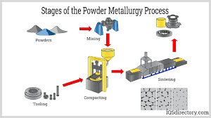
Powder Metallurgy
The powder metallurgy process consists of mixing elemental or alloy powder, compacting the mixture in a die and then sintering or heating the resultant shape in a controlled atmosphere. Powder metallurgy is a highly developed method of manufacturing ferrous and nonferrous materials.
This process is cost effective in producing simple or complex part in manufacturing (Production) rates which can range from a few hundreds to several thousands parts per hour. Due to high cost of die and equipment this process is suitable for mass production only. The basic steps involved in the production process are given below.
• Preparation of powder or powders of desired composition.
• Mixing and blending – Powder are mixed thoroughly and blended to ensure desired property.
• Compacting the powders into desired shape and size and providing strength to the parts.
• Sintering – Green compacts are heated at elevated temperature to impart strength.

Slide 28
ADVANTAGE OF POWDER METALLURGY | Limitation of Powder Metallurgy
Parts with closed dimensional tolerance (nearest shape) and good surface finish can be produced. | The cost of material in powder form is quite high this cost is offset for Large volume production by absence of scrap and low labor cost.
It eliminate or minimizes scrap losses by more than 97% of the raw material in the finished part, unlike other process. | Products with intricate design are difficult to produce as there is little flow of metal powder during compaction.
Process can be fully automated hence unskilled labor can be employed which reduces labor cost. | The residual porosity left in sintered parts makes then rough.
It eliminate or minimizes machining. | This process is economically feasible for Large volume production due to high cost of dies & equip
It facilitates manufacture of certain parts by mixing different metals, metals and non metals, metals and ceramics etc. to obtain desired properties which is impossible with other | Producing parts of Large size and weight is quite expensive due to costly dies. • Parts produce by powder metallurgy have low impact and fatigue strength as compared to other method
High production rates from 500-1000 parts/hour can be achieved. It facilitates manufactures of small and unique shape part which cannot be produce by any other manufacturing process. | The density of compact may not be uniform throughout the components.

Slide 29
APPLICATION OF POWDER METALLURGY
The application of powder metallurgy components fall in two main groups
First are component that are difficult to manufacture by other method such as those made from tungsten, Molybdenum and tungsten carbide.
The second group consists of components that offer a cost effective alternatives to machined components, casting and forging.
Some applications are as follows-
• Used to produce porous parts e.g filters.
• Some components of tungsten employed in jet engines are made by powder metallurgy.
• Auto mobile components such as clutch plates, connecting rods, cam shafts and piston rings etc.
• Many types of hard and soft magnetic components.
• Grinding wheels are manufactured by using steel and diamond powder.
• Nozzle for rockets and missiles are made using silver infiltrated tungsten.
• It is used to produce complex shaped parts which require machining when produced by other methods e.g. gears.
• Electrical bushes for motors are made by combining metallic and non metallic material.
• Some parts used in clocks, type writers, calculators, permanent magnet etc. are made by powder metallurgy

Slide 30
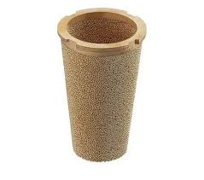
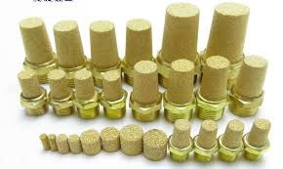
Indian standards on Bronze Powders
Bronze Powder for Metallic Filters
Bronze powder is used to make metallic filters because it can be sintered into a porous structure that's strong and stable, and that allows fluids and gases to pass through while capturing unwanted particles
The powder is placed in a mold and heated to fuse the particles together at a temperature below the melting point of bronze. This process gives the filter its characteristic shape and properties
The sintered bronze has the strength, form, and stability of a bronze component.
Bronze filters are often used for filtering liquids or gases. They can be customized, are relatively inexpensive, and are resistant to temperature and high pressure. They also have a low-pressure drop and produce precise filtration.
On the other hand, bronze powders are also used to produce sintered filters or bearings, for example. These are highly resistant to corrosion due to the choice of material. Bronze is always an alloy with at least 60% copper and the remaining tin content.

Slide 31
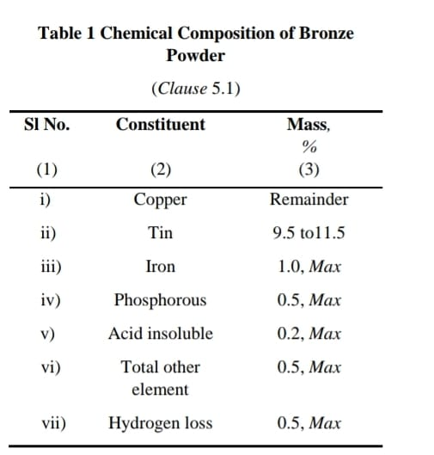
Indian standards on Bronze Powders
IS 10035:2023 - Title : Bronze Powder for Metallic Filters
This standard covers the requirements of bronze powder for use in the manufacture of metallic filters and its Physical Properties Like
Apparent Density: The apparent density of the powder when determined in accordance with IS 4848 shall be not less than 4.0 g/cm3 .
Flow Rate: Flow rate shall be as agreed to between the purchaser and the manufacturer. It shall be determined in accordance with IS 4840.
Particles Shape Particle shape shall be spherical or near spherical.
In the powder metallurgical industry bronze powder is used for the manufacture of metallic filters. The powder may be produced by several methods like atomization, solid state diffusion, electro less plating of copper by tin, etc. Physical properties of the powder vary depending on method of manufacture. However, for manufacture of metallic filters, atomized powder is the most popular. The uniformity of shape (spherical) of atomized powder ensures uniformity of shape and size of pores in the sintered filter.

Slide 32
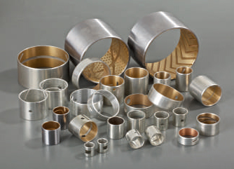
Indian Standards for Leaded Bronze Powders
Lead Bronze Powder are used for manufacturing of Metal & Bimetal – Bronze Bearings –
Composite bimetal bushing bearing is one kind of oil-free lubrication bearing, the product is based on high quality low carbon steel backing, surface sintering lead-tin bronze alloy, by several times high temperature sintering and dense rolling of copper, steel one bimetal strip rolled. It has high bearing capacity, impact resistance, high temperature resistance, self-lubricating ability and other characteristics, especially for heavy load, low speed, reciprocating or oscillating and other difficult to lubricate and form oil film occasions, but also not afraid of water and other acid corrosion and erosion.
Composite bimetal bearings have the advantages of good wear resistance, especially suitable for medium-speed medium load and low-speed high load and other occasions. Through special technology, various oil grooves, oil cavities and oil holes can be machined on the friction surface to adapt to the use of different lubrication conditions. The products are mainly used in heavy vehicle balance axle bushings and gaskets; automobile engines, chassis, motorcycle clutches, gear pump rubbers and lifting equipment.
.

Slide 33
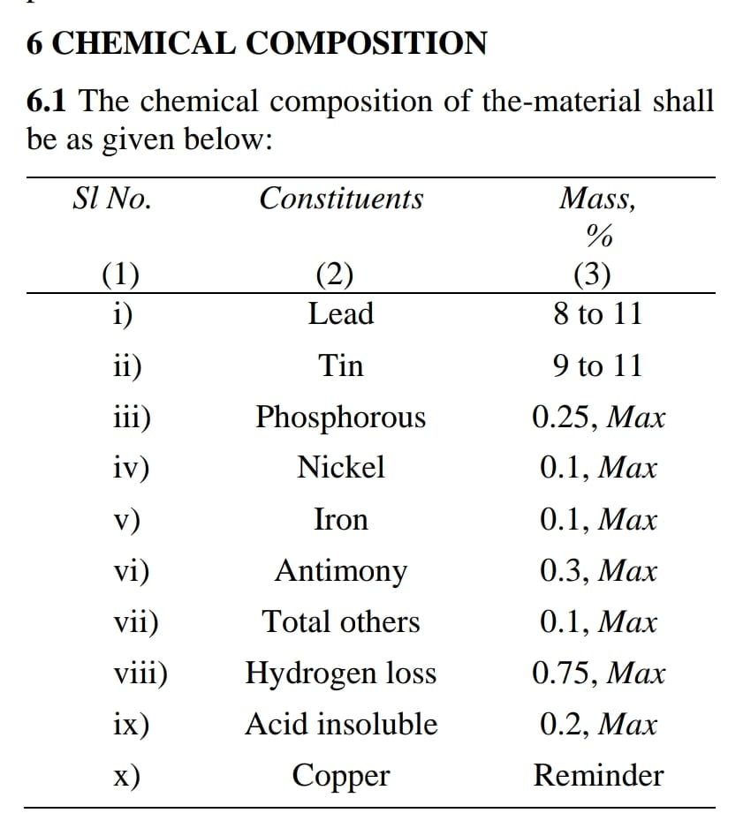
IS 11111 : 2023
Title : Leaded bronze powders - Specification
This standard covers the requirements for leaded bronze alloy powder for use in the manufacture of bimetallic bearings and bushes made by combination of sintering and rolling processes & its various Physical properties like
Apparent Density : The apparent density of the powder when tested in accordance with IS 4848 shall be between 4.0 g/cm3 and 6.0 g/cm3
Flow Rate : The flow rate of powder shall be tested in accordance with IS 4840. The time taken for 50 g of the powder to flow through the orifice shall be less than 25 s.
The chemical analysis of bronze powder shall be done by the methods specified in IS 4027 (relevant parts) or any other established instrumental/chemical method
The hydrogen loss shall be determined as per the procedure given in IS 5644 (Part 2) by reducing the sample at 600 °C ± 10 °C for 10 min in a current of hydrogen.

Slide 34
IS 11111: 1984
TERMINOLOGY
For the purpose of this standard, definitions given in IS 5432: 2022 shall apply.
Few terms from IS 5432 are as follows:
Alloyed powder: metal powder consisting of at least two constituents that are partially or completely alloyed with each other.
Angle of repose: basal angle of a pile formed by a powder when freely poured under specified conditions on to a horizontal surface.
Compressibility: capacity of a powder to be densified under an uniaxially applied pressure.
Dehydrided powder: powder made by removal of hydrogen from metal hydride.

Slide 35

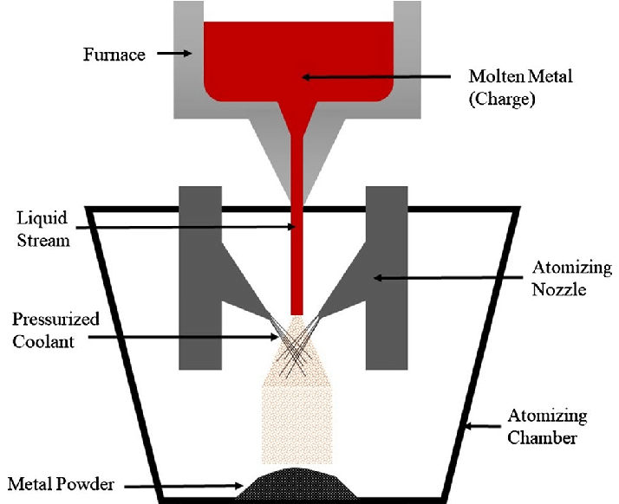
MANUFACTURING
Powder may be manufactured by atomization or any other method. There are four main processes:
Solid-State Reduction
Atomization
Electrolysis
Chemical
CHEMICAL COMPOSITION
Chemical composition of the-material shall be as given below in percentage Mass: Lead (8 to 11), Tin (9 to 11), Phosphorous(0.25 Max), Nickel(0.1 Max), Iron(0.1 Max), Antimony(0.3 Max), Total residual elements(0.1 Max), Hydrogen loss(0.75 Max), Acid insoluble(0.2 Max), Copper (Remainder).
Notes:
Solid-State Reduction: In the furnace, a reaction takes place, reducing the carbon and oxygen from the powder, that leaves a cake of sponge metal which is then crushed, separated from all non-metallic material, and sieved to produce powder.
Electrolysis: By choosing suitable conditions, such as electrolyte composition and concentration, temperature, and current density, many metals can be deposited in a spongy or powdery state.
Chemical: The most common chemical powder treatments involve oxide reduction, precipitation from solutions, and thermal decomposition.

Slide 36

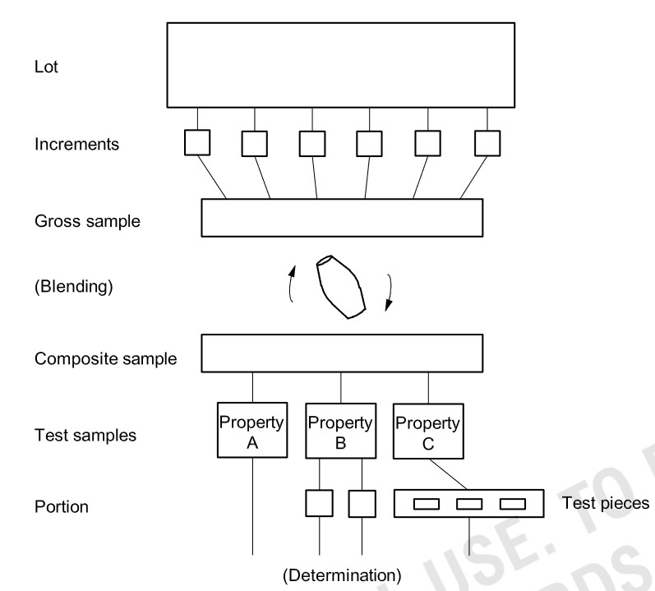
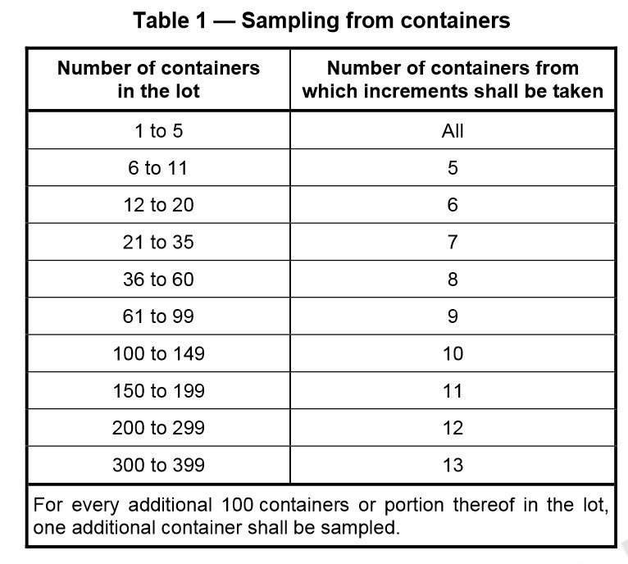
SAMPLING
The sampling of powders for conducting various tests shall be done in accordance with IS 6492.
Scheme of Sampling

Slide 37

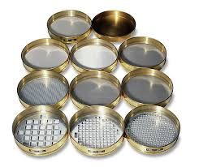

TESTING
Chemical analysis:
  Lead, tin, phosphorous, nickel, iron, antimony and copper content shall be determined in accordance with IS 4027 (Relevant parts) or any other established instrumental/experimental method.
  The hydrogen loss shall be determined as per the procedure given in IS 5644 by reducing the sample at 600 ±10°C for 10 minutes in a current of hydrogen.
Sieve analysis: As agreed to between the purchaser and the manufacturer. However, Test Sieves shall be in accordance with IS 460(relevant parts).

Slide 38

APPARENT DENSITY
The apparent density of the powder when tested in accordance with IS 4848 shall be between 4.0 and 6.0 g/cm³.
FLOW RATE
The flow rate of powder shall be tested in accordance with IS 4840. The time taken for 50 g of the powder to flow through the orifice shall be less than 25 seconds.
PACKING
The material shall be supplied packed in suitable containers in quantities mutually agreed to between the purchaser and the manufacturer.

Slide 39
MARKING
Each container of powder shall be suitably marked with the following information:
Content with process of manufacture ( for example, atomized leaded bronze powder ),
Manufacturer’s name,
Batch number and date of manufacture, and
Net mass of contents.
The container may also be marked with the BIS standard Certification Mark.

Slide 40
Questions
Q How does the manufacturing process affect the properties of leaded bronze powders?
Ans: The manufacturing method, whether it involves atomization, mechanical alloying, or other techniques, influences factors like particle purity, size distribution, shape, and overall quality. Proper control and optimization of the manufacturing process are critical to achieving desired powder characteristics.
Q What are the typical applications for leaded bronze powders?
Ans: Leaded bronze powders find extensive use in various industries such as bi-metal strips for automotive, marine engines, military aircraft bushings, etc. They are often utilized in the production of bearings, bushings, gears, and intricate components requiring a balance of strength, durability, and machinability.
Q What is the apparent density of leaded bronze alloy powder ?
Ans: Apparent density of leaded bronze alloy shall be between 4.0 and 6.0 g/cm3.

Slide 41
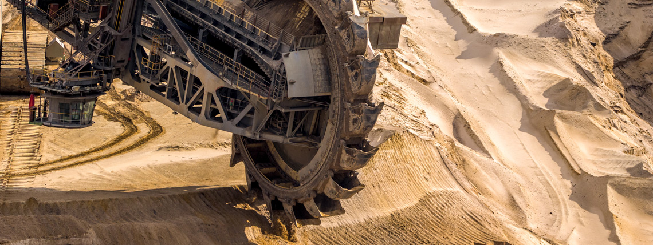
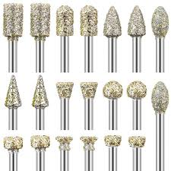
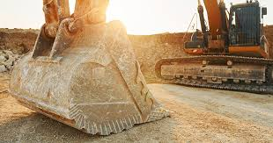
Indian Standards for Cobalt Powders
Cobalt Powder is a versatile material with a range of application across various industries due to its unique properties, some of the unique application are given Below:
Hard facing and wear Resistance: Cobalt based Powder are used in manufacturing of Hard facing materials and coating for Industrial equipment's , such as mining machinery, Drilling Tools because of its excellent Wear resistance and durability.
Super Alloys: Cobalt is the Key Component in the production of High Temp, Corrosion resistant super alloy, these alloys are known for their exceptional strength and heat resistance
Diamond Tool Production: Cobalt Powder is used in the production of diamond tools, such as cutting and Grinding blades, these tools are used in industries like construction , Mining and Metal working
Magnetic Material: Cobalts based magnetic alloys are used in manufacturing of permanent magnets for various application, including electric motor, generator and magnetic sensors.

Slide 42
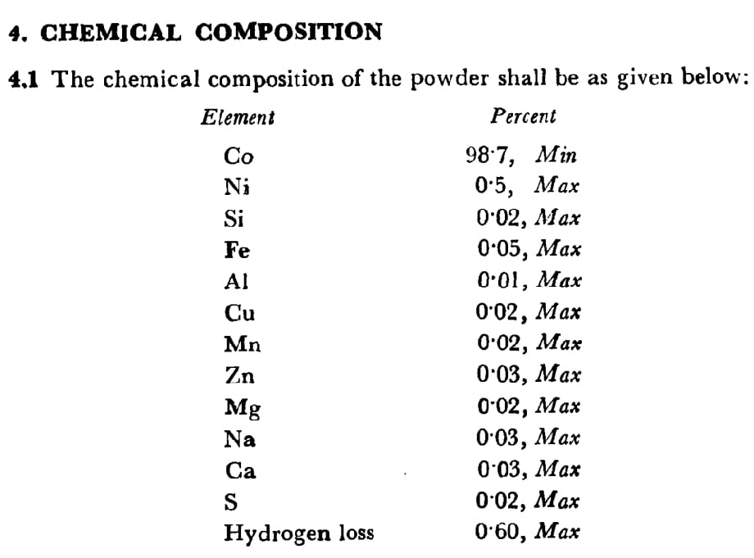
Indian Standards for Cobalt Powder
IS 7505 : 2024 Title : Specification for Cobalt Powder for Hard Metals
This standard covers the requirements of cobalt powder used in the manufacture of Hard metals.
Cobalt powder is used in the manufacture of Hard Metals, which find applications in cutting tool tips, rock drilling bits, wear parts, and dies.
The cobalt powder shall be manufactured by hydrogen reduction process.
Hydrogen reduction can be used to produce cobalt powder in a variety of ways, including
Scrap cobalt is mechanically milled and chemically leached to produce aqueous cobalt salts, which are then precipitated as cobalt hydroxide (Co(OH)2). The cobalt hydroxide is then reduced to produce high-purity cobalt powder.
Cobaltous sulfate solution is reduced using hydrogen at high temperatures and pressures. Sodium hydroxide solution is added at a rate that doesn't exceed the rate of sulfuric acid generation.
The average particle size shall be determined in accordance with IS : 7512-1974f and shall be within 1 to 3 pm.

Slide 43
Indian Standards for Tin Powders
Tin (Sn) Powder is a versatile metallic substance, Known for its unique properties such as high electrical conductivity and excellent solderability, this powder has become privotal in various industries.
From electronics to metallurgy, tin powder's applications are vast, often used in optoelectronics, device manufacturing and as a catalyst. Its attributes combined with its cost-effectiveness, position it as a material of keen interest in ongoing research and commercial applications.
Tin(Sn) Powder is used in chemical industry for various application such as production of chemical and is used a reducing agent, used in Powder based additives to improve the properties such as thermal and electrical conductivity, it is also used in thin-film Photo voltaic devices,
Sn Powder is used in the production of tin cans and other food packaging materials due to its non toxic properties and resistance to corrosion, ensuring the safety and longevity of the packaged food products.
Tin powders are used as coating material for various metal surface providing corrosion resistance and enhancing their appearance and protect them from rust and other form of corrosion

Slide 44
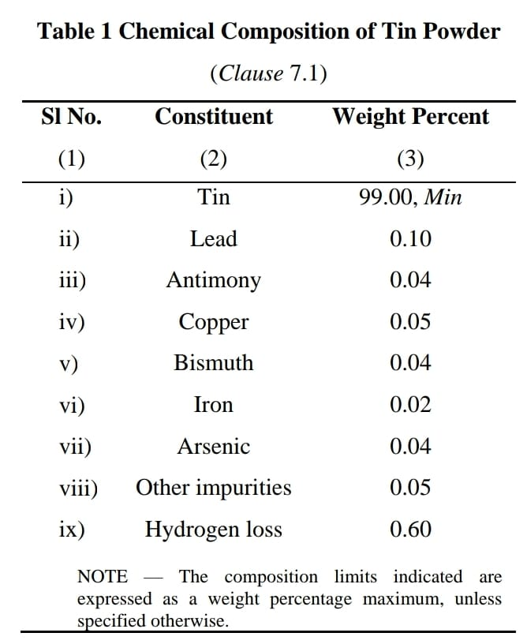
Indian Standards for Tin powder,
IS 8367 : 2023 Title : TIN POWDER - SPECIFICATION
This standard covers the requirements for granular tin powders for powder metallurgical applications.
Tin powder may be manufactured from ingots conforming to IS 26.
There are four grades and maximum particle size for each grade when determined in accordance with IS 5461 shall be as follows:
Grade A 180 micron
Grade B 125 micron
Grade C 90 micron
Grade D 75 micron
The requirements of particle size other than specified above shall be subject to mutual agreement between the purchaser and the manufacturer.
PHYSICAL PROPERTIES
Apparent Density : apparent density for all the grades of powder shall be at least 2.7 g/cm3 but not more than 4.2 g/cm3 .
The apparent density shall be determined in accordance with IS 4848.
Flow Rate : The flow rate shall be as agreed to between the purchaser and the manufacturer.

Slide 45
Indian standard on Methods for determining flow rate of powders
IS 4840 : 2022
ISO 4490:2018
Metallic powders Determination of flow rate by means of a calibrated funnel Hall flow meter
Impact: This test measures the flow rate of metallic Powder, by means of a calibrated funnel (Hall flowmeter) which is important for understanding and to achieve better manufacturing efficiency and product quality in powder processing industries, a predictable powder flow is of greater importance to avoid capacity shortfall and production interruption that involve costly loss of production time.
IS 17074 : 2023
ISO 13517: 2020
Metallic powders Determination of flow rate by means of a calibrated funnel Gustavsson flowmeter
Impact: This standard outlines the method for determining flow rate of fine powder under 40 micron , including powders for hard metals and mixes of metallic powders and organic additives such as lubricants, by means of a calibrated funnel (Gustavsson flowmeter). The method is applicable only to powders which flow freely through the specified test orifice. Measurement of the time required for 50 g of a metallic powder to flow through the orifice of a calibrated funnel of standardized dimensions
IS 11960 : 2023
Metallographic Determination of Apparent Porosity
and Uncombined Carbon in Hard Metals
Impact: The apparent porosity evaluates the internal Bond strength of powder ultimately tells about how compact the product is , apparent porosity is the amount of empty space in a material, or porosity, that's application-based and depends on how the part will be used. The amount of porosity can be controlled by processing conditions like compaction pressure, sintering temperature, and sintering time.

Slide 46
Indian standard on Test methods for determination of Apparent porosity
IS 11960 : 2023 - Title : Metallographic Determination of Apparent Porosity
and Uncombined Carbon in Hard Metals
This standard specifies the procedure for the metallographic determination of the presence, type and distribution of porosity and uncombined carbon in Hardmetals.
Apparatus
Metallographic Optical Microscope or Scanning Electron Microscope (SEM)
Characterization of Porosity and CarbonGraphite) Defects For porosity and carbon defects, the test-piece section shall be prepared as for metallographic examination and (the surface to be examined shall be free from grinding and polishing marks.
Characterisation of Eta-Phase Etching is necessary to reveal eta-phase particles , Eta-phase is metal carbide (usually M6C or M12C, where M is a combination of Co and W

Slide 47
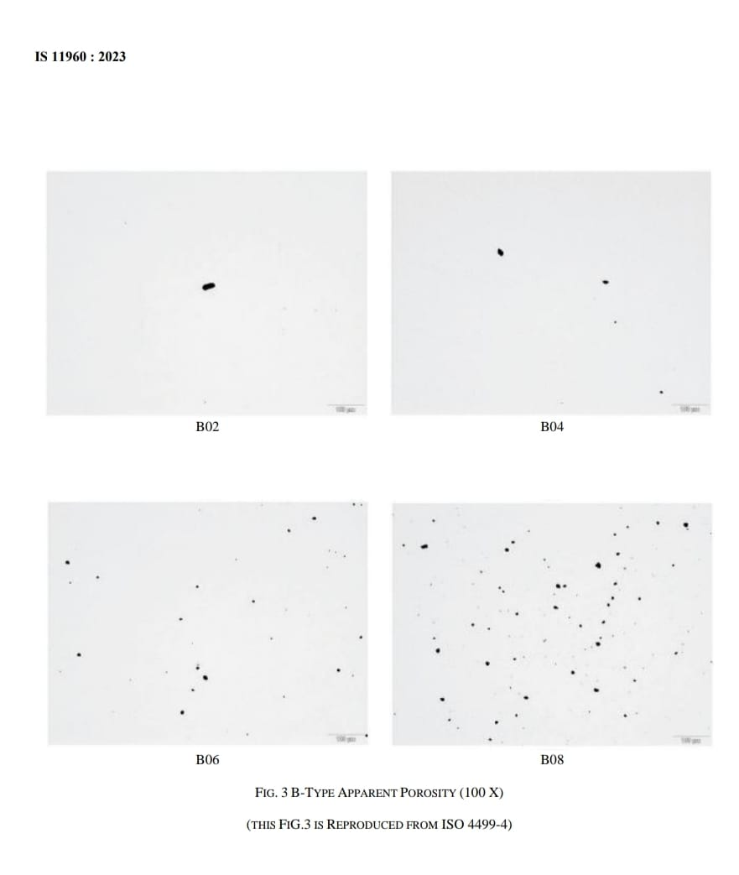
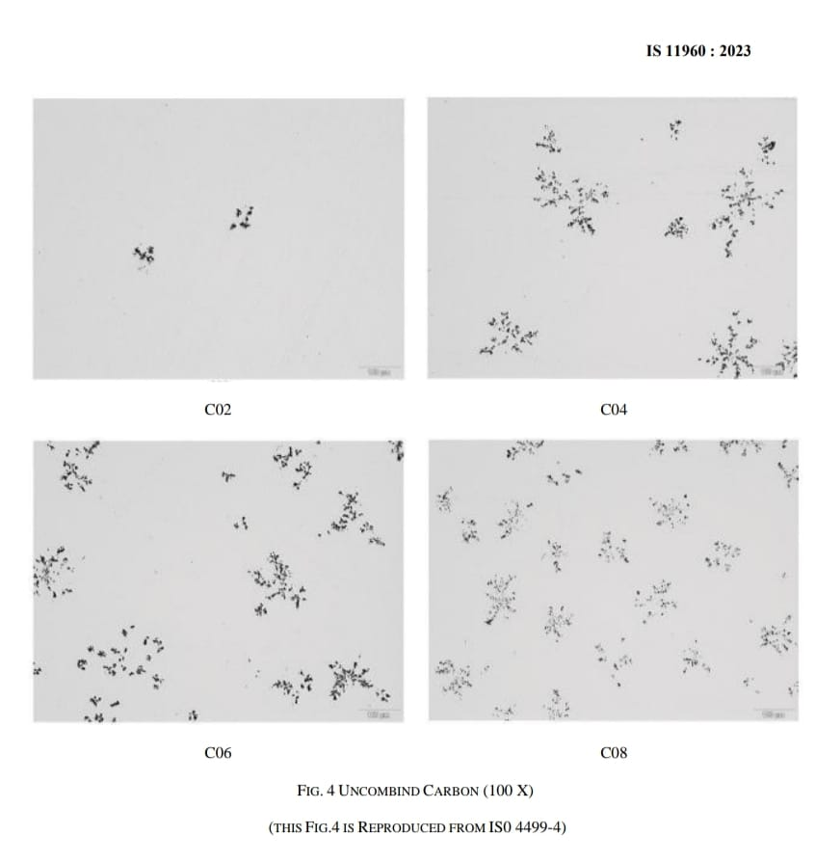

Slide 48
IS 11520: 1985
TYPES OF ETCHING
Chemical Etching: Chemical etching involves the complete immersion of a prepared sample, usually ground (for macro etching) or fine polished (for micro etching), into an etching fluid (etchant).
Electrolytic Etching: The principle of electrolytic etching is the same as that of chemical etching, except that the specimen is placed as an anode in a galvanic cell, resulting in the removal of material from the specimen surface.

Slide 49

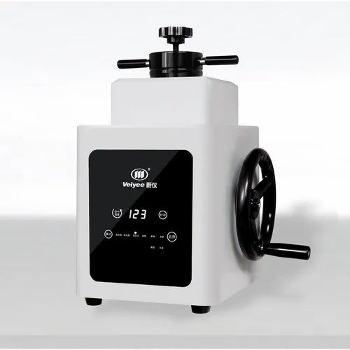
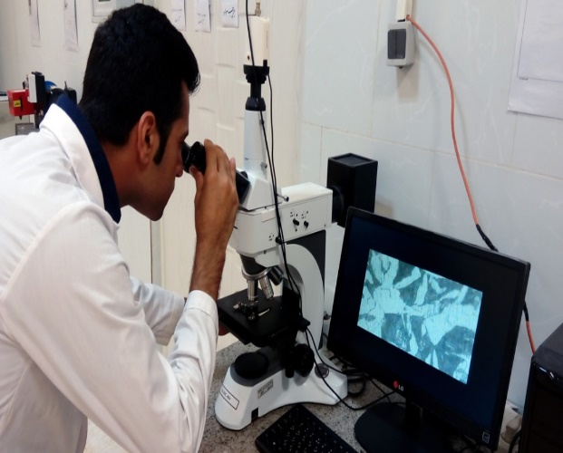
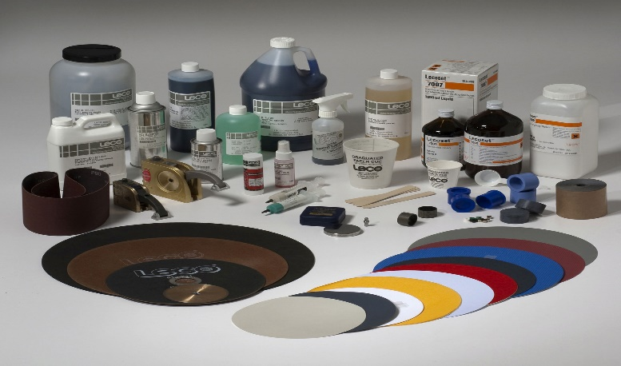
IS 11520: 1985
This standard prescribes a method for preparing hardmetal samples for metallographic examination.
Metallography is the study of the microstructure of all types of metallic alloys. It can be more precisely defined as the scientific discipline of observing and determining the chemical and atomic structure and spatial distribution of the grains, constituents, inclusions or phases in metallic alloys.

Slide 50
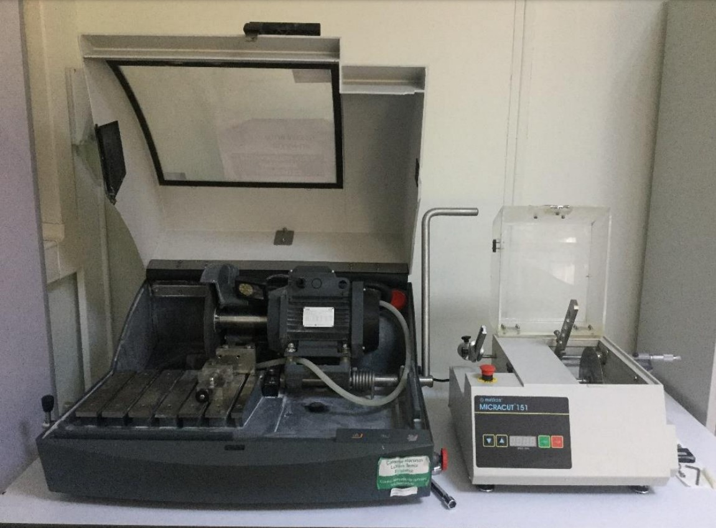
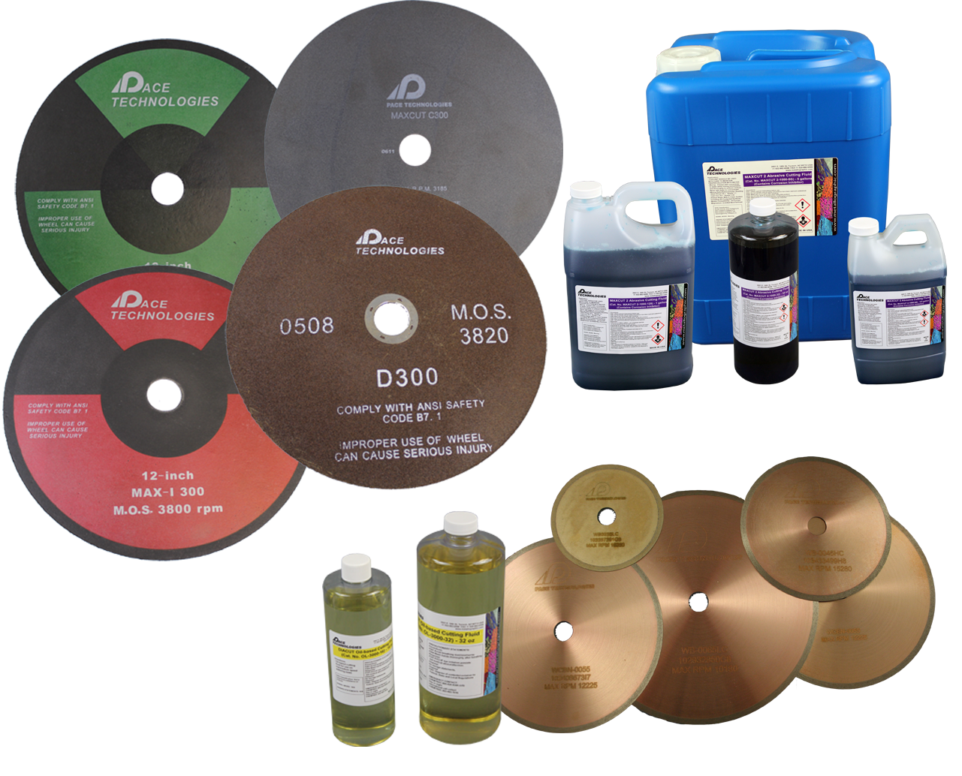
IS 11520: 1985
SELECTION OF SPECIMEN
Hardmetals are very often in the form of relatively small pieces; it is possible to select and mount the entire piece in such a manner as to permit examination of the entire cross section. When pieces are too large, they should be sectioned, using a diamond cut off wheel, to allow viewing as much of a representative cross section as possible
A typical cutting tool equipment used in laboratories
Cutting Consumables

Slide 51
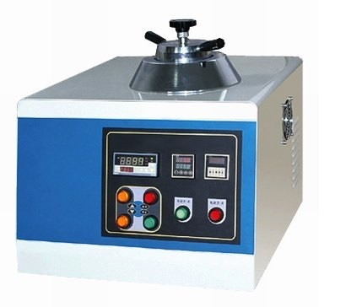
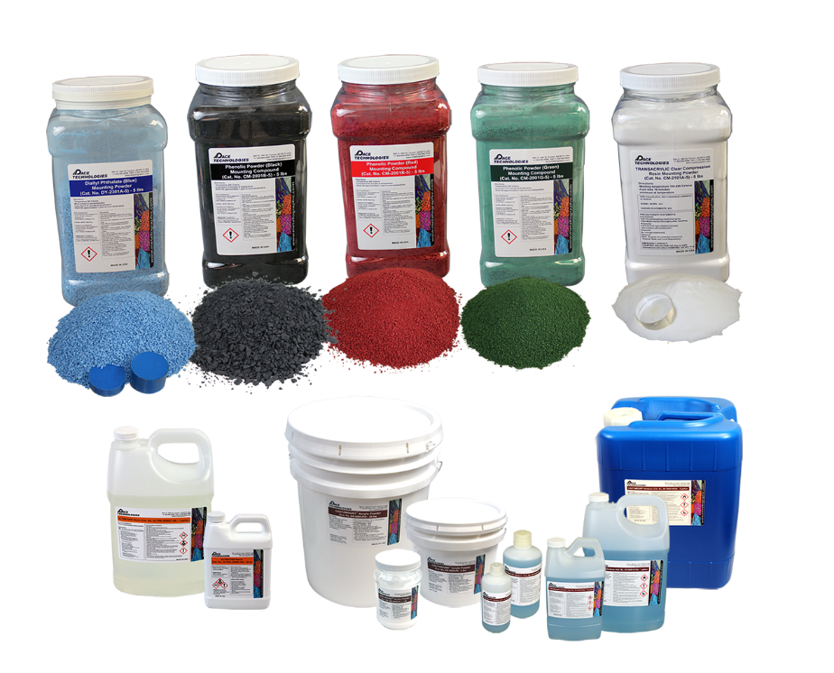
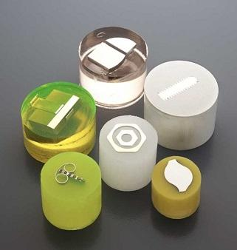
IS 11520: 1985
PREPARATION OF SPECIMEN
There are several method out of which most commonly used is lap operation:
  Mounting: Where possible, specimens should be mounted in a plastic material such as phenol-formaldehyde or poly-methyl methacrylate to facilitate polishing without rounding the edges. Large specimens may be polished without mounting.
Mounting Machine
Mounting Consumables
Mounted Sample

Slide 52
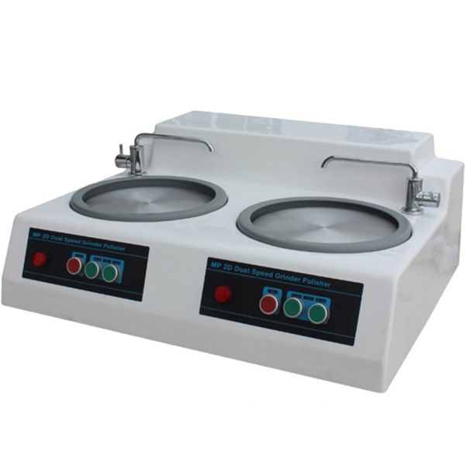
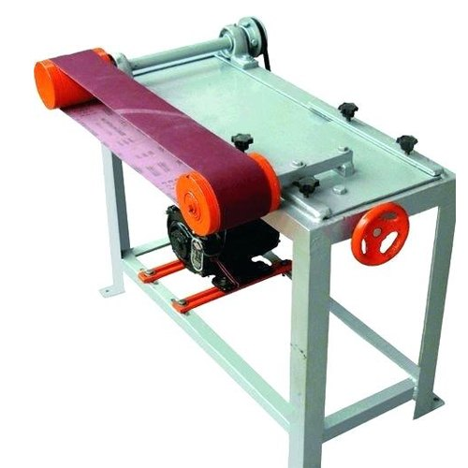
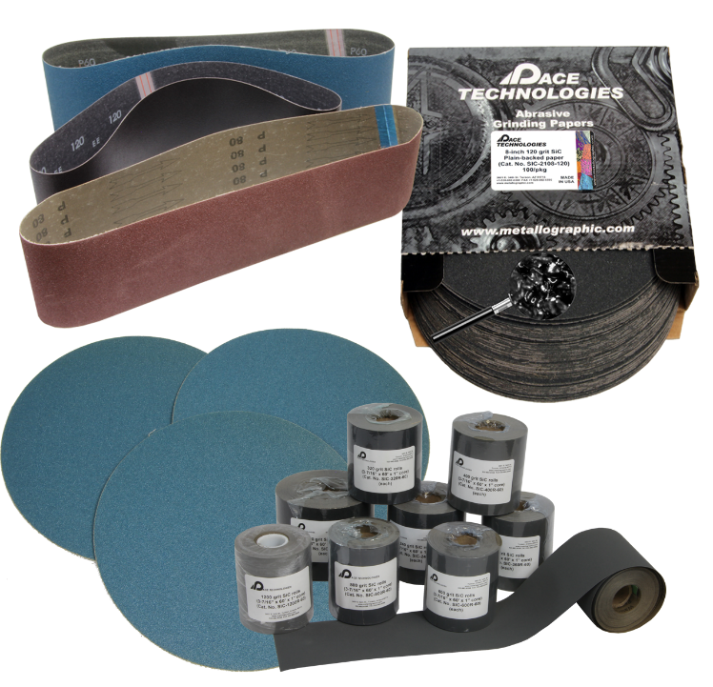
IS 11520: 1985
  Rough Grinding: The surface to be examined may be ground flat on a surface grinder with a resin-bonded diamond wheel ( 100 to 220 grit ) operated at 25 to 28 m/s. After the surface is flat, several clean-up passes are required; the maximum depth of cut is 13 µm per pass and copious amounts of coolant are used.
Typical grinding machines
Apply lubricant to abrasive surface
  Most commonly water
  Water soluble oils for water sensitive specimens
Grinding consumables

Slide 53
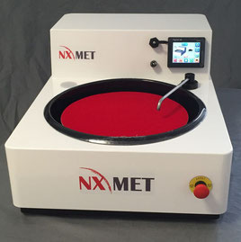

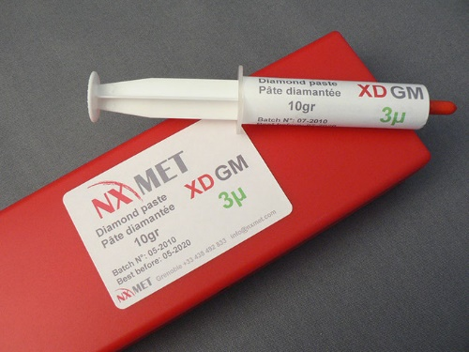
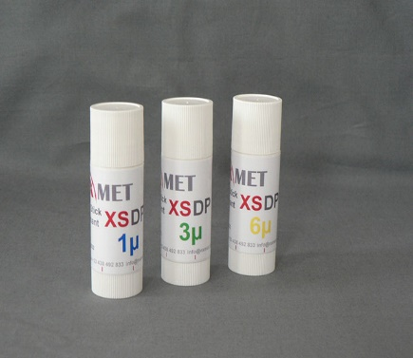

IS 11520: 1985
Polishing: Polishing is done in several steps using diamond powder or paste (15µ to less 2µ) on a synthetic short-napped cloth.
Diamond powder, Monocrystalline/Polycrystalline and Polishing lubricants
Metallographic Polisher
Polishing cloths
Compressed, wowen, flocked, microporous, etc

Slide 54



IS 11520: 1985
ETCHING FOR MICRO EXAMINATION
Should be etched with suitable etchant for a particular period of time and conduct microscopic examination.
Carbon steels
Aluminum and alloys
Copper and alloys

Slide 55
Indian standard on Methods for determination of Density & Apparent Porosity
Impact: This standard outlines the method for determination of the apparent solid density, bulk density, apparent porosity and geometric bulk density of fine ceramics, including all ceramic matrix composites.
IS 17935 : 2022/
ISO 18754 : 2020
Fine Ceramics (advanced ceramics advanced technical ceramics) Determination of density and apparent porosity
Method A: Determination of bulk density, apparent solid density and apparent porosity by liquid displacement (Archimedes' method)
Method B: Determination of bulk density only, by measurement of geometric dimensions and mass.
Apparent Solid Density: (ρa) ratio of the mass of the dry material of a porous body to its apparent solid volume
Bulk Density : (ρb) Ratio of the mass of the dry material of a porous body to its bulk volume
Apparent Porosity: ratio of the total volume of the open pores in a porous body to its bulk volume
Open Pore : pore that is penetrated by an immersion liquid, or that is connected to the atmosphere, either directly or via one another
Bulk Volume : Sum of the respective volumes of the solid material, the open pores (3.1) and the closed pores (3.2) in a porous body

Slide 56
Tests on Hard metals: Generally the Hard metals means higher hardness of the steel material which can be cut, such as alloy steel, die steel. . . etc. Applicable to the cutters with coating, such as: TiAlN, TiN.
Hard metals are used extensively for mounting tools and parts for machining, chipless profiling and abradant attrition.
To determine the quality of the metals, several tests are conducted such as Hardness test, Tensile test, Fatigue test , Creep Rupture Test, Corrosion test, Surface roughness test and many more. These tests offer highly accurate result and help to determine the quality easily.
Hardness Test: Test to determine the resistance a material exhibits to permanent deformation by penetration of another harder material. There are six main hardness tests that can be carried out: Vickers, Rockwell, Brinell, Mohs, Shore and Knoop. Which one to apply depends on the type of material to be tested and the equipment available.
Tensile test: Tensile testing is a destructive test process that provides information about the tensile strength, yield strength, and ductility of the metallic material. It measures the force required to break a composite or plastic specimen and the extent to which the specimen stretches or elongates to that breaking point. Such tests produce stress-strain diagrams used to determine tensile modulus.
Fatigue test: Is a specialized form of mechanical testing that is performed by applying cyclic loading to a test specimen . These tests are used either to generate fatigue life and crack growth data, identify critical locations or demonstrate the safety of a structure that may be susceptible to fatigue.
Creep Rupture Test: Creep. The stress rupture test determines the time necessary to produce failure while the material undergoes constant load at a constant temperature.

Slide 57
Products
  IS 11111: 1984 Specification for leaded bronze powders
  IS 7506 : 1987 Specification for nickel powder
  IS 8368 : 2010 Tungsten carbide powder for hardmetals - Specification
  IS 8370 : 2018 Iron powder for powder metallurgical applications
  IS 15585 : 2018 Sintered metal materials - Specifications

Slide 58
Application of Indian Standards in the field of Powder metallurgy
Overall Impact & Significance
Indian standards enhance the quality and Production of PM related Products
Promotes quality and safety
Supporting education and training,
Integrating with engineering design
Stimulating innovation
Facilitating international collaboration.
Adhering to these standards not only ensures compliance but also fosters continuous improvement and advancement in the field of Powder Metallurgy
Sum Up

Slide 59


