Slide 1
EARTHQUAKE ENGINEERING

Slide 2
Course Name: Introduction to Earthquake Engineering
Characterisation of ground motion, Earthquake intensity and magnitude;
Recording instruments and base line correction;
Predominant period and amplification through soil;
Earthquake spectra for elastic and inelastic systems;
Idealisation of structural systems for low, medium and high rise buildings;
Lateral force evaluation by mode superposition and direct integration;
Reserve energy technique;
Effect of foundation/soil on earthquake response;
Analysis for torsion;
Review of damages during past earthquakes and remedial measures;
Reinforcement detailing for members and joints coupling;
Codal provisions.

Slide 3
Course Name: Analysis and Design for wind and earthquake effects
Earthquake Effects:
Earthquake ground motions;
Analysis of structures: equivalent static analysis, response, and design spectra;
Ductility and energy dissipation capacity;
Response reduction factor;
Capacity design and detailing of reinforced concrete and steel members, joints, connections and building frames.

Slide 4
Contents
General Principles of Earthquake Resistant Design
Basic Seismic Design Standards
Different Lateral Load Resisting Systems

Slide 5
General Principles of Earthquake Resistant Design

Slide 6
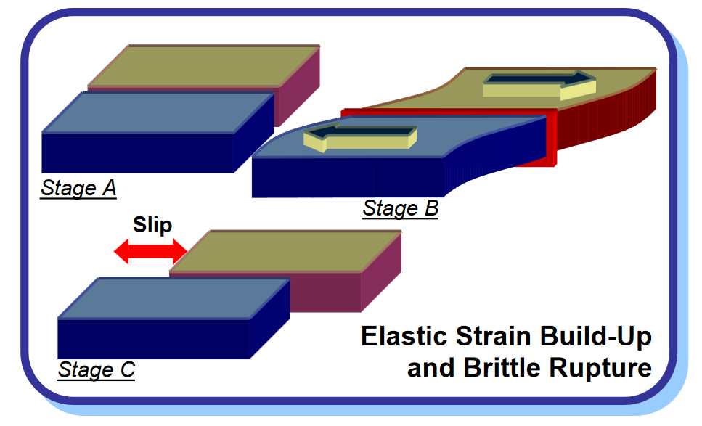
The Earthquake
‘Earthquake’ is that sudden release of large elastic strain energy stored between rock masses.
Splitting of rocks along the faults in the earth OR along the edges of tectonic plates causes earthquakes.
The vibrations traveling through the body of earth are the ‘Seismic Waves’.

Slide 7
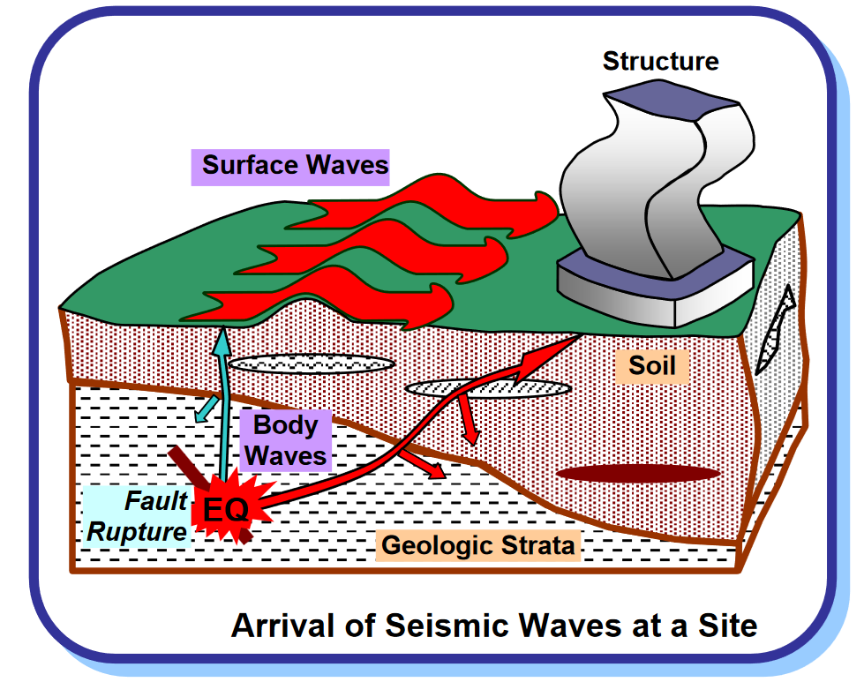
Seismic Waves
During earthquakes, the ground vibrates/moves in all directions, thus random in nature
Seismic waves travel in the body of earth and on the surface of earth

Slide 8
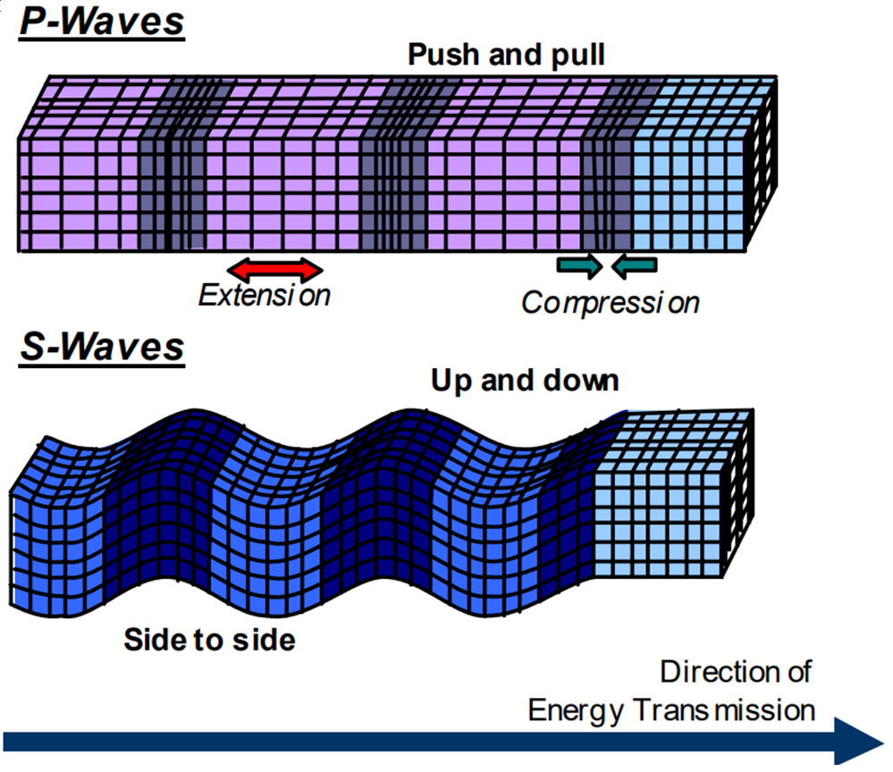
Seismic Waves
Body waves
Primary waves
Secondary waves

Slide 9
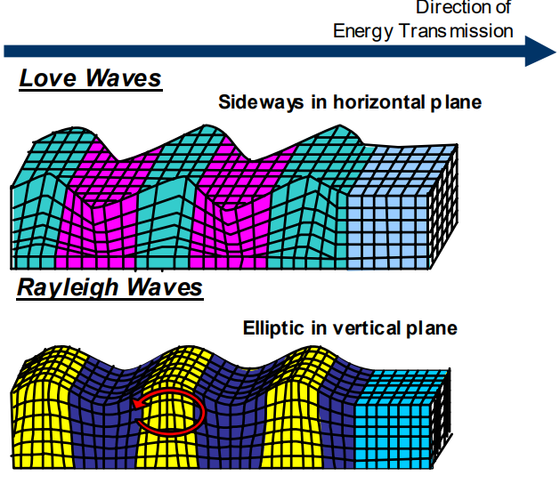
Seismic Waves
Surface waves
Love waves
Rayleigh waves

Slide 10
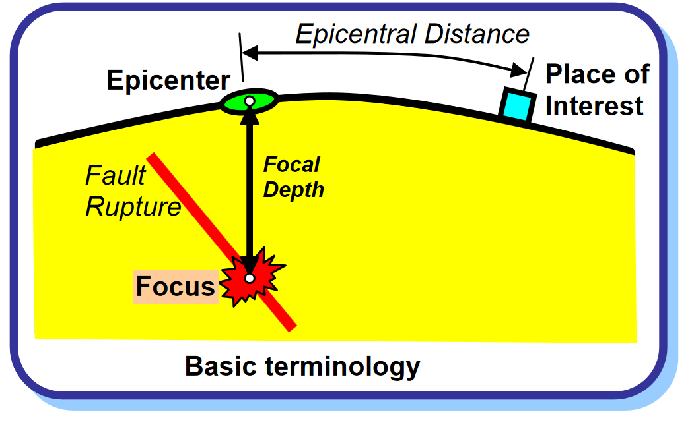
Basic Terms
Focus
Epicentre
Focal depth
Epicentral distance

Slide 11
Terminology
Focus – 'The originating earthquake source' of the elastic waves inside the earth which cause shaking of ground due to earthquake.
Epicentre – Geographical point on the surface of the earth vertically above the point of origin of the earthquake
Defined in IS 1893 (Part 1)

Slide 12
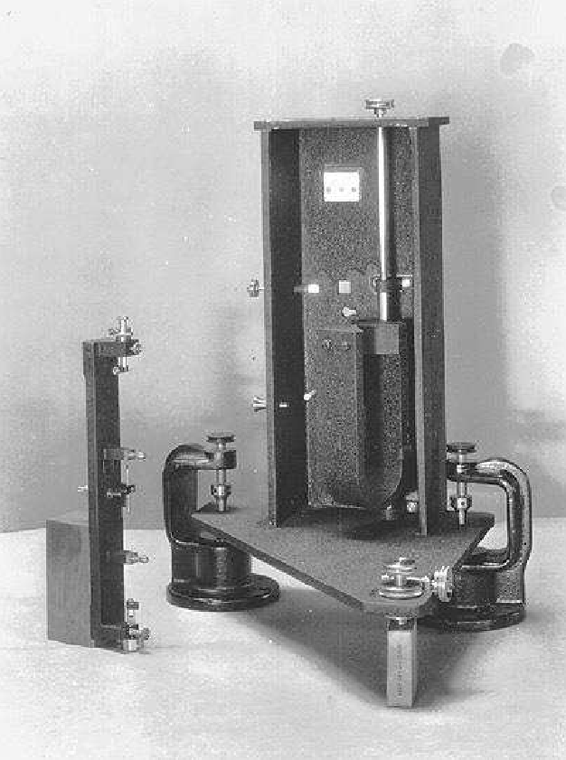
Terminology
Magnitude – Is a number that denotes the measure of energy released in an earthquake
Defined as log to the base 10 of maximum trace amplitude, expressed in microns which, a Standard short-period torsion seismometer (having time period = 0.8 s, magnification = 2800, near critical damping) registers an earthquake at an epicentral distance of 100 km.
Wood-Anderson
Short Period Torsion Seismometer
Defined in IS 1893 (Part 1)

Slide 13
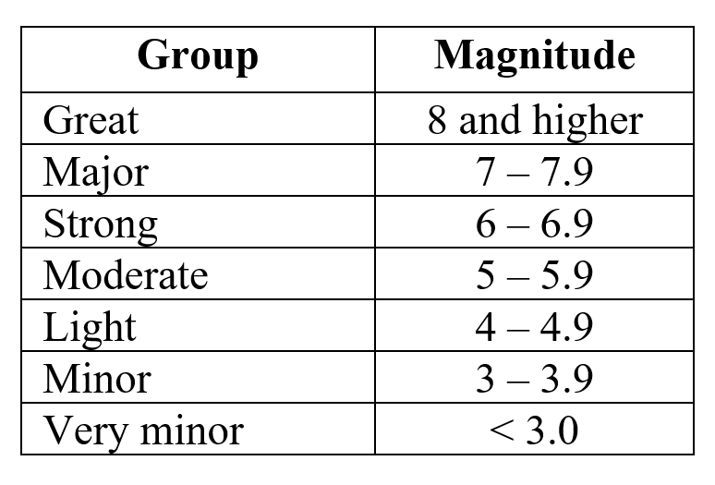
Magnitude – denoted by ‘M’ followed by a numeral
An earthquake is commonly denoted as ‘Strong’ OR
‘Minor’
Increase in magnitude by 1.0 = 10 times higher waveform amplitude
≈ 31 times higher energy released
The energy released in M 7.7 quake ≈ 31 times energy released in M 6.7 quake
≈ 1000 (31*31) times energy released in M 5.7 quake

Slide 14
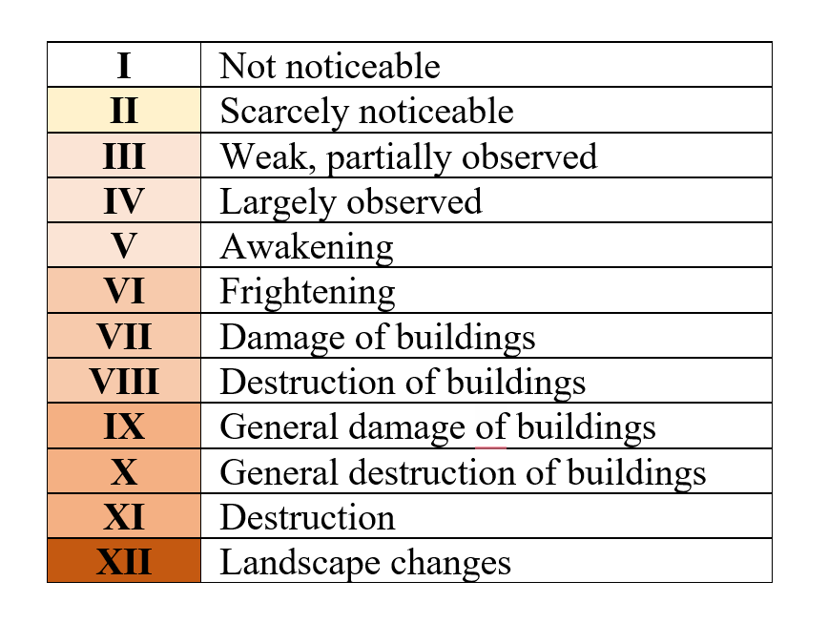
Terminology
Intensity – Measure of the strength of ground shaking manifested at a place during earthquake
Indicated by roman capital numeral on MSK scale
Medvedev–Sponheuer–Karnik (MSK) scale
(Detailed in Annex D of IS 1893)
Defined in IS 1893 (Part 1)

Slide 15
Ground Motions & Use in Design
Motion of the ground can be described in terms of: Displacement, Velocity or Acceleration
During strong earthquakes, the horizontal components of ground movement are more intense than the vertical components
Generally, simultaneous maximum peak movement will not occur
For design purposes, it is assumed that only one horizontal component acts in any one direction, for a given time
In the design of a building or a structure, the self-weight of that building or structure needs to be withstood – this indicates vertical acceleration of ‘1g’ is acting in the entire system’s masses
In most cases, the vertical forces/components due to earthquake are smaller than ‘1g’ acting on the self-weight

Slide 16
Response of Structures to Ground Motions
The response depends on the:
Type of foundation
Materials, form, size and mode of construction
Duration and characteristics of ground motion
The forces for which structures must be designed for, are spelled out in the respective national standards.
In India, the standard is: IS 1893 (Part 1)

Slide 17
Actual forces due to earthquake/ground shaking acting on buildings are significantly higher than the design forces
Yet the buildings and structures perform due to:
Ductility
Over strength
Ductility is achieved through inelastic material behaviour, members (columns, beams, beam-column joints, RC shear walls) have to be designed and detailed
Over strength is achieved through the additional reserve strength in structures (through the inelastic behaviour of structures)
As the maximum possible ductility is limited, the structures are designed for the minimum design lateral forces
Clarified in IS 1893 (Part 1)

Slide 18
Important Design and Construction Codes
Loading codes
- Dead, imposed, wind, snow loads, special loads & combinations
Foundation codes
Concrete code
Steel design code
Masonry design code
Timber design code
Bamboo design code
Glass design code
Earthquake resistant design code
Tall concrete buildings

Slide 19
Basic Seismic Design Standards

Slide 20
Indian Standards on Earthquake Engineering
Sl No. | IS Number | Title | No. of Amd.
1 | IS 1893 : 1984 | Criteria for earthquake resistant design of structures (fourth revision) | 2
2 | *IS 1893 (Part 1) : 2016 | Criteria for earthquake resistant design of structures: Part 1 General provisions and buildings (sixth revision) | 2
3 | *IS 1893 (Part 2) : 2014 | Criteria for earthquake resistant design of structures: Part 2 Liquid retaining tanks (fifth revision) | 1
4 | IS 1893 (Part 3) : 2014 | Criteria for earthquake resistant design of structures: Part 3 Bridges and retaining walls
5 | IS 1893 (Part 4) : 2024 | Criteria for earthquake resistant design of structures: Part 4 Industrial structures including stack-like structures (second revision)
6 | IS 1893 (Part 6) : 2022 | Criteria for earthquake resistant design of structures: Part 6 Base isolated buildings

Slide 21
Indian Standards on Earthquake Engineering
SlNo. | IS Number | Title | No. of Amd.
7 | IS 4326 : 2013 | Earthquake resistant design and construction of buildings ― Code of practice (third revision) | 1
8 | IS 4967 : 1968 | Recommendations for seismic instrumentation for river valley projects
9 | *IS 4991 : 1968 | Criteria for blast resistant design of structures for explosions above ground
10 | IS 6922 : 1973 | Criteria for safety and design of structures subject to underground blasts
11 | IS 13827 : 1993 | Improving earthquake resistance of earthen buildings ― Guidelines | 2
12 | IS 13828 : 1993 | Improving earthquake resistance of low strength masonry buildings ― Guidelines | 3

Slide 22
Indian Standards on Earthquake Engineering
SI No. | IS Number/ DOC Number | Title | No. of Amd.
13 | IS 13920 : 2016 | Ductile design and detailing of reinforced concrete structures subjected to seismic forces ― Code of practice (first revision) | 2
14 | IS 13935 : 2009 | Seismic evaluation, repair and strengthening of masonry buildings ― Guidelines (first revision)
15 | IS 15988 : 2013 | Seismic evaluation and strengthening of existing reinforced concrete buildings ― Guidelines
16 | IS 17848 : 2022 | Confined masonry for earthquake resistance ─ Code of Practice
17 | IS 18168 : 2023 | Earthquake resistant design and detailing of steel buildings — Code of practice
18 | IS 18289 : 2023 | Post-earthquake safety assessment of buildings — Guidelines

Slide 23
Terminology for Earthquake Resistant Design
IS 1893 (Part 1):2016 – Lists the Indian Standard terms relating to ‘Earthquake Engineering’ and the ‘Special terms for Buildings’, such as:
Earthquake Engineering
Damping
Design acceleration spectrum
Design horizontal acceleration coefficient, A_{h}
Importance factor, I
Natural time period, T
Peak ground acceleration
Response reduction factor, R
Response acceleration coefficient of a structure, S_{a}/g
Seismic zone factor, Z
Special Terms for Buildings
Eccentricity, e
Design base shear , V_{b}
Lateral force resisting system
Ordinary moment resisting frame
Special moment resisting frame
Soft storey
Weak storey
Storey drift
Storey shear , V_{i}
Structural wall plan density , ρ_{sw}

Slide 24
Key Provisions of IS 1893 (Part 1)
Seismic zoning map of India
Design spectra up to 6 s fundamental natural period for all types of buildings (steel, concrete)
Load combinations consistent with other loads (no simultaneous EL and severe wind/cyclone)
Requirement for Temporary structures to be designed for earthquake effects
Special requirement for Flat slab structures
Intermediate importance category based on the number of occupants in a building

Slide 25
Key Provisions of IS 1893 (Part 1)
Minimum lateral force that all buildings should be designed for
Plan irregularities and the measures to avoid/overcome
Vertical irregularities and the measures to avoid/overcome
Effects of masonry in-fill walls in structural analysis and design of buildings
Expression for determining the natural frequency of:
Buildings with basements
Step back buildings
Buildings on hilltops
Provisions on effects due to torsion
Evaluation of liquefaction potential (Annex F)

Slide 26
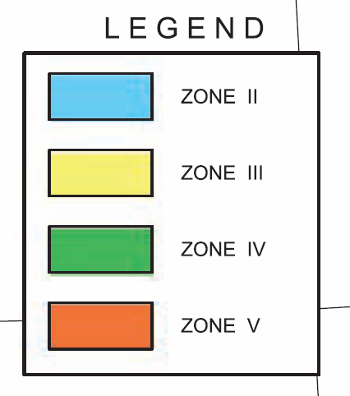
2016 Seismic Zoning Map

Slide 27
Why should the Seismic Zoning Map be used ?
The Seismic Zoning Map in IS 1893 (Part 1) is based on:
various data of past earthquakes,
the intensities observed,
hazard potential,
probabilistic hazard evaluation, etc
Each seismic zone has an associated Zone Factor (a numeric factor used in structural design)
Moreover, this Seismic Zoning Map is included and referred to in the National Building Code of India (NBC) in its Part 6 ‘Structural Design’
NBC in turn is referred to in the local regulations (typically in the Building Byelaws) which are the law of the land

Slide 28
Various factors are to be considered for Earthquake Resistant Design. The key aspects listed in IS 1893 (Part 1) are:
Additions to existing structures
Change in occupancy
Load combinations
Design acceleration spectrum (based on soil type)
Increase in net bearing pressure; skin friction
Seismic zone factor
Equivalent static method of analysis
Dynamic analysis method (response spectrum & time history method)
Cracked moment of inertia
Building and structures located underground
Project-specific design acceleration spectrum

Slide 29
The other aspects listed in IS 1893 (Part 1) are:
Robust structural configuration (plan & vertical irregularities)
Minimum elastic lateral stiffness
Minimum lateral strength
Adequate ductility
Minimum lateral force
Importance factor
Response reduction factor
Damping ratio
Imposed load in earthquake force calculation
RC frame buildings with unreinforced masonry in fills
RC frame buildings with open stories
Separation between adjacent units
Vertical projection & horizontal projections

Slide 30
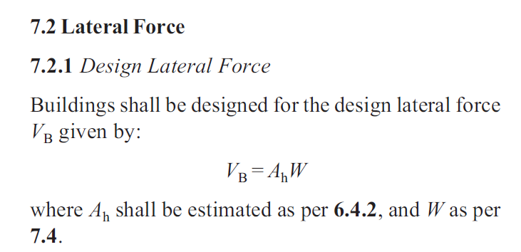
Any building should be designed for a minimum lateral load (in addition to the various load combinations) as given in cl 7.2 reproduced below:
Defined in IS 1893 (Part 1)

Slide 31
If a building is NOT designed for the lateral load (V_{B}), it is bound to fail as explained in this example

Slide 32
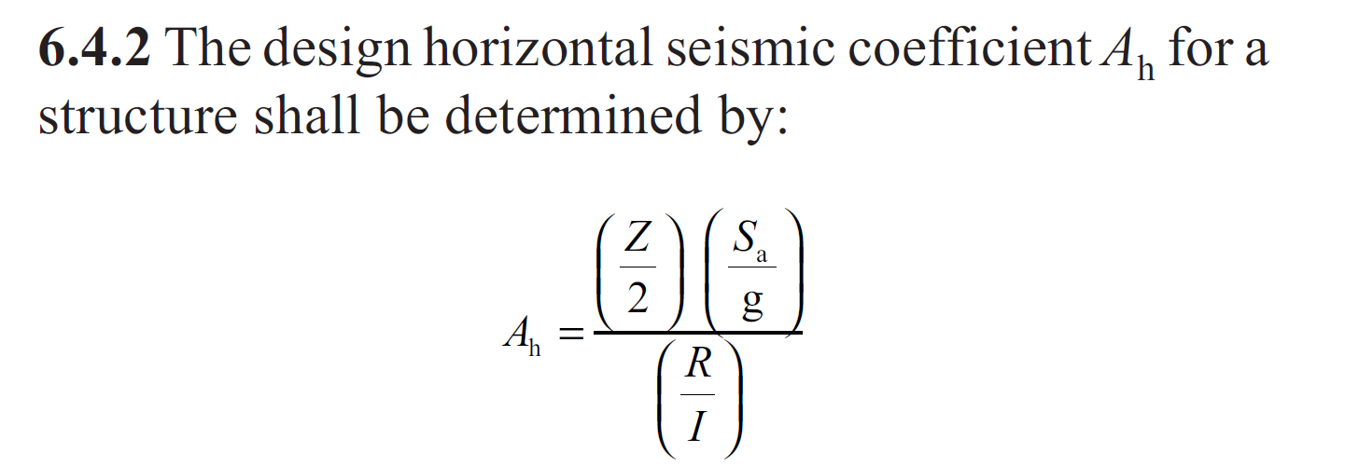
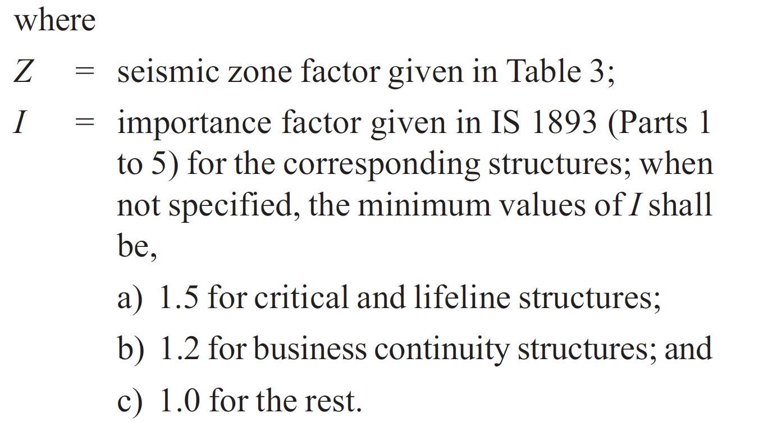
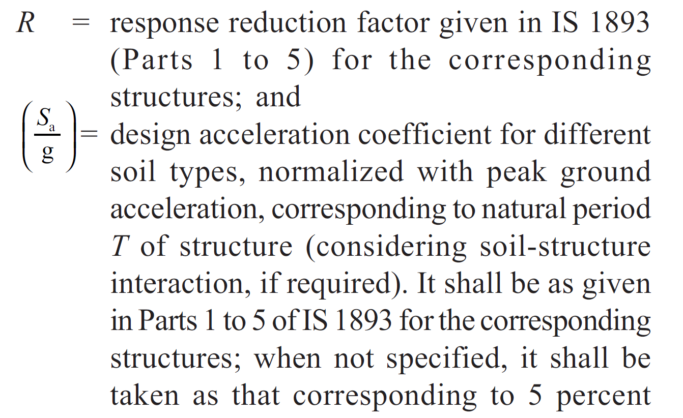
Defined in IS 1893 (Part 1)

Slide 33
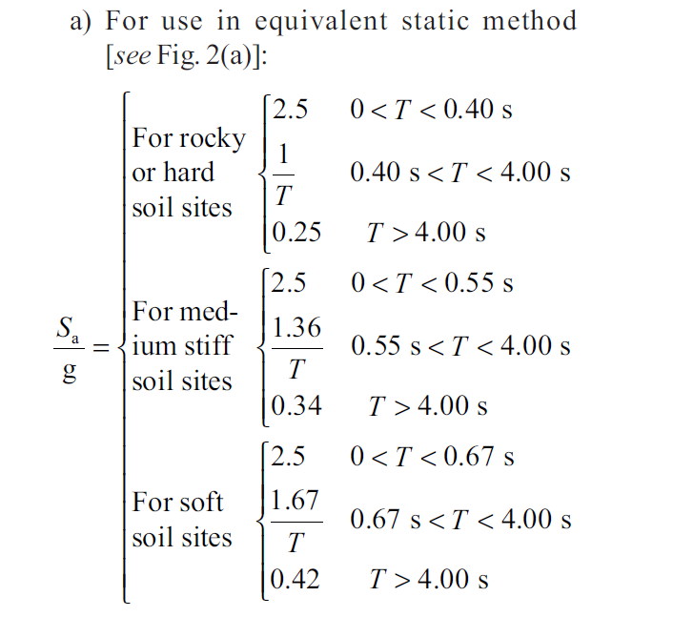
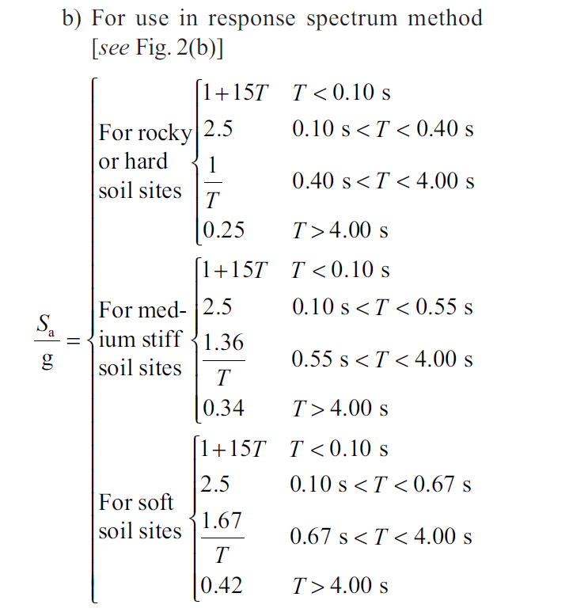
Defined in IS 1893 (Part 1)

Slide 34
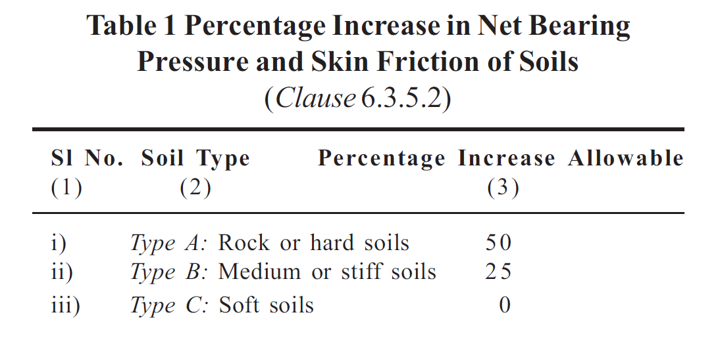
Settlement of foundation due to earthquake has significant effects. But, in soils where settlement is NOT SIGNIFICANT, bearing pressure needs to be increased for earthquakes; and this avoids undesirable differential settlement that can occur prior to an earthquake
Defined in IS 1893 (Part 1)

Slide 35
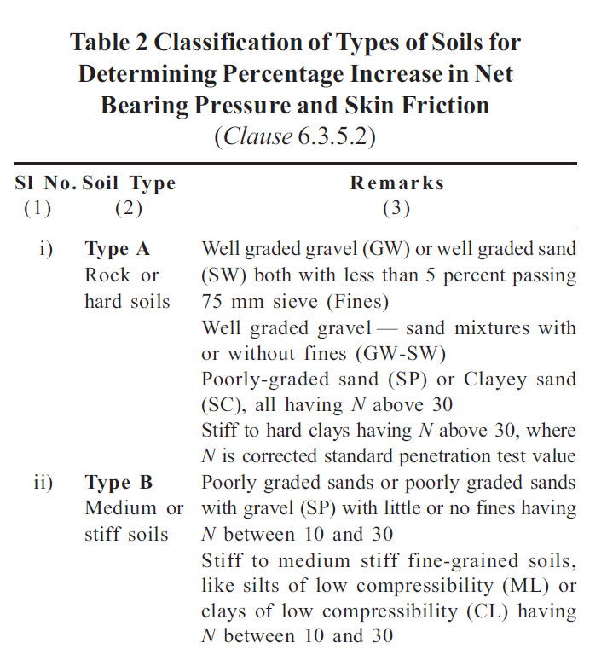
Defined in IS 1893 (Part 1)

Slide 36
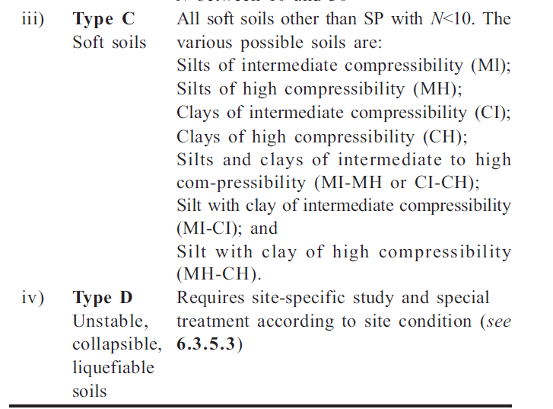
Defined in IS 1893 (Part 1)

Slide 37
Why should the Soil Bearing Pressure be determined ?
Bearing pressure provides the load-carrying capacity of the soil
Indian Standard IS 1892:2021 has established the code of practice for subsurface investigation for foundations
Indian Standard IS 6403 suggests the procedure for bearing capacity (of shallow foundation)
The bearing capacity values obtained from these standard methods are in turn used in the seismic design as per IS 1893
The building byelaws through NBC (its Part 6 Structural Design & Part 2 Administration) also solicits the sub-surface investigation reports prepared by a Geotechnical Engineer that the Structural Engineer uses in the design

Slide 38
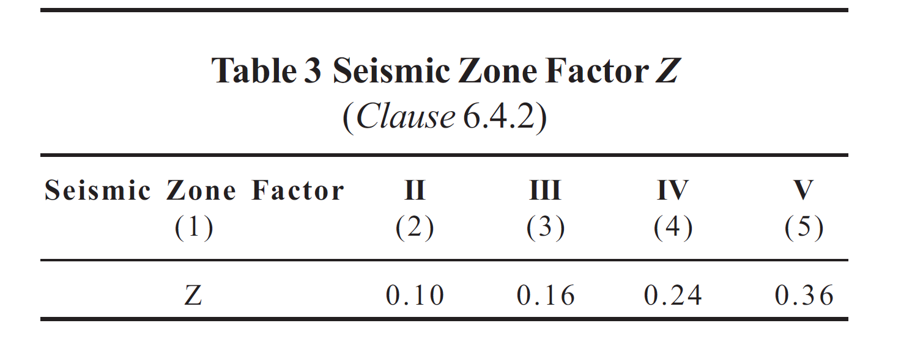
Based on the Seismic Zoning Map of India
Defined in IS 1893 (Part 1)

Slide 39
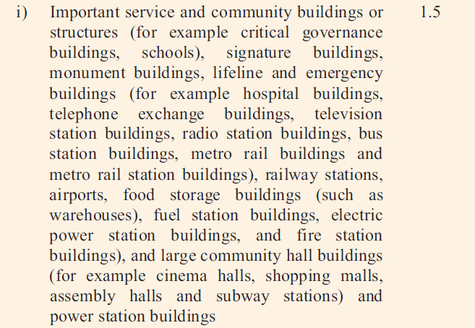
Defined in IS 1893 (Part 1)

Slide 40
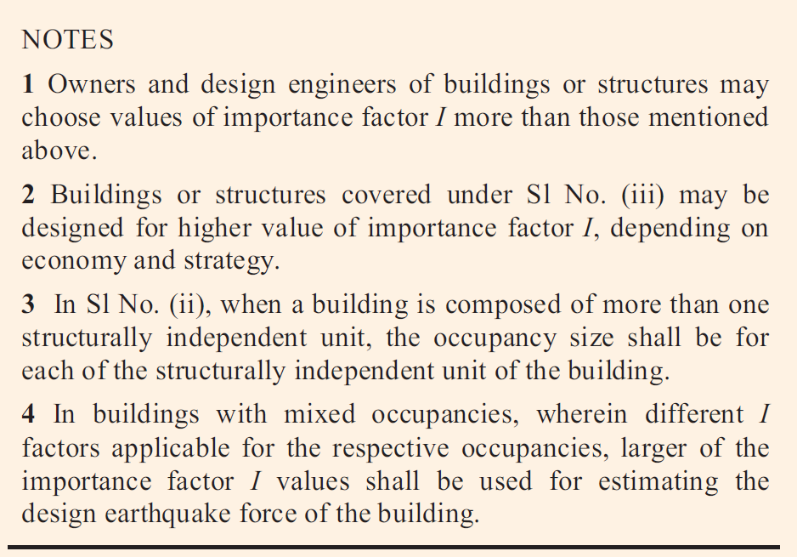
Defined in IS 1893 (Part 1)

Slide 41
Why use this Importance Factor (I) ?
Post-earthquake, buildings and structures DO NOT COLLAPSE but CAN get damaged locally which takes time to repair and requires the occupants to vacate the premises for a brief time (say a few months).
Thus, IS 1893 (Part 1) suggests this importance factor by taking considerations like:
Functional use of a building OR a structure
Consequences of failure of that building OR structure
Post-earthquake functional needs
Historical value
Economic importance
Structural Engineers should discuss with the Owner of a building/structure and are encouraged to take a higher Importance factor

Slide 42
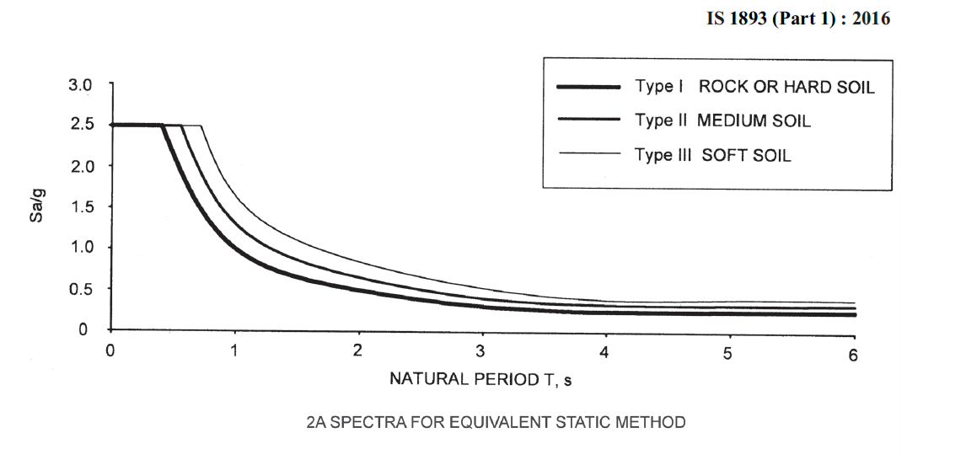
Defined in IS 1893 (Part 1)

Slide 43
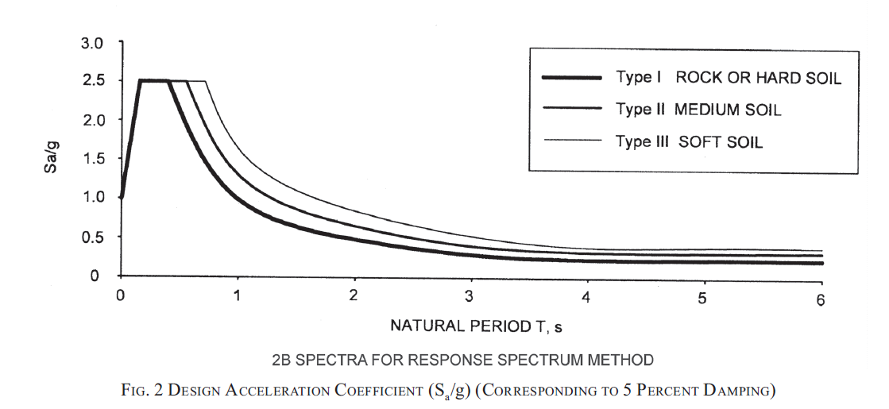
Defined in IS 1893 (Part 1)

Slide 44
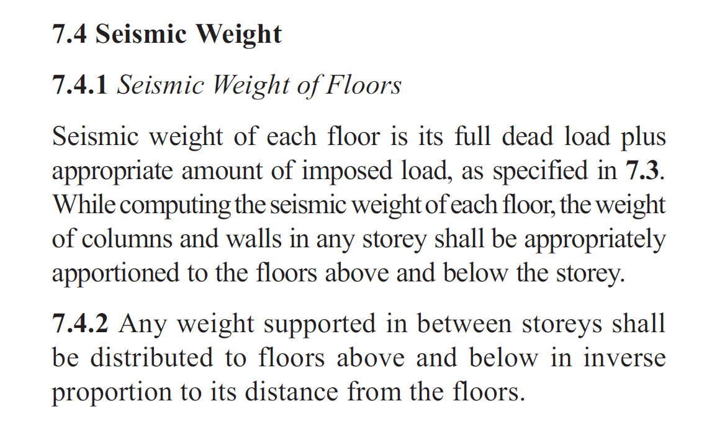
Defined in IS 1893 (Part 1)

Slide 45
The design lateral force V_{B} is to be distributed to various floors depending on the mass on every floor. Two methods are suggested in IS 1893 (Part 1) namely:
Equivalent Static Method – For regular buildings that are less than 15 m in height and located in seismic zone II
Dynamic Analysis Method – For all buildings that are not regular (more than 15 m in height and located in seismic zone II)

Slide 46
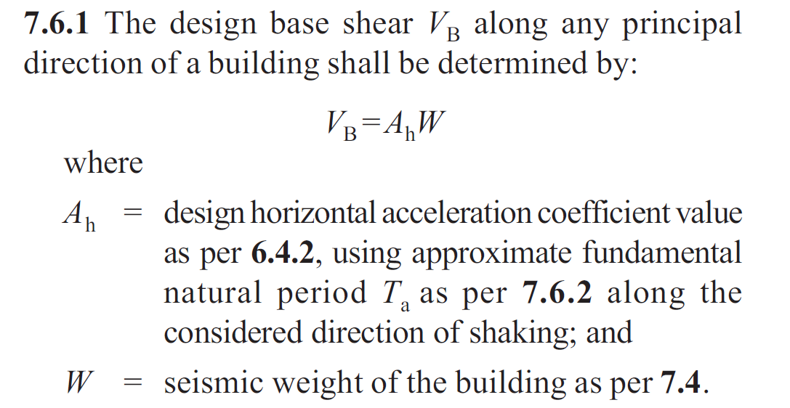
Equivalent Static Method
Defined in IS 1893 (Part 1)

Slide 47
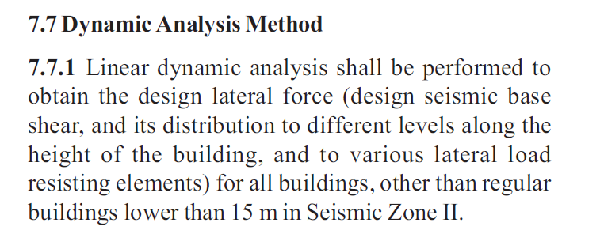
Perform the Dynamic Analysis by:
Time History Method OR
Response Spectrum Method
Defined in IS 1893 (Part 1)

Slide 48
What happens if ‘odd’ building shapes are chosen ?
Improper architectural form and layout of buildings will lead to uneven distribution of mass and stiffness
Such buildings are susceptible to more damage due to earthquakes.
It is BEST to eliminate such irregularities in the buildings OR LIMIT the amount of such irregularities.
IS 1893 (Part 1) defines the following irregularities and also prescribes the permissible limits:
- Plan irregularities
- Vertical irregularities

Slide 49
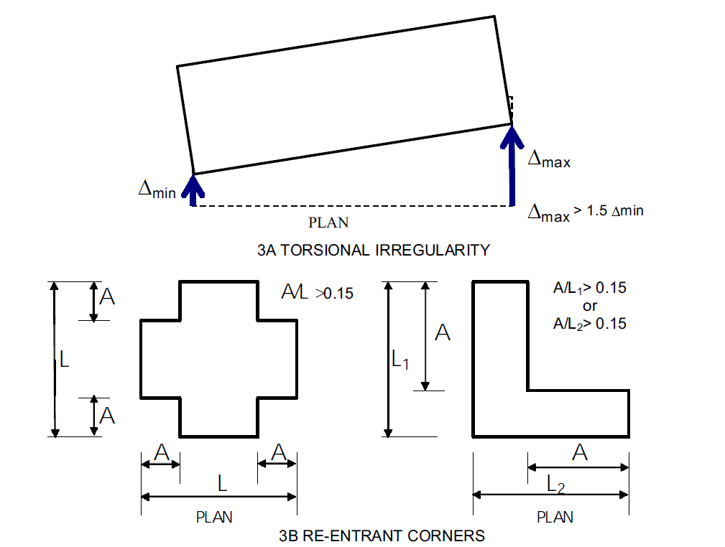
PLAN IRREGULARITIES
Defined in IS 1893 (Part 1)

Slide 50
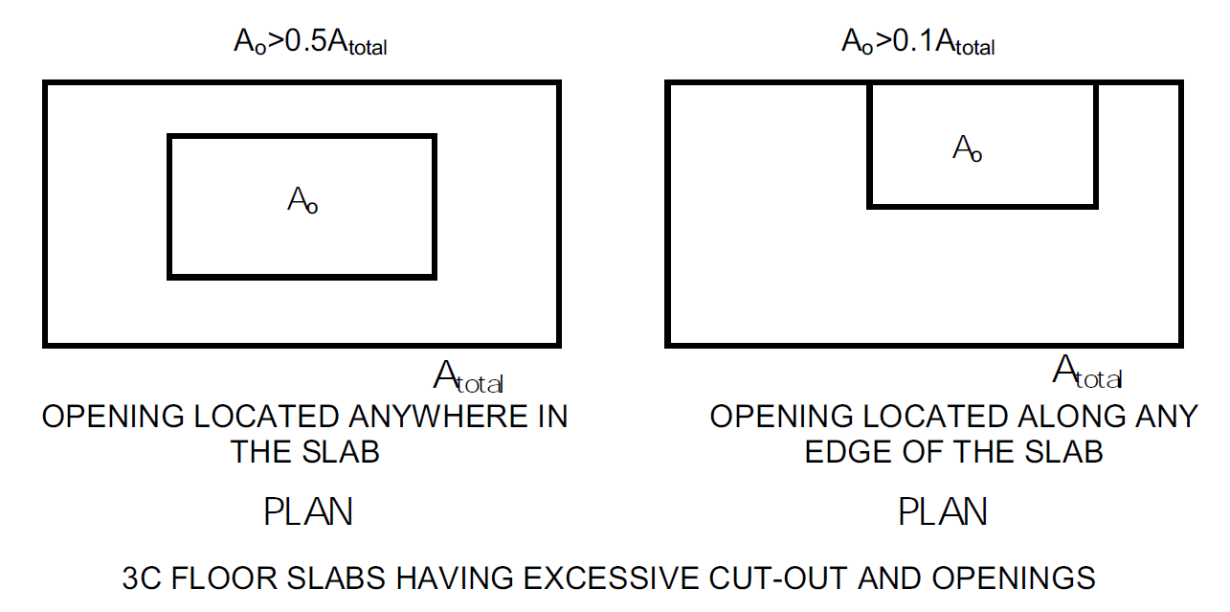
PLAN IRREGULARITIES
Defined in IS 1893 (Part 1)

Slide 51
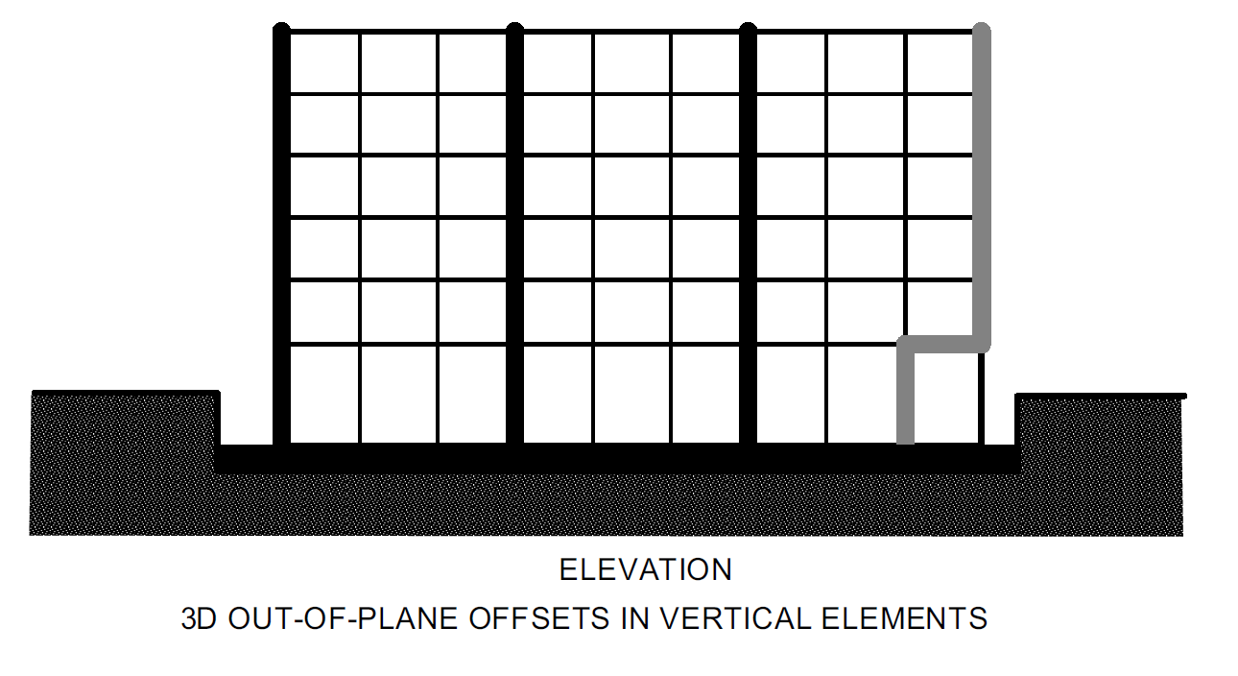
PLAN IRREGULARITIES
Defined in IS 1893 (Part 1)

Slide 52
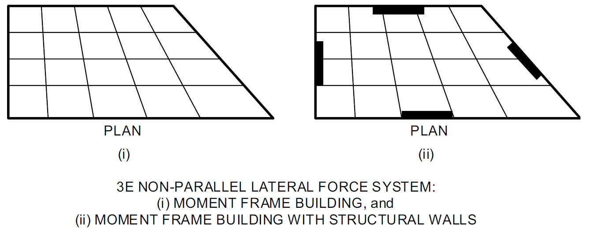
PLAN IRREGULARITIES
Defined in IS 1893 (Part 1)

Slide 53
VERTICAL
IRREGULARITIES
Defined in IS 1893 (Part 1)

Slide 54
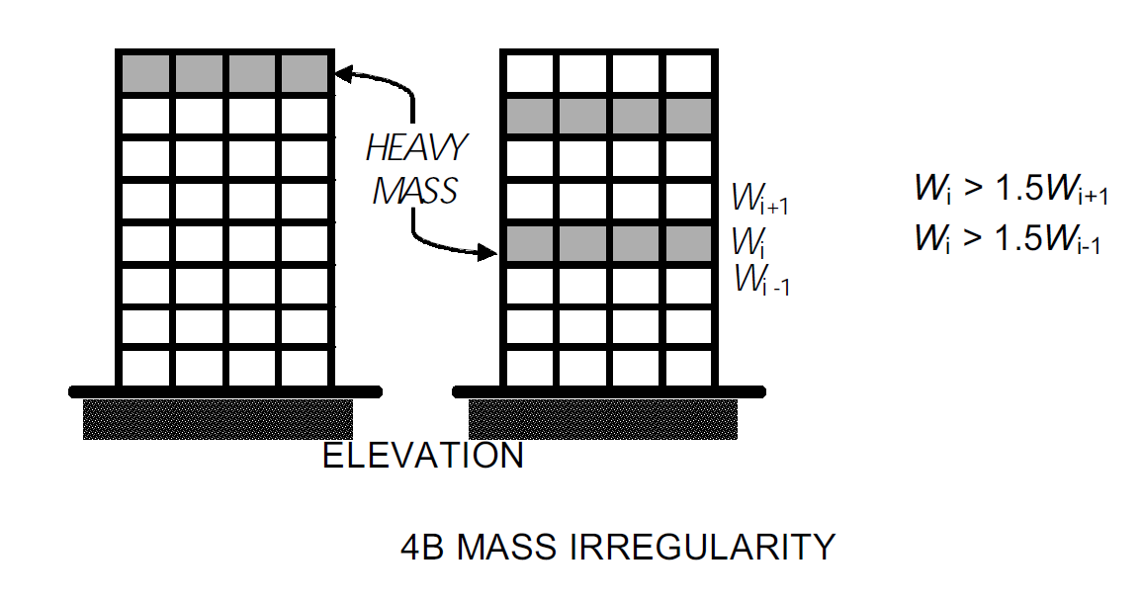
VERTICAL IRREGULARITIES
Defined in IS 1893 (Part 1)

Slide 55
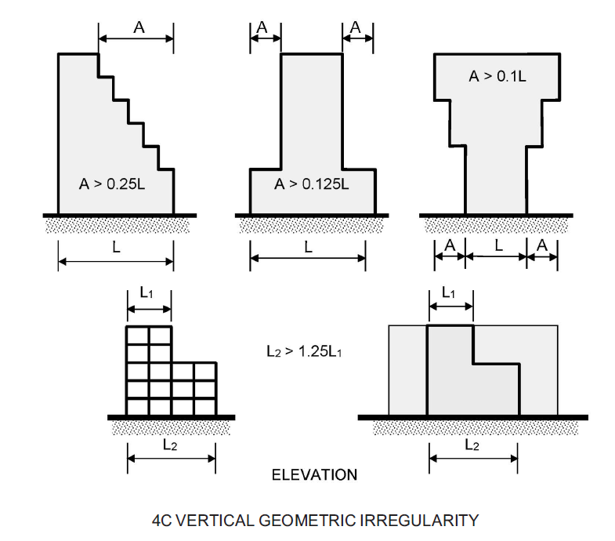
VERTICAL IRREGULARITIES
Defined in IS 1893 (Part 1)

Slide 56
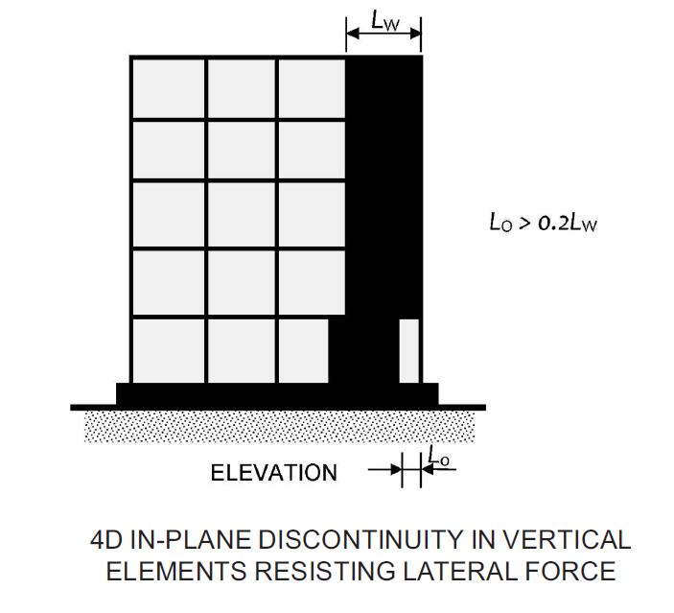
VERTICAL IRREGULARITIES
Defined in IS 1893 (Part 1)

Slide 57
VERTICAL IRREGULARITIES
Defined in IS 1893 (Part 1)

Slide 58
How to achieve an earthquake-safe building (or structure) ?
Achieving the best architectural form, layout, distribution of mass, and stiffness in buildings while ideally good for such buildings (and structures), does not prevent the onset of seismic waves
Designing a building (or a structure) for a certain amount of lateral force is thus pragmatic
IS 1893 (Part 1) specifies that Minimum Design Lateral Force irrespective of the design earthquake forces arrived
Imposed (live) load, snow load, permanent equipment, etc also impact the design seismic force. Guidance on the same is given in IS 1893 (Part 1)
A much better option is through base isolation which is addressed in IS 1893 (Part 6)

Slide 59
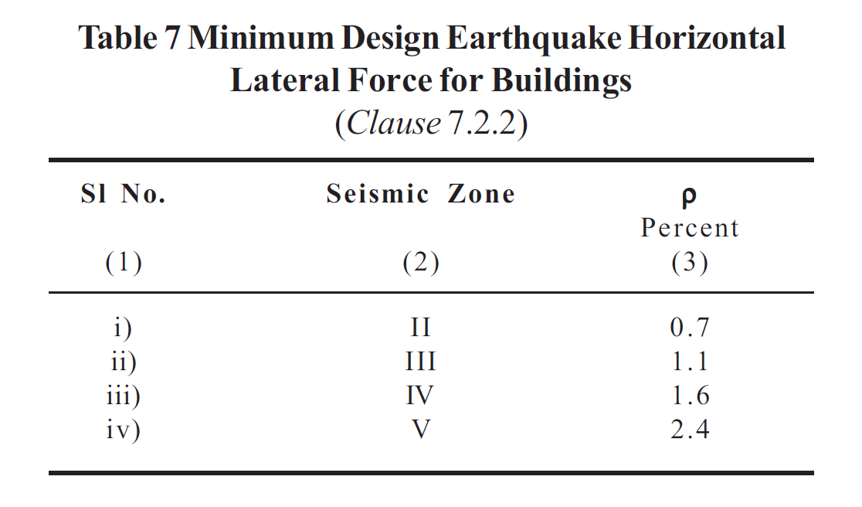
Defined in IS 1893 (Part 1)

Slide 60
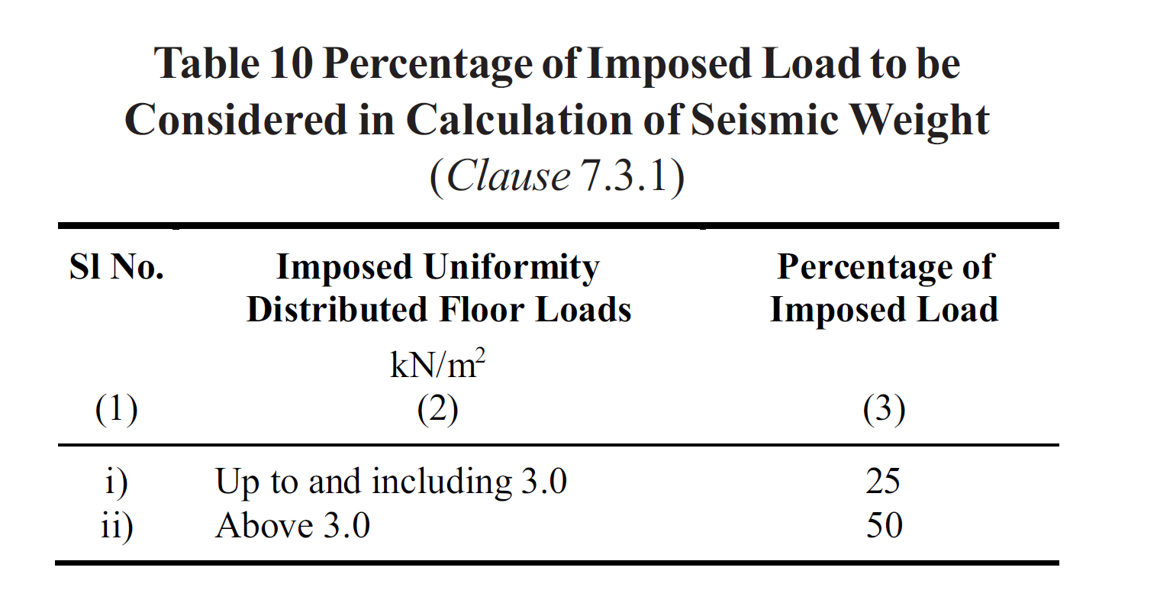
Defined in IS 1893 (Part 1)

Slide 61
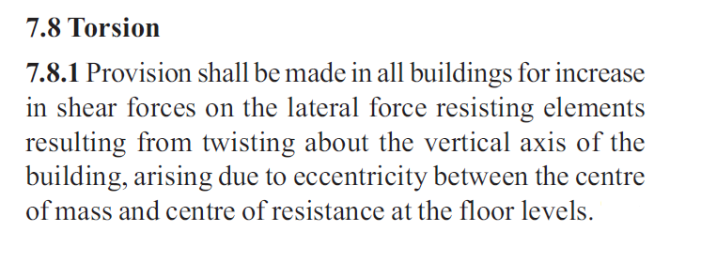
It is generally impractical to obtain the centre of mass and centre of resistance to coincide in buildings and structures.
This leads to Torsion (twisting force).
IS 1893 guides to avoid the effects of Torsion as in clause 7.8
Defined in IS 1893 (Part 1)

Slide 62
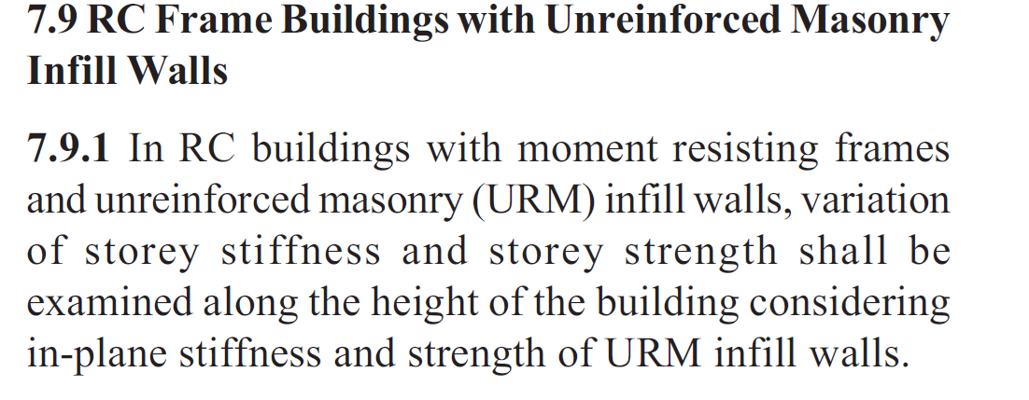
Strong columns and weak beams are good for earthquake-resistant design.
The infill walls (between beams and columns) do take part in the event of an earthquake
IS 1893 guides in this aspect through its clause 7.9
Defined in IS 1893 (Part 1)

Slide 63
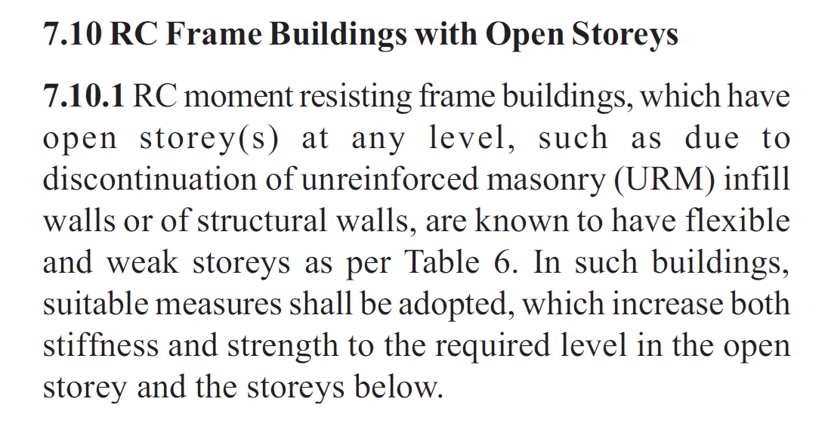
Storey drift < 0.004 times the storey height
Urban Authorities generally solicit car parking features within a plot
In case of a space crunch within the plot, the ground storey OR basement is used for such vehicular parking
Removing 100% of walls in such storeys to aid parking is ‘a recipe for disaster’
IS 1893 (Part 1) guides an engineer in the design of Open Storeys through its clause 7.10
Defined in IS 1893 (Part 1)

Slide 64
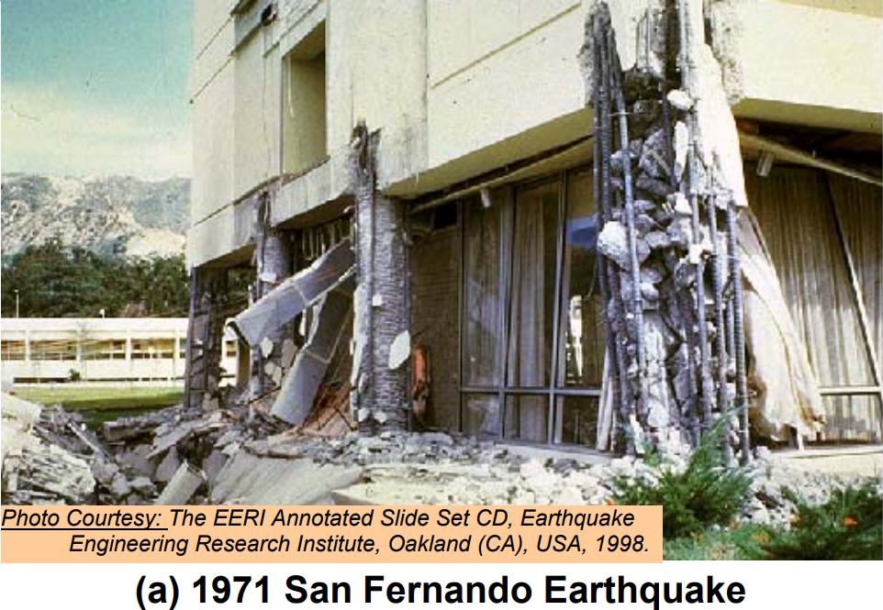
If the open ground storey columns (in the stilt storey) are not designed, failure is bound to happen as in the past

Slide 65
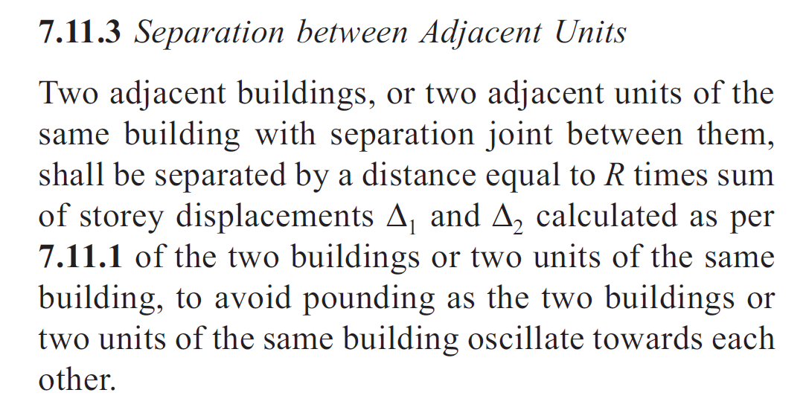
Adjacent buildings vibrate in tandem OR out-of-phase based on their natural frequencies
During out-of-phase vibration, collision takes place (if the buildings are too close)
This phenomenon of ‘Pounding’ can be avoided by following clause 7.11.3 of IS 1893
Defined in IS 1893 (Part 1)

Slide 66
Compound walls are simple cantilevers
Incidences of their failure due to settlement/overturning during rain, are uncommon
Seismic behavior of compound walls is crucial and IS 1893 guides the engineer through its clause 7.12.3
Also, NBC (in its Part 3) defines the height of compound walls and its features in the case of corner plot, and those in schools, hospitals, etc
Defined in IS 1893 (Part 1)

Slide 67
The design earthquake load (lateral load) arrived at using IS 1893 (Part 1) can be carried by structural elements ONLY if they are designed and provided with adequate reinforcement.
This ensures that adequate strength, stiffness and ductility are available within those SELECT STRUCTURAL MEMBERS
The Indian Standard that helps for ductile design and detailing is IS 13920.

Slide 68
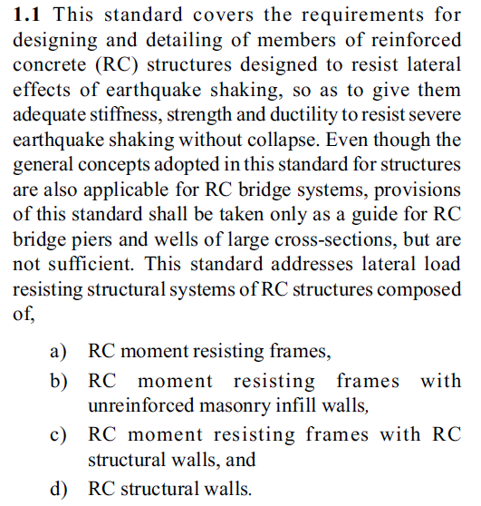
Ductile Design & Detailing IS 13920 : 2016
Mandatory for RC Structures located in
Seismic Zones III, IV & V
Optional for RC Structures located in
Seismic Zone II

Slide 69
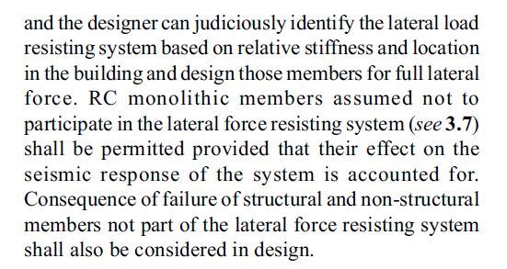
Ductile Design & Detailing IS 13920 : 2016

Slide 70
The minimum grade of concrete and amount of steel in RC elements have to be invariably selected as per the concrete code (IS 456)
However, it is insufficient to opt for this suggestive grade of concrete
For effective performance of the reinforced concrete members to the earthquake effects the strength grade of concrete may have to be better
“Any” steel rebar SHOULD NOT be used by particularly by its brand or claim
Guidance on strength grade vis-à-vis building height and seismic zone is provided in IS 13920 (cl. 5.2)
Also, strength of the steel rebar, elongation, US/YS ratio are crucial; guidance to the same is provided in IS 13920 (cl. 5.3)
Strong column – weak beam concept is emphasized to ensure that only local member failures take place and not a global failure. This is achieved by sizing the columns, beams, shear walls; and detailing them with reinforcement. Guidance is provided in IS 13920.

Slide 71
Design and Detailing of Beams (those are part of the lateral load resisting system)
Minimum width of a beam
Maximum depth of a beam
Size of beam (b/d ratio)
Axial compressive stress in a beam
Width of beam in relation to the size of supporting member (Fig. 1)

Slide 72
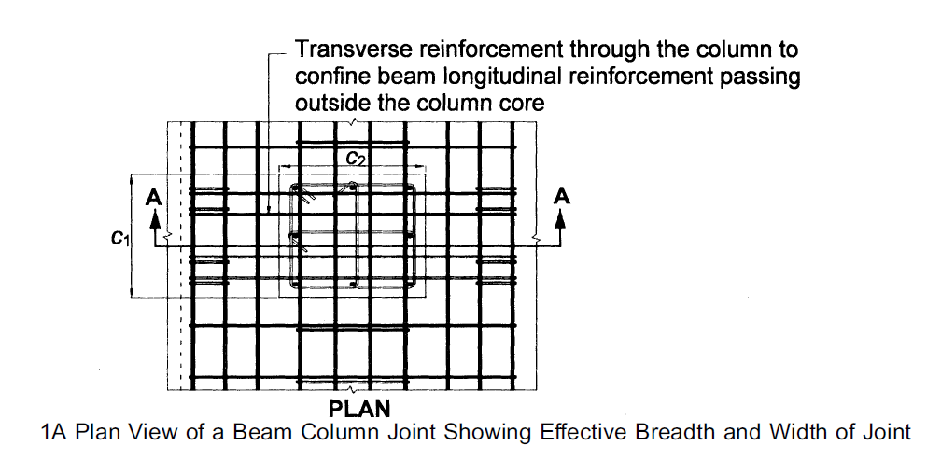
Fig. 1A – IS 13920
Beams wider than the columns need to be effectively tied as in the plan view in Fig. 1A of IS 13920

Slide 73
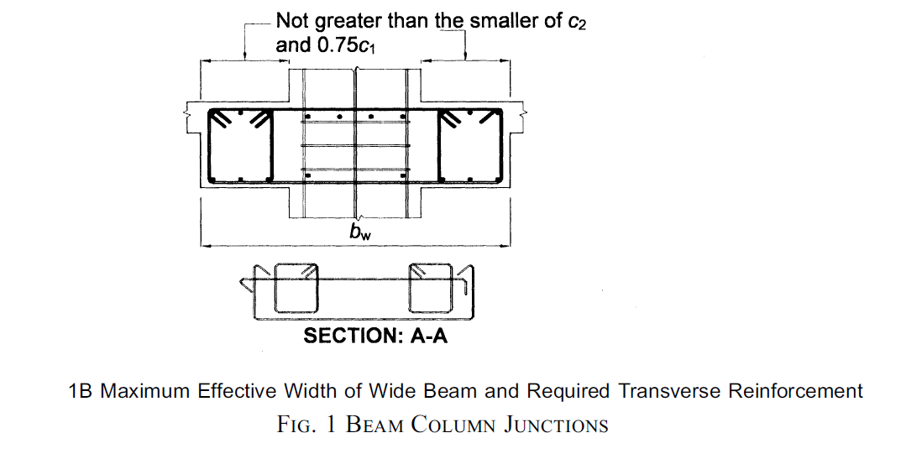
Fig. 1B – IS 13920
Beams wider than the columns need to be effectively tied as in the sectional view in Fig. 1B of IS 13920

Slide 74
Design and Detailing of Beams (those are part of the lateral load-resisting system)
Both less number of bigger-size bars AND large number of smaller-size bars will NOT give the desired performance during earthquake shaking. IS 13920 provides the RIGHT option based on scientific studies:
Longitudinal reinforcement in a beam (Cl 6.2)
Size of rebar
Number of rebars
Number of layers (at top & bottom face)
Anchorage length at the exterior beam-column joint (Fig. 2)
Splicing of longitudinal bars (Cl 6.2.6)
Lap splicing (Fig. 3)
Use of rebar couplers
Weld splicing

Slide 75
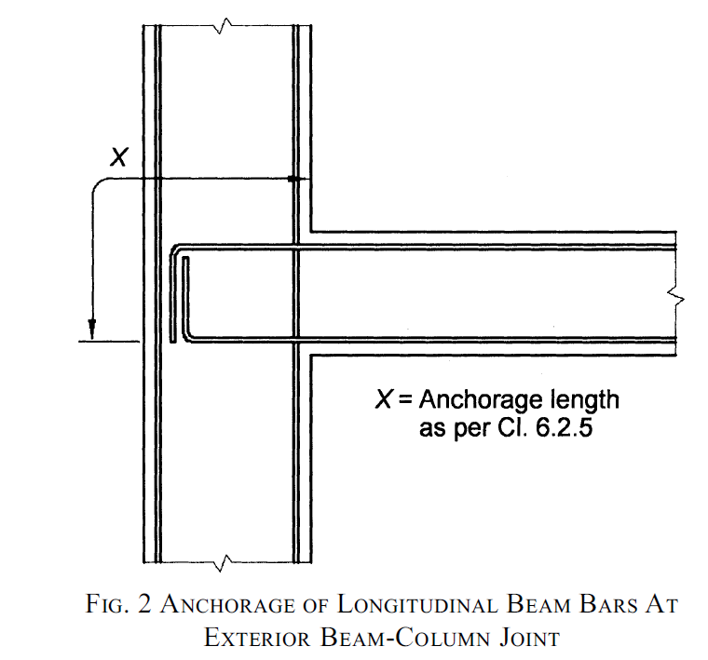
Column- Beam Joint in the case of end columns, needs beam anchorage within the column face itself to have good behaviour of beam-column joint and avoid failure
Fig. 2 – IS 13920

Slide 76
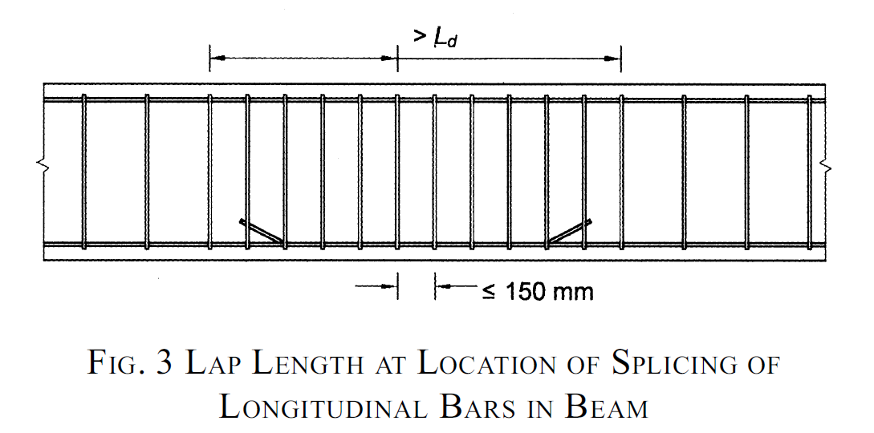
Fig. 3 – IS 13920

Slide 77
Design and Detailing of Beams (those are part of the lateral load resisting system)
Stirrups in beams ensure that the longitudinal bars do not open out during violent earthquake shaking. The ways to design and arrange them are given in IS 13920 as below.
Transverse reinforcement in a beam (Cl 6.3)
Type of link (vertical or inclined)
No. of bars in the link (single bar OR two bars – U link with cross tie) (Fig. 4)
Hooks in the links & cross-ties
Minimum diameter of the link (8 mm)
Shear force capacity of the beam (Cl 6.3.3 & 6.3.4 & Fig. 5)
Spacing of links (Fig. 6)

Slide 78
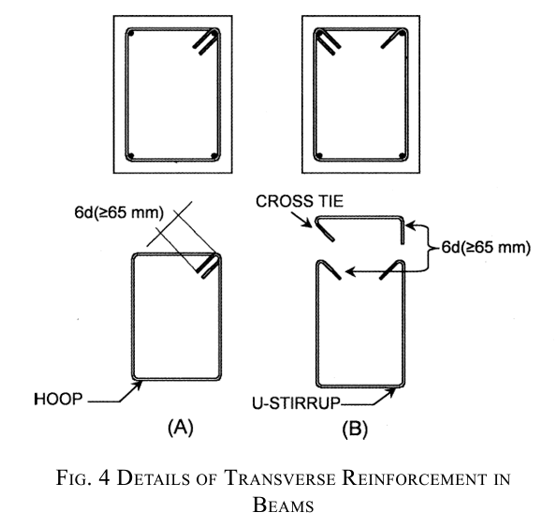
U-hooks avoid opening out of the stirrups/transverse bars during earthquakes thereby holding the longitudinal bars in shape and position and avoiding damage
Fig. 4 – IS 13920

Slide 79
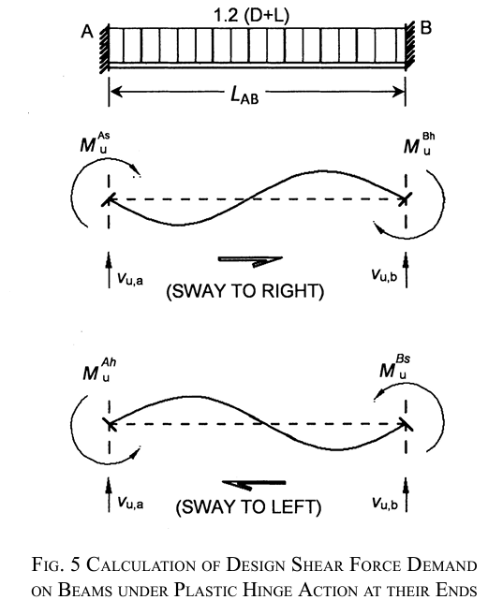
Fig. 5 – IS 13920

Slide 80
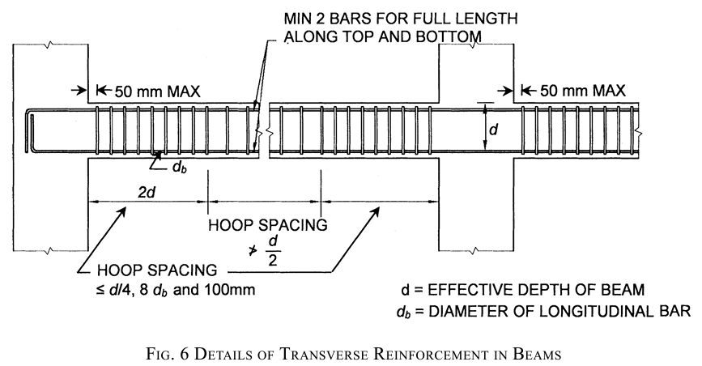
Bar bending and stirrup size, spacing are crucial to do the actual concreting in site, so that the reinforced concrete beam performs. Fig. 6 of IS 13920 should therefore be used by structural designer and site engineer
Fig. 6 – IS 13920

Slide 81
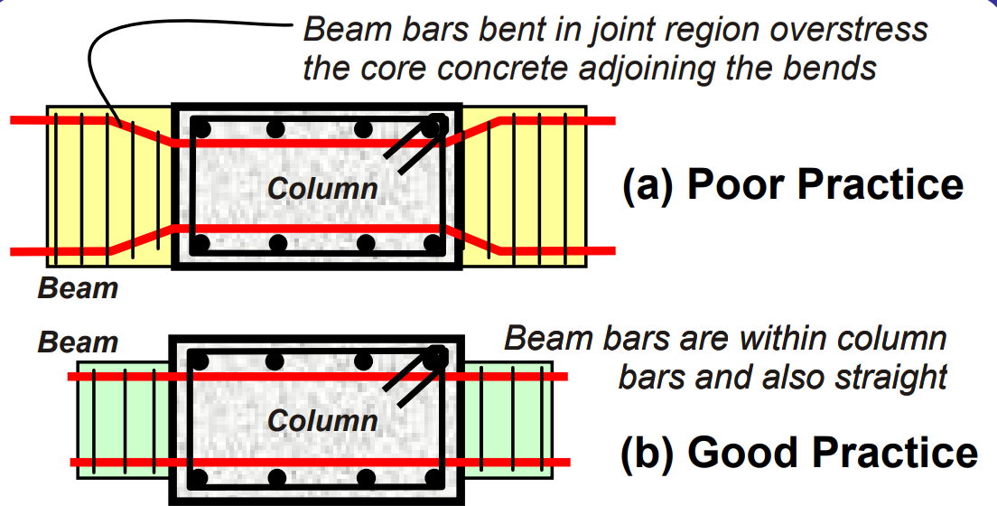
Here is a clear depiction of HOW TO PROVIDE reinforcement in a beam & column joint

Slide 82
Here is an example of actual failure when NOT DETAILED PROPERLY

Slide 83
Design and Detailing of Columns & Inclined Members (those are part of the lateral load resisting system)
Minimum size of a column (20*d_{b}) – Fig .7
Aspect ratio of the cross-section of column (>0.45)
Axial compressive stress in a column
Relative strength of beams & columns at a joint (Cl 7.2) & Fig. 8

Slide 84
While the gravity columns can be chosen by the engineer/architect based on choice (typically 9” to flush finish columns & walls), the columns that RESIST EARTHQUAKE FORCES should be sized, designed and detailed as per IS 13920 (and its Fig. 7) to enable withstand such forces.
Fig. 7 – IS 13920

Slide 85
Strong column – Weak beam is not a proverb; it is proven SCIENCE.
Beam failure is a local one, but Column failure is global failure, thus it should be avoided.
Fig. 8 of IS 13920 acts as the guide.
Fig. 8 – IS 13920

Slide 86
Design and Detailing of Columns & Inclined Members (those are part of the lateral load resisting system)
Longitudinal reinforcement
Circular columns (Cl 7.3.1)
Splicing of longitudinal bars (Cl 7.3.2)
Lap splices
Mechanical rebar couplers
Welded splices
Columns with cores (Fig. 9)
Transverse reinforcement
Spiral OR Circular links – for circular columns
Rectangular links – for rectangular columns (Fig. 10)
Design shear force in columns (Cl 7.5) & Fig. 11

Slide 87
Columns with confined cores need special reinforcement for proper behavior during seismic effects. Fig. 9 of IS 13920 guides in this aspect.
Fig. 9 – IS 13920

Slide 88
Columns with different sizes must be detailed differently as in Fig. 10 of IS 13920. It is essential to effectively tie the bars in the interior portion to avoid their buckling
Fig. 10 – IS 13920

Slide 89
Fig. 10 – IS 13920

Slide 90
Here is an example of a COLUMN FAILURE when 135° hooks are not provided

Slide 91
While the design shear force capacity of RC columns (and design moment of resistance of beams) are given in IS 456, IS 13920 provides the design shear force demand of columns
Fig. 11 – IS 13920

Slide 92
Fig. 11 – IS 13920

Slide 93
Strong earthquakes will lead to flexural yielding in beams
Further high-intensity earthquakes will lead to the flexural yielding of columns as well
These are unavoidable but the failure can be controlled and localized by restricting it to beams only, provided the beam-column joints and the members are adequately engineered with the special confining reinforcement
Cl 8 of IS 13920 guides in this aspect (Fig. 12)

Slide 94
Fig. 12 – IS 13920

Slide 95
Special Confining Reinforcement
Such reinforcement has to be provided at specific locations
Spacing of such reinforcement is essential for performance
Should have a defined cross-section area of such reinforcement
Such reinforcement should be provided in the column extending into the footing (Cl 8.2) & Fig. 13
Stiffness of the column plays an important role
Columns supporting reactions from discontinued stiff members also need to be designed as per Cl 8.5 & Fig. 14

Slide 96
Fig. 13 – IS 13920

Slide 97
Fig. 14 – IS 13920

Slide 98
Beam-Column Joints of Moment Resisting Frames
Design for Distortional Shear
Shear strength of concrete in a joint – based on the number of beams that confine a joint
Design shear stress demand on a joint
Width of beam-column joint (Fig. 15)
Transverse reinforcement
Confining reinforcement in joints
Special requirements in joints in the exterior columns

Slide 99
Fig. 15 – IS 13920

Slide 100
Special Shear Walls
General Requirements (Cl 10.1)
Minimum thickness of the special shear walls (Cl 10.1.2)
Minimum ratio of length of wall to thickness (Cl 10.1.3)
Classification of special shear wall (Cl 10.1.4)
Squat wall
Intermediate wall
Slender wall
Requirements of flanged wall (Cl 10.1.5)
Reinforcement to be provided in horizontal and vertical directions
Two curtains of reinforcement within the cross section
Curtain = bars provided both in vertical and horizontal direction
Maximum diameter of the longitudinal steel bar
Maximum spacing of vertical and horizontal reinforcement
Requirements of foundations to erect special shear walls

Slide 101
Special Shear Walls
Design for shear force (Cl 10.2)
Nominal shear stress demand
Design shear strength
Design for axial force and bending moment (Cl 10.3)
Design moment of resistance
Cracked flexural strength
Structural walls without boundary elements
Boundary elements (Cl 10.4)
Coupling beams (Cl 10.5) & Fig. 16
Openings in walls (Cl 10.6)
Construction joints (Cl 10.7)
Development length, Splice and Anchorages (Cl 10.8)

Slide 102
Fig. 16 – IS 13920

Slide 103
Why should the Ductile Detailing be done ?
The lateral loads are taken up through the CHOSEN building elements
Such elements will be subjected to stress reversal as well
Thus it is necessary to DESIGN & DETAIL them
The building byelaws through NBC (its Part 6 Structural Design & Part 2 Administration) also solicits that concrete elements shall be as per designed Section 5 (updated IS 456 provisions) together with ductile detailing as in Annex to Part 6 (as per IS 13920).
It is essential to abide by the building byelaws.

Slide 104
Different Lateral Load Resisting Systems

Slide 105
Braced Frames – Common in steel buildings; provided in low to mid-rise buildings
Rigid Frames (or Moment Frames) – In Low-rise buildings (concrete and steel)
Shear Walls – In mid to high-rise buildings
All these are the COMMON lateral load-resisting elements in buildings and structures.
They SHOULD be designed and detailed for ductility requirements to enable perform in the effects of earthquake

Slide 106
Braced Frames
Diagonal Bracing
X-Bracing
Inverted V-Bracing
V-Bracing
K-Bracing
The design and ductile detailing guidelines for these braced frames are provided in:
IS 18168:2023 - Earthquake resistant design and detailing of steel buildings — Code of practice

Slide 107
Rigid Frames
The design and detailing guidelines for these moment resisting frames are provided in these two standards:
IS 1893 (Part 1) : 2016 - Criteria for earthquake resistant design of structures:
Part 1 General provisions and buildings (sixth revision)
&
IS 13920:2016 Ductile design and detailing of reinforced concrete structures subjected to seismic forces ― Code of practice (first revision)

Slide 108
Shear Walls

Slide 109
Shear Walls
Commonly provided in the following shapes:
Rectangular shaped
L-shaped
C-shaped
Shear core type

Slide 110
Shear walls have to be located symmetrically to take the best advantage of their combined action

Slide 111
Shear Walls
The design and detailing guidelines for these shear walls are provided in:
IS 1893 (Part 1) : 2016 - Criteria for earthquake resistant design of
structures: Part 1 General provisions and buildings
(sixth revision)
&
IS 13920 : 2016 Ductile design and detailing of reinforced concrete
structures subjected to seismic forces ― Code of practice
(first revision)

Slide 112
Any concrete wall in a building cannot be classified as “Shear Wall”. It needs to meet the essential requirements as below, to enable take the earthquake effects, as described in clause 10 Special Shear Walls of IS 13920
Minimum thickness (10.1.2)
Ratio of Length to Thickness (10.1.3)
Types (10.1.4)
Squat walls
Intermediate walls
Slender walls
Flanged walls (10.1.5)
Minimum area of reinforcement (10.1.6)
Two-curtains of reinforcement (10.1.7)
Spacing of reinforcement (10.1.9)
Design shear force (10.2)
Design axial force and bending moment (10.3)
Boundary elements (10.4)
Coupling beams (10.5)
Openings in walls (10.6)
Construction joints (10.7)
Development, Splice & Anchorage (10.8)

Slide 116
The behaviour of Shear wall is possible ONLY if it is detailed with reinforcement

Slide 117
Here is a clear depiction of boundary elements in shear wall and 2-curtain of reinforcement

Slide 118
HYPERLINK TO LATEST INDIAN STANDARDS
On Civil Engineering & Earthquake Engineering
https://www.services.bis.gov.in/php/BIS_2.0/bisconnect/pow_details

Slide 119
Image/Pictures Courtesy
Indian Standards of BIS
Special Publications of BIS
Earthquake Tips, Building Materials and Technology Promotion Council, Govt of India
National Information Centre of Earthquake Engineering – IIT Kanpur
Publicly available resources on the WWW
Prof C.V.R. Murty, P.S.Rao Institute Chair Professor, IIT Madras

Slide 120
THANKS
FOR YOUR KIND ATTENTION

