Slide 1
OVERVIEW OF BIS STANDARDIZATION ACTIVITY IN PAPER TECHNOLOGY
Virendra Singh,
Scientist ‘E’/ Director
Bureau of Indian Standards

Slide 2
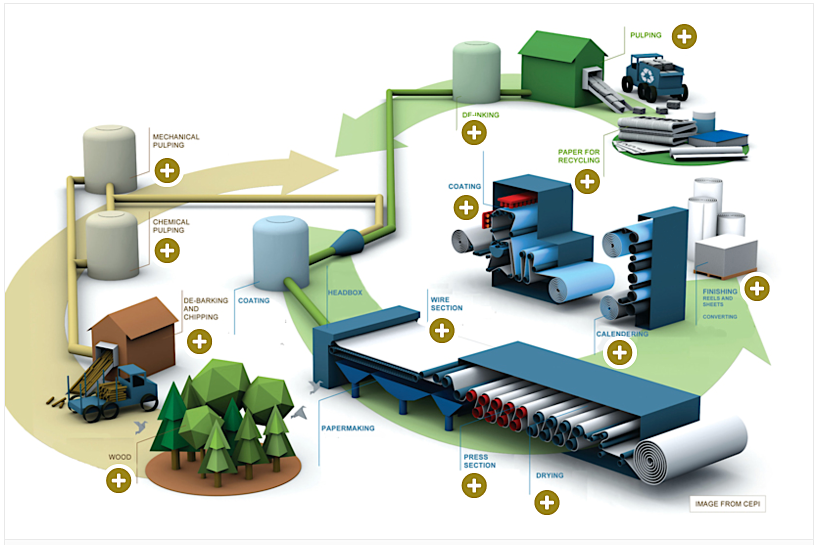
Paper Making Process

Slide 3
International Standardization
ISO TC 6 ‘Paper, Board and pulps’
Creation in – 1947
Scope
Standardization in the field of paper, board, pulps, cellulosic nanomaterials, and lignins, including terminology, sampling procedures, test methods, product and quality specifications, and the establishment and maintenance of appropriate calibration systems. This includes all types of paper, pulps and board as well as products thereof containing any portion of recycled material or material intended for recycling.
Excluded : matters falling within the scopes of particular technical committees (e.g. ISO / TC 42, 46, 122, 130, 154) with which liaison should be maintained.

Slide 4
Standardization at national level
Paper and its Products Sectional Committee (CHD 15)
To formulate Indian Standards for:
i) Terminology, methods of sampling and test, codes of practice and specifications for pulp, paper and paper board, cellulosic materials including nanomaterials, lignin, raw material for paper, including recovered paper / fibre, etc.;
ii) Paper sizes and grammage, sizes of periodicals and paper stationery materials
b) To coordinate with the work of ISO/TC 6.
Paper Based Packaging Materials Sectional Committee (CHD 16)
To formulate standards on terminology, methods of sampling and test, codes of practice and specifications for Paper & Paper board (coated and uncoated) used for Packaging and Serving application; Paper based packaging materials (converted and treated/coated) like cartons, trays, sacks, bags, boxes, paper based Intermediate Bulk Containers, Paper & Paper based Aluminium foil and/or multi-layered laminates, Paper based multilayer composite cartons paper-based food and beverage accessories.
b) To co-ordinate with the work of ISO/TC 6 Paper.

Slide 5
Approach for standardization

Slide 6
Trade of products

Slide 7
Type of standards
Terminology standards – For the sector, followed by product specific
Methods of test standards – For the sector, followed by product specific
Dimension standards – for products
Product standards – Usage of products (Finished and Raw materials) Performance, Sustainability and safety aspects
Code of practice

Slide 8
Terminologies

Slide 9
Board (Paper board)
Generic term applied to certain types of paper frequently characterized by their relatively high rigidity
Notes
In the generic sense, the term ‘Paper’ may be used to describe both paper and board. The primary distinction between paper and board is normally based upon thickness or grammage, though in some instances the distinction will be based on the characteristics and/ or end-use. For example, some materials of lower grammage such as certain grades of folding box board and corrugating raw materials are generally referred to as ‘board’, while other materials of higher grammages, such as certain grades of blotting paper, felt paper and drawing paper are generally referred to as ‘paper’.
For some purposes, materials of grammage less than 224 g/ m² or thickness less than 0.3 mm are considered to be paper and materials of grammage 224 g/ m² or above or thickness 0.3 mm or above are considered to be board.
Ref: IS 4261: 2001 Glossary of terms relating to paper and pulp based packaging materials

Slide 10
Paper
Generic term for a range of materials in the form of coherent sheet or web, excluding sheets or laps of pulp as commonly used for paper making or dissolving purposes, and non-woven products, made by deposition of vegetable mineral, animal or synthetic fibres or their mixtures from a fluid suspension onto a suitable forming device with or without the addition of other substances.
Notes
Paper may be coated, impregnated or otherwise converted during or after their manufacture without necessarily losing their identity as paper. In conventional paper making process, the fluid medium is water, new developments however include the use of air or other fluids.
In the generic sense, the term ‘Paper’ may be used to describe both paper and board. The primary distinction between paper and board is normally based upon thickness or grammage, though in some instances the distinction will be based on the characteristics and/ or end-use. For example, some materials of lower grammage such as certain grades of folding box board and corrugating raw materials are generally referred to as ‘board’, while other materials of higher grammages, such as certain grades of blotting paper, felt paper and drawing paper are generally referred to as ‘paper’.
For some purposes, materials of grammage less than 224 g/ m² or thickness less than 0.3 mm are considered to be paper and materials of grammage 224 g/ m² or above or thickness 0.3 mm or above are considered to be board.
Ref: IS 4261: 2001 Glossary of terms relating to paper and pulp based packaging materials

Slide 11
Corrugated Fibreboard
Fibreboard consisting of one or more sheets of fluted paper stuck to a flat sheet or paper in between separate sheets, usually of kraft. This has the following classifications:
Single Face Corrugated Fibreboard – Board made up on one sheet of fluted paper stuck to one sheet of paper or facing.
Single Wall Corrugated Fibreboard (also known as Double Face) – Board made up of a sheet of fluted paper stuck between two sheets of paper or facing.
Ref: IS 4261: 2001 Glossary of terms relating to paper and pulp based packaging materials

Slide 12
Corrugation (also know as Flute)
It is the configuration of fluting. Particulars of the most commonly used flutes are as under:
Flute Approximate corrugations Height of corrugation
Per 30 cm (Exclusive of Liner), mm
’A’ Flute (coarse) 32 to 38 4.5 to 4.7
‘B’ flute (Fine) 50 to 56 2.1 to 2.8
‘C’ flute (Medium) 38 to 44 3.6 to 3.8
Ref: IS 4261: 2001 Glossary of terms relating to paper and pulp based packaging materials

Slide 13
Paper sack
A container made essentially from one or more flatten tubular plies of paper closed at least at one end, possible in combination with other flexible materials to provide the properties required for filling and the chain of distribution of goods.
Notes
Hereafter where the word sack is used in the text of this standard, paper sack is to be understood. If no prefix is applied to a term under definition, paper sack is also to be understood.
For some purposes it may be necessary to have limits for the size of paper sack. (tube circumference not less than 550 mm may be found useful in practice.)
Ref: IS 9028:1978 Glossary of terms relating to paper sacks

Slide 14
Types of sacks
Flat sack – a sack manufactured from a flat tube
Gusseted sack – a sack manufactured from a gusseted tube
Sewn sack – a sack closed at one or both ends by means of continuous transverse line of stitches
Pasted sack – a sack closed at one or both ends by pasting
Open mouth sack – tube closed at one end only during manufacture
5.1 Open mouth-sewn-flat sack – flat tube closed at one end by means of a continuous transverse line of stitches
5.2 Open mouth-sewn-gusseted sack – gusseted tube closed at one end by means of continuous transverse line of stitches
5.3 Open mouth-pasted-flat-hexagonal bottom sack – flat tube closed at one end by folding, forming and pasting the bottom in a hexagonal shape
5.4 Open mouth-pasted-flat-turn over bottom sack – flat tube closed at one end by turning over the end and bonding (commonly known as pinch type.
5.5 Open mouth-pasted-gusseted-rectangular bottom sack – gusseted tube closed at one end by folding, forming and pasting the bottom in a rectangular shape (commonly known as self opening satchel)
5.6 Open mouth-pasted-gusseted-turn over bottom sack – gusseted tube closed at one end by turning over the end and bonding (commonly known as pinch type)
Ref: IS 9028:1978 Glossary of terms relating to paper sacks

Slide 15
Examples of terminology related standards
Pulping related terms – IS 4661 (Part 2):2022/ ISO 4046 -2:2016
Paper making related terms – IS 4661 (Part 3):2022/ ISO 4046-3:2016
Paper and board grades and converted products related terms - IS 4661 (Part 4):2022/ ISO 4046-4:2016
Properties of pulp, paper and board related terms - IS 4661 (Part 5):2022/ ISO 4046-5:2016
Terms relating of paper and flexible packaging – IS 7186:1973
Terms relating to paper sacks – IS 9028:1978
Terms relating to paper and pulp based packaging materials – IS 4261:2001

Slide 16
Methods of test

Slide 17
Components of methods of test standard
Terms and definitions
Principle
Apparatus
Reagents
Calibration of the instruments and its working standards
Sampling
Preparation of the test pieces
Procedure
Calculations and expression of results
Precision
Test Report

Slide 18
Principle
A test piece is irradiated diffusely in a standard instrument and the light reflected (and emitted as a result of fluorescence) in a direction normal to the surface is passed to a detection system. This detection system may consist either of a defined optical filter and photodetector or of an array of photodetectors where each detector responds to a specific effective wavelength. The desired radiance factors are determined directly from the output from the photodetector in the former case or by calculation from the detector array outputs using appropriate weighting functions in the latter case.
(Ref : IS 1060 (Part 4/ Sec 4):2024/ ISO 2469:2024 Methods of sampling and test for paper and allied products Part 4 Methods of test for paper, board and pulp Section 4 Measurement of Diffuse Radiance Factor (Diffuse reflectance factor)
Extraction of a sample of 2 g for 1 h with 100 ml of boiling water of high purity. Filtration of the extract and addition of a salt solution. Measurement of the pH-value of the extract at a temperature between 20 °C and 25 °C.
(Ref : IS 1060 (Part 4/ Sec 7):2024/ ISO 6588-2:2021 Methods of sampling and test for paper and allied products Part 4 Methods of test for paper, board and pulp Section 7 Determination of pH of aqueous extracts – hot extraction method)

Slide 19
Apparatus
4.1 Sheet former, consisting of three main parts.
4.1.1 Upper section, comprising a stock container, with a mark located 350 mm ± 1 mm above a wire screen (see 4.1.3). It is furnished with a rubber gasket to prevent leakage. The cross-section of the container shall be circular, square or rectangular, and constant throughout the height. If the container is rectangular, the shorter side shall be not less than 120 mm and the ratio of the longer to the shorter side shall not exceed 2,5. If the container is circular, it shall be not less than 158 mm in diameter. It shall be of such height that water will not splash over the edge when the stirrer (4.2) is operating.
4.1.2 Lower section, comprising a drainage vessel, consisting of an upper and a lower part. The upper part shall have the same cross-section as the stock container (see 4.1.1), and its shape shall be such that the flow of liquid through the wire screen is uniform over the whole area. The lower part may be of smaller cross- section but shall be positioned symmetrically in relation to the upper part. The lower part shall be fitted with a valve, which is connected to a draining pipe with a water seal at its lower end. The vertical distance from the top of the wire screen to the overflow of the water seal shall be 800 mm ± 5 mm. The lower part and the drainage valve shall be large enough to permit water in the stock container between the level mark and the wire screen to empty within 4,0 s ± 0,2 s. The lower part of the drainage container shall be provided with a water inlet tube. The design shall incorporate a means of releasing vacuum after the sheet has been formed.
4.1.3 Frame, with a perfectly flat, plain-woven metallic wire screen, to be placed horizontally between the upper section (4.1.1) and the lower section (4.1.2). The screen shall be clean, undamaged and fitted without wrinkles and corrugations. It shall have a nominal size of aperture of 125 μm, according to ISO 3310-1. The preferred diameter of the wire shall be 90 μm with a permissible range between 77 μm and 104 μm. The wire screen is backed by a coarser wire screen, which, in turn, may be backed by a rigid framework.
(Ref : IS 6213 (Part 8/ Sec 1):2017 / ISO 5269-1:2005 Methods of test for pulp Part 8 Preparation of laboratory sheets for physical testing Section 1 Conventional sheet-former method)

Slide 20
Reagents
5.1 Dilute Hydrochloric Acid — 6 m (approx).
5.2 Sodium Acetate Solution — 4 m. Dissolve 540 g of sodium acetate (CH3COONa.3H2O) in water and dilute to 1 litre.
5.3 Hydroxylamine Hydrochloride Solution — Dissolve 2 g of hydroxylamine hydrochloride (NH2OH.HCl) in 100 ml of water.
5.4 O-Phenanthroline Hydrochloride Solution — Dissolve 1 g of ortho-phenanthroline hydrochloride (C12H8N2.HCI.H2O) in 100 ml of water. Keep the solution in the dark. Use only a colourless solution.
5.5 Standard Iron Solution — It contains 0.1 mg of iron (as Fe) per millilitre. Dissolve 0.100 g of pure iron wire in the smallest possible quantity of hydrochloric acid (r.d. 1.19) in a 1-litre volumetric flask and dilute to the mark with water.
(Ref : IS 6213 (Part 14):2013 Methods of test for pulp Part 14 Determination of Iron content)

Slide 21
Calibration of the instruments and its working standards
7 CALIBRATION
7.1 Dilute the standard iron solution ten times so that 1 ml corresponds to 0.01 mg of iron. Pipette aliquots of 5.0, 10.0, 15.0 and 20.0 ml of the diluted solution into 50 ml volumetric flasks. Use the fifth flask for the preparation of a reference solution. Add to each flask 1 ml of hydroxylamine hydrochloride solution and 1 ml of orthophenanthroline hydrochloride solution and dilute to the mark with water. After 15 min measure the optical density at 510 nm with the iron-free solution as a reference.
NOTE — Avoid exposure of the coloured solutions to direct sunlight.
7.2 The iron concentrations of the coloured solutions are 1.0, 2.0, 3.0 and 4.0 mg of iron per litre respectively. Plot on a graph the optical density values divided by the length of the cell, against the iron concentrations and check that the points lie on a straight line going through the origin.
(Ref : IS 6213 (Part 14):2013 Methods of test for pulp Part 14 Determination of Iron content)

Slide 22
Scale of sampling
For papers of substances up to 250 g/m²
For papers of substances above 250 g/m²
Number of units in the lot | Number of units to be selected
Up to 5 | All
6 to 100 | 5
101 to 300 | 8
301 to 500 | 13
501 and over | 20
Number of units in the lot | Number of units to be selected
Up to 5 | All
6 to 300 | 5
301 to 500 | 8
501 to 1000 | 13
1001 and over | 20
Ref: IS 1060 (Part 1):2022 Methods of sampling and test for paper and allied products Part 1 Test methods for general purpose

Slide 23
Selection of units
Bales or bundles
at least 20 % of packages
Min two packages
Units
Random number table
In absence of random number table: Starting from any unit in the lot, count them in any order as 1, 2, 3,...... up to r and so on, where r is the integral part of N/n Every r^{th} unit thus counted shall be withdrawn from the lot.
Ref: IS 1060 (Part 1):2022 Methods of sampling and test for paper and allied products Part 1 Test methods for general purpose

Slide 24
Selection of Sheets
Composed of sheets (for e.g. a Ream)
Remove the outermost sheets and then select the requisite number of sheets at random
Not composed of sheets ( for e.g. a roll or reel)
Remove all damaged layers from the outside and three undamaged layers in case of paper and one in case of board. Cut the unit across its full width to a sufficient depth to yield the requisite number of sheets after rejecting the sheets from the outer layers. The size of the sheets, if possible, should be approximately 45 cm square with sides parallel to those of the unit.
Ref: IS 1060 (Part 1):2022 Methods of sampling and test for paper and allied products Part 1 Test methods for general purpose

Slide 25
Selection and cutting of specimens
4.5.1 The dimensions of the specimens should normally be approximately 30 × 45 cm (in order to allow for their later reduction in the laboratory), the greater of these dimensions being in the machine direction if this is known. If machine direction is not known, select a specimen approximately 45 cm square.
4.5.2 When the sheets selected have dimensions greater than 30 × 45 cm:
Paper or Board in Sheets — Cut specimens, one from each sheet, varying the position of selection every time.
Paper or Board in Reels — Cut specimens from each sheet corresponding (approximately) to each 40 cm across the width of the reel.
4.5.3 When the Sheets Selected have Dimensions less than 30 × 45 cm but the Surface Area is not less than 1 000 cm² — If the surface of the sheet is greater than 1 000 cm², from each sheet, select a specimen in such a manner that its surface area is as near 1 000 cm² as possible, preferably a little greater. Mark the machine direction if it is not the longer dimension.
4.5.4 When the Sheets Selected have Dimensions less than 30 × 45 cm and the Surface Area is less than 1 000 cm² — The sheets themselves constitute the specimen. Select sufficient sheets to provide the required surface area for the determinations.
Ref: IS 1060 (Part 1):2022 Methods of sampling and test for paper and allied products Part 1 Test methods for general purpose

Slide 26
Precautions
The following precautions shall be taken in drawing and handling of samples and test pieces.
4.6.1 Care shall be taken to select samples or portions of rolls or reels that are not damaged. It is good practice to discard a few outermost sheets of reams or the first few layers of roll or reel to be sure of obtaining representative samples.
4.6.2 Where portions have to be taken by cutting, they shall be cut across the full width of the undamaged layers.
4.6.3 Samples shall not be taken from an exposed place.
4.6.4 Samples shall be kept flat, free from wrinkles and folds. They shall be protected from exposure to heat, direct sunlight, liquids, varying humidity conditions as well as any other harmful influences.
4.6.5 Samples shall be handled as little as possible and contact with sweated hands shall be strictly avoided. Contact with hands may quite appreciably affect the chemical, physical, optical, surface or other characteristics.
4.6.6 Samples to be tested for moisture shall be placed immediately after sampling in an air-tight container.
4.6.7 Test of strength characteristics shall not be carried out with portions bearing water-marks, creases or any visible imperfections.
Ref: IS 1060 (Part 1):2022 Methods of sampling and test for paper and allied products Part 1 Test methods for general purpose

Slide 27
Procedure
B-3.4.1 Sample Preparation — Tear the air dry sample into pieces of suitable size. Do not use cut or punched edges or other parts where metallic contamination may have occurred.
B-3.4.2 Preparation of Test Solution — Weigh to the nearest 0.01 g about 20 g of paper, leach the paper with about 200-ml of extraction fluid for 18 ± 2 h using shaker rotating/ moving at 30 ± 2 rev/min. Filter the extract through glass fibre filter with 0.45 micron pore size.
B-3.4.3 Transfer the extract to a 250 ml conical flask. Add 5 ml concentrate nitric acid and a few boiling chips or glass beads. Slowly evaporate on a hot plate to about 10 to 20 ml. Continue heating and adding concentrated nitric acid until digestion is complete. Wash down with water and then filter if necessary. Quantitatively transfer filtrate to a 100 ml volumetric flask, dilute to the mark and mix thoroughly.
B-3.4.4 Inject a measured portion of the digested solution into the graphite oven. Dry, char and atomize according to the preset programme. Measure the absorbance.
B-3.4.5 Prepare a reagent blank and sufficient standards containing 5.0, 7.5 and 10.0 mg/l of lead by diluting suitable volume of the standard lead solution with nitric acid (1:499) and repeat as above (B-3.4.3). Inject a suitable portion of each standard solution in order of increasing concentration. Analyze each standard solution and measure the absorbances.
Ref: IS 6615: 2021 General purpose packing/ wrapping paper – specification

Slide 28
Calculation
B-3.4.6 Calculation — Construct a standard calibration graph by plotting the absorbance versus mg of lead concentration of each standard. Read the concentration of the sample from the graph and determine the lead content of the sample from the calibration graph using the following formula:
Lead (as Pb), ppm = C×F×100 M
where
C = concentration of lead from the calibration curve;
F = dilution factor; and
M = mass of paper sample taken for testing, g.
Ref: IS 6615: 2021 General purpose packing/ wrapping paper – specification

Slide 29
Report
9.5 Report
Report the maximum, minimum and average time of penetration, to the nearest 5 s, for not less than five tests on each side of the paper.
Ref: IS 1060 (Part 1):2022 Methods of sampling and test for paper and allied products Part 1 Test methods for general purpose

Slide 30
Dimensions and constructions

Slide 31
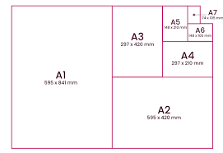
Dimension standards
ISO 216:2007 — Writing paper and certain classes of printed matter — Trimmed sizes — A and B series, and indication of machine direction
Trimmed size – final dimensions of a sheet or board
Basic principle - each normal series (regularly derived sizes) consists of a range of sizes formed in such a manner that each size is achieved by dividing the size immediately above it into two equal parts, the division being parallel to the shorter side (the halving principle). Consequently, the areas of two successive sizes are in the ration 2:1
ISO – A Series (A0, A1, A2, A3, A4, A5, A6, A7, A8, A9 and A10)
ISO – B Series (B0, B1, B2, B3, B4, B5, B6, B7, B8, B9 and B10)
ISO 217: 2013 — Paper — Untrimmed sizes — Designation and tolerances for primary and supplementary ranges, and indication of machine direction
Untrimmed size - dimensions of a sheet of paper, sufficiently large to allow a trimmed size to be obtained from it as required.
Principle – The size of a sheet shall be designated by its two dimensions in millimeters. It may be followed by the letters LG (for long grain) or SG ( for short grain)
Primary range (R) – RA0, RA1, RA2 (LG/ SG)
Supplementary range (SR) – SRA0, SRA1, SRA2 (LG/ SG)

Slide 32
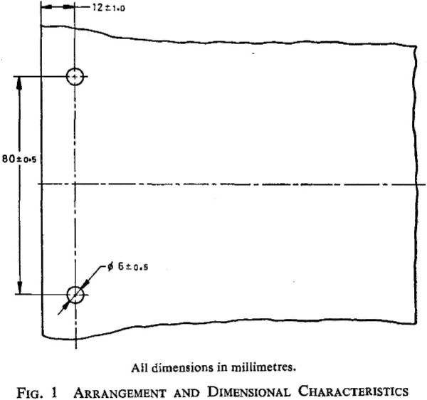
Paper – Holes for general filing purposes
Arrangement – in principle, the holes shall be arranged symmetrically in relation to the axis of the sheet or the document, perpendicular to the line of the axis of the holes.
Note – the axis of the holes may be arranged parallel to the short or long edge of the sheet or the the document, as required.
Dimensional characteristics –
Distance between centres of holes: 80 ± 0.5 mm
Diameter of holes : 6 ± 0.5 mm
Distance from the centre of the holes to the
nearest edge of the sheet: 12 ± 1.0 mm
Ref: IS 10287:2023 Paper – Holes for general filing purposes - Specification

Slide 33
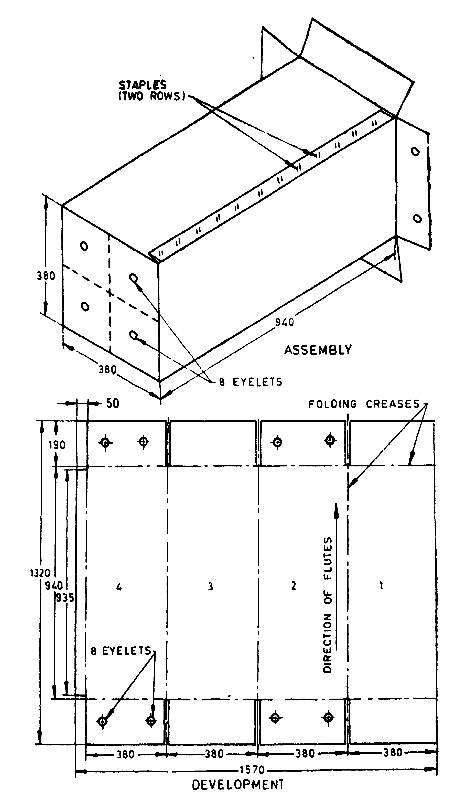
IS 7151:1991 Corrugated fibreboard boxes for paradropping of supplies
Fibreboard box (size 940 mm x 380 mm x 380 mm)

Slide 34
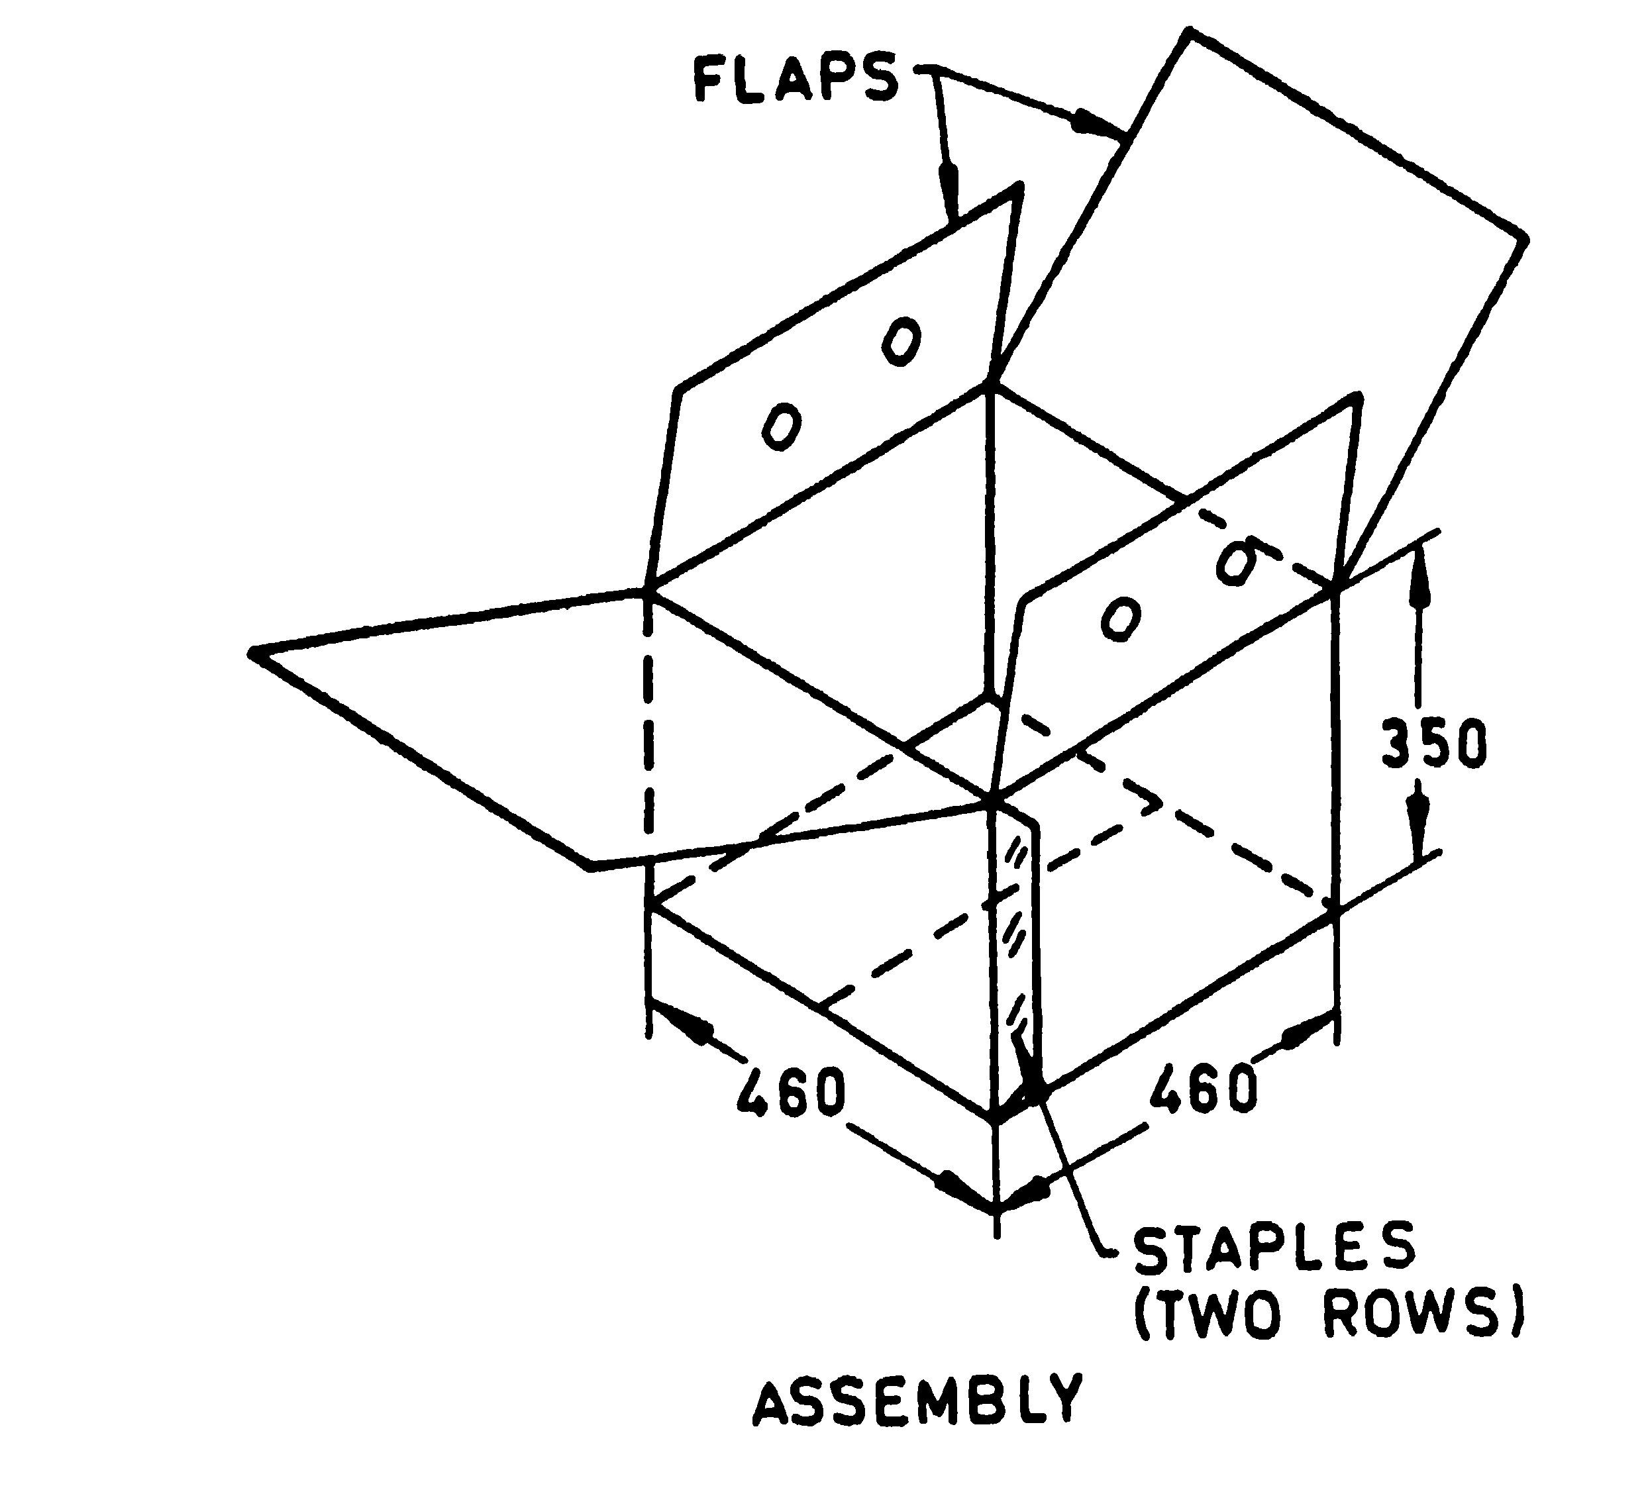
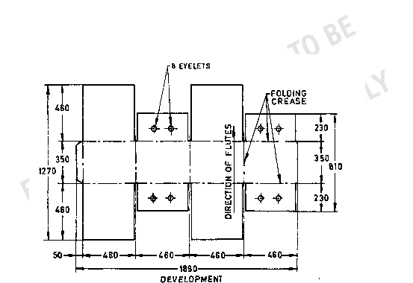
Fibreboard box (size 460 mm x 460 mm x 350 mm

Slide 35
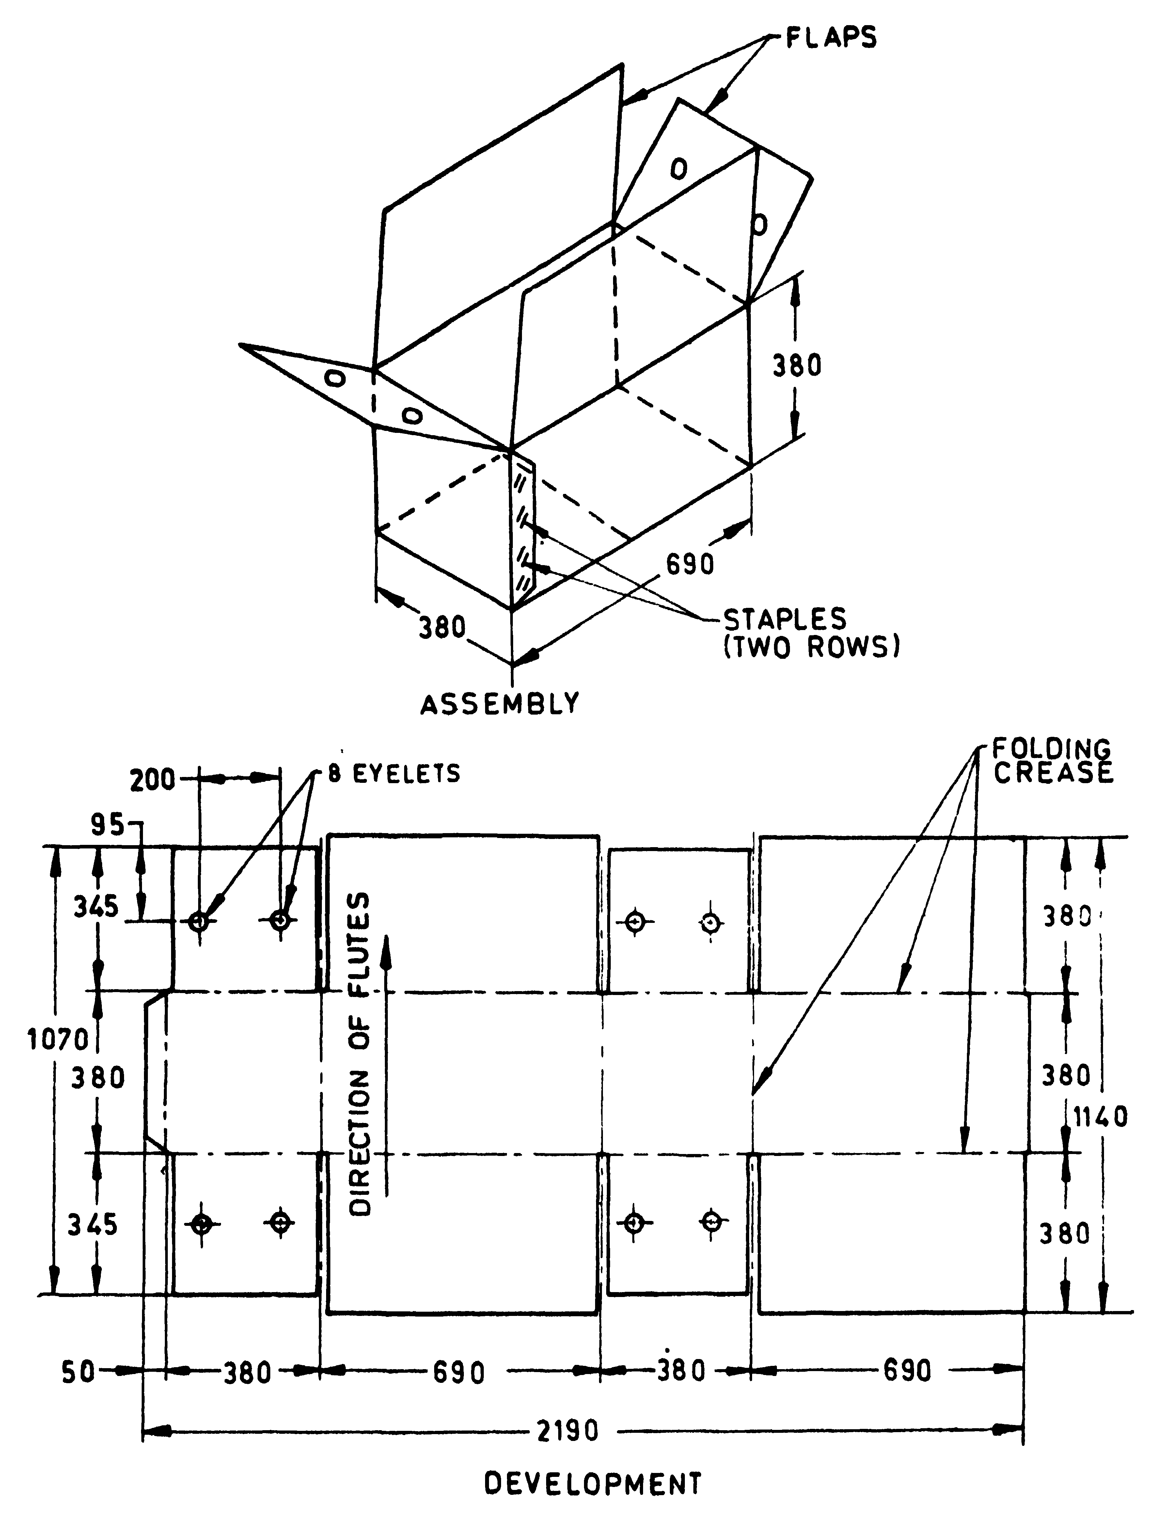
Fibreboard box (size 690 mm x 380 mm x 380 mm

Slide 36
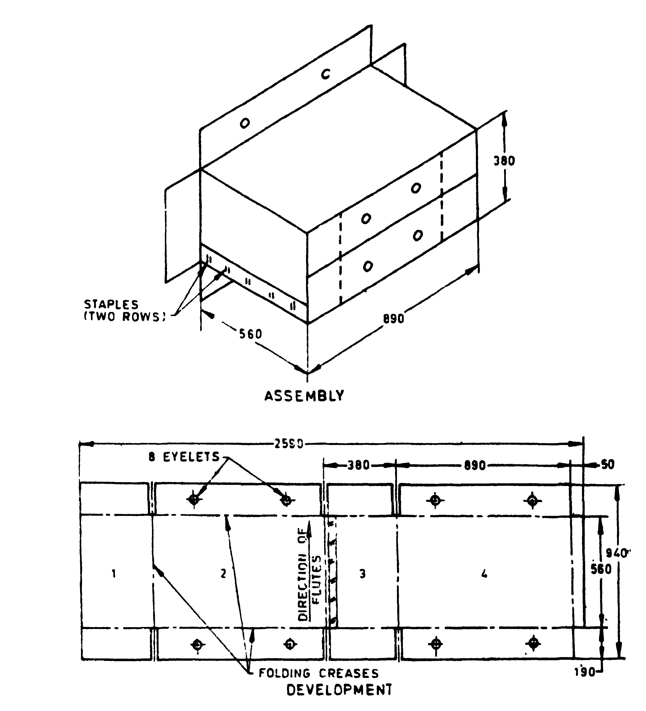
Fibreboard boxes
(size 890 mm x 380 mm x 560 mm)

Slide 37
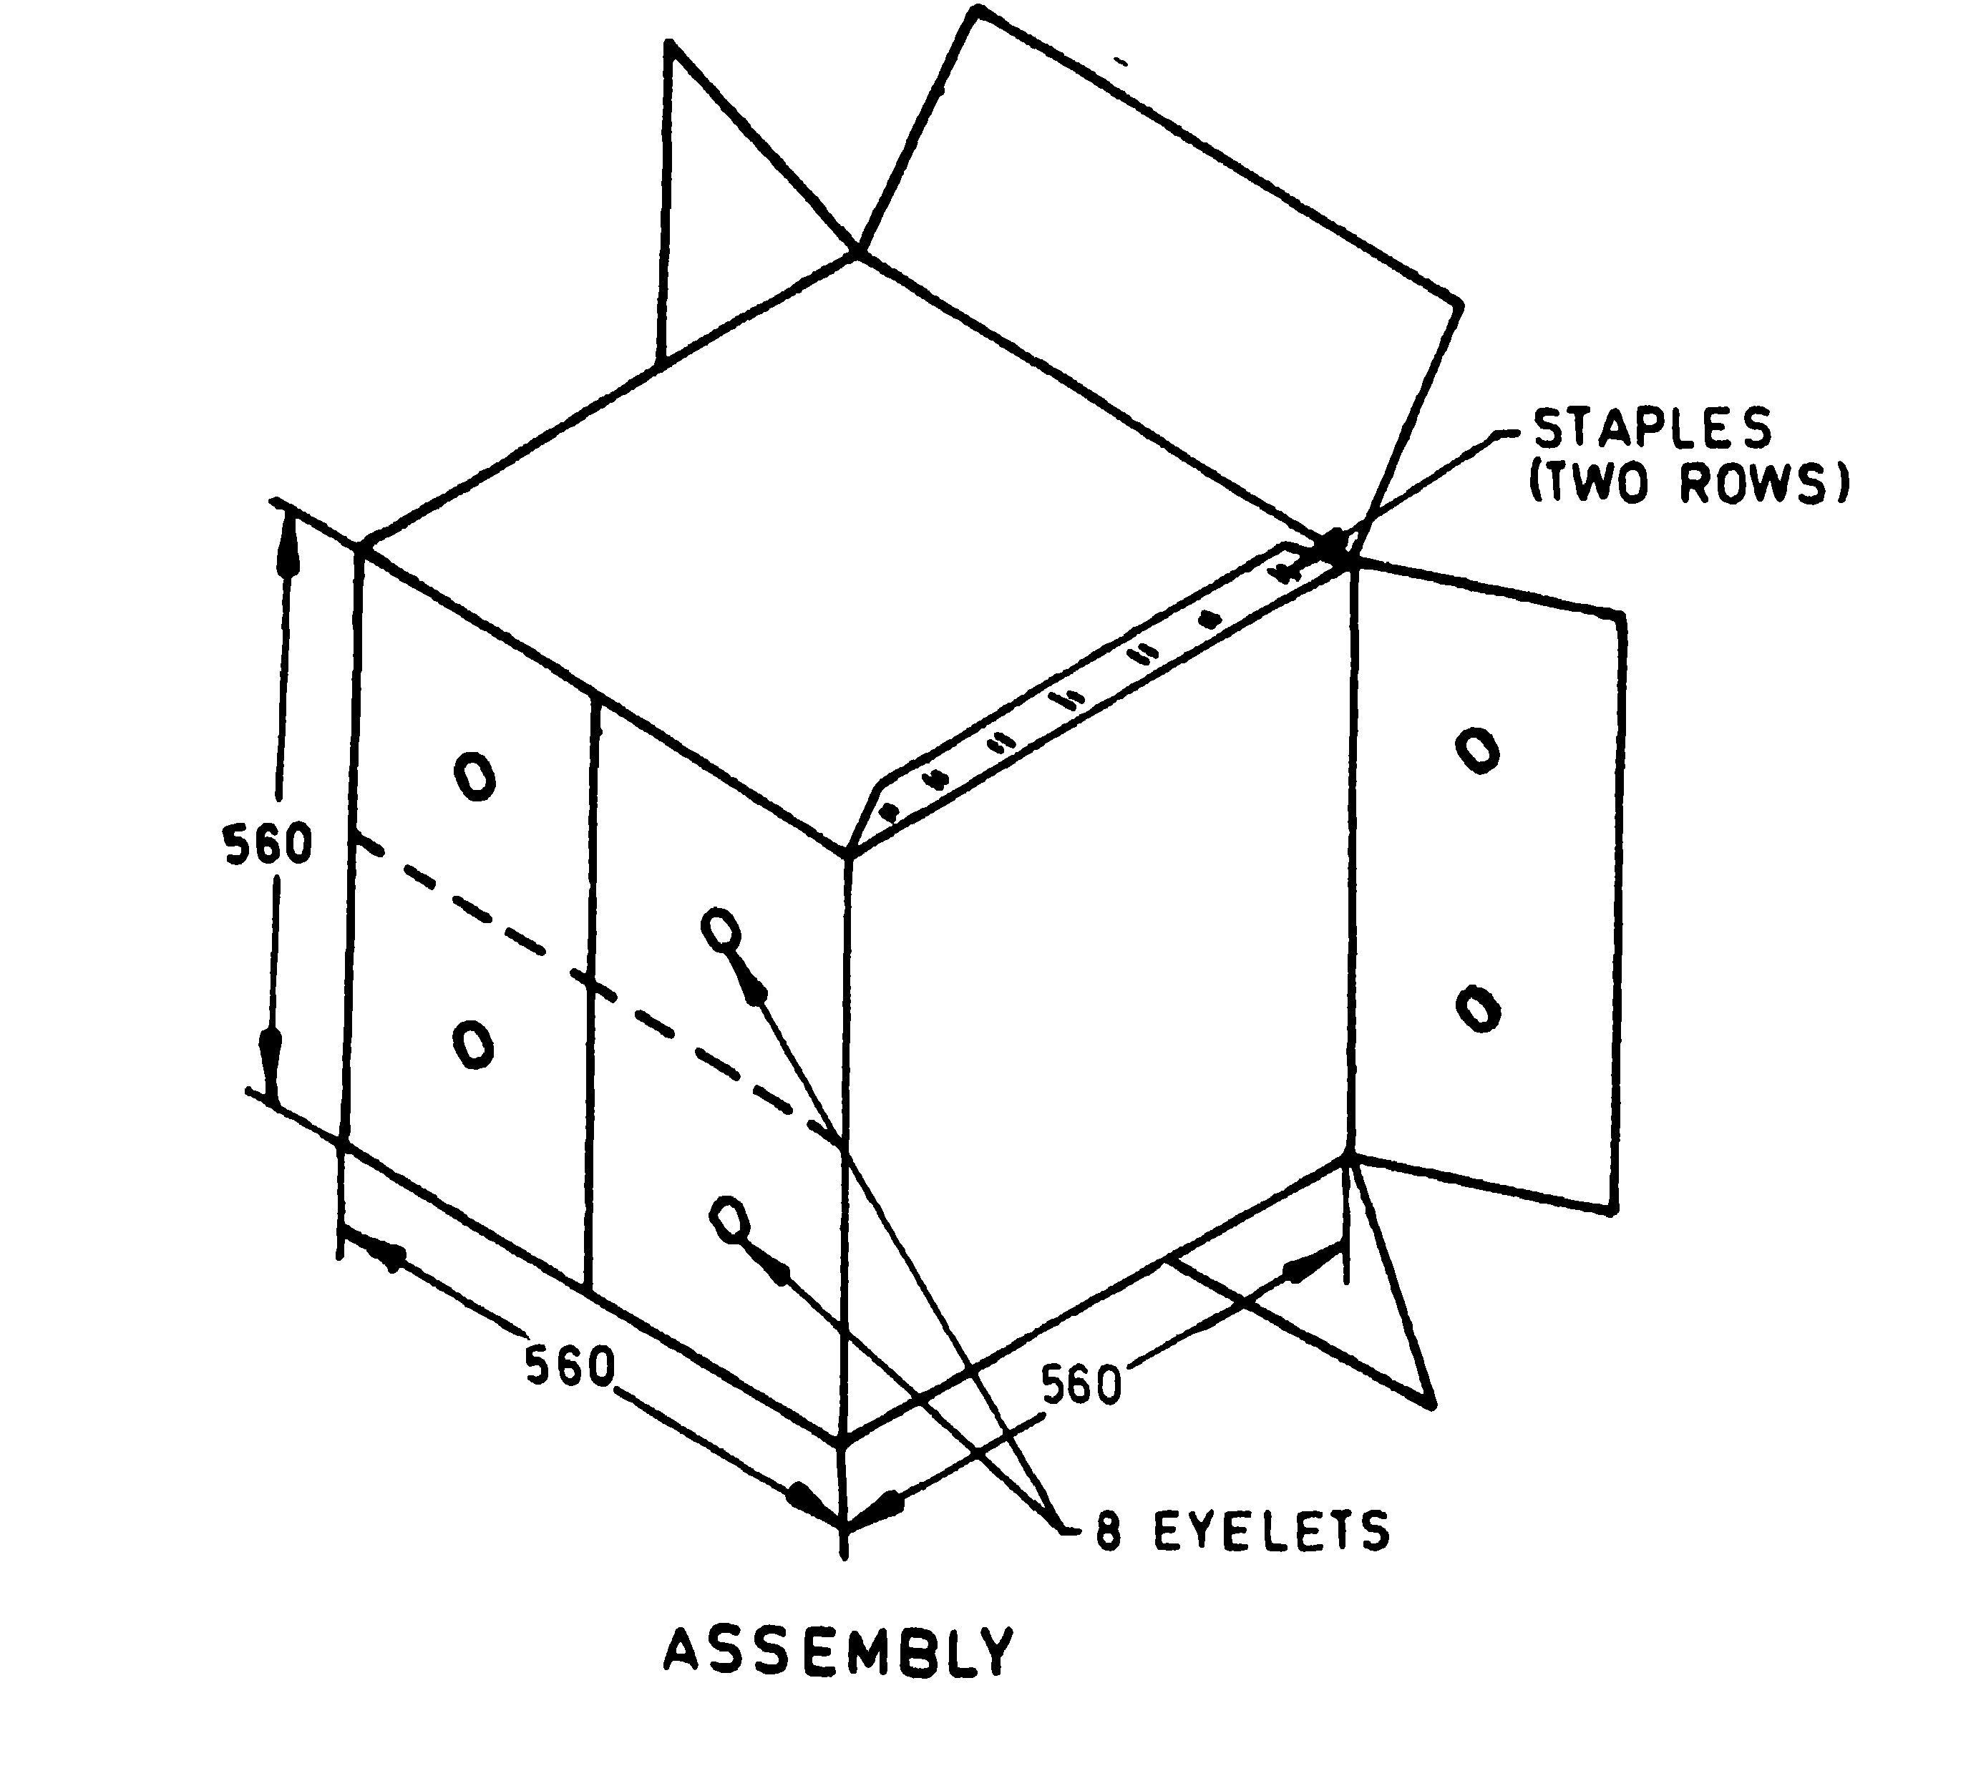
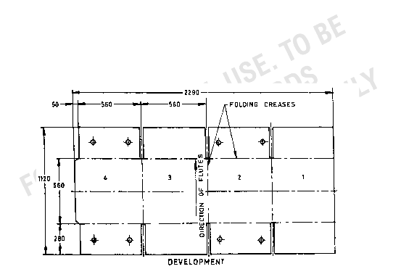
Fibreboard box
(size 560 mm x 560 mm x 560 mm)

Slide 38
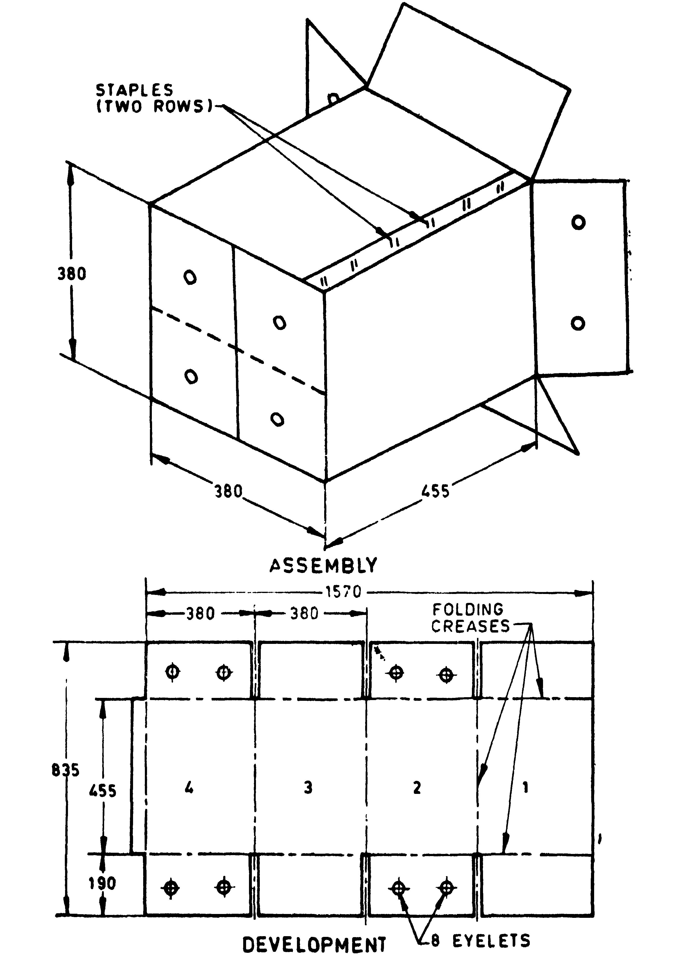
Fibreboard box
(size 380 mm x 380 mm x 455 mm)

Slide 39
Construction requirements
IS IS 17753 : 2021 ‘Paper based Multilayer Laminated/Extruded Composite Cartons (Aseptic and Non-Aseptic) for Processed Liquid Food Products and Beverages — Specification’
This standard is intended to define the quality of paper based multilayer laminated/extruded composite cartons for packaging of processed liquid food and beverages such as dairy products, edible oil, ghee, juice, water, alcoholic beverages, non-dairy beverages, non-dairy cream, puree etc. which are processed either aseptically or non-aseptically.
There are three main components in paper based multilayer laminated/extruded composite cartons.
Paperboard is the main material in composite cartons. It provides stability and strength.
Polyethylene protects against outside moisture and enables the paperboard to stick to the aluminium foil.
Aluminium foil protects against oxygen and light to maintain the nutritional value and flavours of the food in the package.

Slide 40
4 Materials and construction
4.1 The carton shall be made of paper based multilayer composite sheet. The composite sheet shall be made of paper board in combination with polyethylene film and/or aluminum foil. The inner liner of composite sheet shall always be of polyethylene for sealing purpose. Number of layers/ply of multilayer composite sheet shall be either 3-ply or 5-ply or 6-ply based on the desired shelf life of the product. The individual layers of substrate of the composite sheet shall confirm to parameters as given below:
Layer | Requirement | Method of test
Grammage of Paperboard, g/m2, Max | 450 | IS 1060 (Part 5/Sec 5)
Thickness of aluminium foil, microns, Max | 9.7 | Annex A of IS 8970
Thickness of polyethylene, microns, Max | 110 | Annex A of IS 2508

Slide 41
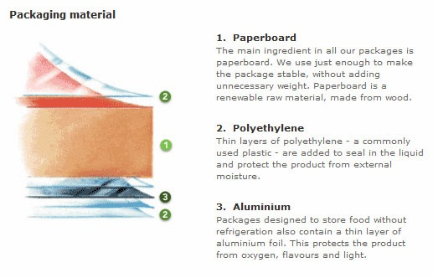
(Cont.)
4.1.1 Paper Board
The paper board used for manufacturing of paper based multilayer laminated/extruded composite cartons shall confirm to IS 16983 or IS 1776 or IS 12999 except for the requirement of grammage. The grammage shall be as given in Table 1. In addition, the paper board shall be OBA (Optical brightening agent) free, and anthraquinone shall not be used in pulp which is used for making paper board. The paper board shall be of virgin material.
4.1.2 Polyethylene
The polyethylene used shall be made from materials LDPE conforming to IS 2508, LLDPE conforming to IS 14500 (or a blend thereof) co extruded film except for the requirement of thickness. The thickness shall be as given in Table 1 above. Polyethylene shall meet the food grade requirements given in IS 10146 and IS 16738.
4.1.3 Aluminium Foil
Aluminium foil used for manufacturing of paper based multilayer laminated/extruded composite cartons shall confirm to clause 4.3 of IS 8970 except for the requirement of thickness. The thickness shall be as given in Table 1.

Slide 42
(Cont.)
4.1.4 Caps shall be made of polypropylene and its copolymers as per IS 10910 for its safe use in contact with liquid foodstuffs.
4.1.5 Drinking Straws shall be made of polypropylene and/or its co-polymer and/or paper based and should be safe to use in contact with liquid foodstuff.
4.1.6 For printing ink application, practices as per IS 15495 shall be followed.
4.2 Composite Cartons Construction
The composite cartons shall be formed, filled and sealed on the suitable form, fill and sealing machine.
4.3 Capacity
The composite cartons shall be in 65 ml, 70 ml, 90 ml, 125 ml, 150 ml, 160 ml, 180 ml, 200 ml, 250 ml, 330 ml, 500 ml and 1000 ml capacity or any other capacity as agreed by the buyer and manufacturer.

Slide 43
Product standards

Slide 44
Structure of a Product Standard
Foreword
Scope
References
Terminology
Materials (Raw materials, if required)
Construction (Construction guidelines, if required)
Requirements (General and performance/ safety requirements)
Packaging and marking
Sampling and criteria for conformity

Slide 45
Scope
IS 14490:2018 Plain copier paper – specification
This standard prescribes requirements and methods of sampling and tests for plain copier paper (cut size paper in A4, A3, A5, FS, B4, B5, Legal sizes) within the specified grammage (GSM).
IS 6615:2021 General purpose packing/ wrapping paper – Specification
This standard prescribes the requirements and methods of sampling and test for general purpose packing/wrapping paper including the brown wrapping paper.

Slide 46
2 References
IS No. | Title
IS 1060 (Part 1) : 2022 | Methods of sampling and test for paper and allied products: Part 1 Test methods for general purpose (second revision)
IS 1060 (Part 3) : 1969 | Methods of sampling and test for paper and allied products: Part 3
(Part 4/Sec 1) : 2014/ISO 187 : 1990 | Methods of Test for Paper, Board and Pulp Section 1 Standard atmosphere for conditioning and testing and procedure for monitoring the atmosphere and conditioning of samples
(Part 5) | Methods of test for paper and board,
(Sec 2) : 2021/ ISO 287 : 2017 | Determination of moisture content of a lot — Oven-drying method (first revision)
(Sec 3) : 2014/ ISO 534 : 2011 | Determination of thickness, density and specific volume
(Sec 4) : 2014/ ISO 535 : 1991 | Determination of water absorptiveness — Cobb method
(Sec 5) : 2021/ ISO 536 : 2019 | Determination of grammage (first revision)
(Sec 6) : 2014/ ISO 1924-2 : 2008 | Determination of tensile properties — Constant rate of elongation method (20 mm/min)
(Part 6/Sec 1) : 2017/ISO 1974 : 2012 | Methods of sampling and test for paper and allied products: Part 6 methods of test for paper: Section 1 determination of tearing resistance - Elmendorf method
IS 1064 : 1980 | Paper sizes (second revision)
IS 4658 : 2019 | Specification for coated paper and board (Art And Chromo) (Second Revision)
IS 4661 (Part 5) : 2022 /ISO 4046-5 : 2016 | Paper, board, pulps and related terms — Vocabulary: Part 5 Properties of pulp, paper and board (third revision)
IS 9894 : 1981 | Methods of test for smoothness/roughness of paper
IS/ISO 2470 (Part 1) : 2009 | Paper board and pulps measurement of diffuse blue reflectance factor : Part 1 Indoor daylight conditions ISO brightness
IS/ISO 2471 : 2008 | Paper and board determination of opacity paper backing diffuse reflectance method

Slide 47
3 Terminology
For the purpose of this standard, the definitions of terms given in IS 4661 shall apply.
4 Material
The reel/sheets intended for manufacturing of plain copier paper (cut size) shall conform to requirements of this standard

Slide 48
5 Requirements
5.1 General
The plain copier paper shall be devoid of pinholes when seen through the naked eyes (see Note 1).The surface shall be well calendered, quite smoothand free from fluff or loose fibers. Surface sizing is desirable for avoiding fluff.
NOTES 1 Eye unaided by any instrument (other than spectacles for eyesight problem) that changes the apparent size or distance of an object. 2 Chemicals sensitive to heat should be avoided for surface sizing as the waxes and some polymers may adhere to photo conductor surface causing defects in photocopy.
The paper shall have good dimensional stability, thermal stability and shall not have any static charge.

Slide 49
(Cont.)
5.2 Moisture
Moisture content shall not be more than 6 percent when tested as per IS 1060 (Part 5/Sec 2).
5.3 Grammage (Substance)
The grammage (substance) of plain copier paper shall be either of 70 g per square metre or75 g per square metre or 80 g per square metre, when tested as per IS 1060 (Part 5/Sec 5). No single test result shall vary by more than ± 4 percent from the nominal grammage. Further the mean value of 10 test results shall not vary from the nominal grammage by more than ± 2.5 percent. The paper under test shall be conditioned as per IS 1060 (Part 4/Sec 1) before it is subjected to this test
5.4 Thickness
The uniform thickness of paper shall not be less than 95 µm, when tested as per IS 1060 (Part 5/Sec 3). 5.5 The paper shall also comply with the requirements given in Table 1.

Slide 50
Table 1 Requirements for Plain Copier Paper
Sl No. | Characteristic | Requirement | Methods of Test, Refer to
(1) | (2) | (3) | (4)
1 | ISO brightness, percent, Min | 85 | IS/ISO 2470 (Part 1)
2 | Opacity, percent, Min | 88 | IS/ISO 2471
3 | One minute cobb test, both sides, g/m2 , Max | 30 | IS 1060 (Part 5/Sec 4
4 | Surface strength, Dennison (Wax Pick) | No pick on 12 A | IS 1060 (Part 3)
5 | Smoothness for both sides (Bendsten), ml/min, Max | 300 | IS 9894
6 | Ash content (at 900°C), percent by mass, Max | 16 | IS 1060 (Part 1)
7 | Taber stiffness, Min |  | Appendix D of IS 4658
 | a) Machine direction (MD | 2.0
 | b) Cross direction (CD | 1.0
8 | Tear index, mN.m2 /g, Min |  | IS 1060 (Part 6/Sec 1)
 | a) Machine direction (MD) | 3.5
 | b) Cross direction (CD) | 4.5
9 | Tensile index, N.m/g, Min |  | IS 1060 (Part 5/Sec 6)
 | a) Machine direction (MD) | 40
 | b) Cross direction (CD) | 25

Slide 51
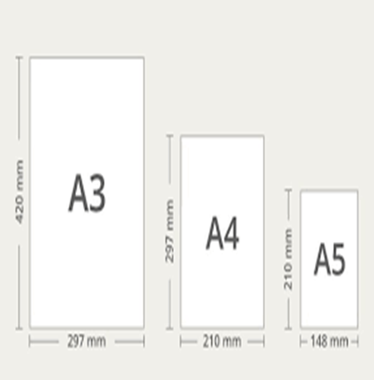
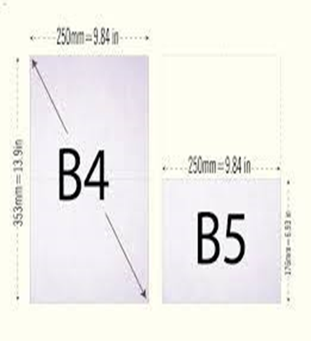
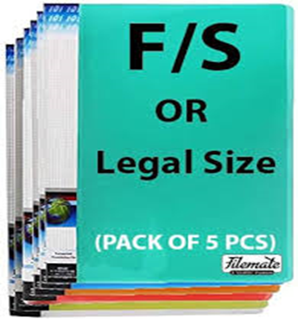
(Cont.)
5.6 Size
The paper shall becut size paper in A4, A3, A5, FS, B4, B5, Legal sizes along with the permissible tolerance according to IS 1064.

Slide 52
(Cont.)
5.7 Additional requirements for Eco-mark
5.7.1 General Requirements
5.7.1.1 The product shall conform to the requirements for quality and performance prescribed under 5.1 to 5.5.
5.7.1.2 The manufacturers need to produce to BIS, environmental consent clearance from the concerned Slate Pollution Control board as per the provisions of Water (Prevention and Control of Pollution) Act, 1974 and Air (Prevention and Control of Pollution) Act, 1981 along with the authorization, if required under the Environment (Protection) Act,1986 while applying for ECO-Mark.
5.7.2 Specific requirements
The material shall be manufactured from pulp containing not less than 60 percent by mass of pulp made from materials other than bamboo, hard woods, soft woods and reed; and
The material shall be manufactured from pulp made from 100 percent waste paper.

Slide 53
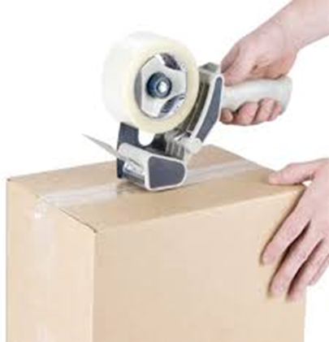
PACKING AND MARKING
6.1 Packing Each ream containing 500/250 sheets of paper shall be wrapped by means of paper of minimum 80 GSM duly laminated to prevent moisture absorption and shall be strong enough to avoid any external impact during transit. It shall then be either packed in shrink bundling or 3/5 ply corrugated cartons to ensure that the paper is not damaged due tohandling and transportation or shall be packed as agreed to between the purchaser and the supplier. The maximum weight per carton should not be more than 40 kg. For packing 100/50 sheets of paper poly pouch may also be used and label shall be marked as per 6.2.
6.1.1 For ECO-Mark, the product shall be packed in such packages which shall be recyclable/reusable or biodegradable.

Slide 54
(Cont.)
6.2 Marking The package shall be marked with the following particulars:
a) Description and size of the paper;
b) Quantity;
c) Mass of 500/250 sheets including wrapping paper, in kg/ream. Chargeable weight should be read as net weight excluding the weight of packing;
d) Lot no. and month and year of manufacture; and e) Name of manufacturer.
6.2.1 For ECO-Mark, following additional information may also be marked on the container/package: The criteria for which the product has been labelled with ECO-Mark.

Slide 55
7 SAMPLING AND CRITERIA FOR CONFORMITY
7.1 The plain copier paper shall be sampled in accordance with 3 of IS 1060 (Part 1).
7.2 Tests
From each of the ream, selected from the lot (see 7.1), one sheet shall be taken out at random from each ream subject to total minimum 10 sheets, if selected reams are less than 10. These sheets shall constitute the sample. The sheets selected shall first be tested for general requirements given in 5.1 and 5.6. One test pieceshall be cut from each sheet selected for each of the characteristics mentioned in 5.2 to 5.4 and Table 1 and tested. A sheet not meeting the requirements for any one or more characteristics shall be considered as defective.
7.3 Criteria for Conformity
A lot shall be declared as conforming to all the requirements of this standard if the number of defective sheets found does not exceed the acceptance number. The acceptance number shall depend upon the size of the sample and shall be zero if the size is less than 13. The acceptance number shall be one if it is greater than or equal to 13.

Slide 56
Some other requirements

Slide 57
Sustainability aspect : Requirements for Eco-mark
General requirements:
The manufacturers need to produce to BIS, environmental consent clearance from the concerned Slate Pollution Control board as per the provisions of Water (Prevention and Control of Pollution) Act, 1974 and Air (Prevention and Control of Pollution) Act, 1981 along with the authorization, if required under the Environment (Protection) Act,1986 while applying for ECO-Mark.
Specific requirements:
The material shall be manufactured from pulp containing not less than 60 percent by mass of pulp made from materials other than bamboo, hard woods, soft woods and reed; and
The material shall be manufactured from pulp made from 100 percent waste paper.

Slide 58
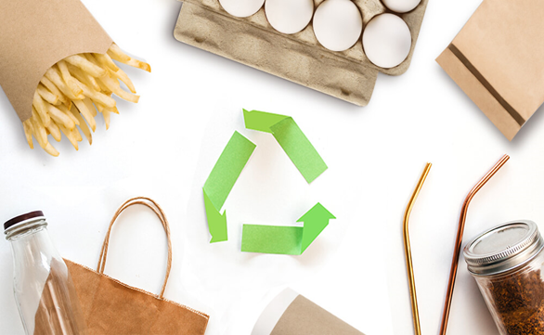
Food safety aspect – Materials in contact with food
The material when used for the packaging of food materials shall be manufactured from virgin pulp and shall be free from dioxins and Bisphenol-A (BPA). Printed surfaces of the paper shall not come into contact with the food and the maximum amounts of contaminants in paper intended to come into contact with food shall not exceed the limits given below:
Contaminant | Paper Intended to Come into Contact with Dry Food (mg/kg of paper) | Paper Intended to Come into Contact with Wet Food and Food with Fatty Surface (mg/kg of paper) | Paper for Filtration (mg/kg of paper)
Cadmium (Cd) | -- | 0.5 | 0.5
Chromium(Cr⁶⁺) | -- | 0.1 | 0.1
Lead (Pb) | -- | 3.0 | 3.0
Mercury (Hg) | -- | 0.3 | 0.3
Pentachlorophenol (PCP) | 0.05 | 0.05 | 0.05
Polychlorinated biphenyls (PCBs) | 2.0 | 2.0 | 0.5

Slide 59
Procedures for determination of contaminants
Chromium (as Cr6+) – Colorimetrically by reaction with diphenylcarbazide in acid solution at a wave length of 550 nm
Mercury (as Hg) – Atomic absorption procedure at 253.7 nm by Mecury vapour
Lead (as Pb) – electro thermal atomic absorption spectrometric method.
CADMIUM (as Cd) – electro thermal atomic absorption spectrometric method
PENTACHLOROPHENOL (PCP) – Soxhlet extraction with acetone, followed by acetylation which is quantified by Gas Chromatograph-Electron Capture Detector (GC-ECD).
POLYCHLORINATED BIPHENYLS (PCBs) – extraction with boiling ethanolic potassium hydroxide solution followed by extraction with hexane which is quantified by GC-ECD by comparing the pattern of the peaks with the pattern of a suitable technical PCB.

Slide 60
IS 17753 : 2021 ‘Paper based Multilayer Laminated/Extruded Composite Cartons (Aseptic and Non-Aseptic) for Processed Liquid Food Products and Beverages — Specification’
Shelf-life test
5.2.4.1 Paper based multilayer laminated /extruded composite sheet shall be tested for shelf-life properties.
5.2.4.2 The shelf-life test for Paper based multilayer laminated /extruded composite sheet shall be carried out at 38 ± 1°C and 90 ± 2 percent RH (accelerated conditions) or 27 ± 1°C and 65 ± 2 percent RH (standard conditions). Aerobic Microbial Count, Staphylococcus Aureus, E. Coli, Coliform Count, Salmonella and Yeast and Mould shall be noted initially and required to meet the requirements given in Col 3 of Table 3 when determined as per the method given in Table 3 as per the schedule given in Col 3 and Col 4 of Table 4.

Slide 61
Microbiological parameters for Paperbased multilayer Laminated/ Extruded Composite Sheet
SI. No. | Characteristic | Requirement | Method of test, ref to
(1) | (2) | (3) | (4)
i | Total bacterial count, CFU/g, Max | 10x10³ | ISO 8784-1
ii | Total spore count, CFU/g, Max | 10x10³ | ISO 8784-1
ii | Yeast and Mould, CFU/100 cm², Max | 10 | ISO 8784-2
Test Period for the Shelf-life test
SI. No. | Shelf Life(month) ¹⁾ | Accelerated Condition (Days) | Standard condition (Days)
(1) | (2) | (3) | (4)
i | 3 | 30 | 90
ii | 6 | 60 | 180
iii | 9 | 90 | 270
iv | 12 | 120 | 365
v | n | 10n | 30n
¹⁾ The period at 6.2.2 (c) from the date ‘date of manufacture’. ²⁾ n is shelf life of product in months.

Slide 62
(Cont.)
During the test period the Paper based multilayer laminated /extruded composite sheet shall be observed for any delamination and deformation into the laminated structure. The sheet shall meet the requirements given in Col 3 of the Table 3 for microbiological parameters. The Paper based multilayer laminated /extruded composite sheet shall be accepted when:
The sheet meets the requirements for microbiological parameters at the end of days declared as shelf life or at the end of accelerated condition days; and
there is no delamination and no deformation into the Paper based multilayer laminated /extruded composite sheet at the end of days declared as shelf life and at the end of accelerated condition days.

Slide 63
(Cont.)
5.2.5 Water Vapour Transmission Rate (WVTR) and Oxygen Transmission Rate (OTR)
5.2.5.1 The paper based multilayer laminated/ extruded composite sheet passing the shelf-life test shall be tested for water vapour transmission rate (WVTR) according to Annex C or IS 17846 and Oxygen transmission rate according to ISO 15105-2.
5.2.5.2 The requirements for WVTR and OTR shall be declared by manufacturer of paper based multilayer laminated/ extruded composite sheet/carton based on the 5.2.5.1. Samples shall be assessed on declared value. The WVTR and OTR when measured in accordance with 5.2.5.1 shall be within ± 5 percent of the declared value.
5.2.6 Print Resistance Test
The printed paper based multilayer laminated/extruded composite cartons when tested in accordance with the method given in Annex D shall not show any significant removal of the print from the surface and the print shall be legible to the naked eye after the test.
NOTE — Print resistance test will not be applicable to composite cartons where outer surface of the carton is laminated/extruded with plastic film.
5.2.7 Ink Adhesion Test — The printed matter on the paper based multilayer laminated/extruded composite cartons when tested in accordance with the method given in Annex E shall be still legible.
NOTE — Ink adhesion test will not be applicable to composite cartons where outer surface of the carton is laminated/extruded with plastic film.

Slide 64
Code of practices

Slide 65
Examples
IS 4645:2024 Storage of Paper and board – Code of practice
This standard provides guidance on practices to be followed for the storage of paper and board.
Structure of the warehouse, mode of stacking and general precautions to protect damage by insects and rodents and protection against environmental damage and fire have been suggested in the standard.
IS 6481:1971 Guide for principal uses and styles of fibreboard containers
This standard gives the factors to be considered for the use and design of fibreboard containers. It also gives various styles of fibreboard containers and the various methods for their closing.
This standard covers
Guiding factors for using fibreboard containers
Symbols and abbreviations
Guidance for using the code
Basic type groups of boxes
Guidance for closing of the boxes

Slide 66
IS 6211:1993 Code of practice for packaging of paper and board
This standard lays down the recommended practices to be adopted in the packaging of common varieties of paper and board. Packaging practices for special types of paper like tissue, varnish, etc, are not covered in this standard.
This standard provides guidance on
Packing in reams
Racking in reels
Packing of paper for export

Slide 67
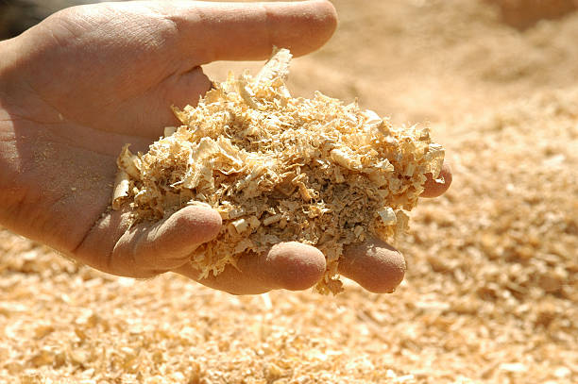
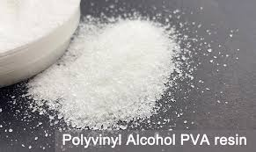
Raw materials
Pulp
Wood pulp (IS 17726:2021)
Sizing materials
Gelatin (IS 11227:2022)
Polyvinyl alcohol (IS 12715:1989)

Slide 68
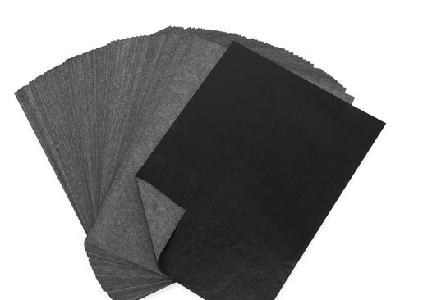
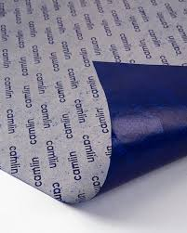
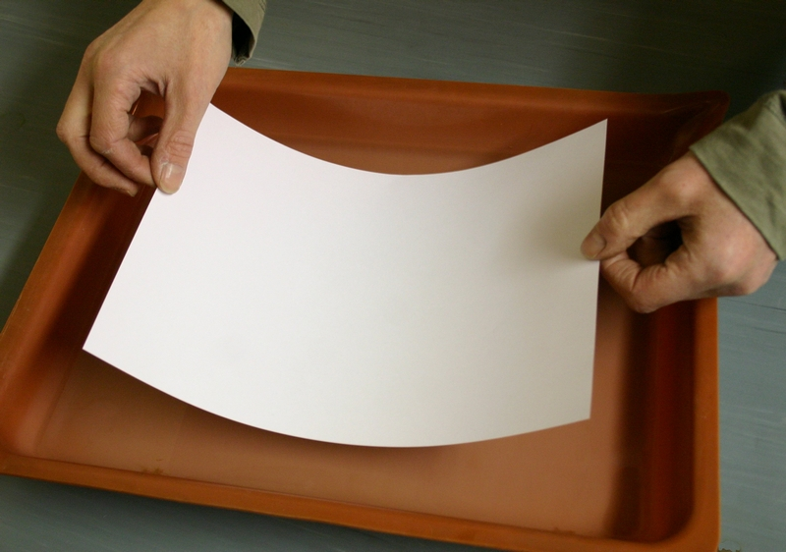
Base papers for finished products
Base paper for Tracing paper (IS 11687:1986)
Base paper for one-time carbon paper (IS 12808:2024)
Base paper for carbon paper (IS 3413:2004)
Release base paper (IS 14619:1998)
Base paper for sensitized paper (IS 1775:1981)

Slide 69
Visit our Website: www.bis.gov.in
Thank You

