Slide 1
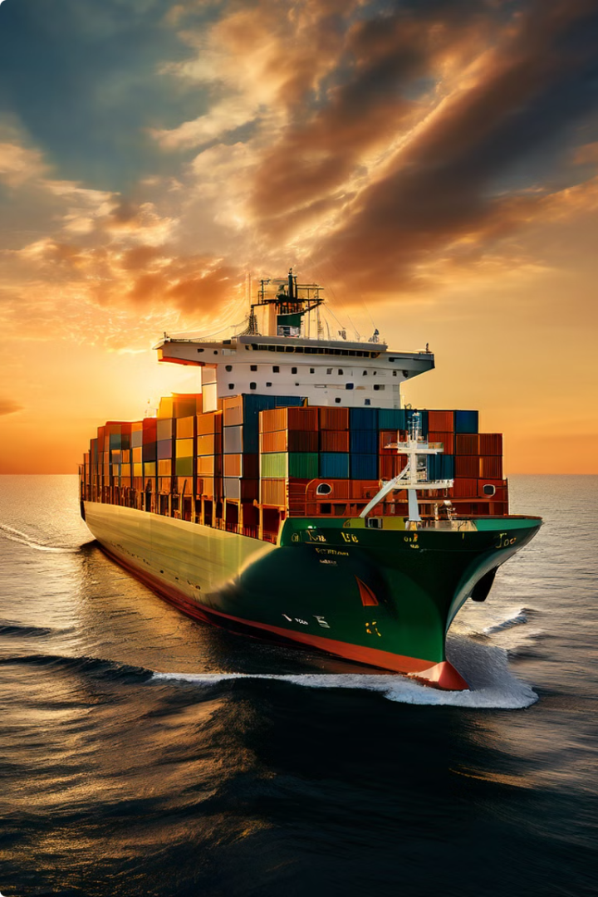
Sailing with Standards – Shipbuilding and Marine Engineering
In the realm of Shipbuilding, the Standards aren't merely guidelines; they're the bedrock upon which every project rests. When it comes to these Standards, Bureau of Indian Standards (BIS) become familiar ally, guiding us through the intricate web of rules and requirements.
Presentation By
TED , BIS

Slide 2
Let’s See Through the Lens of Syllabus
1. Introduction and Terminology
2. Marine Design (Hydrodynamics of Hull & Superstructure)
3. Propulsion System (with Fuel & Lubrication and Cooling system)
4. Navigation System
5. Sustainability & Environmental Concerns
6. Safety Aids

Slide 3
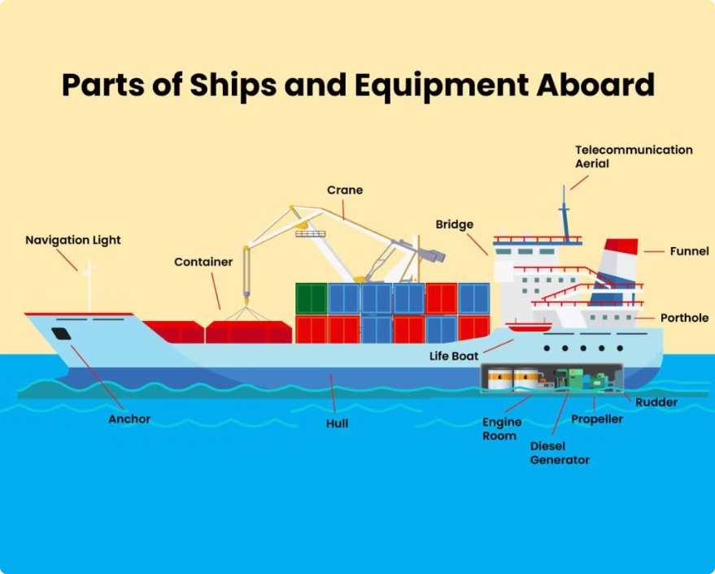
1
Introduction and Terminology
IS 8650: Shipbuilding and marine structures -Vocabulary
This standard outlines the key structural and functional components of a ship, from the bow and stern to the mast and bridge. Understanding these parts is crucial for navigating, operating, and maintaining vessels of all sizes, whether for commercial, military, or recreational purposes.

Slide 4
The Hull
The ship's hull is crucial because it provides buoyancy, allowing the ship to float, and offers structural strength to withstand waves and weather. It also ensures stability, keeping the ship upright and safe during expedition.
Structure
Materials
Hydrodynamics
The hull is the main body of the ship, providing the structural foundation and buoyancy to keep the vessel afloat.
Hulls are typically made from steel, aluminum, or composite materials, each offering different strengths and weight characteristics.
The hull's shape is designed to minimize drag and maximize efficiency in the water, enabling the ship to move smoothly and efficiently.

Slide 5
The Deck
The ship's deck is a flat, horizontal surface covering the hull, providing an open space for crew activities, navigation, and cargo handling. It connects different parts of the ship, ensuring structural integrity and safety during operations. Decks are essential for maintaining stability and accommodating various ship functions.
1
Cargo Handling
2
Passenger Access
3
Navigation and Controls
The deck is where cargo is loaded, unloaded, and secured, often with the aid of cranes and other specialized equipment.
On passenger ships, the deck provides access to various amenities and entertainment areas for travelers.
The deck may also house critical navigation and control systems, such as the ship's steering wheel and communication equipment.

Slide 6
The Superstructure
The superstructure of a ship refers to the part above the main deck, including cabins, navigation bridge, and other facilities. It houses crew and passengers, contains navigation equipment, and provides shelter from weather. This upper portion also affects stability and performance, crucial for efficient and safe maritime operations.
Upper Decks
Functional Spaces
Structural Support
The superstructure refers to the upper levels of the ship, which may house passenger cabins, dining areas, and other amenities.
It may also contain critical operational spaces, such as the bridge, navigation systems, and communication equipment.
The superstructure plays a crucial role in providing additional structural support and stability to the overall ship design.

Slide 7
The Cargo Hold
1
Storage
The cargo hold is the primary storage space for the ship, designed to accommodate a wide variety of goods and materials.
2
Loading/Unloading
Efficient loading and unloading operations are crucial, as they impact the ship's overall turnaround time and profitability.
3
Optimization
Careful planning and organization of the cargo hold's layout can maximize the available space and ensure optimal weight distribution.

Slide 8
The Bridge
The Nerve of Ship
The bridge of a ship is its command center, located on the superstructure. It houses navigation instruments, controls for steering and propulsion, and communication equipment. From here, officers command the vessel, monitor surroundings, and ensure safe navigation, making it essential for coordination and decision-making during voyages.
Navigation
The bridge is the command center of the ship, where the captain and crew navigate the vessel and make critical decisions.
Communication
It houses various communication equipment, allowing the crew to stay in touch with shore-based operations and other vessels.
Monitoring
The bridge is equipped with a variety of instruments and displays that provide the crew with real-time information about the ship's performance and environment.

Slide 9
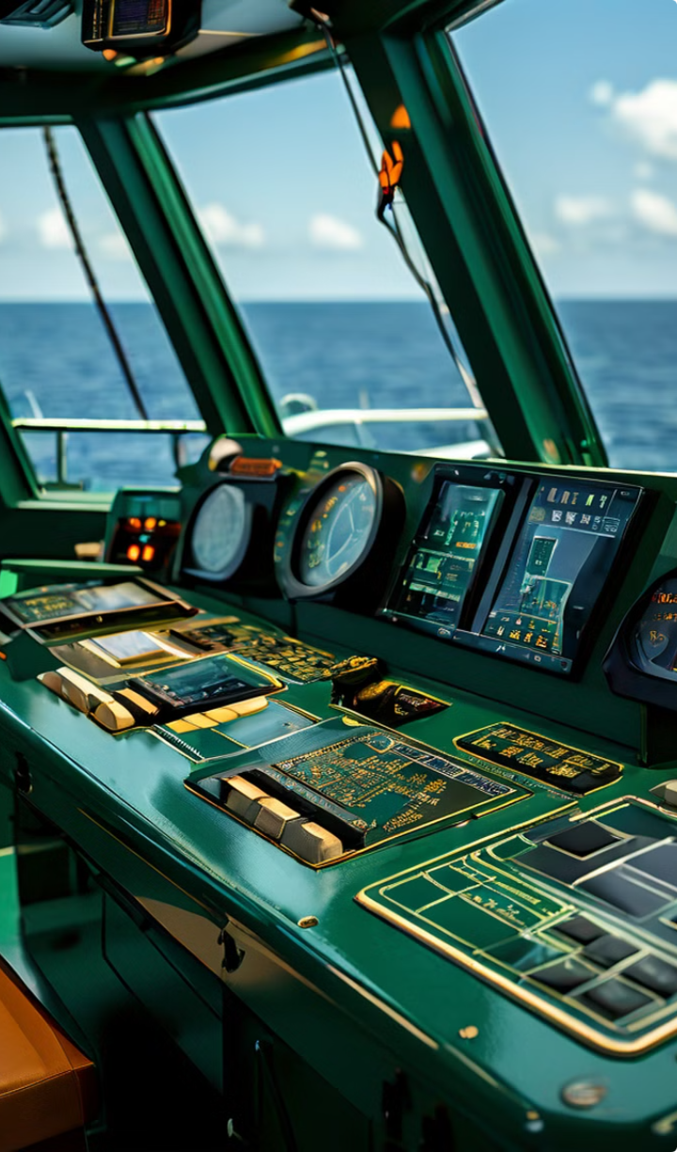
Navigation Equipment
Compass
A compass is a critical navigation tool, helping the crew determine the ship's heading and direction of travel.
Radar
Radar systems allow the crew to detect and track the movement of other vessels, obstacles, and weather patterns.
GPS
Global Positioning System (GPS) technology provides the crew with precise location and navigational data.
Communication
Advanced communication systems enable the crew to stay connected with shore-based operations and other ships.

Slide 10
The Engine Room
The engine room of a ship is its powerhouse, where engines, boilers, and generators are housed. It's vital for propulsion, generating electricity, and providing essential services like heating and cooling. Engineers monitor and maintain equipment here, ensuring the ship operates efficiently and reliably throughout its journey at sea.
Propulsion
Electricity Generation
Maintenance
The engine room houses the ship's main propulsion systems, which provide the power to move the vessel through the water.
It also contains generators that produce the electricity needed to power the ship's various systems and amenities.
The engine room is a hub of critical maintenance and repair work, ensuring the ship's systems remain in top condition.

Slide 11
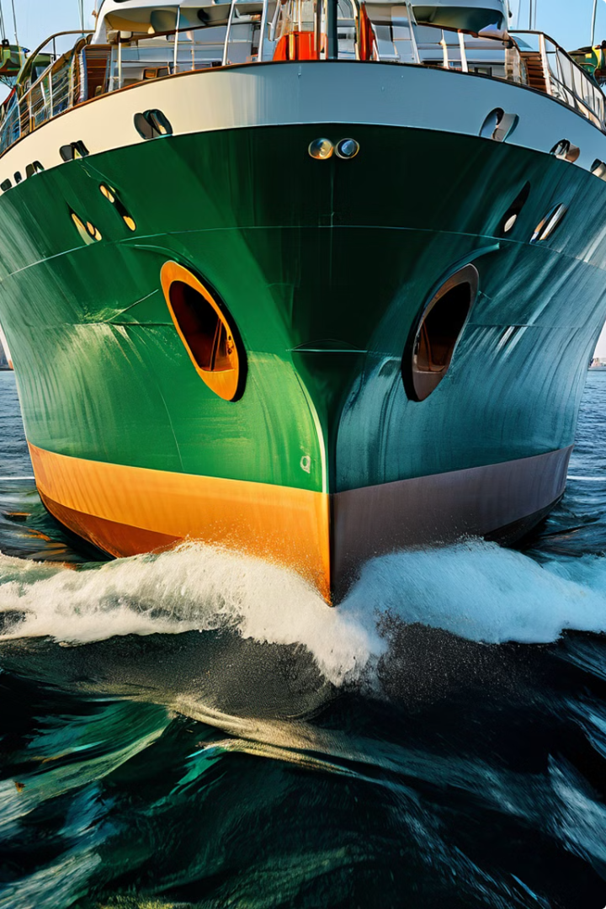
Bow, Stern, Rudder and Anchors
Bow
The bow is the front part of the ship, designed to slice through the water with minimal resistance.
Stern
The stern is the rear part of the ship, where the propulsion system is typically located.
Rudder
It's a flat, vertical plate located at the stern (back) of the ship, typically below the waterline directs the flow of water passing the stern, allowing the ship to change direction by altering the angle of the rudder.
Anchors
Anchors are used to secure the ship in place, preventing it from drifting or being carried away by currents or winds.

Slide 12
Ballast and Safety Equipment
Ballast tanks are filled with water to provide stability and balance the ship, especially when carrying light or no cargo.
Ballast Tanks
Life boats and Life Rafts
Life boats and rafts are essential safety equipment, providing a means of evacuation in the event of an emergency.
Life Jackets
Life jackets are personal flotation devices that help keep individuals afloat in the water.
Emergency Lighting
Illumination systems that activate during power failures or emergencies.

Slide 13
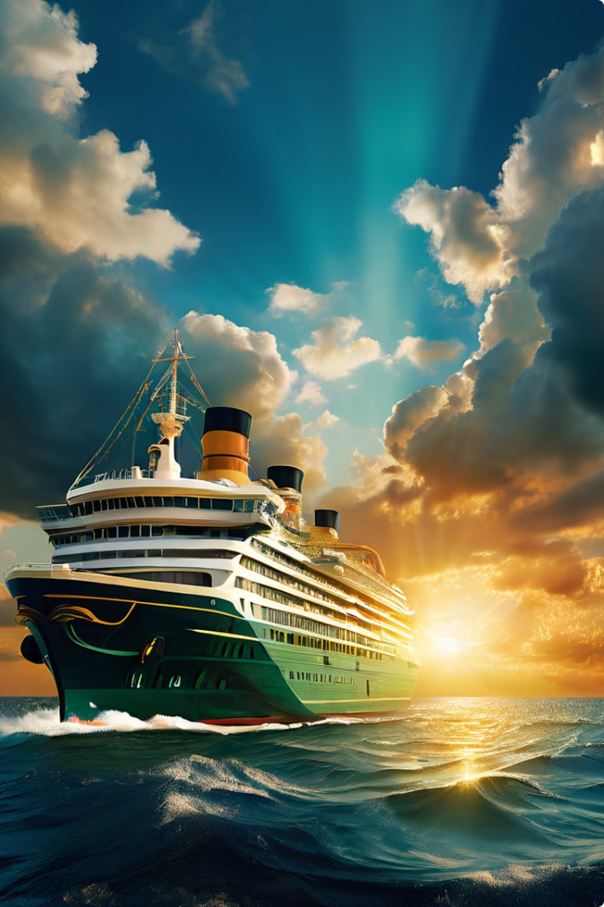
2
Marine Design (Hydrodynamics)
Let us now delve into the scientific principles from the fundamental laws of fluid dynamics to the latest advancements in computational modeling in designing of the ships, highlighting the standards needed.

Slide 14
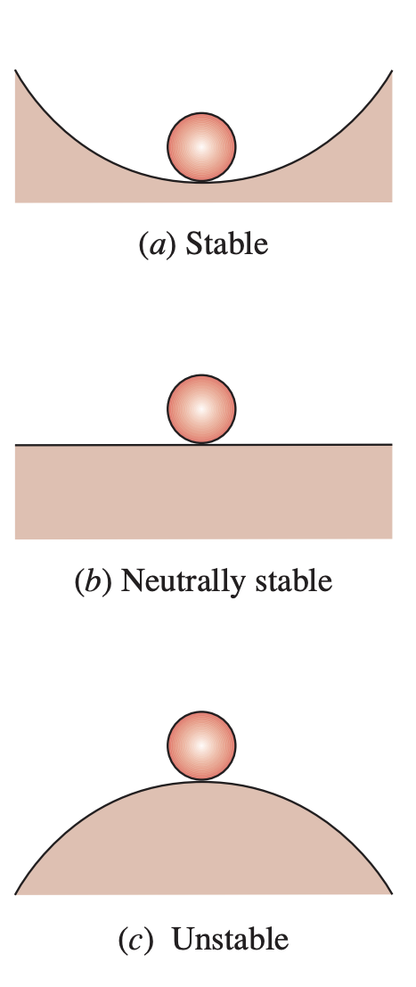
Let's revisit the basic principle of stability of a floating body
Stability can be easily understood by analyzing a ball on the floor

Slide 15
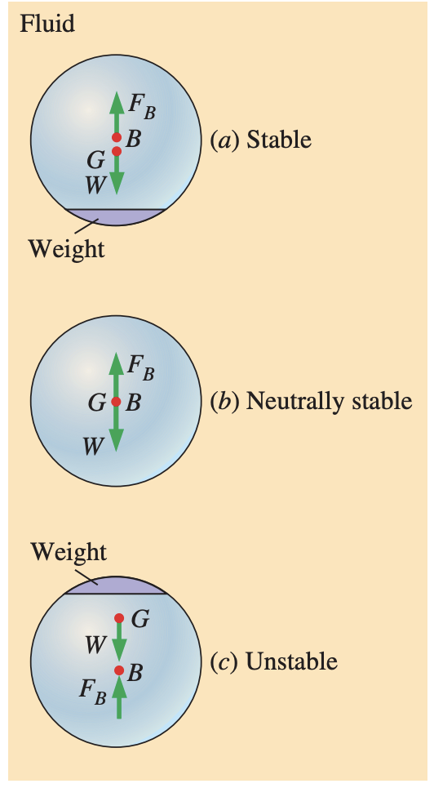
Cont………
Stable if the center of gravity G is directly below the center of buoyancy B of the body
Neutrally Stable if G and B coincident
Unstable if G is directly above B

Slide 16
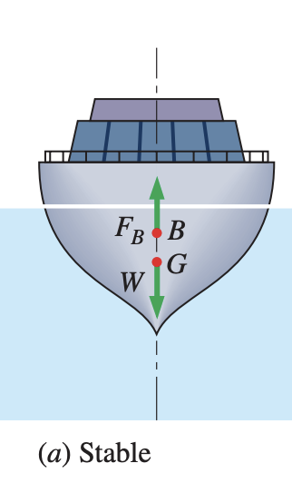
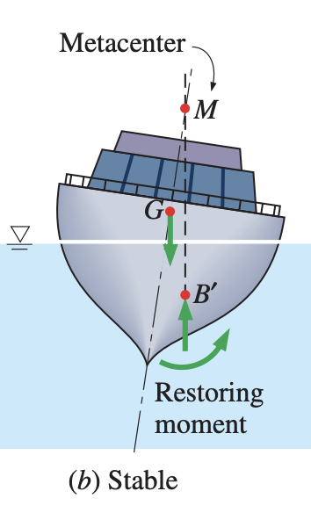
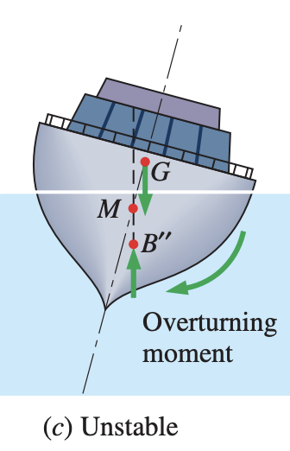
Cont………
Bottom-heavy and thus the center of gravity G is below the centroid B of the body
if the metacenter M is above point G
if the metacenter M is below point G

Slide 17
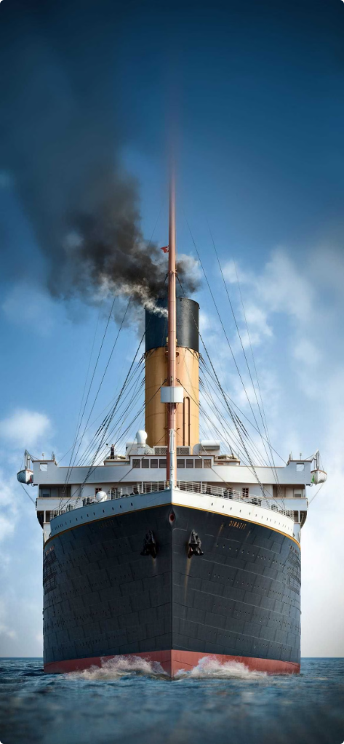
The Anatomy of the Hull
Bow
The forward section of the hull, designed to part the water efficiently.
Midship
The central section of the hull, where the majority of the vessel's volume and weight is concentrated.
Stern
The rear section of the hull, shaped to provide stability and control during propulsion.
Keel
The backbone of the hull, running the length of the ship and providing stability and steering control.

Slide 18
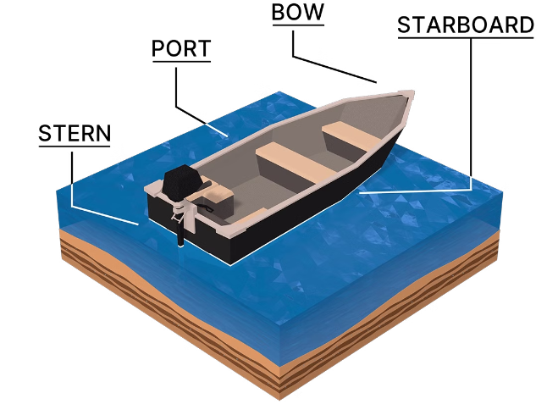
The Hydrodynamics of the Hull
1
Bow
The forward part of the hull, designed to efficiently part the water and reduce drag.
2
Midship
The central section of the hull, where the majority of the vessel's volume and weight is concentrated.
3
Stern
The rear part of the hull, shaped to provide stability and control during propulsion.

Slide 19
The Role of the Hull in Buoyancy
Displacement
The volume of water displaced by the hull determines the ship's buoyancy and weight capacity.
Ballast
Adding or removing water ballast adjusts the ship's center of gravity and stability in the water.
Trim
The hull's trim, or angle, affects the vessel's stability, handling, and fuel efficiency.

Slide 20
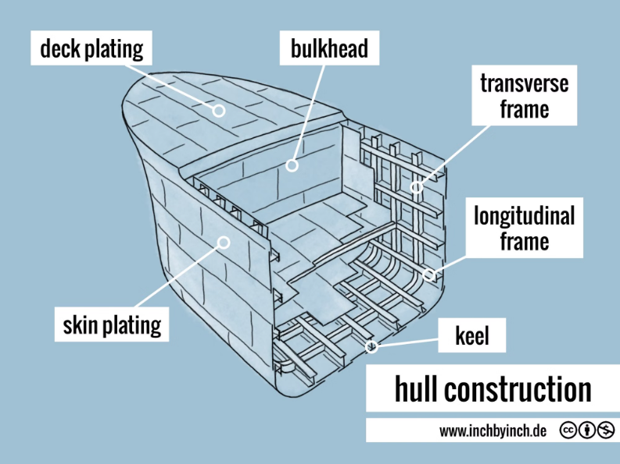
The Structure of the Hull
Frame
The internal skeleton of the hull, providing structural support and defining the overall shape.
Skin
The outer layer of the hull, made of materials like steel or aluminum, protecting the vessel from the elements.
Keel
The backbone of the hull, running the length of the ship and providing stability and steering control.

Slide 21
IS 16183- Hull Design
Hull Shape
Bow Design
The shape of a ship's hull is crucial for its performance in water. It determines the ship's resistance to motion, its speed, and its stability. The hull is designed to minimize drag, maximize efficiency, and ensure safe operation.
The bow, or front, of the ship is carefully designed to cut through the water with minimal resistance. Different bow shapes are used for different types of vessels, optimizing them for speed, maneuverability, and seaworthiness.
Stern Design
Hull Sections
The stern, or rear, of the ship is designed to efficiently direct the flow of water away from the hull, minimizing drag and turbulence. The stern also houses the propulsion system and often features rudders for steering.
The hull is typically divided into sections, each with a specific purpose and shape. These sections include the forebody, midship, and afterbody, which are designed to optimize the ship's hydrodynamic performance.
Standardization Work Related to Hull by BIS

Slide 22
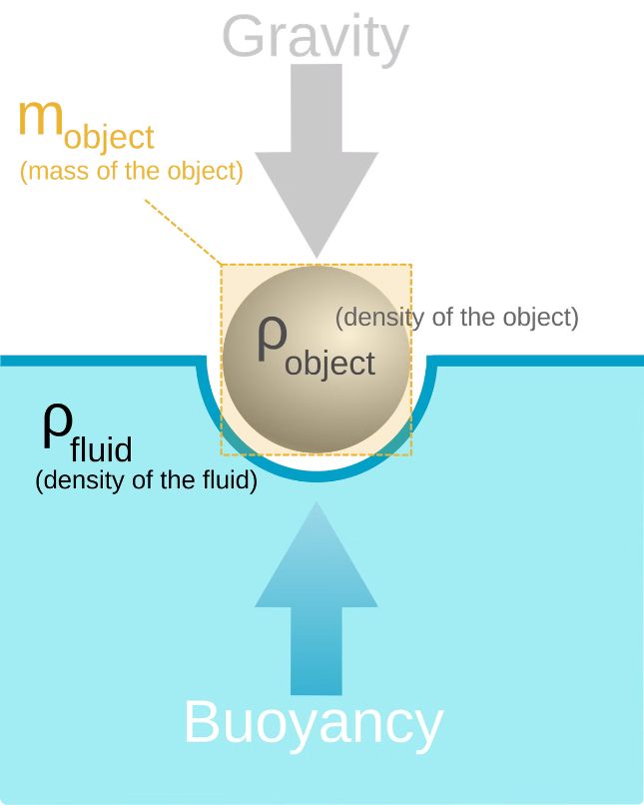
Hydrodynamics of the Hull
1
Structural Integrity
The hull is responsible for the ship's overall strength and durability, protecting the vessel and its cargo from the harsh marine environment.
2
Hydrodynamics
The hull's design directly impacts the ship's speed, maneuverability, and fuel efficiency, making it a critical factor in the vessel's performance.
3
Buoyancy and Stability
The hull's shape and displacement determine the ship's ability to float and remain upright, ensuring a safe and stable voyage.
Standardisation work related to Hull Hydrodynamics by BIS

Slide 23
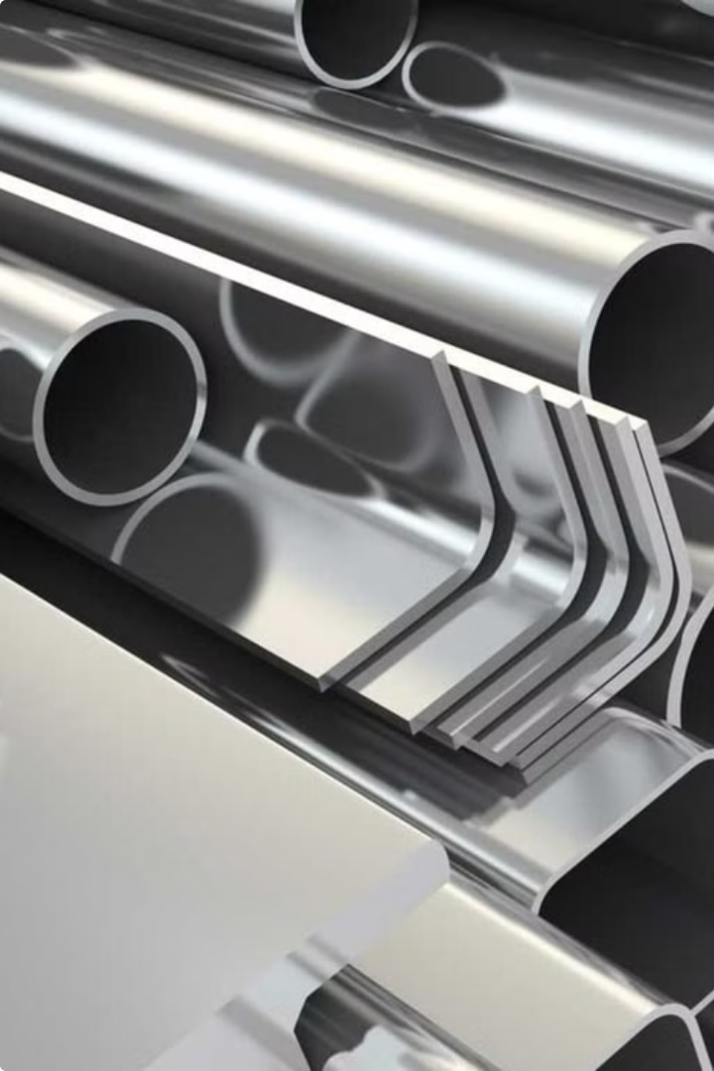
Materials Used in Hull Construction
Steel
A common and durable material used in the construction of large commercial and military vessels.
Aluminum
Lightweight and corrosion-resistant, often used in smaller recreational boats and yachts.
Fiber-Reinforced Composites
Advanced materials that combine strength, lightweight, and customizability for specialized vessels.
Wood
Traditional material used in historical and classic boat designs, providing a unique aesthetic appeal.

Slide 24
Material Selection and Structural Integrity
Material
Properties
Applications
Steel
High strength, durability, affordability
Hull plating, structural components
Aluminum
Lightweight, corrosion resistance, high strength-to-weight ratio
Superstructures, deck structures, smaller vessels
Fiberglass
Lightweight, corrosion resistance, good insulation properties
Recreational boats, smaller vessels, specialized applications
Composite Materials
High strength-to-weight ratio, tailorability, resistance to fatigue
Specialized components, high-performance vessels
Indian Standards related to Materials for Hull Construction

Slide 25
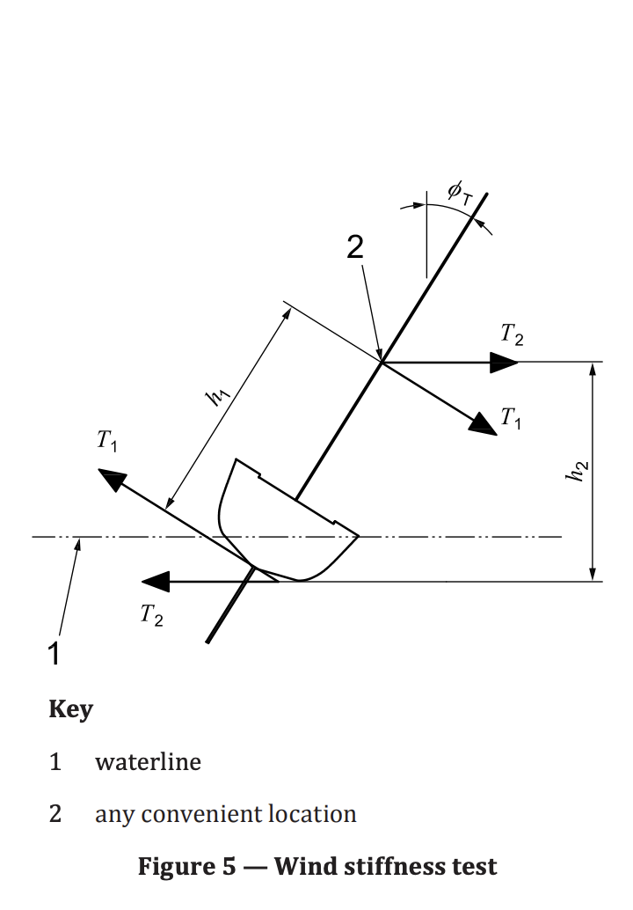
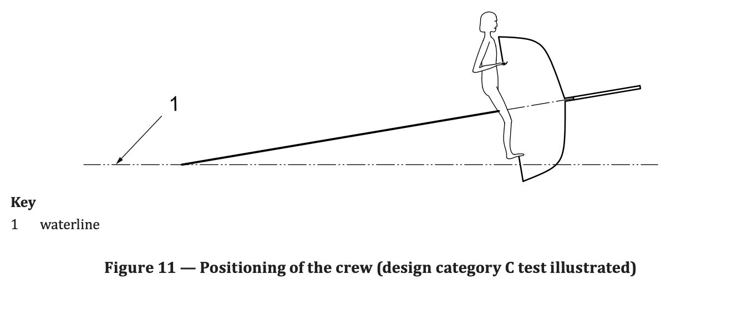
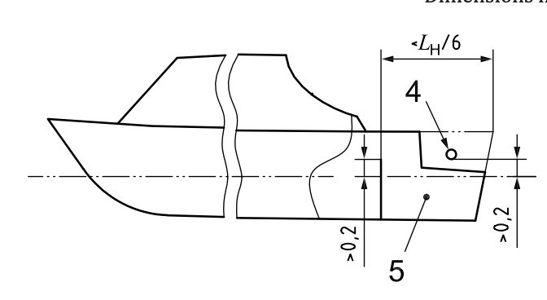
Illustration of Test Covered under mentioned standards

Slide 26
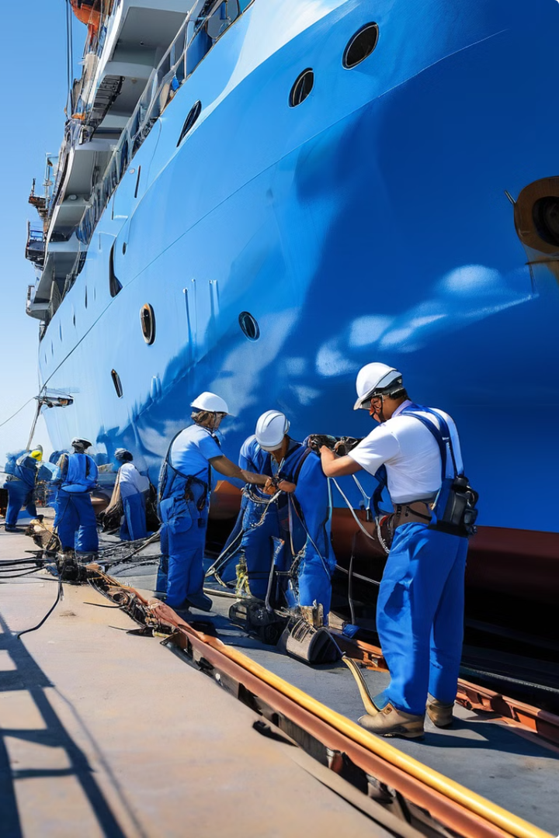
Maintenance and Repair of the Hull
Regular Inspections
Checking the hull for cracks, corrosion, or damage to ensure structural integrity.
Antifouling Coatings
Applying specialized paints to prevent the buildup of marine growth and improve hydrodynamics.
Hull Cleaning
Removing debris, algae, and other fouling to maintain the hull's smooth surface and performance.
Repair and Retrofitting
Addressing any issues through patching, reinforcing, or replacing damaged sections of the hull.
Indian Standards related to Hull Repair

Slide 27
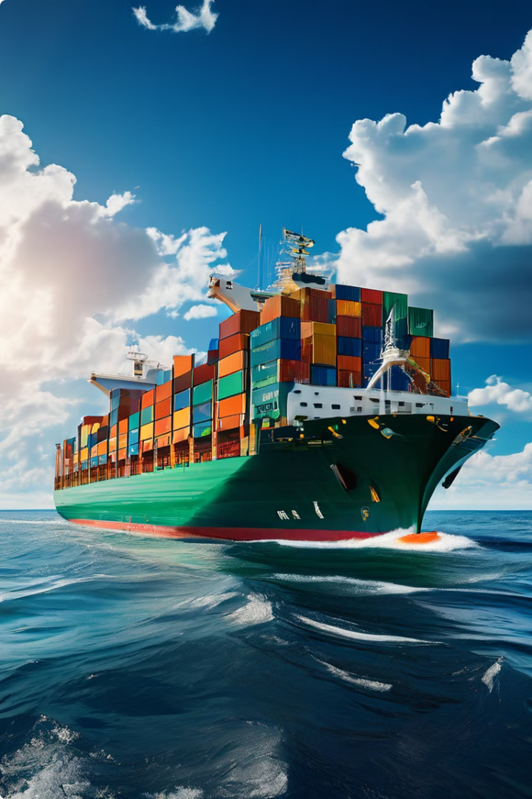
Ship Superstructure: An Introduction
The superstructure of a ship is the uppermost part of the hull that extends above the main deck. It houses essential equipment, living spaces, and navigational instruments. Superstructures play a crucial role in the functionality and safety of a ship, providing vital spaces for crew, cargo, and operation. In this presentation will learn about the ship superstructures, exploring their construction, design, and significance.

Slide 28
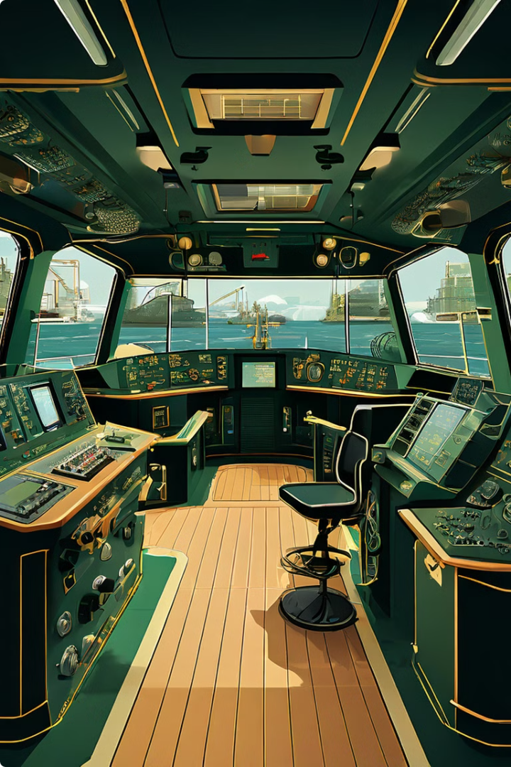
Superstructure-
More Than Just a Roof
The ship's superstructure is much more than just a roof over the deck. It houses vital components that enable the ship to function, navigate, and transport cargo safely. From the bridge where the captain navigates to the accommodation spaces that provide comfort for the crew, the superstructure plays a critical role in ensuring the success of every journey.

Slide 29
Types of Ship Superstructure
1
Forecastle
The forecastle is the superstructure located at the bow (front) of the ship. It typically houses the anchor windlass, chain lockers, and crew quarters.
2
Poop Deck
The poop deck is the superstructure at the stern (rear) of the ship. It often houses the steering gear, accommodation, and the captain's bridge.
3
Midship Superstructure
The midship superstructure is located in the middle of the ship. It can house various facilities like cargo holds, machinery spaces, and accommodations. It often connects the forecastle and poop deck.
4
Bridge
The bridge is a raised platform on the superstructure that provides the captain and crew with a clear view of the surroundings. It houses navigational instruments, communication systems, and control panels.

Slide 30
Design Principles of Ship Superstructure
Structural Integrity
Hydrodynamics
Functionality
The superstructure must be designed to withstand the stresses and loads it will experience at sea. This includes waves, wind, and the weight of cargo and equipment. Design considerations include load distribution, material selection, and structural analysis.
The superstructure's shape influences the ship's hydrodynamic performance. The design must minimize resistance and ensure stability, considering factors like wave interaction, drag reduction, and water flow patterns.
The superstructure must provide adequate space and access for crew, cargo, and equipment. This includes navigational instruments, communication systems, living quarters, and working areas. Ergonomics and efficiency play a crucial role in design considerations.

Slide 31
Materials Used in Ship Construction
1
Steel
2
Aluminum
Steel is the primary material used in shipbuilding due to its strength, durability, and weldability. It can be tailored to specific requirements by varying its composition and heat treatment. Different grades of steel are employed for hull plating, deck plating, and other structural elements.
Aluminum is used in certain applications due to its lightweight and corrosion resistance. It is often used for superstructures, decks, and other non-load-bearing elements, contributing to fuel efficiency and maneuverability.
3
Fiberglass Reinforced Plastic (FRP)
4
Wood
FRP is a composite material used for smaller vessels and components. It offers strength, corrosion resistance, and ease of fabrication. FRP is often used for decks, superstructures, and recreational boats.
While less common in modern shipbuilding, wood still finds use in some applications, particularly for traditional vessels or specific components. It provides a natural material with insulation properties and aesthetic appeal.

Slide 32
Structural Components of Ship Superstructure
Component
Description
Beams
Horizontal structural elements that support the deck and distribute load across the superstructure.
Columns
Vertical structural elements that provide support for the beams and transfer load to the hull.
Bulkheads
Vertical walls that divide the superstructure into compartments, providing structural support and watertight integrity.
Deck Plates
Horizontal plates that form the deck of the superstructure, providing a working surface and sealing the ship.
Frames
Vertical or horizontal structural elements that reinforce the hull and superstructure, providing additional strength and stability.
Materials Indian Standards related to Ship Superstructure

Slide 33
Hydrodynamics and Ship Superstructure
Resistance
Stability
Wave Interaction
The shape of the superstructure can influence the ship's resistance to motion through water. An aerodynamic design minimizes drag and improves fuel efficiency.
The superstructure's location and design play a crucial role in the ship's stability. Proper distribution of weight and buoyancy ensure that the ship remains upright and balanced.
The superstructure's shape can affect how waves interact with the ship. Design considerations minimize wave slamming and ensure smooth passage through rough seas.

Slide 34
Stability and Safety Considerations
Ballast Systems
Ballast systems are essential for maintaining stability. They involve filling and emptying tanks with water to adjust the ship's weight distribution and ensure proper trim.
Freeboard
The freeboard is the height of the deck above the waterline. A sufficient freeboard ensures that the ship remains afloat even if some compartments are flooded.
Watertight Integrity
Watertight compartments and bulkheads within the superstructure prevent flooding in the event of damage. They isolate sections of the ship to minimize the impact of an incident.
Emergency Systems
Emergency systems such as lifeboats, fire suppression systems, and communication equipment are essential for ensuring crew safety in case of an emergency.

Slide 35
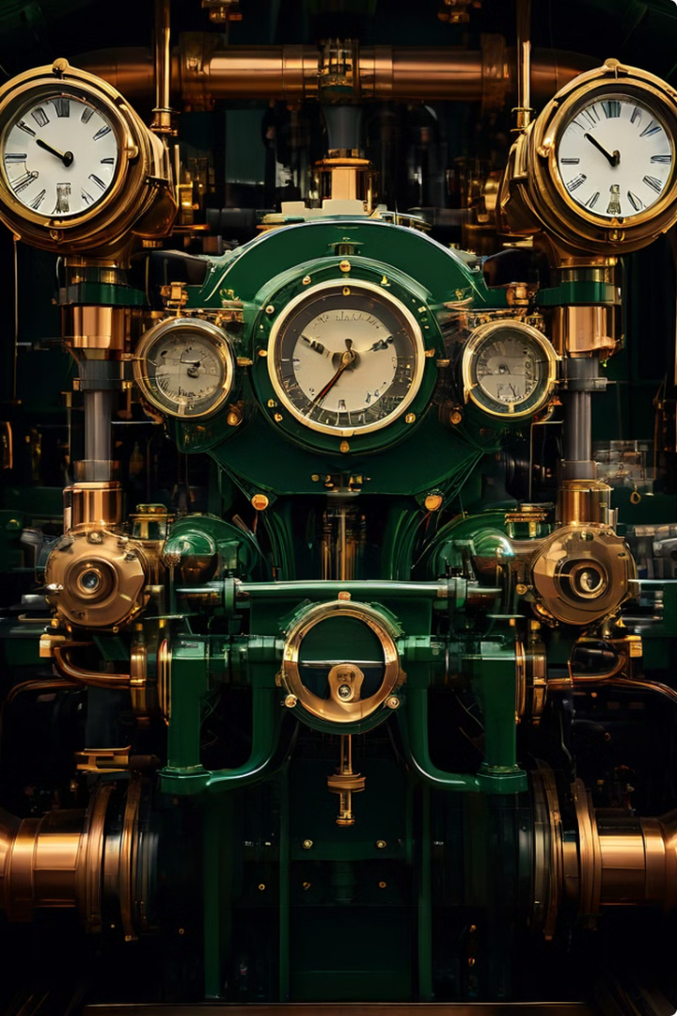
3
Propulsion System
The engine room is the heart of any ship, the powerhouse that propels it across the vast expanse of the ocean. It's a complex and fascinating world of machinery, where intricate systems work in perfect harmony to generate the immense power needed to move a ship. Get ready to embark on a journey into the inner workings of a ship's beating heart.

Slide 36
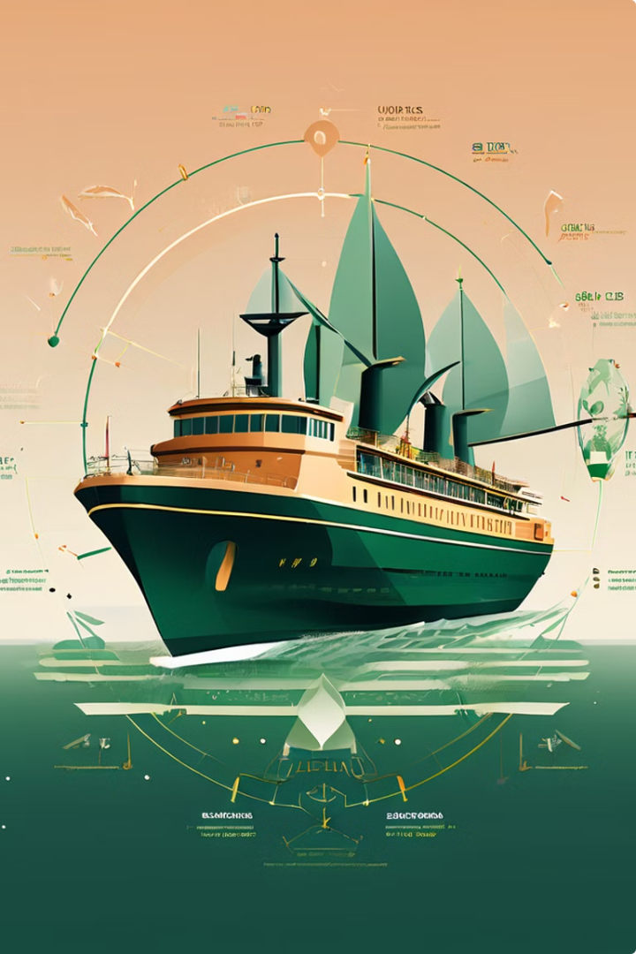
Principle of Ship Propulsion
1
Power Generation
The engine room houses the main engines that generate power. These engines typically burn fuel to create mechanical energy, which is then transferred to the propeller shaft.
2
Transmission
The power from the main engines is transmitted to the propeller shaft through a gearbox. The gearbox reduces the speed of the engine's output and increases its torque, enabling the propeller to turn efficiently.
3
Propeller Rotation
The propeller shaft rotates the propeller, which is submerged in the water. As the propeller rotates, it pushes water backward, creating a forward thrust that propels the ship through the water.

Slide 37
IS 8013- Components of Propulsion System
1
Propellers
Propellers are the primary means of propulsion for most ships. They convert the rotational energy of the engine into thrust, propelling the ship through the water. The design of propellers is critical for maximizing efficiency and minimizing cavitation (formation of bubbles).
2
Engines
Ship engines come in various types, including diesel engines, gas turbines, and electric motors. The choice of engine depends on the ship's size, speed, and intended operation. Efficient engines are essential for minimizing fuel consumption and environmental impact.
3
Auxiliary Systems
Propulsion systems are supported by auxiliary systems, such as the steering gear, rudder, and shafting. These systems ensure that the propulsion system operates safely and efficiently, enabling the ship to maneuver and maintain course.
4
Alternative Propulsion
Emerging technologies are driving innovation in ship propulsion. Hybrid propulsion systems, electric propulsion, and fuel-cell technology offer cleaner and more sustainable options for powering ships, reducing emissions and minimizing environmental impact.

Slide 38
Components of the Engine Room
Main Engines
Auxiliary Engines
Fuel and Lubrication Systems
These are the heart of the engine room, responsible for generating the primary power that propels the ship. They are typically large diesel engines, but some ships may use gas turbines or electric motors.
These engines provide power to various auxiliary systems, such as pumps, generators, and compressors. They are generally smaller than the main engines and can be diesel, gas turbine, or electric.
These systems ensure the smooth operation of the main and auxiliary engines by providing fuel and lubrication. The fuel system stores and delivers fuel to the engines, while the lubrication system provides oil to reduce friction and wear.

Slide 39
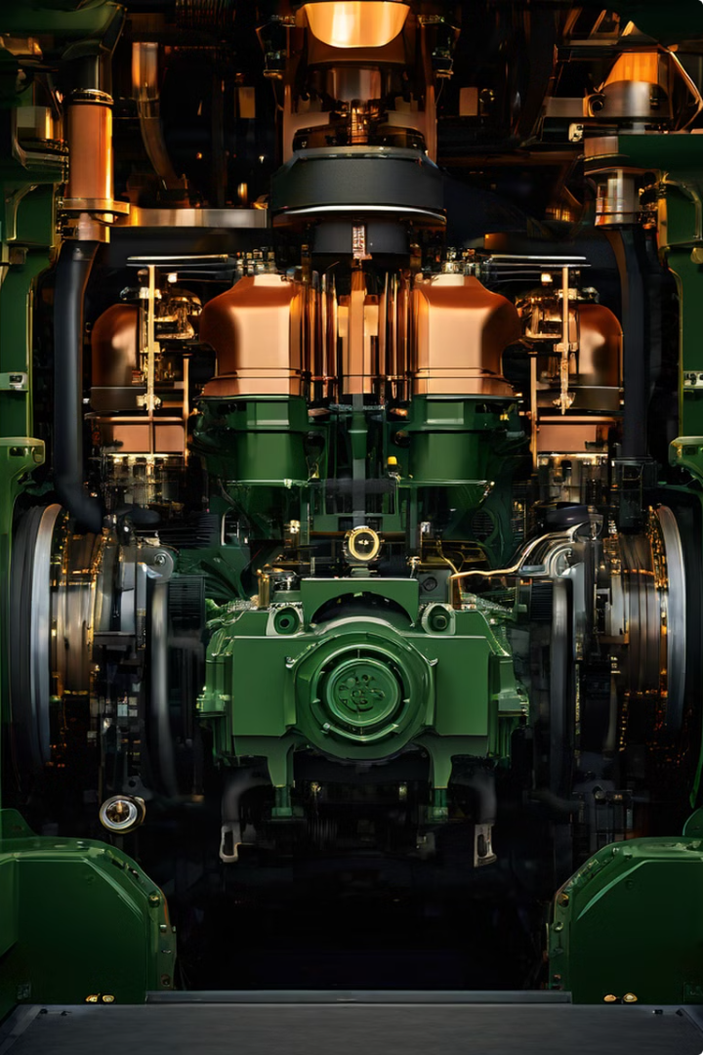
Engines and their Function
Air Intake
The engine draws air into its cylinders through an air intake system. This air is compressed by the piston, increasing its temperature and pressure.
Fuel Injection
Fuel is injected into the cylinders at the appropriate time, mixing with the hot, compressed air. The mixture ignites, creating an explosion that drives the piston down.
Power Output
The piston's downward motion is converted into rotational motion through the connecting rod and crankshaft. This rotating motion is then transferred to the propeller shaft, driving the ship forward.
Exhaust System
The exhaust gases produced during combustion are expelled from the engine through an exhaust system. The exhaust system is designed to reduce noise and emissions.

Slide 40
Auxiliary Engines and their Role
Type
Function
Pumps
Pump water, air, fuel, or other fluids for various purposes, such as cooling, bilge pumping, and cargo handling.
Generators
Generate electrical power for the ship's systems, including lighting, communication, and navigation.
Compressors
Compress air for various purposes, such as operating pneumatic tools, providing air for breathing apparatus, and supplying air for the engine room's ventilation system.
Refrigeration Units
Provide cooling for cargo, food, and other perishable items, ensuring their quality during transport.
Indian Standards related to Propulsion System

Slide 41
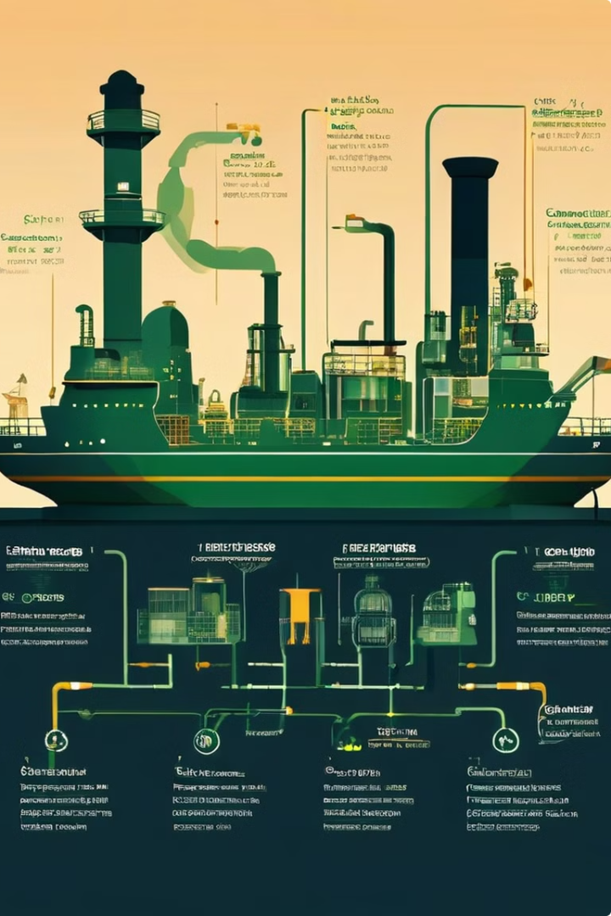
IS 17471- Fuel and Lubrication Systems
Fuel Storage
The ship's fuel is stored in large tanks, typically located near the engine room. The fuel is usually diesel, but some ships may use other types of fuel, such as heavy oil or liquefied natural gas (LNG).
Fuel Delivery
Fuel is delivered from the storage tanks to the main and auxiliary engines through a system of pumps, pipes, and filters. This system ensures that the fuel is clean and at the correct pressure for efficient combustion.
Lubrication System
The lubrication system provides oil to reduce friction and wear in the engine's moving parts. It circulates oil through the engine, ensuring that all the critical components are properly lubricated.
Indian Standards related to Fuel and Lubricating System

Slide 42
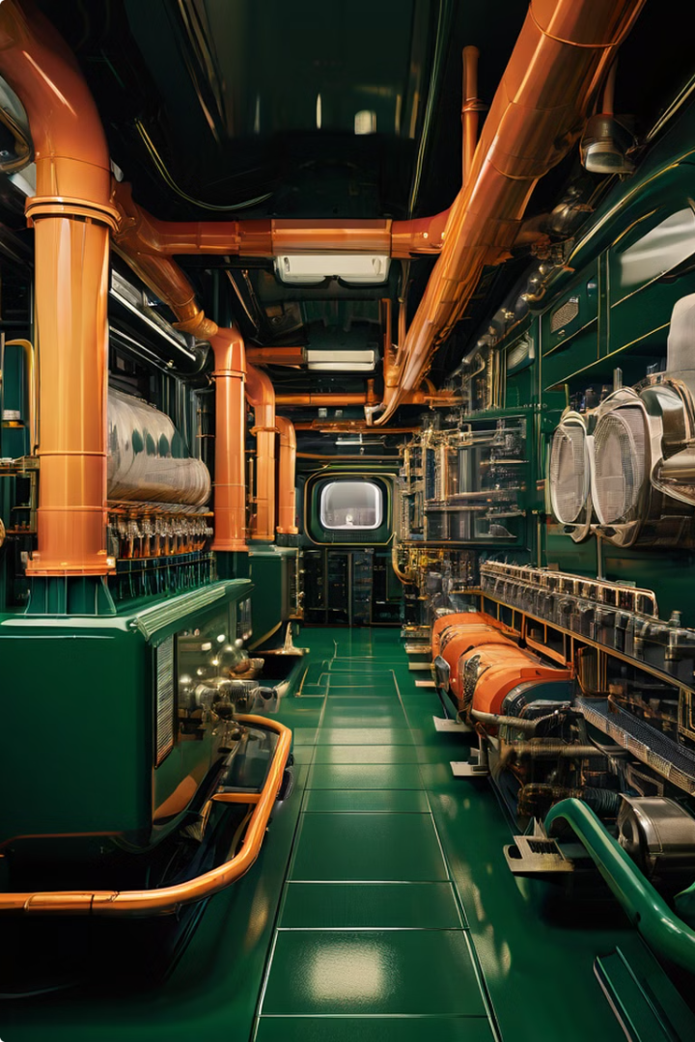
IS 13930- Cooling and Exhaust Systems
Cooling System
The cooling system is essential for preventing the engines from overheating. It circulates water or a mixture of water and antifreeze through the engine's cylinders and other critical components, absorbing heat and transferring it to radiators or other heat exchangers.
Exhaust System
The exhaust system removes the hot combustion gases from the engines and expels them into the atmosphere. It is designed to reduce noise and emissions, minimizing the ship's environmental impact.
Ventilation System
The engine room is often hot and humid due to the heat generated by the engines. A ventilation system ensures adequate airflow, removing hot air and replacing it with fresh air, providing a safe and comfortable working environment for the crew.
Indian Standards related to Cooling and Exhaust System

Slide 43
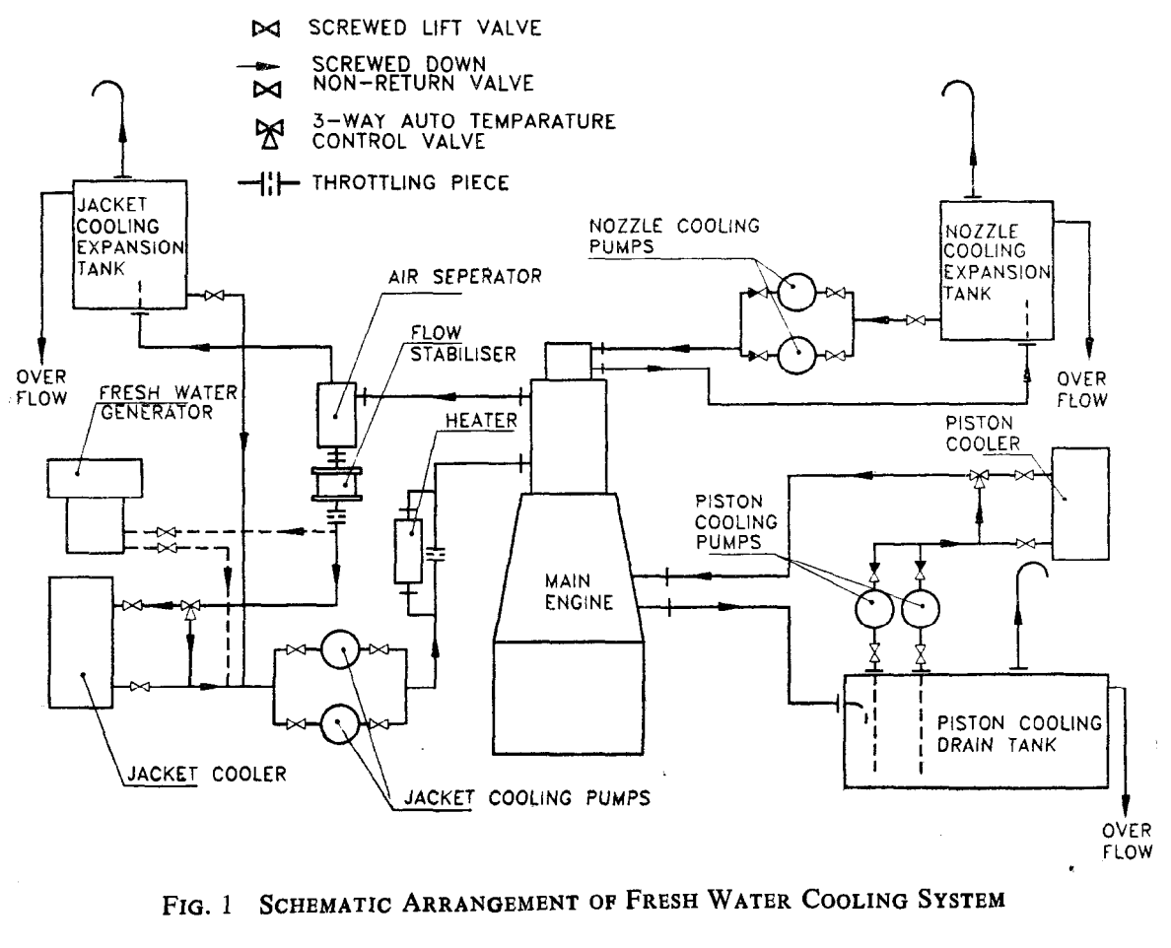
Fresh Cooling Water System
Explained in Indian
Specification
Notes:
Explain how Indian Standards beautifully explained Fresh Water Cooling System in a ship

Slide 44
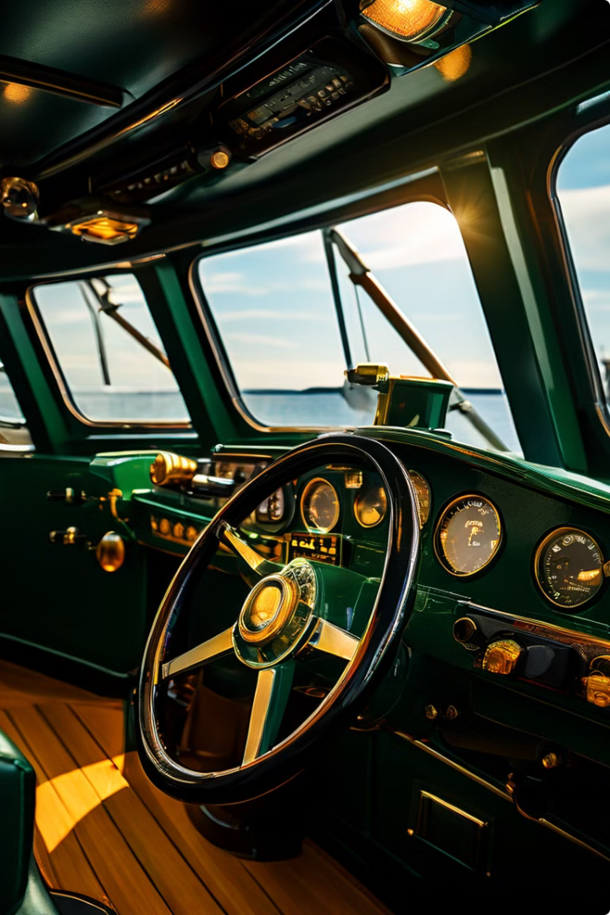
Steering and Propulsion Controls
Steering Wheel
The steering wheel controls the rudder, which guides the ship in the desired direction.
Engine Controls
The engine controls regulate the ship's speed, allowing for precise control over the vessel's movement.
Thrusters
Thrusters are small, powerful propellers used for maneuvering the ship in tight spaces and difficult conditions.

Slide 45
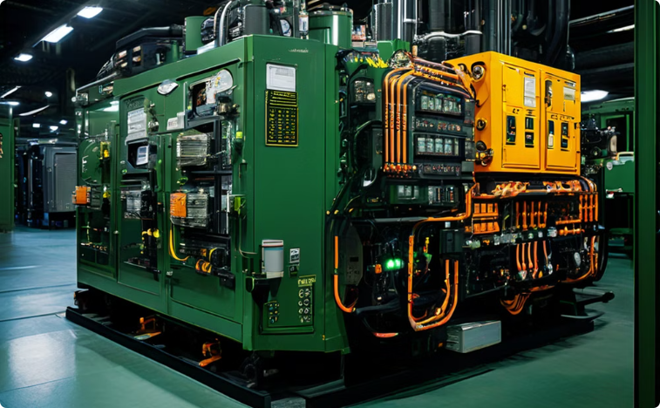
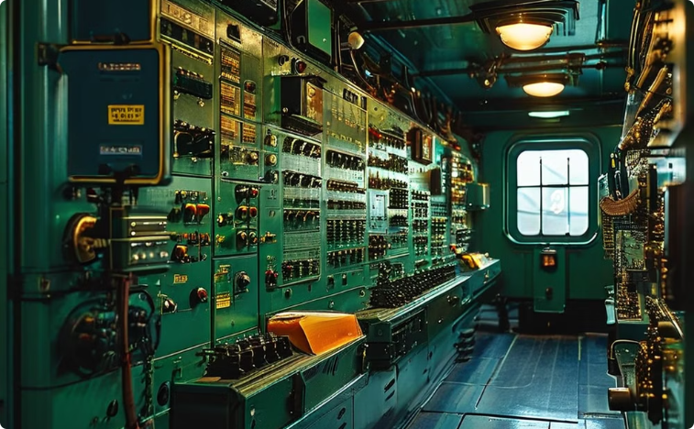
Electrical Power Generation
Generators
Switchboards
Generators are driven by auxiliary engines or, in some cases, directly by the main engine's shaft. They convert mechanical energy into electrical energy, providing power to the ship's systems.
Switchboards are the central control points for the electrical system. They receive power from the generators and distribute it to various parts of the ship

Slide 46
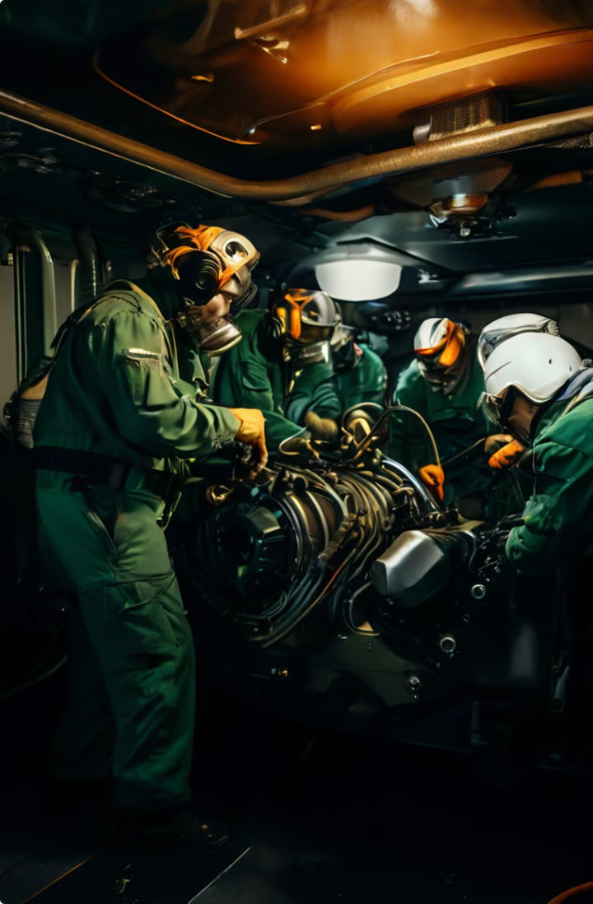
Maintenance and Safety Protocols
1
Regular Inspections
Regular inspections of the engine room's components are essential for identifying potential problems before they escalate. This includes checking engine oil levels, coolant levels, fuel levels, and the condition of belts, hoses, and other components.
2
Preventive Maintenance
Preventive maintenance involves performing regular servicing and repairs to prevent breakdowns. This includes changing engine oil, filters, and other wear items, as well as inspecting and adjusting critical components.
3
Emergency Procedures
Emergency procedures are in place to handle unexpected situations, such as fires, floods, or engine failures. These procedures include evacuation plans, fire suppression procedures, and engine shutdown procedures.
4
Safety Training
All engine room crew members receive comprehensive safety training, which covers topics such as fire prevention, fire fighting, emergency procedures, and the proper use of safety equipment.

Slide 47
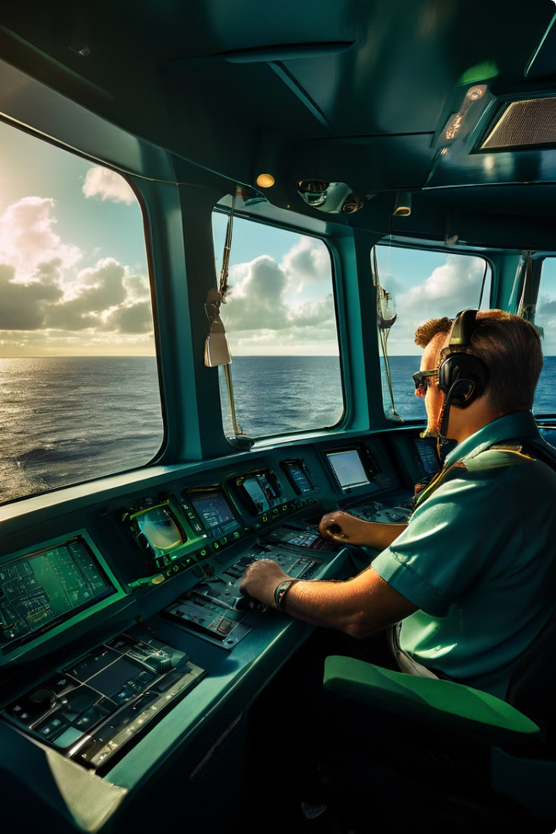
4
Navigation System
The bridge is the nerve center of a ship, where all navigation and operation decisions are made. It is a highly complex and essential part of a ship's design, responsible for ensuring the safety and efficiency of the journey.

Slide 48
Navigation Equipment – IS 13708
Radar
GPS
Chart Plotter
Radar helps detect other vessels, land masses, and weather conditions, providing vital information for safe navigation.
The Global Positioning System (GPS) provides accurate positioning data, crucial for navigating safely in all weather conditions.
A chart plotter displays the ship's position on a digital chart, allowing the crew to plan routes and track progress.

Slide 49
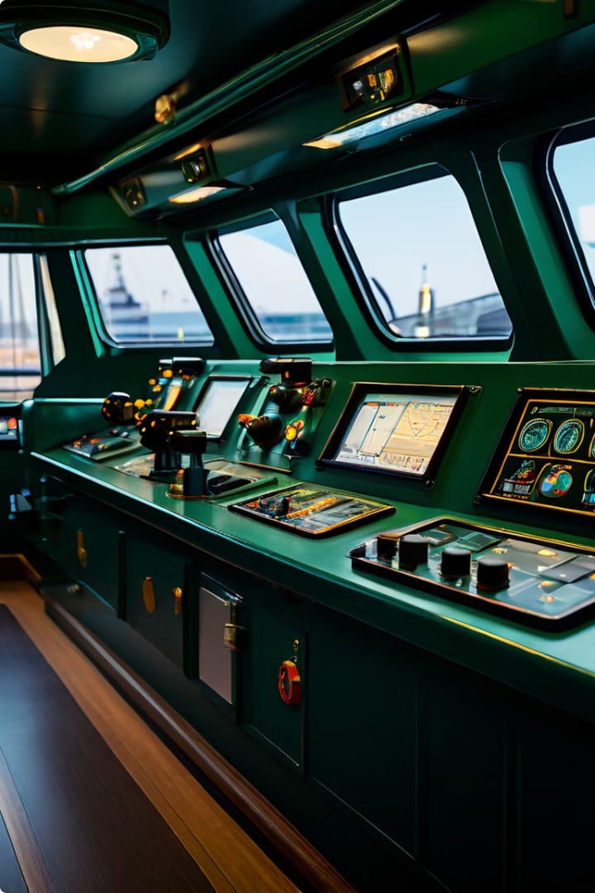
Monitoring and Alarm Systems – IS 16323
Alarms
Signal potential hazards, such as fire, flooding, or engine problems.
Gauges
Monitor vital ship parameters, such as engine speed, fuel levels, and water temperature.
Cameras
Provide live views of various locations on the ship, allowing the crew to monitor activities and detect potential problems.
Indian Standards related to Navigation & Communication

Slide 50
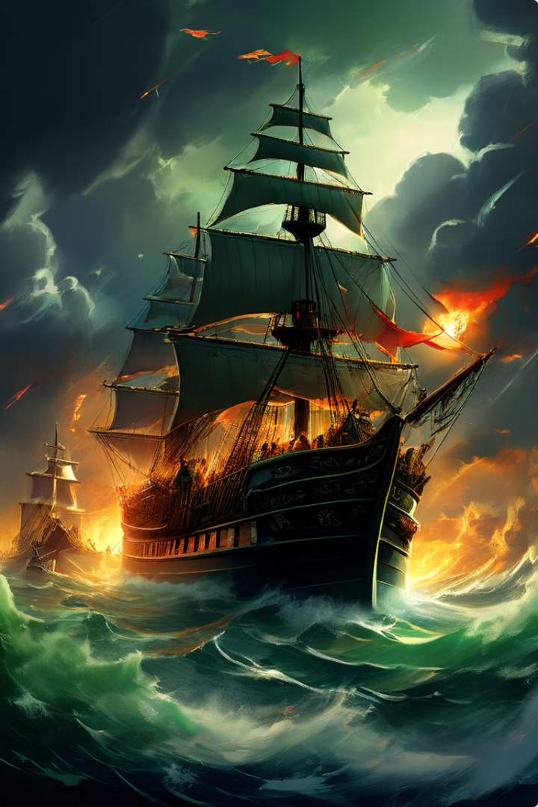
Navigational Challenges
1
Weather Conditions
Storms, fog, and heavy rain can significantly impair visibility, making navigation difficult and requiring careful decision-making.
2
Traffic Density
Busy shipping lanes and congested ports present challenges in avoiding collisions, requiring constant vigilance and communication with other vessels.
3
Technical Malfunctions
Equipment failures or malfunctions can disrupt navigation and safety systems, requiring prompt troubleshooting and backup procedures.

Slide 51
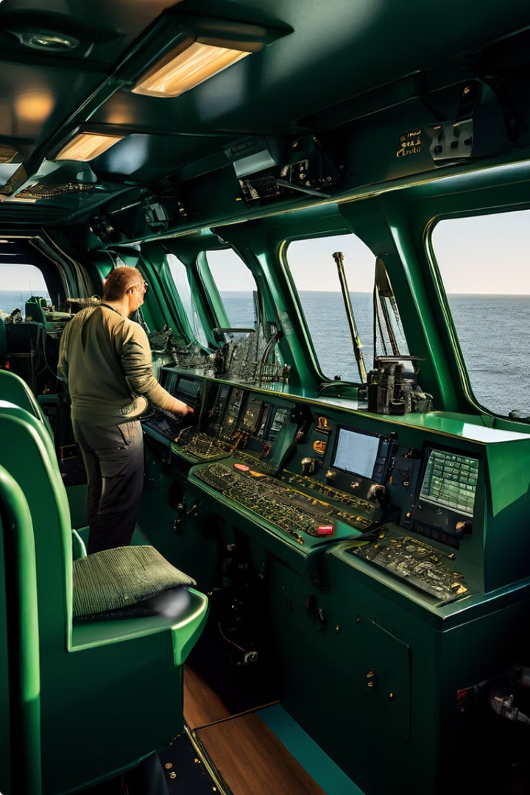
Maintaining Navigation Operations
1
Regular Inspections
Equipment is inspected regularly to ensure it is functioning properly and meets safety standards.
2
Calibration
Navigational instruments are calibrated periodically to maintain accuracy and prevent errors.
3
Training and Drills
The crew undergoes regular training and drills to maintain proficiency in responding to emergencies and operating equipment.
4
Updates and Upgrades
The bridge is constantly being updated with the latest technology and advancements in navigation and safety systems.

Slide 52
5
Sustainability and Environmental Concerns – IS 18277
Emissions
Ships contribute to air pollution through the release of greenhouse gases, such as carbon dioxide and sulfur dioxide. Reducing emissions is a key environmental concern, and ship designers are exploring cleaner fuels and technologies to minimize their impact.
Noise Pollution
Ship engines and propellers generate significant noise that can disrupt marine life, particularly whales and other sensitive species. Ship designers are working to develop quieter propulsion systems and hull designs to mitigate noise pollution.
Oil Spills
Oil spills can have devastating consequences for marine life and ecosystems. Double-hulled ships, improved cargo handling procedures, and robust spill response plans are essential for preventing and mitigating oil spills.
Standardisation work related to Marine Environment

Slide 53
Scope of IS 14546

Slide 54
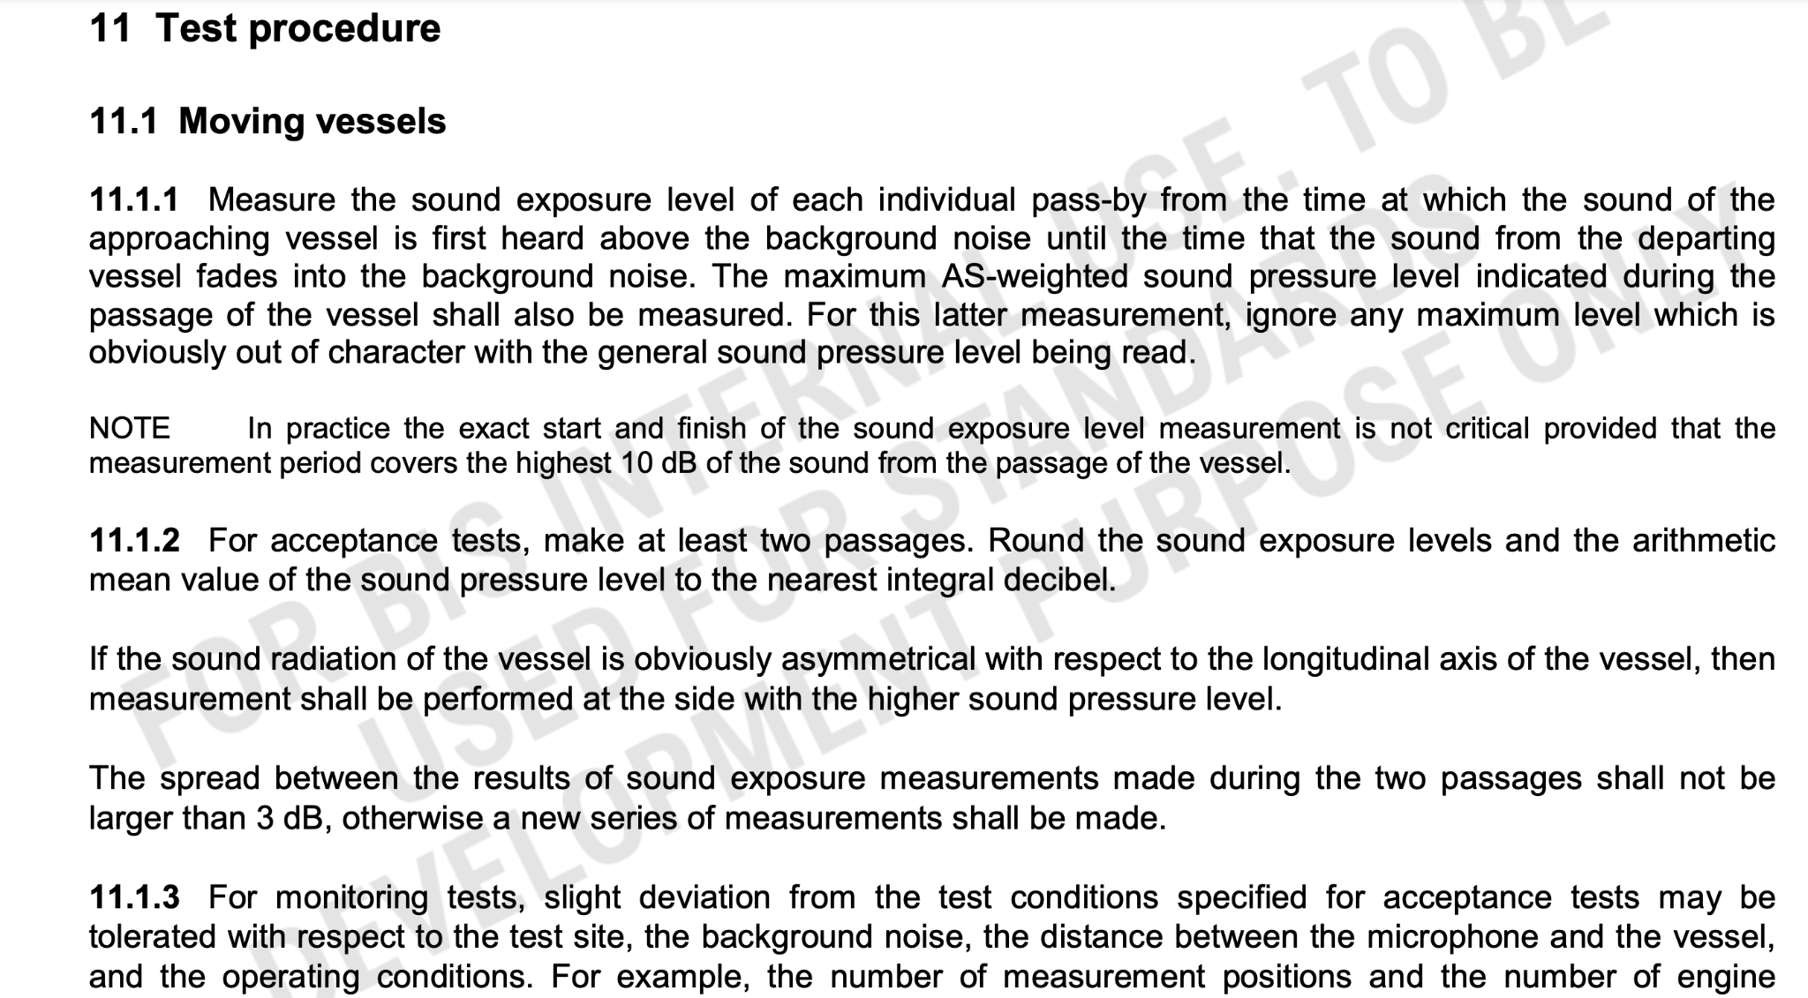
Testing Procedure covered under ISS

Slide 55
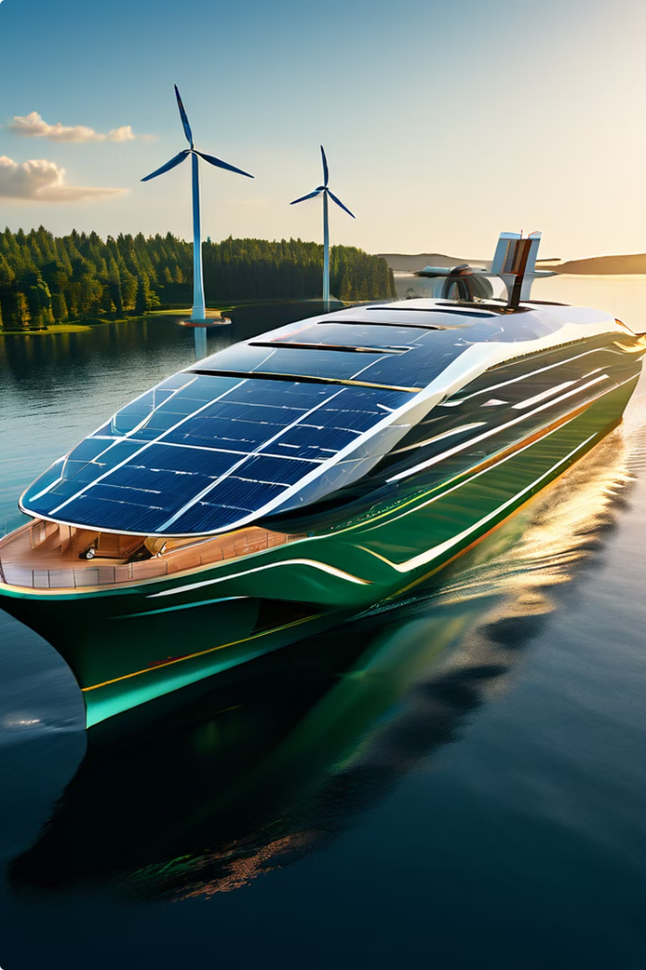
Sustainability
Energy Efficiency
Sustainable ship design focuses on minimizing energy consumption and maximizing efficiency. This involves optimizing hull shape, propulsion systems, and operational practices to reduce fuel consumption and greenhouse gas emissions.
Renewable Energy Sources
Integrating renewable energy sources, such as solar panels and wind turbines, into ship design is a promising area for reducing reliance on fossil fuels. These technologies can supplement or even replace conventional propulsion systems.
Material Recycling
Sustainable shipbuilding involves using recyclable materials and minimizing waste throughout the construction process. This includes using recycled steel, aluminum, and other materials, as well as employing efficient construction techniques to reduce waste.
Environmental Impact Assessment
Conducting thorough environmental impact assessments is crucial for evaluating the potential impact of ship design and operation on marine ecosystems. This helps ensure that ships are designed and operated responsibly, minimizing their environmental footprint.

Slide 56
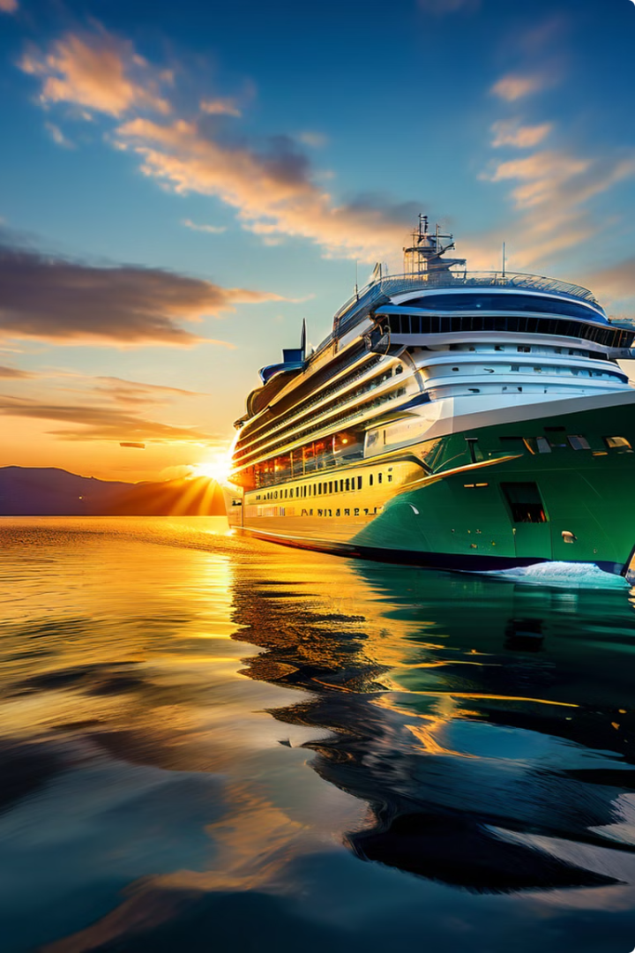
6
Safety Aids
Let us see how standards throw light on essential safety gear onboard ships, highlighting their crucial roles in ensuring the well-being of passengers and crew.

Slide 57
Importance of Safety Equipment on Ships
Safety and Rescue
1
Ship safety equipment is vital for the protection of lives and property in the event of an emergency at sea.
Compliance and Regulations
2
Maritime authorities mandate adherence to strict standards for safety equipment, ensuring compliance with international regulations.
Emergency Response
3
Properly equipped ships enable swift and effective emergency response, increasing the chances of survival in dire situations.
Preventive Measures
4
These tools play a proactive role in mitigating risks, contributing to the overall safety of marine operations.

Slide 58
Life Jackets: IS 6685 & IS 17536
Types
IS 6685
IS 17536
Life jackets come in different types, including inflatable, foam, and hybrid models, each designed for specific situations and individuals.
The standard specifies the design, construction, and performance of life jackets to ensure optimal safety.
Ships and marine technology - Servicing of inflatable life-saving appliances - Part 3: Inflatable lifejackets
Scope: This document provides provisions for servicing stations conducting servicing of inflatable lifejackets, including, but not limited to, those subject to SOLAS III/20.8.
Inflatable
Foam
Hybrid

Slide 59
IS 11461 - Life Rafts: Deployment, Capacity, and Maintenance
Deployment
Capacity
Maintenance
Life rafts are designed for rapid deployment, typically launched using a davit or other specialized mechanisms.
Each raft has a specified capacity based on its size and design, ensuring enough space for all passengers and crew.
Regular maintenance and inspections are crucial for ensuring the proper functioning of life rafts and their safety in emergencies.

Slide 60
IS 11461 – Testing of marine inflatable Liferafts
High Pressure Test
Air Tightness Test
Relief Valve Function Test
Inflation Test
High Inflation Temperature Test
Low Inflation Temperature Test
Drop Test
Seating Test
Freeboard Test
Stability Test
Damage Test
Swamp Test
Boarding Test etc.
Other Indian Standards related to Liferafts
Notes:
We could display the Indian Standards and demonstrate the different types of testing mentioned in the standards and its importance

Slide 61
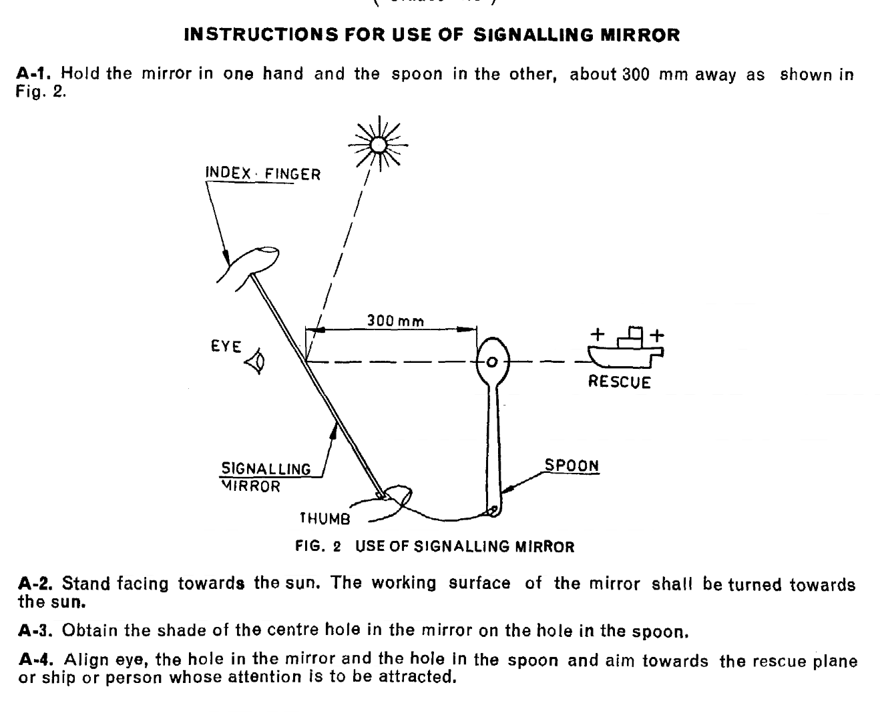
Glimpse of Indian Standard
Notes:
We can illustrate this standards as how products works is also mentioned in the specification

Slide 62
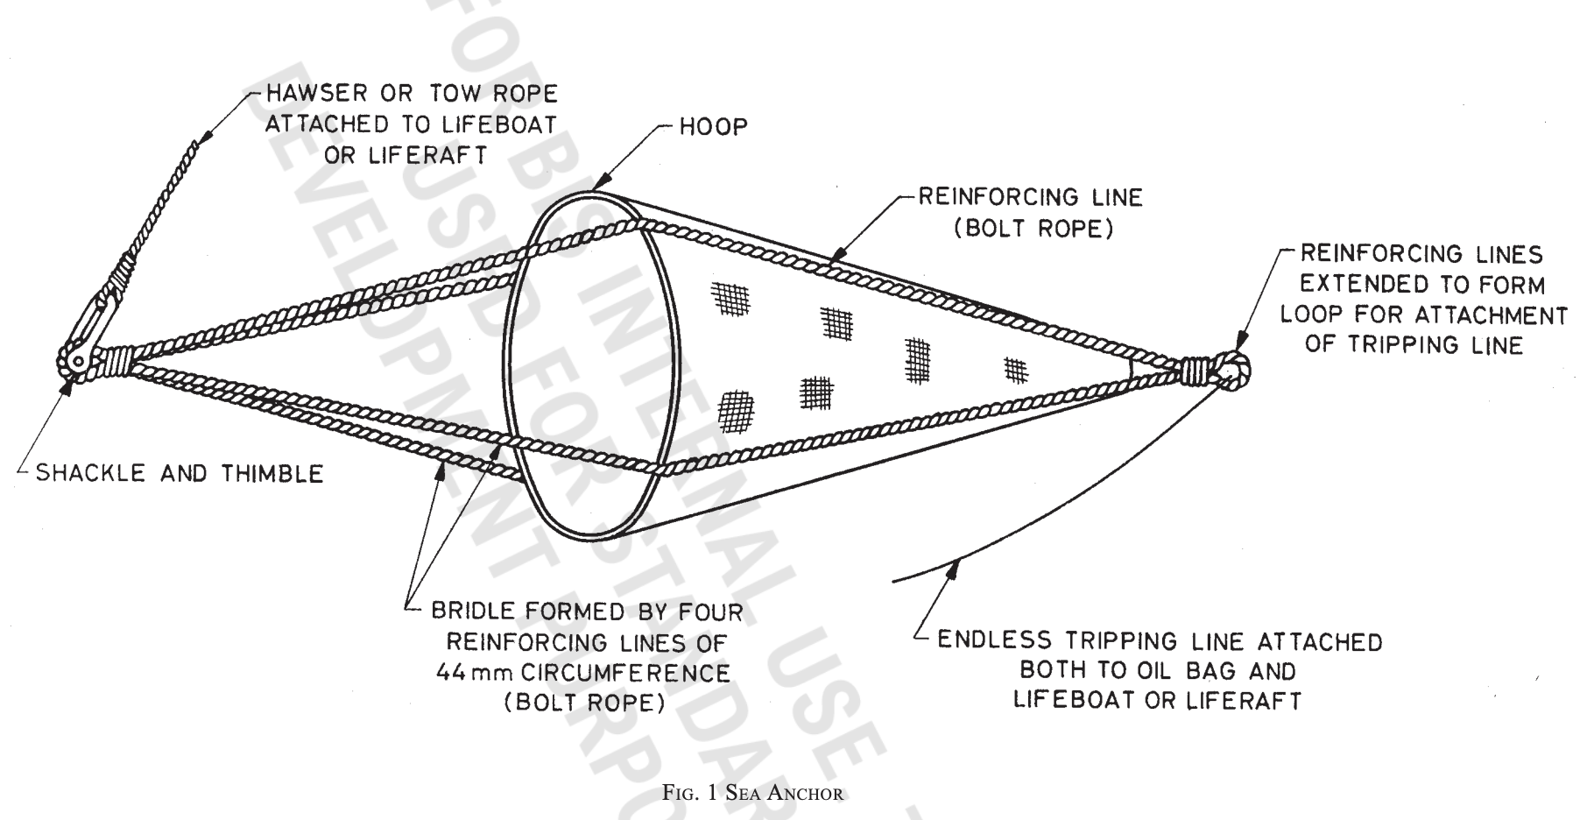
Glimpse of Indian Standard on Sea Anchor
Notes:
Diagram of Sea Anchors. Here we can introduced the difference between Sea Anchors and Anchors

Slide 63
IS 4602- Lifeboats: Deployment, Capacity, and Uses
Deployment
Capacity
Uses
Lifeboats are deployed in emergency situations, offering a more robust and spacious escape option.
Lifeboats are designed to accommodate a larger number of people than life rafts, offering greater safety.
Lifeboats are used for evacuation and rescue operations, providing a stable platform in rough seas.
Indian Standards related to Lifeboats

Slide 64
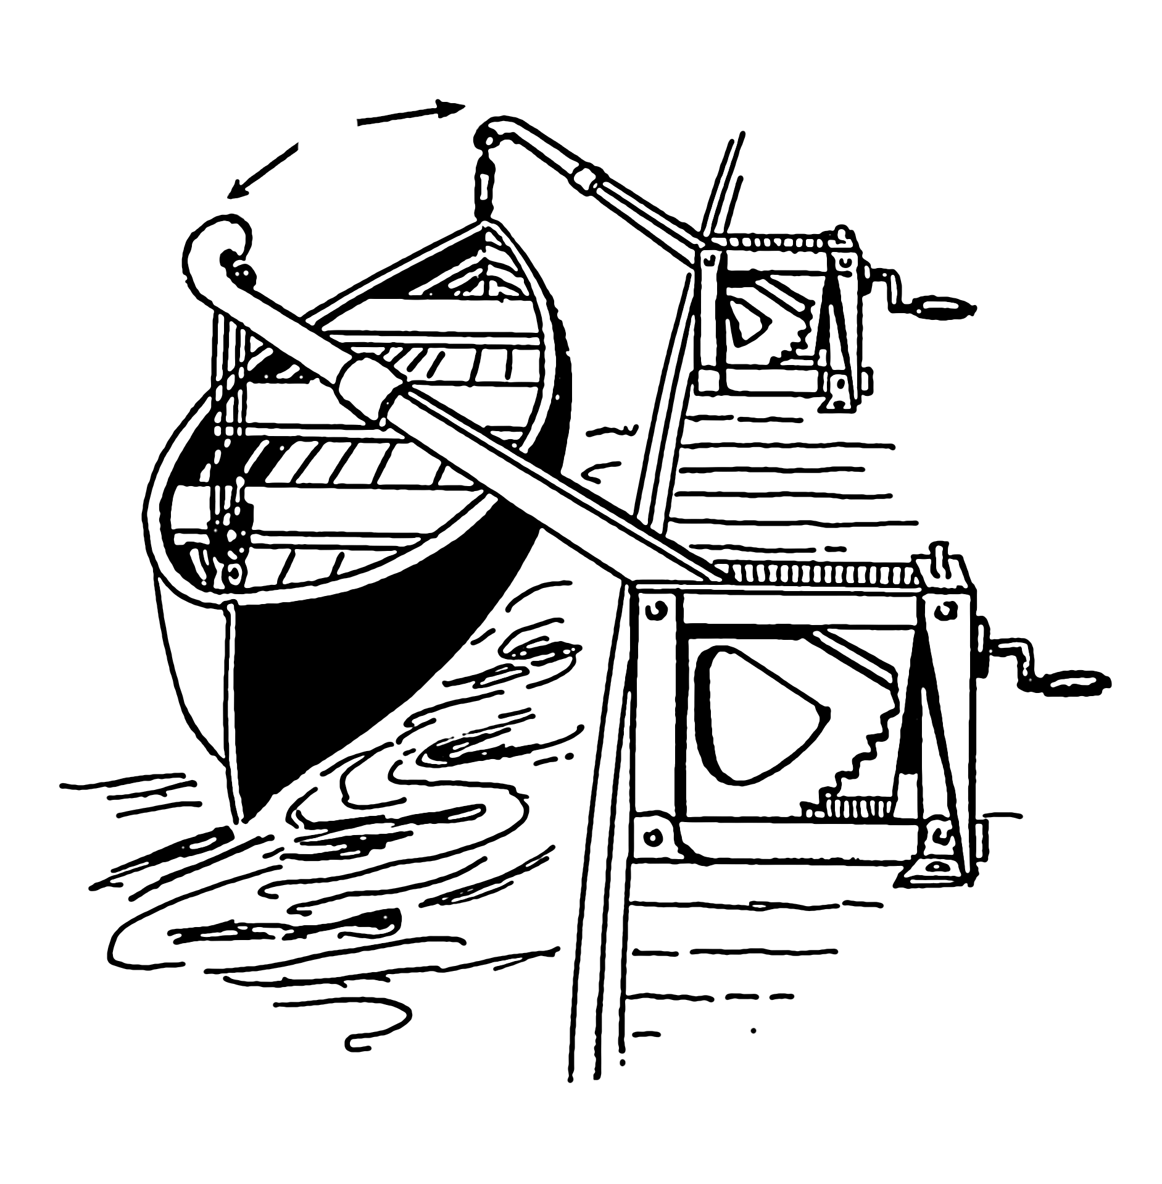
Lifeboat with Davit
What is Davit ?
A davit is a crane-like device mounted on a ship, used to lower, launch, and retrieve lifeboats. It ensures lifeboats can be safely and efficiently deployed during emergencies, providing a crucial means of evacuation for crew and passengers, enhancing overall maritime safety.
IS 5386- General purpose Ship’s Davit
IS 9067- Ships and marine technology - Launching appliances for davit - Launched lifeboats

Slide 65
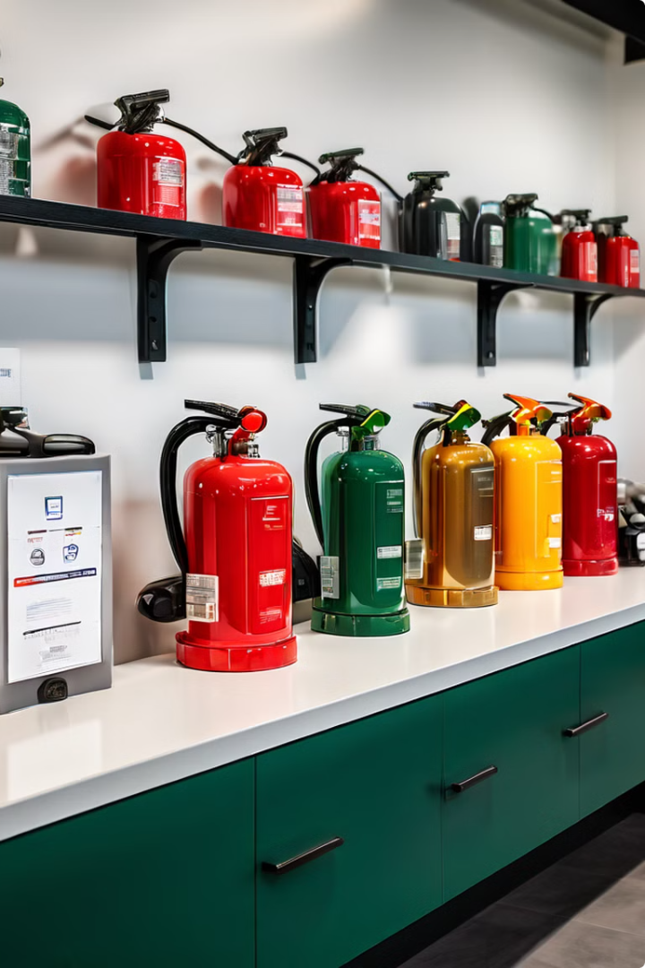
IS 15683- Fire Extinguishers-
Classes, Placement, and Inspection
Class
Type of Fire
Placement
A
Ordinary combustibles (wood, paper, cloth)
Near potential ignition sources
B
Flammable liquids (oil, grease, gasoline)
Near potential spill areas
C
Electrical fires
Near electrical equipment
D
Combustible metals
Specific locations for metal fires
Indian Standards for Fire Extinguishers

Slide 66
IS 4601 & IS 4602: Emergency Lighting and Signage
1
Illumination
Emergency lighting systems provide essential illumination during power outages, ensuring safe navigation and evacuation.
2
Signage
Emergency signage directs people to safety exits, assembly points, and other important locations in case of emergencies.
3
Maintenance
Regular testing and maintenance of emergency lighting and signage systems are crucial for ensuring their reliability.
Indian Standards related to Emergency Lighting and Signage
Others Indian Standards related to Safety

Slide 67
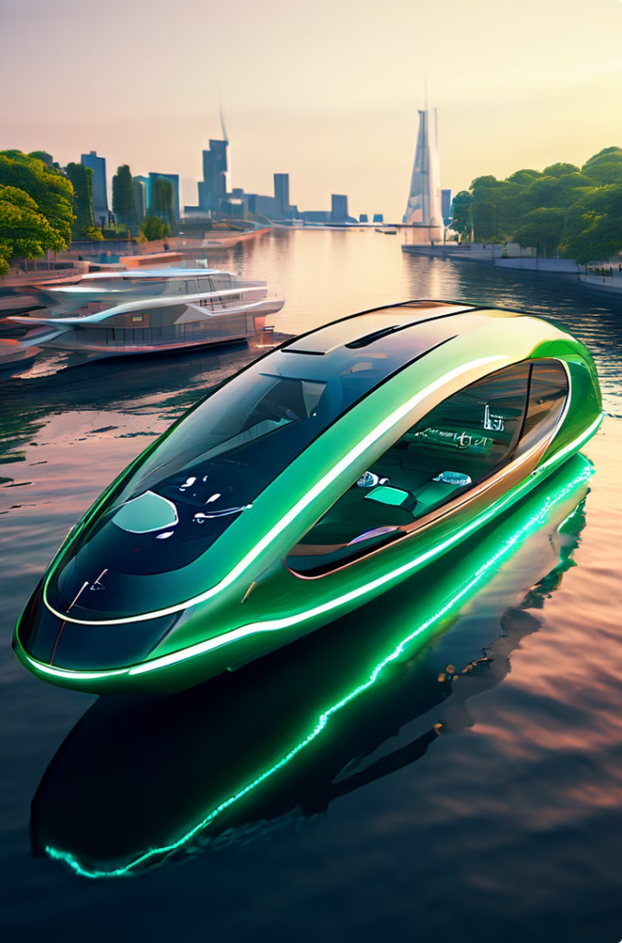
Emerging Technologies in Ship Engineering – Ongoing Work
Autonomous Ships
Autonomous ships, powered by artificial intelligence and advanced navigation systems, are poised to revolutionize maritime transportation. They offer potential for increased safety, efficiency, and reduced human error.
Hybrid Propulsion
Hybrid propulsion systems combine traditional engines with electric motors and battery storage. This allows for greater efficiency, reduced emissions, and enhanced maneuverability in port.
Fuel Cell Technology
Fuel cells offer a clean and efficient alternative to traditional propulsion systems. They generate electricity through the electrochemical reaction of hydrogen and oxygen, producing only water as a by-product.
3D Printing in Shipbuilding
3D printing, or additive manufacturing, is being explored for its potential to create complex and lightweight ship components, reducing material waste and construction time.

Slide 68
Conclusion
Standardisation in shipbuilding is essential for safeguarding lives and property on board ships. By understanding the types, standards, and uses of these tools, we can contribute to a safer maritime environment. Compliance with regulations, regular maintenance, and proper training are crucial for ensuring the effectiveness of safety equipment. Remember, every individual plays a role in maintaining safety on ships.

Slide 69
Thank you

