Slide 1
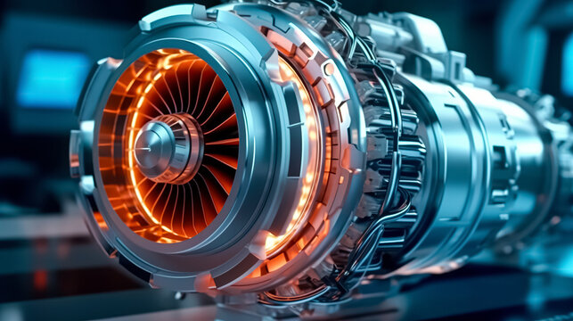
Gas Turbines

Slide 2
“We can create a more sustainable, cleaner and safer world by making wiser energy choices”
Indian Standards (IS) for Gas Turbines, developed by the Bureau of Indian Standards (BIS), play a crucial role in ensuring the quality, safety, and performance across various industrial applications.
This lecture aims to deal with :
General information about turbomachinery
Standardization Efforts in the Industry
Real-world implement-ability, and their linkage with the manufacturing process.
Understanding of Turbines through Standards
How Indian Standards delineate the operational principles of turbines, encompassing their classification, applications, and acceptance criteria, as well as the functional and operational tests, potential safety hazards, and requisite standards included in the course curriculum.
By the end of this lecture, participants will appreciate the importance of these standards, identify areas for improvement, and understand the value of participating in the standardization process.

Slide 3
Types of Turbomachines
Power absorbing
Work is done on the fluid
Mechanical Energy → Hydraulic Energy
Working Principle: Based on Boyle’s Law
(P₁V₁ = P₂V₂)
Power absorbing: Compressors, fans, blowers, Pumps
Power producing: Turbines
Power producing
Work is done by the fluid
Hydraulic Energy → Mechanical Energy
Working Principle: Based on Newton’s Third Law of Motion
(Action and Reaction).

Slide 4
Classification of Turbomachines
Turbomachines
Power Absorbing
Incompressible
Compressible
Power Producing
Incompressible
Compressible
Pump & Propeller
Propeller, Fan, Blower & Compressor
Pelton Wheel Hydraulic Turbine
Steam Turbine, Gas Turbine & Wind Turbine
The density of the fluid remains constant.
The density of the fluid changes.

Slide 5
Gas Turbines: A rotating machine which converts thermal energy into mechanical work, consisting of a compressor(s), a thermal device(s) which heat(s) the working fluid, a turbine(s), a control system, and auxiliary equipment. A gas turbine, gas turbine engine, or also known by its old name internal combustion turbine, is a type of continuous flow internal combustion engine.
A gas turbine consists of several essential components, including a compressor, combustion chamber, turbine, and sometimes a power turbine.
The compressor compresses incoming air, which then mixes with fuel in the combustion chamber, where it ignites. The high-velocity exhaust gases drive the main turbine, producing mechanical energy for various applications, like aircraft propulsion or electricity generation.
Simple Gas Turbine

Slide 6
Standardization Efforts in the Industry
1
Standards Organizations
2
Industry Associations
Organizations like BIS, ISO and ASME develop and maintain comprehensive standards for gas turbine design, operation, and maintenance.
Associations such as the American Gas Association and the Gas Turbine World play a vital role in promoting and enforcing industry standards.
3
Government Regulations
4
Manufacturer Specifications
Government agencies establish regulations to ensure safety, environmental compliance, and overall industry best practices.
Gas turbine manufacturers define specific standards for their products, ensuring compatibility and interchangeability.

Slide 7
Pivotal Role of Bureau of Indian Standards in the Standardization of Gas Turbines

Slide 8
Implementability and Linkage with Manufacturing
The major strength of the Indian Standards is their ability to implement in the real world. These standards are practical tools that link directly with the manufacturing process. By providing detailed specifications and procedures, they ensure that Gas Turbines are designed, manufactured, tested, and maintained to high standards, ensuring efficiency, reliability, and safety in real-world applications. This seamless transition from design to production enhances the overall understanding and practical application of Gas Turbines technology.
Practical Design Guidelines
Standards offer practical design guidelines that can be directly applied in the manufacturing and installation, bridging the gap between theory and practice.
Quality Assurance
Adhering to standards ensures that Gas turbines meet the required quality and performance benchmarks, leading to reliable, efficient and safe operations.
Regulatory Compliance
Standards help in regulatory compliance, ensuring that Gas turbines meet legal and safety requirements set by government and industry bodies.
Standardization
Standards promote uniformity in manufacturing and operational processes, making it easier to maintain and repair and ensuring compatibility of parts and systems.

Slide 9
Comprehensive Guidelines Indian Standards provide exhaustive guidelines covering various aspects of Gas turbines
Understanding of Turbines through
Indian Standards
Design: Standards outline the design principles, ensuring turbines are efficient and robust.
Testing and Performance: Standards include detailed testing methodologies to ensure turbines meet performance criteria, enhancing the reliability and efficiency of operations.
Safety Protocols: Emphasis on safety protocols ensures that turbines are operated within safe parameters, preventing accidents and prolonging lifespan.
Terminology: Creates a common understanding among all stakeholders.

Slide 10
Understanding of Turbines through Standards
Terminology : Standardization of terminology is fundamental to achieving clarity, consistency, and precision across various domains. It ensures that all stakeholders are aligned, reduces errors, facilitates compliance, uniform documentation & training, and supports innovation and development. By using standardized terminology, industries can improve communication, quality, overall efficiency and comply with regulatory requirements.
Design: Design aspects for Gas turbines are pivotal in guaranteeing safety, optimizing performance, ensuring reliability, and achieving cost-effectiveness. Design aspects are indispensable for several compelling reasons such as safety, performance & efficiency, reliability & durability, quality assurance, maintenance & serviceability, innovation & advancement, facilitator to buyer, monitoring, cost-effectiveness.
Testing and performance requirements are critical for ensuring safety, verifying performance, enhancing reliability and durability, fostering innovation, achieving cost-effectiveness, complying with regulations, and building consumer confidence.
Safety protocols: Defining safety requirements is crucial for protecting human life, ensuring regulatory compliance, minimizing legal risks, building consumer confidence, facilitating market access, ensuring operational safety, protecting the environment, and enhancing overall product quality.
These aspects are comprehensively addressed in the Indian Standards cited at the conclusion.

Slide 11
Working principle and classification
IS 14751: 1999/ISO 11086 (Gas turbines – Vocabulary) provides terms and definitions used in the field of gas turbines
General Definitions:
Gas Turbines: <Single unit> rotating machine which converts thermal energy into mechanical work, consisting of a compressor(s), a thermal device(s) which heat(s) the working fluid, a turbine(s), a control system, and auxiliary equipment.
Gas turbine power plant: Gas turbine engine and all essential equipment necessary for the production of power in a useful form (e.g. electrical, mechanical or thermal).
2. Component Terminology:
The standards provide detailed terminology for various turbine components such as compressor, combustion chamber, working fluid heater, gas generator, regenerator, pre-cooler, intercooler, Auxiliaries and accessories etc. Each component is precisely defined to ensure clear communication and understanding among professionals.

Slide 12
Working principle and classification
IS 15666 (Part 1) :2006/ISO 3977-1 :1997 classifies Gas turbines based on type of cycles
Open cycle: Thermodynamic cycle in which the working fluid enters the gas turbine from the atmosphere and is discharged into the atmosphere.
Closed cycle: Thermodynamic cycle having a recirculating working fluid independent of the atmosphere.
Semi-closed cycle: Thermodynamic cycle utilizing combustion in a working fluid that is partially recirculated and partially exchanged with atmospheric air.
Simple cycle: Thermodynamic cycle consisting only of successive compression, combustion and expansion.
Regenerative cycle: Thermodynamic cycle employing exhaust heat recovery, consisting of successive compression, regenerative heating, combustion, expansion and regenerative cooling (heat transfer from the exhaust to the compressor discharge fluid) of the working fluid.
Intercooled cycle: Thermodynamic cycle employing cooling of the working fluid between stages of successive compression.
Reheat cycle: Thermodynamic cycle employing the addition of thermal energy to the working fluid between stages of expansion.
Combined cycle: Thermodynamic cycle employing the combination of a gas turbine cycle with a steam or other fluid Rankine cycle.

Slide 13
Working principle and classification
IS 15666 (Part 1) :2006/ISO 3977-1 :1997 and IS 14751 : 1999/IS0 11086: 1996 further classifies Gas turbines on the following basis
Single-shaft gas turbine: Gas turbine in which the compressor and turbine rotors are mechanically coupled and the power output is taken either directly or through gearing.
Multi-shaft gas turbine: Gas turbine combination including at least two turbines working on independent shafts.
Bled gas turbine: Gas turbine which has, for external use, extraction of compressed air between compressor stages and/or at the discharge of the compressor, or extraction of hot gas at the inlet of the turbine and/or between turbine stages.
Internal combustion gas turbine: Gas turbine in which the combustion takes place within the working fluid.
External combustion gas turbine: Gas turbine in which the combustion takes place in an external region and heat is transferred to the working fluid.
Stationary gas turbine: Gas turbine employed as a stationary energy source and not readily movable.
Mobile gas turbine: Gas turbine employed as a stationary energy source but readily movable.
Free piston gas turbine: Gas turbine utilizing a free piston engine as the source of hot high-pressure gas.

Slide 14
Reference IS 14751: 1999/IS0 11086: 1996
Working principle and classification
Combined cycle: Thermodynamic cycle employing the combination of a gas turbine cycle with a steam or other fluid Rankine cycle
In a common example, the gas turbine exhaust heat is used to generate steam for the Rankine cycle.
The superior thermal performance of this cycle is due to a combination of the best thermodynamic attributes of each cycle, namely, the addition of thermal energy at higher temperatures in the gas turbine cycle and the rejection of thermal energy at lower temperatures in the Rankine cycle.
Cogeneration: Simultaneous production in series of two forms of useful energy such as electrical energy first and then process stream.

Slide 15
Working principle and classification
Clause 6 of IS 14751: 1999/IS0 11086: defines the following types of combined cycle systems:
Un-fired combined cycle: Combined thermodynamic cycle in which all of the heat is added in the gas turbine portion of the cycle.
In general, this is the most efficient of the various combined cycles since heat is added at the higher temperature level of the gas turbine cycle.
Supplementary fired combined cycle: Combined thermodynamic cycle in which a portion the heat is added to the cycle after the working fluid has passed through the gas turbine
In general, the output from the combined cycle is significantly enhanced by supplementary firing to the slight detriment of cycle efficiency.
Fully fired combined cycle: Supplementary fired combined cycle in which substantially all of the oxygen in the working fluid is combined with the fuel.

Slide 16
Reference (IS 14751: 1999/IS0 11086: 1996)

Slide 17
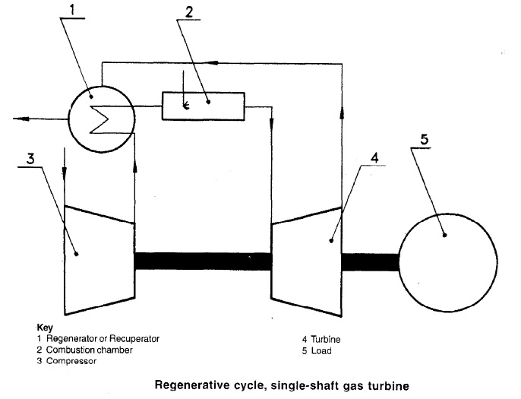
Reference (IS 14751: 1999/IS0 11086: 1996)

Slide 18
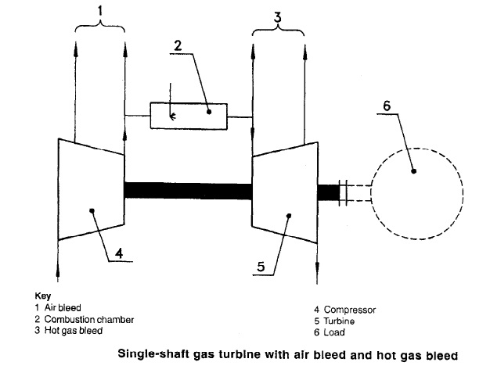
Reference (IS 14751: 1999/IS0 11086: 1996)

Slide 19
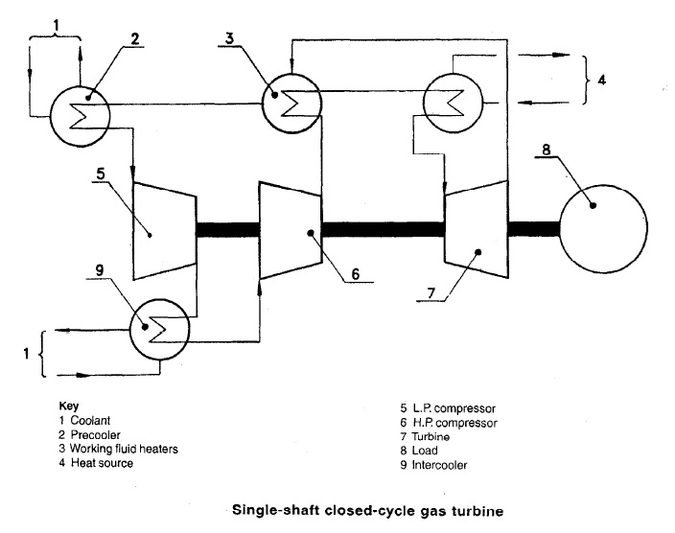
Reference (IS 14751: 1999/IS0 11086: 1996)

Slide 20
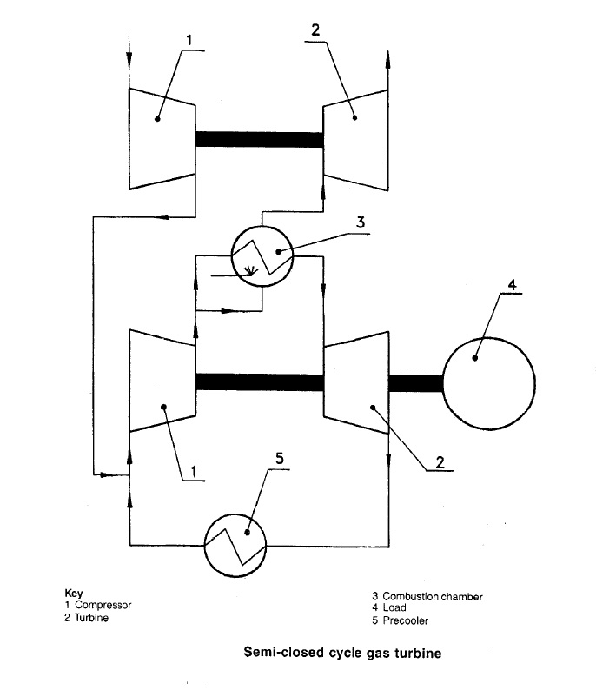
Reference (IS 14751: 1999/IS0 11086: 1996)

Slide 21
Reference (IS 14751: 1999/IS0 11086: 1996)

Slide 22
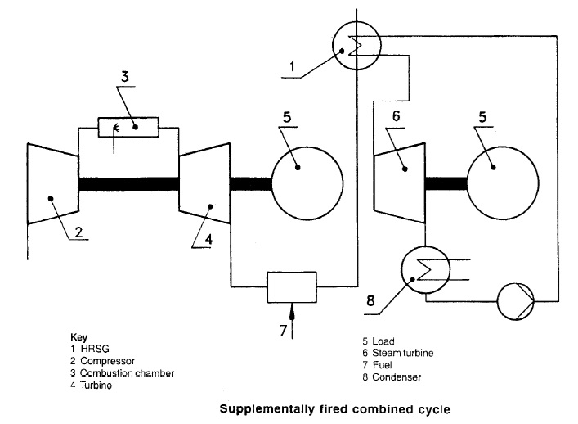
Reference (IS 14751: 1999/IS0 11086: 1996)

Slide 23
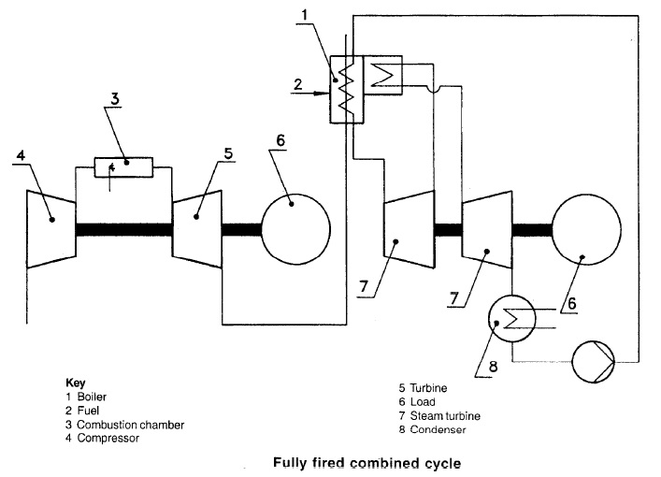
Reference (IS 14751: 1999/IS0 11086: 1996)

Slide 24
Application & Acceptance Criteria
IS 15666 (Part 2): 2006/ISO 3977-2:1997 (Gas turbines - Procurement: Part 2 standard reference conditions and ratings) prescribes standard ratings for gas turbines.
The output power of a given gas turbine at a given reference turbine inlet temperature is, in generaI, proportional to the absolute ambient pressure and is also greatly dependent on the air intake temperature (normally outside dry bulb temperature). Likewise, the output at a given air intake temperature is dependent on the reference turbine inlet temperature.
Steam or water injection may be used to increase the power output and to reduce the NOx emissions.
The performance ratings of gas turbines are assessed on the net specific energy of the fuel used, as follows:
a) turbines intended for use on liquid fuel: 42000 kJ/kg;
b) turbines intended for use on gaseous fuel (100 % methane): 50000 kJ/kg.
The specific energy at constant pressure of the fuel, whether liquid, gaseous or solid, is based on a pressure of 101.3 kPa and a temperature of 15 ºC.
If the fuel to be used for testing the gas turbine is different from that agreed between the purchaser and the manufacturer for service operation, a test fuel of a mutually agreed specification shall be used.

Slide 25
Application & Acceptance Criteria
Classes
Class A: operation up to and including 500 h per annum at reserve peak power rating;
Class B: operation up to and including 2000 h per annum at peak power rating;
Class C: operation up to and including 6000 h per annum at semi-base power rating;
Class D: operation up to and including 8760 h per annum at base power rating.
Ranges
Range I: over 500 starts per annum average;
Range II: up to 500 starts per annum average;
Range III: up to 100 starts per annum average;
Range IV: up to 25 starts per annum average;
Range V: continuous operation without planned shutdown for inspection and/or maintenance within a specified period.

Slide 26
Application & Acceptance Criteria
IS 15666 (Part 2): 2006/ISO 3977-2:1997 specifies that unless specially agreed upon between the purchaser and the manufacturer, the net power rating of a gas turbine shall be specified under a combination of one of the classes with one of the ranges of an average number of starts per annum.
EXAMPLE
B-ll (Class B, Range II) refers to the operation of up to 2000 h per annum associated with any number of starts up to 500 per annum.
Further, the manufacturer is also required to declare standard ratings, based on electrical power at the generator terminals or on turbine output shaft power under the standard reference conditions such as Air intake conditions, Exhaust conditions, Cooling water conditions (if applicable), and Working fluid heater or cooler, associated with the following operational modes:
Standard peak load rating (2 000 h and 500 stats per annum average) Class B: Range II;
Standard base load rating (8 760 h and 25 starts per annum average) Class D: Range IV.

Slide 27
Functional and Operational Tests
IS 15666: Part 8:2006 (Gas turbines - Procurement: Part 8 inspection, testing, installation and commissioning) defines general terms related to inspection, test, witnessed & observed.
Inspection
Process by which it is demonstrated that materials, components, assemblies or complete packages satisfy one or more particular specification requirements of the packager or purchaser
This may include verificational documentation, reports, material certificates, chemical analyses, physical or dimensional checks, build records, visual checks and/or results of documented inspections and tests including any other non-destructive evaluation(NDE) methods or techniques that may be employed.
Test
Process by which it is demonstrated that assemblies, completed components or packages satisfy the physical, functional and operational requirements as specified by the packager’s test schedules and procedures, or the purchaser’s specification

Slide 28
Functional and Operational Tests
Witnessed
Term meaning that a hold is applied to the production schedule and that the inspection or test will be carried out with the purchaser or his representative in attendance
Observed
Term meaning that the purchaser will be notified of the timing of the inspection or test

Slide 29
Functional and Operational Tests
Clause 6 of IS 15666 (Part 2): 2006/ISO 3977-2:1997 prescribes minimum recommended requirements for the physical testing of components, assemblies and the complete package prior to entry into commercial service.
Hydrostatic test
As a minimum, components defined by legislation or national standards as pressure vessels (excluding the casings of gas generator and power turbine) shall be tested hydrostatically according to legislation or national standards, but at least with liquid at a minimum of 1.5 times the maximum allowable working pressure but not less than 140 kPa differential pressure. Other components and systems shall be tested in accordance with the purchaser’s requirements or statutory or mandatory requirements applicable to the destination territory. The test liquid shall be at a higher temperature than the nil-ductility transition temperature of the material being tested.
Tests shall be maintained for a sufficient period of time to permit complete examination of parts under pressure. The hydrostatic test shall be considered satisfactory when neither leaks nor seepage through the casing or casing joint is observed for a minimum of 30 min. Large, heavy castings may require a longer testing period which is to be agreed upon by the purchaser and packager.

Slide 30
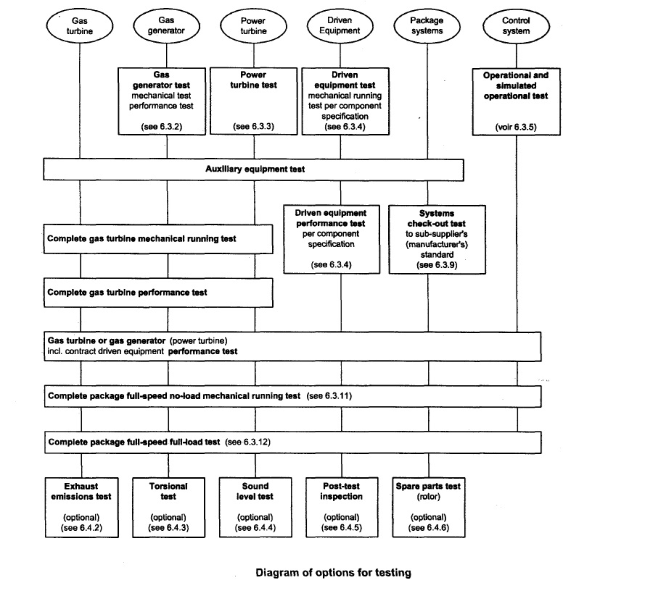
This Figure shows the desired sequence of mandatory and optional operation testing and may be used.
Please refer IS 15666: Part 8:2006

Slide 31
Functional and Operational Tests
The following are examples of the tests which are commonly performed: [Ref: 15666 (Part 2): 2006/ISO 3977-2:1997]
gas turbine tests;
gas turbine with the contract driven equipment;
complete package test.
For gas turbines with a free power turbine#, the following alternative tests may be performed:
gas generator tests;
free power turbine test.
These tests may be performed at no load, part load or full load, For mechanical drive applications, the driver may be used to execute full pressure, full load or full speed tests of the driven equipment.
# A "free power turbine", allows the speed of the power turbine to be optimised for the machinery that it will energize without the need for an additional reduction gearbox within the engine.

Slide 32
Functional and Operational Tests
The tests shall include, as appropriate,
cold start,
hot start,
full range operation of variable inlet guide vanes and/or stator stages,
operation of bleed valves, and
operation of anti-icing systems (when they are furnished).

Slide 33
Functional and Operational Tests
When specified, the optional tests following shall be performed, depending on the facilities, either in the shop or on site as mutually agreed between the packager and purchaser.
Exhaust emissions test: Exhaust emissions test shall be carried out in accordance with ISO 11042-1.
Torsional test: Torsional vibration measurements shall be made to verify the complete power train torsional analysis. The test procedure shall be mutually agreed between purchaser and packager.
Sound-level test: The sound-level test shall be performed in accordance with ISO 6190 or a procedure as agreed between the packager and purchaser.
Post-test inspection: Borescopic inspection and/or dismantling inspection and reassembly of the major driven equipment, gears and the driver may be made after satisfactory completion of the mechanical running test. The packager and purchaser shall agree to what extent the package equipment shall be dismantled and inspected.
Spare-rotor test: Spare rotors shall be tested as specified by the purchaser
Endurance test: Prolonged running (24 h or more) may be specified by the purchaser. The objectives and acceptance-criteria of this running shall be agreed between the packager and purchaser.

Slide 34
Functional and Operational Tests
Heat consumption (Reference 1S 15664: 2008/ISO 2314:1989)
The rate of heat consumption, q_{r} in kilowatts, is determined by the equation :
q_{Ⴀ} = m(Q_{lo} +h_{f4} - h_{o})/ Ⴀ = m(Q_{lo} +h_{f4} - h_{o})
where
Ⴀ is the test duration, in seconds;
m_{t} is the mass of fuel ¹⁾ used during period Ⴀ, in kilograms;
Q_{lo} is the net specific energy of the fuel at 15ºC and constant pressure, in kilojoules per kilogram;
m is the rate of fuel consumption, in kilograms per second, given by m_{Ⴀ}/ Ⴀ
h_{f4} is the specific enthalpy of the fuel at temperature T_{f4} entering the heat source (combustion chamber), in kilo- joules per kilogram;
h_{o} is the specific enthalpy of the fuel at 15ºC, in kilojoules per kilogram.
1) The fuel used shall be the net value of the inlet fuel less by-passed fuel, if any.

Slide 35
Functional and Operational Tests
Thermal efficiency
The thermal efficiency, η_{t} of the engine based on net shaft power output may be computed from:
η_{t = P/q}
where
P is the net shaft power output, in kilowatts:
q is the heat consumption, in kilowatts.
Heat rate
The heat rate, q_{p} in kilowatts of heat per kilowatt of power, may be computed from
q_{p} = q/P = 1/ η_{t}
Where,
q is the heat consumption, in kilowatts.
P is the net shaft power output, in kilowatts,
ηt is the thermal efficiency.

Slide 36
Functional and Operational Tests
The preferred approach in conducting tests is to run at the reference conditions of the compressor inlet (temperature, pressure, and relative humidity), and at the standard exhaust. However this may not always be possible; the tests may have to be run under some other conditions, and the results corrected to reference conditions to facilitate comparison of power and thermal efficiency.
Clause 8.3 of IS 15664:2006/ ISO 2314:1989 provides the procedure for applying corrections of test results to reference conditions

Slide 37
Functional and Operational Tests
MEASUREMENT UNCERTAINTY (Reference Annexure A of IS 15664: 2008/ISO 2314:1989)
The measurement of each value entering into the computation of the test result is liable to some degree of error, depending on the quality of the measuring instruments and the conditions of the measurement. The test result is therefore subject to a degree of uncertainty depending on the combined effect of all the errors of the measurement.
The confidence limits of any measurement can be assessed
a) from measuring recommendations and standards;
b) from the accuracy classes of the measuring instrument or measurement, chain;
c) from the accuracy of calibration of a measuring instrument or transducer;
d) from the influence of unavoidable installation error;
e) from general measuring experience;
f) from fluctuating test conditions.
Due to the many causes involved, the assessment of the measurement uncertainty shall be made by calculation for each case.

Slide 38
Potential Saftey Hazards & Necessary Requirements
The Indian Standards (IS) place a strong emphasis on the safety aspects of turbines, ensuring that these machines operate safely and reliably under various conditions.
IS 15666 (Part 9): 2006/ISO 3977-9:1999 (Gas Turbines — Procurement Part 9 Reliability, Availability, Maintainability and Safety) provides detail of safety elements that need special attention such as:
a) Minimization of fire hazards and provisions for appropriate fire control.
b) Control systems designed to prevent unsafe conditions (speeds, temperature, vibration, etc.).
c) Alarms to warn of unsafe operating conditions.
d) Suitable safety trips to protect operating personnel and/or equipment.
e) If operators will be near the gas turbine while it is operating, guards, insulation, handrails, etc., should be provided to protect personnel from accidental contact with dangerous elements. Where appropriate, warning signals shall also be supplied.
f) Proper handling equipment and tools shall be available to maintenance personnel; particular attention is required for the safe handling of heavy equipment, including rigging or blocking tools, slings, hoists and cranes.
g) Power plant design shall minimize the possibility of a fire fed by lubricating oil, hydraulic oil and fuel oil leaks (localizing any potential leaks shall be given careful attention).

Slide 39
Potential Safety Hazards & Necessary Requirements
g) Power plant design shall minimize the possibility of a fire fed by lubricating oil, hydraulic oil and fuel oil leaks (localizing any potential leaks shall be given careful attention).
h) Adequate ventilation and means of escape shall be provided for any personnel who will be near the power plant when it is operating; recognition shall be given to the fact that fire protection systems operating in a confined area can be dangerous to personnel.
i) Manufacturers’ recommendations relative to occupancy of the gas turbine enclosure during operation shall be followed.
j) If operators are to be exposed to abnormal sound levels, suitable protective ear devices shall be worn.
k) Operating and maintenance personnel shall be provided with instructions to promote safe operation and maintenance of the power plant.
l) The inter-relationship of the gas turbine protective equipment and its possible effect on other power plant or system equipment.
m) Power plant design shall minimize the possibility of fuel gas leakage and gas explosion by provision of suitable arrangements for venting, gas detection, cell/building ventilation, equipment spark suppression, pipework earthinglbonding, etc.

Slide 40
Potential Safety Hazards & Necessary Requirements
In applications where aspects of safety are extremely important (i.e. for aircraft engines), the analysis of the condition of complex systems has already attained a high level. The positive influence on the maintenance effort that accompanies the introduction of monitoring systems (MSS), as well as the possibility of preventing failures, more and more raises the interest in applying such systems to large power plants where the safety requirements are less stringent. The economic performance of a plant can be improved by such monitoring systems.
IS 15667:2006/ISO 19860:2005 classifies and defines monitoring systems and their technical terms. It establishes a system for conversion and validation of measured quantities to enable a comparison of the various systems, their features and their performances.

Slide 41
Potential Safety Hazards & Necessary Requirements
Emergency protection is crucial for safeguarding the gas turbine and its associated equipment from potential hazards and damage. It should be designed to detect and act autonomously, independent of the governor, when necessary. To optimize the gas turbine's lifespan, it may not always be required to immediately initiate an emergency stop or reduce to the minimum self-sustaining speed or load, depending on the circumstances.
IS 15666 (Part 3): 2006/1S0 3977-3:2004 prescribes the following types of emergency protection systems:
Protective load shedding: Under certain fault conditions, the sequence may allow for the gas turbine to go to minimum load, no load (generator breaker open) or trip to self-sustaining speed for a period of time, allowing for cooling before the fuel is shut off automatically and the gas turbine is shut down.
Emergency shutdown: Emergency shutdown may be manually initiated but shall occur automatically on operation of applicable gas turbine/process plant protection devices as agreed with the purchaser. The system shall operate directly on the fuel shut-off valve to stop the gas turbine fuel supply.

Slide 42
Potential Safety Hazards & Necessary Requirements
Fire, gas detection and ventilation failure shutdown: Should a serious fault be detected, such as fire, gas leakage at trip level, or ventilation failure, shutdown shall occur automatically as a result of the function of automatic detection devices, The system shall operate directly on the fuel shut off and vent valves. The gas turbine shall be shut down immediately without ramping to minimum load or cooling period.
In the case of gas detection at an enclosure ventilation outlet (but not the inlet), the ventilation fans shall be retained on to purge remaining gas from the enclosure.
If an unacceptable level of explosive atmosphere is detected at a ventilation inlet, the ventilation fans shall be tripped where applicable as the source is most probably external to the enclosure, and shutdown of the gas turbine shall occur.
Shutdown of generator sets: For electric generation, means shall be provided, either on the gas turbine or on the generator, for prevention of motoring of the generator when the fuel stop valve is closed. Where synchronous compensation or generator starting is specified, these requirements may be operationally over-ridden.
Shutdown of mechanical drive sets: Automatic means shall be provided upon shutdown for isolating the driven equipment from the system it supplies in order to prevent rotation or reverse flow.

Slide 43
S. No. | IS No. | IS Title
1 | IS 1012 : 2002 | Turbine Lubricating Oils - Specification (Third Revision)
2 | IS/Iso 10816-4 : 2009 | Mechanical Vibration - Evaluation of Machine Vibration By Measurements On Non - Rotating Parts: Part 4 Gas Turbine Sets With Fluid - Film Bearings
3 | IS 11159 (Part 6) : 2011/ISO 6743_5 : 2006 | Lubricants, Industrial Oils And Related Products (Class L) - Classification: Part 6 Family T (Turbines)
4 | IS 1448 (Part 97) : 2015/ISO 6249 : 1999 | Methods of Test For Petroleum and Its Products [P : 97] Determination of Thermal Oxidation Stability Of Gas Turbine Fuels - JFTOT Method
5 | IS 1448 (Part 113) : 1983 | Methods of Test For Petroleum And Its Products [P:113] Determination of Total Acidity In Aviation Turbine Fuel
6 | IS 1448 (Part 118) : 2019 | Methods of Test For Petroleum And Its Products [P : 118] Naphthalene Hydrocarbons In Aviation Turbine Fuel By Ultraviolet Spectrophotometry
7 | IS 1448 (Part 123) : 2013/ISO 7624:1997 | Methods Of Test For Petroleum and Its Products [P : 123] Inhibited Mineral Turbine Oils - Determination of Oxidation Stability
8 | IS 1448 (Part 137) : 1991 | Methods of Test For Petroleum And Its Products [P:137] Water Separation Characteristics Of Aviation Turbine Fuels
9 | IS 1448 (Part 142) : 2021 | Determination of Water Separation Characteristics of Aviation Turbine Fuels By Portable Separometer
Relevant standards – Gas Turbine

Slide 44
S. No. | IS No. | IS Title
10 | IS 15664 : 2006/ISO 2314:1989 | Gas Turbines Acceptance Tests
11 | IS 15666 (Part 1) : 2006/ISO 3977-1:1997 | Gas Turbines - Procurement: Part 1 General Introduction and Definitions
12 | IS 15666 (Part 2) : 2006/ISO 3977-2:1997 | Gas Turbines - Procurement: Part 2 Standard Reference Conditions and Ratings
13 | IS 15666 (Part 3) : 2006/ISO 3977-3:2004 | Gas Turbines - Procurement: Part 3 Design Requirements
14 | IS 15666 (Part 4) : 2006/ISO 3977-4:2002 | Gas Turbines - Procurement: Part 4 Fuels and Environment
15 | IS 15666 (Part 5) : 2006/ISO 3977-5:2001 | Gas Turbines - Procurement: Part 5 Applications For Petroleum and Natural Gas Industries
16 | IS 15666 (Part 7) : 2006/ISO 3977-7:2002 | Gas Turbines - Procurement: Part 7 Technical Information
17 | IS 15666 (Part 8): 2006/ ISO 3977-8:2002 | Gas Turbines — Procurement Part 8 Inspection, Testing, Installation and Commissioning
18 | IS 15666 (Part 9): 2006/ ISO 3977-9:1999 | Gas Turbines — Procurement Part 9 Reliability, Availability, Maintainability and Safety
Relevant standards – Gas Turbine

Slide 45
S. No. | IS No. | IS Title
19 | IS 1571 : 2018 | Aviation turbine fuels, kerosine type, jet - A - 1 - Specification
20 | IS 1587 : 2017 | Aviation turbine fuel, high flash point type - Specification
21 | IS 15999 (Part 3) : 2023/IEC 60034-3 : 2007 | ROTATING ELECTRICAL MACHINES Part 3: Specific requirements for synchronous generators driven by steam turbines or combustion gas turbines and for synchronous compensators
22 | IS 16737 : 2018/ISO 8216-2 : 1986 | Petroleum Products- Fuels (Class F) - Classification Part 2 Categories of Gas Turbine Fuels for Industrial and Marine Applications
23 | IS 16775 : 2018/ISO/TS 11365 : 2011 | Petroleum and related products - Guidance for the maintenance and use of triaryl phosphate ester turbine - Control fluids
24 | IS 16852 : 2018ISO/TS 11366 : 2011 | Petroleum and related products - Guidance for in - Servicing of lubricating oils for steam, gas and combined - Cycle turbines
25 | IS 17081 : 2019 | Aviation turbine fuel (Kerosene Type, Jet A - 1) containing synthesized hydrocarbons - Specification
26 | IS 1710 : 2021 | Vertical Turbine Pumps - Specification
Relevant standards – Gas Turbine

Slide 46
S. No. | IS No. | IS Title
27 | IS/ISO 20816-2 : 2017/ISO 20816-2 : 2017 | Mechanical Vibration - Measurement and Evaluation of Machine Vibration Part 2 Land-Based Gas Turbines, Steam Turbines and Generators in Excess of 40 MW, with Fluid-Film Bearings and Rated Speeds of 1 500 r/min, 1 800 r/min, 3 000 r/min and 3 600 r/min ( First Revision )
28 | IS/ISO 20816-4 : 2018/ISO 20816-4 : 2018 | Mechanical Vibration - Measurement and Evaluation of Machine Vibration Part 4 Gas Turbines in Excess of 3 MW, with Fluid-Film Bearings (First Revision)
29 | IS 5422 : 1996 | Turbine type generators - Specification (First Revision)
30 | IS 8843 : 1978 | Accuracy requirements for turbine gears
31 | IS 15667 : 2006/ISO 1986 | Gas turbines - Data acquisition and trend monitoring system requirements for gas turbine installations
32 | IS 15676 : 2006 | Flow measurement of natural gas by turbine meters
33 | IS 14751 : 1999/ISO 11086:1996 | Gas Turbines - Vocabulary
Relevant standards – Gas Turbine

Slide 47
Thank you!..

