Slide 1
VEHICLE DYNAMICS AND CONTROL

Slide 2
BROAD AREAS COVERED 1. Automotive Braking Systems 2. Suspension and Ride comfort 2. Automotive Steering Systems 3. Advanced Driver Assistance Systems (ADAS) 4. Anti-lock Braking Systems 5. Tyre Pressure Monitoring Systems (TPMS) 6. Rear Parking Assistance Systems (RPAS) 7. Electric Power Trains 8. How to download Indian Standards free of cost 9. How to use BIS CARE App

Slide 3
INTRODUCTION Vehicle Dynamics and Control is a field that focuses on understanding and optimizing the motion of vehicles. It encompasses the study of tyre-road interactions, suspensions, design, steering systems and braking technologies, all of which are critical for enhancing vehicle performance, safety and handling.

Slide 4
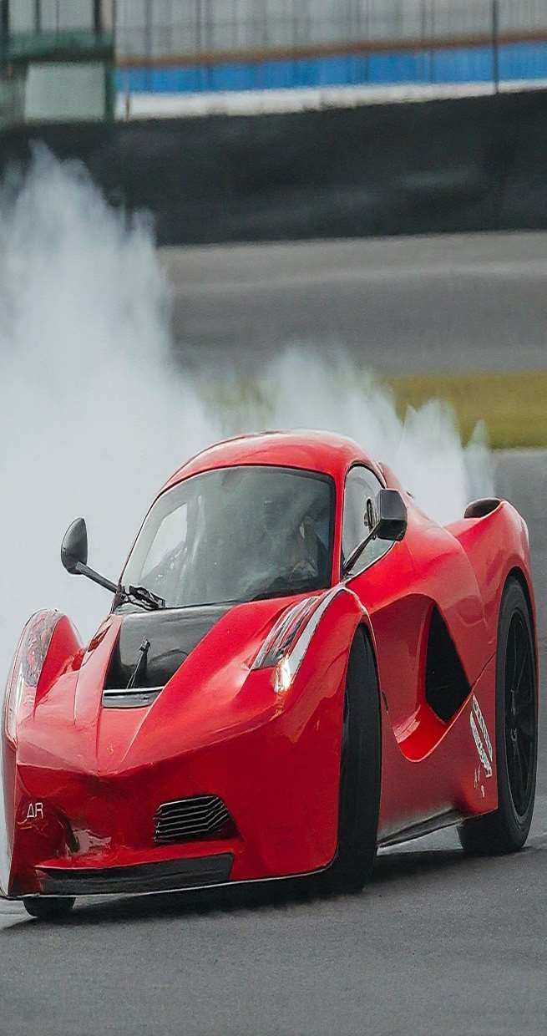
FUNDAMENTALS OF VEHICLE MOTION
Kinematics
Examining the position, velocity, and acceleration of a
vehicle as it moves through space.
1
Kinetics
Analyzing the forces and moments that influence a vehicle's motion, such as gravity, friction, and aerodynamics .
Dynamics
Integrating kinematics and kinetics to understand how a vehicle's design and operating conditions affect its behavior.
2
3

Slide 5
IMPORTANCE OF VEHICLE DYNAMICS
Enhances vehicle handling and stability
Improves | safety | by predicting and
controlling | vehicle | behavior in critical
situations
Optimizes performance in terms of acceleration, braking, and cornering
Contributes to a more comfortable and enjoyable driving experience

Slide 6
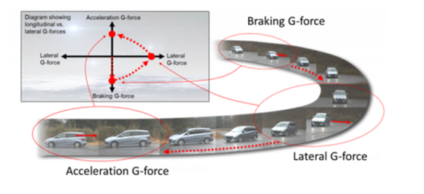
KEY COMPONENTS OF VEHICLE DYNAMICS
Longitudinal dynamics
(Acceleration and Braking)
IS 11851 Method of evaluation of acceleration of automotive vehicle
Lateral dynamics
(Steering and Cornering)
IS 14269 Automotive vehicles integral power steering gear method of test.
Vertical dynamics
(Suspension and Ride comfort)
IS 7906 Helical Compression springs
IS 7907 Helical Extension springs
IS 5423 Automotive vehicles - Shock absorbers - Specification

Slide 7
IS 11851 METHOD OF EVALUATION OF ACCELERATION This standard gives the method of evaluation of acceleration of automotive vehicles such as truck, bus, car & jeep.
Evaluation of Acceleration
The acceleration performance shall be expressed as the time taken in seconds:
to cover a distance of 1 000 m from start or
to achieve speed of 90 kmph or to the nearest multiple of 10 kmph to the maximum speed, whichever is less.
The engine, at the starting point of the measuring strip or track shall be run at the low idling speed as specified by the manufacturer. The centre line of the front wheel of the vehicle shalLcoincide within the starting point of the measuring strip if distance measurement is based on fixed marks on the track. If instruments such as fifth wheel or opticle devices are used for the measurement of distance the location points of such instruments shall be taken as references instead of the front wheel.
Starting gear shall be as per manufacturer recommendations and the vehicle shall be accelerated to achieve speed in shortest duration in different gears and gears shall be changed for different speeds as recommended by the manufacturer and shall be recorded in the test report.
The time taken to cover the distance or to achieve the speed shall be established within +/- 0.7 percent of the measured time
The test shall be repeated in opposite direction.
The acceleration performance shall be equal to the arithmatic average of time taken for 6 readings ( 3 each in either direction ) which do not differ by more than +/- 5 percent from mean expressed in seconds rounded off to the nearest second place of decimal.
For the purposes of detailed analysis, the tests may be conducted for distances starting from 100 m and increased in steps of 100 m and speeds similarly from 10 kmph onwards in steps of 10 kmph each.
Parameters which decides: Vehicle condition
Atmospheric condition: Temperature, relative humidity, Wind Speed, Air density, etc.

Slide 8
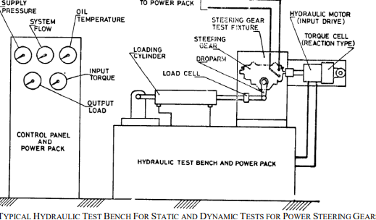
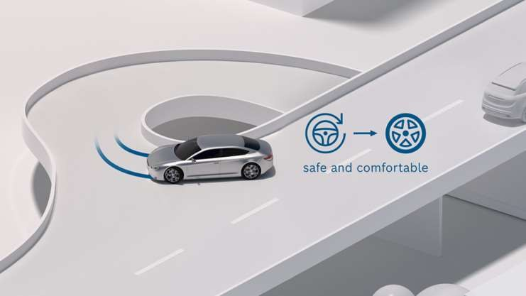
IS 14269 :2024 AUTOMOTIVE VEHICLES - INTEGRAL POWER STEERING GEAR - METHOD OF TEST
This standard gives the methods to evaluate the performance of power steering gears in respect of functional reliability and operational safety under static and dynamic conditions.
Performance Criteria
The gear shall complete 30 000 test cycles and still be operable. One cycle is starting from centre, going to one extreme on to the other extreme and back to centre;
During test, external leakage and loosening of fasteners shall not be permitted;
At the end of test, internal leakage carried out shall not exceed double the specification value before test; and
At the end of test there shall not be any cracks or material detachments. However normal wear marks on the individual components shall not be considered as failure.

Slide 9
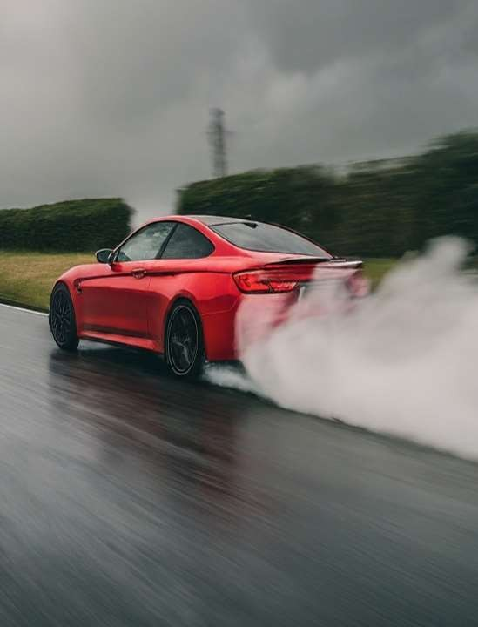
VEHICLE STABILITY
Vehicle stability refers to its ability to resist rollover and maintain control during maneuvers.
Center of gravity (CG): The point at which the vehicle's weight is concentrated. A lower CG improves stability.
(IS 11849 Method of determination of centre of gravity of automotive vehicles)
Wheelbase: The distance between the front and rear axles. A longer wheelbase generally provides better stability.
Track width: The distance between the left and right tires on the same axle. A wider track improves stability.
Suspension tuning: Stiffer suspension can enhance stability but compromise ride comfort.

Slide 10
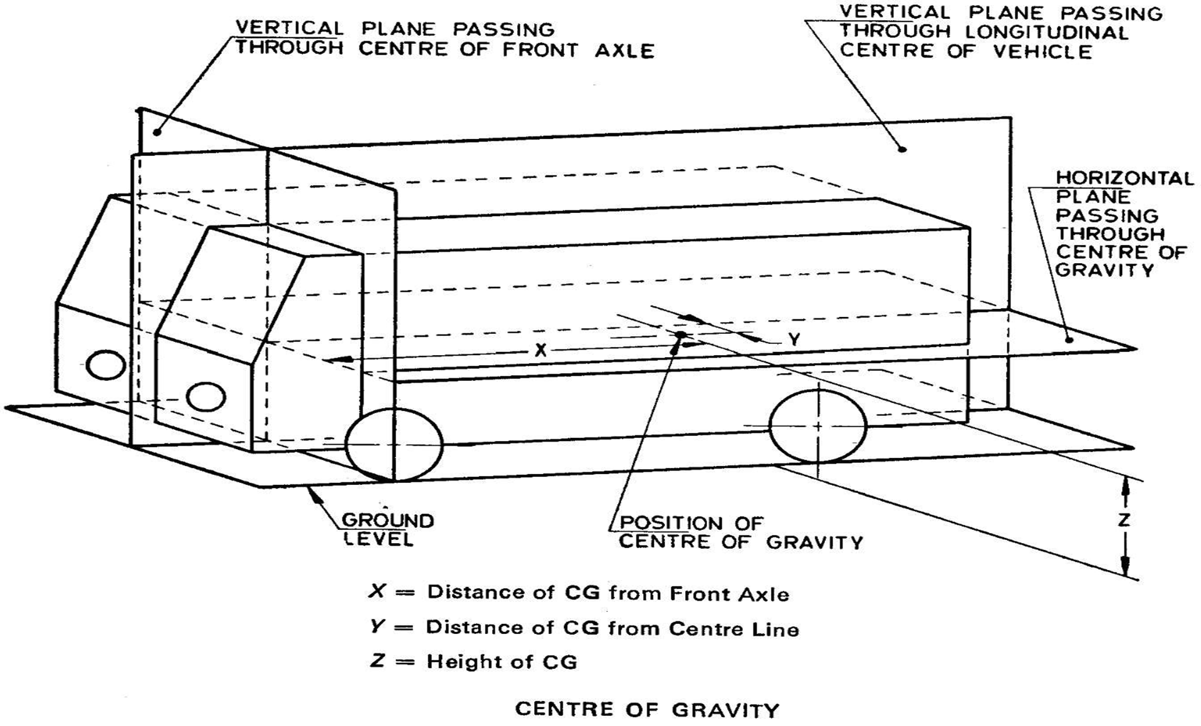
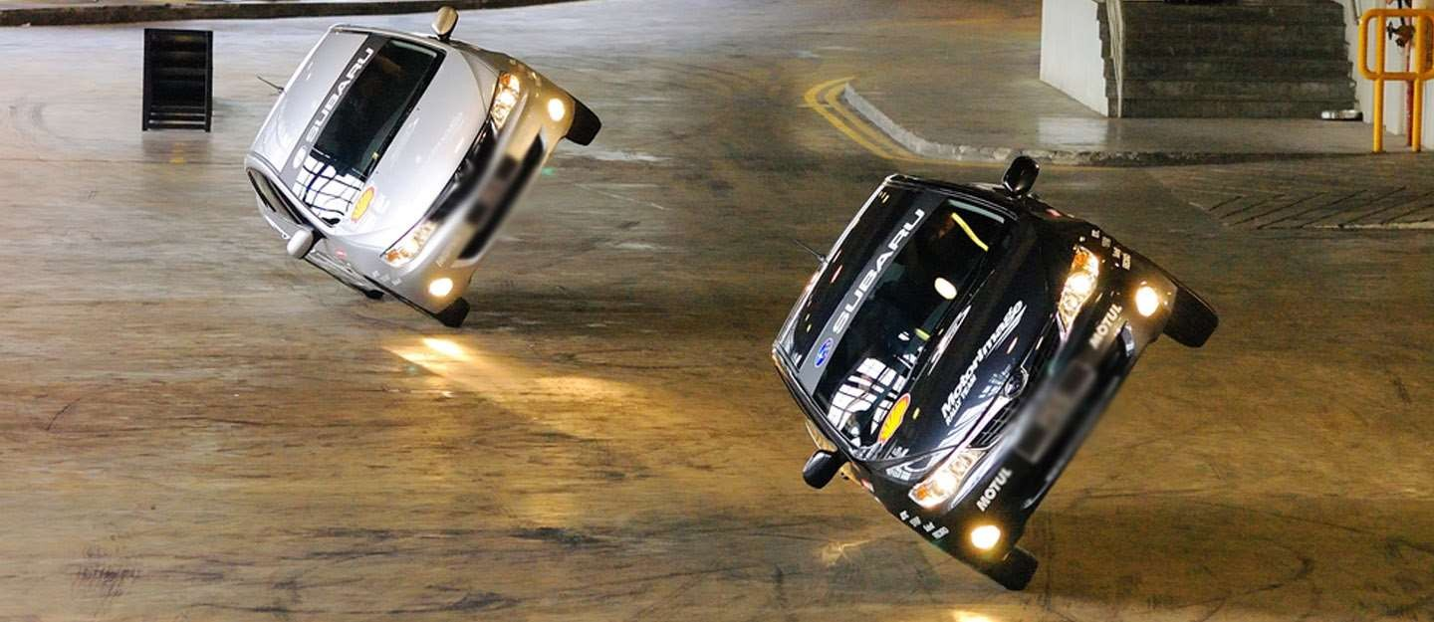
IS 11849 METHOD OF DETERMINATION OF CENTRE OF GRAVITY OF AUTOMOTIVE VEHICLES
This standard gives the procedure for determining the position and the height of Centre of Gravity (CG of car, jeep, truck and bus )

Slide 11
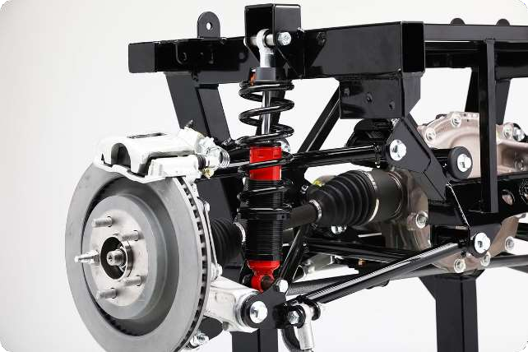
VEHICLE SUSPENSION AND HANDLING
1
Suspension Design
Optimizing the suspension system to provide a balance between ride comfort, handling, and stability.
2
Suspension Kinematics
Understanding the motion of suspension components and
their impact on vehicle behavior.
3
Handling Dynamics
Analyzing how a vehicle's suspension, tires , and other factors
affect its maneuverability and responsiveness.

Slide 12
SPRINGS
A Spring is defined as Elastic machine element which deflects on application of load and returns to original shape when load is removed
Important Functions
Springs are used to Absorbs Shocks and vibrations
Springs are used to Store energy
Springs are used to Measure forces
Springs are used to apply force and control motion

Slide 13
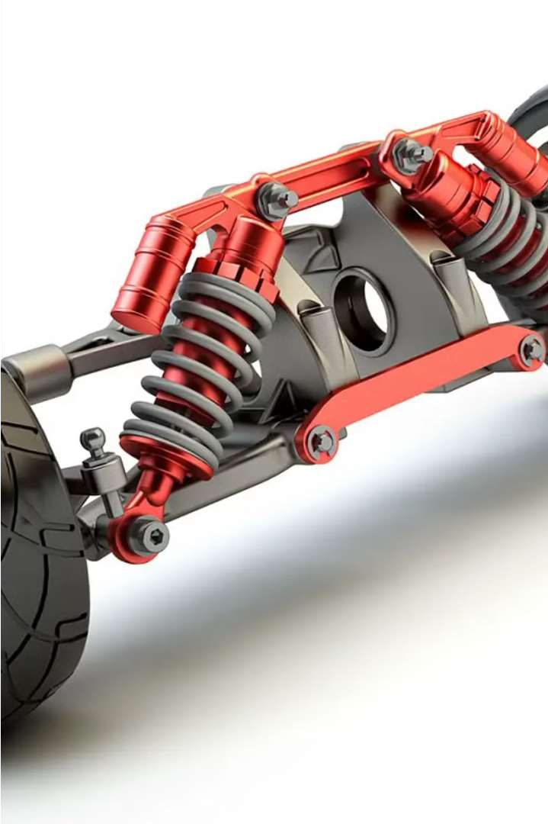
INDIAN STANDARDS FOR AUTOMOTIVE SPRINGS The Indian Standards provide comprehensive guidelines and specifications for various types of springs used in automotive suspension systems. These Standards cover the design materials, performance and testing requirements to ensure the durability, reliability and safety of springs in vehicles. From leaf springs and helical compression springs to torsion bar springs these standards ensure consistent quality and optimal functionality of the critical components that contribute to a smooth and comfortable ride.

Slide 14
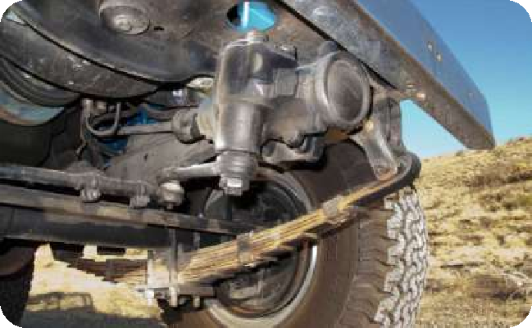
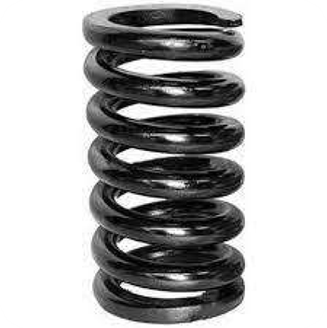
COMPREHENSIVE STANDARDS FOR AUTOMOTIVE SPRINGS
Leaf Spring Assemblies
IS 1135:2018 and related standards provide detailed specifications for the design, materials, and testing of leaf spring assemblies used in automotive suspension systems.
Helical Compression Springs
The IS 7906 series cover the
design, calculation, and specifications for various types of helical compression springs, ensuring optimal performance and reliability.
Helical Extenstion Springs
IS 7907 series outlines the design, calculation, and specifications for helical extension springs, focusing on their use in automotive applications.

Slide 15
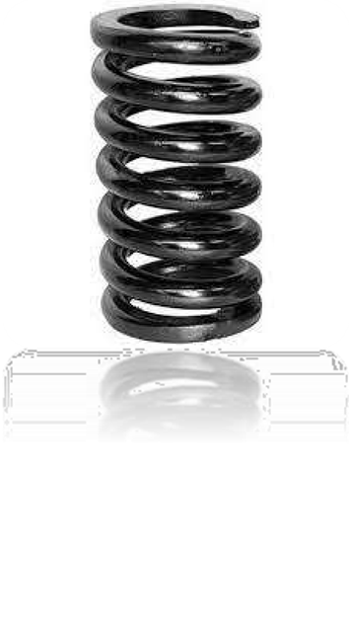
HELICAL COMPRESSION SPRINGS
Design and Calculation
IS 7906 Part 1 provides guidelines for the design and calculation of helical compression springs made from circular section wire and bar, ensuring optimal performance and load-bearing capacity.
Hot Coiled Springs
IS 7906 Part 5 outlines the specifications for hot coiled helical compression springs, focusing on material selection, manufacturing processes, and performance criteria.
Cold Coiled Springs
IS 7906 Part 2 specifies the requirements for cold coiled helical compression springs, including material properties, dimensions, and testing procedures.

Slide 16
HELICAL EXTENSION SPRINGS
Design and Calculation
IS 7907 Part 1 specifies the design and calculation methods for helical extension springs, ensuring proper functionality and load-bearing capacity.
Cold Coiled Springs
IS 7907 Part 2 provides specifications for cold coiled helical extension springs, including guidelines on material selection, manufacturing processes, and testing methods.

Slide 17
IS 7906 (PART 1) & IS 7907 (PART 1) HELICAL COMPRESSION SPRINGS & HELICAL EXTENSION SPRINGS
The main requirements to be satisfied in the design of helical springs are maximum possible dependability and life combined with lowest possible weight and cost.
In spring calculations, a distinction is made between springs subjected to a static or infrequently varying load and springs subjected to dynamic loads.
The cross section of the wire or bar of which a helical spring is made, is stressed mainly in torsion. In the calculations, therefore, the shear stresses likely to occur under load are compared with the permissible shear stresses.

Slide 18
IS 7906 (PART 1) & IS 7907 (PART 1) HELICAL COMPRESSION SPRINGS & HELICAL EXTENSION SPRINGS
The stressing imposed on the spring, consisting in fact of an overwhelmingly torsional element and a negligibly small bending element, is more severe on the inside of the coil than on the outside.
This maximum stress is taken into account in the calculation by introducing stress correction factor k. Tests have shown, however, that stress correction factor k can be omitted in calculations concerned with springs subjected to a static or infrequently varying load.
If the shear stresses occurring in the spring remain below the permissible range of stress or below the fatigue strength values in the case of springs subjected to alternating load, the spring will not fall or become fatigued within the envisaged life.
The permissible shear stresses and fatigue strength for cold and hot coiled springs have been included for spring materials meeting general requirements.

Slide 19
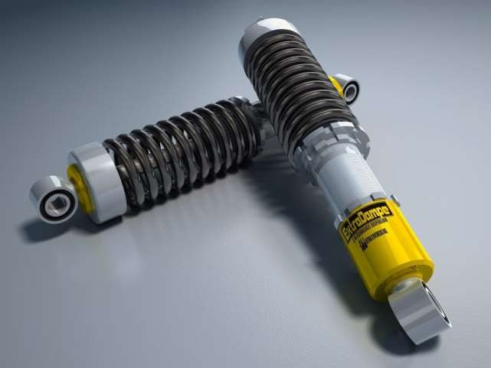
IS 5423
SHOCK ABSORBER
This standard covers Hydraulic telescopic shock absorbers and
gas charged hydraulic shock absorbers

Slide 20
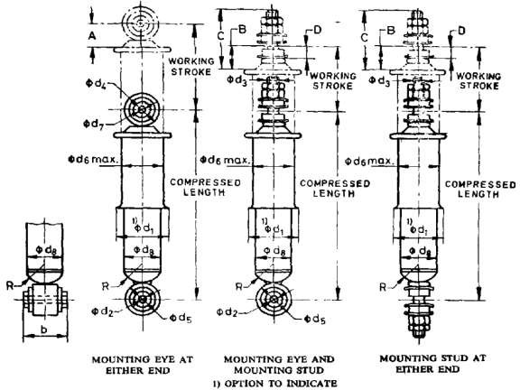
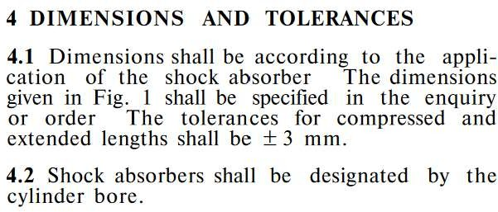
DIMENSIONS FOR SHOCK ABSORBERS
Required tests to assure performance :
Measurements, Damping force test & Endurance Test

Slide 21
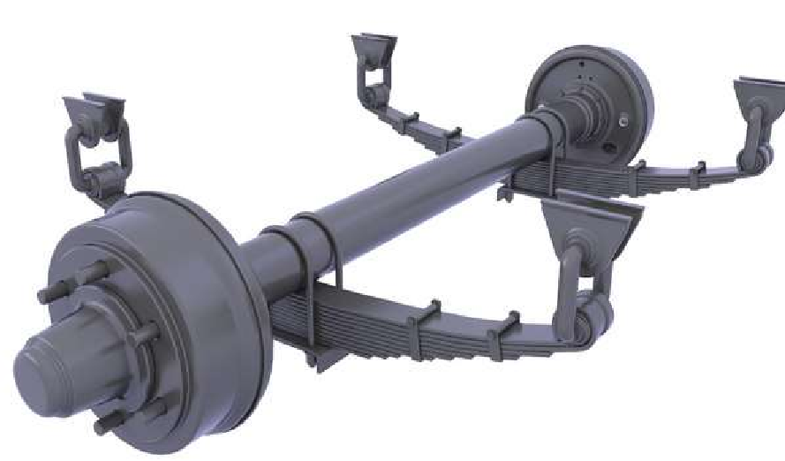
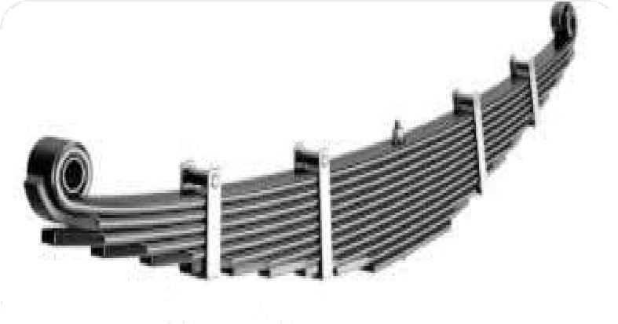
LEAF SPRINGS ASSEMBLY FOR AUTOMOBILE APPLICATIONS
Design Specifications
IS 1135:2018 specifies the requirements for leaf spring assemblies used in automotive suspension systems, including terminology, design parameters, material properties, and performance criteria.
Testing Procedures
The Standards outline comprehensive testing methods to evaluate the strength, resilience, and reliability of leaf spring assemblies, ensuring they meet the demands of automotive applications.
1
2
3
Material Standards
The IS 4454 series covers the specifications of materials used in the manufacture of mechanical springs, ensuring consistent quality and durability.

Slide 22
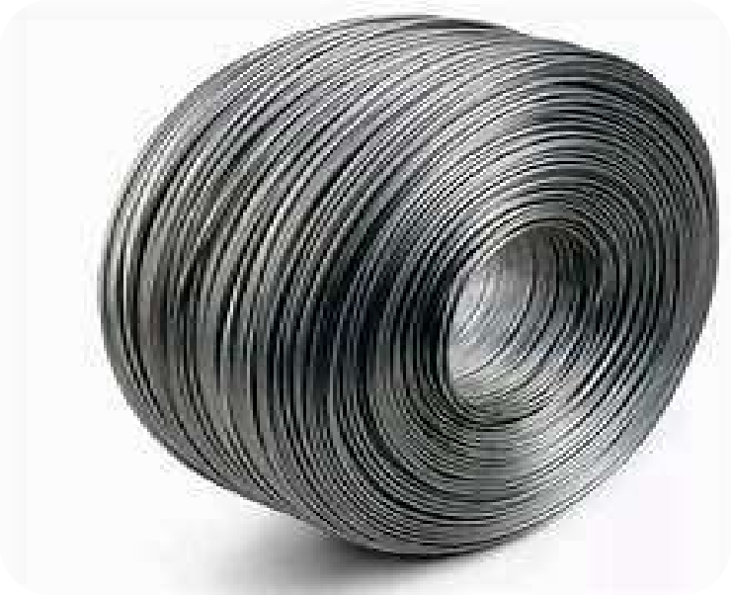
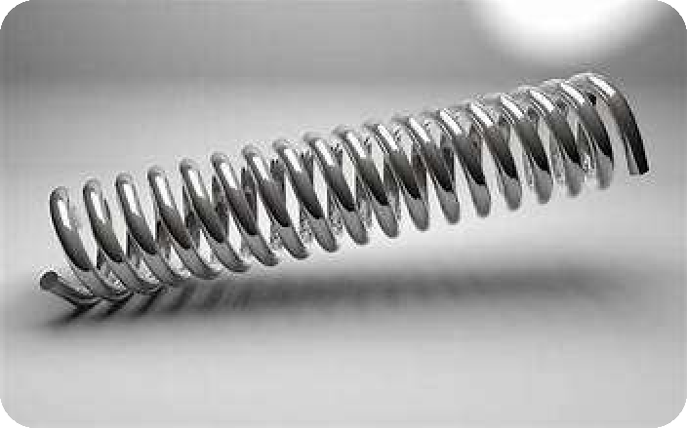
COLD DRAWN STEEL WIRE FOR MECHANICAL SPRINGS
Material Specifications
IS 4454 Part 1 covers the specifications for cold drawn unalloyed steel wire used in the manufacture of mechanical springs, ensuring consistent quality and performance.
Mechanical Properties
The standard provides guidelines on the mechanical properties, tolerances, and testing procedures for the steel wire to meet the requirements of spring applications.

Slide 23
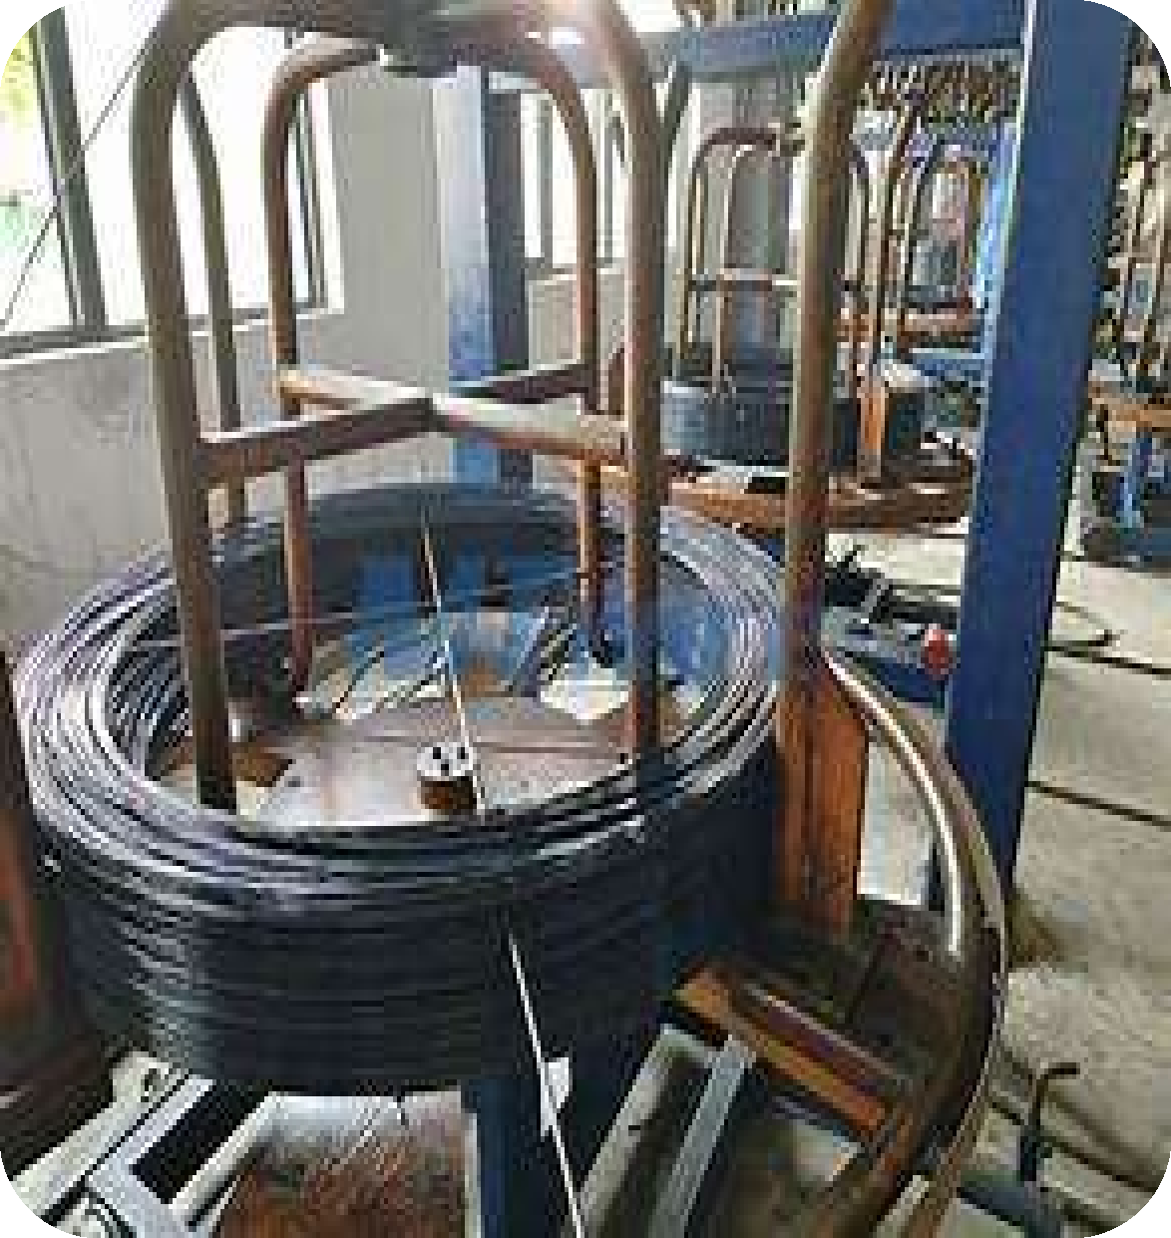
OIL HARDENED AND TEMPERED STEEL WIRE
High Strength and Resilience
IS 4454 Part
2 specifies the
oil hardened and
requirements for
tempered steel wire, which is used for making mechanical springs that require high strength and resilience.
Chemical Composition
The standard includes details on the chemical composition, mechanical properties, and testing methods for the
steel wire to
ensure it meets the
criteria for spring
performance applications.

Slide 24
STEEL WIRES FOR MECHANICAL PURPOSES
The properties governing the application of steels for springs maybe considerably influenced by their chemical composition as well as the modes of mechanical treatment and heat treatment applied.
It is for these reasons that a very large variety of steels maybe employed in the manufacture of steel springs. This variety is further increased owing to the fact that in certain cases these springs have to exhibit considerable resistance against corrosive influences and withstand elevated temperature and that the mechanical stress is imposed on them vary considerably.
In order to facilitate clear survey, the steels are classified into three categories on which
IS 4454 series of Indian Standards on Steel wire for mechanical springs exist:
Part 1: Cold drawn unalloyed steel wire
Part 2 : Oil hardened and tempered steel wire
Part 4 : Stainless steel wire

Slide 25
STEEL WIRES FOR MECHANICAL PURPOSES
IS 4454 (Part 1) : 2001 covers the requirements of cold drawn unalloyed steel wires of circular cross section for the manufacture of mechanical springs for static duty and dynamic duty applications.
IS 4454 ( Part 2 ) : 2001 covers requirements for oil hardened and tempered carbon and low alloy steel wire, for the manufacture of mechanical springs for static duty and dynamic duty applications.
IS 4454 (Part 4) : 2001 covers stainless steels listed in Table 1 in the next slide which are usually used in the cold drawn condition in the form of wire of circular cross-section up to 10 mm in diameter, for the manufacture of springs and spring parts that are exposed to corrosive effects and sometimes to slightly increased temperatures. Stainless steels which are covered in this standard and which exhibit special corrosion resistance are of austenitic type with chromium contents higher than 12 percent and are spring hard cold drawn.

Slide 26
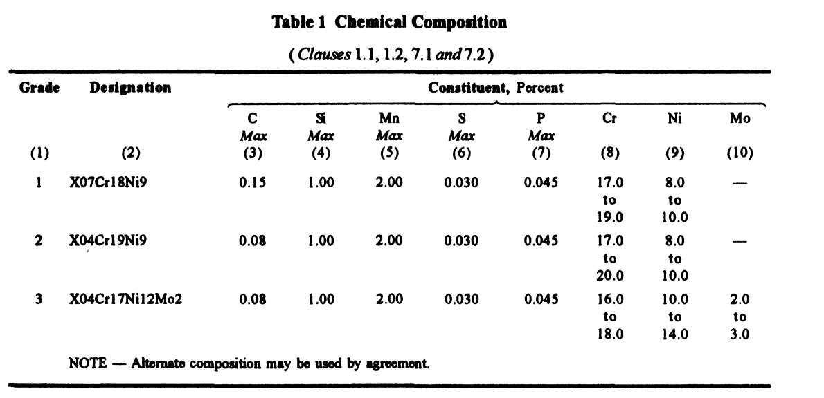
STEEL WIRES FOR MECHANICAL PURPOSES

Slide 27
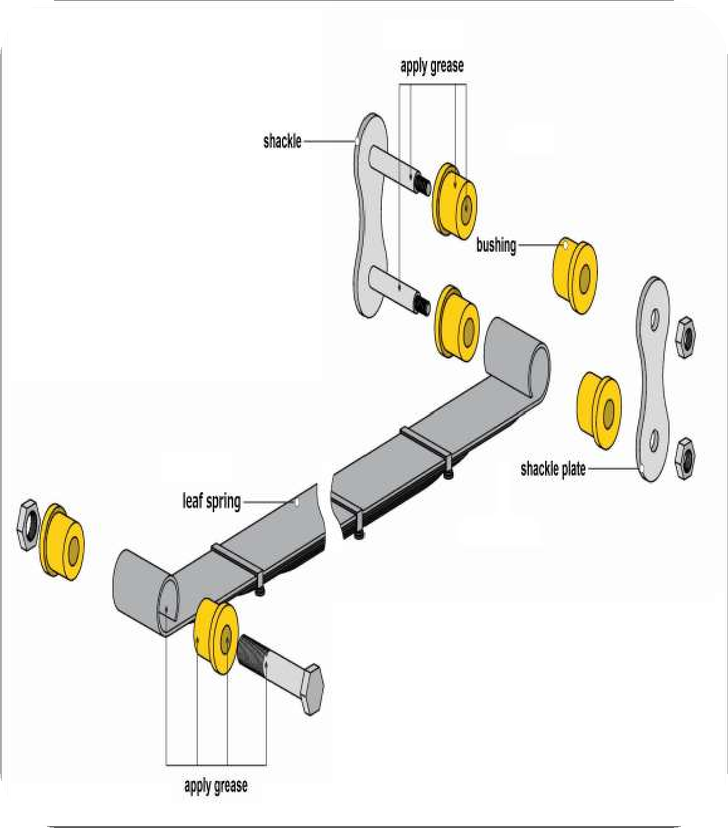
BUSHES FOR LEAF SPRING ASSEMBLIES
IS 8924 covers technical supply conditions for ferrous and non- ferrous bushes for leaf spring assemblies for automotive suspension.
Proper Fit and Function
The standard ensures that the bushes provide the necessary support and alignment for the leaf spring assembly in the automotive suspension system.

Slide 28
IS 8924 BUSHES FOR LEAF SPRING ASSEMBLIES

Slide 29
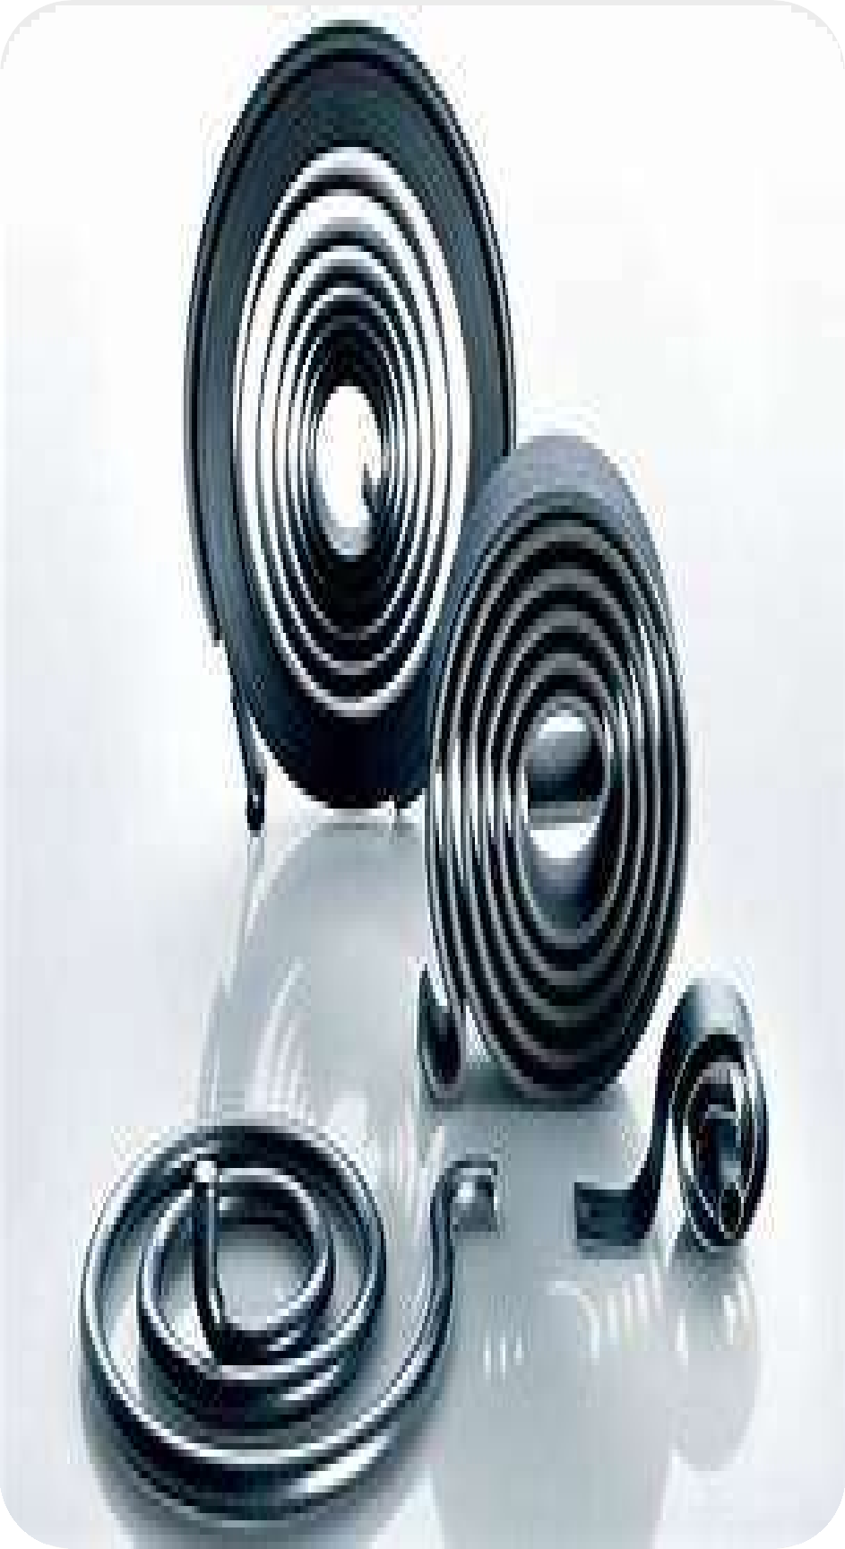
FLAT FORM SPRINGS
Design and Calculation
IS 10878 Part 1 covers the design and calculation for flat form springs made from rectangular cold-rolled strip detailing the parameters for ensuring adequate spring performance and durability.
Material Specifications
IS 10878 Part 2 specifies the requirements for flat form springs, including material properties dimensions, and performance criteria.

Slide 30
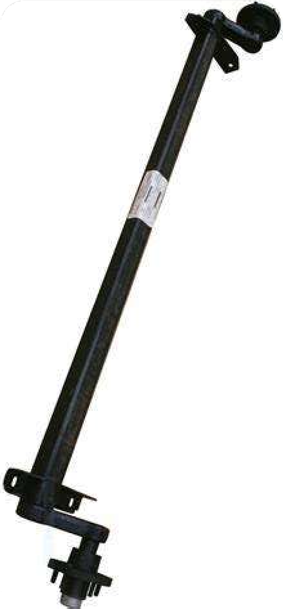
TORSION BAR SPRINGS
Suspension Applications
IS 15453:2004 covers the specifications for torsion bar springs, which are used in various vehicles for suspension purposes.
Durability and Performance
The standard ensures the torsion bar springs meet the necessary requirements for strength, resilience, and reliability in automotive suspension systems.
Consistent Quality
The guidelines provided in the standard help manufacturers produce torsion bar springs that consistently meet the industry's quality and safety standards.

Slide 31
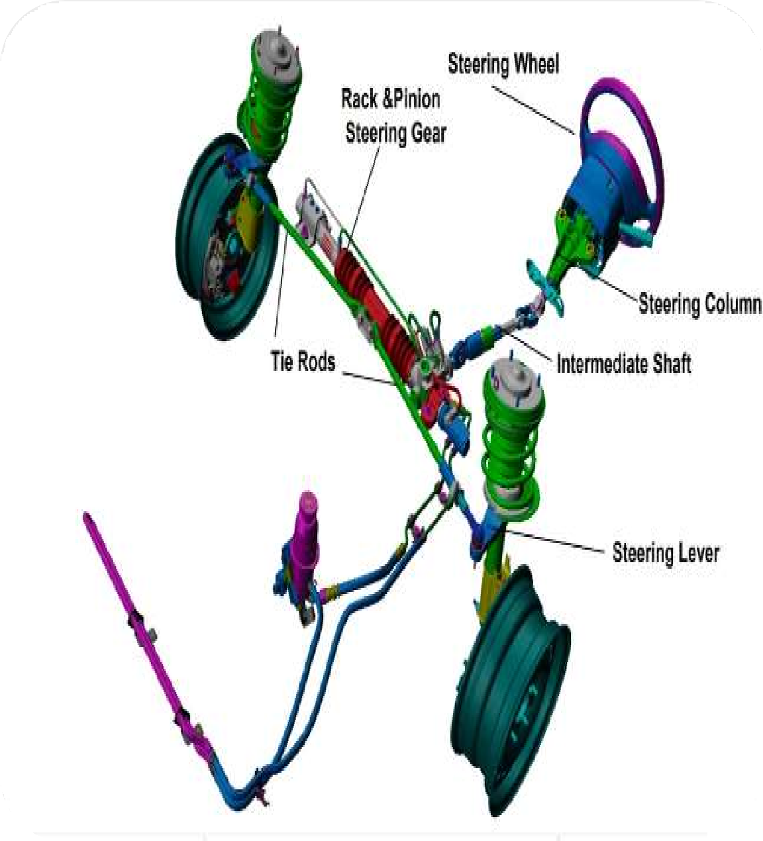
STEERING SYSTEM DESIGN AND ANALYSIS
Steering Geometry
The configuration of the steering linkage and its impact on turning radius and stability.
Power Assist
The use of hydraulic or electric systems to aid the driver in steering the
vehicle.
Feedback and Control
Incorporating sensors and control algorithms to enhance steering
precision and responsiveness.

Slide 32
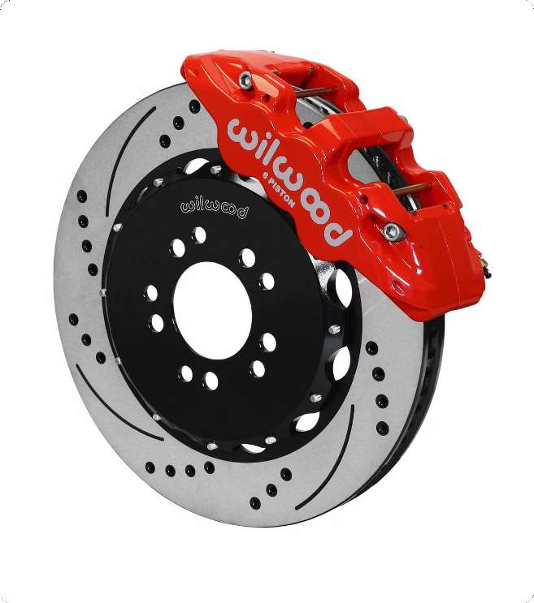
BRAKING SYSTEMS AND ANTI-LOCK BRAKING
Disc Brakes
Calipers and rotors that provide strong, consistent braking force.
Drum Brakes
An alternative brake system that is simpler and less expensive.
Anti-Lock Braking
A system that prevents wheel lockup, improving braking performance and stability.

Slide 33
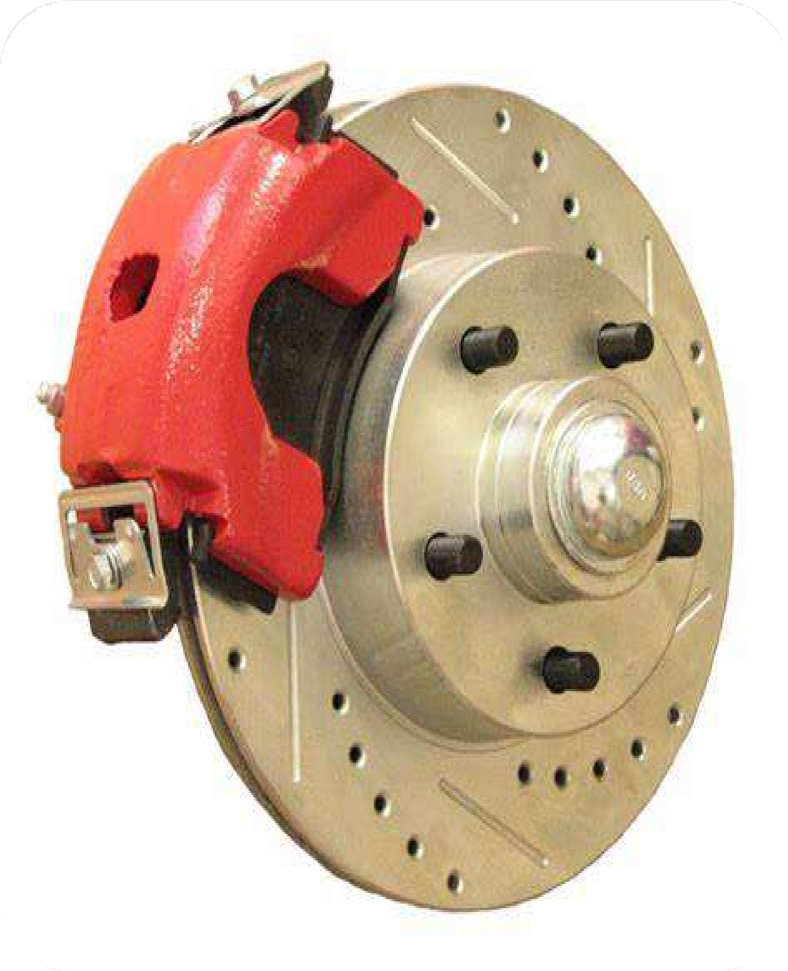
AUTOMOTIVE BRAKING SYSTEMS
The Indian Standards related to Automotive brakes, covering disc brakes, hydraulic brakes, and air brakes specify the performance requirements and test methods for various brake components to ensure safety and reliability.

Slide 34
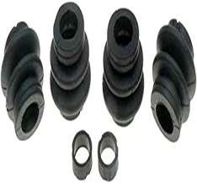
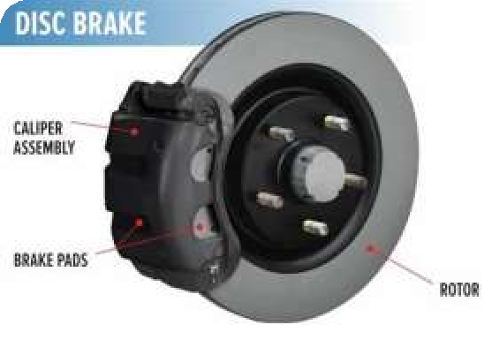
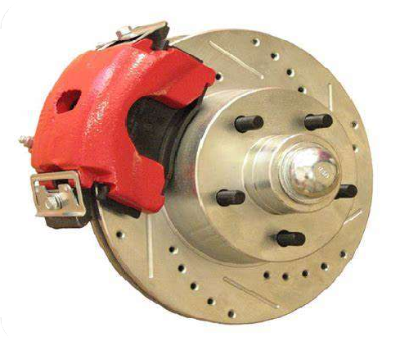
DISC BRAKE STANDARDS
1
IS 13249 : 2014
Specifies performance requirements for elastomeric seals used in disc brake calipers, including cycling humidity, low temperature, and stroking tests.
IS 2742 (Part 7) : 2018
Defines a method for measuring the shear strength of the bond between the lining material and carrier in disc brake pads and drum brake shoes. This S tandard is applicable to assemblies that are integrally moulded only.
IS 15708 : 2006
Also specifies a shear test procedure for measuring the strength of the bond between lining material and carrier in disc brake pads and drum brake shoes. This standard is applicable to assemblies that are riveted also.
2
3

Slide 35
IS 13249 : 2014
BRAKING SYSTEMS
RUBBER SEAL FOR DISC BRAKE CYLINDER — PERFORMANCE REQUIREMENTS

Slide 36
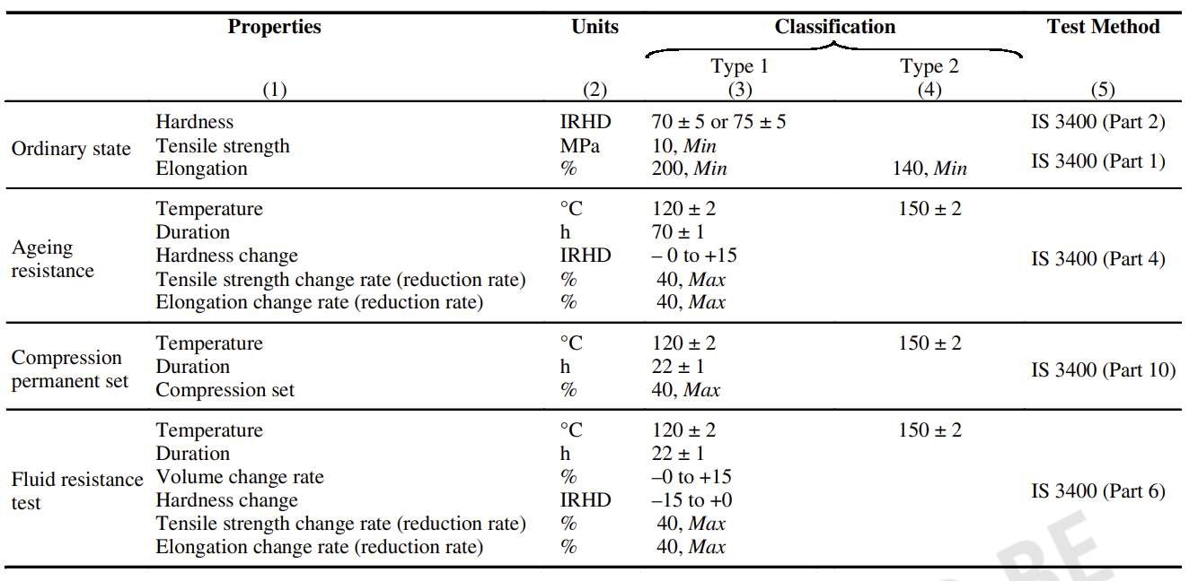
MATERIAL REQUIREMENTS
IS 13249

Slide 37
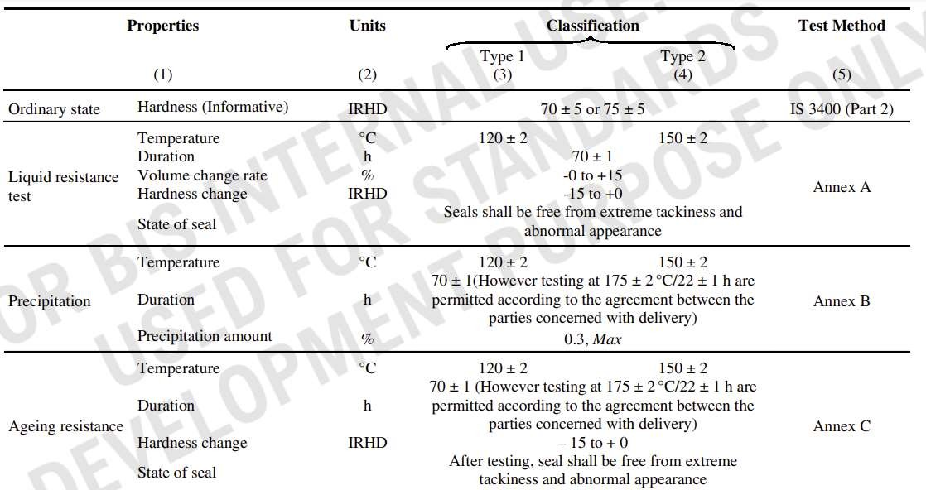
PERFORMANCE REQUIREMENTS
IS 13249

Slide 38
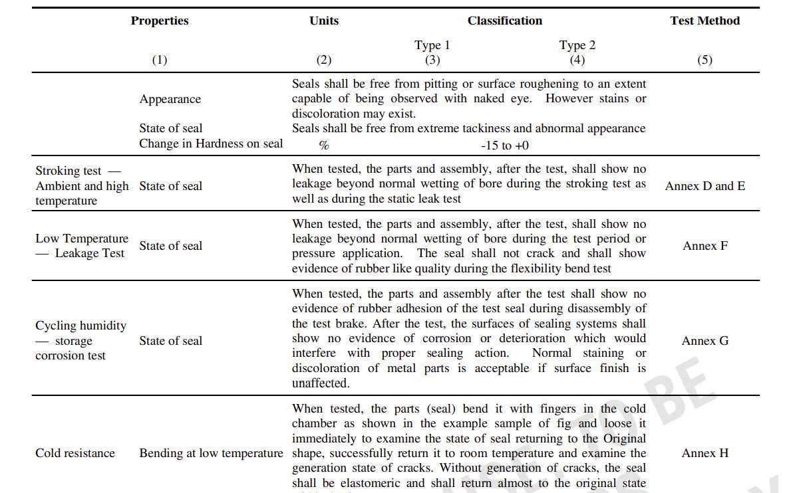
PERFORMANCE REQUIREMENTS
IS 13249

Slide 39
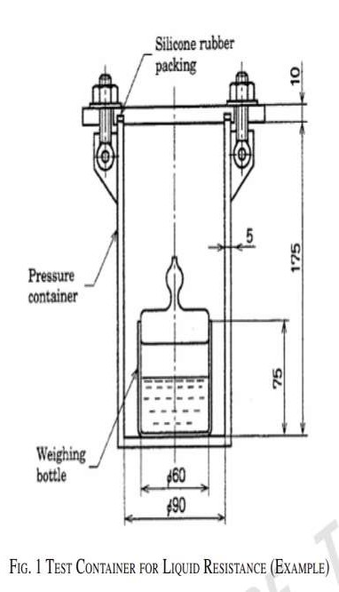
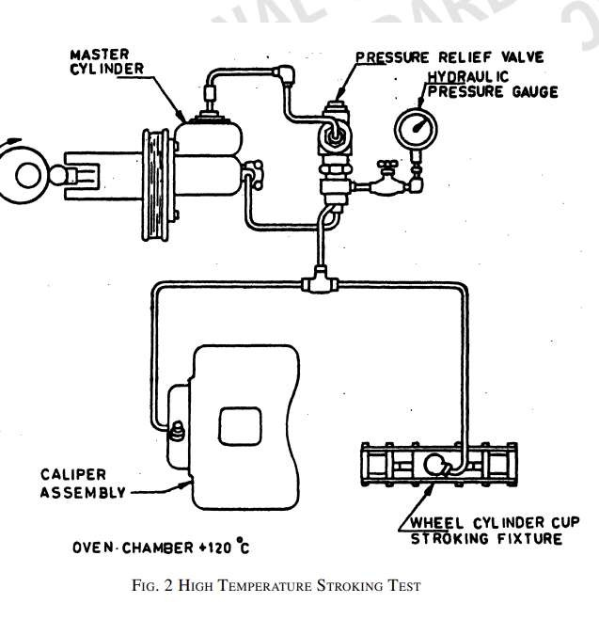
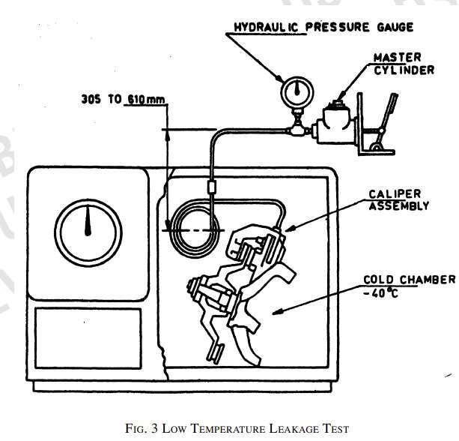
IS 13249
TEST METHODS
COLD RESISTANCE TEST

Slide 40
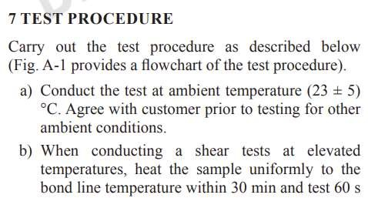
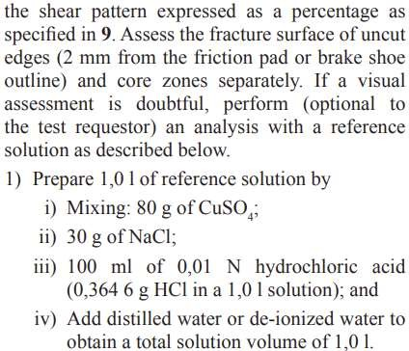
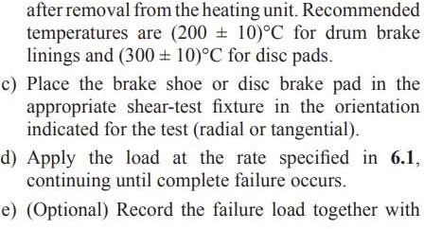
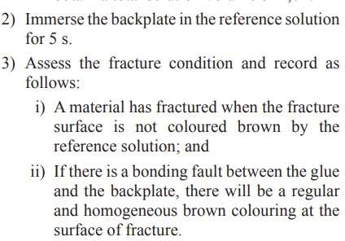
IS 2742 PART 7 :2018
AUTOMOTIVE VEHICLES - BRAKE LININGS: PART 7
SHEAR TEST PROCEDURE FOR DISC BRAKE PAD AND DRUM BRAKE SHOE ASSEMBLIES

Slide 41
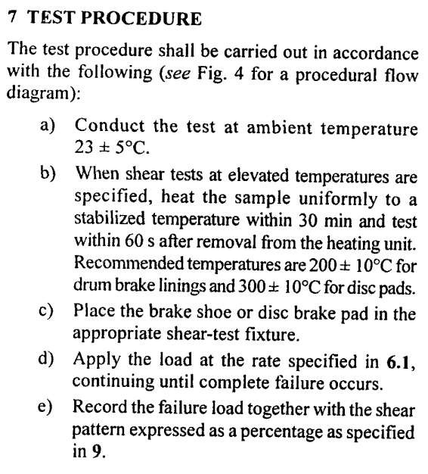
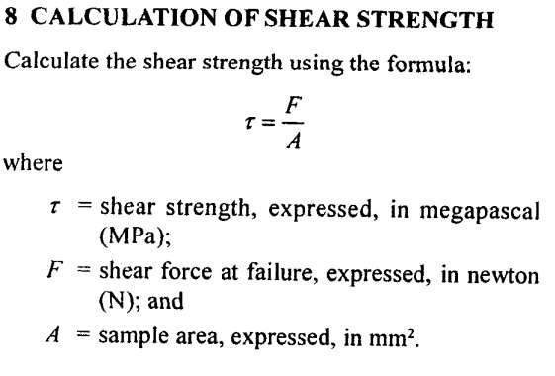
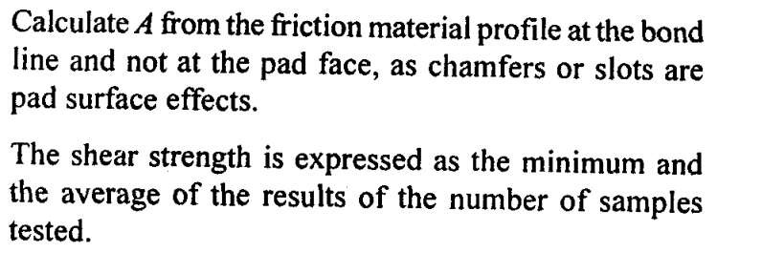
IS 15708 : 2006
ROAD VEHICLES — BRAKE LININGS
SHEAR TEST PROCEDURE FOR DISC BRAKE PAD AND DRUM BRAKE SHOE ASSEMBLIES

Slide 42
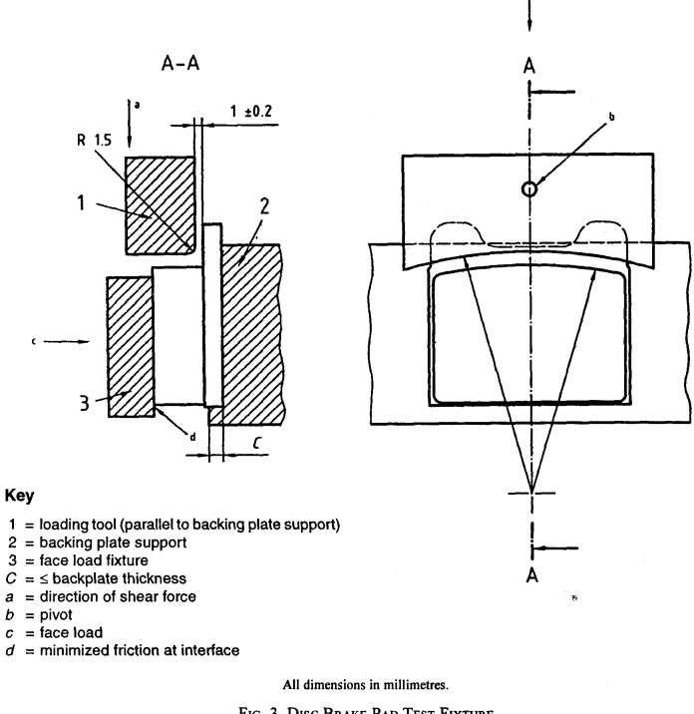
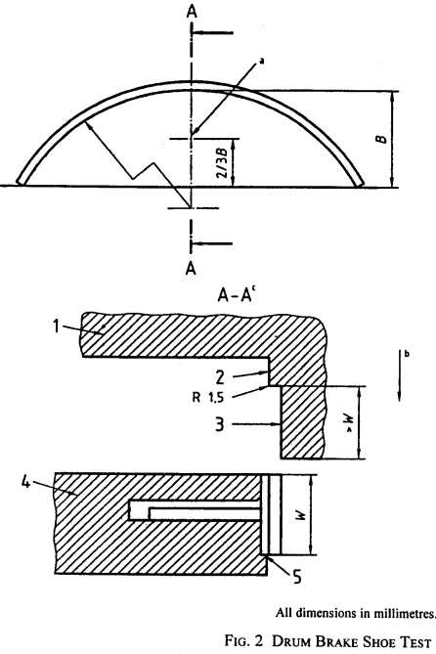
IS 15708 : 2006
ROAD VEHICLES — BRAKE LININGS
SHEAR TEST PROCEDURE FOR DISC BRAKE PAD AND DRUM BRAKE SHOE ASSEMBLIES

Slide 43
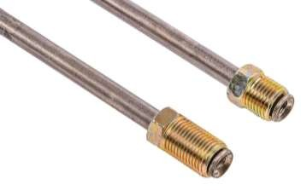
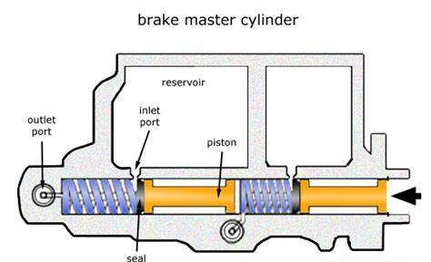
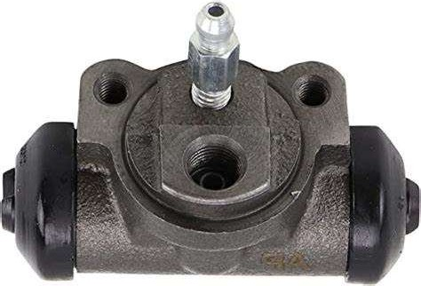
HYDRAULIC BRAKE STANDARDS
Brake Tubing Wheel Cylinders
Master Cylinders
IS 12851
specifies requirements
IS 13207 covers performance requirements and test methods for wheel cylinders, including strength, humidity operation, and low temperature performance.
IS 13224 specifies performance requirements and test methods for master cylinder assemblies,
performance
for metallic tubing used in automotive hydraulic brake
including full stroke, leakage,
systems,
strength,
including
bending,
burst
and
and fluid displacement.
corrosion resistance.

Slide 44
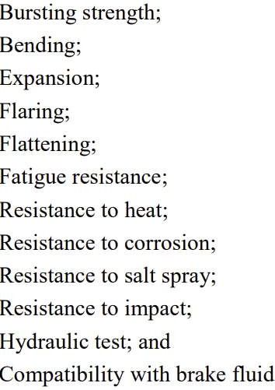
IS 12851 : 2023
AUTOMOTIVE VEHICLES — HYDRAULIC BRAKE SYSTEMS TUBINGS — PERFORMANCE REQUIREMENTS
Types : Seamless or Multiple-Ply Tubing.
Performance Requirements

Slide 45
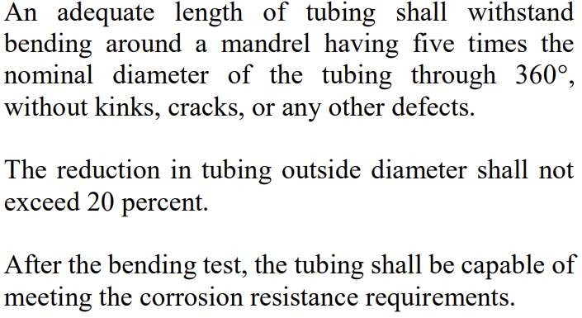
IS 12851
TEST METHODS
Bursting Strength
Bending
Expansion
Flaring

Slide 46
IS 12851
TEST METHODS
Flattening
Resistance to Heat
Expansion
Resistance to Corrosion

Slide 47
IS 12851
TEST METHODS
Fatigue Resistance

Slide 48
IS 12851
TEST METHODS
Compatibility of Brake Fluid
Loss in Weight, pH and Boiling
Point

Slide 49
IS 12851
TEST METHODS
Resistance to Impact
Resistance to Salt Spray

Slide 50
IS 13207 : 1991 AUTOMOTIVE VEHICLES — HYDRAULIC BRAKING SYSTEMS — WHEEL CYLINDERPERFORMANCE REQUIREMENTS
TEST APPARATUS
PERFORMANCE REQUIREMENTS
GENERAL
REQUIREMENTS

Slide 51
IS 13207 TEST METHODS
Unrestricted Application and Release Applied Leakage
Strength

Slide 52
IS 13207
TEST METHODS
Applied leakage
Humidity Operation

Slide 53
IS 13207
TEST METHODS
Heat Pressure Strokings
Storage Corrosion
Static Leakage
Low Temperature Performance
Ozone Resistance

Slide 54
IS 13224 : 1991 AUTOMOTIVE VEHICLES — HYDRAULIC BRAKING SYSTEMS
MASTER CYLINDER — PERFORMANCE REQUIREMENTS
General Requirements
The metallic ports shall be given a suitable anti-corrosive treatment. The cylinder bore and the reservoir shall be free from dust, powder, and chippings. The sliding surfaces of the primary cup, pressure cup and secondary cup of the cylinder body shall be free from any harmful defects like dents, pin holes, rust etc. The valves and the valve seat shall be free of cracks and burns.
The brake fluid used in the system shall conform to IS 8654 : 1986
Performance Requirements

Slide 55
IS 13224
AUTOMOTIVE VEHICLES — HYDRAULIC BRAKING SYSTEMS
MASTER CYLINDER —PERFORMANCE REQUIREMENTS

Slide 56
IS 13224 TEST METHODS
Full Stroke Test
Venting Test
Venting test is carried on a complete master cylinder assembly. Install the master cylinder on the mounting plate and tighten mounting bolts. Make certain that the push-rod is aligned with the cylinder . bore axially. Adjust the push-rod to allow piston(s) to return to normal release position.
Connect a 210 ± 7 kPa air supply to the outlet ports. Bore venting will be indicated by the air flow from the vent port(s). Without changing the setup in procedure , stroke the input pushrod a minimum of 5 mm. Apply 210 ± 7 kPa air pressure to the outlet port(s) and observe that no air is flowing from the vent port(s). The cylinder bore(s) shall be vented to the reservior(s) when the air supply is given to the outlet ports. The cylinder bore shall not be vented to the reservoirs when the input pushrod is stroked 5 mm minimum.
Remove the protective plugs from the ports and then manually stroke the piston to full extent five times.
When tested as per
6.1.1
shall
full and
master move design
cylinder smoothly
assembly throughout
stroke after starting
completely. returned to its original position(s) on the fifth stroke within five seconds by the force of the piston return spring(s).

Slide 57
IS 13224
TEST METHODS
Applied Leakage
Residual Pressure

Slide 58
IS 13224
TEST METHODS
Fluid Displacement
Humidity

Slide 59
IS 13224
TEST METHODS
Reservoir Capacity and Leakage
Corrosion Reistance

Slide 60
IS 13224
TEST METHODS
Low Temperature Performance

Slide 61
AIR BRAKE STANDARDS
1
Valves
IS 12105 specifies test methods for valves used in automotive air brake systems, including performance, leak,
endurance tests, low & High Temperature
2
Brake Chambers
IS 13603 specifies the performance requirements and tests for brake chambers used in air brake systems, including leak, output, and burst pressure tests.

Slide 62
AIR BRAKE STANDARDS
3
Drain Valves
IS 13363 covers performance requirements and tests for drain valves used in air brake systems, such as leak, output, and endurance tests.
4
Dual Brake Valves
IS 13604 covers performance requirements and tests for dual brake valves used in air brake systems, including leak, output, and over-pressure tests.

Slide 63
IS 12105 : 2014 METHODS OF TEST FOR VALVES OF AUTOMOTIVE AIR BRAKE SYSTEMS
Performance Test & Leak Test

Slide 64
IS 12105 METHODS OF TEST FOR VALVES OF AUTOMOTIVE AIR BRAKE SYSTEMS
Endurance Test & Low Temperature Test

Slide 65
IS 12105 METHODS OF TEST FOR VALVES OF AUTOMOTIVE AIR BRAKE SYSTEMS
High Temperature Test

Slide 66
IS 13603 : 2014 AUTOMOTIVE VEHICLES —
AIR BRAKE SYSTEMS —PERFORMANCE REQUIREMENTS FOR BRAKE CHAMBER
Tests
The performance and reliability
Working Conditions
Working medium : Dry air Other conditions shall be as agreed to
test requirement shall be as agreed to between the supplier and the purchaser. In the absence of any such agreement the following life tests shall be carried out on the specimen: a) Leak test, b) Output
between the supplier and the
purchaser. In the absence of any
such agreement the following
values shall be applicable :
performance test, c) Endurance
Normal working pressure : 800/1
test, d) Low temperature leak test, e) High temperature leak
000 kPa (8/10 bar) Maximum
working pressure : 1 000 kPa/1 200 kPa (10/12 bar) Thermal range of operation : –40 °C to +80 °C
test, f) Corrosion resistance test,
g) Burst pressure test, h) Water spray test, j) Vibration test, and k) Port thread integrity test.

Slide 67
IS 13603 : 2014 AUTOMOTIVE VEHICLES —
AIR BRAKE SYSTEMS —PERFORMANCE REQUIREMENTS FOR BRAKE CHAMBER
Output Performance Test
The general form of the output characteristics for brake chambers Type 16 and above shall be as shown in Fig. 2a). Steeper drop of output force at strokes higher than mid stroke can be expected in smaller brake chambers. Refer performance output Fig. 2 b). The actual shape, values and the pressure levels at which the output is required is agreed to between the supplier and the purchaser. In the absence of any such agreement, output co °Corresponding to full system pressure and 200 kPa (2 bar) pressure shall be given. The deviation with respect to the defined output shall be as agreed
Leak Test
The test requirement shall be as agreed
to between the supplier and the
purchaser. In the absence of any such agreement, the following test condition
and acceptance level is used: Test
pressure : Normal working pressure
Leakage permitted : 10 cc/min

Slide 68
IS 13603 : 2014 AUTOMOTIVE VEHICLES —
AIR BRAKE SYSTEMS —PERFORMANCE REQUIREMENTS FOR BRAKE CHAMBER
Endurance Test

Slide 69
IS 13363 : 2017 AUTOMOTIVE VEHICLES — AIR BRAKE SYSTEMS PERFORMANCE REQUIREMENTS FOR DRAIN VALVES
Tests
The following tests shall be carried out on the specimen: a) Leak test (see 5.2), b) Output performance test (see 5.3), c) Endurance test (see 5.4), d) Low temperature test (see 5.5), e) Dry heat test (see 5.6), f) Salt spray test (see 5.7), g) Over pressure test (see 5.8), h) Water spray test (see 5.9), and j) Vibration test (see 5.10).
Leak Test & Performance test
Endurance Test

Slide 70
IS 13604 : 2014 AUTOMOTIVE VEHICLES — AIR BRAKE SYSTEMS — PERFORMANCE REQUIREMENTS FOR DUAL BRAKE VALVE
Tests
The performance and reliability test
Working Condition
Dry air b) Other conditions shall be as agreed to between the supplier and the purchaser. In the absence of any such agreement the following values shall be applicable:
Normal working pressure : 800/1 000 kPa (8/10 bar)
Maximum working pressure : 1 000/ 1 200 kPa (10/12 bar)
Thermal range of operation : –40 to + 80°C
requirement shall be as
agreed to and the
between the supplier
purchaser. In the absence of any such
agreement the following life tests
shall be carried out on the specimen:
a) Leak test, b) Output performance
test, c) Endurance test,
d) Low temperature leak test, e) High
temperature leak test, f) Corrosion resistance test, g) Over pressure test,
h) Water spray test, j) Vibration test, and k) Port thread integrity test.

Slide 71
IS 13604 AUTOMOTIVE VEHICLES — AIR BRAKE SYSTEMS — PERFORMANCE REQUIREMENTS FOR DUAL BRAKE VALVE
Leak Test
Low Temperature Test Salt Spray Test
Water Spray Test
Output Performance Test
High Temperature Test
Over PressureTest

Slide 72
IS 13604 AUTOMOTIVE VEHICLES — AIR BRAKE SYSTEMS — PERFORMANCE REQUIREMENTS FOR DUAL BRAKE VALVE
Thread Integrity Test
All threaded ports shall be checked for
Vibration Test
The unit shall be subjected to a
vibration acceleration level of ±3.5 g at 67 Hz, for 8 h in three mutually perpendicular directions (4 h in main orientation and 2 h each in other two orientations) or as mutually agreed to
thread strength integrity test by
alternately tightening and loosening, to a value specified for the respective
port or as agreed between the
supplier and the purchaser, for 25
between the supplier and the
times. At the end of the test, there should not be visible damage to the
purchaser At the end of the test, the
unit shall not have any structural
threads of the port. Further, shall
damage. Further, the unit shall meet performance test as per 4.3 and 4.4.
meet the leakage test as per 4.3.

Slide 73
BRAKE LINING STANDARDS
Non-Rubberized Linings
IS 2742 (Part 1) specifies requirements
for non-rubberized brake
linings, hardness,
including friction coefficient, and shear strength.
Test Methods
IS 2742 (Part 3) defines the test methods to determine the physical and chemical properties of brake linings, such as specific gravity, hardness, and water swell.

Slide 74
BRAKE LINING STANDARDS
Rubberized Linings
IS 2742 (Part 2) covers requirements for rubber-based brake linings, including density, tensile strength, and friction coefficient.
Replacement Linings
IS 17132
provides replacement brake lining
guidelines for assemblies and
drum brake linings for power-driven vehicles and trailers.

Slide 75
IS 2742 (Part 4) This standard specifies the method of evaluation of friction coefficient of brake linings by a friction material test machine (popularly known as 'Chase' machine).
Coefficient of friction - method of test
BRAKE LINING STANDARDS
Internal shear strength - Method of test
IS 2742 (Part 5) This standard specifies the method of measuring the internal shear strength (stress) of brake lining materials for disc brake pads and drum brake linings used in automotive vehicle brakes

Slide 76
IS 2742 (PART 1) : 1994
AUTOMOTIVE VEHICLES - BRAKE LININGS (NON - RUBBERIZED): PART 1 SPECIFICATION
Designation
Linings shall be designated by their type (moulded, rigid, woven and flexible) suitably in codes, friction coefficients (both normal and ot) and size designation; if oversized the extent of oversize in millimetres and IS number and relevant Part
Example :M 40/28 (Standard size designation ) X 5 IS 2742/l.
Indicates an oversized moulded non- rubberized lining with normal/hot friction coefficient of 0’40 and 0’28 followed by size designation in code or otherwise, with an oversize of 5 mm and falling under Part 1 of IS 2742 : 1994.
Tolerance on Dimensions

Slide 77
IS 2742 (PART 1) : 1994
AUTOMOTIVE VEHICLES - BRAKE LININGS (NON - RUBBERIZED) : PART 1 SPECIFICATION
REQUIREMENTS
Water Swell
Normal and Hot Coefficient of Friction
Heat Swell

Slide 78
IS 2742 (PART 2) : 1989
AUTOMOTIVE VEHICLES - BRAKE LININGS – RUBBERISED : PART 2 SPECIFICATION

Slide 79
IS 2742 (PART 3) : 1994
AUTOMOTIVE VEHICLES - BRAKE LININGS: PART 3 METHODS OF TEST
Specific Gravity
Suspend the specimen from a balance pan hook by means of a thin thread and determine the weight of the specimen in air within an accuracy of 0.l grams.
Immerse the specimen in water at the ambient temperature in such a way that it is freely suspended and does not touch
the surface of the water or the walls of the water container, and re-weigh within an accuracy of 0.l grams.
If the weight of the thread is less than 0.05 percent compared to the weight of the specimen, its weight need not be
considered for the test.
In weighing the specimen in water, air bubbles adhering to the specimen shall be removed. Their removal can be facilitated by the presence of a trace ( example one part in 10 000 ) of detergent in the water, or by dipping the specimen momentarily into industrial methylated spirit, provided that it is known that the material is not affected by this treatment. If the latter procedure is adopted, care shall be taken that the minimum amount of spirit is transferred to the water in which the specimen is weighed.
The specimen shall be weighed as quickly as possible, within three minutes after immersing in water. The specific gravity of the specimen shall be computed as follows:

Slide 80
IS 2742 (PART 3)
AUTOMOTIVE VEHICLES - BRAKE LININGS: PART 3 METHODS OF TEST
Rockwell Hardness

Slide 81
IS 2742 (PART 3)
AUTOMOTIVE VEHICLES - BRAKE LININGS: PART 3 METHODS OF TEST
Shore Hardness
Loss of weight on Ignition
Water Swell Test

Slide 82
IS 2742 (PART 3)
AUTOMOTIVE VEHICLES - BRAKE LININGS: PART 3 METHODS OF TEST
Heat Swell
This test is designed to check the heat swell of brake linings in the laboratory under controlled conditions.
Obtain initial thickness readings at room temperature to the nearest 0.02 mm, measuring the specimen at not less than six points located approximately between 12 and 20 mm from the lining edge.
Place the unconfined specimen in an oven at room temperature. Increase oven temperature to 200 ± 3°C. The time taken to raise the temperature shall be between 30 and 60 minutes. Allow the specimen to remain in oven for 30 to 40 minutes at 200 ± 3°C. In case of rubberised linings the specimen shall be held between two metal bands of equal width on either side of the specimen and then subjected to this test.
The clamping arrangement shall be such that the pressure exerted is same as that used in bonding.
Remove the specimen from the oven and while still hot measure thickness at the same point used for obtaining initial thickness. Record increase in thickness as swell.

Slide 83
IS 2742 (PART 3)
AUTOMOTIVE VEHICLES - BRAKE LININGS: PART 3 METHODS OF TEST
Loss of weight on Ignition
The specimen is extracted by acetone and the extract is isolated and weighed. A soxhlet extraction apparatus comprising of an extractor and a suitable flask and condenser, all connected with ground glass joints shall be used. The acetone used in the extraction shall comply with IS 170 : 1986.
A specimen of fine particles of the friction material shall be prepared by drilling with a 10 mm drill, using conditions which do not produce perceptible overheating. The samples shall be drilled perpendicular to the working face, but not nearer than 6 mm from the edges. The depth of drilling shall be such as to obtain a representative sample of the friction material, uncontaminated with any separate backing layer shall be present. The weight of drillings required for the specimen is 2 ± 0.2 g and sufficient holes shall be drilled to give this weight. It is not advisable to drill a much larger size hole and to take a part of drillings for the required specimen. The time between drilling the specimen and extracting shall not exceed 4 hours.
The specimen shall be weighed to an accuracy of 0.001 g, and shall be wrapped securely in a filter paper. The wrapped specimen shall be placed in an extraction thimble ( previously fat extracted ) 25 × 80 mm. single thickness and transferred to the Soxhlet extractions. Sufficient acetone shall be added to fill the extraction unit plus a further quantity of 25 ml. Extraction shall proceed for six hours, or a shorter period by agreement between manufacturer and purchaser. The cycling rate during extraction shall be 10 to 20 cycles per hour. On completion of the extraction period the flask shall be removed at a stage when the extraction unit is nearly filled with acetone. This should leave about 15 ml of acetone in the extraction flask. The contents of the flask shall be transferred to a pre-weighed vitreous silica crucible, the flask washed out with approximately five millilitres of acetone and the washing transferred to the same crucible. The crucible shall then be placed on a water bath and the acetone evaporated. Suitable precautions against accidental ignition of the acetone shall be taken. The crucible shall finally be dried for ten minutes in an oven at 80 to 85°C, and shall then be transferred to a dessicator, allowed to cool and reweighed.

Slide 84
IS 2742 (PART 4) : 1994
AUTOMOTIVE VEHICLES - BRAKE LININGS: PART 4 COEFFICIENT OF FRICTION - METHOD OF TEST
FRICTION MATERIAL TESTING MACHINE

Slide 85
IS 2742 (PART 4)
AUTOMOTIVE VEHICLES - BRAKE LININGS: PART 4 COEFFICIENT OF FRICTION - METHOD OF TEST
TEST RUNS
Baseline Run Run 10 seconds "ON " ( load applied ) and 20 seconds "OFF" ( load removed ) at 660 N and 411 rev/min for 20 applications. Start run at a drum temperature between 82°C and 93°C and maintain the maximum and minimum temperature during each successive application between 104°C and 82°C with the use of cooling air. Turn cooling air off, on 20th load application.
First Fade Run Allow drum to cool by rotation only and with heating and cooling means turned off. At 82°C apply specimen and energize heating elements. Run continuous drag at 660 N and 411 rev/min. Run for either 10 minutes or until 289°C is attained, whichever occurs first. Take readings of friction force at 93°C, 121°C, 149°C, 177°C, 205°C 233°C, 26l°C, 289°C. Record time required to reach 289°C.
First Recovery Run Immediately following completion of first fade run turn off heater and turn on cooling means and make a 10 seconds application at 660 N and 411 rev/min at 261°C, 205°C, 149°C and 93°C during cooling.
Second Wear Measurement Repeat initial wear measurement.
Wear Run Run 20 seconds "ON" , 10 seconds "OFF" , at 660 N and 411 rev/min for 100 applications. Start run at a drum temperature between 193°C and 205°C and maintain maximum and minimum temperatures during each application between 193°C and 216°C with use of cooling air.

Slide 86
IS 2742 (PART 4)
AUTOMOTIVE VEHICLES - BRAKE LININGS: PART 4 COEFFICIENT OF FRICTION - METHOD OF TEST
TEST RUNS
6. Third Wear Measurement Immediately upon completion of wear run, cool to a temperature between 88°C and 99°C and repeat initial wear measurement.
7. Second Fade Run Upon completion of third wear measurement, allow drum to cool with drum in rotation and heating and cooling means turned off. At 82°C apply specimen loading and energize heating elements. Run continuous drag at 660 N and 411 rev/min. Run for either 10 minutes or until 345°C is attained, whichever occurs first. Take readings of friction force at intervals of 28°C, starting at 93°C. Record time required to reach 345°C.
8. Second Recovery Run Immediately upon completion of second fade run, turn off heater and turn on cooling means and make a 10 seconds application at 660 N and 411 rev/min at 317°C, 261°C, 205°C, 149°C, 93°C during cooling.
9. Baseline Run Repeat baseline run.
10. Final Wear Measurement Repeat initial wear measurement.
11. Final Thickness and Mass Measurement Measure and weigh as per clause 6.4.

Slide 87
IS 2742 (PART 5) : 1994
AUTOMOTIVE VEHICLES - - BRAKELININGS: PART 5 INTERNAL SHEAR STRENGTH - METHOD OF TEST
TEST METHOD

Slide 88
GENERAL BRAKE STANDARDS
Rubber Boots
IS IS 12884 specifies the the performance
Dimensions
IS 12821 and
12831 cover
recommended
dimensions of tubing,
requirements and test
methods for rubber
to protect
fittings, connections automotive
and boots used
in
used
wheel cylinders in drum brakes.
hydraulic
brake systems.

Slide 89
GENERAL BRAKE STANDARDS
Dynamometer Testing
Pedal Strength
IS 13492 and IS
the test
IS 13453 and IS
the
15783 specify
14664 define
requirements and
methods for testing
methods for the static
the braking
strength of brake pedals and control levers.
performance of two-
and vehicles
three-wheeled
on
a
dynamometer.

Slide 90
IS 13453 : 1994
AUTOMOTIVE VEHICLES - BRAKING SYSTEMS
METHOD OF TEST ON BRAKE DYNAMOMETER FOR TWO AND THREE WHEELERS

Slide 91
IS 13453 : 1994
AUTOMOTIVE VEHICLES - BRAKING SYSTEMS
METHOD OF TEST ON BRAKE DYNAMOMETER FOR TWO AND THREE WHEELERS

Slide 92
IS 14664 : 2010
AUTOMOTIVE VEHICLES - PERFORMANCE REQUIREMENTS AND TESTING PROCEDURE FOR BRAKING SYSTEM OF
TWO AND THREE WHEELED MOTOR VEHICLES
TESTS

Slide 93
IS 13492 : 1992
AUTOMOTIVE VEHICLES- —TWO WHEELERS —METHOD OF EVALUATION OF BRAKE PEDAL STRENGTH REQUIREMENTS
The load is applied gradually in the directions of X and Y and residual displacements of x and y are measured.
The stepping surface in the case of foot operated brakes shall be horizontal. The X ( vertical ) and Y ( horizontal ) co-ordinates are established with reference to the stepping surface centre point.
The load is applied vertically at the centre of stepping surface at the rate of 30 mm/min. The load is removed when 330 N ( 33kgf ) is reached. The residual displacements x and y towards X and Y from the central point of stepping surface are measured.
The pedal is again subjected to a maximum loading of 750 N ( 75kgf ) and the displacements are measured.

Slide 94
IS 15783 : 2008
ROAD VEHICLES - BRAKE CONTROL LEVERS FOR TWO AND THREE WHEELED MOTOR VEHICLES
1. General load distribution on brake lever is shown in Fig. 5. Px is the load applied in the direction X
2. Test shall be conducted by fixing the control lever on a fixture as illustrated in this Fig.6 and mounted on a compression testing machine capable of producing a rate of traverse of 30 mm/min.
The loading point A shall be set at the surface of lever at a distance of approx. 30 mm from the edge of the spherical diameter at the end of the lever (see Fig. 6). The setting shall be such that the curved surface of the lever near point A is substantially horizontal.
4. The vertical coordinate X shall be established with reference to point A at the rate of 30 mm/min velocity.

Slide 95
IS 15783 : 2008
ROAD VEHICLES - BRAKE CONTROL LEVERS FOR TWO AND THREE WHEELED MOTOR VEHICLES
A vertical load is applied to point A as shown in Fig. 6 till the load reaches to a value of 250 N. (The compressor testing machine for applying the load should be set at the rate of traverse of 30 mm/min.) The load shall then be released when it reaches 250 N (25 kg). The residual deflection 'x' in the direction of 'X' is measured.
6. The test prescribed in clause 4.2.5 shall be repeated with a maximum vertical load of 400 N (40 kg).
7. Movement of lever due to clearance between mounting pins shall be neglected during testing
Requirement : The strength of brake lever shall be considered satisfactory if no residual displacement is observed during the test as per clause 4.2.5 and not more than 5 mm residual displacement when tested as per clause 4.2.6.

Slide 96
B R AK ING CO-EFFICIE NT STANDAR DS
SRTT Method
IS 16137 (Part 1) specifies a test method for measuring the longitudinal peak braking coefficient of road surfaces using a Standard Reference Test Tire.
Pendulum Method
IS 16137 (Part 2) defines a test method for quick and periodic measurements of road surface skid resistance using a pendulum tester.
Vehicle Braking
IS 11852, IS 15986 and IS/ISO 12161 cover the uniform provisions and test procedures for the braking systems of various vehicle categories.
Please refer to the above Indian Standards for more details.

Slide 97
THE R OL E OF CONTR OL S YS TE MS
Vehicle control systems are electronic systems that assist the driver in maintaining control and improving safety.
Anti-lock Braking System (ABS): Prevents wheel lockup during hard braking, allowing for better steering control.
Electronic Stability Control (ESC): Helps prevent skidding and loss of control by applying brakes to individual wheels and reducing engine power.
Traction Control System (TCS): Limits wheel spin during acceleration to prevent loss of traction.
Tyre Pressure Monitoring System (TPMS): Alerts the driver to underinflated tires, which can affect handling.

Slide 98
THE BENEFITS OF ANTI-LOCK BRAKING SYSTEM (ABS)
ABS is a vital safety technology that has significantly improved road safety by preventing wheel lockup.
The benefits of ABS include:
Improved stopping distances on loose or slippery surfaces (wet roads, gravel, snow)
Maintains braking,
steering allowing
control during hard drivers to maneuver
around obstacles.
Reduces the risk of accidents, especially for drivers who may not be familiar with advanced braking techniques.

Slide 99
HOW ABS WORKS: A STEP-BY-STEP BREAKDOWN
ABS in action
Driver applies hard brake pressure.
Wheel speed sensors detect a rapid deceleration in one or more wheels, indicating an impending lockup.
The ECU determines a wheel is about to lock and signals the hydraulic modulator.
The modulator reduces brake pressure to the locking wheel, allowing it to regain rotational speed.
The ECU monitors wheel speed and adjusts brake pressure as needed, preventing lockup while maintaining maximum braking force.

Slide 100
ADVANCING THE DRIVE: EXPLORING
ADVANCED DRIVER-ASSISTANCE SYSTEMS (ADAS)
Advanced Systems, technology
Driver-Assistance
or
that’s
ADAS,
rapidly
transforming how we drive.
We’ll explore what ADAS is, how it works, the different functionalities it offers, and its impact on the future of transportation

Slide 101
WHAT IS ADAS?
ADAS refers to a collection of intelligent systems in a vehicle that work together to improve safety and driving comfort.
These systems use a combination of sensors, software, and control units to perceive the surrounding environment, interpret information, and provide assistance to the driver.
ADAS is not self-driving technology; it still requires an attentive driver behind the wheel.
IS 16722 Radio Frequency Identification (RFID) System forAutomotive Applications -Specification
IS 16833 Automotive Tracking Device (ATD) and Integrated Systems
IS 17270 Intelligent Transport Systems ( ITS ) : Reverse Parking Alert System ( RPAS )

Slide 102
CORE FUNCTIONALITIES OF ADAS
Driver Assistance Systems: These features provide real-time information and alerts to enhance driver awareness. They include:
Lane Departure Warning (LDW): Alerts driver if the car unintentionally drifts out of its lane.
Blind Spot Detection (BSD): Warns driver of vehicles in the driver’s blind spot.
Forward Collision Warning (FCW): Alerts driver of a potential collision with a vehicle ahead.

Slide 103
CORE FUNCTIONALITIES OF ADAS
Driver | Intervention | Systems: | These
features | take corrective | actions to | prevent
accidents. They include:
Automatic Emergency Braking (AEB): Applies brakes automatically to avoid a collision.
Adaptive Cruise Control (ACC): Maintains a safe following distance from the car ahead.
Lane Keeping Assist (LKA): Gently steers the car back into its lane if it begins to drift.

Slide 104
BENEFITS OF ADAS
Reduced Accidents: Studies show ADAS can significantly reduce road accidents by mitigating human error, a major contributing factor.
Improved Traffic Flow: Features like adaptive cruise control can help maintain consistent speeds and reduce stop-and-go traffic, leading to smoother commutes.
Enhanced Driver Comfort: ADAS
parking assist and lane
features like
centering can take the stress out of driving, making long journeys more manageable.

Slide 105
IS 16722 : 2018 RADIO FREQUENCY IDENTIFICATION (RFID) SYSTEM FOR AUTOMOTIVE APPLICATIONS
This Indian Standard highlights the basic architecture and test requirements of the Radio Frequency Identification (RFID) tags and transceivers for Electronic Toll Collection ‘ETC’ application.

Slide 106
IS 16722
SPECIFICATION FOR RFID TAG
Inter-operability
Tag Antenna
Data Retention and Data Security
Tamper Proof RFID Label
Power
Frequency
Data transfer rate
Protocol
Dimensions (Including the Substrate/Backing)
Physical Printing of Tag ID on the Tag
TAG Position and Orientation
Memory – minimum 96 bit
Range
Tag Architecture and Contents

Slide 107
IS 16722 REQUIRED TESTS TO ASSURE PERFORMANCE
Visual Examination
Functional Test
Range Test
Interoperability Test
Speed Test
Electrostatic Discharge Test
Endurance Test
Vibration Test
Damp Heat Test
Ingress Test
Corrosion Resistance Test
Operating Temperature Test
Storage Temperature Test
UV Radiation Test
Peel Strength Test

Slide 108
IS 16833 : 2018 AUTOMOTIVE TRACKING DEVICE (ATD) AND INTEGRATED SYSTEMS
This standard defines the basic architecture and performance requirements of the automotive tracking systems. Please refer to the standard for more details. Table 18 is illustrated for reference.

Slide 110
TYR E -R OAD INTE R ACTION AND MODE L ING
Friction and Adhesion
Tyre Modeling
Mathematical models that capture the nonlinear behavior of tyres, enabling accurate simulations and analysis.
The complex interactions between the tyre and road surface, influenced by factors like tire composition and road conditions.
Tyre Characteristics
Tires are the critical interface between a vehicle and the road, affecting handling, braking, and stability.

Slide 111
TYRE RETREADING
Environmentally friendly
Tyre retreading is the process of replacing the tread on worn tyres, giving them a second life. This practice is environmentally friendly as it reduces the number of tyres that need to be disposed off.
BIS has formulated several standards
(IS 13531 : 2005 , IS 15428 : 2004, IS
15524 : 2018, IS 15724 : 2006 etc.) to
ensure the quality and safety of retreaded tyres.
Please refer to the above Indian Standards for more details.

Slide 112
ROLLING RESISTANCE
Fuel Efficiency
R olling resistance affects fuel
Rolling Sound
Wet Grip
R ecently BIS publis hed
standard IS 18258:2023, to
address the rolling resistance
and rolling sound.
This standard also addresses the R olling sound emission and wet grip.
efficiency;
means
lower resistance
lower fuel
cons umption.

Slide 113
Tyre Pressure Monitoring Systems (TPMS)
TPMS Snap-In Valves Part 1 Identification
IS/ISO 18885-1 : 2017 defines the characteristics of the tyre pressure monitoring system (TPMS) snap-in valve. Methods for identification and traceability of the valve are recommended. These parameters are defined to facilitate the snap-in valve TPMS application and identification in different countries.

Slide 114
TPMS Snap-in Valves Part 2 Valve Environment
IS/ISO 18885-2 : 2018 specifies some characteristics of TPMS snap-in valves geometry, valve hole of the rim, mounting process and valve limits. These parameters are defined to facilitate the use of snap-in valve for TPMS applications on passenger vehicles in different countries.
Rim hole geometry Valve hole edges on the tyre side of rims shall be rounded or chamfered; valve hole edges on the weather side of rims shall be free from burrs that could damage the valve.
TPMS Snap-in valves Part 3: Performance
IS/ISO 18885-3 : 2021 specifies test methods for TPMS snap-in tubeless valves that determine the minimum level of performances requested.
Test method -The test is performed at a room temperature between 18 °C and 28 °C. a) Screw the cap with sealing gasket at 0,15 Nm to 0,20 Nm torque on valve without core. b) Soak the valve assembly in clean water at 23 °C ± 5 °C with mouth down vertically and not more than 100 mm under water surface. c) Check for leakage with 475 kPa test pressure.
Performance Leakage at a rate of less than 0,2 cm3/min or with no bubble detaching during the test time of 1 min is considered acceptable.
Please refer above Indian Standards for more details.

Slide 115
VEHICLE STABILITY AND CONTROL SYSTEMS
Stability Control
S ystems that monitor and intervene to maintain vehicle stability during critical maneuvers.
Traction Control
Regulating engine power and braking to prevent wheel slip and improve acceleration.
Adaptive Cruise Control
Automatically adjusting vehicle speed to maintain a safe following distance.

Slide 116
REAR PARKING ASSISTANCE SYSTEM (RPAS)
A Rear Parking Assistance System (RPAS) is a safety feature designed to assist drivers when reversing their vehicle.
It typically consists of:
Sensors: Installed on the rear bumper or trunk lid,
these sensors detect obstacles behind the vehicle.
Camera: A rearview camera provides a clear view of
the area behind the vehicle.
Display: A monitor or screen displays the rearview camera feed and sensor data.
Warning system: Audible and/or visual alerts notify the driver of potential collisions.
Benefits of RPAS :
Enhanced safety: Reduces the risk of accidents and injuries when reversing.
Increased confidence: Assists drivers in tight spaces or with limited visibility.
Convenience: Simplifies parking and reversing maneuvers.

Slide 117
IS 17270: 2019
INTELLIGENT TRANSPORT SYSTEMS (ITS): REVERSE PARKING ALERT SYSTEM (RPAS)
Introduction
IS 17270: 2019 specifies requirements for Reverse Parking Alert Systems (RPAS) used in vehicles as part of Intelligent Transport Systems (ITS). This standard aims to enhance vehicle safety by providing guidelines for the design, installation, and performance of RPAS.
Benefits
IS 17270: 2019 provides a comprehensive framework for the development and implementation of Reverse Parking Alert Systems in vehicles. By adhering to this standard, manufacturers can ensure that their RPAS offer reliable performance and enhance vehicle safety, thereby contributing to the overall goals of Intelligent Transport Systems.
Enhanced Safety: Reduces the risk of accidents while reversing by alerting the driver to obstacles.
Convenience: Assists drivers in parking and maneuvering in tight spaces.
Prevention of Damage: Helps prevent damage to the vehicle and other objects.

Slide 118
IS 17270: 2019
INTELLIGENT TRANSPORT SYSTEMS (ITS): REVERSE PARKING ALERT SYSTEM (RPAS)
Key Components of the Standard:
Scope: The standard covers RPAS systems installed in motor vehicles to assist drivers during reversing maneuvers. It specifies the
performance requirements, testing procedures, and installation guidelines for RPAS.
Performance Requirements:
Detection Range: RPAS must effectively detect obstacles within a specified range behind the vehicle.
Alert Mechanism: The system should provide clear and timely alerts to the driver about obstacles. Accuracy: The system must
accurately detect obstacles and minimize false alerts.
System Components :
Sensors: Typically, ultrasonic or radar sensors used to detect obstacles. Control Unit: Processes data from sensors and triggers alerts.
Alert Mechanism: Visual, audible, or haptic alerts provided to the driver.
Installation Guidelines : Proper placement of sensors to ensure optimal detection.Integration with the vehicle's electrical and control
systems.
Testing Procedures: Bench Tests: To verify the functionality of individual components. Field Tests: To assess the system's performance under real-world conditions. Environmental Tests: To ensure reliability under various environmental conditions (e.g., temperature, humidity).
Safety and Compliance :Ensuring that the RPAS does not interfere with other vehicle systems. Compliance with relevant vehicle
safety regulations and standards.

Slide 119
ELECTRIC POWER TRAIN
A powertrain is a system of components in a vehicle that converts the chemical energy of the fuel in the mechanical energy that propels the motion of an automobile.
Electric powertrains offer a sustainable solution for transportation.
Benefits include zero emissions, improved efficiency, and
reduced maintenance.
The main components of electric power train are as
follows:
Battery pack
Traction inverters
Electric motor and reduction drive
On-board charger (OBC)

Slide 120
IS 18590: 2024
ELECTRIC POWER TRAIN OF L CATEGORY VEHICLES SPECIFIC REQUIREMENTS
2. Performance Requirements
1. Scope & Application
Power Output: Minimum and maximum power ratings for the electric
motor(s).
Scope: This section defines the range of vehicles and components covered by the standard. L category vehicles typically include:
L1: Two-wheeled vehicles with a maximum design speed not exceeding 45 km/h and an engine capacity not exceeding 50 cc (if equipped with an internal combustion engine).
L2: Three-wheeled vehicles with similar speed and engine capacity limits.
L3: Two-wheeled motorcycles with a speed exceeding
45 km/h.
L4, L5: Three-wheeled motorcycles and motor tricycles.
L6, L7: Light quadricycles and heavy quadricycles.
Efficiency: Standards for the overall efficiency of the electric power train, including motor and battery efficiency.
Range: Requirements for the minimum distance the vehicle must be able to travel on a single charge.
Acceleration: Minimum acceleration performance criteria to ensure adequate power delivery.
3. Safety Requirements
Electrical Safety: Insulation, grounding, and protection against electric shock.
Thermal Management: Proper cooling and thermal management
systems to prevent overheating.
Application: Specifies that the standard applies to new vehicle designs and may also apply to significant modifications of existing vehicles
.
Fault Protection: Systems to detect and respond to faults, such as
overcurrent, short circuits, and thermal overload.
Battery Safety: Standards for the safe operation, charging, and disposal of batteries, including protection against overcharging and thermal runaway.

Slide 121
IS 18590: 2024
ELECTRIC POWER TRAIN OF L CATEGORY VEHICLES SPECIFIC REQUIREMENTS
4. Environmental Standards
5. Testing and Certification
Emissions: While electric vehicles have zero tailpipe emissions, this section may cover indirect emissions, such as those from the electricity generation process.
Noise: Noise limits for the operation of
Laboratory Tests: Standardized tests in controlled
environments to measure performance, safety, and efficiency.
On-Road Tests: Real-world driving tests to verify laboratory results and ensure performance under actual driving conditions.
electric motors, which are generally quieter
than internal combustion engines but can still produce some noise.
Simulations: Computer simulations to predict performance and identify potential issues without physical prototypes.
Sustainability: Encouragement or requirements for the use of sustainable materials and recycling of components, especially batteries.
Certification Process: Steps for manufacturers to obtain certification, including documentation, testing and approval by relevant authorities.

Slide 122
FUTURE TRENDS AND EMERGING TECHNOLOGIES
Autonomous Driving
Vehicles that can navigate and operate without human input
Electrification | The transition from | internal
 | combustion engines to | electric
 | powertrains
Advanced Sensors
Cameras, radar, and lidar enabling
greater perception and awareness
Vehicle-to-vehicle and vehicle-to- infrastructure communication for improved safety and efficiency
Connectivity

Slide 123
HOW TO DOWNLOAD INDIAN STANDARDS FREE OF COST
Step 1: Visit bis.gov.in
Step 2: Click on “Standards” tab available on the top
Step 3: Click on “Download Standard”
25-07-2024

Slide 124
HOW TO DOWNLOAD INDIAN STANDARDS FREE OF COST
Step 4: Click on Register and Create an account with E-mail Id and Mobile Number.
Confirmation Mail will be sent
to the registered email id.
Step 5: Click on verification
link.
Step 6: Login with the User Id and Password.
25-07-2024

Slide 125
HOW TO DOWNLOAD INDIAN STANDARDS FREE OF COST
Step 7: Use IS number or Title
to search your standard.
Step 8: Click on Download PDF.
Step 9: Enter the Capcha and Go ahead.
Indian Standards Copy will be in your PC/Mobile within seconds.
25-07-2024

Slide 126
HOW TO USE BIS CARE APP
25-07-2024

Slide 127
HOW TO USE BIS CARE APP
STEP 1: Click on “Verify Hallmark” to check the purity of Gold.
STEP 2: Enter the HUID number of the article and Click on ‘Search’.
You will get the complete details of the article,

Slide 128
HOW TO USE BIS CARE APP
STEP 1: Click on “Verify Licence Details” to check the authenticity of the product with ISI Mark.
STEP 2: Enter the CM/L number
mentioned at the
ISI
bottom of the Mark.
You will get the complete details of the product.

Slide 129
HOW TO USE BIS CARE APP
If you find that there is no
such Mark
licence exists or ISI or hallmarks are
misused, then you can file a
complaint using
the
‘Complaints’ tab.

Slide 130
THANK YOU

