Slide 1
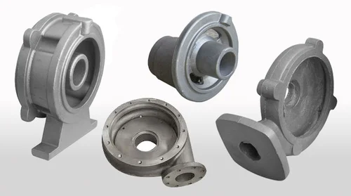
FOUNDRY TECHNOLOGY
V.RAMESH, SCIENTIST-E
BUREAU OF INDIAN STANDARDS

Slide 2
FOUNDRY TECHNOLOGY - CONTENTS
Foundry technology – An Introduction
Ancient Indian Foundries (History)
Various metal shaping process
Foundry technology – Technology / Classification
Casting – Its Fundamental / Technology / Characteristics /Application / Advantage / Limitation / Advancement.
Pattern – Types / material / Color Code / Allowances/ Core box & types.
Indian Foundry Industry – History / Challenges / Focus area / Advantage / Limitation
Indian Standards on Foundry Castings
Other International Standards on Foundry Castings

Slide 3
FOUNDRY TECHNOLOGY - CONTENTS
Contribution of Foundry to Indian Economy
Sector wise Consumption of Foundry castings
Opportunities in Foundries
Technological advancement in Foundry Casting.
Growth of Indian and Global Foundry Casting
Global Foundry Casting – Production Trend
Quality Systems followed in Foundry Units
Gap Areas to focus in Indian Foundry Casting

Slide 4
FOUNDRY TECHNOLOGY : INTRODUCTION
Technology - Molten metal converted into castings using various processes.
Castings – A direct metallurgical product.
Foundry has provided impetus to almost all mechanical industries of world with diversity of products.
Virtually all types of engineering alloy can be cast using appropriate foundry techniques.
Few important classes of engineering alloys can be formed by casting alone. Eg : Cast irons and Cast steels.
Common casting alloys include Grey cast irons, Ductile cast iron, Aus tempered ductile cast irons, Steels etc..

Slide 5
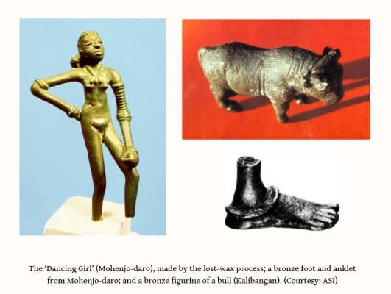
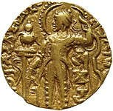
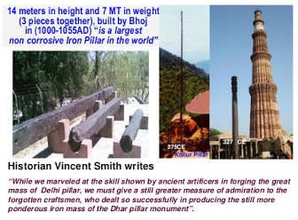
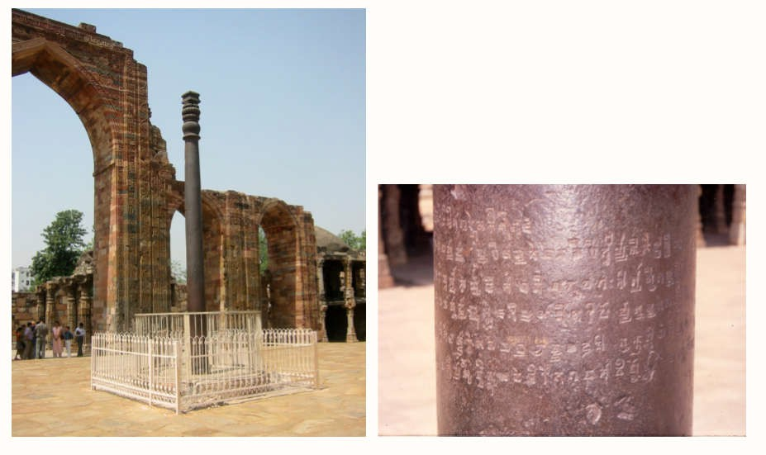
ANCIENT INDIAN FOUNDRY
Our Foundry Technology is 6000 Years old.

Slide 6
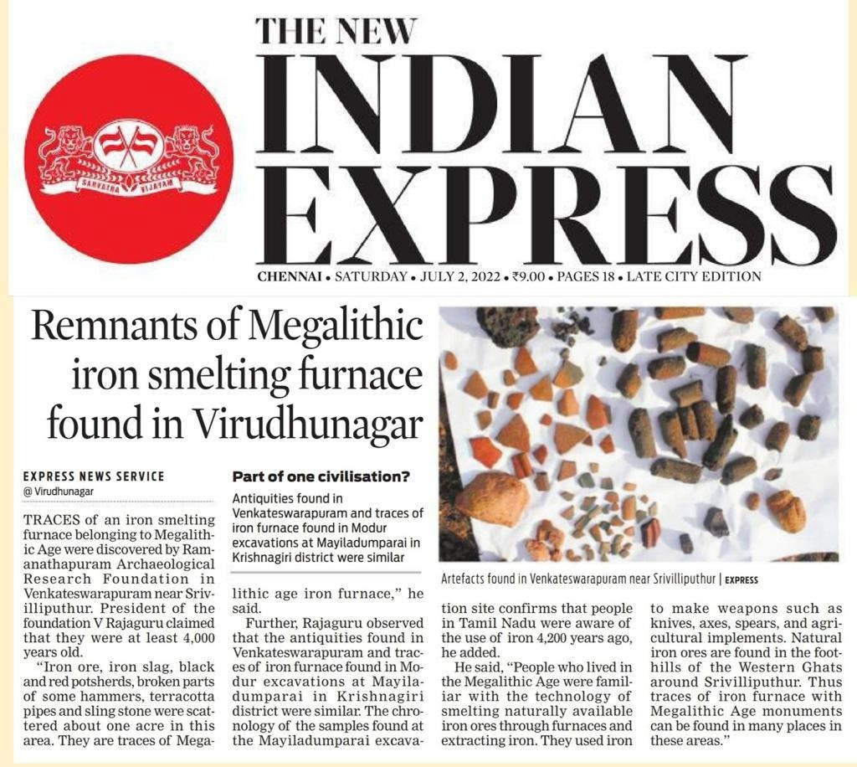

Slide 7
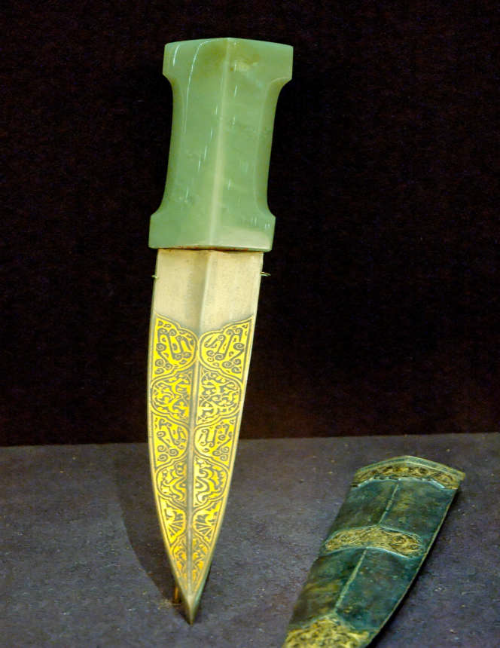
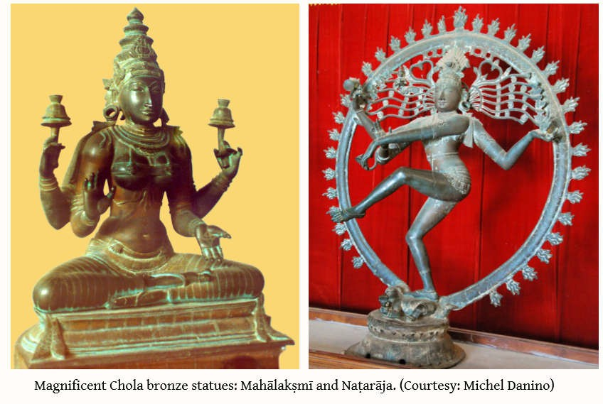
ANCIENT INDIAN FOUNDRY
Dagger and its scabbard, India. Blade: Damascus steel inlaid with gold; hilt: jade; scabbard: steel with engraved, chased and gilded decoration.

Slide 8
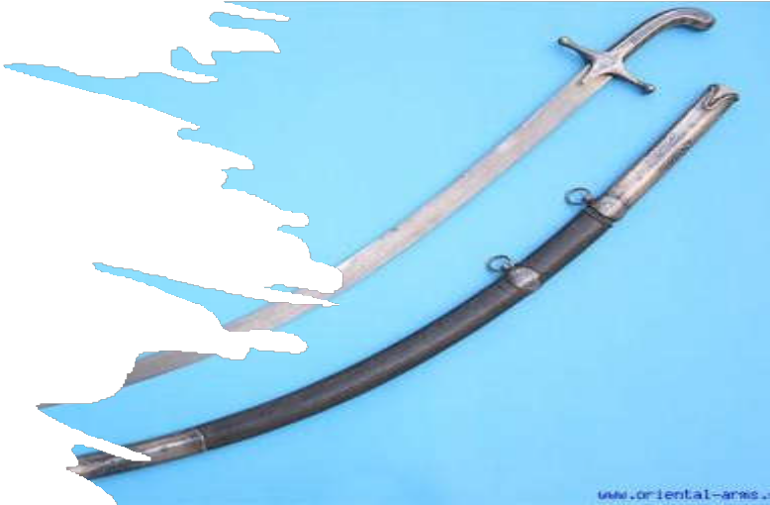
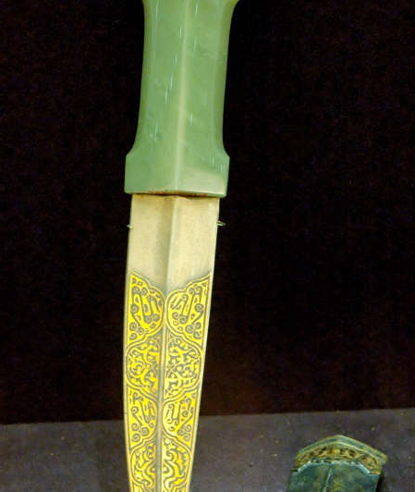
ANCIENT INDIAN FOUNDRY
Wootz is the anglicized version of ukku in Kannada and Telugu, a term denoting steel.
Studies on Wootz - ultra-high carbon steel with between 1-2% carbon, used to make Damascus blades.
A description - One blow of a Damascus sword would cleave a European helmet without turning the edge or cut through a silk handkerchief drawn across it’.

Slide 9
HISTORY - Development of Metal casting technology
5000 B.C - The history of metal casting dates back almost 5,000 years BC.
3200 B.C. - Frog of copper metal, the oldest known casting, cast in ′ Mesopotamia.
233 B.C. - Cast iron plowshares are poured in China.
500 A.D. - Cast crucible steel was first produced in India
1455 - The cast iron pipe to transport the water was used in Dillenburg Castle in Germany.
1480 - Vannoccio Biringuccio "father of foundry industry," Italy. document Foundry process. ′
1709 - First foundry flask for sand and loam molding, created by Englishman Abraham Darby.
1809 - A. G. Eckhardt of Soho, England developed the Centrifugal casting process.
1896 - American Foundrymen's Association (Now American Foundrymen's Society) formed.
1897 - B.F. Philbrook of Iowa rediscovered the Investment casting process.
1947 - The Shell process was invented by J. Croning of Germany during WWII. ′
1958 - Shroyer was granted a patent for the full mold process
1968 - The Coldbox process by L. Toriello and J. Robins for high production core making.
1971 - Japanese developed V-Process molding. Uses unbounded sand, bind by vacuum.
1971 - Rheocasting was developed at Massachusetts Institute of Technology
And the technology grows on….

Slide 10
VARIOUS METAL SHAPING PROCESS
Various Manufacturing Methods - Principal methods for making engineering parts and components from metals and alloys.
1. Casting (Foundry Technology)
2. Mechanical Working
3. Fabrication by joining
4. Machining Process
5. Powder metallurgy
6. Hybrid Process
Major Characteristic of Casting Process:
Economical, Weight Range, Composition, Shape and Intricacy.

Slide 11
METAL CASTING & FOUNDRY INDUSTRY
Plays a key role in all the major sectors of our economy.
Castings in locomotives, cars, trucks, aircraft, factories, and everywhere.
One of the oldest manufacturing methods.
Process: Metal is melted and poured into a cavity and after solidification of the metal in the cavity, the metal takes the exact shape of the cavity.
Solidified object is then taken out from the cavity either by breaking or taking the cavity apart.
The solidified object is called the casting. The cavity is also known as mould, a heat resistant material. Eg - Sand.
Permanent mould made of metal used to cast various complex parts products in one go.

Slide 12
INTRODUCTION TO METAL CASTING
Metal castings form integral components of devices that perform useful functions for human beings.
has a shape, size, chemical composition and metallurgical microstructure, determined by engineering decisions arrived at by
A. Design Engineers (Mechanical Engineers)
B. Pattern Makers (Skilled craftsman, CAD)
C. Casting Engineers (Metallurgical Engineers)
D. Manufacturing Engineers (Mechanical, Metallurgical Engineers)
CASTINGS - BY WIDE VARIETY OF PROCESSES
a) The type of mold material (sand, permanent, etc.)
b) Pouring of molten metal into the cavity (gravity, pressure, vacuum)
c) The state of the metal (percent which is liquid)
d) The state of the mold cavity itself (air, vacuum, solid, gas).

Slide 13
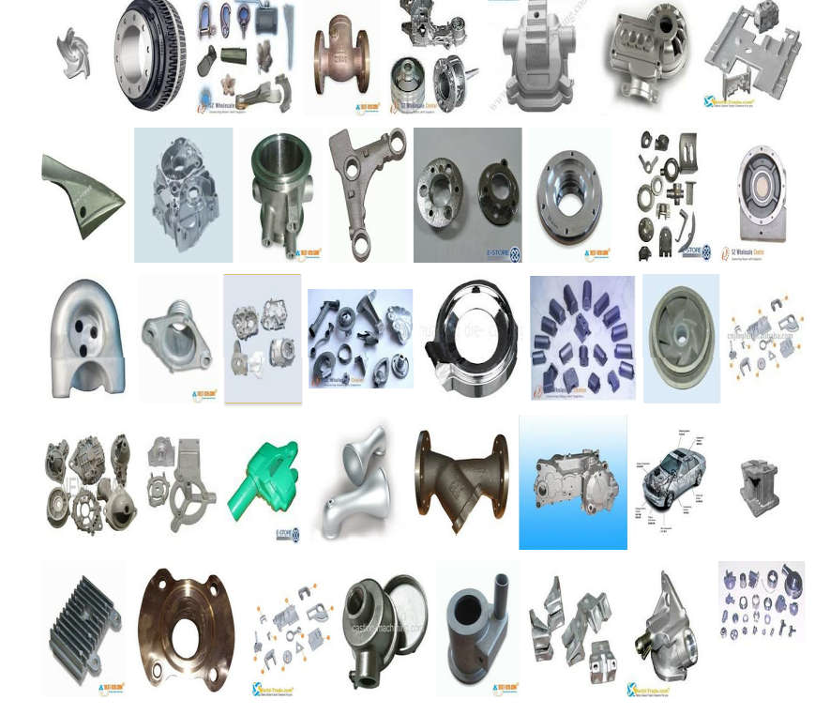
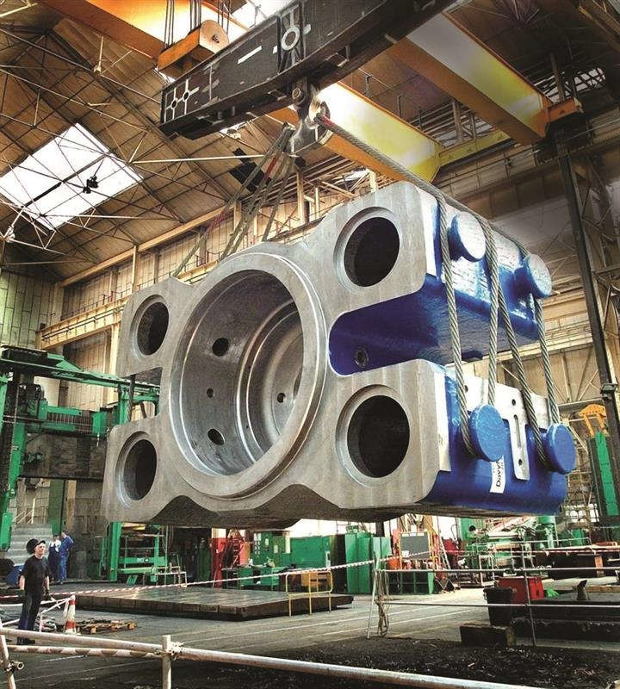
CASTING PRODUCTS
Parts range from Gms to TONs

Slide 14
PROCESS FLOW – FOUNDRY PROCESS
PATTERN SHOP
MOLDING
CORE MAKING
MELTING
POURING
FETTLING &
KNOCK OUT
SHOTBLASTING
HEAT TREATMENT
QUALITY CONTROL
CLEANING AND FINISHING
PAINTING AND
PACKING
DESPATCH

Slide 15
CLASSIFICATION OF FOUNDRY
Type of Metal used:
1.Ferrous
2.Non Ferrous
Nature of Production:
1. Jobbing - (Normally Produces small number of castings of given type for different customers)
2. Production - (Is highly mechanised and can produces castings economically on a large scale)
3. Semi Production - (It is a combination of Jobbing and Production Foundry)
4. Captive - (Integral part of some manufacturing organization, it makes casting for the same)
Casting Process:
1. Centrifugal,
2. Die Casting,
3. Investment Casting etc

Slide 16
ADVANTAGES OF CASTING PROCESS
Design advantages of Castings:
Size or Weight range
Shape and Intricacy
Weight saving
Production of prototypes
Composition of material
Dimensional modifications
Dimensional accuracy
Metallurgical advantages of Castings
Microscopic structure
Grain size
Density of cast metals/alloys
Economical advantages of casting
Cheapest method of metal shaping.
Equally suitable for single object or quantity production
LIMITATION OF CASTING PROCESS:
Limited Dimensional accuracy and surface finish.
Many new casting processes have been developed which solves the above issues.
Some of these processes are Die casting process, Investment casting process, Vacuum-sealed moulding and Shell moulding process.
The metal casting process is a labour intensive process.

Slide 17
MATERIALS USED IN CASTINGS
Metal - Gray iron, Ductile iron, Aluminium, Steel, Copper, Zinc.
Non- Metals - Refractories, Fuel & Fluxes
GRAY IRON CASTING: Widely used, strong, versatile, machined easily, No destruction test, Wide Composition and cost-effective • Damping / vibration control • High strength • Dim stability.
DUCTILE IRON CASTING: For processes requiring • Greater strength • Improved wear resistance • Stronger toughness • Superior ductility • Reduced weight • Reduced shrinkage • Lower cost.
ALUMINUM CASTING: Widely used, superior versatility, corrosion resistance, high thermal / electrical conductivity, good mech properties and strength at high temperatures Done by Die / Permanent mould / Investment / Sand / Lost foam / Squeeze casting & Hot isotonic pressing.
STEEL CASTING: Tough casting material for wear, shock or heavy loads. It is useful for its corrosion resistance in aqueous environments, elevated temperature application. Steel is often mixed with chromium, iron, and nickel to further improve its corrosion or heat resistance.
COPPER CASTING: Excellent electrical conductivity, Good malleability • Superior ductility • Good conduction of heat.
ZINC CASTING: Zinc's low melting point (425 degrees Celsius) for die-cast applications. Easy to cast due fast fill and fast cooling capabilities. Economical option for casting small & high-volume parts.

Slide 18
CASTING APPLICATION & MATERIAL CHOOSING
INDUSTRIAL CASTING APPLICATIONS
• Automotive and Light Truck
• Pipe and Fittings
• Construction, Mining and Oilfield
Machinery
• Internal Combustion Engines
• Railroad
• Valves
• Farm Equipment
• Municipal Castings
THINGS TO CONSIDER WHEN CHOOSING CASTING MATERIALS
• Level of volume required
• Cost-effectiveness
• Melting temperature
• Cooling speed
• Wear resistance
• Weight
• Damping capabilities

Slide 19
ADVANCEMENTS IN CASTING PROCESS
Various Technology Advancement Took Place In The Following Areas Of Casting Industry:
Pattern Development
3d Printing
Metal Flow Simulation
Automation In Core Coating
Robots In Fettling
Automation In Melting
Automation In Melting
Automation In Casting Inspection

Slide 20
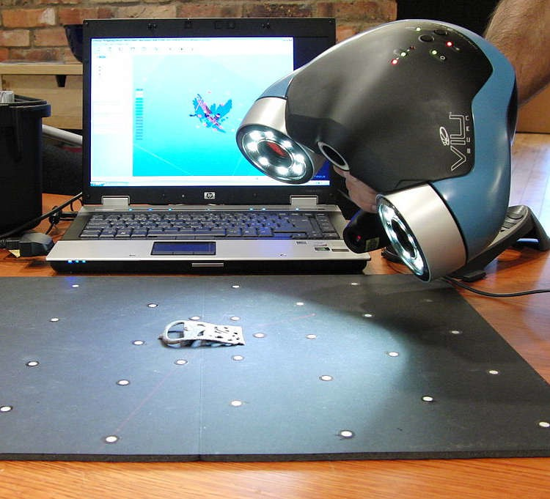
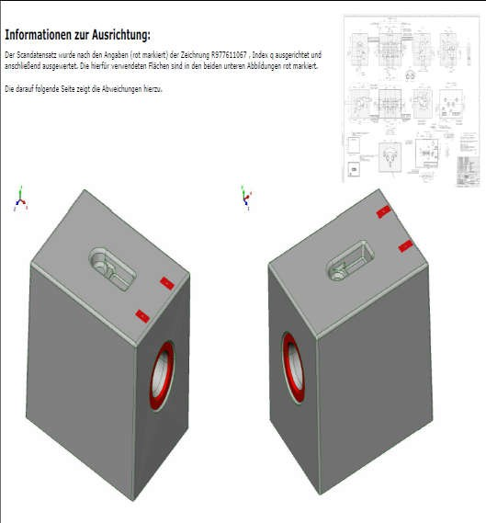
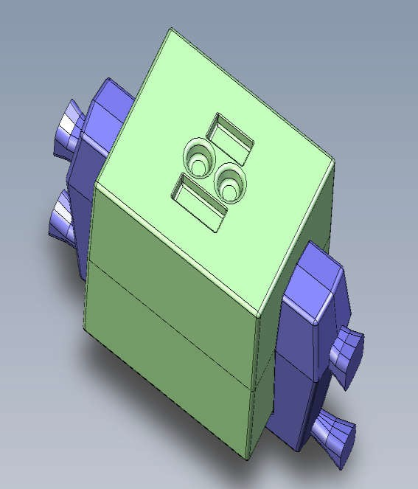
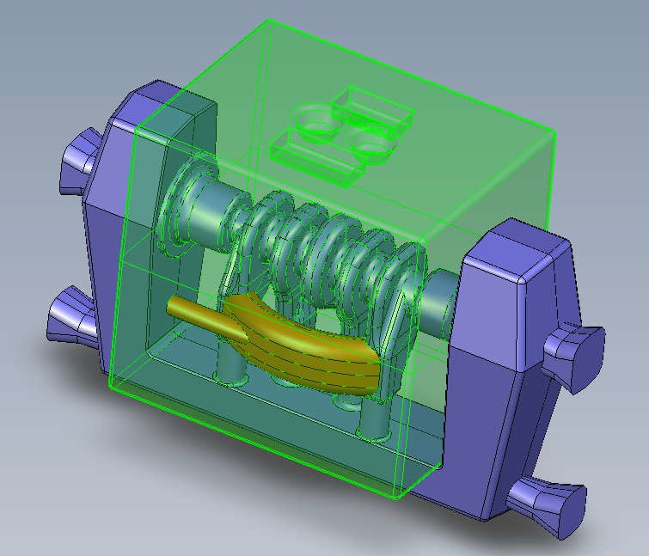
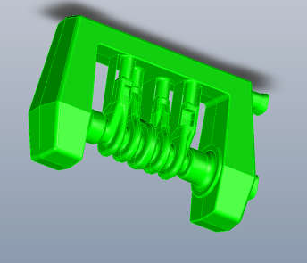
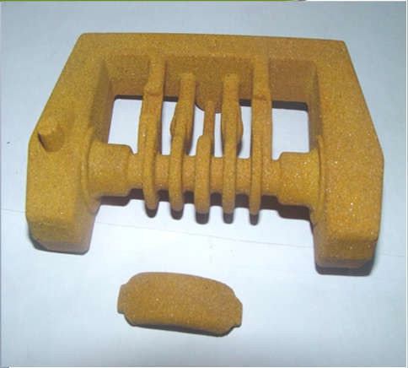
Pattern Development
▶ CAD/CAM
▶ Digitization
▶ Simulation
▶ 3D Printing
▶ Rapid Proto typing

Slide 21
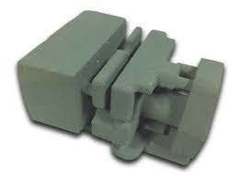
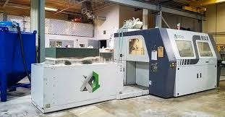
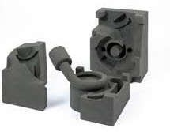
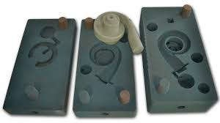
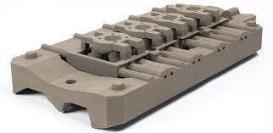
3D PRINTING

Slide 22
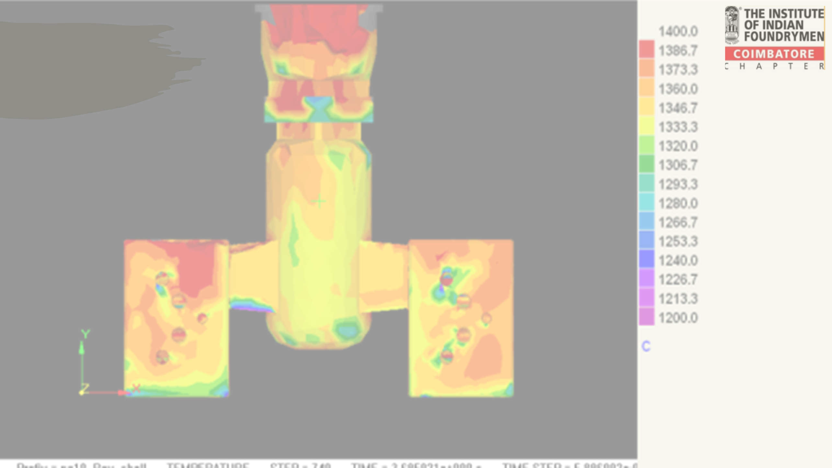
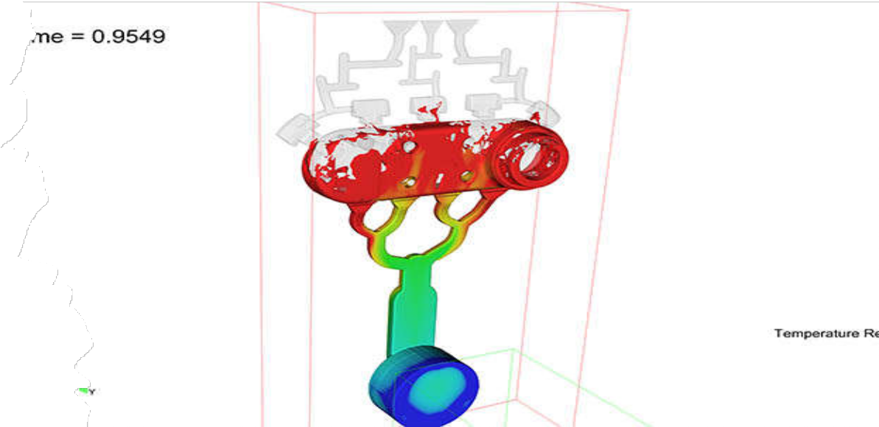
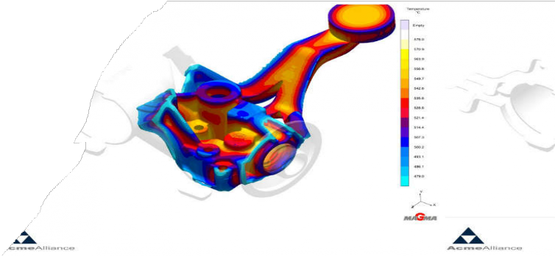
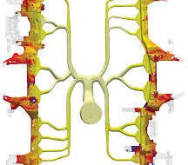
Metal Flow Simulation
Magma
ProCast
Autocast
Solidcast
3D Flow Science

Slide 23
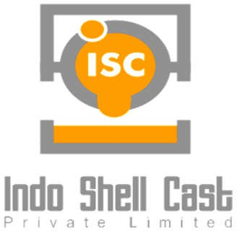
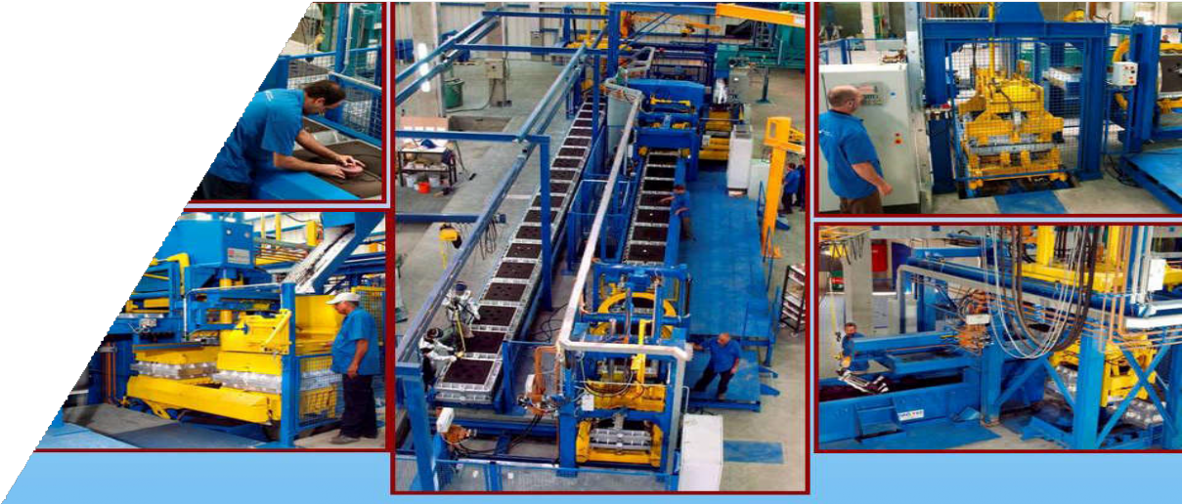
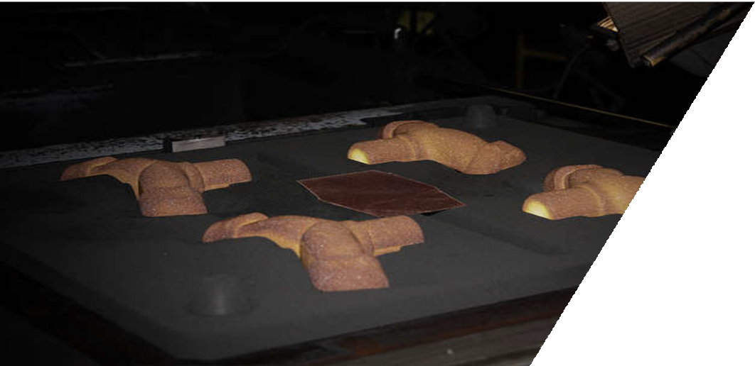

Slide 24
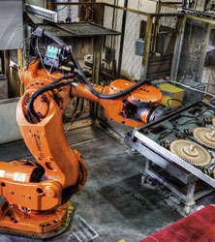
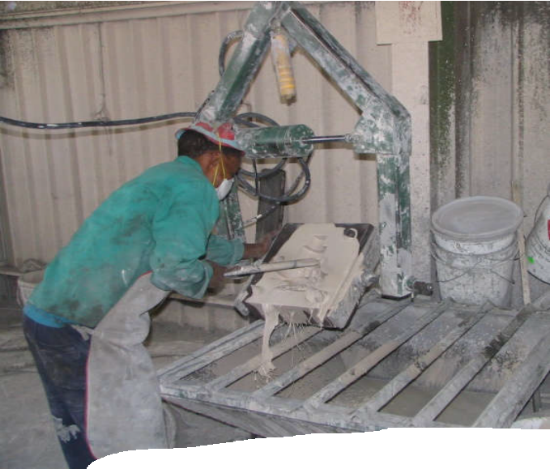
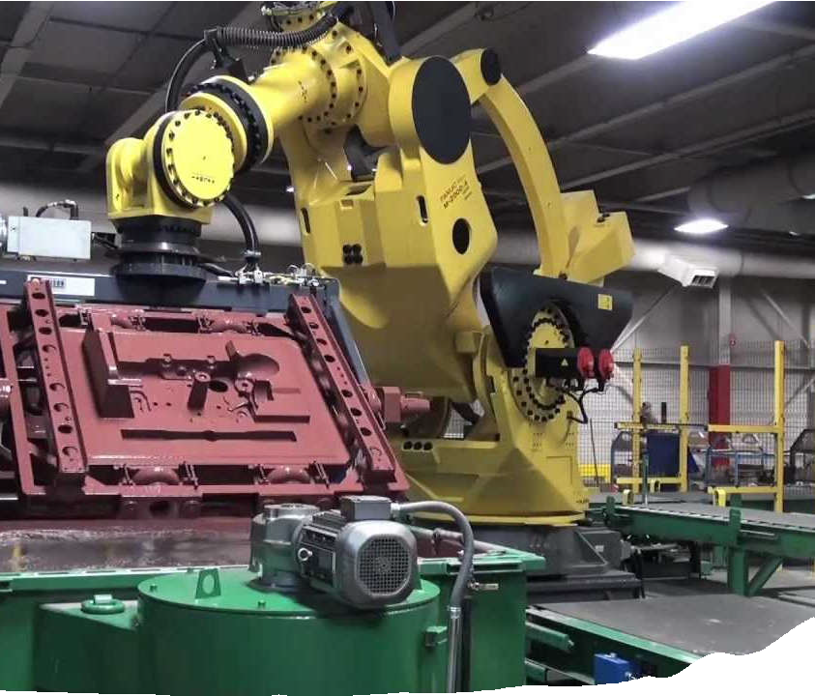
Automation in core coating

Slide 25
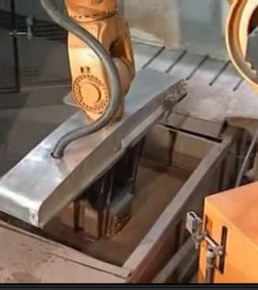
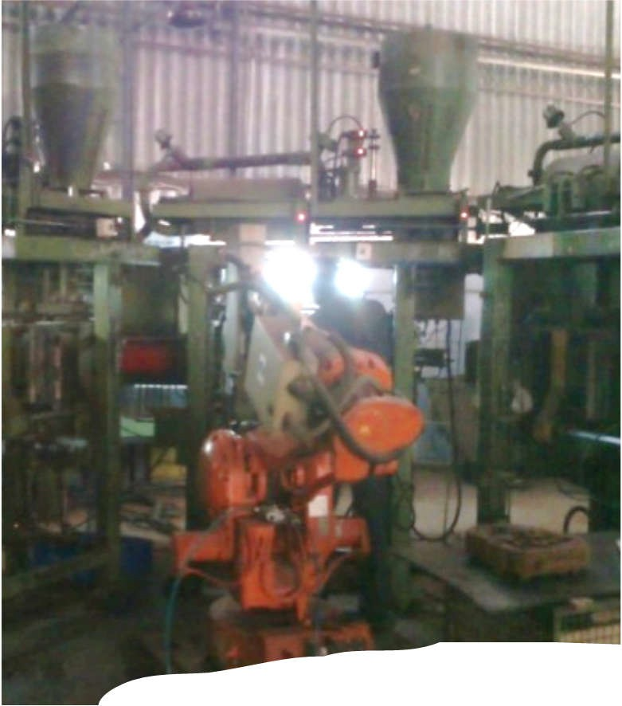
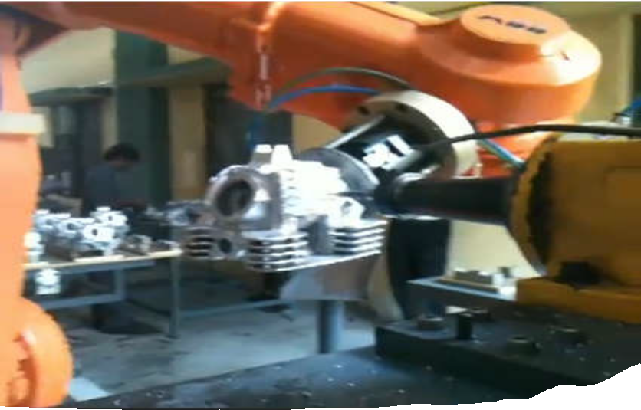
Robots in Fettling

Slide 26
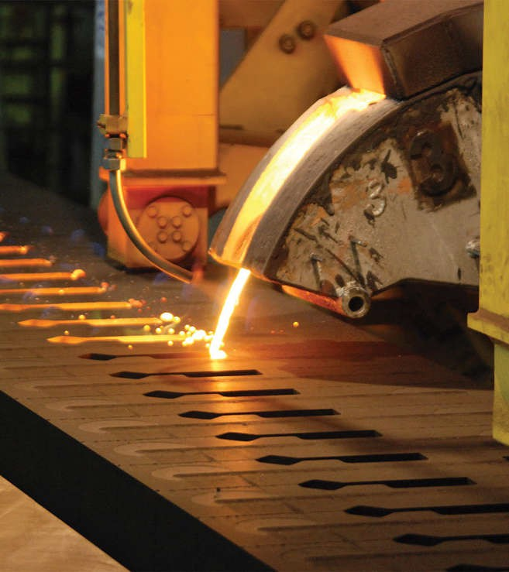
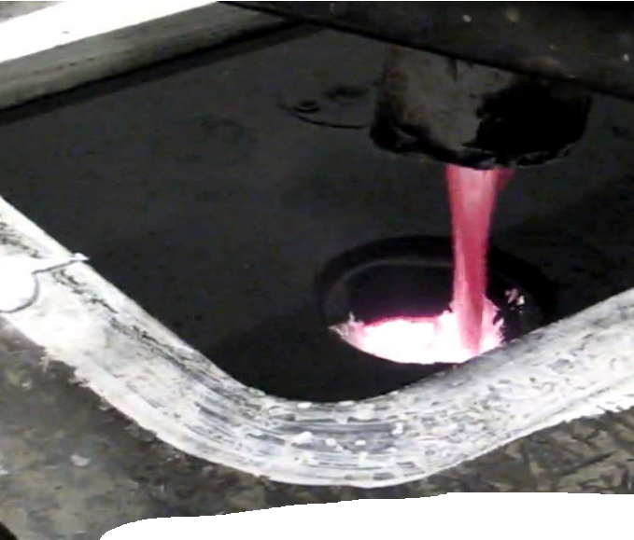
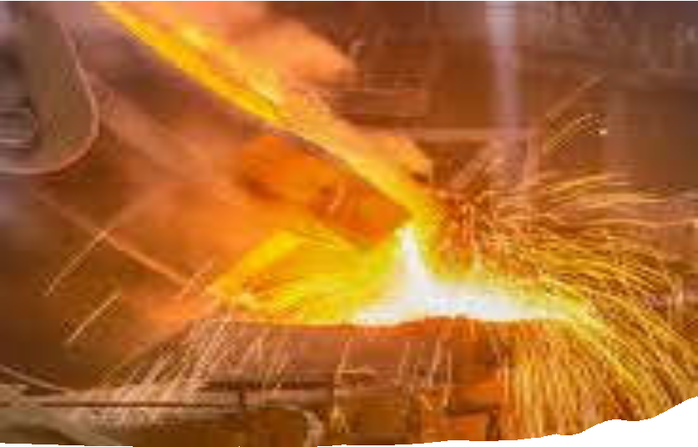
Melting

Slide 27
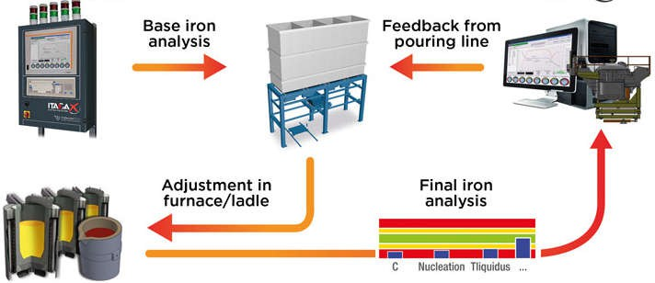
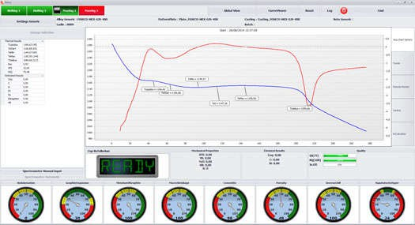
Automation in Melting

Slide 28
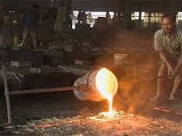
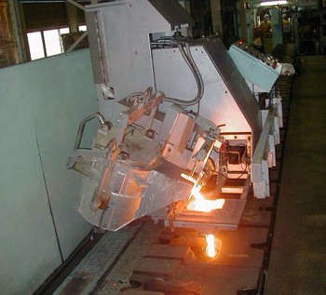
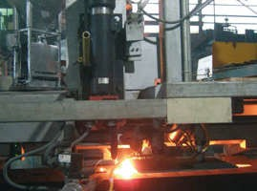
Automation in Melting

Slide 29
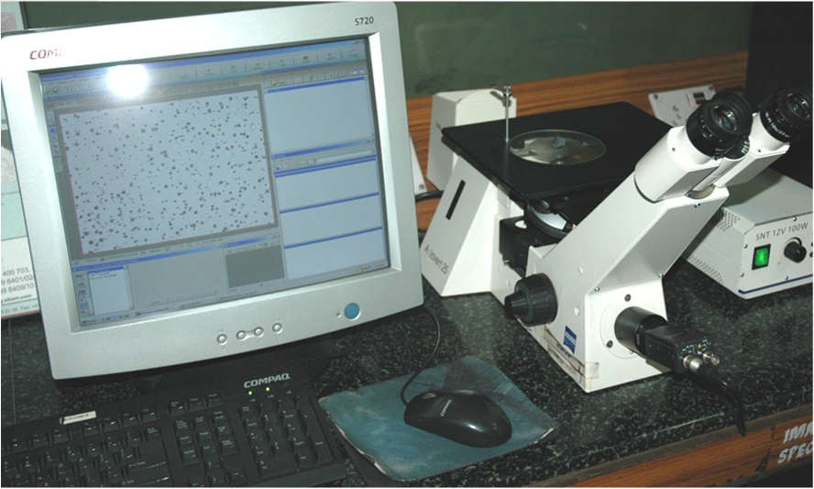
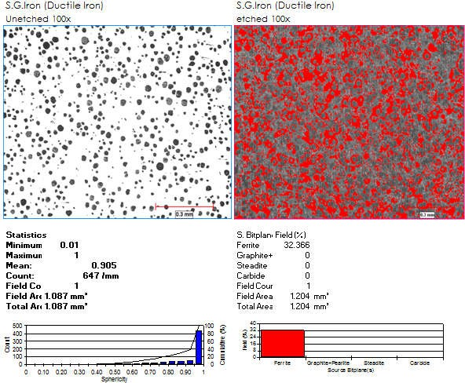
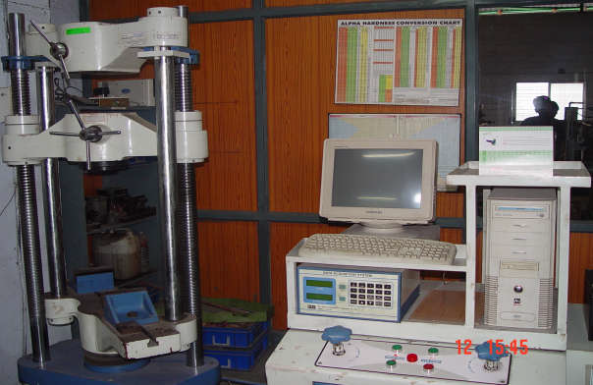
The Core Metallurgical Industry

Slide 30
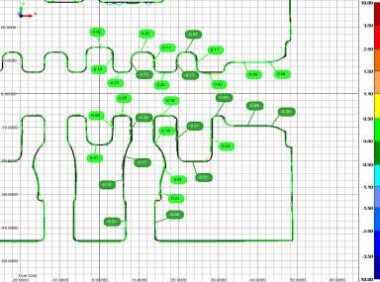
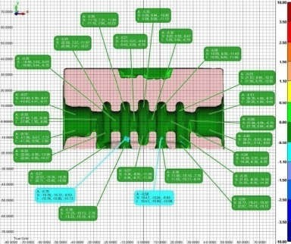
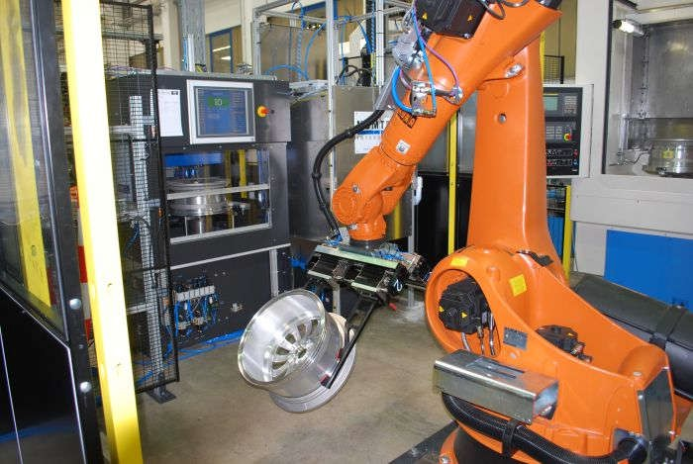
Metrology
Automation in Casting Inspection

Slide 31
Non – Destructive Testing
Radiography
Liquid Penetrant testing
Ultrasonic flaw detection
Magnetic flaw detection
Eddy Current
Acoustic resonance testing
Thermal Imaging

Slide 32
VARIOUS INDIAN STANDARDS ON FOUNDRY AND ITS PROCESS
Glossary of terms relating to foundry technology (First Revision) (IS 2763 :1999)
Tests for foundry core oils (IS 3666 :1966)
Methods of physical tests for foundry sands (IS 1918 :1966)
Foundry Nickel - Specification (Second Revision) (IS 2391 :2024)
Foundry core oils - Specification (First Revision) (IS 9009 :1992)
Guidelines for controlling foundry rejection (IS 12880 :1989)
Methods of sampling foundry sand (First Revision) (IS 1811 :1984)
Refractories for use in foundry industry - Recommendations (IS 14447 :1997)
Foundry - Impregnation of castings - Recommended practice (IS 12799 :1989)
Foundry - Crane suspended ladles specification: Part 3 straight/taper sided ladles 0.25 to 3.0 tonnes (IS 4475 : Part 3 :1989)
Recommended sizes off cupola furnace for foundry (Second Revision) (IS 5032 :1983)
Coal Dust for Use in Cast Iron Foundry ï¿½ Specification (Third Revision) (IS 1752 :2023)
Specification for coal dust for use in cast iron foundry (Second Revision) (IS 1752 :1973)
Specification for graphite for use in foundry coatings (Third Revision) (IS 1305 :1984)
Specification for guide pins for foundry pattern plates (Second Revision) (IS 4981 :1984)
Specification for closing pins for foundry moulding boxes (Second Revision) (IS 4982 :1984)
Specification for foundry moulding boxes of steel construction (Second Revision) (IS 1280 :1975)

Slide 33
QUALITY SYSTEMS FOLLOWED IN FOUNDRIES
ISO 9000 -
IATF 16949 -
ISO 14001 -
ISO 45001 -
ISO 50001 -
ISO 27001 -
OHSAS -
ISO/ IEC 17025 -
TPM -
TQM -
5S -
LEAN -

Slide 34
SCOPE OF INDIAN METAL CASTING INDUSTRY
Foundry industry is the mother of all industries.
Metal casting process is the oldest manufacturing process.
Metal cast products – in almost all application and almost all automobile product.
In India, 6000 foundries - 80 % small, 15 % medium and only 5 % large sector.
Around 3500 units are Grey iron foundries, producing 6.0 million tons of casting.
Scope of casting industry is widening, as government has made efforts to improve infrastructure including power generation, which are power extensive industries.
The knowledge and application of technology in the area of metal casting will help the industries to excel in all of its application areas.

Slide 35
SCOPE OF INDIAN METAL CASTING INDUSTRY
Not limited to metal products, but application also include, plastic products, composite, civil and building infrastructure development, bridge construction etc.
The new initiatives and additional scope of foundry industry will require the skilled manpower and leads to huge job potential for metal casting professionals.
Foundry clusters in India:
Foundries in India are concentrated as clusters; the most important being Jalandar, Ludhiana, Batala, Delhi, Agra, Rajkot, Howrah, Bhopal, Mumbai, Pune, Kolhapur, Solapur, Belgaum, Chennai and Coimbatore.

Slide 36
FOUNDRY INDUSTRY IS THE BACKBONE OF INDIAN ECONOMY
India, on its quest to become a global superpower, is making significant strides towards developing its engineering sector.
Engineering sector is the largest of the industrial sectors in India, which accounts for 27% of the total factories in the industrial sectors and represents 63% of the overall foreign collaborations
3th largest automobile market in the world.
Govt. of India's emphasis on increasing the share of manufacturing in GDP to 20% by 2025 & 25% by 2030
Favorable trade policies are helping India to become an emerging sourcing hub of the world

Slide 37
FOUNDRY INDUSTRY IS THE BACKBONE OF INDIAN ECONOMY
India will be the leader in the shared mobility in the year 2030.
This industry also provides great opportunities for investment on new technology and expanding the capacity. In addition to that it will increase direct and indirect employment.
Indian automotive industry (including component manufacturing) is expected to reach Rs. 16.16-18.18 trillion (US$ 251.4-282.8 billion) by 2026.
Automobile Industry is consuming about 32% of castings, so the growth of this Auto industry will have the potential opportunity for the Indian Foundry Industry

Slide 38
OPPORTUNITIES IN FOUNDRIES DUE TO..
Emerging growth of Auto Industries.
Evolving opportunities of Nano and Micro Electronics.
Exponential growth in Space and Aero Space Technology.
Promising growth of Power sector, Fuel cell and Batteries.
Rapid Development in Infrastructure.
Potential growth of Machine Manufacturing.
Prospective growth in Mining Industry.
Rapid growth of Steel and Casting Industry.

Slide 40
FOUNDRY INDUSTRY CONTRIBUTION

Slide 41
CASTING PARTS IN AUTOMOBILE
Pistons,
Engine blocks,
Valve covers,
Wheels,
Transmission housing, Carburetors,
Fan clutches
Etc….

Slide 42
GLOBAL CASTING PRODUCTION TREND
As per 54rd World casting Census published by Modern Castings USA in January 2021, Total Global Casting Production was 109.05 million metric tonnes, a decrease of 3.2% as compared to the previous year.
China, India and the USA hold the top three spots of casting production in the world.
Country Wise Production Million Tons- 2021
2.38
_{2.31} 2.28
2.85
4.2
China India USA
4.95
Japan Germany Russia Mexico Korea Turkey Brazil
5.27
48.7
11.3
11.49

Slide 43
COUNTRYWISE CASTING PRODUCTION

Slide 44
GROWTH - INDIAN FOUNDRY INDUSTRY
Foundry market in India - Progressing at a CAGR of > 10% from 2020 onwards

Slide 45
Industry revenue of "Casting of metals" in India from 2012 to 2024 (billion Dollars)

Slide 46
Export Data of Major Castings (Million Dollars)

Slide 47
MARKET FORECAST OF INDIAN FOUNDRY

Slide 48
GLOBAL CASTING MARKET

Slide 49
INDIAN FOUNDRY - Today’s Scenario..
Now we are borrowing Material production technologies / Software / Machinery equipment from other countries such as USA, China, Germany, France, Japan etc..

Slide 50
PRESENT CHALLENGES TO INDIAN METAL CASTING INDUSTRIES – GAP??
Lack of focus in R&D in Material development and Casting technology.
High cost of technology and related modern equipment.
The cost of energy, which is increasing every time.
High rate of interest on loans.
Industry and Taxation law policies has become a barrier in the growth and export business.
Irregular supply of raw material.
Environment Pollution.

Slide 51
THE FOCUS OF METAL CASTING INDUSTRIES MUST BE ON
Quality not on the quantity with a spirit of producing right first time and every time. (Standards play a major role)
Waste reduction and on improving the productivity.
Defect prevention not on defect rectification, Zero Tolerance towards Quality.
Competition on pricing, Quality as well reduction in lead time.
Institutions and Government should invest in R&Ds projects and Policy Change.
New curriculum to be developed according to the current industrial requirements.
Technological transactions and transformations to be made between Industry and Institutions. Develop students to the current industry requirements.
Technology adoption
Energy Conservation
Continuous Training
Improvement in work culture
Participation of our Government and Other Institutions

Slide 52
THANK YOU ALL

