Slide 1
Bureau of Indian Standards (under the Ministry of Consumer Affairs, Food & Public Distribution, Govt. of India) Heat Treatment and Metallography
Suman Kumar Gupta
Scientist E & Head

Slide 2
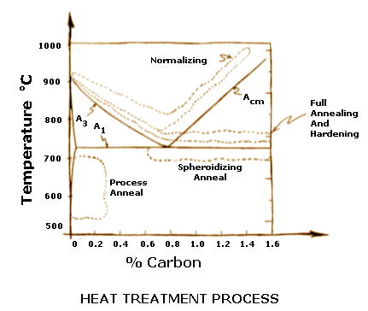
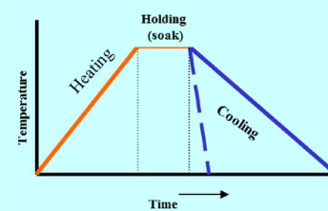
Heat Treatment of steel
Heat treatment is a combination of heating and cooling operations in a prescribed manner (with respect to time, temperature and rate of heating and cooling) to induce desired properties in metals and alloys in the solid state. The conventional heating for hot-working does not come within the scope of heat treatment.
Types of Heat treatment-
Normalising
Annealing
Hardening
Tempering
Special heat treatment
Case hardening
Surface hardening
Please refer to IS 1956 (Part 1) : 1976 and IS 13417:2024 for more details

Slide 3
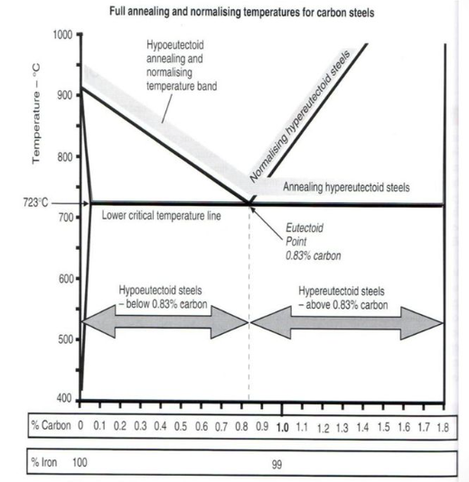
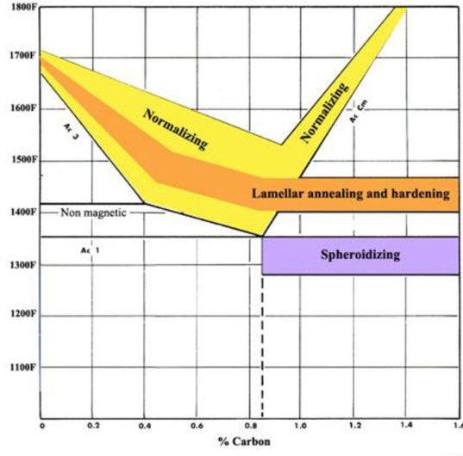
Heat Treatment Process
Equipments for heat treatment:
Heating Media
Air-Chamber Furnaces
Salt Baths
Protective Atmospheres
Vacuum Furnaces
Temperature Uniformity
2. Pyrometric Equipment
Temperature Measuring and Recording Equipment
Accuracy of equipment
Calibration
3. Quenching Equipment
Quenching Baths
Quenching oils
4. Rinsing Equipment
Please refer to IS 13417:2024 for more details

Slide 4
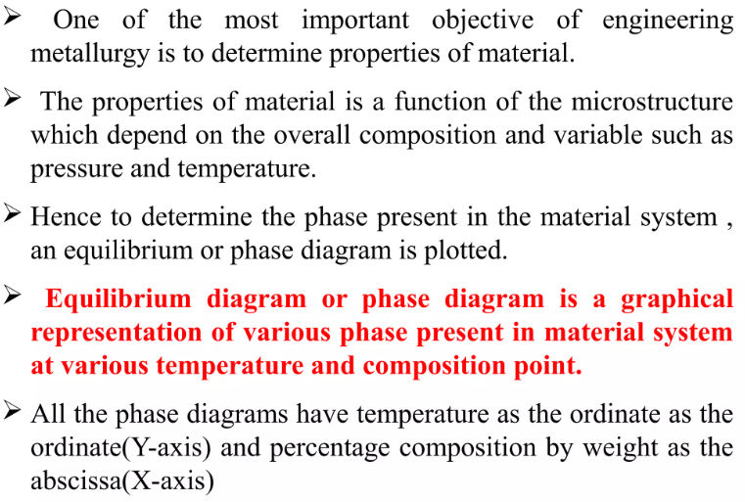
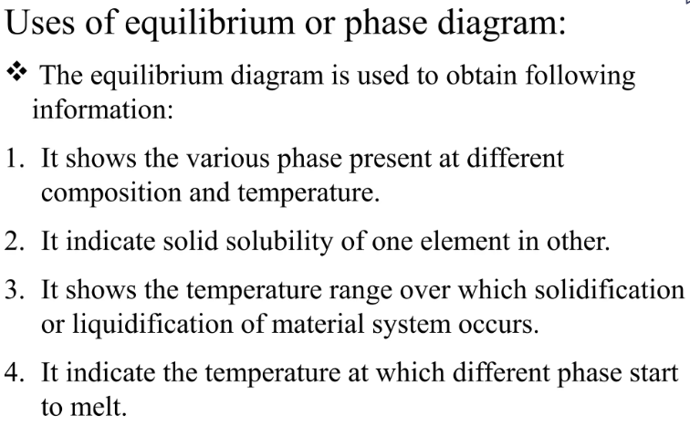
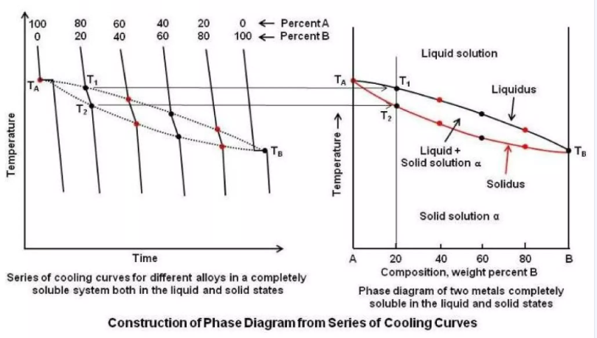
Concepts of Phase Diagrams

Slide 5
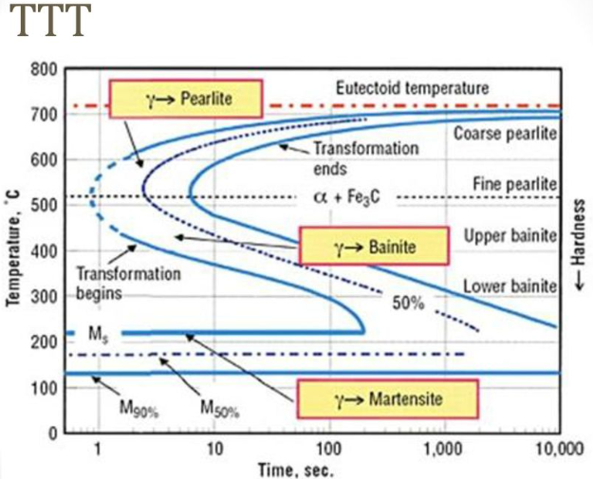
TTT (Time, Temperature, Transformation Curves)
Three Steps-
Austenitizing
Isothermal Holding
Quenching (Cooling)

Slide 6
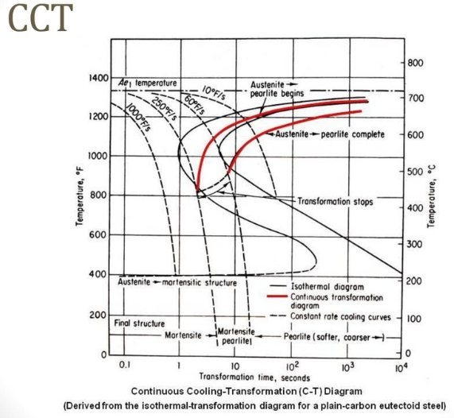
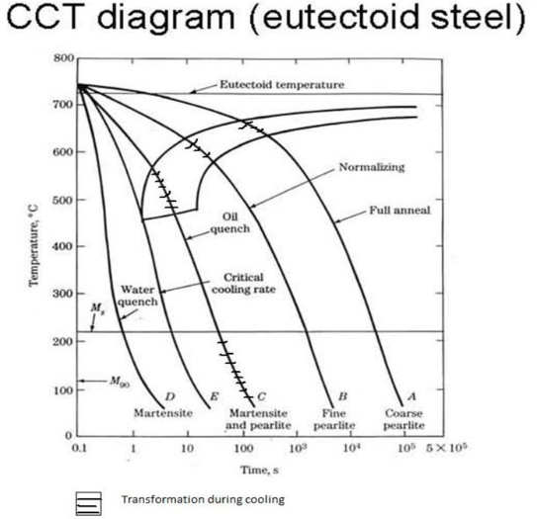
CCT (Continuous Cooling Transformation Curves)
Steel is rarely isothermally transformed. Rather, it is cooled continuously from austenitizing temperatures to room temperature, and transforms incrementally in a complex way dependent on the cooling rate. it is found that transformation during continuous cooling is delayed. This displaces the CCT curve down and to the right of the TTT curve as shown in Fig. below where the two behaviors are superimposed.

Slide 7
Standards related to Heat Treatment
Title of Standard | IS No.
Code of practice for heat treatment of steels | IS 13417 : 2024
Recommended procedure for heat treatment of welded fabrication | IS 10801 : 1984 Reviewed In : 2021
Guidelines for heat treatment of cast iron | IS 13655 : 1993 Reviewed In : 2023
Protective atmosphere for heat treatment furnaces - Recommendations | IS 14245 : 1995 Reviewed In : 2023
Heat treatment of maraging steel - Code of practice | IS 14598 : 1998 Reviewed In : 2023
Glossary of terms relating to iron and steel: Part 1 general metallurgy, heat treatment and testing (First Revision) | IS 1956 (Part 1) : 1976 Reviewed In : 2023

Slide 8
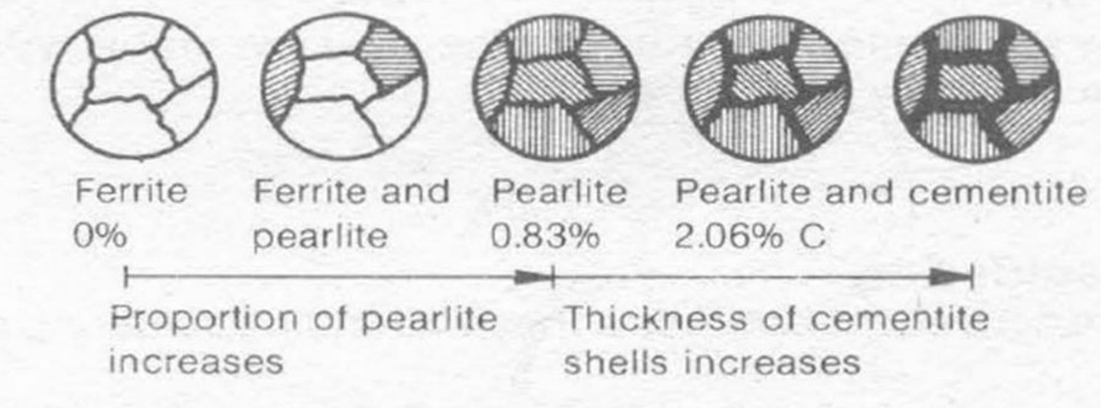
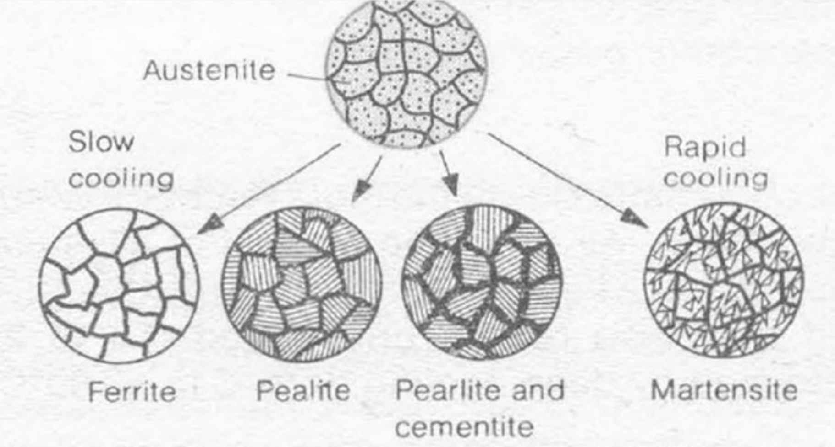
Metallography
Study of microstructure of all types of metals and their alloys
Main microstructural constituents of steel are ferrite, pearlite, cementite, bainite martensite, and austenite
Iron Carbon diagram depicts the relation between iron and carbon at different temperatures, compositions, and phases of iron.
Please refer to IS 7739 (Part 5) : 1976 Code of practice for preparation of metallographic specimens: Iron and steel and their examination and IS 15426 : 2004/ISO 14250:2000 Metallographic characterization of duplex grain size and distributions

Slide 9
Grain Size Determination
International standards for grain size analysis are IS 4748 : 2021/ISO 643:2019, ASTM E112, JIS G 0551 e.t.c
Methods for determination: Comparison Method, Planimetric Method, Intercept Method
Planimetric method:
$$N={\left(\frac{100}{M}\right)}^{2}2^{n−1}$$
Where N = No of grain per Square inch
^{M = Magnification}
^{n = ASTM grain size number}

Slide 10
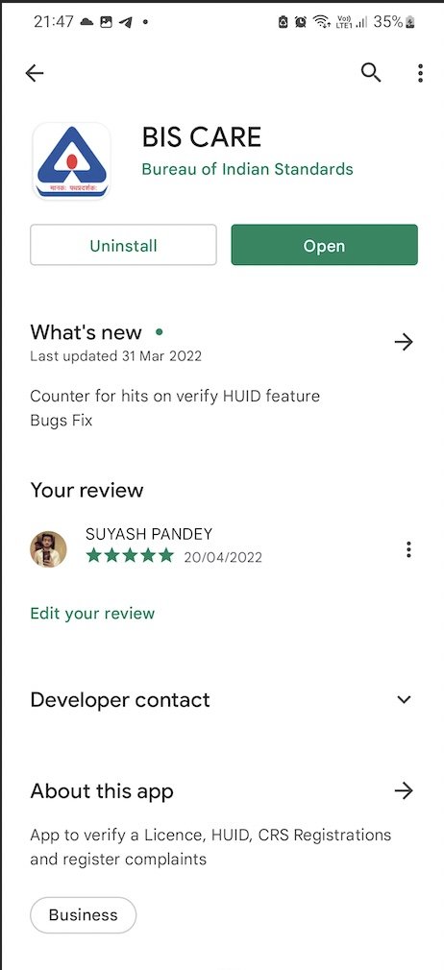
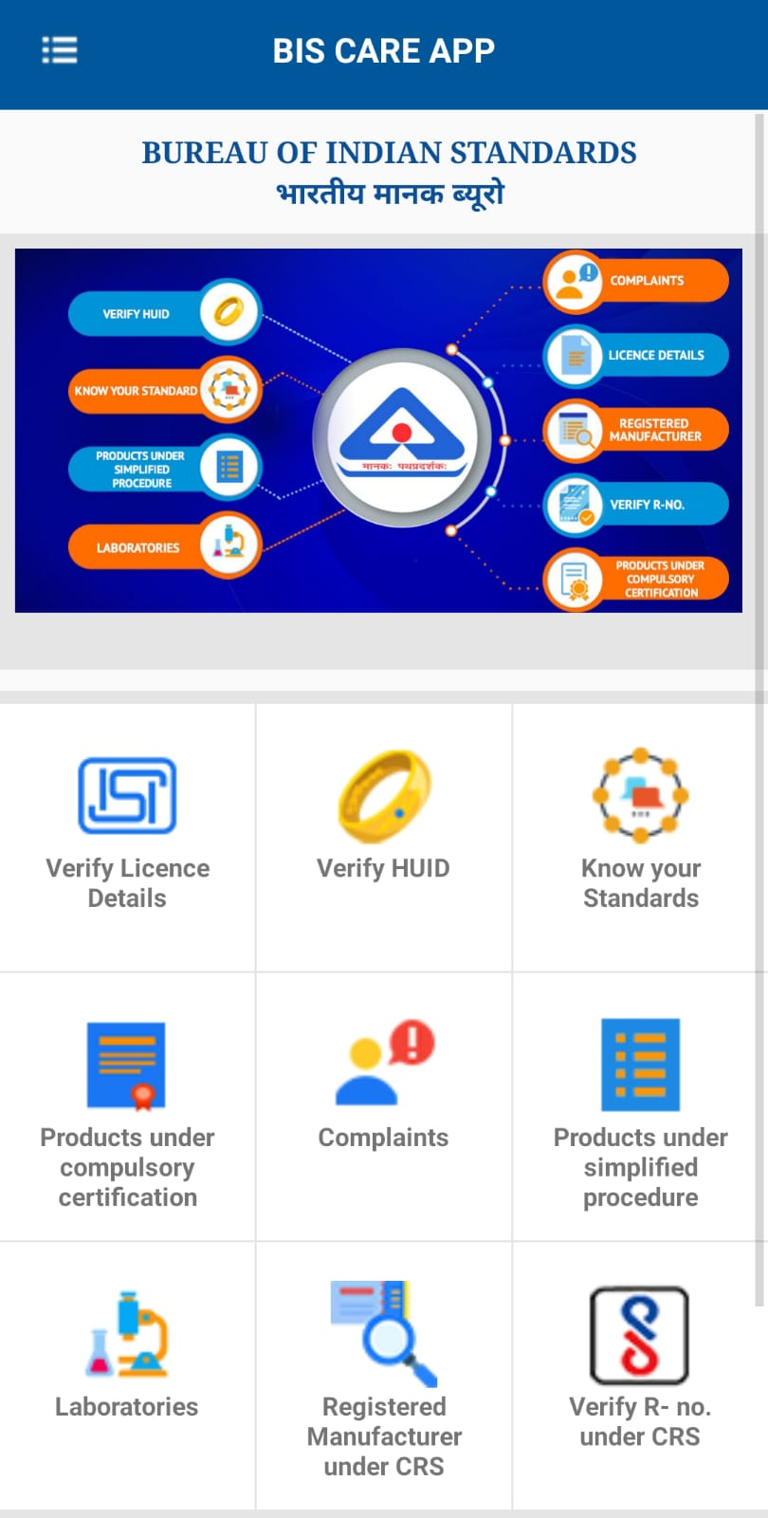
BIS CARE APP- can be downloaded from GOOGLE PLAYSTORE

Slide 11
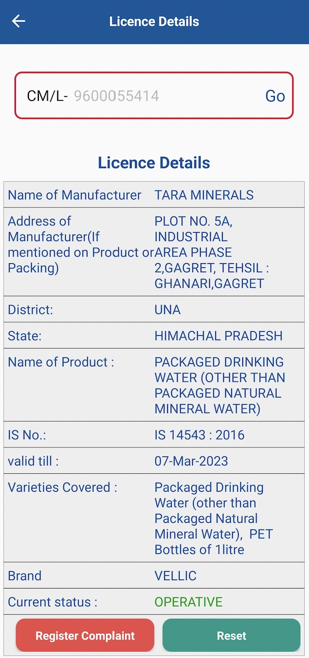
MOBILE CARE APP- Verify Licence details

Slide 12
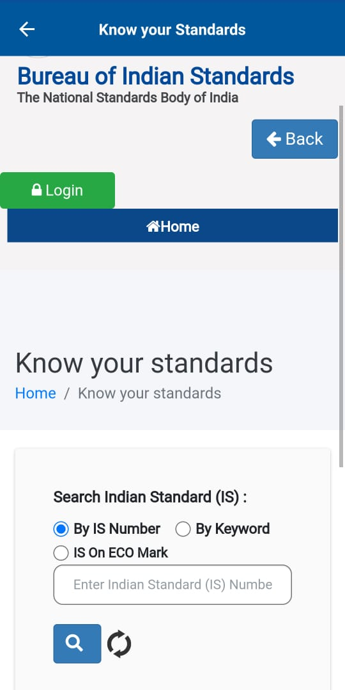
BIS CARE APP- Know your Standards

Slide 13
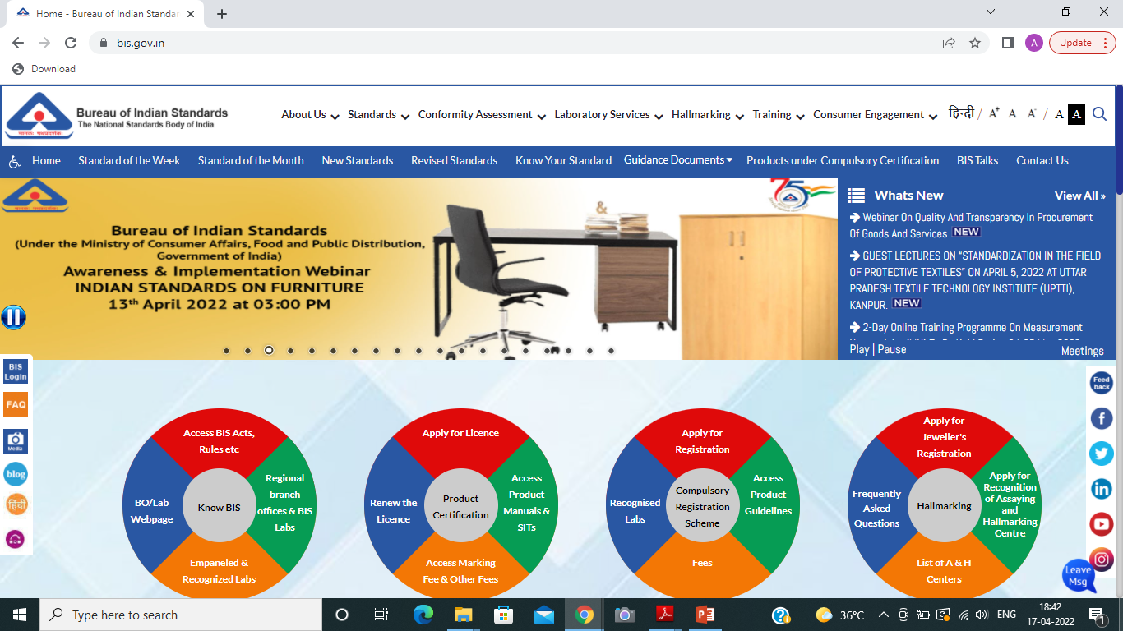
Effective Use of BIS Portals
BIS WEBSITE

Slide 14
Effective Use of BIS Portals
MANAKONLINE PORTAL

Slide 15
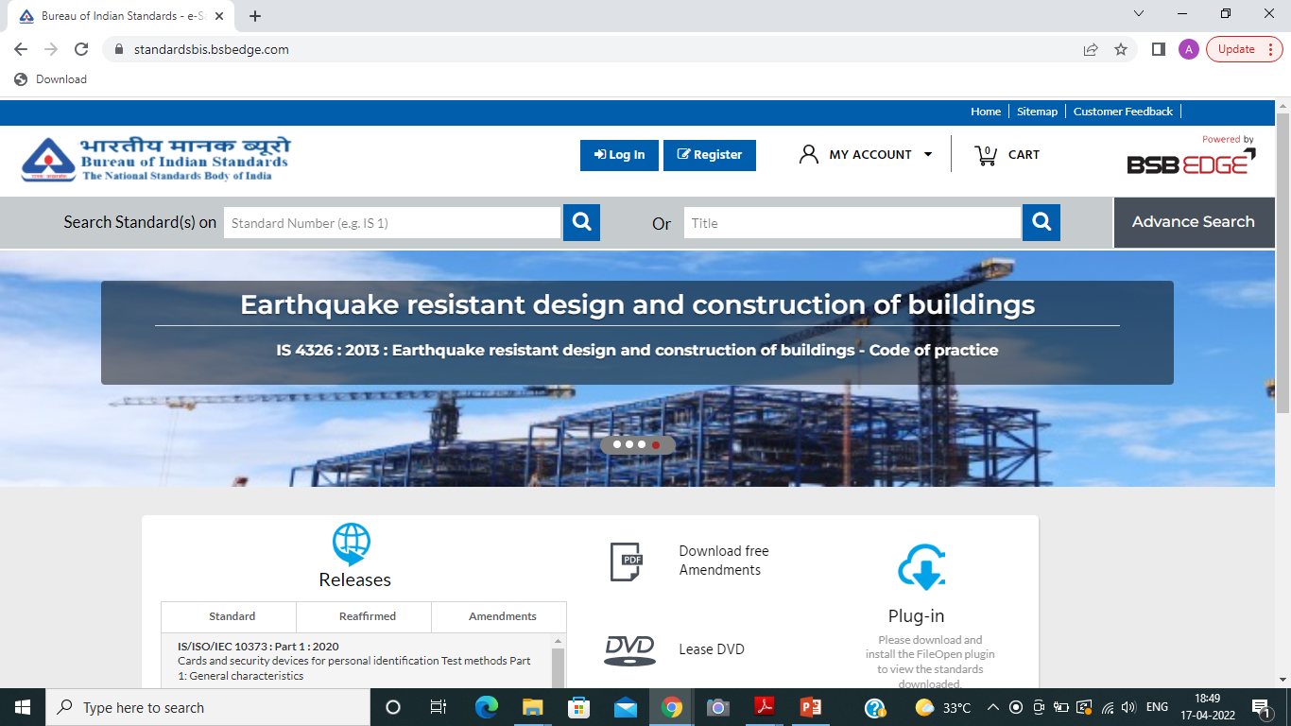
Effective Use of BIS Portals
STANDARDS DOWNLOAD PORTAL

Slide 16
Effective Use of BIS Portals & Use of Repositories
BIS
PORTALS
www.bis.gov.in
www.standardsbis.bsbedge.com
www.manakonline.in
The above will be helpful for getting all the information related to Standards and the technical advancements going on in the industry and education sectors.
One can also go and see the videos made by BIS on the specific Technical Departments and on the Specific Products. i.e. on BIS TALKS.
As Academia, you are also a Stakeholder for BIS and can also be a part of the Technical Committee for any product of your knowledge and interest.

Slide 17
Best of Luck & Thank You!

