Slide 1
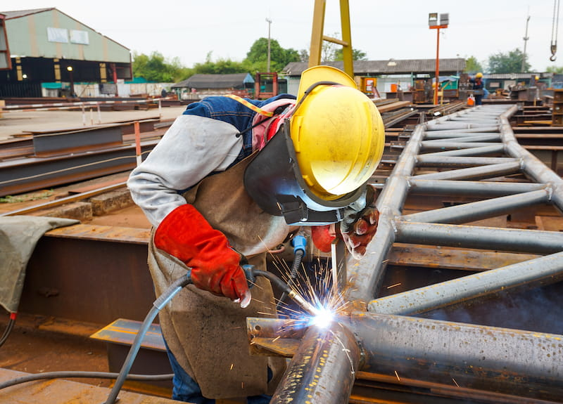
WELDING TECHNOLOGY
Anindya Chakrabarti
“METALS AND WELDING -
A BOND FORGED THROUGH TIME”

Slide 2

WHAT IS WELDING?
Weld *- A union between two pieces of metal at faces rendered plastic or liquid by heat or by pressure, or both. Filler metal may be used to effect the union
Welding* - The making of a weld
*As per IS 812:1957 (Glossary of terms relating to welding and cutting metals):
Started in the Bronze
Era – 3000BC
Mainly Forge Welding
More about history can be found here

Slide 3
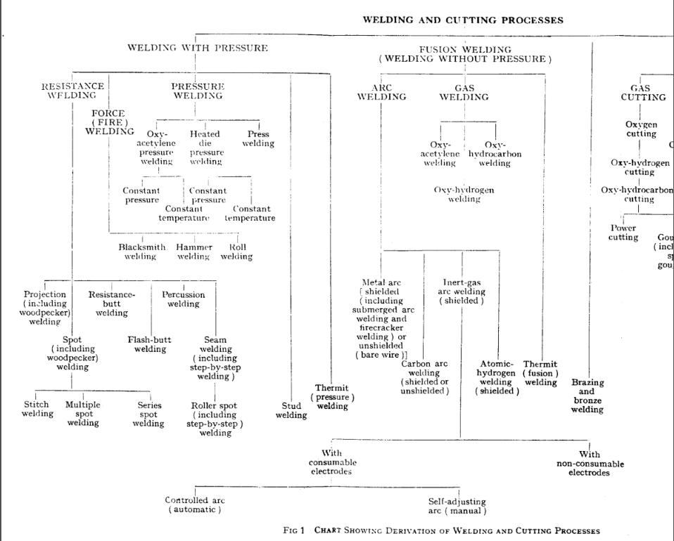
IS 812: 1957

Slide 4
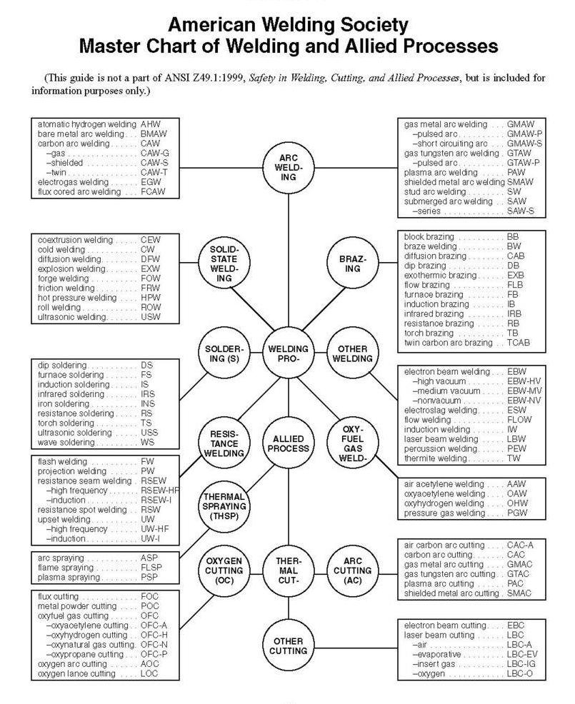

Slide 5
Discussion Subjects
1) Important definitions related to welding
2)Shielded Metal Arc Welding – SMAW (also called Manual Metal Arc Welding ) – manual
3)Flux Cored Arc Welding (FCAW )- Gas Shielded/ Self Shielded - semiautomatic / automatic
4)Tungsten Inert Gas Welding – GTAW – manual / automatic
5)Gas Metal Arc Welding (GMAW ) – MIG/MAG -semi-automatic / automatic
6)Submerged Arc Welding ( SAW ) - automatic
7)Gas welding
8) Safety for eye and face

Slide 6
DEFINING COMMON WELDING TERMS
(IS 812:1957 )

Slide 7
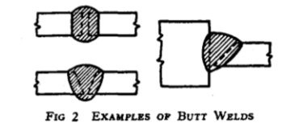
DEFINING COMMON WELDING TERMS(IS 812:1957 )
As-Welded - The condition of weld metal, welded joints and weldments after welding prior to any subsequent thermal or mechanical treatment.
Butt Weld - A weld in which the weld metal lies substantially within the extension of the planes of the surfaces of the parts joined or within the extension of the planes of the smaller of the two parts of differing size .
Filler Metal - Metal to be added in welding or brazing.
Flux - Fusible material used in welding or oxygen-cutting to dissolve and facilitate removal of oxides and other undesirable substances. Also commonly used to designate covering of covered electrodes.

Slide 8
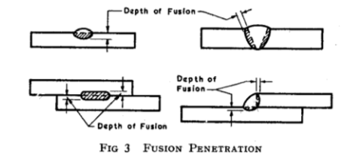
DEFINING COMMON WELDING TERMS AS PER IS 812: 1957
Deposited Metal (Added Metal)
  a) In Welding - Filler metal after it becomes part of the weld
  b) In Bronze Welding or in Brazing -- Filler metal after it becomes part of the joint.
Deposition Efficiency - The ratio of the weight of deposited metal to the net weight of core wire of electrodes consumed, exclusive of stubs.
Fusion Penetration/Depth of penetration
In Fusion Welding - The depth to which the parent metal has been fused.
b) In Spot, Seam, or Projection Welding - The distance from the interface to the edge of the weld nugget, measured in each case on a cross-section through the centre of the weld and normal to the surface.

Slide 9
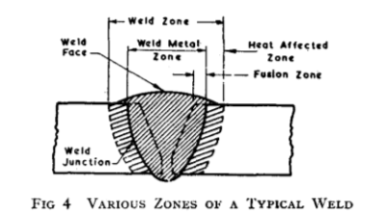
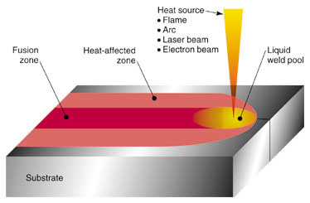
DEFINING COMMON WELDING TERMS AS PER IS 812: 1957
Fusion Zone - The portion of a weld in which parent metal has been fused.
(In Fusion welding, the two edges or surfaces to be joined are heated to and above the melting point and wherever necessary, the molten filler is added to fill the joint gap)
Heat-Affected Zone - Parent metal metallurgically affected by the heat of welding (or cutting), but neither melted nor made plastic.

Slide 10
DEFINING COMMON WELDING TERMS AS PER IS 812: 1957
Ignition Powder - A readily ignitable mixture, usually of powdered aluminium and oxidizing material, used for initiating the reaction in thermit pressure welding and thermit fusion welding.
Longitudinal Axis of Weld - A line through the length of a weld, perpendicular to the cross-section at its centre of gravity (see Fig. on next slide).
Melt Run - A line of parent metal which has been melted by passing a welding flame or arc along the surface of the plate.
Parent Metal (Base Metal ) - The metal to be joined or cut.
Peening - The mechanical working of metals by means of hammer blows.
Penetration ( Through) Pass - The first run of a multi-run butt weld, the penetration bead of which can be seen.

Slide 11
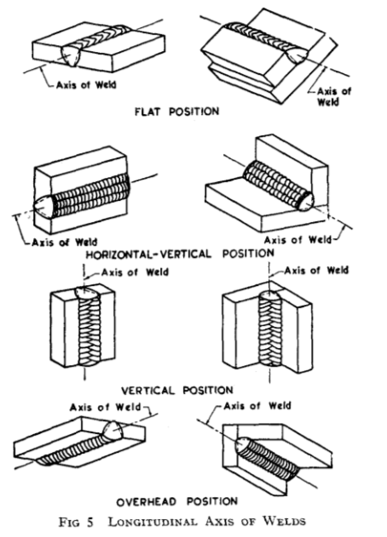
DEFINING COMMON WELDING TERMS AS PER IS 812: 1957

Slide 12
DEFINING COMMON WELDING TERMS AS PER IS 812: 1957
Residual Welding Stress - Stress remaining in a metal part or structure as a result of welding.
Strength Weld - A weld designed to be under stress.
Stress Relief Heat Treatment - Uniform heating of an assembly or portion thereof to a suitable temperature below the lower critical point for sufficient time to reduce the residual stresses followed by uniform cooling.
Stubs - Waste ends of electrodes and welding rods.
Surfacing -The deposition of filler metal by welding process on to a metal surface to obtain desired properties.
Weld Gauge - A device designed for checking the shape and size of welds.
Weld Metal - All metal melted and/or made plastic in making a weld.
Weld-Metal Zone - The portion of a weld consisting of weld metal.
Weld Width - Distance between the toes of the weld.
Weld Zone - The sum of the weld-metal zone and the heat-affected zone.

Slide 13
DEFINING COMMON WELDING TERMS AS PER IS 812: 1957
Welded Joint - For the purposes of design calculations, a full strength butt joint is a joint produced by a fully penetrated weld or by fully penetrated welds between parts of equal section aligned and lying within the included angle of 135 to 180° in such a manner that the flow of normal stresses does not undergo any considerable deviation in the zone of the joint.
Welding Rod - Filler metal, in wire or rod form, used in gas welding and brazing processes, and those arc welding processes wherein the electrode does not furnish the filler metal.
Welding Sequence - The order and/or direction in which either welds or runs are made.
Welding Technique - The manner in which an operator manipulates an electrode, a blowpipe or the like.

Slide 14
Shielded Metal Arc Welding
(SMAW)

Slide 15
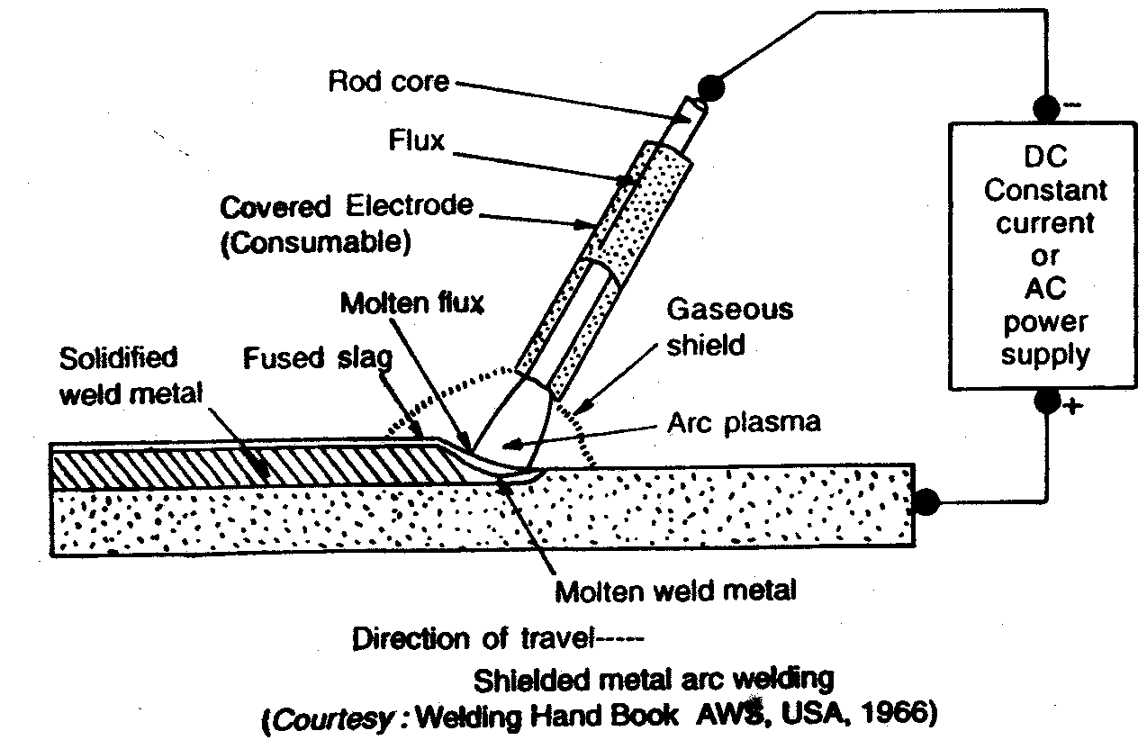
What is maximum used Fusion welding ?
Shielded Metal Arc Welding (SMAW)
An electric arc is maintained between the end of a coated metal electrode and the workpiece.
The flux covering melts during welding and forms gas and slag to shield the arc and molten weld pool
The flux also provides a method of adding scavengers, deoxidizers and alloying elements to the weld metal

Slide 16
SMAW
Some Important ISS on SMAW
Sl | IS | Title
1 | 814 : 2004 | Covered electrodes for manual metal arc welding of carbon and carbon manganese steel
2 | 817 (Part 1) : 1992 | Training of welders - Code of practice: manual metal arc welding
3 | 1395 : 1982 | Specification for low and medium alloy steel covered electrodes for manual metal arc welding
4 | 5139 : 1995 | Repair of cast iron castings by Oxy - Acetylene and manual metal arc welding
5 | 5206 : 1983 | Specification for covered electrodes for manual metal arc welding of stainless steel and other similar high alloy steels
6 | 5511 : 1991 | Covered electrodes for manual metal arc welding of cast iron
7 | 7303 : 1974 | Specification for covered electrodes for surfacing of metal by manual metal arc welding
8 | 8666 : 1977 | Specification for copper and copper alloy covered electrodes for manual metal arc welding
9 | 10803 : 1984 | Method of sampling and preparation of weld pad for chemical analysis of weld metal from covered electrodes for manual metal arc welding
10 | 13043 : 1991 | Covered manual metal arc welding electrodes - Determination of efficiency, metal recovery and deposition co - Efficient

Slide 17
IS 814:2004
COVERED ELECTRODES FOR MANUAL METAL ARC WELDING OF CARBON AND CARBON MANGANESE STEEL

Slide 18
Do you know that more than 80 % of SMAW used for Carbon and Carbon Manganese Steel?
Now we will talk about the most popular IS Specification in welding Industries having more than 180 licences all over India----IS 814:2004
COVERED ELECTRODES FOR MANUAL METAL ARC WELDING OF CARBON AND CARBON MANGANESE STEEL-SPECIFICATION

Slide 19
Scope
Specifies the requirements for covered carbon and carbon manganese steel electrodes for specifies the requirements for covered carbon and carbon manganese steel electrodes for carbon and carbon manganese steel, including hydrogen controlled electrodes for manual metal arc welding of mild and medium tensile steels including structural steels, depositing weld metal having a tensile strength not more than 610 MPa. Electrodes designed specifically for repair welding, often marketed in India as 'low heat input' electrodes are not covered in this standard.

Slide 20
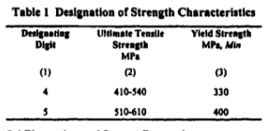
Do u know the classification which combines all the properties of the electrode?
Coding
It consists of the following letters and numerals and shall be followed in the order stated:
a) A prefix letter 'E' shall indicate a covered electrode for manual metal arc welding,
manufactured by extrusion process;
b) A letter indicates the type of covering: A – Acid, B – Basic, C - Cellulosic
R – Rutile, RR - Rutile, heavy coated, SB – Semibasic
c) first digit indicates ultimate tensile strength in combination with the yield stress of the weld metal deposited
d) Second digit indicates percentage elongation in combination with the impact values of the weld metal deposited

Slide 21
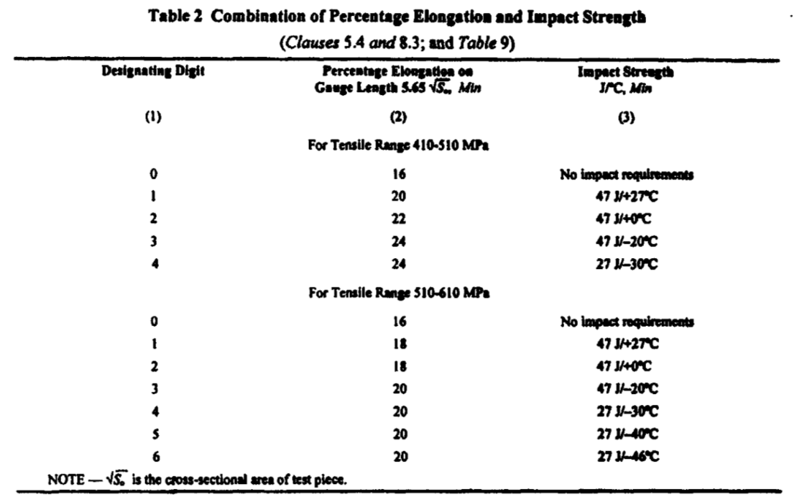

Slide 22
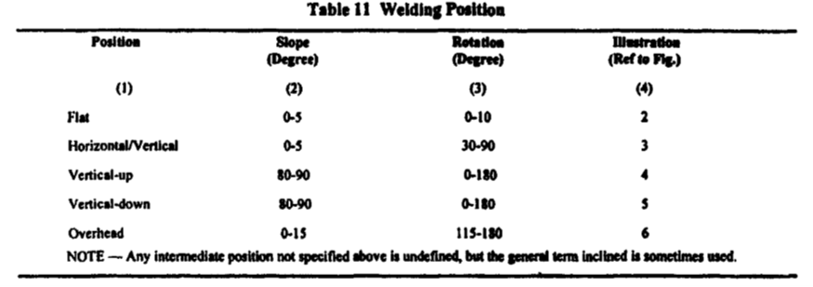
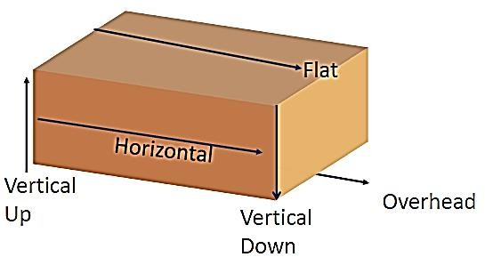
Classification Contd-
e) Third digit indicates welding position(s) in which the electrodes may be used :
a)All positions ; b) All positions except vertical down; c) Flat butt weld, flat fillet weld and horizontal/vertical fillet weld; d) Flat butt weld and flat fillet weld; e) Vertical down, flat butt, flat fillet and horizontal and vertical fillet weld; and ) Any other position or combination of positions
f) Fourth digit indicates the current conditions in which the electrode is to be used

Slide 23
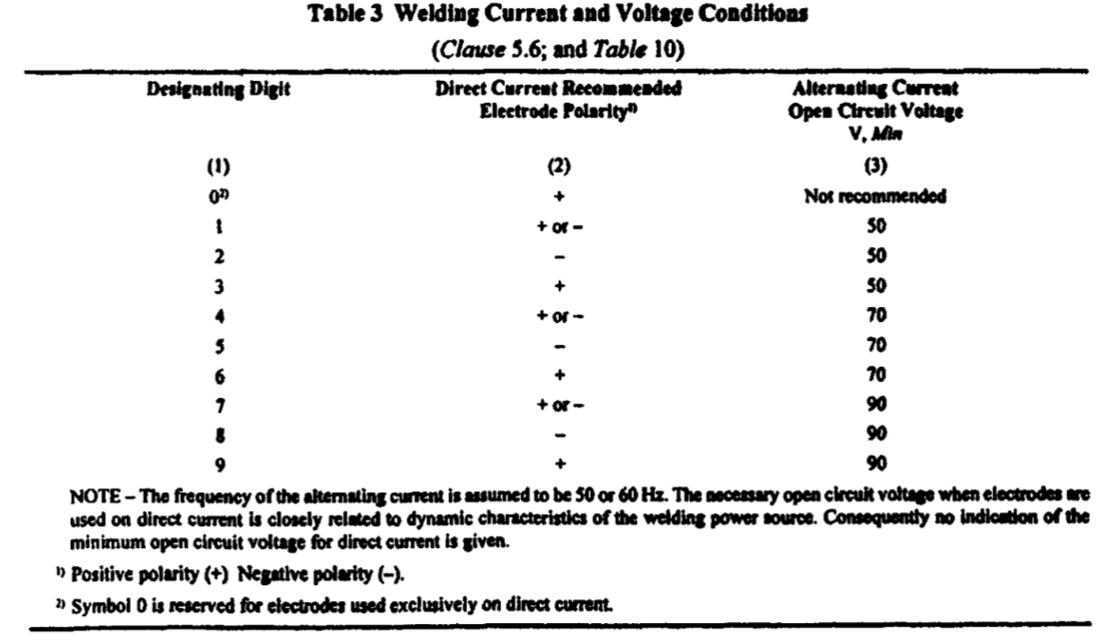
Code with Property

Slide 24
Code with Property
Additional Coding
The following letters indicating the additional properties of the electrodes may be used, if required:
a) Letters H1, H2 and H3 indicating hydrogen controlled electrodes
b) Letters J, K and L indicating increased metal recovery, as effective electrode;
'Efficiency (EE)' as per IS 13043 in the following range :
j = 110-129 percent;
K = 130-149 percent; and
L = 150 percent and above.
Example of Classification in the hyperlink

Slide 25
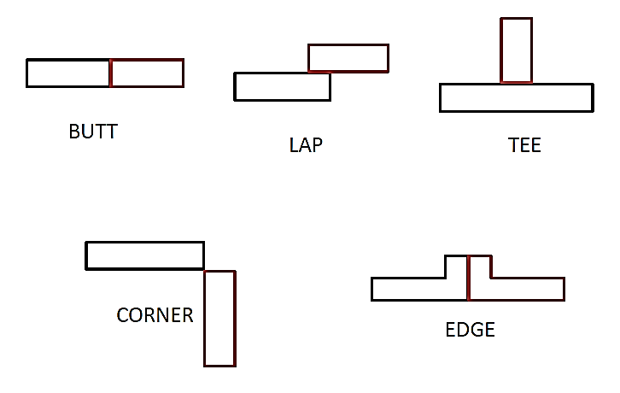
Five basic joint designs

Slide 26
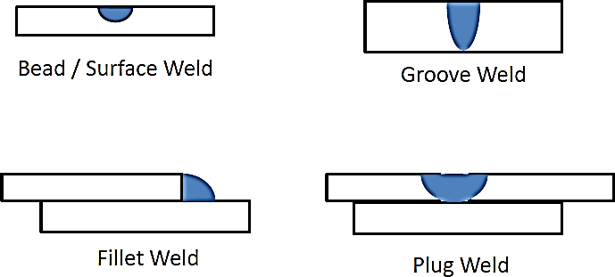
Four basic types of fusion welds

Slide 27
IS 812:1957

Slide 28
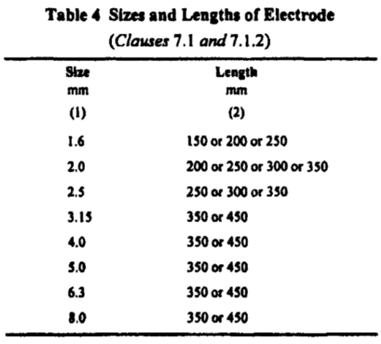
Properties/Requirements
1)DIMENSIONS AND TOLERANCES
Size and Length
Bare Length
Contact End
Arc Striking End
Concentricity
Free from defects including
Covering

Slide 29
How do u know the suitability of using the rod in particular situation?
Physical Properties
a) All weld metal mechanical tests
b) Butt weld bend test ;
c) Running performance test (for sizes up to and including 2.5 mm)
d) Increased metal recovery tests for electrode claiming recovery 110 percent and above
e) Diffusible hydrogen estimation test for hydrogen controlled electrodes
f) Radiographic quality test for radiographic quality electrodes .
Physical and Chemical requirements -Please see hyperlink

Slide 30
IS 2879 : 1998
MILD STEEL FOR METAL ARC WELDING ELECTRODES

Slide 31
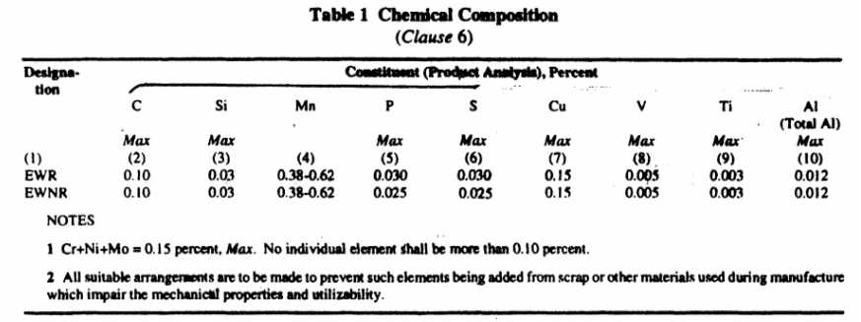
IS 2879 : 1998
Now you have to know the core wire also and What is the Standard of Core rod?-IS 2879 : 1998
MILD STEEL FOR METAL ARC WELDING ELECTRODES
This standard covers the requirements of mild steel billets, blooms, cast billet ingots and wire rods for metal arc welding electrode core wire.

Slide 32
IS: 1395-1982
SPECIFICATION FOR LOW AND MEDIUM ALLOY STEEL COVERED ELECTRODES FOR MANUAL METAL ARC WELDING-

Slide 33
standard covers the requirements for low and medium alloy steel covered electrodes for manual metal arc welding. The range of electrodes covered in this standard and the chemical composition of all weld metal have been given in next slide:
Electrodes are classified in the following order on the basis of the usability characteristics, the mechanical properties of the deposited weld metal, type of flux covering as well as the chemical composition of the deposited weld metal and recommended welding positions and current conditions.
For chemical , Mechanical properties and heat treatment-Please see Hyperlink

Slide 34
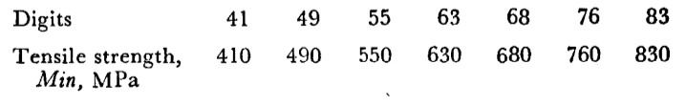
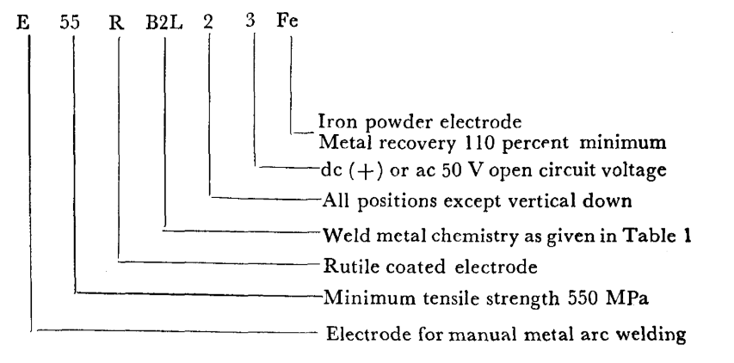
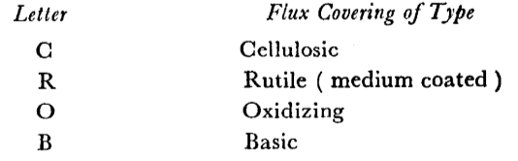
All other symbols are same as IS 814

Slide 35
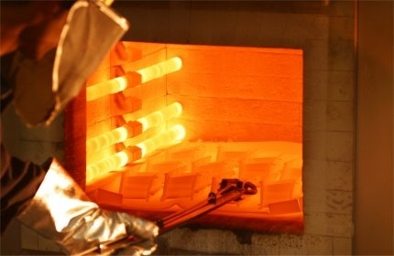
HEAT TREATMENT

Slide 36
IS: 5206 - 1983
SPECIFICATION FOR COVERED ELECTRODES FOR MANUAL METAL ARC WELDING OF STAINLESS STEEL AND OTHER SIMILAR HIGH ALLOY STEELS

Slide 37
This standard covers the requirements for covered electrodes for manual metal arc welding of stainless and other similar high alloy steels.
Classification:
The electrodes are classified on the basis of chemical analysis of weld metal, type of covering, metal recovery, welding characteristics of the electrode and also the special characteristics of the electrode. The classification
is divided into six parts.
1) First part is a symbol for the type of product.Symbol for the Product The prefix letter ‘E' shall indicate the suitability of the covered electrode for manual metal arc welding
2)The second part is a symbol for the chemical composition of the deposited weld metal.
3)The third part is a symbol for the type of covering.
a) B for basic,
b) R for rutile, and
c) S for other types.

Slide 38
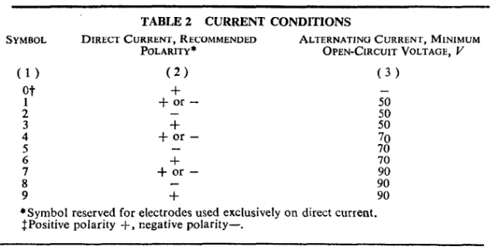
Classification with properties
4) The fourth part is a symbol for metal recovery.If the recovery is less than
110 percent no symbol is used. The higher values found by the method for
determining the recovery, rounded to the nearest multiple of 10, are used as
symbol for metal recovery, for example, 110, 120, 130, 140, 150, etc.
5)The fifth part is a symbol for the welding characteristics of the electrode.
6)The sixth part is a symbol 'X' indicating that the electrode has some
special properties ( synthetic, fully austenitic, etc). This part is always com-
pulsory when the electrode has special feature. In this case the symbols for
metal recovery and for welding characteristics are also
compulsory.
The welding characteristics shall be symbolized by a two digit
number. The first digit indicates the welding positions(same as IS 814) for which the electrode is recommended and the second digit indicates the welding current conditions.

Slide 39
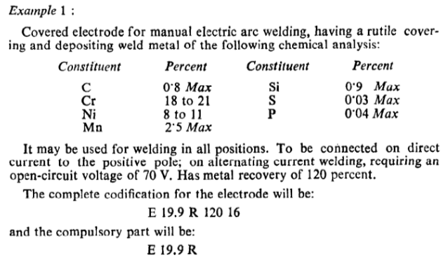
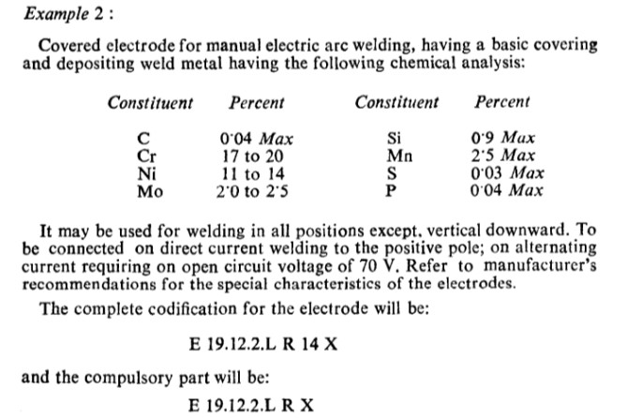

Slide 40
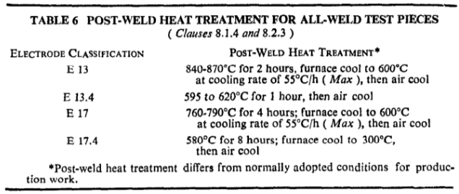
As alloying elements are there, they also need Heat treatment
For physical properties and comparison of different Standards please see hyperlink

Slide 41
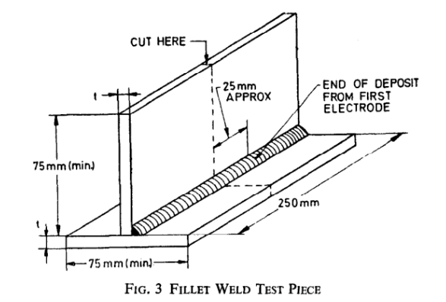

Slide 42
Flux Cored Electrodes

Slide 43
Do u know there are flux cored electrodes also? And we have one standard for it.
IS 15769 : 2008-
FLUX CORED (TUBULAR) ELECTRODES FOR GAS SHIELDED AND SELF-SHIELDED METAL WELDING OF CARBON OR CARBON-MANGANESE STEEL
This standard specifies the requirements for continuous flux cored (tubular) electrodes for metal arc welding with and without shielding gas and depositing carbon or carbon manganese steel weld metal having a tensile strength not exceeding 610 MPa.

Slide 44
CLASSIFICATION
Classification of flux cored (tubular) electrodes shall be indicated by the following coding system of letters and numerals to indicate the specified properties or characteristics of the electrode.
Main Coding
It consists of the following characteristics and shall be followed in the order stated:
a) Prefix characteristics 'ET' shall indicate flux cored (tubular) electrodes for metal arc
welding.
b) Second characteristic indicates ultimate tensile strength in combination with the yield stress and elongation percentage of the weld metal deposited
c) Third characteristic indicates the impact values of the weld metal deposited .
d) Fourth characteristic indicates welding position (s) in which the flux cored (tubular)
electrode may be used
e) Fifth characteristic indicates type of core ingredients
f) Sixth characteristic indicates type of shielding gas
g) Seventh characteristic indicates whether the flux cored electrode can be used for single pass or for multi-pass welding application .
3.2 Optional Coding
Characteristics H5, H10 and H15 indicate the maximum diffusible hydrogen content in the weld metal .
Designation of Strength Characteristics, Impact Strength, Welding position, Core ingredients, Shielding Gas, Single and multi pass, diffusible Hydrogen given in Hyperlink

Slide 45
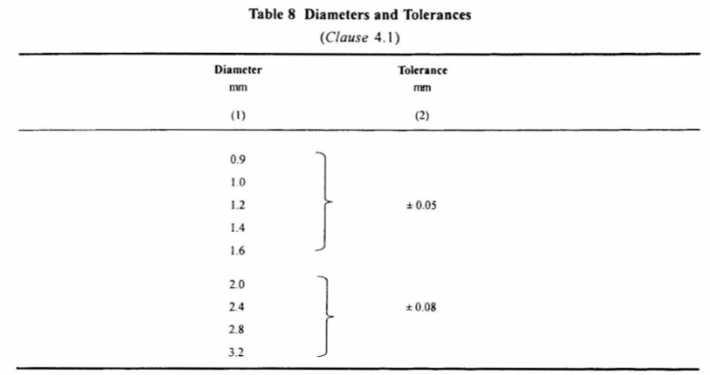
The flux cored (tubular) electrodes may be made by any method that will yield a product conforming to the requirements of this standard. The electrodes shall have a smooth finish, free from surface imperfections, corrosion products, grease or other foreign matters which would adversely affect the quality of weld or the operation of the welding equipment. A suitable protective coating may be applied to flux cored wire (tubular).

Slide 46
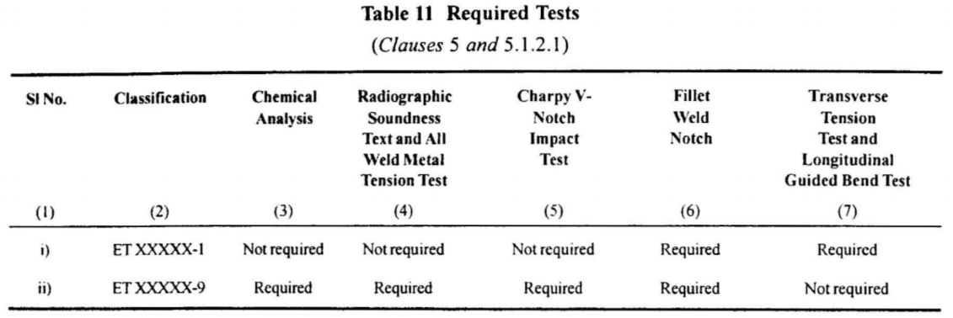
Winding Requirements
Each coil, spool, drum or pay-off pack shall contain one continuous length of electrode. Butt welds, when present in the electrode, shall not interrupt the feeding of the electrode.
The flux cored (tubular) electrode shall be wound so as to avoid kinks, ripples or sharp bends which would interfere with the feeding of the electrode and so that it is free to unwind without restriction. The outside end of the electrode shall be accessible
Test Requirements:

Slide 47
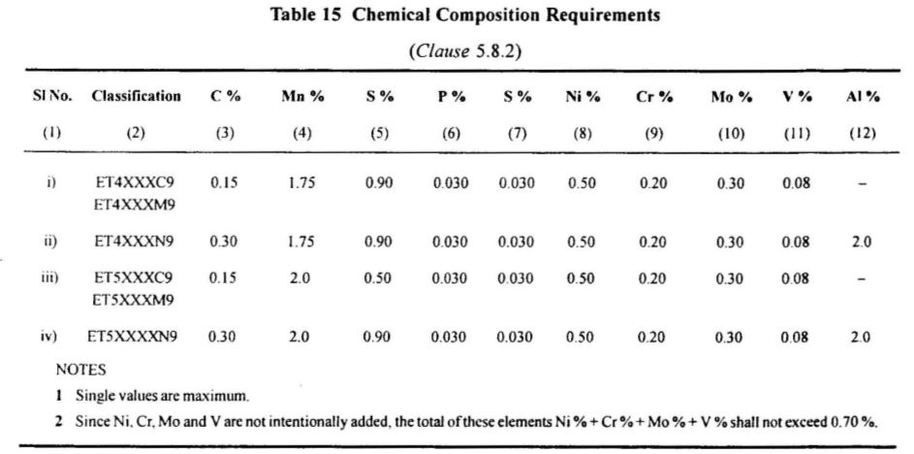

Slide 48
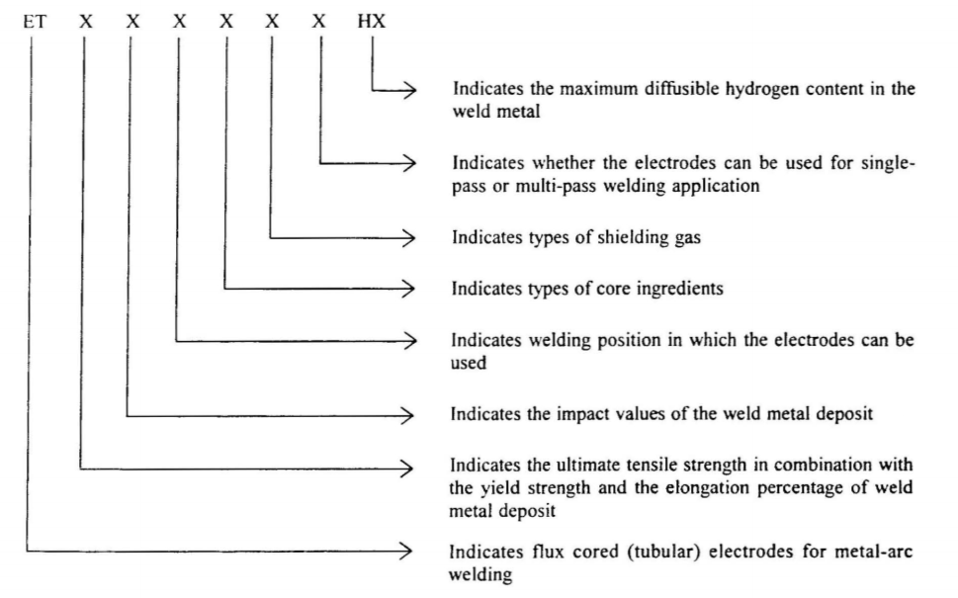

Slide 49
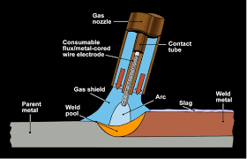
FLUX CORED ARC WELDING (FCAW)

Slide 50
Tungsten Inert Gas Welding – GTAW/TIG

Slide 51
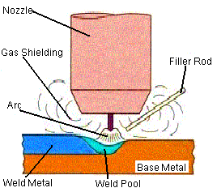
TUNGSTEN INERT GAS WELDING (TIG)

Slide 52
Some Important Standards
Sl | IS | Title
1 | 10186: 2015 | Recommendations for manual tungsten insert gas arc welding of copper and copper alloys
2 | 13007 : 2018 | Arc welding and cutting - Nonconsumable tungsten electrodes
3 | 14289 : 1995 | Manual tungsten insert gas arc welding of nickel and nickel alloys
4 | 9604 : 1994 | Tungsten - Inertgas (Tig) welding equipment
5 | 2811 : 1987 | Recommendations for manual tungsten inert - Gas arc welding of austenitic stainless steel
6 | 2812 : 1993 | Recommendations for manual tungsten inert gas arc welding of aluminium and aluminium alloys

Slide 53
Now we will discuss about TIG
Popular for Non Ferrous Metals and alloys
How do you do TIG welding? The answer lies in the following Standards to be discussed:
IS 9604:1994 -TIG Welding Equipment
IS 10186 : 2015-TIG welding of Cu and Cu alloy
IS 14289: 1995- TIG welding of NI and NI alloy
IS 2812: 1993- TIG welding of Al and Al alloy

Slide 54
IS 9604 : 1994
TUNGSTEN-INERT GAS (TIG) WELDING EQUIPMENT :

Slide 55
This standard lays down the general and safety requirements and test methods for TIG welding equipment.
equipment consists of
1)Welding Torch, A current carrying device which can accommodate non-consumable tungsten electrode (s) around which an inert shielding gas flows from a nozzle at the exit and of the device. Torch shall be air, water or gas cooled.
2)Arc Initiation Unit :High voltage high frequency injection in the welding circuit to enable an arc to be struck between the tungsten electrode and the workpiece without actual physical contact. For AC welding, this unit may be required to be continuously switched on for maintenance of the arc, whereas for DC welding, it may be switched off once the arc is established. The unit is basically a spark gap type oscillator comprising a low-powered iron-cored transformer with HV secondary winding, a spark gap, a high voltage capacitor and an air-core/open core (ferrite) output transformer.
3)HF Filter-The arc initiation unit is of high voltage, high frequency type, and HF filter circuit should be fitted to prevent damage to the power
source.

Slide 56
4) Pulsing
If the power source is fully thyristorized or transisorized, it is often possible to pulse the current to achieve thermal pulsing of the arc. This function is
either built-in the power source or is provided by a separate pulsing unit.
5)Gas Regulator-A gas regulator is a mechanical device for reducing
pressure automatically to a safe working level and controlling the volumetric flow of the compressed gas.
6)Flowmeter-This is used to control and monitor the flow of shielding gases.
7) Gas Mixer-When a mixture of two or more gases is used, the mixture is made in a mixing chamber metering the separate gases.
8)Cables and Hoses
9)DC Suppressor Unit- For conventional ac power sources, this is basically a bank of capacitor housed in a sheet steel construction. It is used in series with arc initiation unit & HF filter for disposal of superficial refractory films during TIG welding of aluminium, magnesium and their alloys with ac power source

Slide 57
The following shall constitute type tests:
a) Insulation resistance test -The insulation resistance shall be not less than 2 megaohms.
b) High voltage test -The torch shall be capable
of withstanding voltage of 2 000 V rms at 50 Hz
c) Performance test -agreement between the manufacturer and the purchaser

Slide 58
IS 10186 : 2015
Recommendations for Manual Tungsten Inert Gas Arc Welding of Copper and Copper Alloys

Slide 59
This standard covers the recommendations on materials, equipment and general workmanship for manual tungsten inert gas arc welding of wrought copper and copper alloys. The recommendations are primarily intended for general engineering application for manual welding of copper and copper alloys up to 20 mm thick with argon, helium, nitrogen or a combination thereof as shielding gas.
Cu Rod will be as per 5898 : 1970- copper and copper alloy bare solid welding rods and electrodes
Following types of parent metals are covered in this standard:
a)pure copper,
b)silicon bronze,
d) cupronickels,
e)aluminium bronze,
f)brasses,
g)manganese bronzes,
h)nickel silvers, and
j)low-lead gun metal.

Slide 60
Alternating current or direct current with electrode negative shall be used for welding copper and copper alloys.

Slide 61
WELDING TORCH- Air cooled torch with ceramic nozzle or water cooled torch with metal nozzle shall be used. For current values up to 200 A, air cooled torches may be used. For current values in excess of 200 A, water cooled torches shall be recommended.
ELECTRODES:The electrodes shall be made out of pure tungsten ,thoriated tungsten or zirconiated tungsten. Ceriated and lanthanated electrodes can also be used.
In the case of dc power with the electrode negative thoriated tungsten or pure tungsten electrodes shall be used.
In the case of ac power source zirconiated tungsten or pure tungsten electrodes shall be used.
Ceriated tungsten electrodes may be used with either ac or DCEN.
Lanthanated electrodes generally have longer life and provide greater resistance to tungsten contamination of the weld.

Slide 62
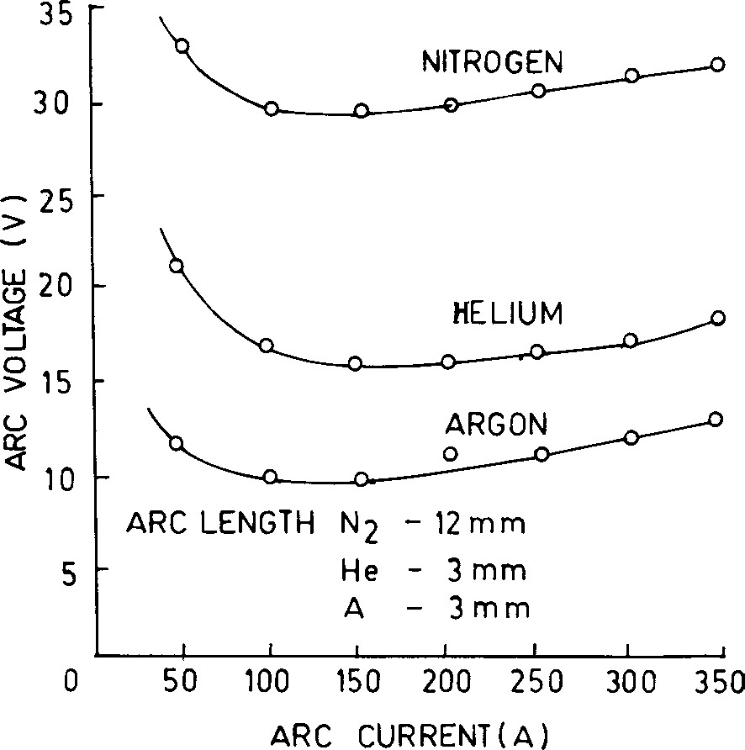
Contd-
Argon gas used for the shielding purpose shall conform to IS 5760. Helium gas and nitrogen gas shall conform to IS 1747.
when the welding current, nozzle diameter, or electrode stick out is increased, the flow rate should be increased. When welding in the ac mode the current reversals have a disturbing effect on the shielding gas and flow should be
increasedby 25 percent.
And of course when welding in a drafty situation, flow rate should be doubled. When welding corner/edge joints, excessive flow rates can cause air entrapment.
In this situation, the effectiveness of the shielding gas can be improved by reducing the gas flow by about 25 percent.
For preparation of parent metal please follow hyperlink

Slide 63
Table 7 Heat Treatment Temperature
(Clause 14.2)
Sl No. | Material | S.R. Heat Temperature¹⁾ | Annealing Temp²⁾
(1) | °C (2) | °C (3) | (4)
i) | Pure copper | — | 370-650
ii) | Aluminum bronze | 593-650 | 675-815
iii) | Silicon bronze | 450 | 482-675
iv) | Phosphor bronze | — | 482-650
v) | Cupro nickel | 530 | 650-816
vi) | Red brass | 288 | 427-732
vii) | Admiralty brass | 288 | 427-593
¹⁾ Heat slowly to these temperatures and hold for 1h , min.
²⁾ Heat slowly to these temperatures and hold for 15 to 30 min.

Slide 64
IS 14289 : 1995
MANUAL TUNGSTEN INERT-GAS ARC WELDING OF NICKEL AND NICKEL ALLOYS

Slide 65
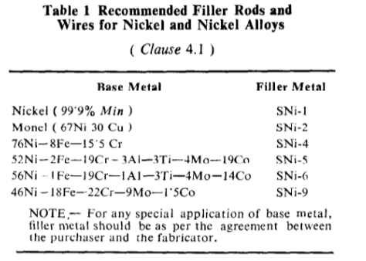
This standard covers the recommendations on material, equipment and general workmanship for the manual tungsten inert-gas arc welding of nickel and nickel alloys. The recommendations are primarily intended for general engineering applications for manual welding of nickel and nickel alloys with argon as the shielding gas.

Slide 66
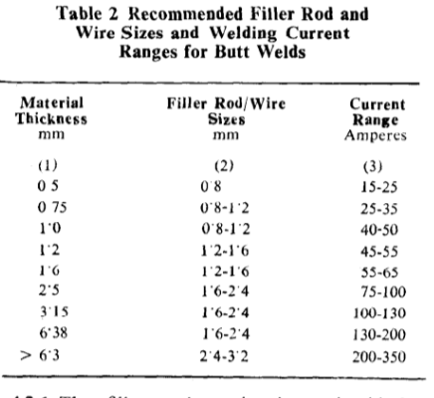
1)Direct current equipment with the electrode connected to the negative pole shall be used for welding nickel and its alloys. If alternating current equipment is used or welding nickel and its alloys of lower thickness any device to suppress the direct current component should preferably be disconnected.
High frequency spark generators usually employed for arc striking. This unit
enables the super imposition of a high voltage on the normal supply for a short time suitable enough for arc establishment.
2) Welding Torch needed same as earlier explained

Slide 67
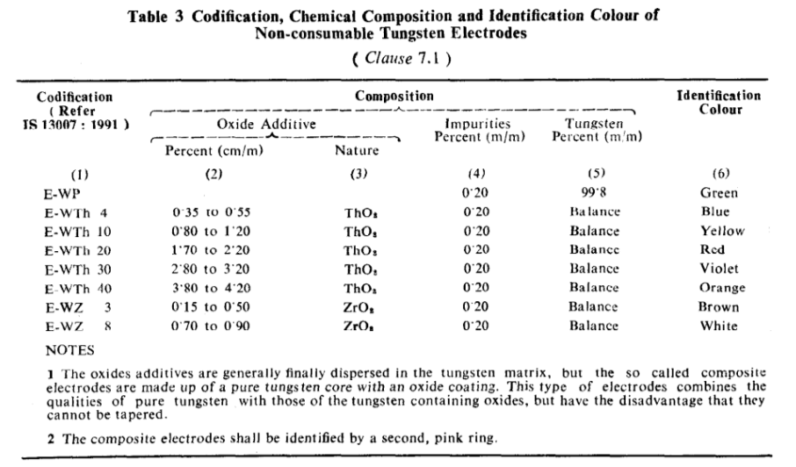
3) ELECTRODES
Non-consumable electrodes made of tungsten are used because of its high melting point.
Tungsten electrodes with 1 or 2 percent thorium or zirconium are superior to pure tungsten electrodes . They have higher electron emissivity, better current carrying capacity, longer life and greater resistance to contamination. With these electrodes, arc starting is easier and arc is also more stable.
Two percent thoriated electrodes should be used with de straight polarity (electrode negative). Pure tungsten or thoriated or zirconlated tungsten electrode should be used for welding with a.c.

Slide 68
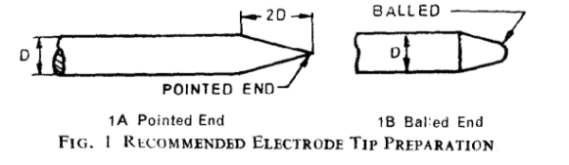
4) Ar gas will be used as inert gas
5)PREPARATION OF PARENT METAL
Cleanliness is the single important requirement for successful joining of nickel and nickel alloys. So before joining or welding, joints should be cleaned thoroughly to remove all foreign substances such as oil, grease, dirt,
paint, cutting fluid, machine lubricants, etc.
Cleaning is done by degreasing, alkali, cleaning or both followed by wire brushing and scrubbing
with hot water.
Nickel oxides and nickel sulphides, if formed at weld edge, should be removed as these oxides and sulphides melt at higher temperature and remain solid and cause defects in weld. These generally cannot be removed by wire hand brushing or power wire brushing, hence grinding or abrasive blasting or machining should be used.

Slide 69
Properties of Tungsten Inert-Gas Arc Welds
Strength of any particular welded joint will depend on several factors including the skill of the welder and the size of the pieces being joined. The welder's skill influences the quality of the weld and this, as well as the size of the weld required affects the amount of heat put into an assembly and subsequently the extent of annealing of the parent material. Thus, when high quality joints are a critical requirement, the weld strength requirements should be specified and checked by tests, and subsequently workmanship kept to the same standard by frequent and capable inspection.

Slide 70
IS 2812: 1993-
RECOMMENDATIONS FOR
MANUAL TUNGSTEN INERT-GAS
ARC WELDING OF ALUMINIUM AND
ALUMINIUM ALLOYS

Slide 71
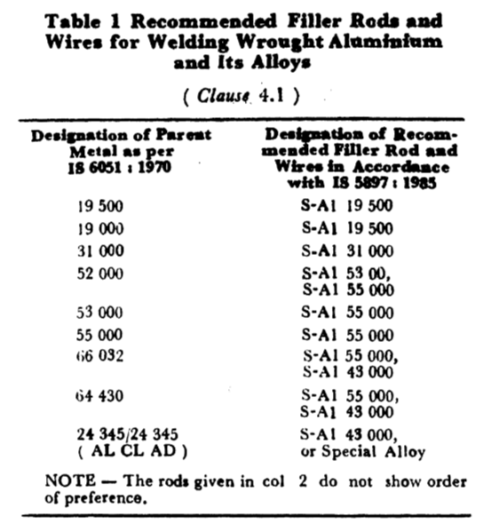
1)This standard covers the recommendations on materials, equipment and general workmanship for manual tungsten inert-gas arc welding of wrought aluminium and aluminium alloys. The recommendations are primarily intended for general engineering application for manual welding of aluminium and aluminium alloys up to 25.0 mm thick with argon as the shielding gas.
2)
For recommendation of size and thickness please see hyperlink

Slide 72
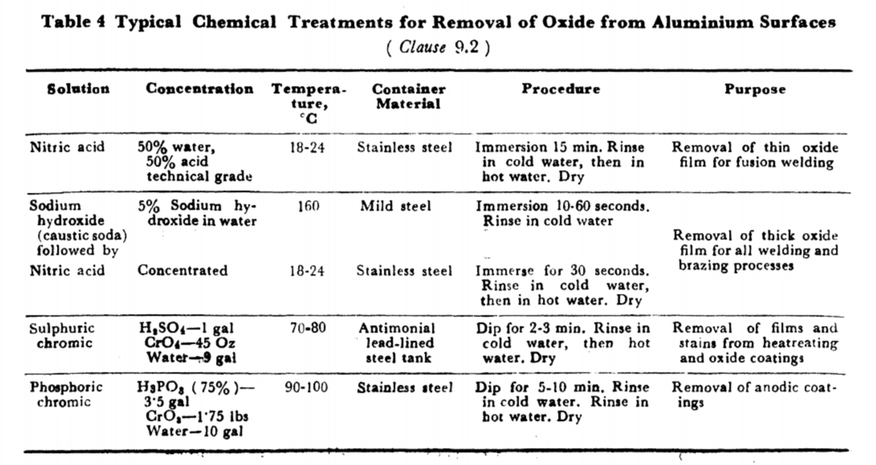
PREHEATING OF POST WELD HEAT TREATMENT
Preheating is generally not necessary. However, where welding has to be attempted on thick material, ог between different thicknesses, preheating should be used judiciously.
Post weld heat treatment (stress relieving ) is not normally necessary for Aluminium and Aluminium Alloys, and shall only be carried out by agreement between the purchaser and the manufacturer

Slide 73
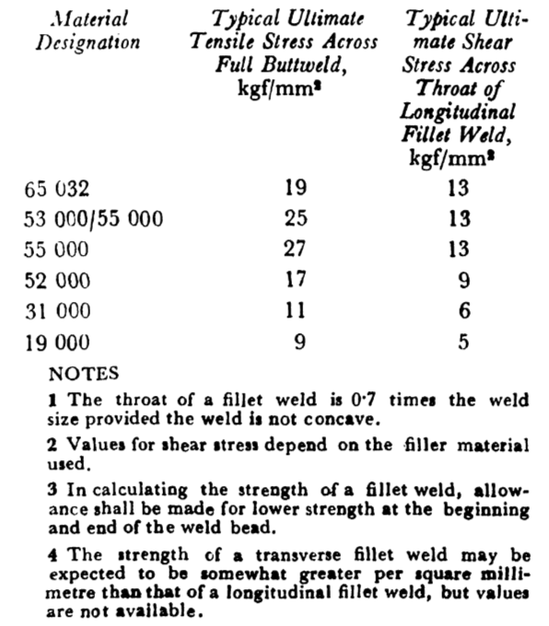
If mechanical tests are required;
they shall be in accordance with IS 7273: 1974( Butt: Tranverse tensile, Macro exam of cross section, side bend, transverse and longitudinal bend , nick break test; Fillet : Macro and fracture)
If dye penetration have been used, the back gouged area shall be examined
before rewelding to ensure that all traces of penetrant have been removed.

Slide 74
What are the Faults in Tungsten Inert-Gas Arc Welds?-IS 14289
The chief faults found in unsatisfactory welds are gas porosity, oxide inclusion, cracks and undercutting, but they can be avoided by attention to welding procedure and by the choice of satisfactory parent metal and filler rod. The appearance of the surface is a good guide to the quality of the weld, the absence of discolouration, 'dirty' edges and under cutting being readily observed. The upper surface of the bead should be smooth with uniform ripples marks evenly spaced, and the underside free from crevices or excessive 'run through'. The form of the ripples is an indicacation of the speed of welding for given material and dimensions, and is also a guide to the grain structure of the weld metal.
Where it is applied? APPLICATION
The tungsten inert-gas arc welding process has been widely adopted and the following indus
tries represent a few of these:
a) Plant for the chemical and food industries;
b) Pipings;
c) Marine;
d) Aircraft, spacecraft and launch vehicles;
e) General engineering including castings;
f) Pressure vessels, boilers and heat exchangers; and
g) Atomic energy and nuclear power.

Slide 75
Can u say ADVANTAGES OF TUNGSTEN INERTGAS ARC WELDING
a) Ideal for joining thin materials, sometimes even without filler wire addition;
b) There is no slag formation;
c) There is no spatter as the filler material added in the weld pool;
d) Enables single sided welding with full penetration;
e) Simple edge preparations are sufficient;
f) Loss of alloying elements is much less than in other processes like metal-arc and gas-welding;
g) Less finishing costs ( hardly involves operations like grinding, etc);
h) Suitable for welding in all positions;
j) The process lends itself to many forms of
automatic or semi-automatic weldings.
And LIMITATIONS OF TUNGSTEN INERT-GAS ARC WELDING
a) The cost is comparatively high because of slow speed and high cost of argon gas and tungsten electrodes;
b) The equipment is rather more complicated, and hence higher initial cost than that required for shielded metal arc or oxy-fuel gas welding;
c) The process cannot be well used on site work, unless precautions are taken to avoid draughts;
d) The process is not suitable for thick sections because of low deposition rates;
e) The operation requires adequate care to prevent electrode or base metal contamination.

Slide 76
SAFETY PRECAUTIONS
1)The ultra-violet rays emitted during tungsten inert-gas arc welding 'of stainless steel are much more intense than those formed during the manual arc-welding of steel because higher current densities are used. For this reason, the
operator should use protective gloves and darker shade of protection glass. Use can also be made of suitable chemical agents like light deflectant creams available for protection against ultra-violet radiations.
2)During the welding of material which has been degreased with trichloroethylene,
highly toxic and poisonous fumes will be encountered which cause severe headaches.
For this reason, degreasing with this reagent should be carried out in a different room from the welding operation, and all material which has been so degreased should be either hot dried or allowed to stand for sufficiently long ime at room temperature to ensure that the material is completely free of degreasing
solvent.

Slide 77
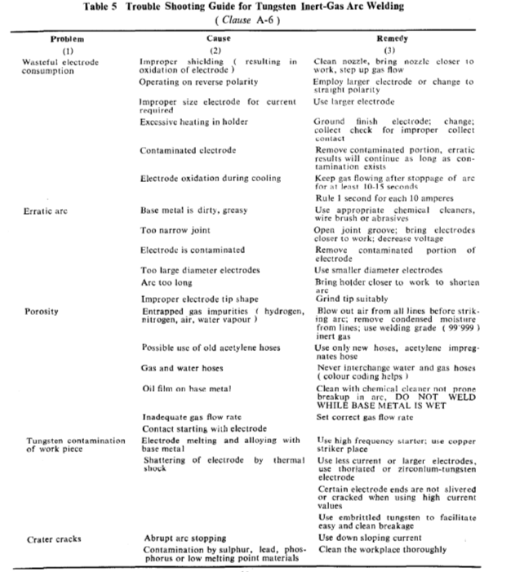

Slide 78
Gas Metal Arc Welding (GMAW )

Slide 79
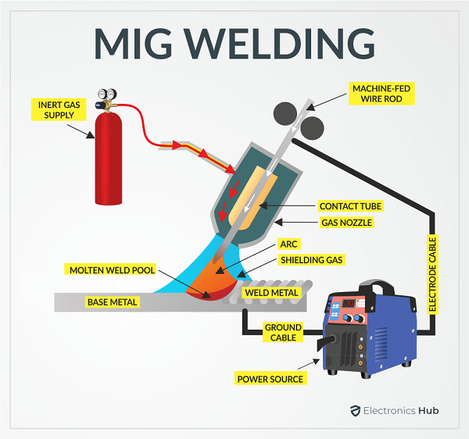
METAL INERT GAS WELDING (MIG)

Slide 80
MIG
Uses a consumable bare metal wire as electrode with shielding flooding arc with a gas Wire is fed continuously and automatically from a spool through the welding gun Shielding gases include argon and helium for aluminum welding, and CO₂ for steel welding Bare electrode wire plus shielding gases eliminate slag on weld bead
Important Standards:
Sl | IS | Title
1 | 10178 : 1995 | Co2 gas shielded metal - Arc welding of structural steels
2 | 6419 : 1996 | Welding rods and bare electrodes for gas shielded arc welding of structural steel
3 | 6560 : 2017 | Welding Consumables- Wire Electrodes, Wires, Rods and Deposits for Gas Shielded Arc Welding of Creep-Resisting Steels

Slide 81
IS 10178 : 1995 -
CO2 GAS SHIELDED METAL-ARC WELDING OF STRUCTURAL STEELS

Slide 82
This standard covers recommendations on equipment, consumables, general procedure and technique for semi-automatic and automatic carbon dioxide gas shielded metal arc welding of weldable structural steels, including tubes and hollow sections.
PARENT METAL
This standard applies to CO2 gas shielded metal-arc welding including overlaying of weldable quality structural steels conforming to IS 2062: 1992, IS 1030 :1989, IS 2002: 1992 and similar steels
The bare wire electrodes shall conform to IS 6419 1971 and IS 6560: 1972 as appropriate. Carbon dioxide gas shall conform to IS 307 : 1966
EQUIPMENT:
1)Power Source- The CO2 gas shielded arc welding process is influenced by the static load characteristic and the dynamic properties of power source. Only welding generators or rectifiers having flat to slightly drooping V-A characteristics and good dynamic properties are suitable.

Slide 83
2)Wire Feed Unit--The wire feed unit consists of a feed motor, sets of feed and drive rollers and wire guiding arrangement. The feed rates vary from 2 to 10 m/min. It shall have proper speed regulator to give uniform and smooth feed almost without inertia, from wire reel to the welding gun and to the welding zone.
3)The Welding Gun--The welding gun shall have 'Start'-'Stop' switch and ensure uniform transport of wire. A hollow cable consisting of a wire-spiral leads the wire electrode from feed rollers to the gun.
4)Mains and Control Unit--Main unit shall consist of a protective transformer and a rectifier to supply current to the control unit. It may be incorporated in the rectifier power source itself or may be a separate unit in case of generators.
5) Instruments and Ancillary Equipment
The flow rate of CO2 gas should be adequate to obtain a clean weld. This depends on several factors such as welding current, welding speed, electrode diameter joint geometry and local conditions. It generally varies from 15 to 22 litres/min. A suitable gas flow meter is mounted just after the pressure regulator and gas heater. Generally CO₂ gas is drawn from cylinders .
The cooling device for water cooled welding gun, consists of a pump with motor, a water tank and a heat exchanger. For gas cooled torches shielding gas itself will cool the torch.
The wire feed unit along with the control unit and the welding gun are mounted on a travelling carriage in case of automatic welding. The travelling speed of carriage shall be infinitely regulable within the welding speed range.

Slide 84

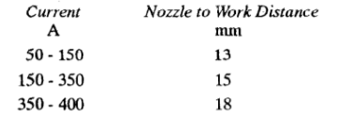
The Extension of Electrodes:
The free end protruding out of contact nozzle carries high current densities (over 100 A/mm²). An increase in this length results in the increase of melting rates. However, the arc-current falls with increase in the protruding length. This is particularly noticeable when welding in deep grooves where a narrow joint preparation limits the access of the nozzle. Excessive protruding length will, therefore, lead to lack of penetration unless special techniques are used as in narrow-gas welding.Recommended values of electrode extension are given below for various current levels:
POLARITY
The electrode is generally connected to positive pole. Only in cases such as overlaying, negative pole is connected to the electrode in order to take advantage of higher melting rates and low penetration.

Slide 85
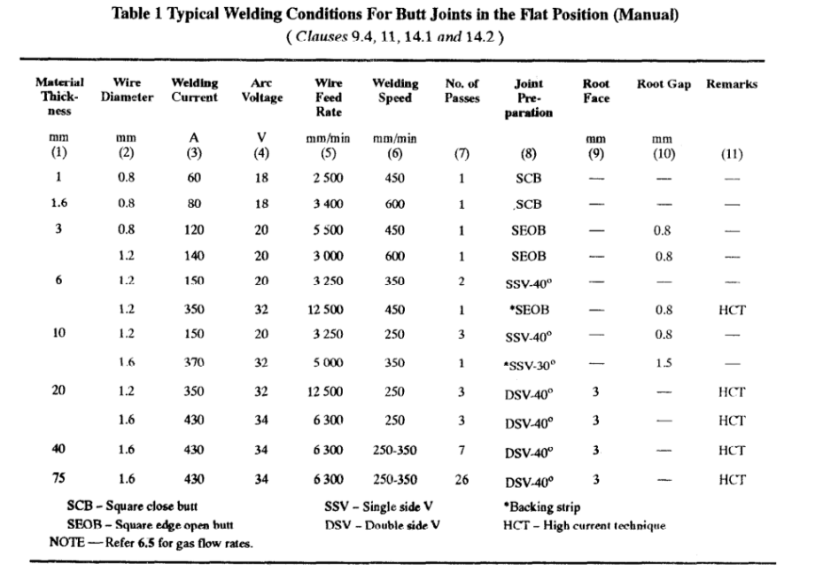
WELDING POSITION
It is possible to weld all types of joints in all welding position by CO2 gas welding process. For difficult positions like vertical and overhead welding, electrodes up to 1.2 mm diameter with lower welding voltage (19-23V) and current (50-155A) are used.
For welding condition Vertical and Flat(manual), melting rate, please see hyperlink

Slide 86
WELDING PROCESS
In CO2 welding, metal transfer in general, takes place under short circuits. It is in the form of small drops for electrodes up to 1.2 mm diameter and in the form of coarse drops for electrodes over 1.2 mm diameter. In both the cases the drop transfer frequency increases with the increase of welding current. There also exists a critical current above which the metal transfer takes place in fine drops without making short circuits.
This critical current value, of course, is appreciable higher than that in the MIG-Welding process.
An increase of voltage makes the drop transfer coarser. The loss of alloying elements of electrode is less when welding is done with thinner wires and lower arc voltages that is for fine drop transfer. This is due to shorter reaction time of drop with the oxygen in arc atmosphere. As such lower arc voltages of 20 to 30 V are recommended. The welding current is selected so as to give current densities between 100 and 200 A/mm² of
the electrode. Such high current densities result in higher melting rates.

Slide 87
Depending on the critical current for a particular electrode diameter two types of techniques are identified:
a) Short-arc technique, and
b) High-current technique.
Short-Arc Technique
In this technique, the metal transfer taken place in a certain cyclic manner, which is reinforced through a corresponding modification of power sources.
By conventional arc welding process, it is difficult to weld sheets of thickness less than 3 mm. Because of longer arcing time between the individual short circuits (heating time), under usual arc welding conditions the metal at the end of the consumable electrode reaches boiling temperature. This results in higher heat inputs in the parent metal leading to deeper fusion penetration and corresponding bigger weld pool in case of thinner sheets because of slower heat dissipation by the parent metal. In short arc process, the overheating of the consumable electrode end, the excess heat input in the parent metal is prevented by reducing the heating time. This is achieved by modification of short-circuiting process through shortening of arc.
This requires a dc set with flat to slightly drooping static characteristic. An additional inductance or choke is required to limit the short circuit current to improve the dynamic characteristics. Generally 0.8, 1.0 and 1.2 mm diameter electrodes with current densities of 100 to 200 A/mm² are used in this process.

Slide 88
High Current Technique
In this CO2 gas welding process the electrode carries current in the range of 300 A per mm of diameter of wire. This results in better productivity because of higher melting rates and increased fusion penetration. The spatter loss is also reduced. Generally 1.2, 1.6 and 2.0 mm diameter electrode are used in this process.
The higher current densities affect the mode of metal transfer. Above critical current, which, for example, is 350 A for 1.2 mm diameter electrode and 450 A for 1.6 mm diameter electrode, the metal transfer is in small drops at higher frequency and without short circuits. However, the typical spray-type mode of drop transfer encountered in MIG-welding is not reached in this process.
In this technique, the heating times of drops at the electrode end is less because of higher drop-frequency. As such the loss of alloying elements is lower,
The high-current technique brings more advantages in welding of thicker plates (higher melting rate and deeper penetration) and in overlaying (high melting rate, less loss of alloying elements). The disadvantages are bigger weld-reinforcements and to some extent poor weld appearance.

Slide 89
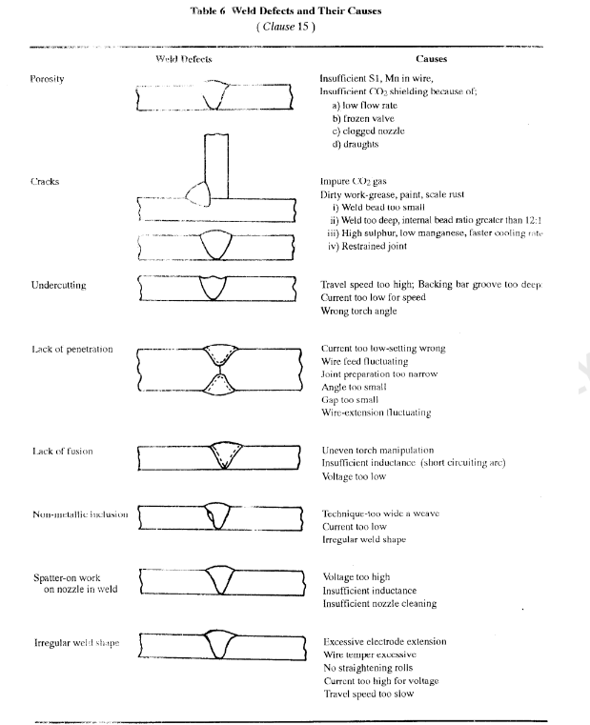

Slide 90
IS 6419 : 1996
WELDING RODS AND BARE ELECTRODES FOR GAS SHIELDED ARC WELDING OF STRUCTURAL STEELS

Slide 91
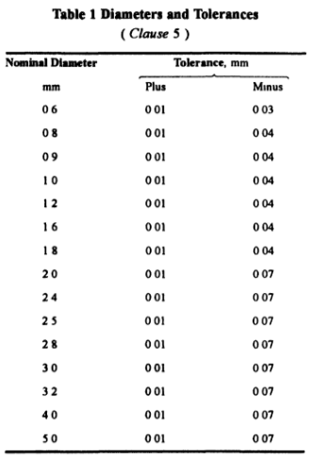
This standard prescribes the requirements of solid filler rods and wires for welding structural steels by inert-gas tungsten arc welding (TIG), gas metal arc welding (MIG) or CO₂ welding processes The chemical composition and tensile properties of filler rods and wires are also specified

Slide 92
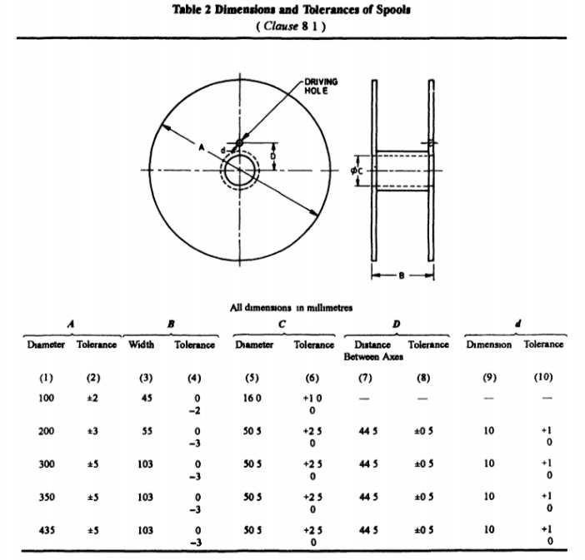
REELS FOR WIRE
The size and type of reel (spool, rims and coils with former) on which the particular diameter of wire is to be supplied shall be as agreed to between the purchaser and the manufacturer The surfaces of reel coming in contact with wire shall be such as to protect the wire from deterioration.
The flanges of spools and rims shall be sufficiently robust to avoid deformation during normal usage.
Rods supplied in straight lengths shall preferably have the following lengths, expressed in millimetres 250, 350, 450, 500, 600, 750, 900, 1000

Slide 93
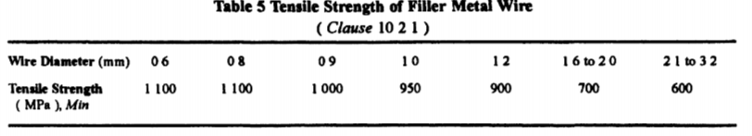
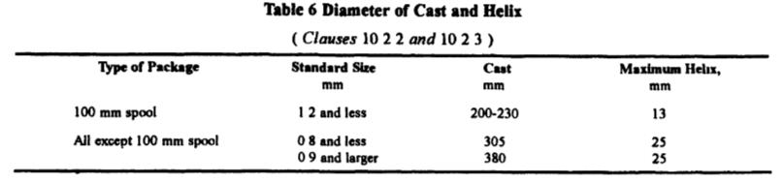

Slide 94


Slide 95
TEST FOR FILLER METALS (WIRE AND ROD)
The following tests are prescribed to demonstrate the test requirement of the solid filler rods and wires and also the soundness and mechanical properties of the weld deposits
1)Chemical Composition
The chemical composition of the filler wire/rod should satisfy the chemical analysis as per Table 7 The chemical analysis shall be made using either 12 mm or 16 mm diameter filler metal If the above sizes are not in the manufacturing range, then the size being manufactured nearer to 12 mm or 16 mm diameter shall be taken for chemical analysis In case of GTAW preferred size shall be 24 or 3°2 mm
2) Soundness Test
Radiographs of the welded test assembly shall reveal no cracks or zone of incomplete fusion The radiographs should conform to the standard as agreed to between the manufacturer and the purchaser
3)All Weld Metal Mechanical Test

Slide 96
GMAW Advantages over SMAW
• Better arc time because of continuous wire electrode
• Better use of electrode filler metal than SMAW
• Sticks must be periodically changed in SMAW
• End of stick cannot be used in SMAW
• Higher deposition rates
• Eliminates problem of slag removal
Can be readily automated

Slide 97
MIG-HEALTH AND SAFETY-IS 10178
As CO2 gas is heavier than air, care should be taken to arrange for proper exhaust and ventilation when welding is done in confined space. In the arc, CO₂ breaks down into carbon monoxide (CO) but this gas generally recombines with atmospheric oxygen at the edge of the arc and only a small amount exists outside the arc zone. The hygenic safety limit lies at 0.01 percent or 100 ppm for CO and 5 000 ppm for CO2. There is no risk of CO poisoning at any point beyond 300 mm from the nozzle. Because of the intense heat from the arc, it is not possible for an operator to get close enough to the nozzle and to be in any danger. However, a good ventilation of working place is a must.
Because of CO2 welding is an open arc which process, can employ high currents, radiation can be a problem. personnel who may be working some distance from Excessive ultraviolet radiation on an unprotected eye will give rise to the condition known as 'arc eye', when irritation is set up and the eyes becomes painful and watery. There is intense photophobia and the acute symptoms may last for one or two days. Although no permanent damage is done, accidental exposure should be avoided by proper screening of personnel working near welding position.
Ultraviolet radiation can also produce severe sunburn effects on exposed areas of the face, neck and arms. This can happen not only to the welder but to other welding areas where high current arcs are being used. Local screening of the arc zone is suggested for
preventing sunburn effects. Reflective surfaces around the area should be kept to a minimum. In a properly ventilated shop, CO₂ welding causes no ill effect on the welders who are regularly employed for it.

Slide 98
Submerged Arc Welding ( SAW )

Slide 99
Some important Standards:
Sl | IS | Title
1 | 15977 : 2013 | Classification and acceptance tests for bare solid wire electrodes and wire flux combination for submerged arc welding of structural steel
2 | 4353 : 1995 | Submerged arc welding of mild steel and low alloy steels

Slide 100

SUBMERGED ARC WELDING (SAW)

Slide 101
Submerged Arc Welding (SAW)
Uses a continuous, consumable bare wire electrode, with arc shielding by a cover of granular flux
Electrode wire is fed automatically from a coil
Flux introduced into joint slightly ahead of arc by gravity from a hopper
Completely submerges operation, preventing sparks, spatter, and radiation
SAW Applications
•Steel fabrication of structural shapes (e.g., I-beams)
•Seams for large diameter pipes, tanks, and pressure vessels
•Welded components for heavy machinery
•Most steels (except hi C steel)
•Not good for nonferrous metals

Slide 102

SUBMERGED ARC WELDING (SAW)

Slide 103


SUBMERGED ARC WELDING (SAW)

Slide 104
IS 4353 : 1995
SUBMERGED ARC WELDING OF MILD STEEL AND LOW ALLOY STEELS

Slide 105
This standard covers recommendations on materials, equipment, plate-edge preparation and testing for automatic submerged arc welding of mild and low alloy steels having a Tensile strength not exceeding 588 N/mm².
Here bare wire or a flux cored wire electrode is used. The arc is completely enveloped in a powdered flux, some of which fuses to form a removable covering of slag on the weld.
Single Wire Welding-Submerged arc welding using only one wire connected to one power source.
Two Wire Parallel Welding-Submerged arc welding using two wires fed through the same current carrying jaws or tips connected to one power source.’
Multi-Wire Multi-Power Welding-Submerged arc welding using two more wires, each with separately controlled power source.
Narrow Gap Submerged Arc Welding-A technique of submerged arc welding charac
terized by a constant number of beads per layer (usually two) that are deposited one on top of the other in deep narrow angle or square groove.

Slide 106
PARENT METAL
The parent metal shall conform to IS 2002:
1992, IS 2041: 1982, IS 2062: 1992, IS 3039:
1988, IS 3503: 1966 and IS 8500: 1991.
FILLER WIRE AND FLUX
The filler wire and flux combination shall
conform to the requirements for the desired
application as laid down in IS 3613: 1974 and
IS 7280 1974.

Slide 107
EQUIPMENT
The equipment used for submerged arc welding shall generally comprise:
a) A welding head or heads with a motor or motors for feeding the wire or wires,and a flux receptacle for feeding the flux;
b) A control panel with ammeter, voltmeter, inch-up and inch-down switch,
c) Power sources, either d.c. with dropping or constant potential characteristics or a.c. or both as required for the arc length controls provided;
d) Appropriate mechanical devices to traverse the welding head or the weldment at desired speeds. Seam tracking and guidance system may be provided.
Joint preparation depends upon plate thickness, type of joint for example longitudinal or circumferential, joint approachability (whether accessible from both sides or from one side only) and standard of construction.

Slide 108



Slide 109


Pre-heating is normally not required for mild steel joints up to 40 mm. For welding restrained joints or when welding low alloy steels, joints may be pre-heated to a temperature of 150°C. However, pre-heating shall be done for all steels having carbon equivalent
greater than 0.45. Post heat treatment also same.

Slide 110
IS 15977 : 2013-
CLASSIFICATION AND ACCEPTANCE TESTS FOR BARE SOLID WIRE ELECTRODES AND
WIRE FLUX COMBINATION FOR SUBMERGED
ARC WELDING OF STRUCTRUAL STEEL

Slide 111
1)CLASSIFICATION OF WIRE
The filler wires shall be classified on the basis of their chemical composition.
In a classification, for example, S-X, ‘S’ indicates solid bare wire. The digit ‘X’ used as a suffix is equal to twice the amount of the average manganese content of the wire. The presence of molybdenum, silicon, nickel, etc, is indicated by further suffixes like Mo, Si, Ni, etc.
Example
The IS classification ‘S-2Mo’ means that the solid wire is suitable for automatic and semi-automatic submerged arc welding and it contains 1 percent average content of manganese and an intentional addition of molybdenum as an alloying element.

Slide 112
2) Following test to be carried out for determining the acceptability of the wire and flux-wire combi- nation;
a) Chemical composition (for the wire),
b) Radiography,
c) Impact test,
d) Tensile test,
e) Dimensional test (for solid wire), and Diffusible hydrogen test (optional).

Slide 113

The diameters of wire shall be as follows:
1.6, 2.0, 2.4, 3.2, 4.0, 5.0, 6.3 and 8.0 mm and The tolerance on the diameter of wires shall be ±0.05 mm.
For dimension and Tolerance, Symbols for TS, YS, Impact, % E, Temperature for determining impact properties, Please see hyperlink

Slide 114
The classification of fluxes is divided in to six parts.
The first part gives a symbol indicating the name of the product. The symbol for fluxes shall be the term
'Flux'.
The second part gives a symbol indicating the method of manufacture of the flux. The symbol below
indicates the method of manufacture:
a) F - Fused flux,
b) A - Agglomerated flux, and
c) M-Mixed flux (Flux made from crushed slag only or a blend of crushed slag with virgin flux).
The third part of the symbol indicates the tensile strength, yield strength, impact strength and percent elongation, when carried out in accordance with IS 1608

Slide 115



Radiographic tesing needed

Slide 116
Gas welding

Slide 117






OXY – ACETELYNE GAS WELDING
OXYGEN + ACETELYNE
WELD NOZZLE
FILLER MATERIAL

Slide 118
Important Standards:
Sl | IS | Title
1 | 818 : 1968 | Code of practice for safety and health requirements in electric and gas welding and cutting operations
2 | 6016 : 2009 | Gas welding equipment - Hose connections for equipment for welding, cutting and allied processes
3 | 15946 : 2018 | Gas welding equipment - Materials for equipment used in gas welding, cutting and allied processes
4 | 6901 : 2018 | Gas welding equipment - Pressure regulators and pressure regulators with flow - Metering devices for gas cylinders used in welding, cutting and allied processes up to 300 bar (30 MPA)
5 | 1278 : 1972 | Specification for filler rods and wires for gas welding
6 | IS: 7653-1975 | SPECIFICATION FOR MANUAL BLOWPIPES FOR WELDING AND CUTTING

Slide 119
OXY-ACETELYNE GAS WELDING SETUP
Gas welding is a fusion welding process.
Acetylene burned in oxygen is used as source of heat. This heat is used to fuse the metal joints.
ADVANTAGES: Simple, portable, easy maintenance
DISADVANTAGES:
1. Very low welding speed,
2. Large amount of heat is required, some amount of heat is wasted, since heat is distributed over a large area.
3. large heat affected zones.
4. Should not be used with reactive metals like Titanium and Zirconium.

Slide 120

OXY-ACETELYNE GAS WELDING SETUP

Slide 121
IS 15946 : 2018/ISO 9539 : 2010
GAS WELDING EQUIPMENT MATERIALS -
FOR EQUIPMENT USED IN GAS WELDING, CUTTING AND ALLIED PROCESSES

Slide 122
This International Standard specifies the general, and some of the special, requirements on materials used for the construction of equipment used in gas welding, cutting and allied processes.
Additional requirements on materials for some equipment are given in other standards. This International Standard is not applicable to materials used for the construction of welding hoses which are specified in ISO 3821.
General requirements
Materials liable to come into contact with the process gases shall be resistant to the chemical, mechanical and thermal action of these gases under all operating conditions (see for example ISO 11114-1 and ISO 11114-2).
The properties of the materials shall be such that the function for which they are intended can be performed correctly within the temperature range of -20 °C to +60 °C.
Where dissimilar materials are in direct contact, steps shall be taken to prevent corrosion.

Slide 123
-Specific requirements
1)Metallic materials- For use with acetylene and gases with similar chemical properties Because of the risk of forming explosive acetylides, the copper content of materials liable to come into contact with such gases shall not exceed 70% (mass fraction). The manufacturer shall not use any procedure
resulting in copper enrichment of the surface. Nozzles and necks of blowpipes are an exception to this requirement.
Metal flame-arresting elements (including sintered metal elements) shall be manufactured from copper-free materials.
Where brazing alloys containing silver and copper are used, the silver content shall not exceed 46% (mass fraction) and the copper content shall not exceed 37 % (mass fraction). The brazing connection shall be designed and completed in such a way that, as far as practicable, the area where acetylene is liable to come into contact with the brazing alloy will be small and all residues of flux will be removed.

Slide 124
For use with oxygen-
Metallic materials for components intended to be used with oxygen shall be selected according to their resistance to ignition and the release of ignition energy.( also oxidation)
2)Non-metallic materials
Resistance to solvents for non-metallic materials in contact with fuel gases
Non-metallic materials (e.g. those used for seals and lubricants) liable to come into contact with acetylene shall be adequately resistant individually to acetone and dimethylformamide (DMF) solvents.
Non-metallic materials (e.g. those used for seals and lubricants) liable to come into contact with propane, butane and methylacetylene-propadiene mixtures shall be adequately resistant to n-pentane.
For the purposes of this International Standard, the term “adequate resistance" (to solvents) will be taken to mean that the material shall fulfill the following conditions.
The change in mass shall not exceed ±15% and the change in hardness shall not exceed ±15 IRHD
after the material has been conditioned as follows:
a) (168 ± 2) h in an atmosphere saturated with solvent as specified above at (23 ± 2) ˚C;
b)a subsequent period in air for (70 ± 2) h at (40 ± 2) °C;
c) a subsequent period (24 ± 2) h at standard atmosphere 23/50 as specified in ISO 554.
The measurement of change of mass and hardness shall be carried out after test step c) in accordance with ISO 1817. (ISO 1817, Rubber, vulcanized or thermoplastic - Determination of the effect of liquids).

Slide 125
Resistance to ageing-
Non-metallic sealing materials for use with air and oxygen shall be capable of withstanding an ageing sensitivity test (e.g. ISO 2440).
Cleanliness and lubricants
All components in contact with oxygen shall be free from substances that may react violently with oxygen under normal operating conditions, e.g. hydrocarbon-based solvents, oils, greases and detergents.
Only lubricants suitable for use in oxygen at maximum operating pressure and temperature shall be used.

Slide 126
IS: 1278 1972-
SPECIFICATION FOR FILLER RODS FOR GAS WELDING

Slide 127

Which filler rod do u use?
This specification covers requirements of ferrous and non-ferrous filler rods for gas welding, made of the following materials supplied in cut lengths:
a) Structural steels, b) Austenitic stainless steels, c) Cast irons (excluding spheroidal graphite and malleable iron castings), d) Copper and copper alloys, e) Nickel and nickel alloys, f) Aluminium and aluminium alloys, and g) Magnesium and magnesium alloys.
Requirements:

Slide 128

Chemical composition
For chemical composition of Filler road of Austenitic SS, CI, CU, Al and their alloys please see hyperlink

Slide 129
IS: 7653-1975
SPECIFICATION FOR MANUAL BLOWPIPES FOR WELDING AND CUTTING

Slide 130
This standard covers the operational and safety requirements, methods of sampling and testing of manual blowpipes for welding and cutting of metals.
This standard also covers the combined manual welding and cutting blowpipes. The general requirements for the flame cleaning and flame heating blowpipes are also covered.
Some important points:
Backfire - The return of the flame into the blowpipe with a popping sound when the flame is either extinguished or re-ignited at the nozzle.
Sustained Backfire- The return of the flame into the blowpipe with
continued burning within the neck or handle of the blowpipe. This is
accompanied by the initial popping and a hissing sound from the continued
burning of the gases within the blowpipe.
Flashback -The return of the flame through the blowpipe in the
hoses and even the regulator.
2.4 Backflow — Flow of the gas with a higher pressure back into the gas
This can be caused if the nozzle becomes hose having the lower pressure.
blocked.

Slide 131



a) High Pressure Blowpipe. In this type the pressure of both the fuel
gas and of the oxidizing gas measured immediately before the point
of mixing is higher than the pressure of the gas mixture measured
directly downstream between the mixer and the nozzle .

Slide 132

b) Low Pressure Blowpipe- In this type the pressure of one of the gases
measured immediately before the point of mixing is lower than the
pressure of the gas mixture measured directly downstream between
the mixer and the nozzle (see Fig. 4).
The shank or handle of the blowpipe may be of one piece with integral
gas control valves or may have separate valves mechanically attached to the
shank.
The welding tip or nozzle may be a single piece swaged component or it may be screwed type for screwing on to the blowpipe neck

Slide 133
GAS MIXING SYSTEM
In welding and cutting blowpipes, the fuel gas and oxidizing gas is
mixed, and the gas mixture is burnt to produce a flame necessary for gas
welding and oxygen metal cutting.
-Injector Type Mixer - The fuel gas and the oxidizing gas is mixed
by the action of the oxidizing gas which while discharging from the orifice
of the injector reduces the pressure, thus entraining the fuel gas .
Accordingly, when the valve in the fuel gas channel is closed while the
oxidizing gas is discharging, the pressure in this channel is below the atmos-
pheric pressure. If during this time the fuel gas hose connection nipple is
exposed to the atmosphere, air will be entrained .
-Mixer Without Injector Action - The fuel gas and the oxidizing
gas is mixed when the latter discharging from the orifice meets the fuel gas
which is discharging at nearly identical pressure. When the fuel gas channel
is closed while oxidizing gas is being discharged, the pressure in this channel
is higher than the atmospheric pressure. If during this time the fuel gas hose
connection nipple is exposed to the atmosphere, oxidizing gas will be dis-
charged .
The mixing system shall be either in the shank or between the shank and the nozzle or in the nozzle.

Slide 134

HOSE COUPLING NIPPLES
-The nipples may be either integral with the shank or permanently fitted
to the shank or detachable. The external profile of the nipple is left to the
choice of the manufacturer but these shall be such as to ensure fitting of a
hose nipple connection conforming to IS: 6016-1970
MATERIAL
The material used for the blowpipes shall have adequate resistance to
chemical and thermal attacks of the gases used and the environmental
conditions.
- The external surface shall be resistant to sparks and to other external
influences.
-Components in contact with oxygen shall be free from oil, grease and
other contaminants.
-Components in contact with acetylene (not the mixed gases) shall not
contain copper over 70 percent.
-Material subject to rusting shall not be used for parts in contact with
oxygen.

Slide 135
VALVES
-The valve spindles shall be captive.
-The oxygen valve (body or the flow control knob) shall be identified
by a 'blue' coloured ring or disc or with suitable indelible paint.
- The fuel gas valve (body or the flow control knob) shall be identified.
by the letter indicating the fuel gas to be used and/or by a 'red'
coloured identification ring or disc or with suitable indelible paint.
Initial approval tests shall comprise the following:
a) Pneumatic test -Test All gas passages, connections and valve seats shall
be gas-tight internally and to atmosphere at a pressure of 1-5 times the
maximum working pressure recommended by the manufacturer or
2.5 kgf/cm² whichever is maximum
b) Cycle test for the gland packing of the gas control valves -Cycle Test for the Gland Packing of the Gas Control Valves
The valve shall be fully open and then the spindle turned through 360°.
This operation shall be repeated 1000 times. After the cycle test the
blowpipe shall be subjected to pneumatic test

Slide 136
c) Test for consumption of gases -he manufacturer shall be able to specify the consumption of oxygen and fuel gas (at normal neutral flame) to be obtained from the nozzle size when the gases are supplied to the blowpipe as specified by the manufacturer.
d) Test for flame adjustment --It shall be possible to adjust the flame continuously from carburizing to oxidizing around the nominated flow and pressures of the gases without any backfire or flashback or sustained backfire.
e) Test for resistance to backfiring and sustained back firing due to overheating---The blowpipe after lighting up and adjustment of
the flame at the flow and pressures of gases recommended by the manufacturer is subjected to the test given in Appendix B of the ISS. There shall be no
backfire or sustained backfire in the mixer and/or injector when the nozzle
is heated by the hemispherical cup :
a) within 30 s after beginning the test, and
b) within 2 s of the initial backfire during the next 32 s.
and
f) Test for resistance to sustained backfiring with partially closed orifice --The blowpipe and nozzle shall be resistant to sustained backfiring when the orifice is partially closed
The periodic check tests shall be carried out at least once a year, unless
the design and/or material of construction is changed in which case the
blowpipe shall be subjected to the initial approval tests . The
periodic check tests shall comprise the following:
a) Pneumatic test,
b) Test for flame setting(Initial flame adjustment shall be made at the set pressures and flow rates recommended by the manufacturer and flow trimmed to neutral), and
c) Test for resistance to backfiring and sustained backfiring due to
overheating.

Slide 137


Slide 138


TYPES OF FLAMES

Slide 139



Slide 140
IS:1179 - 1967---
SPECIFICATION FOR EQUIPMENT FOR EYE & FACE PROTECTION DURING WELDING
This standard covers the requirements of goggles, hand shield and helmet intended to protect an operator above the shoulder, from harmful radiation, spark and particles of hot metal during welding, cutting and similar operations employing a gas flame or electric arc.

Slide 141
-Filter--- The device through which the wearer of the equipment views the welding or cutting operation and which provides protection to the eyes against glare, injurious radiation, or sparks or hot particles of metal or a combination of these hazards.
--Filter Cover- A transparent cover to protect the surface of the filter.
--Goggles- A device worn over the eyes and held in place by a headband used for protecting the eyes and eye sockets from flying particles and injurious radiations.
-Hand Shield -A device held in the hand and designed to give protection during welding and cutting to the eyes, ears, face, neck and part of the top of the head of the user.
-Helmet -A device supported on the head and designed to give protection, during welding and cutting, to the eyes, cars, face, neck and part of the top of the head of the user

Slide 142


Slide 143
BASE MATERIAL VS. WELD
BASE MATERIAL | WELD
Better control on time and temperature | Less control
Less risk of defects | More risk of defects
Relatively uniform in chemical composition | Relatively non-uniform in chemical composition
Relatively homogeneous internal structure (micro structure) | Relatively heterogeneous internal structure
Can be subjected to thermo-mechanical and heat treatment | Change of such treatments are very limited and expecsive.

Slide 144


MICROSTRUCTURE : BASE METAL VS. WELD

Slide 145
OVERCOMING CHALLENGES TO ACHIEVE SATISFACTORY FUSION WELDS
Suitable consumable/s selection ( Matching / Non Matching )
Preheating
Interpass Temperature maintenance
Use of proper Jigs & Fixtures, suitable design of grooves to avoid distortion
Control of Heat Input by control over current, arc voltage, travelling speed etc.
Control of welding passes and sequences
Slow cooling after welding under an insulating cover

Slide 146
Some of the weld defects
1.WELD SPATTER: Caused by a long arc length, very high current, or a phenomenon called arc blow (electric arc being deflected away from the weld pool by magnetic forces). Damages appearance of the weld and increases cleaning cost.
2.POROSITY: Caused due to arc blow.
3.POOR FUSION: Caused by low current, contaminated joint surface, improper electrode
4.SHALLOW PENETRATION: Caused by decreased melting of electrodes. This can be prevented by decreasing weld speed, increasing the current ,using smaller electrodes.
5.CRACKING: High carbon content, high allow content, high sulphur content and excessive restraining of base metal which causes internal stress inside the weld, which leads to cracking when cools down or contracts.

Slide 147
WELDABILITY
Weldability is defined as the capacity of a metal to be welded under the fabrication conditions imposed, into a suitable designed structure, and to perform satisfactorily in the intended service
Weldability is the ease with which a metal can be welded to give the required service
Weldability is the number of problems you face to weld a material

Slide 148

CARBON EQUIVALENT FOR STEELS TO UNDERSTAND WELDABILITY
IS 1786: 2008 CE = same as IIW above

Slide 149
Thank you

