Slide 1
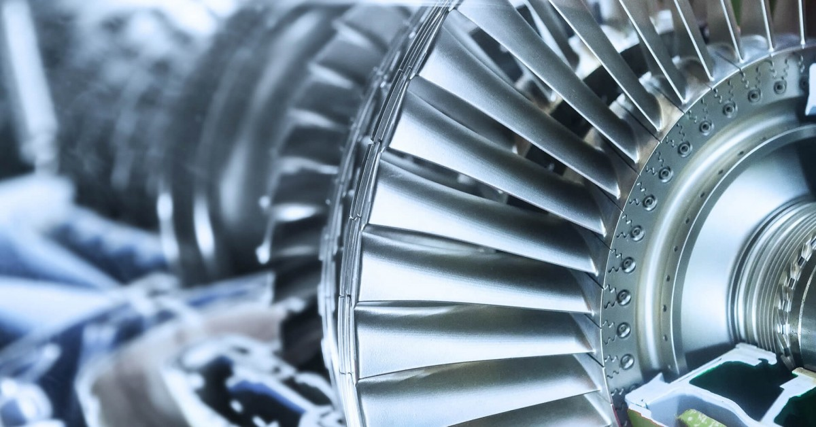
TURBO MACHINERY

Slide 2
“We can create a more sustainable, cleaner and safer world by making wiser energy choices”
Indian Standards (IS) for Turbines & Compressors, developed by the Bureau of Indian Standards (BIS), play a crucial role in ensuring the quality, safety, and performance across various industrial applications.
This lecture aims to deal with :
General information about turbomachinery
Standardization Efforts in the Industry
Real-world implement-ability, and their linkage with the manufacturing process.
Understanding of Turbines & Compressors through Standards
How do Indian Standards encompass the working principles of compressors and turbines, including their classification, applications, and acceptance criteria? Additionally, how do they address the calculation of volume flow rate, specific power consumption, lubricating oil consumption, isentropic efficiency, and volumetric efficiency, as well as potential safety hazards and required safety measures, all of which are integral to the course curriculum?
By the end of this lecture, participants will appreciate the importance of these standards, identify areas for improvement, and understand the value of participating in the standardization process.

Slide 3
What is a Turbomachine?
Turbo means ‘‘spin’’ or ‘‘whirl’’ in Latin.
Definition: A device that exchanges energy with a fluid using continuously flowing fluid and rotating blades
Turbomachines use rotating shafts with attached blades, vanes, buckets, etc.
Examples: Aircraft engines, turbines, compressors, fans, blowers, pumps etc.
Energy conversion: Mechanical ↔ Fluid

Slide 4
Types of Turbomachines
Power absorbing
Work is done on the fluid
Mechanical Energy → Hydraulic Energy
Working Principle: Based on Boyle’s Law
(P₁V₁ = P₂V₂)
Power absorbing: Compressors, fans, blowers, Pumps
Power producing: Turbines
Power producing
Work is done by the fluid
Hydraulic Energy → Mechanical Energy
Working Principle: Based on Newton’s Third Law of Motion
(Action and Reaction).

Slide 5
Classification of Turbomachines
Turbomachines
Power Absorbing
Incompressible
Compressible
Power Producing
Incompressible
Compressible
Pump & Propeller
Propeller, Fan, Blower & Compressor
Pelton Wheel Hydraulic Turbine
Steam Turbine, Gas Turbine & Wind Turbine
Density of the fluid remains constant.
Density of the fluid changes.

Slide 6
Another Classification of Turbomachines
Turbomachines
Power Absorbing
Uncased
Cased
Power Producing
Impulse
Reaction
Axial Flow
Axial, Radial & Mixed Flow
Pelton Wheel & Wind Turbine
Axial (Kaplan), Radial (Banki) & Mixed (Francis)

Slide 7
Standardization Efforts in the Industry
1
Standards Organizations
2
Industry Associations
Organizations like BIS, ISO and ASME develop and maintain comprehensive standards for Turbomachine design, operation, and maintenance.
Associations such as the American Gas Association, Gas Turbine World, Indian Wind Turbine Manufacturers Association play a vital role in promoting and enforcing industry standards.
3
Government Regulations
4
Manufacturer Specifications
Government agencies establish regulations to ensure safety, environmental compliance, and overall industry best practices.
Turbomachine manufacturers define specific standards for their products, ensuring compatibility and interchangeability.

Slide 8
Pivotal Role of Bureau of Indian Standards in the Standardization of Turbines and Compressors

Slide 9
Mechanical Engineering Department (MED) of Bureau of Indian Standards has constituted a Technical Committee namely Turbo Machinery Sectional Committee MED 22. This Committee deals with formulation of standards for compressors, blowers, exhausters and their related accessories. It also covers methods of measuring various quantities connected with the testing and code of practices, preparation of technical supply conditions and acceptance tests for centrifugal, reciprocating, rotary and dynamic compressors, blowers and exhausters.
MED 22 liaison with following Technical Committee of ISO as participating (P) member
TC 118 - Compressors and pneumatic tools, machines and equipment - Principle (P)
TC 118 / SC 1 - Process compressors - Principle (P)
TC 118 / SC 4 - Compressed air treatment technology - Principle (P)
TC 118 / SC 6 - Air compressors and compressed air systems - Principle (P)
ISO TC 118 / SC 6 - Safety
IEC TC 5 - Steam turbines - Principle (P)
IEC TC 4 - Hydraulic turbines - Principle (P)
ISO TC 192 - Gas turbines - Principle (P)

Slide 10
Electro Technical Department (ETD) of Bureau of Indian Standards has constituted a Technical Committee namely Wind Turbines Sectional Committee ETD 42. This Committee deals with formulation of standards for wind turbines that convert wind energy into electrical energy. These standards address design requirements, engineering integrity, measurement techniques and test procedures. Their purpose is to provide a basis for design, quality assurance and certification. The standards are concerned with all subsystems of wind turbines, such as mechanical and internal electrical systems, support structures and control and protection systems.
ETD 42 liaison with following technical Committee of IEC as participating (P) member
TC 88 - Wind energy generation systems - Principle (P)

Slide 11
Implementability and Linkage with Manufacturing
The major strength of the Indian Standards is their ability to implement in the real world. These standards are practical tools that link directly with the manufacturing process. By providing detailed specifications and procedures, they ensure that turbomachines are designed, manufactured, tested, and maintained to high standards, ensuring efficiency, reliability, and safety in real-world applications. This seamless transition from design to production enhances the overall understanding and practical application of turbomachines technology.
Practical Design Guidelines
Indian Standards offer practical design guidelines that can be directly applied in the manufacturing and installation of turbines & compressors, bridging the gap between theory and practice.
Quality Assurance
Adhering to these standards ensures that turbines & compressors meet the required quality and performance benchmarks, leading to reliable and efficient operations.
Regulatory Compliance
Following Indian Standards helps in regulatory compliance, ensuring that turbines & compressors meet legal and safety requirements set by government and industry bodies.
Standardization
Standards promote uniformity in manufacturing and operational processes, making it easier to maintain and repair turbines & compressors and ensuring compatibility of parts and systems.

Slide 12
Comprehensive Guidelines Indian Standards provide exhaustive guidelines covering various aspects of turbine and compressor technology
Understanding of Turbines and Compressors through
Indian Standards
Design: Standards outline the design principles, ensuring turbines & compressors are efficient and robust.
Testing and Performance: Standards include detailed testing methodologies to ensure turbines & compressors meet performance criteria, enhancing the reliability and efficiency operations.
Safety Protocols : Emphasis on safety protocols ensures that turbine & compressors are operated within safe parameters, preventing accidents and prolonging lifespan.
Terminology : Creates a common understanding among all stakeholders.

Slide 13
Understanding of Turbines & Comressors through Standards
Terminology : Standardization of terminology is fundamental to achieving clarity, consistency, and precision across various domains. It ensures that all stakeholders are aligned, reduces errors, facilitates compliance, uniform documentation & training, and supports innovation and development. By using standardized terminology, industries can improve communication, quality, overall efficiency and comply with regulatory requirements.
Design: Design aspects for turbines & compressors are pivotal in guaranteeing safety, optimizing performance, ensuring reliability, and achieving cost-effectiveness. Design aspects are indispensable for several compelling reasons such as safety, performance & efficiency, reliability & durability, quality assurance, maintenance & serviceability, innovation & advancement, facilitator to buyer, monitoring, cost-effectiveness.
Testing and performance requirements are critical for ensuring safety, verifying performance, enhancing reliability and durability, fostering innovation, achieving cost-effectiveness, complying with regulations, and building consumer confidence.
Safety protocols: Defining safety requirements is crucial for protecting human life, ensuring regulatory compliance, minimizing legal risks, building consumer confidence, facilitating market access, ensuring operational safety, protecting the environment, and enhancing overall product quality.
These aspects are comprehensively addressed in the Indian Standards cited at the conclusion.

Slide 14
Working principle of compressors and its classification
IS 10617:2018 prescribes the classification of the hermetic compressors as:
Hermetically Sealed Compressor — A machine consisting of an electrically driven refrigerant pump housed in a container which is welded or brazed together to form a gas tight shell also called as housing. The machine cannot be taken apart without cutting open the container housing and has no access to internal moving parts. The electrical windings are exposed to both the refrigerant and the compressor lubricating oil.
There are various types of hermetically sealed compressors using different pumping mechanisms as below
Reciprocating Compressors - These compressors use a pump mechanism of piston cylinder arrangement to compress the refrigerant gas. The rotary motion of the motor shaft is converted to reciprocating motion for compressor.
Rotary Compressors - These compressors use a impeller type of piston vane combination having rotary motion to compressor the refrigerant gas.
Scroll Compressors - These compressors use a combination of fixed and moving scroll sets, moving scroll have a mechanism to covert rotary mechanism into orbital motion to compressor refrigerant gas.
Linear Compressor - These compressors are a type of reciprocating compressor, uses a mechanism wherein the piston moves in the linear track to compress the refrigerant gas.

Slide 15
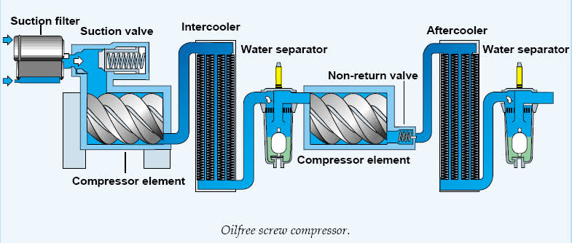
Working principle of compressors and its classification
IS 11461 : 1985 ‘Code of practice for compressor safety’ prescribes the compressor categories based on the lubrication as under:
Oil Lubricated Compressors in which the moving parts in the compression chamber are lubricated with oil which is either specially injected for that purpose by a mechanical lubricator or is carried over from other parts of the machine, as in single acting trunk type of reciprocating compressor without a crosshead.
‘Oil-free’ Compressors in which the air does not come into contact with the oil used to lubricate the machine, for example, dynamic Compressors, labyrinth compressors, diaphragm compressors or compressors with unlubricated piston rings.
These are used in food and beverage processing, the pharmaceutical industry (manufacturing and packaging), waste water treatment, chemical and petrochemical processing, semiconductor and electronics manufacturing, the medical sector, automotive paint spraying, textile manufacturing and many more. Contamination by even the smallest quantities of oil can result in costly production downtime and product spoilage.

Slide 16
Working principle of compressors and its classification
Oil-lubricated compressors are grouped into any of the four classes below (Ref IS 11461 : 1985):
Air-cooled reciprocating types with a power input up to 20 kW, usually built as single or two-stage machines up to about 25 bar (2.5 MPa) often for intermittent services.
Air-cooled reciprocating types with a power input about 20 kW, usually built as single stage machines up to about 3 bar (0.3 MPa) two-stage up to about 25 bar (2.5 MPa) and more stages for higher pressures.
Water-cooled reciprocating types, Usually built as single-stage machines up to about 5 bar (0.5 MPa), two stage up to about 25 bar (2.5 MPa) and more stages for higher pressures.
Water or air-cooled rotary vane types, usually built as single-stage machines up to about 4 bar (0.4 MPa) to 7 bar (0.7 MPa) and two-stage up to about 12 bar (1.2 MPa).

Slide 17
Working principle of turbines and its classification
IS 14751: 1999/ISO 11086 provides terms and definitions used in the field of gas turbines
General Definitions:
Gas Turbines: <Single unit> rotating machine which converts thermal energy into mechanical work, consisting of a compressor(s), a thermal device(s) which heat(s) the working fluid, a turbine(s), a control system, and auxiliary equipment.
Gas turbine power plant: Gas turbine engine and all essential equipment necessary for the production of power in a useful form (e.g. electrical, mechanical or thermal).
2. Component Terminology:
The standards provide detailed terminology for various turbine components such as compressor, combustion chamber, working fluid heater, gas generator, regenerator, pre-cooler, intercooler, Auxiliaries and accessories etc. Each component is precisely defined to ensure clear communication and understanding among professionals.

Slide 18
Working principle of turbines and its classification
IS 15666 (Part 1) :2006/ISO 3977-1 :1997 classifies Gas turbines based on type of cycles
Open cycle: Thermodynamic cycle in which the working fluid enters the gas turbine from the atmosphere and is discharged into the atmosphere.
Closed cycle: Thermodynamic cycle having a recirculating working fluid independent of the atmosphere.
Semi-closed cycle: Thermodynamic cycle utilizing combustion in a working fluid that is partially recirculated and partially exchanged with atmospheric air.
Simple cycle: Thermodynamic cycle consisting only of successive compression, combustion and expansion.
Regenerative cycle: Thermodynamic cycle employing exhaust heat recovery, consisting of successive compression, regenerative heating, combustion, expansion and regenerative cooling (heat transfer from the exhaust to the compressor discharge fluid) of the working fluid.
Intercooled cycle: Thermodynamic cycle employing cooling of the working fluid between stages of successive compression.
Reheat cycle: Thermodynamic cycle employing the addition of thermal energy to the working fluid between stages of expansion.
Combined cycle: Thermodynamic cycle employing the combination of a gas turbine cycle with a steam or other fluid Rankine cycle.

Slide 19
Working principle of turbines and its classification
IS 15666 (Part 1) :2006/ISO 3977-1 :1997 and IS 14751 : 1999/IS0 11086: 1996 further classifies Gas turbines on the following basis
Single-shaft gas turbine: Gas turbine in which the compressor and turbine rotors are mechanically coupled and the power output is taken either directly or through gearing.
Multi-shaft gas turbine: Gas turbine combination including at least two turbines working on independent shafts.
Bled gas turbine: Gas turbine which has, for external use, extraction of compressed air between compressor stages and/or at the discharge of the compressor, or extraction of hot gas at the inlet of the turbine and/or between turbine stages.
Internal combustion gas turbine: Gas turbine in which the combustion takes place within the working fluid.
External combustion gas turbine: Gas turbine in which the combustion takes place in an external region and heat is transferred to the working fluid.
Stationary gas turbine: Gas turbine employed as a stationary energy source and not readily movable.
Mobile gas turbine: Gas turbine employed as a stationary energy source but readily movable.

Slide 20
Reference IS 14751: 1999/IS0 11086: 1996
Working principle of turbines and its classification
Combined cycle: Thermodynamic cycle employing the combination of a gas turbine cycle with a steam or other fluid Rankine cycle
In a common example, the gas turbine exhaust heat is used to generate steam for the Rankine cycle.
The superior thermal performance of this cycle is due to a combination of the best thermodynamic attributes of each cycle, namely, the addition of thermal energy at higher temperatures in the gas turbine cycle and the rejection of thermal energy at lower temperatures in the Rankine cycle.
Cogeneration: Simultaneous production in series of two forms of useful energy such as electrical energy first and then process stream.
A combined cycle power plant uses both gas and steam turbines to generate electricity, maximizing efficiency by using waste heat from the gas turbine to power the steam turbine.
A cogeneration turbine generates electricity and simultaneously produces useful heat, often as steam. This waste steam is then utilized for heating, industrial processes, or further electricity generation, improving overall energy efficiency by maximizing the use of fuel input, reducing waste, and lowering energy costs.

Slide 21
Working principle of turbines and its classification
Clause 6 of IS 14751: 1999/IS0 11086: defines the following types of combined cycle systems:
Un-fired combined cycle: Combined thermodynamic cycle in which all of the heat is added in the gas turbine portion of the cycle.
In general, this is the most efficient of the various combined cycles since heat is added at the higher temperature level of the gas turbine cycle.
Supplementary fired combined cycle: Combined thermodynamic cycle in which a portion the heat is added to the cycle after the working fluid has passed through the gas turbine
In general, the output from the combined cycle is significantly enhanced by supplementary firing to the slight detriment of cycle efficiency.
Fully fired combined cycle: Supplementary fired combined cycle in which substantially all of the oxygen in the working fluid is combined with the fuel.

Slide 22
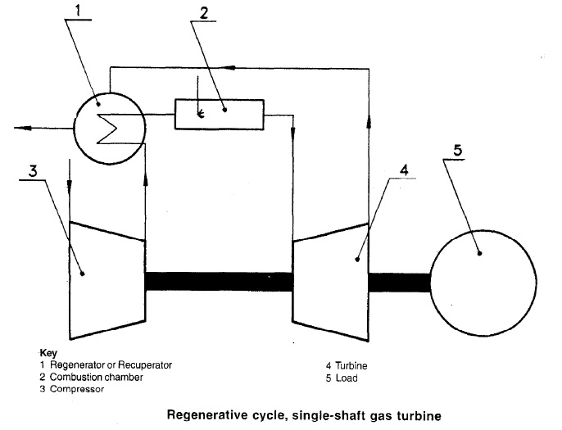
Reference (IS 14751: 1999/ISO 11086: 1996)

Slide 23
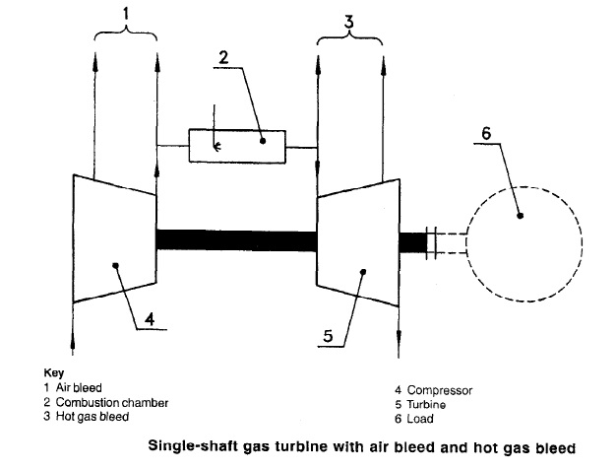
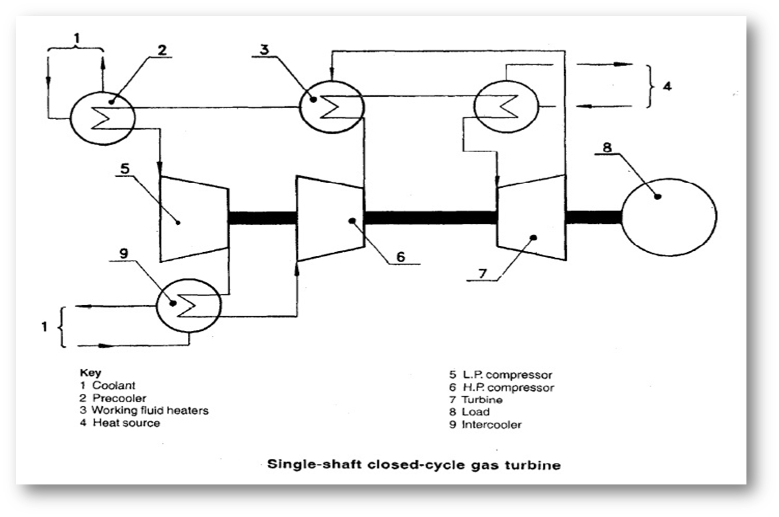
Reference (IS 14751: 1999/ISO 11086: 1996)

Slide 24
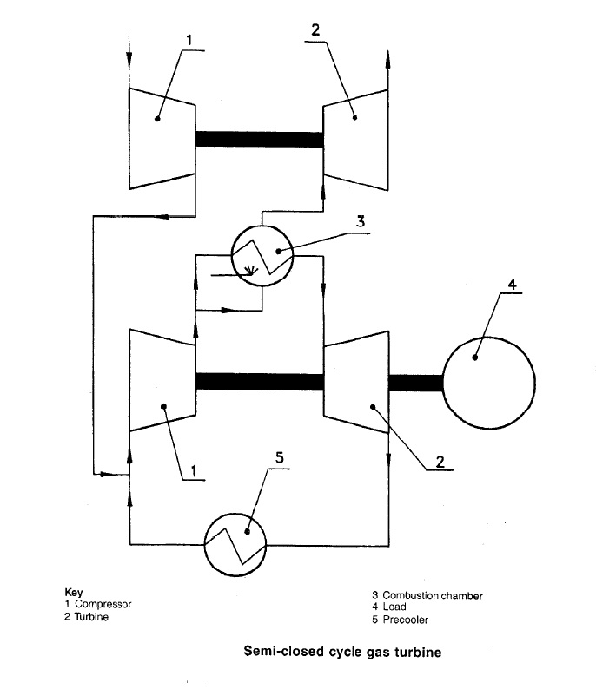
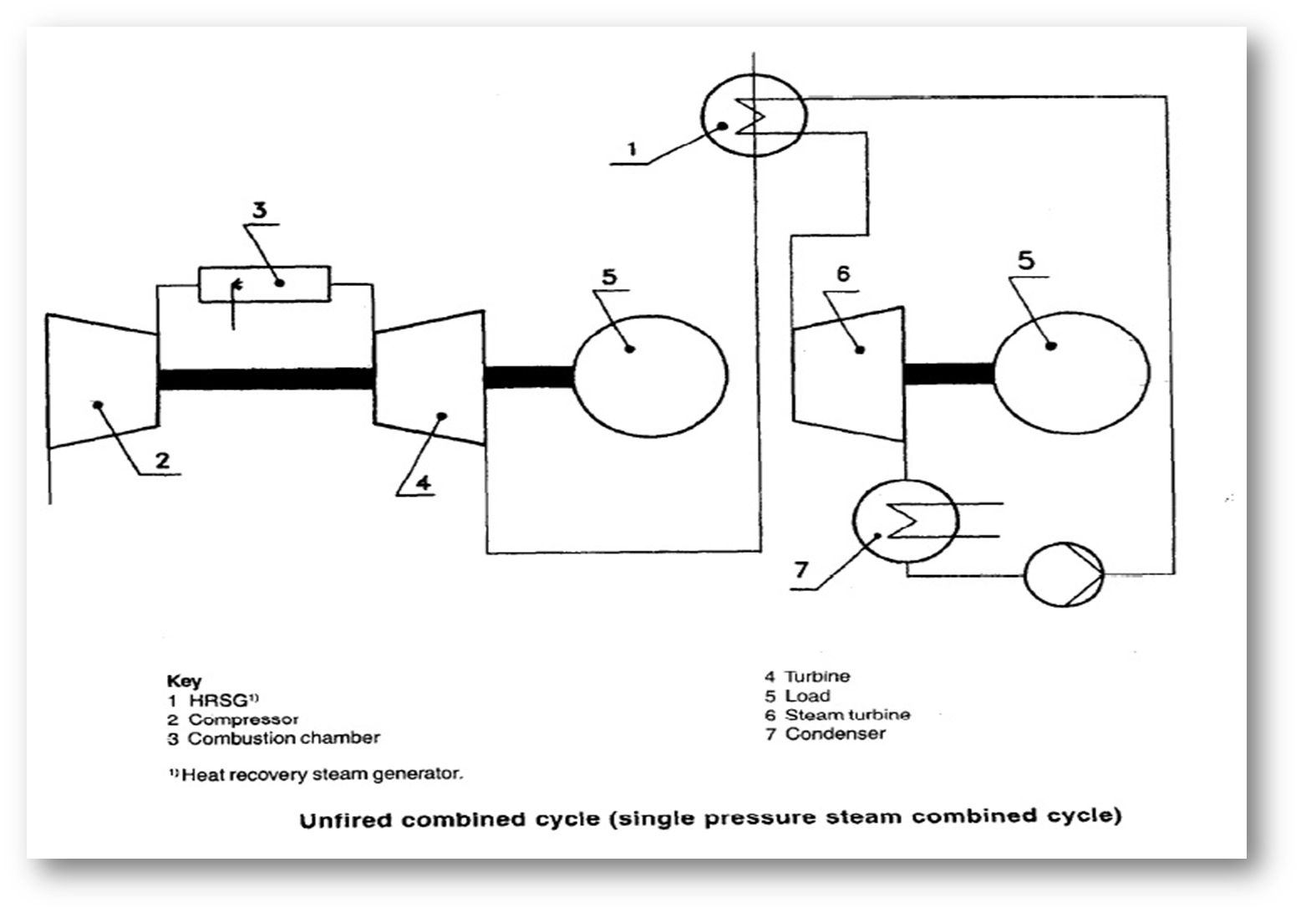
Reference (IS 14751: 1999/ISO 11086: 1996)

Slide 25
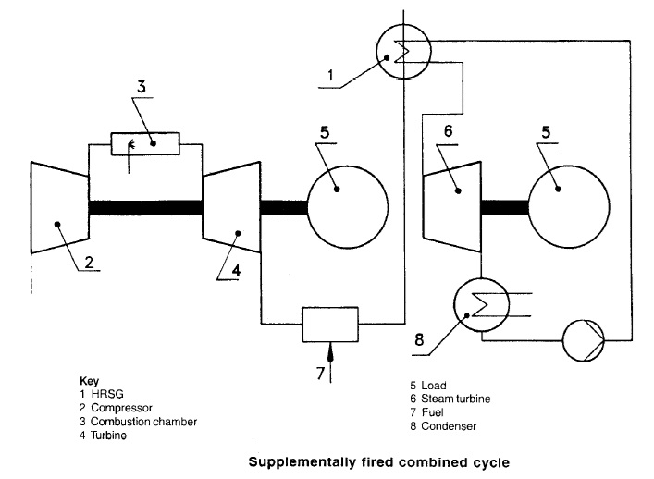
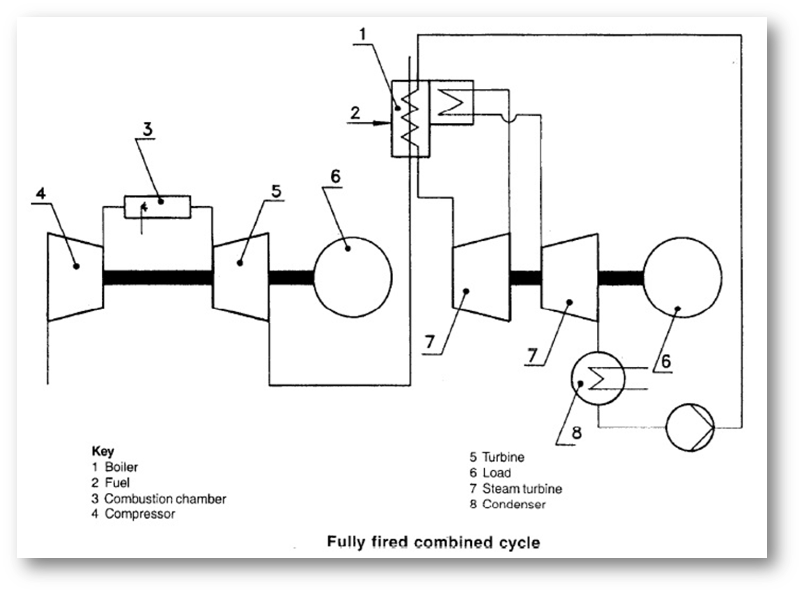
Reference (IS 14751: 1999/ISO 11086: 1996)

Slide 26
Working principle of turbines and its classification
IS 14205 (Part 1) : 1994 /IEC 45-1: defines the following types of steam turbine:
Superheat turbine: A turbine whose initial steam is significantly superheated.
Wet-steam turbine: A turbine whose initial steam is saturated or nearly so. (Also referred to as saturated-steam turbine.)
Reheat turbine: A turbine from which the steam is extracted part-way through the expansion, reheated (one or more times) and readmitted to the turbine.
Non-reheat turbine: A turbine in which the steam is not reheated.
Mixed-pressure turbine: A turbine provided with separate inlets for steam supplied at two or more pressures.
Back-pressure turbine: A turbine whose exhaust heat will be used to provide process heat, and whose exhaust is not directly connected to a condenser. The exhaust pressure will normally be above atmospheric pressure. (Also referred to as a non-condensing turbine.)

Slide 27
Working principle of turbines and its classification
Condensing turbine: A turbine whose exhaust is directly connected to a condenser. The exhaust pressure will normally be below atmospheric pressure.
Regenerative-cycle turbine: A turbine from which some of the steam is extracted part-way through the expansion in order to heat feed water.
Extract ion turbine: A turbine in which some of the steam is extracted part-way through the expansion in order to provide process steam. if the turbine includes means for controlling the pressure of the extracted steam, it is called a controlled (or automatic) extraction turbine.
Combined cycle: A combination of boiler, steam turbine and gas turbine, in which the gas turbine exhaust normally contributes to the heat input to the steam cycle.

Slide 28
Working principle of turbines and its classification
Working principle of wind turbine (Ref IS/IEC 61400-2 : 2013) :
A wind turbine converts kinetic energy from the wind into mechanical energy. This mechanical energy can then be converted into electrical energy through a generator. The main components of a wind turbine include the rotor (blades and hub), nacelle (which houses the gearbox, generator, and other components), tower, and control systems.
Wind Energy Capture: Wind flows over the blades, creating lift (similar to an airplane wing). The lift causes the blades to turn the rotor.
Mechanical Energy Conversion: The rotor is connected to a shaft, which spins as the rotor turns.
Electrical Energy Generation: The shaft is connected to a generator. As the shaft spins, it turns the generator, converting mechanical energy into electrical energy.
Power Transmission: The generated electricity is transmitted to the grid or used locally.

Slide 29
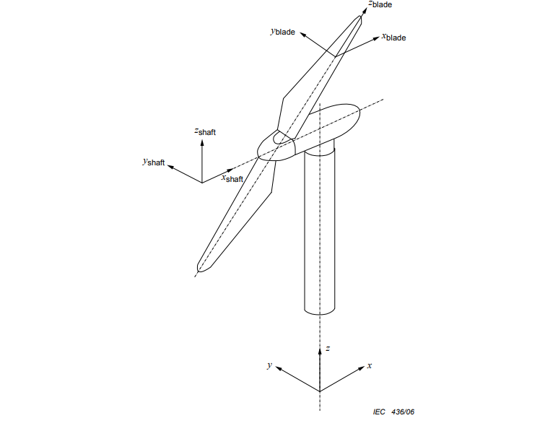
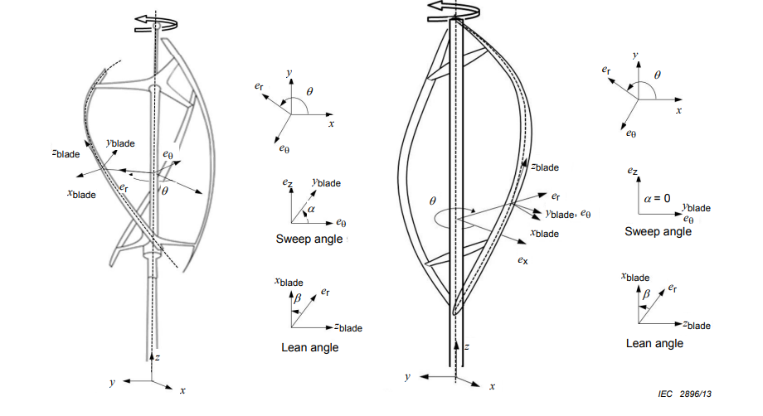
Working principle of turbines and its classification
IS/IEC 61400-2 : 2013 : defines the following types of wind turbine
Horizontal Axis Wind Turbines (HAWTs):
1. Most common type
2. Rotor shaft is horizontal
Blades are upwind of the tower
Vertical Axis Wind Turbines (VAWTs):
1. Rotor shaft is vertical
2. Blades are often parallel to the tower
3. Can capture wind from any direction

Slide 30
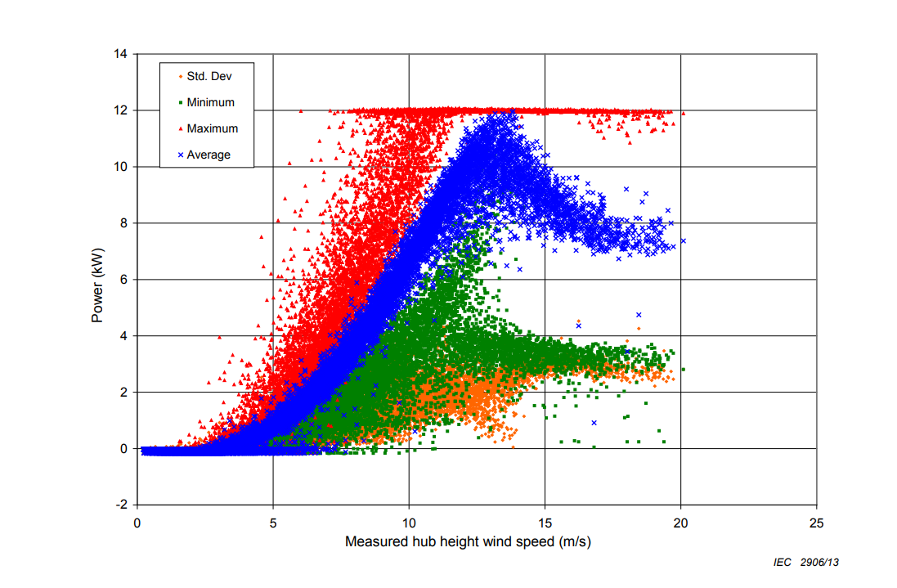
Working principle of turbines and its classification
A binned sea level normalized power curve represents the average power output of a wind turbine at different wind speeds, adjusted to sea level conditions, categorized into specific wind speed intervals.

Slide 31
Application & Acceptance Criteria
IS 15666 (Part 2): 2006/ISO 3977-2:1997 (Gas turbines - Procurement: Part 2 standard reference conditions and ratings) prescribes standard ratings for gas turbines.
The output power of a given gas turbine at a given reference turbine inlet temperature is, in generaI, proportional to the absolute ambient pressure and is also greatly dependent on the air intake temperature (normally outside dry bulb temperature). Likewise, the output at a given air intake temperature is dependent on the reference turbine inlet temperature.
Steam or water injection may be used to increase the power output and to reduce the NOx emissions.
The performance ratings of gas turbines are assessed on the net specific energy of the fuel used, as follows:
a) turbines intended for use on liquid fuel: 42000 kJ/kg;
b) turbines intended for use on gaseous fuel (100 % methane): 50000 kJ/kg.
The specific energy at constant pressure of the fuel, whether liquid, gaseous or solid, is based on a pressure of 101.3 kPa and a temperature of 15 ºC.
If the fuel to be used for testing the gas turbine is different from that agreed between the purchaser and the manufacturer for service operation, a test fuel of a mutually agreed specification shall be used.

Slide 32
Application & Acceptance Criteria
Classes of gas turbines based on applications
Class A: operation up to and including 500 h per annum at reserve peak power rating;
Class B: operation up to and including 2000 h per annum at peak power rating;
Class C: operation up to and including 6000 h per annum at semi-base power rating;
Class D: operation up to and including 8760 h per annum at base power rating.
Ranges of gas turbines based on applications
Range I: over 500 starts per annum average;
Range II: up to 500 starts per annum average;
Range III: up to 100 starts per annum average;
Range IV: up to 25 starts per annum average;
Range V: continuous operation without planned shutdown for inspection and/or maintenance within a specified period.

Slide 33
Application & Acceptance Criteria
IS 15666 (Part 2): 2006/ISO 3977-2:1997 specifies that unless specially agreed upon between the purchaser and the manufacturer, the net power rating of a gas turbine shall be specified under a combination of one of the classes with one of the ranges of an average number of starts per annum.
EXAMPLE
B-ll (Class B, Range II) refers to the operation of up to 2000 h per annum associated with any number of starts up to 500 per annum.
Further, the manufacturer is also required to declare standard ratings, based on electrical power at the generator terminals or on turbine output shaft power under the standard reference conditions such as Air intake conditions, Exhaust conditions, Cooling water conditions (if applicable), and Working fluid heater or cooler, associated with the following operational modes:
Standard peak load rating (2 000 h and 500 stats per annum average) Class B: Range II;
Standard base load rating (8 760 h and 25 starts per annum average) Class D: Range IV.

Slide 34
Applications and acceptance criteria
Acceptance Criteria for wind turbine (IEC 61400-2)
Performance Standards: Compliance with energy production and efficiency metrics.
IS/IEC 61400-12-1) : 2017 (Wind Energy Generation Systems Part 12 Electricity Producing Wind Turbines Section 1 Power performance measurements) : this standard describes a Procedure to be used to determine the power performance characteristics of small wind turbines (as defined in IEC 61400-2) when connected to either the electric power network or a battery bank.
IS/IEC 61400-12-1 outlines the standards for measuring the power performance of wind turbines, focusing on the relationship between wind speed and electrical power output. Key aspects include accurate wind speed measurement, environmental condition adjustments, and systematic data collection and analysis. The standard emphasizes uncertainty analysis and standardized reporting to ensure reliable and consistent performance data. This facilitates transparent comparison and verification of turbine performance against manufacturers' specifications.

Slide 35
Applications and acceptance criteria
Safety Standards: Adherence to safety guidelines for construction, operation, and maintenance.- standards provide comprehensive guidelines for the safe design, operation, and maintenance of wind turbines. They cover structural integrity, electrical and mechanical safety, fire protection, environmental considerations, and human safety. Key aspects include load calculations, control systems, emergency shutdown mechanisms, noise limits, and lightning protection. The standards ensure reliable and safe operation, risk management, and safe working environments throughout the turbine's lifespan.
Durability and Reliability: Long-term performance under varying weather conditions.
Noise Emission: Limits on acceptable noise levels for both onshore and offshore installations.
Environmental Impact: Assessment of ecological impacts and mitigation measures.

Slide 36
Volume flow rate, specific power consumption, lubricating oil consumption, isentropic efficiency, and volumetric efficiency
Thermal efficiency (Steam Turbine IS 14198 (Part 1) : 1994)
$$n_{t}=\frac{P}{\sum{\left({\dot{m}}_{j}Δh_{j}\right)}}$$
Where:
P is power output
${\dot{m}}_{j}$ are the mass flows, to which heat is added.
$Δh_{j}$ the resulting enthalpy rises

Slide 37
Volume flow rate, specific power consumption, lubricating oil consumption, isentropic efficiency, and volumetric efficiency
Performance Test for Compressor (Ref IS 10617:2018 hermetic compressors).
Type tests prescribed in IS 10617 are as under:
Cold Startability Test - A cold startability test for a compressor is designed to evaluate how well a compressor performs when it is started in cold conditions. This is crucial for ensuring reliability and efficiency in various applications, such as in HVAC systems, industrial processes, or automotive engines. IS 16017 prescribes the test methods for startability test at low temperature (25~35°C). The compressor shall start and run at 85 percent of the rated voltage.
Hot startability test - A hot startability test for a compressor assesses how well the compressor performs when starting from a high-temperature state, typically after it has been running and is already hot. This is important for ensuring the compressor's reliability and efficiency in real-world operating conditions where it might need to restart frequently or after being shut down during high temperatures. The compressor shall be run at rated voltage and frequency till steady state is achieved, then switched OFF to achieve pressures at saturated temperatures and then switched ON. The compressor shall start and run at minimum voltage, as per the compressor specification.

Slide 38
Volume flow rate, specific power consumption, lubricating oil consumption, isentropic efficiency, and volumetric efficiency
Locked Rotor Test with Accessories - A locked rotor test for a compressor with accessories is designed to evaluate how the compressor behaves when its rotor is prevented from turning, often simulating a worst-case scenario for the system. This test is critical for assessing the reliability of the compressor and its accessories (such as overload protection devices) under extreme conditions. The compressor with overload protection system shall undergo short duration locked rotor testing. The test shall be conducted for 3 h or until shell / housing temperature is stabilized within ±5°C, whichever is earlier.
High Voltage Test - A high voltage test for a compressor, also known as a high potential or dielectric strength test, is conducted to verify the insulation integrity of the compressor’s electrical components. This test is crucial for ensuring that the compressor can withstand high voltage conditions without breakdown, preventing electrical failures and ensuring safety. The compressor shall be able to withstand 1.5 kV AC voltage for 1 min/s without breakdown. The leakage current measured shall not exceed 5 mA.
Leakage Current - A leakage current test for a compressor is conducted to assess the amount of electrical current that leaks from the electrical components of the compressor to its ground or enclosure. This test is important for ensuring that the compressor is safe to operate and that it complies with safety standards. Excessive leakage current can indicate insulation problems or potential safety hazards.

Slide 39
Volume flow rate, specific power consumption, lubricating oil consumption, isentropic efficiency, and volumetric efficiency
Pneumatic Test of Shell - A pneumatic test of the shell of a compressor is designed to check for leaks and ensure the structural integrity of the compressor's casing or shell. This test involves applying pressurized air to the compressor shell to verify that it can withstand operational pressures without leaking or failing. The shells shall be tested pneumatically (dry air/nitrogen) at a test pressure of 1MPa (gauge) and shall not show any leakage.
Bursting Test - A bursting test for a compressor, also known as a burst pressure test, is designed to determine the maximum pressure that a compressor shell or component can withstand before failing or bursting. This test is crucial for validating the structural integrity and safety of the compressor under extreme pressure conditions. The test samples are filled with a liquid, such as water, to exclude air and are connected in a hydraulic pump system. The pressure is raised gradually until the required test pressure is reached. This pressure is maintained for 1 min during which time the sample shall not leak.
Holding Charge - A holding charge test for a compressor is used to verify whether the compressor can maintain a specific pressure over time without leaking. This is important for ensuring that the compressor’s internal components and seals are intact and that the system can operate reliably without losing pressure. Compressors shall have a positive charge of 0.03 MPa to 0.1 MPa of dry air/nitrogen having a dew point not more than -40°C.

Slide 40
Volume flow rate, specific power consumption, lubricating oil consumption, isentropic efficiency, and volumetric efficiency
RESISTANCE TO RUSTING - Testing for resistance to rusting in compressors typically involves evaluating how well a compressor or its components resist corrosion over time. This is crucial for maintaining the reliability and longevity of the equipment, especially in environments prone to moisture or other corrosive conditions. This test to be carried out as per clause 31 of IS 302-1 ‘Safety of household and similar electrical appliances, Part 1: General Requirements’.

Slide 41
Volume flow rate, specific power consumption, lubricating oil consumption, isentropic efficiency, and volumetric efficiency
IS 15666: Part 8:2006 (Gas turbines - Procurement: Part 8 inspection, testing, installation and commissioning) defines general terms related to inspection, test, witnessed & observed.
Inspection
Process by which it is demonstrated that materials, components, assemblies or complete packages satisfy one or more particular specification requirements of the packager or purchaser
This may include verificational documentation, reports, material certificates, chemical analyses, physical or dimensional checks, build records, visual checks and/or results of documented inspections and tests including any other non-destructive evaluation(NDE) methods or techniques that may be employed.
Test
Process by which it is demonstrated that assemblies, completed components or packages satisfy the physical, functional and operational requirements as specified by the packager’s test schedules and procedures, or the purchaser’s specification

Slide 42
Volume flow rate, specific power consumption, lubricating oil consumption, isentropic efficiency, and volumetric efficiency
Witnessed
Term meaning that a hold is applied to the production schedule and that the inspection or test will be carried out with the purchaser or his representative in attendance
Observed
Term meaning that the purchaser will be notified of the timing of the inspection or test

Slide 43
Volume flow rate, specific power consumption, lubricating oil consumption, isentropic efficiency, and volumetric efficiency
Clause 6 of IS 15666 (Part 2): 2006/ISO 3977-2:1997 prescribes minimum recommended requirements for the physical testing of components, assemblies and the complete package prior to entry into commercial service.
Hydrostatic test
As a minimum, components defined by legislation or national standards as pressure vessels (excluding the casings of gas generator and power turbine) shall be tested hydrostatically according to legislation or national standards, but at least with liquid at a minimum of 1.5 times the maximum allowable working pressure but not less than 140 kPa differential pressure. Other components and systems shall be tested in accordance with the purchaser’s requirements or statutory or mandatory requirements applicable to the destination territory. The test liquid shall be at a higher temperature than the nil-ductility transition temperature of the material being tested.
Tests shall be maintained for a sufficient period of time to permit complete examination of parts under pressure. The hydrostatic test shall be considered satisfactory when neither leaks nor seepage through the casing or casing joint is observed for a minimum of 30 min. Large, heavy castings may require a longer testing period which is to be agreed upon by the purchaser and packager.

Slide 44
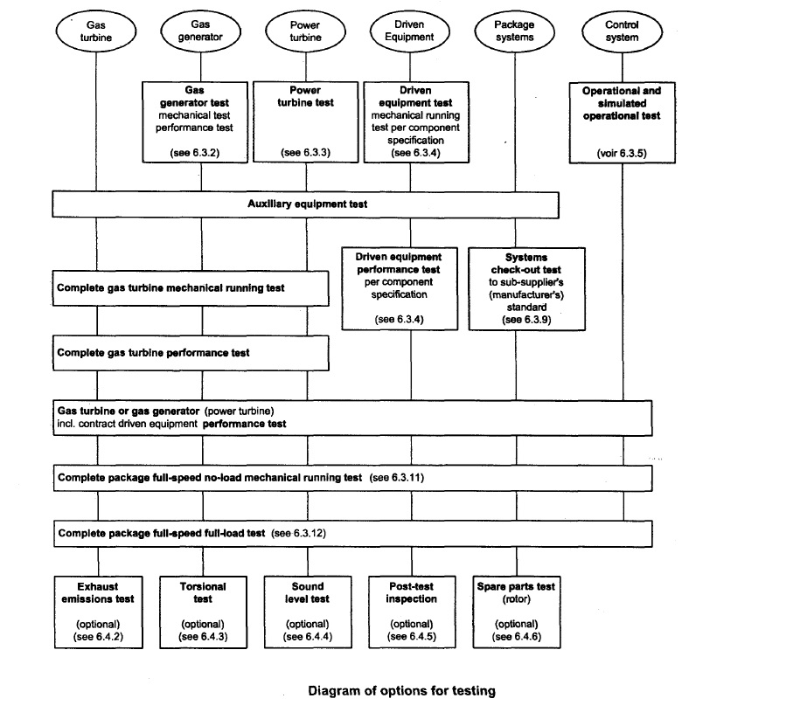
This Figure shows the desired sequence of mandatory and optional operation testing and may be used.
Please refer IS 15666: Part 8:2006

Slide 45
Volume flow rate, specific power consumption, lubricating oil consumption, isentropic efficiency, and volumetric efficiency
The following are examples of the tests which are commonly performed: [Ref: 15666 (Part 2): 2006/ISO 3977-2:1997]
gas turbine tests;
gas turbine with the contract driven equipment;
complete package test.
For gas turbines with a free power turbine#, the following alternative tests may be performed:
gas generator tests;
free power turbine test.
These tests may be performed at no load, part load or full load, For mechanical drive applications, the driver may be used to execute full pressure, full load or full speed tests of the driven equipment.
# A "free power turbine", allows the speed of the power turbine to be optimised for the machinery that it will energize without the need for an additional reduction gearbox within the engine.

Slide 46
Volume flow rate, specific power consumption, lubricating oil consumption, isentropic efficiency, and volumetric efficiency
The tests shall include, as appropriate,
cold start,
hot start,
full range operation of variable inlet guide vanes and/or stator stages,
operation of bleed valves, and
operation of anti-icing systems (when they are furnished).

Slide 47
Volume flow rate, specific power consumption, lubricating oil consumption, isentropic efficiency, and volumetric efficiency
When specified, the optional tests following shall be performed, depending on the facilities, either in the shop or on site as mutually agreed between the packager and purchaser.
Exhaust emissions test: Exhaust emissions test shall be carried out in accordance with ISO 11042-1.
Torsional test: Torsional vibration measurements shall be made to verify the complete power train torsional analysis. The test procedure shall be mutually agreed between purchaser and packager.
Sound-level test: The sound-level test shall be performed in accordance with ISO 6190 or a procedure as agreed between the packager and purchaser.
Post-test inspection: Borescopic inspection and/or dismantling inspection and reassembly of the major driven equipment, gears and the driver may be made after satisfactory completion of the mechanical running test. The packager and purchaser shall agree to what extent the package equipment shall be dismantled and inspected.
Spare-rotor test: Spare rotors shall be tested as specified by the purchaser
Endurance test: Prolonged running (24 h or more) may be specified by the purchaser. The objectives and acceptance-criteria of this running shall be agreed between the packager and purchaser.

Slide 48
Volume flow rate, specific power consumption, lubricating oil consumption, isentropic efficiency, and volumetric efficiency
Heat consumption (Reference 1S 15664: 2008/ISO 2314:1989)
The rate of heat consumption, q_{r} in kilowatts, is determined by the equation :
q_{Ⴀ} = m(Q_{lo} +h_{f4} - h_{o})/ Ⴀ = m(Q_{lo} +h_{f4} - h_{o})
where
Ⴀ is the test duration, in seconds;
m_{t} is the mass of fuel ¹⁾ used during period Ⴀ, in kilograms;
Q_{lo} is the net specific energy of the fuel at 15ºC and constant pressure, in kilojoules per kilogram;
m is the rate of fuel consumption, in kilograms per second, given by m_{Ⴀ}/ Ⴀ
h_{f4} is the specific enthalpy of the fuel at temperature T_{f4} entering the heat source (combustion chamber), in kilo- joules per kilogram;
h_{o} is the specific enthalpy of the fuel at 15ºC, in kilojoules per kilogram.
1) The fuel used shall be the net value of the inlet fuel less by-passed fuel, if any.

Slide 49
Volume flow rate, specific power consumption, lubricating oil consumption, isentropic efficiency, and volumetric efficiency
Thermal efficiency
The thermal efficiency, η_{t} of the engine based on net shaft power output may be computed from:
η_{t = P/q}
where
P is the net shaft power output, in kilowatts:
q is the heat consumption, in kilowatts.
Heat rate
The heat rate, q_{p} in kilowatts of heat per kilowatt of power, may be computed from
q_{p} = q/P = 1/ η_{t}
Where,
q is the heat consumption, in kilowatts.
P is the net shaft power output, in kilowatts,
ηt is the thermal efficiency.

Slide 50
Volume flow rate, specific power consumption, lubricating oil consumption, isentropic efficiency, and volumetric efficiency
The preferred approach in conducting tests is to run at the reference conditions of the compressor inlet (temperature, pressure, and relative humidity), and at the standard exhaust. However this may not always be possible; the tests may have to be run under some other conditions, and the results corrected to reference conditions to facilitate comparison of power and thermal efficiency.
Clause 8.3 of IS 15664:2006/ ISO 2314:1989 provides the procedure for applying corrections of test results to reference conditions

Slide 51
Volume flow rate, specific power consumption, lubricating oil consumption, isentropic efficiency, and volumetric efficiency
MEASUREMENT UNCERTAINTY (Reference Annexure A of IS 15664: 2008/ISO 2314:1989)
The measurement of each value entering into the computation of the test result is liable to some degree of error, depending on the quality of the measuring instruments and the conditions of the measurement. The test result is therefore subject to a degree of uncertainty depending on the combined effect of all the errors of the measurement.
The confidence limits of any measurement can be assessed
a) from measuring recommendations and standards;
b) from the accuracy classes of the measuring instrument or measurement, chain;
c) from the accuracy of calibration of a measuring instrument or transducer;
d) from the influence of unavoidable installation error;
e) from general measuring experience;
f) from fluctuating test conditions.
Due to the many causes involved, the assessment of the measurement uncertainty shall be made by calculation for each case.

Slide 52
Volume flow rate, specific power consumption, lubricating oil consumption, isentropic efficiency, and volumetric efficiency
Lubricating Oil used in Turbine (Ref IS 1012: 2002):
Types of Turbine Oils:
R&O (Rust and Oxidation inhibited)
EP (Extreme Pressure) types.
Requirements:
Viscosity: The standard specifies the viscosity of the oil at different temperatures (usually 40°C and 100°C). The viscosity must be within the specified range to ensure proper lubrication under various operating conditions.
Flash Point: The minimum flash point (the temperature at which the oil gives off enough vapor to ignite) is specified to ensure safety during operation.
Pour Point: The pour point (the lowest temperature at which the oil can flow) must be low enough to ensure the oil remains fluid in cold conditions.

Slide 53
Volume flow rate, specific power consumption, lubricating oil consumption, isentropic efficiency, and volumetric efficiency
Neutralization Number: This measures the acidity or alkalinity of the oil, indicating its level of degradation or contamination.
Water Content: The maximum allowable water content is specified to prevent corrosion and ensure proper lubrication.
Foaming Characteristics: The oil should have low foaming tendencies to ensure stable operation without air entrainment.
Oxidation Stability: The oil should resist oxidation to prevent the formation of sludge and varnish that can impair turbine performance.
Rust Prevention: The oil should prevent rust and corrosion of turbine components.
Demulsibility: The oil should have good water separation properties to ensure any water contamination can be easily removed.
Demulsibility is the ability of oil to separate from water.

Slide 54
Potential safety hazards and necessary requirements
The Indian Standards (IS) place a strong emphasis on the safety aspects of turbines, ensuring that these machines operate safely and reliably under various conditions.
IS 15666 (Part 9): 2006/ISO 3977-9:1999 (Gas Turbines — Procurement Part 9 Reliability, Availability, Maintainability and Safety) provides detail of safety elements that need special attention such as:
a) Minimization of fire hazards and provisions for appropriate fire control.
b) Control systems designed to prevent unsafe conditions (speeds, temperature, vibration, etc.).
c) Alarms to warn of unsafe operating conditions.
d) Suitable safety trips to protect operating personnel and/or equipment.
e) If operators will be near the gas turbine while it is operating, guards, insulation, handrails, etc., should be provided to protect personnel from accidental contact with dangerous elements. Where appropriate, warning signals shall also be supplied.
f) Proper handling equipment and tools shall be available to maintenance personnel; particular attention is required for the safe handling of heavy equipment, including rigging or blocking tools, slings, hoists and cranes.
g) Power plant design shall minimize the possibility of a fire fed by lubricating oil, hydraulic oil and fuel oil leaks (localizing any potential leaks shall be given careful attention).

Slide 55
Potential safety hazards and necessary requirements
g) Power plant design shall minimize the possibility of a fire fed by lubricating oil, hydraulic oil and fuel oil leaks (localizing any potential leaks shall be given careful attention).
h) Adequate ventilation and means of escape shall be provided for any personnel who will be near the power plant when it is operating; recognition shall be given to the fact that fire protection systems operating in a confined area can be dangerous to personnel.
i) Manufacturers’ recommendations relative to occupancy of the gas turbine enclosure during operation shall be followed.
j) If operators are to be exposed to abnormal sound levels, suitable protective ear devices shall be worn.
k) Operating and maintenance personnel shall be provided with instructions to promote safe operation and maintenance of the power plant.
l) The inter-relationship of the gas turbine protective equipment and its possible effect on other power plant or system equipment.
m) Power plant design shall minimize the possibility of fuel gas leakage and gas explosion by provision of suitable arrangements for venting, gas detection, cell/building ventilation, equipment spark suppression, pipework earthinglbonding, etc.

Slide 56
Potential safety hazards and necessary requirements
In applications where aspects of safety are extremely important (i.e. for aircraft engines), the analysis of the condition of complex systems has already attained a high level. The positive influence on the maintenance effort that accompanies the introduction of monitoring systems (MSS), as well as the possibility of preventing failures, more and more raises the interest in applying such systems to large power plants where the safety requirements are less stringent. The economic performance of a plant can be improved by such monitoring systems.
IS 15667:2006/ISO 19860:2005 classifies and defines monitoring systems and their technical terms. It establishes a system for conversion and validation of measured quantities to enable a comparison of the various systems, their features and their performances.

Slide 57
Potential safety hazards and necessary requirements
Emergency protection is crucial for safeguarding the gas turbine and its associated equipment from potential hazards and damage. It should be designed to detect and act autonomously, independent of the governor, when necessary. To optimize the gas turbine's lifespan, it may not always be required to immediately initiate an emergency stop or reduce to the minimum self-sustaining speed or load, depending on the circumstances.
IS 15666 (Part 3): 2006/1S0 3977-3:2004 prescribes the following types of emergency protection systems:
Protective load shedding: Under certain fault conditions, the sequence may allow for the gas turbine to go to minimum load, no load (generator breaker open) or trip to self-sustaining speed for a period of time, allowing for cooling before the fuel is shut off automatically and the gas turbine is shut down.
Emergency shutdown: Emergency shutdown may be manually initiated but shall occur automatically on operation of applicable gas turbine/process plant protection devices as agreed with the purchaser. The system shall operate directly on the fuel shut-off valve to stop the gas turbine fuel supply.

Slide 58
Potential safety hazards and necessary requirements
Fire, gas detection and ventilation failure shutdown: Should a serious fault be detected, such as fire, gas leakage at trip level, or ventilation failure, shutdown shall occur automatically as a result of the function of automatic detection devices, The system shall operate directly on the fuel shut off and vent valves. The gas turbine shall be shut down immediately without ramping to minimum load or cooling period.
In the case of gas detection at an enclosure ventilation outlet (but not the inlet), the ventilation fans shall be retained on to purge remaining gas from the enclosure.
If an unacceptable level of explosive atmosphere is detected at a ventilation inlet, the ventilation fans shall be tripped where applicable as the source is most probably external to the enclosure, and shutdown of the gas turbine shall occur.
Shutdown of generator sets: For electric generation, means shall be provided, either on the gas turbine or on the generator, for prevention of motoring of the generator when the fuel stop valve is closed. Where synchronous compensation or generator starting is specified, these requirements may be operationally over-ridden.
Shutdown of mechanical drive sets: Automatic means shall be provided upon shutdown for isolating the driven equipment from the system it supplies in order to prevent rotation or reverse flow.

Slide 59
Potential safety hazards and necessary requirements.
IS 11461 : 1985 Lay down requirements for Safe design and construction of stationary and skid-mounted air compressors for general use.
Improper Lubrication - The common causes of improper lubrication are use of improper lubricant, lack of oil, poor maintenance leading to bearing wear with increased clearance and too low oil pressure, insufficient or excessive cooling, and Over lubrication and malfunction of the lubrication system may lead to a temperature increase which, with continued operation, may introduce the risk of an oil fire.
Improper Cooling - The risks stemming from poor cooling are obvious. However, overcooling shall also be avoided because it gives rise to internal cylinder corrosion as the condensate modifies the lubricant.
Mechanical Failures - These usually emanate from one or more of the following causes like Excessive pressure, Overspeed, Secondary phenomena caused by improper lubrication, Secondary phenomena caused by improper cooling, Poor maintenance, and Excessive vibrations or external forces.

Slide 60
Potential safety hazards and necessary requirements.
Personal Injury - The more common potential causes of injury are contact with moving parts; contact with hot parts; falling from elevated positions; slipping ( for example, caused by oil spillage ); electrical hazards; use of incorrect tools during maintenance; bursting or explosion of an apparatus or component under pressure; and production of smoke or toxic oil vapor arising from accidental ignition of the oil.
Exposure to Noise - Noise, even at reasonable levels, can cause irritation and disturbance which over a long period of time may cause severe injuries to the human nervous system and may take such forms as lack of sleep, and irritation. Noise at average sound pressure levels exceeding 90 dB(A) is considered to damage hearing. The effect depends on the level and the duration of the exposure. Reference is made to national regulations. The noise from a compressor has three main components: intake noise, noise radiated from the surfaces of the machine and noise from pipework. The noise level in a room depends on the noise emission from all noise sources in the room and the acoustic properties of the room itself, that is the sound absorption of walls, floors and ceiling. The noise emission from the compressors is not always the most important factor for the total noise level. The noise from the prime movers must also be considered.

Slide 61
Potential safety hazards and necessary requirements.
Fires and Explosions in the Pressure System
a) Oil-lubricated compressors - It is generally accepted that the occurrences of fires in oil lubricated compressor system is dependent on the build-up of oil degradation (oilcoke) deposits. The factors that effect coke formation are Rate of oil feed - Excessive oil feed promotes deposit formation, Air filteration - Solids ingested with the suction air thicken the oil and delay its passage through the hot part of the delivery system, increase the time it is subject to oxidation, and hence increase the rate of deposit formation, Temperature -The temperature at which significant oxidation starts is related to the grade and type of oil used. In the case of compressors with water-cooled cylinders, it is recommended that treated or demineralised water be used to prevent the formation and deposit of scale inside the pipework. A failure of cooling water may result in a sharp rise in temperature above the level appropriate to that particular machine, and is a well-recognized cause of fire initiation when the coke layer in the hot zone is thick enough. raise the temperature and cause dangerous conditions.

Slide 62
Potential safety hazards and necessary requirements.
b) Oil-flooded rotary compressors (special precautions) - Experience shows that oil-flooded rotary air compressors of good design, correctly lubricated and maintained, are free from fire hazards. Abnormal temperature rise in the oil filter pads may, however, accelerate the oil oxidation with consequent fire risk.Laboratory tests and experience from the field indicate that the following three factors are important to prevent the risk of such oil fires are i) Design; ii) Choice of oil; and iii) Operation and maintenance of the compressor.
Points are of particular importance
i) keeping the oil consumption low,
ii) regular oil changes, and
iii) ensuring that the oil cooling arrangements are working satisfactorily.

Slide 63
Potential safety hazards and necessary requirements.
Incorrect Installation, Operation or Maintenance - Besides the types of potential hazard described above, hazards also exist if the installation, operation and maintenance work shall not be carried out in the correct way.
Guards - Guards shall be provided on all rotating and reciprocating parts which may be hazardous to personnel. Guards shall also be provided for flywheels. An opening shall be provided in flywheel guards, when required, for barring over the machine and to provide access to timing marks, wheel centers and any other part which may require attention. The guards shall be easy to remove and to reinstall, and shall have sufficient rigidity to withstand deflection and prevent rubbing as a result of bodily contact.
Belt and chain-drive guards for outdoor installations shall be weather proof.
Pipework or other hot parts shall be adequately guarded or insulated.
Pipework running in a horizontal plane or which might otherwise be accessible to personnel shall either be guarded or shall be robust enough, when supported, to carry a vertical load of 1.5 kN” without unacceptable deflection or damage.

Slide 64
Potential safety hazards and necessary requirements.
Overheating The design of single-stage, oil-flooded compressors shall be such that the maximum temperature at the delivery flange of the compressor before the oil separator does not exceed 110°C at an ambient temperature of 30°C.

Slide 65
S. No. | IS No. | IS Title
1 | IS 1012 : 2002 | Turbine lubricating oils - Specification (Third Revision)
2 | IS/ISO 10816-4 : 2009 | Mechanical vibration - Evaluation of machine vibration by measurements on non - Rotating parts: Part 4 gas turbine sets with fluid - Film bearings
3 | IS 11159 (Part 6) : 2011/ISO 6743_5 : 2006 | Lubricants, industrial oils and related products (Class L) - Classification: Part 6 family T (Turbines)
4 | IS 12800 (Part 1) : 1993 | Guidelines for selection of turbines, preliminary dimensioning and layout of surface hydro - Electric powerhouses: Part 1 medium and large power houses
5 | IS 12800 (Part 2) : 1989 | Guidelines For Selection Of Turbines, Preliminary Dimensioning And Layout Of Surface Hydro-electric Power House Part 2 Pumped Storage Power Houses
6 | IS 12800 (Part 3) : 1991 | Guidelines for selection of hydraulic turbine, preliminary dimensioning and layout of surface hydroelectric power houses: Part 3 small, mini
7 | IS 12837 : 1989 | Hydraulic turbines for medium and large power houses - Guidelines for selection
8 | IS 14197 : 2023 | Hydraulic Turbines Storage Pumps and Pump-Turbines - Model Acceptance Tests
9 | IS 14198 (Part 1) : 1994/IEC 953-1:1990 | Rules for steam turbine thermal acceptance tests: Part 1 method A - High accuracy for large condensing steam turbines
10 | IS 14198 (Part 2) : 1994/IEC 953-2:1990 | Rules for steam turbines thermal acceptance tests
Relevant standards – Turbine

Slide 66
S. No. | IS No. | IS Title
11 | IS 14205 (Part 1) : 1994/IEC 45-1:1991 | Steam turbine: Part 1 specification
12 | IS 1448 (Part 97) : 2015/ISO 6249 : 1999 | Methods of test for petroleum and its products [p : 97] determination of thermal oxidation stability of gas turbine fuels - Jftot method (First Revision)
13 | IS 1448 (Part 106) : 1981 | Methods of test for petroleum and its products [p:106] determination of oxidation characteristics of inhibited steam - Turbine oils
14 | IS 1448 (Part 113) : 1983 | Methods of test for petroleum and its products [p:113] determlNatlOn of total acidity in aviation turbine fuel
15 | IS 1448 (Part 118) : 2019 | Methods of test for petroleum and its products [p : 118] naphthalene hydrocarbons in aviation turbine fuel by ultraviolet spectrophotometry (First Revision)
16 | IS 1448 (Part 123) : 2013/ISO 7624:1997 | Methods of test for petroleum and its products [p : 123] inhibited mineral turbine oils - Determination of oxidation stability (First Revision)
17 | IS 1448 (Part 137) : 1991 | Methods of test for petroleum and its products [p:137] water separation characteristics of aviation turbine fuels
18 | IS 1448 (Part 142) : 2021 | Determination of water separation characteristics of aviation turbine fuels by portable separometer
19 | IS 14751 : 1999/ISO 11086:1996 | Gas turbines - Vocabulary
20 | IS 15539 : 2004 | Recommended practice for magnetic particle examination of steam turbine rotor blades
Relevant standards – Turbine

Slide 67
S. No. | IS No. | IS Title
21 | IS 15664 : 2006/ISO 2314:1989 | Gas turbines â€” Acceptance tests
22 | IS 15666 (Part 1) : 2006/ISO 3977-1:1997 | Gas turbines - Procurement: Part 1 general introduction and definitions
23 | IS 15666 (Part 2) : 2006/ISO 3977-2:1997 | Gas turbines - Procurement: Part 2 standard reference conditions and ratings
24 | IS 15666 (Part 3) : 2006/ISO 3977-3:2004 | Gas turbines - Procurement: Part 3 design requirements
25 | IS 15666 (Part 4) : 2006/ISO 3977-4:2002 | Gas turbines - Procurement: Part 4 fuels and environment
26 | IS 15666 (Part 5) : 2006/ISO 3977-5:2001 | Gas turbines - Procurement: Part 5 applications for petroleum and natural gas industries
27 | IS 15666 (Part 7) : 2006/ISO 3977-7:2002 | Gas turbines - Procurement: Part 7 technical information
28 | IS 15667 : 2006/ISO 1986 | Gas turbines - Data acquisition and trend monitoring system requirements for gas turbine installations
29 | IS 15676 : 2006 | Flow measurement of natural gas by turbine meters
30 | IS 1571 : 2018 | Aviation turbine fuels, kerosine type, jet - A - 1 - Specification (Tenth Revision)
Relevant standards – Turbine

Slide 68
S. No. | IS No. | IS Title
31 | IS 1587 : 2017 | Aviation turbine fuel, high flash point type - Specification (Fourth Revision)
32 | IS 15999 (Part 3) : 2023/IEC 60034-3 : 2007 | ROTATING ELECTRICAL MACHINES Part 3: Specific requirements for synchronous generators driven by steam turbines or combustion gas turbines and for synchronous compensators first revision
33 | IS 16589 (Part 4) : 2017/IEC 61400-4 : 2012 | Wind turbines: Part 4 design requirements for wind turbine gearboxes
34 | IS 16589 (Part 11) : 2018/IEC61400-11 : 2012 | Wind Turbines Part 11 Acoustic Noise Measurement Techniques
35 | IS 16737 : 2018/ISO 8216-2 : 1986 | Petroleum Products- Fuels (Class F) - Classification Part 2 Categories of Gas Turbine Fuels for Industrial and Marine Applications
36 | IS 16775 : 2018/ISO/TS 11365 : 2011 | Petroleum and related products - Guidance for the maintenance and use of triaryl phosphate ester turbine - Control fluids
37 | IS 16852 : 2018ISO/TS 11366 : 2011 | Petroleum and related products - Guidance for in - Servicing of lubricating oils for steam, gas and combined - Cycle turbines
38 | IS 17081 : 2019 | Aviation turbine fuel (Kerosene Type, Jet A - 1) containing synthesized hydrocarbons - Specification
39 | IS 1710 : 2021 | Vertical Turbine Pumps - Specification ( Third Revision )
40 | IS 2026 (Part 16) : 2023/60076-16 : 2018 | Power transformers: Part 16 transformers for wind turbine applications
Relevant standards – Turbine

Slide 69
S. No. | IS No. | IS Title
41 | IS/ISO 20816-2 : 2017/ISO 20816-2 : 2017 | Mechanical Vibration â€” Measurement and Evaluation of Machine Vibration Part 2 Land-Based Gas Turbines, Steam Turbines and Generators in Excess of 40 MW, with Fluid-Film Bearings and Rated Speeds of 1 500 r/min, 1 800 r/min, 3 000 r/min and 3 600 r/min ( First Revision )
42 | IS/ISO 20816-4 : 2018/ISO 20816-4 : 2018 | Mechanical Vibration - Measurement and Evaluation of Machine Vibration Part 4 Gas Turbines in Excess of 3 MW, with Fluid-Film Bearings (First Revision)
43 | IS/IEC 41 : 1991 | Field acceptance tests to determine the hydraulic performance of hydraulic turbines, storage pumps and pump - Turbines
44 | IS 5422 : 1996 | Turbine type generators - Specification (First Revision)
45 | IS/IEC 61400-2 : 2013/IEC 61400-2:2013 | Wind Turbines Part 2: Small Wind Turbines
46 | IS/IEC 61400-12-1) : 2017/IEC 61400-12-1 : 2017 | Wind Energy Generation Systems Part 12 Electricity Producing Wind Turbines Section 1 Power performance measurements
47 | IS/IEC 61400-12-4) : 2020/IEC TR 61400-12-4:2020 | Wind energy generation systems - Part 12- Power performance - Section 4 Numerical site calibration for power performance testing of wind turbines
48 | IS/IEC 61400-12-6) : 2022/IEC 61400-12-6:2022 | Wind energy generation systems - Part 12-6: Measurement based nacelle transfer function of electricity producing wind turbines
49 | IS/IEC/TS 61400-13 : 2015/IEC 61400 : Part 13 | WIND TURBINES PART 13: MEASUREMENT OF MECHANICAL LOADS
50 | IS/IEC/TS 61400-14 : 2005/IEC 61400-14:2005 | Wind Turbines Part 14: Declaration of Apparent Sound Power Level and Tonality values
Relevant standards – Turbine

Slide 70
S. No. | IS No. | IS Title
51 | IS/IEC 61400-21-1) : 2019/IEC 61400-21-1:2019 | Wind Energy Generation Systems Part 21 Measurement and Assessment of Electrical Characteristics Section 1 Wind Turbines
52 | IS/IEC/TR 61400-21-3) : 2019/IEC TR 61400-21-3:2019 | Wind energy generation systems - Part 21: Measurement and assessment of electrical characteristics - Section 3: Wind turbine harmonic model and its application
53 | IS/IEC 61400-22 : 2010/IEC 61400-22 : 2010 | Wind Turbines Part 22 Conformity Testing and Certification
54 | IS/IEC 61400-23 : 2014/IEC 61400-23 : 2014 | Wind Turbines Part 23 Full-Scale Structural Testing of Rotor Blades
55 | IS/IEC 61400-25-1) : 2017/IEC 61400-25-1 : 2017 | Wind Turbines Part 25 Communications for Monitoring and Control of Wind Power Plants Section 1 Overall description of principles and models
56 | IS/IEC 61400-25-2) : 2015/IEC 61400-25-2 : 2015 | Wind Turbines Part 25 Communications for Monitoring and Control of Wind Power Plants Section 2 Information model
57 | IS/IEC 61400-25-3) : 2015/IEC 61400-25-3 : 2015 | Wind Turbines Part 25 Communications for Monitoring and Control of Wind Power Plants Section 3 Information exchange models
58 | IS/IEC 61400-25-4) : 2016 | Wind Turbines Part 25 Communications for Monitoring and Control of Wind Power Plants Section 4 Mapping to communication profile
59 | IS/IEC 61400-25-5) : 2017/IEC61400-25-5 : 2017 | Wind Turbines Part 25 Communications for Monitoring and Control of Wind Power Plants Section 5 Compliance testing
60 | IS/IEC 61400-25-6) : 2016 | Wind Turbines Part 25 Communications for Monitoring and Control of Wind Power Plants Section 6 Logical node classes and data classes for condition monitoring
Relevant standards – Turbine

Slide 71
S. No. | IS No. | IS Title
61 | IS 6846 : 1972 | General requirements for control unit for airturbine, dental
62 | IS 7326 (Part 1) : 1992 | Penstock and turbine inlet butterfly valves for hydropower stations and systems: Part 1 criteria for structural and hydraulic design (First Revision)
63 | IS 7326 (Part 2) : 1992 | Penstock and turbine inlet butterfly valves for hydro - Power stations and systems: Part 2 guidelines for design and selection of control
64 | IS 7326 (Part 3) : 1976 | Penstock and turbine inlet butterfly valves for hydropower stations and systems: Part 3 recommendations for operations and maintenance
65 | IS 8843 : 1978 | Accuracy requirements for turbine gears
Relevant standards – Turbine

Slide 72
S. No. | IS No. | IS Title
1 | IS 10075 : 1981 | Specification for start relay and overload protector for resistance start induction run hermetic compressor
2 | IS 10617 : 2018 | Hermetic compressors - Specification (Second Revision)
3 | IS 11119 : 2023 | TECHNICAL SUPPLY CONDITIONS FOR SLIDING VANE ROTARY AIR COMPRESSORS First Revision of IS 11119
4 | IS 11159 (Part 4) : 2011/ISO 6743-3 : 2003 | Lubricants, industrial oils and related products (Class L) - Classification: Part 4 family d (Compressors)
5 | IS 11421 : 1985 | Techniques of pulsation for suppression for reciprocating compressors
6 | IS 11461 : 1985 | Code of practice for compressor safety
7 | IS 11563 : 2022 | TECHNICAL SUPPLY CONDITIONS FOR DYNAMIC COMPRESSORS
8 | IS 11780 : 2023 | CODE FOR SELECTION AND TESTING OF ROTARY SCREW AIR COMPRESSOR OIL-FLOODED First Revision of IS 11780
9 | IS 11891 : 2022 | LUBRICATION AND OIL SEAL SYSTEM FOR DYNAMIC COMPRESSORS-SPECIFICATION (First Revision)
10 | IS/ISO 1217 : 2009/ISO 1217 : 2009 | Displacement Compressors - Acceptance Test
Relevant standards – Compressors

Slide 73
S. No. | IS No. | IS Title
11 | IS 12258 : 2023 | TECHNICAL SUPPLY CONDITION FOR AIR SCREW COMPRESSORS (OIL-FLOODED) FOR GENERAL PURPOSE AND INDUSTRIAL APPLICATIONS (First Revision)
12 | IS 13256 : 1992 | Air compressor lubricants - Types daa and dab - Specification
13 | IS/ISO 13631 : 2002/ISO 13631 : 2002 | Petroleum and Natural Gas Industries â€” Packaged Reciprocating Gas Compressors
14 | IS 13707 : 2022/ISO 13707 : 2000 | PETROLEUM AND NATURAL GAS INDUSTRIES RECIPROCATING COMPRESSORS
15 | IS 15661 : 2006/ISO 10439:2002 | Petroleum, chemical and gas service industries - Centrifugal compressors
16 | IS 15879 : 2009 | Breathing air compressor package - Specification
17 | IS 17083 (Part 9) : 2019/ISO 14617-9 : 2002 | Graphical symbols for diagrams: Part 9 Pumps, compressors and fans
18 | IS 17093 : 2019 | Technical supply conditions for reciprocating air compressors for general purpose and industrial applications
19 | IS 17382 : 2021 | Syn Gas Ammonia Turbo Compressor Lubricating Oils Specification
20 | IS/ISO 3857-1 : 1977 | Compressors, pneumatic tools and machines - Vocabulary: Part 1 general
Relevant standards – Compressors

Slide 74
S. No. | IS No. | IS Title
21 | IS/ISO 3857-2 : 1977 | Compressors, pneumatic tools and machines - Vocabulary: Part 2 compressors
22 | IS 5111 : 1993/ISO 917:1989 | Testing of refrigerant compressors (First Revision)
23 | IS/ISO 5389 : 2005/ISO 5389 : 2005 | Turbocompressors - Performance test code
24 | IS 5456 : 2006 | Testing of positive displacement type air compressors and exhausters - Code of practice (Second Revision)
25 | IS 60335 (Part 2/Sec 34) : 2021/IEC 60335-2-34: 2021 | Household and similar electrical appliances Safety Part 2-34: Particular requirements for motor-compressors Adoption of IEC 60335-2-34: 2021
26 | IS/IEC 60335-2-89 : 2010/IEC 60335-2-89 : 2010 | Household and similar electrical appliances - Safety: Part 2 - 89: particular requirements for commercial refrigerating appliances with an incorporated or remote refrigerant unit or compressor
27 | IS 6206 : 2023 | GUIDE FOR SELECTION INSTALLATION AND MAINTENANCE OF AIR COMPRESSOR PLANTS WITH OPERATING PRESSURES UP TO 10 BARS (Second Revision of IS 6206)
28 | IS 6206 : 1985 | Guide for selection, installation and maintenance of air compressor plants with operating pressures up to 10 bars (First Revision)
29 | IS 6430 : 2023 | MOBILE AIR COMPRESSOR FOR CONSTRUCTION PURPOSES SPECIFICATION ( Second Revision )
30 | IS 9242 : 1986 | Rated pressure of air compressors (First Revision)
31 | IS 9994 : 1981 | Specification for potential relays for capacitor - Start capacitor - Run hermetic compressors
Relevant standards – Compressors

Slide 75
Thank you!..

